Slide 1
SciTil development Workshop Vienna July 2014

Slide 2
Agenda
9:30 Greetings, Hans Marton
9:45 Introduction, Herbert Orth
10:00 R&D on time resolution studies at SMI, Lukas Gruber
11:00 News from Krakow on Sci-Rods , Jerzy Smyrski
11:30 Performance Comparison of SciRods and SciTils, Albert Lehmann
12:00 R&D on Readout solutions, NNs-
13:30 Status of detector geometry integration in PANDA root , Herbert Orth, Alicia Sanchez
14:00 Radiation hardness , Dominik Steinschaden and Ken Suzuki-
14:30 Mechanical integration Carsten Schwarz, Lars Schmitt
15:00 Organization of the SciTil group - discussion
15:30 Schedule towards the TDR - discussion
16:00 Funding and personnel - discussion

Slide 3
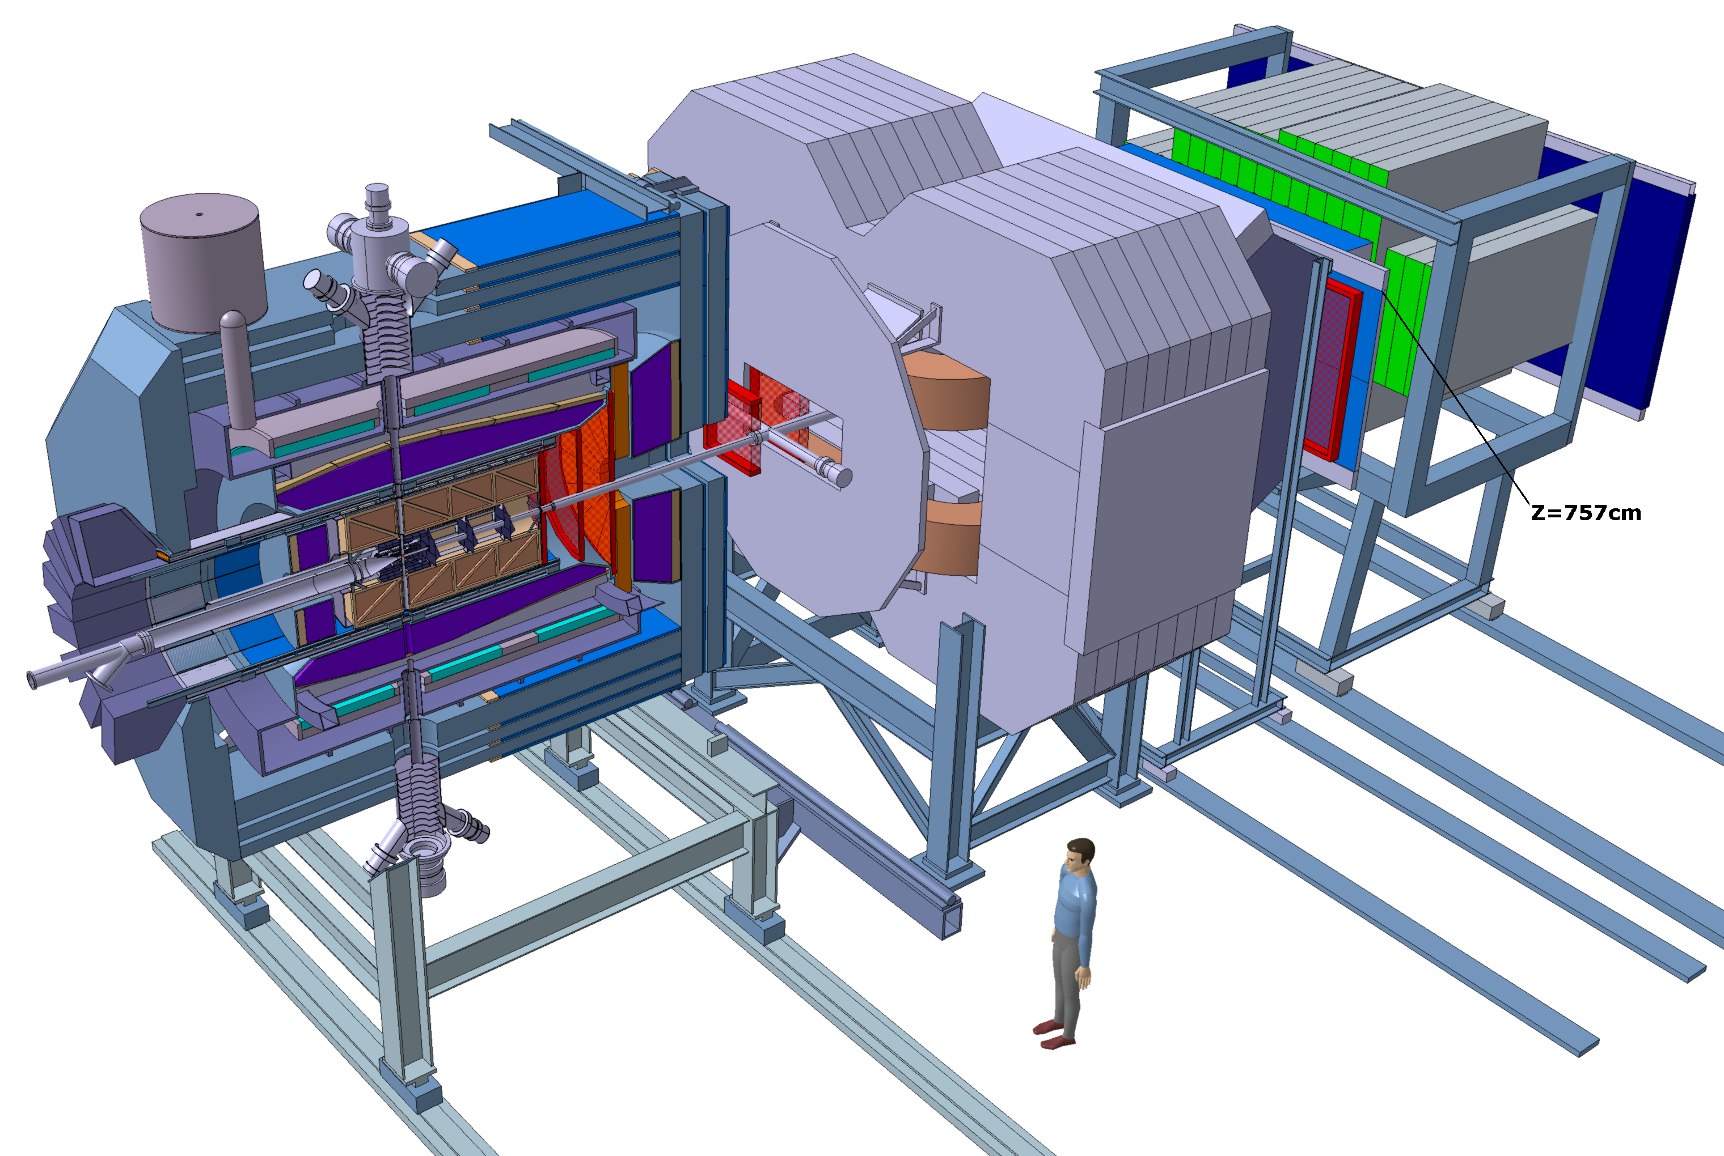
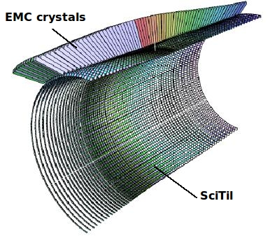
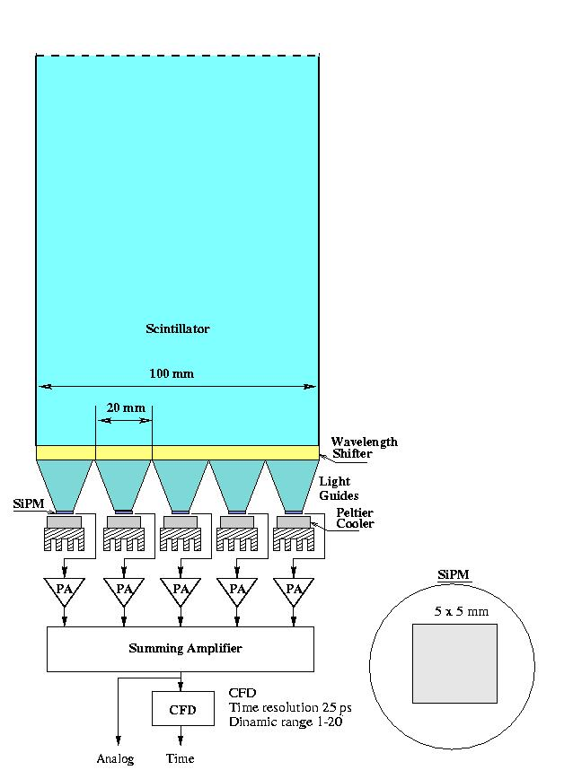
PANDA Detector

Slide 4
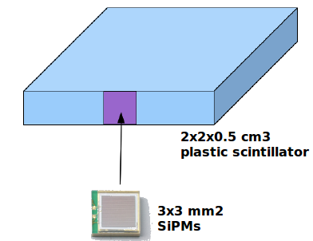
Scintillating Tile Hodoscope
Timing detector for PANDA
Properties:
1 % radiation length
Fast timing (100 ps)
Preshower detector for converted photons
Charged/neutral discrimination
+ ASIC
R&D
Simulations
Selection of scintillator and mached SiPM
Optimization of SiPM position
Time resolution
Light collection efficiency
Tests in Beam
GSI, BARC, Glasgow, PNPI, JINR

Slide 5
Gatchina
Dear Herbert,I'm very sorry for the late reply, I was on vacation and arrived yesterday.Stan has no access to internet (he is on his "dacha").We are in progress with the simulations and at the moment we have no results for channel: p-bar + p-> Lambda-bar + Lambda and we are planning to do this kind of study together with some other benchmarks (D+D-) for TDR.Best Regards, Yuri.

Slide 6
STT Pavia
Lieber Herbert,leider kann ich nicht an dem Workshop teilnehmen. Es tut mir leid aber it is impossible for me on such a short time notice to go to Vienna first of all (I have obligations here in Pavia) and also to prepare the material necessary to support the statement (in which I STRONGLY believe) the PANDA NEEDS the SciTil system both for Particle ID by means of the time of flight AND for the determination of the T0 of the physical events.
To be totally honest I am not aware that anyone in Panda has done simulations without the SciTil in a realistic situation (== with pileup background events) to demonstrate that. Tschuess Gianluigi

Slide 7
DIRC
Lieber Herbert,
-------
Das groessere Problem ist, dass es keine Studie gibt die belegen koennte, dass die gute Zeitaufloesung des SciTil fuer den DIRC hilfreich ist. Es ist plausibel, dass diese Information hilft, klar.So gibt es Ideen, dass die Positionsinformation eines Tiles ueber eine Lookup-Table dafuer genutzt werden koennte, dass man schneller als durch das Tracking weiss in welchen Radiatormodul die Spur war und entsprechend im richtigen Sensormodul Photonen zaehlen koennte. Vielleicht hilft auch die gute Zeitmessung als Startwert fuer die DIRC Event Time.Aber beides existiert wirklich nur als Idee ohne Beweise, nicht als Studie. Zum event timing und der Realisierbarkeit eines DIRC Timings a la BABAR sind wir noch nicht gekommen.Zudem haben Marko's Simulationen fuer das Time Imaging der Plattengeometrie gezeigt, dass fuer den DIRC wenig Unterschied zwischen 100ps und 500ps Zeitaufloesung besteht was die PID Qualitaet angeht. Diese Studie beruecksichtigt den Untergrund nicht, ist nur event- und nicht time-based, usw, also nicht trivial zu interpretieren.
Grüße, Jochen Schwiening

Slide 8
BARC
it is very good that the Vienna group is willing to take responsibilities. I have seen their test results on sipm timing measurement and it is very encouraging. Please go ahead with them and any other interested institutions. I think we are practically out from scitil. But of course if on the individual capacity/experiences I can be of any help, I am ready.Kind regards,Bidyut

Slide 9
Mechanical Layout

Slide 10
3D View of integration with DIRC

