Slide 1
FairMQ with FPGAs and GPUs
Simone Esch – s.esch@fz-juelich.de

Slide 2
Message Queues
The FairRoot analysis framework uses message queues for data exchange between different computing tasks and processes
Asynchronous communication protocol
(i.e. receiver not necessarily active while sending of data)
Not received data is saved in a FIFO (first in, first out) like structure
Message queue benefits:
  Processes are independent from each other
  Datapaths between processes can be easily changed and adjusted
  Work can be spread over several processes on different hosts

Slide 3
FairMQ
FairMQ: Abstract transport layer in FairRoot to use message queues, at the moment ZeroMQ and NanoMSG supported
Base class: FairDevice
Supported patterns: push-pull and pub-sub
Documentation + examples: https://github.com/FairRootGroup/FairRoot/tree/dev/example/Tutorial3/macro
Further information about FairMQ:
M. Al-Turany et al.
Extending the FairRoot framework to allow for simulation and reconstruction of free streaming data
DOI: 10.1088/1742-6596/513/2/022001

Slide 4
Integration of FairMQ
Integration of FairMQ into external projects:
Integration into Jülich Digital Readout System for ASICs (JDRS)
  Analyze data from ASIC prototypes with FairRoot
  Create datapaths with FairMQ for saving and monitoring of data stream
Use GPU as high performance processor for FairRoot
  As work towards GPU-based online reconstruction
    Understanding & evaluation algorithms
    Possible data transport layer for actual experiment
  Possible application in offline analysis

Slide 5

ZeroMQ
ZeroMQ is a high-performance asynchronous messaging library aimed at use in scalable distributed or concurrent applications.
Open source lightweight messaging system, designed for high throughput and low latency scenarios
Usable in inter-thread, inter-process and inter-node communication
Bindings (interfaces) to use ZeroMQ available in more than 30 languages
For further Information: http://zguide.zeromq.org/
inter-node
inter-process
inter-thread
PGM
TCP/IP
named pipe
in-memory

Slide 6
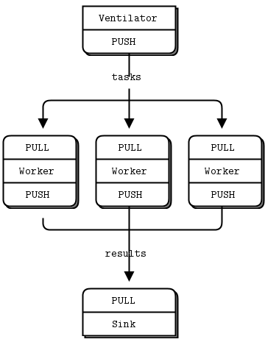
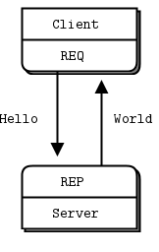
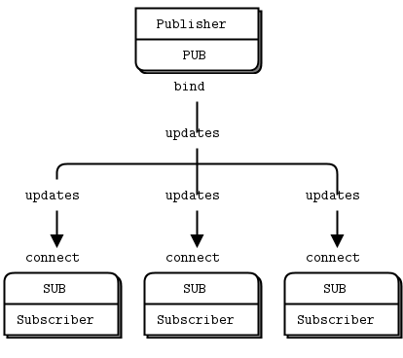
ZeroMQ Patterns
Publisher-Subscriber
(distribution of data)
Push-Pull
(distribution of load)
Request-Reply
Notes:
----- Meeting Notes (08.09.14 08:22) -----
req-rep peer to peer ?

Slide 7
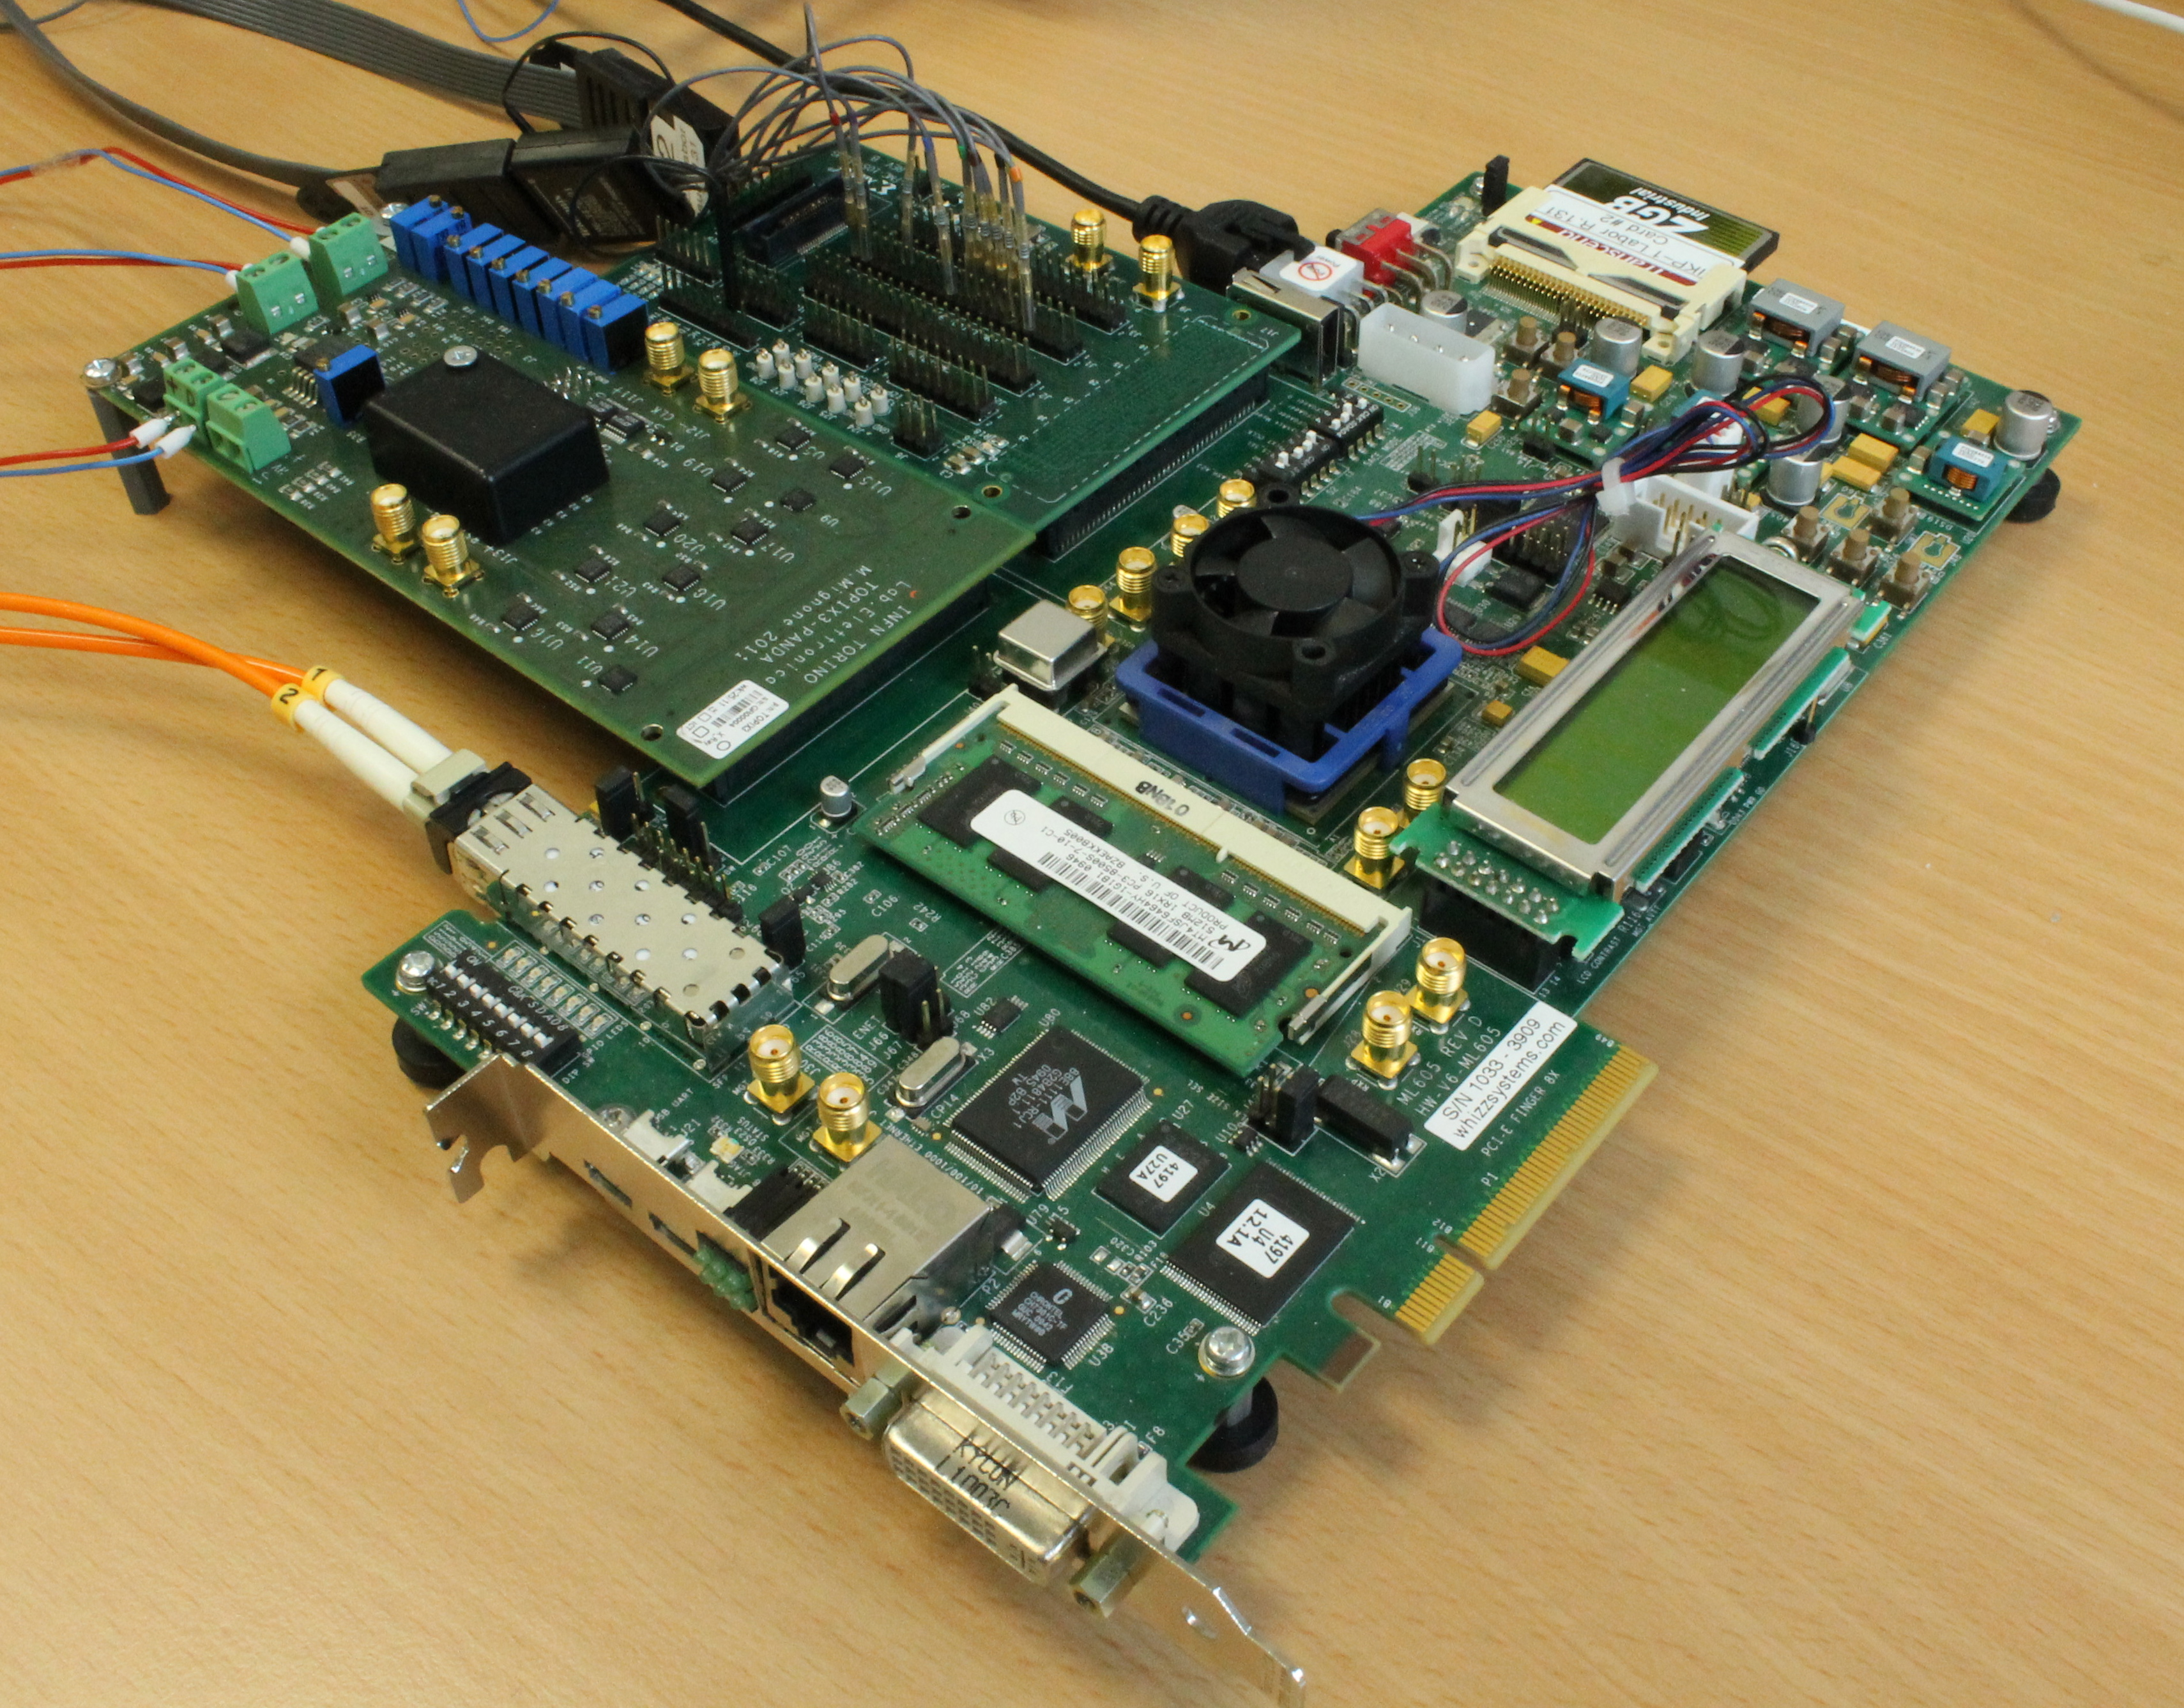
Jülich Digital Readout System
Xilinx diagnostic board
HPC and LPC
connector
Readout system for front end ASIC development
One system to characterize different ASICs
Requirements:
  Fast for high data rates,
  flexible for different kinds of ASICs
  easy adoptable
Virtex 6 FPGA
Test device (ToPix3)
Xilinx ML605
Virtex 6 FPGA
Optical and electrical gigabit readout
via SIS1100 or UDP
DDR3 memory interface
Readout PC
MRF Software
FPGA
Readout Board
Firmware
DUT
MRF Software
Firmware

Slide 8
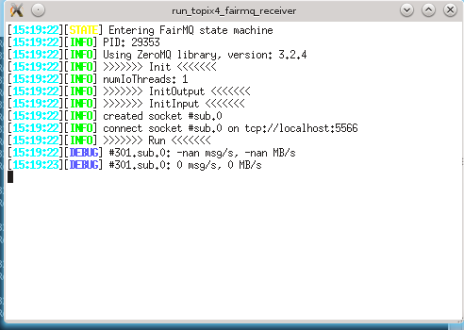
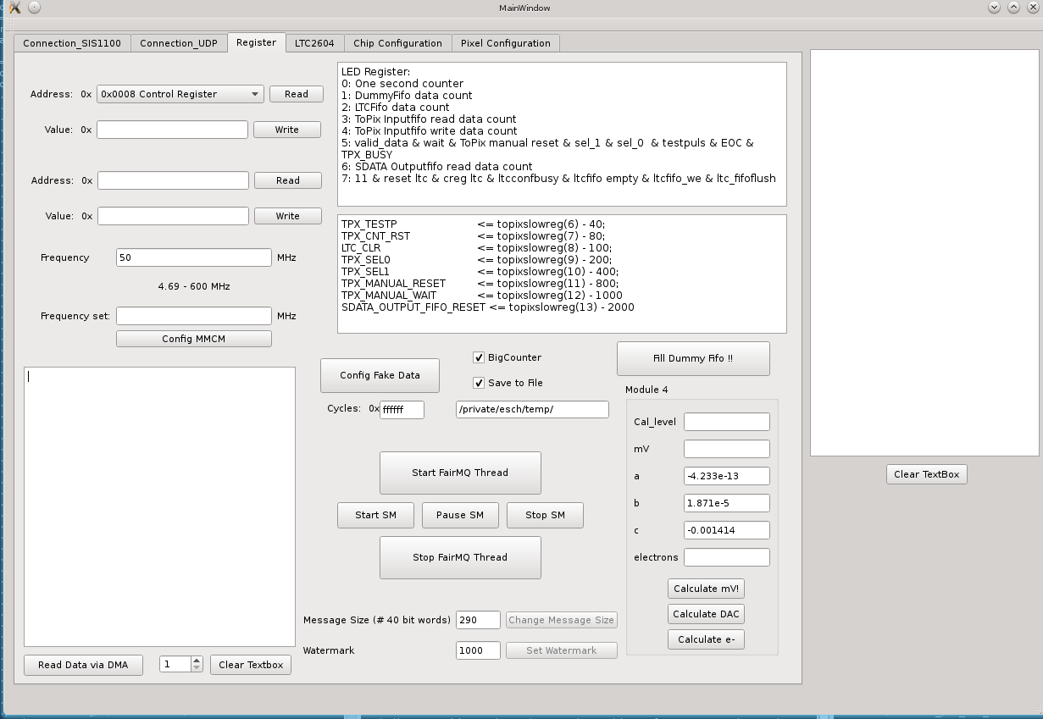
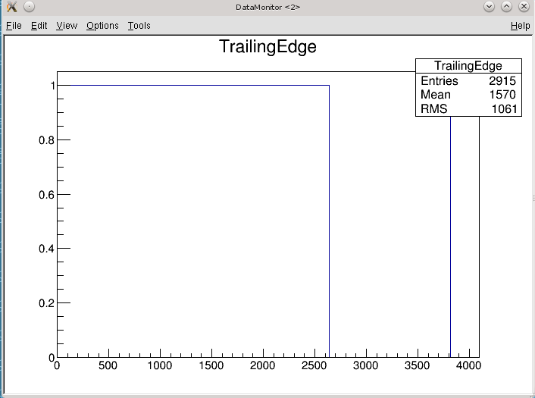
Tests of JDRS with FairMQ
FPGA Readout Board
JDRS Main
JDRS MUX
JDRS Receiver
sub
push
pull
pub
JDRS Receiver
sub
JDRS
DataMonitor
sub
FairMQDevice

Slide 9
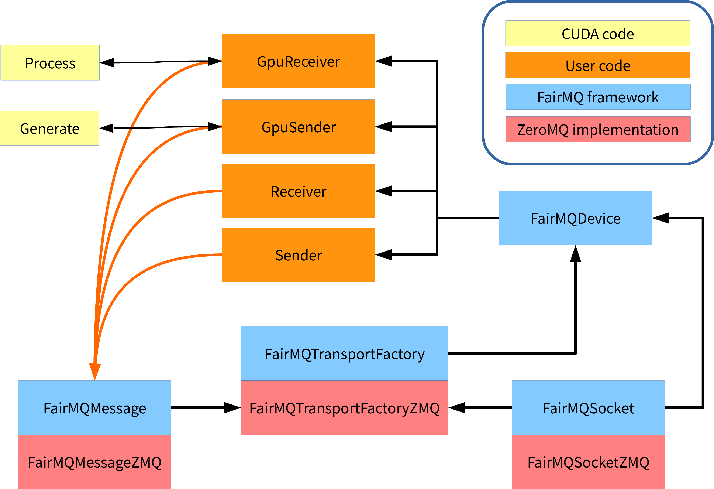
GPU Online Analysis
Sender/Receiver: create/read message over transport factory
GpuSender: creates message, calls Generate on GPU to create test data payload
GpuReceiver: reads message, calls Process on GPU to perform operations on test data payload
Generate: cuRAND RNG
Process: x^2, sqrt(x), check difference

Slide 10
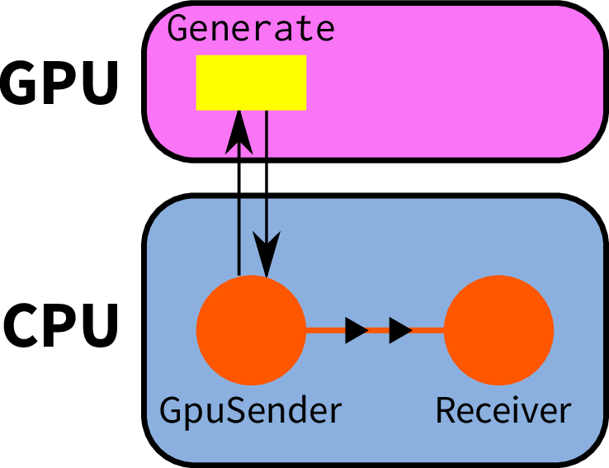
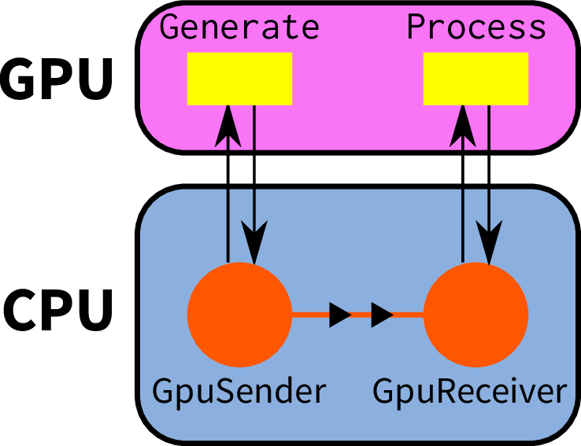
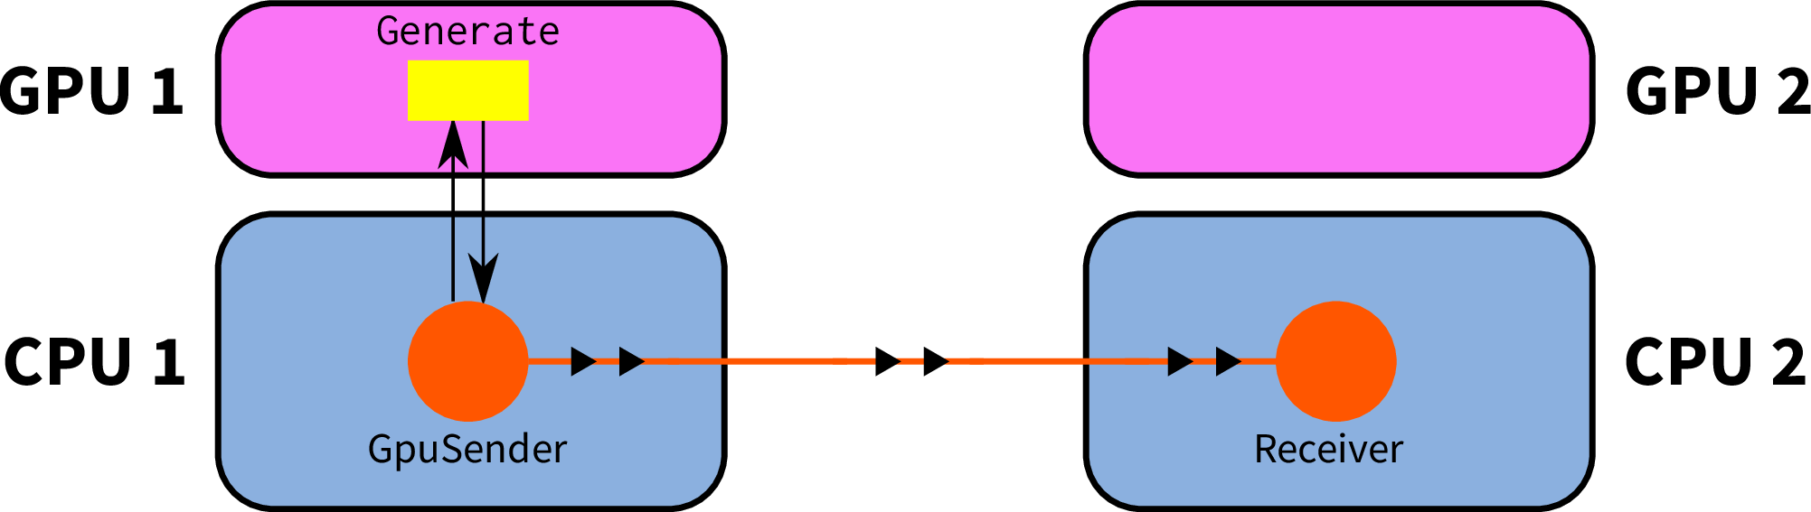
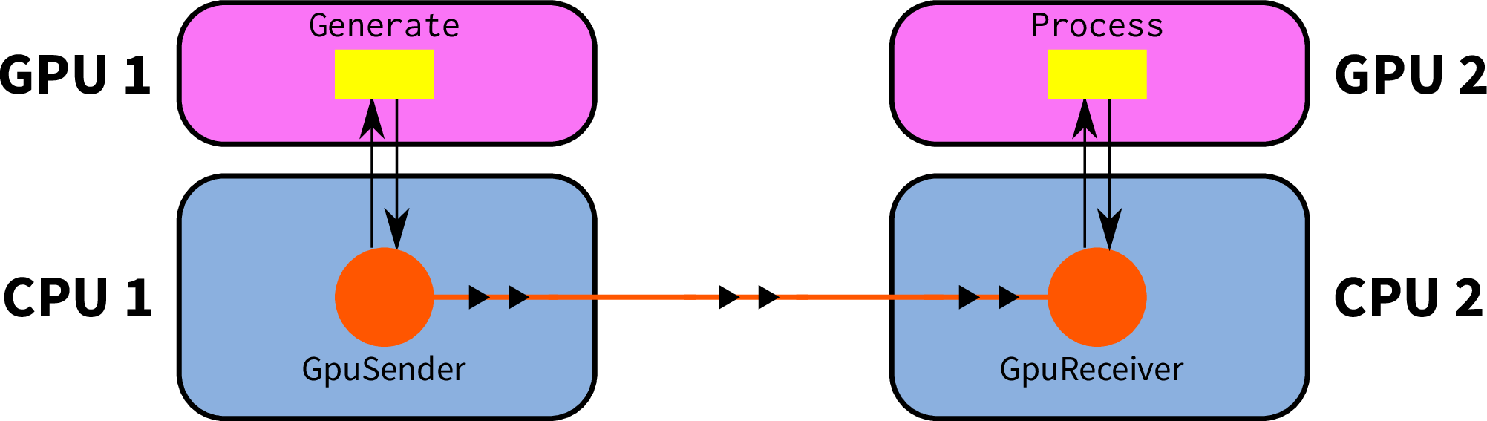
Test Configuration
GpuSender to Receiver
GpuSender to GpuReceiver
GpuSender to Receiver
GpuSender to GpuReceiver

Slide 11
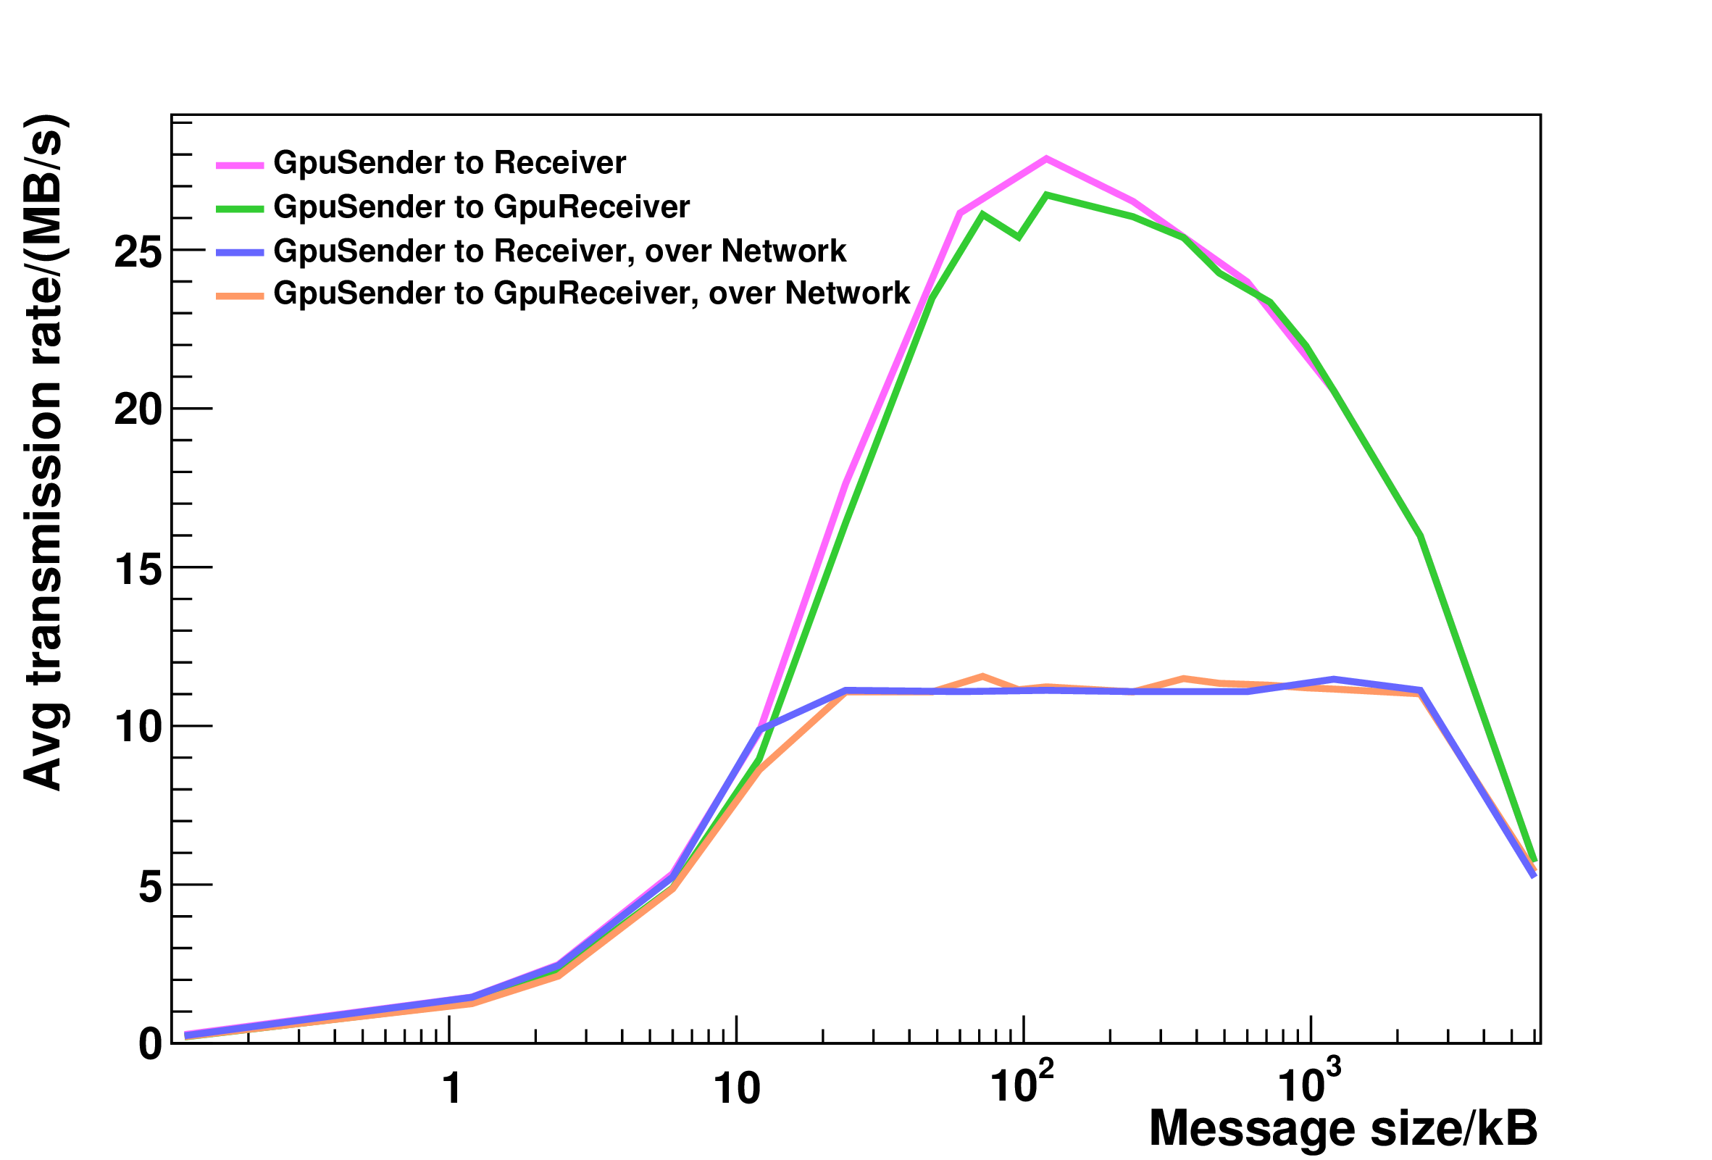
Test Results
Study response of data generation and transmission chain:
analyze transmission rate as a function of the number of events
for different configurations
Performance of transmission over network limited by available bandwidth

Slide 12
Summary
FairRoot uses message queues for inter-process and/or inter-host communication, FairMQ
JDRS and GPU have been interfaced with FairMQ transport layer
Planned to use for ToPix4 testbeam in October 2014
Performance tests an optimization for GPU online analysis are ongoing
Thank you for your attention

Slide 13
Dankeschön
Thank you for your attention

