Slide 1
Studying the Character of the Pygmy Dipole Resonance using Hadronic Probes
M. Spieker^{1,*}, V. Derya¹, J. Endres¹, M. N. Harakeh^{2,3}, A. Hennig¹, D. Savran^{4,5},
P.G. Pickstone^{1,*}, M. Weinert¹, H. J. Wörtche², and A. Zilges¹
¹Institute for Nuclear Physics, University of Cologne, Germany
²KVI, Rijksuniversiteit Groningen, The Netherlands
³GANIL, CEA/DSM-CNRS/IN2P3, Caen, France
⁴ExtreMe Matter Institute EMMI and Research Division, GSI, Darmstadt, Germany
⁵Frankfurt Institute for Advanced Studies FIAS, Frankfurt a.M., Germany
* Supported by the Bonn-Cologne Gradudate School of Physics and Astronomy
4th International Symposium on the Nuclear Symmetry Energy NuSYM14
University of Liverpool, UK
7-9 July 2014
Supported by the DFG (ZI 510/4-2), by the EU under EURONS Contract No. RII3-CT-2004-506065
in the 6th framework programme, and by the Alliance Program of the Helmholtz Association (HA216/EMMI)

Slide 2
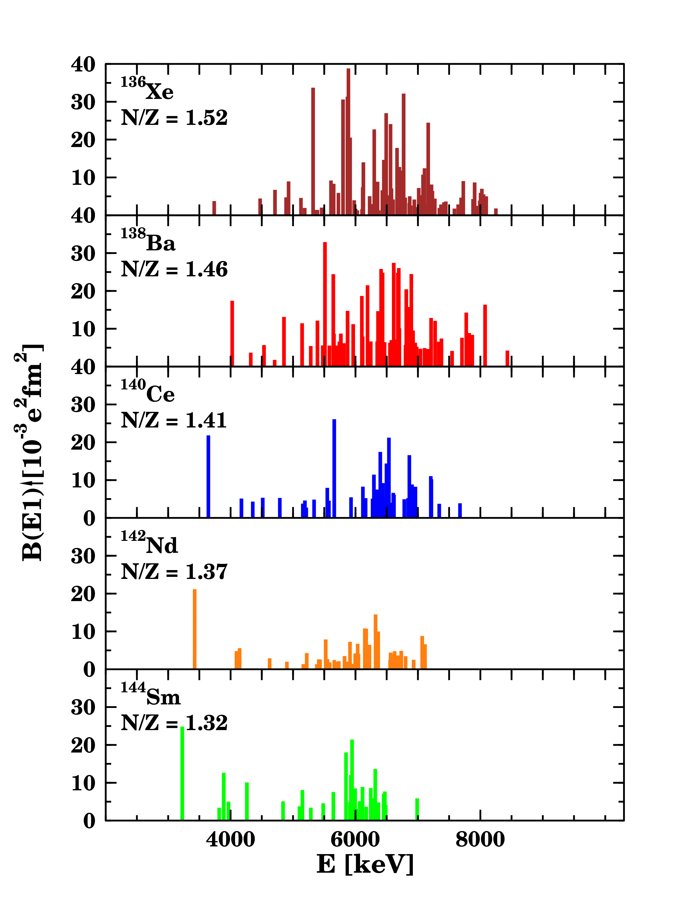
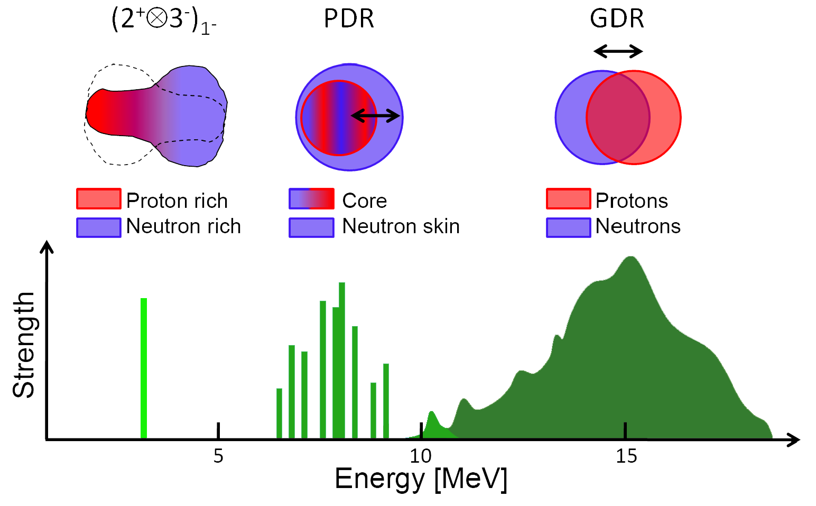
PDR – A Common Dipole Mode of Nuclei
E1 strength distribution in atomic nuclei
PDR
?
A. Zilges et al., Phys. Lett. B 542 (2002) 43
S. Volz et al., Nucl. Phys. A779 (2006) 1
D. Savran et al., Phys. Rev. Lett 100 (2008) 232501
Experiment
PDR recognized as common feature of many nuclei
Various experimental approaches to study strength distribution,
e.g., (γ,γ’) (real and virtual photons)
Recent Review: D. Savran., T. Aumann, and A. Zilges, Prog. Part. Nucl. Phys. 70 (2013) 210

Slide 3
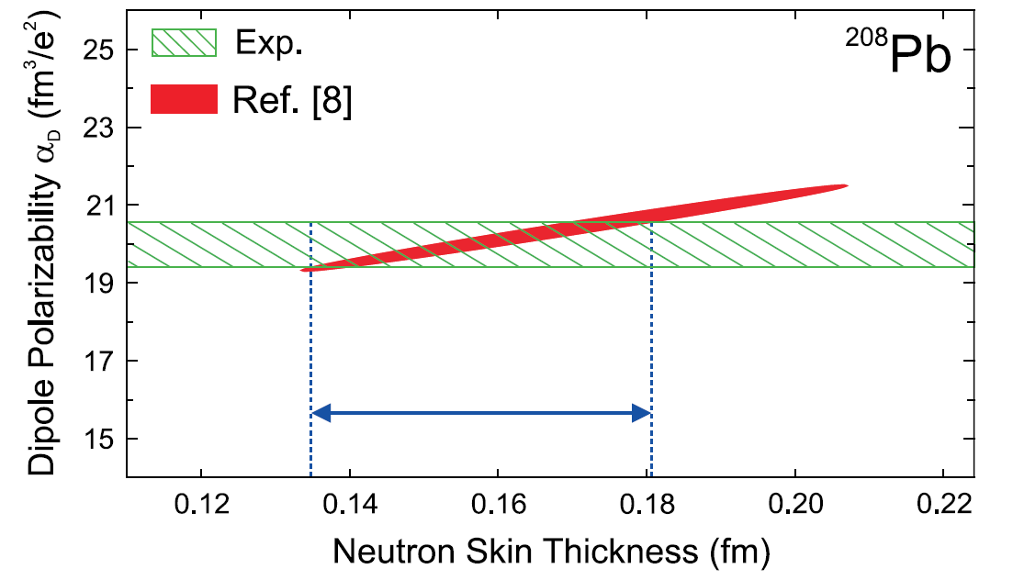
Relevance of the PDR
E1 strength as a constraint on the symmetry energy of the
equation of state
A. Tamii, I. Poltoratska, P. von Neumann-Cosel et al., PRL 107 (2011) 062502
→ Dipole polarizability α_{D} correlated to neutron-skin thickness
P.-G. Reinhard and W. Nazarewicz, PRC 81 (2010) 051303(R)
P.-G. Reinhard and W. Nazarewicz, PRC 81 (2010) 051303(R)
J. Piekarewicz et al., PRC 85 (2012) 041302(R)
B. Alex Brown and A. Schwenk, PRC 89 (2014) 011307(R)

Slide 4
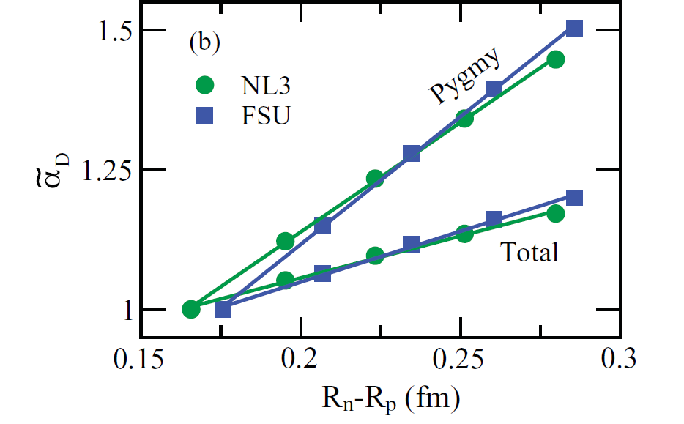
Relevance of the PDR
E1 strength as a constraint on the symmetry energy of the
equation of state
A. Tamii, I. Poltoratska, P. von Neumann-Cosel et al., PRL 107 (2011) 062502
→ Dipole polarizability α_{D} correlated to neutron-skin thickness
… PDR strength stronger correlated to neutron-skin thickness?
Precise PDR strength needed!
P.-G. Reinhard and W. Nazarewicz, PRC 81 (2010) 051303(R)
P.-G. Reinhard and W. Nazarewicz, PRC 81 (2010) 051303(R)
J. Piekarewicz et al., PRC 85 (2012) 041302(R)
B. Alex Brown and A. Schwenk, PRC 89 (2014) 011307(R)
J. Piekarewicz, PRC 83 (2011) 034319
J. Piekarewicz, PRC 83 (2011) 034319

Slide 5
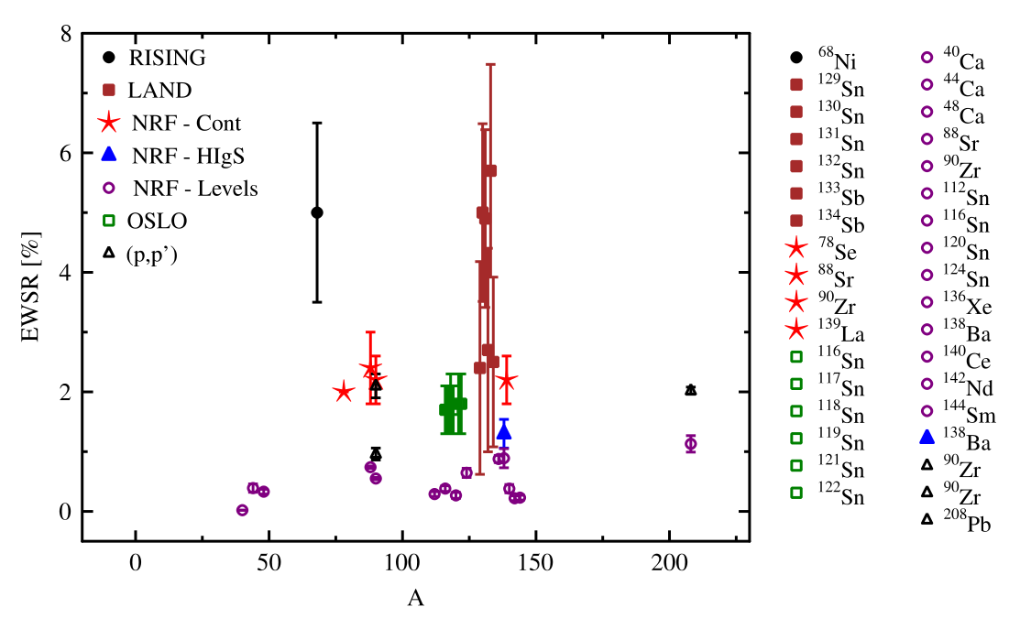
Experiment: E1 strength connected to PDR
… inconsistent experimental data sets
Open questions:
Discrepancies due to different approaches?
Correct some data, e.g., for γ-decay branching?
How to distinguish the PDR from other E1 strength?
D. Savran., T. Aumann, and A. Zilges, Prog. Part. Nucl. Phys. 70 (2013) 210

Slide 6
Experiment: E1 strength connected to PDR
… inconsistent experimental data sets
Open questions:
Discrepancies due to different approaches?
Correct some data, e.g., for γ-decay branching?
How to distinguish the PDR from other E1 strength?
D. Savran., T. Aumann, and A. Zilges, Prog. Part. Nucl. Phys. 70 (2013) 210
    Experiments needed which are sensitive to underlying structure of the E1 strength!
Isospin structure
γ-decay branching
Single-particle structure

Slide 7
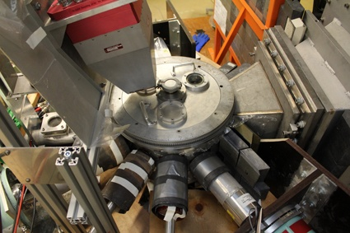
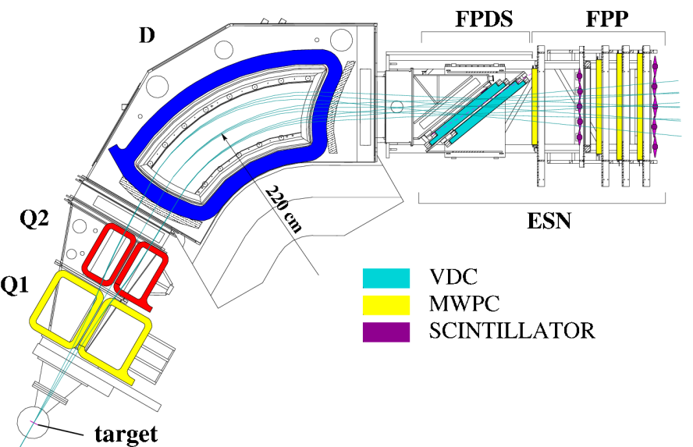
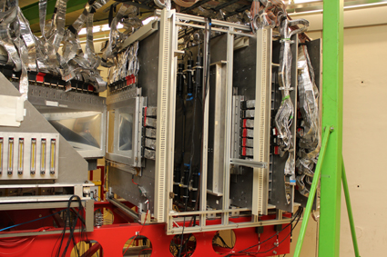

Studying the Isospin Character of the PDR
[D. Savran et al., Nucl. Inst. and Meth. A 564 (2006) 267]
Photos: S.G. Pickstone
γ-detector array
target
40cm
α beam
α detection at focal plane
BBS @ KVI, Groningen (Netherlands)
α beam of 136 MeV
p beam of 80 MeV
Scattering at forward angles
Coincidence measurement: (α,α‘γ), (p,p‘γ)
6-8 HPGe detectors (ε ∼ 0.5% @ 1.3 MeV)
1m

Slide 8
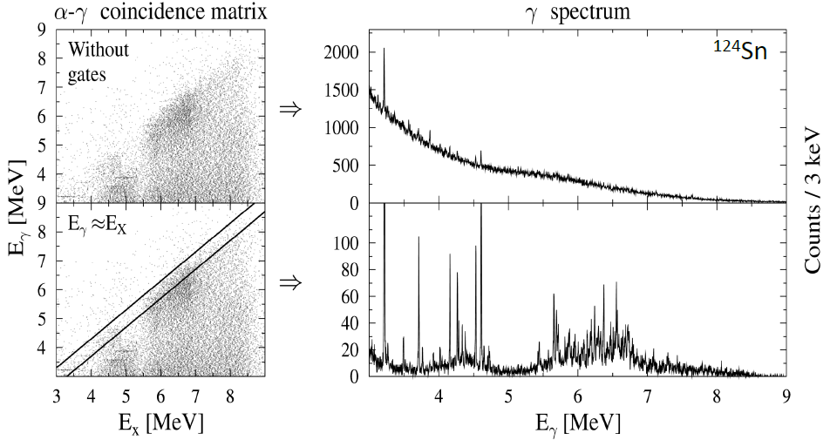
Selective Study of the PDR
(α,α’γ) experiments with E_{α}=34 MeV/u @ KVI, Groningen (Netherlands)
PDR region
[J. Endres et al., PRL 105 (2010) 212503 ; J. Endres et al., PRC 85 (2012) 064331]

Slide 9
Selective Study of the PDR
(α,α’γ) experiments with E_{α}=36 MeV/u @ KVI, Groningen (Netherlands)
PDR region
Powerful method to gain selectivity to ground-state transitions!
[J. Endres et al., PRL 105 (2010) 212503 ; J. Endres et al., PRC 85 (2012) 064331]

Slide 10
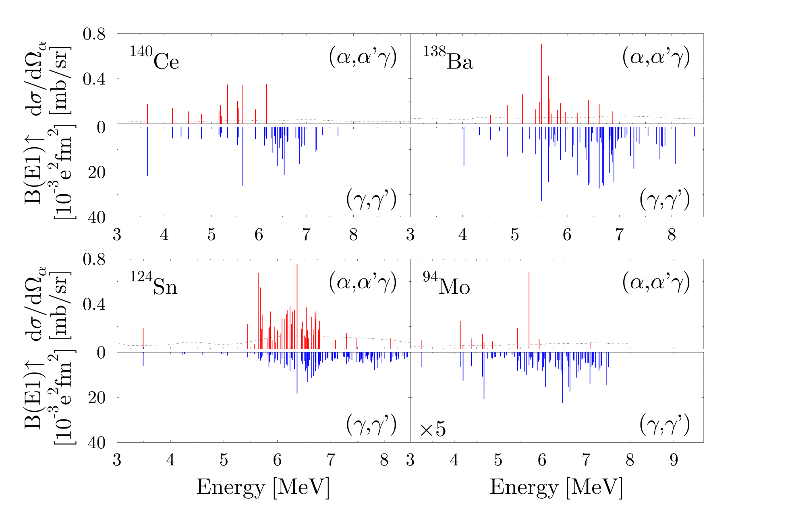
Systematic Study in (α,α′γ) and (γ,γ′) Experiments
D. Savran et al., PRL 97 (2006) 172502
J. Endres, E. Litvinova et al., PRL 105 (2010) 212503
J. Endres et al., PRC 80 (2009) 034302
V. Derya et al., NPA 906 (2013) 94

Slide 11
Systematic Study in (α,α′γ) and (γ,γ′) Experiments
  Isospin splitting:
  low-energy part (γ,γ′) and (α,α′γ)
  → isospin-mixed
  high-energy part (γ,γ′) only
  → dominantly isovector
D. Savran et al., PRL 97 (2006) 172502
J. Endres, E. Litvinova et al., PRL 105 (2010) 212503
J. Endres et al., PRC 80 (2009) 034302
V. Derya et al., NPA 906 (2013) 94

Slide 12
Systematic Study in (α,α′γ) and (γ,γ′) Experiments
neutron magic
proton magic
non-magic
D. Savran et al., PRL 97 (2006) 172502
J. Endres, E. Litvinova et al., PRL 105 (2010) 212503
J. Endres et al., PRC 80 (2009) 034302
V. Derya et al., NPA 906 (2013) 94

Slide 13
Systematic Study in (α,α′γ) and (γ,γ′) Experiments
neutron magic
Is the isospin splitting a common feature of the low-lying dipole response in heavy neutron-rich nuclei?
proton magic
non-magic
D. Savran et al., PRL 97 (2006) 172502
J. Endres, E. Litvinova et al., PRL 105 (2010) 212503
J. Endres et al., PRC 80 (2009) 034302
V. Derya et al., NPA 906 (2013) 94

Slide 14
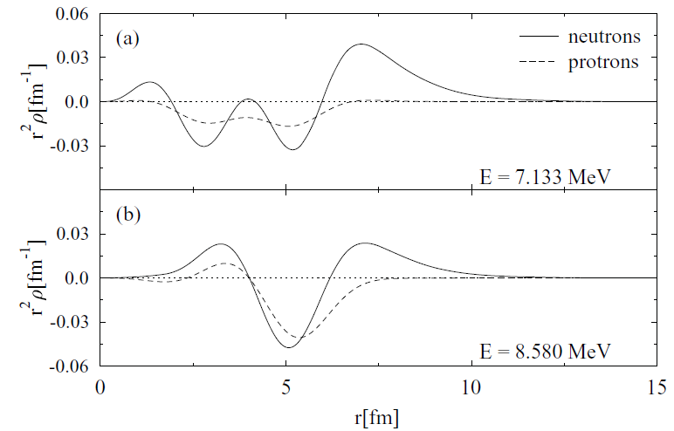
Theoretical Interpretation of the Splitting
  Transition densities for two RQTBA states in ¹²⁴Sn
  Low-lying state: Typical PDR state → The “real” PDR?
  High-lying state: Transitional region of the GDR
neutrons
protons
J. Endres, E. Litvinova et al., Phys. Rev. C 85, 064331 (2012)
Similar conclusions : N. Tsoneva et al., Phys. Rev. C 77, 024321 (2008)
D. Bianco et al., PRC 86 (2012) 044327

Slide 15
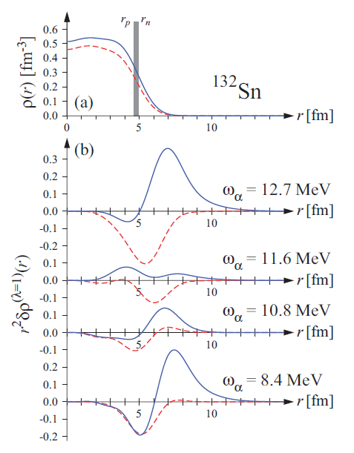
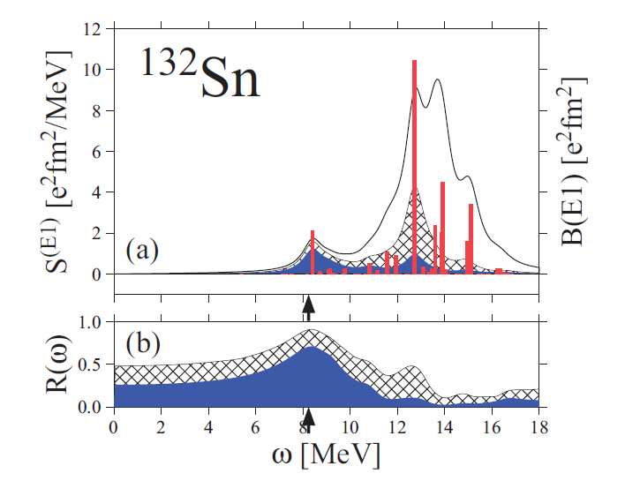
Theoretical Interpretation of the Splitting
How to disentangle PDR strength and GDR strength in theory?
H. Nakada, T. Inakura, and H. Sawai, PRC 87 (2013) 034302

Slide 16
Theoretical Interpretation of the Splitting
  Transition densities for two RQTBA states in ¹²⁴Sn
  Low-lying state: Typical PDR state → The “real” PDR?
  High-lying state: Transitional region of the GDR
neutrons
protons
Different isospin character for low- and high-energy part also predicted in some theoretical models
J. Endres, E. Litvinova et al., Phys. Rev. C 85, 064331 (2012)
Similar conclusions : N. Tsoneva et al., Phys. Rev. C 77, 024321 (2008)
D. Bianco et al., PRC 86 (2012) 044327

Slide 17
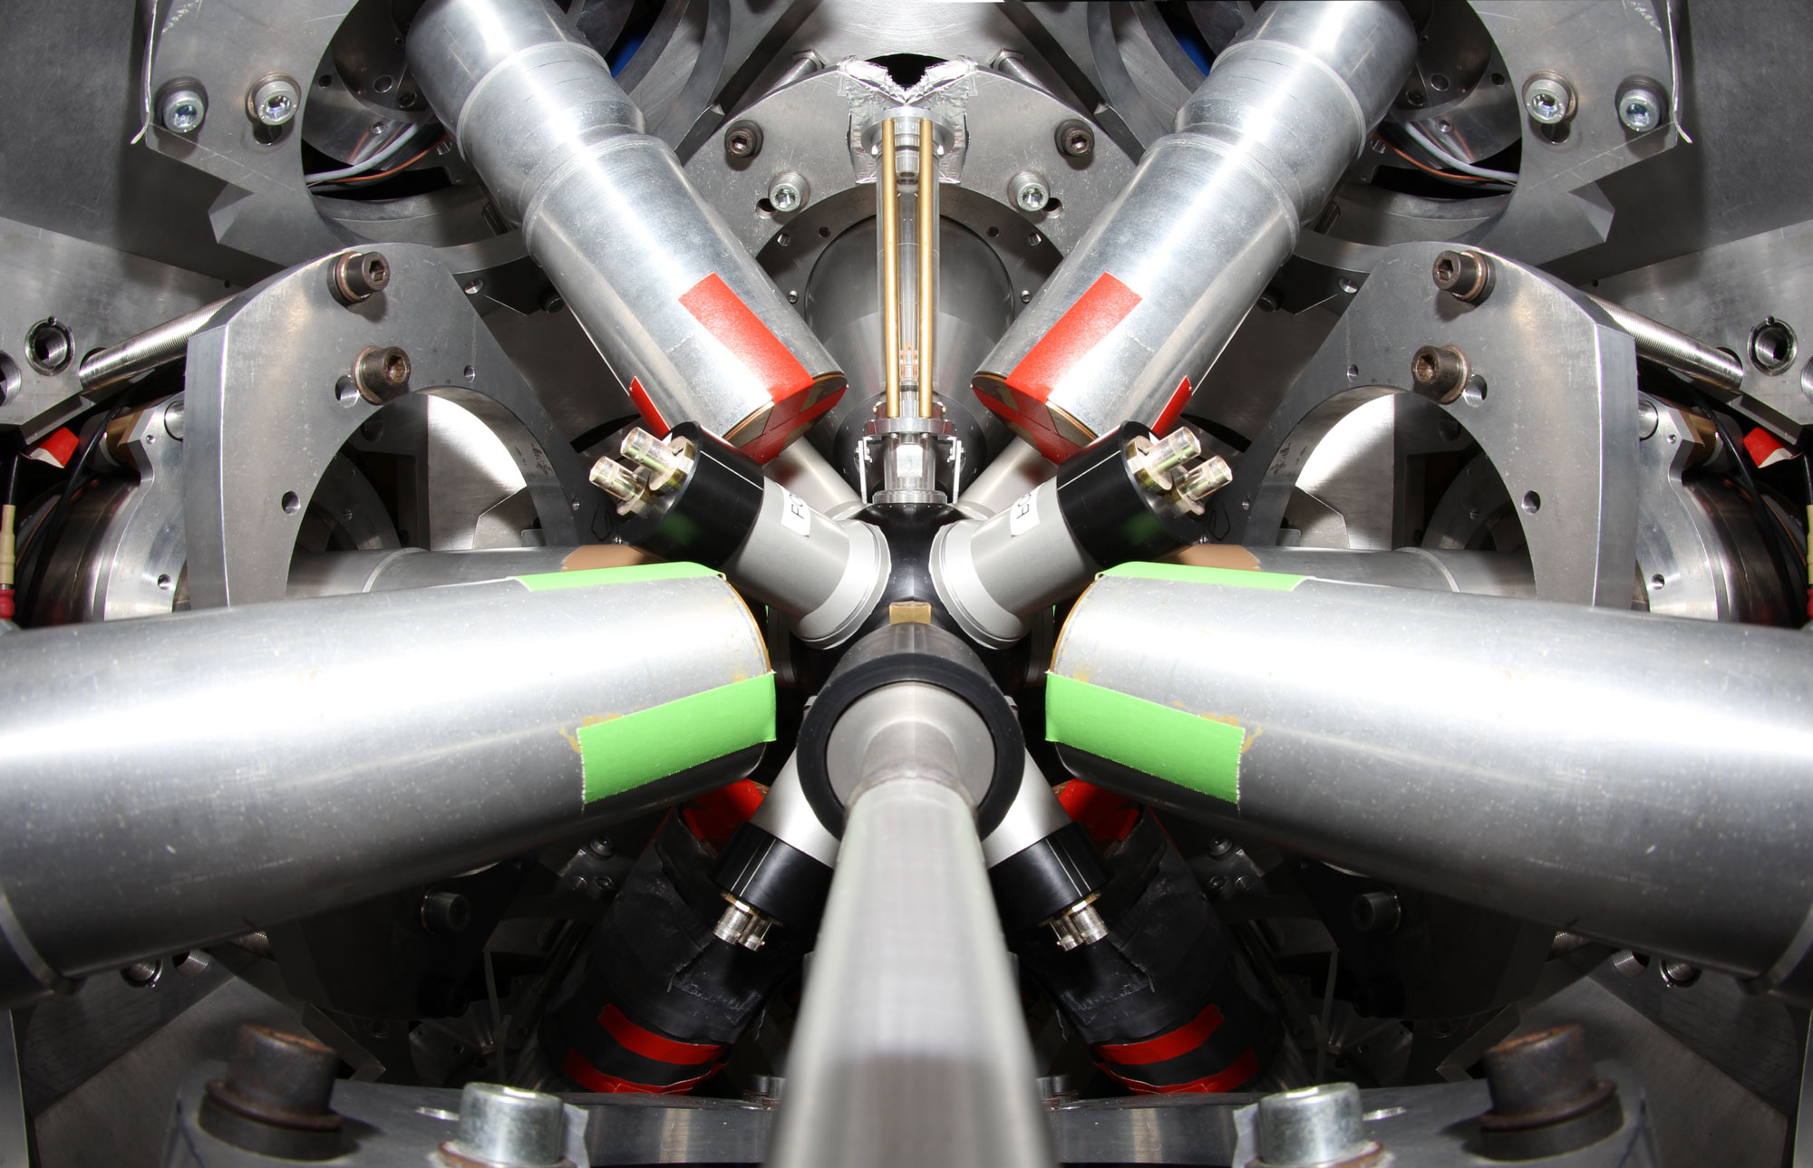
γ-Decay Behavior of the PDR
Combined setup: SONIC@HORUS @ IKP, Cologne (Germany)
HORUS
HORUS
HORUS
SONIC
HORUS
Beam →
⊗

Slide 18
γ-Decay Behavior of the PDR
Combined setup: SONIC@HORUS @ IKP, Cologne (Germany)
γ-spectrometer HORUS
14 HPGe detectors (6 BGO shielded, 2 Clover detectors optional)
Photopeak efficiency (∼ 2% @ 1.3 MeV)
Energy resolution
  Digital Signal Processing (XIA):
  ≤2.5 keV@ 1.3 MeV, 6 kcps
HORUS
HORUS
HORUS
SONIC
HORUS
Particle silicon-detector array SONIC
8 detector tubes in gaps between HPGe detectors with variable distance to target
  Reaction channel from particle identification by ∆E-E
  Excitation energy from ejectile energy measurement
Beam →
⊗

Slide 19
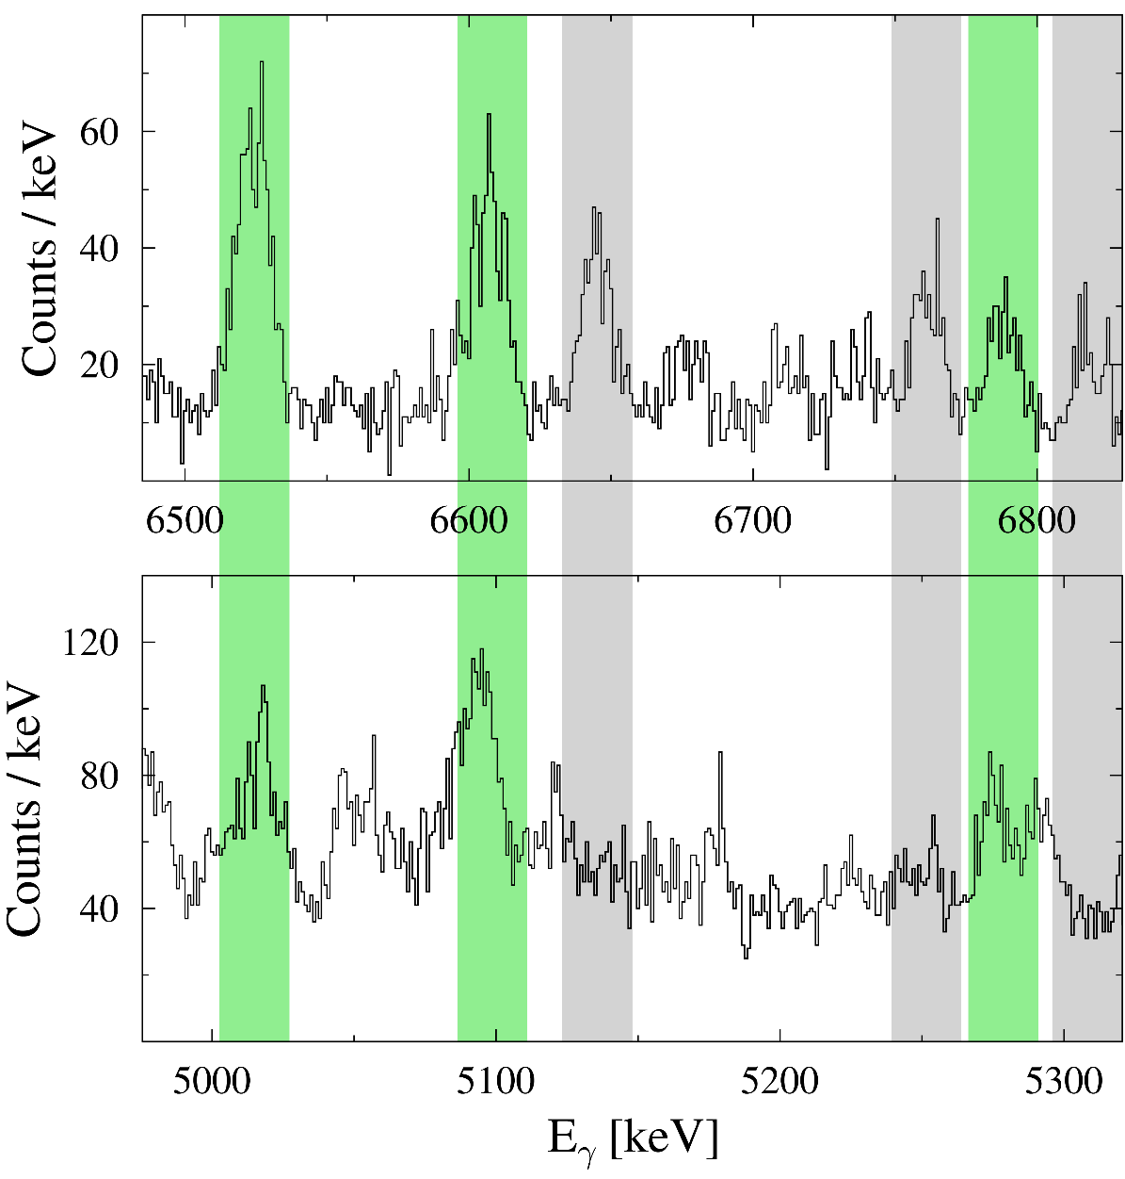
γ-Decay Behavior of the PDR in ⁹²Mo
Courtesy of S.G. Pickstone
PDR states in ⁹²Mo
Decay to ground state
⁹²Mo(p,p’γ) @ E_{p}=10.5 MeV
23 J=1 states excited between 5 MeV and 7 MeV known from (γ,γ’)
→ observed ground-state transitions
16 states do additionally decay to other states than g.s.
→ B(E1; 1⁻ → g.s.) has to be corrected!
Decay to first 2⁺

Slide 20
Single-Particle Structure of the PDR
… Single-particle structure influences neutron-skin thickness
→ Test the single-particle structure of the PDR!
M. Warda et al., Phys. Rev. C 89, 064302 (2014)

Slide 21
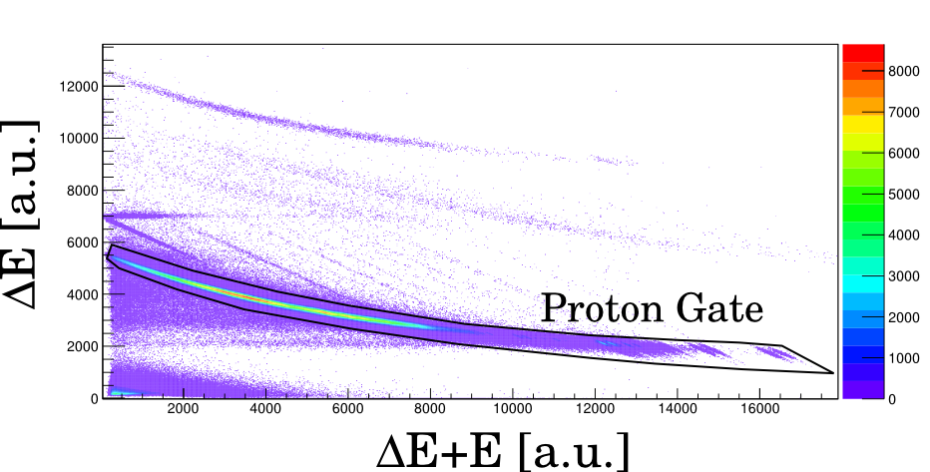
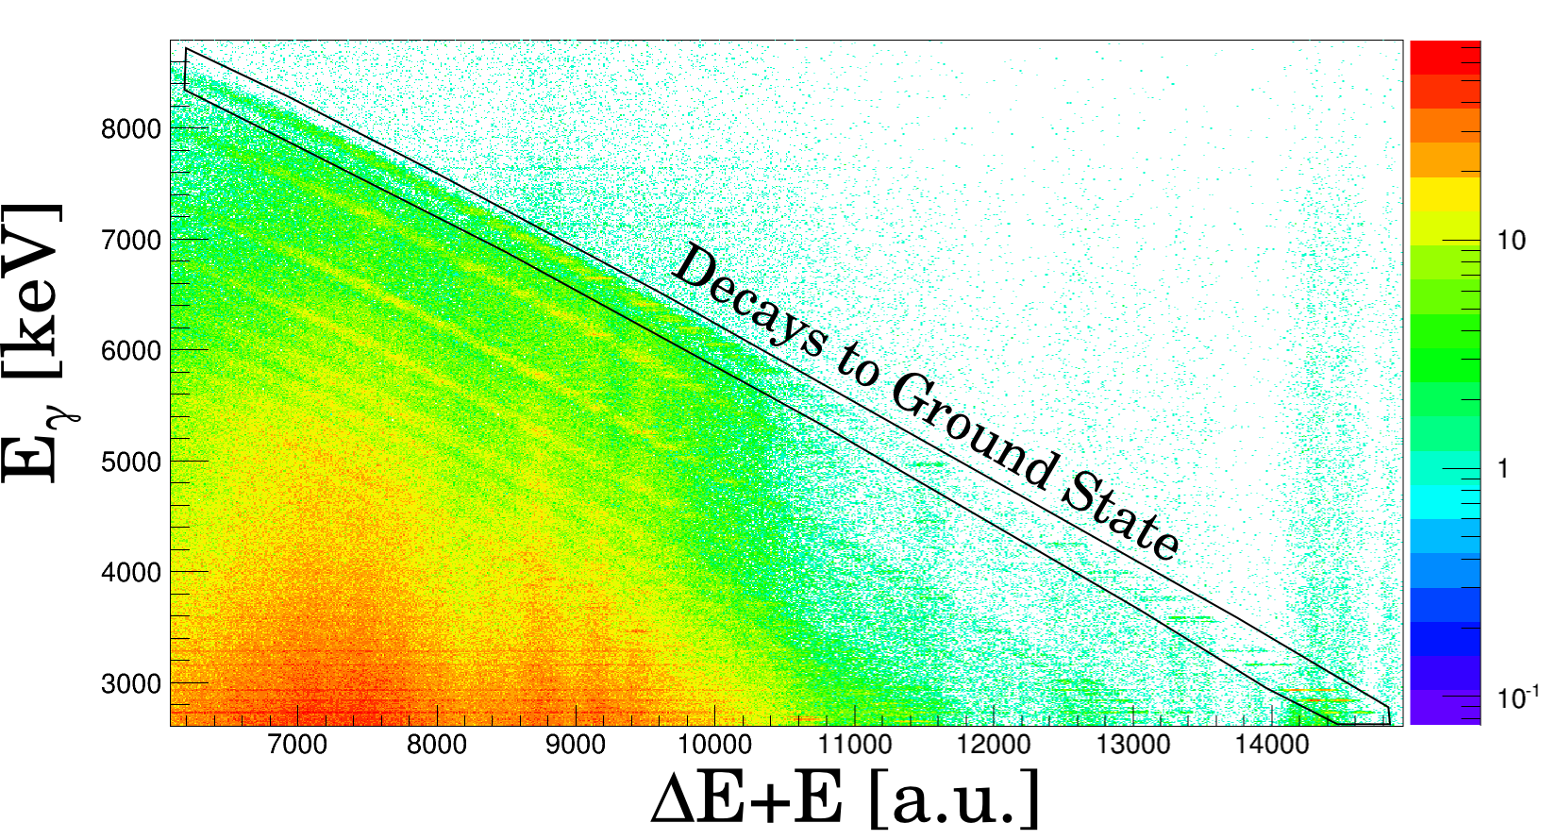
Single-Particle Structure of the PDR
… Single-particle structure influences neutron-skin thickness
→ Test the single-particle structure of the PDR!
M. Warda et al., Phys. Rev. C 89, 064302 (2014)
Pioneering experiment: ¹¹⁹Sn(d,pγ)¹²⁰Sn, E_{d}= 8.5 MeV using SONIC@HORUS
Selective to neutron particle-hole configurations, e.g., (p_{3/2})(s_{1/2})⁻¹
Clean selection of reaction channel
Separate selectivity to ground-state decays and decays to other excited states due to pγ coincidence
Particle Identification
Decay-Channel Selection

Slide 22
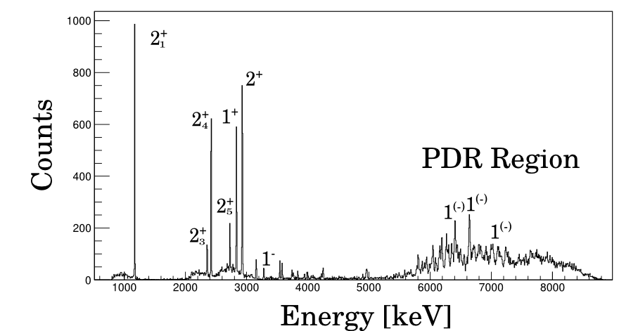
Single-Particle Structure of the PDR
Selective and strong excitation of PDR states
¹¹⁹Sn(d,pγ)¹²⁰Sn
@ E_{d}=8.5 MeV
Preliminary
Talk by T. Hashimoto after lunch
“Complete Measurement of Electric Dipole Response of ¹²⁰Sn”

Slide 23

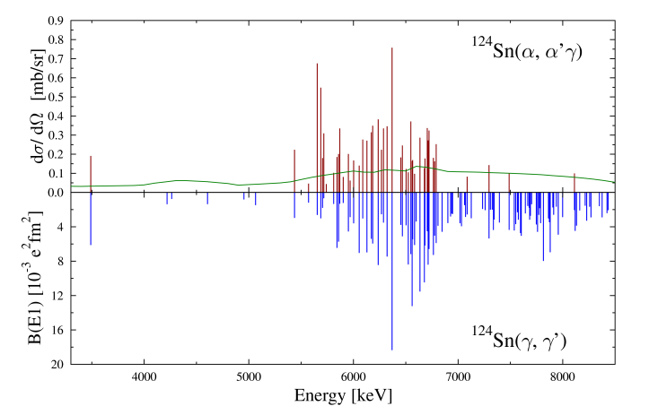

Summary
PDR common mode of atomic nuclei
Strength and location do not unambiguously characterize the PDR
→ Inconsistent data sets
Complementary experiments to understand the underlying structure of the PDR
Isospin structure
→ Isospin-dependent splitting observed in (α,α’γ) experiments
γ-decay branching
→ PDR states do decay into other states than the ground state in (p,p’γ)
Single-particle structure
→ PDR states strongly excited in (d,pγ) reaction sensitive to neutron particle-hole structures
PDR
?
Sensitive probes to the different components of the wave function

Slide 24
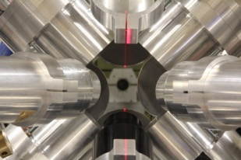
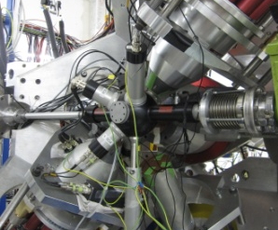
Outlook
Character of PDR in light, deformed, exotic nuclei?
  RIKEN: (α,α′γ) experiments in inverse kinematics on radioactive and stable nuclei
  iThemba LABS and CAGRA@RCNP: (α,α′γ) and (p,p′γ) experiments on stable nuclei
  Q3D@MLL: (d,p) experiments on single-particle structure
  SONIC@HORUS@IKP: (d,pγ) experiments on single-particle structure
γ-decay behavior of the PDR?
  γ³ at HIγS: γγ coincidence experiments
  SONIC@HORUS in Cologne: particle-γ coincidence experiments

Slide 26
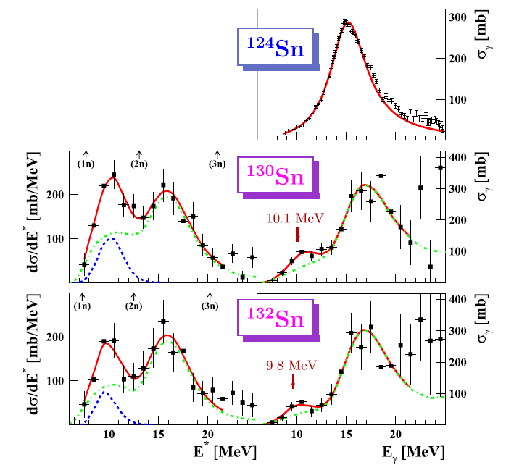
PDR Strength and its Identification
H. Nakada, T. Inakura, and H. Sawai, PRC 87 (2013) 034302
P. Adrich et al., PRL 95 (2005) 132501

Slide 27
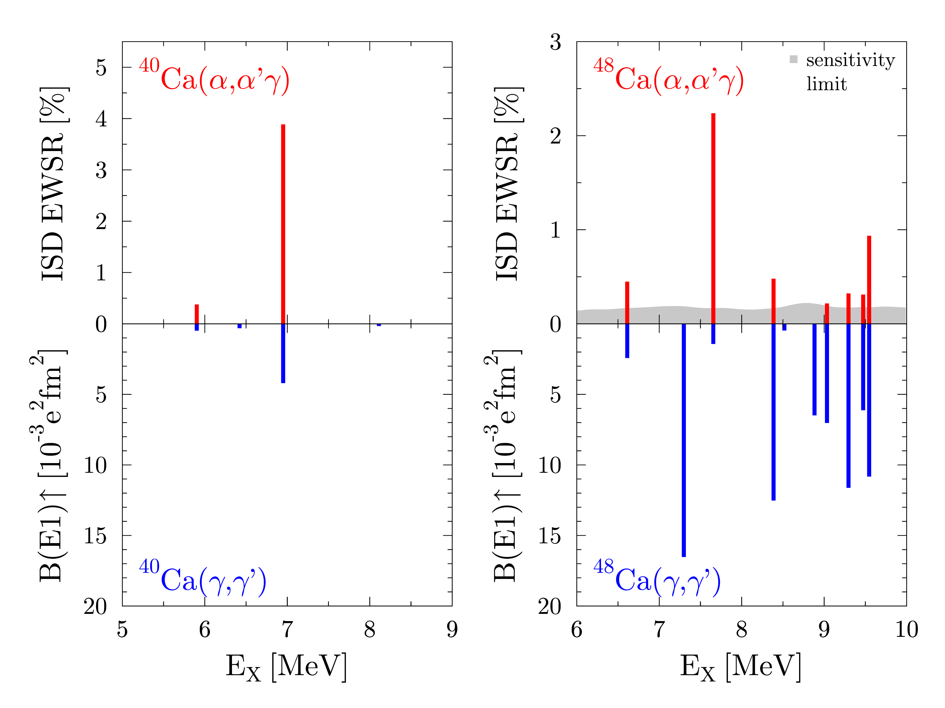
State-to-State Isospin Difference in Ca Isotopes
T.D. Poelhekken et al., Phys. Lett. B 278 (1992) 423
T. Hartmann et al., Phys. Rev. C 65 (2002) 034301
V. Derya et al., Phys. Lett. B 730 (2014) 288
T. Hartmann et al., Phys. Rev. C 65 (2002) 034301

Slide 28
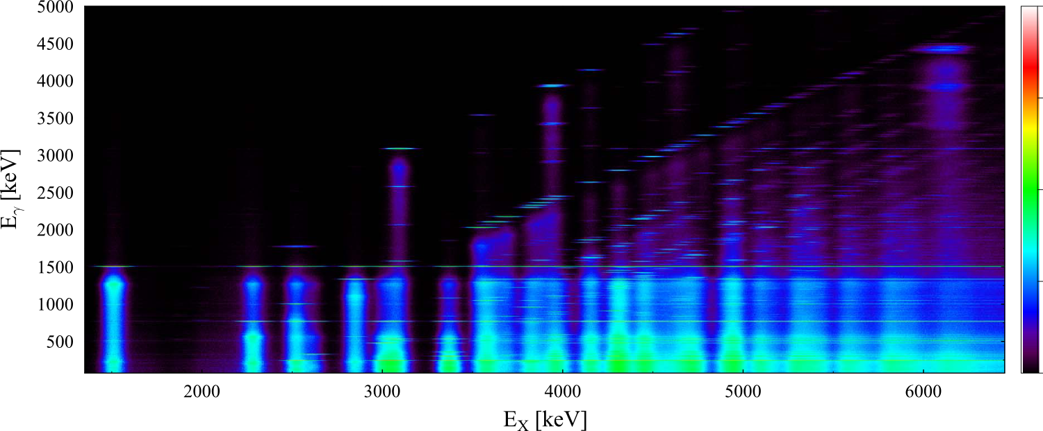
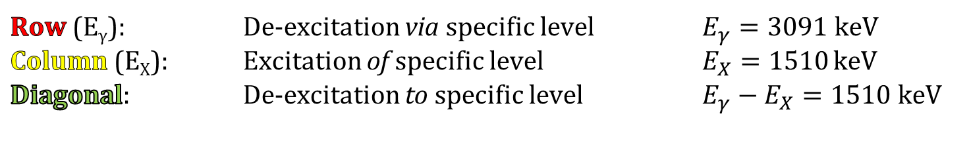
γ-Decay Behavior of the PDR
γ-ray spectrum
⁹²Mo(p,p'γ)@10.5 MeV
E_{γ} [keV]
Courtesy of S.G. Pickstone

Slide 29
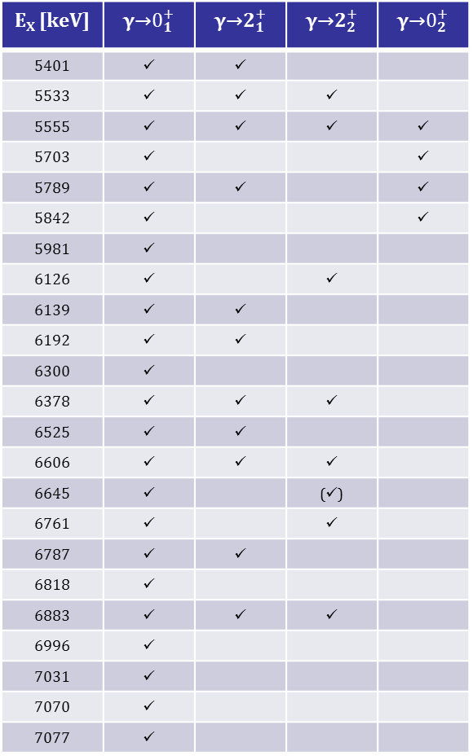
γ-Decay Behavior of the PDR in ⁹²Mo
Courtesy of S.G. Pickstone
E_{X} [keV]
5401 | ü | ü
5533 | ü | ü | ü
5555 | ü | ü | ü | ü
5703 | ü |  |  | ü
5789 | ü | ü |  | ü
5842 | ü |  |  | ü
5981 | ü
6126 | ü |  | ü
6139 | ü | ü
6192 | ü | ü
6300 | ü
6378 | ü | ü | ü
6525 | ü | ü
6606 | ü | ü | ü
6645 | ü |  | (ü)
6761 | ü |  | ü
6787 | ü | ü
6818 | ü
6883 | ü | ü | ü
6996 | ü
7031 | ü
7070 | ü
7077 | ü
Decay to ground state
Decay to first 2⁺

Slide 30
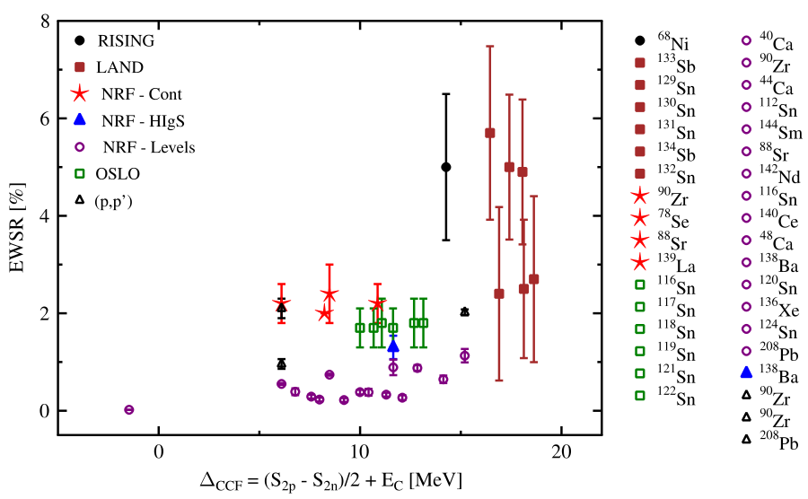
Evolution of PDR strength?
D. Savran., T. Aumann, and A. Zilges, Prog. Part. Nucl. Phys. 70 (2013) 210

