Slide 1
NuSYM14
University of Liverpool, Liverpool, UK, July 7-9, 2014
Influence of symmetry energy and nucleon effective mass splitting on HIC observables
Yingxun Zhang (张英逊)
China Institute of Atomic Energy
Collaborator:
M.B.Tsang （曾敏儿）,NSCL/Michigan State University
Zhuxia Li （李祝霞）,China Institute of Atomic Energy,
Hang Liu （刘航）, Texas Advanced Computer center, University of Texas,

Slide 2
Outline
1, Symmetry energy and n/p effective mass splitting
2, Influence of Skyrme force on HIC observables
    isospin diffusion and DR(n/p) ratios
3, Summary and outlook

Slide 3
Isospin asymmetric Equation of State
It is a fundamental properties of nuclear matter, and is very important for understanding
properties of nuclear structure
properties of neutron star
properties of heavy ion reaction mechanism
S(r) (MeV)
S(r) is the density dependence of symmetry energy, it is a key ingredient of the isospin asymmetric EOS. However, S(r) uncertainty
Where is the uncertainty from?
density dependent, momentum dependent, tensor force, exchange term, …..

Slide 4

Example,
density dependent of symmetry energy from Skyrme interaction in HF:
two-body term
three-body term
Density dependent
Mom. dependent
Symmetry energy depends on both the density dependent and momentum dependent (effective mass) term.

Slide 5




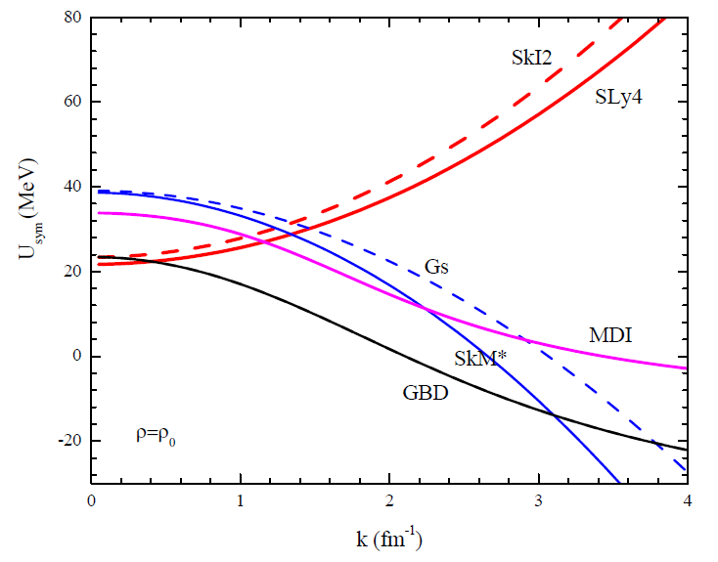
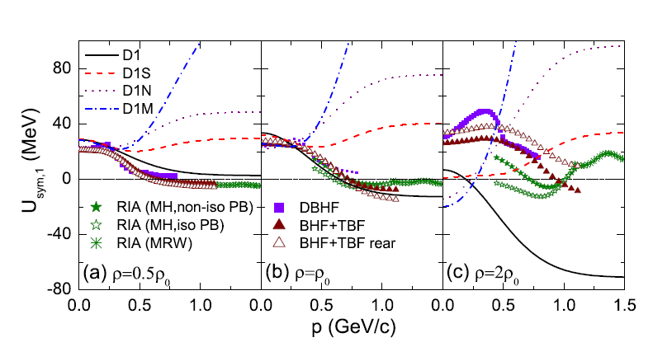
Effective mass: slope of single particle potential as a function of k.
Effective mass:
K-mass
E-mass
Effective mass splitting
R. Chen et al., PRC 85, 024305 (2012).

Slide 6
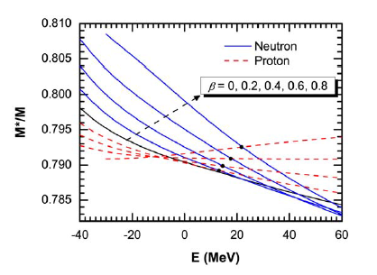
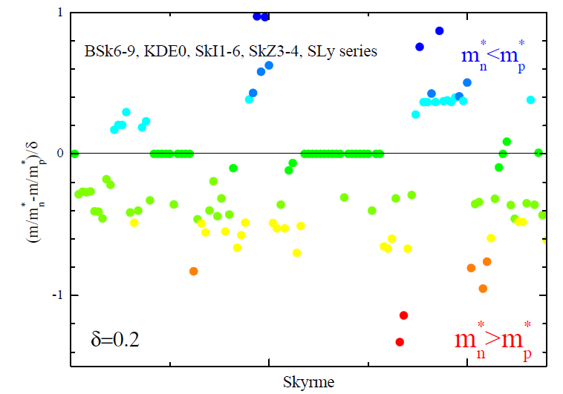
Effective mass splitting
WHLong, N Van Giai, J.Meng, PLB640(2008)150
RHF with PKO1

Slide 7
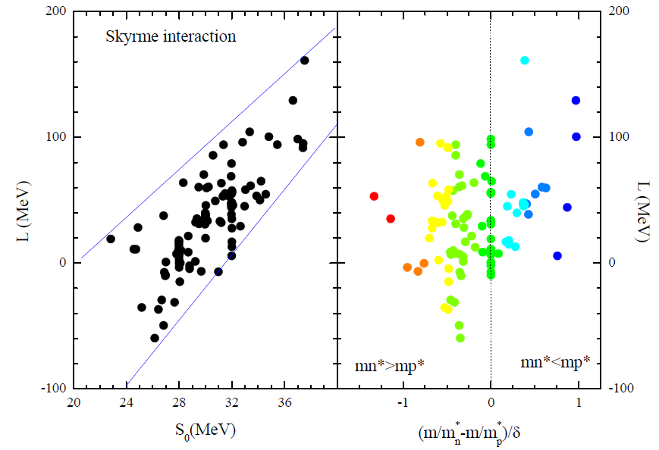
There is no strong correlation between effective mass splitting and slope of symmetry energy.
We must constrain the L and effective mass splitting together.
Notes:
So, what’s about the correlations between the slope of symmetry energy and the effective mass splitting?

Slide 8
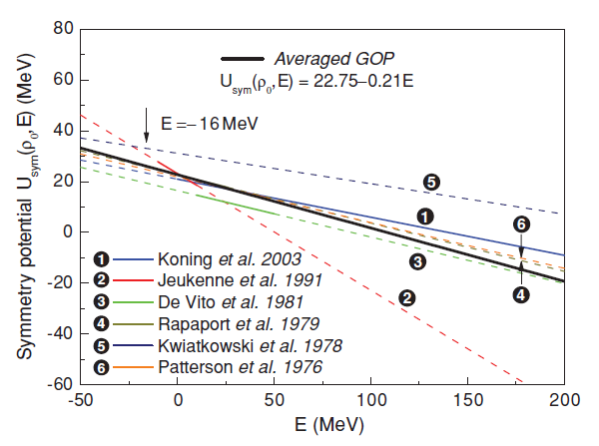
Constraints on the n/p effective mass splitting (mn*>mp*) and symmetry energy (B.A.Li, C. Xu, et.al., PRC2006,2010).
CXu,BALi,LWChen, PRC82,054607
U_{sym}(ρ₀,E)=22.75-0.21E
m_{n}*>m_{p}*
( m_{n}*-m_{p}*)/m=0.32δ

Slide 9
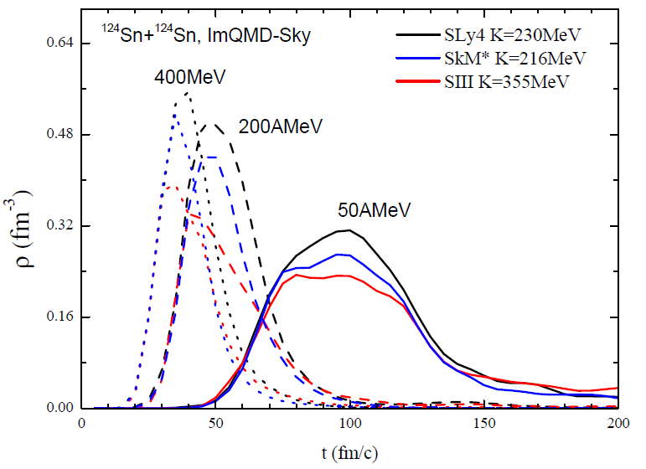
Need more information on n/p effective mass splitting away from the normal density
  Sign of effective mass splitting can be changed with energy?
  .......
HICs (away from normal density and Fermi momentum), need transport model

Slide 10
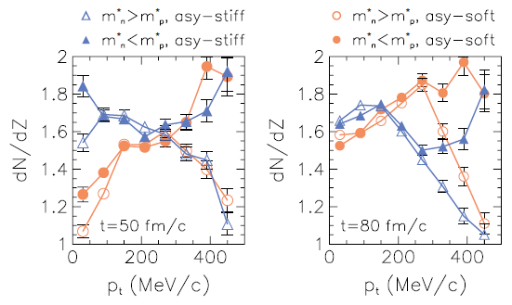
Symmetry potential is direct input instead of symmetry energy in the transport models.
probing the momentum dependence of symmetry potential(or n/p effective mass splitting) by HICs
J.Rizzo, et.al., Phys.Rev.C (2005)

Slide 11
Here, we would like to investigate the influence of symmetry energy and n/p effective mass splitting on heavy ion collisions observables simultaneously by using the transport model calculations with Skyrme type interaction.

Slide 12
The reasons why we choose Skyrme interaction in transport models
The Skyrme parameter sets have been adjusted for fitting the properties of nuclear matter, binding energy, actinide fission barrier, masses, …… Thus, E₀, K₀, S₀, L, K_{sym}, m*_s, m*_v, ……. are correlated.
In Skyrme EDF, one can easily choose different values L, m*_v for similar K_0 and S₀, m*_s from lot of sets.
Same interaction as nuclear structure studies, one may compare the constraints from nuclear structure studies and reaction studies.
One could get the constraints on Skyrme parameters, also on symmetry energy and n/p effective mass splitting from reaction data simultaneously.

Slide 13
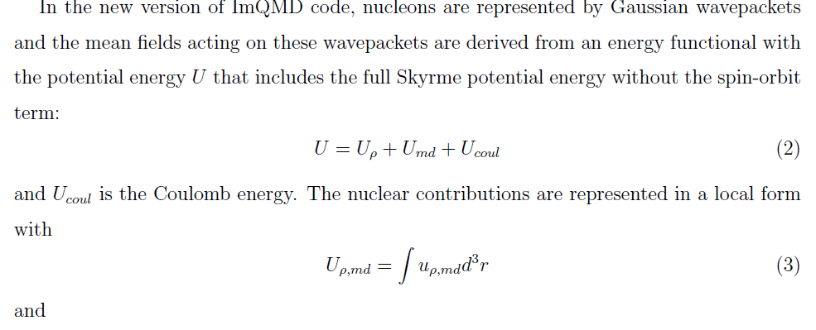
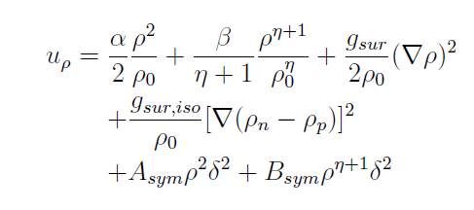
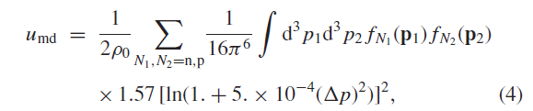
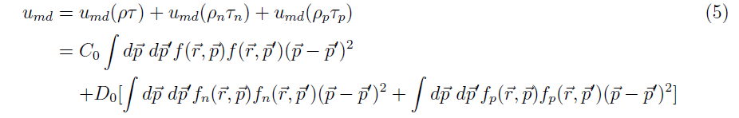
New version of ImQMD
Y.X. Zhang, M.B.Tsang, Z.X. Li, HLiu, PLB(2014)
Changes:

Slide 14
Select four parameter sets
K₀ = 230 ± 20MeV, S₀ = 32 ± 2MeV, m*_s=0.7+/-0.1
different L and n/p effective mass splitting.
Para. | Rho_0 | E₀ | K₀ | Q₀ | J | L | K_{sym} | m*_s | m*_n/m*_p
SLy4 | 0.16 | -15.97 | 229.91 | 363.11 | 32 | 46 | -120 | 0.69 | <1
SkI2 | 0.158 | -15.78 | 240.93 | 339.70 | 33 | 104 | 71 | 0.68 | <1
SkM* | 0.16 | -15.77 | 216.61 | 386.09 | 30 | 46 | -156 | 0.79 | >1
Gs | 0.158 | -15.59 | 237.29 | 348.79 | 31 | 93 | 14 | 0.78 | >1
 | Small L | Large L
m_n*<m_p* | SLy4 (L=46MeV) | SkI2 (L=104MeV)
m_n*>m_p* | SkM* (L=46MeV) | Gs (L=93MeV)

Slide 15
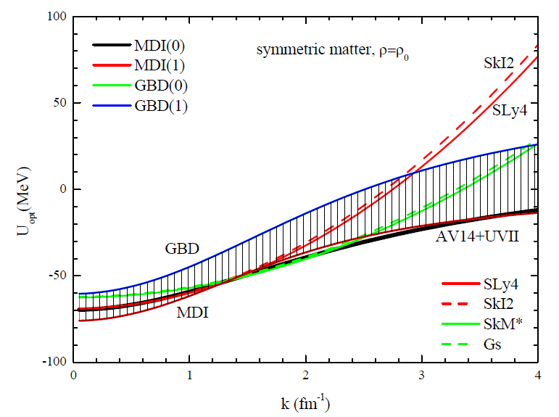
Below ~200MeV, optical potential for symmetric matter can be well approximated by Skyrme type interaction.

Slide 16
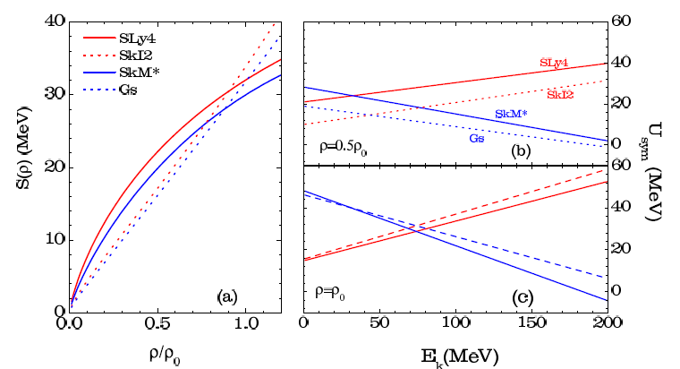
Corresponding density dependence of symmetry energy , and the symmetry potential as a function of nucleon energy
Zhang, Tsang, Li, Liu,, PLB732,186(2014)
The Larger the L is, the smaller the symmetry energy at <rho0 is.
The larger the U_{sym} is, the larger the n/p ratio is

Slide 17
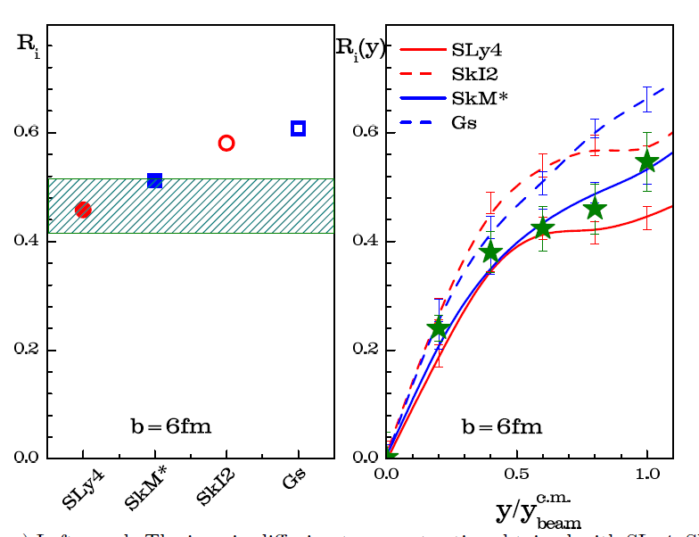
Isospin diffusion and isospin transport ratios as a function of rapidity
A=124Sn, B=112Sn
Isospin diffusion occurs only in asymmetric systems A+B, and diffusion ability depends on the symmetry energy and n/p effective mass splitting.
Zhang, Tsang, Li, Liu,, PLB732,186(2014)
For m*_{n}<m*_{p}, the isospin diffusion process is accelerated due to larger Lane potential at subsaturation density.
R_{i}=(2X-X_{AA}-X_{BB})/(X_{AA}-X_{BB})
In absence of isospin diffusion R=1 or R=-1,
R~0 for isospin equilibrium
Ri(SLy4, L=46MeV, m*_n<m*_p)<Ri(SkM*, L=46MeV, m*_n>m*_p) < Ri(SkI2, L=104MeV, m*_n<m*_p)<Ri(Gs, L=93MeV, m*_n>m*_p)
R_{i} is more sensitive to L than n/p effective mass splitting.

Slide 18
The calculated results of Ri from SLy4 and SkM* can fall in the data range.
For SLy4 and SkM*, they have S₀=30-32MeV, L=46MeV
Isospin diffusion data is hard to distinguish the effective mass splitting

Slide 19
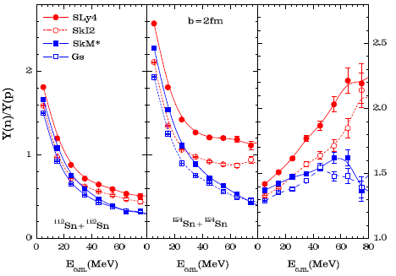
n/p and DR(n/p) ratios as a function of kinetic energy
DR(n/p)=R_{n/p}(124)/R_{n/p}(112)
50AMeV, b=2fm
The Larger the L is, the smaller the n/p ratio is.
m*_{n}<m*_{p} enhance the Y(n)/Y(p) ratios at higher kinetic energy region.
DR(n/p) ratios are sensitive to the n/p effective mass splitting.
Y(n)/Y(p) and DR(n/p) are more sensitive to n/p effective mass splitting than L

Slide 20
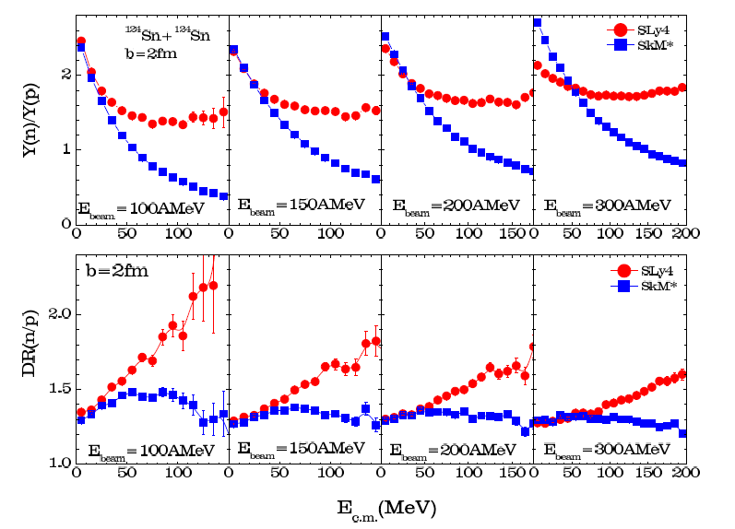
n/p and DR(n/p) at different beam energy
Cross over
SLy4 (S₀=32MeV, L=46MeV, m*_{n}<m*_{p})
SkM*(S₀=30MeV, L=46MeV, m*_{n}>m*_{p})
the Y(n)/Y(p) obtained with m*_{n}>m*_{p} are greater than that with m*_{n}<m*_{p} cases at lower beam energy for higher beam energy.

Slide 21
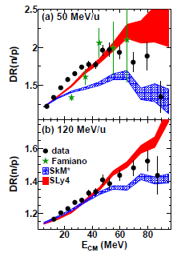
Theoretical predictions and New data
D.D.S.Coupland, et al., arXiv:1406.4546
New data seems to favor small effective mass splitting at high momentum
need more calculations with different effective mass splitting to understand this difference.

Slide 22
Separately change the effective mass splitting values in the code
input variables for ImQMD, as same as in MSL
MSL parameters, L.W.Chen, et al., PRC82, 024321(2010)
parameters | default
Rho0 | 0.16
E0 (MeV) | -16
K0 (MeV) | 230 | 280 | 330
Ms* | 0.7 | 0.85 | 1.0
Mv* | 0.6 | 0.7 | 0.8
S₀(MeV) | 32 | 30 | 34
L (MeV) | 46 | 60 | 80 | 100
G_sur (MeVfm^2) | 24.6
G_sur,iso (MeVfm^2) | -4.99
Xs*/xs_free | 1-eta*rho | (mu*/mu)^2 | 1

Slide 23
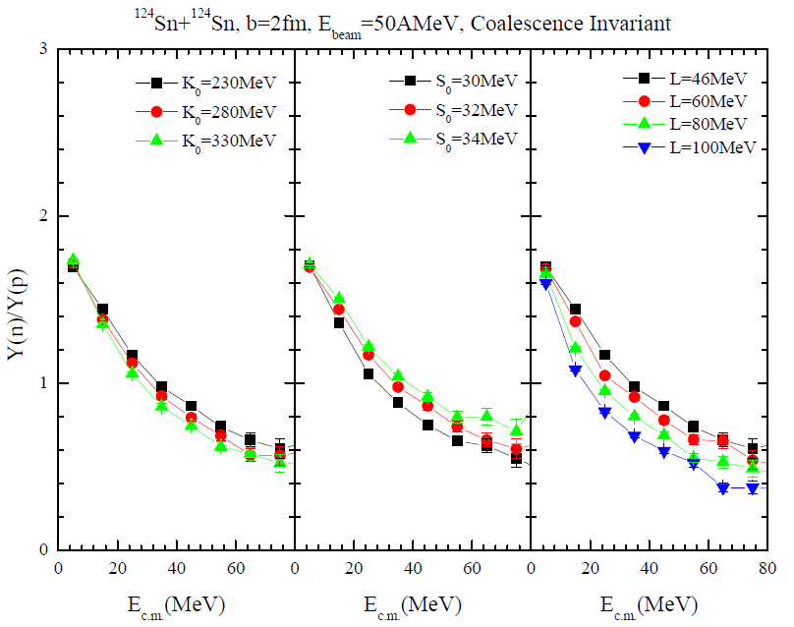
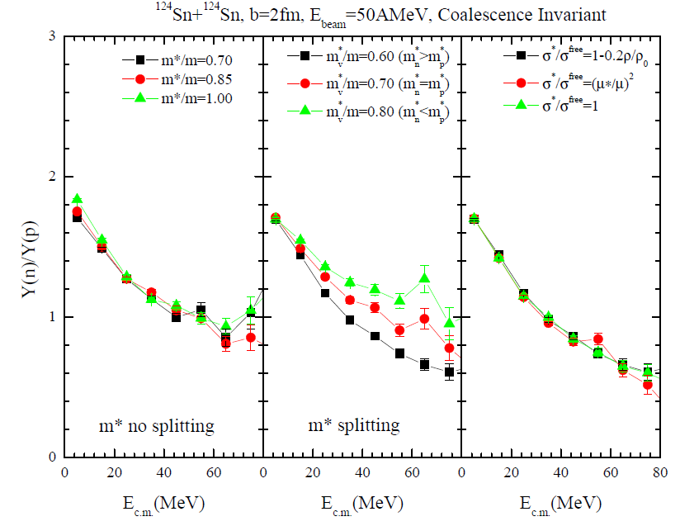
Coalescence invariant Y(n)/Y(p) ratio, at Ebeam=50AMeV, b=2fm
CI-Y(n)/Y(p) ratio is sensitive to effective mass splitting (mv*), L and S₀ at 50AMeV.
CI-Y(n)/Y(p) weakly depends on K0, ms*, and in-medium xs.

Slide 24
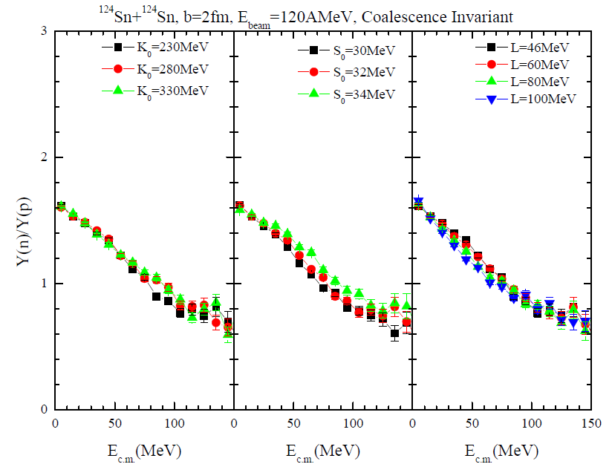
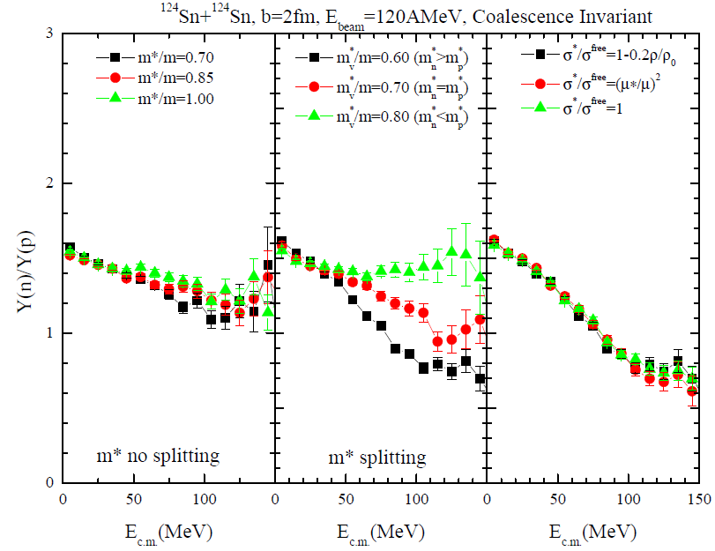
Coalescence invariant Y(n)/Y(p) ratio, at Ebeam=120AMeV, b=2fm
CI-Y(n)/Y(p) ratio at high energy region is sensitive to effective mass splitting (mv*) at 120AMeV.
CI-Y(n)/Y(p) weakly depends on K0, S0, L, ms*, and in-medium xs.

Slide 25
4, Summary and outlook
1, Developed a new version of ImQMD which can accommodate the Standard Skyrme interaction in parameters. It can bridge the reaction and structure study by using same EDF.
2, The Ri and Ri(y) support the SLy4 and SkM* interactions, they have L=46MeV.
3, CI-Y(n)/Y(p) ratio is sensitive to S₀, L and effective mass splitting (mv*) at 50AMeV, and weakly depends on K0, ms*, and in-medium xs.
4, CI-Y(n)/Y(p) ratio at high energy region is sensitive to effective mass splitting (mv*) at 120AMeV, and weakly depends on the K0, S0, L, ms*, and in-medium xs.
5, the behaviors of symmetry potential at high momentum should be further understand.

Slide 26
Thanks for your attention!

Slide 27
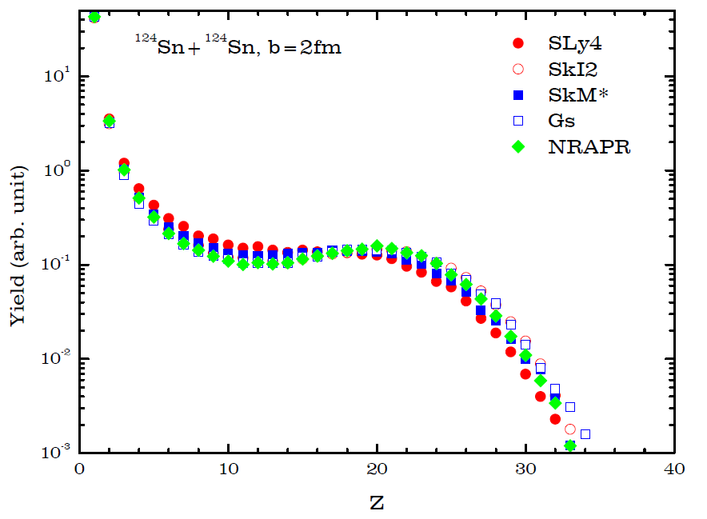
Charge distribution
Weak dependence on the parameters we selected
E_{beam}=50AMeV

