Slide 1



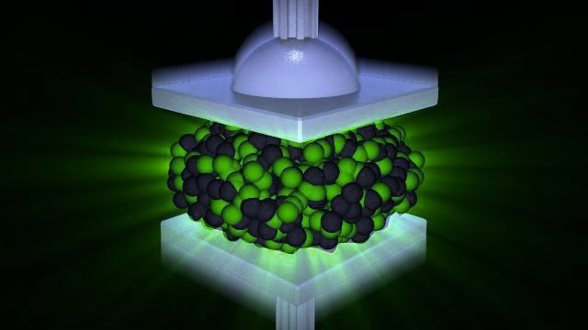
First measurement of the isoscalar giant resonances in a neutron-rich nucleus: ⁶⁸Ni with the active target MAYA
Isoscalar Giant Resonances
Motivations
Setup : the active target MAYA
Results
Marine VANDEBROUCK
Present address marine.vandebrouck@ganil.fr
M. Vandebrouck et al. accepted in PRL (2014)

Slide 2
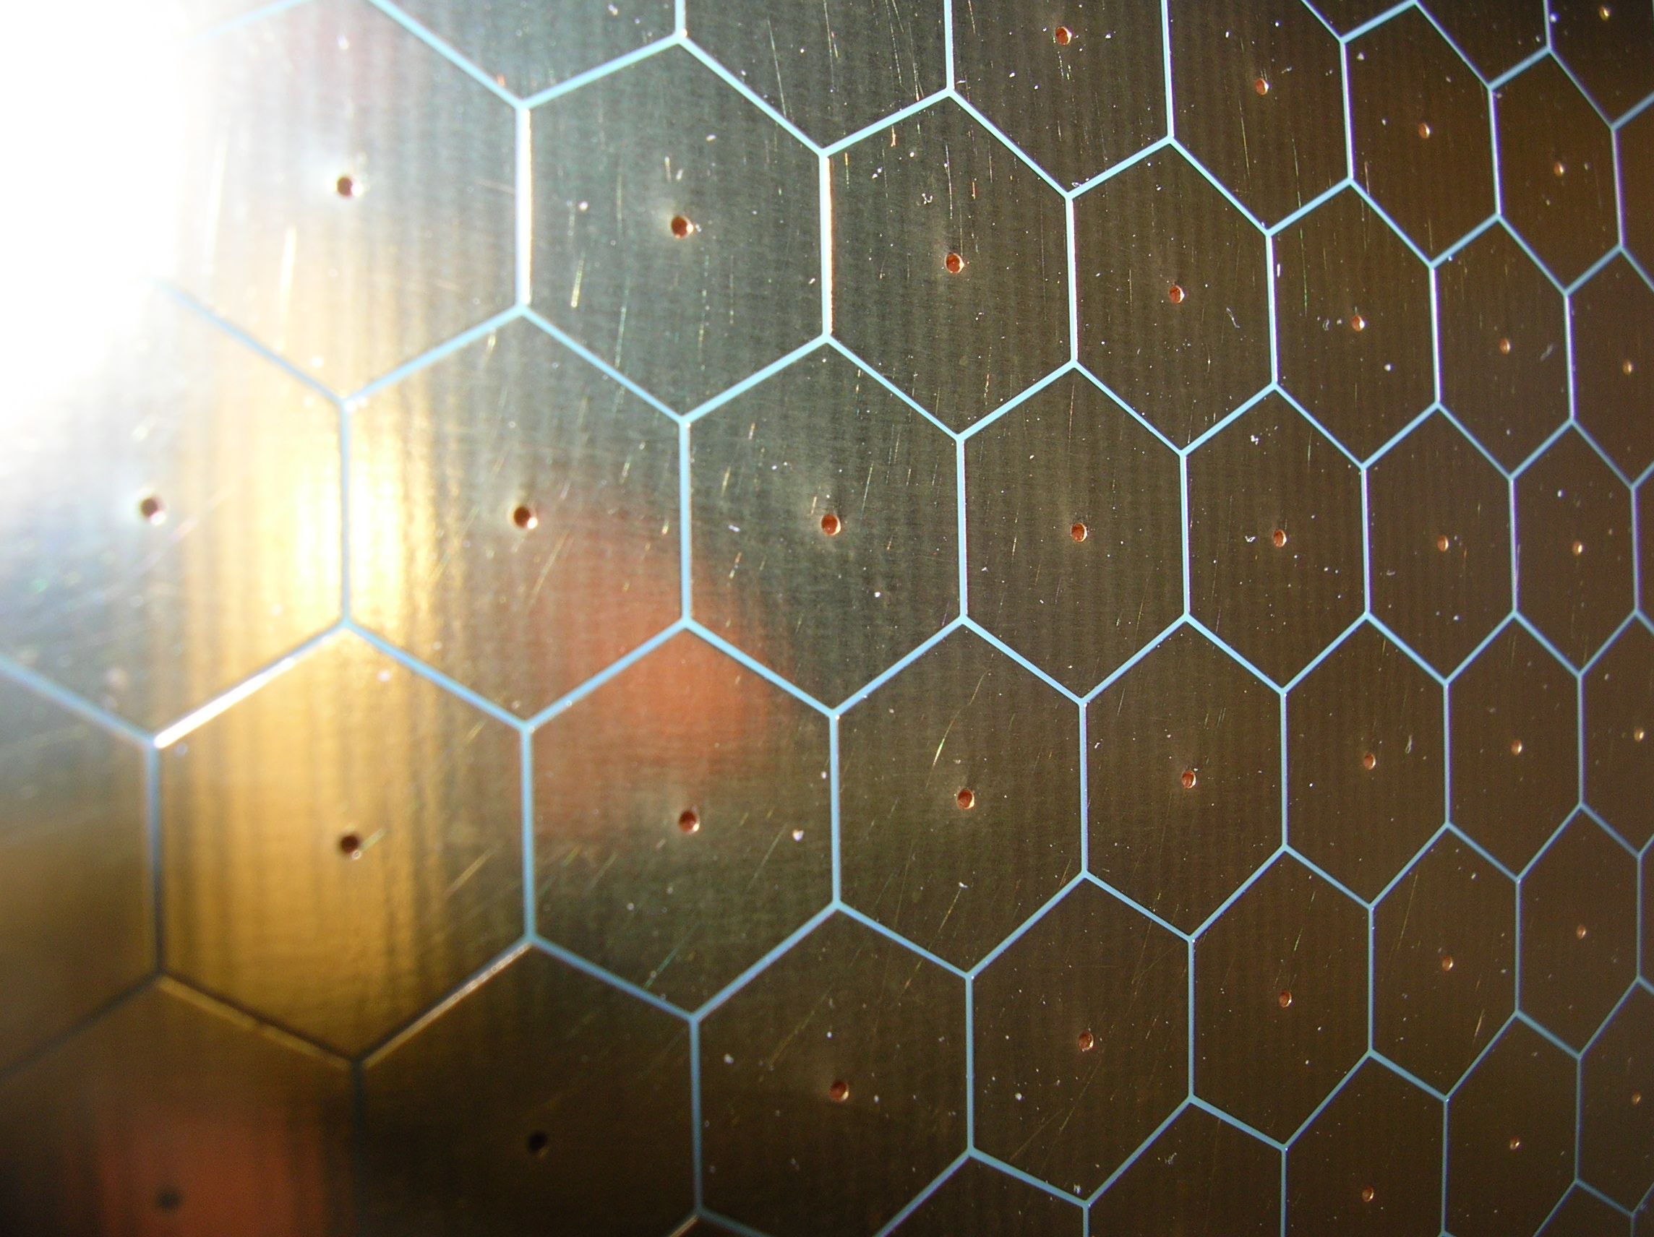
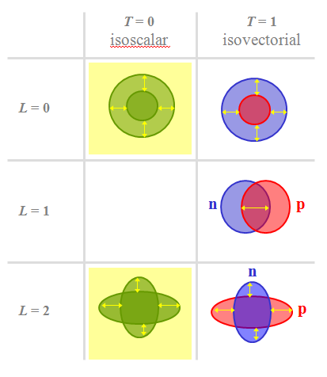
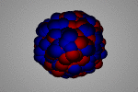
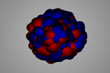
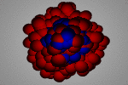
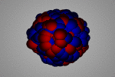
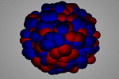
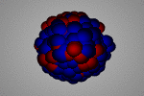
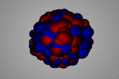
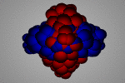
Giant Resonances
What are giant resonances ?
Collective excitation mode
Feature :
- Important cross section (100 mb)
- Exhaust a large part of the EWSR
- Properties change smoothly with the number of nucleons
Quantum number of the excitation :
- Spin S
- Isospin T
- Multipolarity L
T = 0
isoscalar
T = 1
isovectorial
Electric GR :
Electric GR :
monopole
(GMR)
ISGMR
dipole
(GDR)
quadrupole
(GQR)
ISGQR

Slide 3
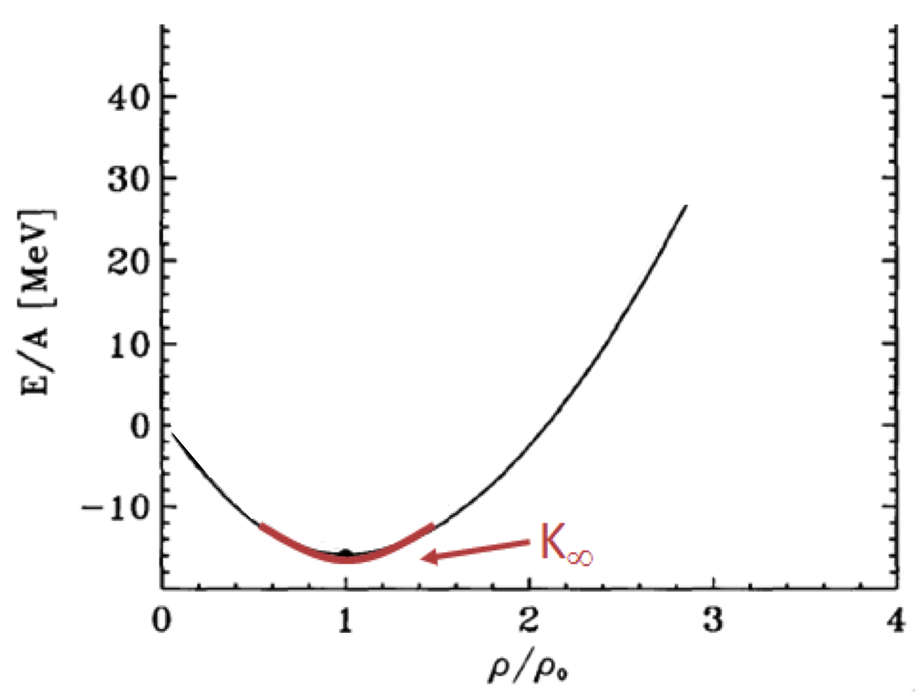
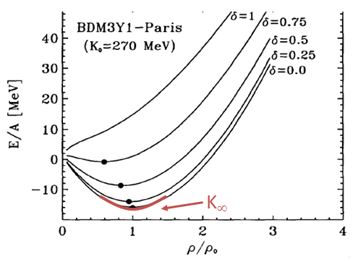
Motivations
Nuclear matter incompressibility and ISGMR
Asymetry δ=(N-Z)/A
• Centroid of the ISGMR E_{ISGMR}
Determination of the compression modulus of the nucleus K_{A}
• Compression modulus of the nucleus K_{A}
Determination of the nuclear matter incompressibility K∞
Microscopic
calculation
Liquid drop development
D.T.Khoa et al. Nucl. Phys A. 602 (1996)
w
Status
K∞ has been constrained for symmetric and asymmetric matter. To gain a better knowledge of K∞ , we need studies along isotopic chains, including exotic nuclei.

Slide 4
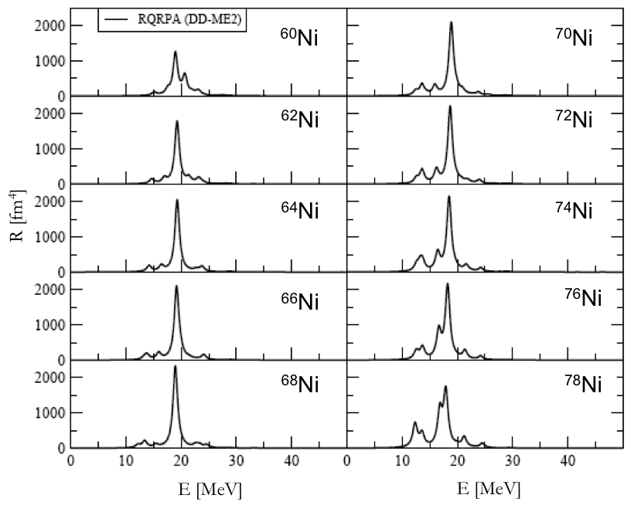
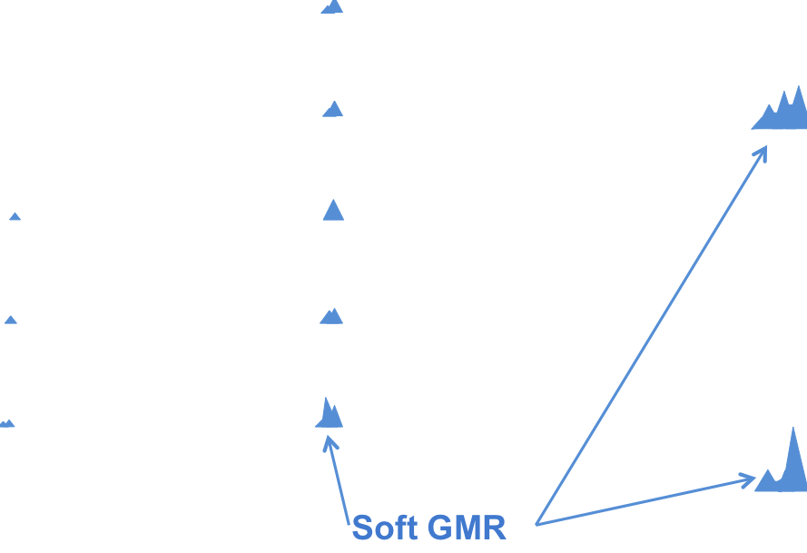
Motivations
Prediction of a soft monopole mode
Prediction of the monopole strenght in Ni isotopic
Prediction of a low energy mode
d’
⁶⁸Ni L=0 SLy4
RQRPA
E [MeV]
RPA
⁶⁸Ni L=0 SGII
E [MeV]
E. Khan, N. Paar and D. Vretenar, Phys. Rev. C. 84, 051301 (2011)

Slide 5
Motivations
Status of the GR measurement in unstable nuclei
Understand these excitation modes from stable to exotic nuclei : the IVGDR/PDR has been measured in ⁶⁸Ni, neutron rich Oxygen and Tin isotopes at GSI, in ²⁶Ne at Riken
1st measurement of the ISGMR and ISGQR in unstable nuclei ⁵⁶Ni : ⁵⁶Ni(d,d’)⁵⁶Ni*
C. Monrozeau et al., Phys. Rev. Lett. 100, 042501 (2008)
Study of the ISGMR and ISGQR in a neutron rich Ni : ⁶⁸Ni Continue the study of the Ni isotopic chain
Z=28
⁵⁶Ni
⁵⁸Ni
⁶⁰Ni
⁶²Ni
⁶⁴Ni
⁶⁸Ni
Study of the ISGMR and ISGQR using inelastic scattering ⁶⁸Ni(α,α’)⁶⁸Ni* and ⁶⁸Ni(d,d’)⁶⁸Ni*
Experiment at GANIL

Slide 6
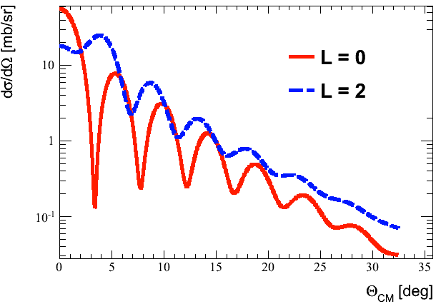
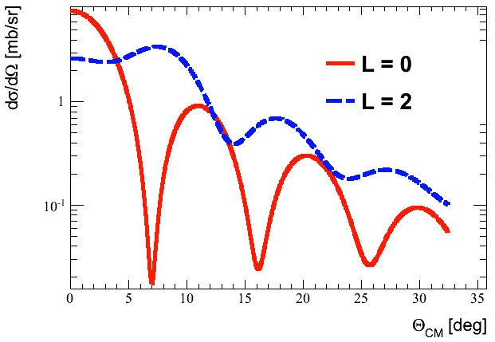
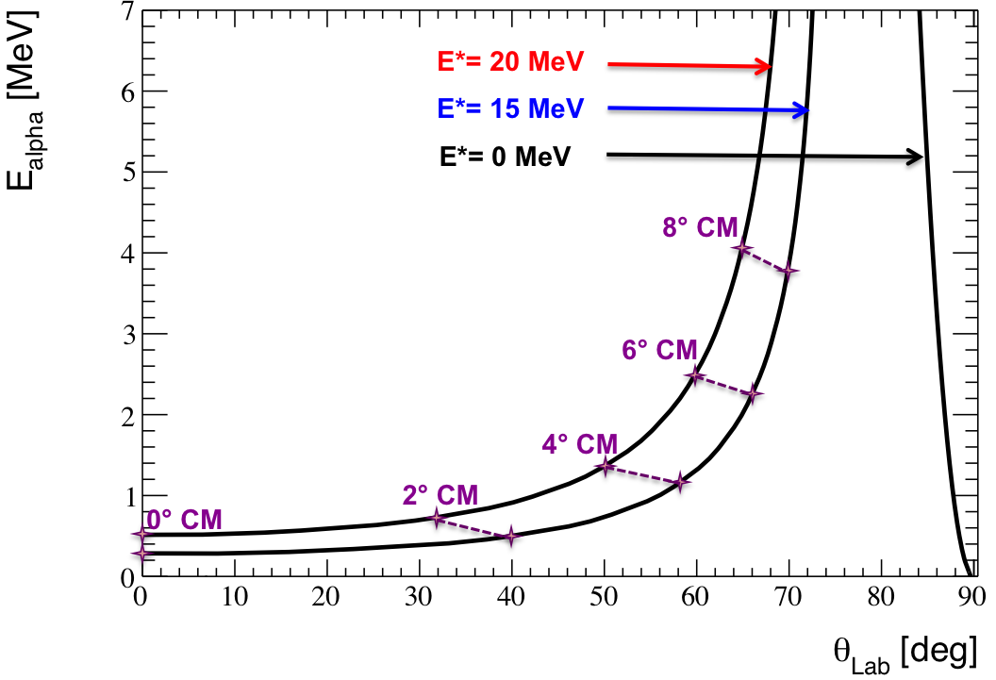
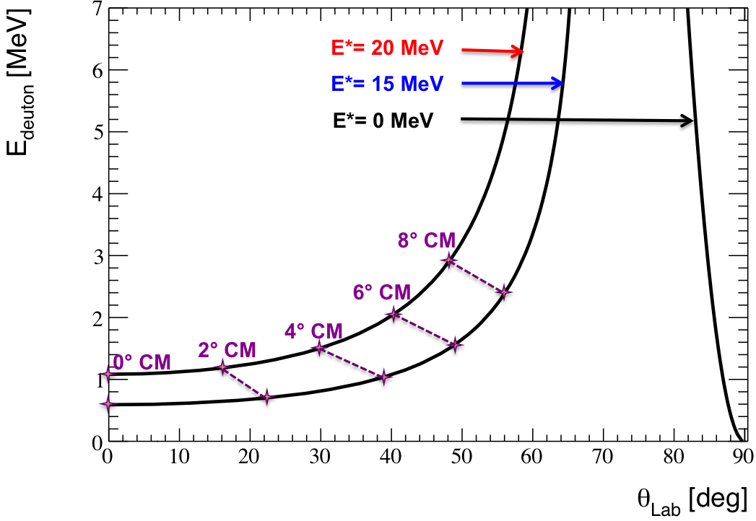

Setup : the active target MAYA
Need an active target
Study of the ISGMR and in ISGQR using inelastic scattering ⁶⁸Ni(α,α’)⁶⁸Ni* and ⁶⁸Ni(d,d’)⁶⁸Ni*
⁶⁸Ni(α,α’)⁶⁸Ni*
⁶⁸Ni(d,d’)⁶⁸Ni*
Challenge :
Measurement at small angles and low energies
We have to consider :
- Inverse kinematics with a low recoiling energy
- Low production rate
Use of an Active Target :
- low detection threshold
- thick target

Slide 7
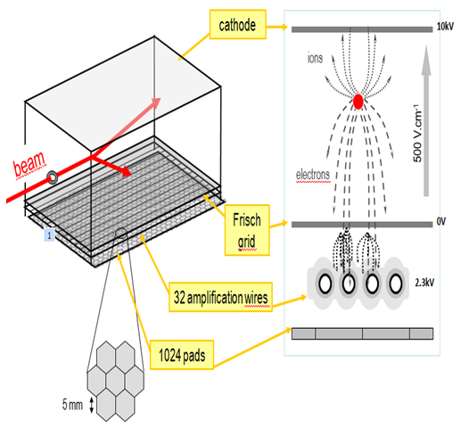

Setup : the active target MAYA
Principle
Gas : D2
Pressure : 1 bar
⁶⁸Ni + d → d’ + ⁶⁸Ni*
Gas : Helium 98% + CF4 2%
Pressure : 0.5 bar
⁶⁸Ni + α → α’ + ⁶⁸Ni*
Time Projection Chamber (TPC) :
cathode
3kV
10kV
Ions
1. The scattered deuteron or α ionizes the gas
+
-
-
-
+
Electrons
beam
+
2. The electrons drift
towards the Frisch grid
⁶⁸Ni
Frisch
grid
0V
3. Amplification on the wires
32 amplification wires
4. Signal on each pad proportionnal to the amount of electrons collected on the wire above
1200V
2300V
1024 pads
Which information are stored ?
Time on each wire
Charge induced on each pad

Slide 8
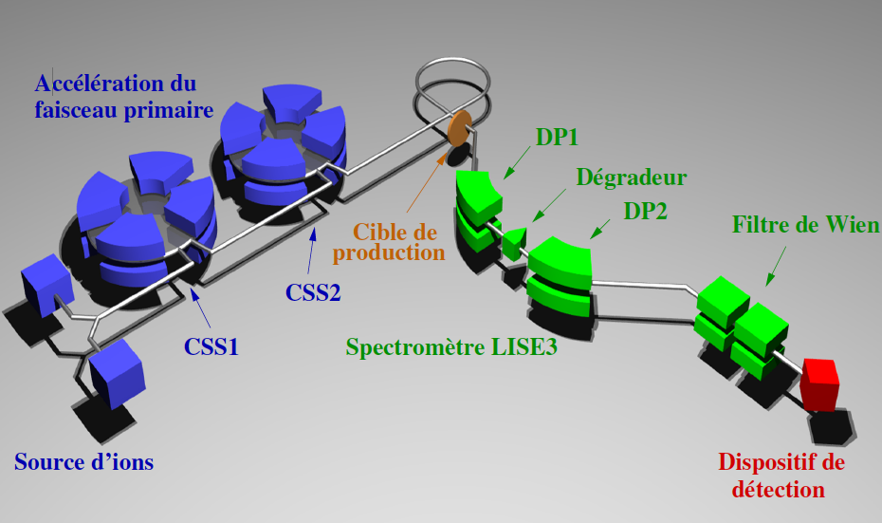
Setup : the active target MAYA
Production of the ⁶⁸Ni at GANIL
Production of ⁶⁸Ni beam from fragmentation of ⁷⁰Zn
⁷⁰Zn at 62.3 A.MeV
Acceleration of the primary beam ⁷⁰Zn
DP1
Degrador
DP2
Wien filter
(not used)
Target production
⁹Be 140 μm
⁹Be 140 μm
LISE Spectrometer
⁶⁸Ni 50MeV/A
Intensity : 10⁴ pps Purity : 75%
Ion source
C0
⁶⁸Ni at 50 A.MeV
Experimental setup

Slide 9
Results
Tracking reconstruction
θ2D
Charges projection
Range2D
Range2D
[μs]
θ_{2D} angle
Range_{2D}
beam
Φ angle
Reconstruction of the 3rd dimension
• Excitation energy ⁶⁸Ni
Angular distribution
recoil

Slide 10
Results
Efficiency correction
• Geometric efficiency using ActarSim code (based on Geant4 and ROOT)
Each simulated event is reconstructed with the code for physical events
Geometric and reconstruction efficiency
ACTAR
⁶⁸Ni(α,α’)⁶⁸Ni*
⁶⁸Ni(d,d’)⁶⁸Ni*

Slide 11
Results ⁶⁸Ni(α,α’)⁶⁸Ni*
Excitation energy spectra
 | Centroid (MeV) | FWHM (MeV)
Lorentzian 1 | 12.9±1.0 | 1.2±0.4
Lorentzian 2 | 15.9±1.3 | 2.3±1.0
Lorentzian 3 | 21.1±1.9 | 1.3±1.0
M. Vandebrouck et al. accepted in PRL (2014)

Slide 12
Results ⁶⁸Ni(α,α’)⁶⁸Ni*
Angular distribution
12.9MeV
15.9MeV
21.1MeV
w
Results
L = 0 at 12.9 MeV : EWSR 33±13%
L = 2 at 15.9 MeV : EWSR 22±7%
L = 0 at 21.1 MeV : EWSR 52±22%

Slide 13

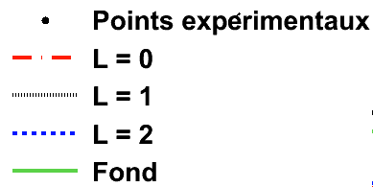

Results ⁶⁸Ni(α,α’)⁶⁸Ni*
Multipole Decomposition Analysis
E*(⁶⁸Ni) = 13 MeV
E*(⁶⁸Ni) = 17 MeV
E*(⁶⁸Ni) = 21 MeV
E*(⁶⁸Ni) = 25 MeV
E*(⁶⁸Ni) = 27 MeV
Experimental points
L = 0
L=1
L = 2
Background

Slide 14
Results ⁶⁸Ni(α,α’)⁶⁸Ni*
Multipole Decomposition Analysis
L=0
L=1
Résultats
L = 0 : - fragmentation of the ISGMR with a shoulder at 21 MeV
    - increase of the strenght at 13 MeV
L = 1 : - increase of the strenght at 21MeV and below 15MeV
L = 2 : - concentration of the strenght around 16 MeV
• From 23 MeV other multipolarities…
L=2
w

Slide 15
Results
Synthesis
⁶⁸Ni(α,α’)⁶⁸Ni* - Resonance at 12.9MeV, L=0
- Resonance at 15.9MeV, L=2
- Resonance at 21.1MeV, L=0
⁶⁸Ni(d,d’)⁶⁸Ni* - Resonance at 12.7 MeV, L=0
- Resonance at 20.9 MeV, L=0
w
Synthesis of results
L = 0 : - ISGMR fragmented, strength around 21.1 ± 1.9 MeV clearly observed
- First indication of « soft » GMR measured at 12.9 ± 1.0 MeV
  L = 2 : - ISGQR identified in analysis with lorentzian fit in (α,α’) à 15.7 ± 1.0 MeV

Slide 16
Conclusion and outlook
w
Conclusion
Measurement of the isoscalar strength in ⁶⁸Ni
Study of inelastic scattering ⁶⁸Ni(α,α’)⁶⁸Ni* and ⁶⁸Ni(d,d’)⁶⁸Ni* with MAYA active target
Better statistics in (α,α’)
2nd measurement of ISGR in an exotic nuclei : - Study of isotopic chain including exotic nuclei
                - GR with active target
First use of MAYA with the mixture (He + CF₄)
w
Outlook
Active target development
Active target adapted for GR studies
ACTAR + GET development
Isoscalar monopole strength in exotic nuclei
St udy in heavier nuclei

Slide 17







Collaboration
J. Gibelin², E. Khan¹, N.L. Achouri², H. Baba³, D. Beaumel¹, Y. Blumenfeld¹, M. Caamaño⁴, L. Càceres⁵, G. Colò⁶, F. Delaunay², B. Fernandez-Dominguez⁴, U. Garg⁷, G.F. Grinyer⁵, M.N. Harakeh⁸, N. Kalantar-Nayestanaki⁸, N. Keeley⁹, W. Mittig¹⁰, J. Pancin⁵, R. Raabe¹¹, T. Roger^{11,5}, P. Roussel-Chomaz¹², H. Savajols⁵, O. Sorlin⁵, C. Stodel⁵, D. Suzuki^{10,1}, J.C. Thomas⁵.
¹ IPN Orsay, Université Paris-Sud, IN2P3-CNRS, F-91406 Orsay Cedex, France
² LPC Caen, ENSICAEN, Université de Caen, CNRS/IN2P3, F-14050 CAEN Cedex, France
³ RIKEN Nishina Center, 2-1 Hirosawa, Wako, Saitama 351-0198, Japan
⁴ Universidade de Santiago de Compostela, E-15782 Santiago de Compostela, Spain
⁵ GANIL, CEA/DSM-CNRS/IN2P3, 14076 Caen, France
⁶ Dipartimento de Fisica Università degli Studi di Milano and INFN, Sezione di Milano, 20133 Milano, Italy
⁷ Physics Department, University of Notre-Dame, Notre Dame, Indiana 46556, USA
⁸ KVI-CART, University of Groningen, NL-9747 AA Groningen, The Netherlands
⁹ National Centre for Nuclear Research ul. Andrzeja Soltana 7, 05-400 Otwock, Poland
¹⁰ NSCL, Michigan State University, East Lansing, Michigan 48824-1321, USA
¹¹ IKS, K.U. Leuven, B-3001 Leuven, Belgium
¹² CEA-Saclay, DSM, F-91191 Gif sur Yvette Cedex, France

