Slide 1
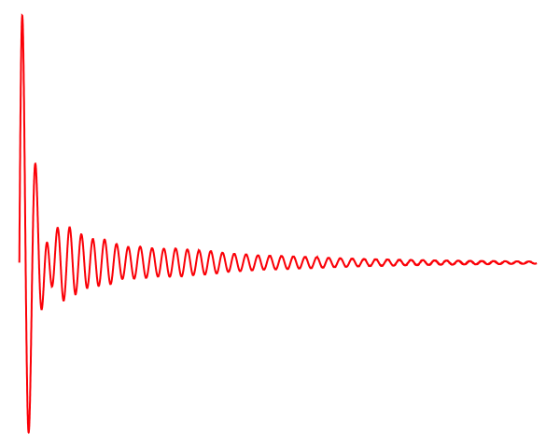
The Isovector Giant Quadrupole Resonance & Nuclear Matter
Paul Stevenson, University of Surrey
NuSYM Workshop, Liverpool, July 2014

Slide 2
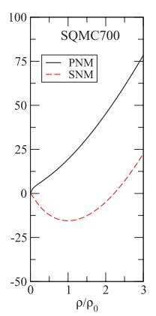

Nuclear Matter
Characterised by Equation of State
Inspired by liquid drop model, expand round minimum, with respect to various variables:
INM
(from Farine, Pearson Tondeur et al, NPA615 135-161 (1997))
Assume that Taylor expansion converges reasonably well.

Slide 3
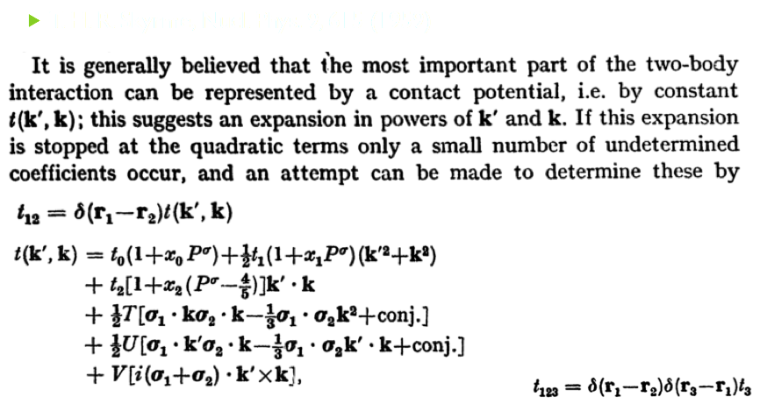
Skyrme forces
T. H. R. Skyrme, NPA 9, 615 (1959)
Assume that Taylor expansion converges reasonably well.

Slide 4
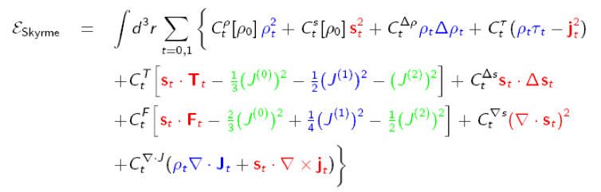
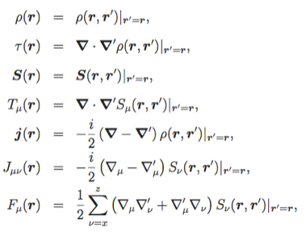

Or as EDF:
Taylor expansion -> order by order in derivatives of density

Slide 5
Correlating NM parameters with force parameters
Force parameters always fitted to some nuclear matter properties
Many correlations!: See several other talks…
Summary, e.g. Dutra et al, PRC 85 035201 (2012):
Incompressibility K ↔︎ GMR
K’ ↔︎ GMR
m*↔︎ GDR
EoS ↔︎ matter flow
EoS ↔︎ Kaon production in HIC
Symmetry energy (J) ↔︎ HIC ,PDR, IAS …
L=J’ ↔︎ isospin diffusion / HIC
S(ρ₀/2) ↔︎ neutron skin
X. Roca-Maza et al, PRC 87 034301 (2013)
IS & IV GQR ↔ S(ρ=0.1 fm⁻³) ↔ L ↔ Δr_{np}

Slide 6
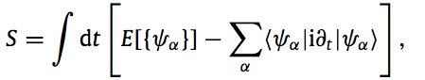

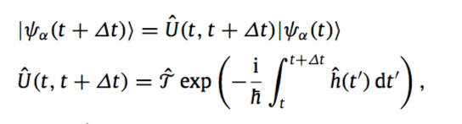
TDHF for collective motion

Slide 7
TDHF as means to look at collective motion

Slide 8
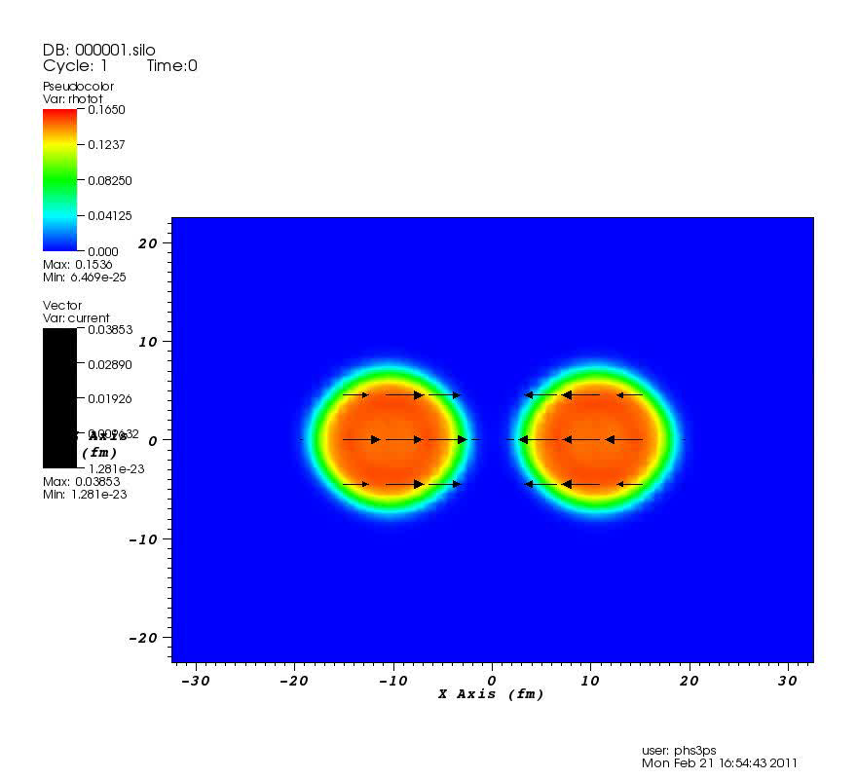
Aside: you can do this when you download the code

Slide 9
For GR
Start with static HF calculation
Apply instantaneous boost with multipole shape at t=0
Follow

Slide 10
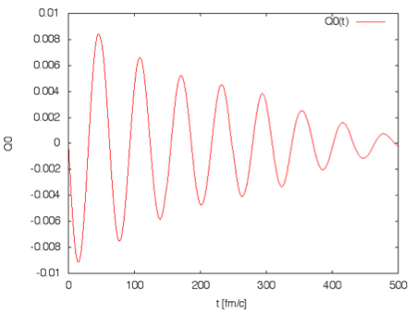
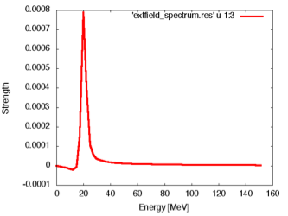
IS GQR
Sample calculation of O-16 ISGQR with SV-bas force
General feature of ISGQR that single-peaked (at mean-field level)
N.B. 1 zs=300 fm/c

Slide 11
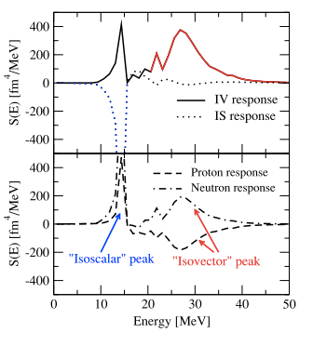
Isospin mixing
Can kick nucleus with one kind of boost and measure a different kind of response
S(E) = Σ_{ν}〈0︱F︱ν〉〈ν︱G︱0〉δ(E-E_{ν})
Strength function measure matrix element
Learn about normal modes in isospin sector and isospin mixing within giant resonances (and hence nuclear matter)

Slide 12
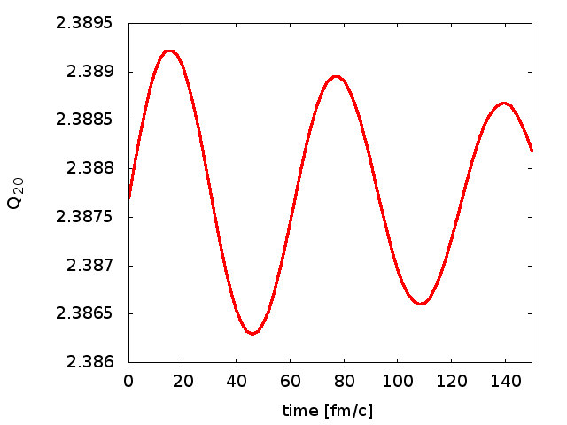
K’ ?
-- We looked at ISGQR in various nuclei where data is known
-- because of single-peak character, we follow time evolution only for one cycle
-- gives single characteristic energy & allows straightforward way to perform systematic study

Slide 13
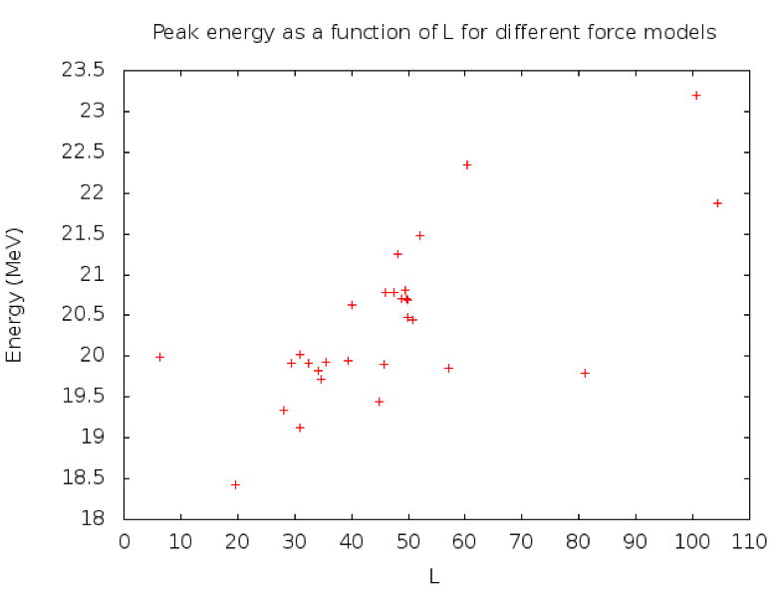
E_{ISGQR} vs […]
¹⁶O

Slide 14
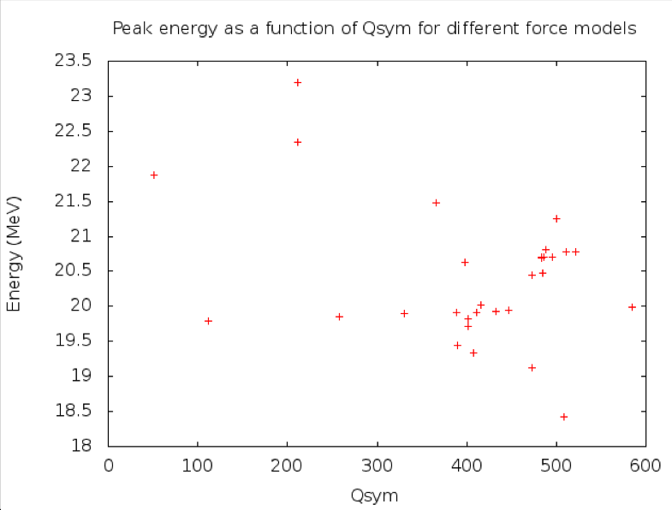
Q_{sym} aka K’_{sym}

Slide 15
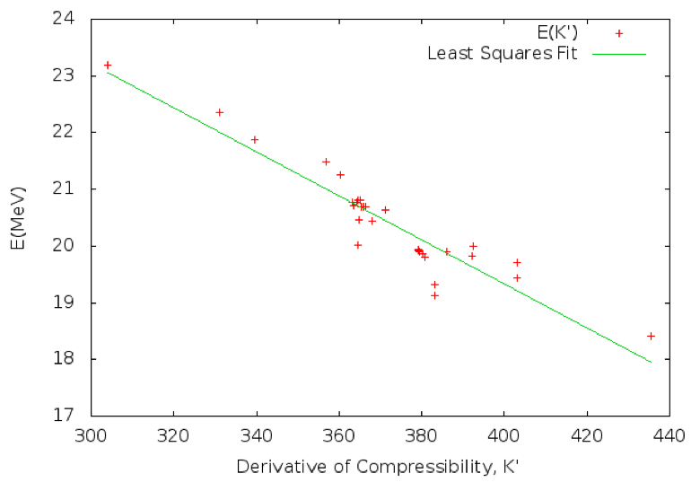
K’ correlation : ¹⁶O

Slide 16
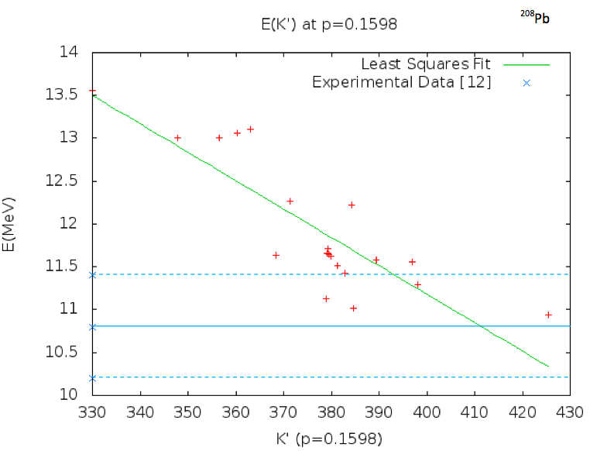
K’ correlation : ²⁰⁸Pb
Exp data: F E Bertrand Annu Rev Nucl Sci 26, 457 (1976)

Slide 17
Improved constraint
Previously K’ = 700 ± 500 MeV
Now ~ 400 ± 30 MeV
“CSKP” Parameterisations:
  SKRA: 379 MeV
  KDE0v1: 385 MeV
  SQCM700: 370 MeV
  NRAPR: 362 MeV
  LNS: 382 MeV

Slide 18
Conclusions
Link between nuclear matter properties and effective interaction parameters via GR
ISGQR has good correlation with K’ – previously weakly constrained only via K
Constraint from ±500 MeV to ±30 MeV
All “CSkP” forces pass tightened constraint

Slide 19
Acknowledgements
Thank you to:
  J Petts (Surrey)
  P M Goddard (Surrey)
  J R Stone (Oxford)
  M Dutra (Brazil)
  Sky3D collaborators: J A Maruhn, A S Umar, P-G Reinhard
  STFC

