Slide 1
Constraints on E_{sym}(ρ)-L from RIB induced reactions…and more
Zach Kohley
NSCL/MSU
NuSYM14
July 7, 2014

Slide 2
Outline
Introduction
New constraints on E_{sym}(ρ) from: RIBs@NSCL + MoNA-LISA → EoS
New observables for E_{sym}(ρ) from HICs: Isospin transport in dinuclear system
Conclusion/Future

Slide 3
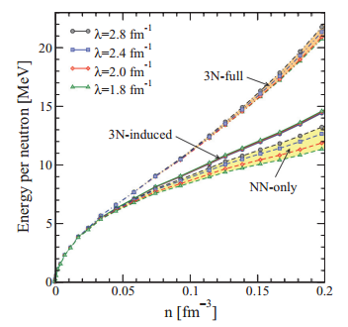
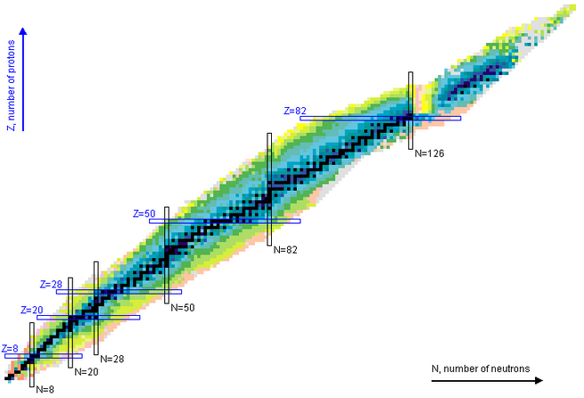
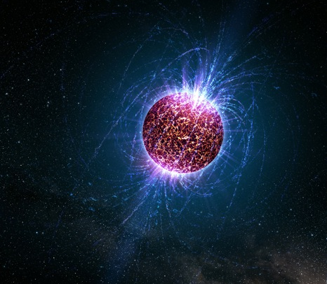
Introduction
Hebler and Furnstahl.
PRC 87, 031302(R) (2013)
Study properties and reactions of finite nuclei to extract information about infinite nuclear matter.
Neutron matter

Slide 4
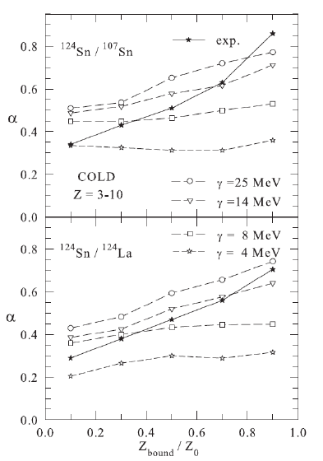
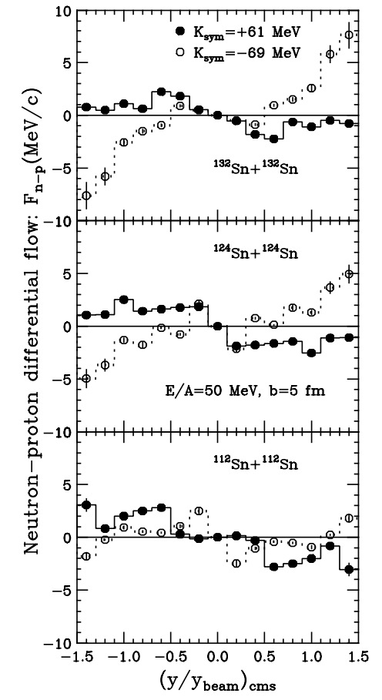
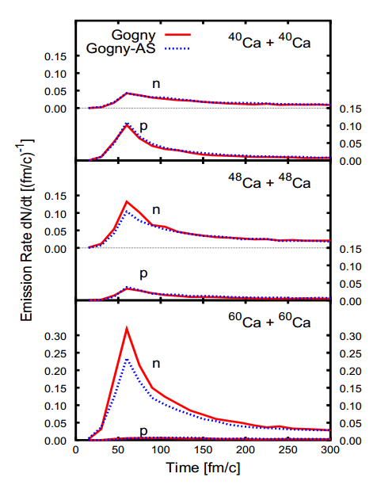
Using RIBs to explore EoS
Increase asymmetry, Increase sensitivity
Overcome model differences?
Very few experiments using RIBs for EoS studies.
Theorists seem to have access to more intense RIBs and radioactive targets.
NSCL
RIKEN
TAMU
-Isospin Diffusion
Radioactive Sn
-SPIRIT TPC
ALADIN
Ogul, PRC 83, 024608 (2011)
Li, PRL 85, 4221 (2000)
Ono, AIP 791, 83 (2005)

Slide 5
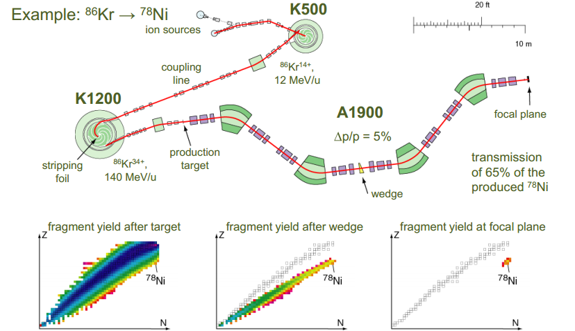
NSCL – Fast Fragmentation
Coupled Cyclotron Facility

Slide 6
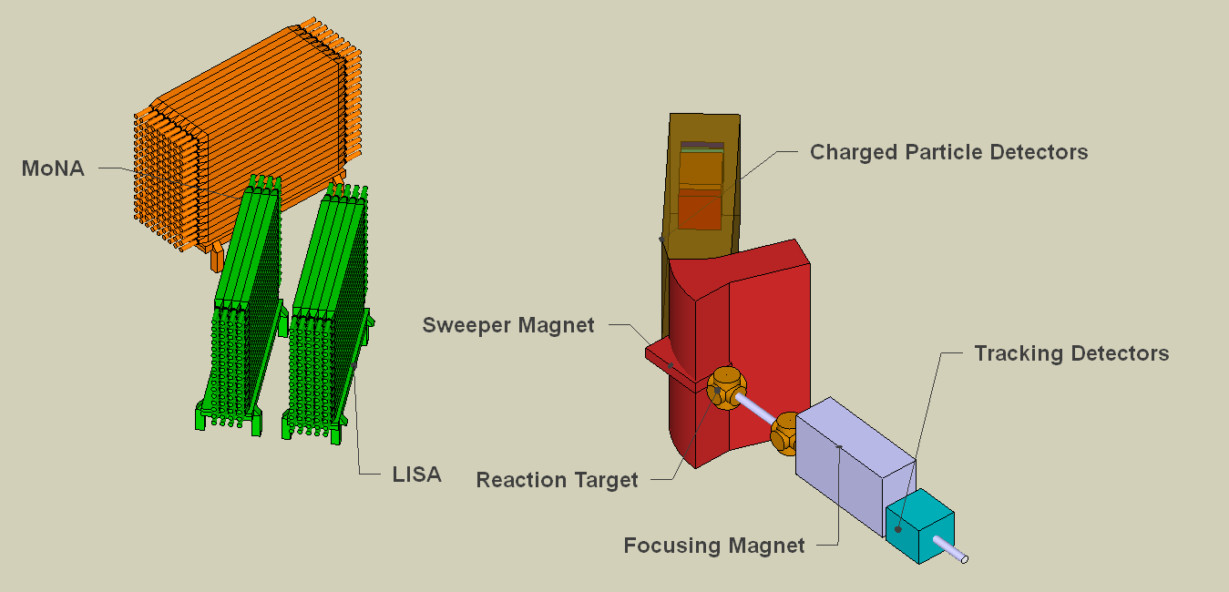
MoNA-(LISA) Experiment ³²Mg + ⁹Be @ 73 MeV/u
Test case at the NSCL
Christian, PRC 85, 03427 (2012)
Christian, PRL 108, 032501 (2012)
³²Mg, δ = 0.667
¹³²Sn, δ = 0.64
Measuring projectile-like fragments (PLFs) in coincidence with neutrons.

Slide 7
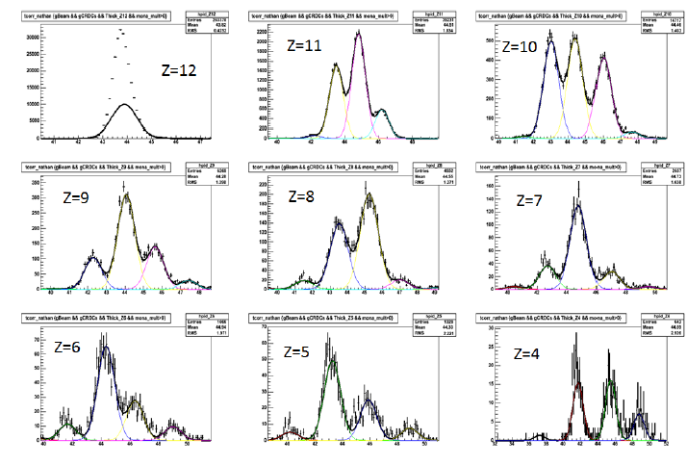
MoNA Experiment
Sweeper Magnet:
4 Tm, bends fragments ~43º
Large acceptance; +/- 8% Bρ
CRDCs for tracking (Mass, Energy)
CsI Hodoscope

Slide 8
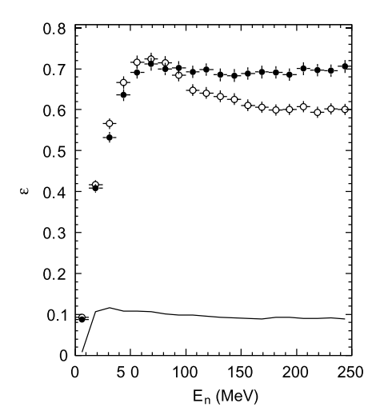
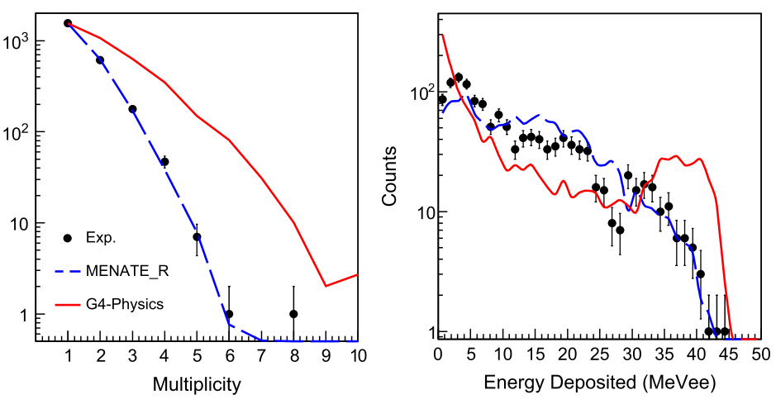
MoNA Experiment
MoNA-LISA:
Neutron ToF (velocity)
7cm position resolution
¹⁷C(-p)→¹⁶B→¹⁵B+n
Kohley et al., NIMA 682, 59 (2012)

Slide 9
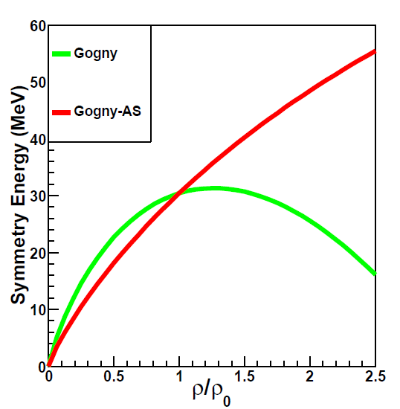
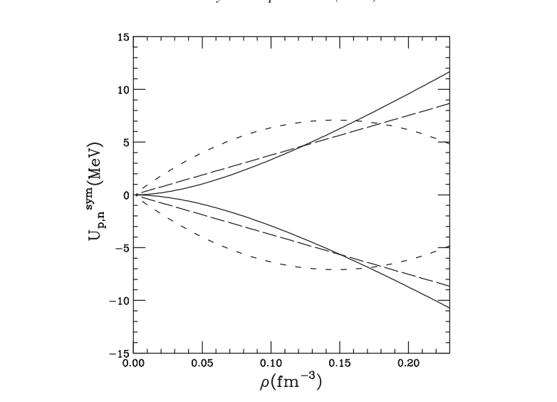
MoNA-LISA Experiment
32Mg
Pre-fragment
Very n-rich
Excited, E*
Expanding
Deformed
Decay
“Stiff”
At ρ/ρ₀ < 1:
Soft is more repulsive = emit more neutrons
Stiff is less repulsive = emit less neutrons
“Soft”
neutrons
protons

Slide 10
MoNA-LISA Experiment
Constrained Molecular Dynamics (CoMD-II) model:
3 forms of E_{sym}(ρ)
Consistent model of dynamics and decay (time = 1500 fm/c)
M. Papa, T. Maruyama, and A. Bonasera. PRC 64, 24612, (2001).
Kohley et al. PRC 88, 041601(R) (2013).

Slide 11
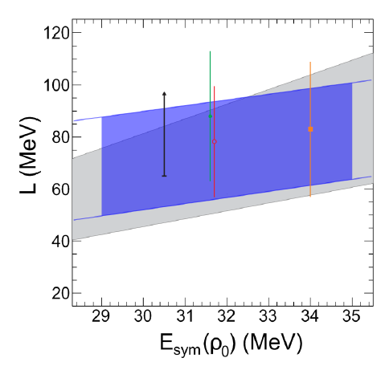
Constraints on E_{sym}(ρ)
Kohley et al. PRC 88, 041601(R) (2013).
Kohley, Yennello, EPJA 50, 31 (2014).
Blue area constraints extracted from 32Mg RIB experiment.
HICs
HICs Refs:
Tsang et al, PRL (2009)
Kohley et al, PRC (2010).
Russotto et al, PLB (2011)
Li, Chen, and Ko, Phys. Rep. (2008).
Shetty et al. PRC (2007)
NStar Refs:
Steiner and Gandolfi, PRL (2012)
Sotani, Nakazato, and Oyamastsu, PRL (2012)

Slide 12
Future MoNA-LISA Program
Approved PAC experiment to make further measurements with n-rich and p-rich RIBs.
Thoennessen
Spyrou
Baumann
Yennello
McIntosh
Bonasera
Kohley
Tsang
Lynch

Slide 13
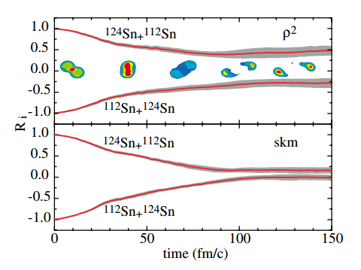
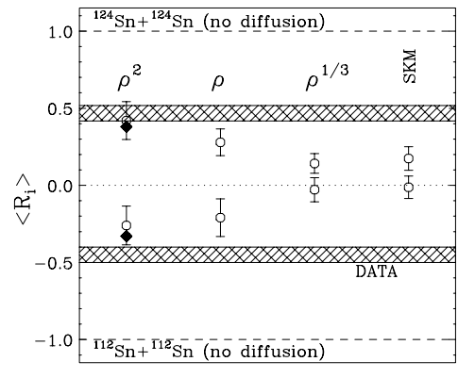
New observables for E_{sym}(ρ) from HICs
Isospin transport/equilibration used to probe and constrain E_{sym}
Isospin diffusion:
- equilibration b/w proj. and tgt
- timescale ~ 100-150 fm/c
- requires ~4 reactions to be measured
Tsang et al. PRL 92, 062701 (2004).
What if we could measure isospin transport as a function of time in a single reaction?

Slide 14
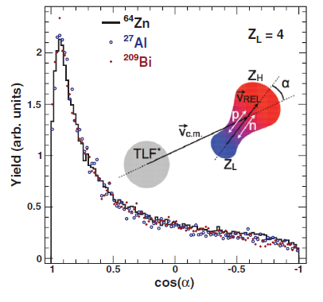
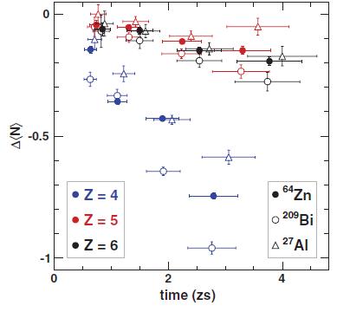
IU: Dinuclear system experiments
de Souza and Hudan (IU) measured binary break-up of PLF*
Extract time-scale from rotation
α
projectile
TLF*
TLF
v_{rel}
v_{c.m.}
target
PLF*
PLF
Z_{H}>11
Proposed:
- Measurement of isospin transport and time-scale (up to 900 fm/c!) between heavy (Z_{H}) and light (Z_{L}) fragments of the dinuclear system.
- Sensitive probe of E_{sym}(ρ)
A.B. McIntosh et. al., PRC 81, 034603 (2010)
S. Hudan et al. PRC 86, 021603(R) (2012)
K. Brown et. al., PRC 87, 061601(R) (2013)

Slide 15
Confront experiment with theory
Questions:
Can theory reproduce complicated reaction dynamics?
Is isospin transport occurring between Z_{H} and Z_{L}? (Experiment only measured mass of light fragment)
Could this be a probe of E_{sym}(ρ)?
Constrained Molecular Dynamics Model (CoMD-II)
⁶⁴Zn+⁶⁴Zn @ 45 MeV/A
Simulate 1000 fm/c
Extract events consistent with binary break-up from IU exps. (Match angular/KE acceptance of experiment)
M. Papa, T. Maruyama, and A. Bonasera. PRC 64, 24612, (2001).

Slide 16
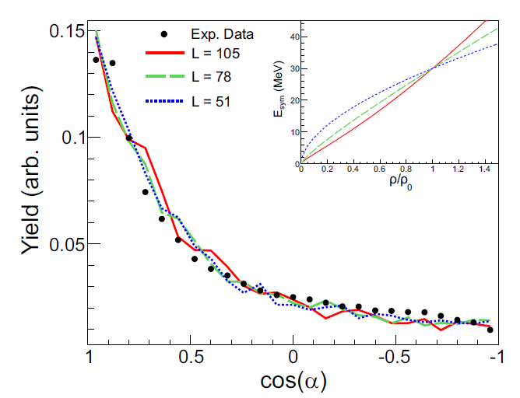
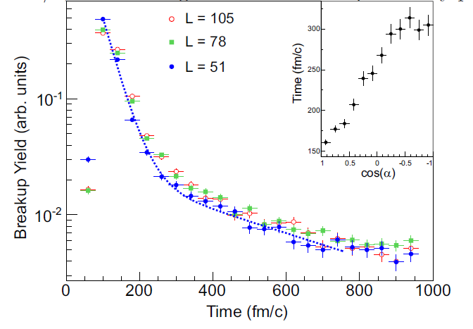
Binary break-up dynamics
Z_{L} = 4
Z_{H} > 11

Slide 17
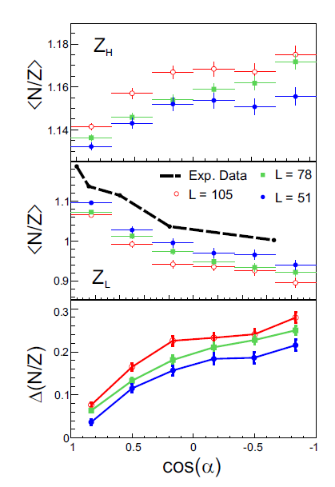
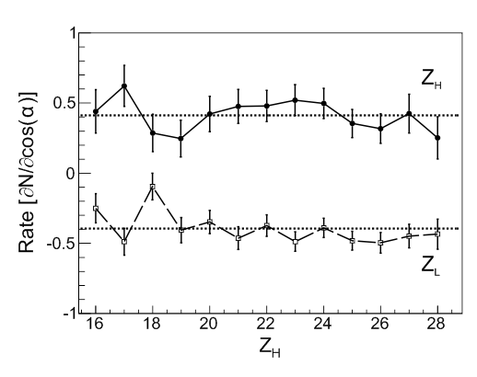
Isospin transport and E_{sym}
Z_{L} = 4
Z_{H} > 11
Clear evidence of isospin transport between Z_{H} and Z_{L}.
Reproduce exp. trends
Sensitivity to L
Good observable would be Δ(N/Z)

Slide 18
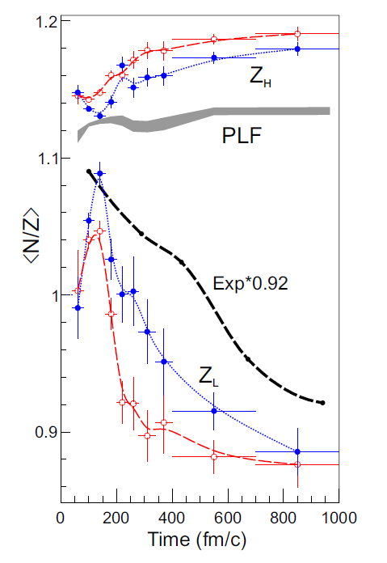
Time-scale and E_{sym}
Clear evidence of isospin transport between Z_{H} and Z_{L}.
N/Z of PLF constant (no L dependence)
Reproduce exp. trends
Sensitivity to L
Z_{L} = 4
Z_{H} > 11

Slide 19
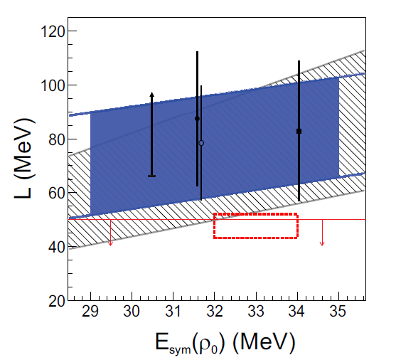
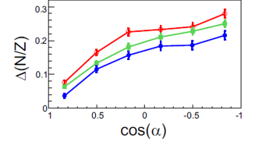
Summary and Future Outlook
New constraints on E_{sym}(ρ₀) – L from RIB experiment.
Next experiment ~October…
Opportunities to explore E_{sym} through binary break-up of dinuclear systems.
CoMD showed promising results in reproducing complex dynamics and isospin transport.
Coincident measurement of Z_{L} and Z_{H} with A_{H}-identification?
Kohley et al. PRC 88, 041601(R) (2013).

Slide 20
Acknowledgments
My group:
Krystin Stiefel
Kalee Hammerton
Aditya Wakhle (post-doc)
Thomas Baumann
Greg Christian
Mike Jones
Jenna Smith
Jesse Snyder
Artemis Spyrou
Michael Strongman
Michael Thoennessen
Romualdo de Souza
Sylvie Hudan
CoMD
Aldo Bonasera
Hua Zheng

Slide 21
Symmetry Energy
Nuclear Equation of State (EoS)
“Stiff”
“Soft”
Binding Energy of Symmetric Nuclear Matter
Symmetry Energy Term for Asymmetric Matter

Slide 22
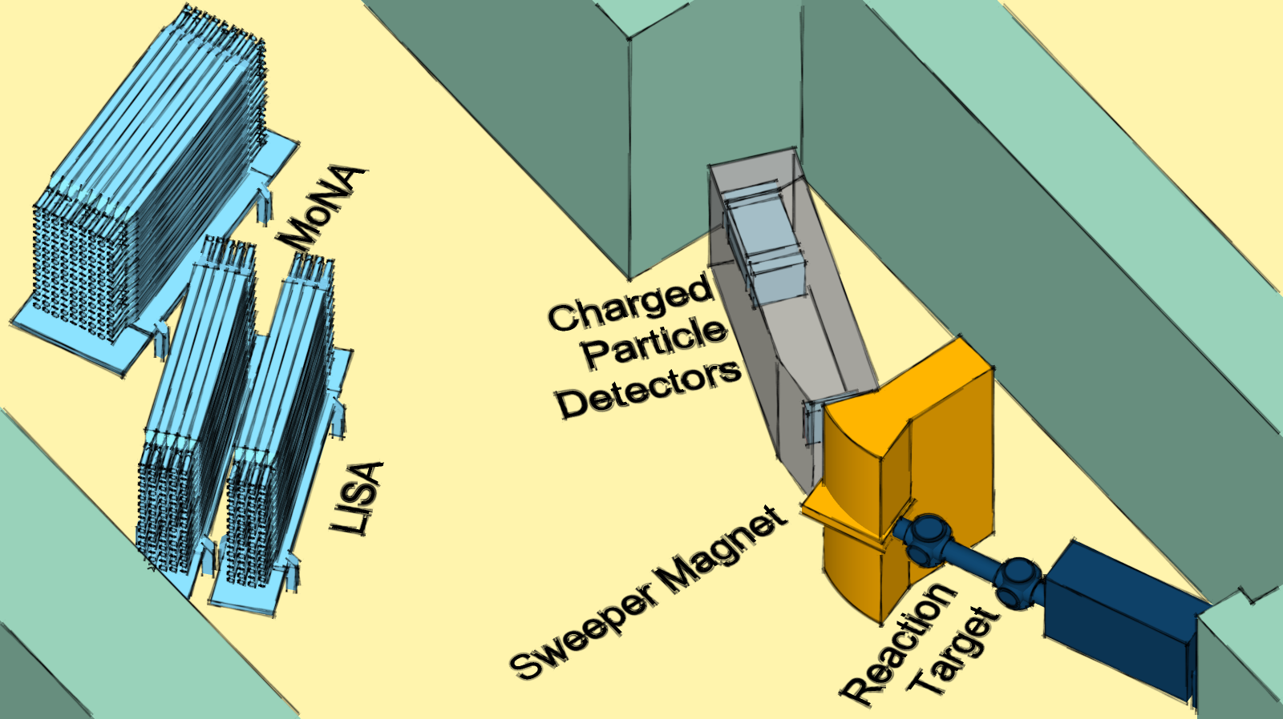
Nuclear structure beyond the dripline
Spyrou, Thoennessen, Kohley et. al
Evolution of nuclear shell structure at extreme neutron to proton ratios.
Correlations in two neutron decays.
New phenomena in exotic nuclei.
NSF-MRI
²⁷F
²⁶O
²⁴O
^{n}
1-proton knockout reaction.
⁹Be target
10⁻²¹-10⁻²²s
^{n}

Slide 23
Symmetry energy with MoNA
Kohley et. al
Expand scientific scope of MoNA-Sweeper setup for EoS studies.
High efficiency neutron detection with N/Z of heavy residue.
Analysis of previous MoNA data with neutron-rich ³²Mg RIB.
Factor of 3 increase in sensitivity of ³²Mg compared to stable beam.
First E_{sym} constraint from RIB rxn.
³²Mg + ⁹Be
Kohley et al. PRC Rapid 2013

Slide 24
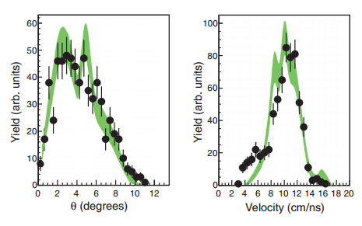
MoNA-LISA Experiment
Constrained Molecular Dynamics (CoMD) model:
3 forms of E_{sym}(ρ)
Consistent model of dynamics and decay (time = 1500 fm/c)
M. Papa, T. Maruyama, and A. Bonasera. PRC 64, 24612, (2001).
Kohley et al. PRC 88, 041601(R) (2013).

Slide 25
RIBs – Balance of intensity and sensitivity
How would the analysis have faired with a stable beam?
Increase sensitivity to E_{sym} by factor of 3
Kohley et al. PRC 88, 041601(R) (2013).

