Slide 1

Scaling properties
of light-cluster production
Zbigniew Chajęcki
National Superconducting Cyclotron Laboratory
Michigan State University
Outline:
EoS: symmetry energy
p and ρ dependence?, effective mass
Transport models vs data
  Old approach: coalescence invariant
  New approach: chemical potential scaling

Slide 2
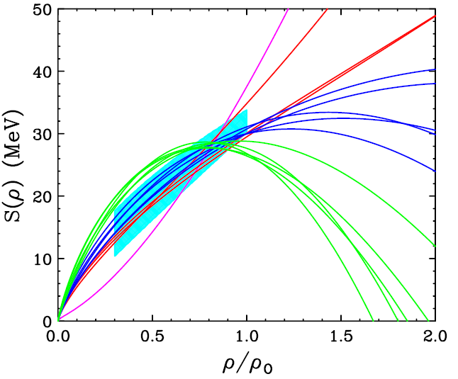
Equation of state of nuclear matter
E/A (ρ,δ) = E/A (ρ,0) + δ²⋅S(ρ)
δ = (ρ_{n}- ρ_{p})/ (ρ_{n}+ ρ_{p}) = (N-Z)/A
adapted from
M.B. Tsang, Prog. Part.Nucl.Phys. 66, 400 (2011)
Brown, Phys. Rev. Lett. 85, 5296 (2001)
δ →1
Stiff
Soft
Both astrophysical and laboratory observables can constrain the symmetry energy indirectly
Super soft

Slide 3
Laboratory constraints on symmetry energy at ρ<ρ₀
Experimental observables are mainly sensitive to S₀=S(ρ₀) and L.
Low density constraints from
nuclear structure
  masses
  Isobaric Analog States (IAS)
  Electric dipole polarizability (α₀)
  neutron skin
nuclear reactions
  Diffusion of neutrons and protons between nuclei of different N/Z in peripheral collisions HIC (Sn+Sn)
  Transverse flow HIC (RIB)
  neutron and proton spectra/ratios
ρ_{HIC(Sn+Sn)} < 0.45ρ₀
ICNT 2013 Summary report Horowitz, et al.,
ρ_{mass} ≈0.6- 0.7 ρ₀
Realistic theoretical “error bars” are key to combining constraints

Slide 4
Key uncertainty:
Density and momentum dependence of the potential energy
EoS (T=0): E/A ≡ ε(ρ,δ) = <KE>/A + <V>/A:
In the mean field approx., <V> is obtained from mean field potentials for the nucleons. e.g. in a semi-classical approximation
  Density dependence
  local two body interactions → ~ linear dependence on ρ;
  local three body interactions → ~ ρ² term contribute to density dependence
  Momentum dependence
  p (momentum) dependence can come from:
    range of NN force
    exchange (Fock) term
    intrinsic mom. dep. of NN interaction.
  Effective mass; at low p
    Momentum dependence of the mean field (real part of optical potential) is well established for symmetric matter.
    At low energies, it can be described by
    effective mass, m*:
}
also contributes to density dependence.

Slide 5
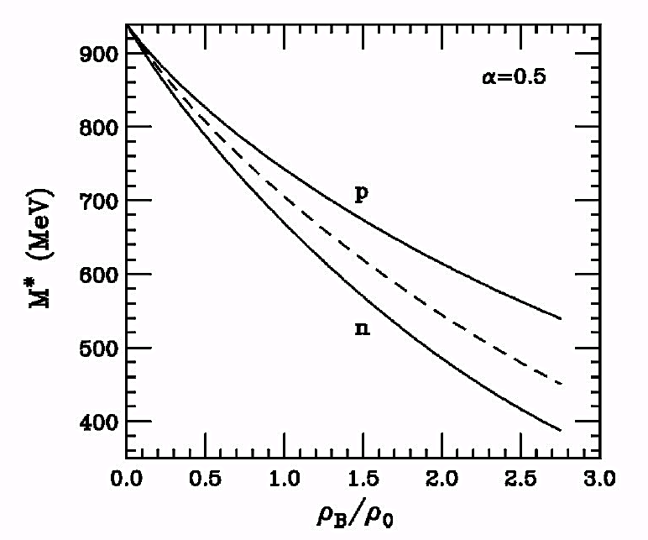
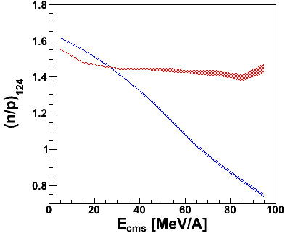
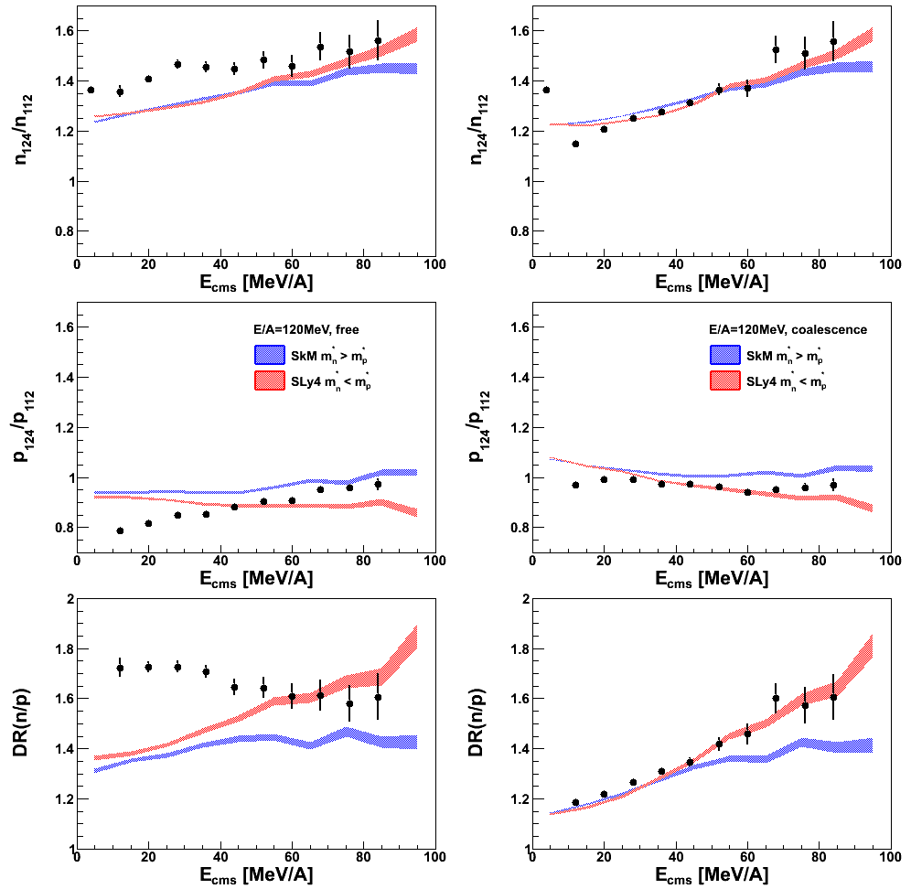
Influence of effective mass
ImQMD simulations: ¹²⁴Sn+¹²⁴Sn
@ 120 MeV/A
m*_{n}<m*_{p} - more neutrons accelerated to high energies
B. Liu et al. PRC 65(2002)045201
S(ρ) = S_{k}(ρ/ρ₀)^{2/3} + S_{i}(ρ/ρ₀)^{γ}
+ mean field
m*_{n}>m*_{p} - more protons accelerated to high energies
ImQMD05_sky: incorporate Skyrme interactions
Y. Zhang, Tsang, , PLB 732 (2014) 186
Similar effect observed by J. Rizzo et al, Phys. Rev. C72, 064609 (2005)

Slide 6
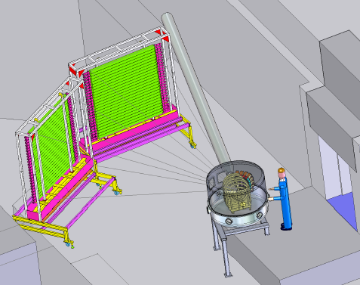
Experiment
¹¹²Sn+¹¹²Sn and ¹²⁴Sn+¹²⁴Sn at 50 and 120 MeV/A
measure emitted neutrons, protons
and light clusters
from central
collisions
e09042 NSCL
E/A (ρ,δ) = E/A (ρ,0) + δ²⋅S(ρ)
= (ρ_{n}- ρ_{p})/ (ρ_{n}+ ρ_{p}) = (N-Z)/A
beam
¹¹²Sn: 50 protons, 62 neutrons δ~0.10
¹²⁴Sn: 50 protons, 74 neutrons δ~0.19

Slide 7
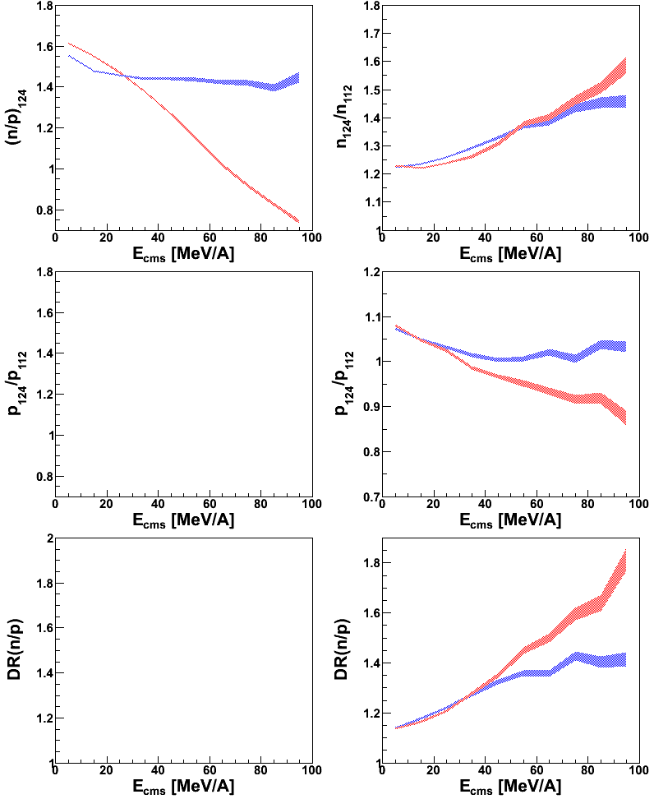
Our observables
Isospin ratio
double ratio
particle ratio
Caveat:
- neutron measurements have known efficiency ~10%
- Effects we are going to measure are often of the same order
Advantages:
reduce systematic uncertainties
reduce differences in energy calibration
Coulomb “cancels out”

Slide 8
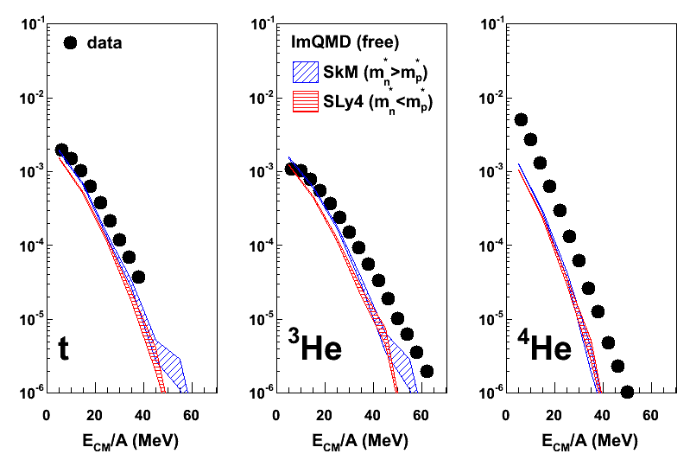
ImQMD transport model
ImQMD transport model:
Cluster production for alphas is not realistic
Possible solution: Ignore the cluster production mechanism and look at all the light particles (neutrons and protons) at a given velocity
¹¹²Sn+¹¹²Sn @ 50 MeV
Coalescence invariance:
Coalescence protons (neutrons): Include protons (neutrons) from within clusters with the free proton (neutron) spectra
Possibly a better match between simulation and experimental data
Coalescence spectra
ImQMD05_sky: incorporate Skyrme interactions
Y. Zhang, Tsang, , PLB 732 (2014) 186

Slide 9
ImQMD – effective mass
(coalescence)
m*_{n} > m*_{p}
m*_{n} < m*_{p}
Single particle ratios
Y(x); ¹²⁴Sn+¹²⁴Sn
Y(x); ¹¹²Sn+¹¹²Sn
R₂₁(x)=
n/p double-ratio
Y(n)/Y(p); ¹²⁴Sn+¹²⁴Sn
Y(n)/Y(p); ¹¹²Sn+¹¹²Sn
DR(n/p)=
ImQMD05_sky: incorporate Skyrme interactions
Y. Zhang, Tsang, , PLB 732 (2014) 186

Slide 10
ImQMD – effective mass
Coupland et al, arXiv:1406.4546 (2014)
(coalescence)
m*_{n} > m*_{p}
m*_{n} < m*_{p}
Y(n)/Y(p); ¹²⁴Sn+¹²⁴Sn
Y(n)/Y(p); ¹¹²Sn+¹¹²Sn
DR(n/p)=
Skyrme | S₀(MeV) | L (MeV) | m_{n}*/m_{n} | m_{p}*/m_{p}
SLy4 | 32 | 46 | 0.68 | 0.71
SkM* | 30 | 46 | 0.82 | 0.76
ImQMD05_sky: incorporate Skyrme interactions
Y. Zhang, Tsang, , PLB 732 (2014) 186
Coalescence ratios

Slide 11
What can we learn from data?
Until now: we had to use coalescence invariant spectra to compare data to theoretical models
  Can we overcome this limitation? (we do not always measure neutrons)
Issues with cluster production in transport models
  What drives the relative abundance of clusters?
  We want to understand it to be able to compare data to theory
Can we avoid neutrons?

Slide 12
What can we learn from data?
n
t
Scaling laws
in the data
d
α
p
³He
Z. Chajecki et al, ArXiv:1402.5216
as a function of E_{CM}

Slide 13
Single particle ratios
Z. Chajecki et al, ArXiv:1402.5216,
submitted to PRL
e.g. R(p)=R(³He)/R(d) and
R(t)=R(d)R(n)
R(α)=R(d)R(d)
R( )
α
=
R( )
p
R( )
Useful relations:
t
Works remarkably well!

Slide 14
Chemical potential scaling
Z. Chajecki et al, ArXiv:1402.5216,
submitted to PRL
Δμ_{n}/T
e.g.
≈0
(Δμ_{n}+Δμ_{p})/T
Δμ_{p}/T

Slide 15
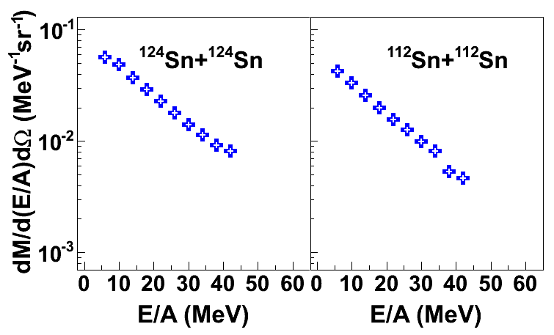
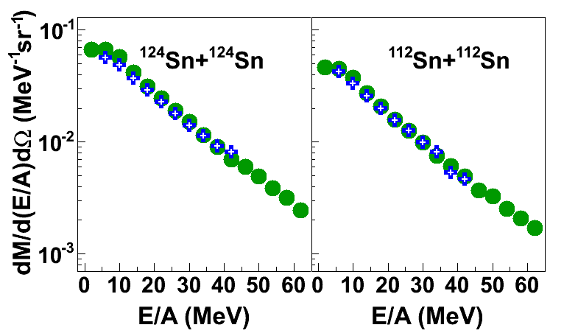
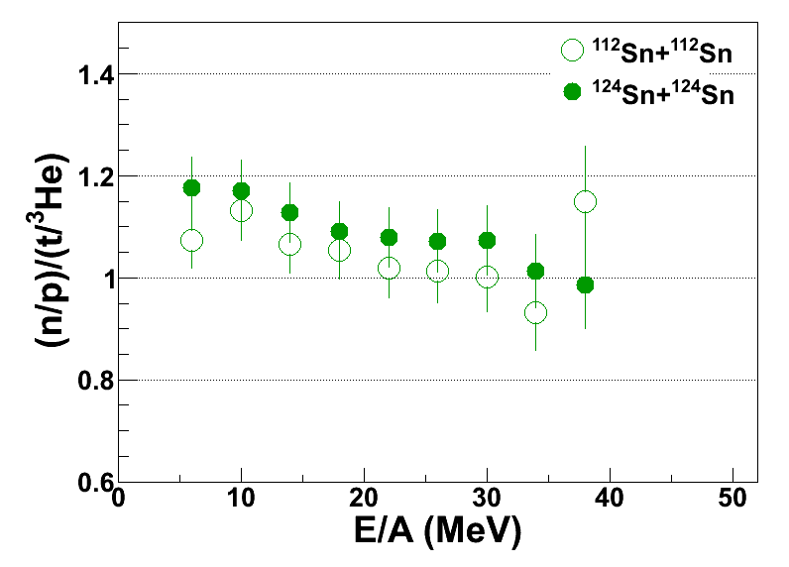
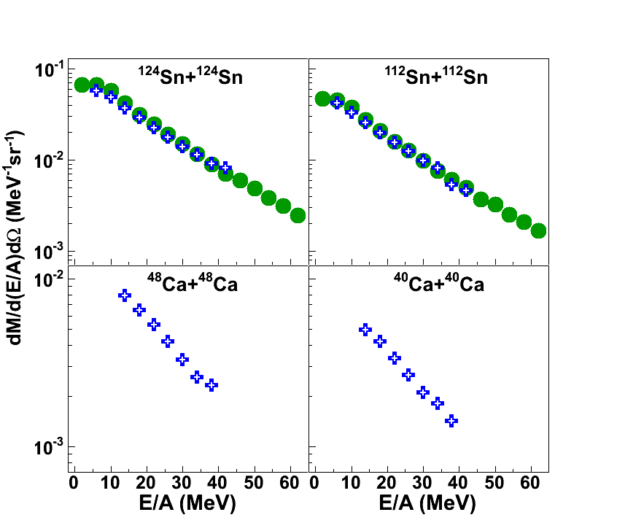
“pseudo” neutron spectra
neutrons / pseudo neutrons
Use the thermal interpretation of the particle ratios and apply it to a single reaction
neutrons
pseudo neutrons
Pseudo neutron yields
Calculating pseudo neutron spectra from charge-particle spectra introduces 10% uncertainties (within systematics of measuring neutrons)

Slide 16
What we’ve learnt so far
Scaling laws observed in experimental particle ratios.
Particle production described by the chemical potential
degree of freedom.
Allows to calculate the spectra or ratios of unmeasured particles
We can obtain neutron spectra from charged-particle spectra!
We can reanalyze old experimental data as well as propose new experiments (w/o need to measure neutrons).
Dynamical models don’t generally respect ∆μ/T scaling, but this should be an important test of the models and their cluster production mechanisms.
Let’s look at another system to verify the chemical potential scaling of particle ratios: Ca+Ca @ 80 MeV (NSCL)

Slide 17
Ca+Ca @ 80 MeV; particle ratios
Proton, neutron and deuteron groups not obviously visible

Slide 18
Chemical potential fits
N,Z
N,Z
2,1
3,3
1,0
2,2
1,1
1,2
0,1
Δμ_{n}/T
e.g.
(Δμ_{n}+Δμ_{p})/T
Δμ_{p}/T

Slide 19
pseudo neutron spectra from Ca+Ca collisions
pseudo neutrons
Pseudo neutron yields
Now, we can construct coalescence invariant spectra (without measuring neutrons!)

Slide 20
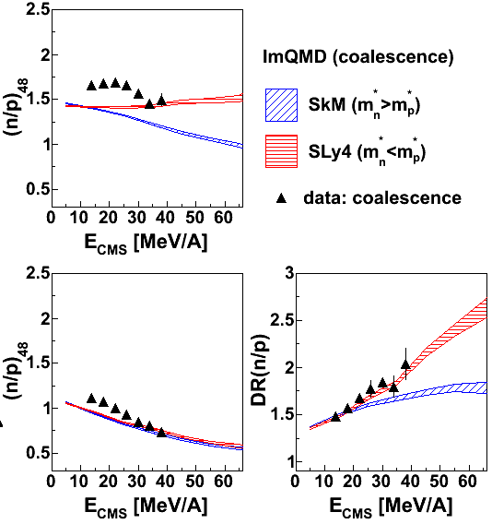
Data vs ImQMD simulations
Soft AsyEOS
We can compare experimental n/p ratios to transport model since we don’t have a problem with neutron efficiency when using pseudo neutron spectra
Y. Zhang et al, PLB 732 (2014) 186

Slide 21
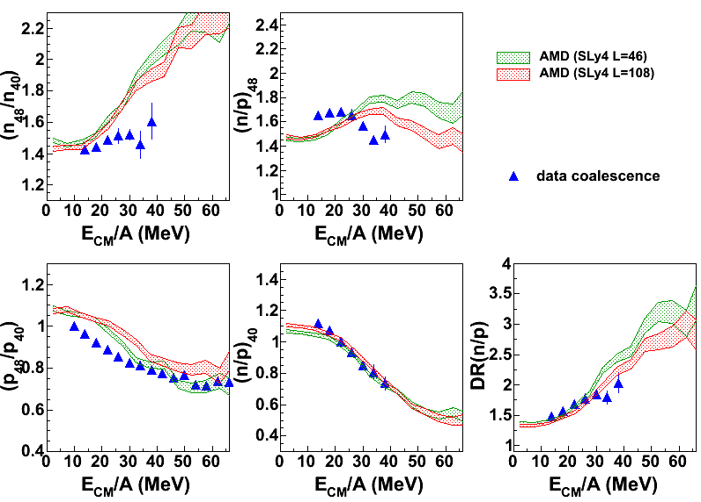
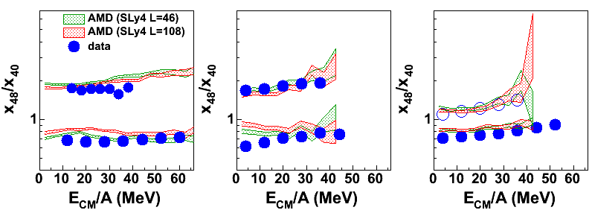
Data vs AMD simulations
AMD
Antisymmetrized Molecular Dynamics; solution to time- dependent Slater determinant
reproduces binding energies
describes multifragmentation
describes liquid-gas phase transition
used also for structure calculations
More sophisticated quantum calculations
data
coalescence
AMD vs data : Free particle ratios
n
t
⁴He
p
³He
d x 0.7
A. Ono, J of Phys. Conf. Series 420, 012103; 436, 012068

Slide 22
Summary
the density and momentum dependence of the symmetry energy is of fundamental importance to nuclei, nuclear matter and neutron stars
We presented results on n/p double-ratios from
Sn+Sn @ E/A=50 and 120 MeV and Ca+Ca @ 80 MeV.
Calculations show a sensitivity of the n/p (double-) ratio to the symmetry energy and effective mass
The particle production is determined by the chemical potential degrees of freedom
  It allows us to calculate spectra of unmeasured fragments, including neutrons!
  Crucial test for theory
  Open a door of opportunities to reanalyze old data in search for sensitivity to the symmetry energy or effective mass even in the absence of neutron spectra

Slide 23
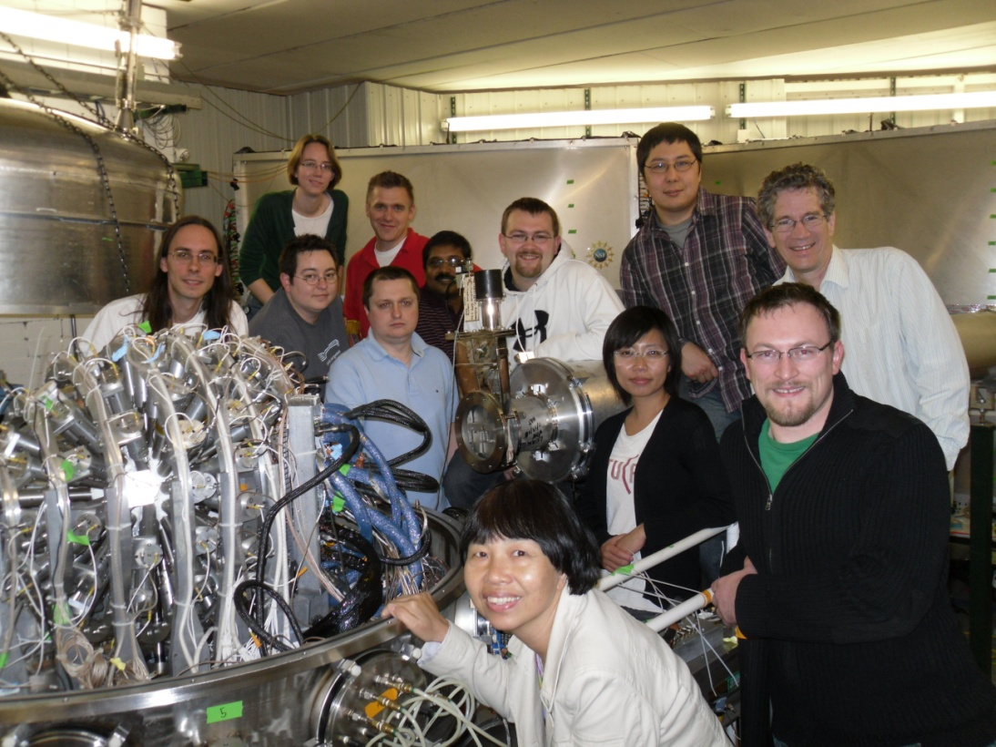
Thank you!
Dan Coupland
Mike Youngs
William Lynch
Betty Tsang
Michael Famiano
Brenna Giacherio
Tilak Ghosh
Rachel Showalter
Micha Kilburn
Jenny Lee
Fei Lu
John Novak
Paulo Russotto
Alisher Sanetullaev
Concettina Sfienti
Giuseppe Verde
Jack Winkelbauer

