Slide 1
Nuclear Symmetry Energy in QCD degree of freedom Phys. Rev. C87 (2013) 015204 (arXiv:1209.0080) Eur. Phys. J. A50 (2014) 16 NuSYM14, University of Liverpool, UK July 9, 2014
Kie Sang JEONG
Su Houng LEE
Nuclear and Hadron Theory Group
Yonsei University

Slide 2
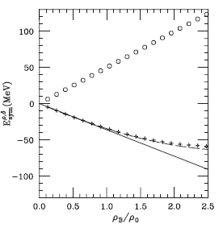
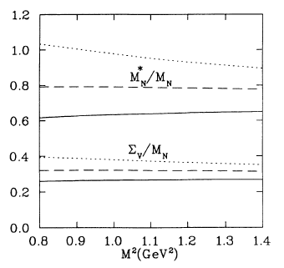
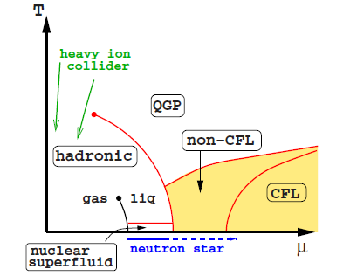
Motivation and Outline
Nuclear phenomenology – QCD sum rule
Extremely high density matter?
– QCD itself is main dynamics
Re V>0
Re S<0
Dirac optical potential
Physical Review C49, 464 (1993)
(Thomas Cohen et al.)
Physics Report, 410, 335 (2005)
(V. Baran et al.)
Cold matter Symmetry Energy from
Hard Dense Loop resummation
Color BCS pairing
Rev. Mod. Phys. 80, 1455 (2008) (M. G. Alford et al.)

Slide 3
Mean field approximation
Nuclear Symmetry Energy in continuous matter
RMF type nucleon propagator
Quasi-nucleon on the asymmetric Fermi sea
(Up to linear density order)

Slide 4
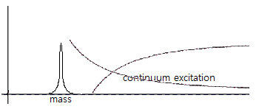
QCD Sum Rule
Correlation function
Energy dispersion relation
Phenomenological ansatz in hadronic degree of freedom
Weighting - Borel transformation
Ioffe’s interpolating field for proton
Contains all possible hadronic resonance states in QCD degree of freedom
Equating both sides, hadronic quantum number can be expressed in QCD degree of freedom

Slide 5
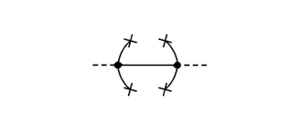
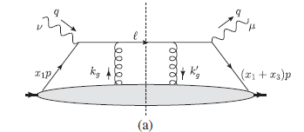
QCD Sum Rule
Operator Product Expansion
In-medium condensate near normal nuclear density
Multi-quark operators (twist-4)
Non-perturbative contribution
Medium property can be accounted by nucleon expectation value x density
can be estimated from DIS experiments data

Slide 6
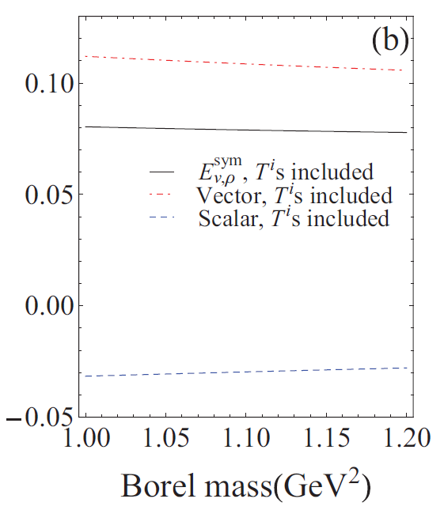
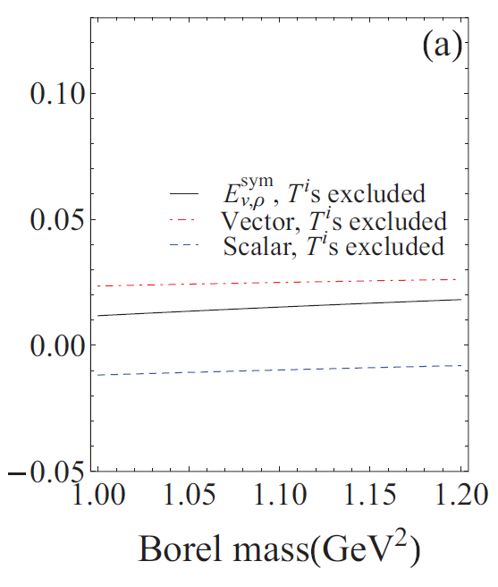
Nuclear Symmetry Energy fom QCD SR
Iso-vector scalar / vector decomposition of Nuclear Symmetry Energy
RMFT result
In the result without twist-4 ops., both self energies give weak contribution
Contribution of Twist-4 Ops. enhances Scalar attraction – Vector repulsion mechanism
Iso-vector meson exchange
Vector meson exchange -> Repulsive
Scalar meson exchange -> Attractive
Esym (GeV)
Twist-4 excluded
(Physics Report 410, 335, V. Baran et al.)
Twist-4 included
Becomes important at high density?
-> Have to find counter multi quark operator

Slide 7
At extremely high density?
QCD phase transition
Euclidean Lagrangian for dense QCD at normal phase
In region, QCD can be immediately applicable
Statistical partition function for dense QCD
Normal QM phase - BCS paired phase
(For fermion)
(For boson)
Continuous energy integration -> Discrete sum over Matsubara frequency

Slide 8
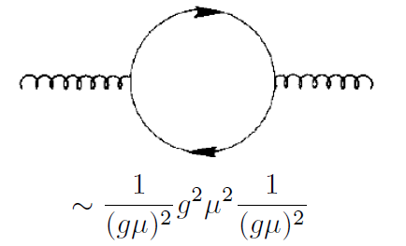
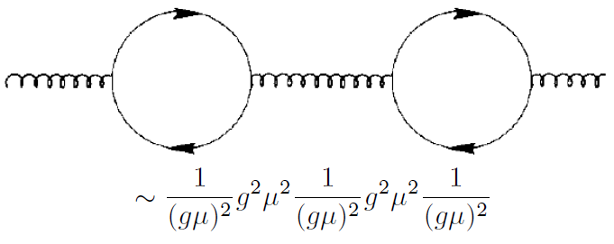
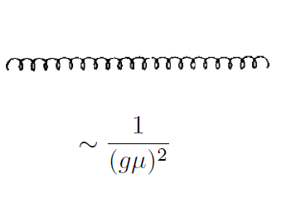
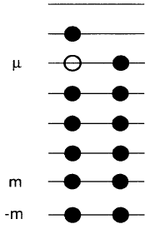
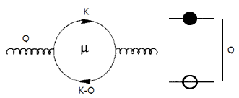
Hard Dense Loop resumation
Gluon self energy in cold matter (Q~T ≤ gμ )
Only quark-hole excitation is relevant (Q~T ≤ gμ )
~ order
-> all equivalent 1PI diagrams should be resumed!
Phys. Rev. D.53.5866 (1996) C. Manuel
Phys. Rev. D.48.1390 (1993) J. P. Blaizot and J. Y. Ollitrault
Effective Lagrangian for soft gluons
Gluon/Ghost contribution (~T ≤ gμ ) is negligible
Debye mass from hard(dense) quark loop

Slide 9
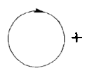
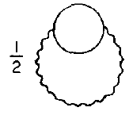
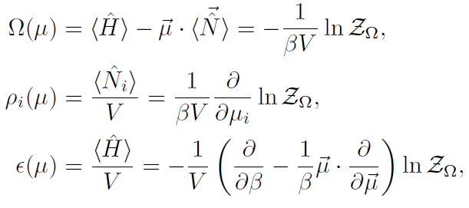
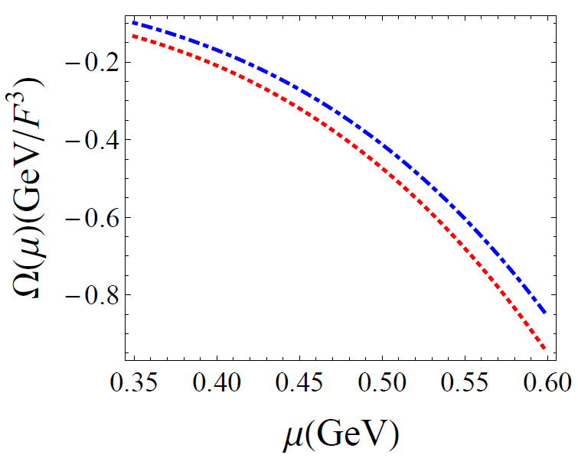
HDL resumed thermodynamic potential
Relevant ring diagrams
Thermodynamic quantities can be obtained from
Where in T ≤ gμ limit
Preliminary
Ideal quark gas
HDL involved

Slide 10
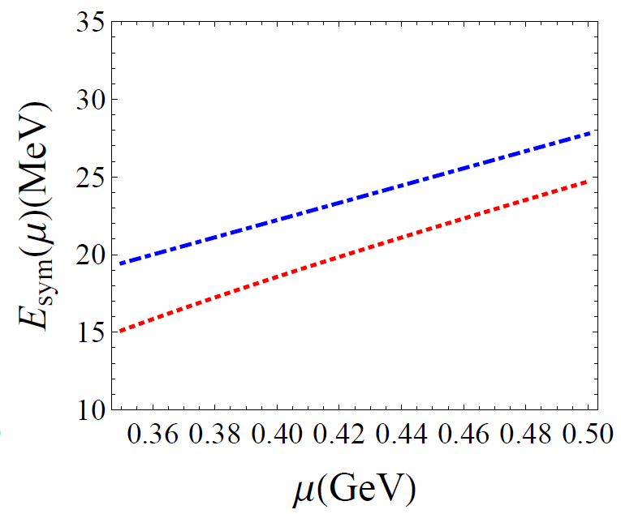
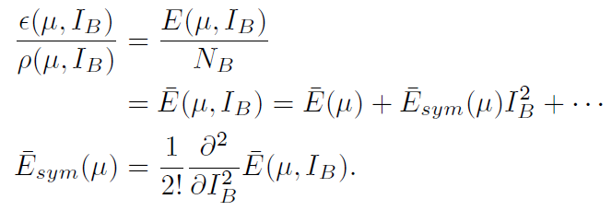
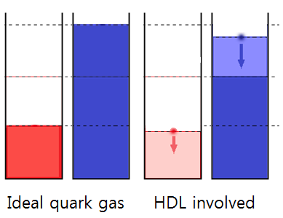
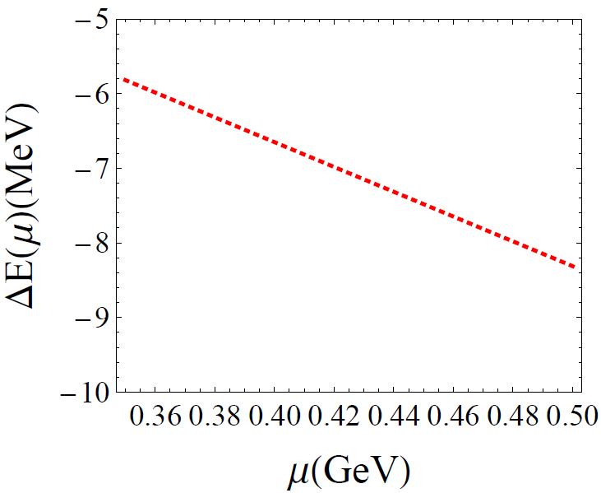
Symmetry Energy at normal phase
Symmetry Energy
HDL correction suppress Quasi-Fermi sea
Preliminary
Ideal quark gas
HDL involved
As density becomes higher, suppression becomes stronger
The difference between quasi-Fermi seas becomes smaller
=> Reduced symmetry energy

Slide 11
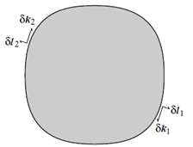
Color Superconductivity
BCS Pairing near Fermi sea
Nambu-Gorkov Formalism
In terms of effective interaction near Fermi sea
is marginal along to Fermi velocity
Fermion – conjugated fermion interaction
When V<0 two states form a condensate (gap)
Inverse propagator of
Diagrammatical described gapped quasi-state
->
In Wilsonian high density effective formalism

Slide 12
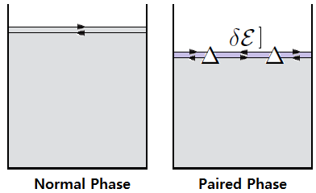
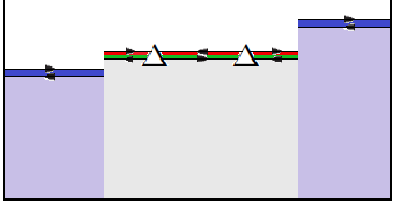
Color BCS paired state
BCS Pairing locks the gapped quasi-states
2 color superconductivity
In QCD, anti-triplet gluon exchange interaction is attractive (V<0)
In non negligible , 2SC state is favored
Ms ~ 150 MeV
μ ~ 400 MeV
In 2SC phase, u-d red-green states are gapped
Only s quarks and u-d blue quarks are liberal
s quarks d (blue)
s quarks u (blue)
u-d red green
quasi-Fermi sea is locked

Slide 13
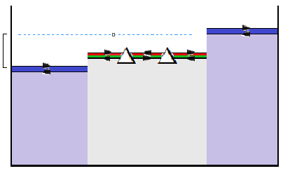
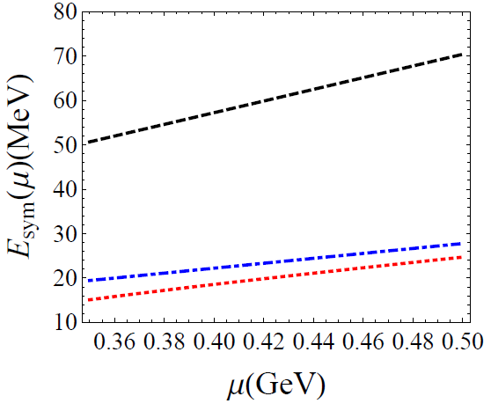
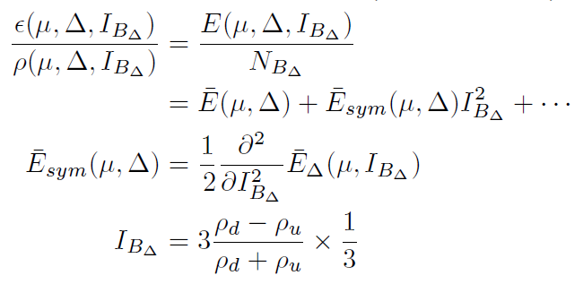
Symmetry energy at 2SC phase
Only Blue state affects iso-spin asymmetry
Symmetry energy
In Wilsonian effective formalism (HDET)
BCS phase remains in
(Phys. Rev. Lett. 9, 266 (1962) A. M. Clogston )
Preliminary
BCS gapped (2SC)
Ideal quark gas
HDL involved
Only u-d blue states can be asymmetrized
The other 4 gapped quasi-states are locked

Slide 14
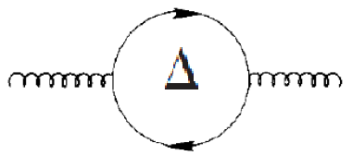
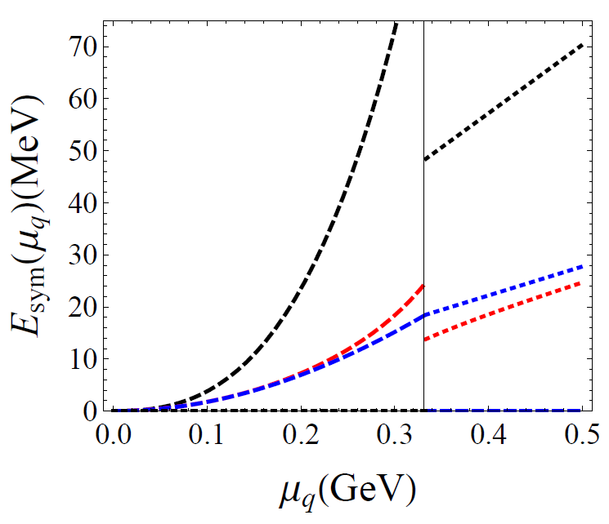
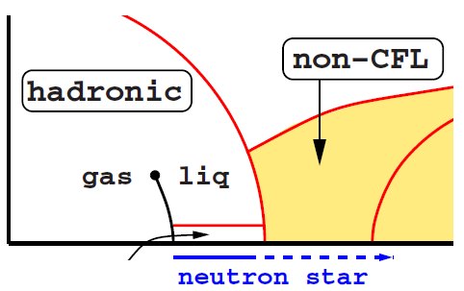
Future goals and Summary
Meissner mass effect
Hadron-quark continuity?
Nuclear Symmetry Energy in hadron and quark phase
When gap size is quite large
Hadron phase | Quark phase
Not need resummation -> reduction vanish
Symmetry Energy from QCD SR
(Kin. + Pot.)
BCS gapped (2SC)
Ideal quark gas
HDL involved
When gap size is quite small
-> need resummation -> reduction remains
Kinetic part (Ideal nucleon gas)
Kinetic part (QCD SR based interaction involved)
Important quantum numbers? (e.g. strangeness)
-> High density behavior at hadron phase

Slide 15
Conclusion
For hadron phase, Nuclear Symmetry Energy can be described in terms of quark and gluon condensate via QCD Sum rule
For quark phase (in T~0 limit), Symmetry Energy of normal phase can be calculated immediately via thermal QCD. The Debye mass from HDL resummation reduces Symmetry Energy
BCS paired states lock the gapped quasi-states and favors symmetrized condition (enhancing Symmetry Energy)
Quark-hadron continuity may provide fruitful information for high density behavior in hadron phase

