Slide 1
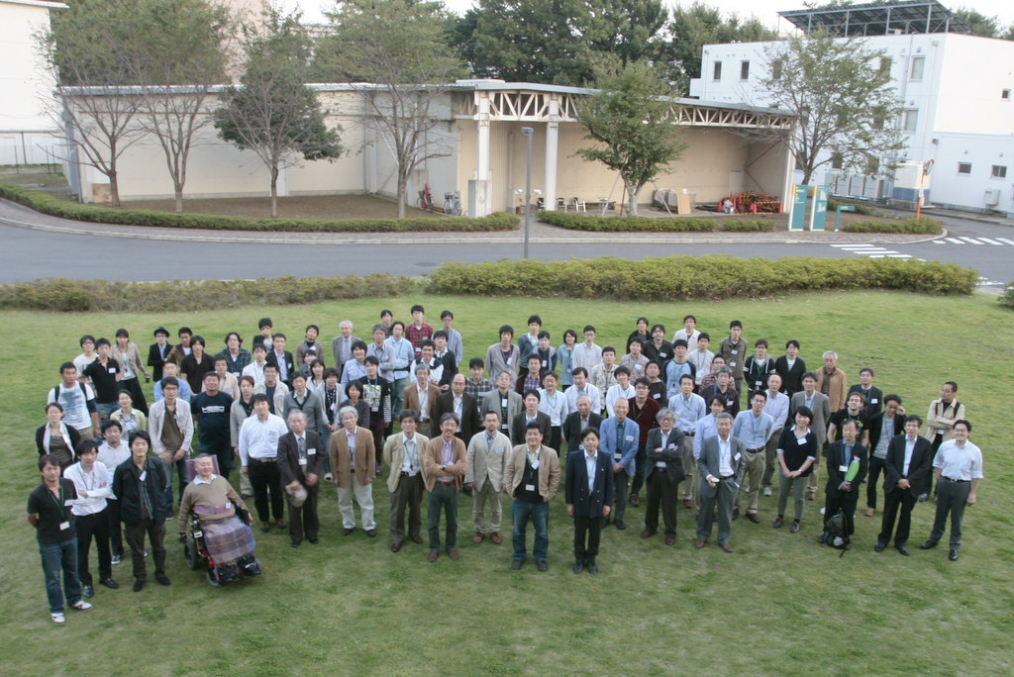

Japanese New Approach to Neutron-Star Matter
Tetsuya MURAKAMI
Department of Physics, Kyoto University
for the Innovative Areas "Neutron-star Matter"

Slide 2
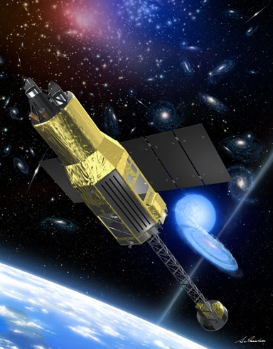
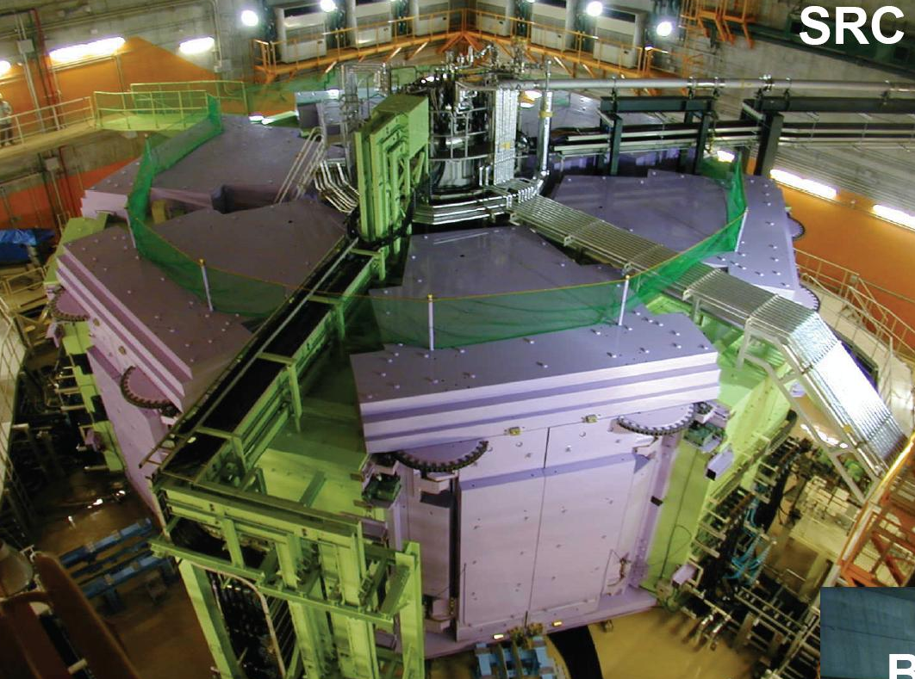
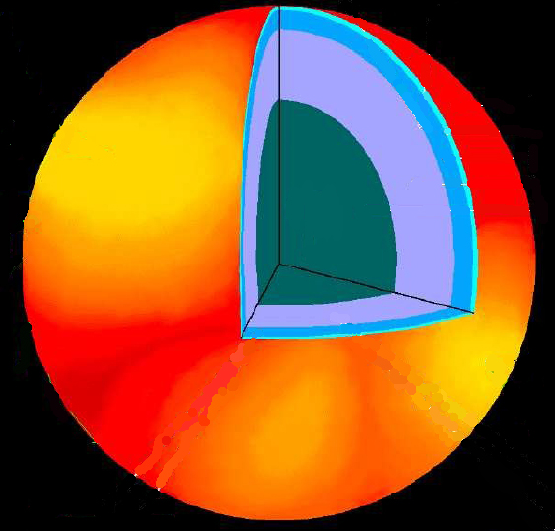
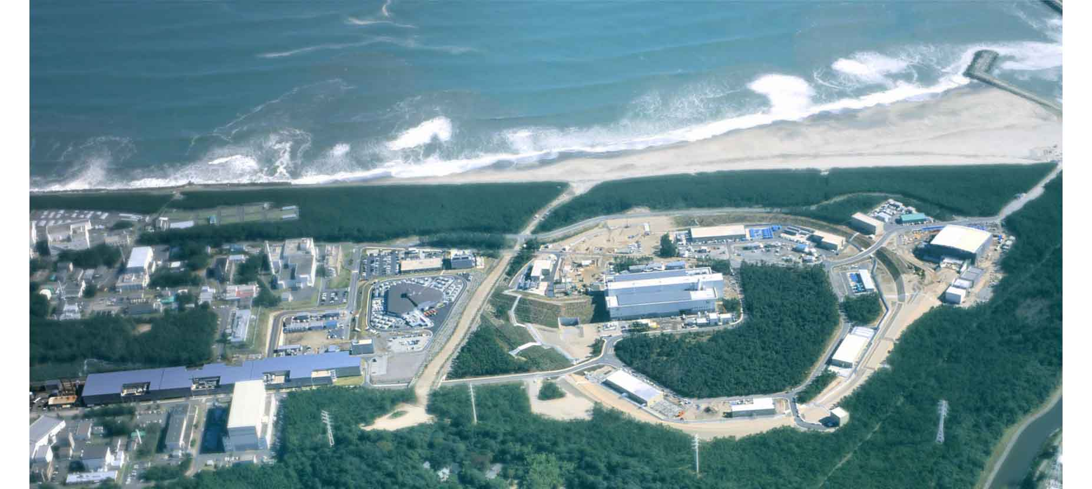
r
New field
“Material Science of Quarks”
ASTRO-H
Understand Internal structure of Neutron Star
Theory
RIBF
Determine“EOS “of nuclear Matter
X-ray Observation
⇒Radius of Neutron Star
Neutron-Rich Nuclear Physics
J-PARC
Cold Atomic Gas
⇒ Nature of Neutron Matter
Strangeness
Nuclear Physics
⇒Interaction between hyperons

Slide 3
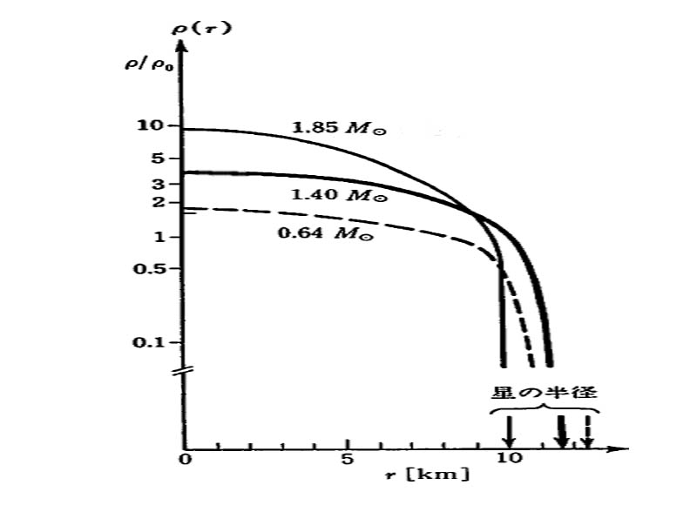
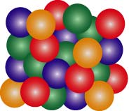
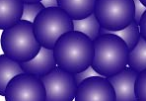
Organization of the Project
Baryon Density
A01 “Baryon-baryon Interaction with multi strangeness”
Toshiyuki Takahashi (KEK)
Λ
Group A
n
A02 “Strangeness in the Neutron-Rich Nuclear Matter”
p
Ξ
Hirokazu Tamura
(Tohoku Univ.)
Existence of
hyperon
B01 “EOS for High-Density Neutron-Rich Matter”
Group A
Tetsuya Murakami (Kyoto Univ.)
B02 “Properties of Medium- and Low-Density Neutron-Rich Nuclear Matter”
Almost all
neutron
Takashi Nakamura
(TIT)
Group B
Group B
n, p,
Λ, Ξ,..
?
B03 “EOS for Low-Density Neutron-Rich Nuetron Matter studied by Cold Atoms”
n
n
Souichi Horikoshi (Univ. Tokyo)
Radius [km]
C01 “New Development of Research on Neutron Stars by X- and Gamma-
Rays Observatory”
Tadayuki Takahashi
(JAXA)
Group C
D01 Theoretical Study for Neutron-Star and nuclear matter
Akira Ohnishi (YITP)
Group D

Slide 4
Executive Committee of the Project
Members consisted of PI’s of each subgroup
Main Tasks
  Recruit New activities in the “Area”
  Open annual school for young scientists
  Hold annual domestic WS
  Support small International Symposium
  Exchange technical knowhow
  Public relations
    Seminar for public
    Delivery lecture for high school students
Group | Post Docs | Master Thesis | PhD Thesis
A01 | 1 | 4 | 1
A02 | 1 | 8 | 1
B01 |  | 4
B02 | 1 | 4 | 1
B03 |  | 2
C01 | 1 | 3 | 2
D01 | 4 | 15 | 9

Slide 5
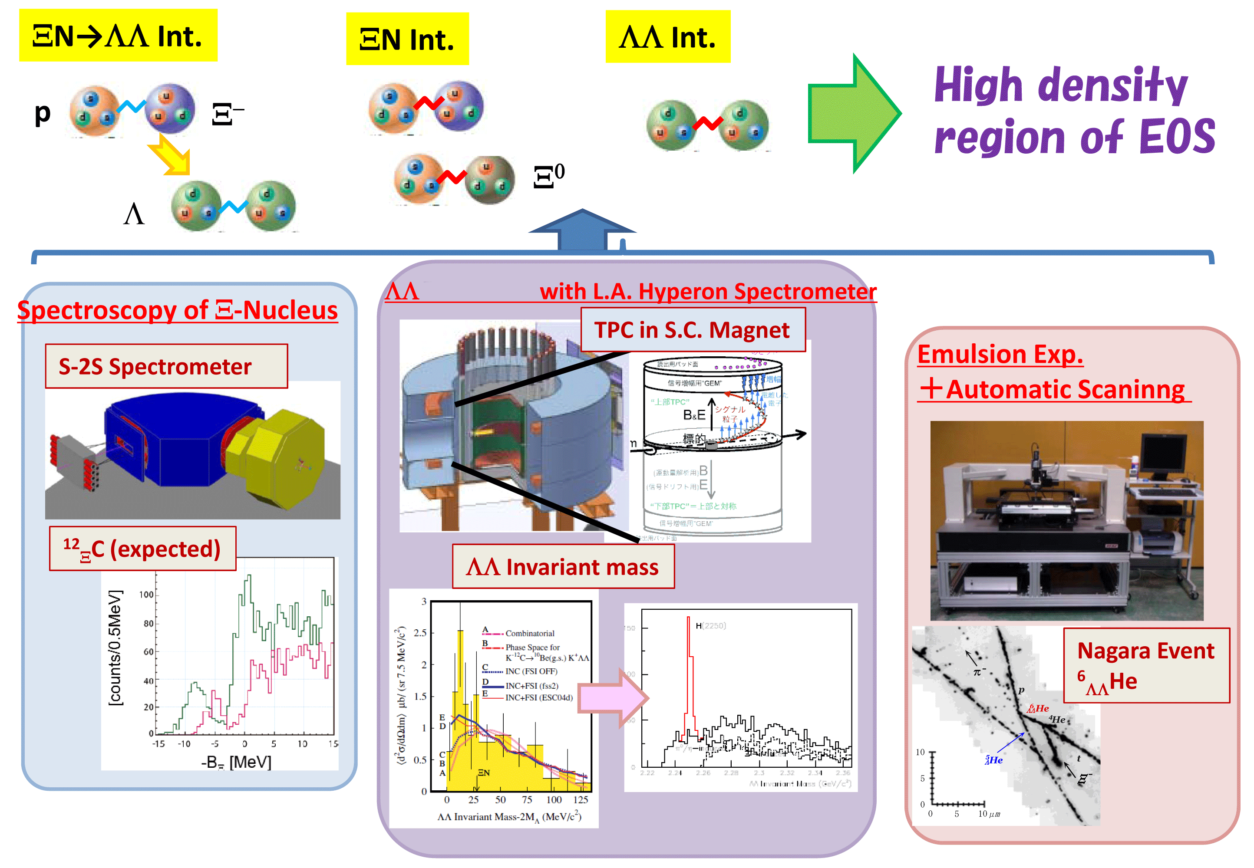
Group A01 “Baryon-baryon Interaction with multi strangeness”
correlation
J-PARC E05
J-PARC E42
J-PARC E07

Slide 6
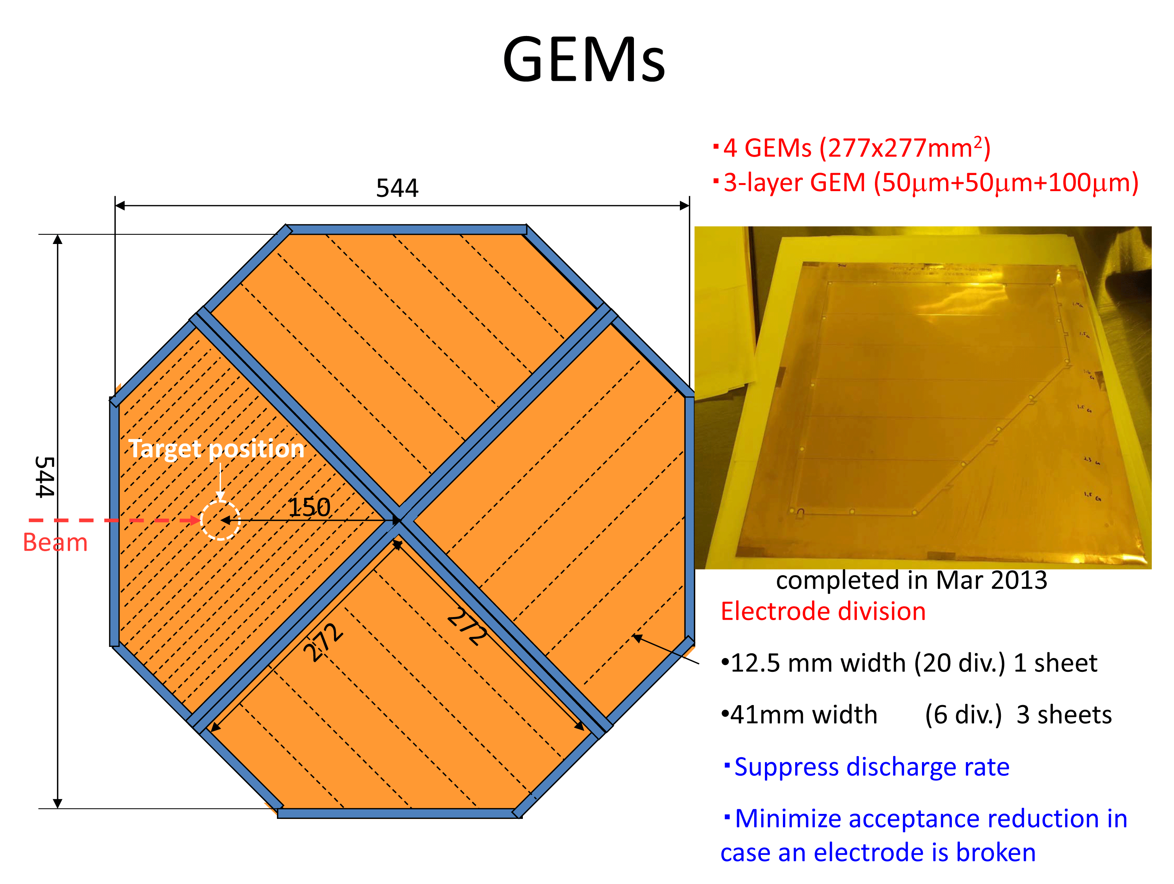
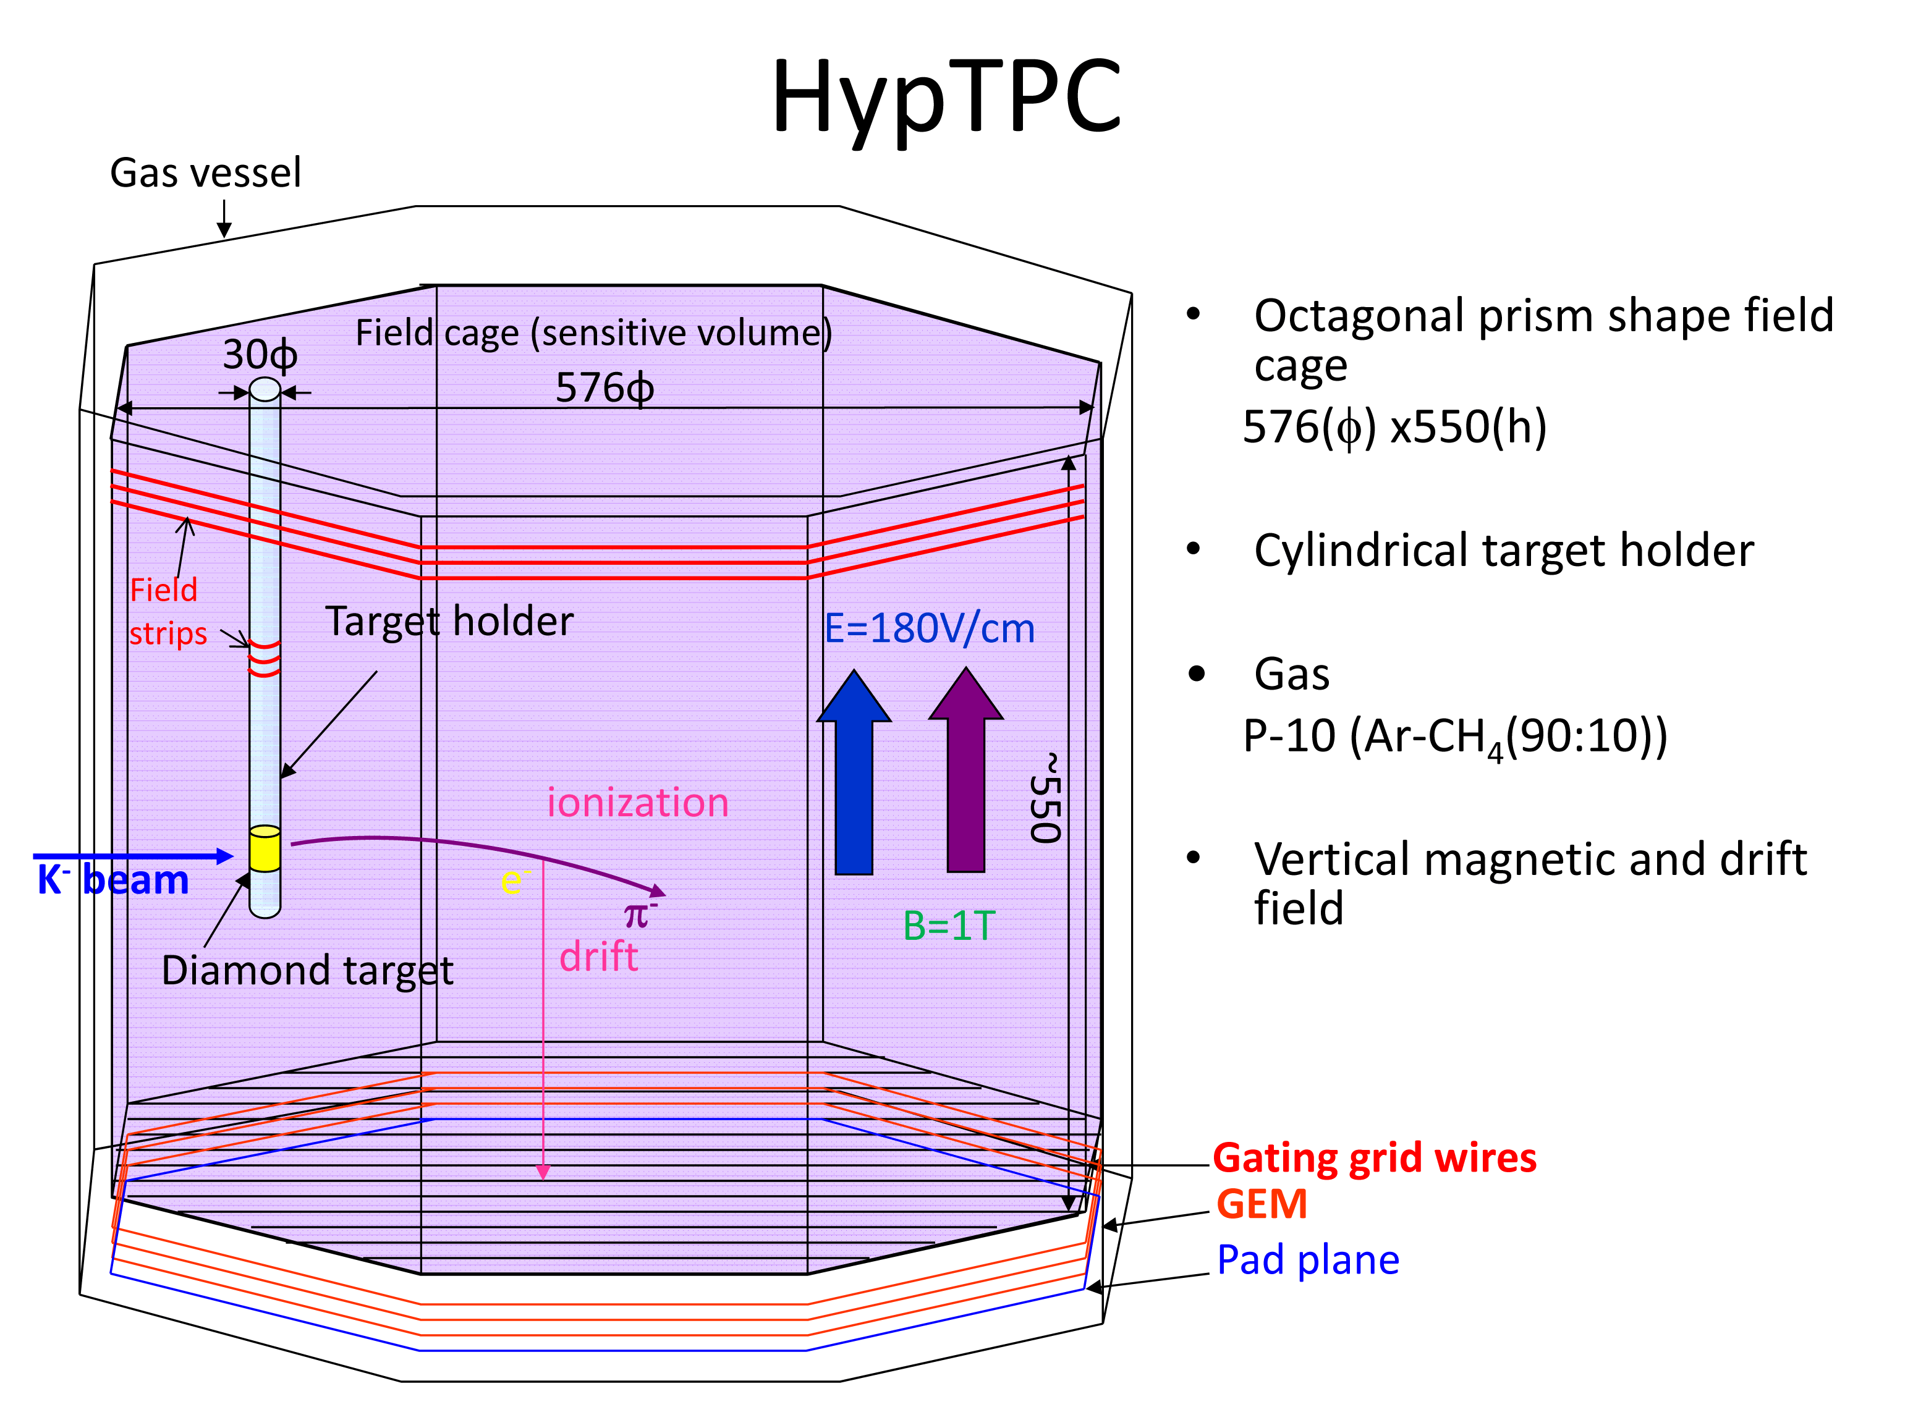
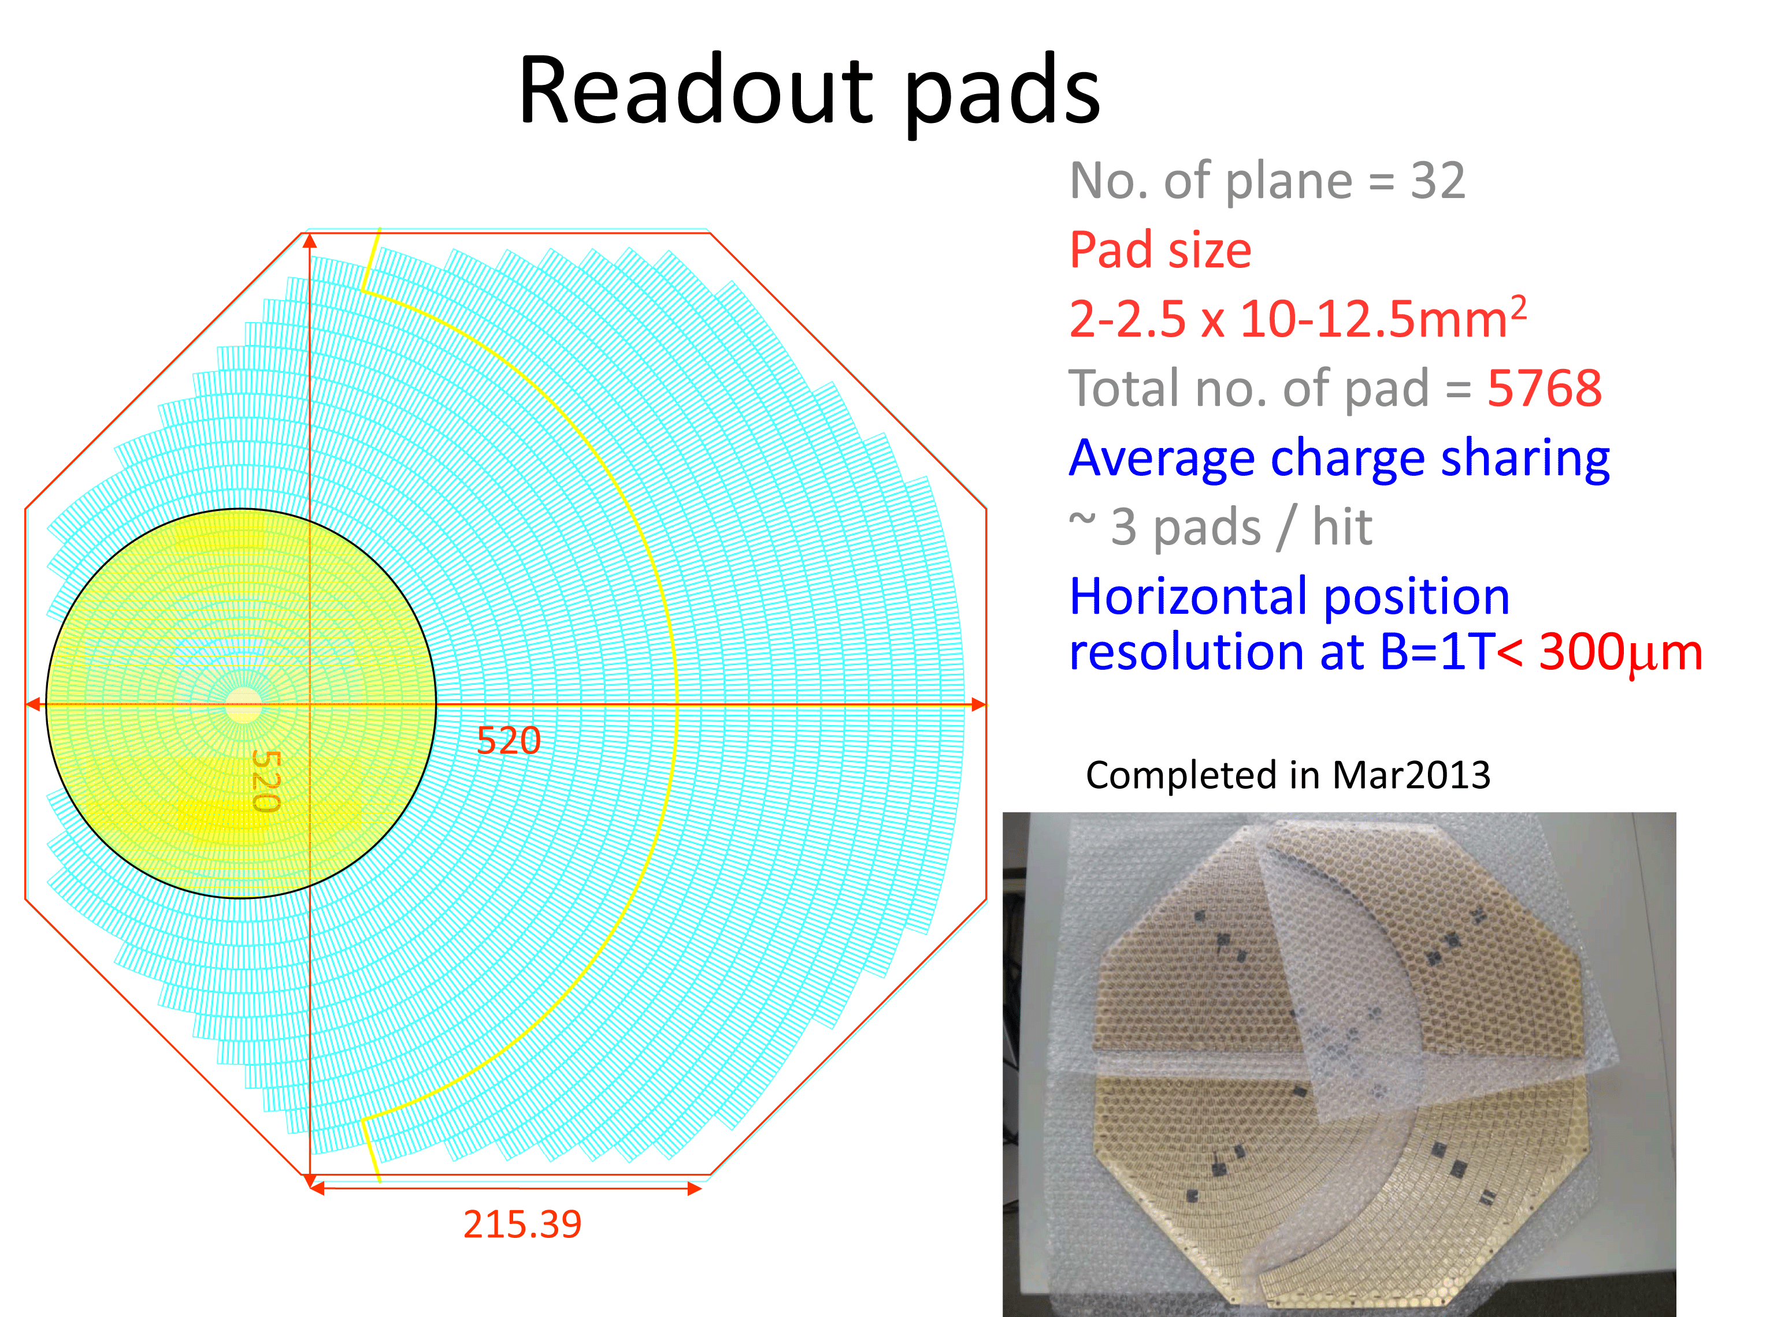

Slide 7
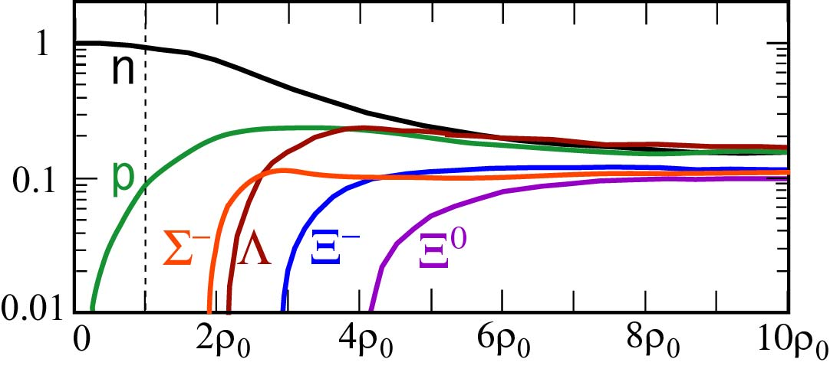
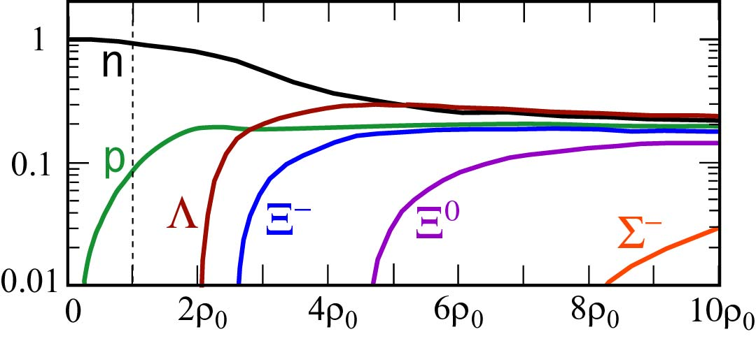
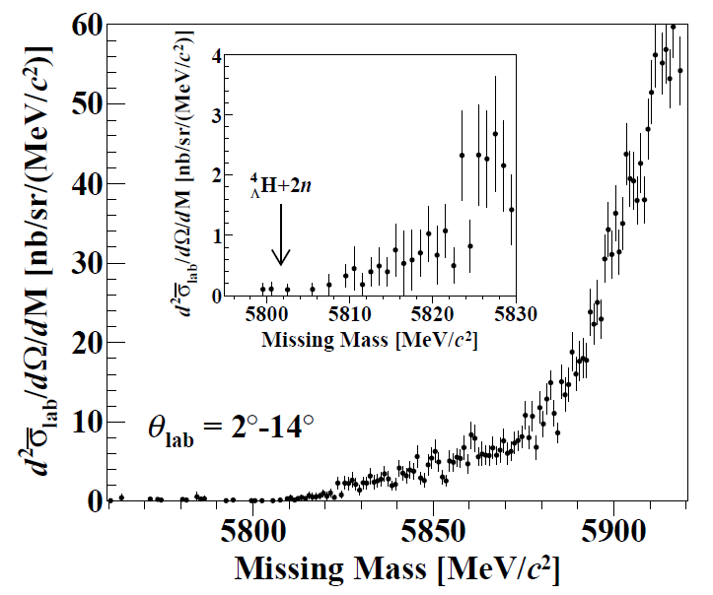
Group A02
“Strangeness in the Neutron-Rich Nuclear Matter”
Σ⁻n - attractive
Is there Σ⁻ in neutron star?
  Σ±p Scattering JPARC-E40
Determine Λnn three-body force
  Neutron rich Λ hyper nuclei
  JPARC-E10
  Gamma-spectroscopy of Λ hyper nuclei
  JPARC-E13
Search for K⁻ nuclei JPARC-E15
abundance
Σ⁻n - repulsive
density
⁶Li(π⁻,K⁺)X
No significant peak structure in the threshold region

Slide 8
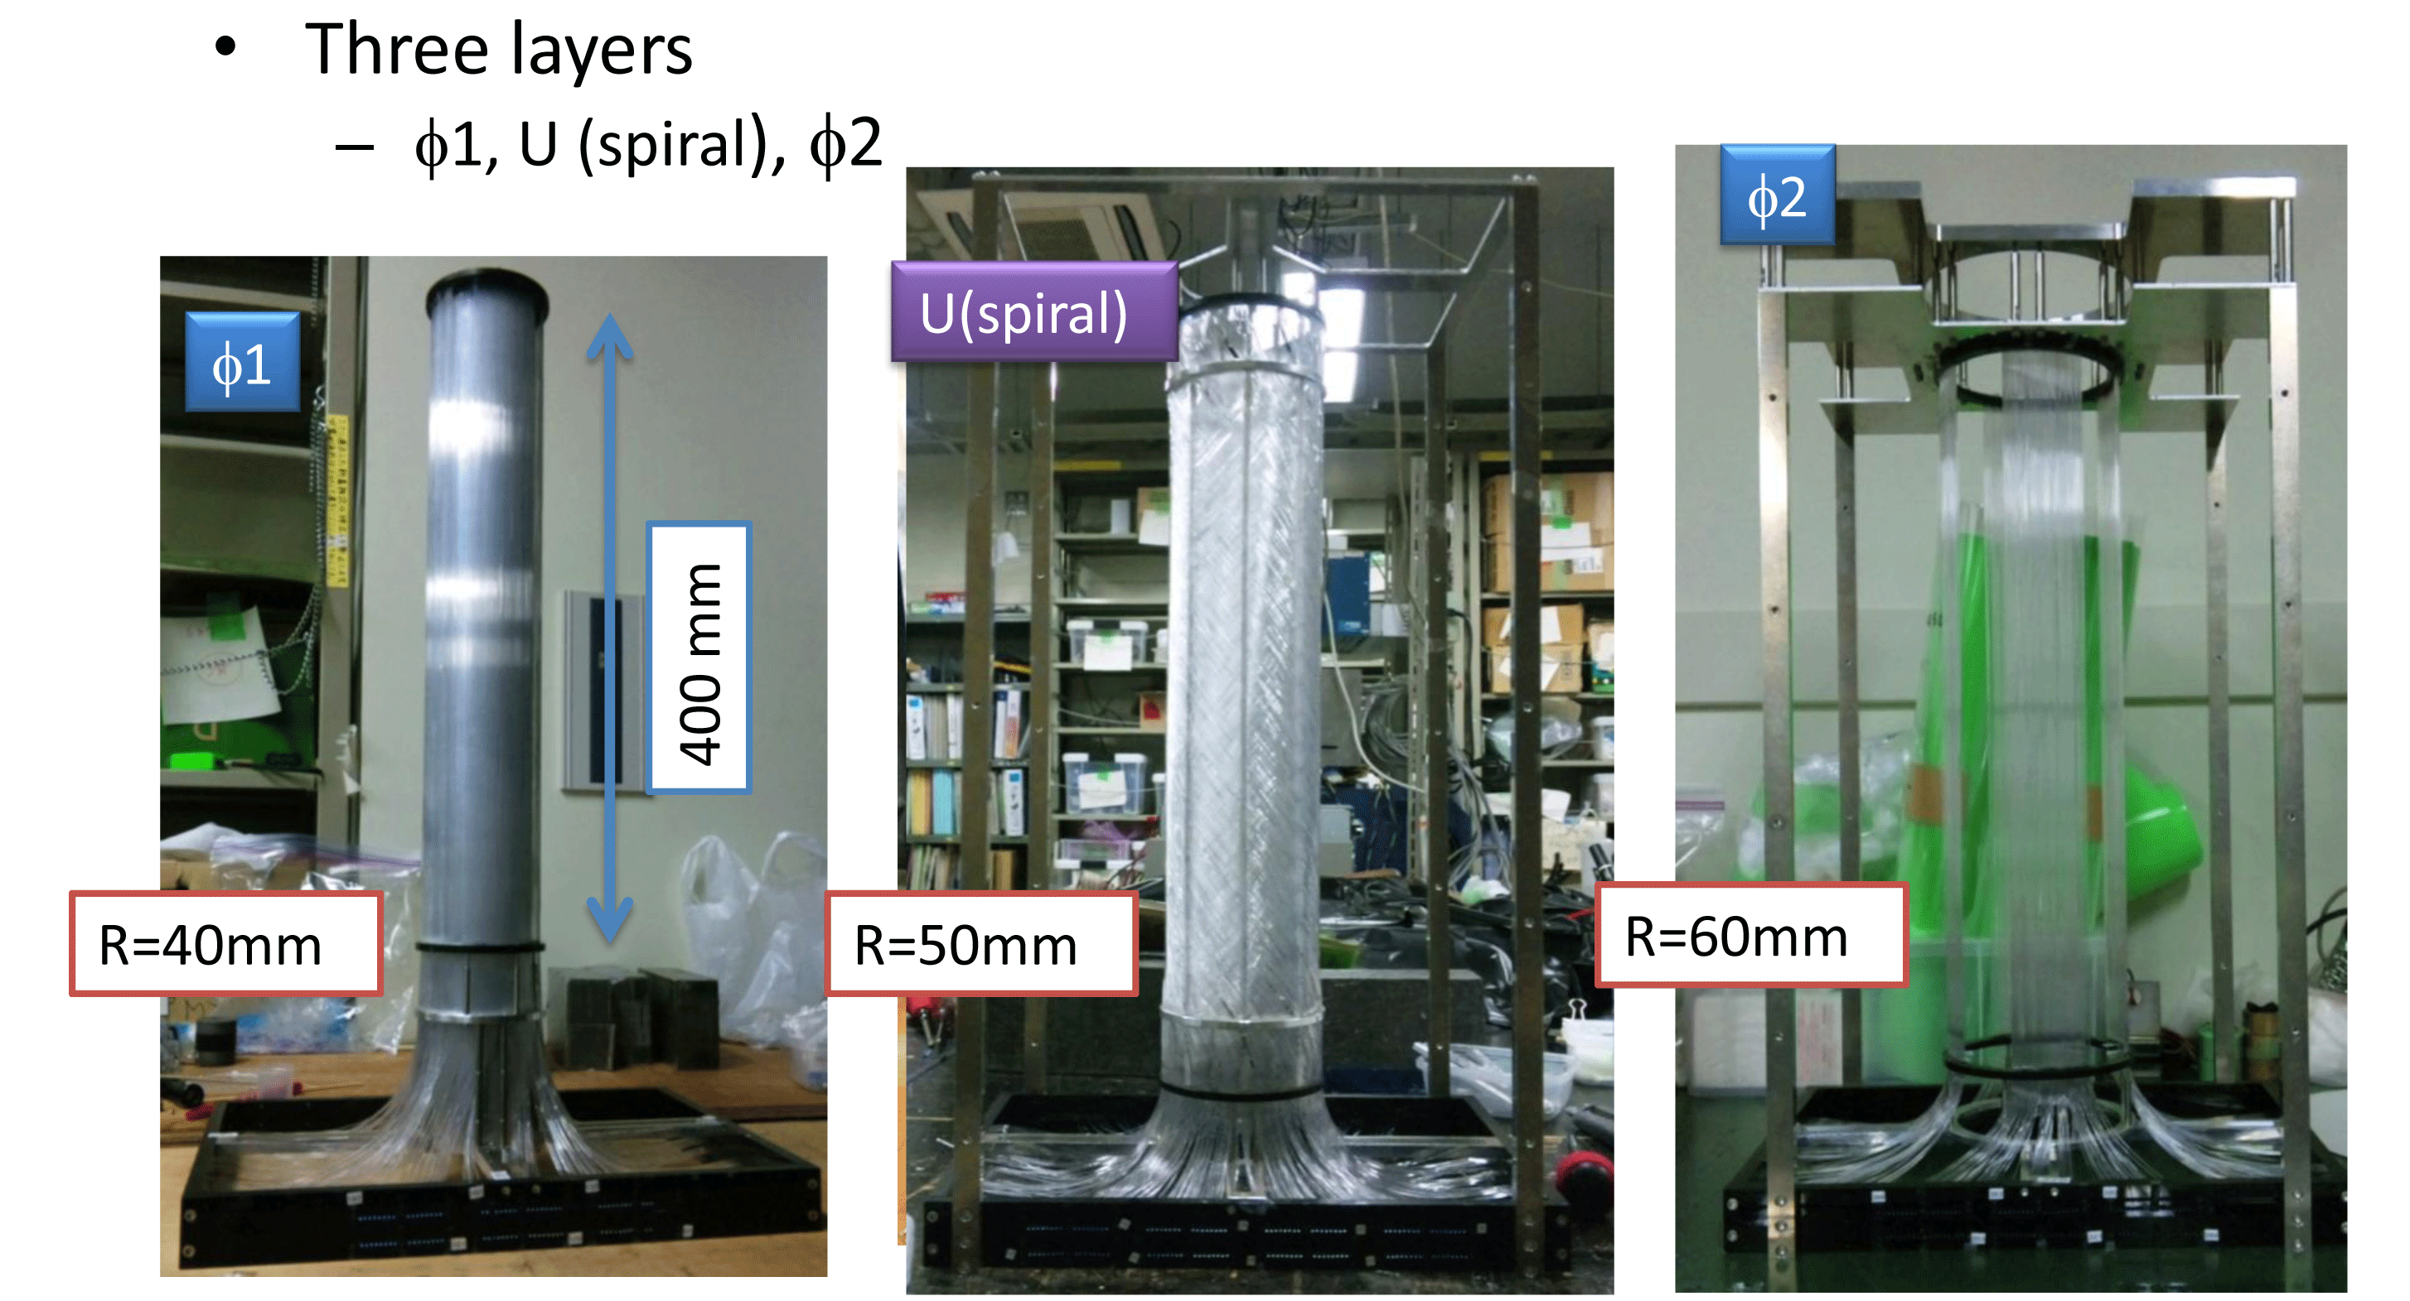
Measurement of dσ/dΩ of Σp scatterings
Measurement of dσ/dΩ
  Aim to detect 10,000 events
  Σ⁺p elastic scattering
  Σ⁻p elastic scattering
  Σ⁻p → Λn inelastic scattering
Kinematical identification of Σp scattering
Using LH2 target and surrounding detector
High intensity π beam to get a large Σ beam
  Beamline tracker under 10⁷ Hz
Large acceptance Scattered proton detector
  Cylindrical fiber tracker + BGO Calorimeter
Notes:
This is the summary of our J-PARC E40 experiment.
Our physics motivation is to verify the quark Pauli repulsive force in S+p channel.
And we will do systematic study of SN interaction by separate isospin channel.
For these purpose, we will measure differential cross section of following Sp channel from the 10,000 events.
S+p elastic scattering, S-p elastic scattering and S-p->Ln inelastic scattering.
We proposed a new experimental technique.
We use LH2 target as hyperon production and hyperon-proton scattering target.
By detecting scattered proton, we kinematically identify the Sp scattering.
We are considering to perform at K1.8 beam line with SKS spectrometer.
We also handle high intensity p beam to produce intense S beam.

Slide 9
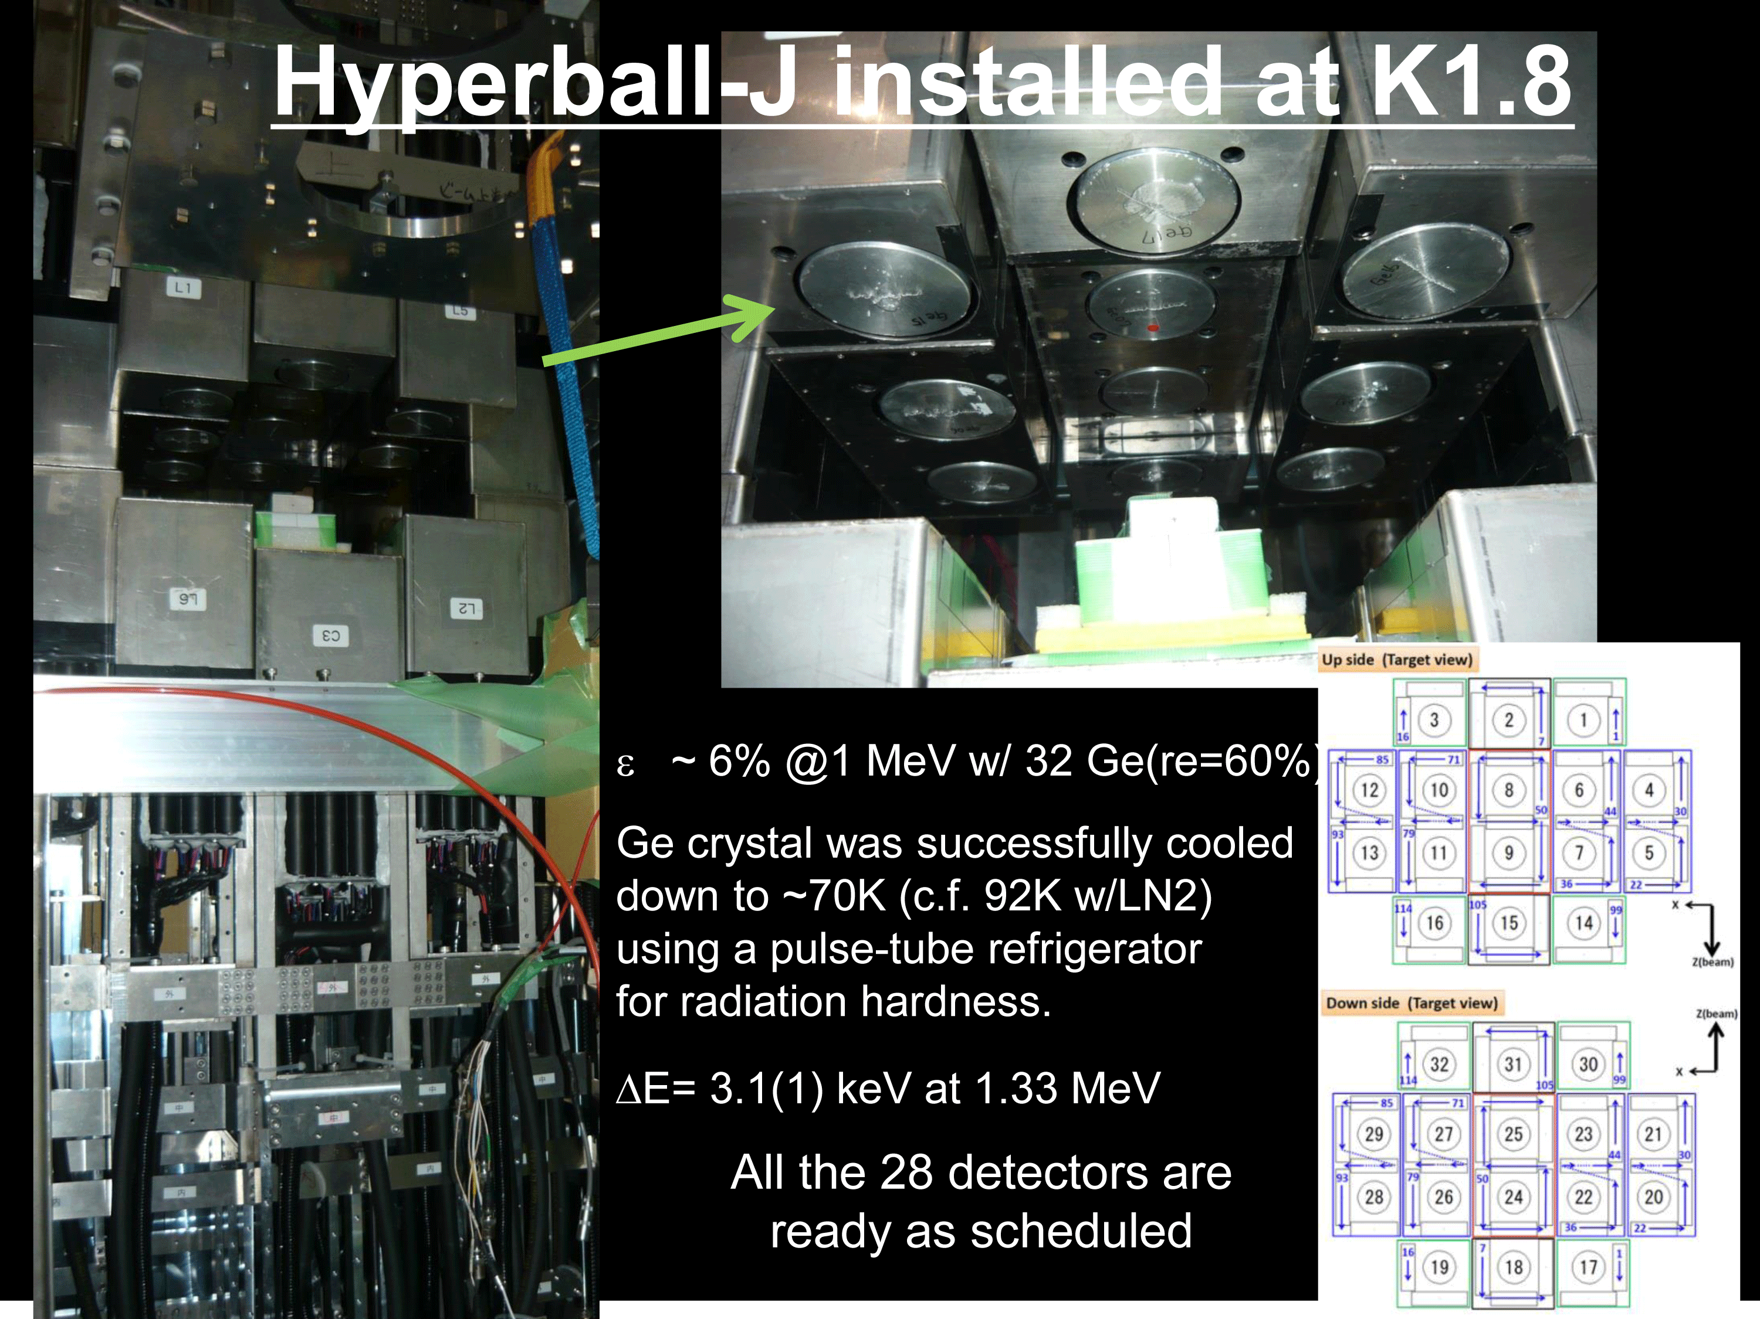
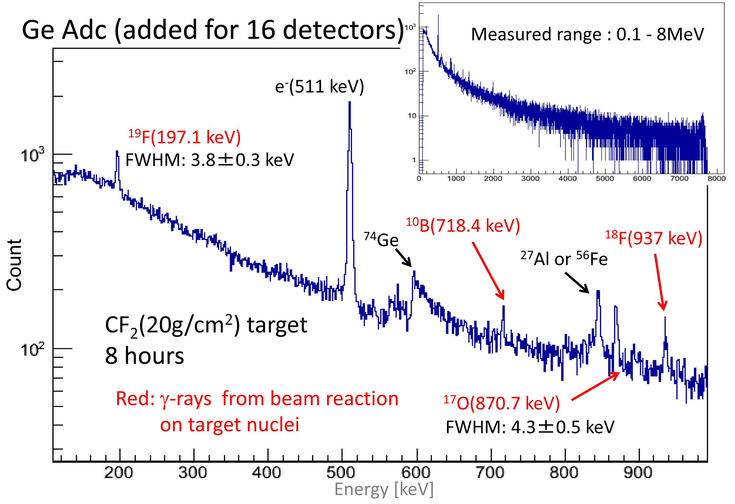

Slide 10
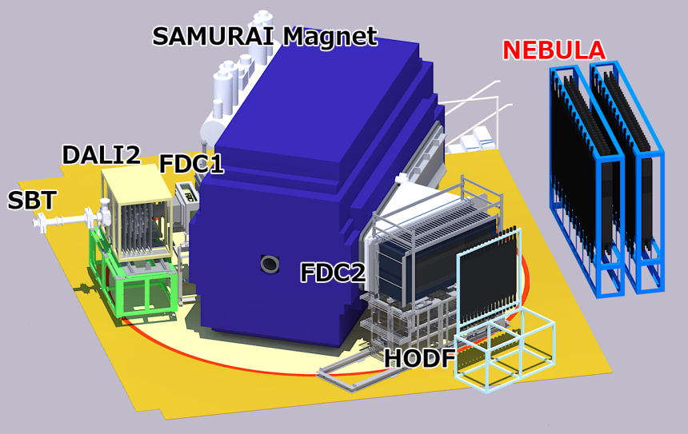
Group B02
“Properties of Medium- and Low-Density neutron-Rich Nuclear Matter”
Collective Motion of Neutron-rich Nuclei
  Pygmy Dipole Resonance; PDR of ⁵²Ca (approved)
  Breathing Mode
Dineutron correlation in low-density matter
  Coulomb Breakup of 2n Halo ²²C and ¹⁹B (SAMURAI-day one)
Tetra Neutron, Exotic nucleonic system
  Nuclear force
  ²⁶O (SAMURAI-day one)
  ²⁸O (approved)

Slide 11
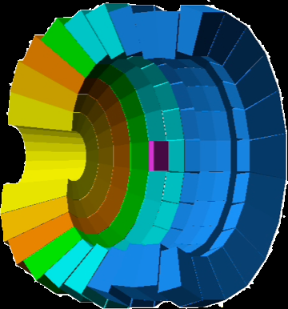
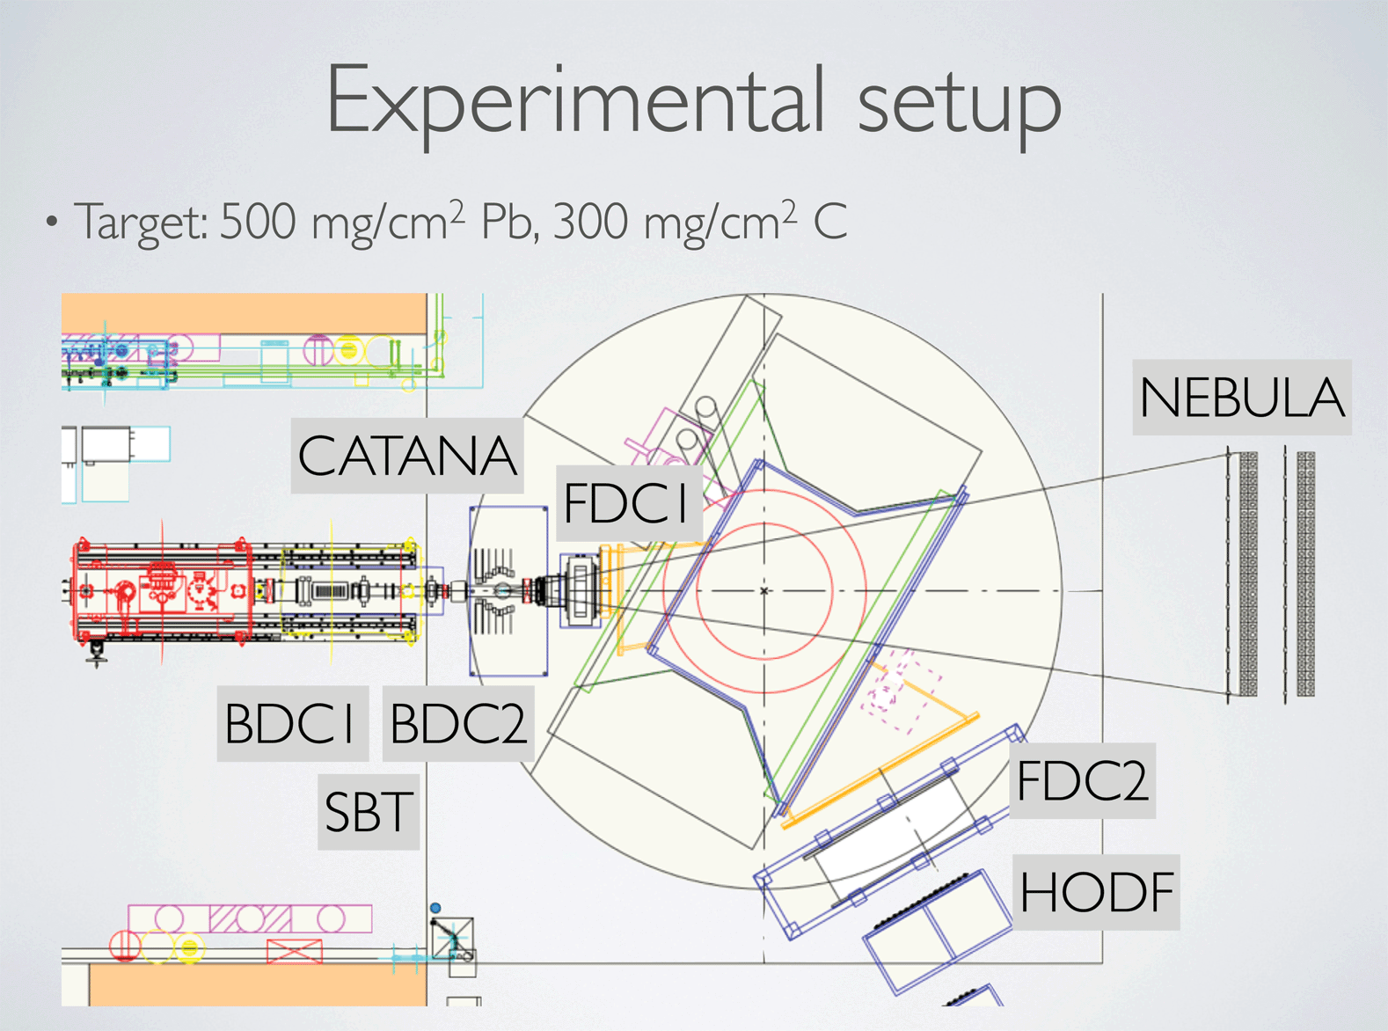
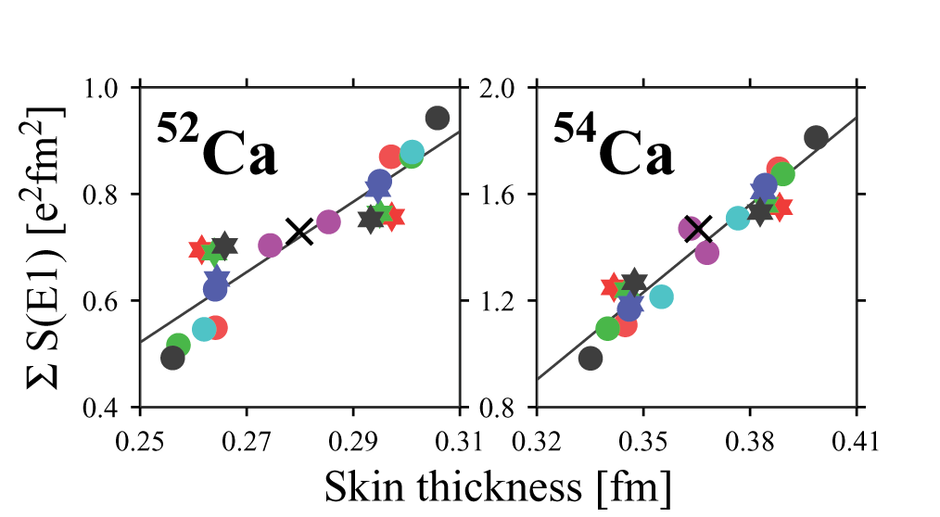
CATANA for SAMURAI (T. Togano (TIT) et al.)
CAlorimetric deTector for rAdiations from exotic Nuclear beAms
• 200 Crystals: CsI(Tl) or CsI(Na)
• Thickness: 9.5—15cm
• Photo peak efficiency 56% for 1MeV (β=0.6)
Isovector dipole response of ⁴⁸⁻⁵²Ca
→ skin thickness, EOS
  PDR strength and
  dipole polarizability
T. Inakura et al., arXiv:1306.3089

Slide 12
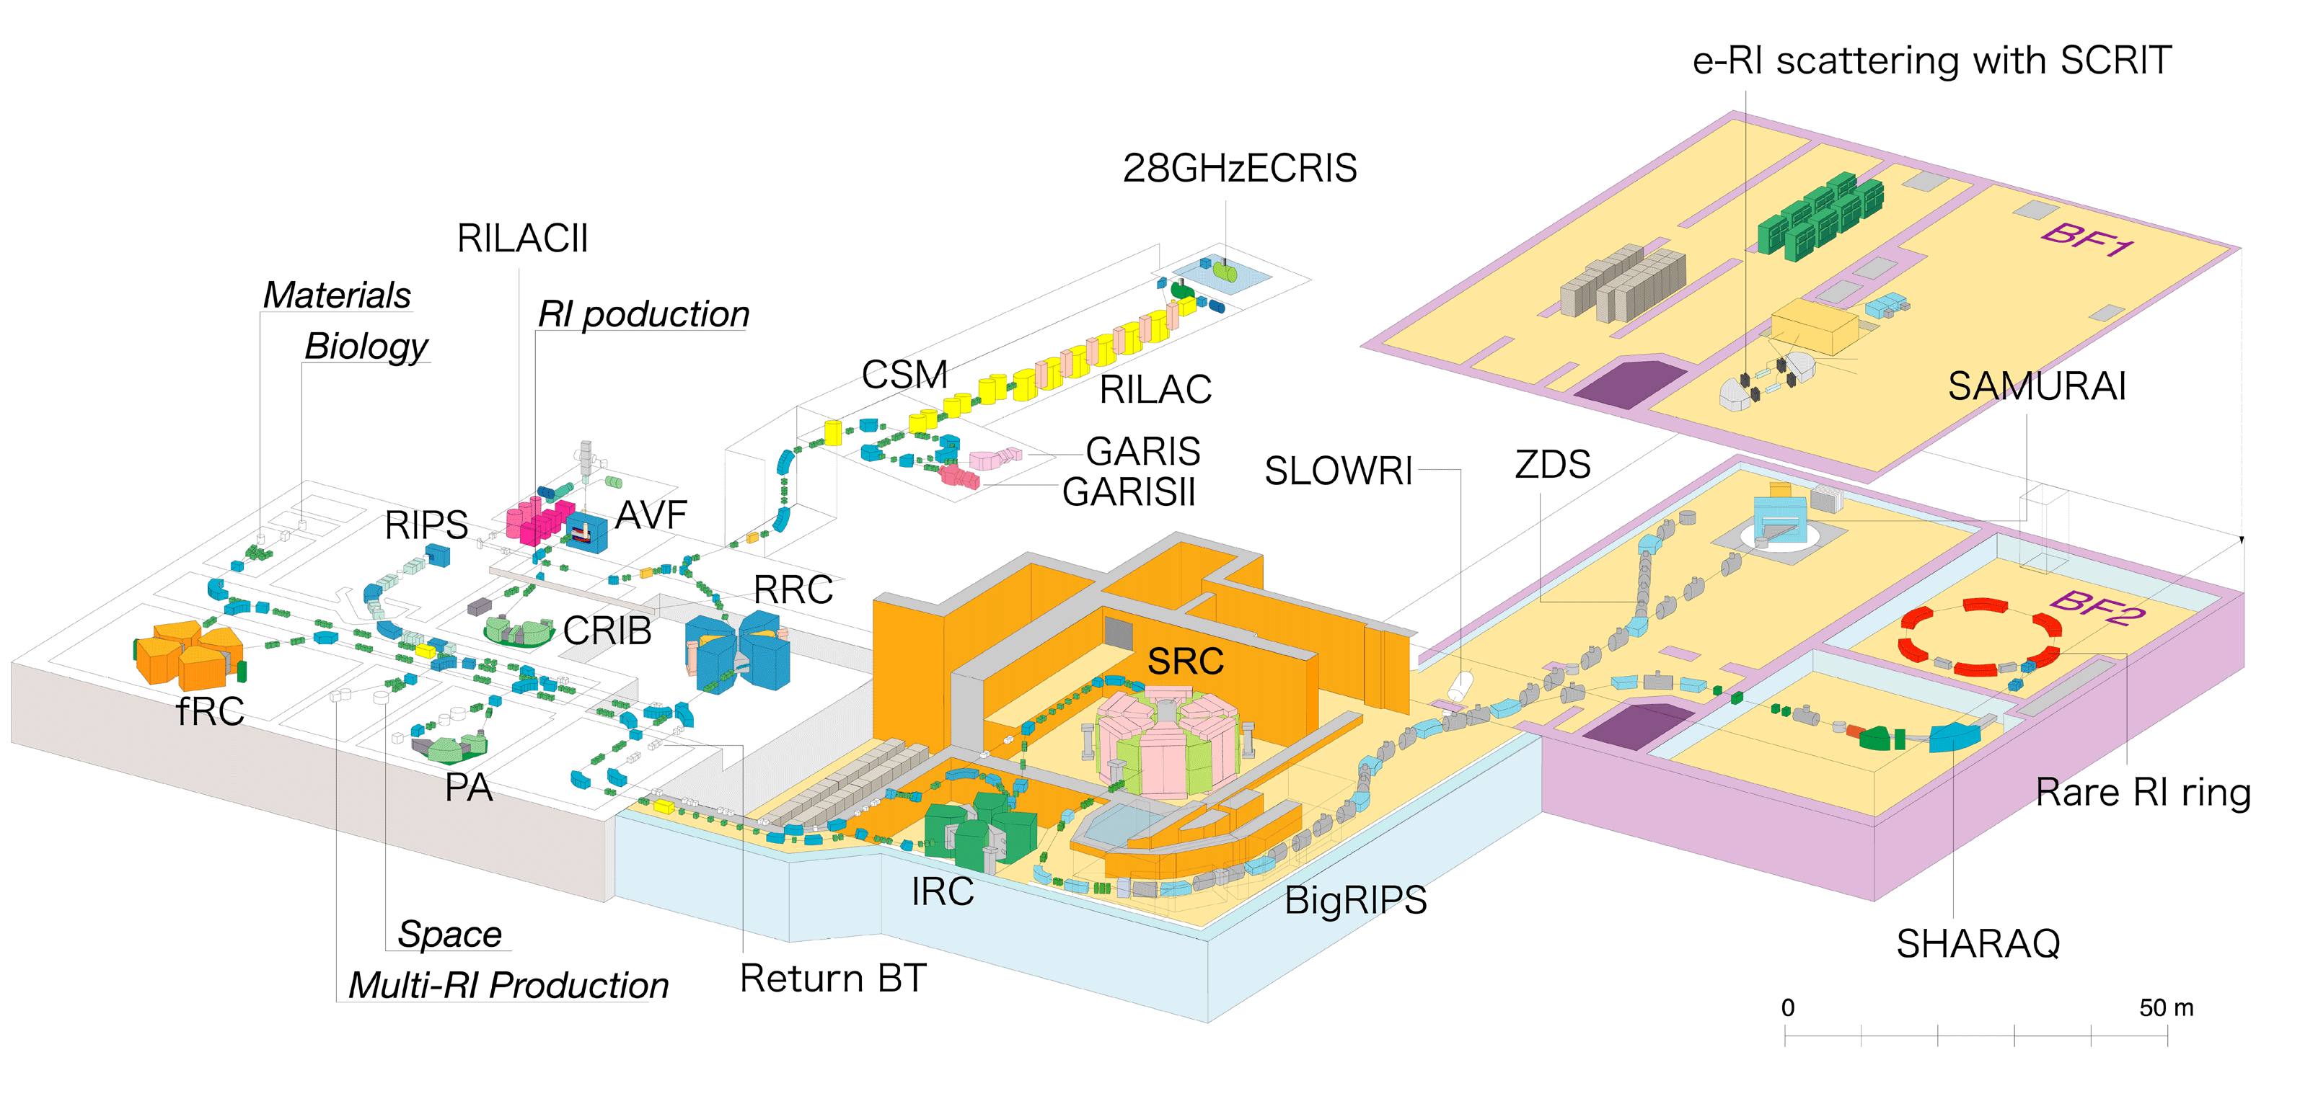
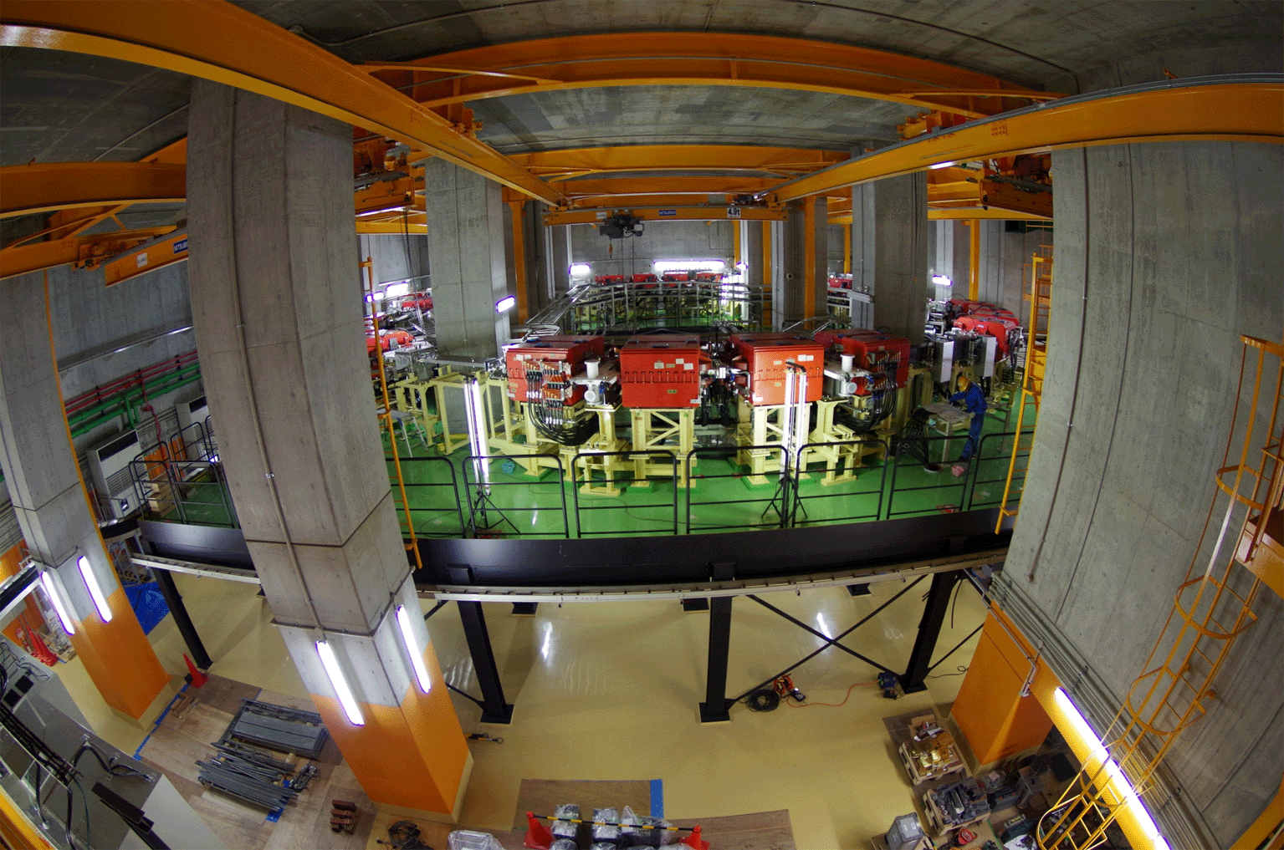
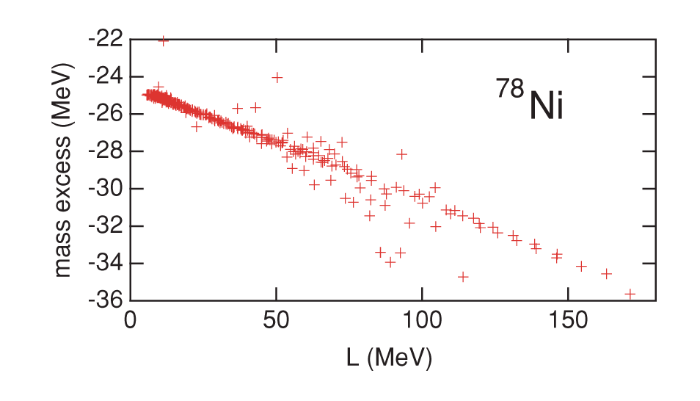
New Direction of Mass Measurement:
A. Ozawa (Tsukuba Univ.) Group
Measure mass of
⁷⁸Ni with an accuracy
of 10⁻⁶ to determine L
K. Oyamatsu and K. Iida,
Phys. Rev. C 81 (2010) 054302
Ready for commissioning

Slide 13
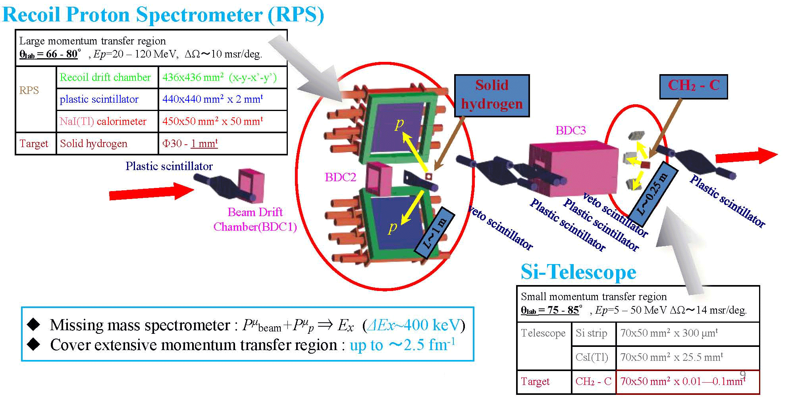
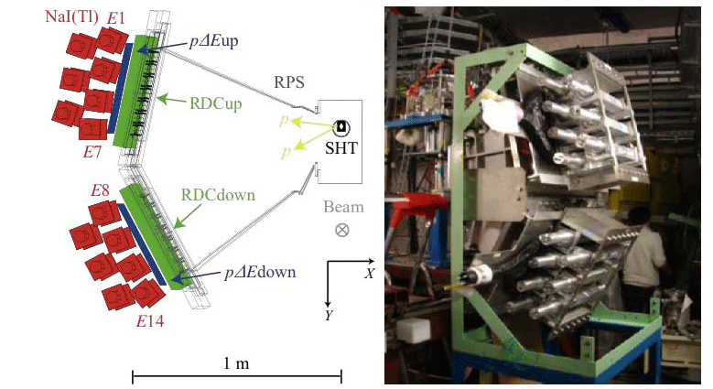
Neutron Skin thickness of ¹³²Sn:
ESPRI Group (J. Zenihiro et al.)
Elastic Scattering of Protons with RI beam
Approved ; in preparation

Slide 14
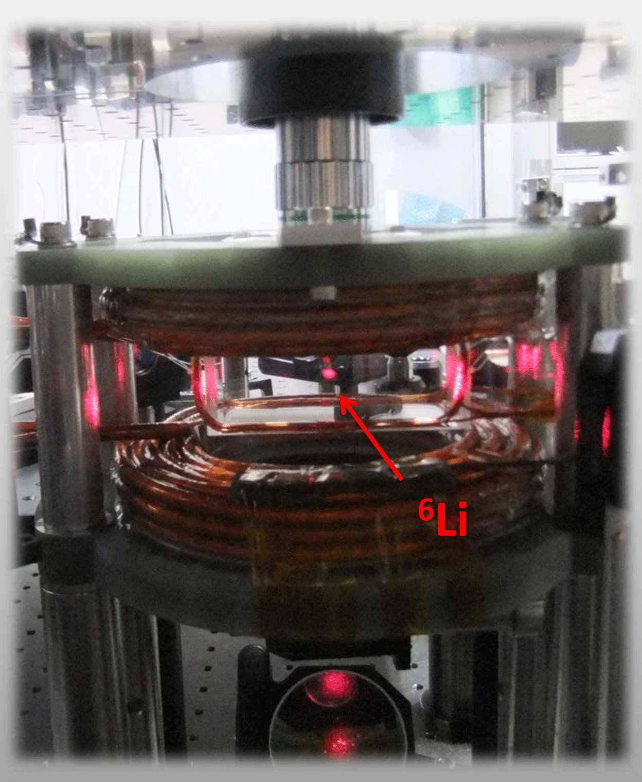
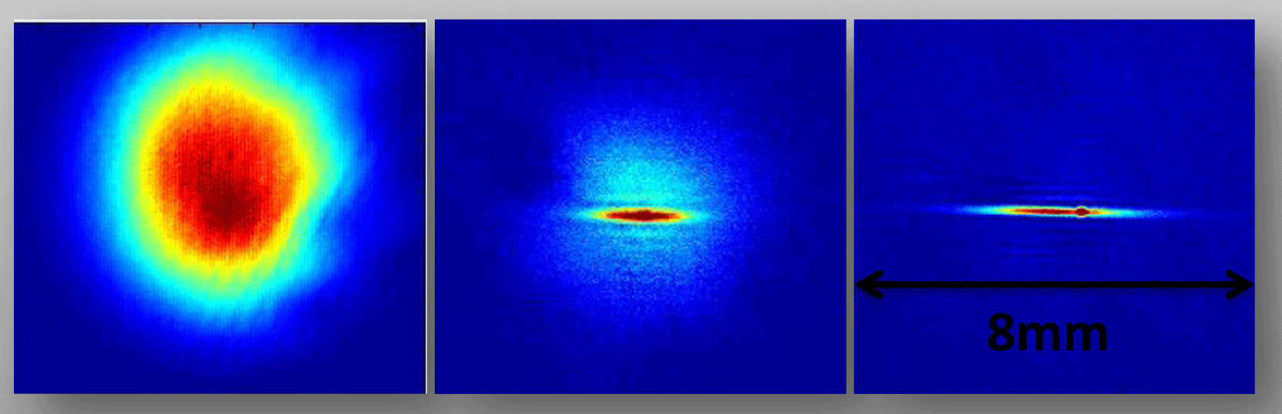
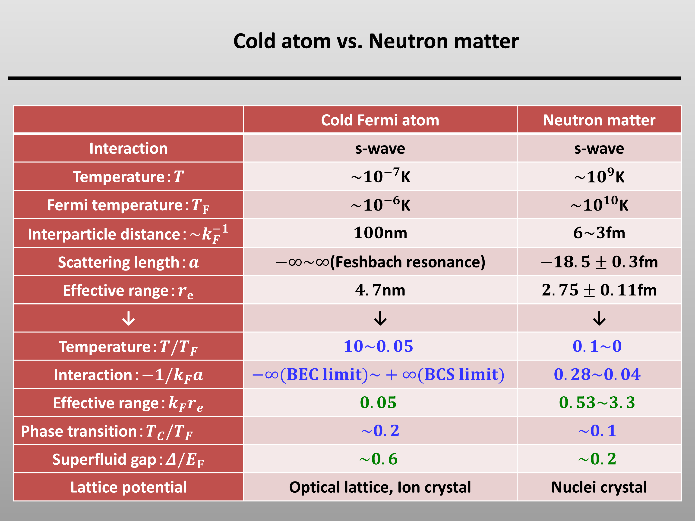
Group B03
“EOS for Low-Density Neutron-Rich Nuetron Matter studied by Cold Atoms”
Visualize low density neutron-like matter
optical dipole trap
Laser cooling

Slide 15
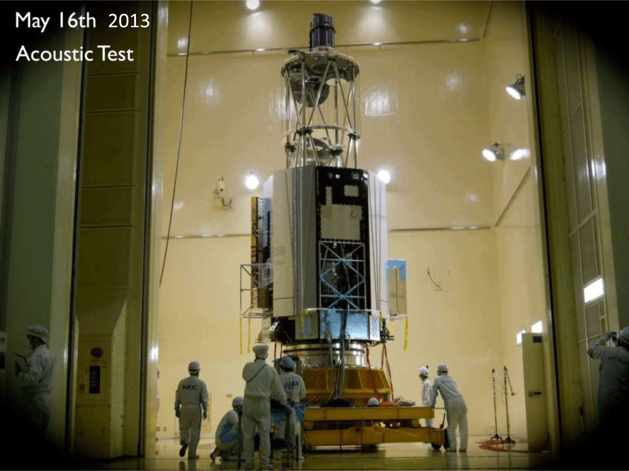
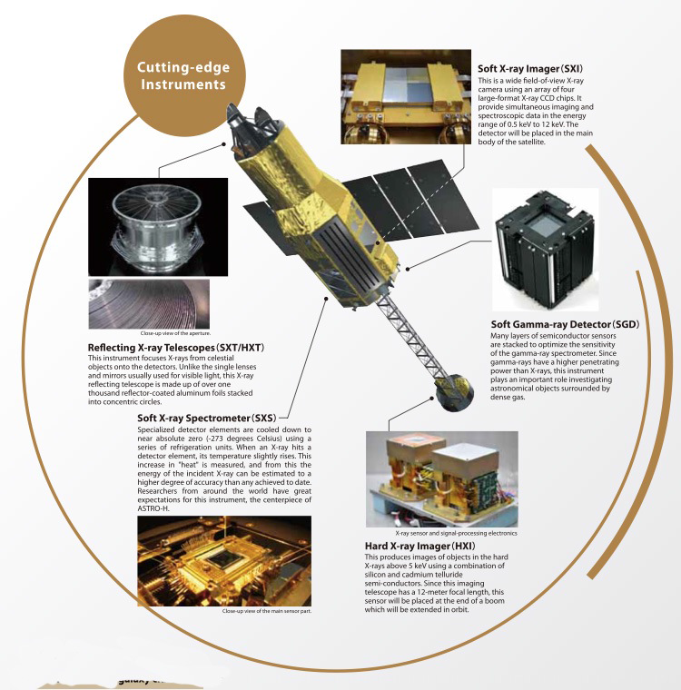
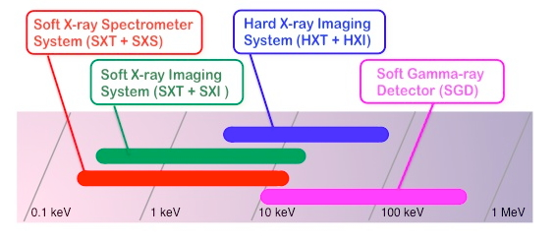
Group C01
“New Development of Research on Neutron Stars
by X- and Gamma-Rays Observatory”
Wide Band /High Sensitivity
Observation
0.3 keV - 600 keV : Four Instruments
including Hard X-ray Focusing optics

Slide 16
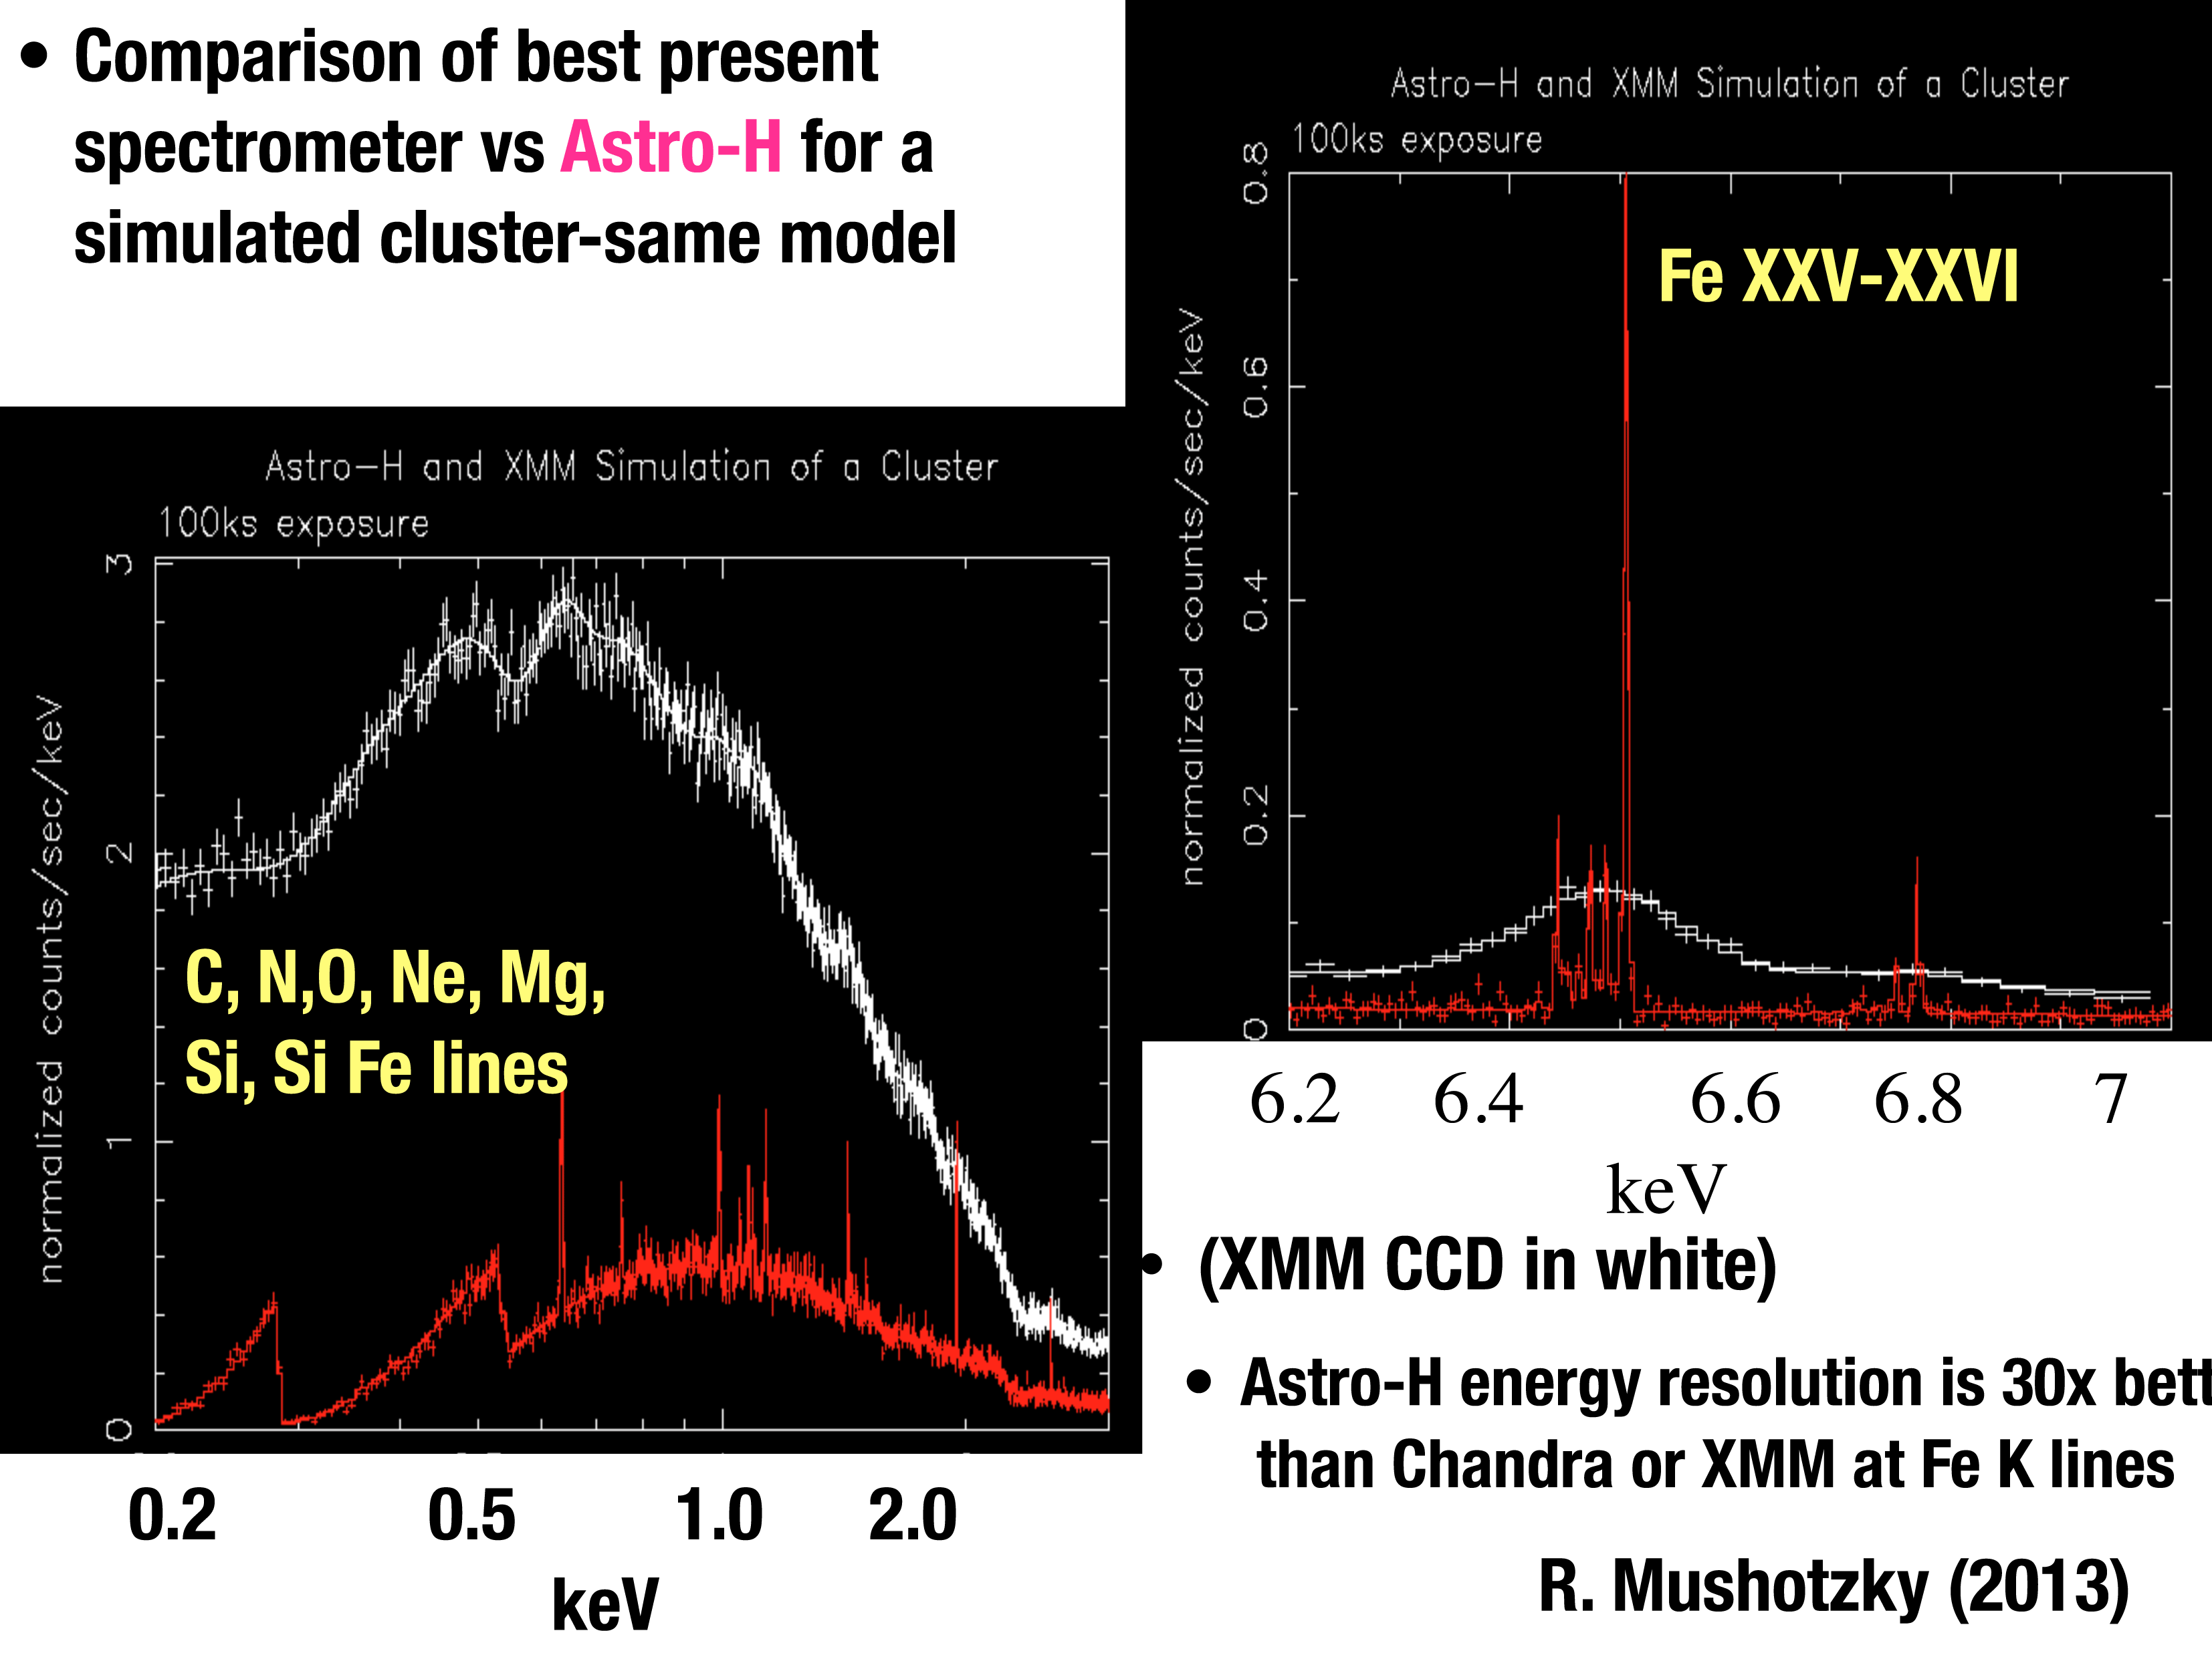
Gravitational Red-shifts of absorption lines precise determination of radius (Terzan 5 X2)

Slide 17
Summary
We have formed a new research field under the name of “Neutron Star Matter”.
We are getting ready for performing several experiments using either J-PARC or RIBF.
Astro-H is nearly ready for the launch in 2015.
Theoretical supports are getting stronger.

