Slide 1
Constraining the Symmetry Energy: Future Directions (mainly U.S. efforts)
W. Lynch
Work performed at NSCL and Department of Physics and Astronomy
Michigan State University
Status
Improving Constraints at Sub-saturation densities
Improving constraints on momentum dependence (finite temperature and non-equilibrium phenomena)
Improving constraints at supra-saturation densities
Outlook: preparing for future success
Notes:
Thank the of this workshop for opportunity to present results of our work to participate in the interesting discussions.
Acknowlege collaborators
Read outline

Slide 2
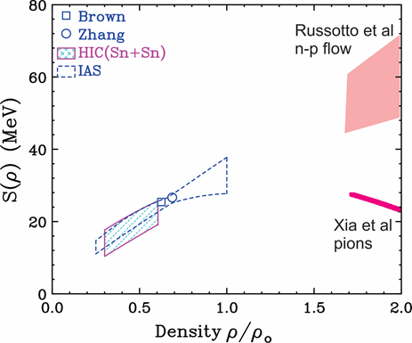
Present status of laboratory measurements
Where sensitive densities are assessed
For ρ<ρ₀
Adapted from ICNT 2013 Summary report Horowitz, et al.,
Adapted from ICNT 2013 Summary report Horowitz, et al.,
Have initial constraints at sub and supra-saturation densities:
  Contours reflect assessment of theoretical and experimental uncertainties
Relevant questions:
  How do we improve the constraints at ρ<ρ₀?
  How do we deal with momentum dependencies of mean fields?
    Extension to non-zero temperatures and non-equilibrium systems
  How do we improve the constraints at supra-saturation densities?

Slide 3
Laboratory constraints on Symmetry energy at ρ<ρ₀
Sensitive observables that are or will be more extensively explored :
  masses:
    Penning traps, TOF
  Isobaric Analog States (IAS)
    Reaccelerated RIB’s ReA3 and CARABU: AT-TPC collab.
  Isospin diffusion between nuclei of different N/Z in peripheral HIC
    Sn+Sn NSCL: new results soon!
  Neutron skins:
    PREX, CREX at JLAB
  Isoscalar GMR
    Notre Dame, AT-TPC collab
  Neutron and proton transverse and elliptical flow
    NSCL: Chajecki, Kohley
  Fragmentation of hot nuclei:
    TAMU
  .
ICNT 2013 Summary report Horowitz, et al.,
ρ_{HIC(Sn+Sn)} < 0.45ρ₀
ρ_{mass} ≈0.6- 0.7 ρ₀
Realistic theoretical “Error bars” are key to combining constraints.
Notes:
There have been a lot of work trying to constrain the symmetry energy.
Most of this concentrated on the properties of nuclei that are sensitive to the symmetry energy. This provides sensitivity to the symmetry energy at subsaturation density (S adn L)
THe relative observables are are (read them)
By comparing data to calcualtions in which the interactons are varied, varying L and S, we can get the ranges of L and S allowed by the data. POnt them out.
The countrous are regious about a straight line. This occurs because the observable is sensitive mainly to one average density. we saw that for masses here it appears again. Steeper slopes mean high denstieis. Masses here aper to be sensitive to (read it)
Polarizability is sensitive to somwhat lower density.
Isospin diffusion (descdribe it) is sensitive to densities less that 0.45 rho0. It is even a more flot contour
neutrons skins are senstive only to l
intersection of these constrains can ge simulataneous constrains on l and S
but it is very sensitive to the theoretical error bars.

Slide 4
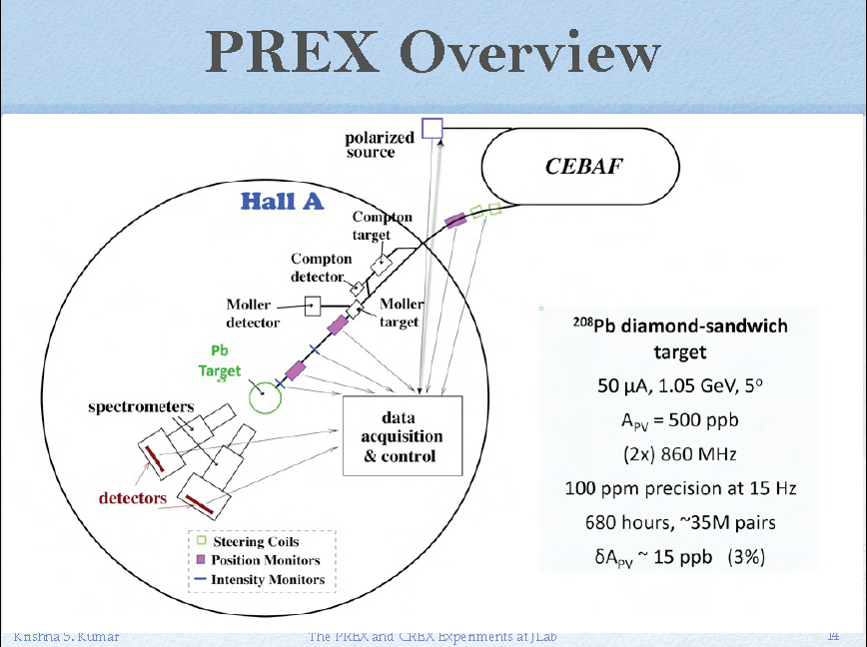

Slide 5
Planned neutron skin measurements
Plus previous measurements
ICNT 2013 Summary report Horowitz, et al.,
PREX measured neutron RMS radius of ²⁰⁸Pb.
PREX measured neutron RMS radius of ²⁰⁸Pb.
Prex II will provide improved precision
  δ
PREX II
²⁰⁸Pb(p,p)
J. Zenihiro, ..., PRC 82, 044611 (2011)
ρ_{HIC(Sn+Sn)} < 0.45ρ₀
²⁰⁸Pb(γ,π⁰)
Mainz
Previous proton elastic scattering measurement
  Zenhiro et al, (2011)
Latest result from ²⁰⁸Pb(γ,π⁰)
  suggest rather soft symmetry energy
Also expect CREX result for⁴⁸Ca

Slide 6
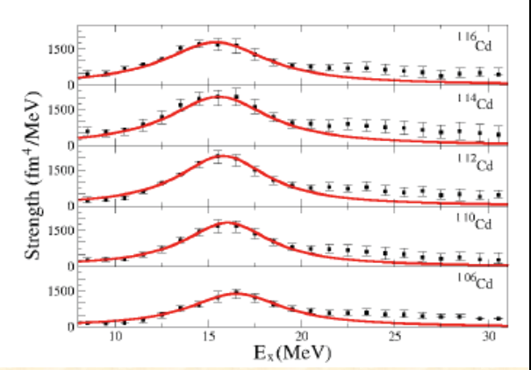
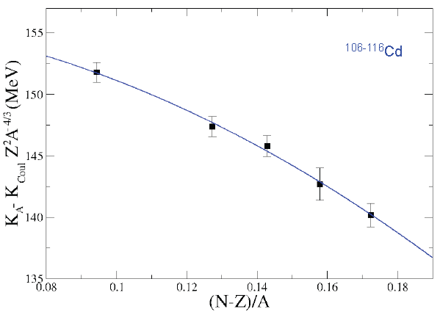
Isoscalar Giant Monopole Resonance
Breathing mode vibration
  excitation
  operator
  Excitation energy
Qualitative idea
Better idea: Calculate the GMR using RPA and realistic interactions.
Measure E_{GMR} along isotopic chain and determine K_{τ} , e.g. Cd

Slide 7
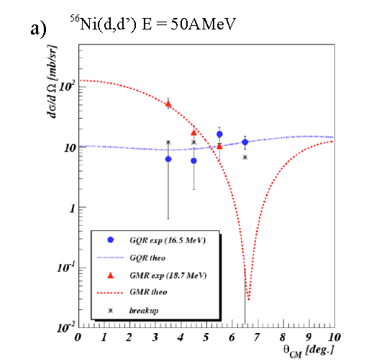
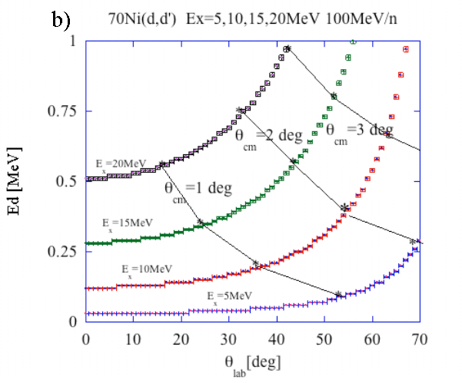
GMR in rare isotopes using Active Target-Time Projection Chamber AT-TPC
selectivity
reverse
kinematics
Interesting to explore long isotope chains: e.g. Sn isotopes ¹⁰⁴Sn – ¹³⁴Sn
Gives

Slide 8
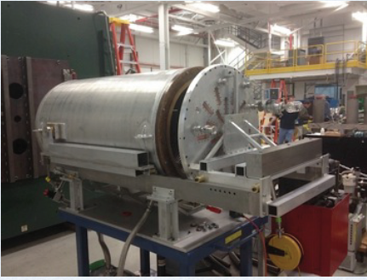
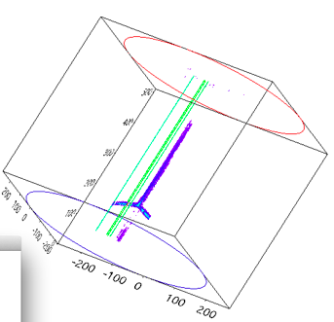
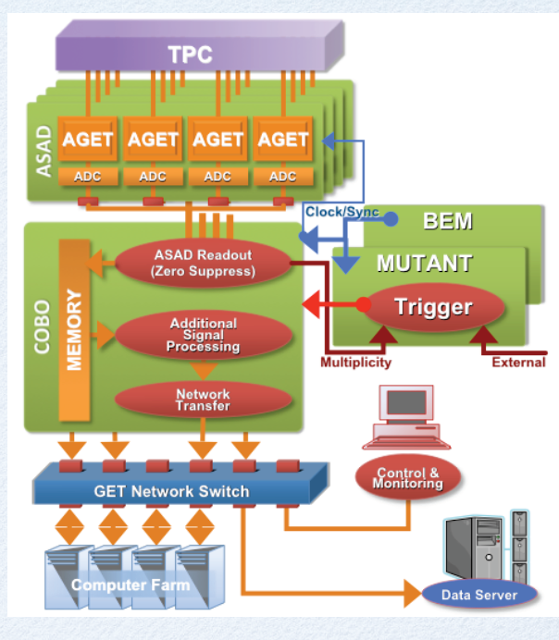
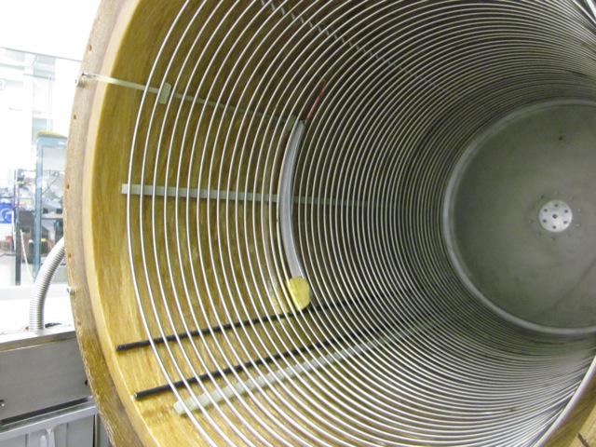
Active Target-Time Projection Chamber
Mittig, Lynch, Bazin, et. al
Commissioning with ⁴He beam at ReA3. Can also be used with fast beams.
  March 2014
GET Electronics
High-density electronics
CEA-Saclay, GANIL, Bordeaux, MSU
⁴He+⁴He scattering event

Slide 9
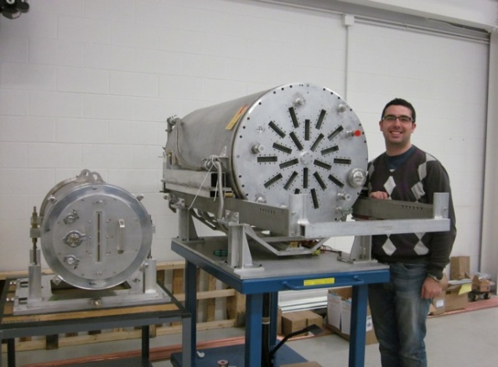
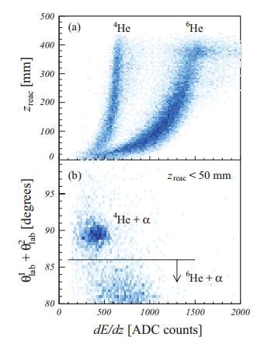
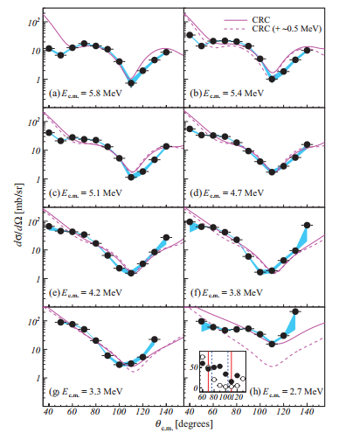
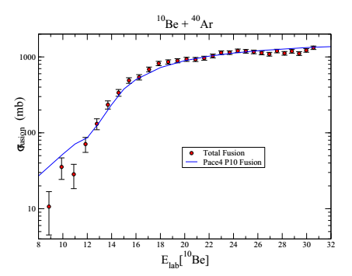
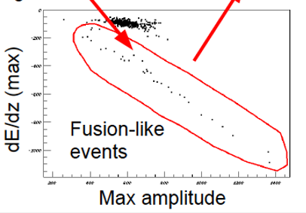
Active Target-Time Projection Chamber
Mittig, Lynch, Bazin, Kohley
Successful operation of prototype TPC:
Scattering ⁶He + α at Twinsol
2000 pps ⁶He
Confirm strong α-cluster state in ¹⁰Be.
Fusion ¹⁰Be + P10 (Ar/Methane)
Sub-barrier fusion with low-intensity RIBs. (200 cps)
J. Kolata
A. Howard
(Notre Dame)
Suzuki et al. PRC 2013

Slide 10
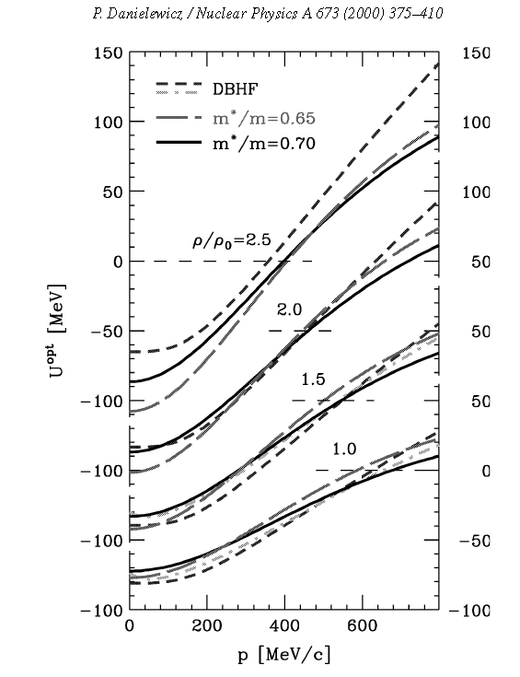
Neutron-proton flows
Momentum dependence of mean fields
Momentum dependence of the mean field (real part of optical potential) is well established for symmetric matter.
  At low energies, it can be described by effective mass, m*:
  Momentum dependence increases with ρ, is maximal at p=p_{F} and vanishes as p→∞.
Is the symmetry potential mom. dependent?
If so, the uncertainty in m*_{n}, and m*_{p} has an significant influence on the excitation energy – temperature relationship for neutron stars.
It also influences the neutrino flux from neutron stars:
U_{SM} (MeV)
Notes:
Well established
Instructure – low energies effe. Mass
Symmetric matter optical potential
Quadratic momtnum dependen
Tails off at high eneriges
Increases with density
There also can be a momentum dependence to the symmetry mean field difference proton and neutron effective masses
This needs to be constrained at higher than saturation densities by expeirment.

Slide 11
Constraining the effective mass splitting via n/p spectral ratios
The ratios of neutron/proton spectra are extremely sensitive to differences in the effective masses between neutrons and protons.
Also sensitive to density dependence of symmetry and short-range correlations.
Skyrme | S₀(MeV) | L (MeV) | m_{n}*/m_{n} | m_{p}*/m_{p}
SLy4 | 32 | 46 | 0.68 | 0.71
SkM* | 30 | 46 | 0.82 | 0.76
Y. Zhang, et al., Phys. Lett. B 732, 186 (2014).

Slide 12
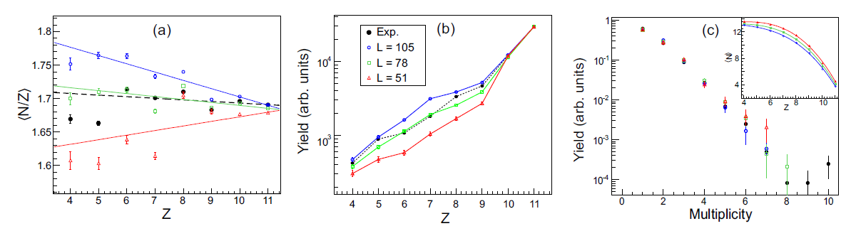
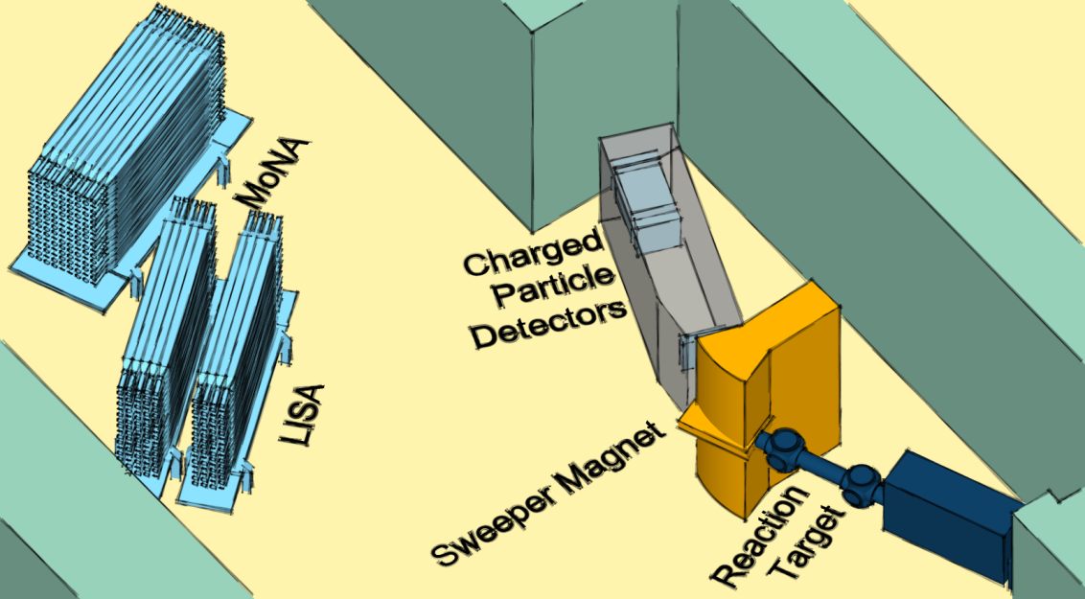
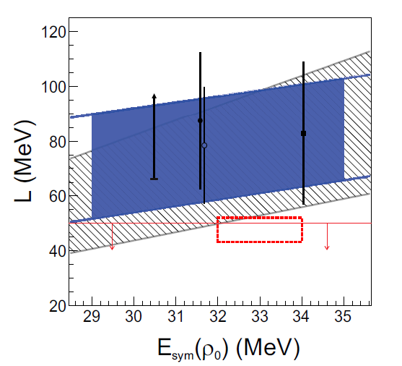
Sensitivity of n/p observables to EoS
(See also Russotto presentation)
High efficiency neutron detection with N/Z of heavy residue allows test of dependence of fragmentation on symmetry energy
Analysis involve previous MoNA data with neutron-rich ³²Mg RIB.
Kohley et. al
³²Mg + ⁹Be
Kohley et al. PRC Rapid 2013

Slide 13
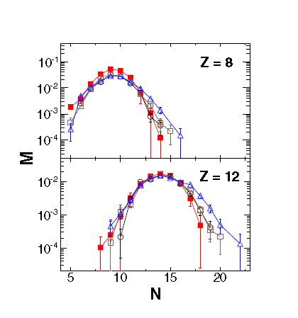
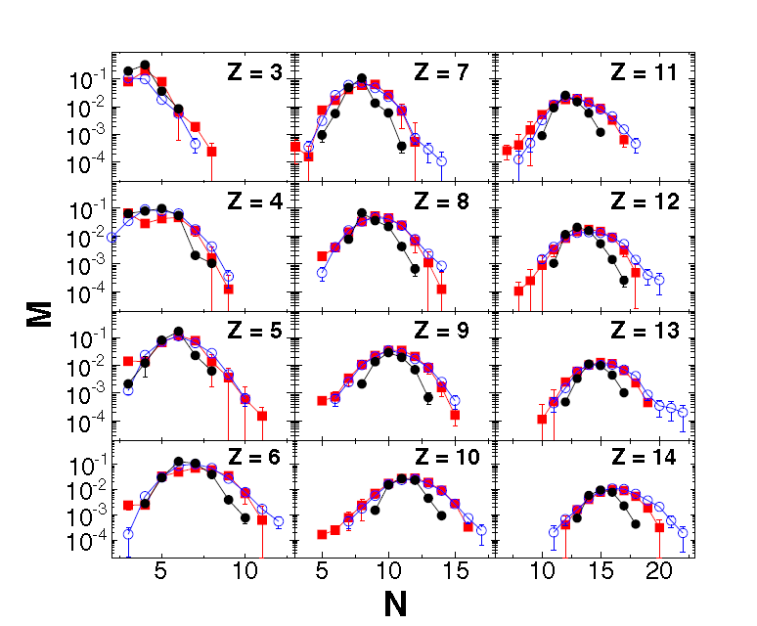
Fragmentation and EoS of neutrinosphere
Lin et al., arXiv 1405.6911v1
Lin et al., arXiv 1405.6911v1
theory
theory with various EoS’s
measured
reconstructed
reconstructed
Multifragmentation can produce a chemically equilibrated ensemble of fragments and light particles, which could be used to probe the neutrinosphere EoS since the temperatures and densities are correct.
This ensemble is very sensitive to the low density symmetry energy.
Efforts are underway at TAMU and GANIL to learn how to test theories for the hot fragments by correcting for the effects of secondary decay.

Slide 14
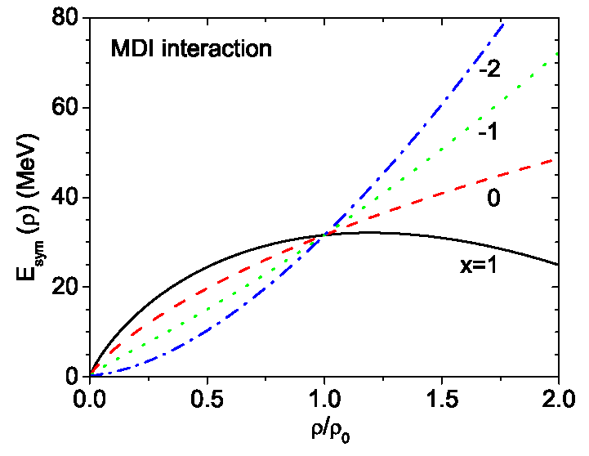
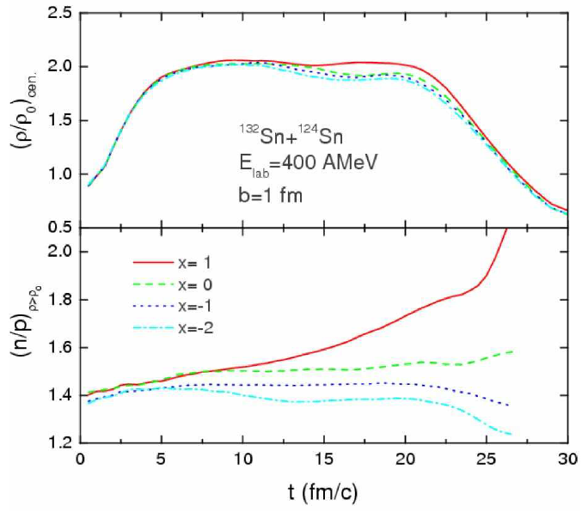
Symmetry energy studies at ρ≈2ρ₀
Densities of ρ≈2ρ₀ can be achieved at E/A ≈400 MeV.
  Provides information about direct URCA cooling in proto-neutron stars, stability and phase transitions of dense neutron star interior.
  Stronger (stiffer) density dependence of symmetry energy expels more neutrons from densest region. Since π⁻ originates from n-n collisions and π⁺ originates from p-p collisions, this reduces the π⁻/ π⁺ spectral ratio
B-A Li
stiffer
larger π⁻/π⁺
softer
R
smallerπ⁻ /π⁺

Slide 15
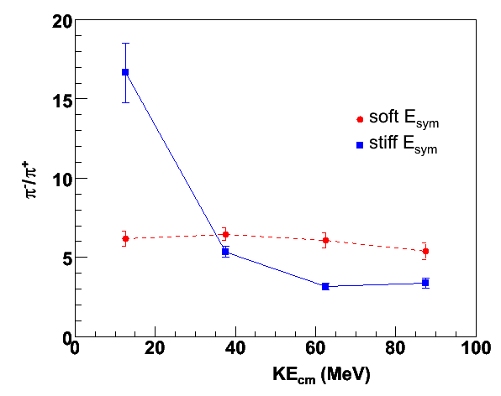
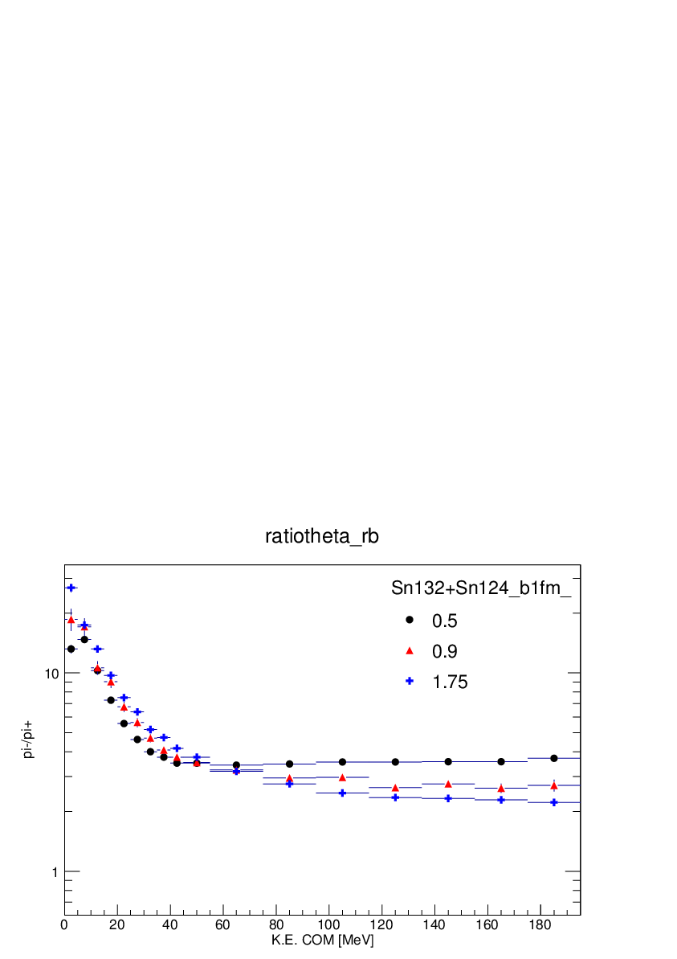
Probing ρ>ρ₀ via pion production
E/A =120 MeV
E/A = 300 MeV
¹²⁴Sn+¹²⁴Sn
E_{lab}=120 MeV/A
b = 1fm
Coulomb and
optical potential
=
Bickley et al., private comm. (2009)
J. Hong, P. Danielewicz, private commicatons (2013)
Y(π ⁻ )/Y(π ⁺ )
Y(π ⁻ )/Y(π ⁺ )
more n-n than p-p collisions for soft Symmetry energy
Pion ratio depends strongly on the symmetry energy.
Ratios of spectra are more sensitive than ratios of integrated yields.
  Integrated yields at E/A≥400 MeV suggest soft symmetry energy at ρ≥2.5ρ₀ (Xiao PRL, 102, 062502 (2009)
Built two TPC’s to probe these observables
  E/A<150 MeV at MSU and E/A=200-350 MeV at RIKEN (probes ρ≈2ρ₀).
Notes:
Looking forward to probing higer densities, we would like to explore pion production. We follow a suggestion of BAL that the ratios of pion- to pi+ spectra are of the order of 5 times more sensitive to the symmetry energy than the ratio of the integrated pi+ to pi- yield, that that is true because the shape of these two spectra and how they depend on the symmetry neregy are very different. we should this ratio at two incident energies and we see factors of three diffrence inhe ratios at low energies that flip sign at higher energies. THis is an easily measurable effect.

Slide 16
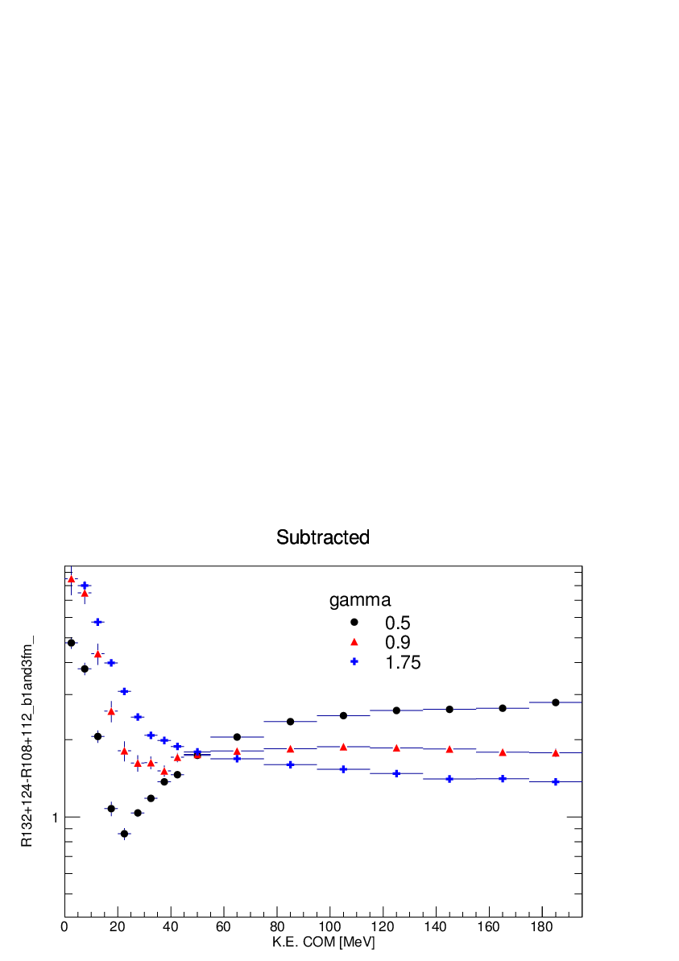
Difference between ¹³²Sn+ ¹²⁴Sn and ¹⁰⁸Sn+ ¹¹²Sn collisions
E/A =120 MeV
E/A = 300 MeV
¹²⁴Sn+¹²⁴Sn
E_{lab}=120 MeV/A
b = 1fm
Y(π ⁻ )/Y(π ⁺ )
Bickley et al., private comm. (2009)
J. Hong, P. Danielewicz, private commicatons (2013)
Y(π ⁻ )/Y(π ⁺ )₁₃₂₊₁₂₄ - Y(π ⁻ )/Y(π ⁺ )₁₀₈₊₁₁₂
Pion ratio depends strongly on the symmetry energy.
Ratios of spectra are more sensitive than ratios of integrated yields.
  Integrated yields at E/A≥400 MeV suggest soft symmetry energy at ρ≥2.5ρ₀ (Xiao PRL, 102, 062502 (2009)
Built two TPC’s to probe these observables
  E/A<150 MeV at MSU and E/A=200-350 MeV at RIKEN (probes ρ≈2ρ₀).
Notes:
Looking forward to probing higer densities, we would like to explore pion production. We follow a suggestion of BAL that the ratios of pion- to pi+ spectra are of the order of 5 times more sensitive to the symmetry energy than the ratio of the integrated pi+ to pi- yield, that that is true because the shape of these two spectra and how they depend on the symmetry neregy are very different. we should this ratio at two incident energies and we see factors of three diffrence inhe ratios at low energies that flip sign at higher energies. THis is an easily measurable effect.

Slide 17
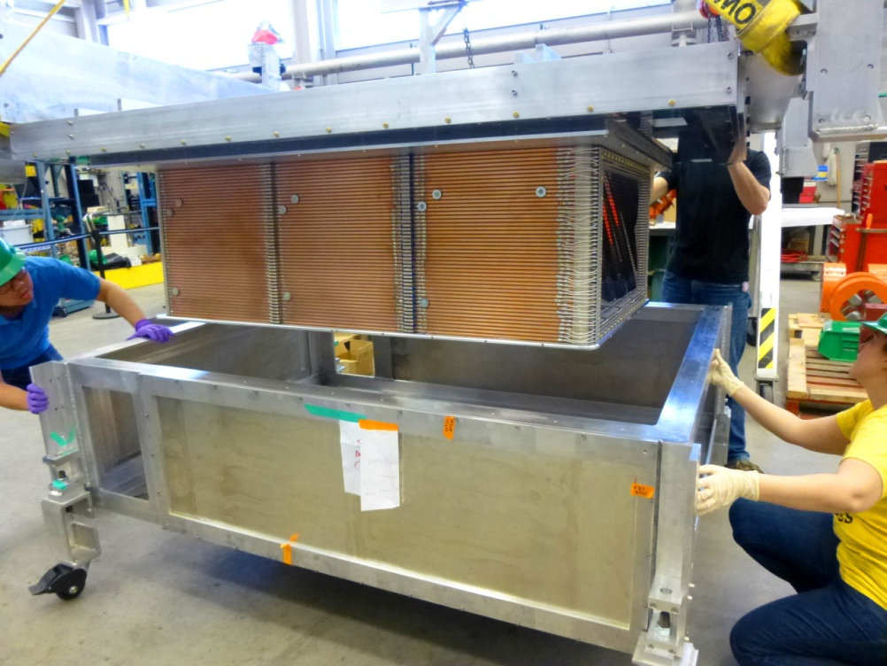
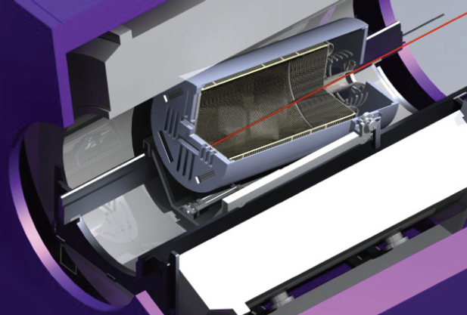
Time Projection Chambers : SAMURAI TPC and AT-TPC
SAMURAI TPC
Active Target -TPC
SAMURAI TPCv
AT/TPC @MSU
U.S./Japan collaboration
  Uses SAMURAI dipole
  Recently completed (2013)
  Measure π ⁺, π ⁻, t, ³He, n, p
U.S. Collaboration (NSF MRI)
  Solenoidal (MRI) magnet
  Recently completed (2013)
  Measure π ⁺, π ⁻, t, ³He, n, p
Notes:
So we have been developing two tpc’s to do these measurements. One will be used at RIKEN in the SAMURAI dipole and the other wllle be sued at NSCL/FRIB in a solenoidal MRI style magnet. THe latter is also intended for dual use as an active target, i,e, the TPC gas will be target. BOth will be finished this year and will be commissioned int 2014

Slide 18
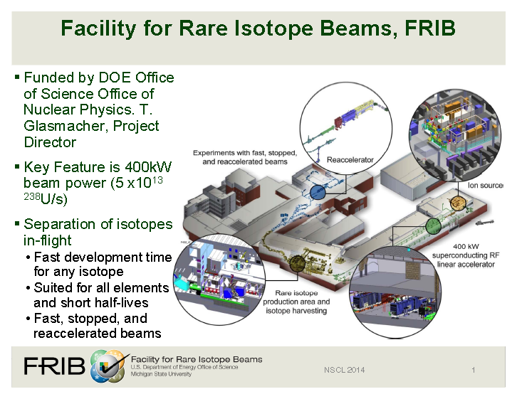
Most significant new N.P. investment in the U.S.

Slide 19
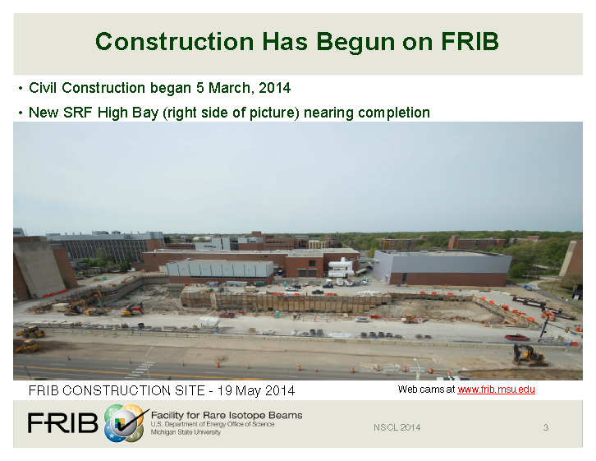

Slide 20
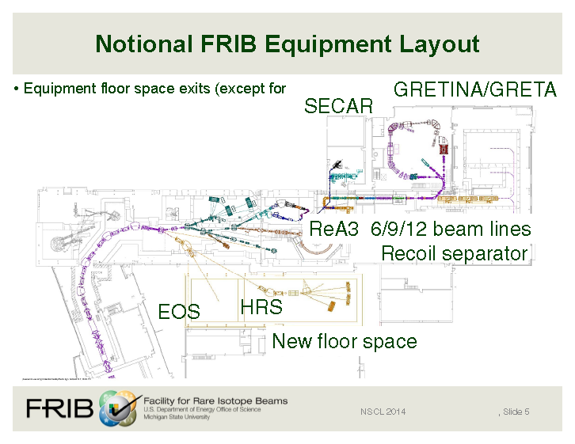
Space: The Final Frontier
exists
High Rigidity Spectrometer will allow efficient high resolution analysis of most neutron rich fragments without degrading ⇒significant luminosity gains

Slide 21
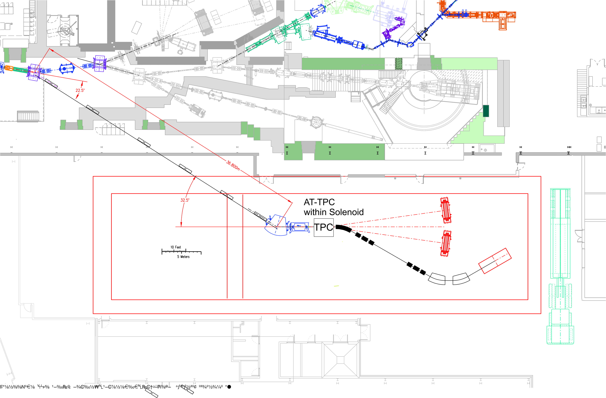
Two Configurations for High Rigidity Vaults
TPC
Configuration A
Configuration B
Configuration A
  Allows standalone operation and more flexible arrangements and higher angular coverage.
  pion production and flow
  n-p, t, ³He, fragment (IMF) spectra and flows
  Fragmentation studies, very low density (neutrino-sphere EOS)
Configuration B
  Allow some of the studies of configuration but with reduced efficiency.
  Allows GMR studies in active target mode
  Allows d,2He) excitations of Gamow-Teller and Spin Dipole resonances
  five week typical switchover times between major configurations

Slide 22
Summary and Outlook
We have some initial constraints on the symmetry energy .
We expect progress in a number of areas.
  Successful PREX and CREX experiments will contribute significant constraints on ΔR_{n-p}.
  Additional constraints at low densities from Isospin Diffusion (in the next year).
  Addition measurements of GMR on isotopic chains will provide values for K_{τ} over a range of nuclei.
    AT-TPC will extend these studies to unstable nuclei at extreme asymmetry
  New results for n/p, t/³He spectra and flows will allow constraints on the effective mass splitting and density dependence of the symmetry energy.
  New results for π⁻ π⁺ spectra and flows will provide sensitivity to the symmetry energy at supra-saturation densities
This is a critical time to prepare for a vital research program on the symmetry energy with rare isotope beams at FRIB and other new facilities, such as Fair and Spiral2.

