Slide 1

Wasa-at-COSY
Dibaryons
in vacuum and in nuclear matter
Mikhail Bashkanov

Slide 2
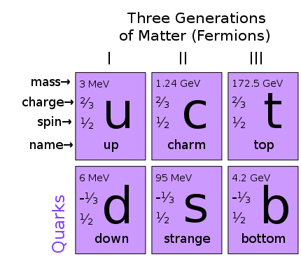
Types of particles/resonances
Meson
Baryon
white
color
anticolor

Slide 3
Possible particles
Tetraquark
Meson-Meson molecule
Dibaryon
Baryon-Baryon molecule
Pentaquark
Meson-Baryon molecule
Do they exist ? ? ?

Slide 4
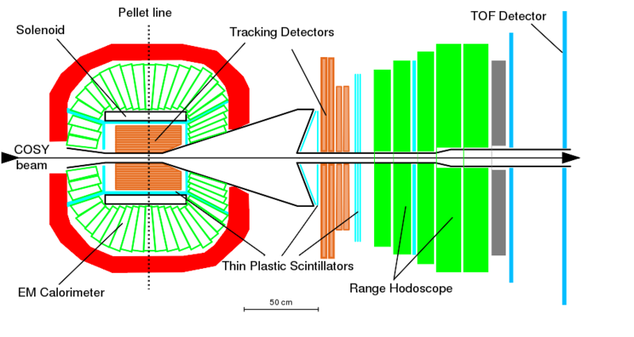
WASA 4π Detector
$$pn→dibaryon→dπ^{0}π^{0}$$
π
γ
γ
p
d
n
γ
γ
π

Slide 5
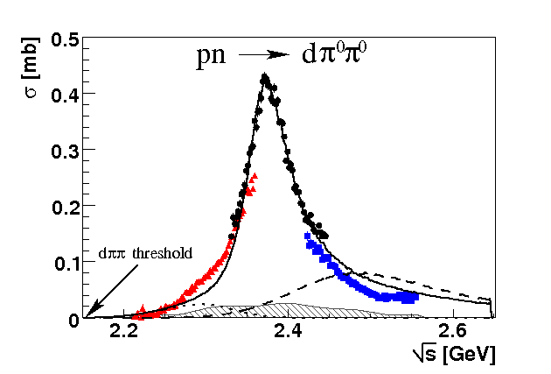

The dibaryon footprint
$$pn→dibaryon→dπ^{0}π^{0}$$
d* dibaryon
Γ∼70 MeV
ΔΔ
NN*(1440)
Phys. Rev. Lett. 106:242302, 2011

Slide 6
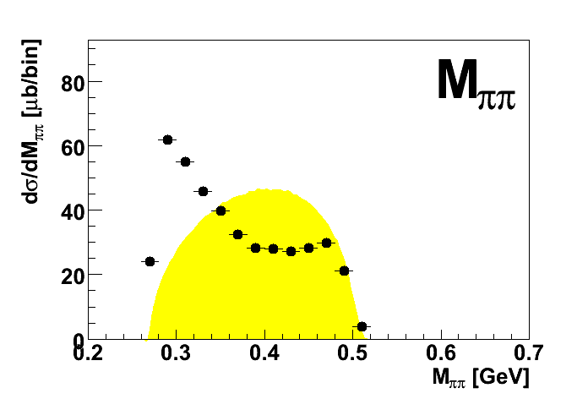
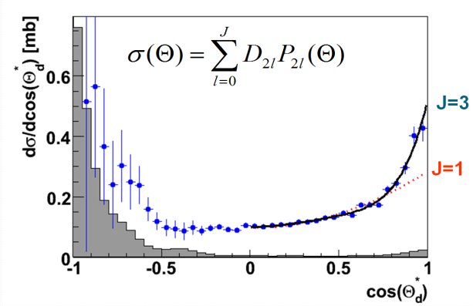
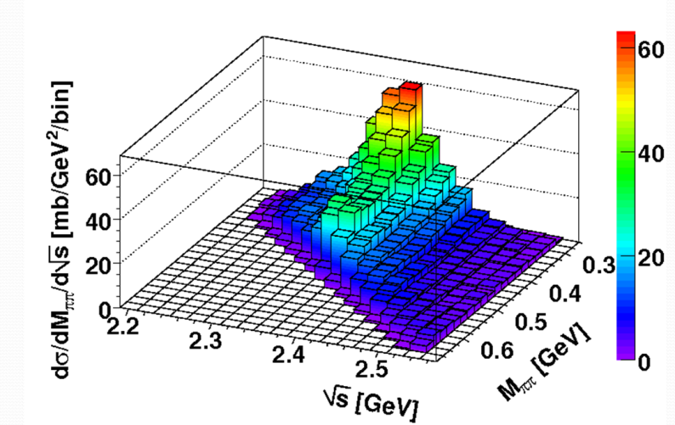
Pieces of Evidence

Slide 7
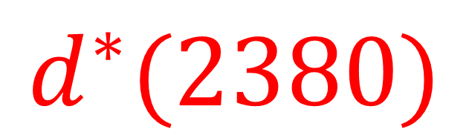
The extracted properties of the new particle
$$d^{∗}(2380)$$
pn → dibaryon → ΔΔ → dπ⁰π⁰
p
Δ
π
d
n
Δ
π
I(J^{p}) = 0(3⁺)
$$M_{d^{∗}}=2.38 GeV≈2M_{Δ}−90 MeV$$
$$Γ_{d^{∗}}=70 MeV≪Γ_{ΔΔ}=240 MeV$$

Slide 8

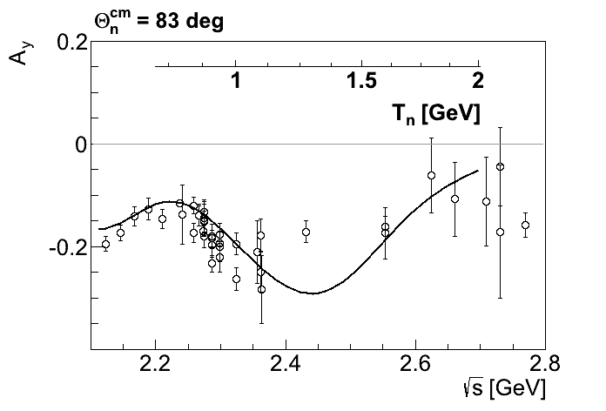
p
p
n
n
SAID

Slide 9
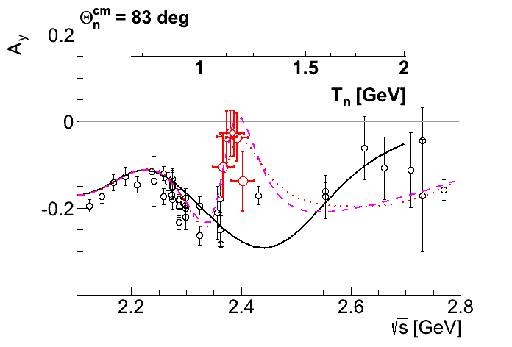
p
p
n
n
SAID
New SAID
solutions
P. Adlarson et al. Phys. Rev. Lett. 112, 202301, (2014)

Slide 10
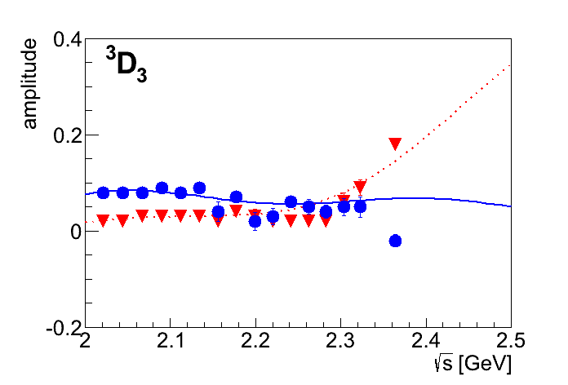
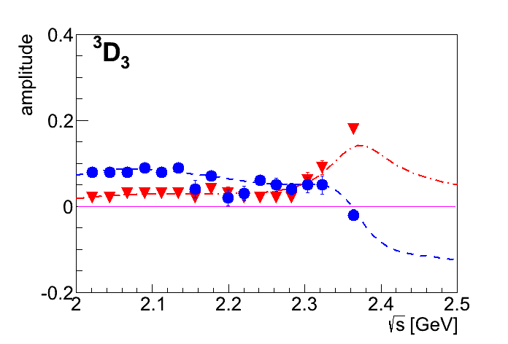


Dimensionless partial wave amplitudes
Pole at $(2380±10)−i(40±5) MeV$
Old
New
Im
Re
$${}_{}^{3}{D_{3}}$$
Resonance in the pn system
P. Adlarson et al. Phys. Rev. Lett. 112, 202301, (2014)

Slide 11
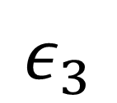
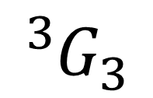
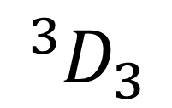
Dimensionless partial wave amplitudes
Pole at $(2380±10)−i(40±5) MeV$
Dimensionless partial wave amplitudes
Im
SP14
SP07
Re
$${}_{}^{3}{D_{3}}$$
$$ε_{3}$$
$${}_{}^{3}{G_{3}}$$
Resonance in the pn system
P. Adlarson et al. Phys. Rev. Lett. 112, 202301, (2014)

Slide 12
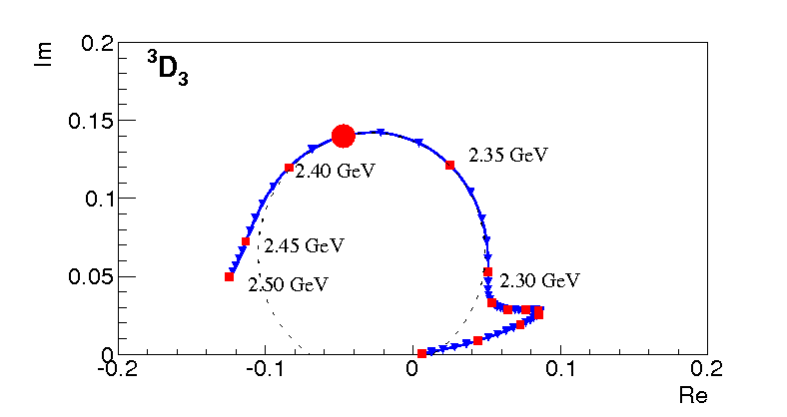
Argand plot
P. Adlarson et al. Phys. Rev. Lett. 112, 202301, (2014)

Slide 13
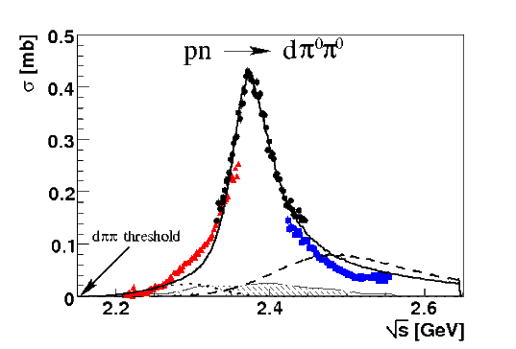
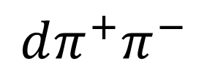
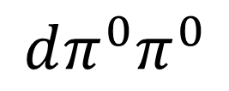
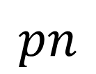
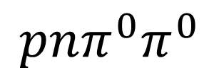
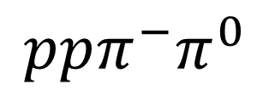
Dibaryon hadronic decays
$$dπ^{0}π^{0}$$
$$dπ^{+}π^{−}$$
pn → dibaryon
$$ppπ^{−}π^{0}$$
$$pn$$
$$pnπ^{0}π^{0}$$

Slide 14
The decay modes of the dibaryon
Channel | Publications
d π⁰π⁰ | M. Bashkanov et. al Phys.Rev.Lett. 102 (2009) 052301 P. Adlarson et. al Phys. Rev. Lett. 106:242302, 2011 P. Adlarson et. al Phys.Lett. B721 (2013) 229-236
d π⁺π⁻ | P. Adlarson et. al Phys.Lett. B721 (2013) 229-236
ppπ⁰π⁻ | P. Adlarson et. al Phys. Rev. C 88, 055208
npπ⁰π⁰ | + In work
np | A. Pricking, M. Bashkanov, H. Clement. arXiv:1310.5532 P. Adlarson et al. Phys. Rev. Lett. 112, 202301, (2014)
pn e⁺e⁻ | M. Bashkanov, H. Clement arXiv:1312.2810 submitted to EPJ
³He ππ | M. Bashkanov et. al Phys.Lett. B637 (2006) 223-228 E. Perez PhD thesis
⁴He ππ | P. Adlarson et. al Phys.Rev. C86 (2012) 032201
+ activities from other groups
M. Bashkanov, Stanley J. Brodsky, H. Clement Phys.Lett. B727 (2013) 438-442

Slide 15
The family of dibaryons

Slide 16
Predictions of I(J^{p}) = 0(3⁺) state
F. J. Dyson, N-H Xuong Phys. Rev. Lett. 13(1964) 815
  first prediction
T. Goldman, et al, Phys. Rev. C 39, 1889 (1989)
  “d*”, “inevitable dibaryon”
T. Kamae and T. Fujita, Phys. Rev. Lett. 38, 471 (1977)
  deuteron photodisintegration
A. Gal, H. Garcilazo Phys.Rev.Lett. 111 (2013) 172301
  Faddeev-Yakubovsky calculations
H. Huang, J. Ping, F. Wang, Phys. Rev. C 89, 034001 (2014)
  Quark model

Slide 17
Mirror dibaryon
d*
I(J^{p}) = 0(3⁺)
I(J^{p}) = 3(0⁺)
Δ
Δ
Δ
Δ
u
u
u
d
d
d
u
u
u
u
u
u
Freeman J. Dyson, Nguyen-Hue Xuong Phys. Rev. Lett. 13(1964) 815
Avraham Gal, Humberto Garcilazo arXiv:1401.3165 (2014)

Slide 18
Ultimate QCD states
Maximum Spin
Maximum color
u
u
u
d
d
d
u
u
u
u
u
u
RED:
d
u
u
u
u
d
GREEN:
u
u
u
d
BLUE:
u
u

Slide 19
How many ways can you combine 6q?
Isospin
6d
6u
Mirror dibaryons
d*
3u3d
Strangeness
2u+3d+s
3d3s
6s

Slide 20
Dibaryons
a paradigm shift in our understanding of nuclear matter

Slide 21

Nuclear matter at high density
d*
n
p

Slide 22
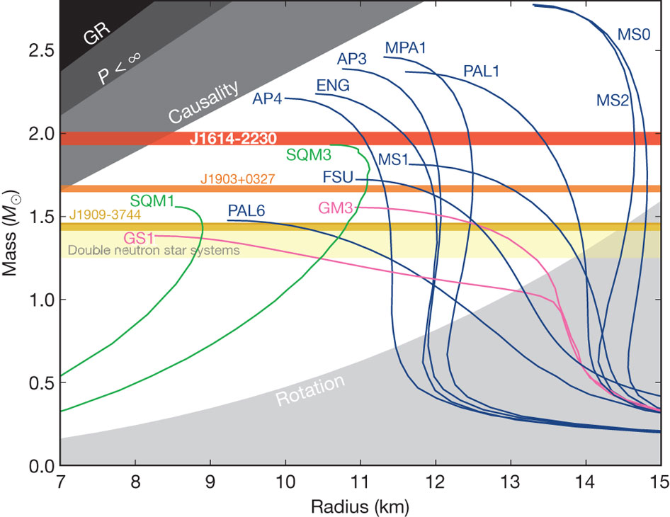
Neutron Stars: Equation of State
P.B. Demorest et. al, Nature 467, 1081–1083 (2010)

Slide 23
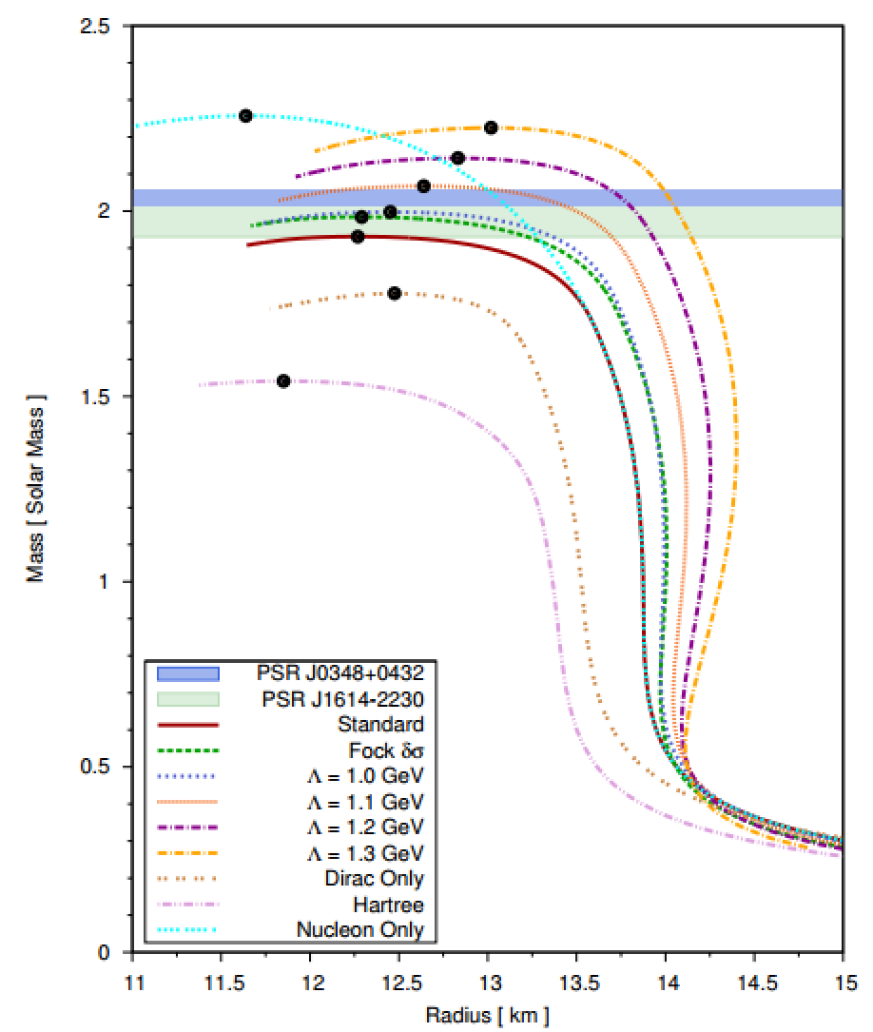
Neutron Star EoS and dibaryons
Mass
Radius
Lifetime
A. W. Thomas, et al. EPJ Web of Conferences, 63, (2013), 03004

Slide 24
Dibaryons in nuclear matter
Size?
Structure?
Medium modifications?
Strength?

Slide 25
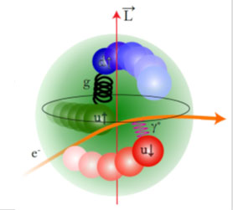
Size and internal structure
e⁺
γ
e⁻
d*
d
d
Charge distribution
Internal Structure

Slide 26

Total cross section dd → ⁴Heπ⁰π⁰
$$σ [μb ]$$
n
p
Δ
π
Preliminary
He
n
Δ
π
p
P. Adlarson et. al., Phys.Rev. C86 (2012) 032201

Slide 27
Trivial medium modifications
Fermi smearing
Collision damping
p
n
p
N
N
n
N
Δ
n
4-body forces
p
Δ
π
He
N
n
Δ
Δ
π
p
p
n
Δ
N

Slide 28
Total cross section dd → ⁴Heπ⁰π⁰
$$σ [μb ]$$
n
p
Δ
π
Preliminary
He
n
Δ
π
p
P. Adlarson et. al., Phys.Rev. C86 (2012) 032201

Slide 29
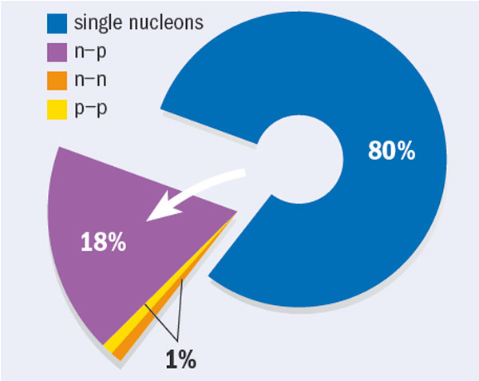
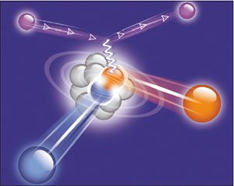
Two-nucleon knockout
γ
p
n
n
p
R.Subedi et al. Science, 320, 1476, (2008)

Slide 30
Two-nucleon knockout
γ
p
d*
n
n
p
Short Range Correlations - SRC

Slide 31
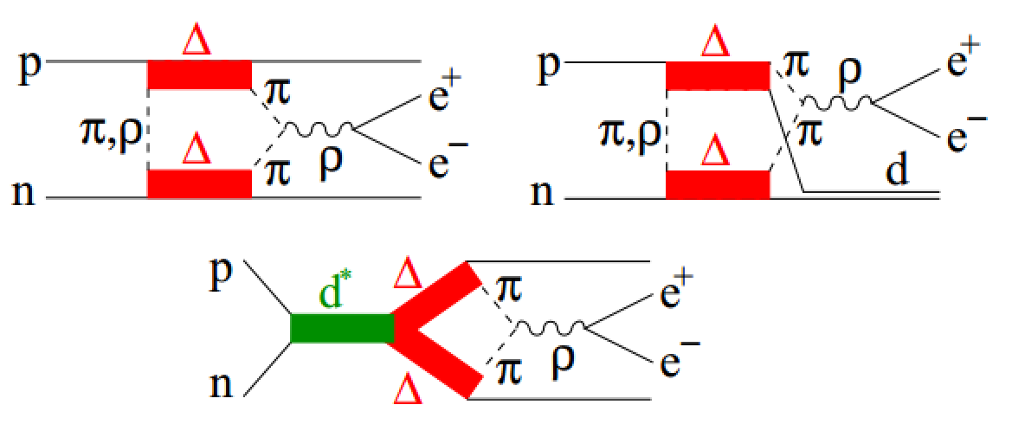
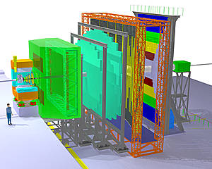
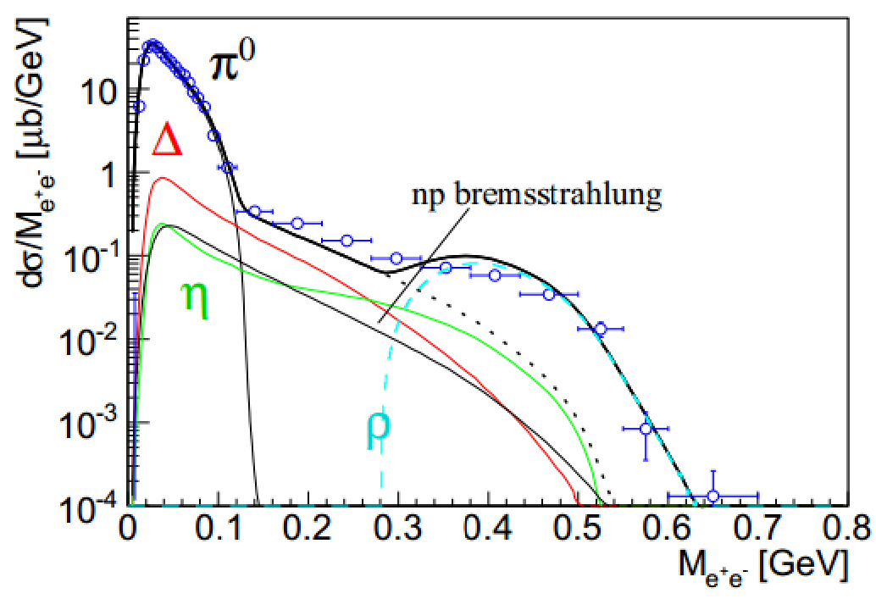
Cold Baryonic Matter
DLS puzzle
Dibaryons as a probes of
“cold hadronic soup”
M. Bashkanov, H. Clement, Eur. Phys. J. A50, 107, (2014)

Slide 32
Dibaryons – a new state of matter
Discovery of dibaryon:
  Establish the size and structure of dibaryons
  Test fundamental aspects of QCD
  Understanding of the true nature of the NN, 3N, 4N forces in nuclei
  Dibaryons Multiplets/Mirror states
Implications
  Nuclear equation of state
  Astrophysics – compact stellar objects, black holes, …
  Heavy ion collisions, …
    An exciting new era of discovery for nuclear, particle and astrophysics !

Slide 33
Thank you

Slide 34
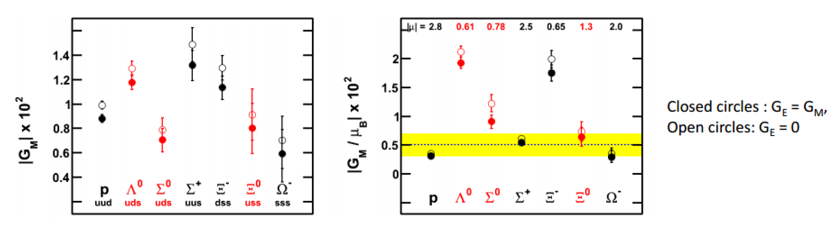
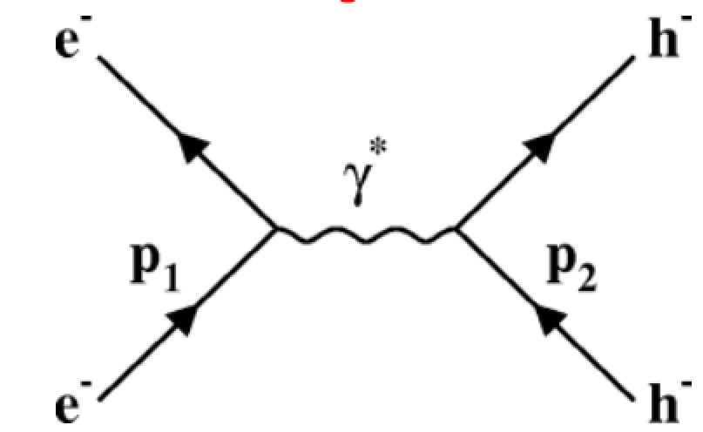
Space-like Form Factors
Diquark correlations
Dibaryon form factor
Diquarks
“Missing baryons”
K. Seth, Baryon 2013

Slide 35
Neutron-proton decay of dibaryon !
p
p
n
n
SAID new solution
n
p
Phys. Rev. Lett. 112, 202301, (2014)
SAID previous solution
pole (2380±10 - i40±5) MeV

Slide 36
pn Vector Analysing Power
A_{y}
SAID new solution: pole (2380±10 - i40±5) MeV
SAID SP07 fit

Slide 37
Total pn cross-section
Devlin et al, PRD8, 136 (73)
LisowskI et al, PRL49, 255(82)
SAID SP07
SAID new solution

Slide 38
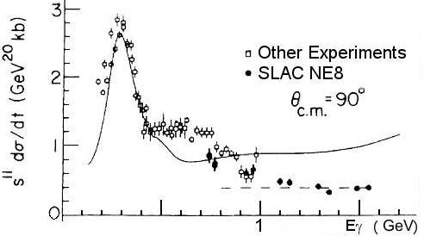
Hints in deuteron photodisintegration
γ
p
d
n
S.J. Freedman et al., Phys. Rev. C48 1864 (1993)
Federico Ronchetti
arXiv 1301.5886
d*
Could the dibaryon be the cause of a decades old puzzle in the disintegration
of the simplest nucleus?

Slide 39
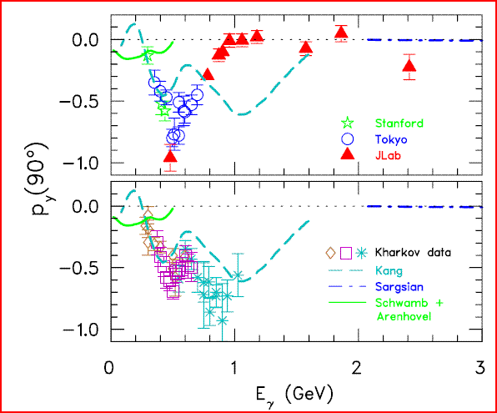

Further hints..!
R. Gilman and F. Gross nucl-th/0111015 (2001)
d*
γ
p
T. Kamae, T. Fujita Phys. Rev. Lett. 38, Feb 1977, 471
d
n
H. Ikeda et al., Phys. Rev. Lett. 42, May 1979, 1321
I(J^{p}) = 0(3⁺)
$$M=2.38 GeV$$

Slide 40
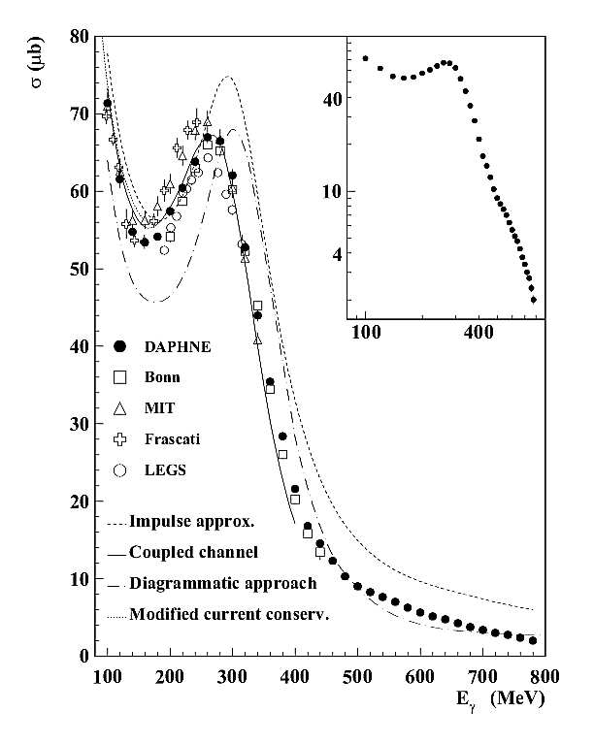
Deuteron photodisintegration
γ
p
d
n
d*
Federico Ronchetti
arXiv 1301.5886

Slide 41
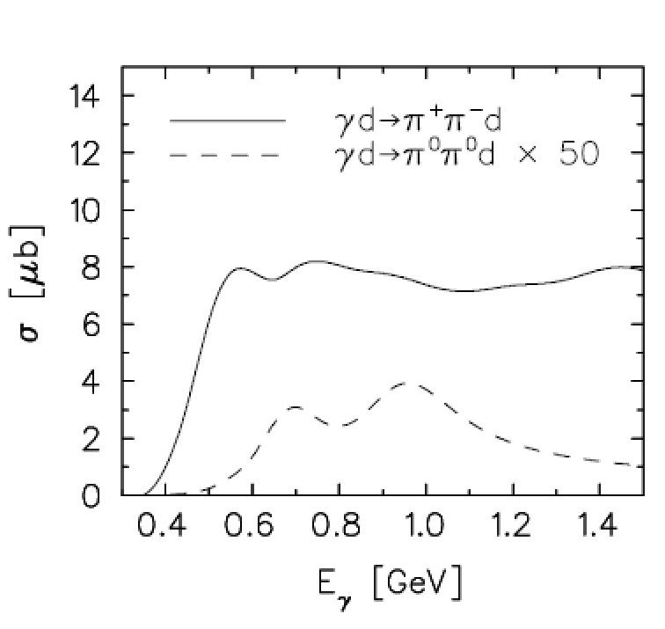

$$γd→dπ^{0}π^{0}$$
γ
Δ
π
d
d
Δ
π
γ
Δ
π
d
d
Δ
π

Slide 42
Status of the d* Resonance
decay channel branching status
------------------------------------------------------------------------
d π⁰π⁰ 15 % observed
d π⁺π⁻ 25 % observed
ppπ⁰π⁻ 7 % observed
npπ⁰π⁰ (12 %, predicted*) observed
npπ⁺π⁻ (31 %, predicted*) HADES
np (10 %, predicted) observed
* Fäldt & Wilkin, PLB 701 (2011) 619
Albaladejo & Oset, Phys.Rev. C88 (2013) 014006

Slide 43
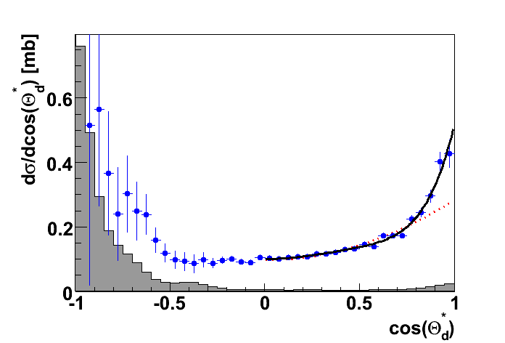
Angular distribution in the peak
J=3
J=1

Slide 44
Angular distribution in the peak
J=3 (3D3)
J=1 (3D1)
Quantum numbers I=0, J=3

Slide 45
Quantum numbers of the structure
pn → d* → ∆∆→ d π⁰π⁰
  Antisymmetrization: J^{p}=1⁺or 3⁺ : if L_{ΔΔ}=0
1⁺
1⁺ excluded by σ(Θ).
3⁺ assigned
3⁺
pn → d π⁰π⁰
I=0
I=0,1
I=0
I=0,2

Slide 46
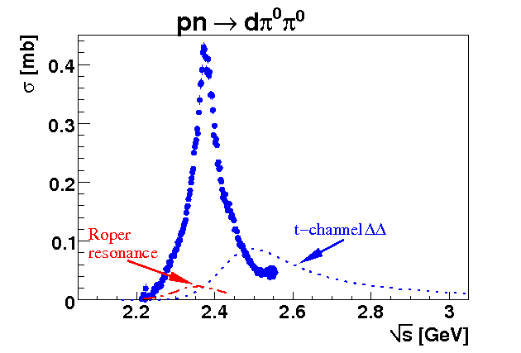
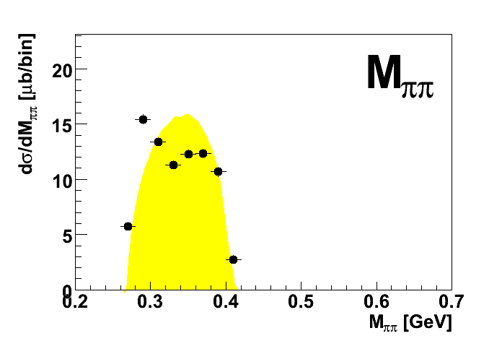
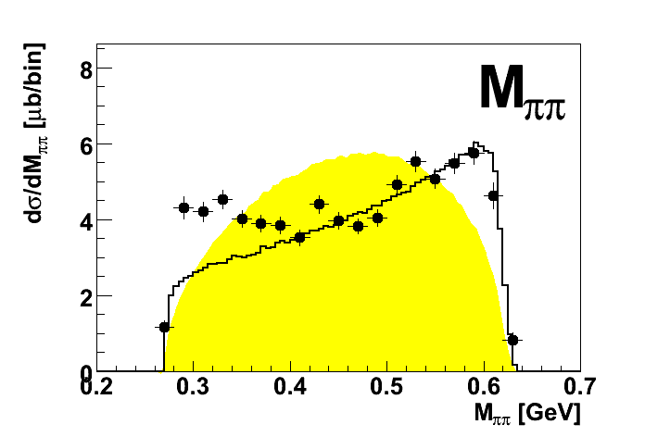
M_{ππ} for different energies
t-channel ΔΔ
“ABC effect”

Slide 47
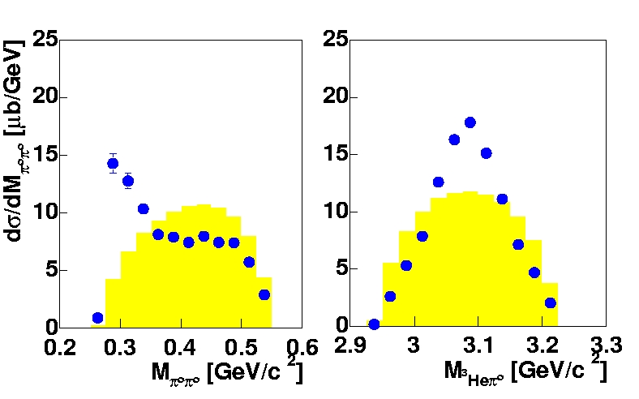
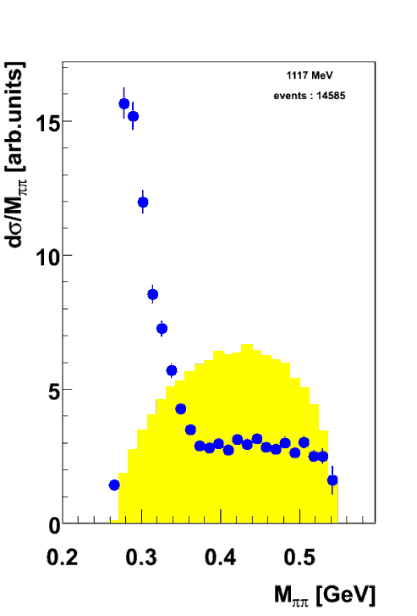
History of the ABC effect
Low mass enhancement in M_{ππ}
P. Adlarson et. al, Phys. Rev. Lett. 106 (2011) 242302
M.Bashkanov et. al, Phys. Lett. B637 (2006) 223-228
P. Adlarson et. al, Phys. Rev. C86 (2012) 032201
Alexander Abashian, Norman E. Booth Kenneth M. Crowe, Phys. Rev. Lett. 5, 258 (1960)

Slide 48
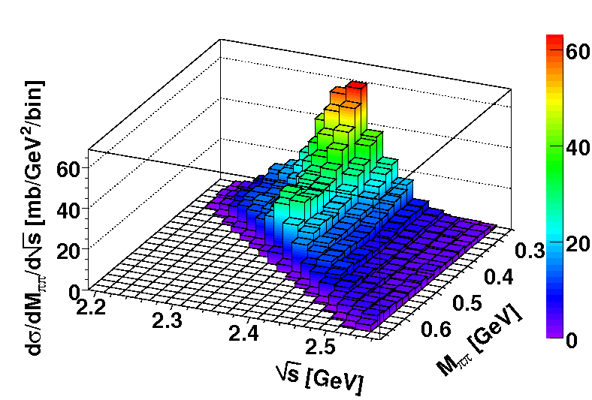
3D x-section

Slide 49
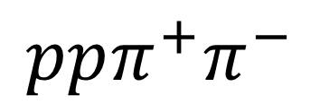
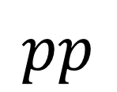
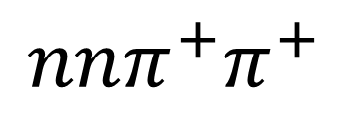
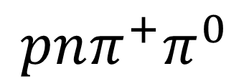
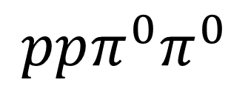
Two-pion production
“σ”
N*
$$ppπ^{+}π^{−}$$
$$ppπ^{0}π^{0}$$
N*
Δ
$$pp$$
$$pnπ^{+}π^{0}$$
Δ
$$nnπ^{+}π^{+}$$
Δ
Δ(1600)
Δ
T_{p} < 1.5 GeV

Slide 50
Isospin Decomposition
N*(1440)
ΔΔ
Δ(1600)
T. Skorodko et al.,
PLB 679 (2009) 30

Slide 51
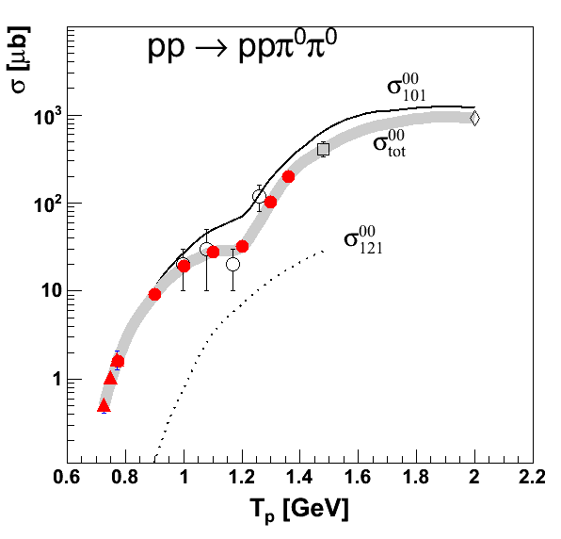
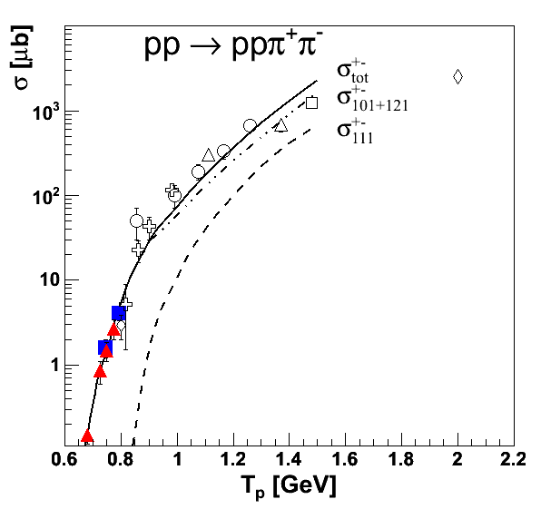


Isospin Decomposition
N*(1440)
ΔΔ
[Δ(1600)]
Skorodko at al., Phys. Lett. B679 (2009) 30

Slide 52


Total cross section
pp→nnπ⁺ π⁺
(1600)

Slide 53

Total cross section

Slide 54




Total cross section pN → dππ
I=1
$$σ\left[pn→dπ^{+}π^{−}\right]=\frac{1}{2}σ\left[pp→dπ^{+}π^{0}\right] \\ +2σ\left[pn→dπ^{0}π^{0}\right]$$
$$dπ^{+}π^{−}$$
I=0
$$\frac{1}{2}∙dπ^{+}π^{0}$$
$$2∙dπ^{0}π^{0}$$
P. Adlarson et. al Phys. Lett. B721 (2013) 229

Slide 55

Isospin relations
I=1
$$σ\left[pn→dπ^{+}π^{−}\right]=\frac{1}{2}σ\left[pp→dπ^{+}π^{0}\right] \\ +2σ\left[pn→dπ^{0}π^{0}\right]$$
I=0

Slide 56
Total cross section pp → dπ⁺π⁰
Shimizu et al.
F. Kren et al.

Slide 57
Total cross section pn → dπ⁰π⁰

Slide 58
Total cross section pn → dπ⁺π⁻

Slide 59
Total cross section pn → dπ⁺π⁻

Slide 60
M_{ππ} in pN → dππ

Slide 61
M_{ππ} in pN → dππ

Slide 62
M_{ππ} in pN → dππ

Slide 63

Isospin violation
π⁰π⁰
π⁺π⁻

Slide 64

pn → ppπ⁻π⁰
Conventional process +d*
ΔΔ
Conventional process
d* “expected”

Slide 65
pn → pnπ⁰π⁰
ΔΔ
d*
Conventional process

Slide 66








Beam polarization
$$P_{ZZ}$$
$$+1$$
Polarization 2
Polarization 1
$$−2/3$$
0
$$+2/3$$
$$−1$$
$$+1$$
$$P_{Z}$$
$−$2

Slide 67

pn Vector Analysing Power
SAID SP07 fit

Slide 68

pn Vector Analysing Power
SAID new solution: pole (2380±10 - i40±5) MeV
SAID SP07 fit

Slide 69
pn Vector Analysing Power
SAID new solution
SAID SP07 fit
pole (2380±10 - i40±5) MeV

Slide 70
pn Vector Analysing Power
SAID new solution
SAID SP07 fit
pole (2380±10 - i40±5) MeV

Slide 71
Kinematics
dp→np + p_{sp}
neutron
Proton spectator
proton

Slide 72
Total pn cross-section
Devlin et al, PRD8, 136 (73)
LisowskI et al, PRL49, 255(82)
SAID SP07
SAID new solution

Slide 73
Total cross section dd → ⁴Heπ⁰π⁰
Preliminary

Slide 74


M_{π}0_{π}0
Td=1117 MeV

Slide 75

pd→³Heππ, T_{p}=0.89 GeV
(I=0,1)
(I=0)
M.Bashkanov et. al,
Phys. Lett. B637 (2006) 223-228

Slide 76

ΔΔ resonance in differential distributions
pd→³Heππ
Δ
π
Δ
π
+
Δ
π
π
Δ
Δ
π
Δ
π
q_{ΔΔ} ∼ q_{ππ}
Parameter of F(q) is fitted here

Slide 77
Dalitz plots
Peak
Outside
Data
MC

Slide 78

DLS puzzle
Strong dilepton enhancement over hadronic coctails

Slide 79


HADES results
e⁺e⁻ pair yield C+C, 1.25AGeV
PLB 690 (2010) 118

Slide 80


Large Isospin dependence
DLS : W.K Wilson et at. PRC57(1998)1865
η ω
$$\frac{pd}{pp}$$
Dilepton Yield Ratio
~2

Slide 81
Large Isospin dependence
DLS : W.K Wilson et at. PRC57(1998)1865
η ω
d*
~2

Slide 82


$$np→de^{+}e^{−}$$
B.V. Martemyanov, M.I. Krivoruchenko, A. Faesler, PRC84, 047601 (2011)

Slide 83

DLS puzzle
M. Bashkanov, H. Clement arXiv:1312.2810

Slide 84

DLS puzzle

Slide 85
Dyson‘s Multiplet Prediction

Slide 86
Dyson‘s Prediction
State I J Asymptotic Configuration m_{theor} [MeV] m_{exp} [MeV] Γ_{exp} [MeV]
---------------------------------------------------------------------------------------------------------------------------------
D₀₁ 0 1 Deuteron 1876 1876
D₁₀ 1 0 virtual ¹S₀ 1876 1878
D₁₂ 1 2 NN(¹D₂) ↔ ΔN ↔ NNπ 2160 2144 110
D₂₁ 2 1 ΔN ↔ NNπ 2160 ? ?
D₀₃ 0 3 NN(³D₃) ↔ ΔΔ ↔ NNππ 2350 2370 70
D₃₀ 3 0 ΔΔ ↔ NNππ 2350 ? ?
---------------------------------------------------------------------------------------------------------------------------------
√
√
√
√

