Slide 1

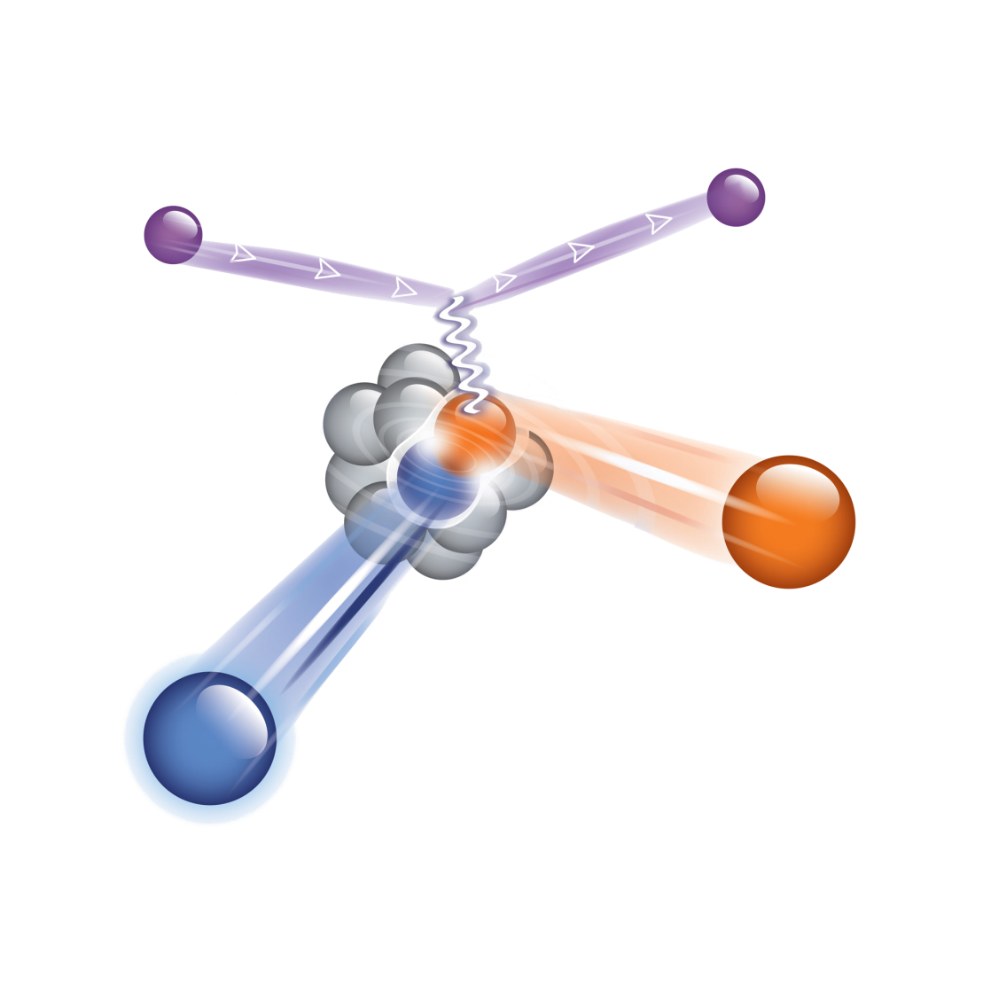
Short Range Correlation in Cold Atomic Gases and Nuclei
short-range correlations in N/Z asymmetric nuclei
neutron-proton momentum distributions
Two Fermions systems and the Contact term
SRC role in the nuclear equation of state
* short distance large momentum
description of nuclei
* New data on asymmetric nuclei
Two Fermions systems
and the Contact term
SRC and symmetry energy
Eli Piasetzky
Tel Aviv University ISRAEL

Slide 2

What are Short (intermediate) Range Correlations in nuclei ?
(tensor)
2N-SRC
SRC ~R_{N}
LRC ~R_{A}
~1 fm
≤1.f
1.7f
k_{F} ~ 250 MeV/c
High momentum tail:
300-600 MeV/c
1.5 K_{F} - 3 K_{F}
1.7f
1.7 fm
ρ_{o} = 0.16 GeV/fm³
Nucleons
In momentum space:
K ₁
A pair with large relative momentum between the nucleons and small CM momentum.
K ₁
K ₂
K ₁ > K_{F} ,
K ₂ > K_{F}
K ₂
Notes:
2

Slide 3
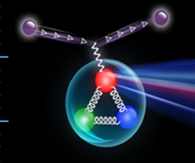
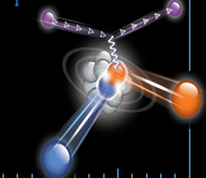
This long standing challenge for nuclear physics can experimentally be effectively addressed thanks to high energy and large momentum-transfer (hard scattering) reached by present facilities.
Hard processes
~1 fm
structure of nucleons
structure of nuclei
A(e,e’)
A(e,e’p)
A(e,e’pN)
DIS
A(p,p’pN)

Slide 4
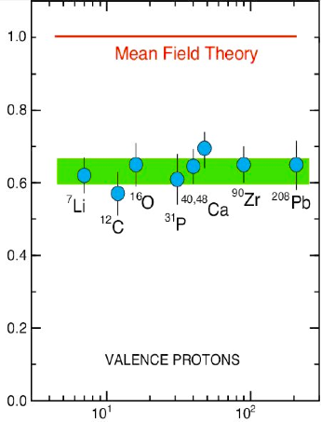
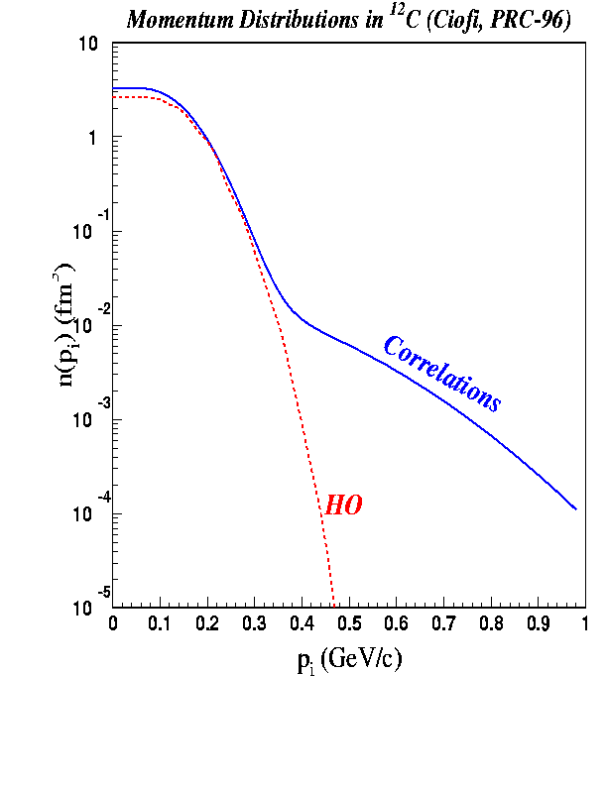
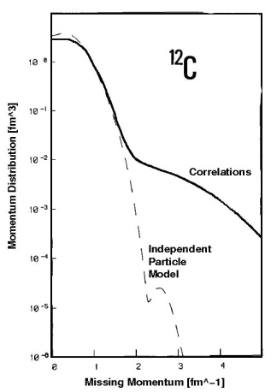
Spectroscopic
factors
for (e, e’p)
reactions
show only
60-70%
of the
expected
single-particle
strength.
L. Lapikas, Nucl. Phys. A553, 297c (1993)
Benhar et al., Phys. Lett. B 177 (1986) 135.
MISSING :
Correlations Between Nucleons
SRC and LRC
Notes:
4

Slide 5
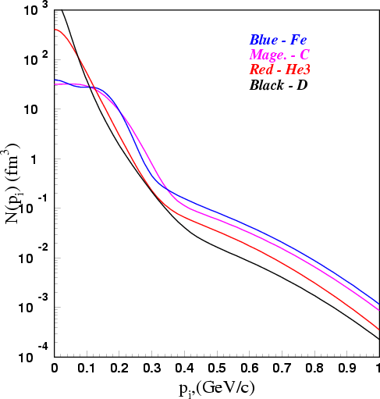
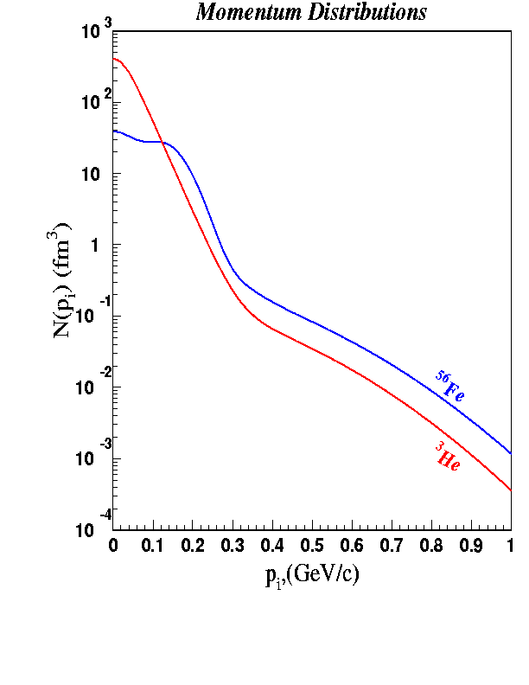
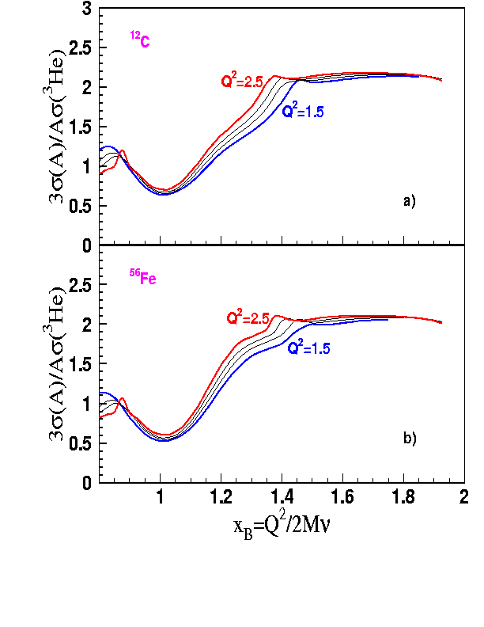
The inclusive A(e,e’) measurements
At high nucleon momentum
distributions are similar in shape for
light and heavy nuclei: SCALING.
  Can be explained by 2N-SRC dominance.
Adapted from
Ciofi degli Atti
  Within the 2N-SRC dominance picture one can get the probability of 2N-SRC in any nucleus, from the scaling factor.
In A(e,e’) the momentum of the struck proton (p_{i}) is unknown.
e
e/
p_{i}
q
But: For fixed high Q² and x_{B}>1, x_{B} determines a minimum p_{i}
Prediction by Frankfurt, Sargsian, and Strikman:

Slide 6
JLab. CLAS A(e,e') Result
K. Sh. Egiyan et al. PRC 68, 014313 (2003)
A₂(A/d)
K. Sh. Egiyan et al. PRL. 96, 082501 (2006)
³He | 2.08±0.01
⁴He | 3.47±0.02
Be | 4.03±0.04
C | 4.95±0.05
Cu | 5.48±0.05
Au | 5.43±0.06
“scaling”
For ¹²C 2N-SRC (np, pp, nn) = 20 ± 4.5%.
The probabilities for 3-nucleon SRC are smaller by one order of magnitude relative to the 2N SRC.
More r(A,d) data:
SLAC D. Day et al. PRL 59,427(1987)
JLab. Hall C N. Fomin et al.
PRL 108:092502, 2012.

Slide 7
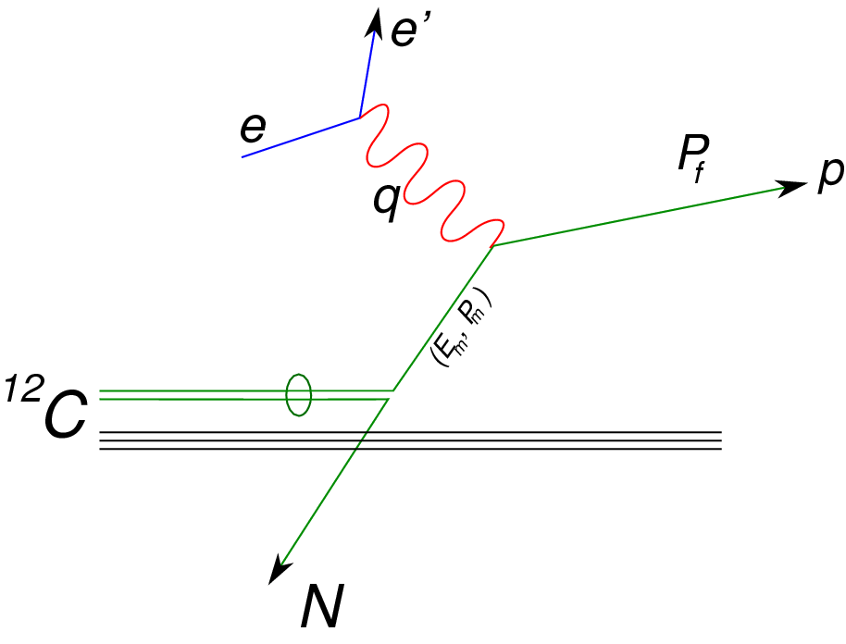
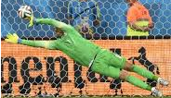



Quasi-Free scattering off a nucleon in a short range correlated pair
EVA / BNL
A triple – coincidence measurement
p
p
K ₁
p
n
E01-015 , E07-006 / Hall A
(CLAS/Hall B)
K ₂
JLab

Slide 8
R. Subedi et al., Science 320, 1476 (2008).
¹²C
BNL / EVA
¹²C(e,e’pn) / ¹²C(e,e’p)
There are 18 ± 5 times more np-SRC than pp-SRC pairs in ¹²C.
Why ?
[¹²C(e,e’pn) / ¹²C(e,e’pp)] / 2
[¹²C(e,e’pp) / ¹²C(e,e’p)] / 2

Slide 9
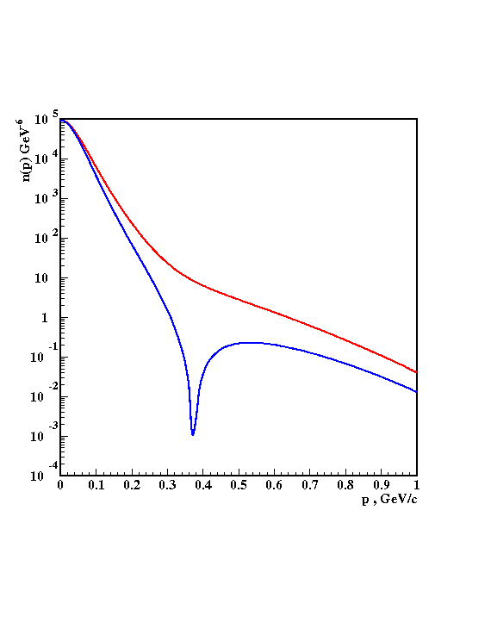
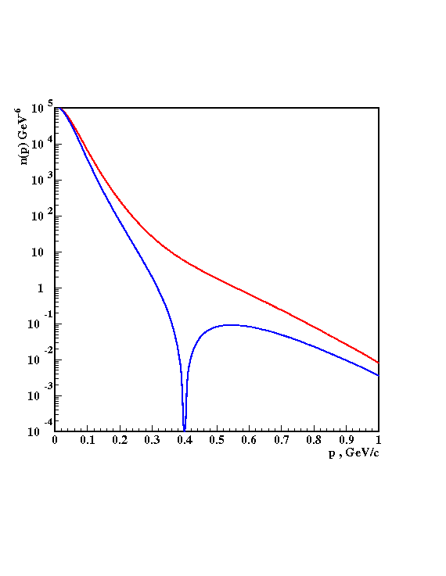
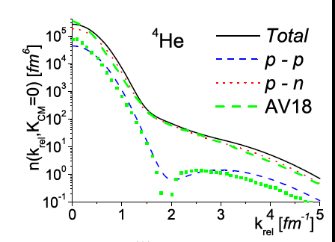
At 300-600 MeV/c there is an excess strength in the np momentum distribution due to the strong correlations induced by the tensor NN potential.
³He
³He
np
np
pn
pp
pp
pp
V18
Bonn
pp/np
Schiavilla, Wiringa, Pieper, Carson, PRL 98,132501 (2007).
³He
Ciofi and Alvioli
PRL 100, 162503 (2008).
Sargsian, Abrahamyan, Strikman, Frankfurt PR C71 044615 (2005).

Slide 10
Short distance structure of symmetric nuclei
1
The probability for a nucleon to have momentum ≥ 300 MeV / c in medium nuclei is ~25%
1
CLAS / HALL B
5
2
More than ~90% of all nucleons with momentum ≥ 300 MeV / c belong to 2N-SRC.
1
. PRL. 96, 082501 (2006)
Most of kinetic energy of nucleon in nuclei
is carried by nucleons in 2N-SRC.
2
4
3
Probability for a nucleon with momentum 300-600 MeV / c to belong to np-SRC is ~18 times larger than to belong to pp-SRC.
4
Dominant NN force in the 2N-SRC is tensor force.
PRL 98,132501 (2007).
The high momentum tail (300-600 MeV/c) is dominated by
L=0,2 S=1 np –SRC pairs.
2
EVA / BNL and Jlab / HALL A
3
Three nucleon SRC are present in nuclei. They contribute about an order of magnitude less than the 2N_SRC
5
PRL 162504(2006); Science 320, 1476 (2008).

Slide 11
Asymmetric Nuclei
N≠Z

Slide 12
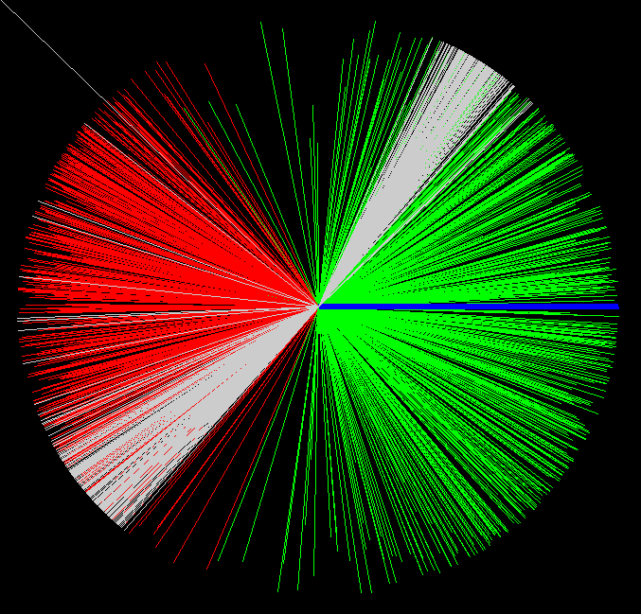
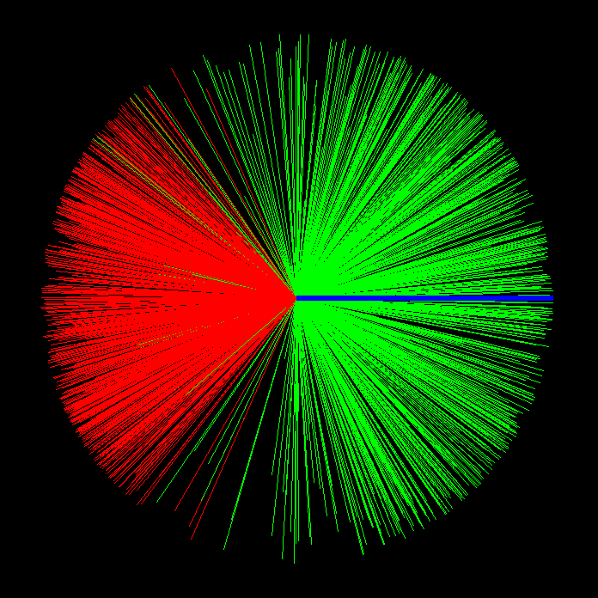
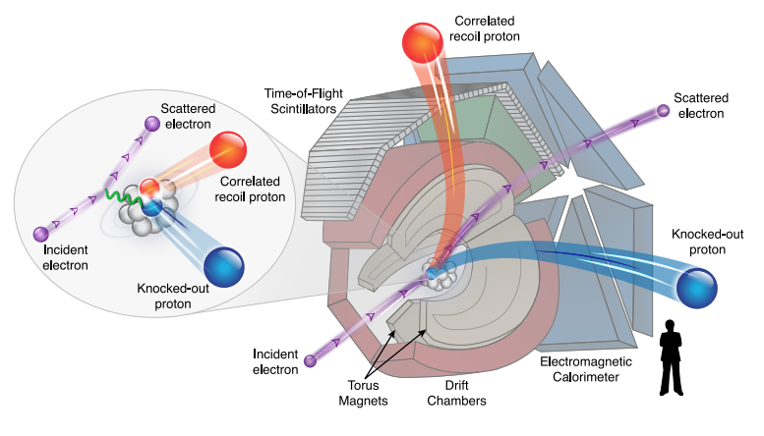
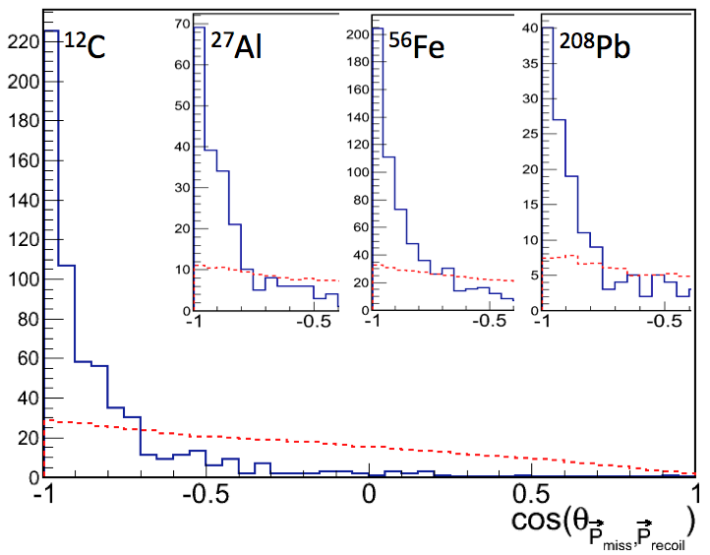
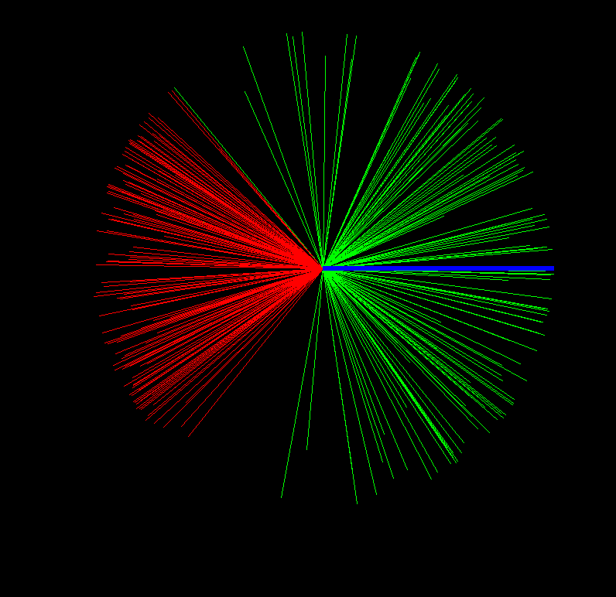
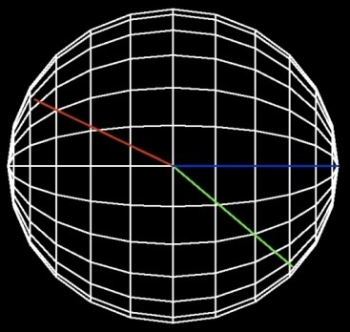
JLab / CLAS, Data Mining, EG2 data set
¹²C(e.e’pp)
P_{recoil}
⁵⁶Fe(e,e’pp)
P_{recoil}
q
q
P_{miss}
²⁰⁸Pb(e,e’pp)
pp-SRC events
q
Or Hen et al. submitted for publication
γ
Ein =5.014 GeV
P_{miss}
Q²>1.5GeV/c²
X>1.2

Slide 13

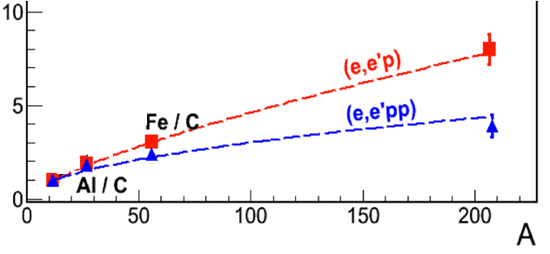

(e,e’p) and (e,e’pp) cross section ratios
pp-SRC
2N-SRC dominance
np –SRC pp-SRC
  ²⁰⁸Pb / ¹²C = 7.2±0.8
  ²⁰⁸Pb / ¹²C = 4.4 ± 0.35
np –dominance in
heavy neutron reach nuclei
Or Hen et al. submitted for publication

Slide 14
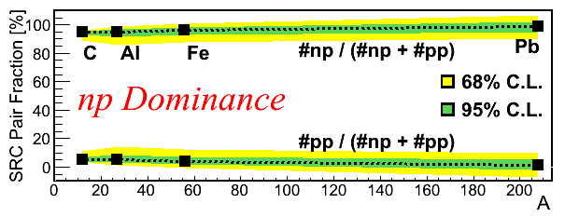
np / pp SRC pairs ratio
c
Al
Fe
Pb
Or Hen et al.
submitted for publication
Large-A nuclei have many nuclear shells.
Nucleons from higher shells can from non L=0 pairs – diminishing the np-dominance previously observed in ¹²C.

Slide 15
Momentum sharing in Asymmetric
(imbalanced) two components
Fermi systems
For non interacting Fermions
Pauli exclusion principle ➔
Majority
Minority

Slide 16
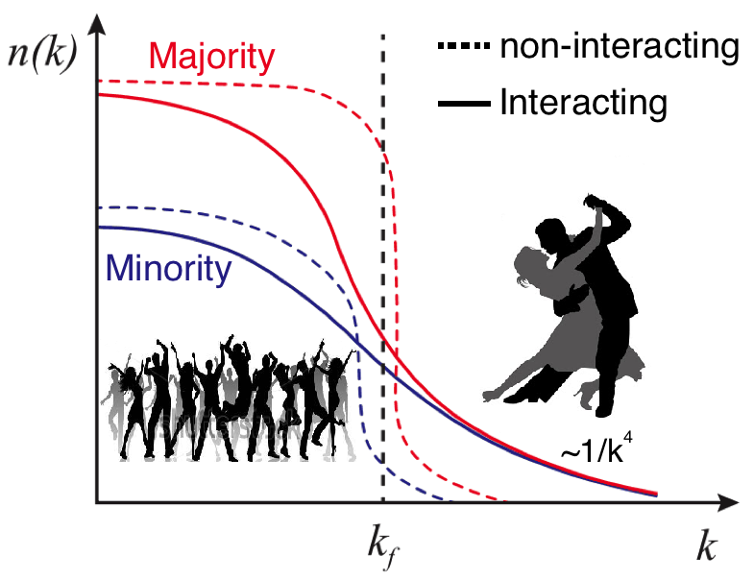
with short-range interaction : strong between unlike fermions, weak between same kind.
Universal property
A minority fermion have a greater probability than a majority fermion to be above the Fermi sea
Possible inversion of the momentum sharing :

Slide 17
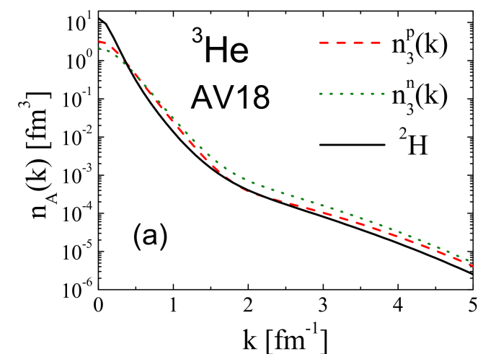
Protons move faster than neutrons in N>Z nuclei
( protons move faster than neutrons in N>Z nuclei )
<KE>
<KE>
Light nuclei A<11
p
n
p − n
Variational Monte Carlo calculations by the Argonne group
Wiringa et al.
phys. Rev. C89, 034305 (2014).
Notes:
Fix this up
Choose the n star stuff to include

Slide 18
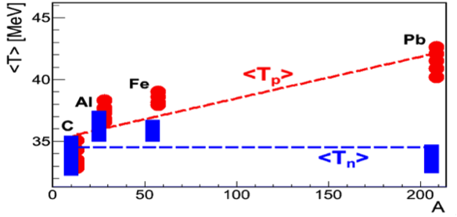

A toy (np-dominance) Model Calculation
Protons Move Faster Then Neutrons
Wood-Saxon
Serot-Walecka
Ciofi - Simula

Slide 19
with short-range interaction : strong between unlike fermions, weak between same kind.
A universal result that can be study in ulta-cold atomic gases.
Majority have a greater probability than minority to have
Possible inversion of the momentum sharing :

Slide 20
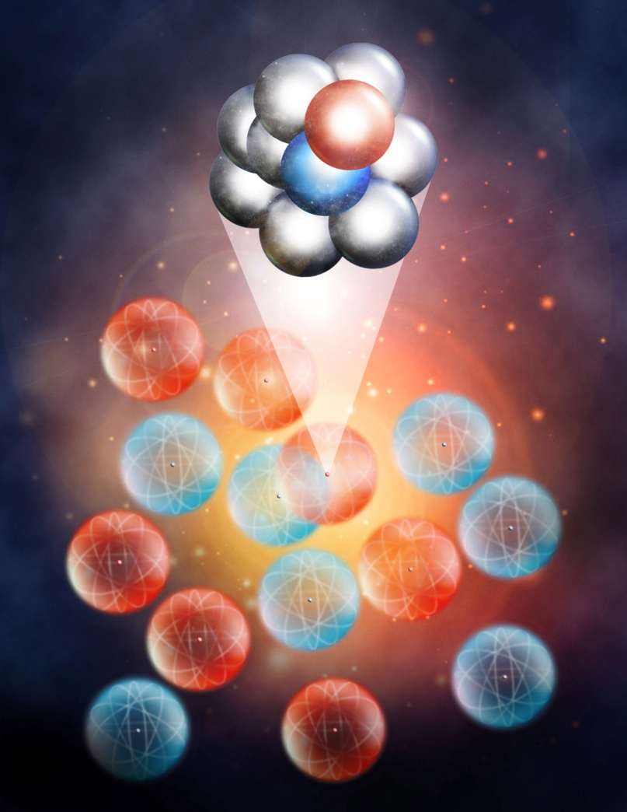
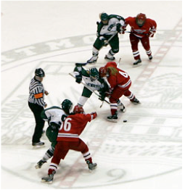
Two-component interacting Fermi systems
The contact term
Probability for
two-fermions SRC ~20%
Adapted from Debora Jin (JILA).
In collaboration with: O. Hen L. B. Weinstein G.A. Miller M.M. Sargsian

Slide 21
The contact and universal relations
For systems of two different type of fermions
With short-range interaction and large scattering length between different fermions
Thermodynamics can be describe by a single parameter: ‘contact’
The contact measure the number of close different –fermions pairs
S. Tan Annals of Physics 323 (2008) 2952, ibid 2971, ibid 2987
In these systems there is high- momentum tail:
C is the contact term
Units: (length)⁻¹

Slide 22
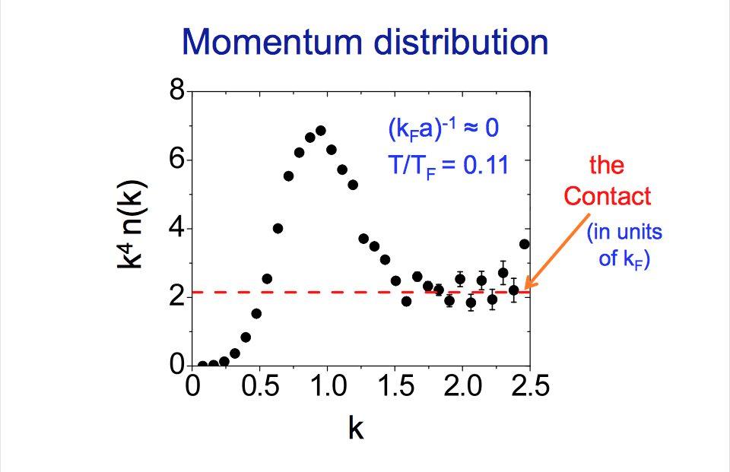
Experiments with two spin-state mixtures of ulta-cold ⁴⁰K and ⁶Li atomic gas systems extracted the contact term and verified the universal relations
Adapted from a talk by Debora Jin (JILA).
Stewart et al. PRL 104, 235301 (210)
Kuhnle et al. PRL 105, 070402 (2010)

Slide 23
What about nuclear contact ?
?
Tensor force
The high- momentum tail is predominantly:
J=1 S and D pairs :
T=0 S=1 L=0 ³S₁
T=0 S=1 L=0 ³D₁
a(³S₁)=5.424±0.003 fm.

Slide 24
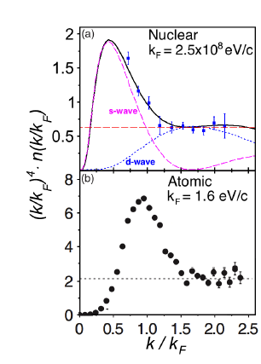
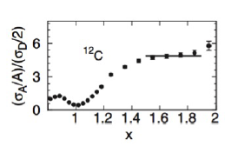

For
AV18
Boeglin et al. PRL 107, 262501 (2011)

Slide 25
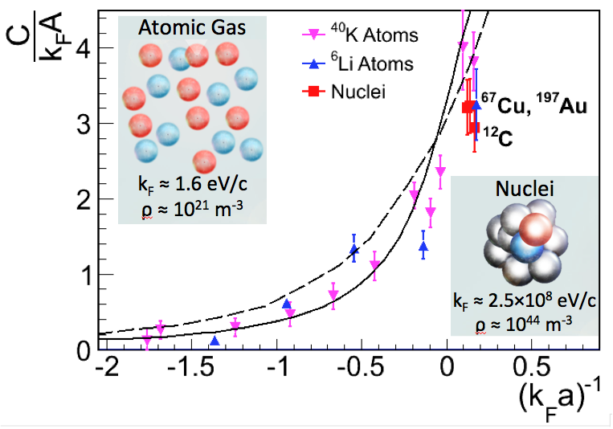

For (k_{F}a)⁻¹ ~0 in both cases the two-fermion SRC probability is ~20%
Stewart et al. PRL 104, 235301 (210)
Kuhnle et al. PRL 105, 070402 (2010)

Slide 26
The nuclear contact term and symmetry energy
In collaboration with: O. Hen L. B. Weinstein G.A. Miller M.M. Sargsian

Slide 27
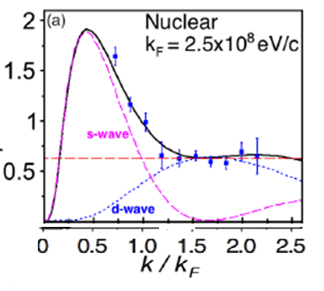
Symmetric Nuclear Matter (SNM)
no correlation
With correlation
Xu and Li
Model proposed here
K_{max} is not a function of K_{F}
a and b
A₀

Slide 28
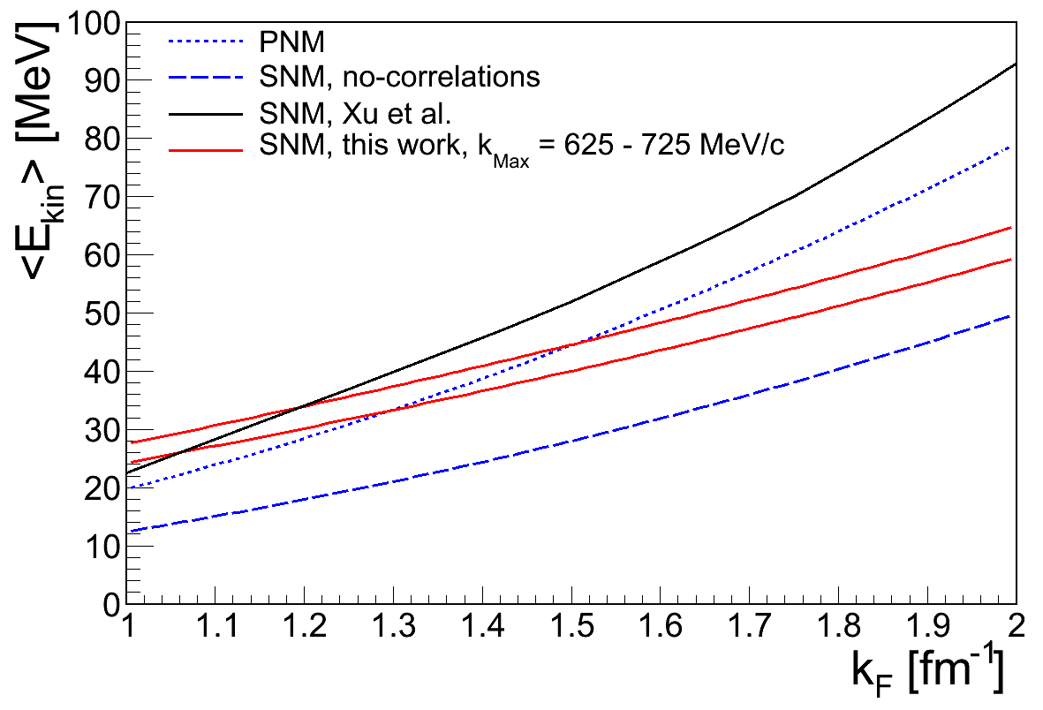
The effect of 2N-SRC on the kinematic Symmetric energy
PNM
Xu and Li
K_{max}=725 MeV/c
K_{max}=625 MeV/c
VMC(¹²C)
This work
SNM no correlation

Slide 29
Summary
Study the small and near allow us to understand the big and far
CLAS / HALL B
-1
EVA / BNL and Jlab / HALL A
Supper- cold atoms and Nuclei
CLAS / Hall B JLab

Slide 30
Acknowledgment
EVA collaboration / BNL
Carroll, S. Heppelman, J. Alster,
J. Aclander,(TAU) A. Malki (TAU), A. Tang (KSU)
Exp 01 – 015 collaboration
Hall A / JLab
S. Gilad , S. Wood, J. Watson, W. Bertozzi,
D. Higinbotham, R. Shneor (TAU), P. Monaghan (MIT), R. Subedi (TAU)
Exp 07 – 006 collaboration
Hall A / JLab
S. Gilad , S. Wood, J. Watson, W. Bertozzi,
Sulkosky, Vincent
D. Higinbotham, Muangma Navaphon (MIT), Igor Korover (TAU), Or Hen (TAU)
Data mining collaboration
Hall B / JLab
L. Weinstein,
Or Hen (TAU)
L. Frankfurt, M. Strikman, M. Sargsian, G.A. Miller, J.Ryckebusch

Slide 31



I thanks the organizers for the invitation
Roy Lemmon
Marielle Chartier

