Slide 1
Complete Measurement of
Electric Dipole response of ¹²⁰Sn
Takashi Hashimoto
Institute for Basic Science, Korea
Collaborators
A. M. Krumbholz¹, A. Tamii², P. von Neumann-Cosel¹, N. Aoi², O. Burda²,
J. Carter³, M. Chernykh², M. Dozono⁴, H. Fujita², Y. Fujita², K. Hatanaka²,
E. Ideguchi², N. T. Khai⁵, T. Itoh², C. Iwamoto², T. Kawabata⁶, K. Miki¹,
M. Murata², R. Neveling⁷, H. J. Ong², I. Poltoratska¹, P.-G. Reinhard⁸, A. Richter¹,
F.D. Smit⁶, H. Sakaguchi^{2,4}, Y. Shimbara⁹, Y. Shimizu⁴, T. Suzuki², M. Yosoi¹, J. Zenihiro⁴, K. Zimmer¹
¹IKP, Technishe Universitat Darmstadt, Germany
²RCNP, Osaka University, Japan
³Wits University, South Africa
⁴RIKEN, Japan
⁵Institute for Nuclear Science and Technology (INST), Vietnam
⁶Kyoto University, Japan
⁷iThemba LABs, South Africa
⁸Institut Theoretical Physik II, Universiät Erlanen-Nürnberg, Germany
⁹CYRIC, Tohoku University, Japan

Slide 2
Table of Contents
Physics motivation and Strategy
Previous works of ¹²⁰Sn
Experiment
Experimental Result and Discussion
Summary and Future Plan

Slide 3
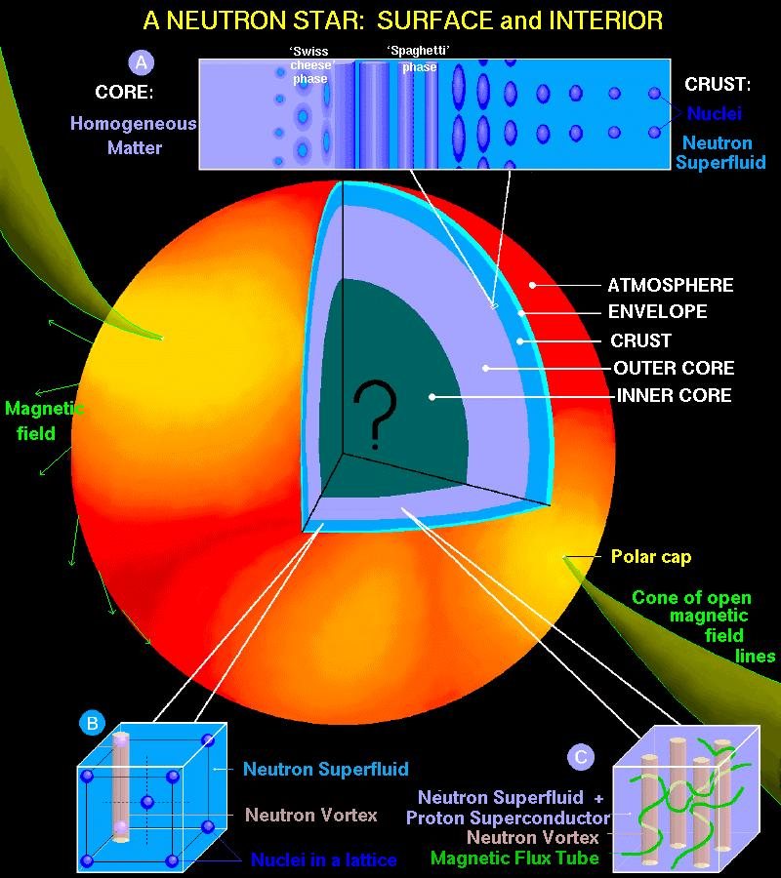
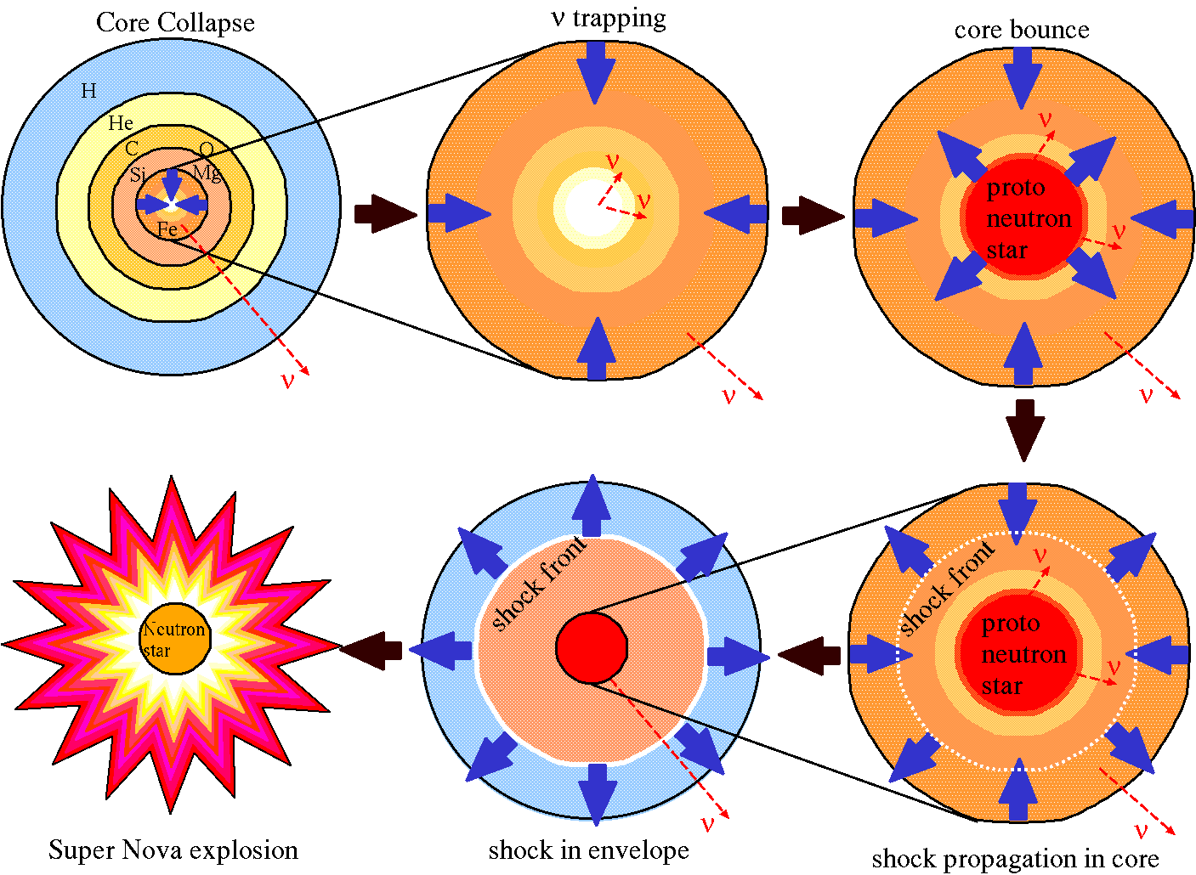
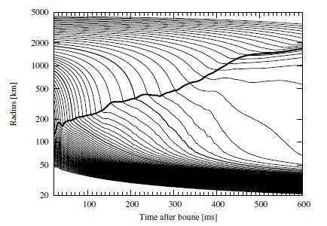
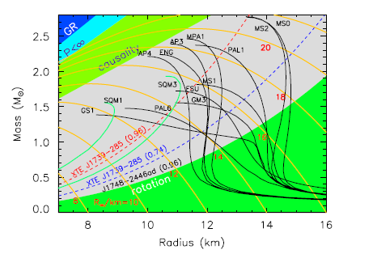
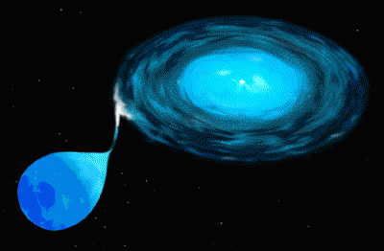
Physics Motivation and Strategy
Symmetry energy of Nuclear EoS is important
for nuclear physics as well as nuclear astrophysics
Structure of neutron star
Core collapse supernova
Y. Suwa, et.al. Apj764(2013)99
http://www.astro.umd.edu/~miller/nstar.html
Accreting neutron star
X-ray bursts
Neutron star mass vs
radius
http://science1.nasa.gov/science-news/science-at-nasa/1997/ast19sep97_3/

Slide 4
Physics Motivation and Strategy
EoS for Energy per nucleon
Symmetry energy
Salutation density
ρ₀=~0.16 fm⁻³
L: Slope parameter
P: baryonic pressure
Determination of J and L is important for
nuclear astrophysics related to neutron star

Slide 5
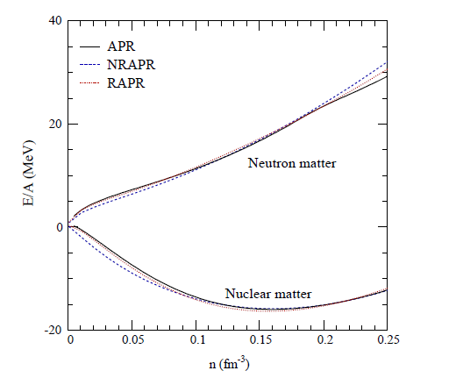
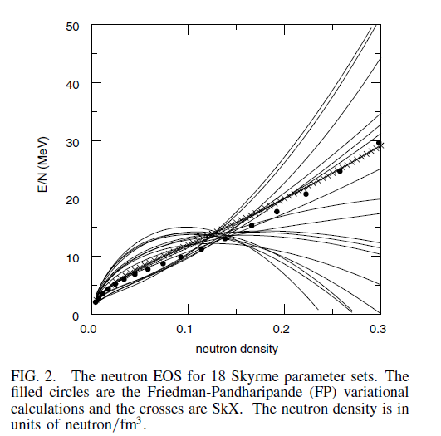
Physics Motivation and Strategy
Neutron matter
~ L
Symmetry energy
(+ Coulomb)
~ J
Saturation density
A. W. Steiner et al., Phys. Rep. 411(2005)325
B. A. Brown, Phys. Rev. Lett, 85(2000)5296
Prediction of the neutron matter EOS is much model dependent

Slide 6
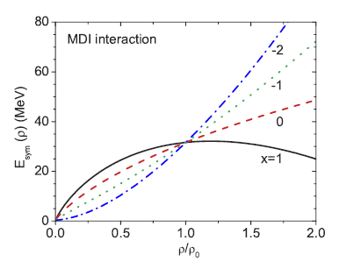
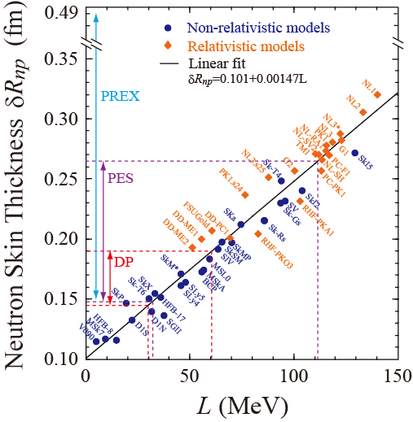
Physics Motivation and Strategy
Slope parameter (L) and Neutron Skin
Large L ⇔ Small E_{sym} in low ρ ⇔ Thick neutron skin
Small L ⇔ Large E_{sym} in low ρ ⇔ Thin neutron skin
Lie-Wen Chen etal., PRL94(032701)
X. Roca-Maza et al., PRL106, 252501 (2011)

Slide 7
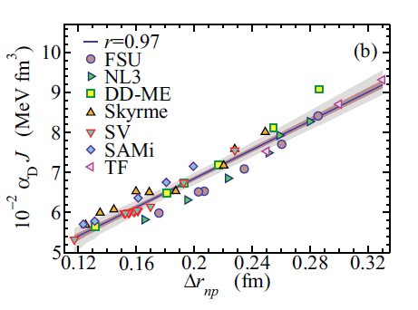
Physics Motivation and Strategy
Neutron Skin Thickness and Dipole Polarizability (α_{D})
P. –G. Reinhard, W. Nazarewicz, PRC81, 051303 (2010)
X. Roca-Masa, et al., PRC818 024316(2013)
Covariance analysis of energy density functional calculations with Skyrm SV-min effective interaction
Droplet model
Strong correlation between the dipole polarizability and
the neutron skin of ²⁰⁸Pb

Slide 8
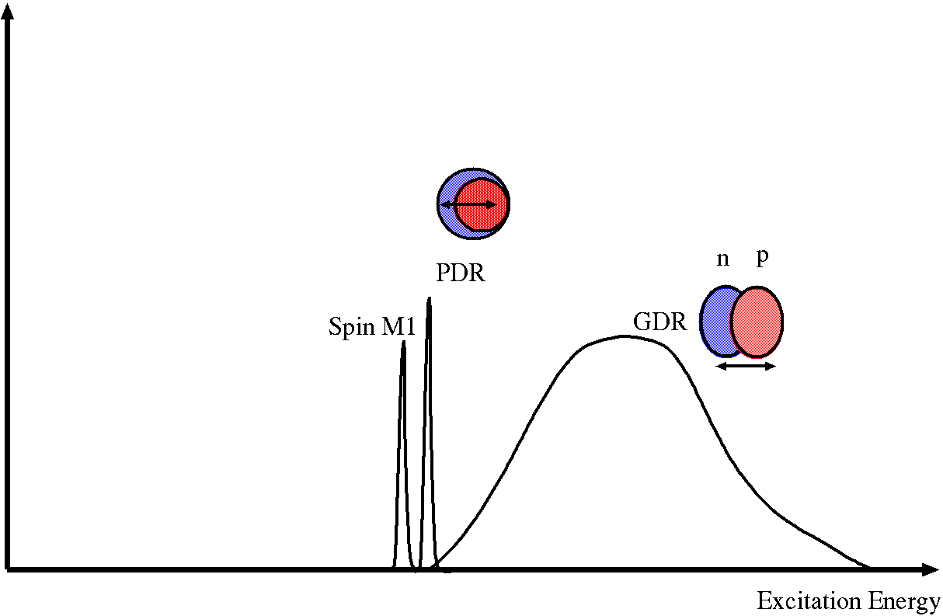
Physics Motivation and Strategy
Electric Dipole Polarizability (α_{D})
Inversely energy weighted sum-rule of B(E1)
?
B(E1)
Discrete E1
states
PDR
GDR
S_{n}
Excitation Energy
Key of experimental issue:
precise measurement of E1 strength in wide energy region
including PDR and GDR

Slide 9
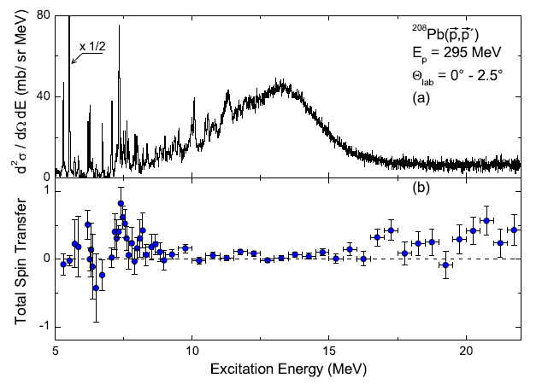
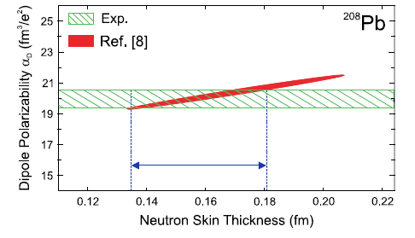
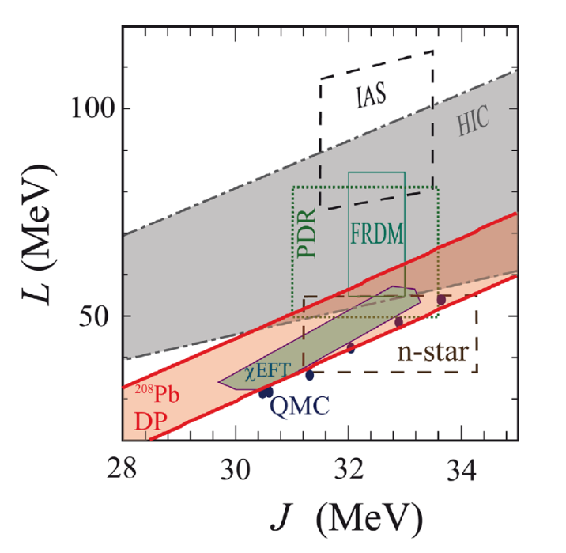
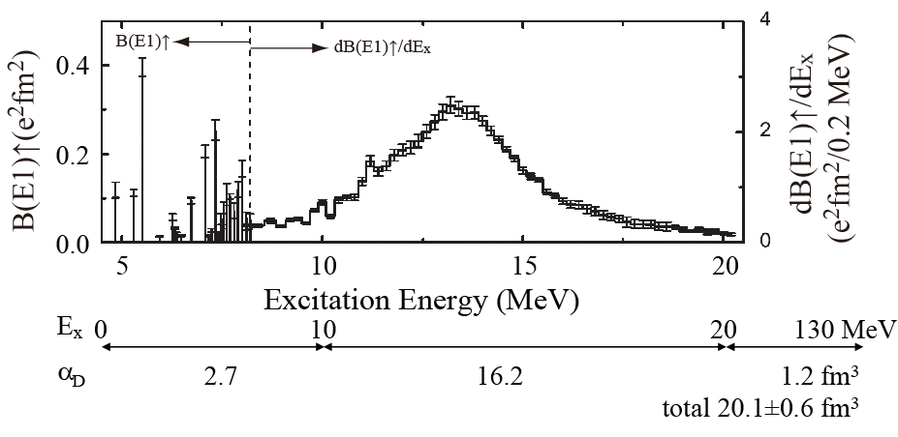
Physics Motivation and Strategy
The results of ²⁰⁸Pb(p ,p’)
A. Tamii et al., PRL107(2011) 062502
Σ = 1 → Spin M1
Σ = 0 → E1
DP: Dipole polarizability
HIC: Heavy ion Collision
PDR: Pygmy Dipole
Resonance
IAS: Isobaric Analog State
FRDM: Finite Range
Droplet Model
(nuclear mass analysis)
n-star: Neutron Star
Observation
cEFT: Chiral Effective
Theory
QMC: Quantum
Monte-Carlo Clac.
A. Tamii et al., EPJA50(2014) 24

Slide 10
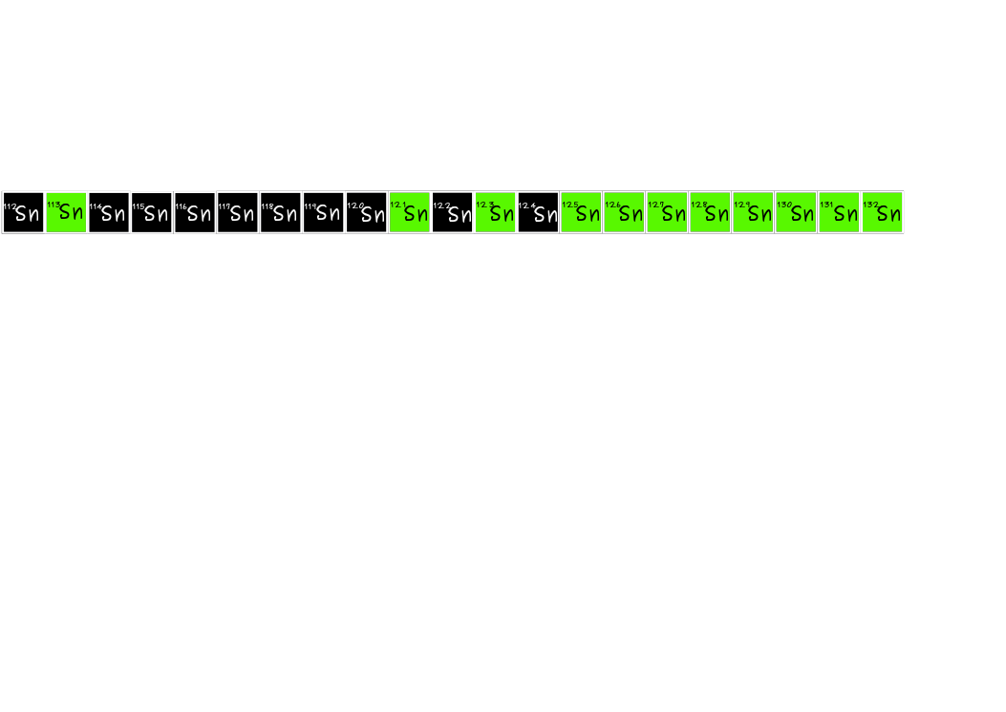
Physics Motivation and Strategy
In order to further constraint the symmetry energy parameters,
dipole pralizability data of other nuclei are important.
Are there consistency a knowledge of nuclear matter from all experimental result ?
What about isotope and isopin dependence ?
Can a Self-Consistent Mean Filed theory reproduce nuclei in a consistent method?
We focused Sn isotopes
Z = 50
1.24
(A-Z)/Z
1.48
1.64
(γ, xn)
(γ, γ’)
Coulomb
dissociation
There are missing part of E1 strength at around
single neutron separation energy.
At first, we have been measured
the electric dipole response of ¹²⁰Sn

Slide 11
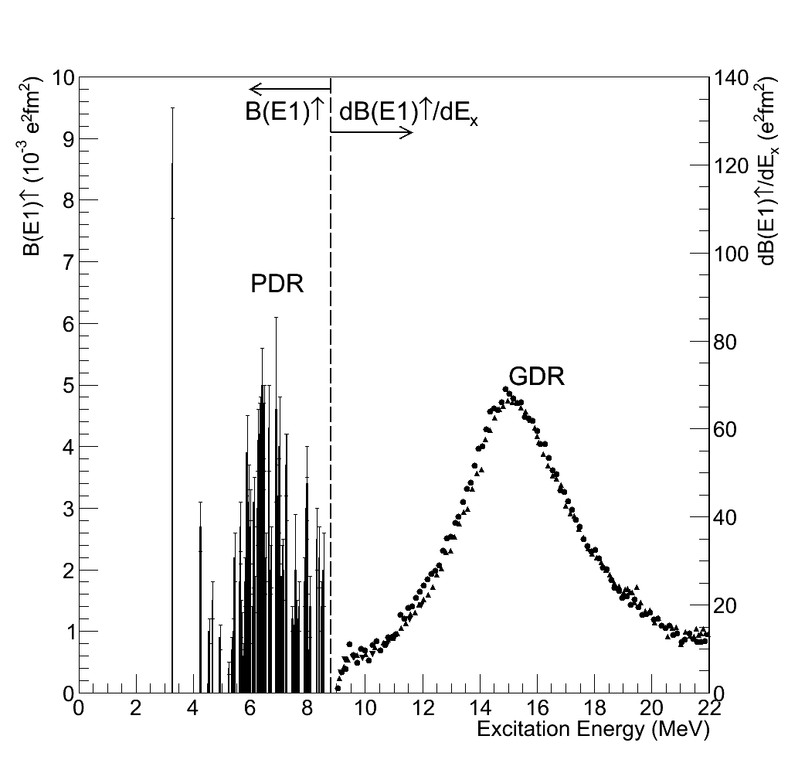
Previous works of E1 response of ¹²⁰Sn
B. Ozel, Ph. D Thesis
A. Lepreter et al.
Nucl. Phys. A219(1974)39
C. S. Fullz et al.,
Phys. Rev. 186(1969)1255
H. Ustunomiya eta l.,
Phys. Rev. C 84(2011)055805
(γ, γ’)
(γ, xn)
S_{n} = 9.1045 MeV

Slide 12
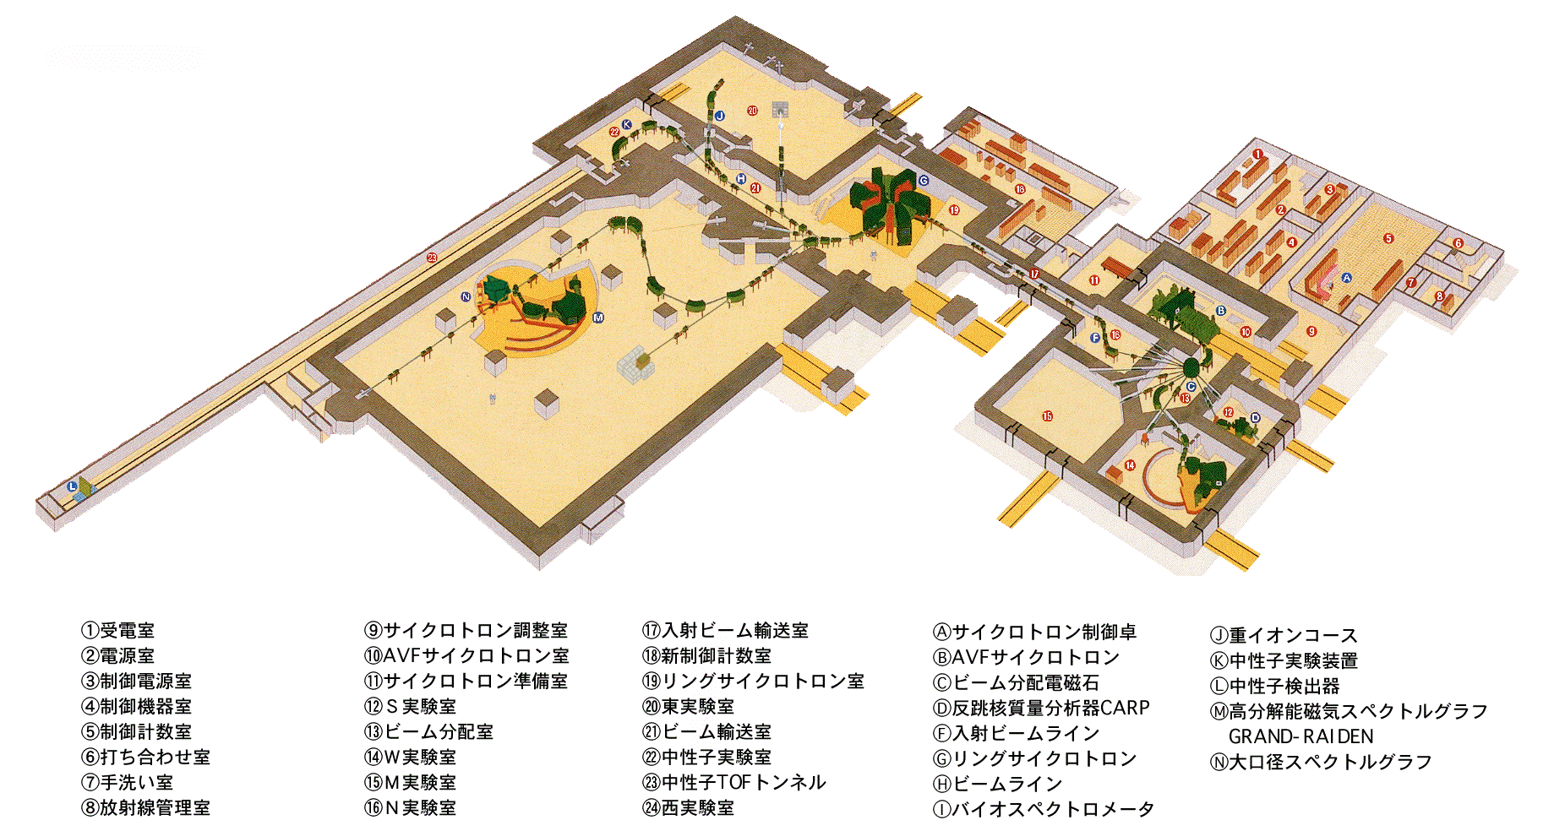
Experiment
RCNP Cyclotron facility
High-resolution WS beam-line
(dispersion matching)
RING cyclotron
AVF cyclotron
High-resolution spectrometer
Grand RAIDEN
Total Spin Transfer (Σ)
Polarized proton beam
Energy: 295 MeV
Energy resolution: ~25 keV
Intensity: 2 nA
Averaged polarization: ~ 0.7
(both of longitudinal and sideway)
D_{SS} and D_{LL} : Spin transfer observable

Slide 13
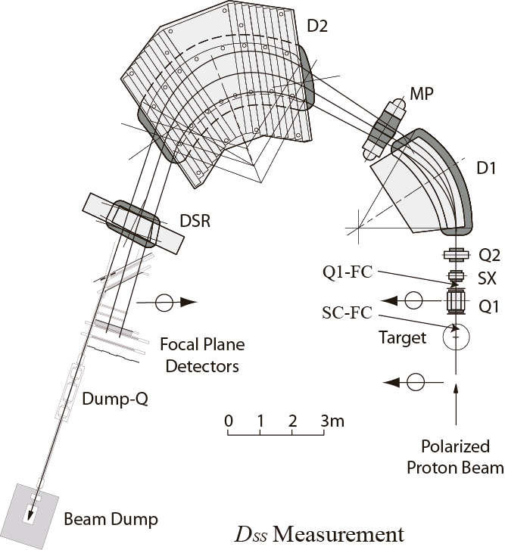
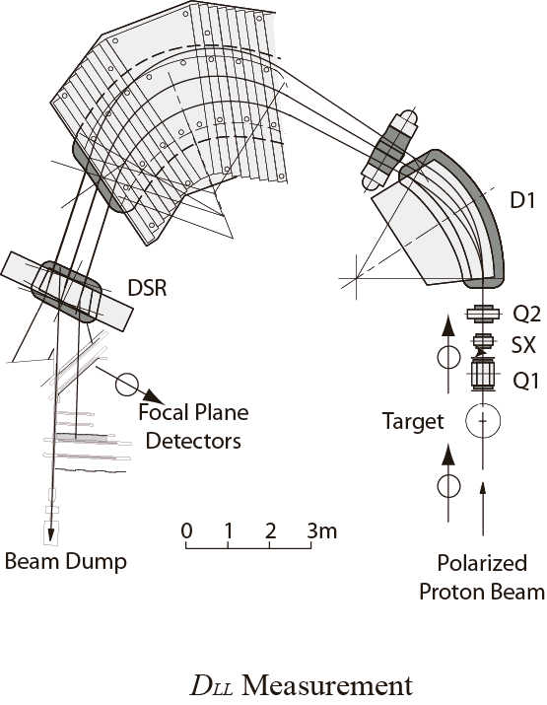
Experiment
Grand Raiden spectrometer @ RCNP
Focal plane detectors
p
VDC
VDC
PLA
PLA
C block
MWPC
MWPC
p
Focal plane
Polarimeter
Polarized
Proton beam
E_{p} = 295 MeV
Polarized
Proton beam
E_{p} = 295 MeV
¹²⁰Sn target
Thickness: 6.5 mg/cm²
Purity 98.4 %

Slide 14
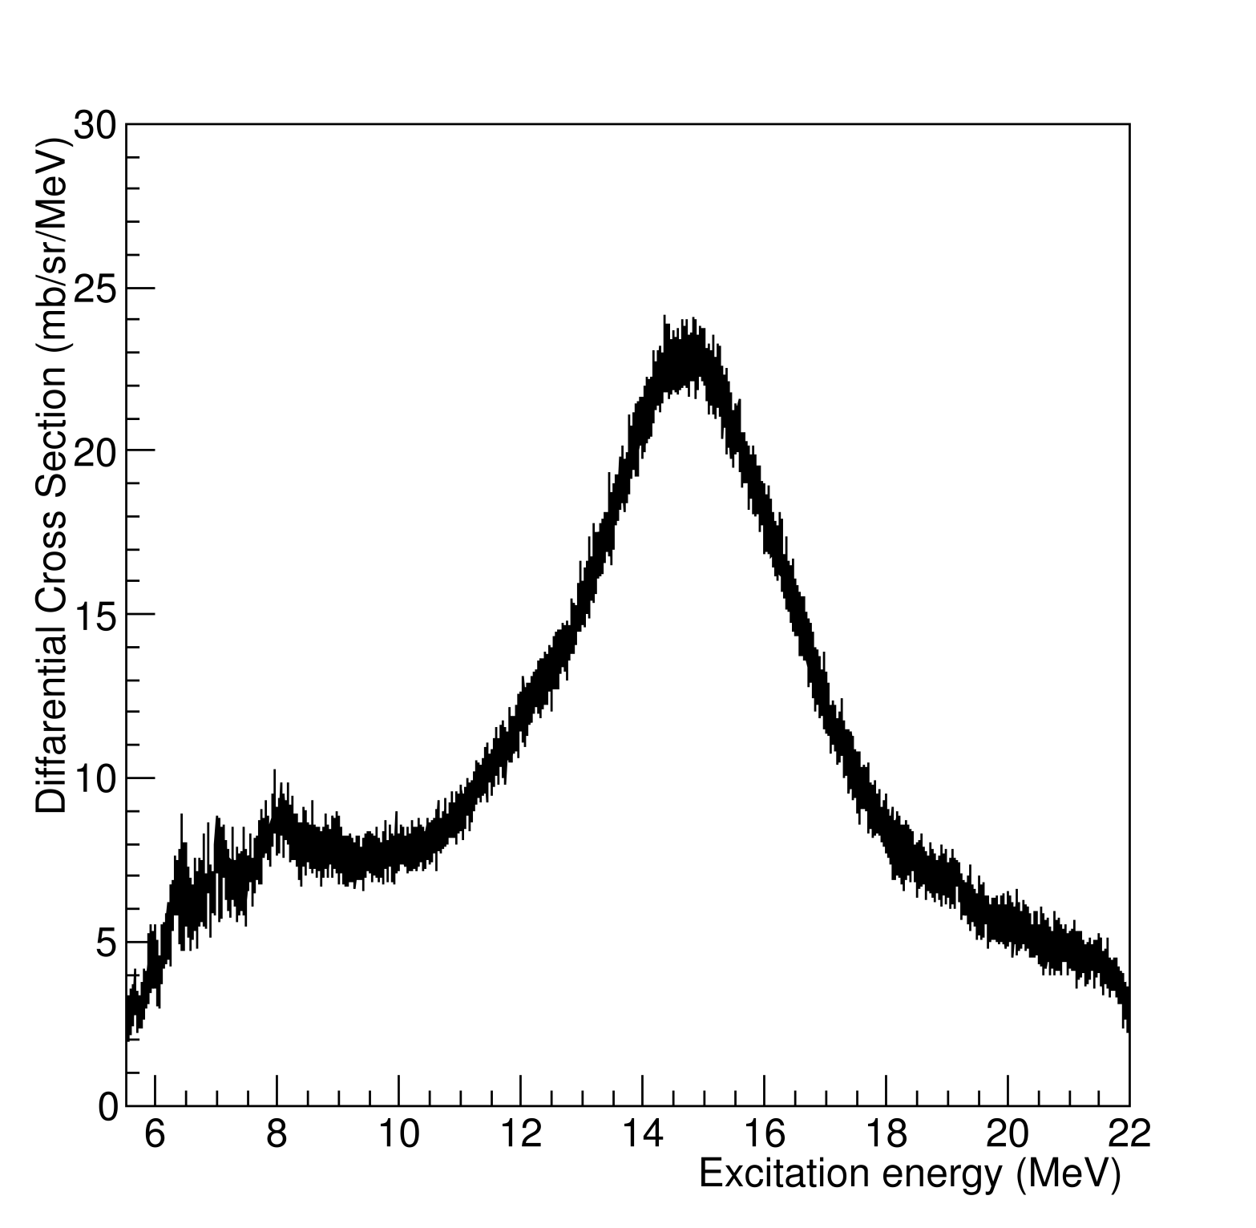
Experimental Results
Excitation energy spectrum
Preliminary
Differential Cross Section (mb/sr/MeV)
Excitation Energy (MeV)

Slide 15
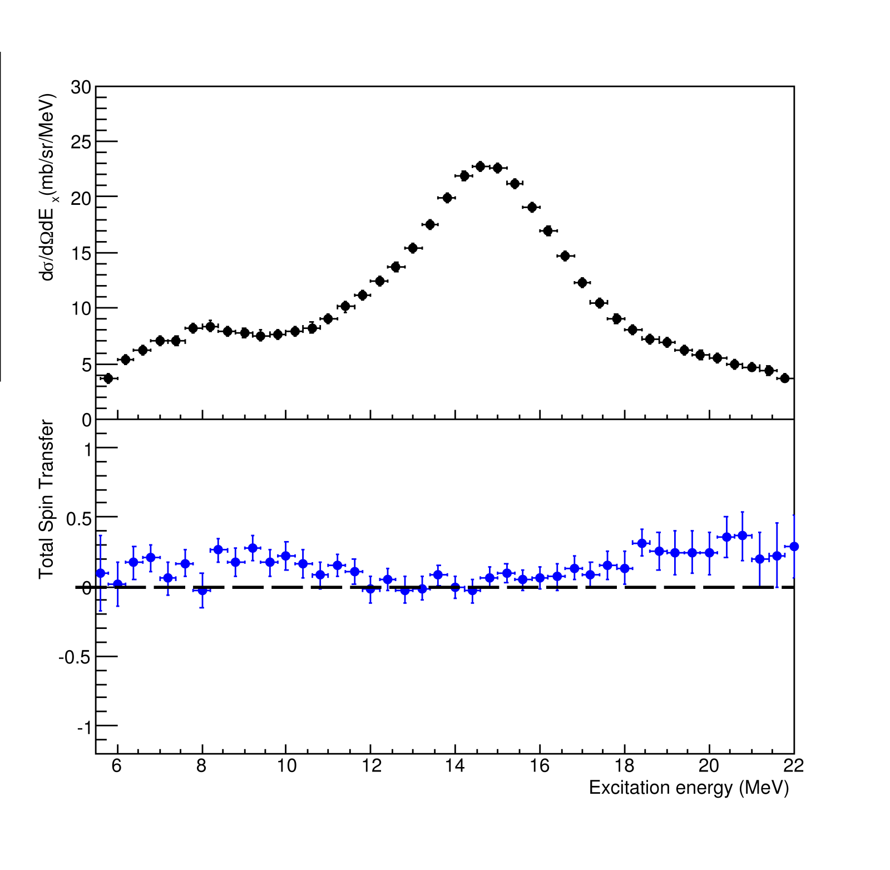
Experimental Results
E1 and M1 decomposition
Polarization observable at 0 degs
Spin flip/non-spin flip separation
Preliminary
Total Spin Transfer
Preliminary
1 for ΔS = 1 (Spin M1)
0 for ΔS = 0 (E1)
=

Slide 16
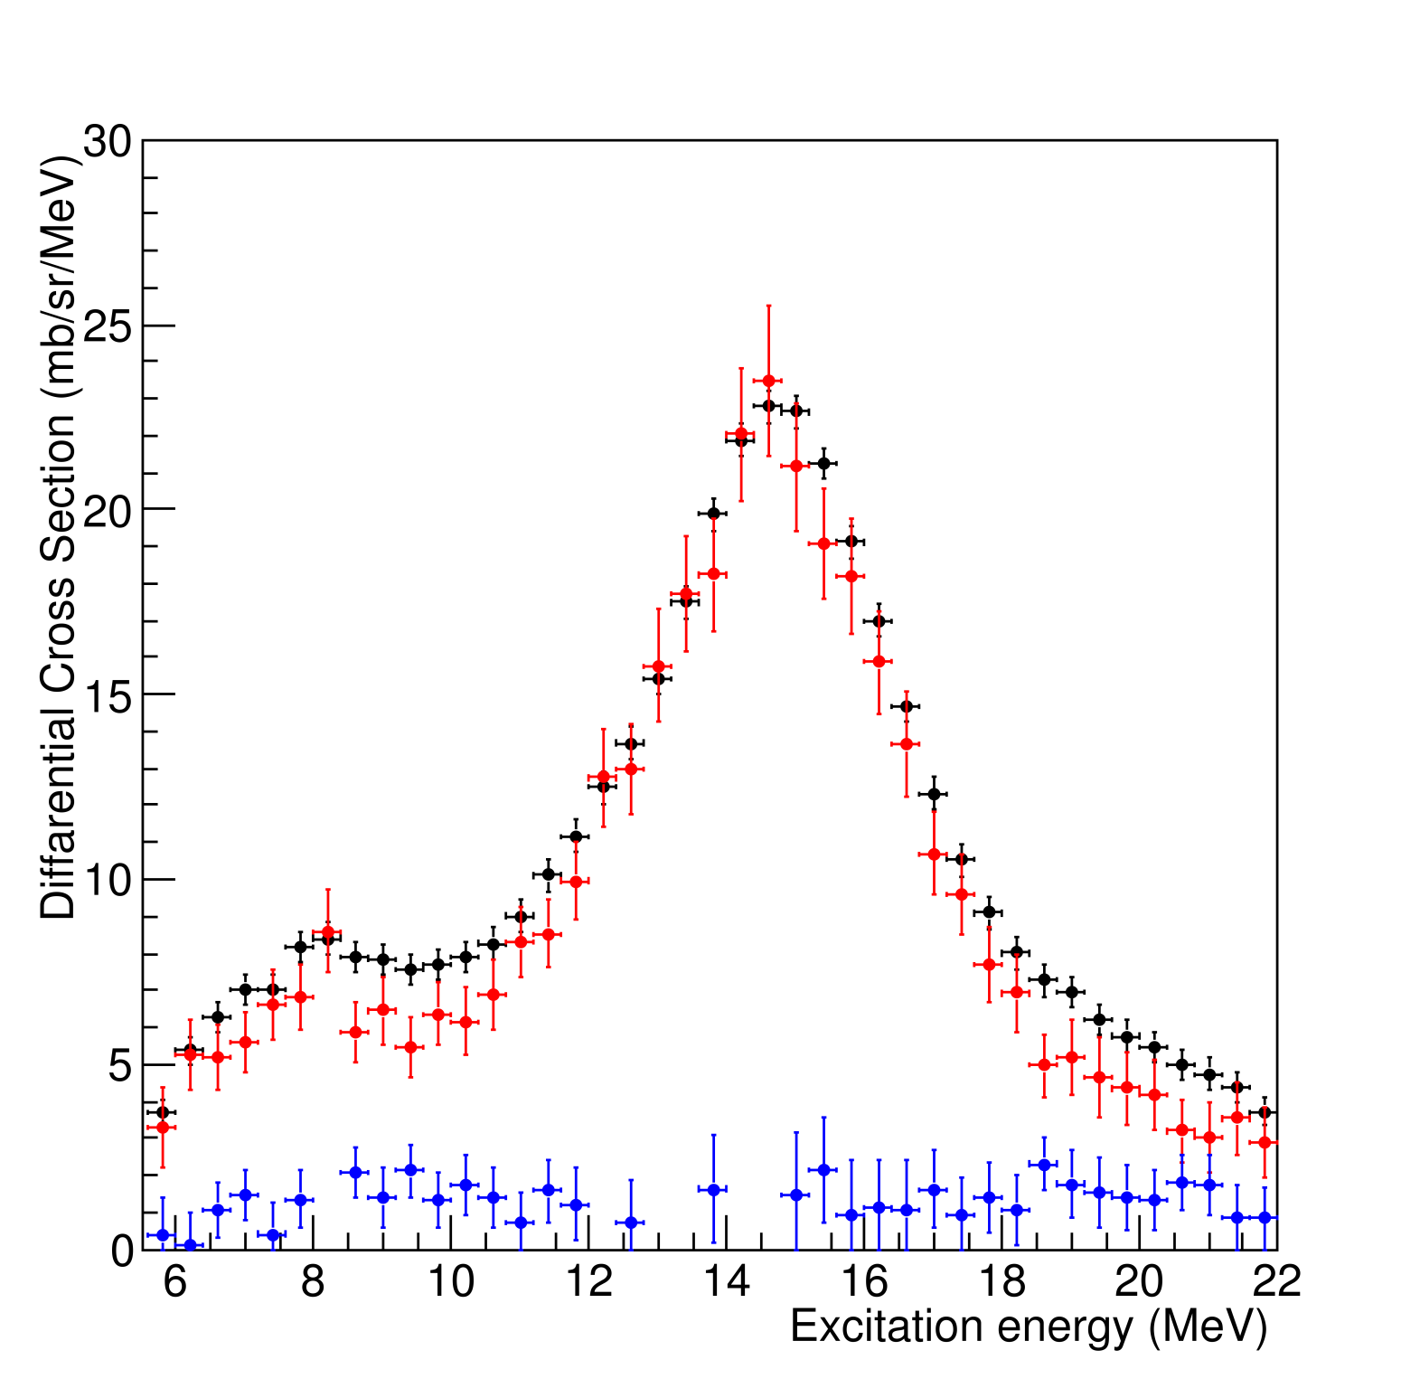
Experimental Results
E1 and M1 decomposition
¹²⁰Sn(p, p’)
¹²⁰Sn(p, p’), E1
¹²⁰Sn(p, p’), Spin M1
Preliminary
Differential Cross Section (mb/sr/MeV)
Excitation Energy (MeV)

Slide 17
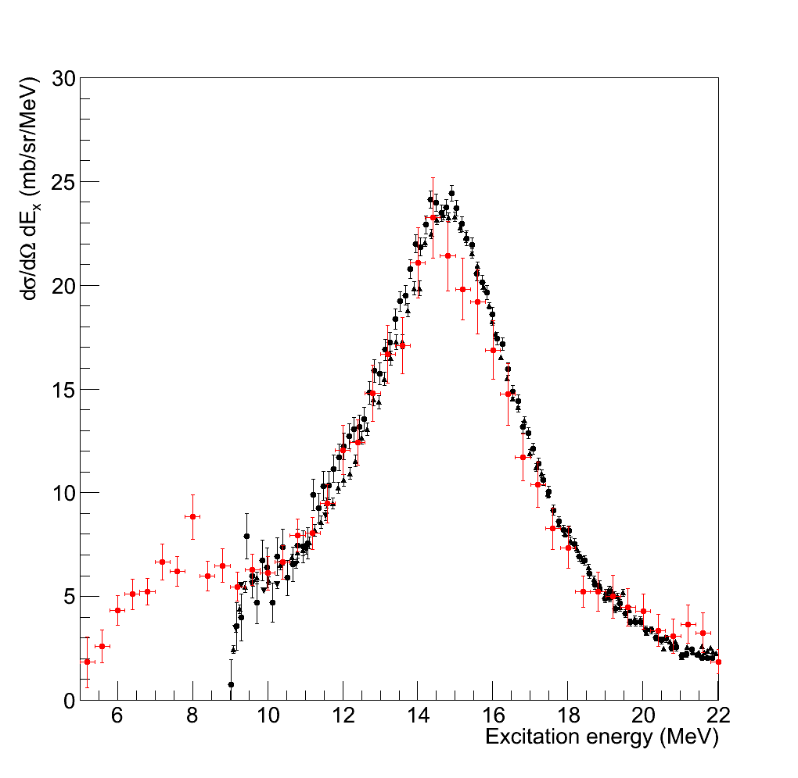
Experimental Results
Comparison with (γ, xn) results around the GDR region
Preliminary
Present
A. Lepreter et al.
Nucl. Phys. A219(1974)39
C. S. Fullz et al.,
Phys. Rev. 186(1969)1255
H. Ustunomiya et al.,
Phys. Rev. C 84(2011)055805
The extracted E1 cross sections are good agreement with results of (γ, xn) experiments

Slide 18
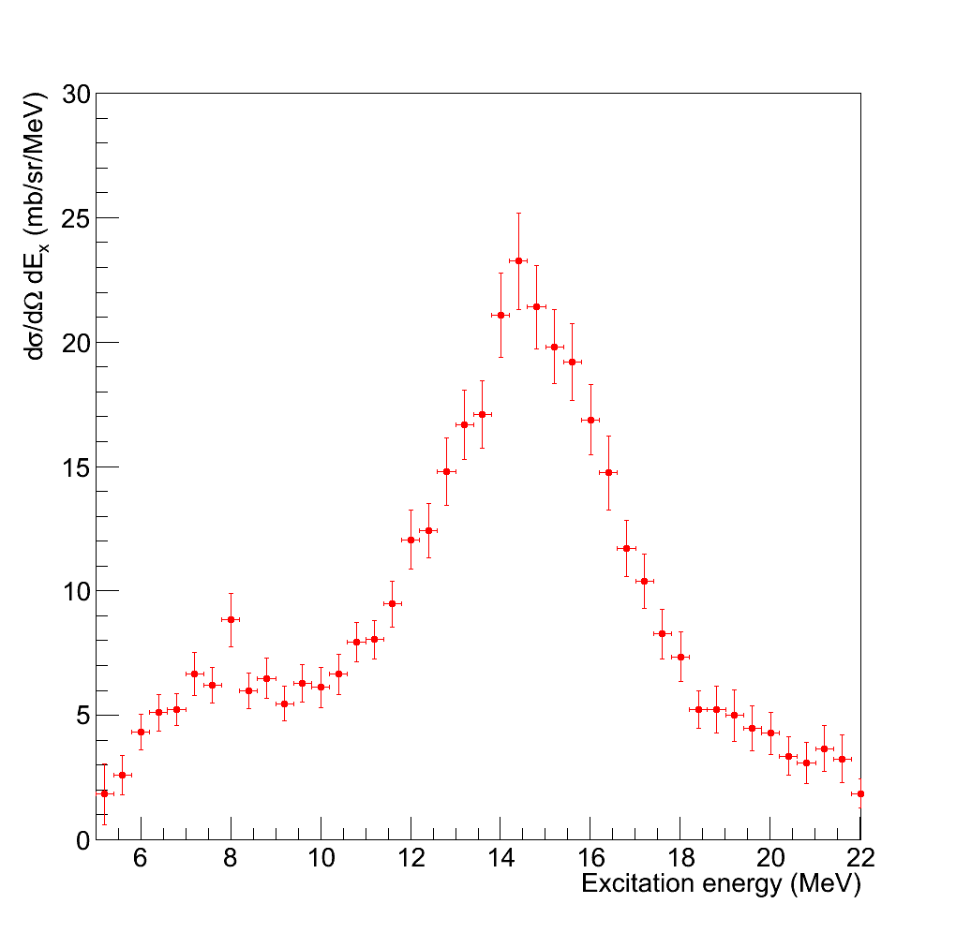
Experimental Results
Preliminary
Dipole Polarizability (α_{D})
¹²⁰Sn(γ, γ’)
B. Ozel PhD thesis, TU Darmstadt
¹²⁰Sn(γ, xn)
C. S. Fullz et al., PRC186(1969)1255
^{nat}Sn(γ, xn)
A. Lepretre ra al., NPA367(1981)237
Ex
0.0
6.0
22.0
28.9
135 MeV
α_{D}
0.18
7.65
0.51
0.31
¹²⁰Sn(γ, γ’)
¹²⁰Sn(p, p’)
Present
¹²⁰Sn(γ, xn’)
^{nat}Sn(γ, xn’)
Total: 8.65 ±0.18 fm³ (preliminary)

Slide 19
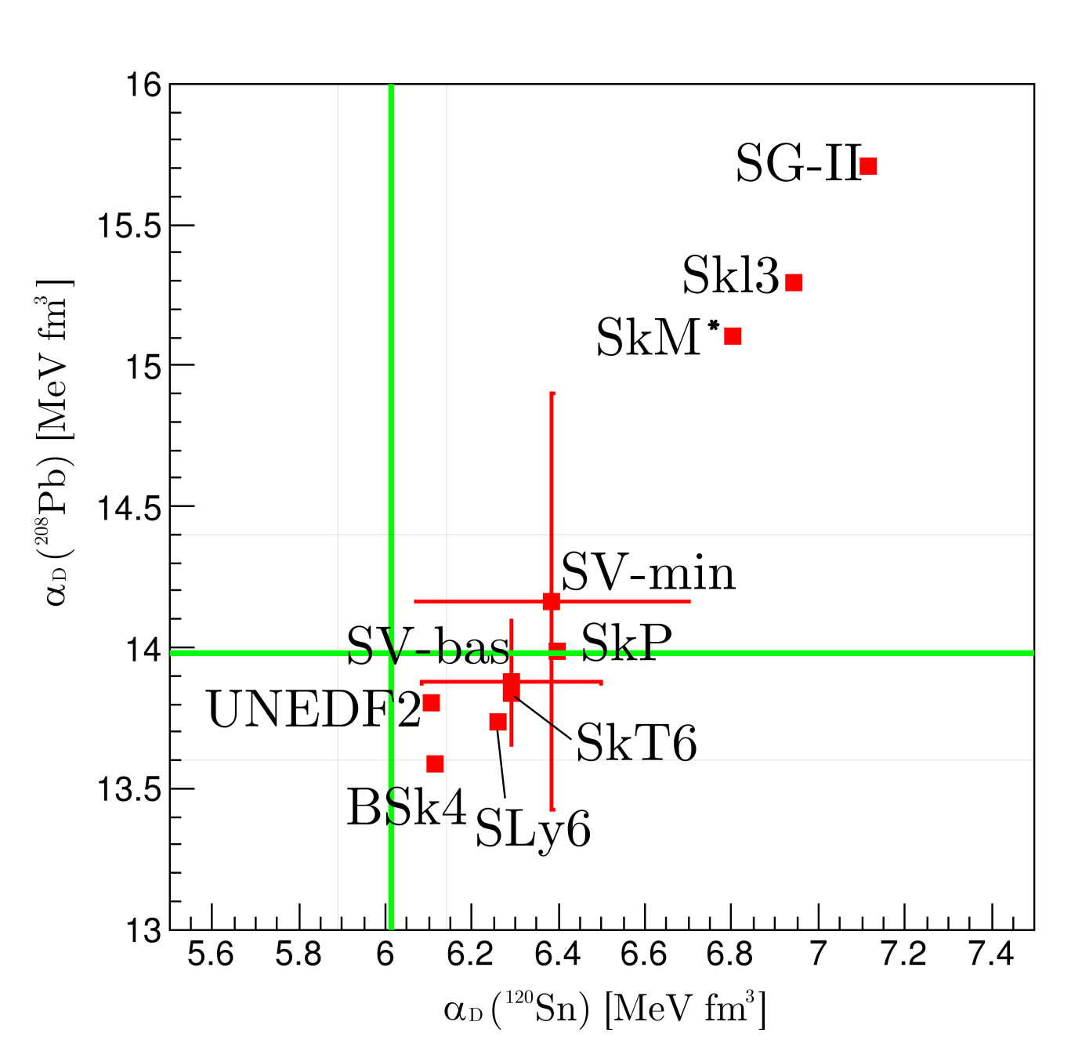
Discussion
α_{D} of ¹²⁰Sn :8.65 ±0.l8 fm³
²⁰⁸Pb :20.1 ± 0.6 fm³
Experiment
8.65 ± 0.18 fm³
α_{D} (²⁰⁸Pb) [MeV fm²]
Experiment
20.1 ± 0.6 fm³
Preliminary
Calculated by P. –G. Reinhard
α_{D} of ²⁰⁸Pb: PRL107(2011)062502
α_{D} of ¹²⁰Sn: Present
α_{D} (¹²⁰Sn) [MeV fm²]

Slide 20
Summary and Future Plan
We have been performed ¹²⁰Sn(p, p’) experiment at very forward angle including 0 degree.
The continuous excitation energy spectrum was obtained from PDR region to GRD region.
The E1 and spin-M1 cross section is decomposed by using the total spin transfer.
The extracted E1 cross sections are good agree with the previous results of (γ, xn) measurements.
The electric dipole ploralizability (α_{D}) was extracted from the E1 cross section.
α_{D} = 8.65 ± 0.18 fm³ (preliminary)
We suggested a new constraint of symmetry energy parameter by using
the α_{D} of ²⁰⁸Pb and ¹²⁰Sn.
Calculated results of α_{D} are located near our constraint region. But there are not consistent with the constraint region.
We need more discussion about the frame works and further more parameterization.

Slide 21
Summary and Future Plan
We have been measured following targets (MDA: Multi pole decomposition, PT: Polarization transfer)
⁴⁸Ca (MDA) J. Birkhan (M1 strength, submitted)
⁹⁶Mo (MDA & PT) D. Martin
^{144, 154}Sm (MDA &PT) A. Krugmann
⁹⁰Zr (MDA) C. Iwamoto (PDR-region is published in PRL108,(2011)262501)
Analysis are in progress. Results are coming soon.
In order to investigate mass dependence of α_{D},
following targets have attracted attention.
¹¹²⁻¹²⁴Sn
⁹⁰⁻⁹⁶Zr
The experiments of ^{112,116,124}Sn was approved at RCNP.
To investigate PDR nature,
We have a plan (α, α’) or (p, p’) scattering and γ coincidence experiments at RCNP.
For the experiment, we constructed a new beam line of Grand RAIDEN, named GRAF.
The commissioning of beam line will be performed in next week.

Slide 22
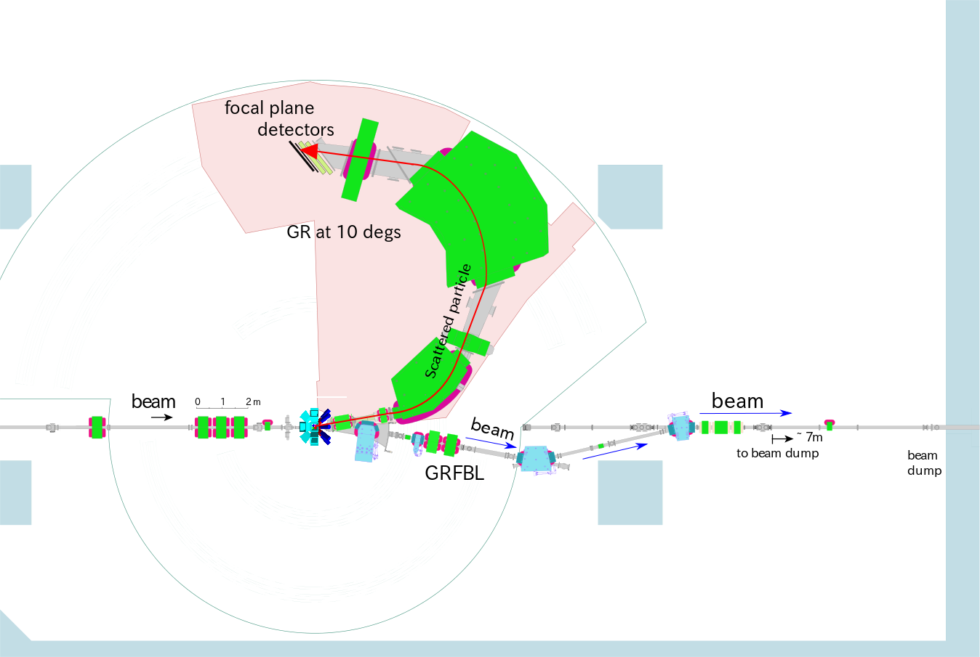
GRAF (Grand RAiden Forward beam line)
To measure γ-ray at around the target position of GR,
low background condition is necessary.
Primary beam particles are led to wall beam dump!
γ-ray detector
(CAGRA)
Beam dump
GRAF

Slide 23
Thank you for your attention

