Slide 1

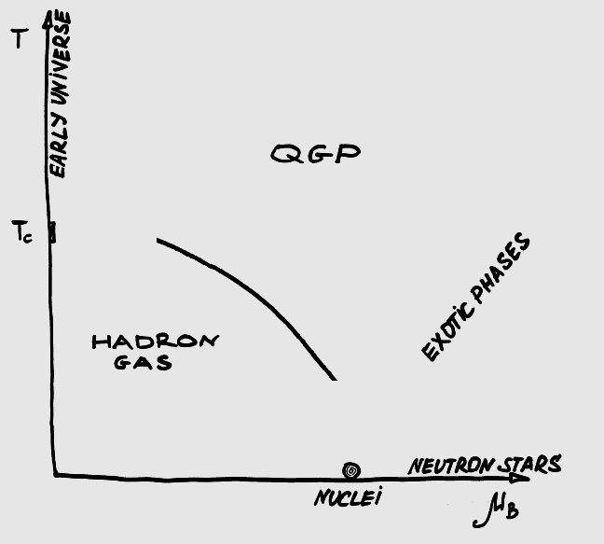

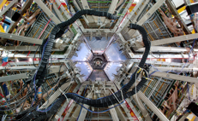
HADES overview from cold matter to low energy Heavy-Ion collisions
Tetyana Galatyuk for the HADES Collaboration
Technische Universität Darmstadt / GSI

Slide 2
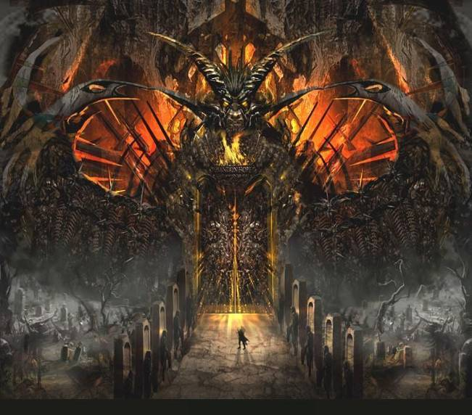
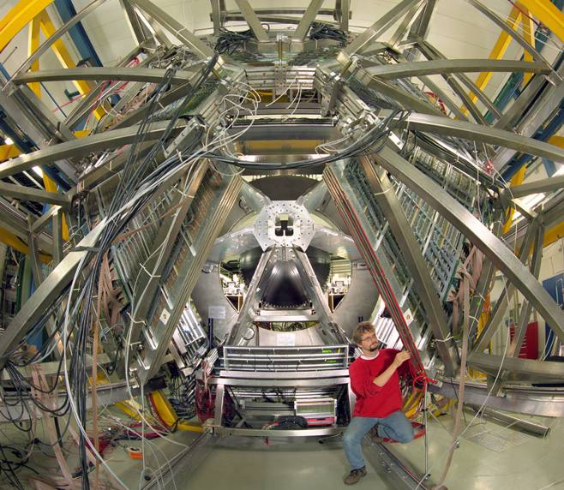
Hades gate
High Acceptance DiElectron Spectrometer

Slide 3

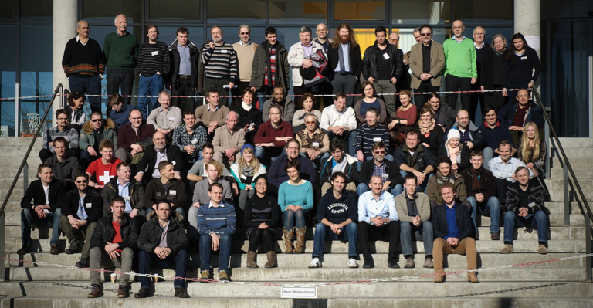
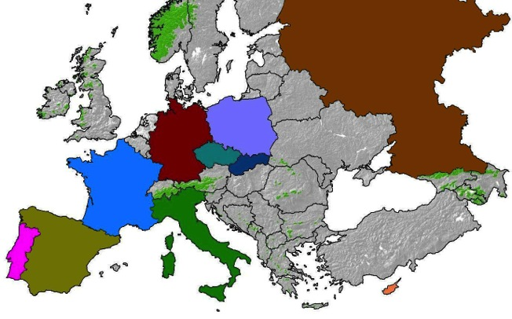
The hades collaboration
Catania, Italy
  Coimbra, Portugal
    Cracow, Poland
      GSI Damstadt, Germany
        TU Darmstadt, Germany
          Dresden, Germany
          Dubna, Russia
          Frankfurt, Germany
          Giessen, Germany
          Lisboa, Portugal
          München, Germany
          Milano, Italy
        Moscow, Russia
      Nicosia, Cyprus
    Orsay, France
    Rez, Czech Rep.
  Santiago de Compostela, Spain
18 institution partners
~100 collaborators

Slide 4
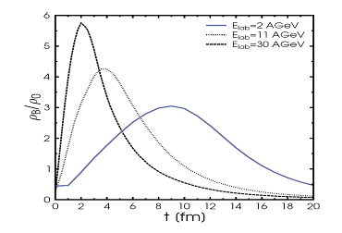
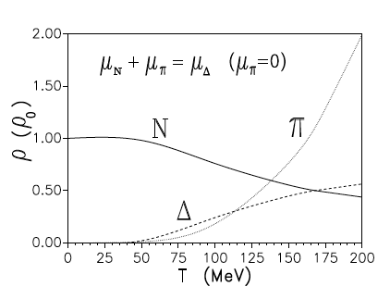
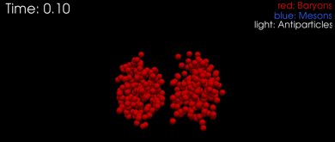

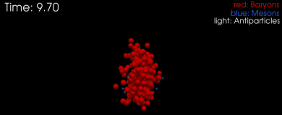
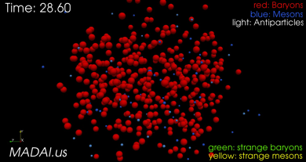
Baryonic matter at 1-2 AGeV Beam Energy
Evolution of average ρ_{B}
Composition of a hot πΔN gas
γ*
l⁺
E_{lab}=30GeV
l⁻
E_{lab}=11GeV
Rapp, Wambach, Adv.Nucl.Phys. 25 (2000)
E_{lab}=2GeV
τ >10 fm/c
Κ, Λ, φ, Ξ,
γ*
l⁺
l⁻
Moderate densities but long lifetime:
  ρ_{max}/ρ₀ = 1-3, T<80 MeV,
  τ ~15 fm/c
Baryon dominated:
  π densities a factor ~10 lower as compared to SPS regime!
  Matter enriched by baryonic resonances (~30%), N_{π}/A_{part} ≈ 10%
γ*
l⁺
l⁻
HADES
Rare and penetrating probes

Slide 5

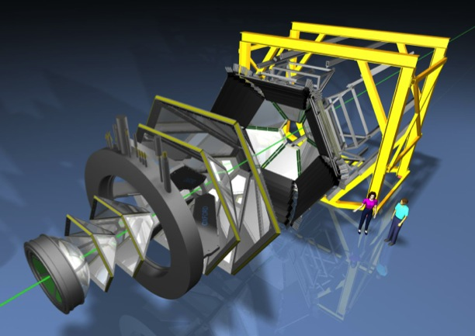
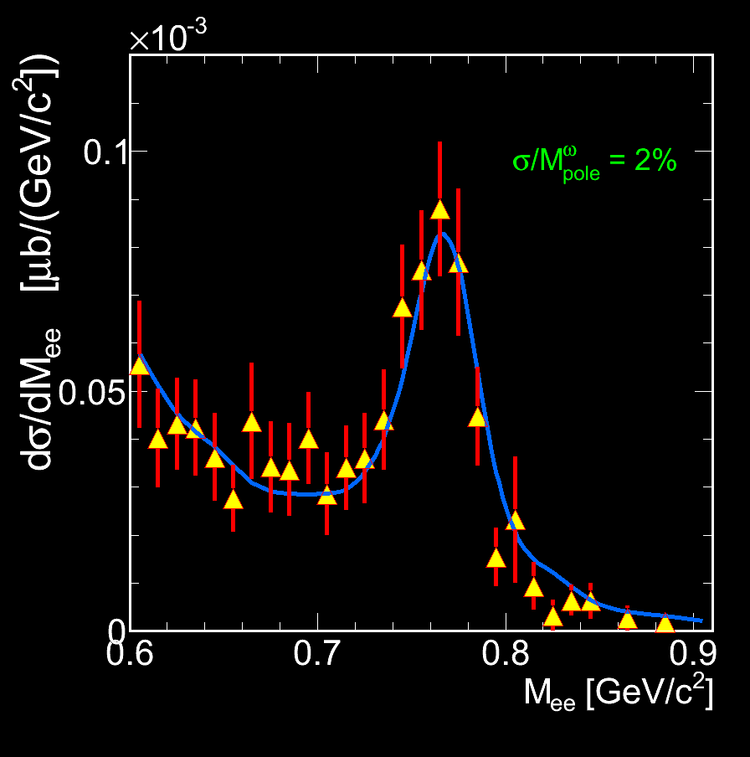
The hades at GSI, Darmstadt, Germany
SIS
HADES strategy:
  Excitation function for low-mass lepton pairs and (multi-)strange baryons and mesons
  Various aspects of baryon-resonance physics
Beams provided by SIS18: π, proton, nuclei
Full azimuthal coverage, 18 to 85 degree in polar angle
Hadron and lepton identification
Event-plane reconstruction
e⁺e⁻ pair acceptance 35%
Mass resolution 2 % (ρ/ω region)
~ 80.000 channels
50 kHz event rate (400 Mbyte/s peak data rate)
p+p 3.5 GeV

Slide 6
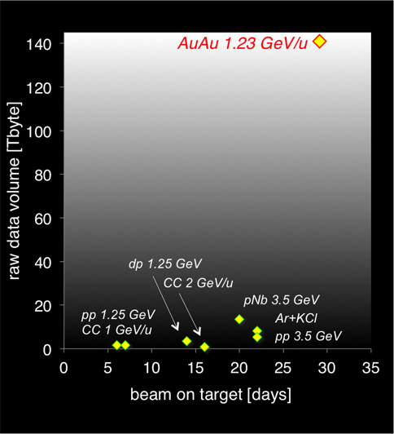
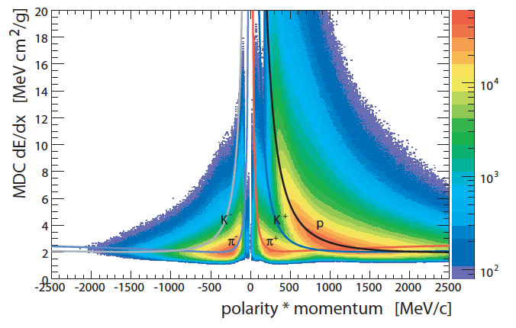
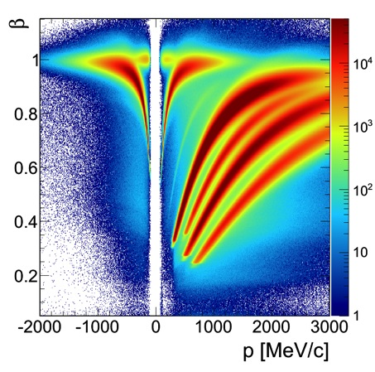
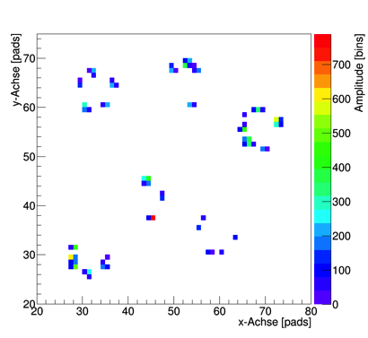
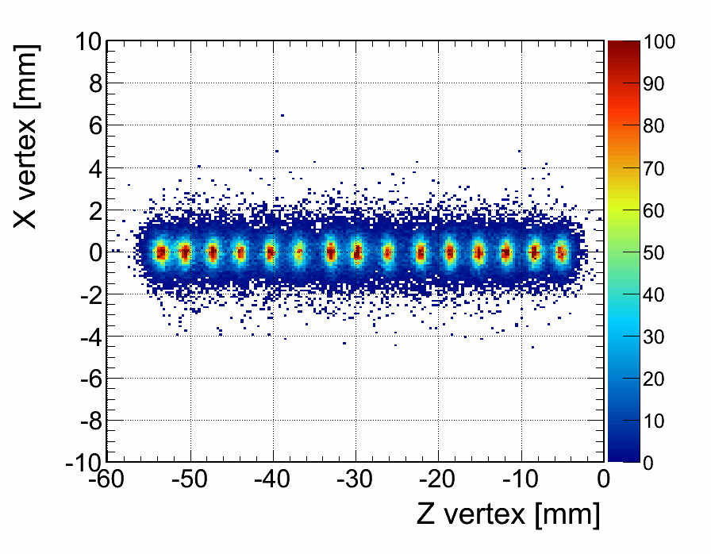
Hades event reconstruction
Recorded data sets
Particle identification by means of:
dE/dx in the MDC and ToF
Velocity vs. momentum
Operational at GSI since 2002
Upgrade 2008 – 2010
e⁻
e⁺
π⁻
π⁺
p
Κ⁺
³He
d,⁴He
t
RICH rings
Vertex reconstruction

Slide 7
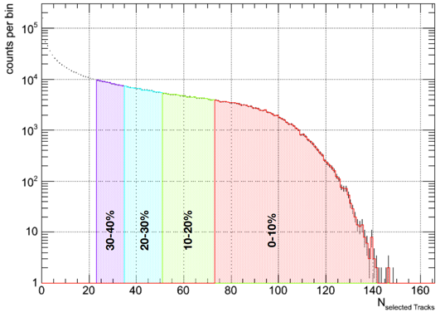
Event characterization in hades (Au+Au collisions)
Number of reconstructed tracks
First-level trigger conditions:
  Hit multiplicity in TOF detector > 20
  && signal in the START detector
Centrality determination using Glauber
Distributions agree with transport model calculations (transport processed by Geant and filtered with standard analysis code)
  → 4.3 billion 40% most central
  Au+Au collisions recorded

Slide 8
Final state
“Hadron-chemistry”

Slide 9
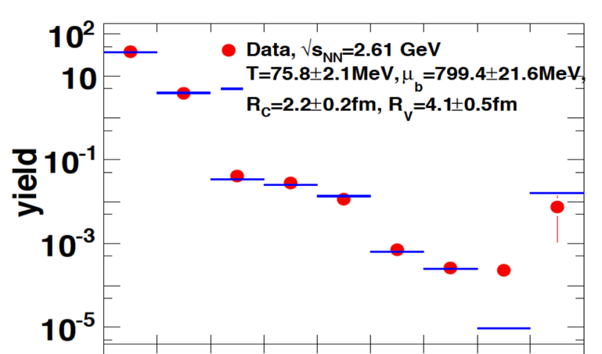


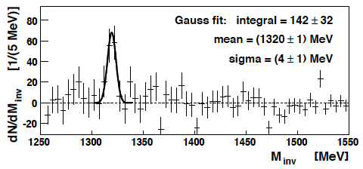
Strangeness production in 1.75 AGeV Ar+KCl collisions
High-statistics measurement of
π⁺, π⁻, K⁺ and K⁻, K⁰_{s}, Λ, φ,
but also Ξ⁻ (630 MeV below NN production threshold!)
Phys.Rev.Lett.103:132301,2009
Eur.Phys.J.A40:45-59,2009
Phys.Rev.C80:025209,2009
Eur. Phys. J. A 47:21, 2011
Statistical Hadronization Model (SHM) describes hadron abundances except in case of large Ξ⁻ (s=-2) yield
Production mechanism of multi-strange baryons?
No φ suppression. Can be described
with SHM (THERMUS)
Ξ⁻ → Λ+π⁻
-- THERMUS fit: J.Cleymans, J.Phys.G31(2005)S1069
HADES Ar+KCl data at 1.76 AGeV

Slide 10
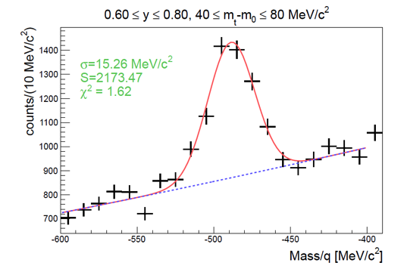
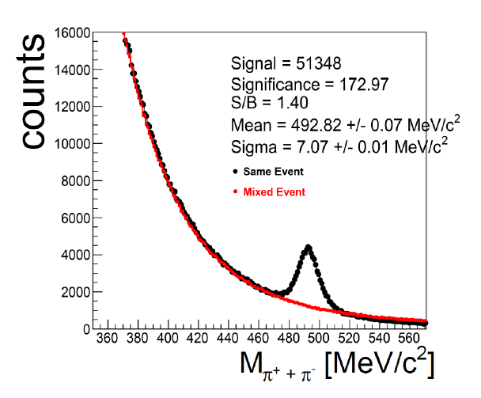
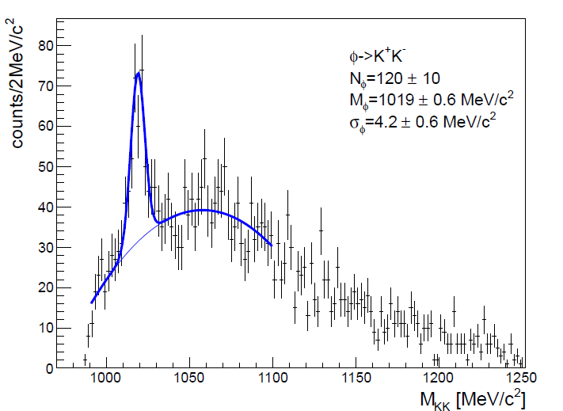
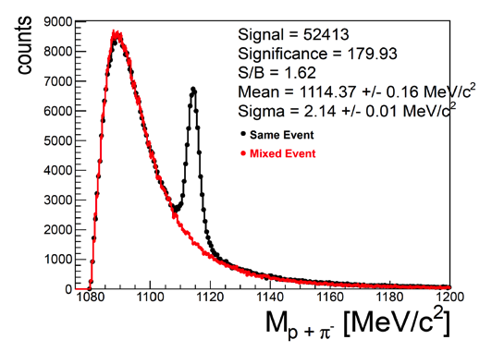
hadron production in 1.23 AGeV Au+Au collisions
PhD thesis: Heidi Schuldes,
Timo Scheib
  First measurements at such low beam energy!
Κ⁻
HADES Preliminary
Κ⁰_{s}
HADES Preliminary
φ
√s-√s_{th} = -0.44 GeV
HADES Preliminary
HADES Preliminary
Λ
Far below NN production threshold
Strong constraints on production mechanism!

Slide 11
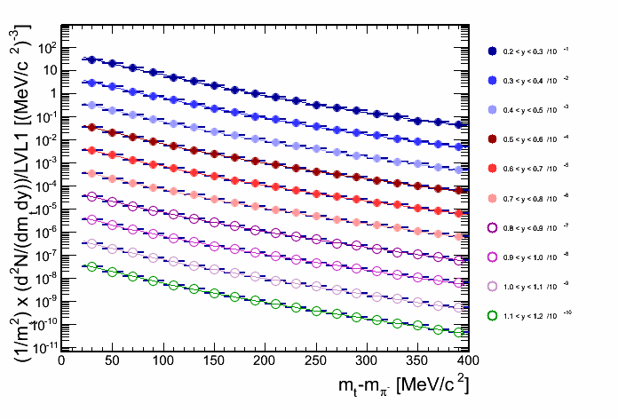
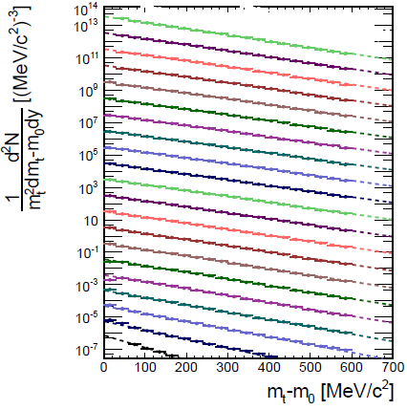
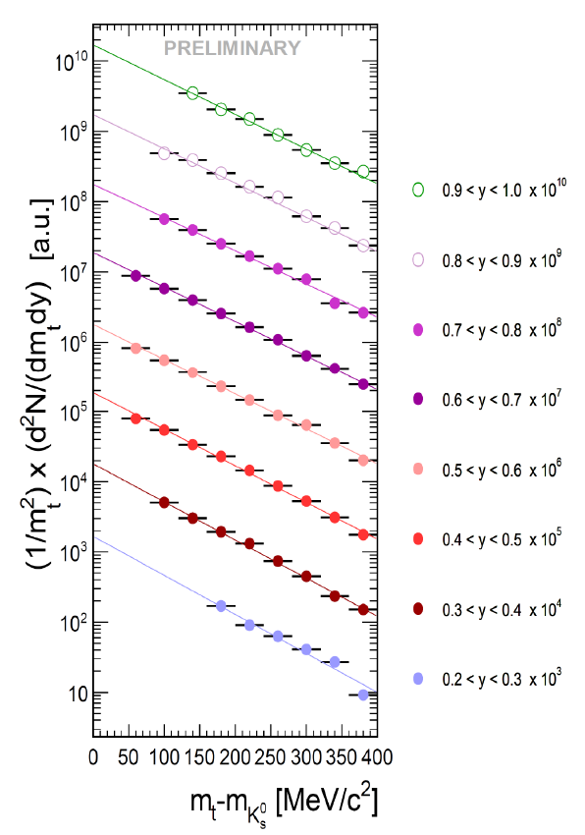
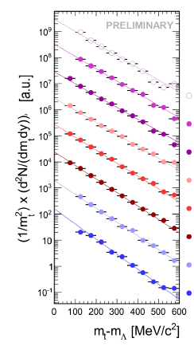
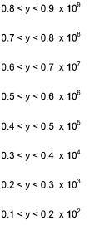
Particle spectra in 1.23 AGeV Au+Au collisions
p
π
HADES Preliminary
Rapidity:
0.065 – 1.165
Δy = 0.05
HADES Preliminary
Κ⁰_{s}
HADES Preliminary
Λ
HADES Preliminary

Slide 12
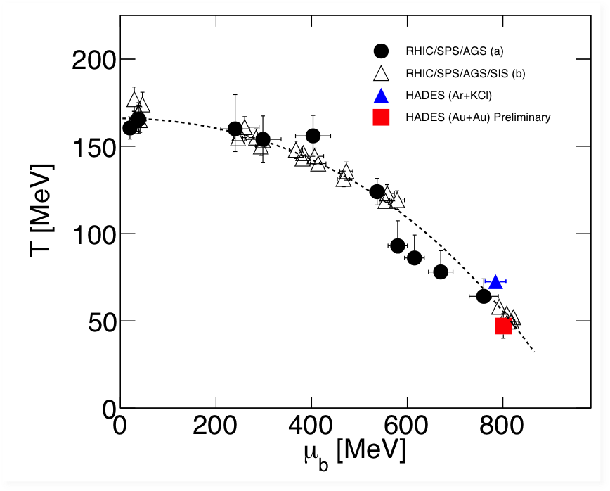
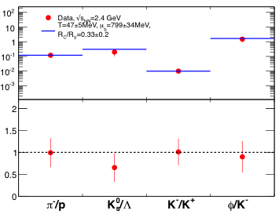
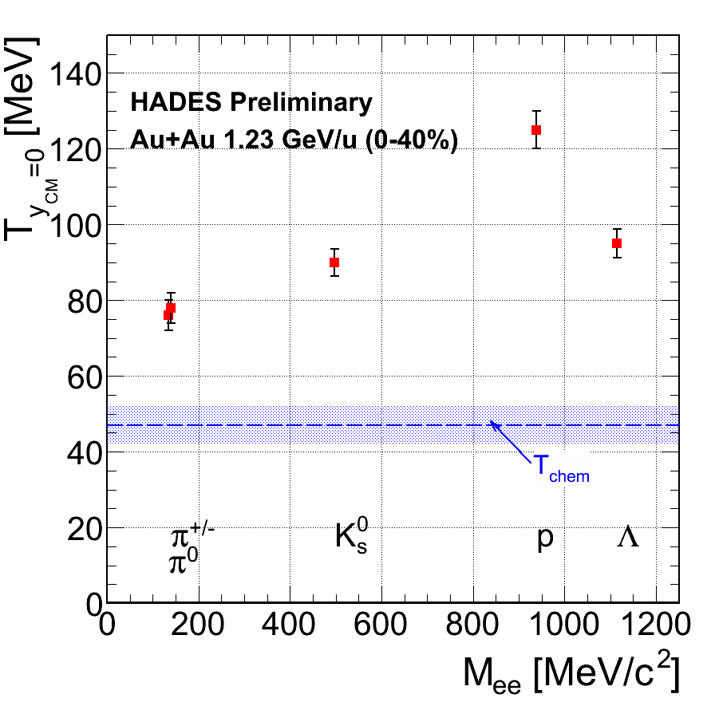
Hades and the phase diagram of QCD matter
Extracted (T, μ_{b}) fit in the systematics of the SHM
Thermal equilibrium also at low energies (high μ_{B})?
Thermal vs. chemical equilibrium?
-- THERMUS fit: J.Cleymans, J.Phys.G31(2005)S1069
HADES Au+Au data at 1.25 AGeV PRELIMINARY,
Ar+KCl: Phys.Rev.C80:025209,2009

Slide 13
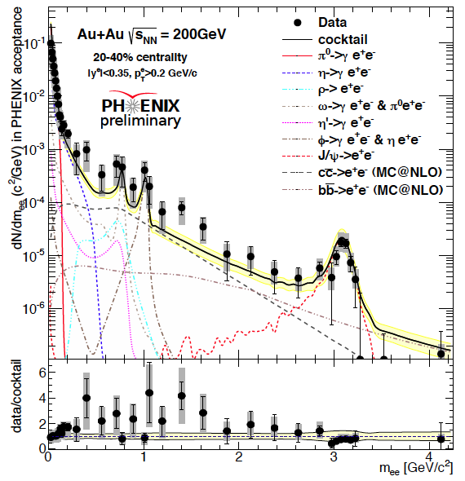
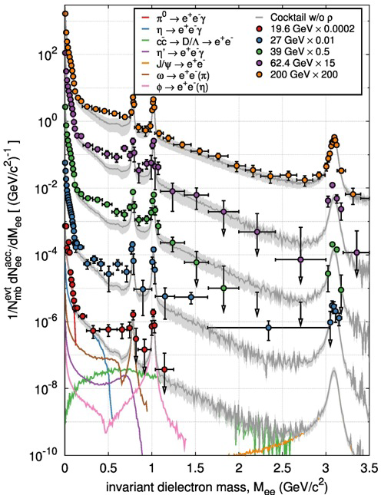
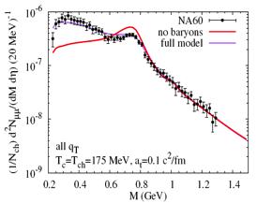
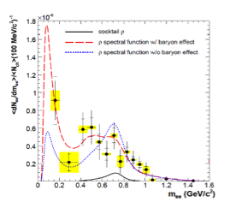



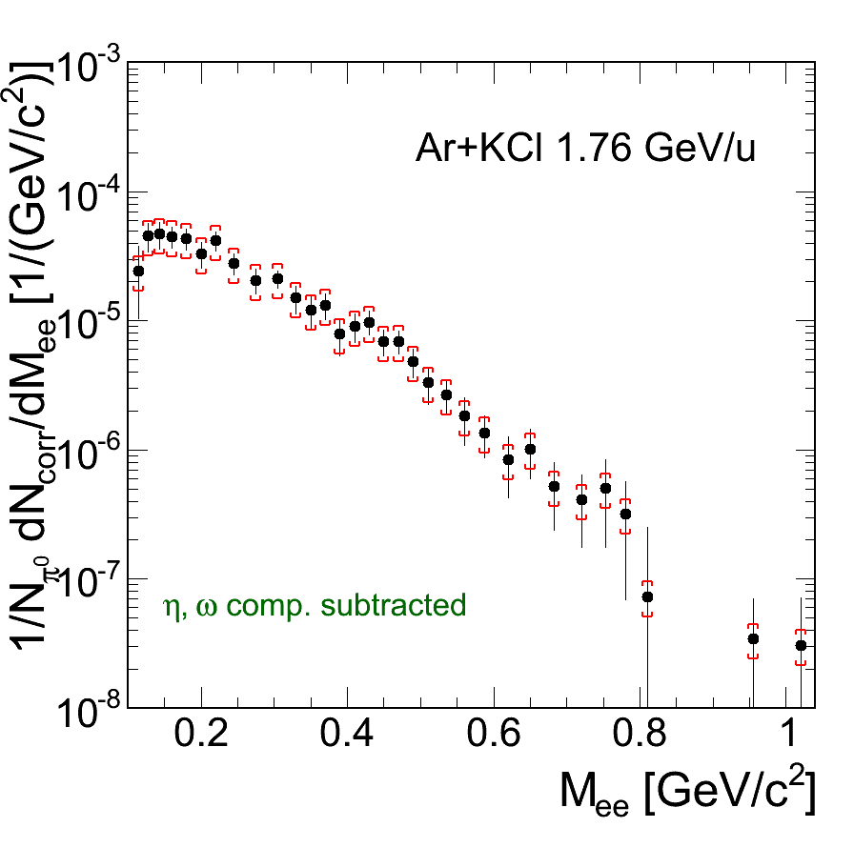

Virtual photon radiation from hot and dense
QCD matter
T
Model: Ralf Rapp
STAR: QM2014,
NA60: EPJC 59 (2009) 607,
CERES: Phys. Lett. B 666 (2006) 425,
HADES: Phys.Rev.C84 (2011) 014902
Highly interesting results from RHIC, SPS, SIS18
→ lepton pairs as true messengers
of the dense phase
μ_{B}

Slide 14
In-medium self energy of the rho
π
N*
π⁺
ρ
>
ρ
l⁺
SPS, RHIC, LHC
Δ
>
π⁻
l⁻
N⁻¹
N⁻¹
l⁻
ρ
l⁺
N*
SIS18
N
Resonance Dalitz-decays
NN bremsstrahlung
N
N
N
ρ - Δ/N* couplings play substantial role in ρ melting observed in UrHIC
→ connection to elementary process of baryon-resonance Dalitz-decays

Slide 15
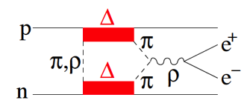
Lepton pairs from pp and np (tagged n) reactions at 1.25 GeV
Goal
Reference measurement for Au+Au at 1.23 AGeV
Exploring hadron electromagnetic structure
Results
Remarkable isospin effect!
First measurement of the Δ transition form factor in the time-like region
  Role of π EM form factor
  Double Δ excitation
  plus "final state" interaction Clement et al.
HADES : PLB 690 (2010) 118
Notes:
→ Understand Δ → Nγ* transition
One-π production at 1.25 GeV essentially due to delta excitation
Allows for the first time to extract the
Δ → pγ* branching ratio

Slide 16
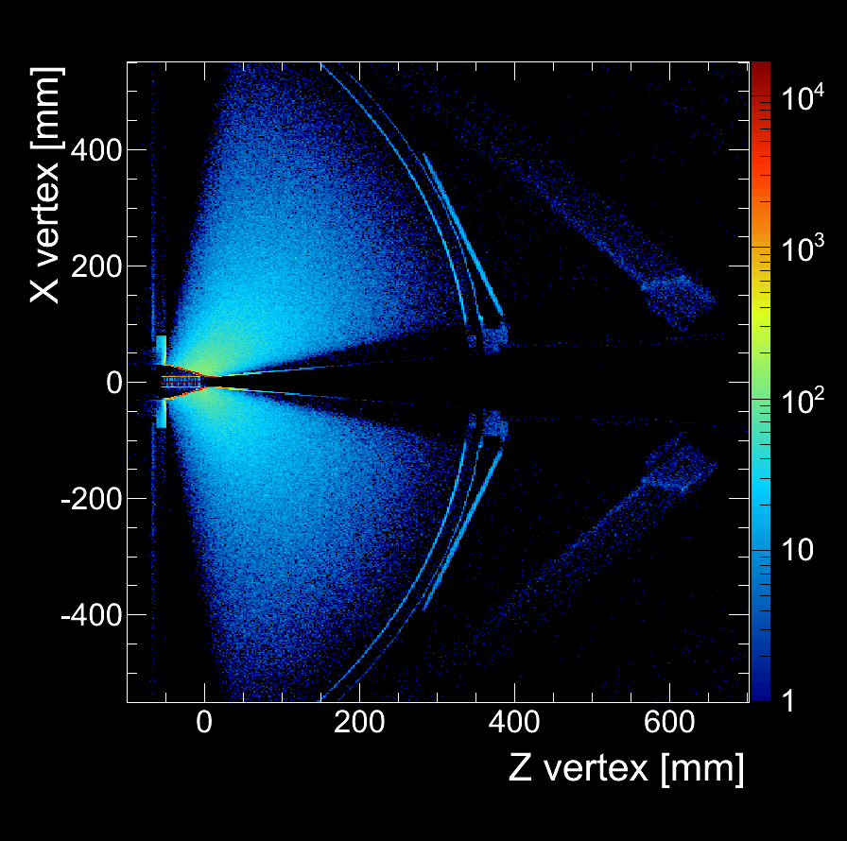
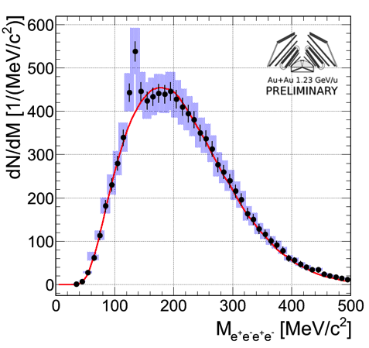
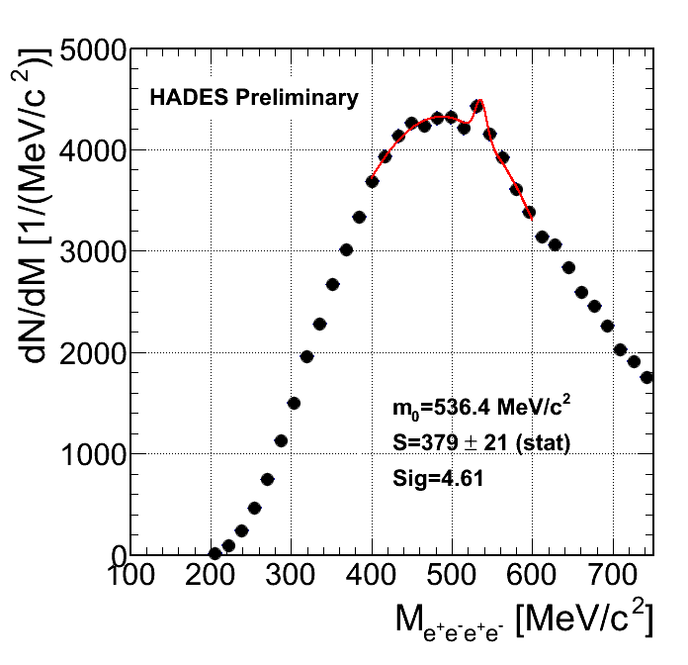
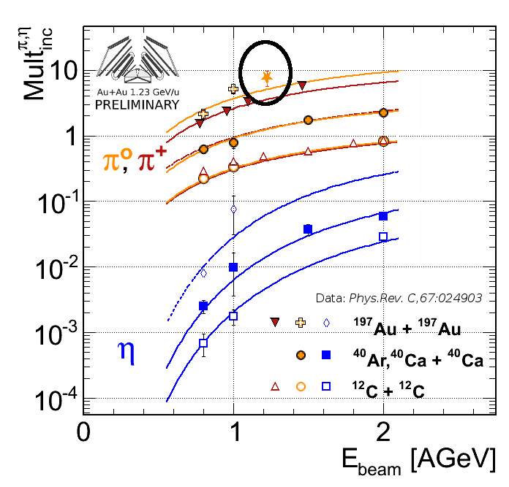
Fixing important components of the hadronic cocktail
PhD thesis: Claudia Behnke
π⁰ and η from full conversion method
π⁰
η
HADES low mass spectrometer
  Segmented target
  RICH: X/X₀ < 1%!
  MDC: X/X₀ ≈ 0.42%
→ specially optimized to minimize conversion and multiple scattering
HADES p+Nb Phys. Rev. C 88, 024904 (2013) η cross section provides constraint on Δ and N* contributions
Crucial component of the cocktail

Slide 17
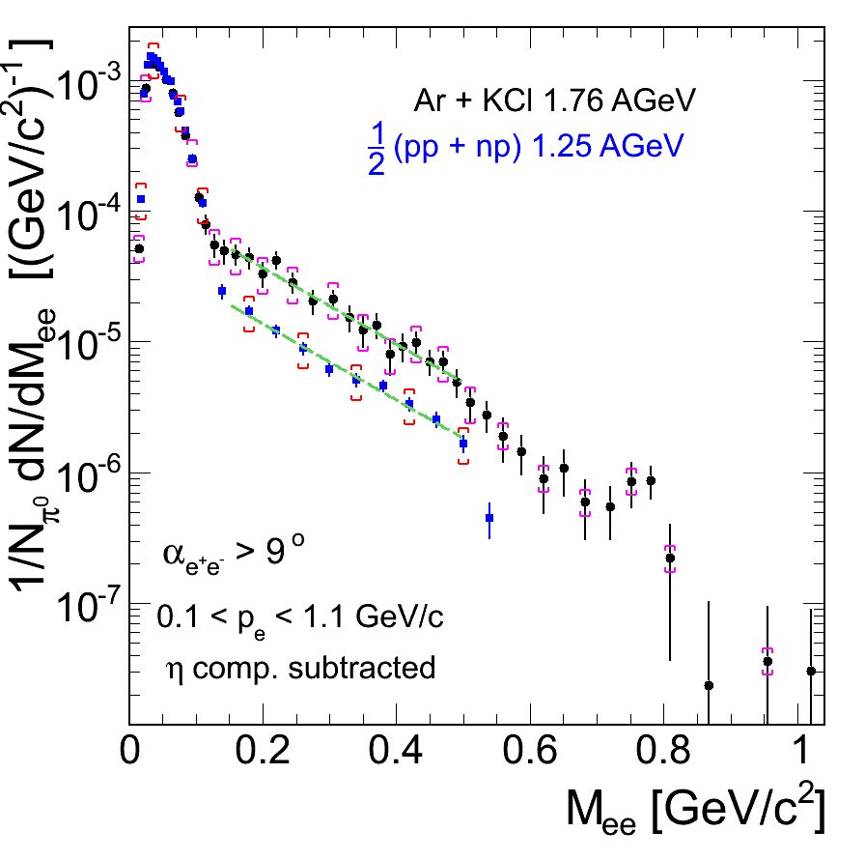
Virtual photon emission in A+A collisions
Ar+KCl compared to reference
after subtraction of contributions from η
Isolation of excess by a comparison with a measured “reference” spectrum
First evidence for radiation from the “medium” in this energy regime!
Excess yield scales with system
size like A_{part}^{1.4}
½[pp+pn]=C+C
^{x} 2.5 - 3
ω → e⁺e⁻
Quest for heavier systems!
HADES: Phys.Rev.C 84 (2011) 014902

Slide 18
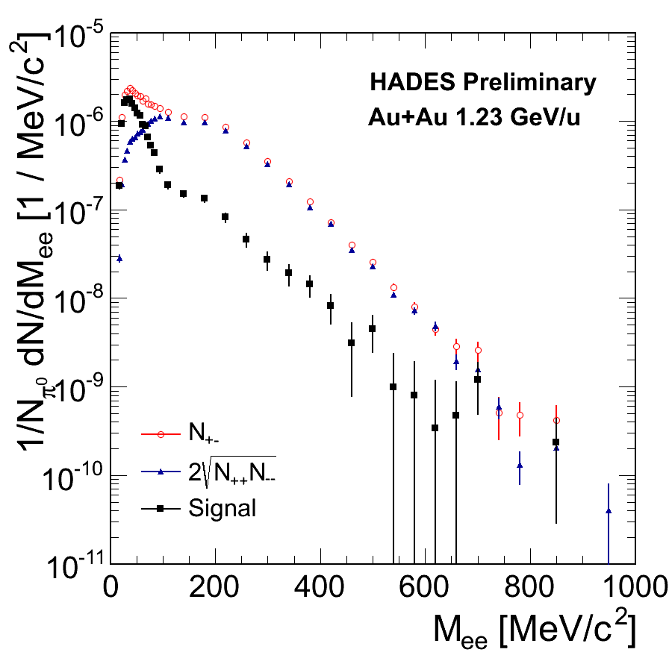
Reconstruction of the signal
PhD thesis:
Szymon Harabasz
Corrected for efficiency, not for acceptance, only a fraction of the total statistics analysed
Normalized to the number of produced
π⁰ (N_{πo} = 13±4)
Comb. Background (CB)
  Same-event like-sign pairs
  M_{ee} > 250 MeV/c² → Event mixing
  (in progress)
Signal (1/3 of the stat.):
  S₊₋ < 150 MeV/c²: ~105k counts
  S₊₋ ≥ 150 MeV/c²: ~ 20k counts
Almost exponential spectrum up to VM region!

Slide 19
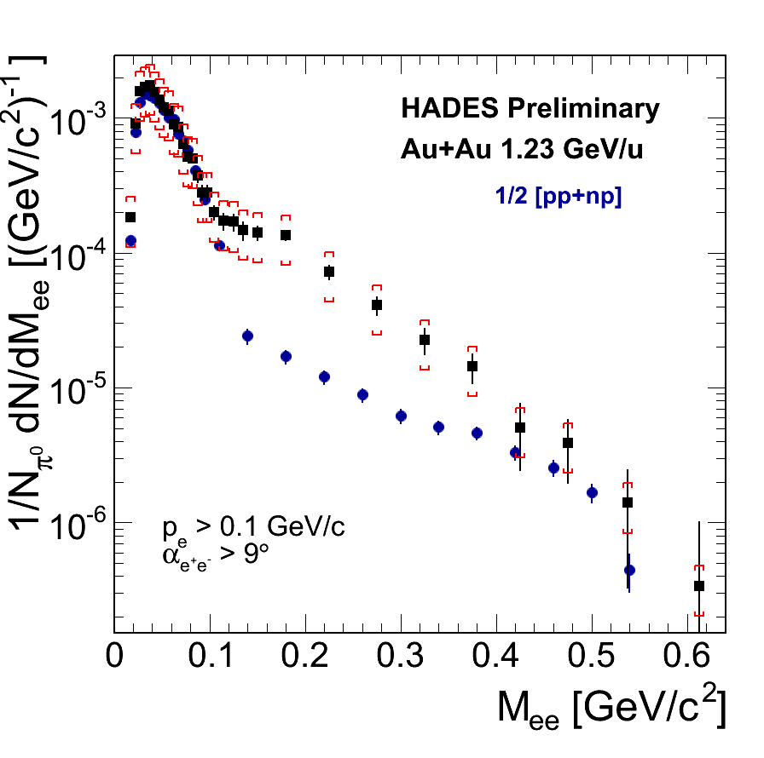
Virtual photon emission in Au+Au collisions at 1.25 AGeV
HADES “Resonance clock”
Excess yield scales with system
size like A_{part}^{1.4}
  Ar+KCl: 34% most central collisions (A_{part}=38)
  Au+Au: 40% most central collisions (A_{part}=180)
Rapid increase of relative yield reflects the number of Δ‘s/ N*’s regenerated in fireball
^{x} 8-10!

Slide 20
Reference for fair

Slide 21
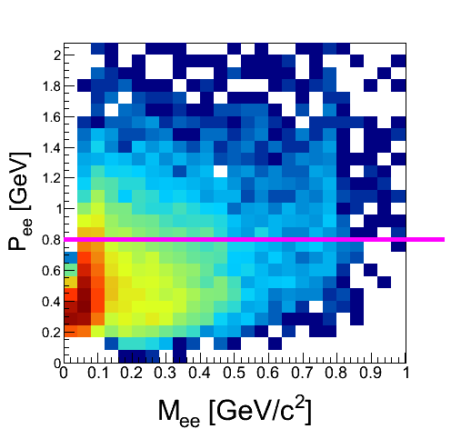
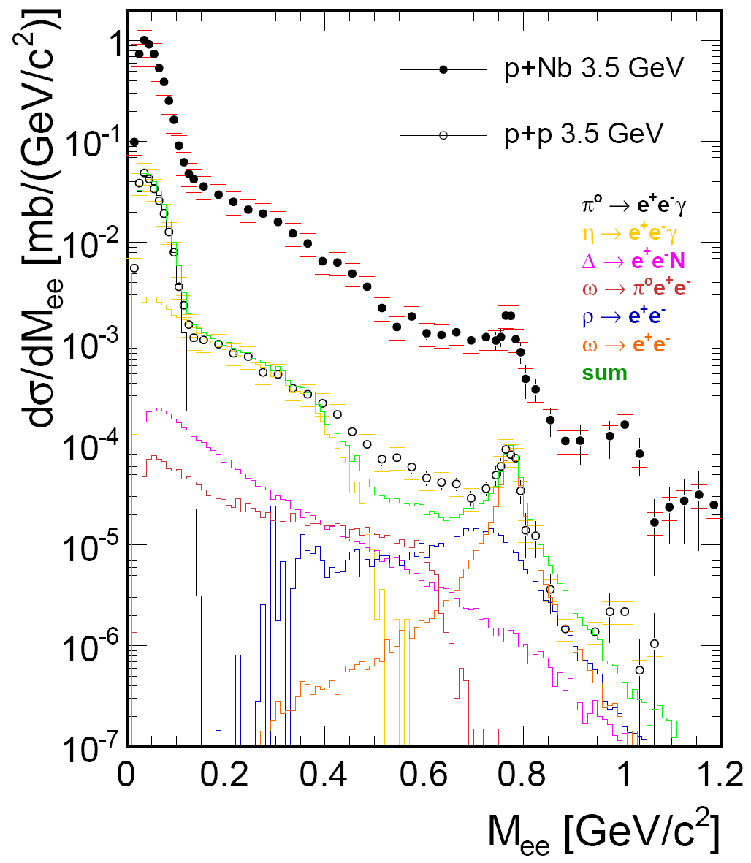
pp and pNb reactions at 3.5 GeV
First measurement of in-medium vector meson decays in the relevant momentum region (P_{ee} down to 200 MeV/c)
PDG Entry 2012, 2014
BR(η→e⁺e⁻) < 2.5x10⁻⁶ (90% CL)
Still far above theoretical
expectations: BR ≃ 5x10⁻⁹
HADES: Phys.Lett. B715 (2012) 304-309

Slide 22
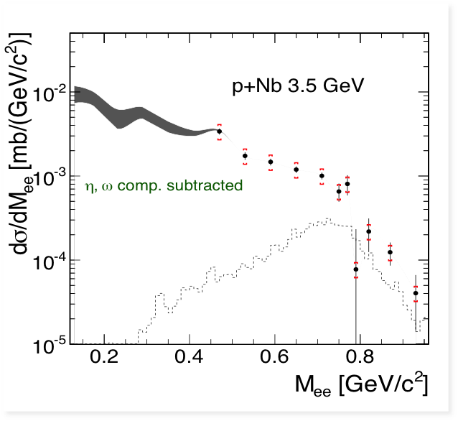
Prompt dielectrons from p+Nb
Prompt inclusive e⁺e⁻ invariant mass spectrum
Prompt in-medium dilepton excess isolated by comparison to measured decay cocktail
Systematic uncertainties due to accuracy on η multiplicities (-15%)
→ Coupling to baryon resonances:
introduces strong deviations from
Breit-Wigner shape
ρ
e⁺
N*
ρ
γ*
HADES: Phys.Lett. B715 (2012) 304-309
e⁻
N

Slide 23
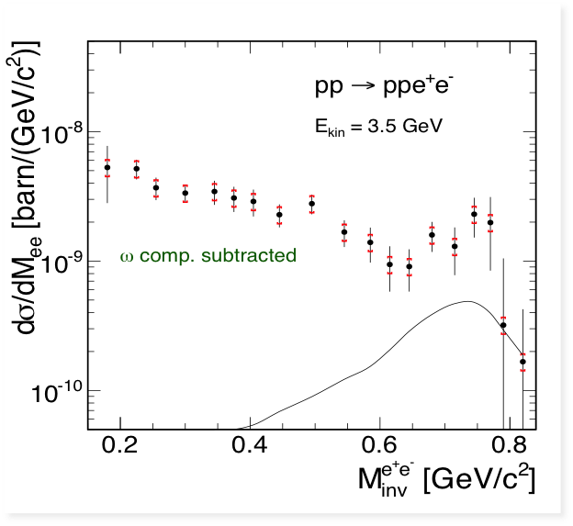
Exclusive dilepton production pp → pp e⁺e⁻
”if you are out to describe the truth, leave elegance to the tailor” (A. Einstein)
HADES Collab.: Eur. Phys. J. A (2014) 50: 82
ρ line shape in pp
ρ
R assumes no ρ contribut.
Significant contribution from higher (than Δ) mass resonances
fixed through decomposition of the exclusive π production: pp→ppπ⁰ and np→npπ⁺
In-medium ρ-line shape not settled before pp reference spectrum
fully understood!

Slide 24
nuclear equation-of-state and symmetry energy with hades?

Slide 25

Access to EoS and the symmetry energy with HIC?
K⁺ and K⁻ mass splitting due to vector potential
Probes:
Interplay EoS ←→ K potential
  Yields, in-, out-of-plane flow
Collective flow of protons and light nuclei
Far sub-threshold kaon production
  Differential analysis of K⁰_{s}/K⁺, K⁻/K⁺
η, dileptons and photon production are very sensitive to N/Z ratio of fireball
10 – 20%
… in isospin asymmetric systems
and central collisions
G.E Brown et al., Nucl. Phys. A 567 (1994) 937
T. Waas et al., Phys. Lett. B 379 (1996) 34
J. Schaffner-Bielich et al., Nucl. Phys. A 625 (1997)
C. Fuchs, Prog. Part. Nucl. Phys. 56:1-103,2006
Zhi-Gang Xiao et al., arXiv:1312.5790v1.pdf
Notes:
The equation of state of asymmetric nuclear matter is an
essential ingredient in nuclear physics and astrophysics but,
as of today, insufficiently constrained by experiment.
Heavy-ion reactions are a unique tool for obtaining
information on the symmetry energy in the laboratory, and a
considerable activity is presently devoted to its behavior at
sub- and supra-saturation densit
Compression (yield up rho^2) wins against repulsive K+ potential (yield down rho)

Slide 26



Kaon production and propagation mechanism in matter
p+Nb 3.5 GeV
Extraction of a strengths of the potential by means of microscopic transport model
  pA consistent with AA!
  Data support in-medium
  repulsive vector K⁰ potential ~40 MeV
− w/o pot
− with pot
Κ⁰_{s}
Ar+KCl 1.76 GeV/u
p+Nb: submitted to PRC
GiBUU J. Weil et. al., Eur. Phys. J. A 48:111, 2012
Ar+KCl: Phys.Rev.C82:044907,2009
IQMD C. Hartnack et al.,, Eur.Phys.J.A1:151, 1998
Κ⁰_{s}
+ Various aspects of hyperon
(Λ(1405), Σ(1385)) physics in pp and AA
PDG Entry 2012
Σ(1385)⁺ mass and width
p_{t} coverage down to 50 MeV/c

Slide 27



Azimuthal angular distributions of Kaons
HADES: Au+Au 1.23 AGeV
KaoS: Au+Au 1.5 AGeV
FOPI: Ni+Ni 1.91 AGeV
Κ⁺
Κ⁺
HADES Preliminary
Fitted with: f(Φ)=1+2v1*cos(Φ)+2v2*cos(2Φ))
Φ = Φ_{K+} – Φ_{RP}
FOPI collab., arXiv: 1403.1504v2 [nucl-ex]
Far subthreshold produced kaons highly sensitive to collective effects
Statistics is clearly improved! KaoS data: Ph.D. thesis A.Forster
K⁻ measured for the first time! → flow analysis
  HADES data complementary to FOPI and KaoS results
  will further constrain model calculations

Slide 28




Differential Flow in au+au collisions
Minimizes role of isoscalar part of the EoS
High statistic measurements of proton flow components
v1 and v2 components are in agreement with FOPI data (Open symbols: W. Reisdorf et. al. FOPI collab., Nucl. Phys. A 876 (2012))
Measurements of v3 and v4 for protons, but also for d and t and light nuclei
Additional input and check for model calculations
-v2
v1
v3
v4

Slide 29
What else?

Slide 30




Dark matter in the Universe : observations
Planck (2009)
  CMB
  Large-scale structures in the universe (galaxies, clusters of galaxies). In particular orbital velocity profiles of galaxies
  Also, hints from comic ray spectrum
  (e⁺/e⁻ excess > 10 GeV, 511 keV line)
  Muon g-2 anomaly
dark energy: 74%
Analysis of cosmic microwave background anisotropies
dark matter 22%
nuclear matter: 4%
Recent review: Bertone, Hooper & Silk, Phys. Rept. 405 (2005) 279, PDG 2012 long writeup
HADES
Searching the U boson !
in electromagnetic processes
η → γγ* → γe⁺e⁻
γU → γe⁺e⁻

Slide 31

Mixing parameter: Comparison with world data set
For the first time a rather broad mass range is covered: 0.02 < M_{U} < 0.6 GeV/c²
  Clear improvement at low masses (M_{U} < 0.1 GeV/c²)
  Complementary information to the KLOE-2 results at higher masses (M_{U} > 0.13 GeV/c²)
  Excludes to large degree the parameter range preferred by the muon g-2 anomaly
  → Au+Au e⁺e⁻ data might allow to constrain the low-mass region even further
Phys. Lett. B 731 (2014), pp. 265-271

Slide 32
Encouraging prospects for studying QCD matter
in the region of finite μ_{B}
Explore unknown territory of the nuclear matter phase diagram with HADES at SIS18:
  Unique possibility of characterizing properties of baryon dominated matter
  with rare probes:
    long-lived states of compressed nuclear matter are produced
    in heavy-ion collisions at few GeV energy regime
    this state of matter might be much more exotic than a hadron gas
  HADES and CBM at FAIR: Establish a complete excitation function of dilepton production up to energies of 40 AGeV:
    baryon dominated to meson dominated fireballs!
    from "transport" to "thermal expansion" models!
    from "no QGP" to "QGP”?

Slide 33
Thank you!

Slide 34
Still to come…

Slide 35



Pion beam run in 2014
Primary beam:
10¹¹ N (2A GeV) /spill
SIS fast ramping
Spill: 4s cycle
Stable run for 3 weeks!
Secondary π beam:
Intensity I=10⁶ π⁻/s
Momentum:
0.6 < p < 1.5 GeV/c
πA experiments:
  In-medium effects
  (strange and vector mesons)
πp experiments
  Resonance-Dalitz decays
  Special interest to sub-threshold
  vector meson production
Crucial to control the interpretation
of medium effects from SIS to LHC
Unique chance to study Time-Like electromagnetic structure of
higher lying resonances
Successful test of the pion tracker and beam optics in May 2014!
Ready for the beam in July and August!

Slide 36






Hades Performance studies at SIS100: Au+Au at 3.5 AGeV
Track reconstruction efficiency
Κ⁻
Λ
Mass vs. momentum distributions
Κ⁰_{s}
CB
π⁰ → γe⁺e⁻
ω → π⁰e⁺e⁻
η → γe⁺e⁻
ρ → e⁺e⁻
ω → e⁺e⁻
Δ→pe+e-

Slide 37


Searching the U boson in electromagnetic processes
The HADES approach:
Search for a peak structure in the
raw dN/dM_{ee} spectrum of known
mass resolution
If no peak found, get an UL on peak
Transform this UL into an UL on the mixing parameter ²
Compare with other experiments
If better, publish result
→ HADES Collaboration,
Phys. Lett. B Volume 731, 265-271
3.5 GeV p+Nb: UL at CL_{90%}
UL from data
median
±1σ from
±2σ resampling
UL on possible signal counts (CL_{90%})

