Slide 1


Study the QCD Phase Structure at the High Baryon Density
Nu Xu^{(1,2)}
Outline:
1) Introduction
2) Selected results from RHIC BES-I
3) Selected day-I observables for CBM
⁽¹⁾ College of Physical Science & Technology, Central China Normal University, China
⁽²⁾ Nuclear Science Division, Lawrence Berkeley National Laboratory, USA

Slide 2
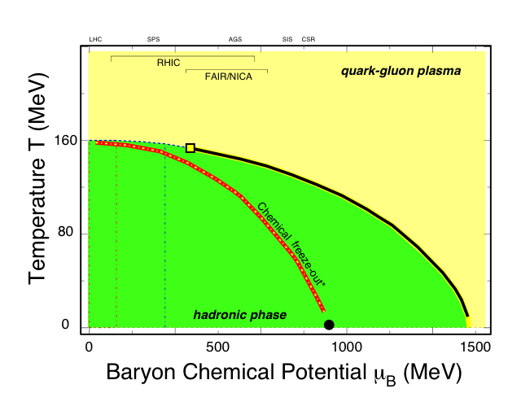
Exploring QCD Phase Structure
1
LHC, RHIC
2
RHIC
3
RHIC, FAIR
LHC+RHIC
Property of sQGP
√s_{NN} ~ 0.05 - 5 TeV
RHIC + FAiR
CP and
Quarkyonic Matter?
√s_{NN} ≤ 8 GeV
RHIC
CBM
Quarkyonic matter?
For region μ_{B} > 500 MeV, √s_{NN} ≤ 5 GeV, fixed-target experiments are much more efficient
RHIC BES-II
QCD CP and phase structure
√s_{NN} ≤ 20 GeV
39 11.5 8

Slide 3

QCD Thermodynamics
CBM RHIC LHC
SB Ideal Gas
                Zoltan Fodor, Lattice 2007
At μ_{B} = 0: cross over transition, 150 < T_{c} < 200 MeV
The SB ideal gas limit: T/T_{c} ~ 10⁷
T_{ini} (LHC) ~ 2-3*T_{ini} (RHIC)
Thermodynamic evolutions are similar for RHIC and LHC

Slide 4
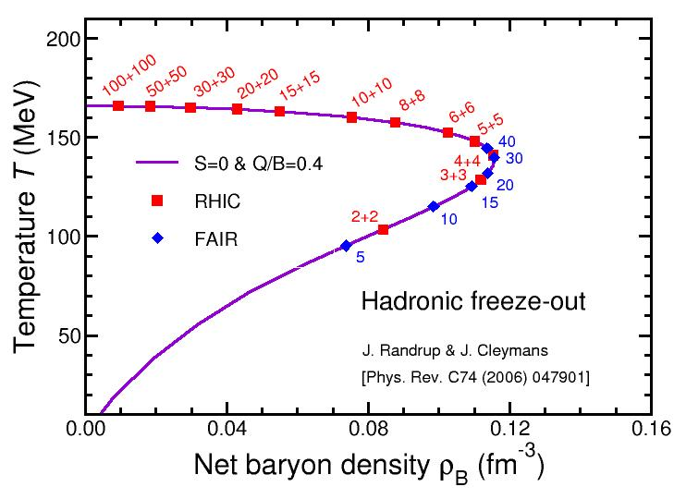
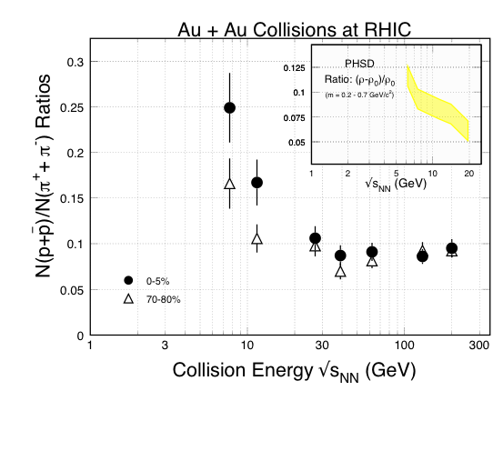
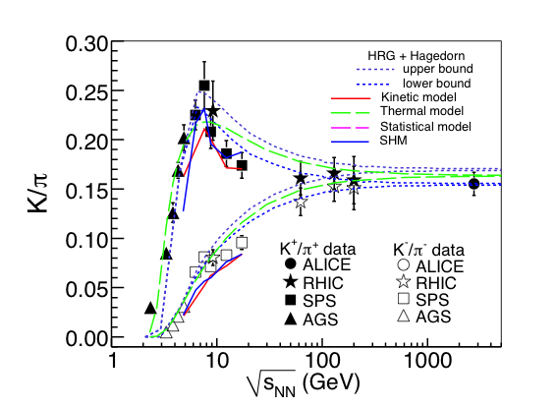
Baryon Density Peaks at ~ √s_{NN} = 8 GeV
1304.2969
High
Baryon
Density
CP
NICA (4 - 11)
????
2019
2018/19
CBM (2 - 5 - 8)
BESII (8 - 20)
Collision Energy √s_{NN} (GeV)

Slide 5
The CBM Experiment
Target
STS
RICH/TRD
TOF
EMCal
ZDC
FAIR: the highest intensity accelerator complex in the 21st century
Precision measurements at high baryon density region for:
(i) dileptons (e, μ); (ii) high order baryon correlations; (iii) flavor productions (s, c)

Slide 6
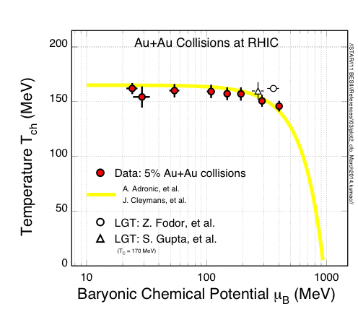
Bulk Properties at Freeze-out
CBM
STAR Preliminary
Chemical Freeze-out: (GCE)
- RHIC (20 ≤ μ_{B} ≤ 420 MeV): small temperature variation
- CBM (400 ≤ μ_{B} ≤ 750 MeV): temperature changes dramatically!

Slide 7
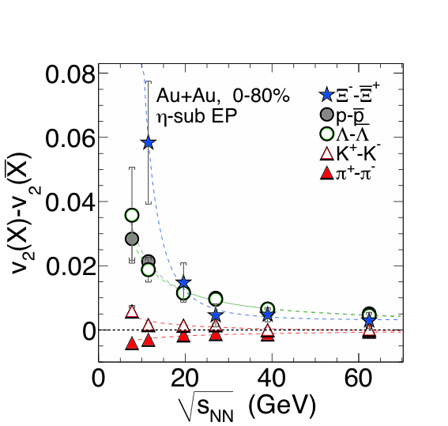
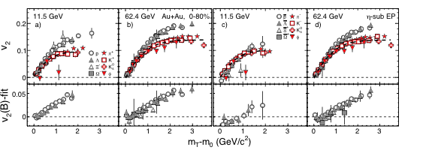
Collectivity v₂ Measurements
STAR: Phys. Rev. Lett. 110 (2013) 142301
Number of constituent quark (NCQ) scaling in v₂ => partonic collectivity => deconfinement in high-energy nuclear collisions
At √s_{NN} < 11.5 GeV, the universal v₂ NCQ scaling is broken, consistent with hadronic interactions becoming dominant.

Slide 8
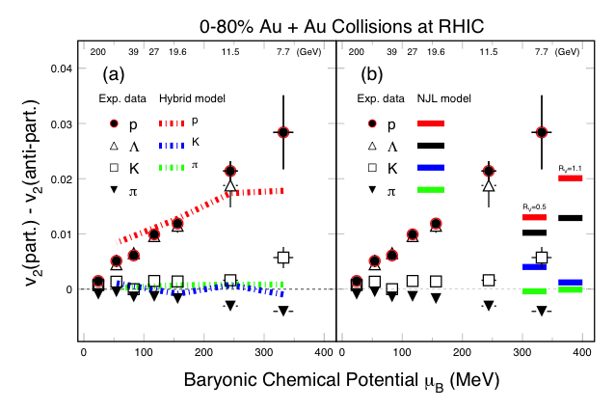
BES v₂ and Model Comparison
Hydro + Transport: consistent with baryon data.
[J. Steinheimer, V. Koch, and M. Bleicher PRC86, 44902(13).]
(b) NJL model: Hadron splitting consistent. Sensitive to vector-coupling, CME, net-baryon density dependent. [J. Xu, et al., arXiv:1308.1753/PRL112.012301]

Slide 9
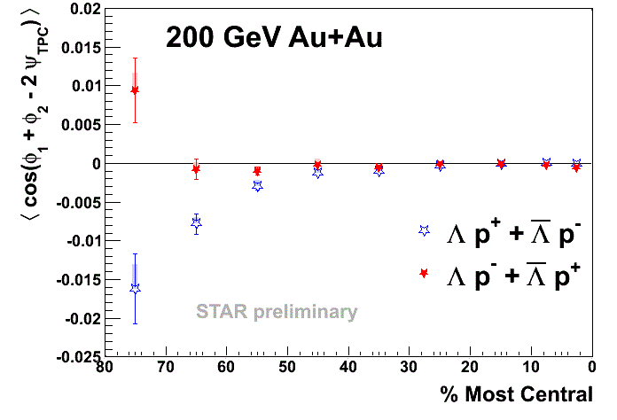
Chiral Effects
Hot/dense QCD Medium
Parity odd domains form
Chiral Vortical Effect
Λ-proton correlation measurement:
External Magnetic Field
Initial Angular Momentum ➔ Fluid Vorticity
Chiral magnetic effect (CME)
(electric charge)
Chiral vortical effect (CVE)
(baryon charge)
The opposite baryon number (Λ-pbar or Λbar-p) correlations (OB) are similar
The same baryon number (Λ-p or Λbar-pbar) correlations (SB) are lower than that of the OB, as expected from the CVE.
D. Kharzeev, D.T. Son, PRL106, 062301(11)
D. Kharzeev. PLB633, 260 (06)
D. Kharzeev, et al. NPA803, 227(08)

Slide 10
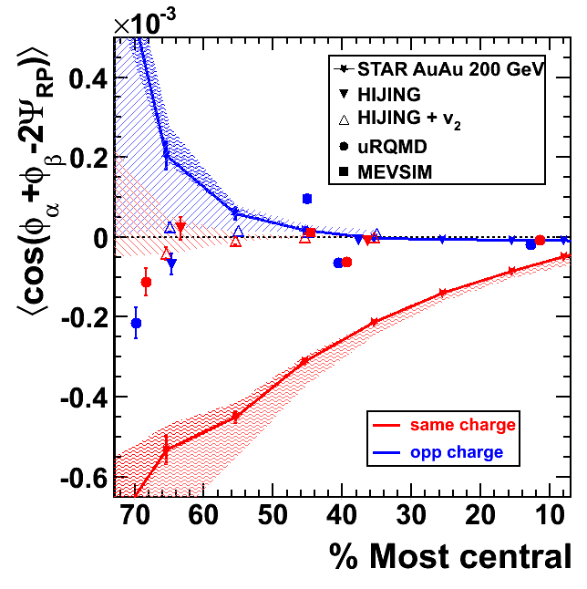
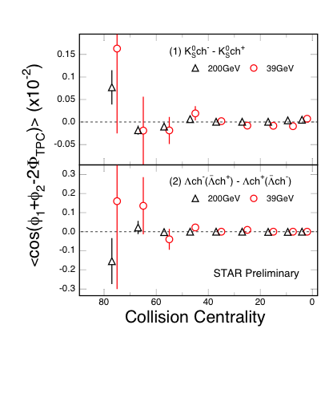
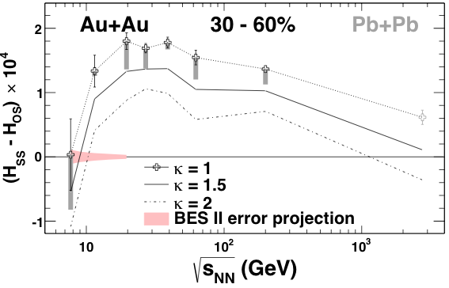
Charge Separation wrt Event Plane
SS - OS
LPV(CME) disappears: with neutral hadrons:
LPV(CME) disappears at low energy:
hadronic interactions become dominant at √s_{NN} ≤ 11.5 GeV
STAR: PRL. 103, 251601(09)
D. Kharzeev. PLB633, 260 (06)
D. Kharzeev, et al. NPA803, 227(08)
STAR: submitted to PRL, arXiv: 1404.1433

Slide 11
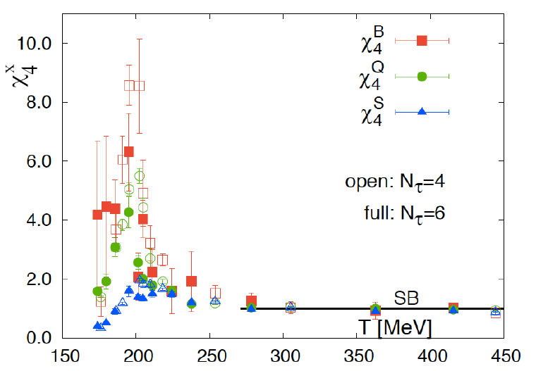
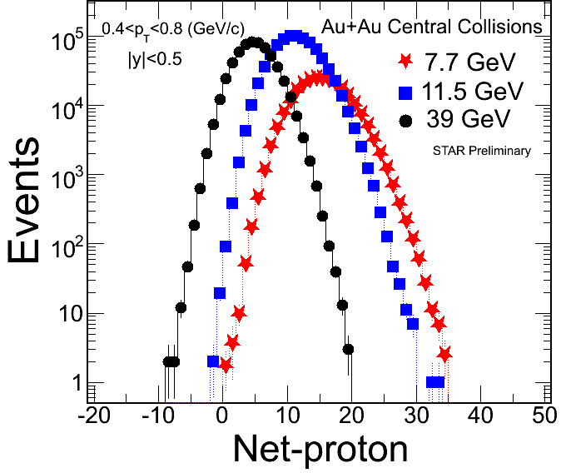
Higher Moments
1) Higher moments of conserved quantum numbers: Q, S, B, in high-energy nuclear collisions
2) Sensitive to critical point (ξ correlation length):
3) Direct comparison with calculations at any order:
Extract susceptibilities and freeze-out temperature. An independent/important test of thermal equilibrium in heavy ion collisions.
References:
- STAR: PRL105, 22303(10); ibid, 032302(14)
- M. Stephanov: PRL102, 032301(09) // R.V. Gavai and S. Gupta, PLB696, 459(11) // F. Karsch et al, PLB695, 136(11) // S.Ejiri et al, PLB633, 275(06)
- A. Bazavov et al., PRL109, 192302(12) // S. Borsanyi et al., PRL111, 062005(13) // V. Skokov et al., PRC88, 034901(13)
μ_{B} = 0

Slide 12
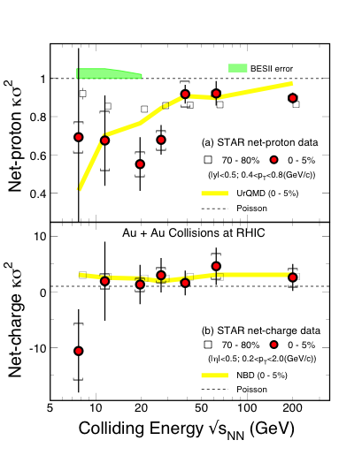
Higher Moments Results
BESII
Net-proton results:
All data show deviations below Poisson for κσ² at all energies. Larger deviation at √s_{NN}~20GeV
UrQMD model shows monotonic behavior in the moment products
STAR: PRL112, 32302(14)/arXiv: 1309.5681
Net-charge results:
No non-monotonic behavior
More affected by the resonance decays
STAR: arXiv: 1402.1558
P. Garg et al, PLB726, 691(13)
BESII is needed:
Higher statistics needed for collisions at √s_{NN} < 20 GeV
Comparing to LGT calculations
T_{f} = 146 ± 6 MeV ,√s_{NN} > 39 GeV

Slide 13
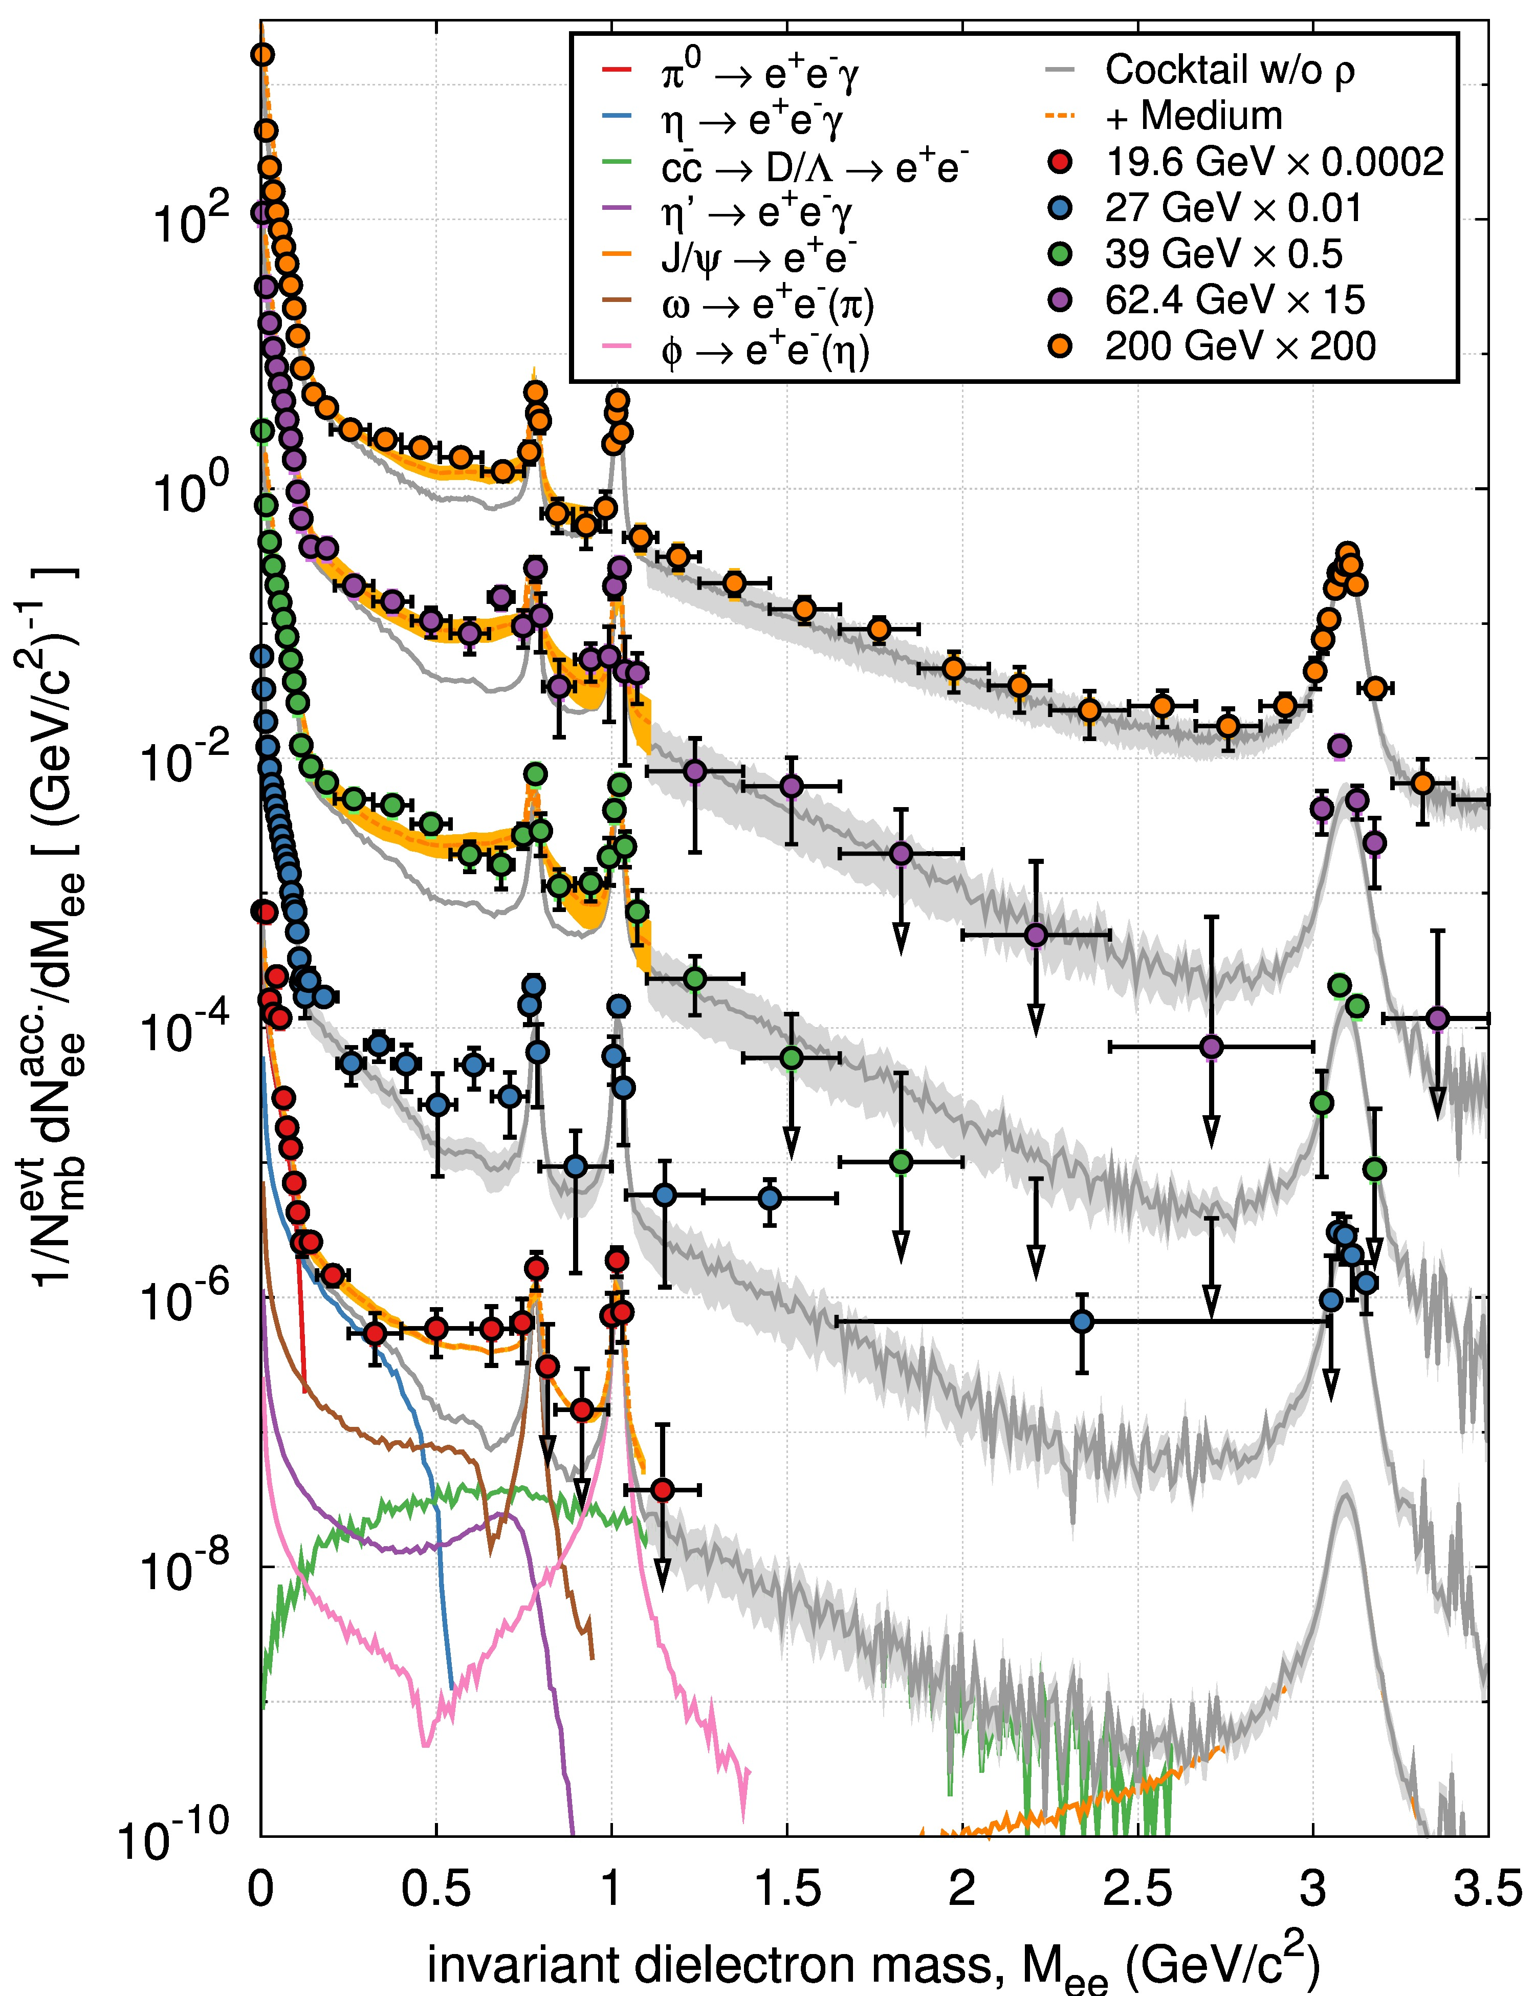
Energy Dependence of Di-electrons
Bulk-penetrating probe:
M_{ee} ≤ 1GeV/c²: In-medium broadened ρ, model results* are consistent with exp. data. At 200GeV, the enhancement is in the order of 1.77±0.11 ±0.24±0.33 within 0.3<M_{ee}<0.7GeV/c²) (* driven by the baryon density in the medium)
1≤M_{ee} ≤ 3GeV/c²: Thermal radiation: exp(-M_{ee}/T)? HFT: Charm contributions.
High statistics data are needed, BESII!
- STAR: (200GeV data) sub. to PRL. 1312.7397
- R. Rapp: PoS CPOD13, 008(2013)
- O. Linnyk et al, PRC85, 024910(12)
STAR Preliminary
200GeV
62.4GeV
39GeV
27GeV
19.6GeV

Slide 14
Day-I Observables at CBM
Hadron spectra and anisotropies: π, K, p, Φ, Λ, Ξ, Ω
- Freeze-out property
- Phase boundary
Baryon/strangeness correlations: κ(net-Q, net-p, net-s)
- Critical point, phase boundary
- Global Chiral effect
Dilepton spectra m_{ll}(b, p_{T}, A)
- Chiral property, quarkyonic matter
Exotics, …

Slide 15
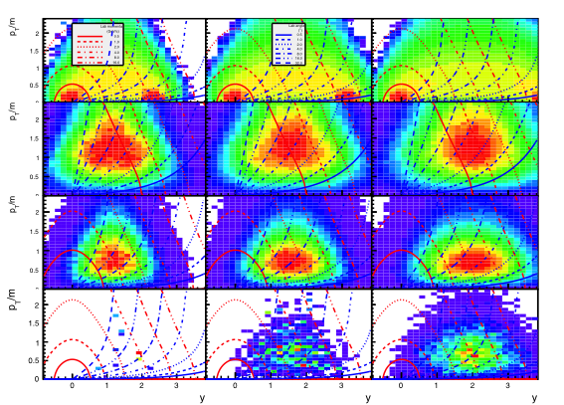
Phase Space vs. Acceptance
Beam E/A (√s_{NN}) = 4 (3.05) GeV 10 (4.54) GeV 25 (6.98) GeV
proton
pion
Kaon⁺
pbar

Slide 16
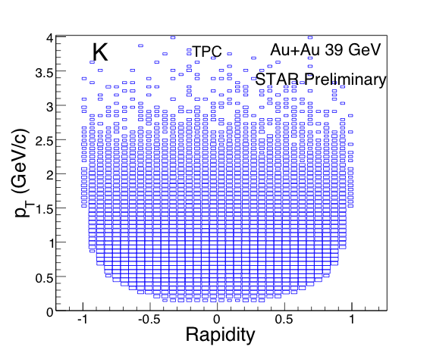
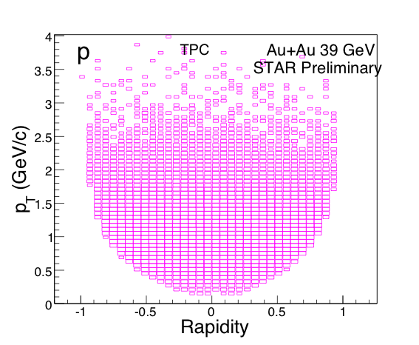
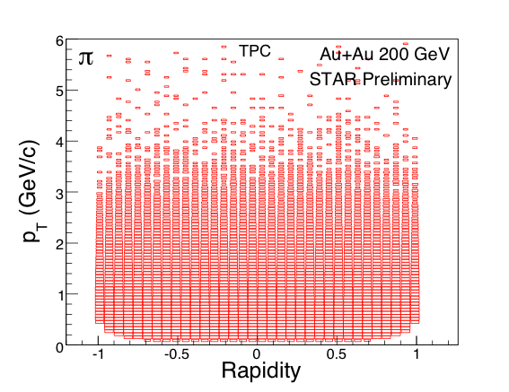
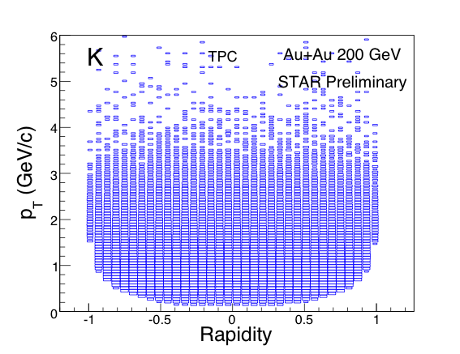
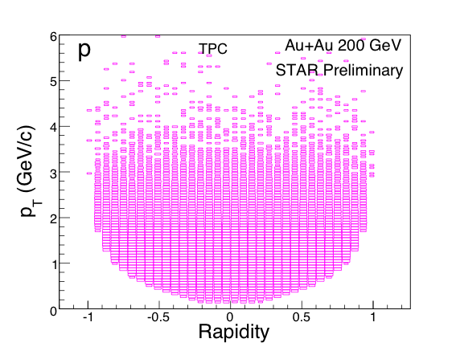
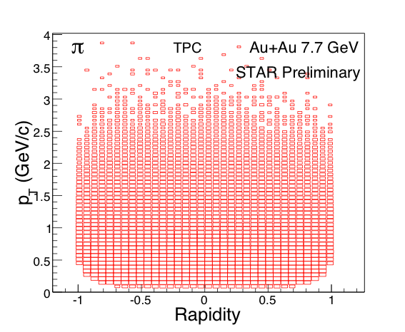
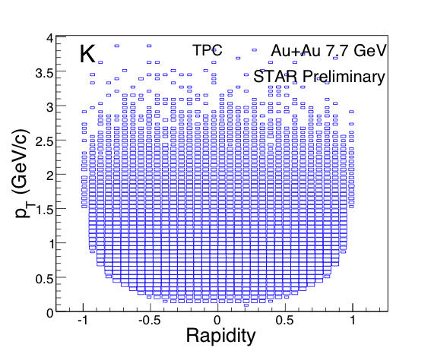
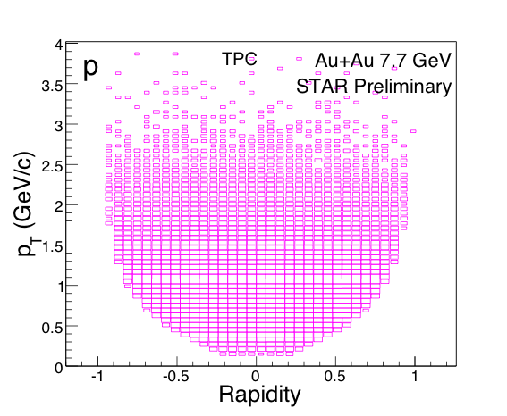
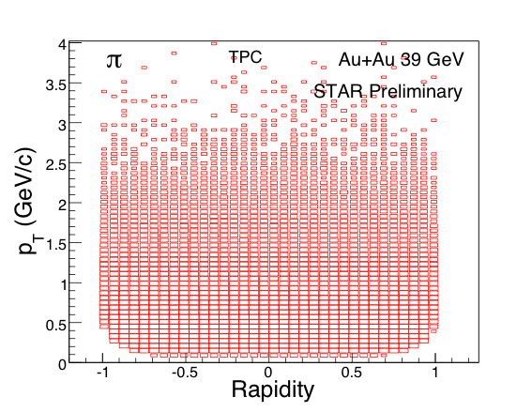
STAR PID for (π, K, p)
Au+Au at 7.7 GeV Au+Au at 39 GeV Au+Au at 200 GeV

Slide 17
Exploring QCD Phase Structure
1
LHC, RHIC
2
RHIC
3
RHIC, FAIR
LHC+RHIC
Property of sQGP
√s_{NN} ~ 0.05 - 5 TeV
RHIC + FAiR
CP and
Quarkyonic Matter?
√s_{NN} ≤ 8 GeV
RHIC
CBM
Quarkyonic matter?
For region μ_{B} > 500 MeV, √s_{NN} ≤ 5 GeV, fixed-target experiments are much more efficient
RHIC BESII
QCD CP and phase structure
√s_{NN} ≤ 20 GeV
39 11.5 8

