Slide 1



JUAS: accelerator training between Universities and Laboratories
Louis Rinolfi
1st October 2014

Slide 2
The School is 17 km South of CERN
CERN
JUAS

Slide 3

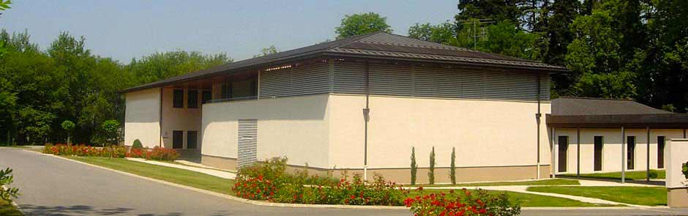


Bâtiment Mont Blanc 1
61 rue Antoine Redier
Archamps Technopole
F-74166 Saint-Julien-en-Genevois Cedex
Tél: 04 56 44 81 40
The “Conseil Général de Haute Savoie” provides financial support to ESI which organizes JUAS
“Archamps Technopole” provides ESI with facilities for the organization of the school including amphitheaters and computing room

Slide 4
JUAS started in 1994 at Archamps - France
JUAS Directors :
1994 – 2000 : Marcelle Rey-Campagnolle
2001 – 2005 : Joël Le Duff
2006 – 2010 : François Méot
2011 – : Louis Rinolfi
JUAS lecturers : 122 since 1994
JUAS students : more than 800 since 1994
JUAS is supervised by 15 European Universities and several Laboratories:
=> Advisory Board composed of 26 members

Slide 5
15 European Universities partners of JUAS
Universities | Since | Members of Advisory Board in 2014
Université Joseph Fourier Grenoble (UJF) | 1994 | Jean-Marie De Conto
Technische Universität Darmstädt | 1994 | Joachim Enders
Karlsruher Institut fur Technologie (KIT) | 1994 | Anke-Susanne Müller
Grenoble INstitut Polytechnique (Grenoble INP) | 1994 | Elsa Merle-Lucotte
Universitat Autonoma de Barcelona (UAB) | 1994 | Antoni Mendez
Università degli studi di Napoli “Federico II” | 1994 | Vittorio Vaccaro
Universitat Politècnica de Catalunya (UPC) | 1994 | Youri Koubychine
Università degli studi di Roma “La Sapienza” | 1994 | Mauro Migliorati
Università degli studi di Genova | 2002 | Marco Bozzo
Technische Universität Berlin | 2002 | Heino Henke
Universitat de Valencia | 2002 | Angeles Faus-Golfe
University of Liverpool | 2011 | Carsten Welsch
Université Paris-Sud Orsay | 2012 | Patrick Puzo
University of Rostock | 2013 | Ursula van Rienen
University of Oxford | 2014 | Andrei Seryi

Slide 6















Logos of the 15 European Universities
Barcelona
Napoli
Oxford

Slide 9
11 representatives from Institutes
Institutes | Members of Advisory Board
ESI President | Hans Hoffmann
ESI administrator | Marie Gauthier
JUAS Director | Louis Rinolfi
JUAS Deputy Director | Elias Métral
CAS Director (CERN Accelerator School) | Roger Bailey
Oxford University | Chris Prior
ESRF (European Synchrotron Radiation Facility) | Jean-Luc Revol
PSI (Paul Scherrer Institute) | Terry Garvey
GSI (GSI Helmholtzzentrum für Schwerionenforschung) | Peter Forck
DESY (Deutsches Elektronen-Synchrotron) | Winfried Decking
BNL (Brookhaven National Laboratory) | François Méot

Slide 10

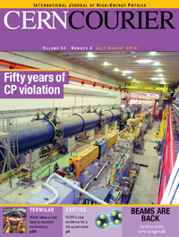
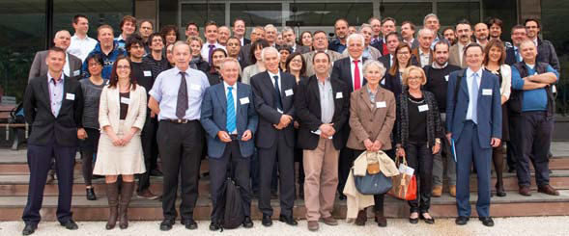
JUAS 20 years anniversary
Friday 25th April 2014
Brochure
July / August 2014
Article in the CERN Courier about this anniversary

Slide 11
Overview of JUAS courses 2014
Course 1 : Sciences and Physics of Particle Accelerators
Course 2 : Technology and Applications of Particle Accelerators
 | Number of professors + assistants | Lectures | Tutorials | Seminars | Total
Course 1 | 17 | 72 h | 34 h | 2 h | 108 h
Course 2 | 19 | 63 h | 24 h | 1 h | 88 h
 |  | Visits (CERN, ESRF, PSI, HUG) | Practical works at CERN | Practical works at BERGOZ | Grand total
Course 1 | 108 h | 8 h | - | - | 116 h
Course 2 | 88 h | 16 h | 6 h | 6 h | 116 h

Slide 12
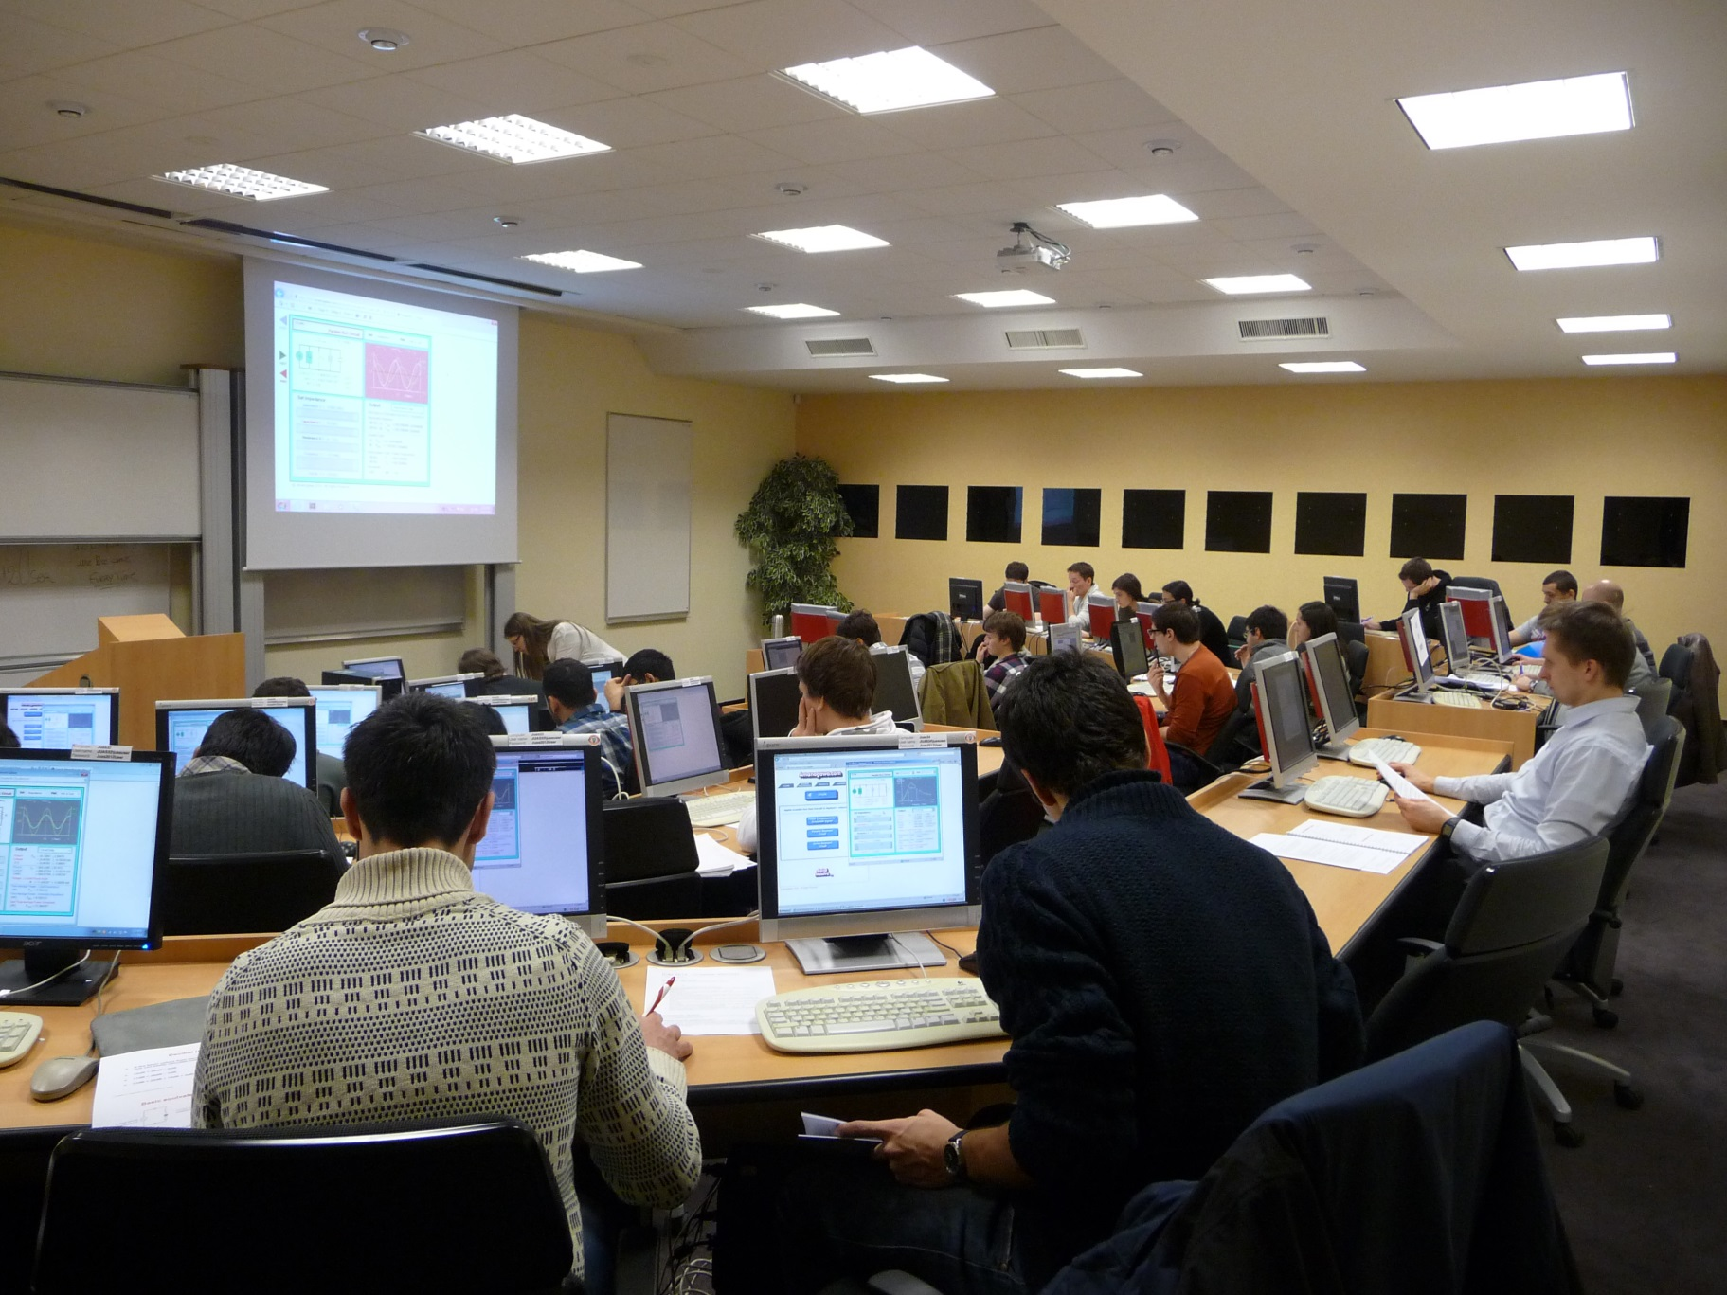
Computing room
connected to the CERN servers via optic fibres

Slide 13
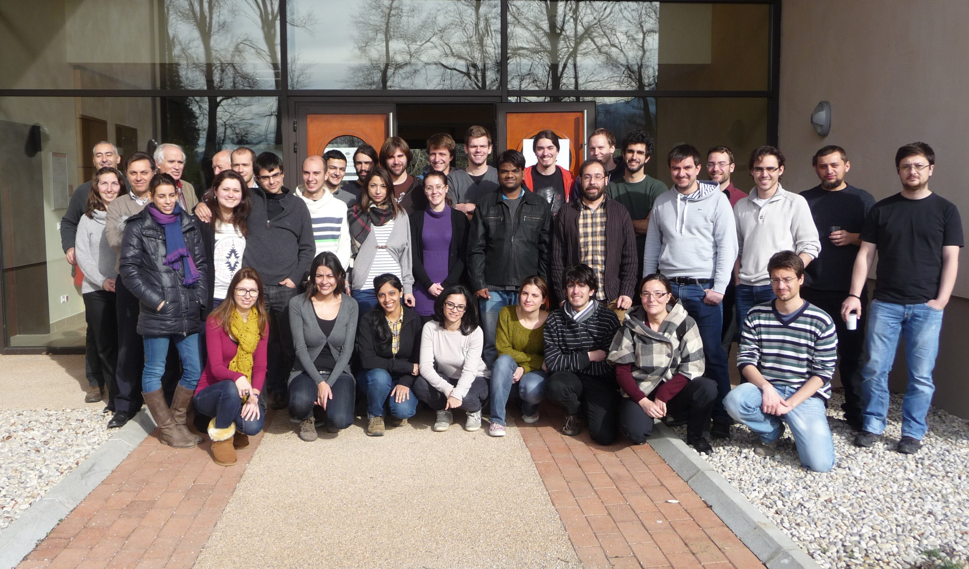
Students JUAS 2014 – Course 1
Sciences & Physics of Particle Accelerator

Slide 14
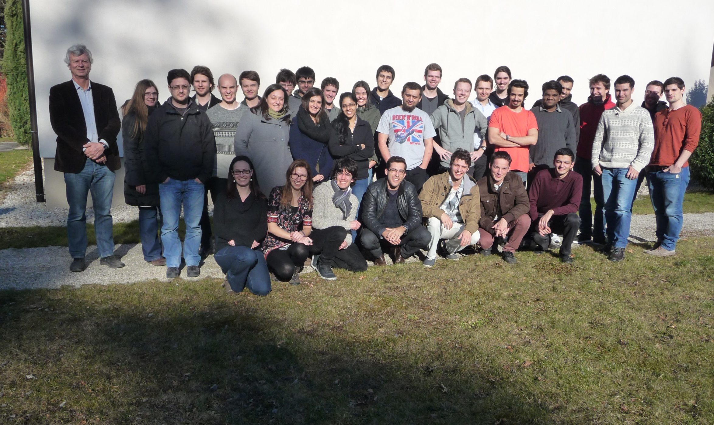
Students JUAS 2014 – Course 2
Technology & Applications of Particle Accelerator

Slide 15
Overview of students status
2014 | Masters | PhD | Professionals | Total | Presented exam
Course 1 | 12 | 19 | 3 | 34 | 30
Course 2 | 16 | 10 | 5 | 31 | 25
2013 | Masters | PhD | Professionals | Total | Presented exam
Course 1 | 13 | 20 | 12 | 45 | 30
Course 2 | 12 | 9 | 18 | 39 | 19
2012 | Masters | PhD | Professionals | Total | Presented exam
Course 1 | 20 | 4 | 13 | 37 | 25
Course 2 | 21 | 8 | 11 | 40 | 28

Slide 16
JUAS students 2014 by countries

Slide 17
Professors and assistants – Course 1
Professors / Assistants | Lecture | Home
P. Bryant | Introduction to Accelerators | England
H. Henke | Relativity & Electromagnetism | University Berlin
J.M. De Conto | Particle optics | University J. Fourier
A. Latina / J. Resta Lopez / R. Alemany | Transverse Beam Dynamics | CERN
G. Sterbini / D. Pellegrini | MADX | CERN
E. Métral / E. Benedetto | Longitudinal Beam Dynamics | CERN
J.B. Lallement / V. Dimov | Linacs | CERN
Y. Papaphilippou | Linear imperfections + Non linear effects | CERN
M. Migliorati | Space charge + Instabilities | University Roma
R. Bartolini | Synchrotron radiations | Oxford University
F. Chautard | Cyclotrons | GANIL
T. Perron | Injection / Extraction | ESRF

Slide 18
Professors and assistants – Course 2
Professors / Assistants | Lecture | Home
F. Caspers / S. Federmann | RF engineering including superconductivity | CERN
P. Chiggiato / R. Kersevan | Vacuum | CERN
Russenschuck + Tommasini | Magnets design | CERN
T. Zickler / J. Bauche | Normal conducting magnets | CERN
M. Wilson / P. Ferracin | Superconducting magnets | Oxford Instruments
P. Forck | Beam instrumentation | GSI - Darmstadt
T. Thuillier | Particle sources | J. Fourier university
E. Zimoch | Accelerator control | PSI - Villigen
W. Mondelears | Low energy electron accelerators | Gent university
W. Kleeven | Accelerators for industrial & medical appl. | IBA - Belgium
S. Bousson | High current proton linacs | IN2P3/IPNO - Orsay
R. Miralbell | Therapeutic applications | HUG - Geneva
S. Meyroneinc | Particle therapy and accelerators | Institut Curie - Paris
X. Queralt | Radiation safety | ALBA - Barcelona

Slide 19
Evaluation proposed to the students for lectures and tutorials
Notations used
Requested Level | Oral Presentation (Pedagogy) | Written Documentation
Too easy = 5 As expected = 3 Too difficult = 0 | Excellent = 5 As expected = 3 Bad = 0 | Excellent = 5 As expected = 3 Not acceptable = 0

Slide 20
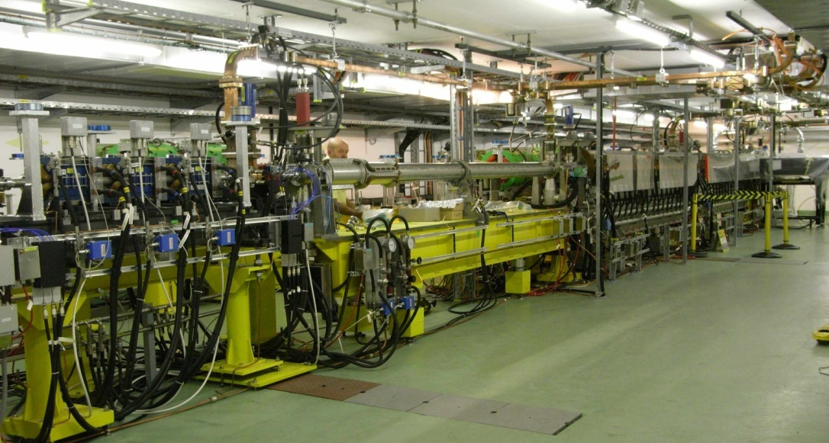
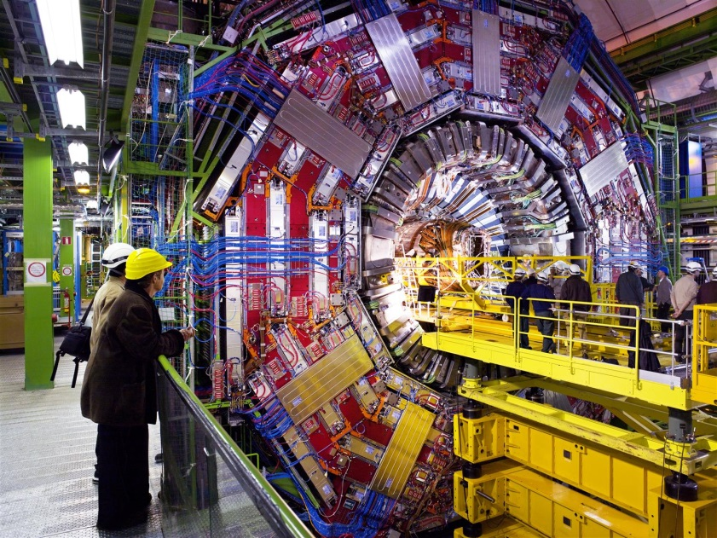
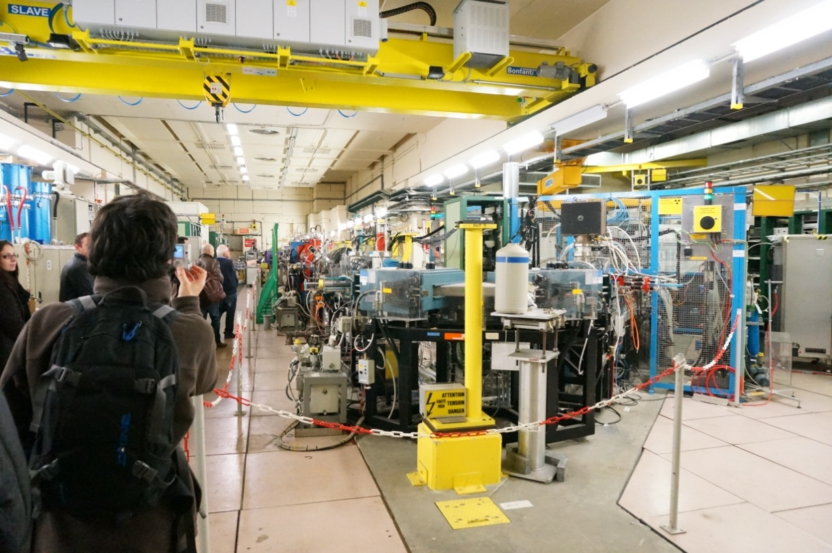
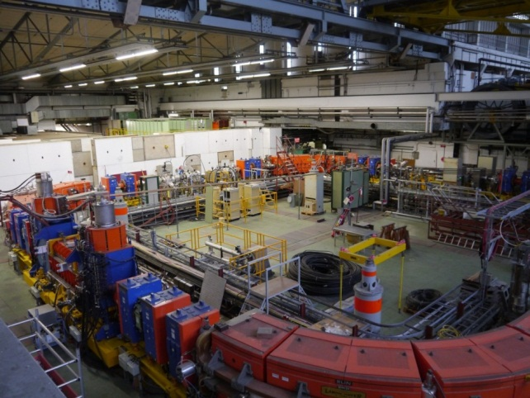
CERN visits
CLIC Test Facility 3
CMS Detector
Linac 3 (Ions)
LEIR

Slide 21
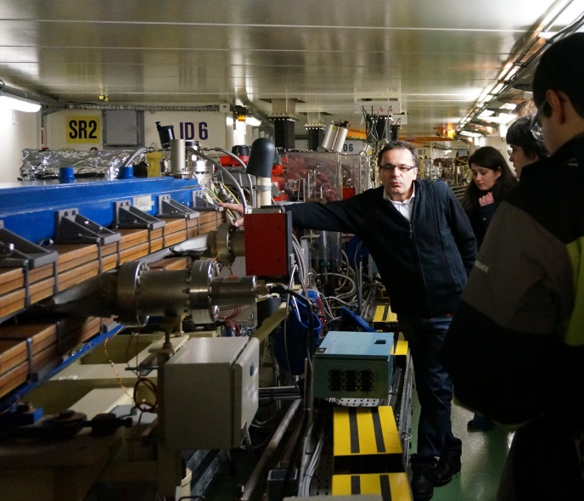
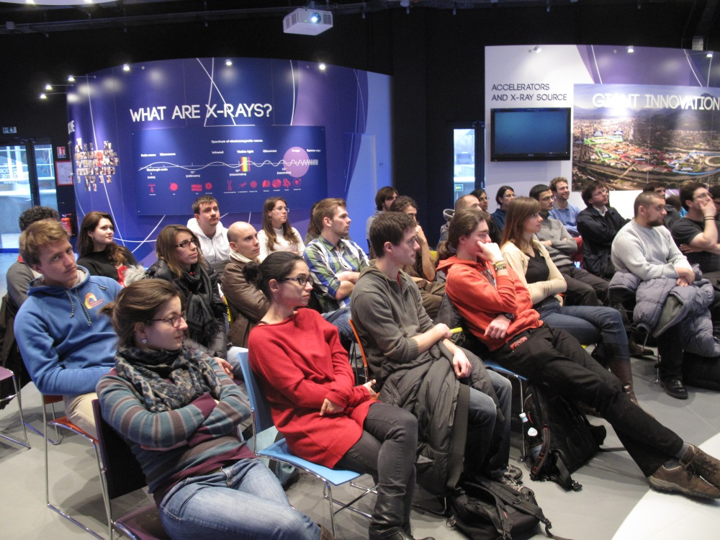
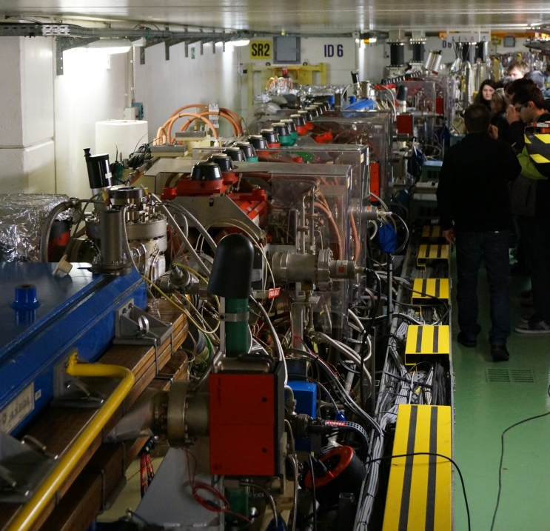
ESRF visit
During the presentation
Inside the Main Ring

Slide 22
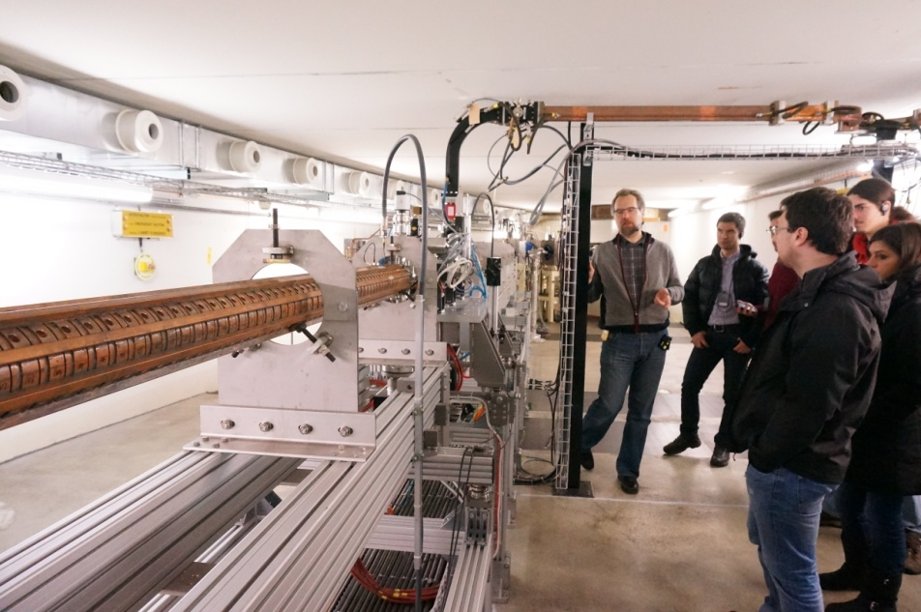
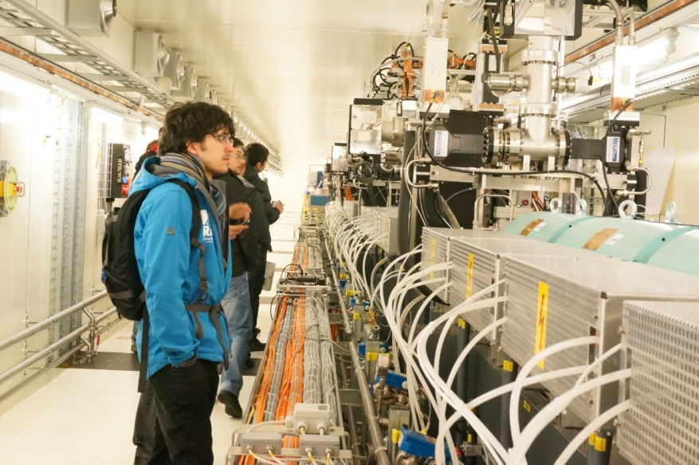
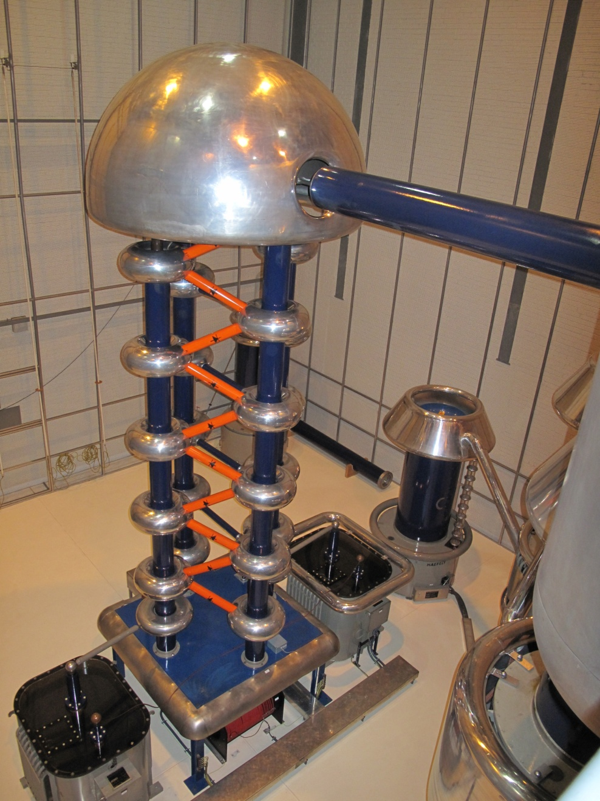
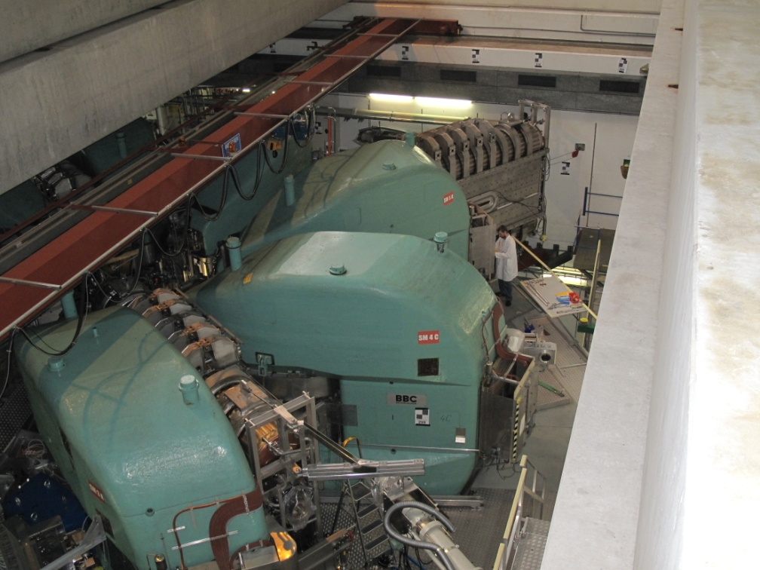
PSI visit
The SLS Linac at PSI
The Swiss FEL Injector at PSI
The source at PSI
The Cyclotron at PSI

Slide 23
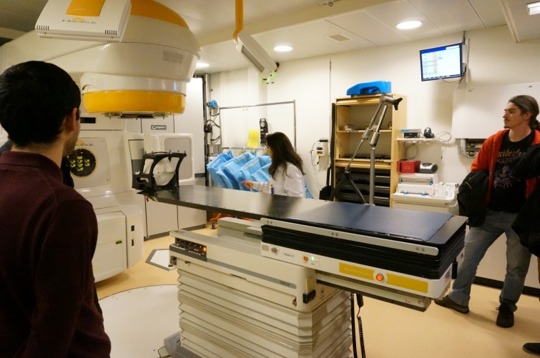
HUG visit
Hôpitaux Universitaires de Genève
Prof. Raymond Miralbell gives an excellent overview on medical applications before the visit.
The Irradiation machine at HUG

Slide 24
Practical days at CERN
and
Bergoz

Slide 25
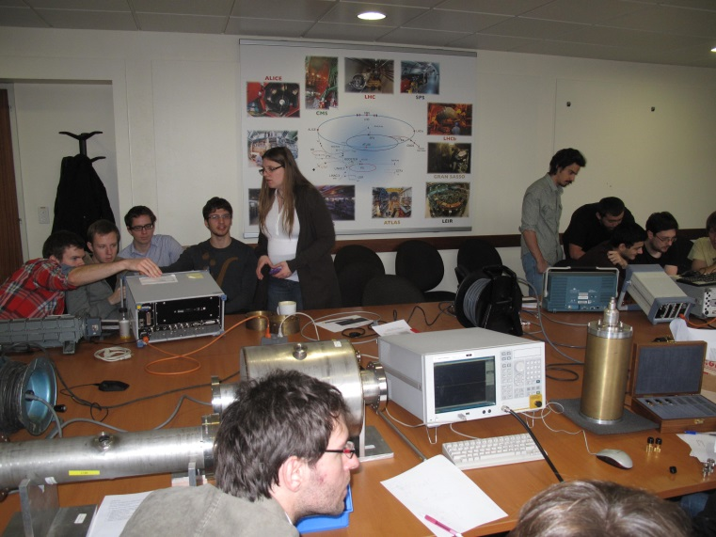
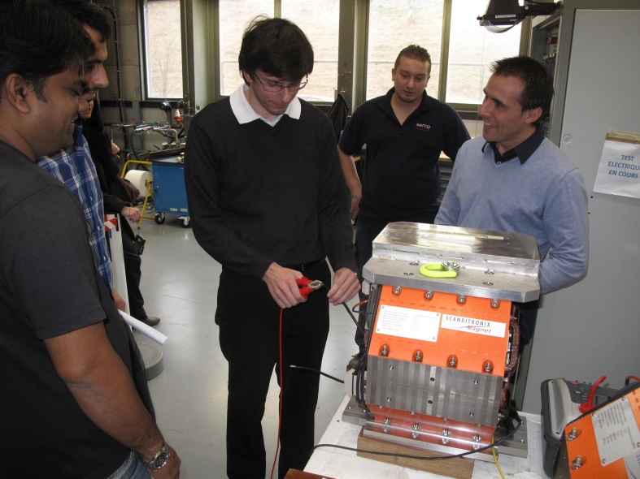
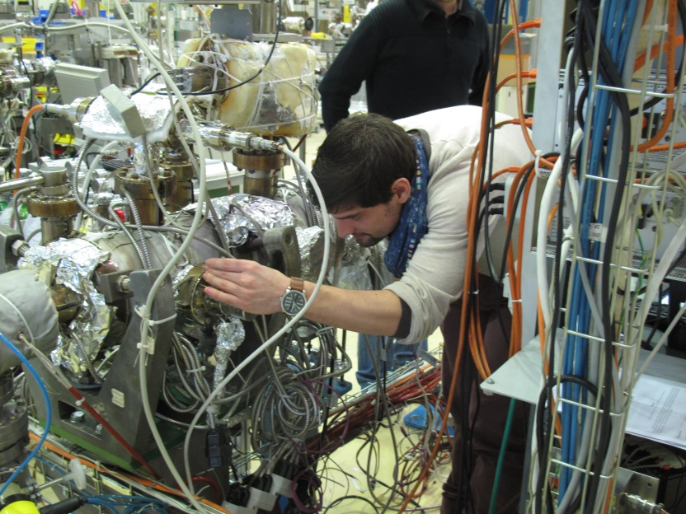
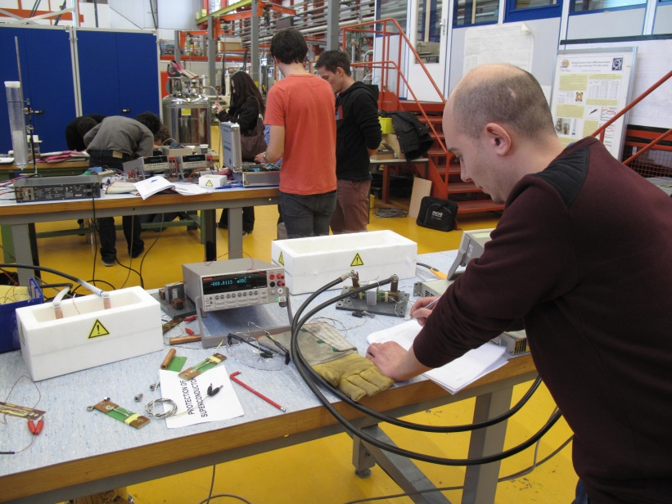
Practical day at CERN
RF group
Magnets group
Vacuum group
Superconductivity group

Slide 26
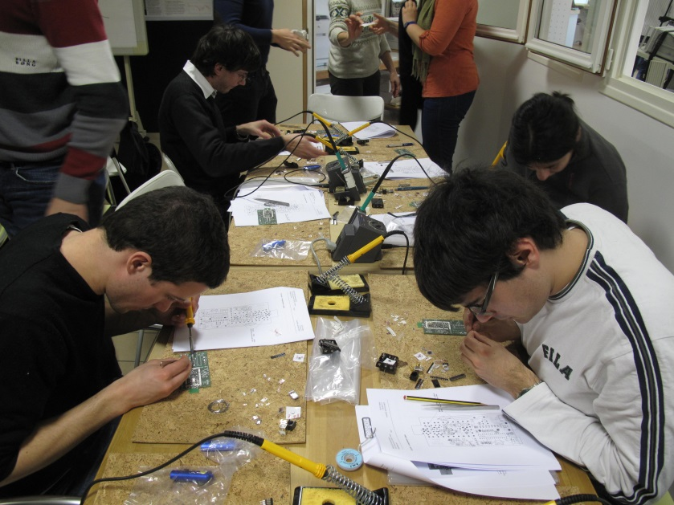
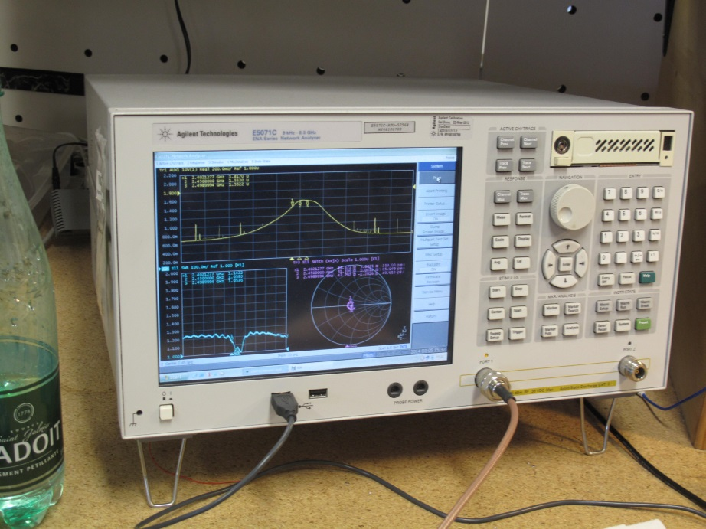
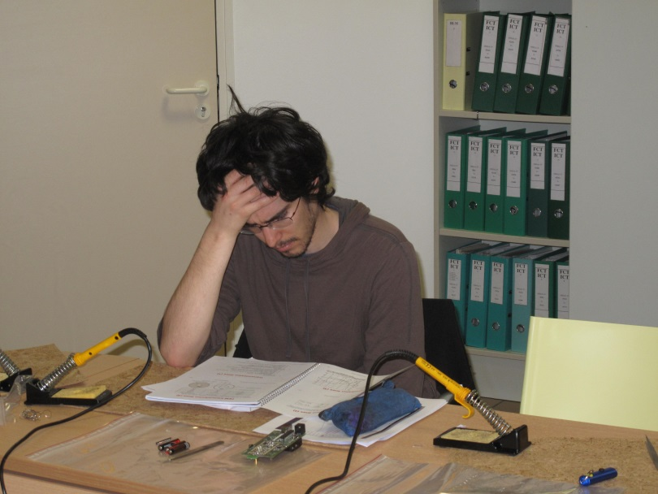
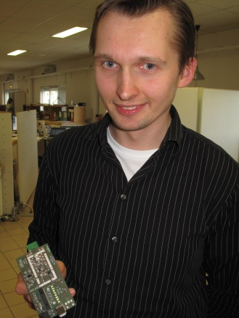
Practical day at BERGOZ company
A. Lesjone and B. Simony with soldering irons
Test of the Wi-Fi meter
M. Bartosik with his built device in hands
C. Camincher

Slide 27
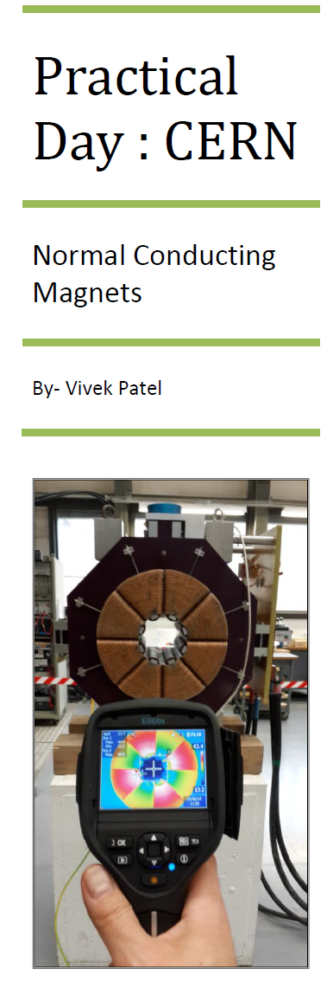
Reports from students
Toma Sebastian
NIPNE-HH, Mǎgurele, Romania
UPB, Bucharest, Romania
Report
Practical Works – RF Measurement Techniques
JUAS 2014
The present report summarizes the practical works performed at CERN, as part of JUAS 2014, Module 2. The chosen topic was RF Engineering – RF Measurement techniques. Two methods were covered – signal inspection using a spectrum analyzer (1) and measurements using a vector analyzer (2).

Slide 28
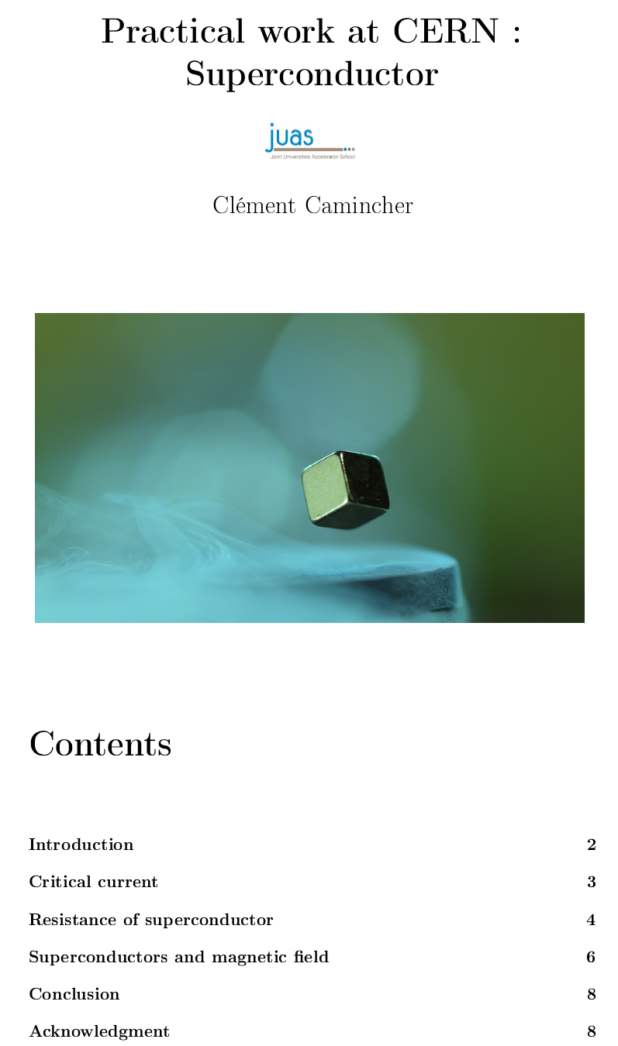
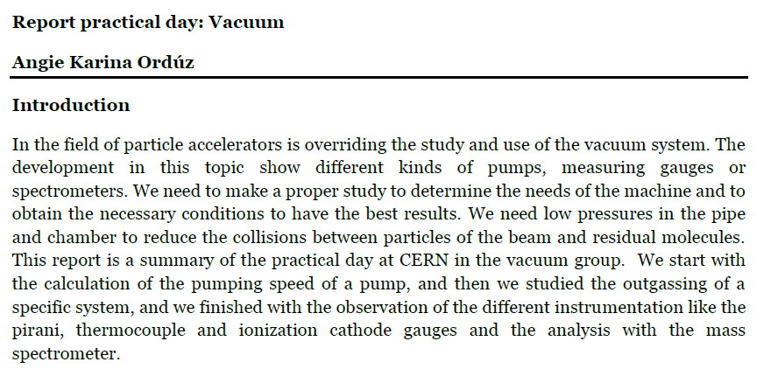
Reports from students

Slide 29
EXAMINATIONS
Each student who get an average mark of 10/ 20 (or above) could receive ECTS credits recognized by the partner Universities.
There are 5 topics, each of them lasts 1.5 hour:
Course 1:
* Transverse Beam Dynamics
* Longitudinal Beam Dynamics
* Synchrotron Radiations
The remaining 2 exams are announced the week 4 (week before the exams)
Course 2:
* RF
* Magnets
* Beam Instrumentation
The remaining 2 exams are announced the week 9 (week before the exams)

Slide 30
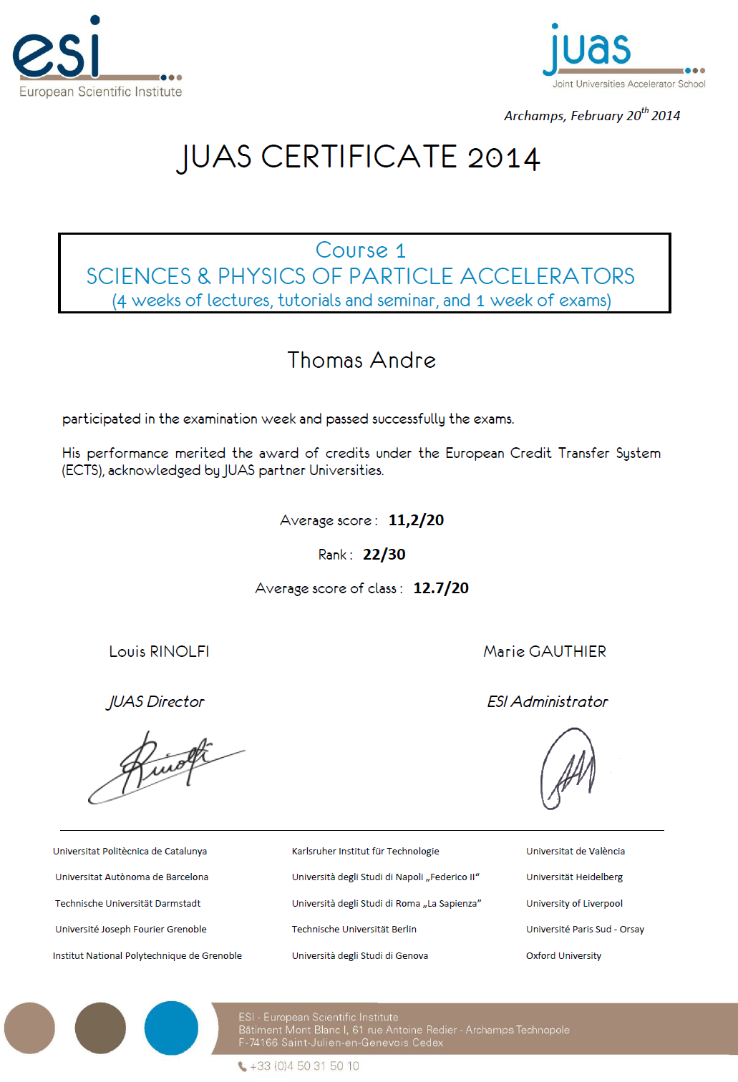
JUAS certificate of examination
for Course 1
The certificate for Course 2 is similar to this one

Slide 31
Another JUAS certificate

Slide 32
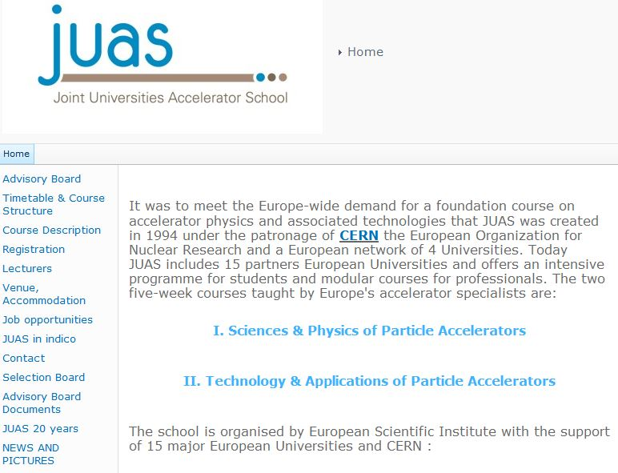
www.cern.ch/juas

Slide 33
Phil Burrows
IoP PAB Group Chair
http://tiara.physics.ox.ac.uk/training/index.html

Slide 34
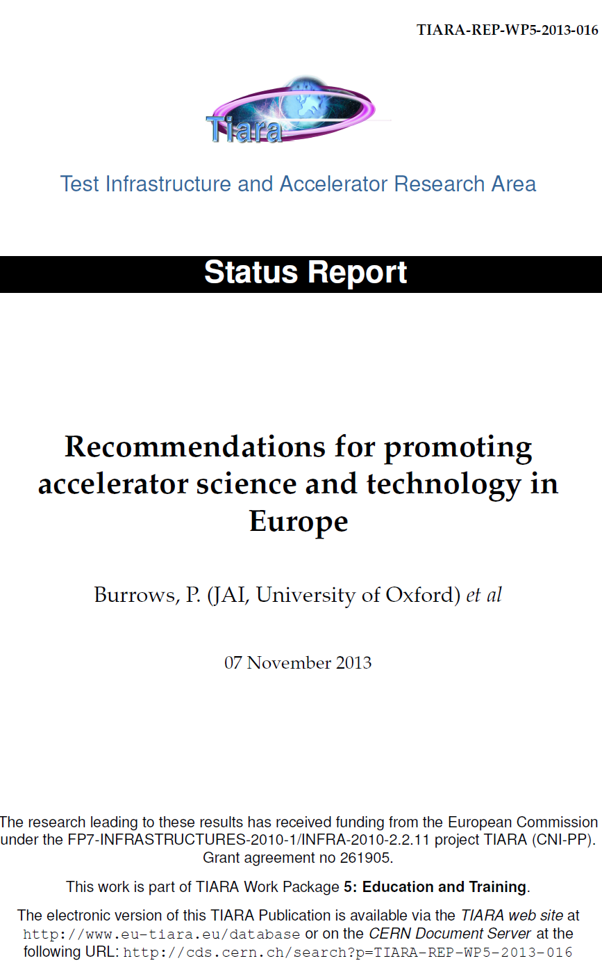
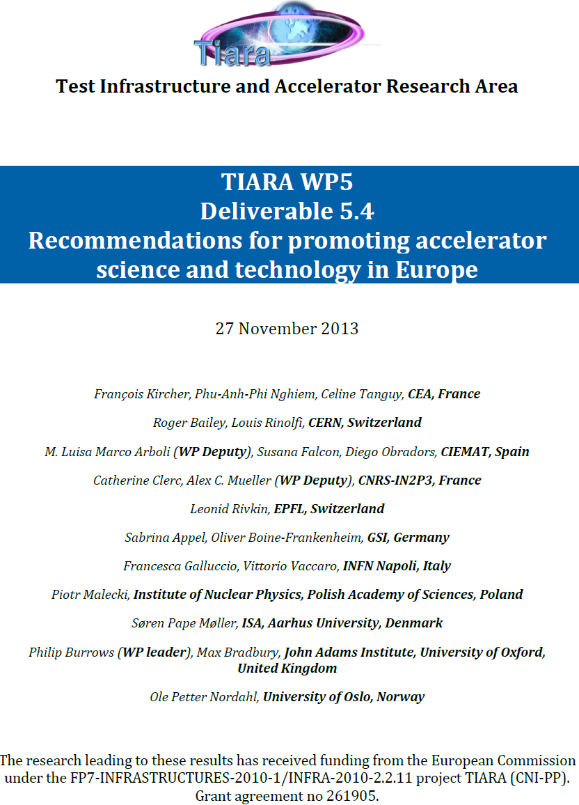

Slide 35

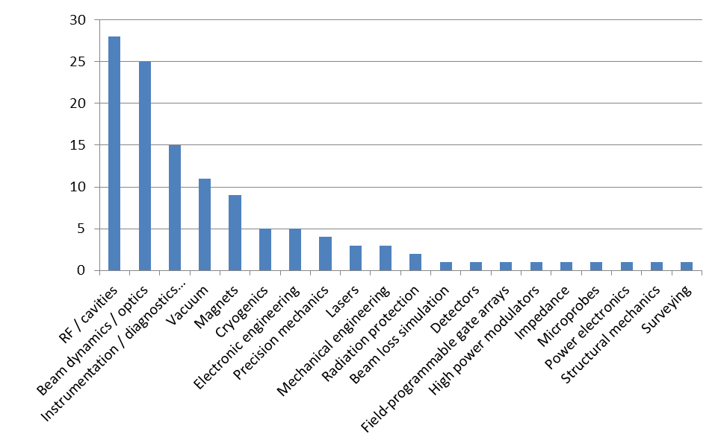
TIARA – Survey
Test Infrastructures and Accelerator Research Area
JUAS provides major training for the 6 first needs

Slide 36













Laboratories supporting JUAS

Slide 37



JUAS and private companies
=> provides financial support for 2 JUAS students
=> opens his company for a full day for practical works
cover the cost to print RF booklets in color

Slide 38
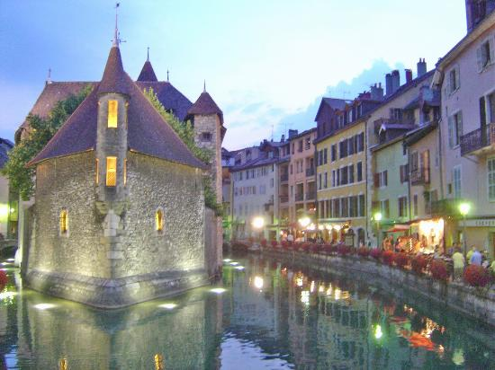
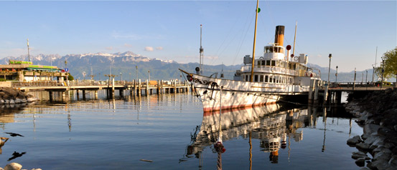
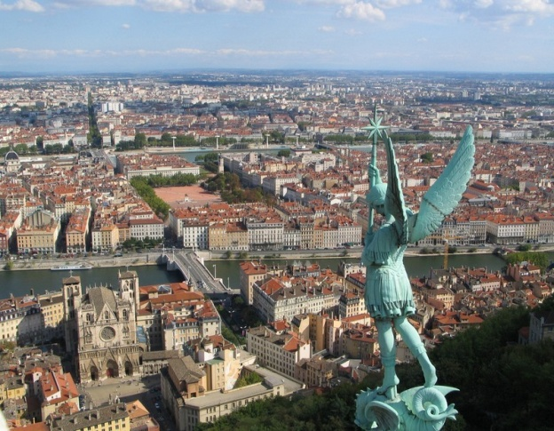
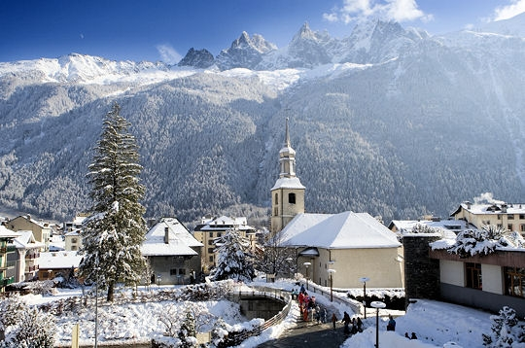
Touristic excursions for students
ANNECY
LAUSANNE
LYON
CHAMONIX

Slide 39
Applications are open for the next school in January 2015

Slide 40
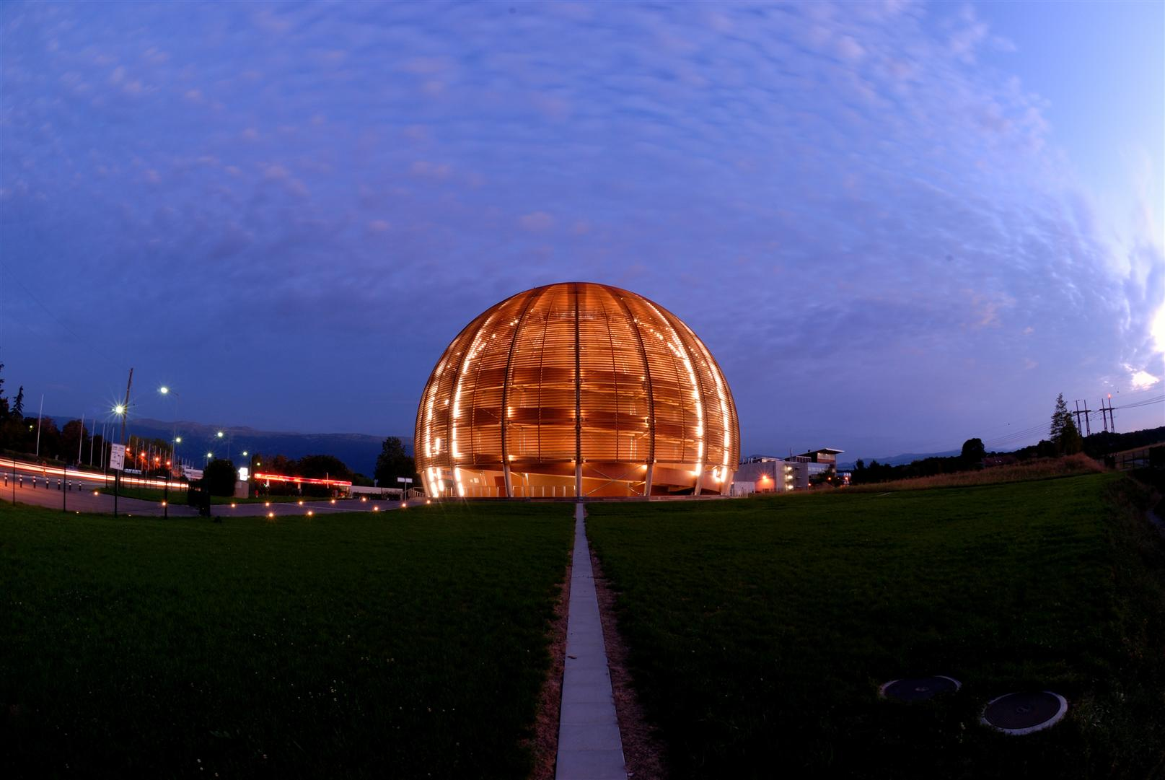




Thank you very much for your attention

