Slide 1
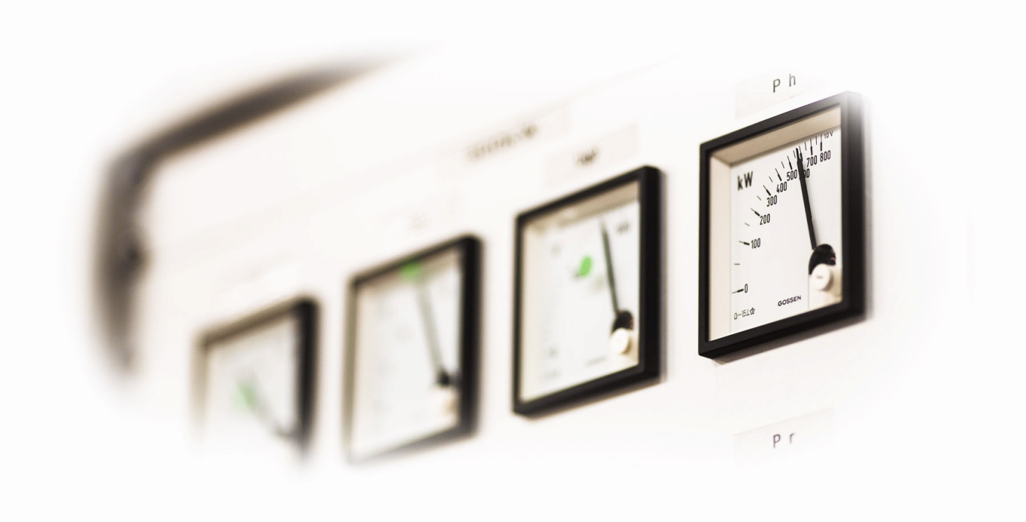
Energy efficiency of particle accelerators –
a network in the European program EUCARD-2
M.Seidel, PSI
Universities meet Laboratories (ULA2014), Frankfurt, Sep 30 – Oct 1, 2014

Slide 2
Workpackages in Eucard
Management and Communication
WP1: Management and Communication (MANCOM)
Networking Activities
WP2: Catalysing Innovation (INNovation)
WP3: Energy Efficiency (EnEfficient)
WP4: Accelerator Applications (AccApplic)
WP5: Extreme Beams (XBEAM)
WP6: Low Emittance Rings (LOW-e-RING)
WP7: Novel Accelerators (EuroNNAc2)
Transnational Access
WP8: ICTF@STFC
WP9: HiRadMat@SPS and MagNet@CERN
Joint Research Activities
WP10: Future Magnets (MAG)
WP11: Collimator Materials for fast High Density Energy Deposition (COMA-HDED)
WP12: Innovative Radio Frequency Technologies (RF)
WP13: Novel Acceleration Techniques (ANAC2)

Slide 3
Motivation for EnEfficient
worldwide scarcity of resources and climate change also impacts research facilities and is of great political importance
[e.g. Swiss “Energiestrategie 2050”:
public institutions asked to improve efficiency by 20% till 2020 …]
next generation accelerator facilities provide a new quality of research opportunities, but often connected with a new quality of energy consumption as well
[EuroXFEL, FAIR, ESS, LHeC, FCC, ILC, CLIC, Project-X …]
→ wee need to intensify our efforts to optimize the energy efficiency of accelerator systems

Slide 4
Energy: Order of Magnitude Examples
generation | consumption | storage
1d cyclist „Tour de France“ (4hx300W): 1.2kWh | 1 run of cloth washing machine: 0.8…1kWh | car battery (60Ah): 0.72kWh
1d Wind Power Station (avg): 12MWh | 1d Swiss Light Source (2.4GeV, 400mA): 82MWh | ITER superconducting coil: 12,5MWh
1d nucl. Pow. Stati. Leibstadt (CH): 30GWh | 1d CLIC Linear Collider @3TeV: 14GWh | all German storage hydropower: 40GWh

Slide 5
Energy: Order of Magnitude Examples
generation | consumption | storage
1d cyclist „Tour de France“ (4hx300W): 1.2kWh | 1 run of cloth washing machine: 0.8…1kWh | car battery (60Ah): 0.72kWh
1d Wind Power Station (avg): 12MWh | 1d Swiss Light Source (2.4GeV, 400mA): 82MWh | ITER superconducting coil: 12,5MWh
1d nucl. Pow. Stati. Leibstadt (CH): 30GWh | 1d CLIC Linear Collider @3TeV: 14GWh | all German storage hydropower: 40GWh
1d Earth/Moon System E-loss: 77.000GWh | 1d electrical consumpt. mankind: 53.000GWh | World storage hydropower: O( 1.000GWh )
1d sunshine absorbed on Earth: 3.000.000.000GWh | 1d total mankind (inc.fuels): 360.000GWh
→ better communication to the public desirable

Slide 6
Powerflow in Accelerators
public GRID
Accelerator
Radio Frequency
Magnets
Vacuum etc.
direct beam application:
p-therapy
isotope production
beam
conversion to secondary radiation (beam collisions, targets, undulators …)
secondary radiation
exotic particles, e.g. Higgs, B-mesons
synchrotron radiation
neutrons
muons
Auxiliary systems
cryogenics
conv. cooling, AC etc.
Instruments
e.g. particle detectors
finally all converted to waste heat !
figure of merit:
secondary particles, X-rays on sample per KWh

Slide 7
tasks within EnEfficient
task 1: energy recovery from cooling circuits, Th.Parker, E.Lindström (ESS)
[workshop April 14, survey of European Labs, applications of heat, T-levels etc.]
task 2: higher electronic efficiency RF power generation, E.Jensen (CERN)
[workshop Daresbury in June, e.g. Multi Beam IOT’s]
task 3: short term energy storage systems, R.Gehring (KIT)
[non-interruptable power, short term storage, wide spread of time scales …, workshop Q2/2015]
task 4: virtual power plant, J.Stadlmann (GSI)
[adaptation of operation to grid situation – context renewables…, possibly backup power generator …, ongoing survey of Labs]
task 5: beam transfer channels with low power consumption, P.Spiller (GSI)
[pulsed magnets, low power conventional magnets, permanent magnets, parameter comparison etc., workshop Nov 14, CERN]

Slide 8
EnEfficient: collaboration with Universities
in this workpackage we are receiving support through several Master and PhD Students, associated with Universities:
Christpher Ripp, GSI, Analysis of GSI Energy consumption, Master thesis
Johanna Toberntsson, Lund University: Master thesis on Heat Recovery in Accelerator based Research Facilities
Damian Batorowicz, Henning Zimmer, TU Darmstadt, Survey on consumption volatility in accelerators; dynamic behavior of distribution networks
Philip Gardlowski, GSI, comparison of energy-efficient beam transport systems; Carmen Tenholt, GSI, pulsed quadrupoles

Slide 9
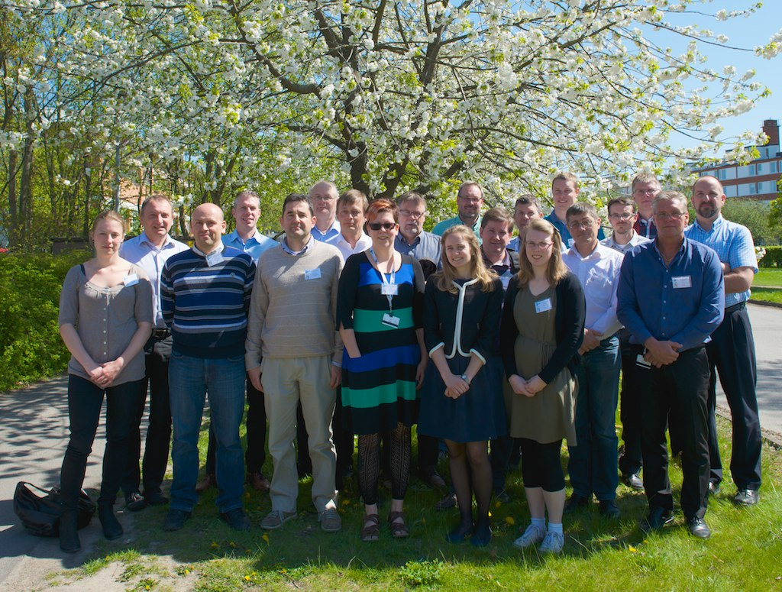
Workshop in Lund on Heat Recovery and General E-Themes
Participants (Experts) from
DESY, ALBA, SOLEIL, ESS, MAX-4, PSI, DAFNE, ISIS (institutes)
E.ON, Kraftringen, Lund municipality (industry, local authorities)
heat recovery works for many facilities; high temperatures beneficial
local heat distribution system required
greenhouses present interesting application (non-linear scaling)
new facilities MAX-4 and ESS foresee heat recovery on large scale

Slide 10
Lab Survey: Energy Consumption & Heat
J.Torberntsson, ESS

Slide 11
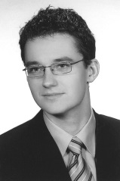
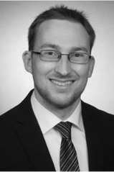
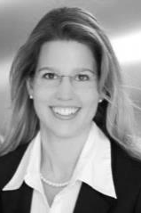
Collaboration with Institute „Electrical Power Systems“ of TUD
Collaboration in projects with focus on energy efficiency
Prof. Dr.-Ing. Jutta Hanson
jutta.hanson@e5.tu-darmstadt.de
Head of Department Electrical Power Supply
with Integration of Renewable Energies
Analyses of
energy consumption
for accelerators
to determine energy efficiency and associated potential
Analyses of
power quality problems
in the electrical network
Damian Batorowicz
damian.batorowicz@e5.tu-darmstadt.de
Network Protection for Distribution Networks
Henning Zimmer
henning.zimmer@e5.tu-darmstadt.de
Dynamic Behavior of Power Plant Auxiliary Grids
Christina Mahler
christina.mahler@e5.tu-darmstadt.de
Control Strategies for Power Systems

Slide 12
Potential Fields of Cooperation
Motivation : Increase share of renewable energies and shut-down of nuclear power plants requires new approaches to ensure reliable and safe operation of the German transmission system
Accelerator Conditions
and Innovations
Increased energy efficiency and high power factor at network connection point
Increased supply from renewable energies (e.g. self-generation)
Independent and innovative supply, development of UPS, high reliability
Require/exchange huge amount of reactive power from/with public grid
Innovative Research Activities
Analyses of innovative facilities for reactive power compensation and reduction of harmonics
Optimization of control strategies to increase efficiency and robustness
Optimization of reactive power supply in transmission systems
Network design and analyses
Analyses of power quality problems
Network modelling with high proportion of renewable energies
Potential Synergies between TUD and Research Accelerator Facilities

Slide 13
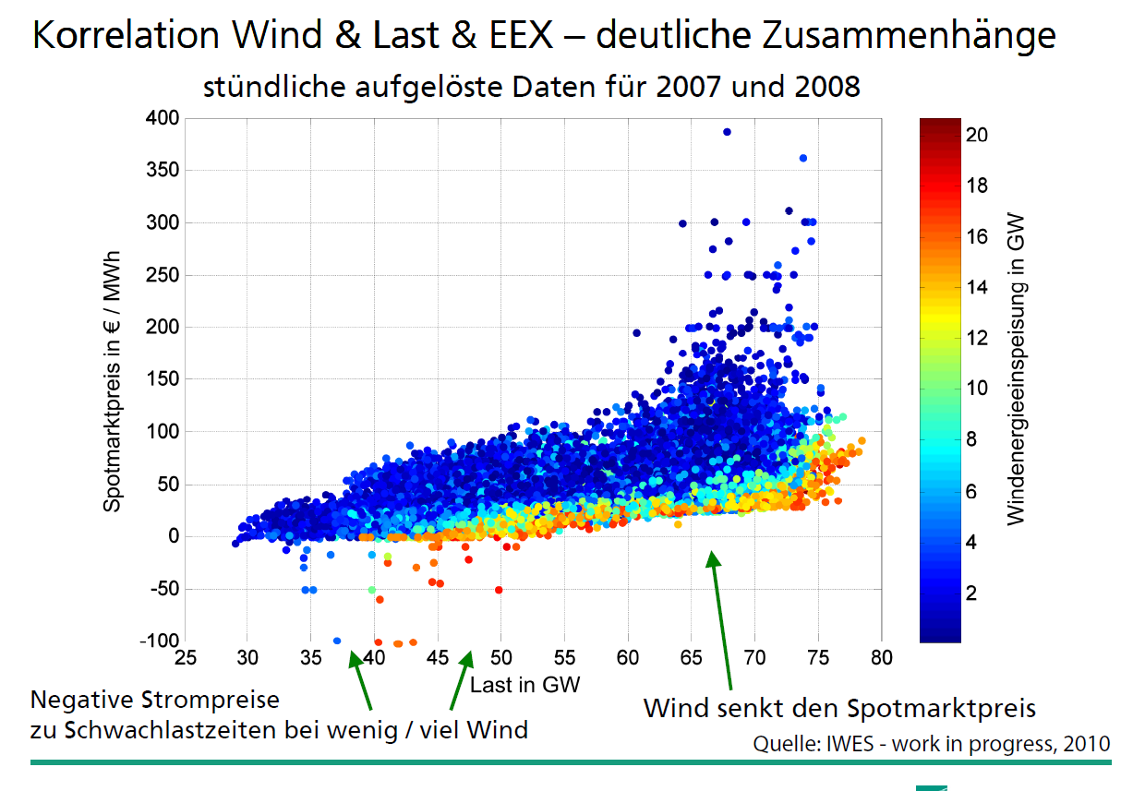
energy spot market prices → energy managment, virtual power plant
found on the internet
renewables cause strong variations
Impact on accelerators?

Slide 14
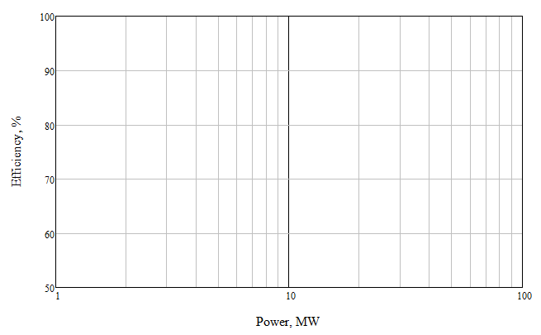
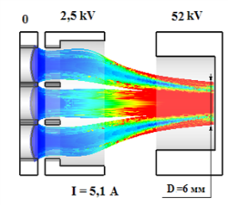
Strategy for high-efficiency high RF power klystron development
L-band
CW (TLEP, proton linac)
>30 beams; <30 kV?
??? years
4 years
L-band. CLIC.
30 beams; 116 kV
<60 beams; 60 kV
2/gun+3years
L-band
CLIC/Double C. Gun
12 beams; 164 kV
1.5 year
Optionally – gun with controlled electrode (2.5 kV)
S-band Demonstrator
40 beams; <60 kV
L-band
CLIC
6-8 beams; 164 kV
Exploring X-band MBK
L-band
ILC
6 beams; 116 kV
2 years
SC solenoid
Exists
2
6
20
40
I.Syratchev, CERN

Slide 15
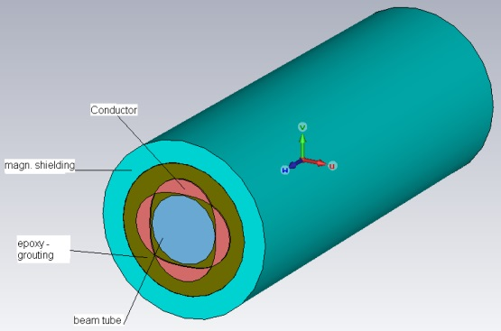
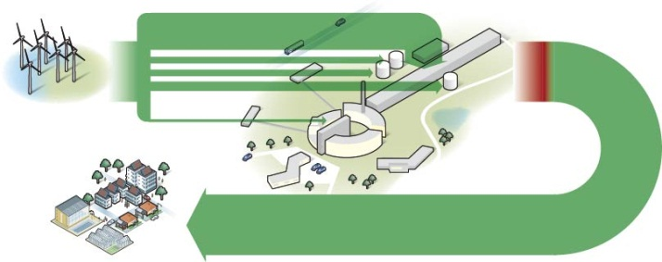
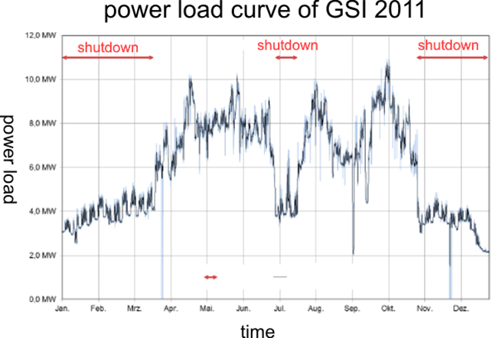
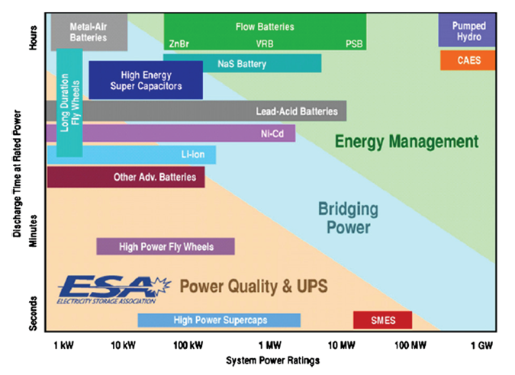
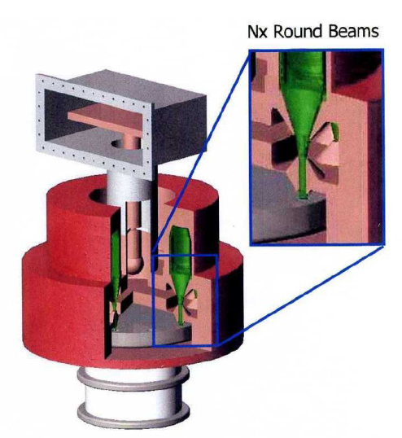
Energy Efficiency Examples
need for energy management
heat recovery at ESS
pulsed quads [GSI]
review of energy storage systems
permanent magnet [CLIC]
multi-beam IOT by company CPI

Slide 16
EnEfficient: summary and outlook
EnEfficient is a new networking activity related to efficient utilization of electrical power in accelerator based facilities
at present participating institutes and interested partners: CERN, ESS, GSI, KIT, PSI, DESY
next workshops:
November 26-28, 2014: Compact and Low Consumption Magnet Design for Future Linear and Circular Colliders, at CERN.
March, 2015: Energy Storage Systems, KIT, Heidelberg(?).
we are seeking more collaborators, interested colleagues are very welcome to participate in this network
information and contact under: www.psi.ch\enefficient

