Slide 1
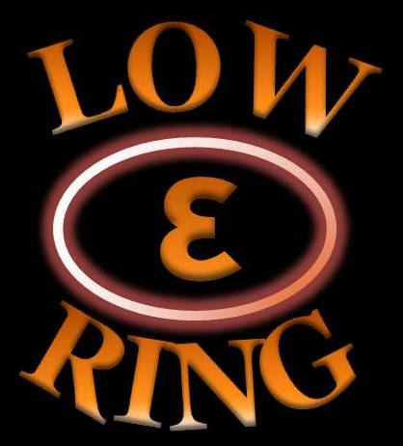
WP6- Low emittance rings LOWεRING
"Universities meet Laboratories" Workshop
30 Sept. - 1 Oct. 2014,
Frankfurt am Main
S. Guiducci (INFN-LNF),
Y. Papaphilippou (CERN), R. Bartolini (Oxford Un.)

Slide 2
WP6 - Low Emittance Rings: scope and background
Bring together scientific communities of synchrotron light sources’ storage rings, damping rings and e+/e- ring colliders in order to communicate, identify and promote common work on topics affecting the design of low emittance electron and positron rings
Initiated by the CLIC-ILC collaboration working group on damping rings, chaired by YP and Mark Palmer (now at FNAL)
State of the art in design of accelerator systems especially in X-ray storage rings approaches the goals of damping rings for linear colliders and future e+/e- ring collider projects

Slide 3
WP6: Objectives
Task 6.1: Coordination and Communication
Task 6.2: Low Emittance Ring Design (LERD)
Task 6.3: Instabilities, Impedances and Collective Effects (IICE)
Task 6.4: Low Emittance Rings Technology (LERT)

Slide 4
Task 6.1: Coordination and Communication
Coordinators:
  R. Bartolini (UOXF)
  S. Guiducci (INFN-LNF)
  Y. Papaphilippou (CERN)
Formed collaboration board, representing the Low Emittance Rings community (including non-EU members)
  B. Hettel (SLAC)
  Q. Qin (IHEP)
  D. Rubin (Cornell)
  J. Urakawa (KEK)
  Task coordinators: M. Böge (PSI), R. Nagaoka (Soleil), H. Schmickler (CERN)
Organize Low Emittance Rings’ general and topical workshops
Each one representing community of X-ray storage rings of e+/e- colliders and damping rings
Representing “Ultimate-storage ring” community and damping ring test facilities

Slide 5
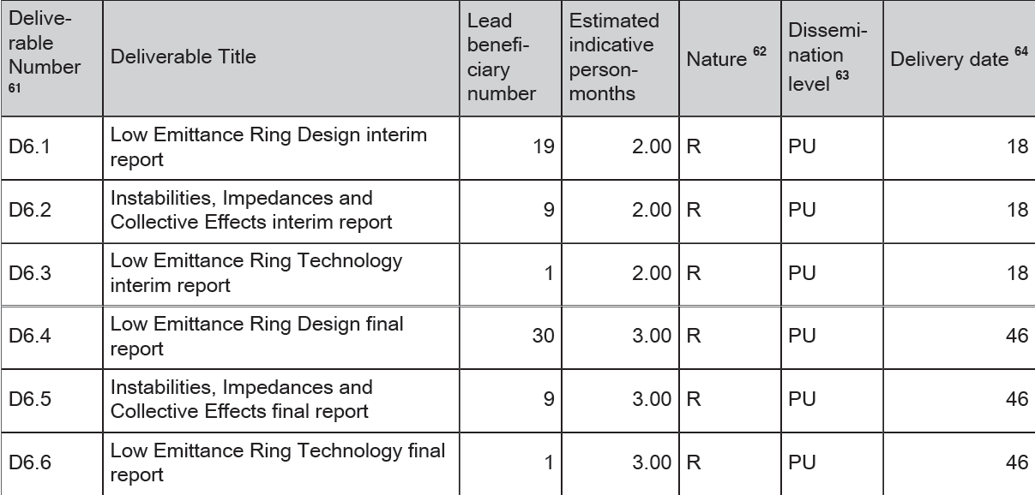
Deliverables
One interim and one final report per task
Help provided by sub-task coordinators (already identified)

Slide 6
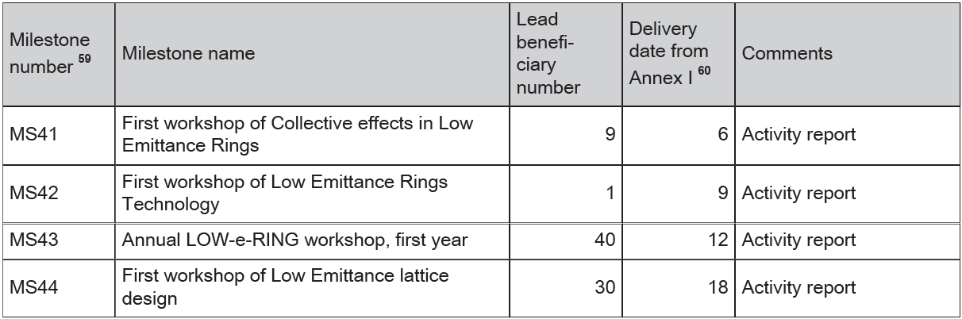
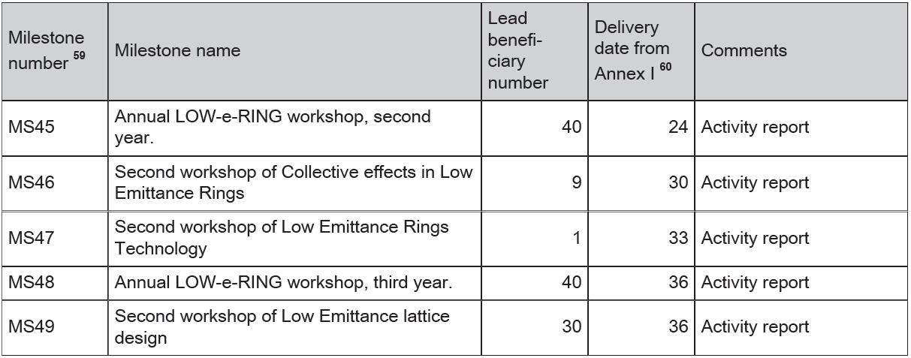
Milestones
3 topical and 3 general workshops (dates will be slightly adapted)
Organize common events with other WPs (X-BEAM, Future magnets, Innovative RF technologies)
✓
January 2014
✓
May 2014
✓
July 2013
April 2015
✓
September 2014

Slide 7
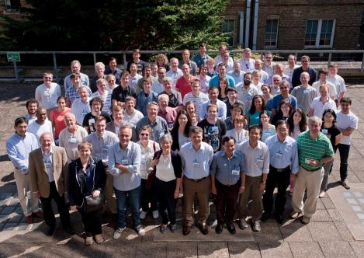
3rd Low Emittance Rings’ workshop
After:
LER2010 CERN
http://ler2010.web.cern.ch/
LER2011 Crete
http://lowering2011.web.cern.ch/
1st workshop sponsored by network: Oxford, July 2013
87 participants (Europe: 65, USA: 10, Asia: 12)
Great scientific and organizational success (thanks to Riccardo et al.)
1st Student prize
http://www.physics.ox.ac.uk/lowemittance13/

Slide 8

3rd Low Emittance Rings workshop Oxford, July 8th-10th 2013
John Adams Institute
Workshop subjects:
Low emittance lattice design and tuning
  algorithms and optimisation tools
  nonlinear beam dynamics
  novel injection schemes
  beam based tuning techniques and model calibrationtion
  beam loss management and Top-Up operation
Collective effects
  intrabeam scattering
  electron cloud
  machine impedance effects and minimisation
  coherent synchrotron radiation
Low emittance ring technology
  IDs and magnets
  kickers
  diagnostics and instrumentation
  vacuum
  engineering integration
41 talks in 3 days

Slide 9
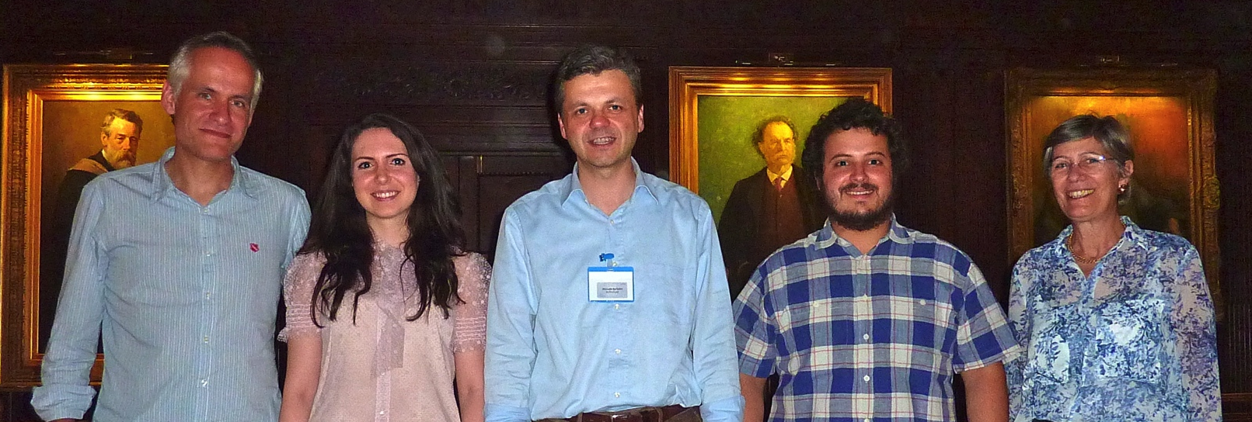
Student prize
Sponsor trip to a major accelerator conference for presenting work related to low emittance rings
Selection procedure:
  Poster presentations in general Low-ε-ring workshops
And the first ex-equo winners are…
  Eirini Koukovini Platia (CERN/EPFL), Simone Liuzzo (ESRF/Un. Of Rome)

Slide 10
Workshop Program
Session 1 - AP1 - design/modelling (7 talks)
  Review of design and optimisation issues on low emittance rings, L. NADOLSKI, SOLEIL
Session 2 – Collective effects
  Review of collective effects for low emittance rings, K. Bane, SLAC
Session 3 – Technology: magnets, vacuum and instrumentation
  Review of vacuum technology issue for low emittance rings, R. Kersevan, CERN
Session 4 – AP2 – experiment
Session 5 – Technology 2:pulsed magnets and diagnostics
Only plenary sessions
Each session has an opening review talk on the main issues
A large fraction of time, Session 6, is used for discussion to share experience and set-up collaborations

Slide 11






35 talks in 2 days
1st workshop on collective effects sponsored by the network
~80 participants (Europe: ~65, Americas: 11, Asia: 2), at least 1/3rd students and post-docs
Great scientific and organizational success (thanks to Ryutaro and other colleagues

Slide 12
TWIICE2014 Workshop Program
3 Sessions on Impedances and instabilities (17 talks)
  Chaired by J. Byrd (LBNL), G. Rumolo (CERN), B. Podobedov (BNL)
1 Session on Particle Scattering (3 talks)
  Chaired by Y. Papaphilippou (CERN)
1 Session on Two stream instabilities (5 talks)
  Chaired by C. Bane (SLAC)
1 Session on CSR Instabilities (7 talks)
  Chaired by G. Wustefeld (BESSY)
1 Session on Instrumentation and Feedback (4 talks)
  Chaired by P. Kuske (BESSY)
Only plenary sessions
Each session had an opening review talk on the subject
The last session was dedicated to the summaries and discussions (chaired by Y. Cai, SLAC)

Slide 13
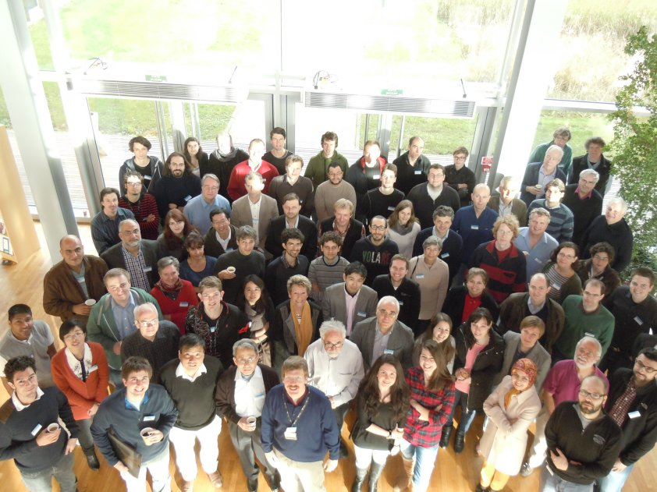
TWIICE2014 - Topical workshop on Instabilities, Impedances and Collective Effects

Slide 14
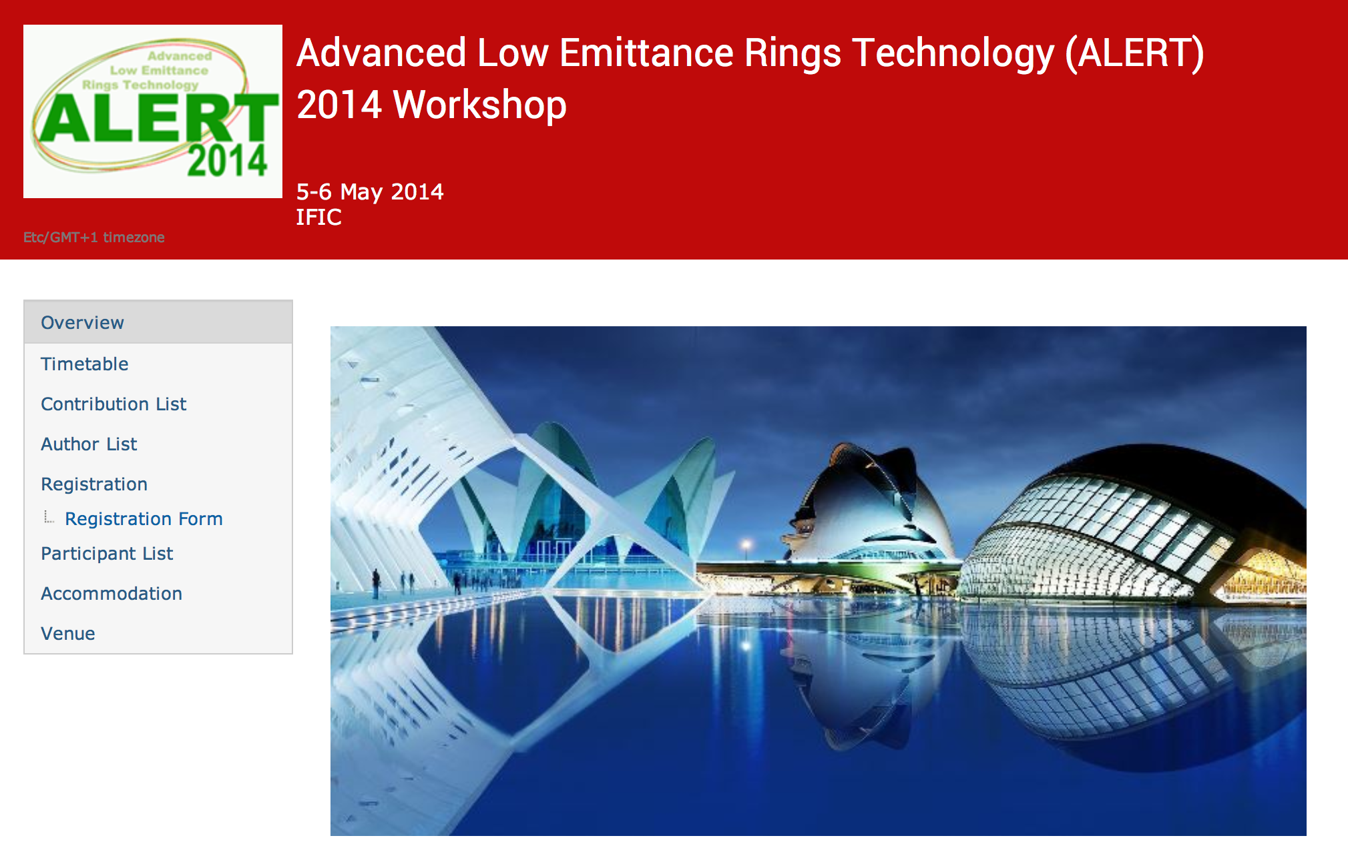
28 talks in 2 days
1st workshop on Technology sponsored by the network
52 participants (Europe: 39, USA: 11, Asia: 2)

Slide 15
ALERT 2014 - Scope
Gather scientists but also industrial partners who are designing and building hardware for low emittance rings
Emphasis on studies and experimental programs in existing rings and facilities.
Specifically address impact of targeting and reaching ultra-low emittances to the design of technical systems in an environment dominated by synchrotron radiation
  Operational issues
  Manufacturing tolerances
  Calibration and stability/repeatability problems

Slide 16
ALERT 2014 – Workshop Program
Two full days
22 presentations (20-25 minutes)
15-minutes of fame talks on the first afternoon afternoon
Subjects treated
  Insertion devices, magnets and alignment
  Beam Instrumentation
  Kicker systems
  RF system design, including harmonic RF systems
  Vacuum design – NEG coating
  Feedback systems
Podium discussion on second afternoon
Happy hour for discussion on the first evening

Slide 17
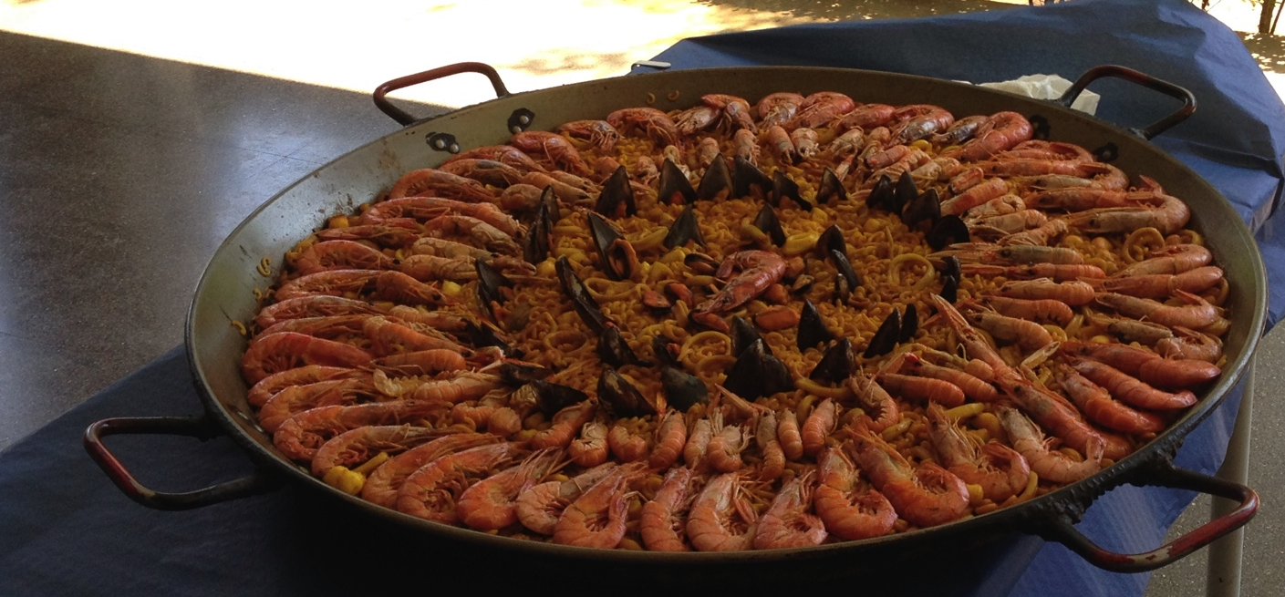
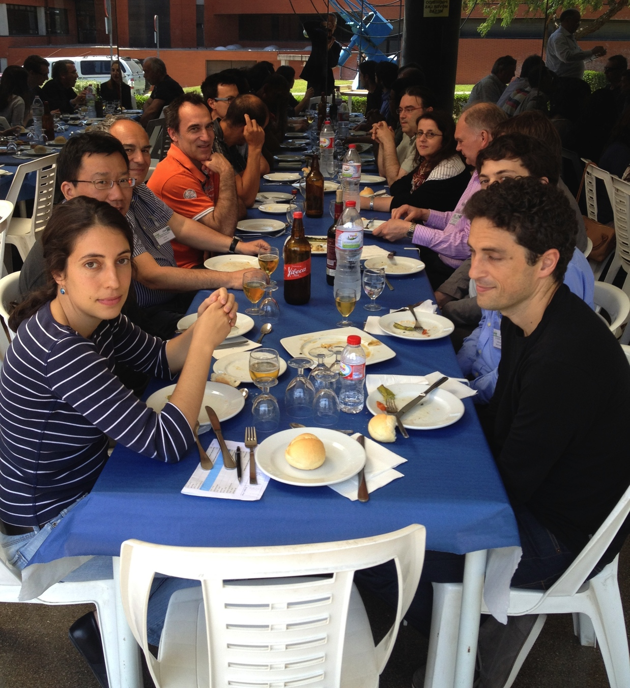
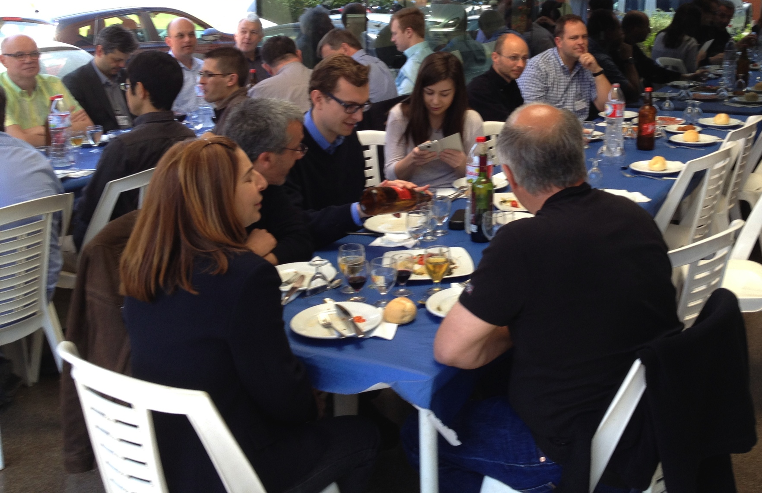
ALERT2014- Advanced Low Emittance Rings’ Technology

Slide 18
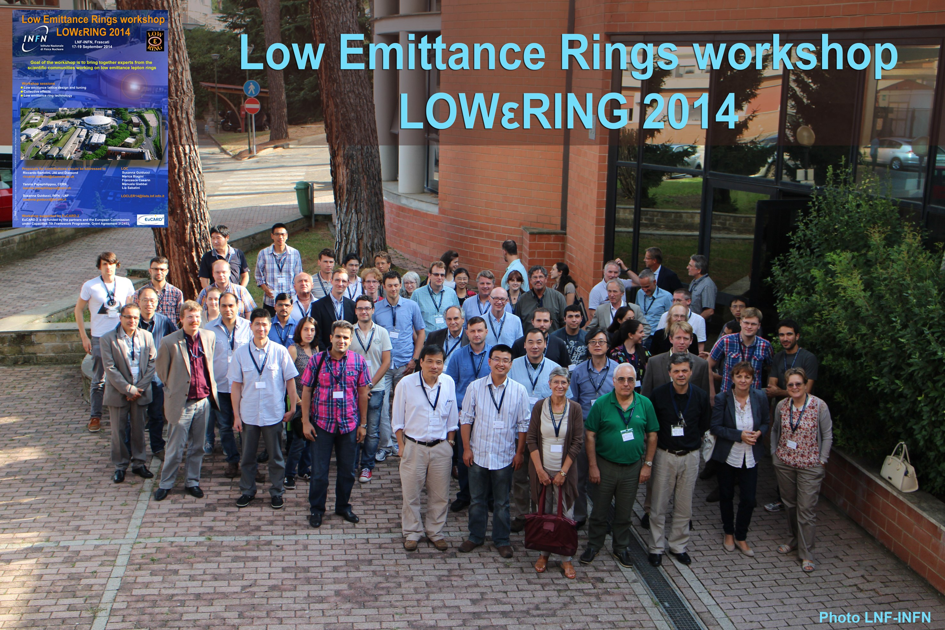
4th Low Emittance Rings’ workshop
2nd workshop sponsored by network: Frascati, September 2014
78 participants (Europe: 47, USA: 17, Asia: 14)
2nd Student prize

Slide 19
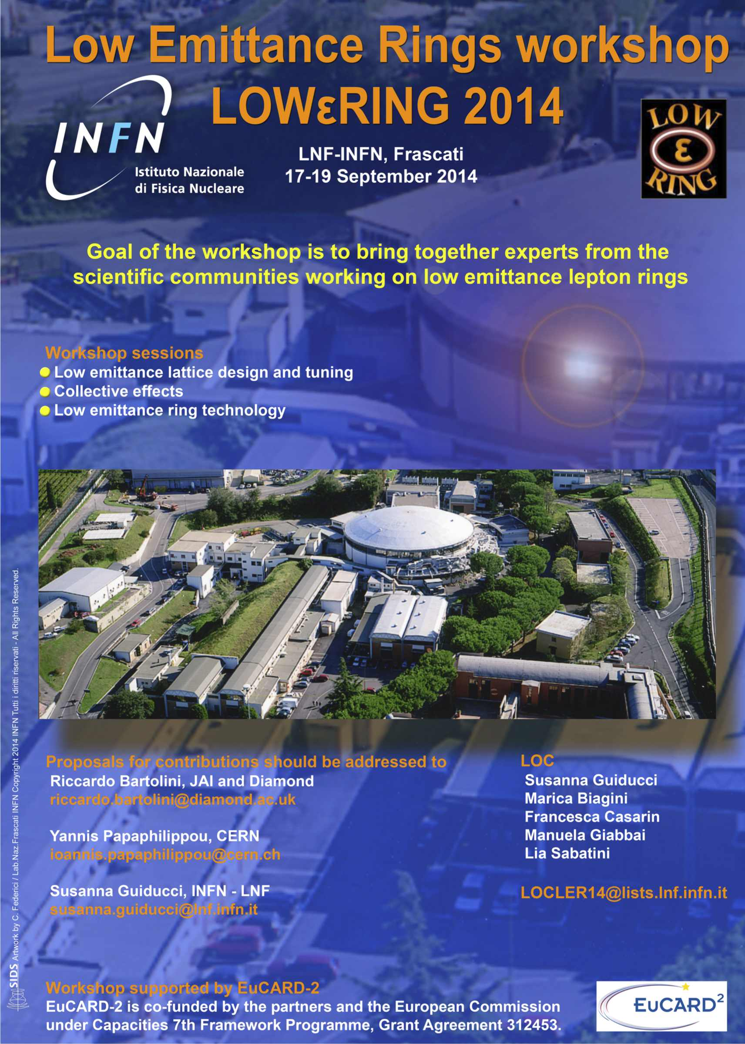
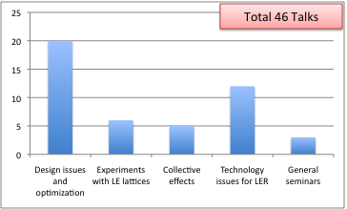
4th Low Emittance Rings workshop INFN – LNF, Frascati
17-19 September 2014
Workshop sessions:
Low Emittance optics design (LERD)
  New proposals and upgrades
  nonlinear beam dynamics and optimisation tools
  novel injection schemes
  beam experimentsn
Collective Effects and beam instabilities (IICE)
  intrabeam scattering
  electron cloud
  machine impedance
Low Emittance Ring Technology (LERT)
  IDs and magnets
  Kickers
  RF design
  vacuum

Slide 20
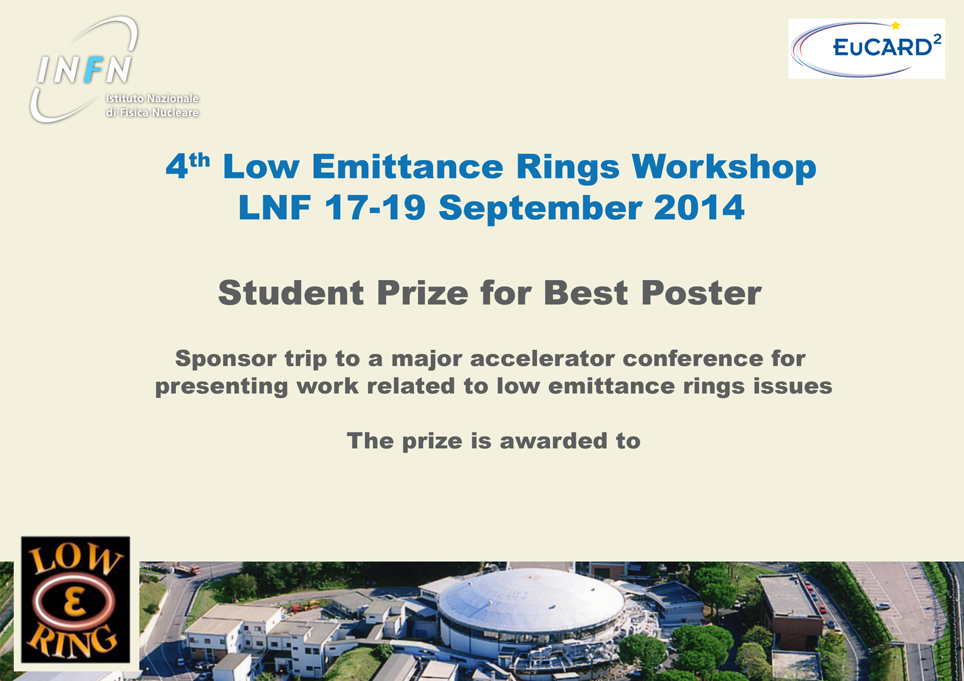
Tobias GOETSC (HZB)
A Robinson wiggler proposal for the Metrology Light Source

Slide 21
Workshop Program
Session 1 - Design issues and optimization (LERD) (20 talks)
  Introduction to design issues and optimisation of low emittance rings, Yunhai Cai (SLAC)
  8 talks on proposals of new generation machines or upgrades of present ones toward very low emittances
Session 2 – Collective effects (IICE) (5 talks)
  Review of Instabilities issues for low emittance rings and Summary of TWIICE workshop, Ryutaro Nagaoka (Soleil)
Session 4 – Experiments with low emittance lattices (LERD) (6 talks)
  Review of experiments with low emittance lattices, James Safranek (SLAC)
Session 3 – Technology issues for lowerings (LERT) (10 talks)
  Review of technology issue for lowerings and summary of ALERT workshop, John Byrd (LBNL)
All the talks in plenary sessions
Each session has an opening review talk on the main issues
A fraction of time is used for discussion (in parallel) and summaries in preparation of the network interim reports

Slide 22
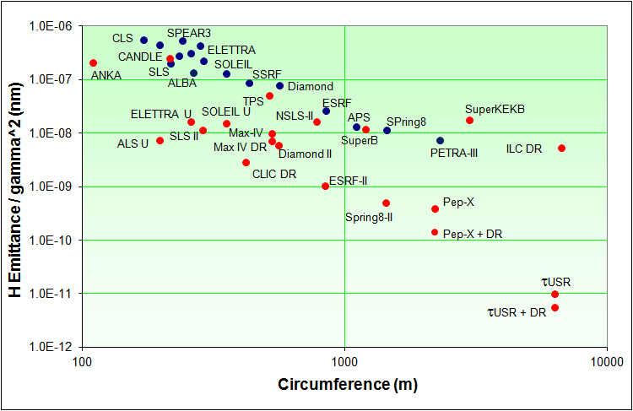


Survey of low emittance lattices
Diamond (561.6 m)
Present emittance 2.75 nm
Target emittance < 0.275 nm
R. Bartolini
LER 2014 Workshop Frascati,
17 September 2014

Slide 23
General talks
Next Generation X-ray Analyses and the ESRF Upgrade Programme, Francesco Sette (ESRF)
  A reduction of a factor ~30 in emittance allows to increase x-ray brilliance by 2 orders of magnitude, and transverse coherence by factor 30-40. A new page in X-ray science: intense – stable – coherent X-ray nano-beams to unveil the mysteries of materials and living matter in the lengthscale gap between optical and electron microscopies: 1-1000 nanometers
Challenges of Low Emittance Rings, Yannis Papaphilippou (CERN)
  A review of beam physics and technical challenges facing x-ray light sources, damping rings and storage ring colliders aiming at ultra low emittances
Bejing Higgs Factory, Qing QIN (IHEP)
  A ring-based Higgs factory, CEPC, is under study at IHEP and R&D will be proposed in the near future.
Notes:
Metti meglio nomi di rings e speakers

Slide 24
Highlights
“Vertical Emittance at the Quantum Limit”, Rohan Dowd, Australian Synchrotron
NSLSII commissioning: good results and interesting measurements on IBS and Collective Effects in a short time
New machines or upgrades proposals aiming at very low emittances have been presented: ESRF, APS, BAPS, Diamond, SLS, Elettra, ANKA
Proposals for alternatively generate round beams: horizontal field wigglers (BINP)
New injection schemes with small transverse aperture
  Pulsed multipole kicker injection, successfully tested at Bessy-II
  Swap-out injection
  Longitudinal injection
Powerful optimization algoritms for linear and nonlinear dynamics: MOGA, MOPS
Notes:
Metti meglio nomi di rings e speakers

Slide 25
Highlights on technology
Magnets
  DDBA upgrade of DIAMOND
  ESRF upgrade dipoles and quadrupoles
  CLIC wigglers: NbTi (3T, ~5cm period) and Nb3Sn (>3.5T, period < 4.8cm)
Kickers
  DAΦNE injection kicker tested with very short pulse duration ~10ns
  Laboratory measurements of CLIC stripline kicker in progress
RF design
  Concepts for high frequency RF system (1-2GHz) with tight phase jitter tolerances and large transient beam loading have been developed
Vacuum
  Impedance behaviour of NEG films in some special cases (thickness changes, high frequency, roughness effects) need to be considered carefully in the design. High frequency measurement preparation is promising.
Y. Papaphilippou
Notes:
Troppi dettagli

Slide 26
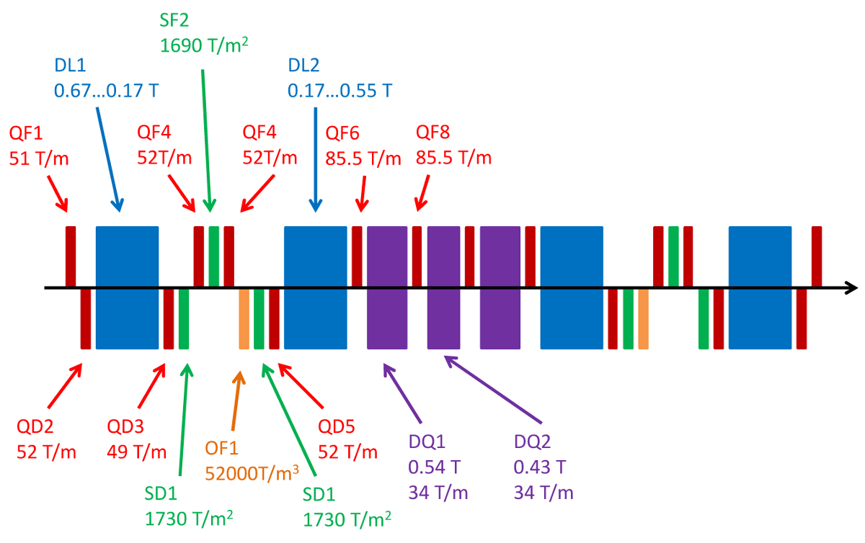
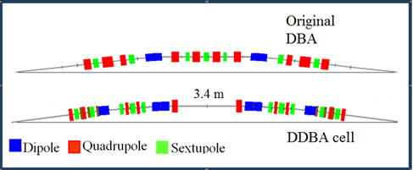
Challenging magnets design
Challenges
High gradients
Combined magnets
Small bore radius
Tight tolerances
No space longitudinally
More than 1000 magnets
ESRF Upgrade
G. Le Bec
Dipole
0.67 and 0.965 m
14.385Tm⁻¹
0.8 T Central
Quadrupole
0.25 m
70 Tm⁻¹
Diamond Upgrade
Sextupole
0.175 m
2000 Tm⁻²
C. Bailey

Slide 27
3. Conclusions
Review of Instabilities Issues for Low Emittance Rings …
• Efforts to lower the beam emittance generally tend to enhance beam instability and collective effects, both in terms of impedance and beam sensitivity.
• Therefore, if the beam intensity is to be used as a knob to attain higher brilliance in future low emittance rings, the coupling impedance, as well as all concerned beam instabilities and collective effects must be well studied and mastered in advance.
• The high quantity and quality of studies presented at TWIICE workshop demonstrate the enormous efforts actively being made by the colleagues in the low emittance ring community (and also of hadron ring community) in all directions.
• For more details of the presentations made at TWIICE, please visit the workshop site at
http://www.synchrotron-soleil.fr/Workshops/2014/TWIICE
where all the contributions are accessible. The 2nd TWIICE is to be organized in 2016.
R. Nagaoka
Review of Instabilities Issues for Low Emittance Rings …
LER2014, Frascati, 17-19 September 2014 21/21

Slide 28
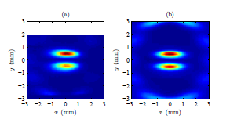
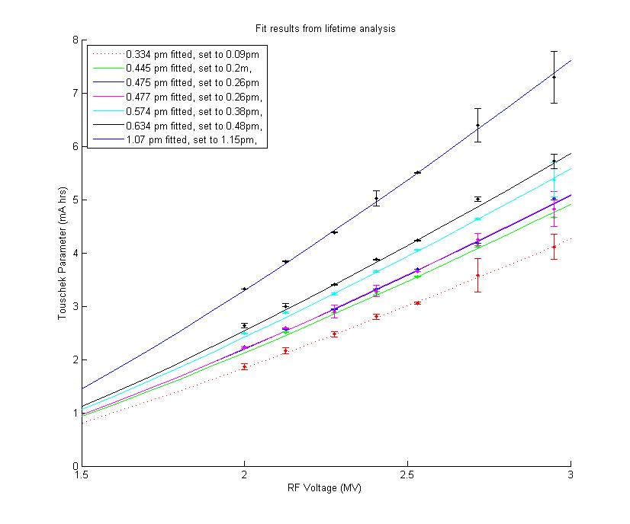
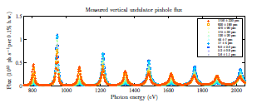
Vertical Emittance at the Quantum Limit
Very precise tuning of the ring and nice measurements
Indirect measurement of vertical beam size through Touschek lifetime
Direct beam emittance measurements with vertical undulator down to ~1pm
Photon flux ratios between odd and even harmonics can be used to determine vertical spatial coherence and therefore emittance.
Reference: K. Wootton, et al, Submitted to PRST:AB
Thesis of K. Wootton at http://hdl.handle.net/11343/39616
R. Dowd, Australian synchrotron

Slide 29
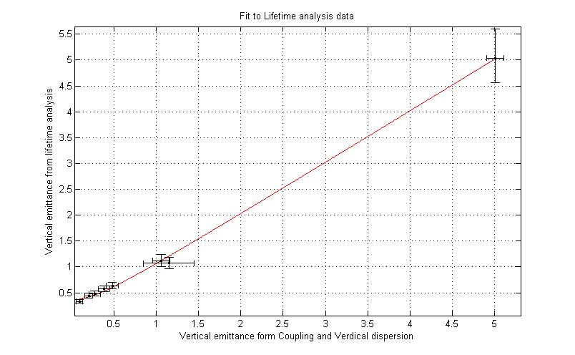
Experimental determination of Quantum Limit
Sub-picometer emittances measured
Fit using y = sqrt(QL^2 + x^2).
Result: Experimental QL = 0.37 ± 0.06 pm,
Quantum Limit of vertical emittance, calculated from the Raubenheimer equation, QL = 0.346 pm

Slide 30
Next workshops
  Low emittance rings design (2 days)
    Time proposal: April 2015
    Place proposal: Alba, Barcellona
  Low emittance rings general (3 days)
    Time: Autumn 2015
    Place: TBD

Slide 31

Thank you for the attention!
http://agenda.infn.it/event/ler2014

