Slide 1
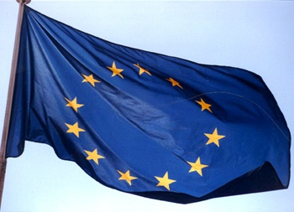
Role and Impact of EC Co-Funded Accelerator R&D Projects
http://www.esgard.org/
R. Aleksan
EuCAN, Frankfurt
September 30th, 2014
Accelerator R&D in EC-FP
DS Projects submitted
Conclusion

Slide 2
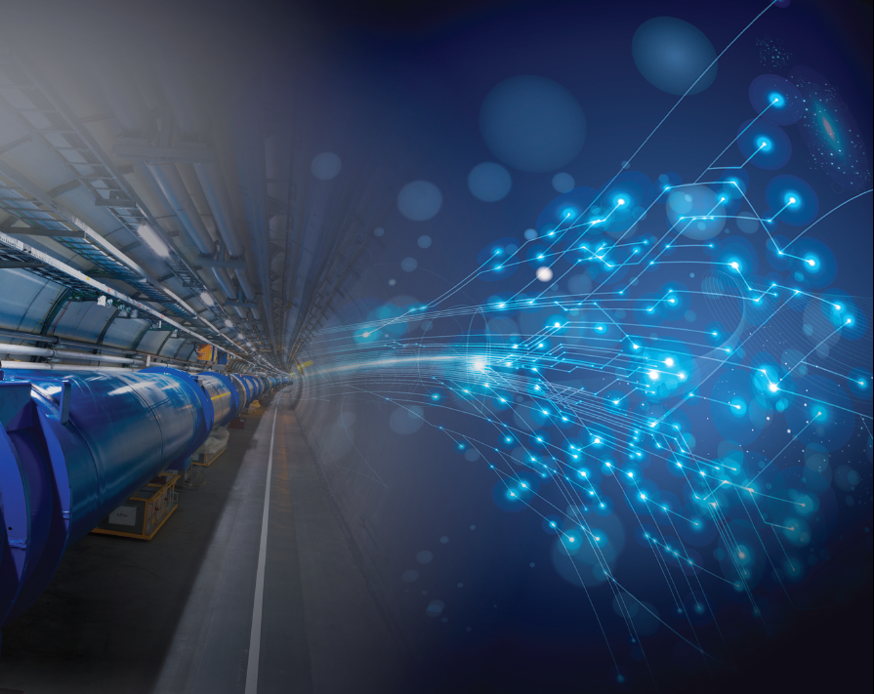

Accelerator R&D in Europe (History and today’s Organization)
Established in 2002 from the initiative of several labs.
R. Aleksan (CEA,Chair), M. Cerrada (CIEMAT),
R. Edgecock (STFC), E. Elsen (DESY) ,
S. Guiducci (INFN), M. Jezabek (IFJ)*, O. Kester (GSI), B. Launé (CNRS/IN2P3), K. Osterberg (HU)**, L. Rivkin (PSI), M. Vretenar (CERN,secretary)
http://esgard.lal.in2p3.fr
* Representing consortium of Polish institutes
** Representing consortium of Nordic institutes
ESGARD mandate: develop and implement a Strategy to optimize and enhance the outcome of the Research and Technical Development in the field of accelerator physics in Europe by
q promoting mutual coordination and facilitating the pooling of European resources
q promoting a coherent and coordinated utilization and development of infrastructures
q promoting inter-disciplinary collaboration including industry
Needless to say, this includes universities, which represent a significant fraction of the resources (see later)
This developed strategy led to the preparation and implementation of a coherent set of collaborative projects using the incentive funding EC Framework Programme.
Notes:
For each of these steps, there are EC calls

Slide 3
To build future accelerators, a strong and sustainable effort is indispensable during which it is important to get the EC involved through the EC calls issued within European the Framework Programmes (the present FP is called Horizon 2020)
Step 1: Design Studies
First step to be visible at the EC level and to enter the strategic infrastructure Roadmap of the European Union
Be included in the ESFRI roadmap
Step 2 : Preparatory Phase
Technical, managerial and Political Preparation Phase for the construction of the infrastructure
Step 3: Implementation
Launch of the construction including technology transfer and industry involvment
Step 0: Integration activities
Basic R&D
Assessment of new concepts
For each of these steps, there are EC calls
Although the amounts are small, it is politically extremely useful to be integrated in the EC “landscape”
Notes:
For each of these steps, there are EC calls

Slide 4
EC projects are at the very heart of the ESGARD strategy for promoting and supporting Accelerator Science and Technology
Notes:
For each of these steps, there are EC calls

Slide 5

ESGARD developed and implemented a strategy to promote Accelerator R&D
with the incentive of the EC Framework Programme within ERA
 | 2003 |  | 2004 | 2005 | 2006 | 2007 | 2008 |  | 2009 |  | 2010 | 2011 |  | 2012 |  | 2013 | 2014 | 2015
Accelerator R&D
CARE (IA) |  | 3 Networks (e, ν, p) |  |  |  |  |  |  | EuCARD (IA) |  |  |  |  |  |  | EuCARD2 (IA)
CARE (IA) |  | SRF |  |  |  |  |  |  | EuCARD (SRF)
CARE (IA) |  | PHIN |  |  |  |  |  |  | EuCARD (SRF, ANAC) |  |  |  |  |  |  | EuCARD2 (RF)
CARE (IA) |  |  |  | HIPPI |  |  |  |  | EuCARD (SRF, ColMat) |  |  |  |  |  |  | EuCARD2 (COMA)
CARE (IA) |  |  |  | NED |  |  |  |  | EuCARD (HFM) |  |  |  |  |  |  | EuCARD2 (MAG)
SLHC (PP) |  |  |  |  |  |  | SLHC-PP |  |  |  |  |  | HiLumi (DS)
EUROTEV |  |  |  | DS: ILC+CLIC |  |  | ILC-HiGrade (PP)
EURISOL |  |  |  | DS: Neutrino β-beam
DS νFact |  |  |  | Scoping study |  |  |  | DS-EuroNu
EUROLEAP |  |  |  |  | e in plasma |  |  |  |  |  |  |  |  |  |  | EuCARD2 (ANAC2)
SuperB
TIARA (PP) |  |  |  |  |  |  |  |  |  |  |  | R&D-RI & program
FP6
FP7
1 euros from the EC has triggered
2 additional euros from the partners
EuCARD (ANAC)
EuCARD (ANAC)
Altogether EC has partially financed projects in FP6 and FP7
with a total budget of ~228 M€ (68 M€ from EC)

Slide 6
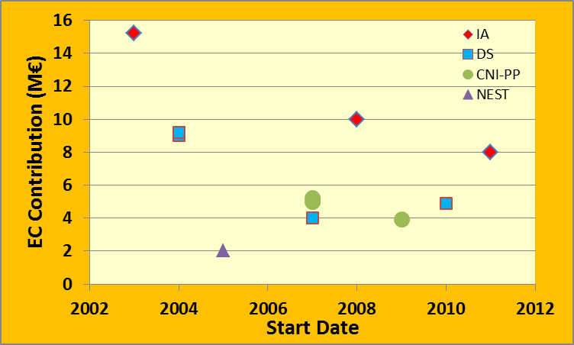
EC contribution in FP6-7
EC contribution is decreasing in all type of FP6-7 projects
Trend seems to continue in H2020 (e.g. DS limited to 3 M€ max)
Integrating activities for AS&T in 2016 (see later)? Flattening at 10 M€ level?
CARE
EuCARD
EURISOL
EUROTEV
SLHC
EuCARD2
HiGrade
HiLumi
EURONU
TIARA
EUROLEAP
FP6
FP7

Slide 7
EC projects have been and are instrumental
For collaborating, integrating, knowledge building and innovating
For fostering the community to carry out Accelerator R&D in a collaborative manner
For enabling smaller institutes/universities to gain knowledge and experience by collaborating with large institutes and to access world class infrastructures
For enabling coordinated and efficient means for a regionally balanced scientific and technological development.
For triggering new ideas and developing further novel concept, e.g. crab waist scheme, plasma acceleration
For allowing Europe to build expertise in domains where it was behind, e.g. Nb3Sn magnet, HTS links, PWFA…

Slide 8
EC projects have been and are instrumental
For collaborating, integrating, knowledge building and innovating
For helping improving accelerator R&D infrastructures, e.g.
  CTF3, SLS, SPARC, ICTF…
For helping enabling the improvement or launch of large infrastructure projects, e.g.
  Linac4, LHCupgrades, FAIR, ESS
  ELBE, FLASH, XFEL
  …

Slide 9
Participants in FP6-7
Strong participation from universities
In FP6-7 : 3 IA and 3 DS projects
Total of 72 participants (number of participant in any of the 6 projects)
Out of which 43 universities (60%)
[note: this is a lower limit as there are joint partners (lab+uni , e.g. CNRS, INFN)]

Slide 10
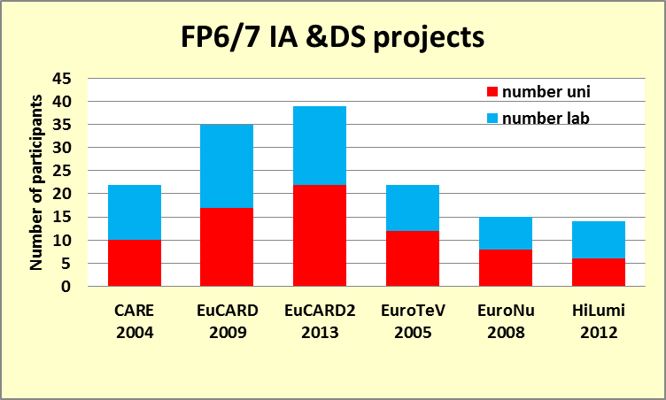
Participants in FP6-7
Detailed analysis of participants according to FP6-7 projects
Stronger participation from universities in Integrating Activities
Growing participation in IA despite reduced budgets
55%
46%
55%
45%
53%
43%
IA
DS

Slide 11
Participants in FP6-7
Detailed analysis of personnel effort in IA projects
Growing fraction of university involvement despite reduced budgets
10%
29%
33%
IA

Slide 12


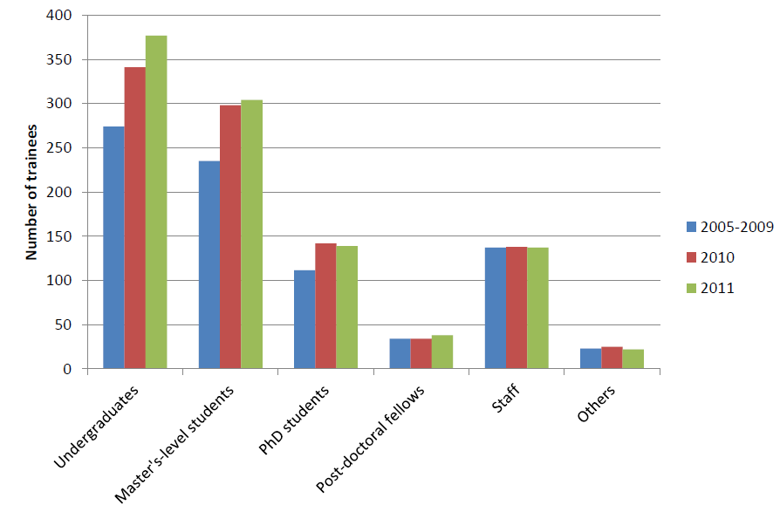
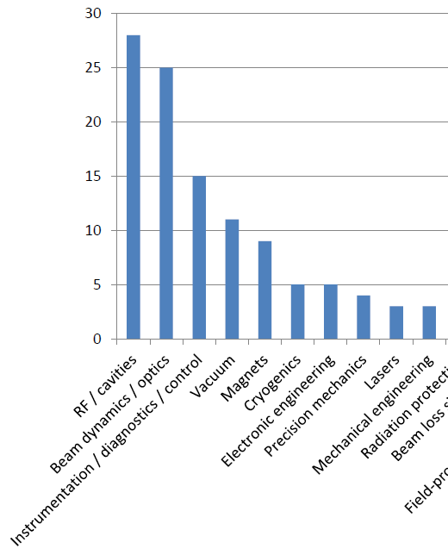
Education &Training programme
Area where Universities have a strong impact
Trainees (>10 hours) per year
Survey and Database
https://cdsweb.cern.ch/record/1442599
The number of institutes (70) that reported lacking expertise vs. area of expertise
Needs for accelerator scientists in Europe
http://cds.cern.ch/record/1521336
Promoting Accelerator Science and Technology in Europe Report
http://cds.cern.ch/record/1627600

Slide 13
News from the EC
Proposed funding (in M€ for 2014-2020, 2011 constant prices)
European Research Council Frontier research by the best individual teams | 13 268
Future and Emerging Technologies Collaborative research to open new fields of innovation | 3 100
Marie Curie actions Opportunities for training and career development | 5 572
Research infrastructures (including e-infrastructures) (IA,DS, CNI-PP, ERA-NET…) Ensuring access to world-class facilities | 2 478
Estimated Work programme 2014-2015 Budget:
INFRA = ~580 M€, FET = ~450M€

Slide 14
3 DS (INFRADEV-1) projects being prepared
Calls | 2014 (M€) | «Max.» EC co. (M€) | Deadline
INFRADEV-1 (DS) | 15 | « 3 » | 2 Sept. 2014
ESGARD has overseen the preparation these projects
EuroCIRCOL: FCC-hh 100km Circular collider (Core part of FCC)
Coordination: lab a CERN, coordinator a M. Benedikt
Duration: 4 years; Requested EC contribution: 3 M€
EuPRAXIA: European Plasma Accelerator with High Beam Quality and Pilot Applications
Coordination: lab aDESY, coordinator a R. Assmann
Duration: 4 years; Requested EC contribution: 3 M€
ESSnuSB : neutrino Super-Beam based on ESS linac
Coordination: lab a CNRS, coordinator a M. Dracos
Duration: 3 years; Requested EC contribution: 1.8 M€

Slide 15
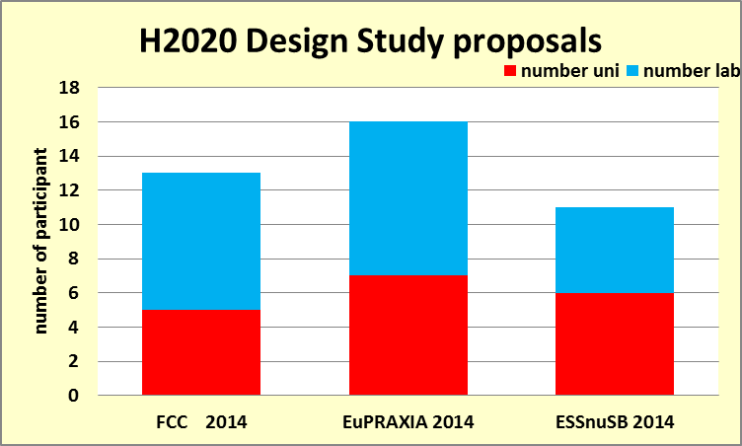
Participants in H2020
Strong participation from universities
In H2020 : 3 DS projects have been submitted
Total of 29 participants (number of participant in any of the 3 projects)
Out of which: 16 universities (55%)
[note: this is a lower limit as there are joint partners (lab+uni , e.g. CNRS)]
44%
38%
55%

Slide 16
Horizon 2020: INFRAIA calls (1/3)
Integrating Activities (starting and advanced communities)
Calls id. | Type | Deadline
INFRAIA-1-2014 /2015 | Integrating Act. | 02/09/2014 at 17.00.00 Brussels time
Calls | 2014 (M€) | 2015 (M€) | Max. EC contr. (M€)
INFRAIA-1-2014/2015 | 90 | 50 | 5 (10 advanced)
Unfortunately Accelerators Science and Technology is not included in the call because EuCARD2 has just been accepted.
This is a real limitation as
we have several very interesting R&D projects
Only projects enabling to set up networking activities
Very popular for the universities

Slide 17
Horizon 2020: INFRAIA calls (2/3)
Hopefully, Accelerator R&D should be in the following call in one form or the other
i.e. 2016/2017 timely with the end of EuCARD2
ESGARD is initiating the preparation of a proposal
ESGARD would like to collect topics proposals from
EuCARD2 partners
TIARA and ESGARD partners
… and AS&T community at large
Setting a template for topic proposals
According to proposals, we would
Define a few main themes
Nominate theme conveners in charge of developing a coherent theme package within specific budget guidelines (as we did for EuCARD2)

Slide 18
Horizon 2020: INFRAIA calls (3/3)
A possible H2020 schedule could be :
Fall 2015: H2020 call
Submission deadline : Spring 2016
Start of project : Fall 2016/early 2017
Accordingly, a possible schedule for bid preparation could be:
End 2014: Collect topic proposals
Early 2015: Definition of themes and nomination of conveners
Summer/Fall 2015: very first organization of the proposal:
  Definition of proposal scope and topics
  Nomination of coordinator and WP leaders to build the proposal

Slide 19
Horizon 2020: FET calls
Future and Emerging Technologies
New opportunity (existed only for IT in FP6-7)
Calls id. | M€ | Type | Deadline
FETOPEN | 160 | Novel Ideas for Radically New Tech. | 30/09/2014, 31/03/2015, 29/09/2015
Calls | 2014 (M€) | 2015 (M€) | « Max. » EC contr. (M€)
FETOPEN-1 (Open research projects ) | 77 | 37+40 | 4
Key words:
Long-term vision, Breakthrough S&T target, Foundational, Novelty , High-risk, Interdisciplinary

Slide 20
Horizon 2020 : Projects for FET
Plasma Acceleration
Project: HiFLUX: High repetition rate Fiber Laser-Plasma accelerators for Ultrabright X-rays
Objective: Use a train of laser pulse separated by plasma period to resonantly excite wakefield
Proposer labs a UK (JAI, ICL, UCL) +DE (JENA) + FR (ESRF)
Duration: 4 years; Requested EC contribution: 4.2 M€
Project: Electron-Beam driven Plasma Acceleration
Objective: Plasma accelerator driven by single or multi-pulse electron beams for advanced light source applications (FLASH, SPARC, VELA/CLARA)
Proposer labs a IT (INFN, Roma uni), DE (Max Planck Inst., DESY), PT(IST), UK (STFC, Manchester, Strathclyde)
Duration: 4 years; Requested EC contribution: 3.9 M€

Slide 21
Simplification in EC management and reporting rules
Integration of EC instruments in a single and large instrument including IA, DS, CNI-PP, NEST, MC grants
Integrate the funding of innovation and technology transfer in the instrument above
Build thrust with consortia and delegate them the organization of specific calls for projects
TIARA

Slide 22
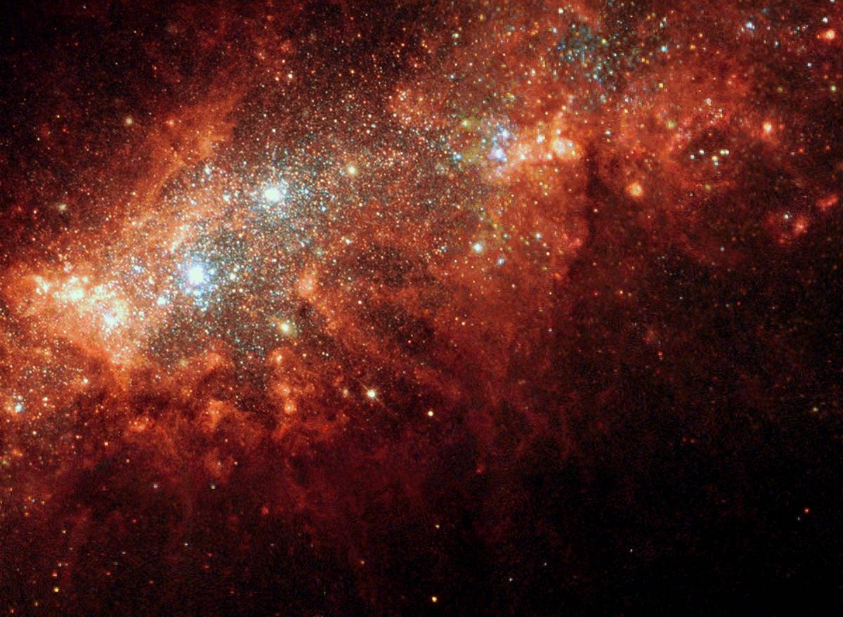
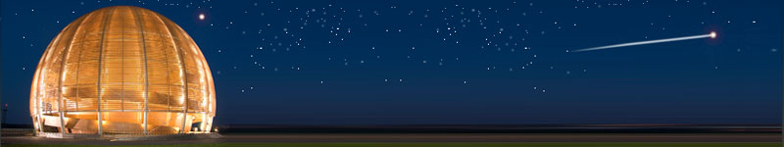
Conclusions
After having established an accelerator R&D strategy, its implemention through several very successful projects in FP6 & FP7, has enabled to attract many partners including universities.
TIARA/ESGARD will continue to work toward a successful integration of all AS&T actors in Europe in order to enhance further the impact of Accelerators in Science and Society.
Accelerator science is a powerful mean
toward scientific, technical and
industrial breakthroughs and innovations…

Slide 23
BACKUP

Slide 24
FCC : 100km Circular (pp, ee, ep) collider
FCC DS is huge a WP with EC funding and WP without EC funding
a number of partners for H2020 part are limited
Physics and Experiments
Accelerators
Infrastructures
and Operation
Implementation
and Planning
Study and Quality
Management
Hadron Collider Physics
Hadron Injectors
Civil Engineering
Project Risk Assessment
Study Administration
Hadron Collider Experiments
Hadron
Collider
Technical Infrastructures
Implementation Scenarios
Communications
Lepton Collider Physics
Lepton Injectors
Operation and Energy Efficiency
Cost
Models
Conceptual
Design Report
Lepton Collider Experiments
Lepton Collider
Integration
Lepton-Hadron Collider Physics
Lepton-Hadron Collider
Computing and
Data Services
Lepton-Hadron Collider Experiment
Technology R&D
Safety, RP and Environment

Slide 25
FCC : 100km Circular (pp, ee, ep) collider
H2020-DS core subpart: Key activities
Management
Projet Management , Global collaboration issues, Projet Costing, CD&O…
Arc Lattice Design (lattice, dynamic aperture, magnet field quality, design collinmation sections, functional specs beam pipe & magnets… )
EIR (IR Design, functions andperformance of key beam-line elements, MDI … )
Hadron
Collider design
Cryogenic Beam Vaccuum System (beam screen, proximity cryogenics, magnet cold bore and vaccuum system, radiation heat load absorption…)
Dipole magnet design
FCC is likely to be the next large scale project in particle physics in Europe after the LHC
H2020-DS is important for FCC
  To get a European visibility
  For being in the list of ESFRI infrastructures
  To get funding for some key partners

Slide 26
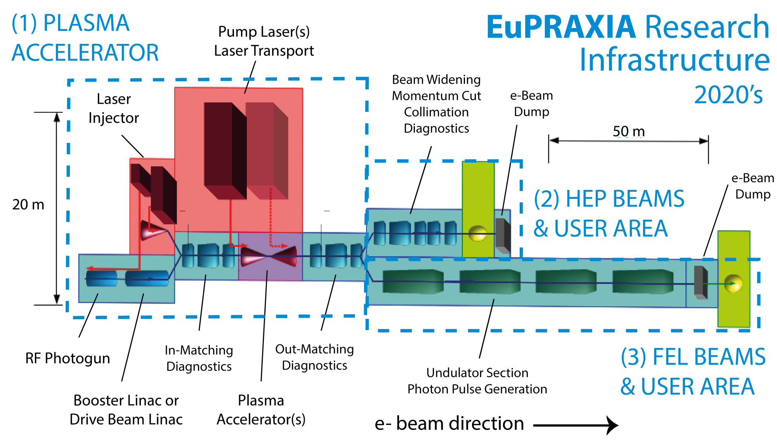
European Plasma Accelerator with High Beam Quality and Pilot Applications
a Go from Plasma Acceleration to Plasma Accelerator with useable beam quality
  Cood. DESY, 16 beneficiaries from France (3), Germany (2), Italy (4), Portugal (1), UK (6)

Slide 27
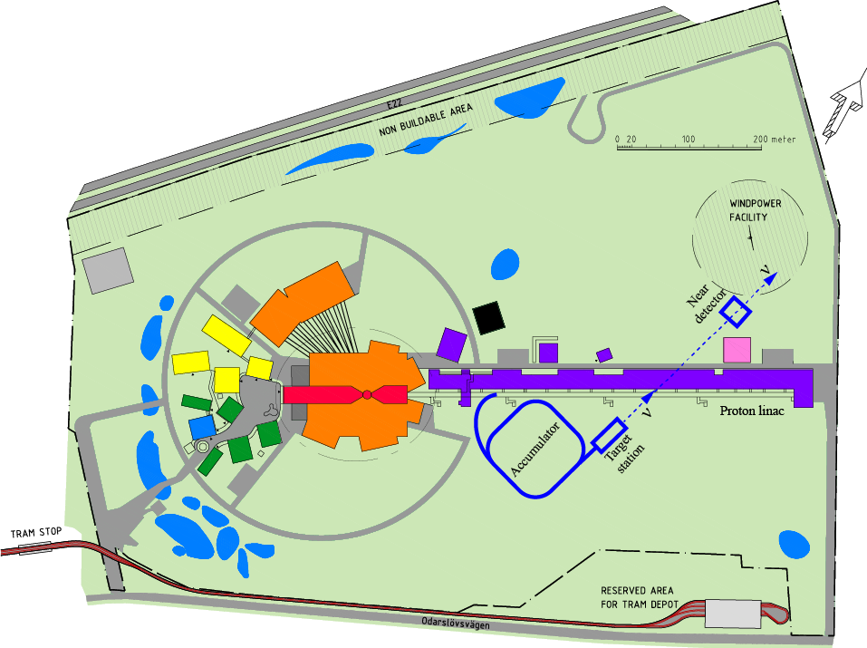
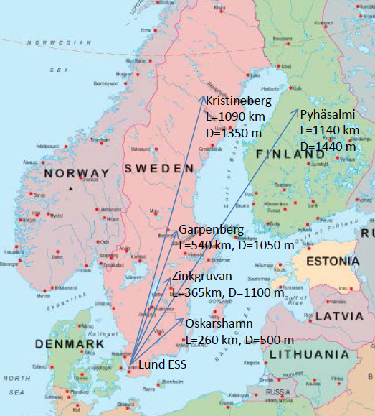
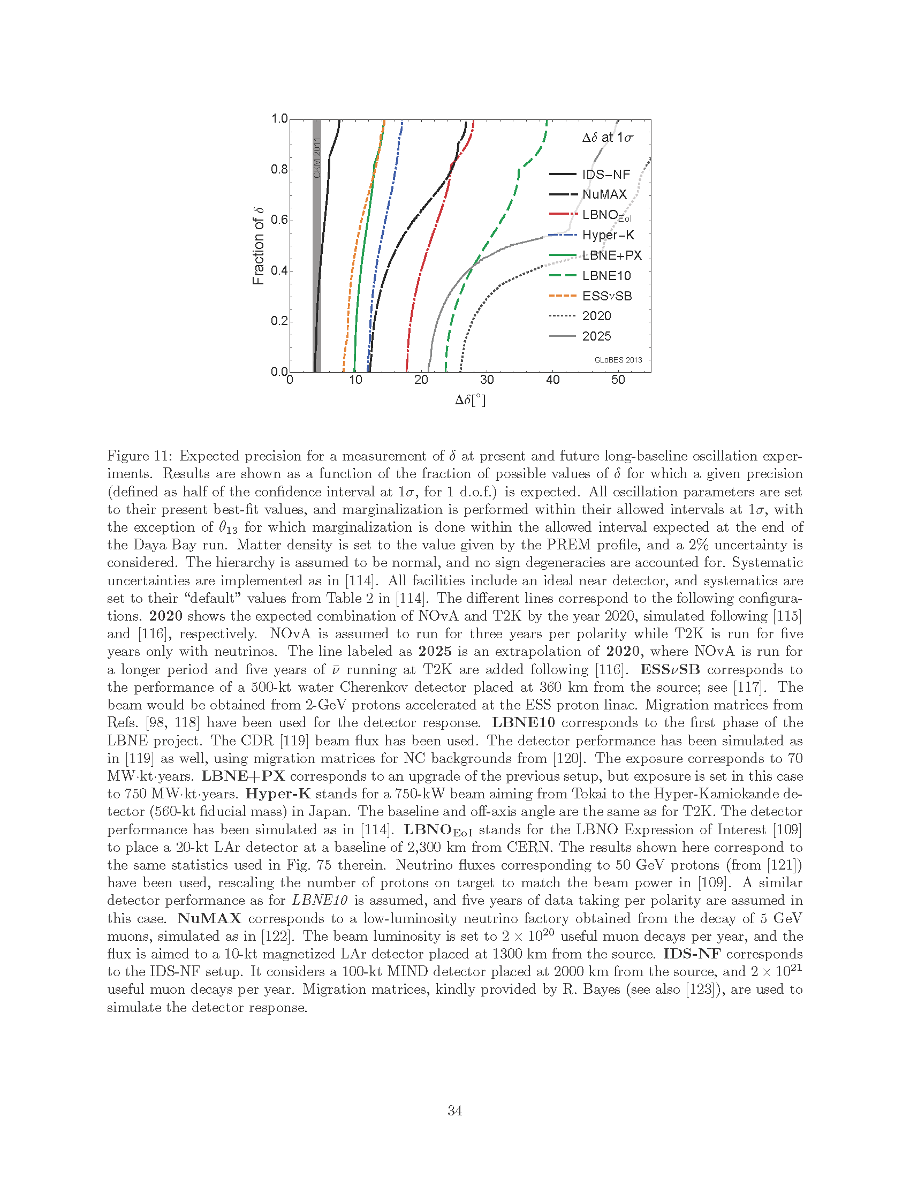
ESSnuSB : neutrino Super-Beam based on ESS linac
a Doubling the power of the linac (10MW) by doubling the duty cycle (4% to 8%)
a Buiding accumulator ring(s), target, horn, detectors
Envisaged Work Packages and participants
Management
Linac
accumulator
Target station Horn
Detectors
Physics performance
Strasbourg, Uppsala
ESS, CERN, CNRS, Uppsala
Uppsala, CERN, CNRS
AGH Krakow, CNRS, Uppsala
Lund, , CERN, INFN, Sofia, Uppsala
UAM Madrid, KTH, INFN, UDUR

