Slide 1
Results of the Mainz Test Experiment
Update
M. Hoek
XLIX. PANDA Collaboration Meeting | 10/06/2014 | GSI

Slide 2
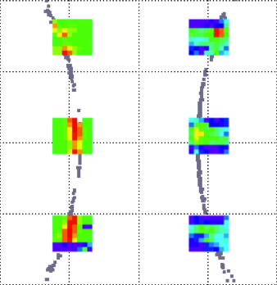
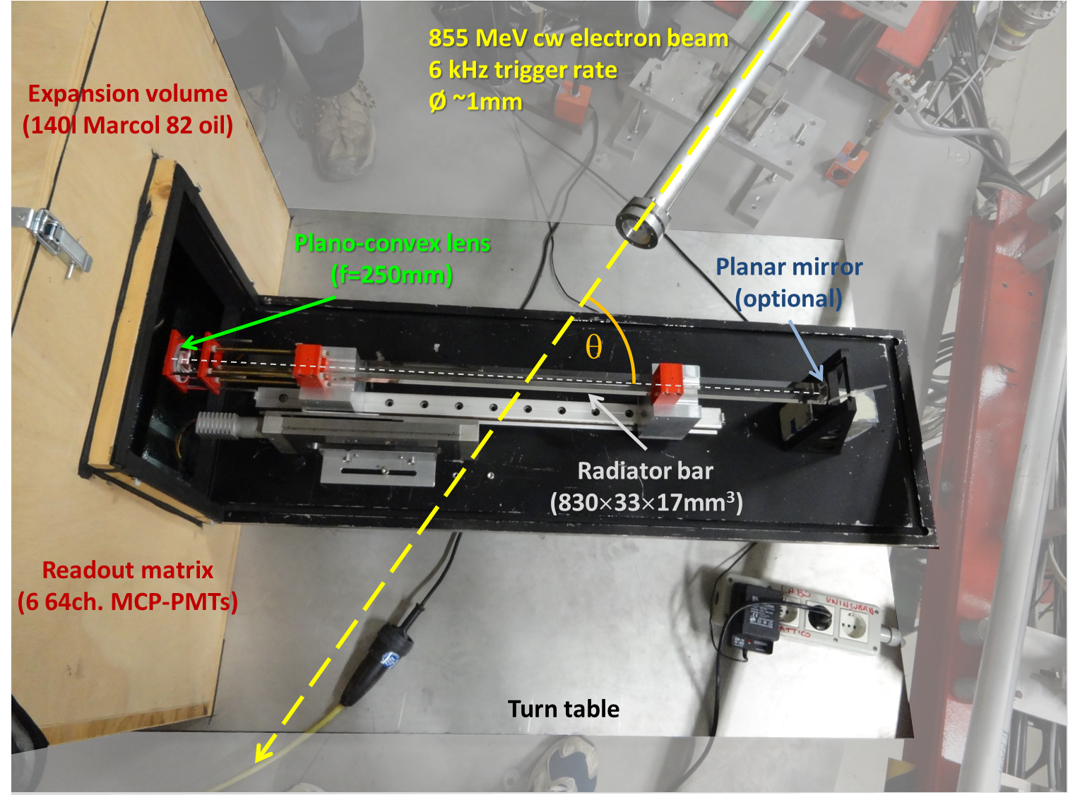
Brief Reminder - Setup
2013, MAMI, 855 MeV e⁻ beam
  NINO & PADIWA;
  up to 6 MCPs;
  384 readout channels;
  2-3 detected photons per event.
Incident e⁻ beam at 57°
200
NINO
PADIWA
0
y (mm)
-200
-200
0
-200
x (mm)
Clear Cherenkov pattern (especially for NINO FEE);
Padiwa issue (now solved).

Slide 3
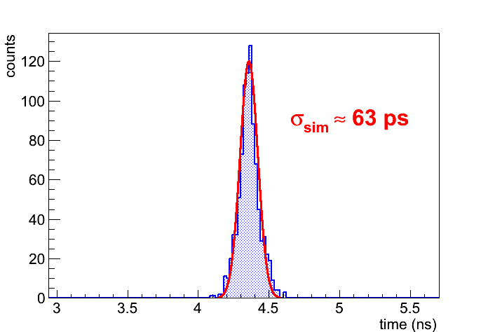
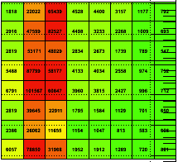
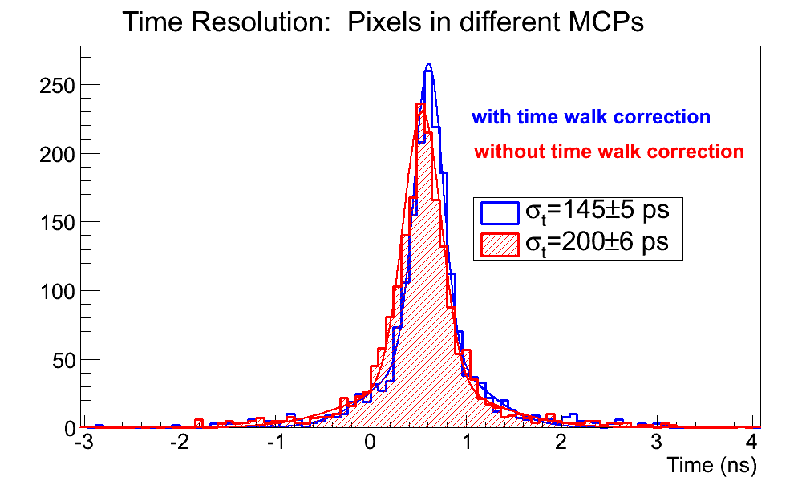
Timing Results – Full System (NINO Boards only)
Timing resolution of the entire prototype:
optimised walk correction;
Simulation of propagation time;
MCP 0
MCP 1
around from the sync. time of TRBs.

Slide 4
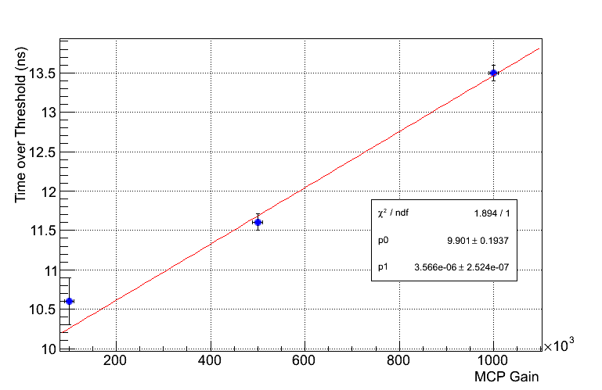
Timing Results – Gain Dependence (NINO only)
1 x 10⁶ has been used for the test experiment;
can we use a smaller gain?
 | Timing Resolution
Gain | not corrected | corrected
1 x 10⁵ | ~190 ps | ~180 ps
5 x 10⁵ | ~175 ps | ~130 ps
1 x 10⁶ | ~161 ps | ~40 ps
Clear correlation between gain and time over threshold;
the corrected timing resolution gets worse (walk correction needs to be adapted).

Slide 5
Announcment
Tutorial for Mainz TRB Analysis Software
Tomorrow (11/06/2014) at 11:00

