Slide 1
Charmed Hadrons@PANDA
H. Lenske
Institut für Theoretische Physik, JLU Giessen
and
GSI Darmstadt

Slide 2
Agenda:
Charmonium Spectroscopy
Charmonium Production
Physics Content of Line Shapes
Charmed Baryons@PANDA: pp→ Λ_{c} Λ_{c}

Slide 3
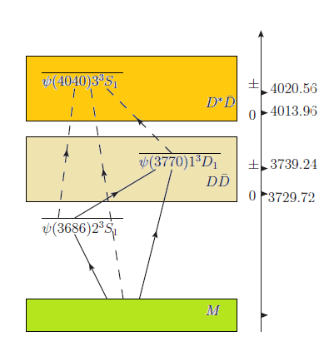
Charmonium at the DD-Threshold
Closed quarkonic channels: confined cc states
Closed hadronic channels : sub-threshold DD-states
Open hadronic channels : DD-channels

Slide 4
Charmonium State Vectors
Confined cc quarkonic component φ_{c}
Coupled to hadronic DD components φ_{sω}
Coupling via qq-creation out of the vacuum:
cc → cqqc → D(cq) D(qc)
Interfering production amplitudes:
(τ=e⁺e⁻,pp…)

Slide 5
Charmonium Spectroscopy in the Quark Model

Slide 6
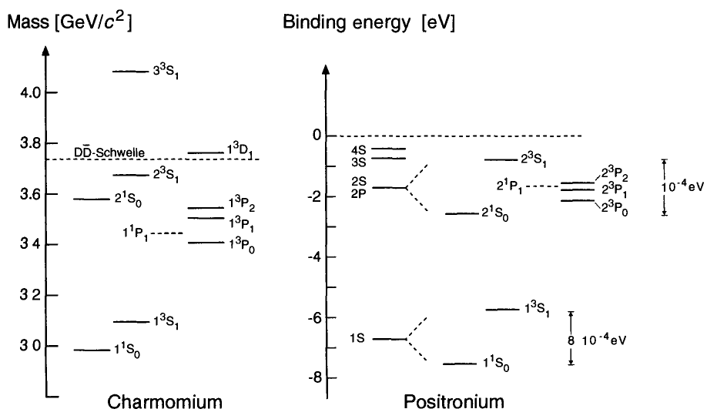
Quarkonium:
Confined Systems of Heavy (cc,bb) Quarks

Slide 7
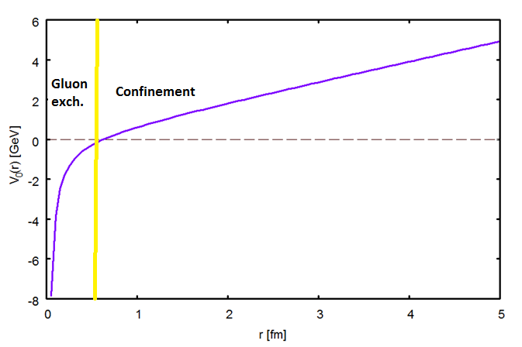
Quarkonium Spectroscopy:
Potential Model for Charmonium and Bottonium

Slide 8
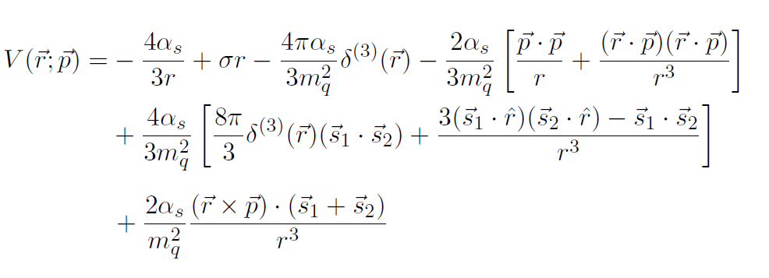
Modelling Gluon Exchange by the Breit-Potential:
Cornell-Potential and relativistic (hyperfine) interactions
The Quark-Model
Cornell-Potential : Eichten, Gottfried ~ 1980
Hyperfine interactions: Isgur, Godfrey ~ 1985
Description of D-mesons and charmonium

Slide 9
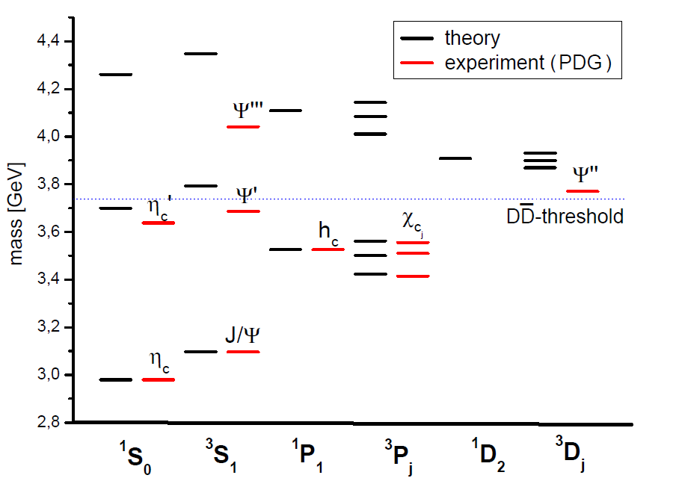
Charmomium Spectrum
J. Lopez, H.L., 2014

Slide 10
Charmonium Production and Spectroscopy at the Threshold

Slide 11
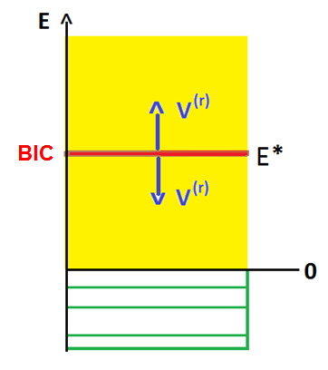
The „BIC“-view of Continuum Spectra
Closed channel E* is embedded into a continuum of open channels
E* decays only via interaction V^{(r)} with open channels
BIC - Bound State Embedded into the Continuum
→ Scale-independent, universal phenomenon ←

Slide 12
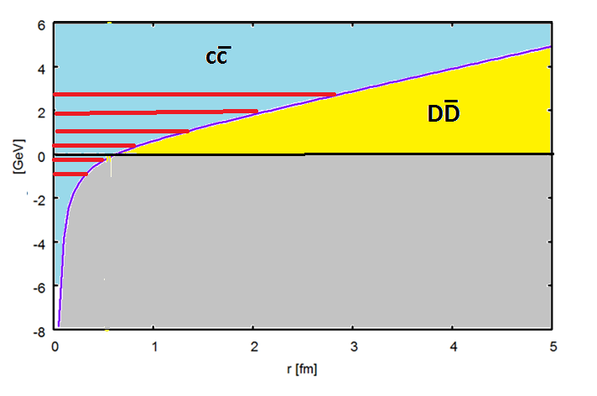
The spectroscopic environment of charmonium
(closed channels)
(open channels)

Slide 13
Charmonium Wave Function at the DD Threshold
Quark model description of charmonium and D-mesons
„³P₀“ Lagrangian for pair creation in cc→DD coupling

Slide 14
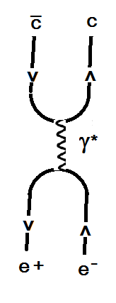
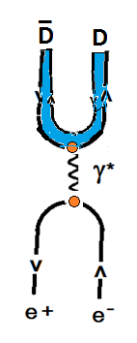
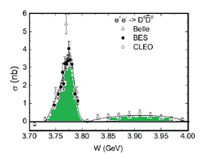
Charmonium Production Scenario
Quarkonic
Hadronic

Slide 15
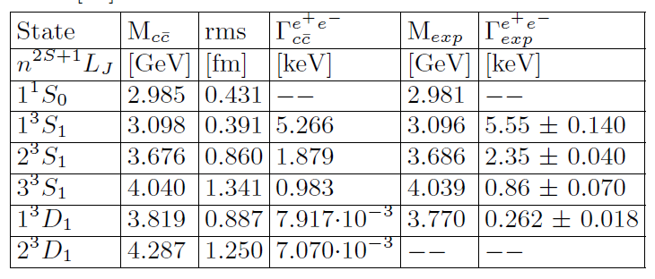
Spectral Properties of cc-States
(Cornell-Breit Potential)
Quark Model predictions for e⁺e⁻ width and ³D₁ suppression:

Slide 16
Wave Function at the Charmonium Threshold
Single confined channel b=ψ(1³D₁) and single open channnel s=DD:

Slide 17
Charmonium Production@BES III and PANDA:
BIC and Fano-Resonances
The line shape parameter:
Controlling the line shape asymmetry
Indicator of the reaction scenario: quarkonic vs. hadronic

Slide 18
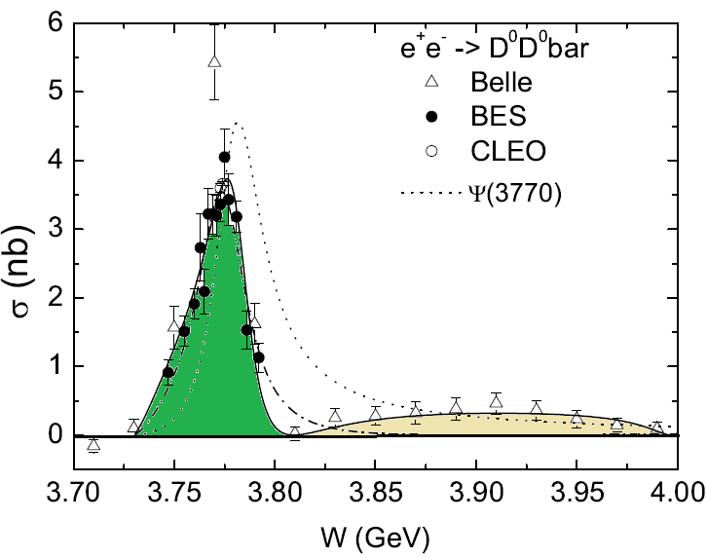
DD-Dynamics at Threshold
Channel Coupling and the Line Shape of ψ‘‘(3770)
q=-2.1±0.3
X(3900) ??
3.65
Xu Cao, H. L., PRL, submitted

Slide 19
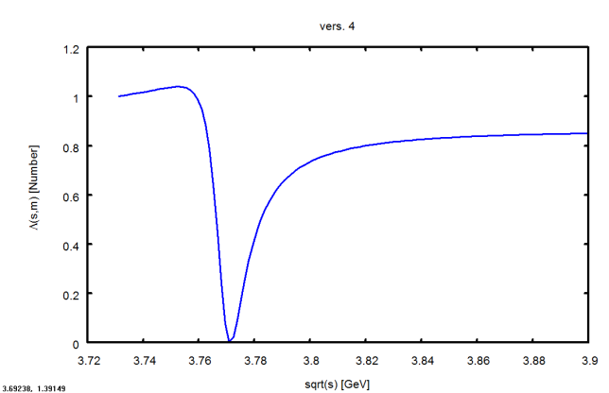
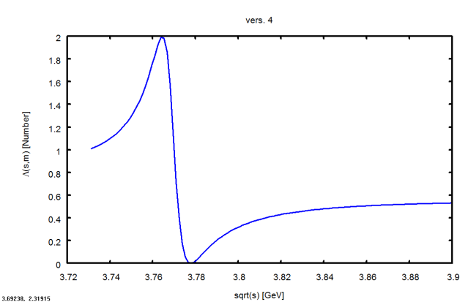
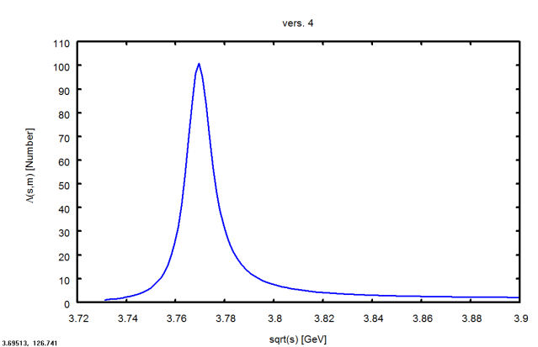
Line Shape of Reaction Form Factor and Physics Content
q=-0.2
q=-1
q=-10
balanced quarkonic and hadronic production
Dominance of
hadronic production
Dominance of quarkonic production
Line shape controlled by quarkonic content
Line shape depends on production reaction
Spectral distribution of the SAME final state depend on initial state

Slide 20
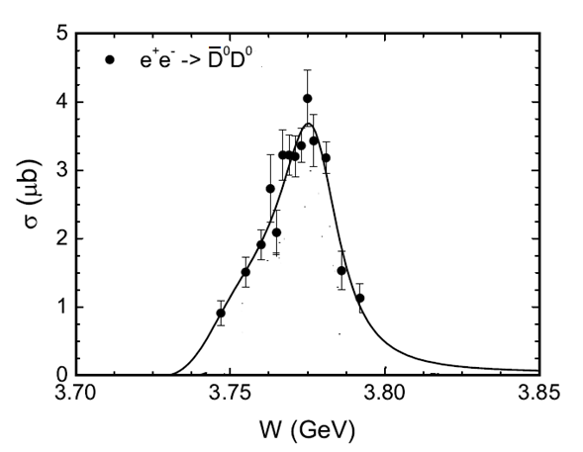
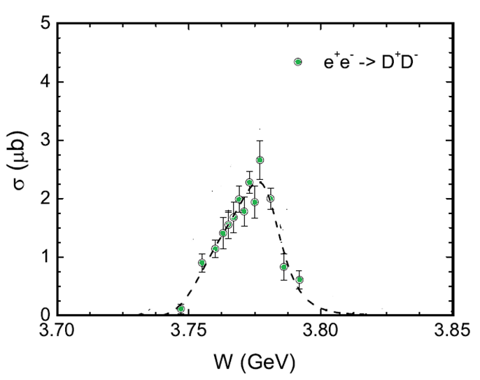
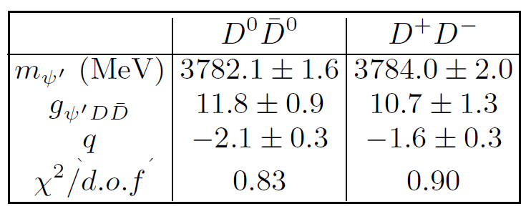
Production of ψ‘‘(3770) and the DD Spectral Distributions
(Data: BES Collaboration)
Derived Parameters:
Xu Cao, H.L., 2015

Slide 21
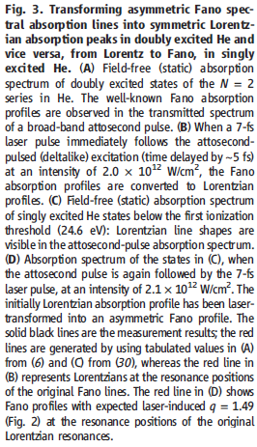
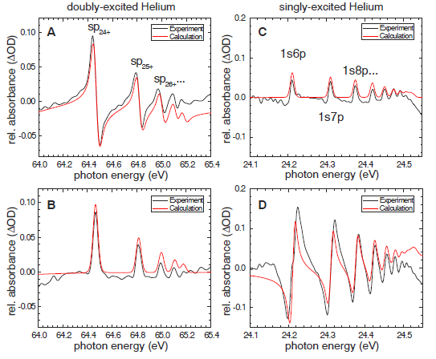
Laser-Modelling of Fano-Line Shapes
Defining features of Fano-Resonances:
Asymmetric line shapes and Γ_{R}<<m_{R}
Science 340,716 (2013)

Slide 22
Summary and Outlook
Charmonium Spectroscopy
Reaction mechanism of charmonium production
Resonances, closed and open channels
Charmonium spectral distributions
Physics content of charmonium line shapes
Charmonium production and spectroscopy at PANDA
Production of charmed baryons at PANDA
Credits to Xu Cao, Juan Lopez, and Radhey Shyam

Slide 23
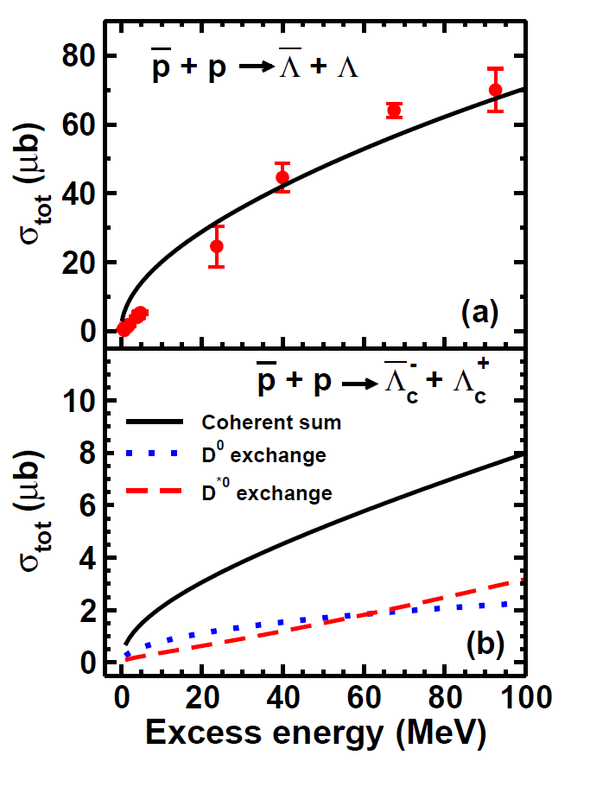
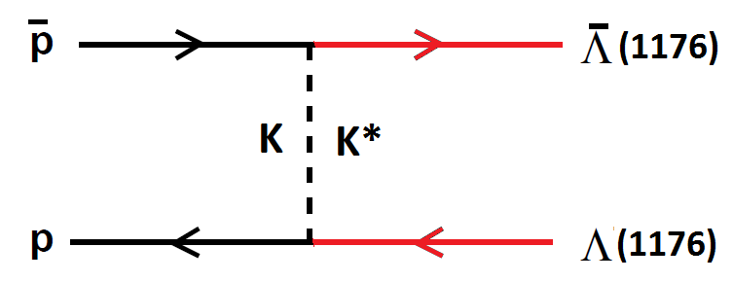
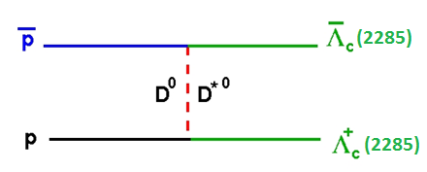
Λ(uds) and Λ⁺_{c}(udc) Production in Antiproton-Proton Annihilation
(ISI/FSI included!)
R. Shyam, H.L., Phys. Rev. D 90, 014017 (2014)

Slide 24
Charmed Baryons@PANDA

Slide 25
Lagrangian Appraoch to Λ⁺_{c}(udc) Production in Antiproton-Proton Annihilation
[Lab System: T_{thres}=9.24 GeV; p_{thres}=10.14 GeV/c]
R. Shyam, H.L., Phys. Rev. D 90, 014017 (2014)

Slide 26
Λ(uds) and Λ⁺_{c}(udc) Production in Antiproton-Proton Annihilation
(ISI/FSI included!)
R. Shyam, H.L., Phys. Rev. D 90, 014017 (2014)

Slide 27
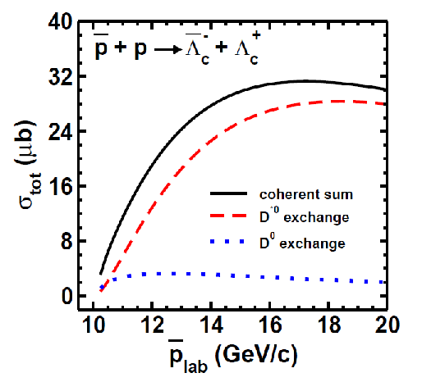
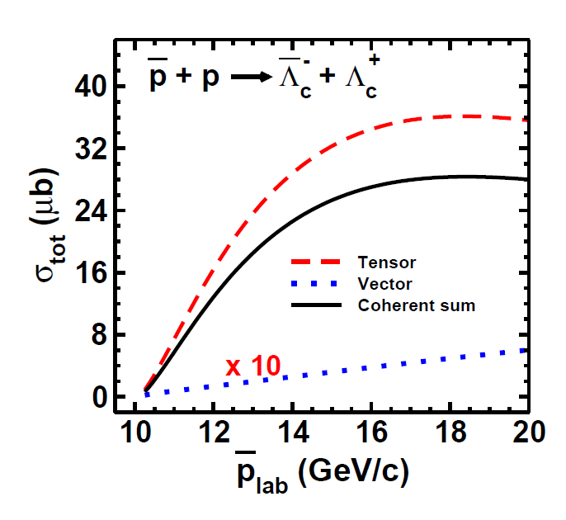
Dynamics of Λ⁻ Λ⁺ Production
(ISI/FSI included!)

Slide 28
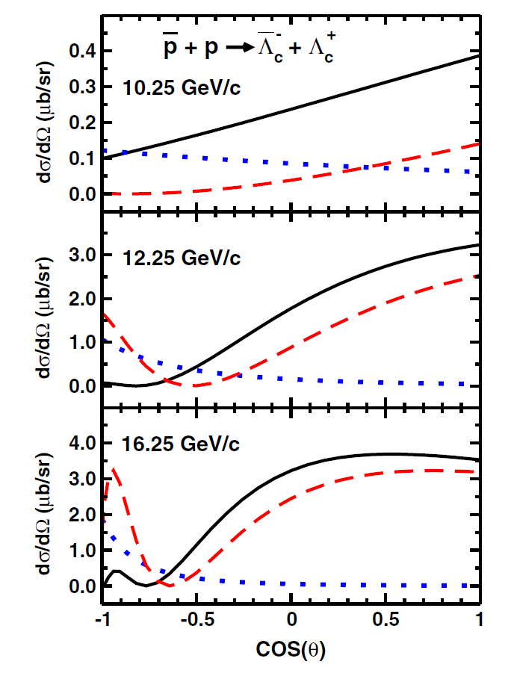
Angular Distributions

Slide 29
Summary and Outlook
Charmonium Spectroscopy
Reaction mechanism of charmonium production
Resonances, closed and open channels
Charmonium spectral distributions
Physics content of charmonium line shapes
Charmonium spectroscopy at PANDA
Production of charmed baryons at PANDA
Credits to Xu Cao, Juan Lopez, and Radhey Shyam

