Slide 1
FAIR Proton Linac
Status and plans with France
GSI Helmholtzzentrum für Schwerionenforschung GmbH
Wolfgang Vinzenz 11th MAC Meeting May 2014
26.05.14

Slide 2




FAIR Proton Linac
Status GSI
RFQ progress
CH and Prototype
Test bench
Status France
CEA - Source, Magnets, Power converters
CNRS / IN2P3 - Klystron, modulators + accessory, CH cavities, Buncher
GANIL - Power converters
...final remarks

Slide 3
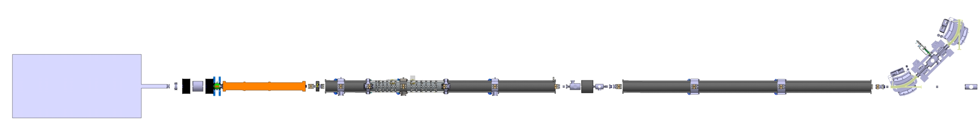
FAIR Proton Linac
45kW SSA
GANIL
Power supplies
...the parties involved
GANIL
Power supplies
GSI
GANIL
Power supplies
CNRS/IN2P3
GSI
CEA
RFQ
Buncher
Internal Magnets
Magnets
Source and LEBT
3 coupled CH Cavities
Beam Diagnostic
3 CH Cavities
CEA
GSI
CNRS/IN2P3
CENBG
CEA
GSI
CNRS/IN2P3
CENBG
Tehnodrom
LLRF
Klystron, Modulator
Circulator, WaveGuides
# just a basic display

Slide 4
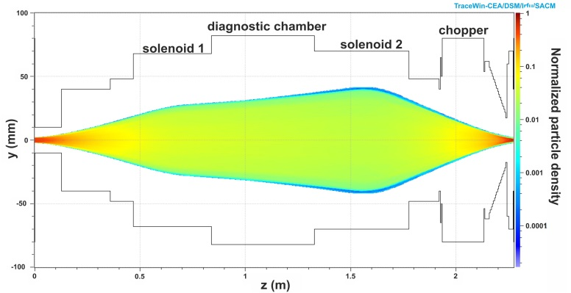
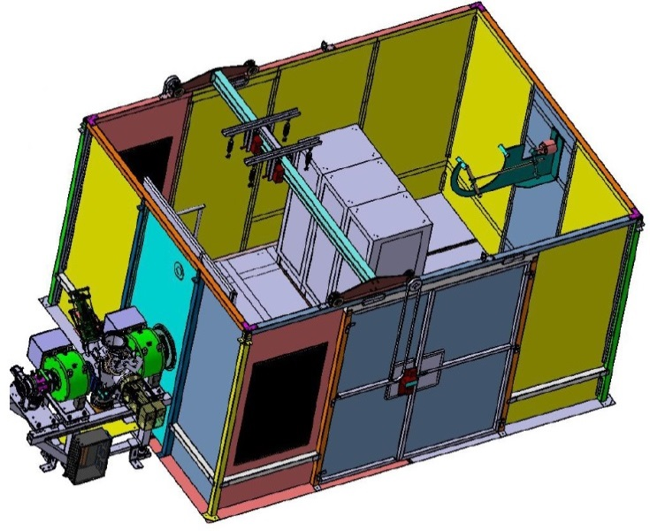
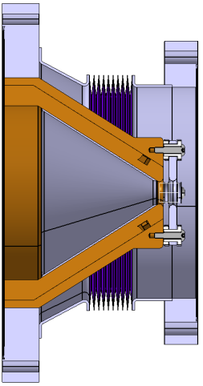
FAIR Proton Linac
FRANCE [CEA] Source activities
Good progress at the source commissioning
Chopper design is taken over by CEA,
production in collaboration with GSI
Mini control system will be installed in September
performed by N. Chauvin
Chopper design
by CEA Saclay
Sketch of assembling of
the Faraday cage and LEBT
for commissioning
at CEA Saclay

Slide 5
FAIR Proton Linac
FRANCE [CEA] Source activities
Faraday cage, HV platform | assembled at CEA Saclay
Solenoids, ACCTs | assembled and tested at CEA Saclay
Allison scanner, Wien filter | production in process at CEA Saclay
Iris, SEM-grid | assembled at GSI
Turbo pumps, valves, gauges, LEBT chamber | delivered to CEA Saclay
Plasma chamber, source coils | assembled at CEA Saclay
Accelerating column | assembled + vacuum tested at CEA Saclay
Extraction system (Pentode) | delivered and tested at CEA/Saclay
HV Power Supply | expected delivery in Q1 2015
Puller Power Supply | expected delivery in Q4 2014
Repeller Power Supply | expected delivery in Q4 2014
Coils Power Supplies | expected delivery in Q4 2014
Commissioning at CEA/Saclay | planed in Q2 2015
Table provided by Violetta Ivanova and Rustam Berezov

Slide 6
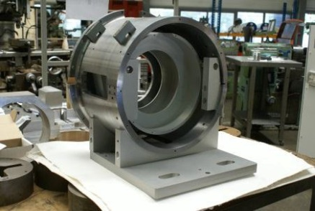
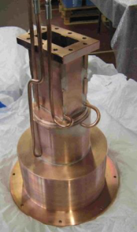
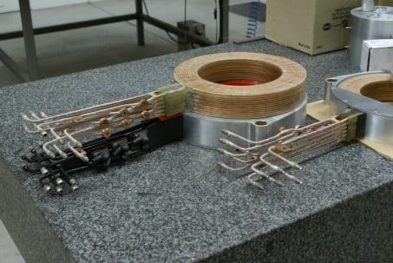
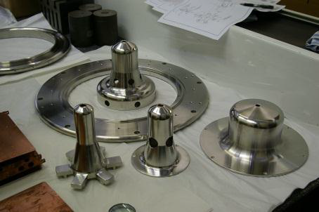
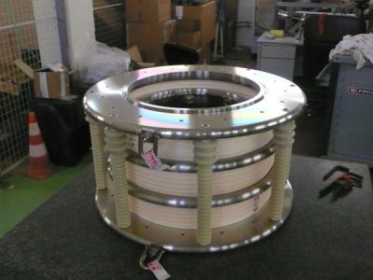
FAIR Proton Linac
FRANCE [CEA] Source activities
Faraday cage
Plasma chamber and RF components
Pictures provided by CEA
Source coils
Extraction system
Accelerating column

Slide 7
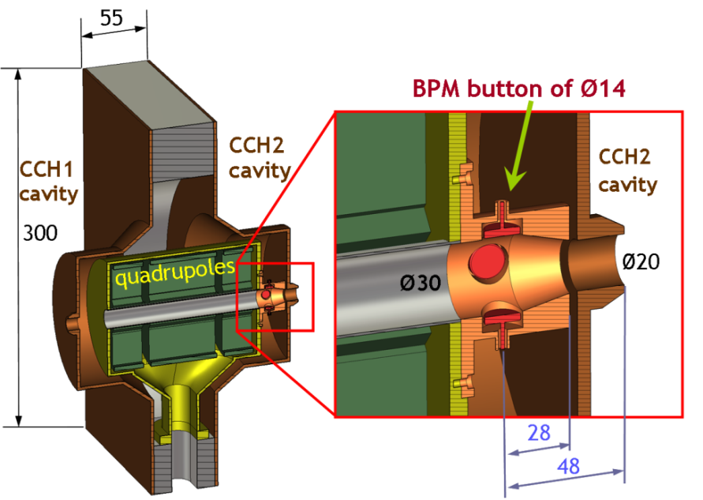
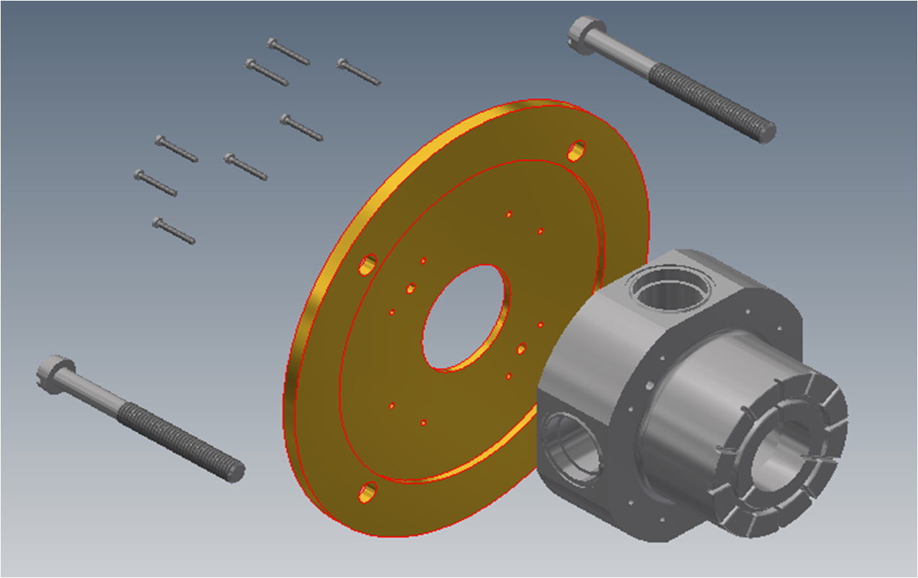
FAIR Proton Linac
FRANCE [CEA] and GSI BMP activities
BMP design
by Claire Simon (CEA),
Mohammed Almalki
and Peter Forck (GSI)

Slide 8
FAIR Proton Linac
RFQ status
RFQ and Source/LEBT parameters have been finally fixed
and agreed by a group of experts in March
Beam dynamic calculations are making good progress
  very fruitful collaboration with CERN experts
  GSI decided a constant vane-width
  for easier fabrication
RF simulation to the cross section started 352/325
___________________________________________________
IAP Frankfurt is working on a 4-rod and a ladder model of 1 m length
  to be tested at the GSI test bench with the adequate power ?
Energy (Input) = 95.0 keV
Energy (Output) = 3000.0 keV
Design Current = 70 mA
Current (Input) = 100 mA (max.)
Max. Field strength = 333 kV/cm
Max mech. Length = 3500 mm
Decision to the RFQ type latest in September 2014 as requested by MAC 10

Slide 9
FAIR Proton Linac
CH and Prototype status
Specifications to start the tendering process by CNRS/CENBG
will be available mid of July 2014 [external order is in progress]
Contract with IAP for finalizing the very detailed
RF and beam dynamic simulation will be signed in May 2014
_________________________________________________________________
We failed the milestone for copper plating the CH proto type in April
  tests with a simplified cavity version are performed at present
RF coupling loop is currently under production

Slide 10
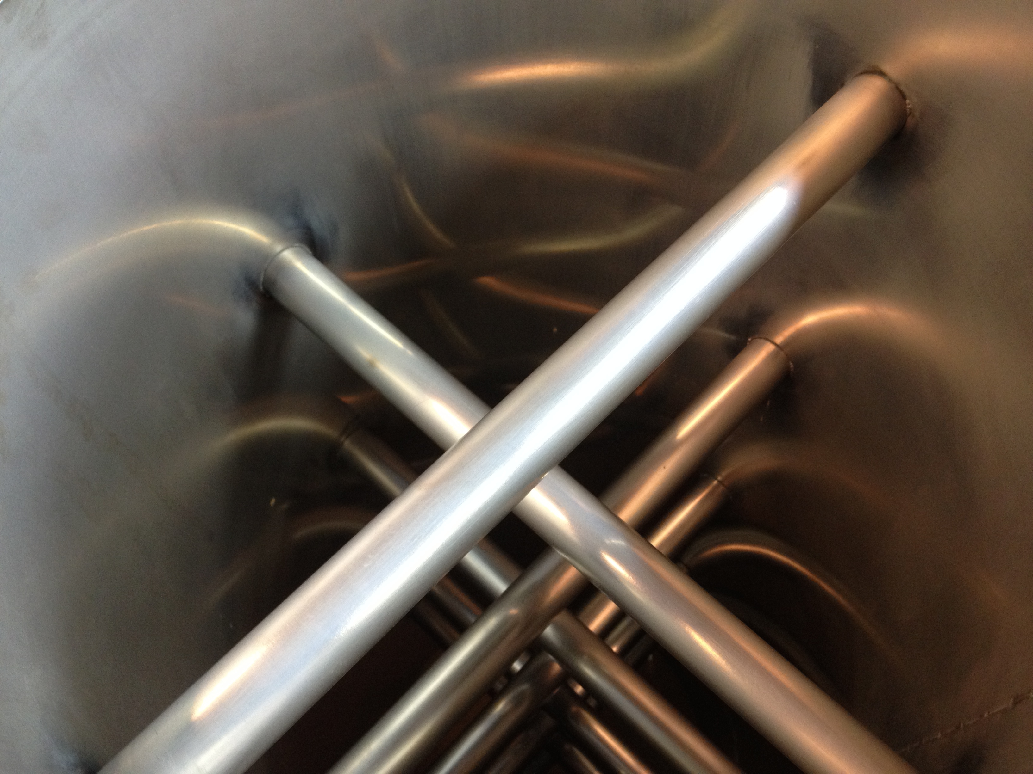
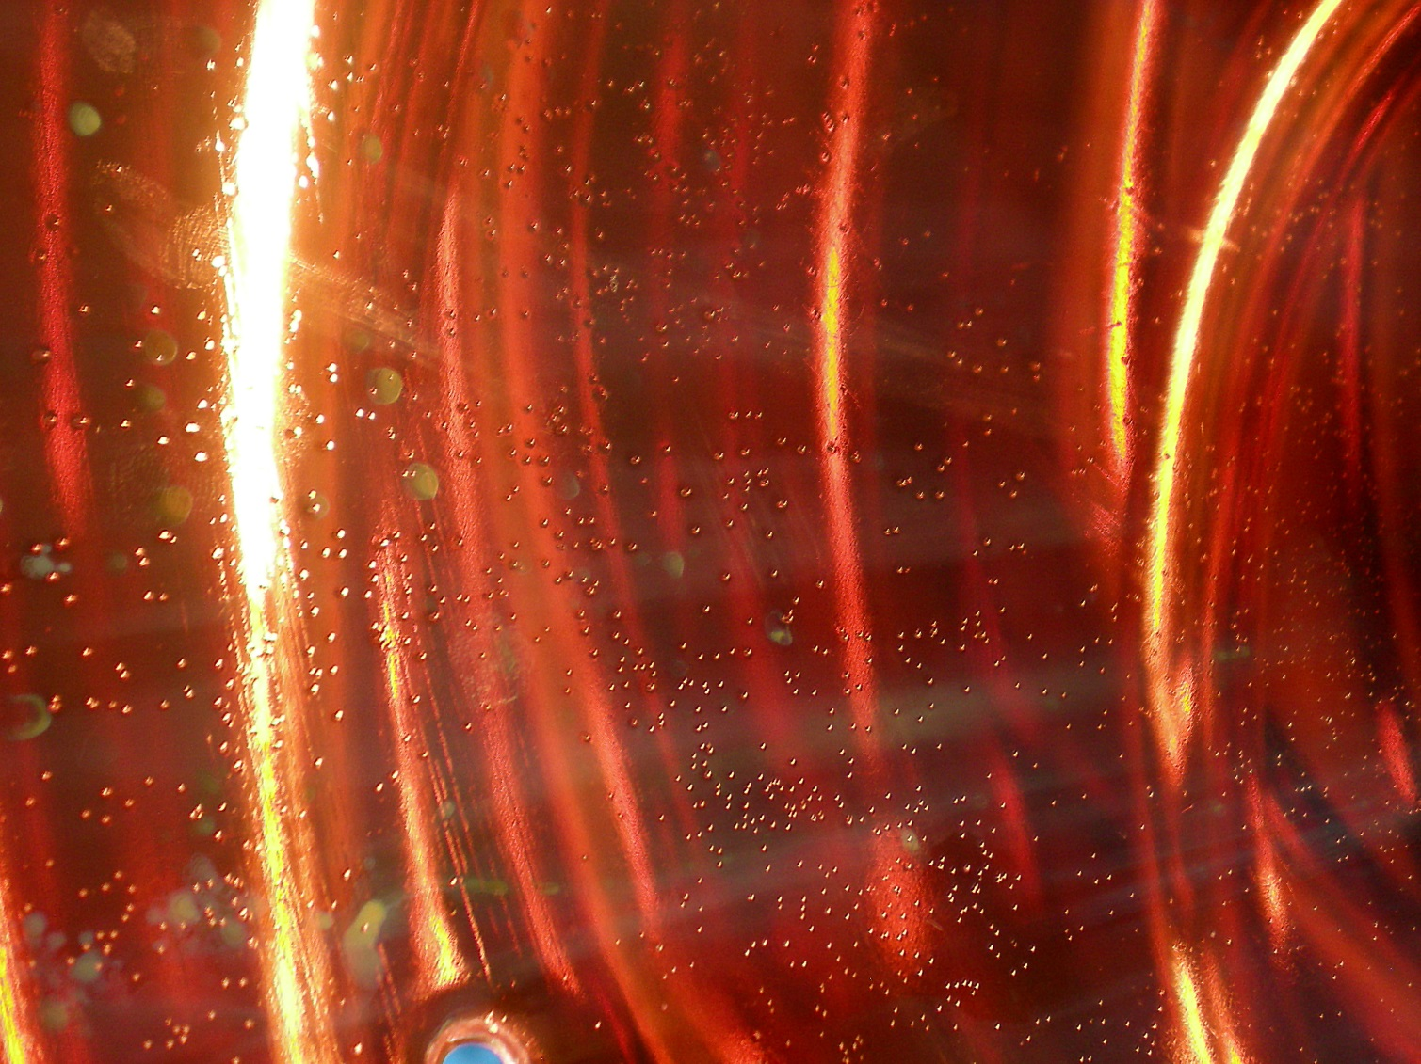
FAIR Proton Linac
CH and Prototype Galvanic tasks
3 cm
Temporarily manpower shortage at the mechanical workshop and a general shortage at the galvanic shop leads to delays in urgent problem-solving
Results of the nickel plating at dummy_1
Results of the latest copper plating trial at the CH dummy_1
Latest end of July the feasibility of the copper plating should be shown → ♦ Milestone
Details to the production of the entire cavities are expected in October → ♦ Milestone

Slide 11
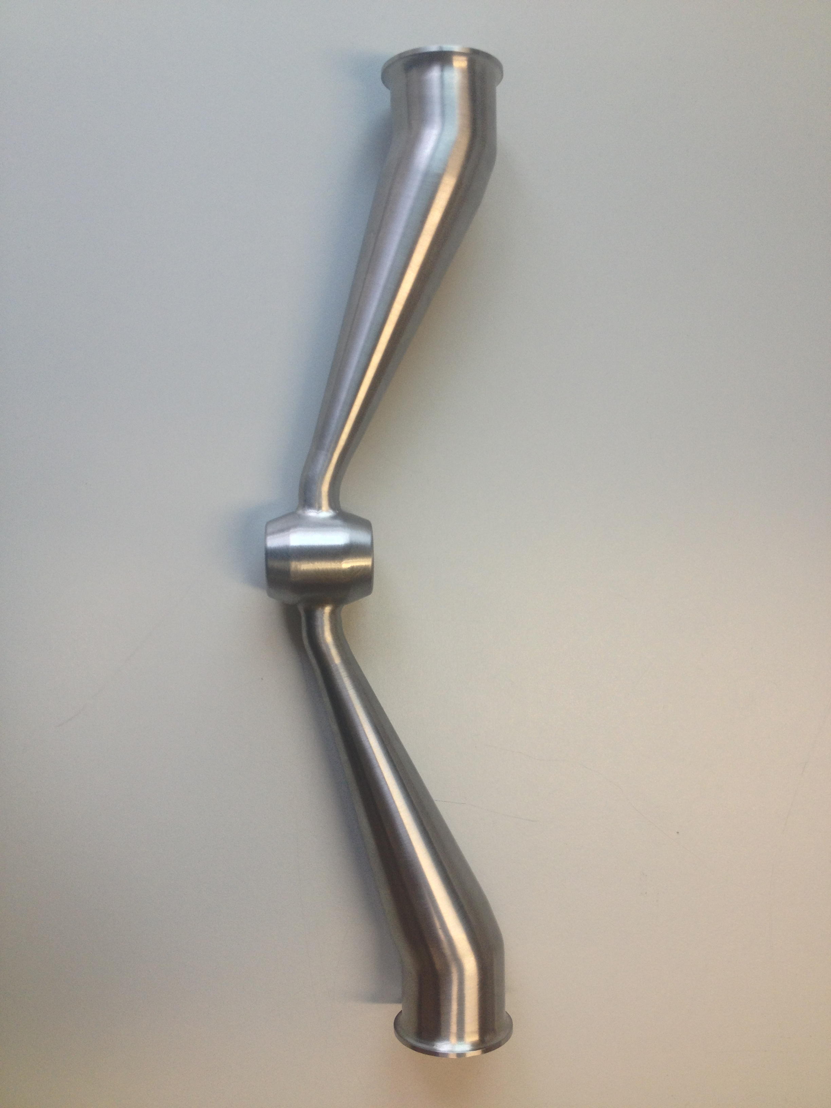
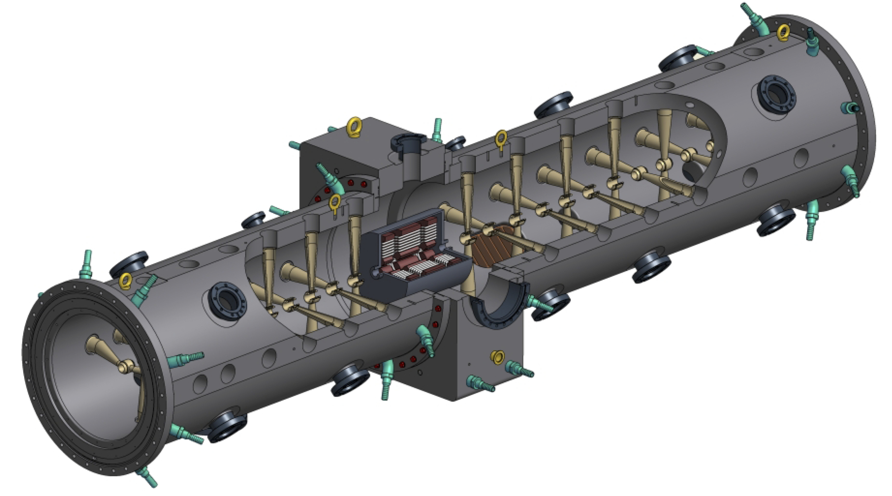
FAIR Proton Linac
CH and Prototype
CH cavities of this kind were not build so far
As far as known a ‘completely composed’ cavity was never copper plated from inside before.
Difficulties because of turbulent flow of the electrolyte
One of the possible solutions:
Shorter cavity sections could be possible,
but complication due to the stem shape at
each side of the section,
plus much more flanges and vacuum seals

Slide 12
FAIR Proton Linac
Test bench activities
THALES klystron arrived in March [Many thanks to the colleagues at CNRS/IN2P3]
Test bench is prepared for the modulator
  loan-contract with CERN for the modulator is signed by GSI
  at the moment at TE/EPC (CERN) for check
  briefing and training at CERN is planned
Cavity support frame is under construction
Cooling water supply and distribution inside the bunker
is in preparation
Low Level measurement (bead-pull) is in preparation
Housing for the quadrupole-triplet (dummy) for the CH
is currently being reworked and prepared at the GSI work shop
  next steps: welding, testing and copper plating

Slide 13
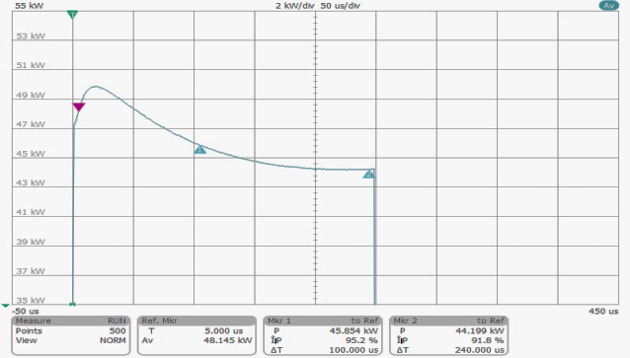
FAIR Proton Linac
FRANCE [CNRS-IN2P3] RF power
First 45 kW solid-state amplifier tested at SIGMAPHI
  result not sufficient, rework required
  delivery of 3 amplifiers is expected in July 2014
Klystrons
  order is placed at THALES
  delivery of the last one in June 2017 (fits this minute to the schedule)
Modulators
  because of administrational delay, the call for tender will restart in June
  3 years for construction (fits to the schedule as well)
Circulators
  call for tender will start soon (French statement)
Wave guides
  call for tender takes place in 2015
250 µs@1% pulse
P = 45kW on dummy load
Graph by SIGMAPHI

Slide 14
FAIR Proton Linac
FRANCE [GANIL] Power converters
11 power converters for steerers
27 power converters for quadruples
2 power converters for dipoles
At the moment we are:
  waiting for information
  contractual issues with Spiral2 / France / Germany / GSI
  if all that is not clear until mid of 2015, call for tender by GSI is proposed
800

Slide 15
FAIR Proton Linac
Final remarks (1)
The status to the production of a 4-vane RFQ is not clear at the moment.
  contract with CERN is currently prepared and waiting for a decision at the management level
  recently CEA is interested in fabrication, alignment and tests
Most crucial items are the CH cavities.
  partial success with the nickel plating
  for copper plating a procedural method is currently not available
  more skilled personal and more time is needed
  verification of the method started with TU Darmstadt
  manufacturing under professional conditions is not proofed
  information to the feasibility of the series production is expected
  off September by CENBG
A fall back position should be available (Plan B)

Slide 16
FAIR Proton Linac
Final remarks (2)
Looking at other proton projects
  some solutions could be applicable for FAIR as well (e.g. J-PARC/CERN)
  physical boundary conditions have to be worked out clearly
  financial, scheduling and staff resources effects as well
One of the most important issues is the building
My personal suggestion
  To be prepared for Plan B we should use the opportunity to redesign the building to accommodate two different DTLs.
A draft version describing the major changes and influences is at hand.

Slide 17
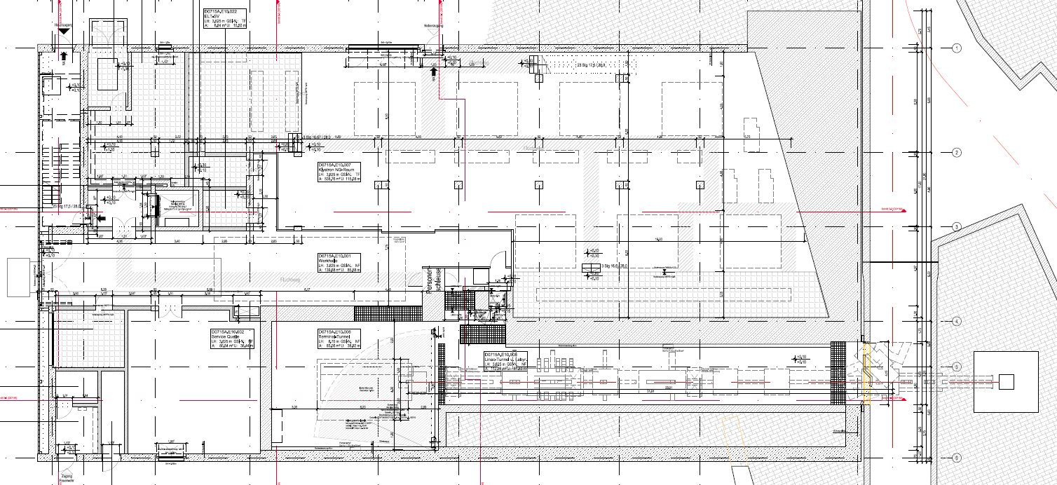
FAIR Proton Linac
Final remarks (3)
CH solution
Alvarez solution
~8 m
~11 m
~27 m

Slide 18
FAIR Proton Linac
Next steps
Expert meeting
expert meeting !
incl. all aspects
GSI
GSI

Slide 19
FAIR Proton Linac
Last remark
I am highly pleased with the work of my work package leaders, they are very committed and doing an excellent job. Same is valid for the French colleagues and the friends at CERN. Thanks to all.
Thank you for listening and for your comments...

