Slide 1
UNILAC: Review follow-up and upgrade plans
W. Barth

Slide 2
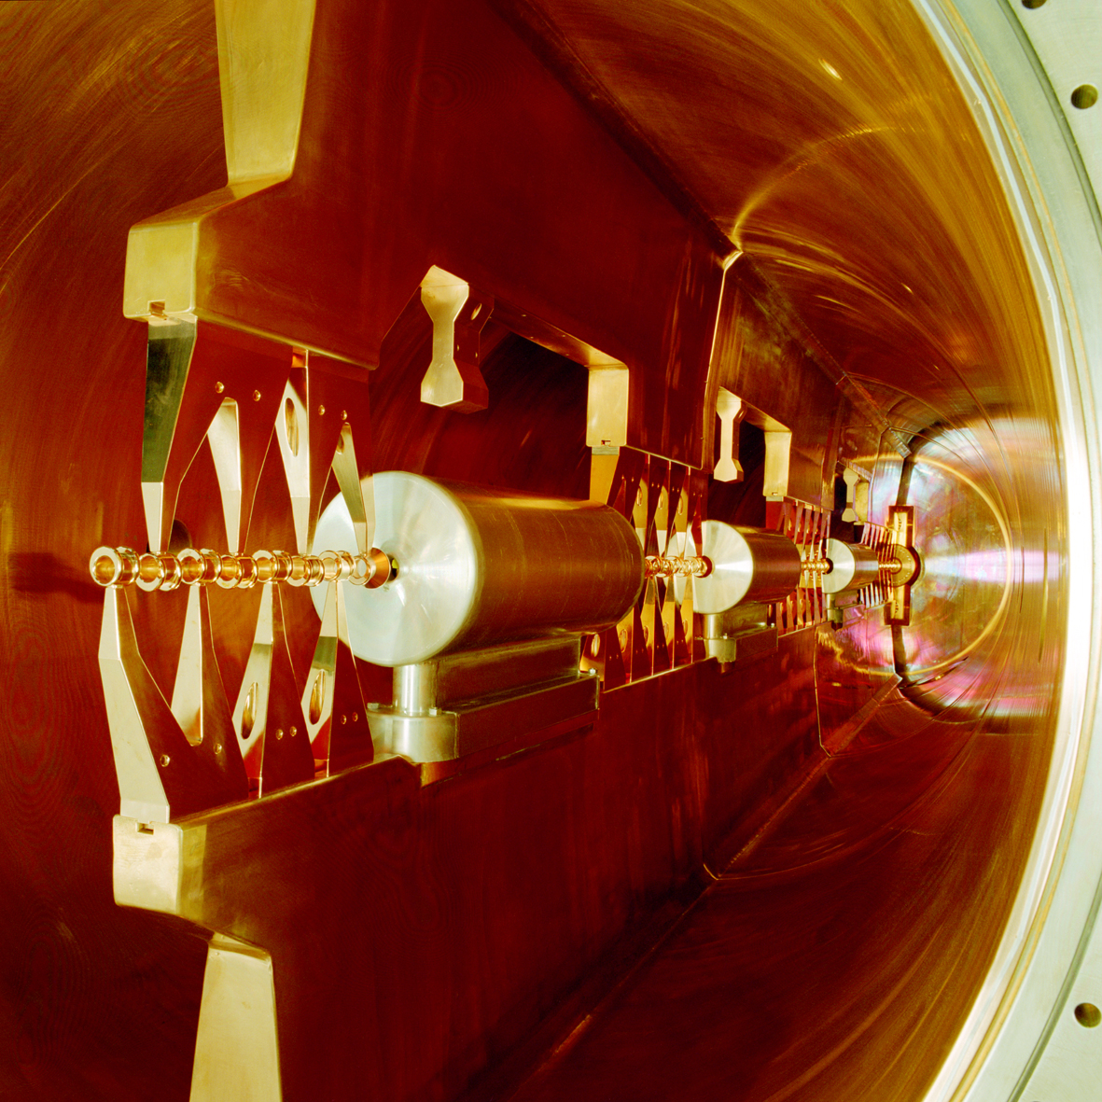
UNILAC: Review follow-up and upgrade plans
W. Barth, GSI - Darmstadt
Introduction
FAIR-requirements
Recommendation UNILAC-Review
Status of the Unilac High Current Performance
Further Investigations
  ion source emittance
  RFQ-Matching
  superlens performance
  pulsed gas stripper
UNILAC proton performance
28 GHz-ECR ion source
High Energy LINAC
  rf-amplifiers
  beam dynamics studies
  accelerator cavity studies
Aiming FAIR Uranium intensities (strategy)
Schedule

Slide 3
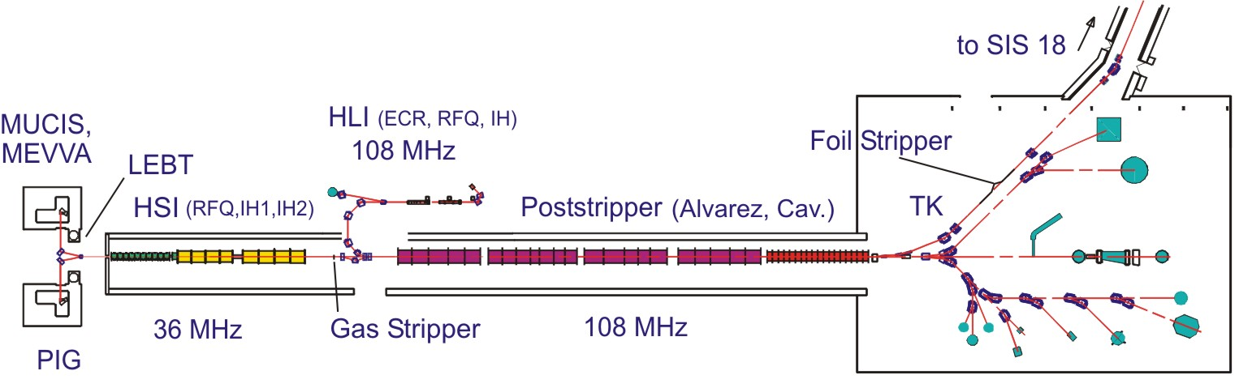
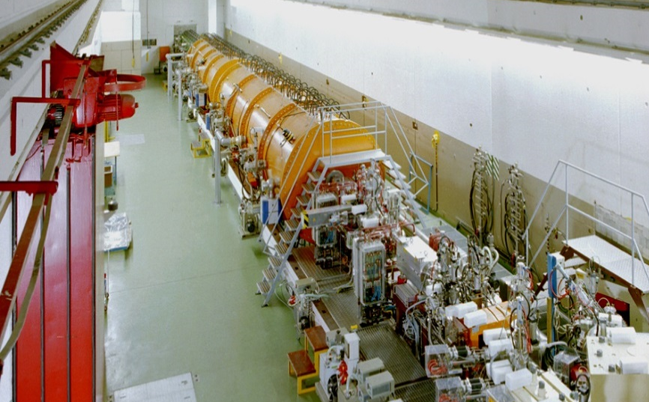
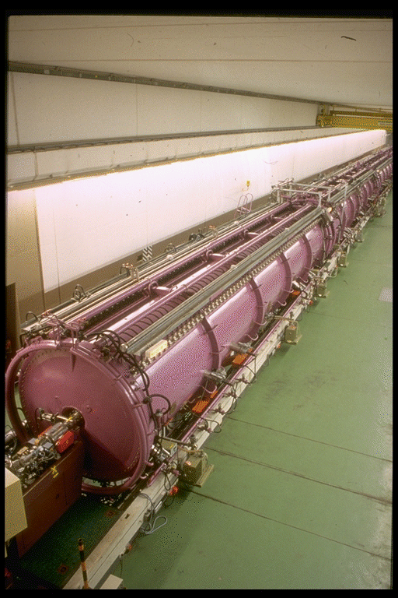
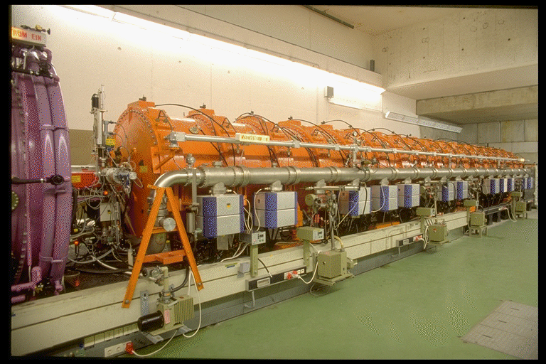
The GSI UNIversal Linear ACcelerator
High Current Injector
Alvarez
Single Gap Resonators

Slide 4
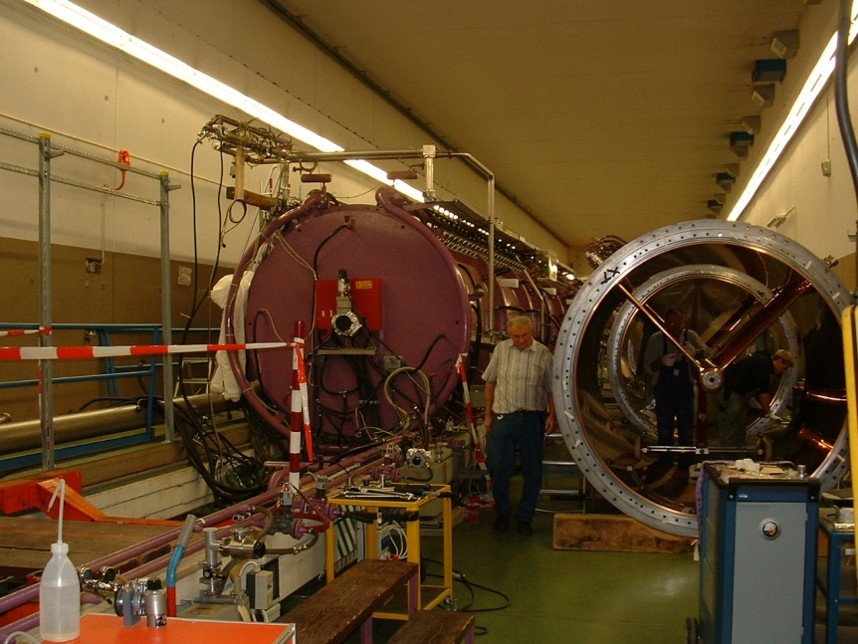
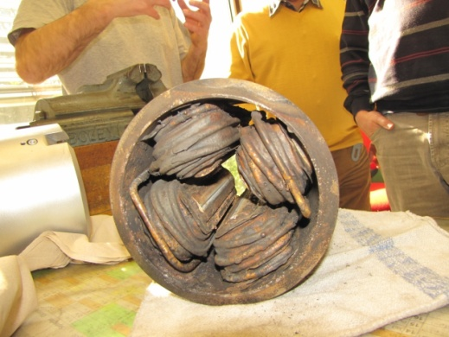
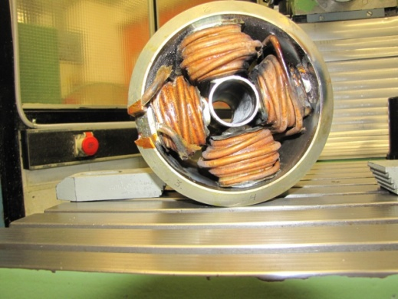
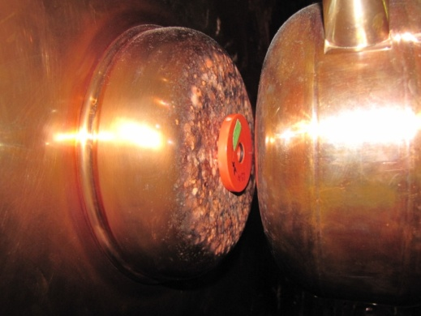
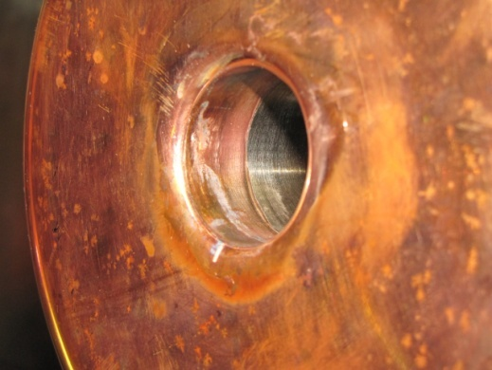
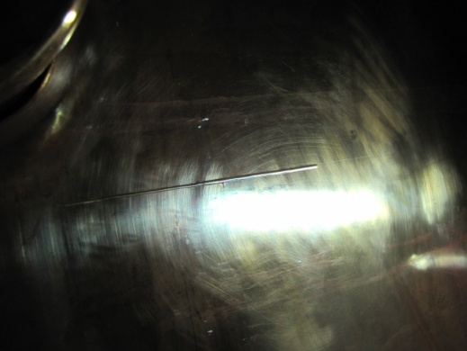
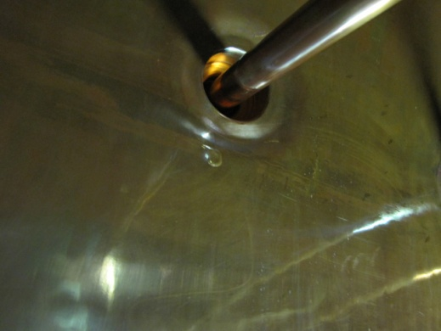
Active defects
178 tank-quadrupoles
(leak tightness/water/pre-vakuum, el. properties, ground faults), drift tubes + supports (water& vakuum leaks)
Leak tightness of all tanks
Reduced availibility of the focussing system → limited beam intensity and quality, (no) multi beam operation !
Regular and substantial repairing program for all tanks!
Drift tubes
massive sparkovers beam induced surface defects
Copper surface quality
... inner tank blanket at different positions
High probality of long term-break downs, significant limitations during operation (reduced duty factor, limited rf-voltage, ...)

Slide 5
FAIR-Requirements

Slide 6
UNILAC-Upgrade for FAIR
Front End Upgrade

Slide 7
Recommendation UNILAC-Review
Increase of U⁴⁺
beam intensity:
Terminal West&
Compact LEBT
injector requirements w.r.t MTI ?
Short
gas-stripper section
High Current Injector
Alvarez
Single Gap resonators
- strong periodic focussing -> (ALVAREZ type DTL prefered)
- no performance limitations (vs. costs, length, ...)
- RFQ-Upgrade (rf-sparking)
- KONUS beam dynamics vs. strong periodic focusing -> beam brilliance!
- UNILAC as FAIR injector only !!!
Strong performance issues
overall injector strategy?

Slide 8
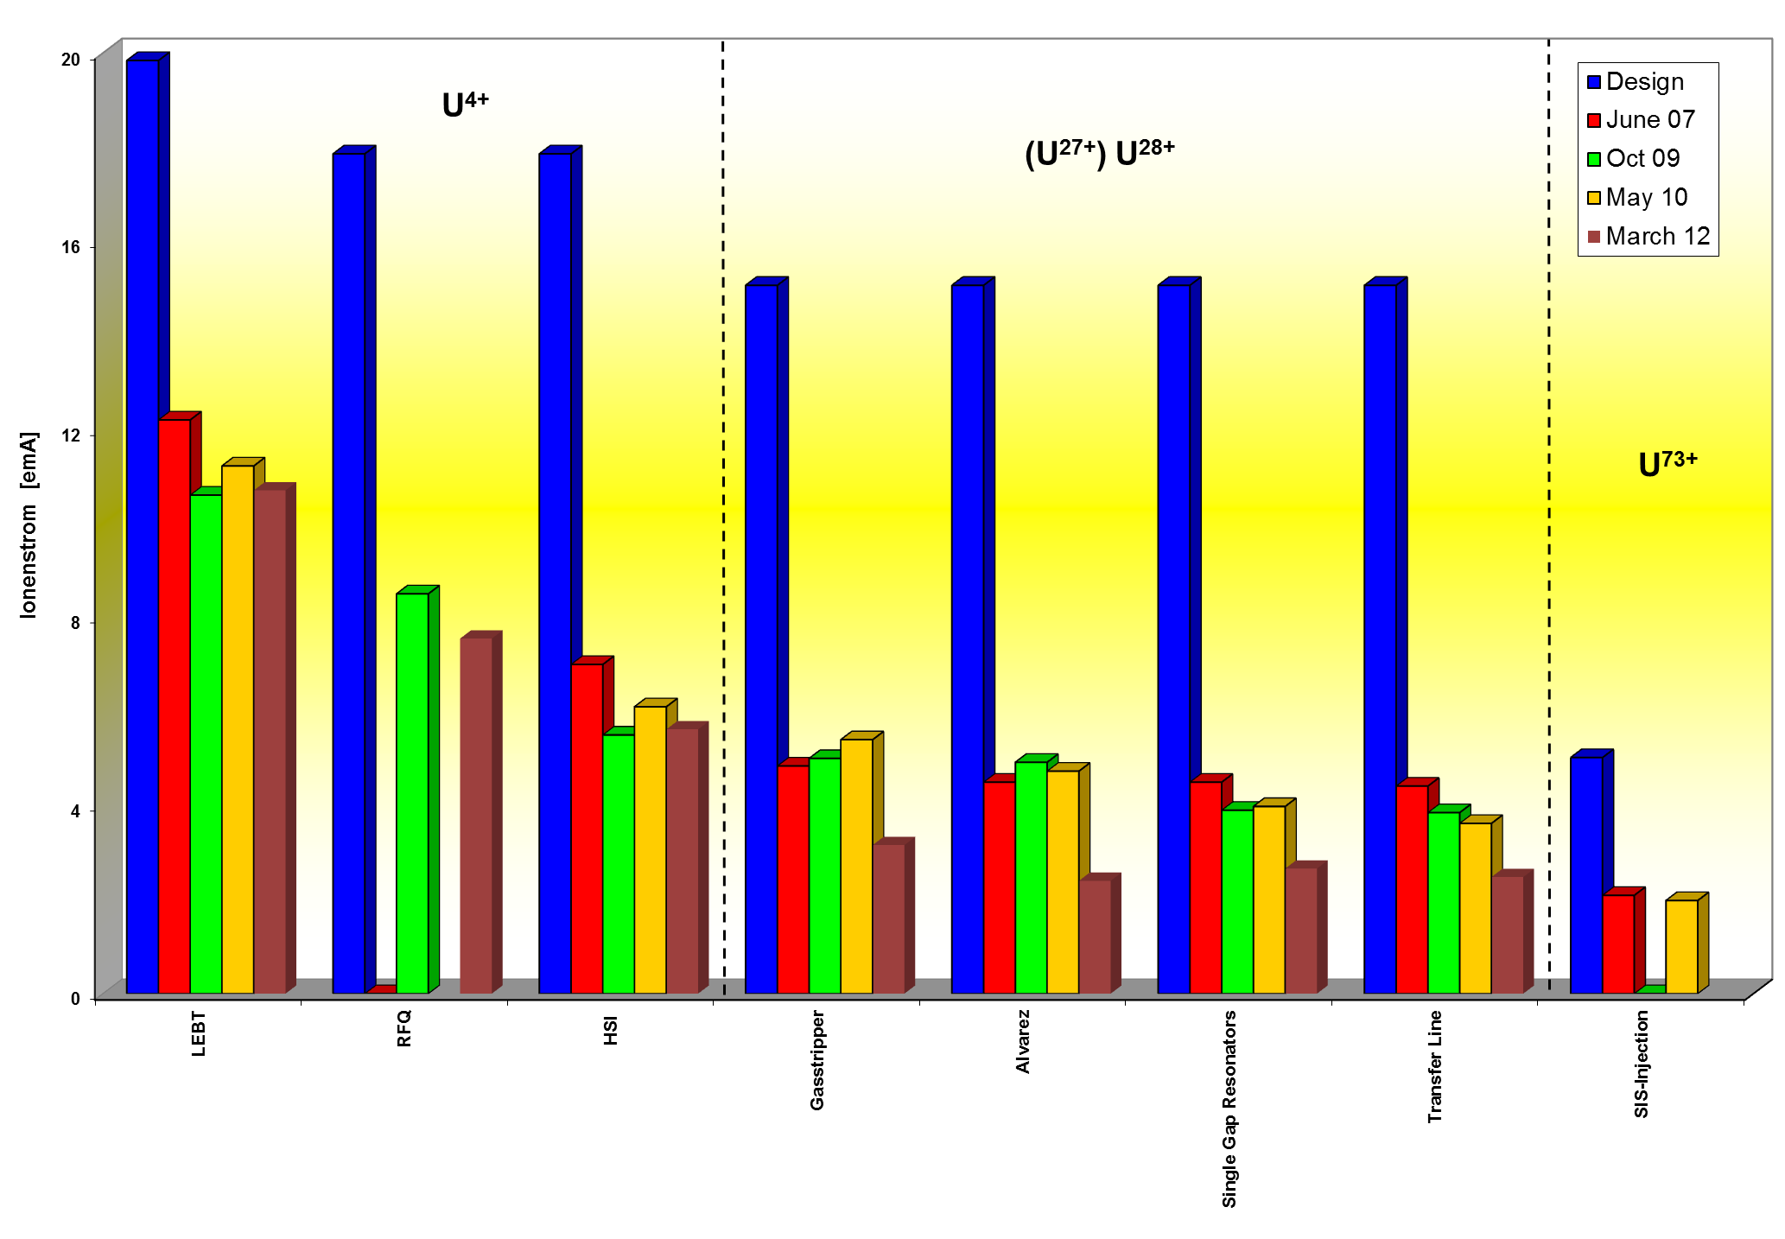
Status of the Unilac High Current Performance
U ²⁸⁺
source+LEBT performance
Injector per-formance???
March 14: 2.35 emA, U²⁸⁺@Transfer Line

Slide 9
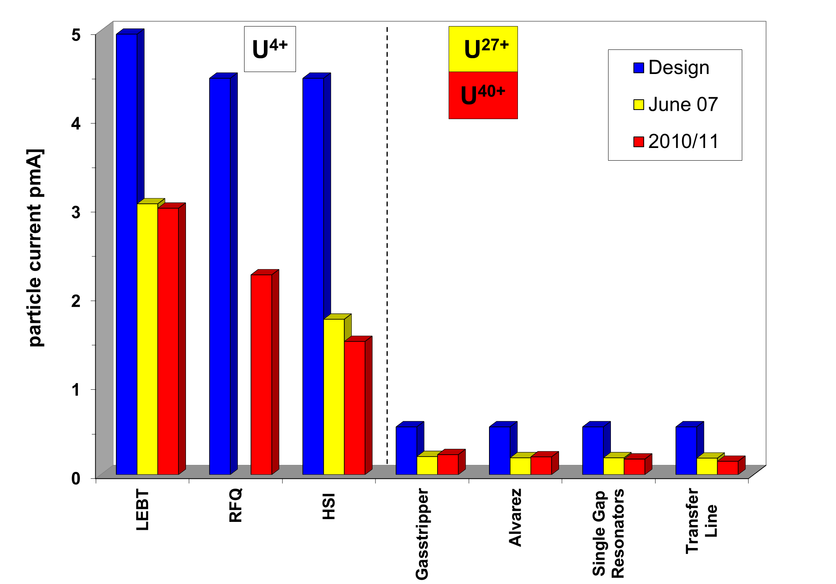
Status of the Unilac High Current Performance

Slide 10
Status Quo

Slide 11
Status of the Unilac High Current Performance
max. U²⁷⁺-beam intensity ≈ 5.5 emA (0.200 pmA) (2007)
max. U⁷³⁺-beam intensity ≈ 2.7 emA (0.037 pmA) (2007)
max. U²⁸⁺-beam intensity ≈ 4.5 emA (0.161 pmA) (2007)
max. U⁴⁰⁺-beam intensity ≈ 6.0 emA (0.150 pmA) (2010/11)
intensity/transmission data confirmed after RFQ-upgrade (2009)
30% design intensity
Injector performance dropped down in 2012 ?!
High current emittance measurement performed in 2007
25% of the design performance w.r.t. beam brilliance
Last emittance measurements (2012) for 0.8mA only -> tbd. 10/2014

Slide 12
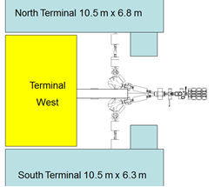
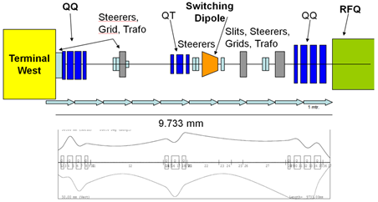
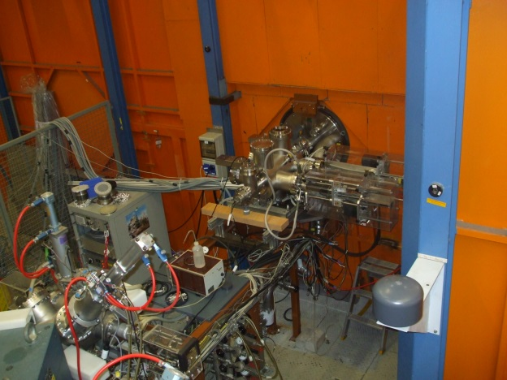
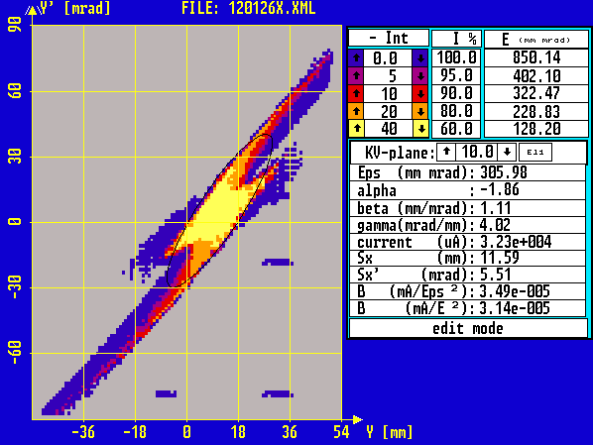
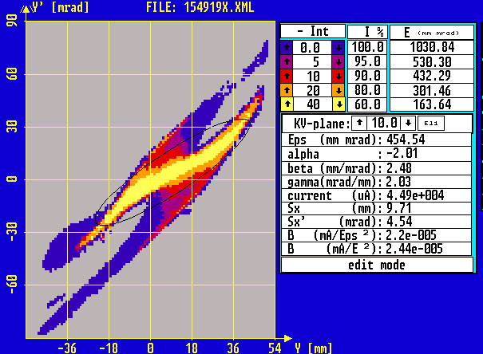
Design of LEBT
9733mm
Latest solution: Use existing quartet before RFQ, and a new quartet behind source
(Alternatively: existing sc solenoid could be used, additional simulations...)
Measurements of uranium beam emittance@North Terminal, Oct. 2013
Results of emittance measurements@North Terminal for medium and high uranium currents (35 mA, 55 mA)

Slide 13
Terminal West
Dedicated Terminal exclusively for uranium beam
General layout exists (LOIS)
Integrated service area
All power supplies integrated in the Faraday room
No extension within the basement, only ground floor

Slide 14
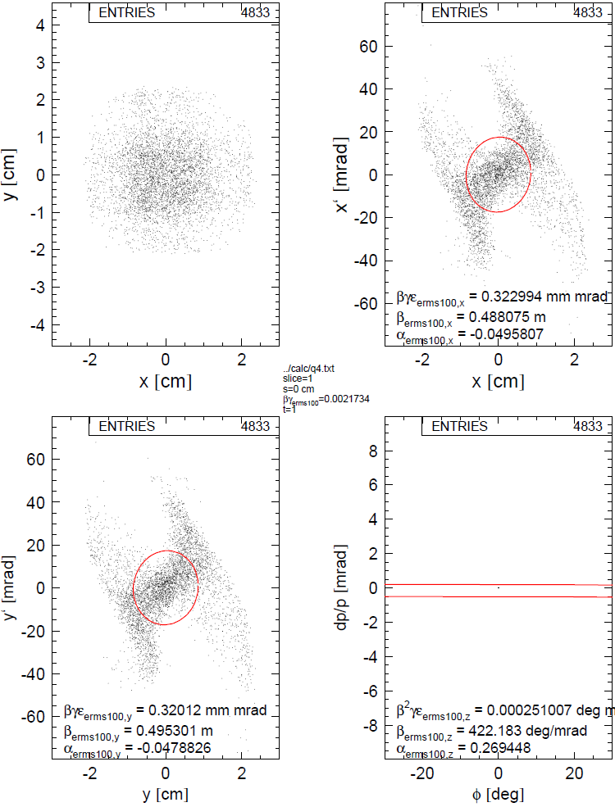
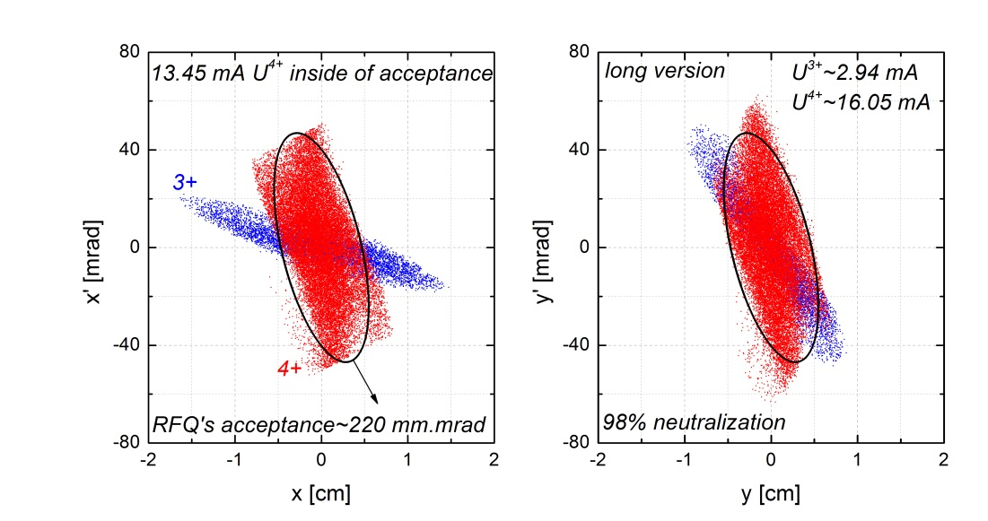
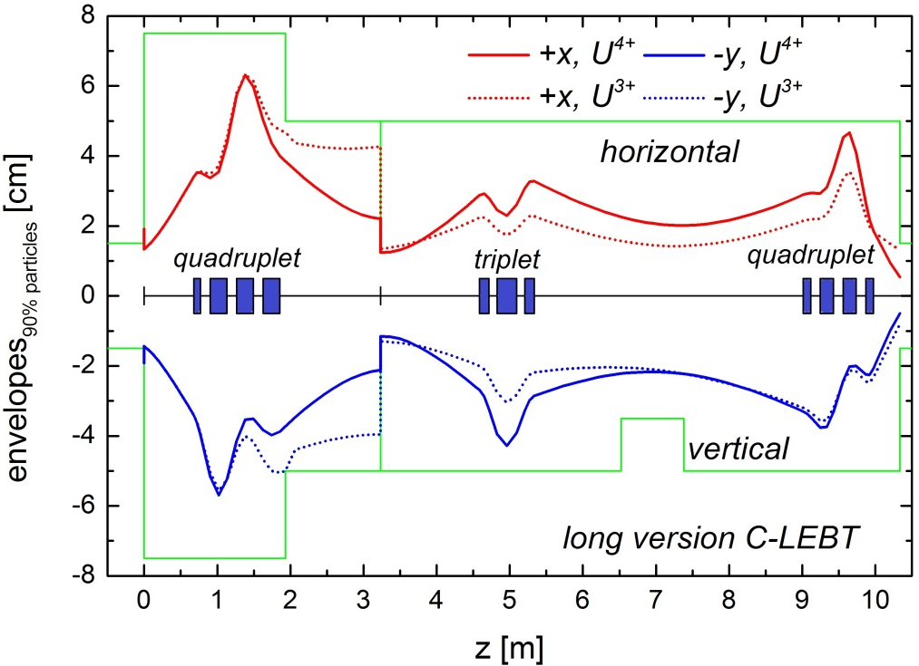
Design of a Dedicated Uranium LEBT
(long version, allows for three sources feeding the HSI)
initial
U³⁺ ~ 20 mA
U⁴⁺ ~ 36 mA
final
iris (U³⁺ suppression)
14 mA U⁴⁺ inside
220 mm*mrad
13.45 mA U⁴⁺ inside ellipse
98% space charge compensation
magnet field maps used
two charge states
cutting of off-acceptance ions
220 mm*mrad
C. Xiao

Slide 15
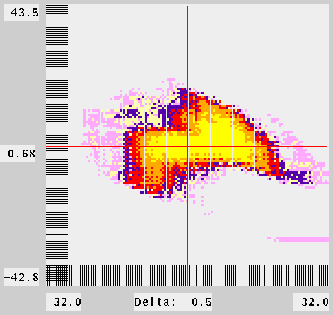
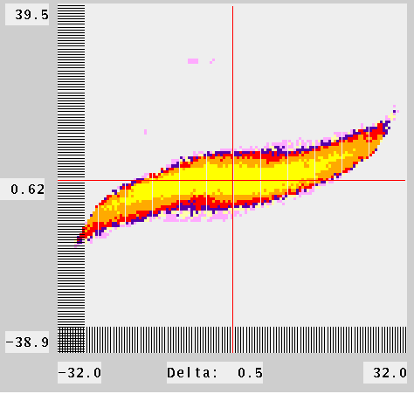
RFQ Matching
Data for required advanced beam dynamics simulations (further optimization, upgrade, redesign and development of machine) were collected -> Measurements are complete and self-consistent.
A gain in particle transmission with new QQ settings was confirmed with Ta ⁴⁺ (RFQ transmission of 75±2% instead of 51±4%; 4 mA) and with U ⁴⁺ (77±7 instead of 74±1% ;10 mA) – even with a lower RFQ-voltage.
Typically this effect is higher for medium and low beam current
Additional tuning of the LEBT, based on dedicated beam dynamics simulations with recently measured beam emittance behind ion source terminal potentially could lead to increased particle transmission for the entire HSI
An optimization of the whole HSI for high current beam applying new QQ setting is proposed by means of medium ions (e.g. Argon or Xenon beam).

Slide 16
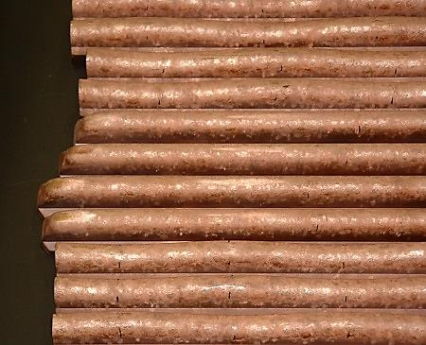
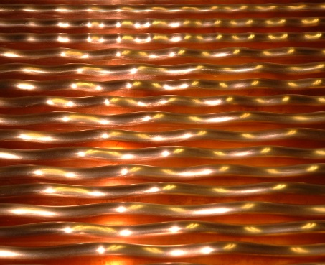
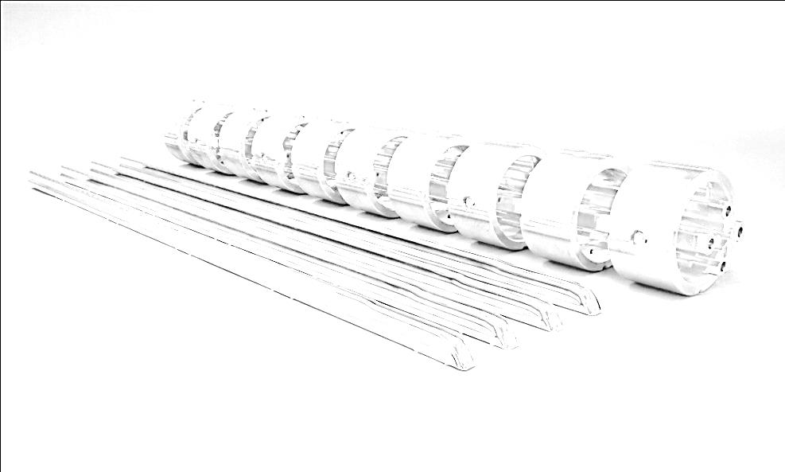
RFQ-Upgrade
5 years of operation
New RFQ-rods
RFQ-Upgrade 2004 (RFQ-Matching, surface quality)
RFQ-Upgrade 2009 (surface quality as well, increase of acceptance, increased field gradient
extensive mixed operation (high duty factor operation m/q=25 (⁵⁰Ti²⁺ + short pulse heavy ion beams (m/q=59.5; ²³⁸U⁴⁺) -> Reduced performance (10% less field gradient): reduced transmission, increased beam emittance
2014: no mixed operation until now -> 96,4% of the design gradient reached.
High probality of ireversible damages of the electrode surface (field emission stimulated by thermal stress, high voltage breakdowns caused by strong particle losses)
tank voltage [a.u.]
Design
tank voltage [a.u.]

Slide 17
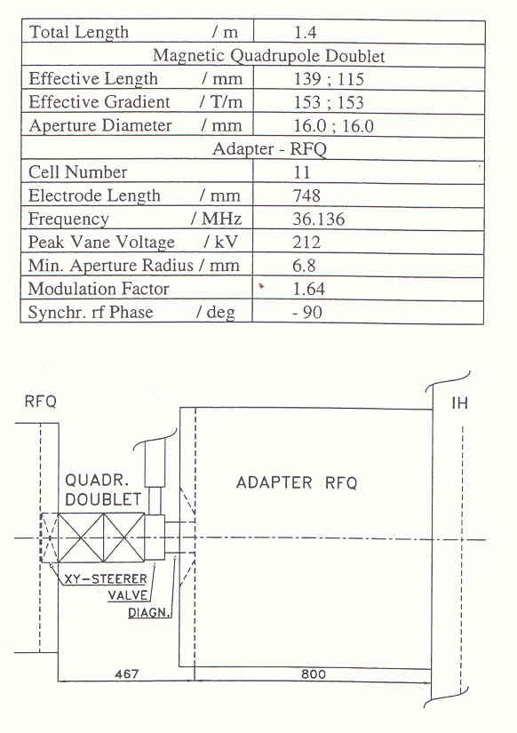
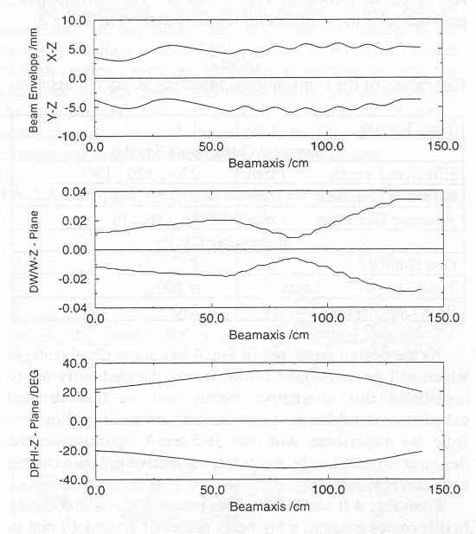
Further Investigations III – MEBT performance
Beamload for a 6.5 mA Uranium beam was appr. 25 kW ( beamload with 2 mA Krypton beam 7.5 kW)
With improved setting for Krypton beam, the measured beamload was reduced to appr. 4 kW.
Beamload caused by a mismatch of the RF-power -> reduced shunt impedance of the resonator (beam is hitting the surfaces).
⁸⁶Kr²⁺: 10% higher superlens rf-amplitude & 15% higher quadrupole field strength -> MEBT-transmission increased 75% -> 93%
Recommendation: new quad doublet with increased field strength, trapezoidal shaped superlens electrodes!
(Redesign of the MEBT in discussion)

Slide 18
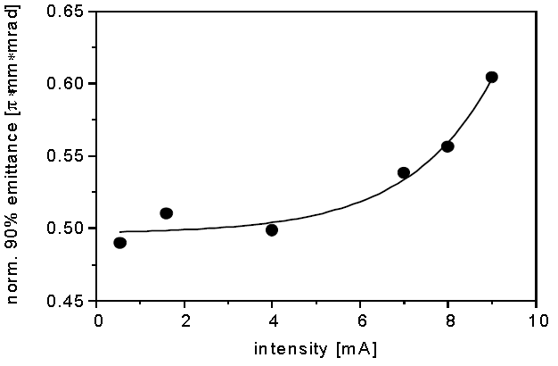
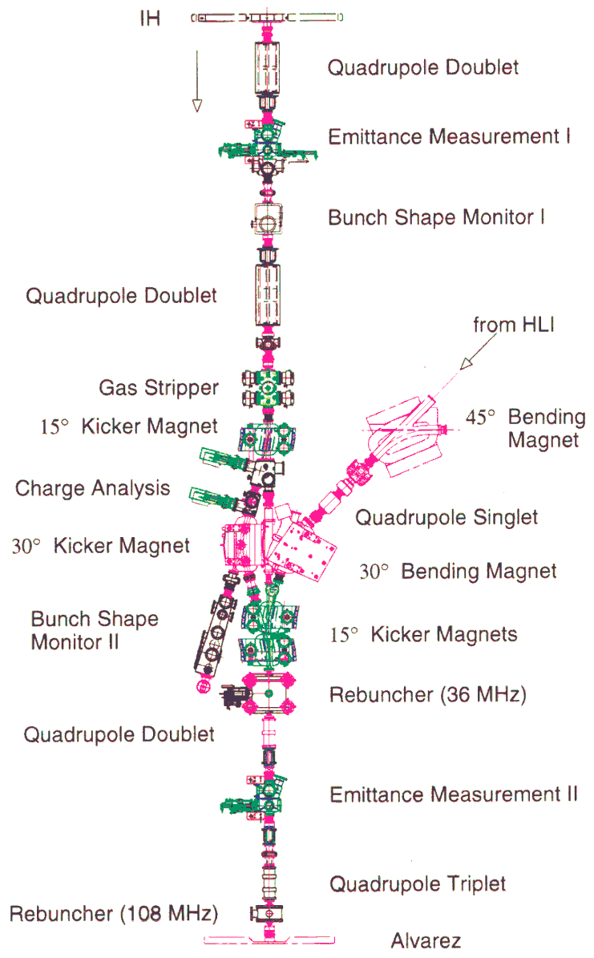
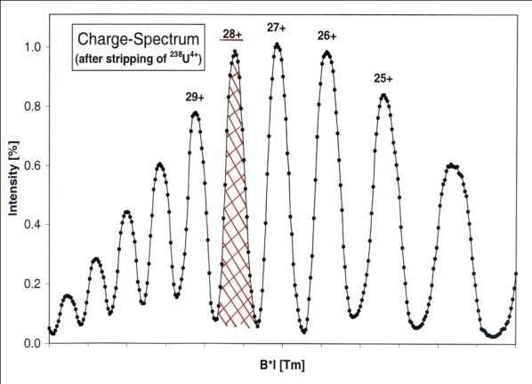
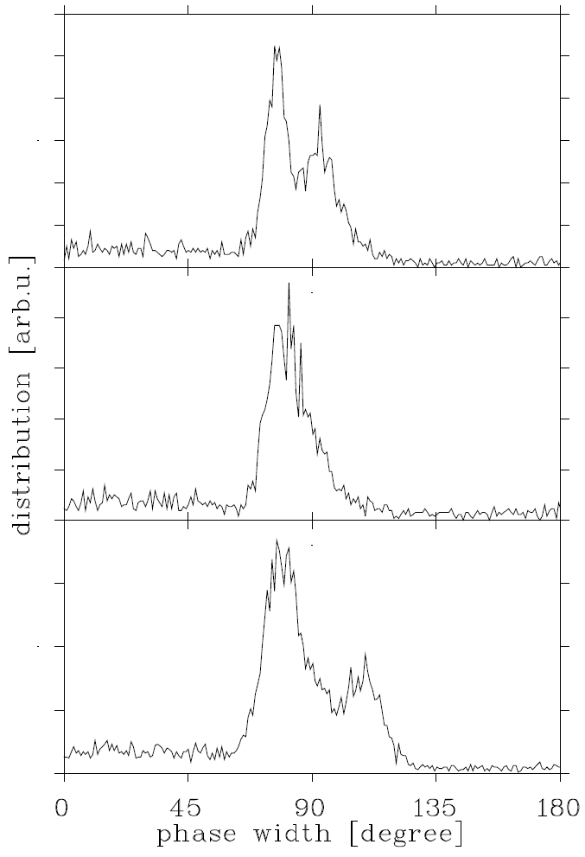
Optimization of gas stripper area (1.4 MeV/u)
enlarged apertures
high stripper target density
high current operation (extremely high space charge forces)
full transmission
separation of Uranium charge states
optimum stripping efficiency
less long./transv. emittance growth
FAIR
⁴⁰Ar¹⁰⁺
^{high current}
max.
^{high current}
^{(HSI)}
^{low current}

Slide 19
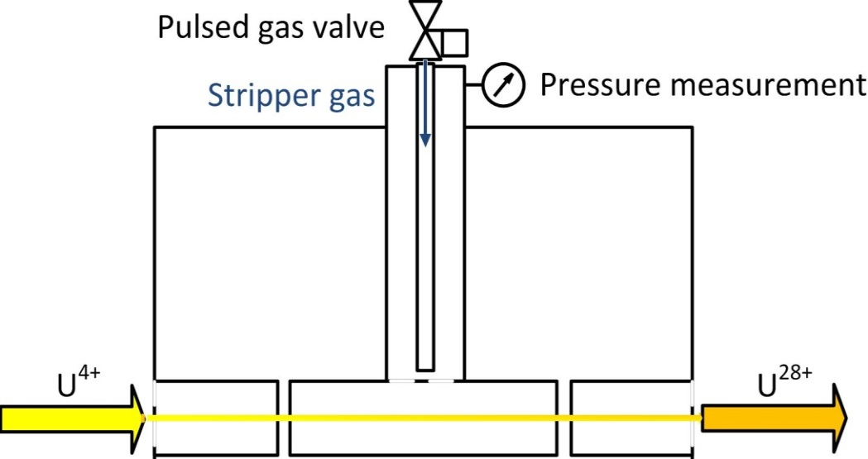
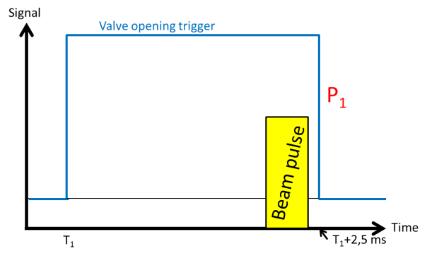
Further Investigations – fast switching gas stripper
P. Scharrer, et.al.
U⁴⁺ + He; 4 ms
25+
How does the gas
distribution looks like?
gas cell
27+
reduced average gas pressure
increased target density
pulse to pulse variation
lower gas consumption
→ dense noble gas target available
He -> lower (equilibrium) charge state, increased yield
U⁴⁺ + N₂; 2,5 ms
V.P. Shevelko

Slide 20
UNILAC proton performance

Slide 21
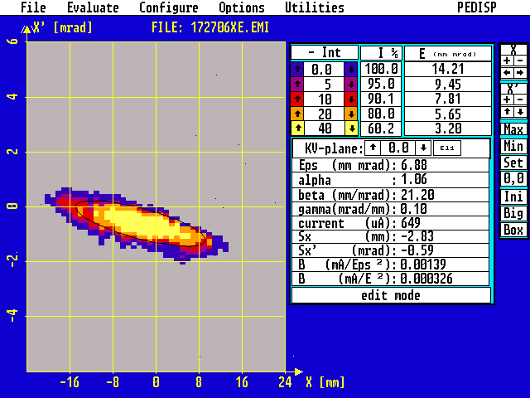
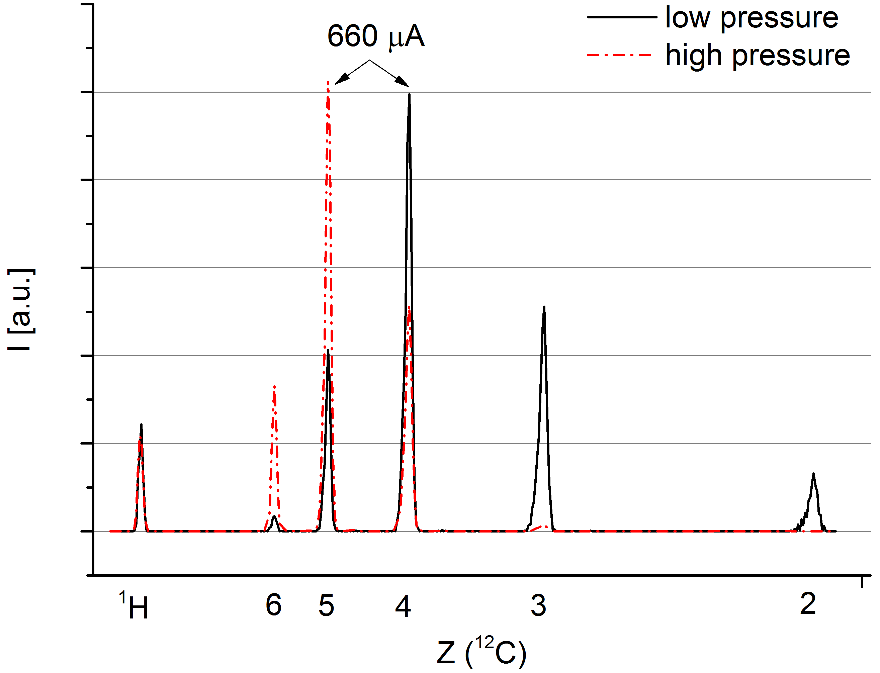
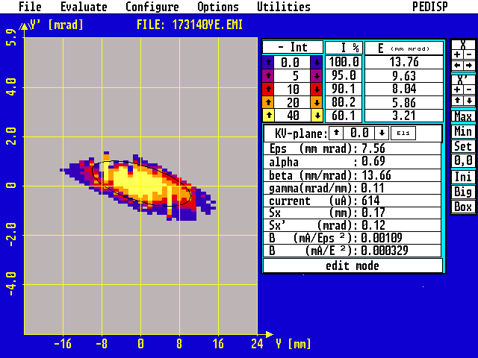
High intensity proton beam@UNILAC
clean gas-stripperspectrum
high brilliance beam
main limitations: ion source performance, rf-controls
parallel operation -> carbon beam operation!
Further development goal: 2emA, improved ion source performance, careful UNILAC-optimization (transmission)

Slide 22
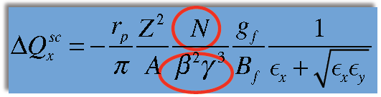
High Intensity protons@FAIR
S. Appel, GSI
FAIR
p-LINAC
GSI-UNILAC
E [MeV] | 70 | 11,4 | 11,4 | 15 | 15
I [mA] | 35 | 1 | 2 | 1 | 2
Ex,y (phys. 4*rms) [mm mrad] | 7/8 | 7/8 | 7/8 | 6/7 | 6/7
gamma | 1,07 | 1,01 | 1,01 | 1,02 | 1,02
beta | 0,37 | 0,15 | 0,15 | 0,18 | 0,18
beta**2*gamma**3 | 0,17 | 0,02 | 0,02 | 0,03 | 0,03
Space charge limit (N) | 5,8E+12 | 8,6E+11 | 8,6E+11 | 1,1E+12 | 1,1E+12
SIS100 output (particles/cycle) | 1,7E+13 | 1,2E+12 | 2,3E+12 | 1,2E+12 | 2,3E+12
SIS100 output (relative) | 100% | 7,1% | 13,5% | 7,1% | 13,5%

Slide 23
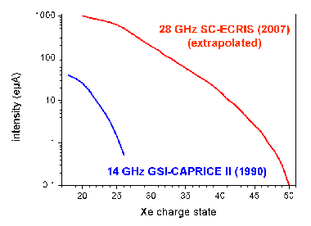

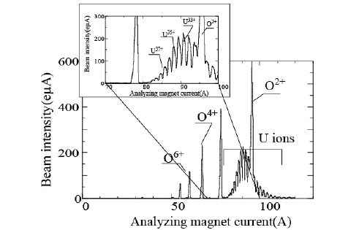
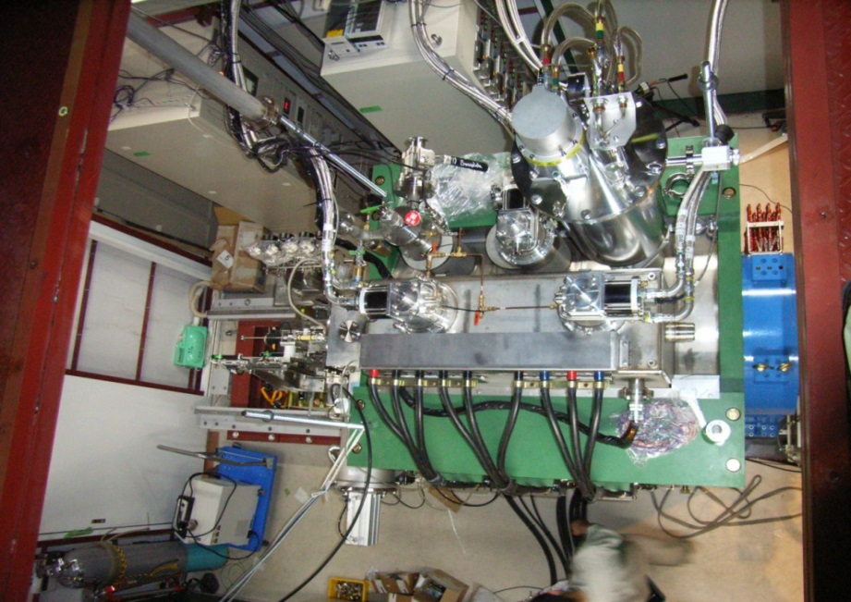
28 GHz-ECR ion source (to be ordered 2014!)
GOAL:
Higher Charge State → higher energy gain
Higher Charge State → higher beam intensity without stripping
Higher heavy ion beam intensity → cw-/ pulse-mode operation
Compact accelerator → lower cost
low consumption rate -> operation with rare isotope
ECR-projects/developments for heavy ion application:
VENUS (LBNL)
SERSE (INFN)
SUSI (NSCL/MSU) -> FRIB (U33+/34+)
MS-ECRIS@RIKEN (U35+)
SECRAL (IMP-HIRFL) (U41+)
Increase pulse intensities for medium and heavy ions by a factor of 10-15!
Uranium-Charge state distribution from the RIKEN 28 GHz SC-ECRIS
RF injection side
Beam extraction side

Slide 24
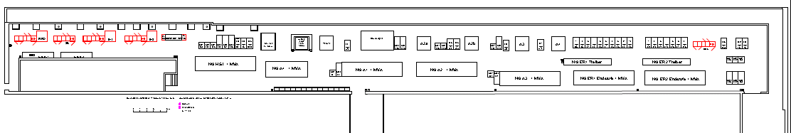
High Energy LINAC - rf-amplifiers (2015-2017)
UNILAC rf-amplifier gallery (since 1975)
≈120m
Modularized Upgrade strategy
Exchange of supply and control units
Exchange LLRF, Measurement, interlock
Independent exchange of driver amplifier system (Solid state amplifiers)
Independent exchange of high power amplifiers
  Prototype (THALES) ordered
  Dedicated test area allocated
  Milestone: Successful test operation
  Procurement of series: 2017
  Step by step mounting in shutdowns
Potentially finalized until 2020!

Slide 25
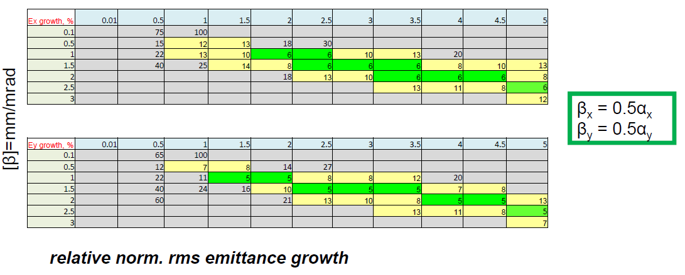
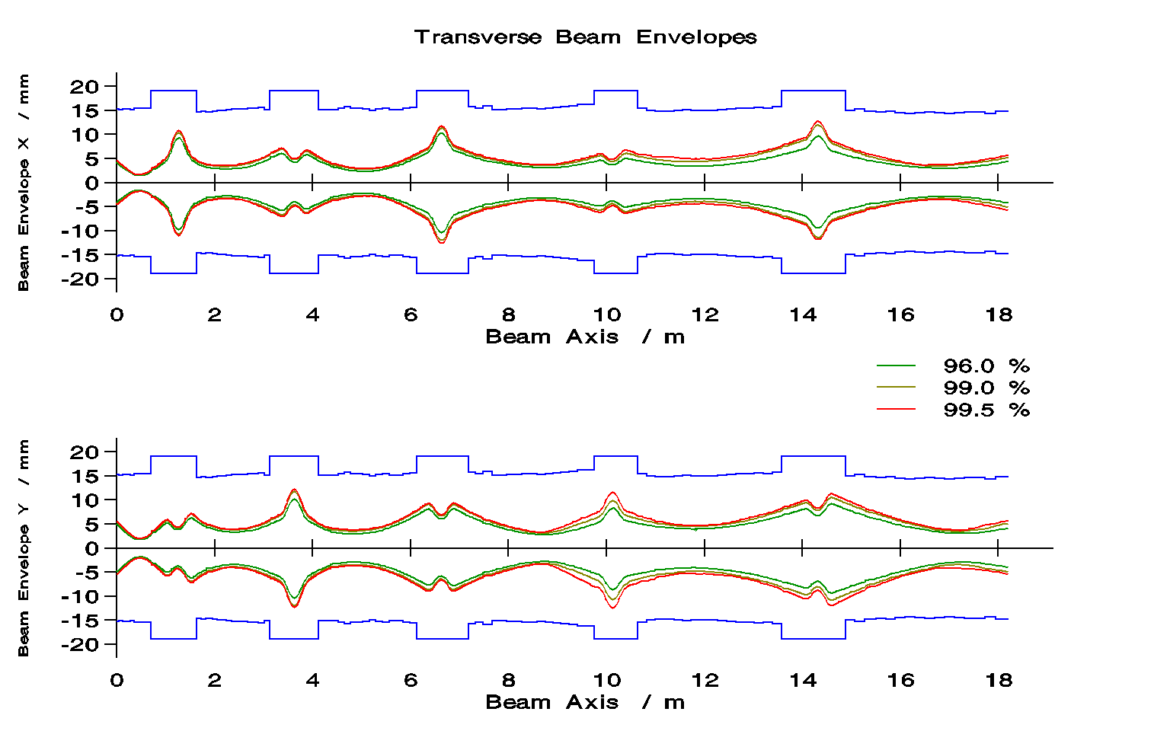
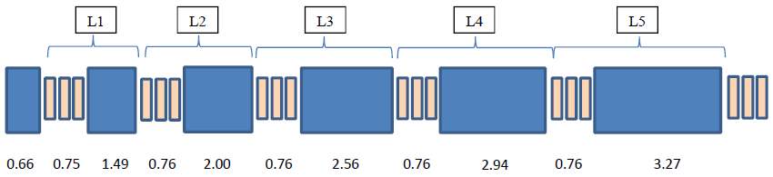
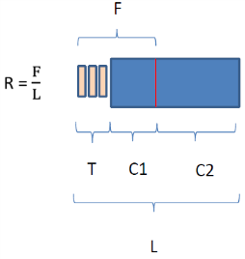
Emittance Growth Reduction for KONUS Beam Dynamics
A. Orzhekhovskaya
KONUS beam dynamics features high effective R_{s}
the price to pay is reduced focusing & periodicity in transv. & long. planes
for time being KONUS lattices were designed manually wrt emittance growth reduction
efforts were put to establish a semi-empirical procedure for providing a quasi-periodic lattice & per. matching
but, straight forward recipe for periodic KONUS lattice design still missing
new design (2014)
scan for first section
alfa
new: old: UNILAC*:
Transmission: 92% 88% 100%
Emittance growth: ~ 35% ~ 50% 20-40%
*measured
keep constant C1/C2
find individual per. solution for each section
try to match between them

Slide 26
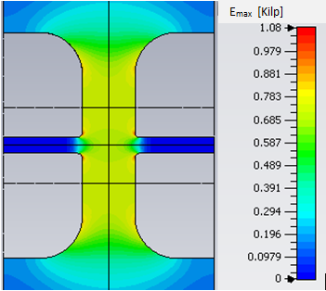
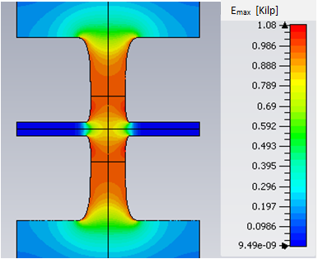
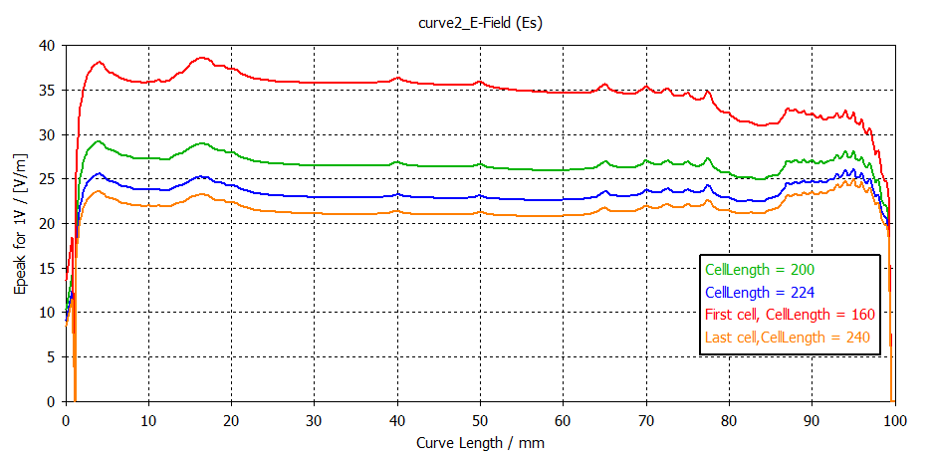


Rf-Simulations on Drift Tube Design for
HE-Linac Alvarez-DTL with strong periodic Focusing
108 MHz, example: L_{cell} = 200 mm ≙ 2.45 MeV/u
present
modified (current status)
homogeneous distribution of surface field
R_{s} = 53 MΩ/m
R_{s} = 60 MΩ/m
mod. geometry promises higher R_{s} per surface field
Epeak @ Ugap=1V [V/m]
Curve Length [mm]
X. Du
(varied through changing L_{gap/}L_{cell} from 0.15 to 0.35)

Slide 27
Aiming FAIR Uranium intensities (strategy)
Terminal West., Compact LEBT – increased primary beam intensity
RFQ-upgrade (new rods as a copy of existing, medium range)
Avoiding long duty operation (in particular mixed operation with short pulse heavy ion beams) -> applying HSI as injector for UNILAC only
MEBT-upgrade
Careful beam matching for entire HSI (may be additional quadrupole PS for individual set up)
High current beam diagnostic (beam position monitors, online transmission, BIF monitors)
no change for HSI-IH-DTL focusing scheme
no change for stripper section incl. charge separation system
Optionally re-design of matching line (depending on the DTL solution)
Two to be considered alternatives: ALVAREZ type DTL (strong periodic focusing) or IH-type DTL: short tanks, triplet focusing scheme – avoiding emittance growth driven by strong space charge forces! -> further beam dynamics studies!
Design and layout, testing of the major key components: rf acceleration cavity, (may be) focusing lenses (until 4/2017)
FAIR commissioning with upgraded HSI, but existing UNILAC DTL (improved reliability)
UNILAC usefull as a (medium) high current proton injector for the first time!
Reconstruction of rf-amplifier gallery -> prepare for HE-LINAC (to be installed >2020!)

Slide 28
Time schedule I (Ion source, LEBT, HSI-Upgrade)

Slide 29
Time schedule II (UNILAC-rf system)

Slide 30
Time schedule III (UNILAC-availibility)

Slide 31
Backup

Slide 32
Compact-LEBT – Status
Design of the LEBT in progress, optimum solution proposed, other solutions under investigation.
Optimum solution: Length appr. 9.7 m , two focusing magnets up to switching magnet (quadrupole/solenoid not yet decided): Appropriate for various alternative scenarios of RFQ (unchanged or redesigned), adjustable for various beam emittances from ion source.
Measurements at North terminal with Uranium und Tantalum June-October 2013, used for simulations for proposed LEBT-design!

Slide 33

Emittance Growth Reduction for KONUS Beam Dynamics
old design (2012)
new design (2014)
Transmission 88 %
Emittance growth ~ 50 %
Transmission 92 %
Emittance growth ~ 35 %
G. Clemente
A. Orzhekhovskaya

