Slide 1
Status FAIR@GSI
project planning and procurement
O. Kester
11th FAIR - Machine Advisory Committee Meeting

Slide 2
Outline
Some technical highlights
Project management and planning
Status specifications and procurement
Quality assurance
Outlook

Slide 3
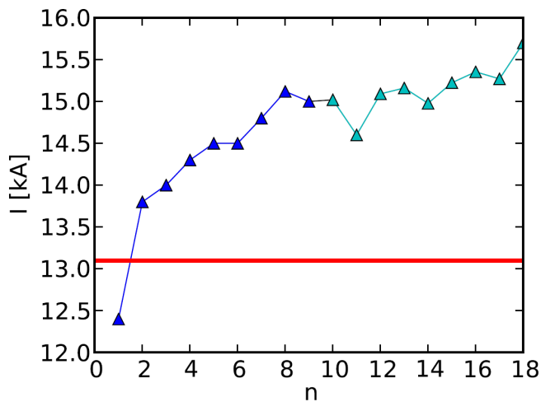
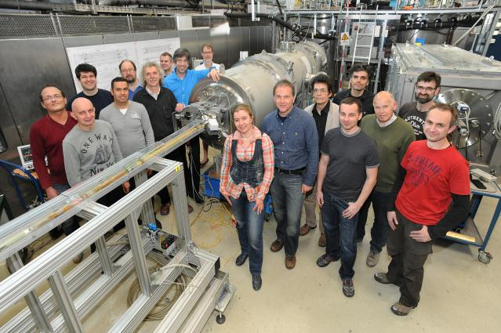
SIS100 dipole testing status
Cycle tests:
  injection field → maximum field → injection field
  period T = 1.1 s achieved → minimum
  cycle time still to be checked
Magnetic field: DC measured
→ evaluation in progress
  central field → focus
  → see contribution from
  Pierre Schnizer
Next activities
    mapping B_{x}
    cold rotating coil probe
  end insert optimisation
training

Slide 4
SIS100 magnet series test facility
Preparing Test station
  Cryogenic infrastructure procurement ongoing
  Power converters (2 pcs, 20 kA, 22/66 V) ordered
  HTS current leads: based on already tested ones
  Quench detection system ordered (1. test setup delivered)
Preparing measurements
  measurement systems described, procurements to be launched
  HV tests ← contribution Gdansk TU
  Software stack build up started (control system, software)
  colleagues from other groups → participating at current measurements → training

Slide 5
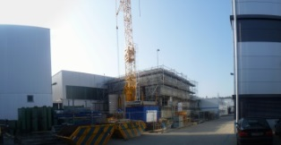
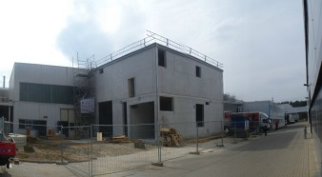
Cryogenics
Civil construction series test facility will be finished including all technical infrastructure in may 2014
Conceptional design studies on CRYO2 and CRYO1 running at LINDE and Air Liquide
SH5 January 2014
SH5 March 2014

Slide 6
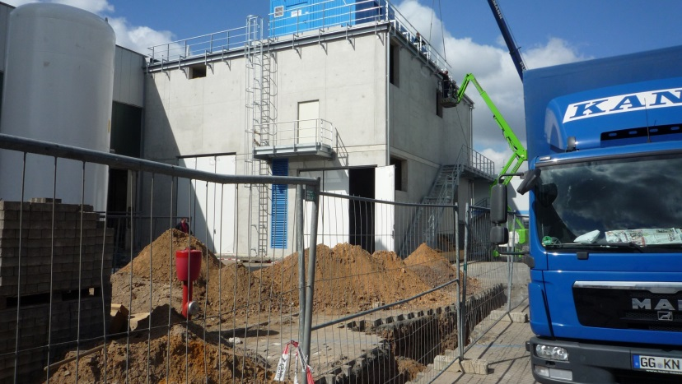
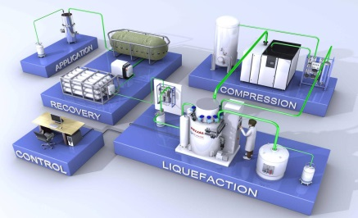
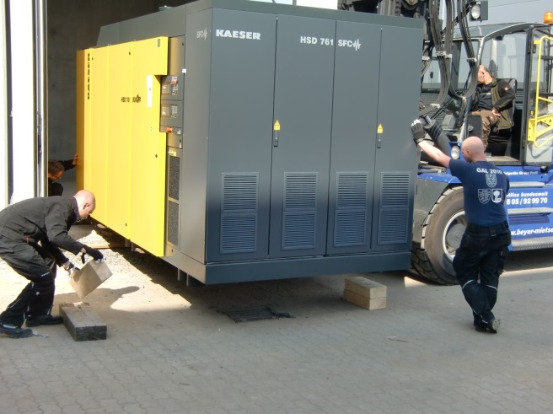
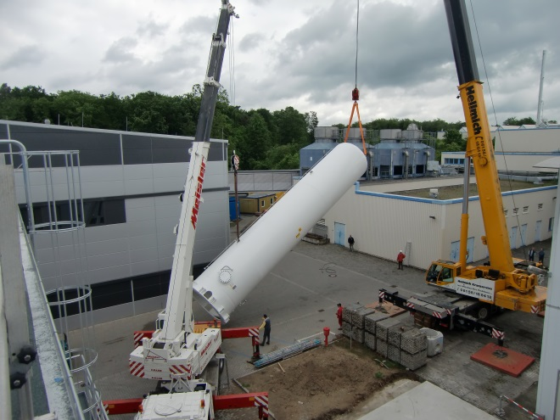
Cryogenic infrastructure
STF : cryogenic infrastructure (LINDE) → delivery May-June 2014, installation and commissioning (by LINDE) August 2014
HeSu :
cryogenic infrastructure delivery May 2014, installation (by AirLiquide) June 2014

Slide 7
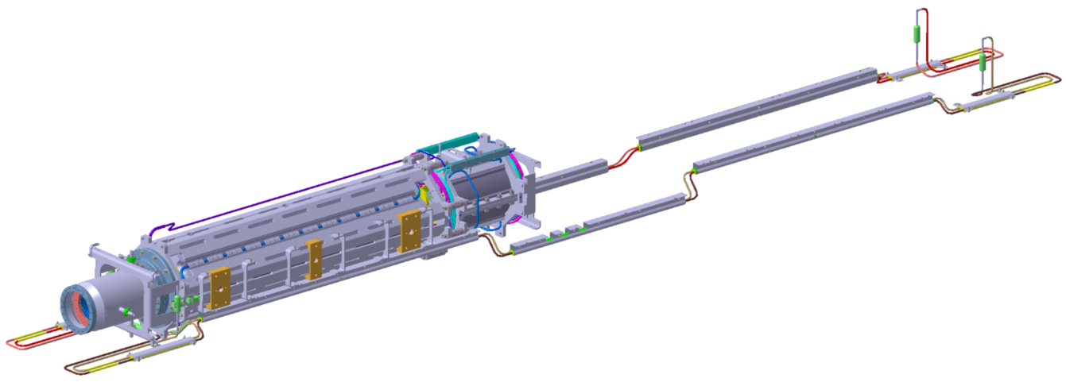
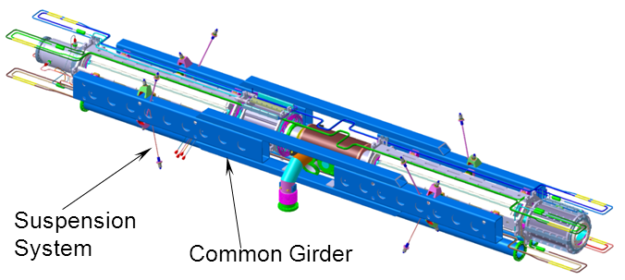
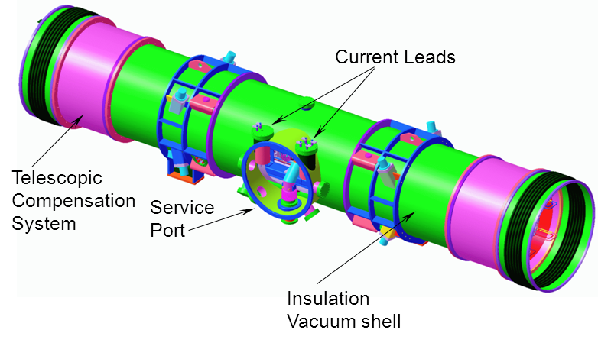


SIS100 quadrupole modules
Example of a Unit
(with BPM, QP and chrom. SP):
Example of a Doublet
(with Cryo-catcher module):

Slide 8
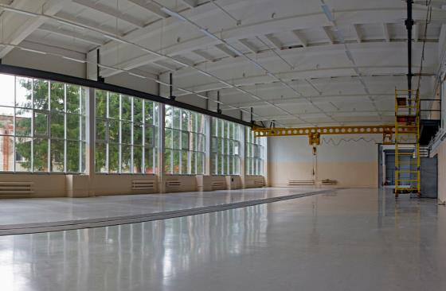
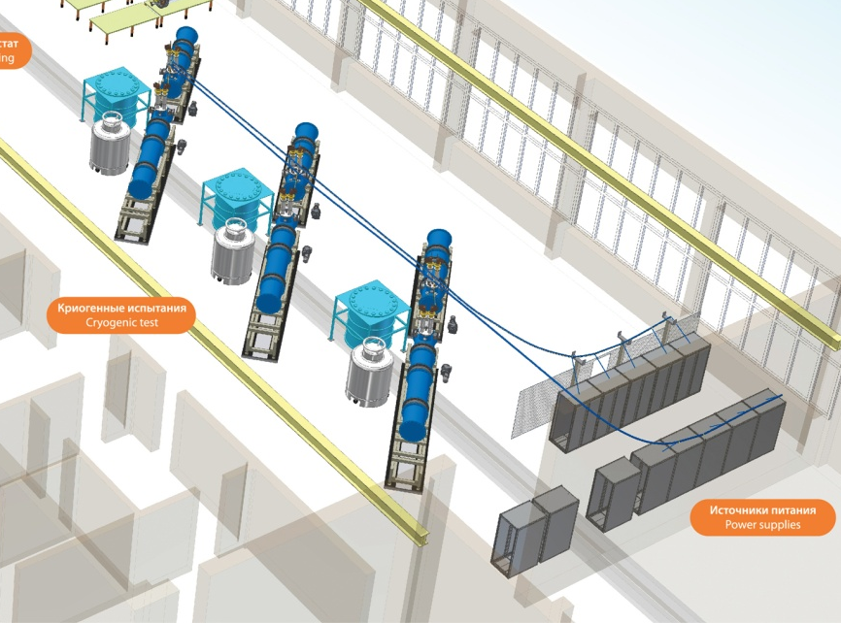
Testing SIS100 Quadrupoles:
Units Testing @ JINR
Common Test facility: NICA & FAIR
share of:
  infrastructure (power converters,
  cryo-supply)
  test benches
  measurement systems:
    magnetic field
    thermodynamic parameters
NICA test bench
one SIS100 unit
SIS100 test bench
power converter

Slide 9
HEBT magnets
75 dipole magnets (19 types) in M0-3
189 quadrupole magnets (7types) in M0-3
Almost all HEBT Magnets (338/356) ➔ Efremov institute (Council V, VI, VII)
Magnets similar to CR Magnets (2+5) ➔ Budker institute (IKRB VIII)
Super-FRS Quadrupoles (9) ➔ GSI in-kind (Council IV)
HEBT magnets completed
verbal confirmation that BINP will take over all related vacuum chambers (not yet all PSP-codes assigned to BINP, some PSP-codes unclear)
92 steering magnets (3types) in M0-3

Slide 10
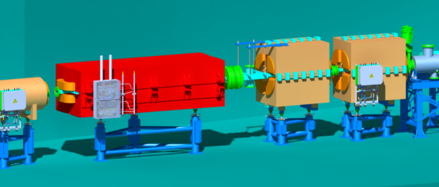
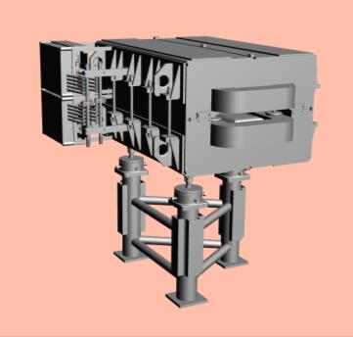
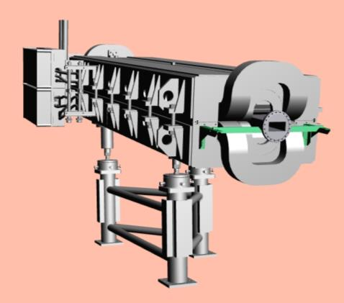
Status HEBT magnets batch 1-3
Batch1
content: 51 dipoles and related vacuum chambers
contracts signed with BINP and Efremov in 2013
exchange on working-level with BINP started in Feb. 2013,
with Efremov in October 2013
common kick-off meeting at GSI on 10.-11.12.2013
common techn. meeting at Efremov Inst. on 13.-14.5.2014
Batch2
content: 17 dipoles, 102 quadrupoles, 80 steering magnets and related vacuum chambers
Detailed Specs in 2nd EDMS approval process (release expected 30.05.), draft given to Efremov and BINP in 12/ 2013.
contracts in preparation; draft version will be sent to Efremov at beginning of June, to BINP at mid of June
Batch3
content: 5 dipoles, 71 quadrupoles, 12 steering magnets and related vacuum chambers
parameter tables ready and given to Efremov and BINP in December 2013;
3D models and 2D drawings ready
Detailed Specs ready in early summer; draft version will be given to Efremov and BINP within the next 4 weeks

Slide 11
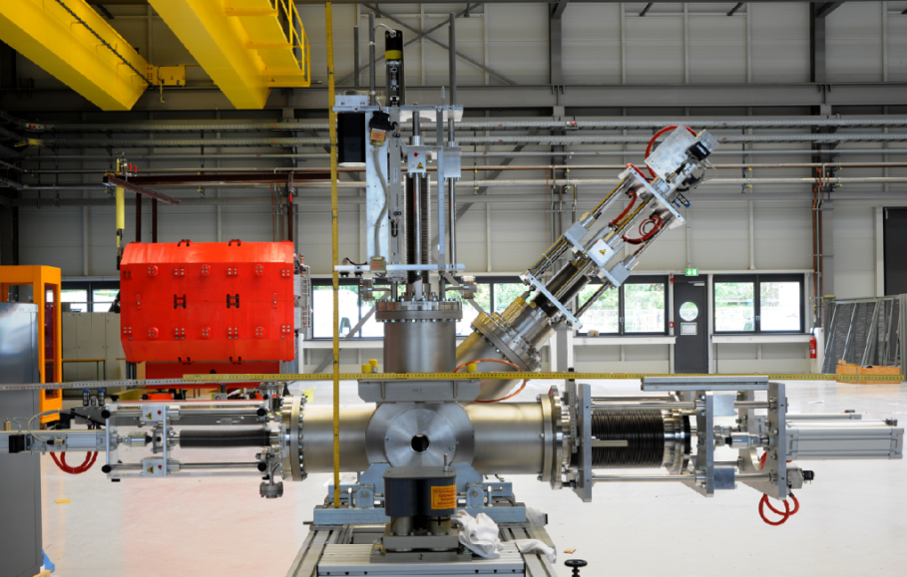
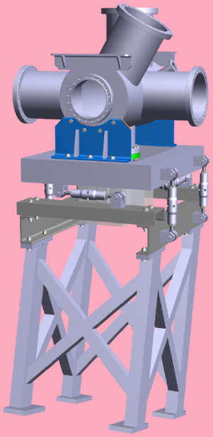
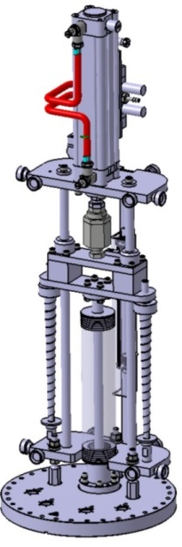
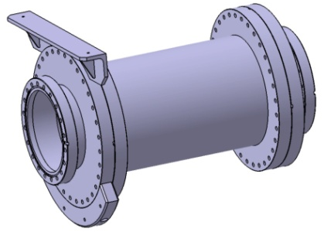
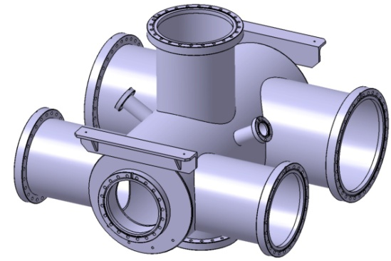
Beam Diagnostics Progress: Mechanics HEBT
detailed, technical drawing and specification of all standard diagnostic chamber and BPM chamber
detailed, technical drawing of diagnostic chamber with collimator
3D models for special diagnostic chamber
pre-series production of first diagnostic chamber
detailed, technical drawing of FCT/RT assembly
detailed, technical drawing of FAIR standard pneumatic drive
pre-series production of first FAIR pneumatic drive

Slide 12
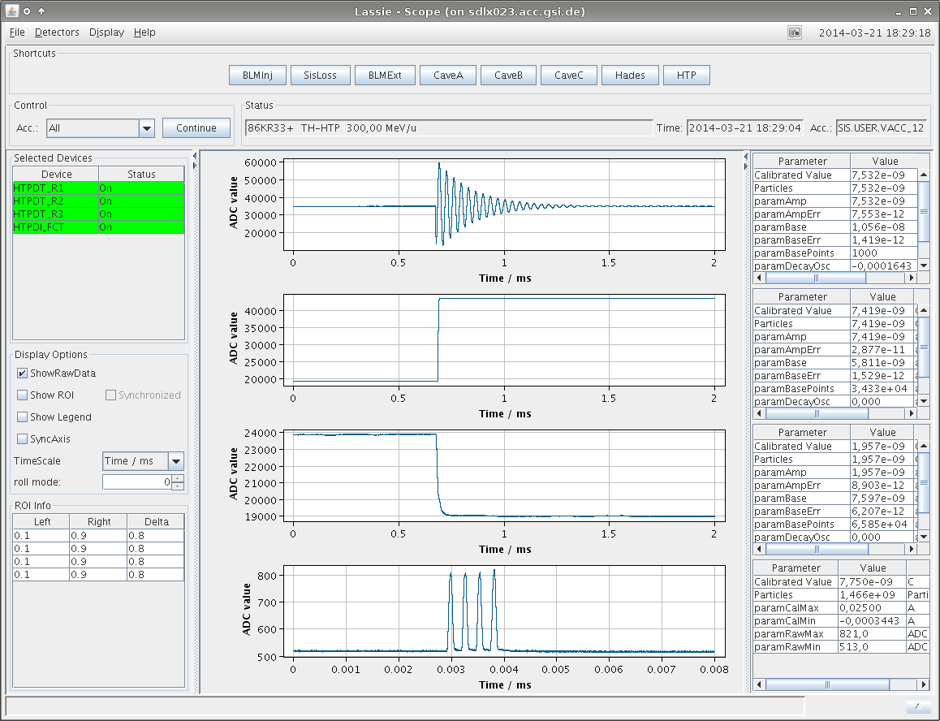
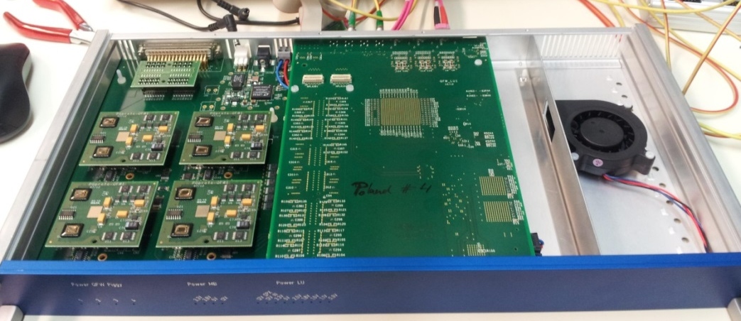
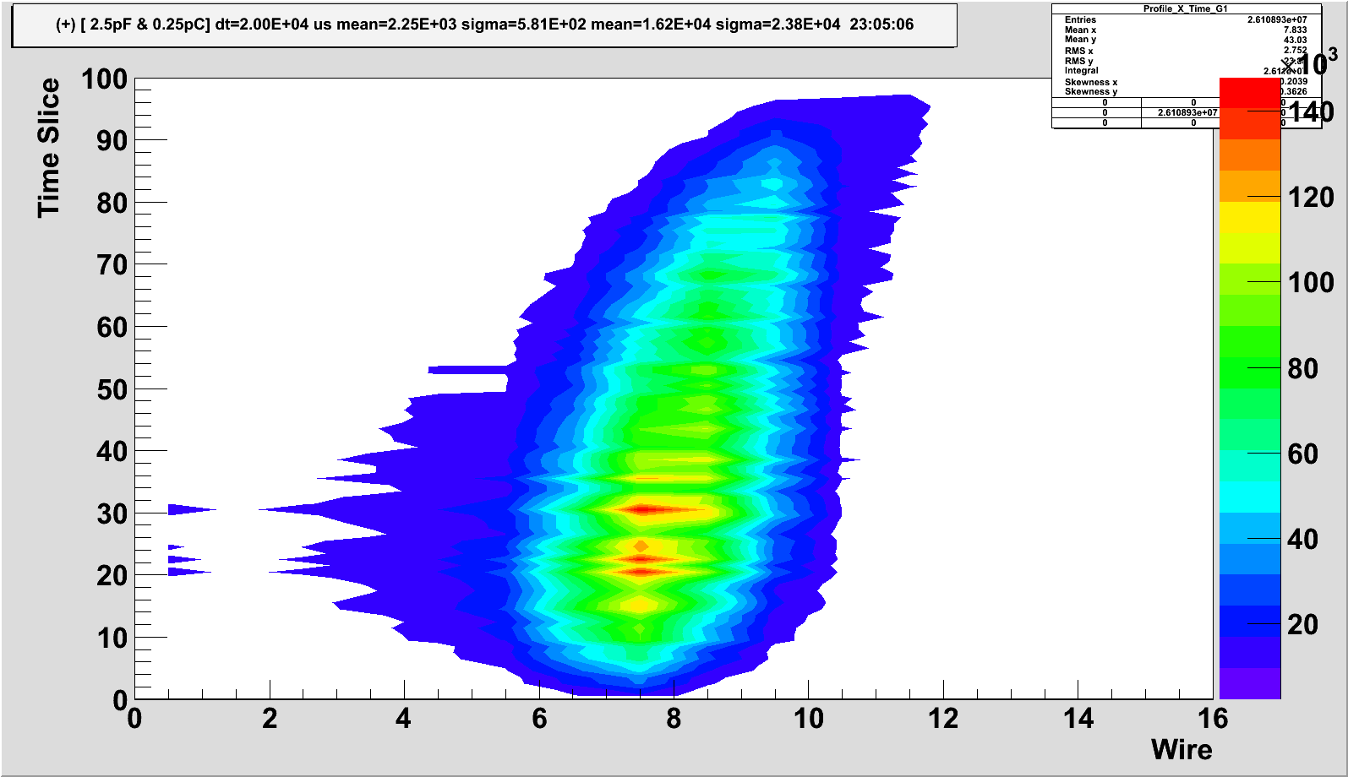
Beam Diagnostics Progress: DAQ systems
BD acquired extensive expertise with the software architecture of the new control system, FrontEnd Software (FESA) as well as expert GUIs
future software architecture for DAQ and expert GUIs have been implemented for major beam diagnostic devices: beam position monitors, beam transformers, GigE cameras for scintillating screens, counting devices like scintillators, ionization chambers or SEM-Grids
Electronics
pre-series production and beam test of new MWPC and SEM-Grid electronics
new concept for pneumatic drive and stepping motor control system

Slide 13
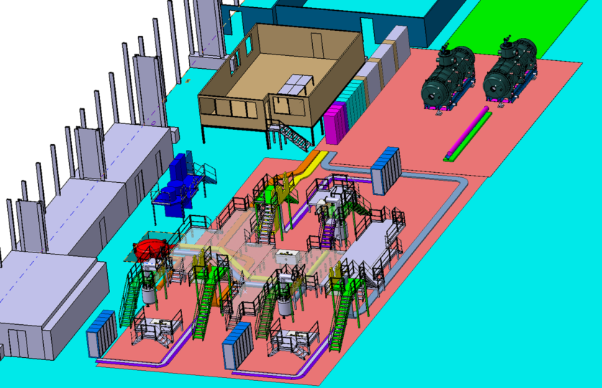
  Testing SuperFRS @ CERN: Planning
Test Facility Layout in blg. 180
3 Test benches
9 power converter
cryogenic infrastructure
measurement systems
power converters
multiplets
control room
cold box
storage
area
3 test benches
satellite valve box

Slide 14
Progress on the Collector Ring
  The TDR CR has been updated and approved in February 2014.
  IKRB meeting (01.04.20014) assigns a major part of the CR components (63 %) to the BINP
  Contract on transfer of the CR system responsibility to BINP is prepared. After Council decision it can be signed.
  BINP and GSI make good progress in design
  and procurement of CR components

Slide 15
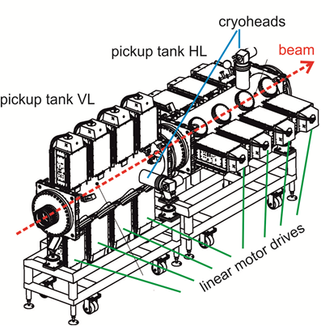
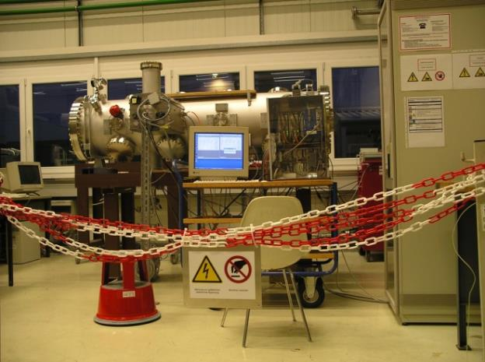
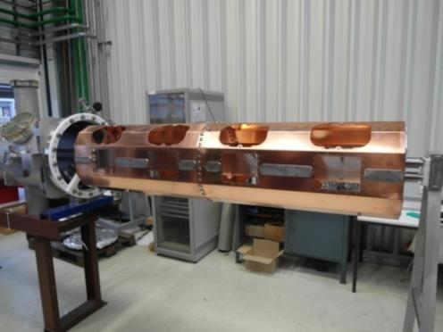
Collector Ring: Stochastic cooling
  The contract with external company for production of 34 power amplifiers has been signed. The procurement is started.
Cryoshield
(part of
Pick-Up)
at GSI
Prototype Pick-up tank at GSI

Slide 16
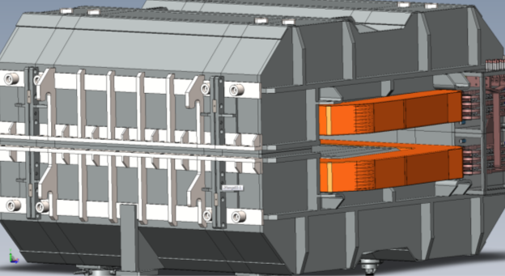
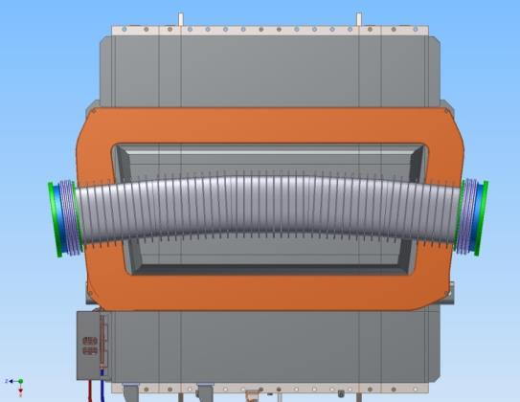
Collector Ring: Dipole magnet and its vacuum chamber
  The final specifications for the laminated dipole magnets has been agreed with BINP experts and officially approved. The contract between FAIR and BINP for the dipole production can be established.
  The preliminary specifications for dipole vacuum chamber have been prepared.

Slide 17
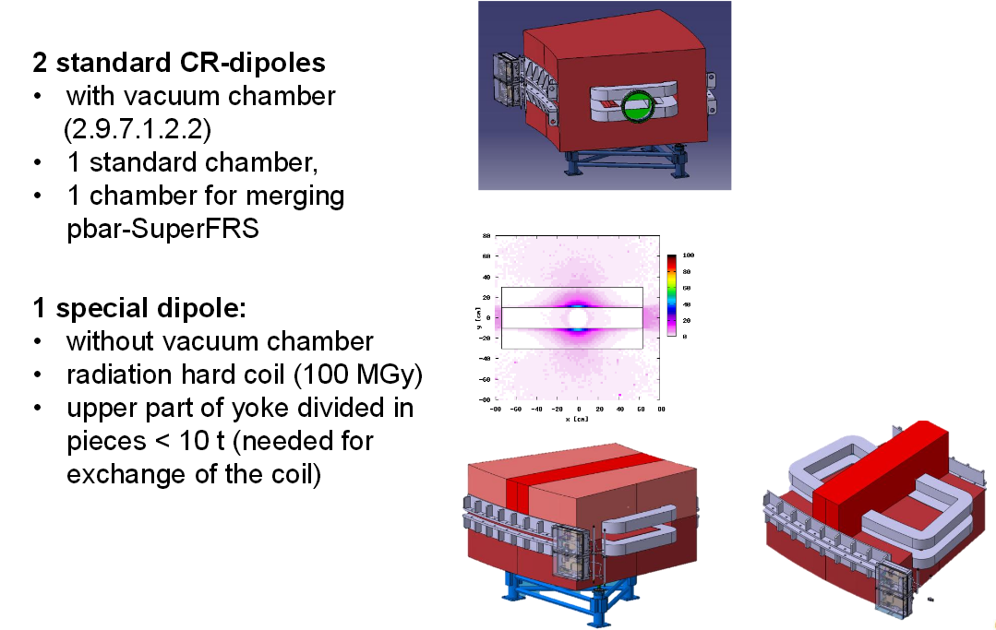
Work on dipole magnet design – p-bar separator

Slide 18
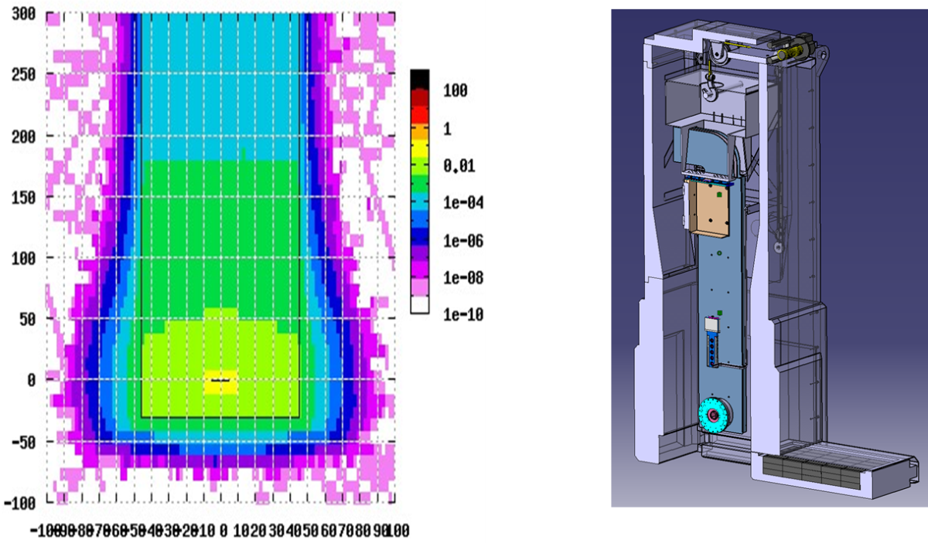
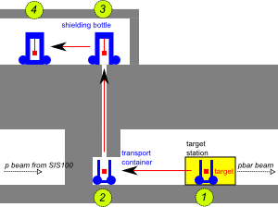
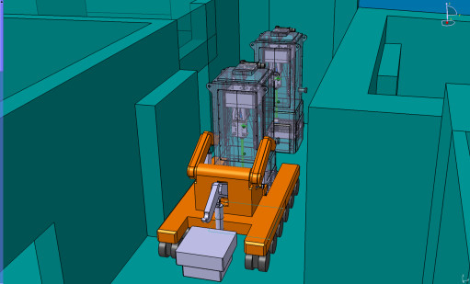
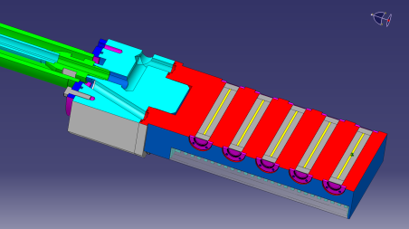
Study on transport concept of used target / horn
The study is started in cooperation with Kraftanlagen Heidelberg

Slide 19
Some technical highlights
Project management and planning
Status specifications and procurement
Quality assurance

Slide 20
Ressource loaded schedule
  Critical path
  MILESTONE trend analysis:
  COST:
  - detailed payment plans for each work package
  - agreement on cost targets, tracking and evaluation of measures for
  cost reduction
      RESSOURCES:
      Detailed planning of necessary personnel and qualification based on analysis of tasks in the work packages
      Component data →Common component data base

Slide 21
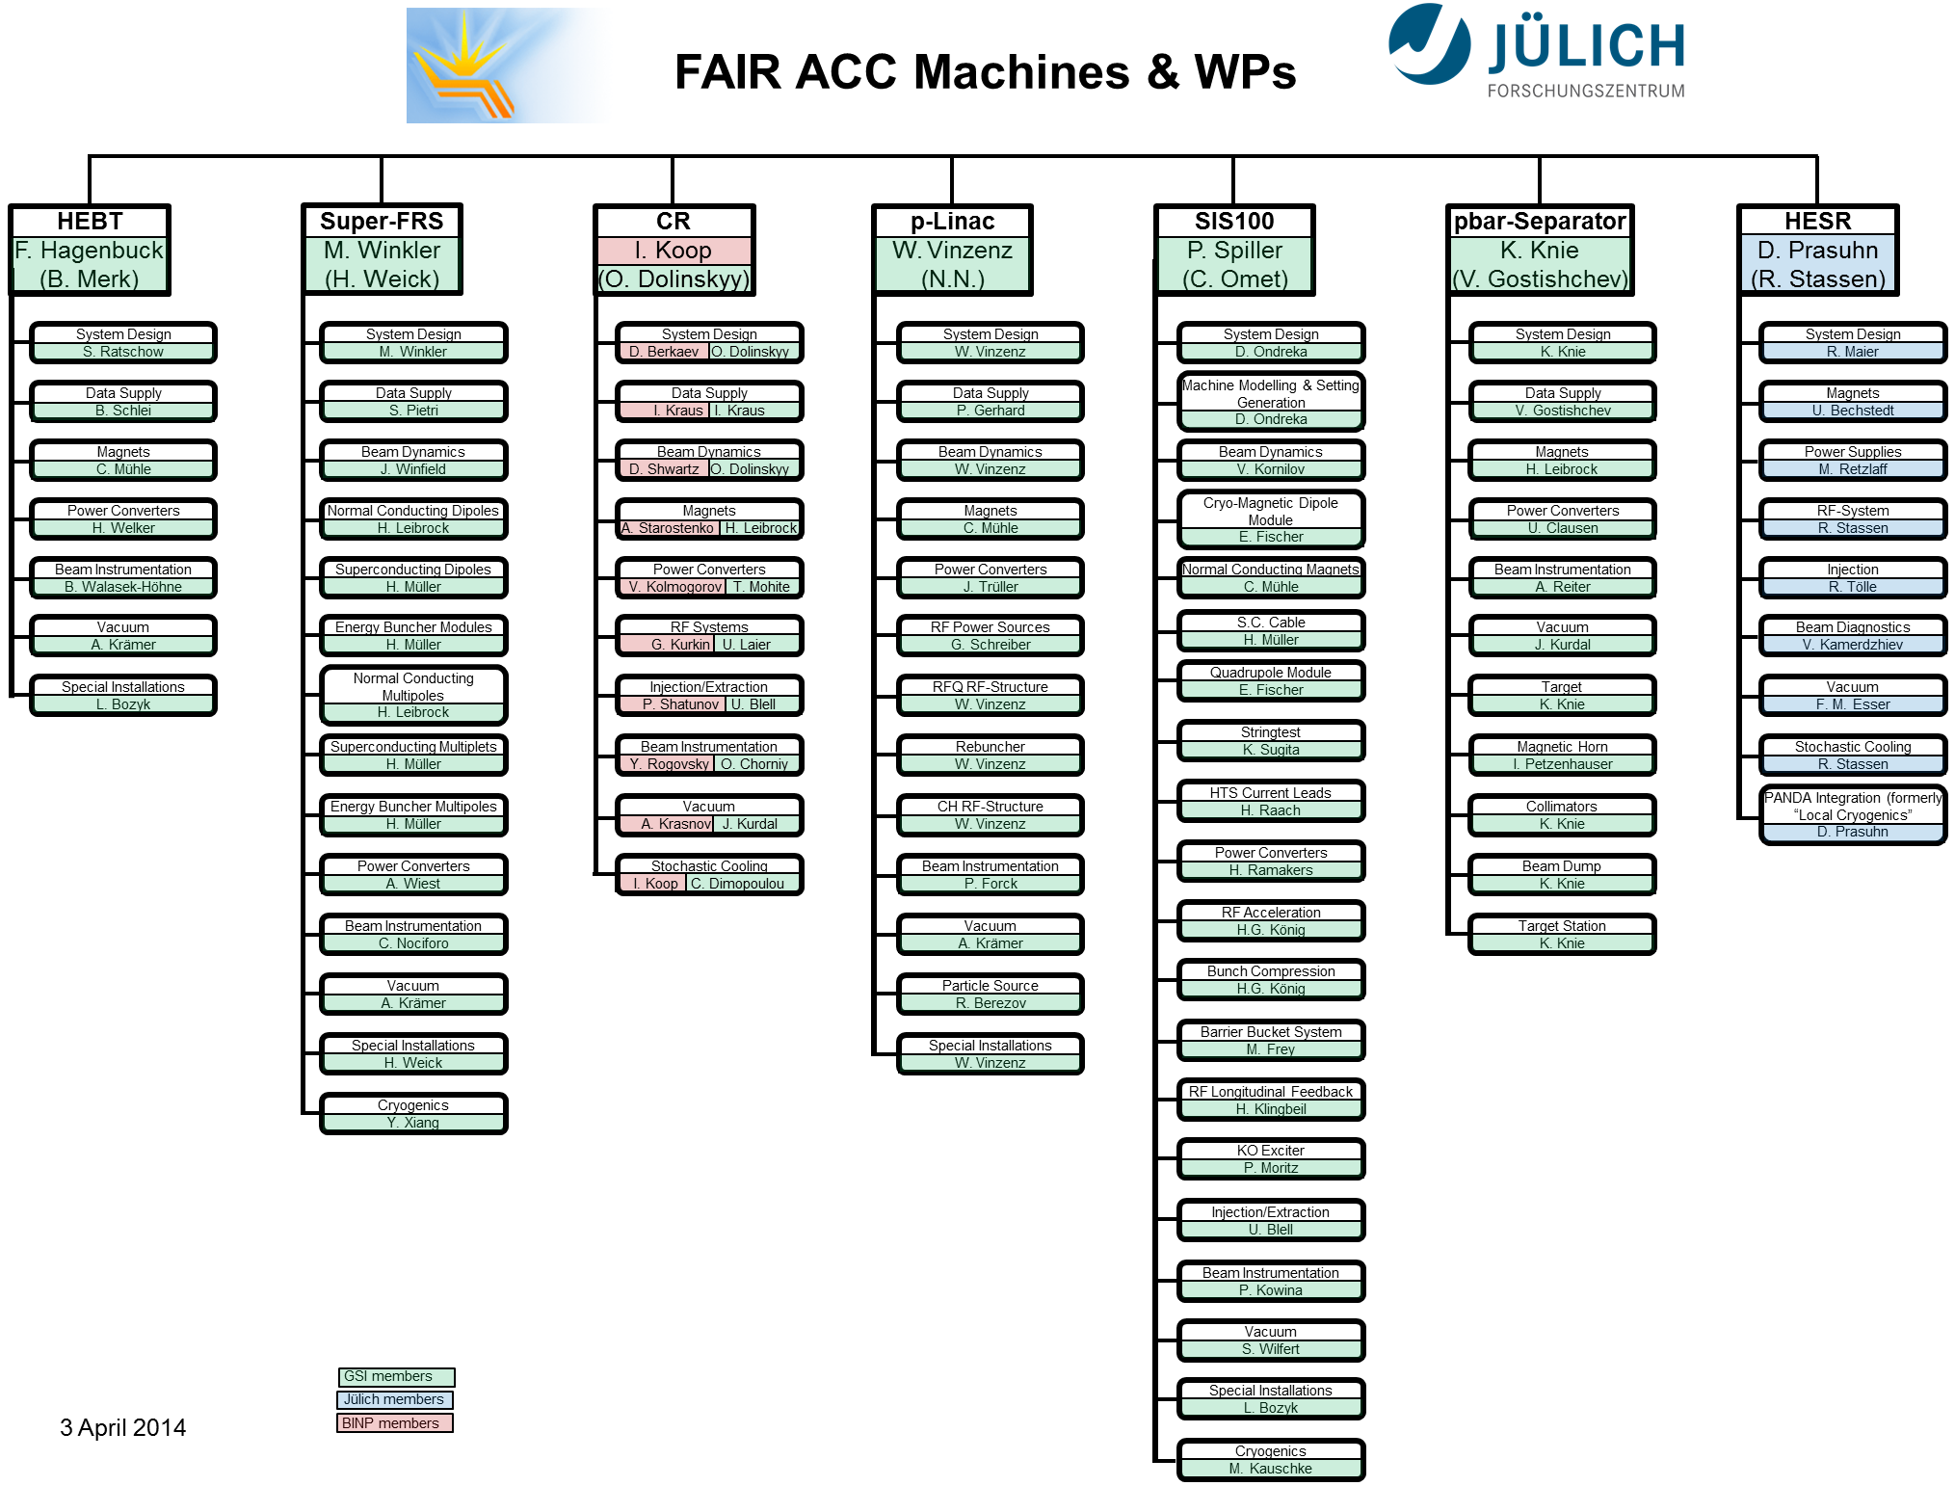
Project organization along the accelerators

Slide 22
Status of Resource Planning (05/08/2014)
Notes:
FollowUp der Folie vom letzten Mal.
Quintessenz: Personalrekrutierung ist zäh.

Slide 23
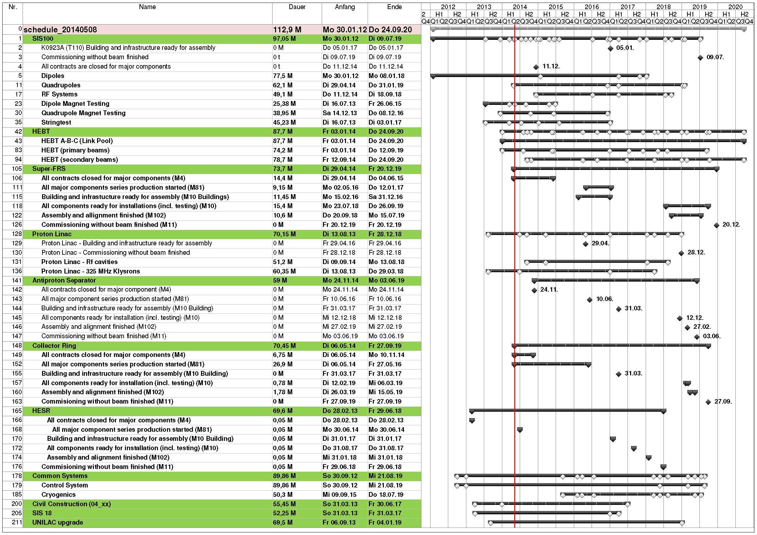
Major Milestones FAIR Accelerator (05/08/2014)
Notes:
Übersichtsplan Major Milestones FAIR Accelerator mit Status vom 08. Mai 2014.

Slide 24
Milestone Trend Analysis (MTA)
start of milestone
tracking
Milestones:
M4 – Contract closed,
M81 – Series Production started
M10 – Component Ready for Installation
M102 – Component Assembled and Aligned
M11 – Component accepted without beam

Slide 25
Critical Workpackages
Principle of critical path:
  forward calculation of the whole project schedule → earliest start and end dates of all tasks
  backward calculation of the whole project schedule → latest start and end dates of all tasks
  ⇒ result: tasks without buffer time determine critical path
Due to complex linking between project plans automated determination of critical path not possible – preparation & maintenance by hand extremely time consuming, lifetime of result comparable short
Concept:
  linking of dedicated summary tasks of each WP to a separat project plan for each machine and
  additional linking of corresponding milestone, e.g. M11
  → validation of end date of summary task
  ⇒ automated overview of currently time critical WP
  paths of critical WPs can be displayed in MS Project for further evaluation

Slide 26
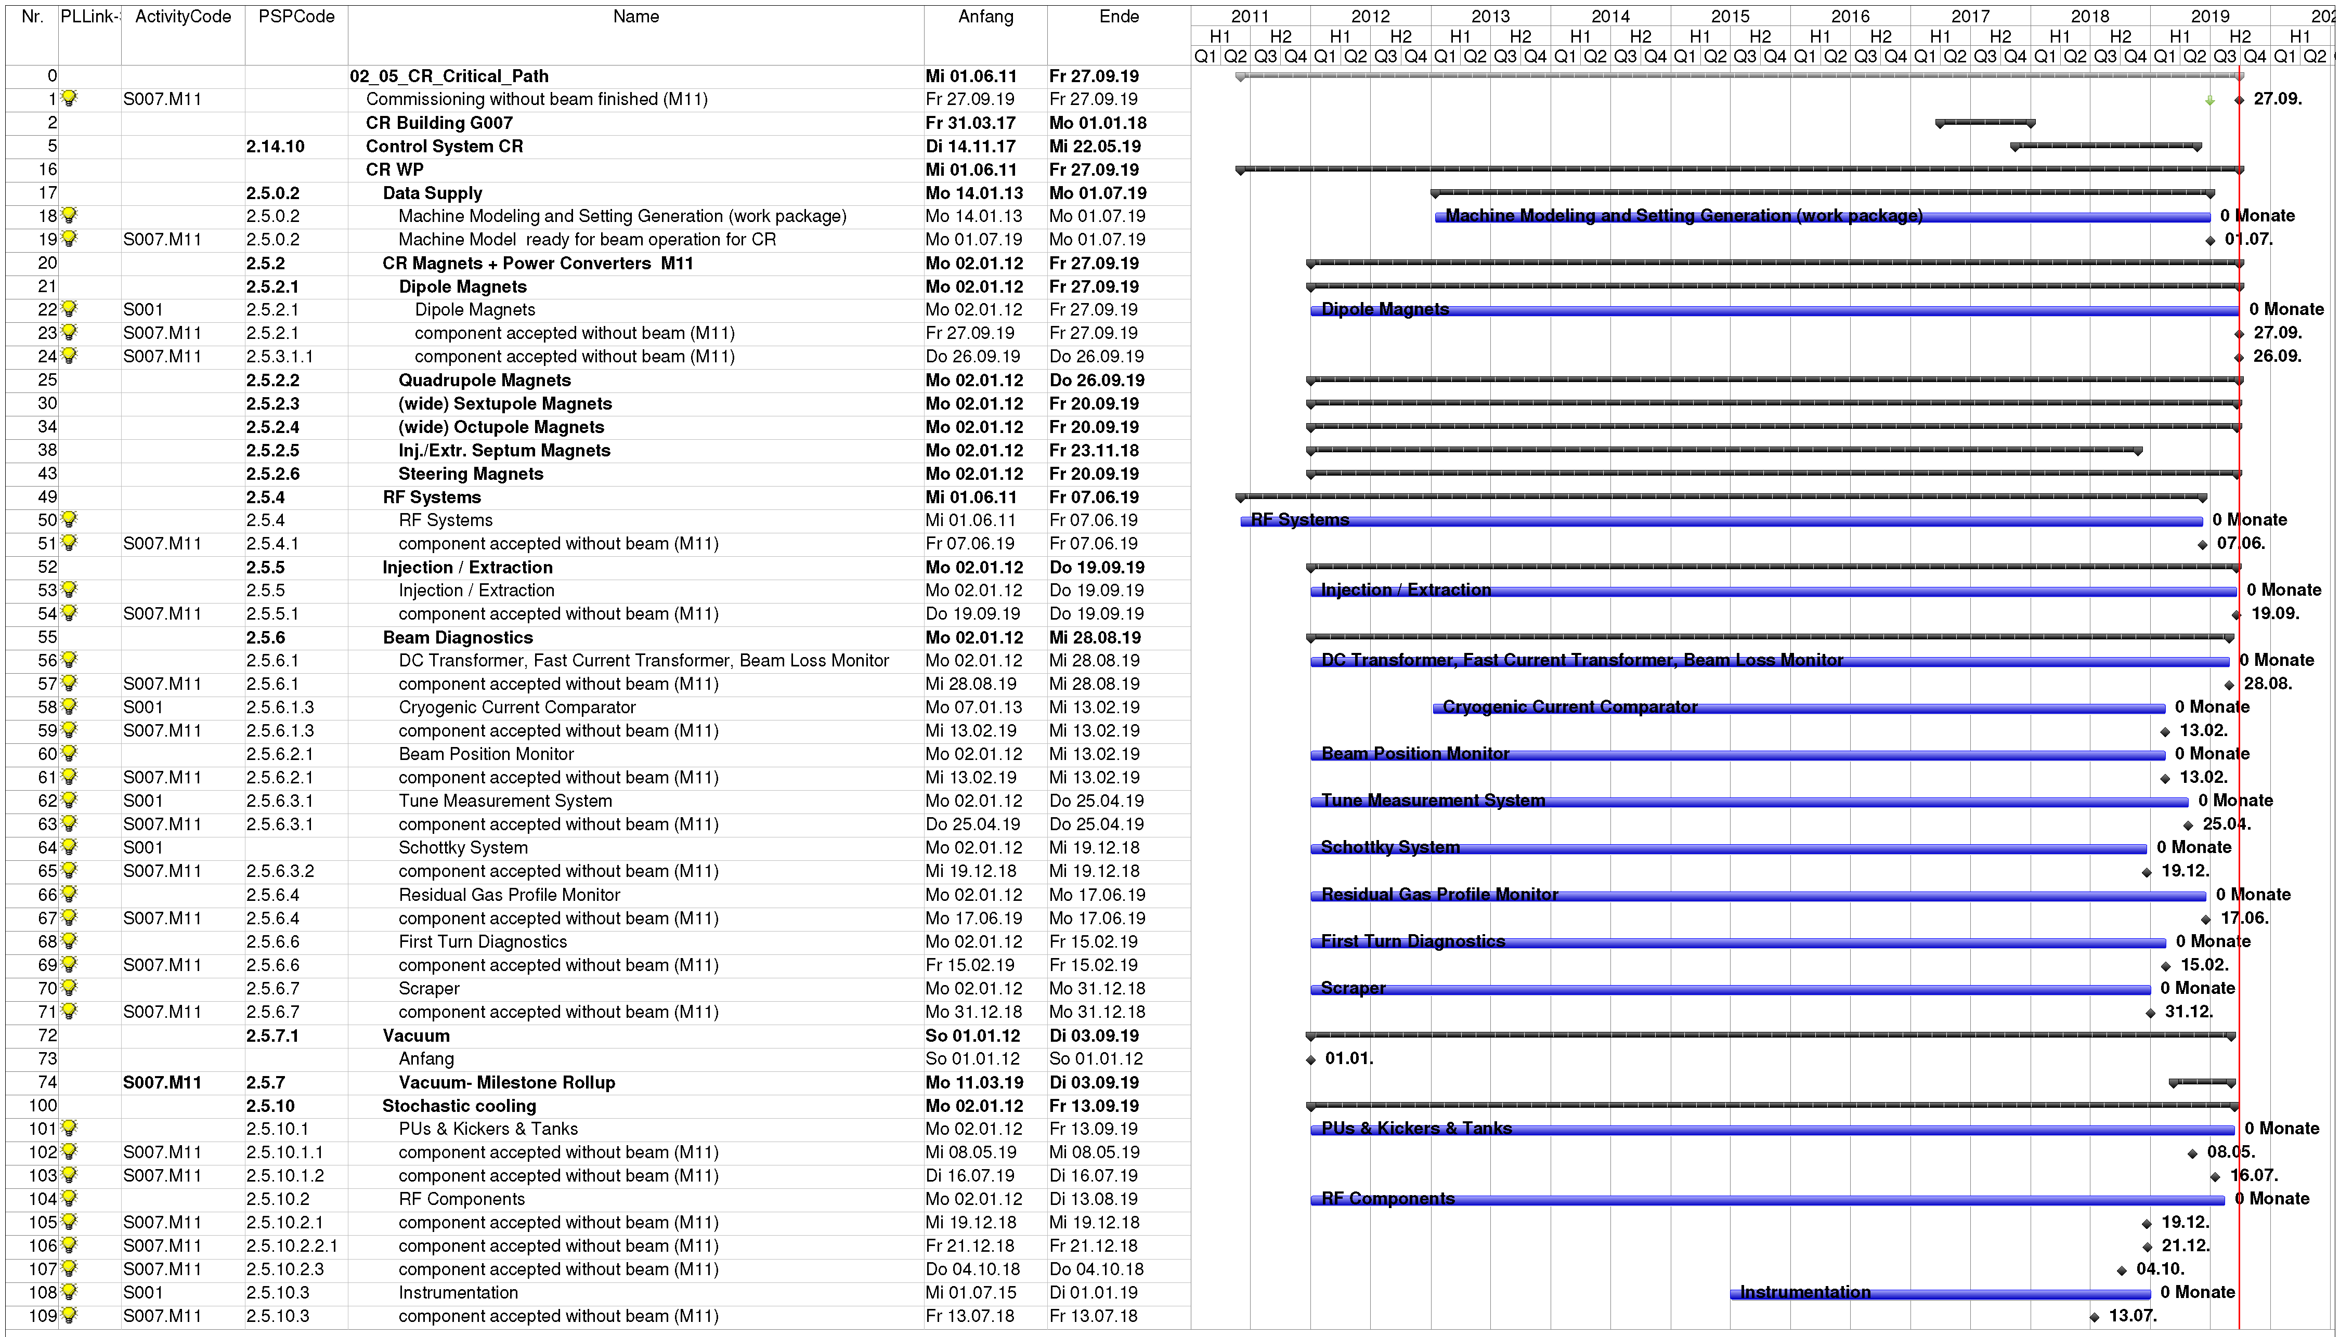
Example of Critical WP Project Plan
structure corresponds to that of WBS
end date of machine presently defined
by magnets & injection/ extraction
additional task within summary task;
end date does not fit to latest milestone

Slide 27
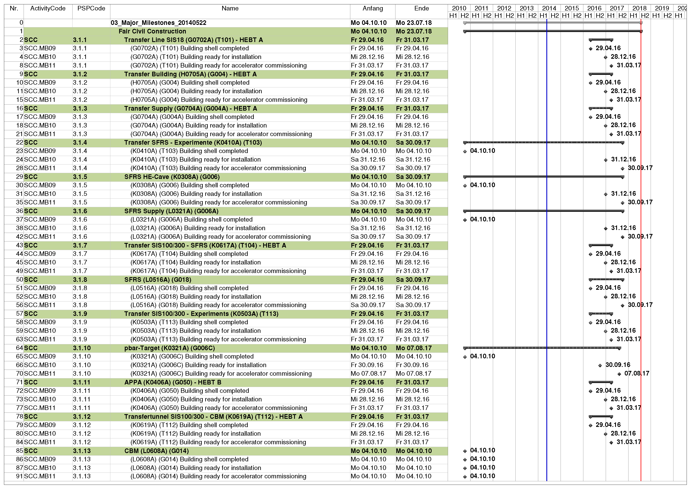
Building Milestones – Estimates for ACC-Planning
Milestones without
schedule
Hidden milestones: Low Voltage Distribution (MB10-LV) and Communication Active (MB10-CA)
Status of linking:
all milestones are linked to each machine major milestone plan incl. common systems
the following milestones are linked to WP plans and have successors there
  MB09 Building shell completed
  MB10 Building ready for installation
  MB11 Building ready for accelerator commissioning

Slide 28
Building Milestones – influence on accelerator completion
Latest MB10 schedule – building ready for installation
  earliest MB10 date in latest MB10 date
  project plan* in project plan**
  HEBT 12/2016 3/2018
  SFRS 6/2016 9/2017
  CR 1/2017 11/2017
  p-linac 4/2016 3/2017
  SIS100 10/2016 9/2017
  pbar 11/2016 10/2017
  * machine might delay the project ** machine will be delayed

Slide 29
Component Database (CDB)
Goal:
Central and common database, up-to-date and accurate
Status
  Basic technical conditions are created
  The basic structure is sound and prepared for all known components – possibility for further expansion in the future
Perspective 2014
Q2 / 2014: NC magnets implemented
Q3 / 2014: Power converters implemented
Q4 / 2014: Test version for vacuum systems und SC magnets

Slide 30
Some technical highlights
Project management and planning
Status specifications and procurement
Quality assurance

Slide 31
Status Specifications
Status: 19.05.2014:
(Numbers in brackets show the difference from 25.11.2013)
 | Open | Draft in internal review | Draft in release process | Released
Technical guideline | 4 (+4) | 0 (+0) | 8 (+6) | 174 (+0)
Common specification | 11 (+1) | 8 (+0) | 5 (+1) | 19 (+0)
Detailed specification | 241 (-1) | 10 (+0) | 55 (+18) | 76 (+5)
Sum | 256 (+4) | 18 (+0) | 68 (+25) | 269 (+5)

Slide 32
Status Procurement - GSI in-kind, contracts signed
Work package/Components | PSP-Code
SIS100 dipole modules | 2.8.2.1
Magnet Testing cold Super-FRS magnets | 2.14.13.22
CR Debuncher cavity and amplifier | 2.5.4.1.1
Steel for vacuum chambers (Dipoles & QMs) | 2.8.2.x
Vacuum chambers SIS100 dipoles | 2.8.7.1.2.2
Superconducting wire SIS100 dipole modules | 2.8.2.7
Cryogenic Plant Test Facility SIS100 dipoles | 2.14.8.1.6
Cryogenic Helium Supply Unit | 2.14.8.1.5
Upgrade SIS18 dipole power supply | 2.14.11.4.2
Design SIS100 quadrupole modules | 2.8.2.2
Quench detection system for Magnet Testing | 2.14.14
Building for SIS100 dipole test cryo plant | 2.14.13.20
HTS Current Leads for SIS100 dipole test bench (asap) | 2.14.13.20
HTS Current Leads for SIS100 dipole series (asap) | 2.8.2.13
SIS100 Bunch Compression System | 2.8.4.3.1
Power Converter SIS100 Dipole Test Facility | 2.14.13.20
CR Stochastic Cooling (RF-Power Amplifier) | 2.5.10.2.2.1

Slide 33
Status Procurement - GSI In-Kind, Call for tender
Work package/Components | PSP-Code
Super-FRS Superferric Multiplets | 2.4.2.2
Quench Detection System Series (Negotiation with KIT) | 2.14.14
CR Debuncher Power Converters | 2.5.4.1.3
Cabinets for Low Level RF | 2.x.4.y
in progress
Work package/Components | PSP-Code
SIS18 Ionisation Profile Monitor | 2.14.11.x
SIS100 Adsorption pumps | 2.8.7.1.1.5.x
SIS100 Cryo collimators | 2.7.4.1.x
SIS100 Barrier Bucket | 2.8.4.4.1
Cryogenic plant 2 (SIS100) | 2.14.8.1.2
Compressor station plant 1+2 | 2.14.8.1.3
SIS100 Quadrupole chambers | 2.8.7.1.2.3
SIS100 SC wire for corrector magnets | 2.8.2.7.2
P-bar magnetic horn | 2.9.11.2
SIS100 NC Resonance Sextupole | 2.8.2.3.3
in preparation

Slide 34
Status Procurement
FAIR, Tendering in progress / in preparation
Work package/Components | PSP-Code
SIS100 Acceleration System | 2.8.4.1.1
SIS100 Supply Units for Acceleration System | 2.8.4.1.3
P-Bar Power Converter for magnetic horn | 2.9.11.4
Super-FRS Quadrupole 1 | 2.4.2.2.1
Super-FRS Quadrupole 2 | 2.4.2.2.2

Slide 35
Some technical highlights
Project management and planning
Status specifications and procurement
Quality assurance

Slide 36
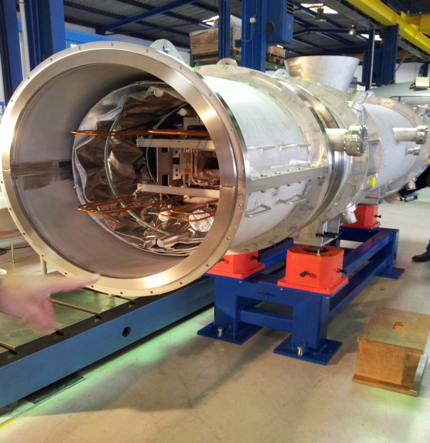
Quality Assurance - SIS100 Dipol FOS
  Based on internal tests GSI identified 95 variations/ modifications with influence for the following main categories are identified:
  Adjustments with impact on electrical properties
  (wiring, insulation, etc.)
  Design modifications (connection of helium line system,
  position of the busbars, etc.)
  Optimization of the production at supplier BNG,
  including deviation yoke sagging and flanges
  Drawing- and documentation adjustments
  Magnetic field: The measurement of the magnetic field does not reflect the expected characteristic, stamping tools for the yoke plates are still not release → talk of Pierre Schnizer
  ➔ Root cause analyses is running together with supplier BNG

Slide 37
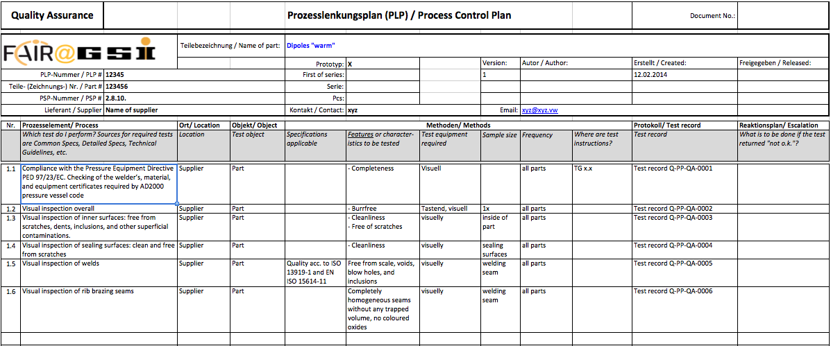
HEBT NC Dipoles – Q-Plan from NIIEFA/ Russia
The Process Control Plan of Efremov is showing following information:
    General data of test specimen and administrative information (PSP number, part-description, responsible member, release data, etc.)
    Description of production step and test step (quality gates)
    Number of production- and test steps
    Location of production and testing
    Requirement and reference (per number)
    Test equipment and test instruction
    Test record and escalation process (in case of non-conforming parts)
    ➔ We released the Q- Plan of Efremov, all required production steps and quality gates are defined.

Slide 38
Russian Quality Assurance Center
(Resident QA engineers in Russia)
    It’s planed, to establish a central Quality Assurance office in Moscow
    (within FAIR - Russia Research Center)
    It is provided, to place 3 Russian speaking GSI QA-staff members in Moscow
    These employees will be responsible for all Russian suppliers or institutes, which will deliver components of accelerators to the FAIR project
    1 employee will be the team leader → he/she will report directly to the
    Head of Quality Assurance at GSI/ Darmstadt
    QA methods like Q-Planning, control plans, acceptance, approval- and release processes will be equal to all other FAIR and GSI suppliers, defined standards are used
    The existing IT infrastructure will continue to be used, central measurement and other data will be stored in the DMS- or SAP- system of GSI.

Slide 39
Outlook – key points for the next 6 months
Recruitment of personnel, external support
Optimization of MS-Project plans → Tracking of milestones and
budget → project steering via release processes
Matching of the FAIR ACC master schedule with civil
construction planning
Follow up of the specification process and procurement
Implementation of Component Data Base and change management
Cost and technical reviews (cryogenics for instance)
QA office in Moscow
Series production start of SIS100 dipoles
SIS100 QDMs (FDR of BNG design for the other QDM families)

Slide 40
Additional slides

Slide 41
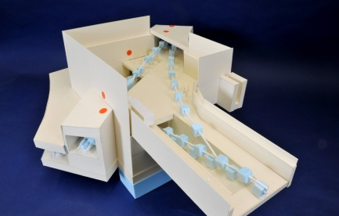
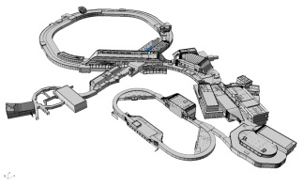
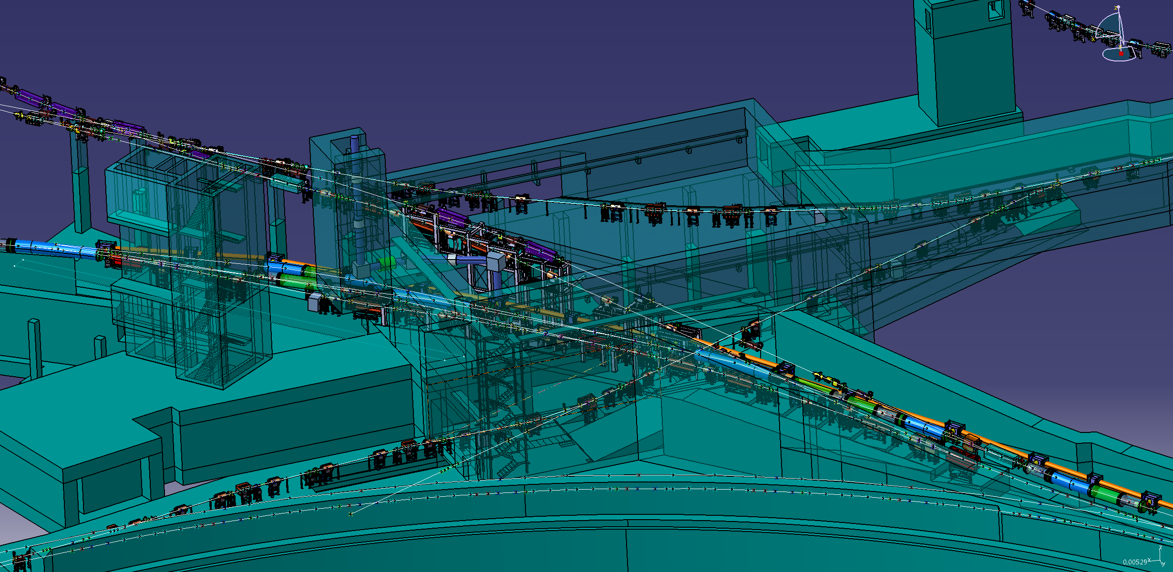
System design HEBT
Central Transfer Building H0705A
branching and crossing point for 8 beam lines (full version)
several beam lines inclined
components of many other beam lines are transported through this building
pbar, APPA
SIS18
SFRS
CBM
SIS100/300
SIS100/300

Slide 42

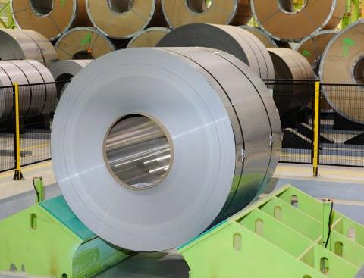
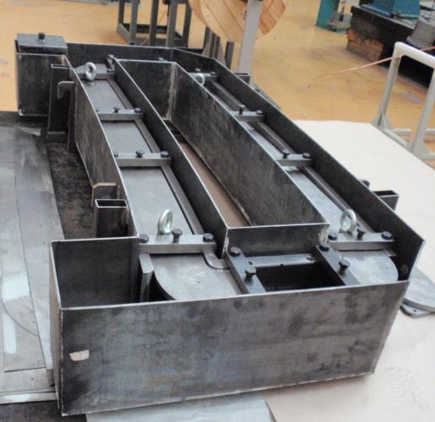
Purchase of materials for HEBT magnets
F. Hagenbuck
Copper conductors
yoke steel:
Tooling for compression and impregnation of coils
Forecast material delivery date – September 2014

Slide 43
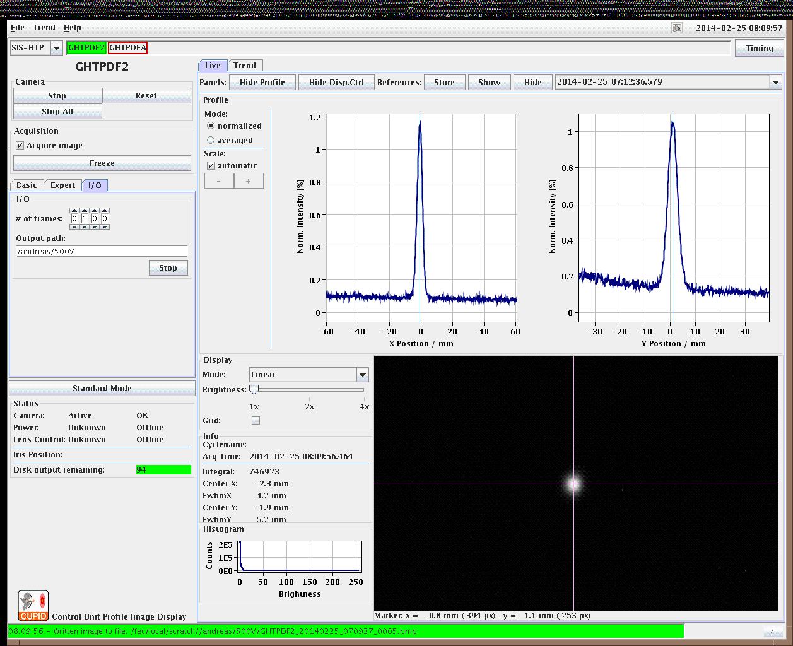
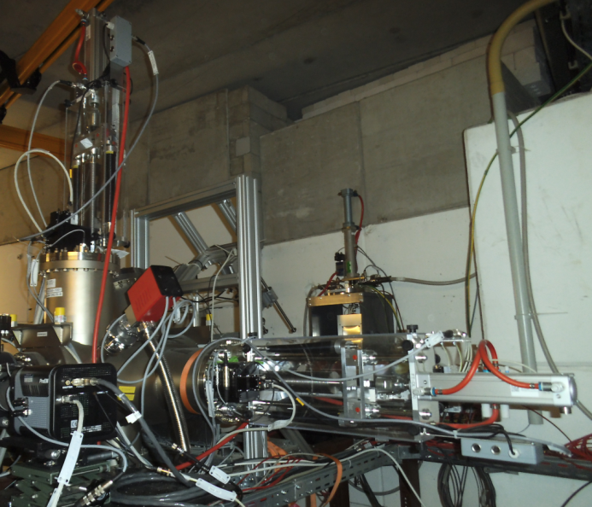
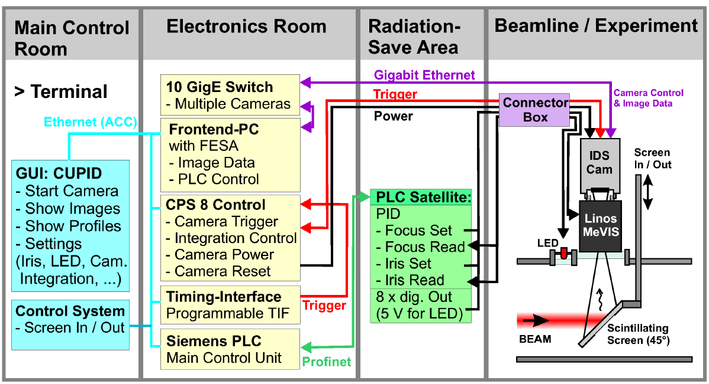
Progress: Scintillating Screen Complete System
A new, fully FAIR-conformal system for standard scintillating screen based beam diagnostics including digital image acquisition, remote controllable optical system and mechanical design
→ commissioned with beam
CUPID (Control Unit for Profile and Image Data) is based on the Front-End Software Architecture (FESA) to control beam diagnostic devices.
LOBI – M. Schwickert

Slide 44
Building Milestones – Explanation
MB10 – Building ready for installation
  roads to buildings accessible
  technical infrastructure building available
  cable trace and cables with large diameters and bending radius installed
  on site power distribution active
  false floor, coverage, rails installed
  floors prepared, cranes, lifts & bring-in ducts usable
  basic communication exists
  in case of tunnels: Network measurements for alignment done
  MB11 – Building ready for accelerator commissioning
  20kV low voltage distribution boards active
  Ethernet, ProfiNet, timing network and IP telephones fully available
  technical infrastructure works completely
  uninterruptable power supply available
  all cables of MSV0-3 installed, labeled and surveyed
  doors, fire protection separations, banisters installed
  cryogenics supply available if needed

Slide 45
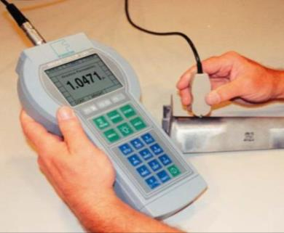

Quality Assurance – HEBT Vacuum Chambers Tests
➔ Measuring System Analysis
  Results of measuring system analyses at HEBT vacuum chambers:
    Our measurements showed that measuring equipment used by partners for checking permeability of vacuum chamber walls is not capable of controlling the tolerance specified (µ_{rel} ≤ 1,010).
    QA has tested a new measuring instrument at its manufacturer‘s site, has it proven capable, and has it recommended for purchase (Institut Dr. Foerster Prüfgerätebau, Magnetoscop 1.069).
  Consequences and benefits for other parts of the project:
    Specifications for SIS100 vacuum chambers will be modified accordingly (µ_{rel} ≤ 1,010) ➔ standardization of specifications.
    Presentations and trainings for elementary measuring system analysis were held for GSI and in-kind partners.

