Slide 1
Super-FRS Status
M. Winkler
11th FAIR - Machine Advisory Committee Meeting

Slide 2
Outline
Status SC Magnets & Testing
Status Local Cryogenics
Status (radiation hard) NC Magnets
Status Target Area Installation and Infrastructure
Status Super-FRS Instrumentation
Redesign of the Energy Buncher
Status Civil Construction
Summary
Notes:
In-Flight → energies as high as 1500 MeV/u

Slide 3
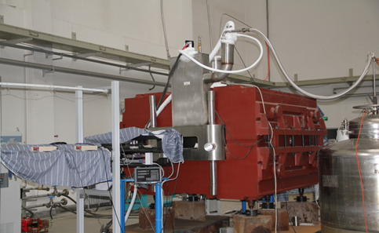
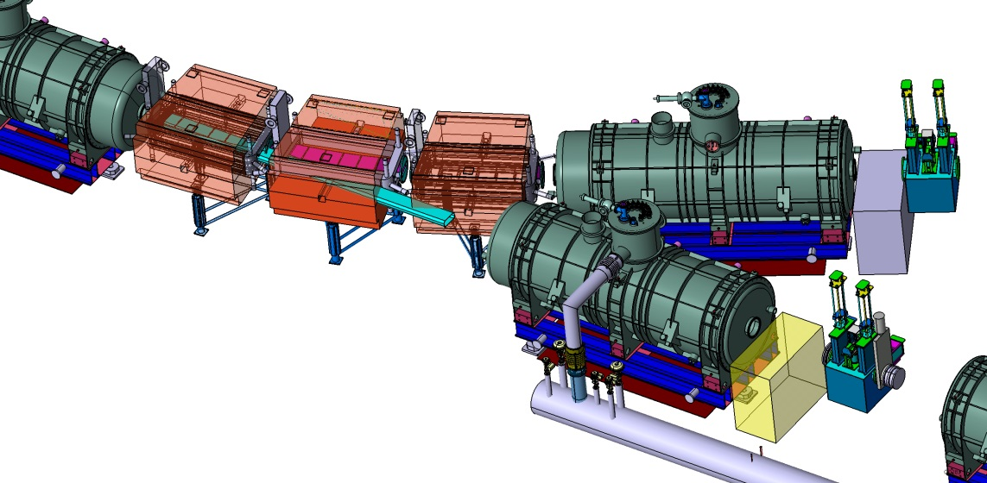
SC Dipole Magnets
Status:
Collaboration agreement with CEA/Saclay signed (11/2013):
  Detailed design
  Technical follow-up
  Participation at CERN testing
Technical Kick-off 1/2014
IMP Visit 4/2014 (CEA & GSI)
PDR planned for 6/2014 (includes external advisor)
FDR planned for 9/2014 (without special dipoles)
Tender by FAIR Q4/2014 (option on special dipoles)
First of Series ready for testing: Q2/2016
Series production and testing: Q3/16 – Q4/18
3 dipole units 11°
21 dipole units 9.75°
  3 times modified cryostat
Iron dominated
Warm iron
SC coil
Aperture ±190mm x ±70mm
Weight: 50 to 60 ton
Prototype built and tested (FAIR China Group)
Branching Point
cryostat & yoke
modification
small yoke
modification

Slide 4
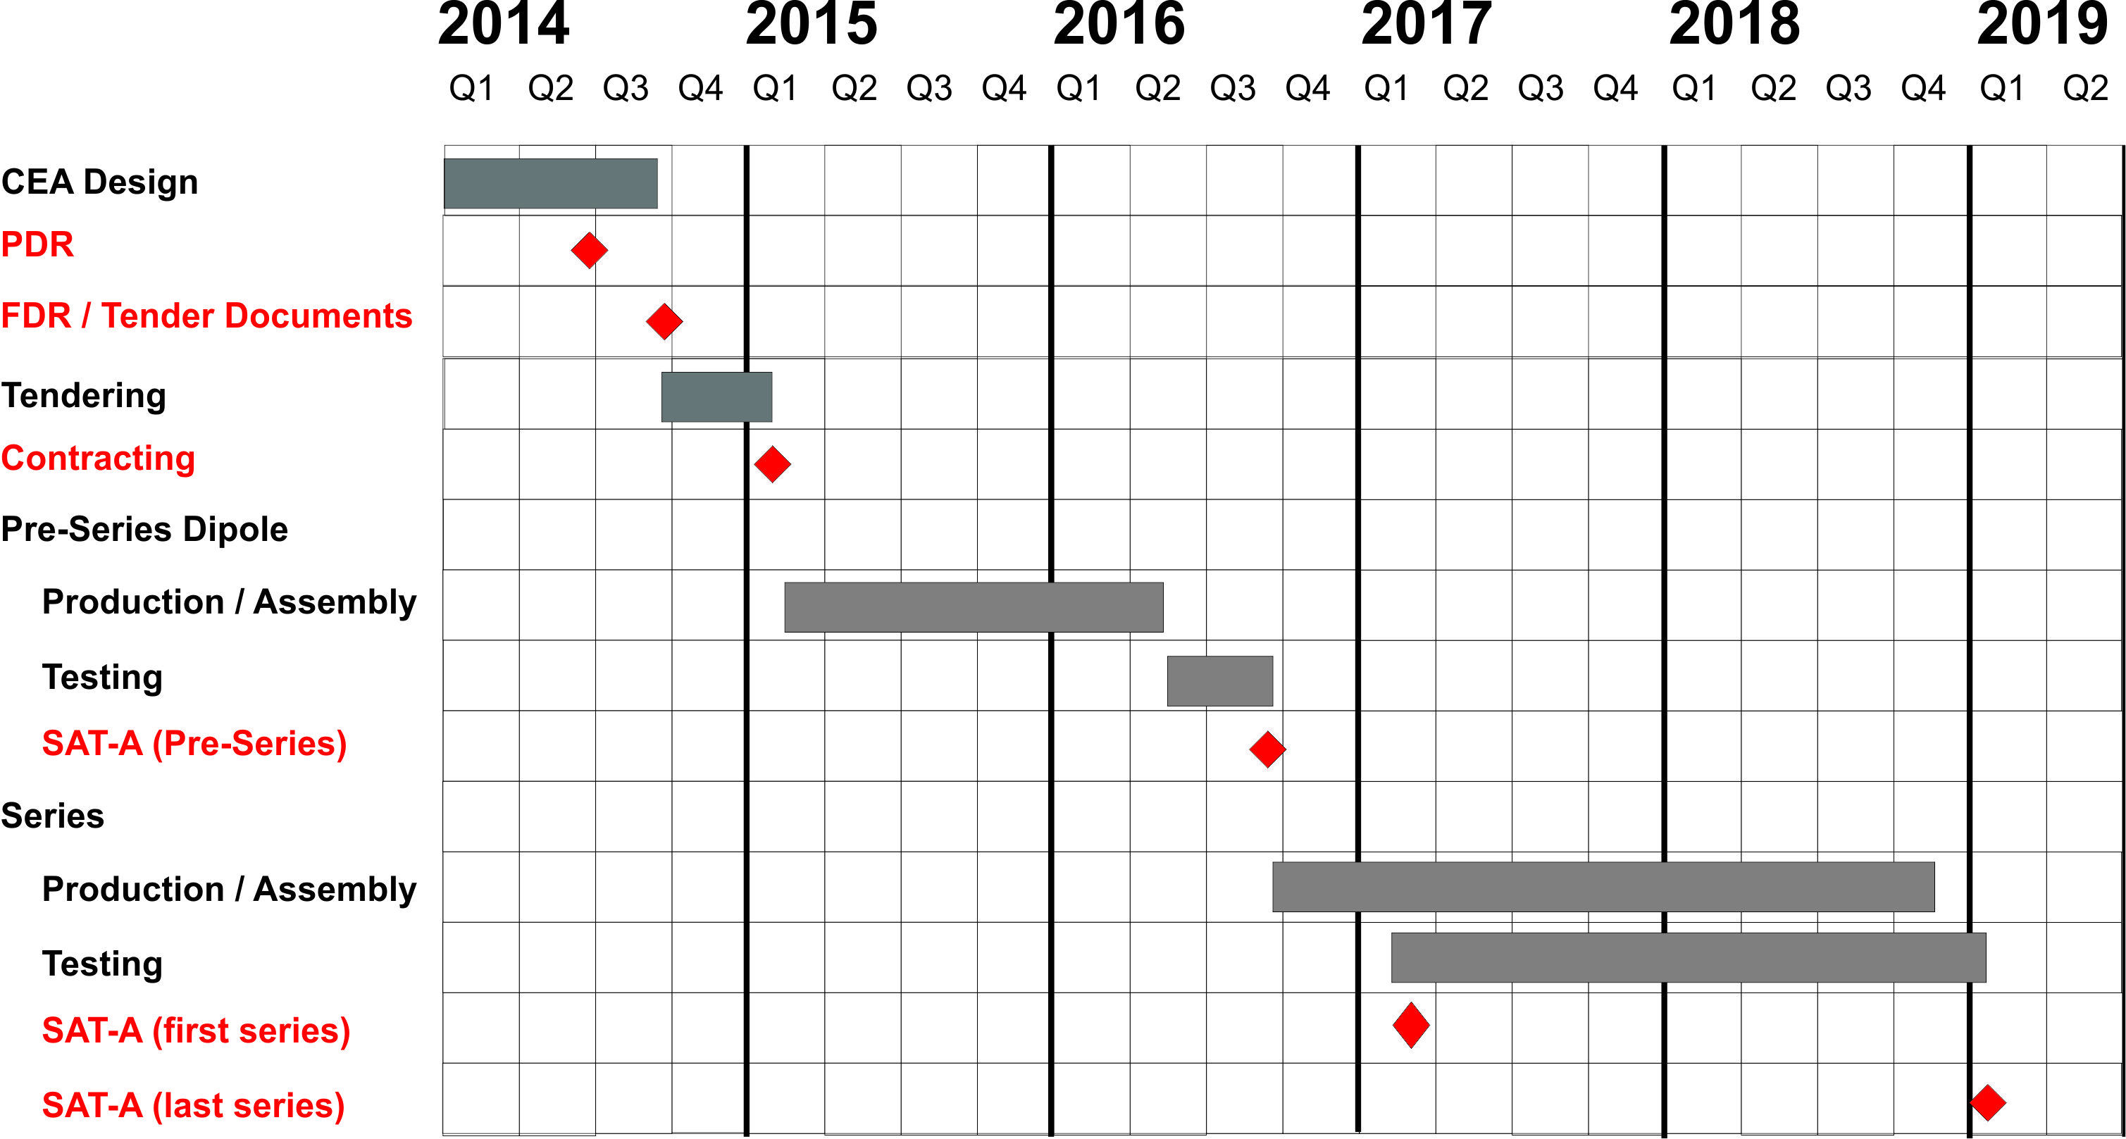
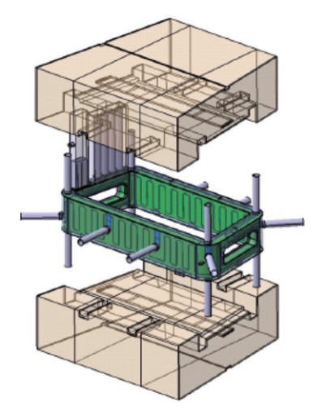
Collaboration with CEA/Saclay
Overall Status
Focus on the short dipole version
Project includes
Magnetic design
Cryogenic Design
Quench Analysis
Mechanical Design (including
cool down, magnetic forces)
Protection & Quench Detection
Instrumentation
Interfaces with GSI/FAIR
(cryogenics, PC, DMU, ...)
Procurement Strategy under discussion
  3 lots (yoke, cold mass, integration)
  branching units as option
  pre-ordering of wire ?
  ‘pre-bidder conference’ after PDR
Time Schedule updated

Slide 5
Collaboration with CEA/Saclay
Status Magnetic Design
Magnetic design finalized
Good field region +/-190mm (horizontal), +/-70mm (vertical)
field homogineity: about 2x10⁻⁴
Updated design with faced end chamfers shapes being calculated
Prototype magnet end chamfer

Slide 6
Collaboration with CEA/Saclay
Status Mechanical Design
First CAD model provided by IMP
Modification of mechanical design under way
  By taking into account the lessons learned from the prototype (motion of the cryostat during the test)
  By ensuring the lack of physical interference between two successive magnets
Old
Design
New
Design

Slide 7
Collaboration with CEA/Saclay
Preliminary CAD Model

Slide 8
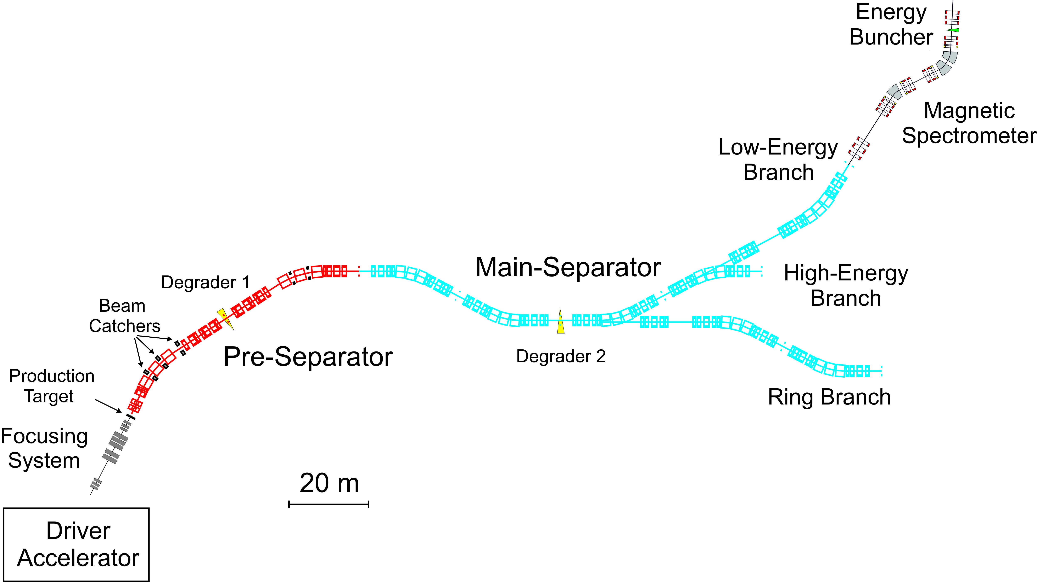
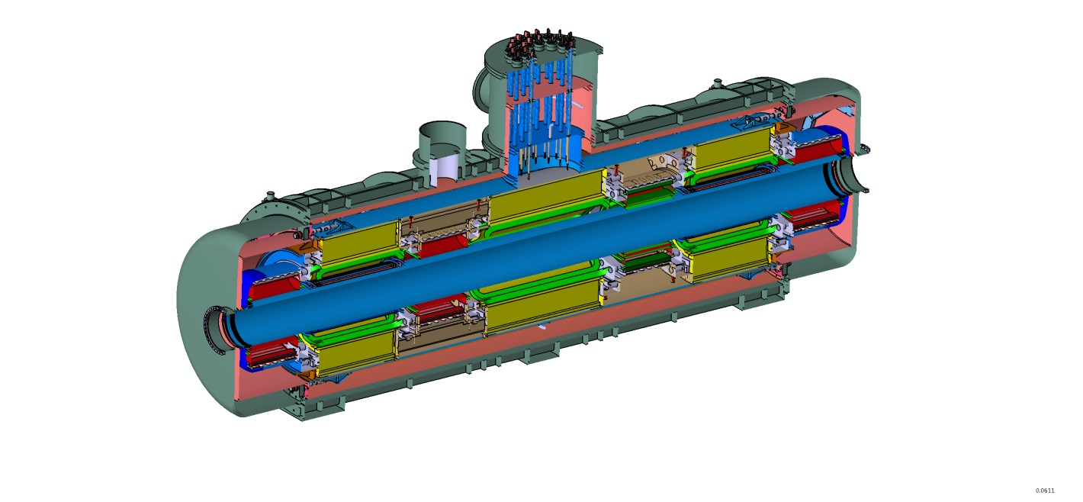
SC Multiplets
Tender Status:
Tender opened Q3/2013
Bidder submitted quotes Q4/2013
1st round negotiation finished Q1/2014
2nd round negotiation finished Q2/2014
3rd round negotiation and signing of contract expected for June 2014
FAT of first short multiplet Q1 - Q2/2016
FAT of first long multiplet Q2 - Q3/2016
Series production: Q3/2016 – Q1/2020
25 long multiplets (MS)
8 short multiplets (PS)
Quadrupol triplet / QS configuration
up to 3 sextupoles and 1 steerer
Octupole coils in short quadrupoles
iron dominated, cold iron (≈40 tons)
common helium bath
warm beam pipe (38 cm inner diameter)
per magnet 1 pair of current leads
max. current <300A for all magnets
7 m

Slide 9
Multiplet tendering:
Comparison of Timelines
 | FAT short multiplet (month after project start) | FAT long multiplet (month after project start) | Release of SP (month after project start) | FAT 1st series (month after project start) | FAT last series (month after project start)
Project Plan | 19 | 23 | 27 | 31 | 62
Bidder 1 | 20 | 22 | 26 | 33 | 68,5
Bidder 2 | 22 | 25 | 27 | 36 | 73
Bidder 3 | 24 | 27 | 28 | 34 | 56
Overall time for production of 33 multiplets ≈5.5 to 6 years
Start in Q3/2014,
  1st multiplet at CERN: Q1–Q2 /2016
  WP runs at least until Q4/2019
Series Production Rate approximately 1 unit/month;
  PR of Bidder 3 too fast (<2 years, would require 4 test benches at CERN)

Slide 10
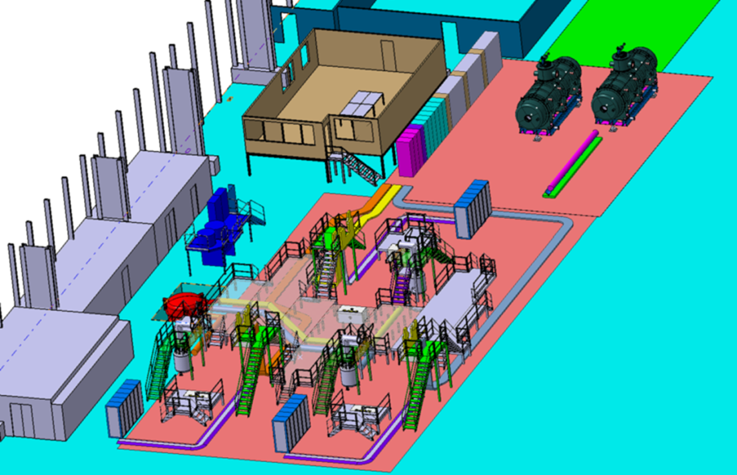
Magnet Testing & Mapping @ CERN
GSI-CERN Agreement K1727/DG & Addendum #2 (signed)
Scope (separator magnets):
  24 Dipoles (PS & MS),
  31 Multipletts (+ 2 spare)
Place: CERN building 180
3 universal test benches, basically:
  1 setting-up & cool-down
  1 measuring
  1 warm-up & disassemble
Ready for testing: Q4/2015
Time estimate (single multiplet): 44 days
  Installation, connection, cool-down: 15 days
  Cold test (powering, magnetic field): 15 days
  Warm-up, disassembly: 14 days
overall series measurement time: ≈ 3-3.5 years
Notes:
10
10

Slide 11
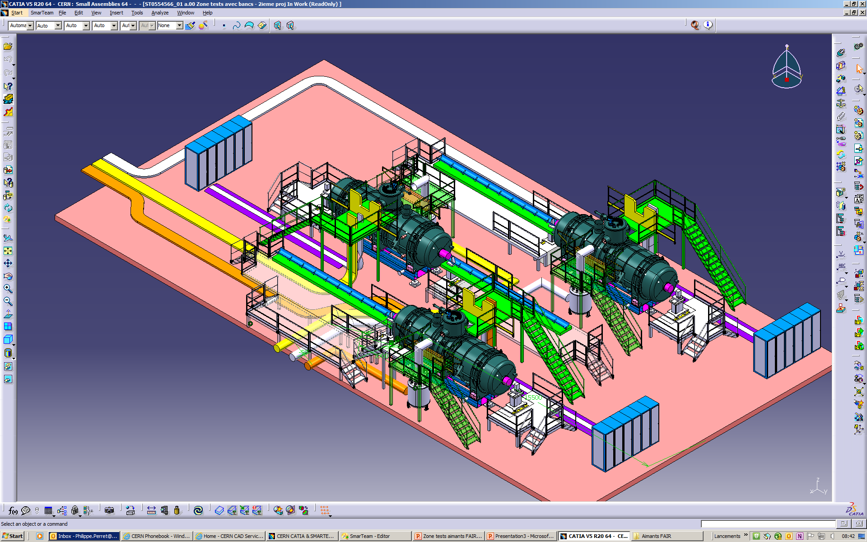
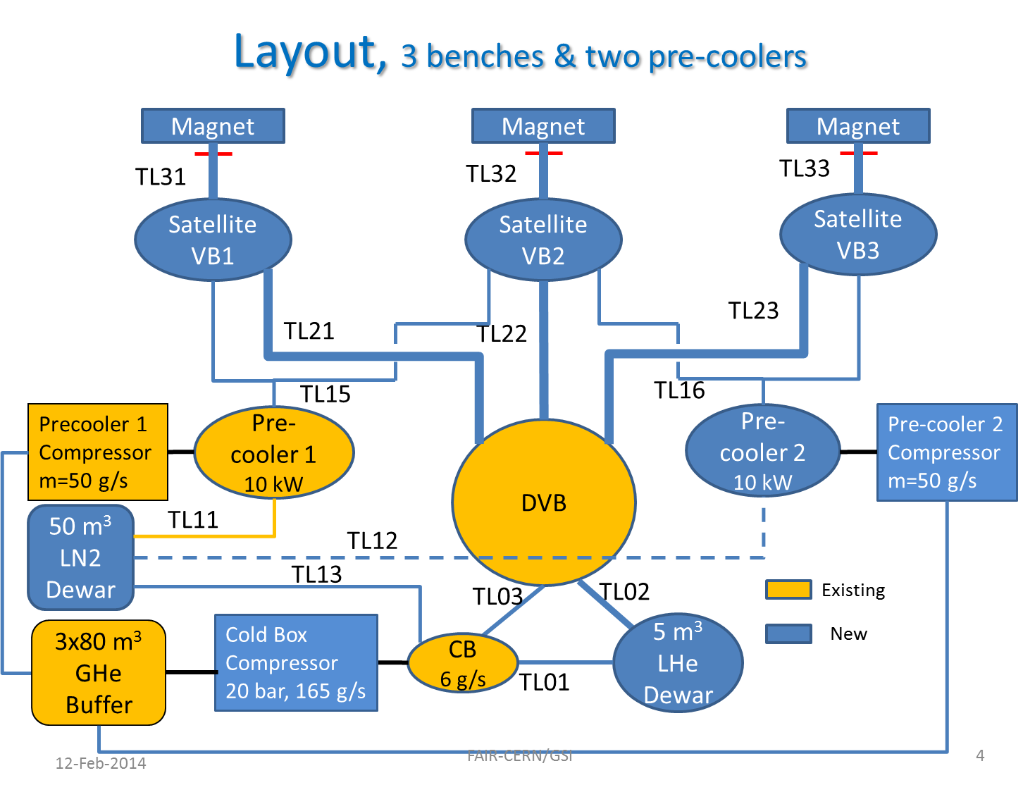
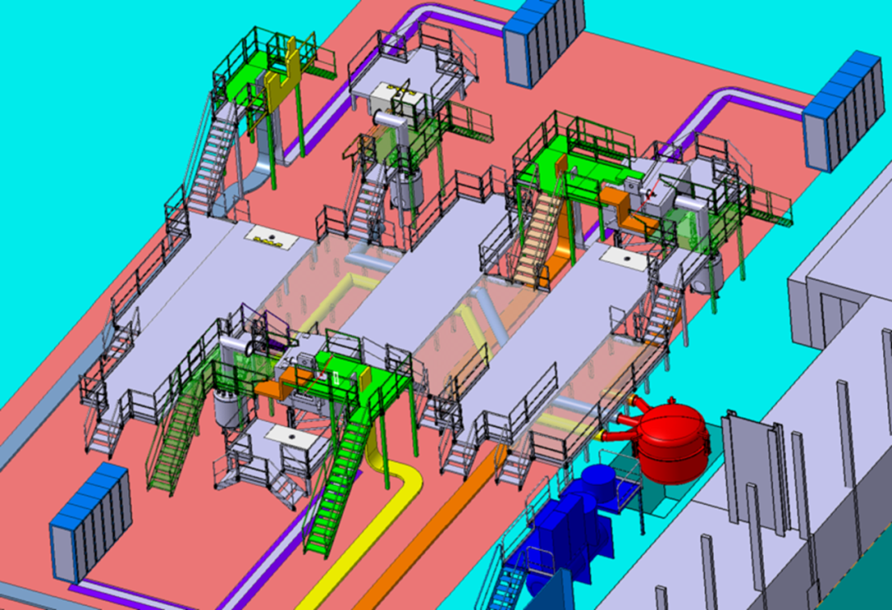
Magnet Testing Area @ CERN
Existing equipment
  magnet-measurement station, crane
  Cryo: Ghe Buffer, distribution box pre-cooler (10kW) + compressor
New required equipment (mainly cryo-parts):
  2nd pre-cooler (10kW) + compressor
  3 satellite valve-boxes & cryogenic lines
  LN2 & LHe tank
Notes:
11
11

Slide 12
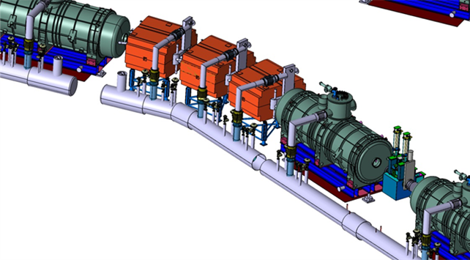
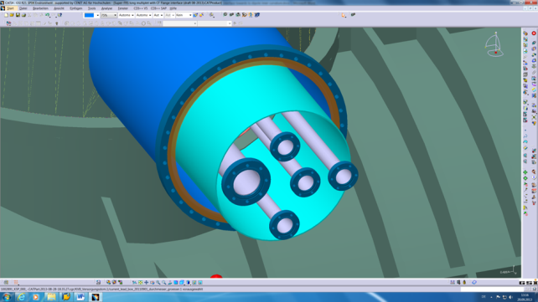
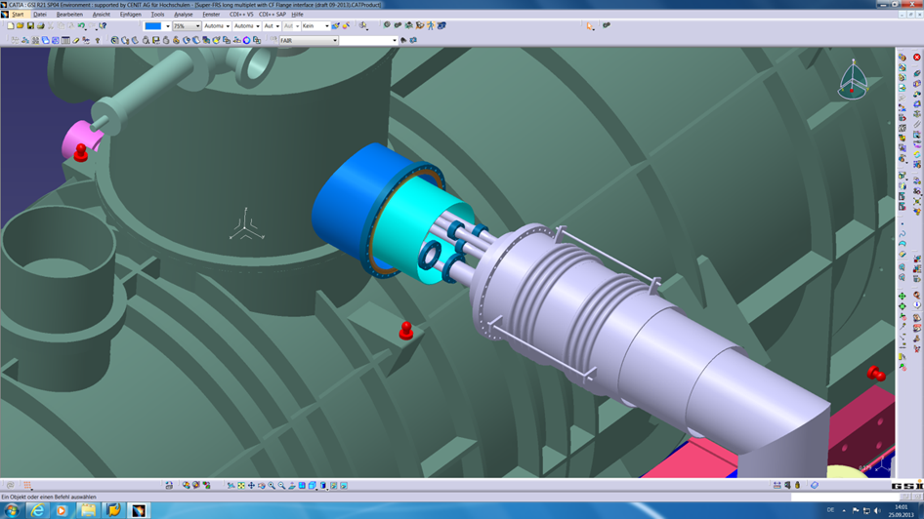
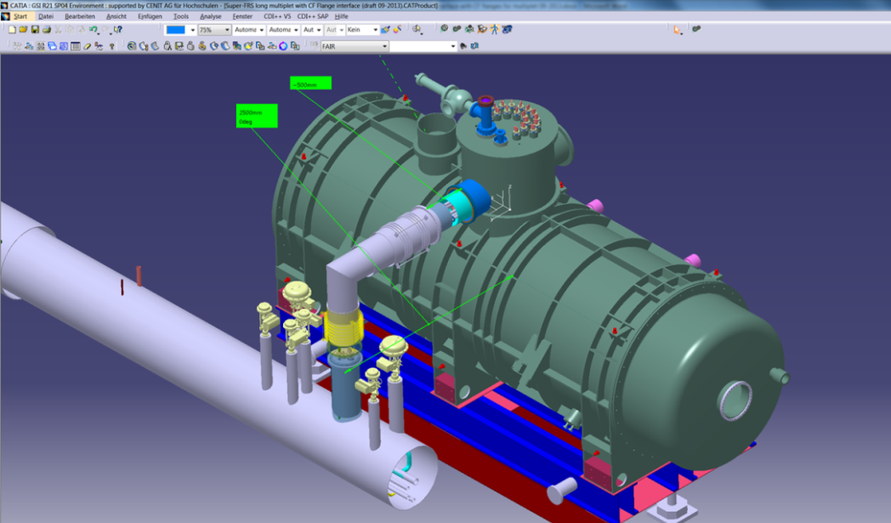
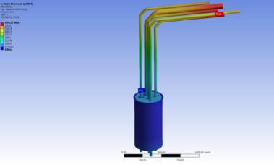
Super-FRS Local Cryogenics
Flow scheme / Cooldown processes
  FB controls: 3 dipoles / 2 multiplets
  Total cold mass (PS + MS): ≈1.100 ton
  Cryogenic operation modes
Revision of feedboxes
Updates of cryogenic interfaces
Emergency cases
  Normal quench → 70% of energy deposited in quench protection system
  Worst case scenario → full energy in He
  dimensioning of safety valves/burst disc

Slide 13
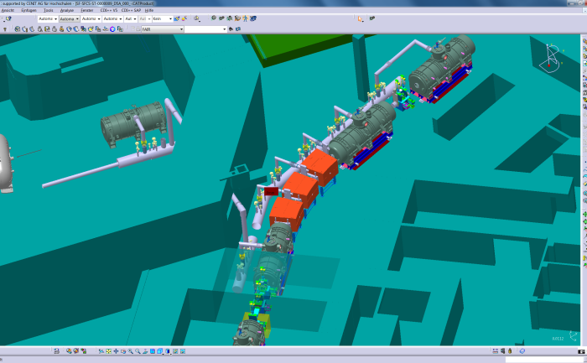
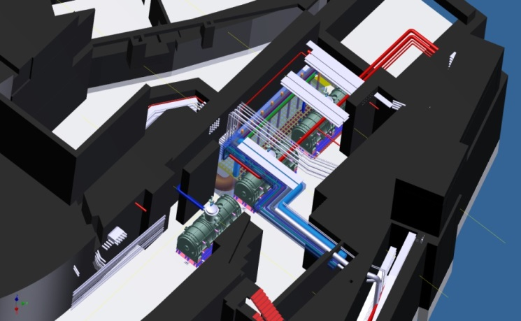
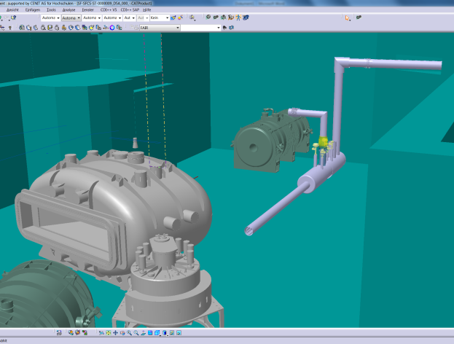
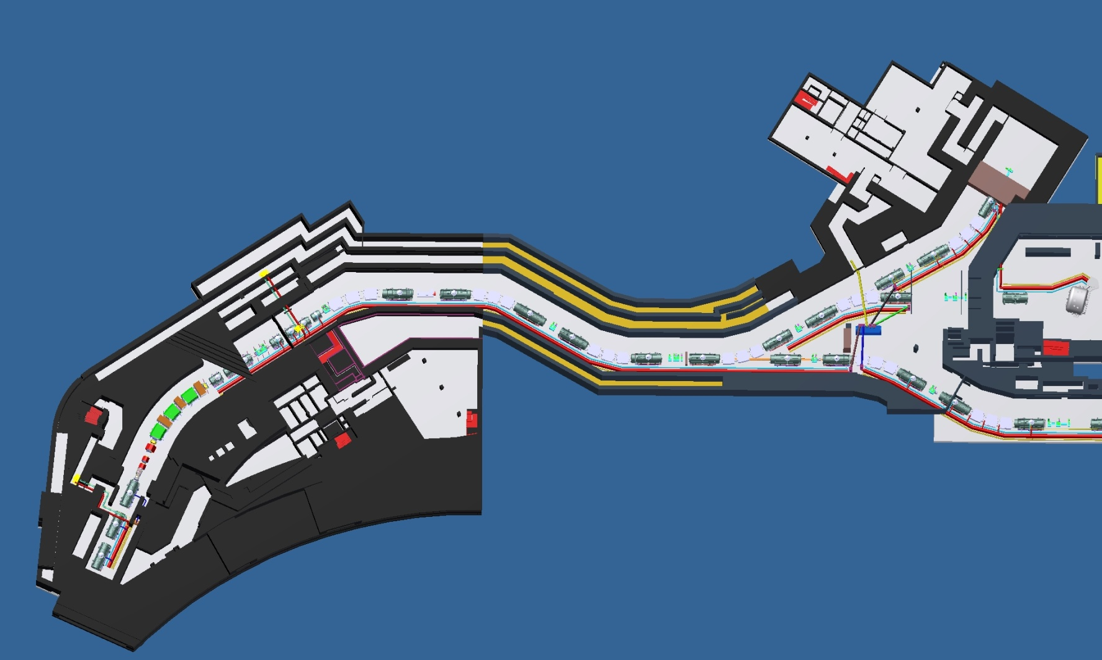
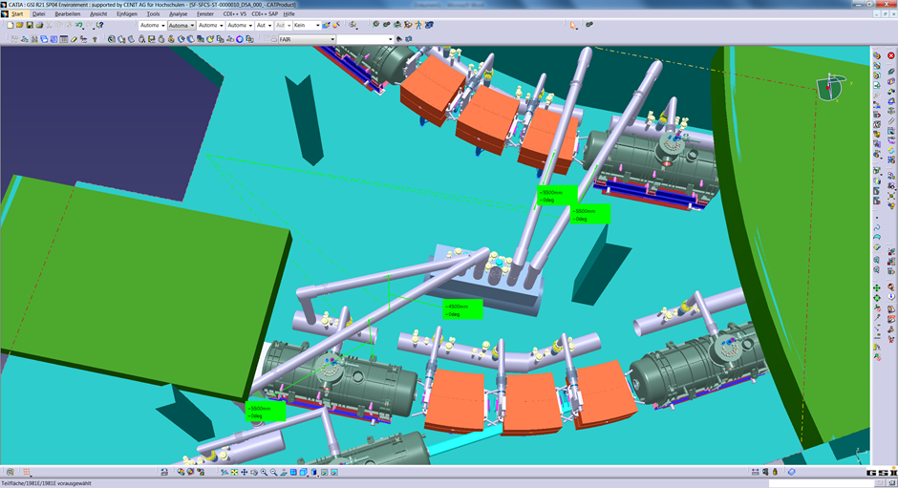
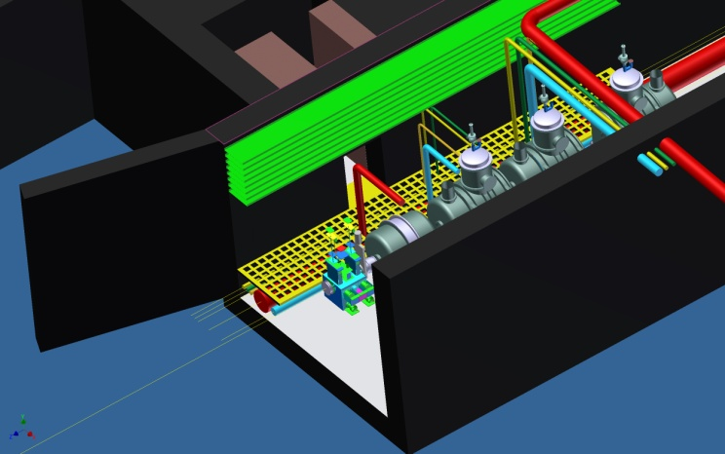
Super-FRS Local Cryogenics Routing
Focusing system
LEB
R3B
FPF2
FHF1
100 m

Slide 14
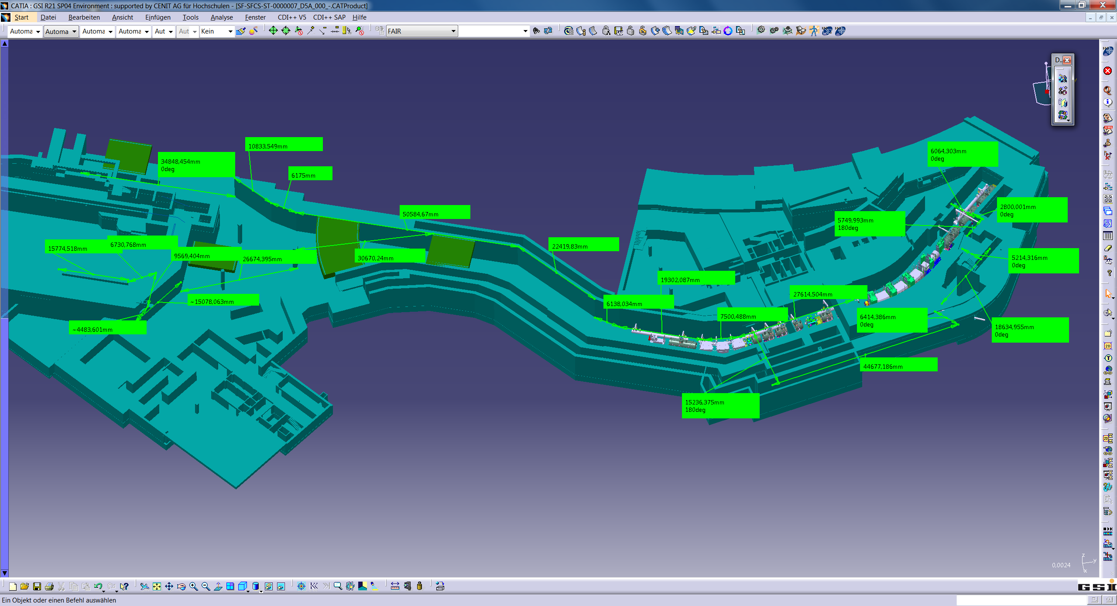
Warm gas lines for local cryogenics in the main tunnel of Super-FRS
After the Super-FRS target and throughout the Super-FRS tunnel:
Main Current Leads Gas Return line (ND)
DN 80
Main 300 K high pressure Gas Supply line (HD)
DN 80
Branching Current Leads Gas Return line (ND)
DN 80
Branching 300 K high pressure Gas Supply line (HD)
DN 80
Vacuum jacketed warm multipurpose line (ND - HD)
DN 200

Slide 15
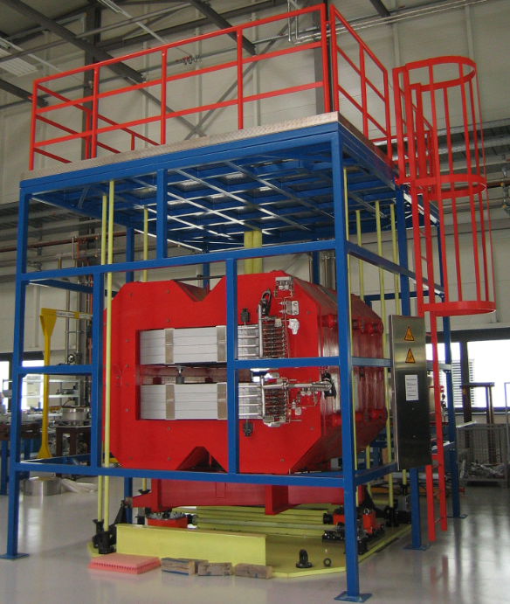
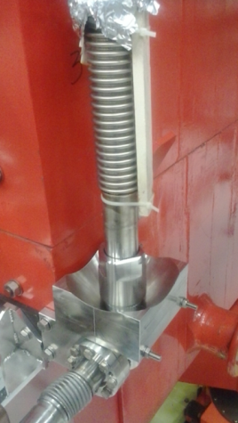
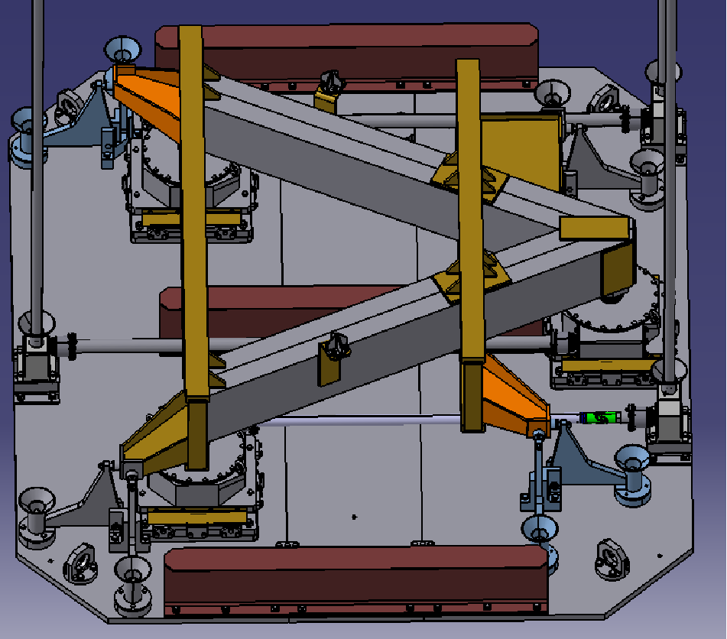
Radiation Resistant Magnets
(at the Target Area of Super-FRS)
Prototype dipole
at GSI testing-hall
Normal conducting magnets using MIC cable
3 dipole units, 3 quadrupoles, 2 sextupoles
Prototype dipole built (95 ton) and tested by BINP
Handling tests at GSI under way
Remote alignment under revision
Remote connectors (current, water, and interlocks) under revision
Specification in preparation,
Tendering via FAIR
new water
connector

Slide 16
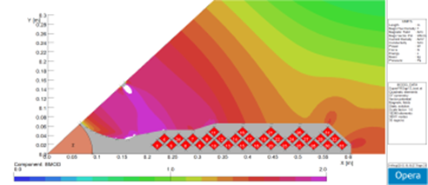
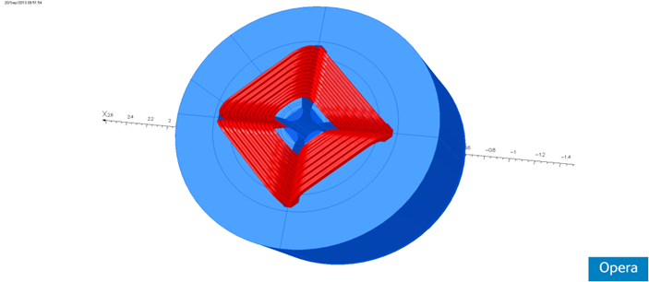
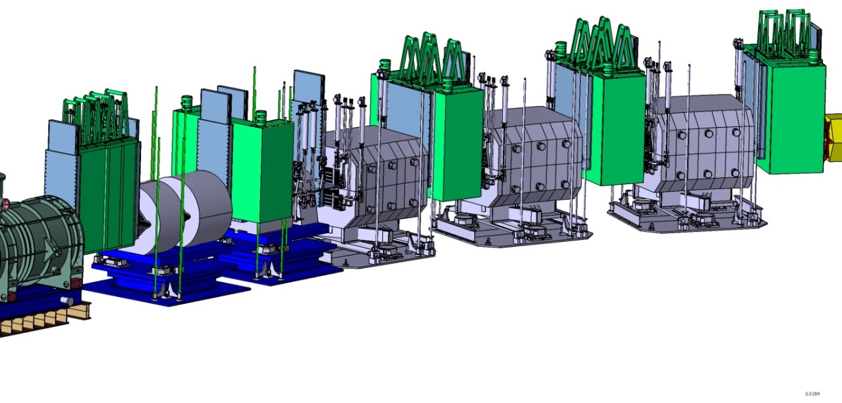
Radiation Resistant Magnets
(at the Target Area of Super-FRS)
New design of first two NC quadrupoles
  required field gradients were too high
  no technical/mechanical solution found due to too large bending radius of MIC
  individual designs for the each NC quad
Specification in preparation,
GSI resigned EoI on quads at last IKRB
Tendering via FAIR (together with dipoles)
BC2
BC3
BC1
Target
Chamber
 | Quad 1a | Quad 1b
L_{eff} | 0,9 m | 1,2 m
(Br)_{max} | 15,9 T/m | 12,2 T/m
R_{Pol} | 70 mm | 95 mm
I_{Max} | 980 A | 1.400 A
Beam

Slide 17
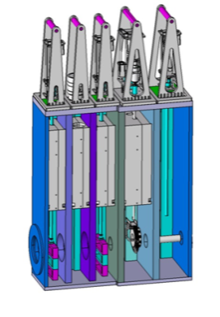
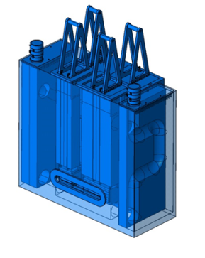
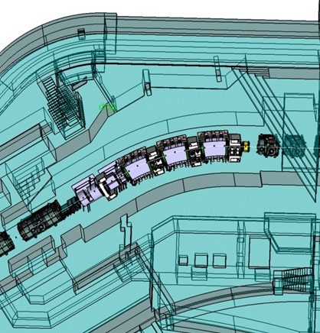
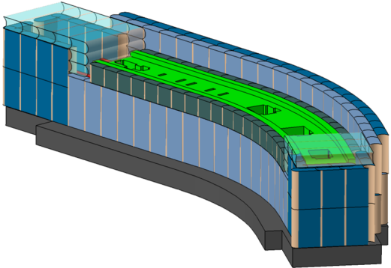
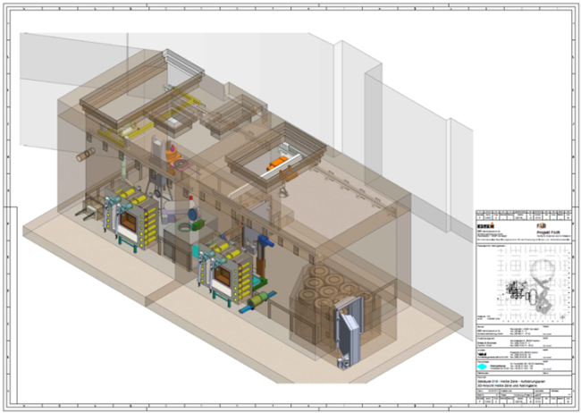
Target Area Installation
Overview
Major Installation
Target chamber & plug inserts
  German in-kind
  collaboration contract with KVI-CART in preparation
Target wheel & plug inserts
  German in-kind
  collaboration contract with KVI-CART in preparation
Beam catcher
  Indian in-kind
  chamber and plug inserts for
  slow and fast extracted beams
Major Infrastructure
Hot Cell Complex
      German in-kind
      So far planning by nuclear engineering company
Shielding flask
  Finnish in-kind
  requires special authority approval.
Iron shielding (approximately 6.000 ton)

Slide 18
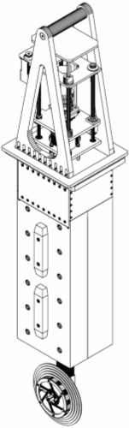
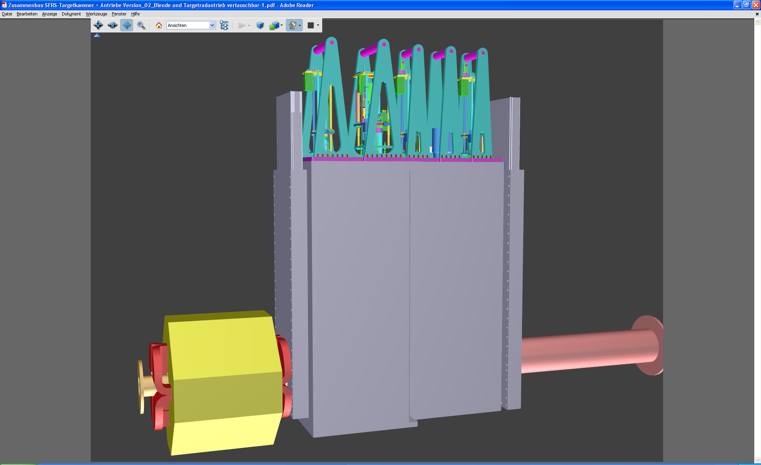
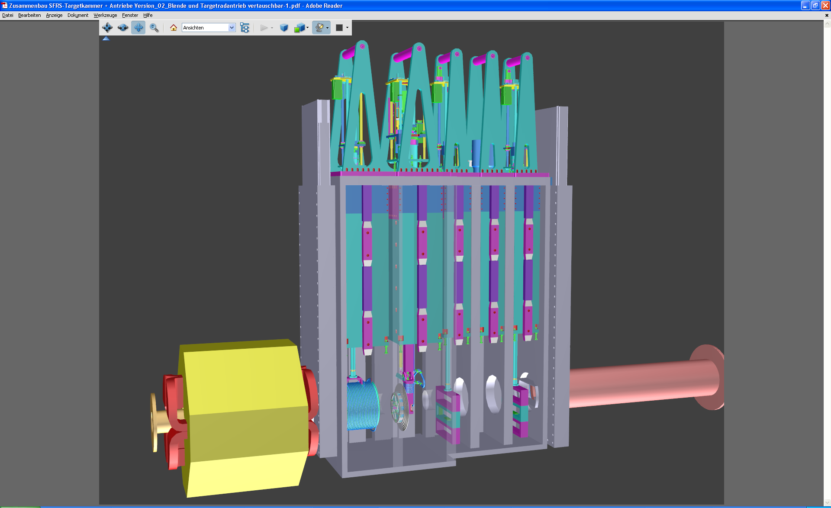
Target Chamber
(needs revised layout)
connections
(hands on)
motor
vacuum seals
pillow
seals
pillow seals
target
plug
devices in beam

Slide 19
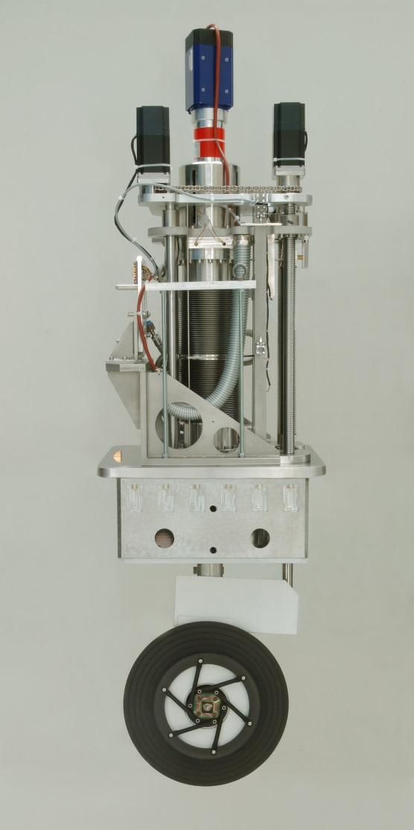
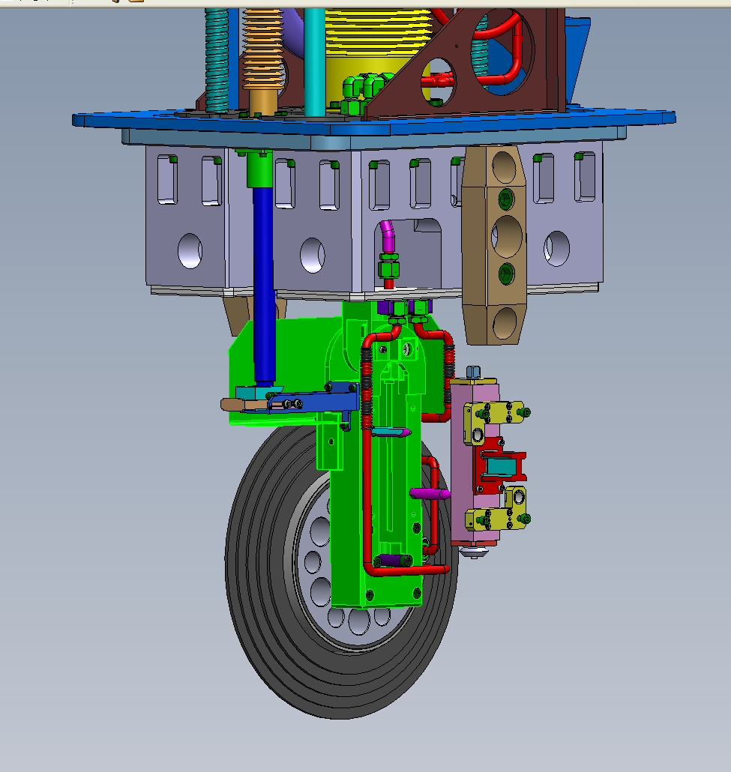
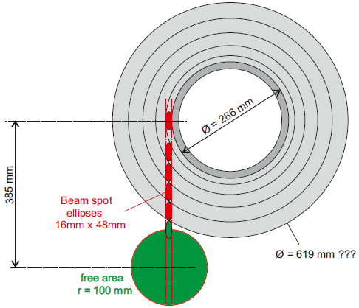
Target Wheel
Revision ongoing
  larger wheel size
  omit transverse motion (moving mechanism)
  design for remote handling
WP will be done in collaboration with KVI-CART
increase beam spot size
usually (σ): 1x2 mm²
to (σ): 4x6 mm²
to have target survive
P_{max tensile} ~ 26 MPa
d = 450mm (prototyp)
biggest issue, bearings in vacuum
Notes:
19

Slide 20
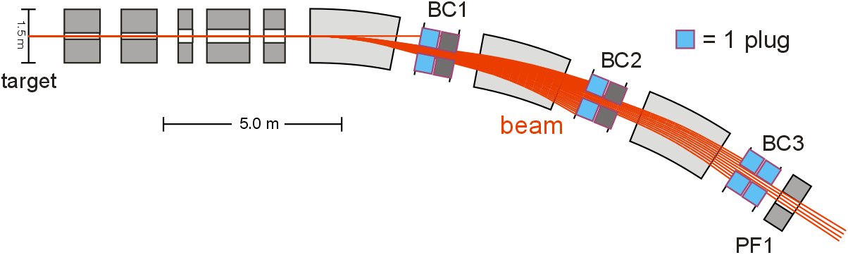
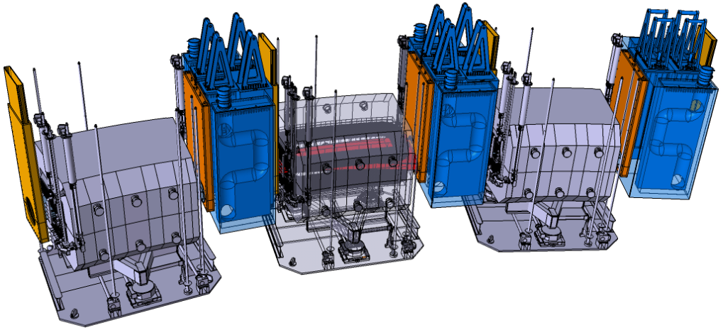
Beam Catchers
Indian in-kind
Institute CMERI Durgapur designated to do the mechanical design work
Chamber design adjusted (additional pumping channels)
Draft specification available
Mechanical design and draft spec need to be updated to represent the status of actual planning
GSI@FAIR installed a direct GSI contact person
Beam power in one short pulse of 100 ns can destroy vacuum chamber. It must not
hit chamber only dedicated beam catchers.

Slide 21
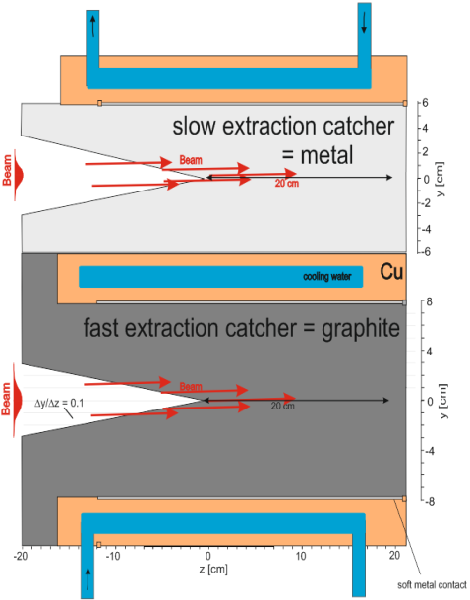
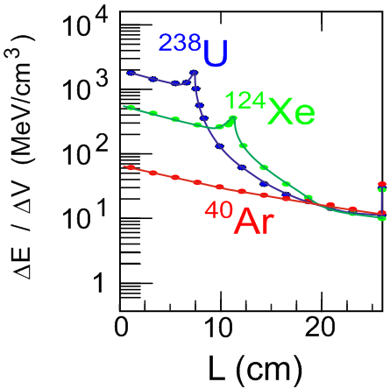
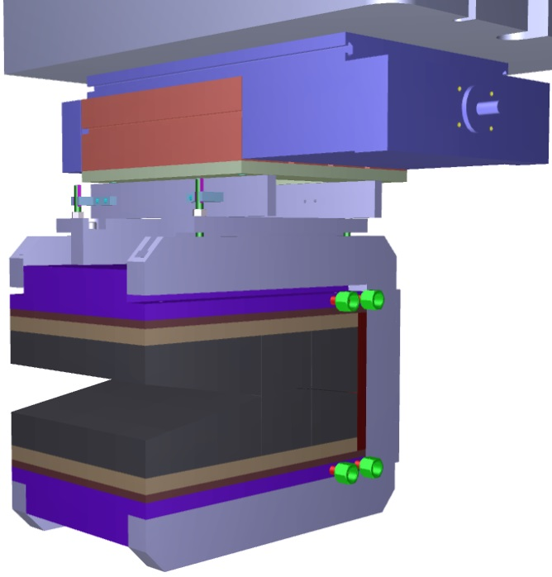
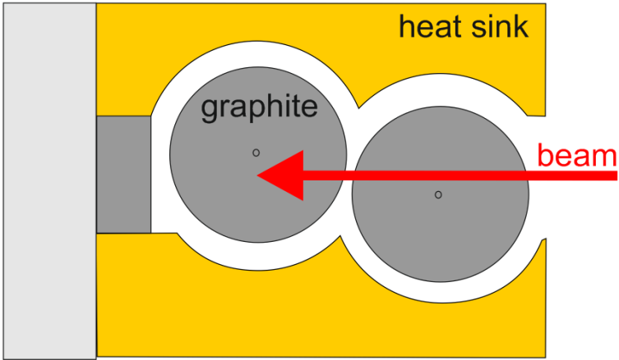
Energy Deposition
linear drive
Be/Al
copper
graphite
graphite
460 mm
Thermal simulation shows cooling problem with radiation damaged graphite,
10¹⁴/cm² is reached after ~1/2 day.
Separate catcher for fast extraction,
(NUSTAR storage ring experiments)

Slide 22
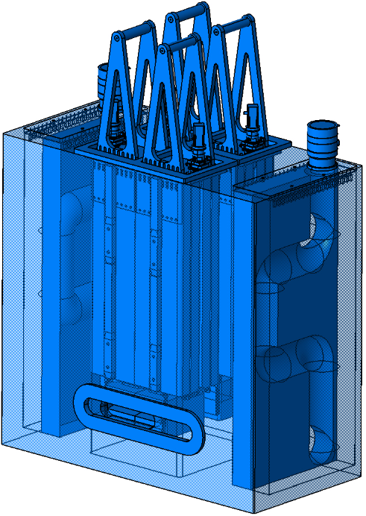
Indian In-kind
Institute CMERI Durgapur designated to do the mechanical design work
instead of VECC Kolkata.
However, CMERI wants large extra sum (from India) for:
R&D, man-power and infrastructure, 500 INR Lakh (625 k€), + more ?
for construction 700 INR Lakh (875 k€), latter close to costbook (779 k€ in 2005)
Reduction of R&D and testing in India would require more effort at GSI.
- choice and behavior of material in beam (GSI)
- design of alignment system (can be GSI)
- types of drives and moving parts (can be partly GSI)
- vacuum layout + testing (should be India)
Or find other partner in India -> time delay.
Testing is foreseen this year, contract Feb 2015.
GSI mechanical designs need up-date,
to represent state of actual planning.

Slide 23

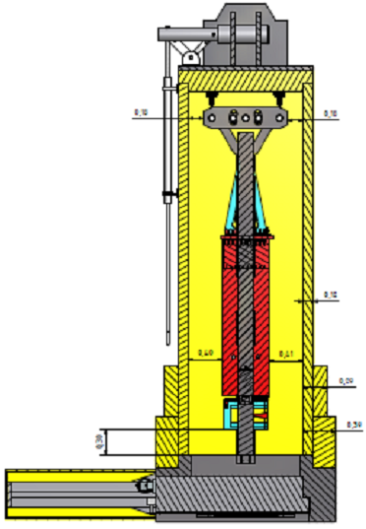
Shielding Flask
hall crane interface
In-kind Finland
  Hollming Works Ltd., ENMAC,
  Aalto University (academic partner)
Goal: agreement on allowed reduced dose rates
  0.5 μSv/h -> 3 μSv/h
  Weight 60 ton -> 50 ton.
Some uncertainty on size without more detailed beam catcher and target design
Draft specs available (October 2013)
GSI/FAIR will have responsibility on operation permissions, preplanning to go into approval process, then order production.
Internal crane
0.1 m
Internal guide rails
5.35 m
beam catcher plug
dust collection
tray and brushes
0.4
shielding
lid

Slide 24
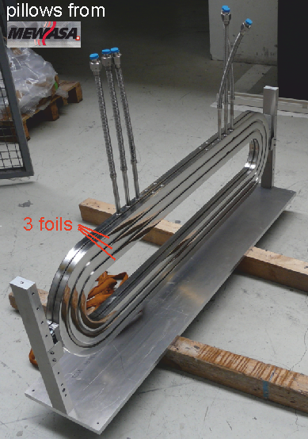
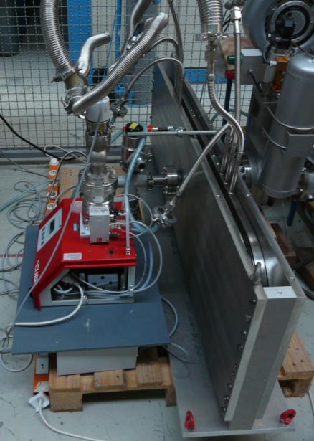
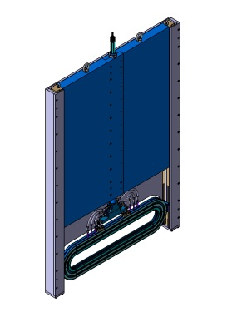


Large Size Pillow Seals
Pillow seals to be used in the Target Area
standard will be round Pillow Seal with Ø500mm
special large size rectangular (1200x160 mm²) seals between dipole and beam catcher
Developed together with MEWASA
Test setup at GSI
Requirements fulfilled
Long time stability tests running (temperature, ...)
Next steps: full plug design
new polishing, seal #4 ~ 1x10⁻⁶ mbar l/s
seal #3 ~ 1x10⁻⁶ mbar l/s

Slide 25




SuperFRS Hot Cell
Based on a study by nuclear
engineering company
Preliminary planning completed
Execution planning running
Mock-up installed on ESR roof
Window frames in preparation
(to be installed during shell construction)
Hot-Cell mockup installed on ESR roof
(Getinge, France)
Window frame at company
(Getinge, Sovis, France)
Quantity: 2
Size: 2.8m x 2.5 m
Weight: 4 ton (each)

Slide 26


Super-FRS Beam Instrumentation
y-slit system:
block size: 400mm x 90 mm
material: Tungsten alloy
Slit-systems
  Specification established
  Overall 18 slit pairs along the separator
  Remote handling in the Pre-Separator
  Collaboration signed with KVI-CART
  Project group at KVI established
  Kick-off done / regular meetings with KVI
    Pre-designs in preparation
    Pre-Series slit-system expected for Q2/2015
Media pannel,
robot controlled
x-slit system:
block size: 200mm x 200 mm
material: Tungsten alloy
total weight: ca. 750 kg

Slide 27




Beam Diagnostics
  GEM-TPC (Finnish in-kind)
    Collaboration Partner: HIP, Helsinki
    Various prototypes ready and on-line tested
    Large-active-area size prototype in preparation
    High-energy beam test at GSI, August 2014
    Final specification (Q1/15) → series production
    Ongoing design of multi-channel dead-free FEE
Optical Measurement at HIP
(precision table)
GEM Foil
Field
Cage
Larger active area 380x80 mm²
Twin-TPC design
Usage in Vacuum chamber and air
Including as supply system
FEE
GEMEX

Slide 28



Layout off the Super-FRS
(including revised S-shape EB)
±
revised Energy Buncher & LEB cave

Slide 29

Energy Buncher: S-shape layout
(using standard multiplet magnets)
Flexible operation
  large acceptance spectrometer
  high-resolution / energy buncher mode
  dispersion matching (Main-Separator and EB)
Intermediate focus at focal plane FLF4
  keep overall dispersion in limits
  in particular reduce gap size of magnets (use standard multipole magnets)
  reduce requirements on monoenergetic degrader at FLF5
  reduce technical risks
Enlarged experimental areas
  better matching of detectors / spectrometer performance

Slide 30

Magnets for Energy Buncher
Magnets are Indian in-kind, revised parameters discussed with VECC
Maximum beam rigidity: 7 Tm
3 dipole units with 30°deflection angle
    superferric, warm iron, SC coils
    usable aperture: (x = ±250mm, y = ±70mm)
    expected weight <80 ton,
    cost reduction, easier to handle and to measure
    VECC is working on the new design
  Multiplet (quadrupole design same as in the separator)
    superferric, cold iron
    usable aperture: Ø380 mm,
    leff: 800 mm, max. gradient: 10 T/m
    configurations: 1 x QS, 3 x QQS, 1 x QQQ
    y-steerer still in discussion
    specifications ready
    saving development time & costs, reducing technical risks
  Magnet testing must be discussed, in principle possible at CERN
Original VECC dipole design

Slide 31

Cave for LEB/Energy Buncher
Architects feasibility study prepared by ION42 (FAIR architects)
Cost estimate: 8.300k€ (2014)
  breakdown according German CC cost type (KG xxx) provided
Low-energy cave:
  area ≈800 m²
  height: 7.6m
  5 ton crane
MATS/LASPEC (annex):
  area ≈430 m²
  height: 10m (2 floors)
  5 ton crane
Annex space (technique):
  area 2 x 68 m²
  height: 3m / 4.5m (2 floors)
Most important now: clarify funding
Discussion with funding agenecies/RRB has been initiated
Additional required pillars can not be provided in an early phase (mid 2014)
Discussion with FLAIR/SPARC concerning possible impact of FLAIR SPARC building

Slide 32

Super-FRS Buildings (MSV)
Build. 006a, Service building
3 floors (~2000 m²)
Technique (PS, controls, ... )
Experimental preparation
Control room, electronics
Gas supply, gas mixing station
Main tunnel access
Basic evaluation completed
Preliminary planning completed
Approval planning completed
Execution planning under approval
but on-hold now since approximately 12 month
Running: route planning (cable, pipes, cryo)
Formwork planning & Tendering
Establishing cable data bank → tender of cables
FLF2
Experimental Area
Build. 018, Target building
5 floors
Target area, shielding
Technique (PS, controls, ... )
Hot Cell complex
Tunnel 103
(Separator tunnel, supply tunnel)
To CR
FHF1
(End Focus HEB)
Build. 006
(High-Energy cave)
On top: Build. 17.2
(FAIR service building)
100 m

Slide 33



Iron Shielding
Mass (blue 4574 t,
green 682 t, red 499 t,
all ~ 5756 t
Base plate concrete
planned as PSP 2.4.11.3.12
but not in cost book ~ 10 M€
Core
mass: 498.8 t
volume: 71.26 m²

Slide 34



(Detector) Gas Supply
Gas Mixing Station in Build. 6a
Super-FRS Gas Supply
Standard Beam Diagnostic
defined for each focal plane
Detector gases defined for each focal plane (separator)
Gas storage & mixing station
Security requirements to be clarified
LN2 storage available (piping
not provided)

Slide 35
Summary
SC dipoles: collaboration agreement signed with CEA/Saclay, design finalization and tendering documents in preparation; tender via FAIR, expected to start in Q4/2014
SC multiplets: tendering close to final; contract signing expected for June
Magnet test facility at CERN under preparation; timeline and testing scenario based on 3 test benches
NC magnets: remote alignment under revision, specification in preparation
Revision of target area components and preparation of specifications ongoing (will be partly procured in collaboration with KVI-CART)
Development of various beam instrumentation items in progress (various in-kind/collaboration partners, timeline critical elements under pre-production
Civil Construction
  execution planning under approval (basically on-hold since 12 month)
  route planning so far only for some NUSTAR buildings done
Revised layout for Energy Buncher (S-shape) proposed, using standard multiplets, dipole magnets under redesign by VECC, India

