Slide 1
CR: status and activities at BINP
I.Koop, BINP, Novosibirsk
O.Dolinskyy, GSI,Darmstadt
27.05.2014, MAC, GSI, Darmstadt

Slide 2
Outline
Outline
Introduction
CR tasks
Review of CR optics
List of parameters
Dipole design
Bakeable vacuum chamber in dipoles
Quads, Sextupoles
Injection septum design
Kickers
Conclusion

Slide 3

Introduction: activity on the CR project
  The TDR CR has been updated and approved in February 2014.
  IKRB meeting (01.04.20014) assigns a major part of the CR (63 %) and antiproton separator components to the BINP.
  Contract on transfer of the CR and TCR1 line system responsibility to BINP is prepared. After Council decision it will be signed.
  The collaboration work of GSI and BINP experts is going on.
  Four GSI-BINP Workshops were held at GSI. The next Workshop will be held at the end June of this year.

Slide 4
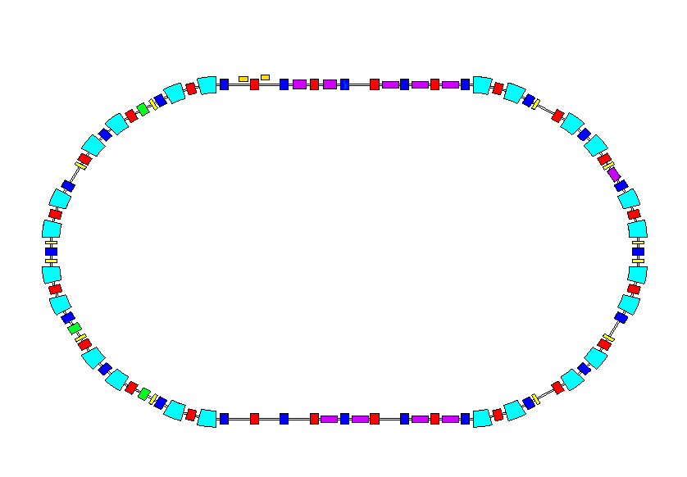
Tasks of the CR
CR
From antiproton separator
Cooling of antiproton beams
ε ⊥ = 240 mm mrad
Δp/p = +-3 %
CR
ε ⊥ ≤ 5 mm mrad
Δp/p ≤ 0.1 %
 10 sec
to the HESR
Cooling of secondary beams of radioactive ions
From Super-FRS
ε ⊥ = 200 mm mrad
Δp/p = +-1.5 %
CR
ε ⊥ ≤ 0.5 mm mrad
Δp/p ≤ 0.05 %
 1.5 sec
to the RESR
Mass spectrometer of radioactive ions (TOF)
From Super-FRS
ε ⊥ = 100 mm mrad
Δp/p = +-0.5 %
CR
 few turns

Slide 5
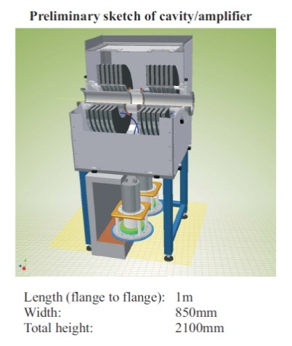
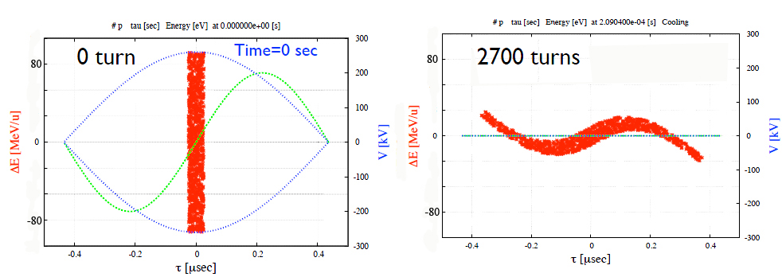
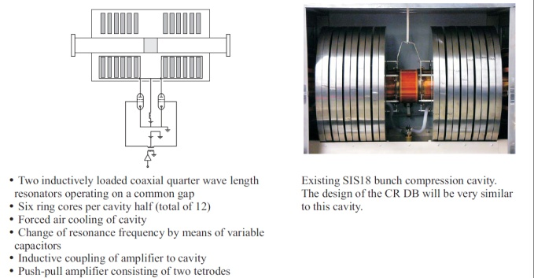
First step of cooling-
RF bunch rotation
Using bunch rotation RF cavity the momentum spread is reduced by factor of 3
P-bars (from 6% to less than 2%)
RIBs (from 3% to less then 1 %)
Time of such cooling is about 3 ms
Δp/p=6%
Δp/p=2%
Total voltage (5 cavities) | 200 kV
Peak voltage per cavity | 40 kV
Peak dissipation per valve | 393 kW
Peak dissipation per valve into ring cores | 648 kW
Peak power per valve | 1040 kW

Slide 6
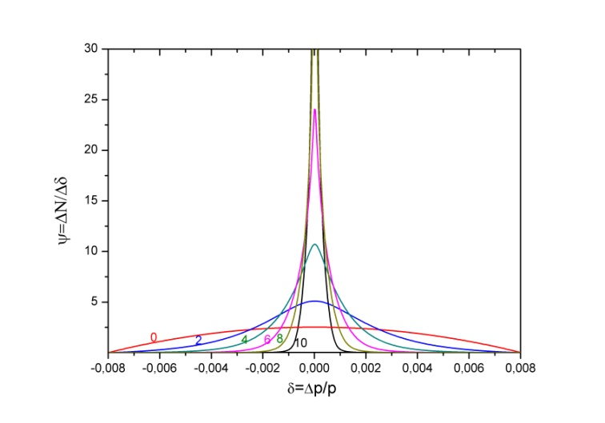
Second step of cooling-
Stochastic cooling
After bunch rotation Stochastic cooling is applied to reduce
both the beam emittance and momentum spread
Pbar : Momentum spread - from 2% to 0.1%
Emittance - from 240 to 5 mm mrad
Cooling time - 10 seconds
RIBs: RIB momentum spread from 1 % to 0.05 %
Emittance from 200 to 0.5 mm mrad (time 1.5 seconds)
Cooling time – 1.5 sec

Slide 7
Questions addressed to CR optics
How optimal are 3 different optics of the CR?
Is it possible to relax some technical requirements (apertures, weights, power consumption and so on)?
Is it possible to improve optics properties?
How optimal are the proposed in TDR technical solutions ?
And many others.

Slide 8
Main goals of the CR-optics optimization
Maximization of the transverse acceptance in all optics
Minimization of beam sizes in dipoles
Optimal betatron tunes, which will guarantee the large DA
Providing the space in the arcs to install separate vertical correctors (3rd type of a wide quadrupole with a length 70 cm )
Providing optimal values of global and local slip factors, hence, optimizing initial conditions for stochastic cooling
Optimal Injection-extraction scheme

Slide 9
Proposed antiproton optics changes
Qx=4.18, Qy=3.23 (CR71: Qx=4.31, Qy=4.88)
Back up option: Qx=4.41, Qy=3.44
Momentum compaction: α=0.04272 (CR71: 0.069)
Global slip factor: η=α - γ⁻²= -0.014 (CR71:
η=0.012)
Local slip factor: η_pk=0!
Phase advances: Qx_pk=1.76, Qy_pk=1.25
Q8 – Q10 quads permuted with nearby sextupoles to minimize beam sizes in dipoles

Slide 10
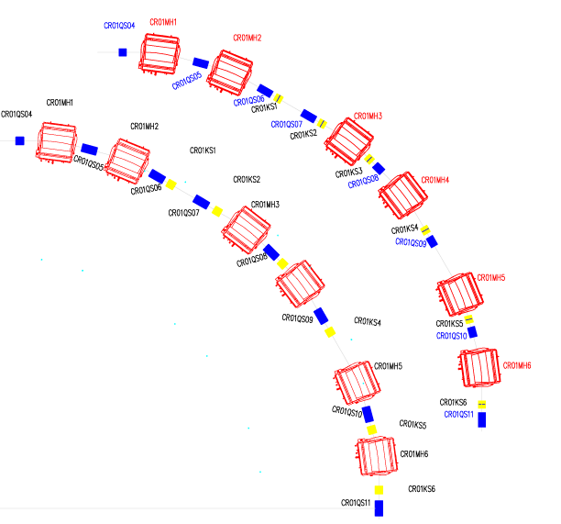
Proposed CR arc layout changes
KV – Vertical corrector
KV
QW 70 cm
TDR’s arc layout
with QW 100 cm
The proposed arc changes:
Some quads and sextupoles are shifted longitudinally to optimize the ring acceptance.
2. Provide a space for vertical correctors,
by making 3 quads/quadrant shorter
(70 cm instead of 100 cm )
KV

Slide 11
BINP version of pbar optics: Qx=4.18, Qy=3.23
βx
βy
D
Dmax= 4.4 m (CR71-version: Dmax = 5.05 m), γ=4.2, γ_tr=4.84

Slide 12
BINP version of RIB optics: Qx=3.18, Qy=3.23
D
βx
βy
D_{max} =9.25 m, α=0.1153, η= - 0.1968, γ=1.79 < γ_{tr}=2.945

Slide 13
Beam sizes in dipoles
BINP version of RIB optics: Qx=3.18, Qy=3.23
X_{max} =173 mm, Y_{max} =65 mm, α=0.1153, η= - 0.1968, γ=1.79

Slide 14
Beam sizes in dipoles
BINP pbar optics: Qx=4.18, Qy=3.23
X_{max} =153 mm, Y_{max} =67 mm, α=0.04272, η= - 0.01397, γ=4.2

Slide 15
BINP pbar optics: Qx=4.18, Qy=3.23
Beam sizes in quads Q6 – Q11
X_{max} =179 mm, Y_{max} =72 mm, R_{QW} =156 mm, R_{SX} =185 mm

Slide 16
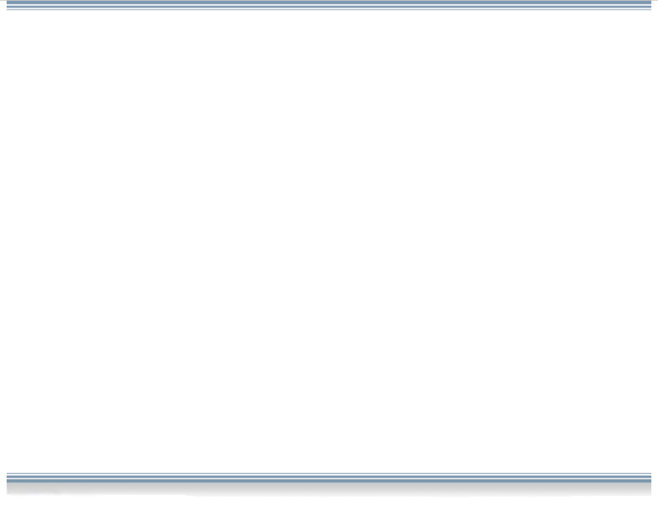
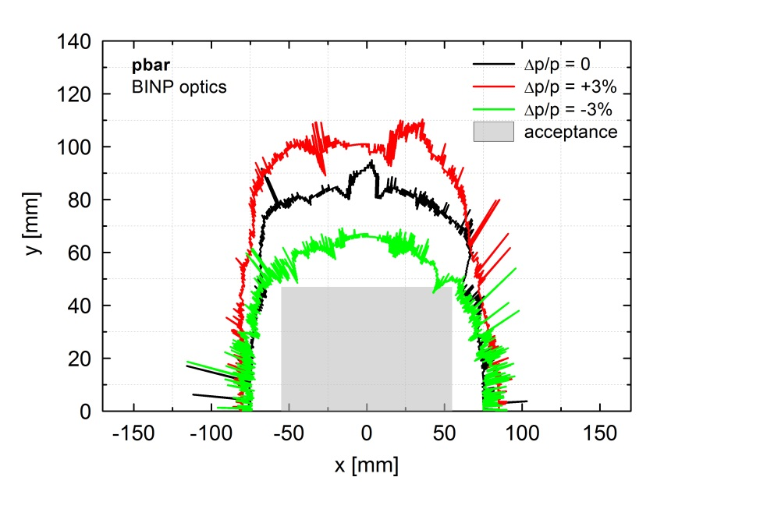
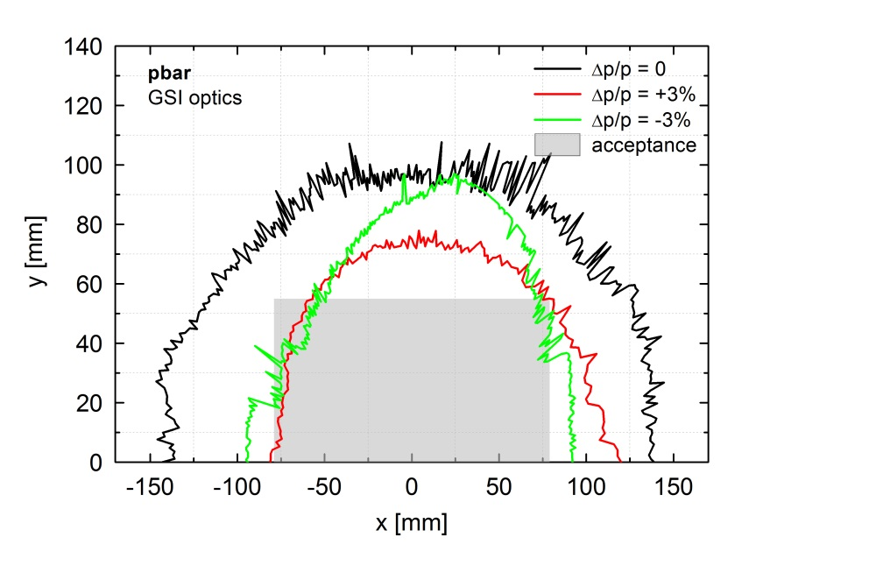
Dynamic aperture (1), sim. by O.Gorda
particle tracking by PTC-module of MAD-X
tracking over 1000 turns
fringe fields and field errors (see table below) are included
Relative integral field harmonics b_{n} of CR magnets, in units 10⁻⁴
 | b₁ | b₂ | b₃ | b₄ | b₅ | b₆ | b₇ | b₈ | b₉ | b₁₀
Dipole, at r = 190 mm | 0 | 0 | 6.3 | 0.03 | 1.7 | 0.009 | -0.002 | -0.001 | -0.001 | -0.007
Wide quadrupole, at r = 150 mm | 0 | 0 | 0 | 0.0004 | 0.01 | -3.0 | 0.01 | 0.0002 | 0.01 | 10.0
Narrow quadrupole, at r = 90 mm | 0 | 0 | 0 | 0 | 0 | 6.2 | 0 | 0 | 0 | 3.81
Sextupole, at r = 200 mm | 0 | 0 | 0 | 0 | 0 | 0 | 0 | 0 | -0.69 | 0
pbar-mode

Slide 17
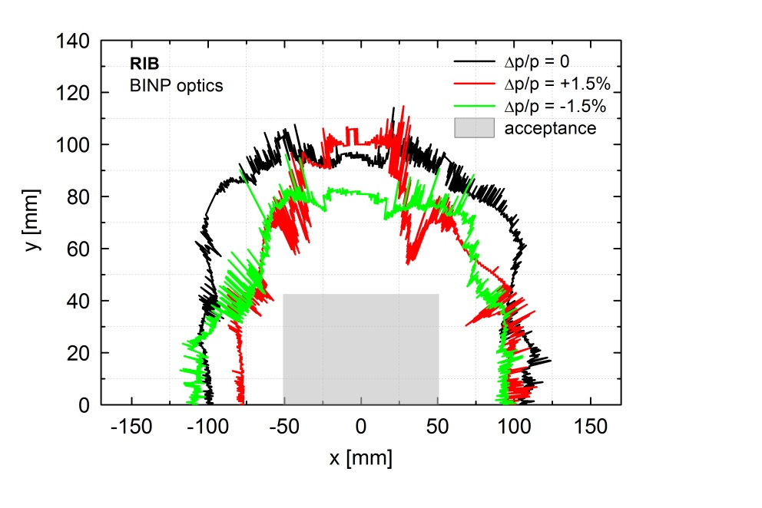
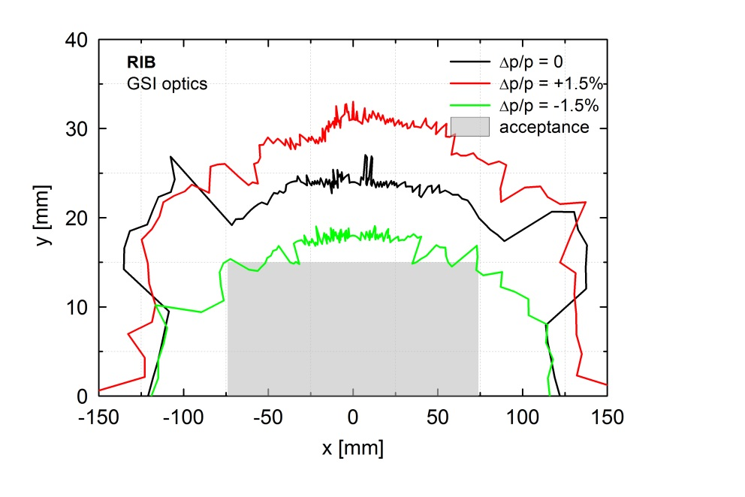
Dynamic aperture (2), sim. by O.Gorda
RIB-mode

Slide 18
Basic CR parameters. BINP options.
Circumference | m | 221.45
Max. magnetic rigidity | Tm | 13
 |  | Anti-protons | Rare isotopes | Isochronous mode
Max. number of particles |  | 10⁸ | 10⁹ | 1-10⁸
Kinetic energy | MeV/n | 3000 | 740 | 790
Velocity, β | v/c | 0.971 | 0.83 | 0.84
Lorentz, γ |  | 4.2 | 1.79 | 1,43 - 1.84
Transition energy, γ_{tr} |  | 4.8382 | 2.945 | 1.43 - 1.84
Momentum compaction, α |  | 0.04272 | 0.1153 | 0.489 - 0.2954
Frequency slip factor , η=α -γ ⁻² |  | 0.013969 | 0.1968 | 0
Betatron tunes , Q_{h} / Q_{v} |  | 4.18 / 3.23 | 3.186 / 3.23 | 2.42/ 2.84
Revolution frequency | MHz | 1.315 | 1.124 | 1.137
Bunch length at injection | ns | 50 | 50 | 50
Bunch length at extraction | ns | 300-500 | 200-700 | no extraction
Beam injection |  | fast single turn, full aperture
Beam extraction |  | fast single turn |  | no extraction
Average vacuum | mbar | 10⁻⁹

Slide 19
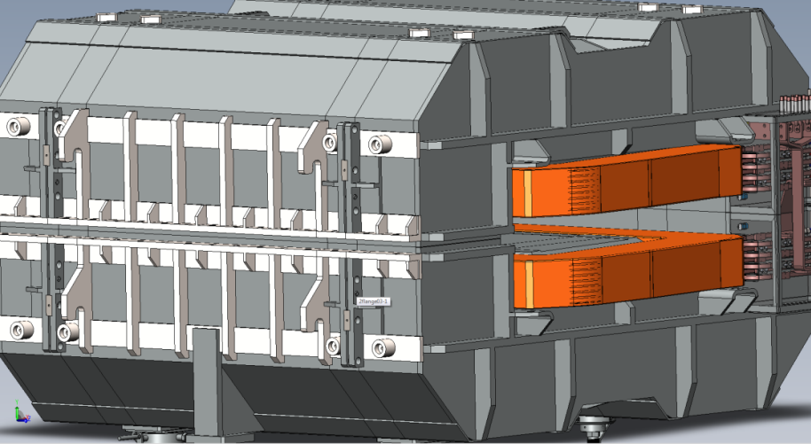
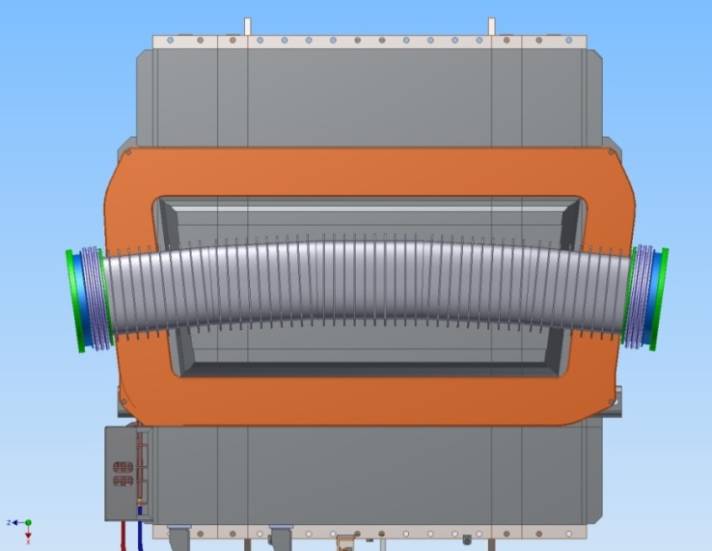
Collector Ring: Dipole magnet and its vacuum chamber
  The final specifications for the laminated dipole magnets has been agreed with BINP experts and officially approved. The contract between FAIR and BINP for the dipole production can be established.
  The preliminary specifications for dipole vacuum chamber have been prepared.

Slide 20
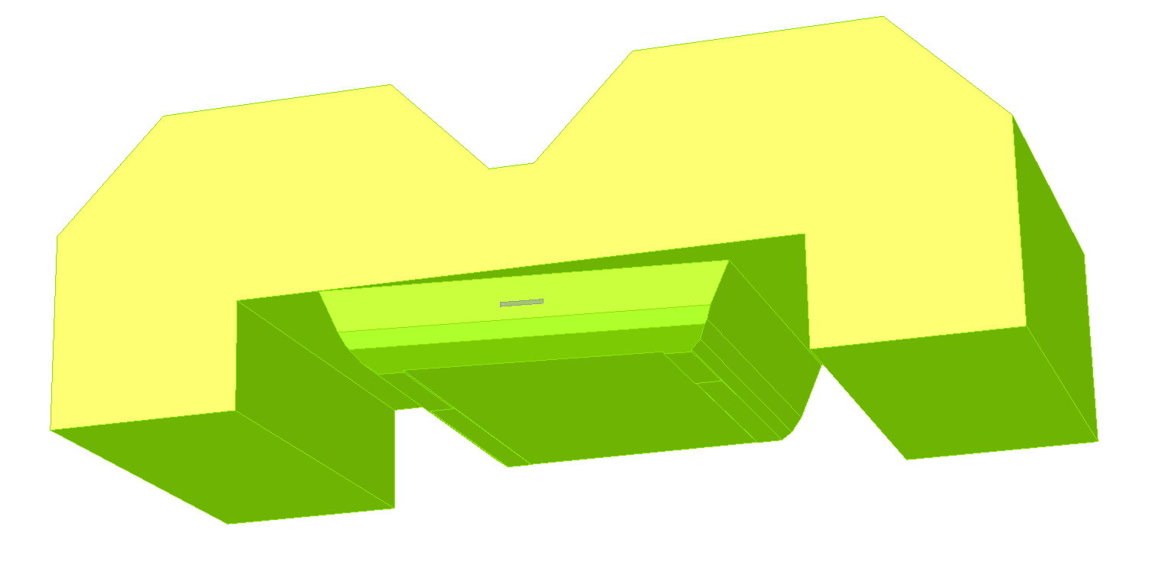
CR laminated sector type dipole iron

Slide 21
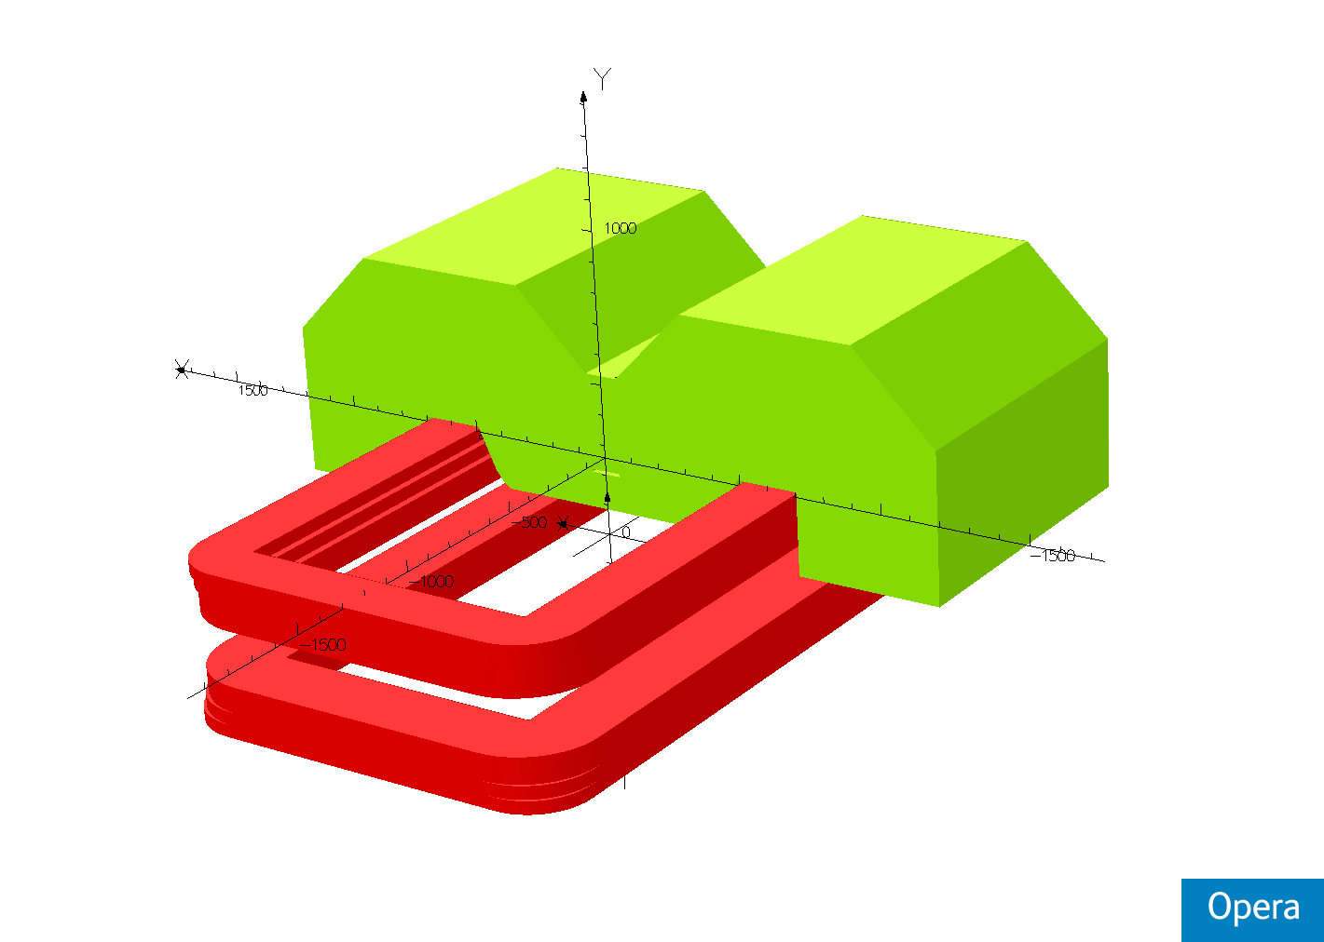
3d model of CR dipole

Slide 22
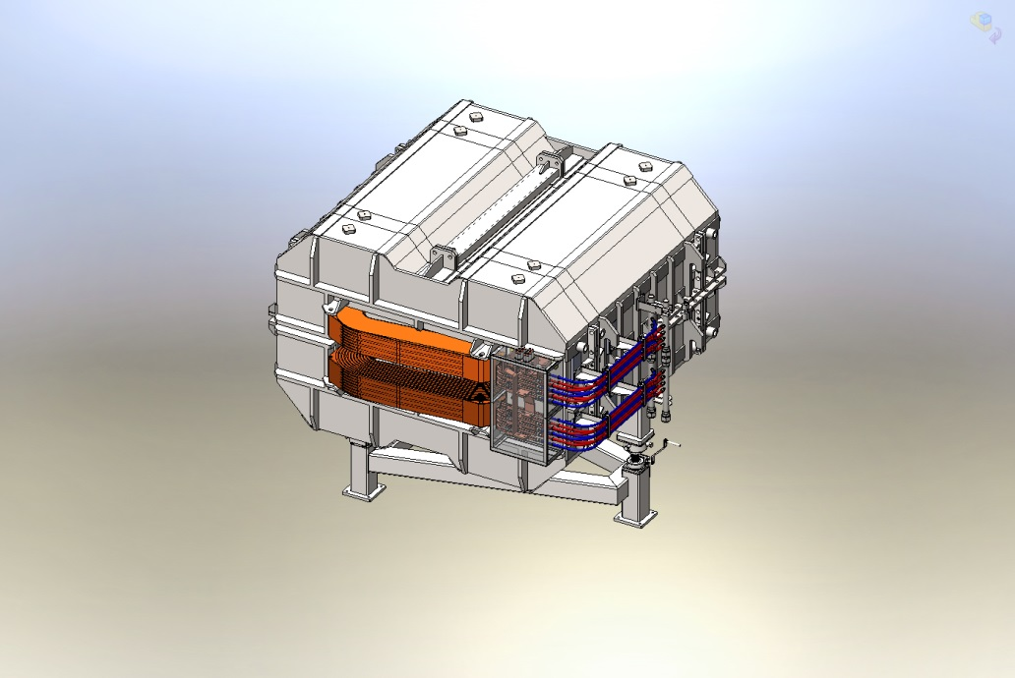
CR dipole assembly

Slide 23
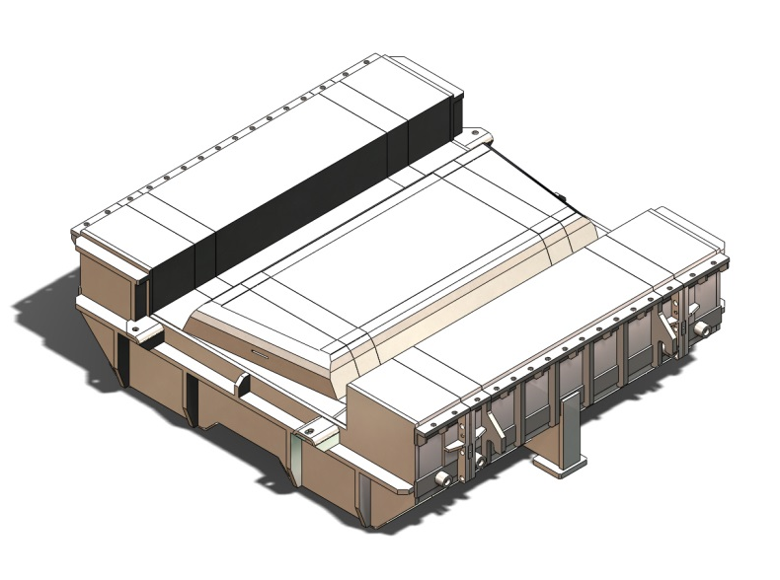
CR dipole lower yoke

Slide 24
Bake-able vacuum chamber with ribs

Slide 25
Bake-able rectangular vacuum chamber

Slide 26
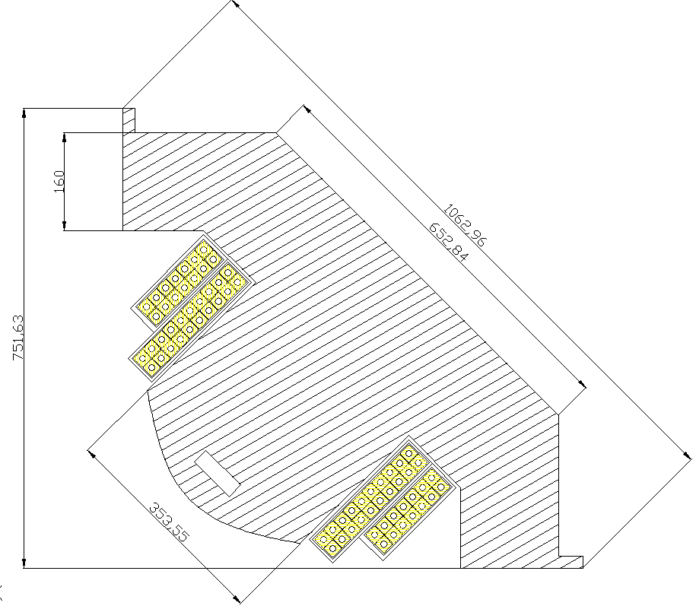
Wide quard cross-section, preliminary

Slide 27
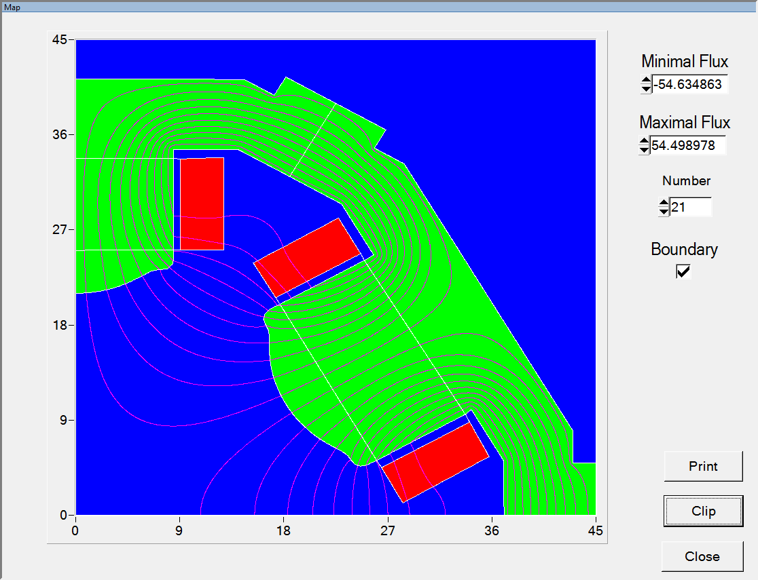
CR sextupole, preliminary

Slide 28
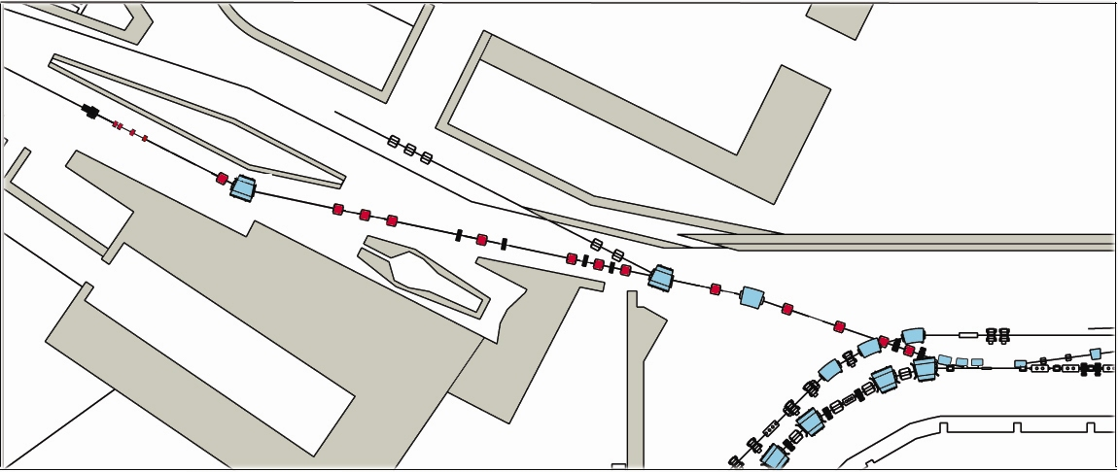
Beams from separators
29 GeV protons from SIS100
740 MeV/u RIBs
From the SFRS
target station
3 GeV antiprotons
TCR1
Pbar TL
CR

Slide 29
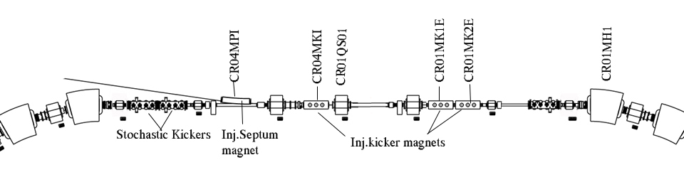
CR-injection (GSI optics)
Present layout of kicker magnets in the CR
3 kickers tanks (total 9 modules)
from separators

Slide 30
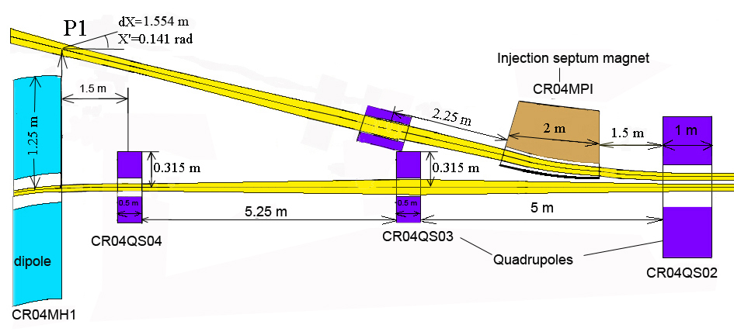
CR-injection (GSI proposal)
Present layout of kicker magnets in the CR
3 kickers tanks (total 9 modules)
from separators
143 mm
24 mrad

Slide 31
BINP approach to injection-extraction
Divide septum magnet into 2 pieces: short 0.8 m, B=0.5 T,
30 mr pulsed septum and 2.5 m with the same field 96 mr
DC magnet (~60 kW), connected in series with main CR dipoles.
Ceramic vacuum chamber in the septum, 5 mm thick, 150 mm
inner diameter. Stainless steel chamber looks not feasible due to
large heat generated by eddy currents.
Stainless steel vacuum chamber for the stored beam with iron
shield wrapped around it. Squared oval shape preferable to
reduce distance between the injected and stored beams.
Ferrite kickers placed inside of vacuum tank, as proposed in TDR.

Slide 32
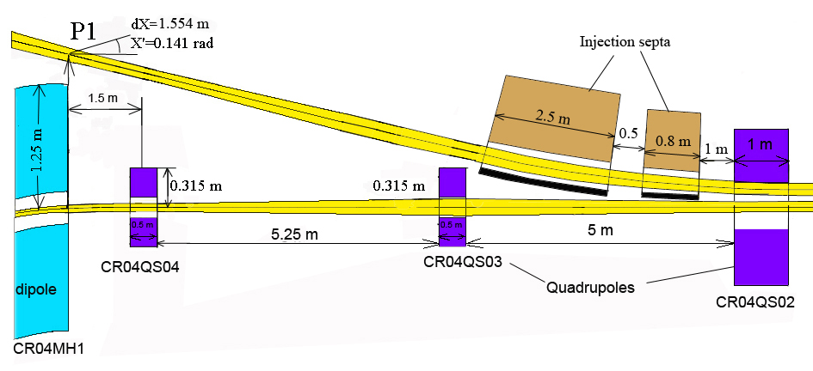
CR-injection (BINP proposal)

Slide 33
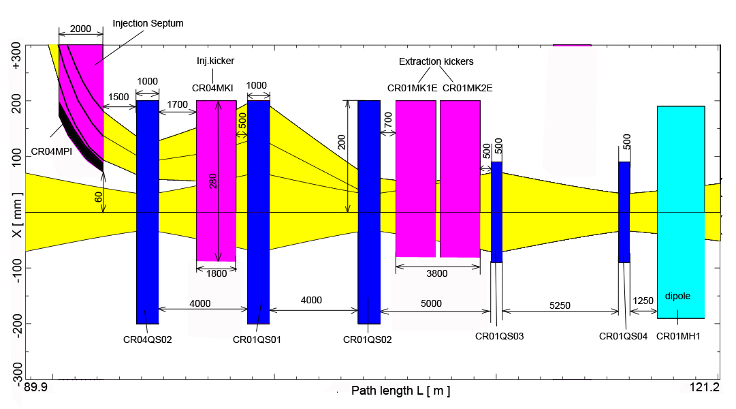
CR-injection (GSI optics)
143 mm
24 mrad
Present injection optics in the CR
max total kick angle: 21 mrad
(one module provides 2.3 mrad kick)

Slide 34
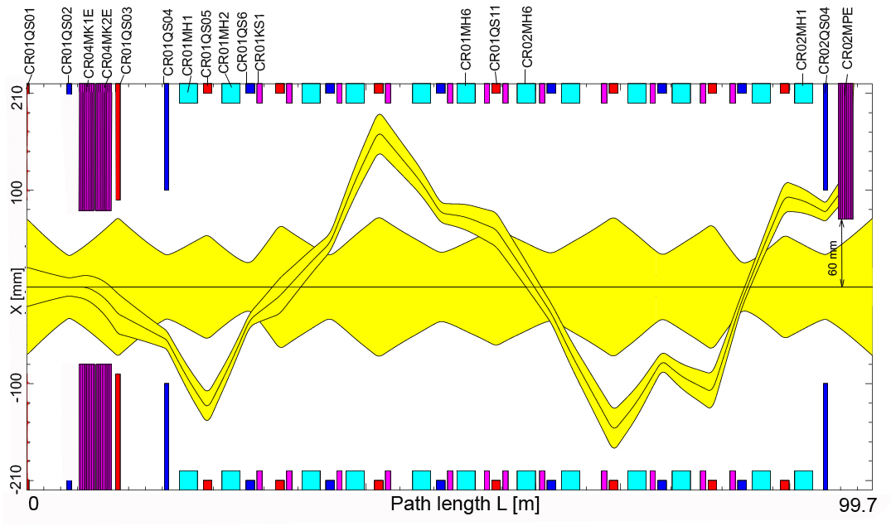
CR-Extraction (GSI pbar-optics)
Present extraction optics in the CR
max total kick angle: 14 mrad
95 mm
13 mrad

Slide 35
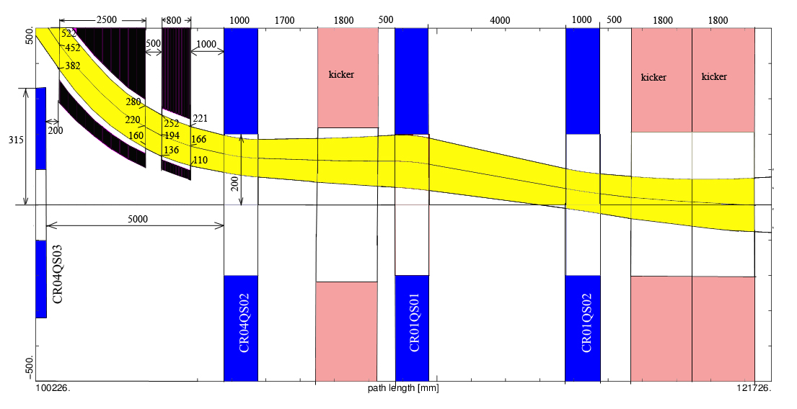
Injection into CR (BINP proposal)

Slide 36
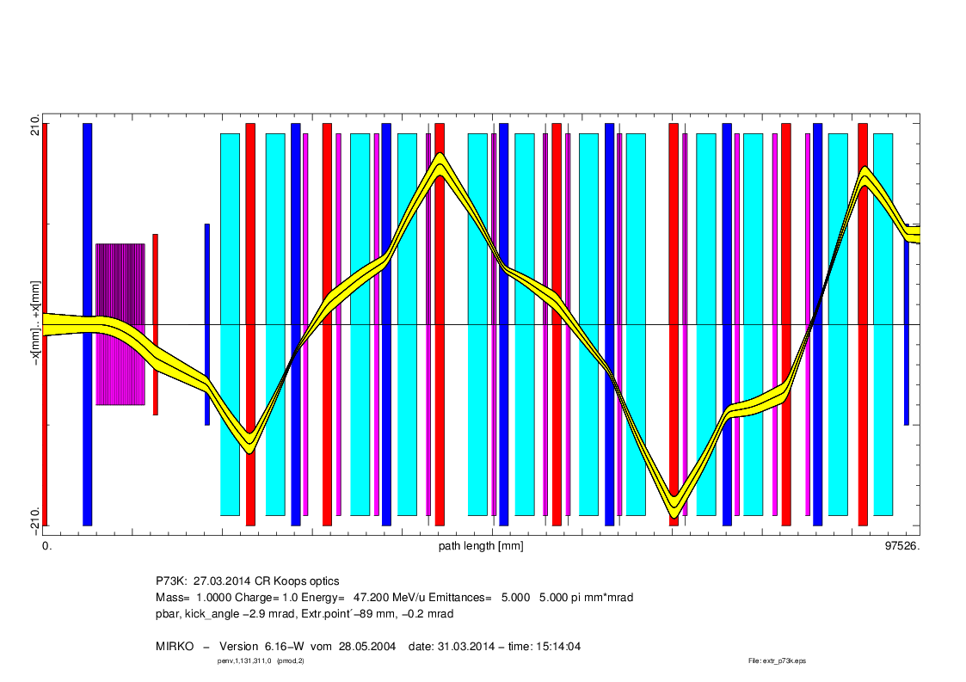
BINP pbar extraction: Option 1
Option 1: 2 kickers (6 modules)
Total kick=5.8 mrad
Extraction (BINP pbar-optics)
95 mm
13 mrad
89 mm
-0.2 mrad

Slide 37
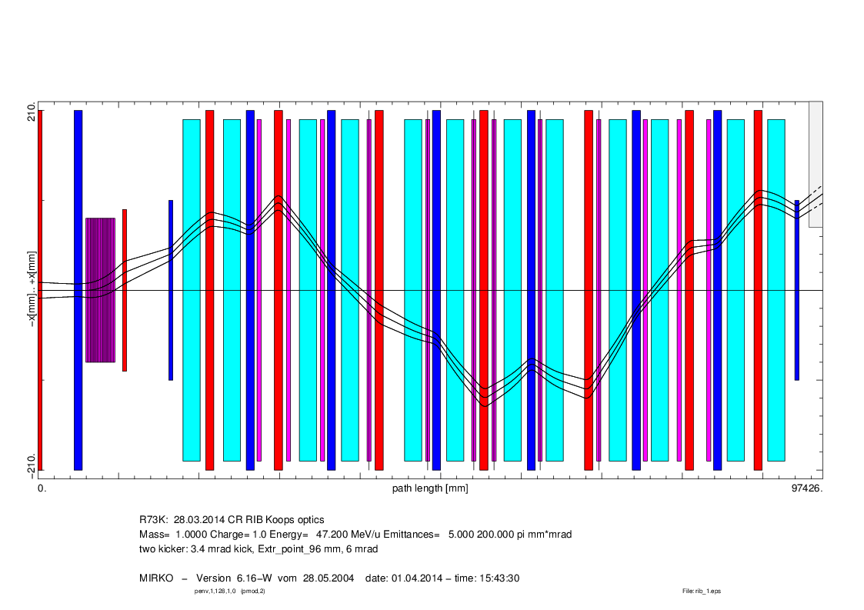
BINP RIBs extraction: Option 1
Option 1: 2 kickers (6 modules)
Total kick=6.8 mrad
Extraction (BINP RIB optics)
95 mm
13 mrad
96 mm
6 mrad

Slide 38
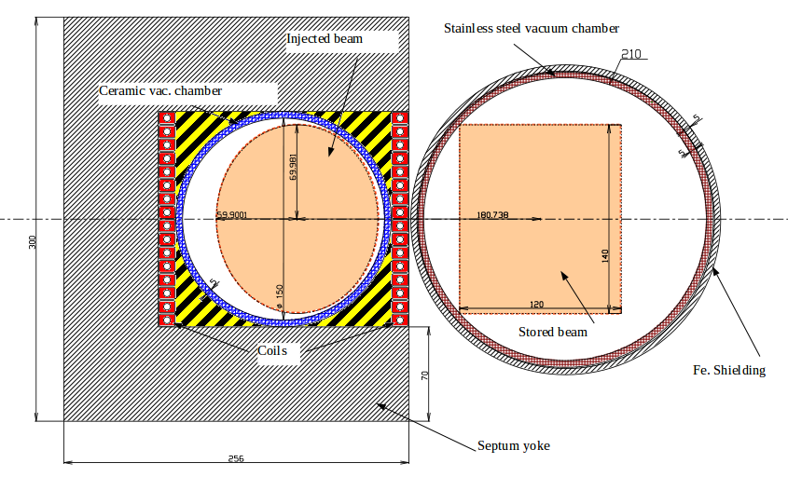
Injection septum design1, preliminary

Slide 39
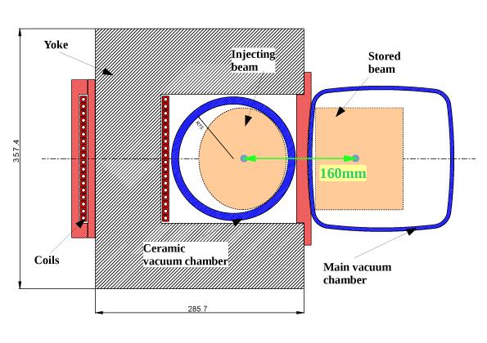
Injection septum design2, preliminary

Slide 40
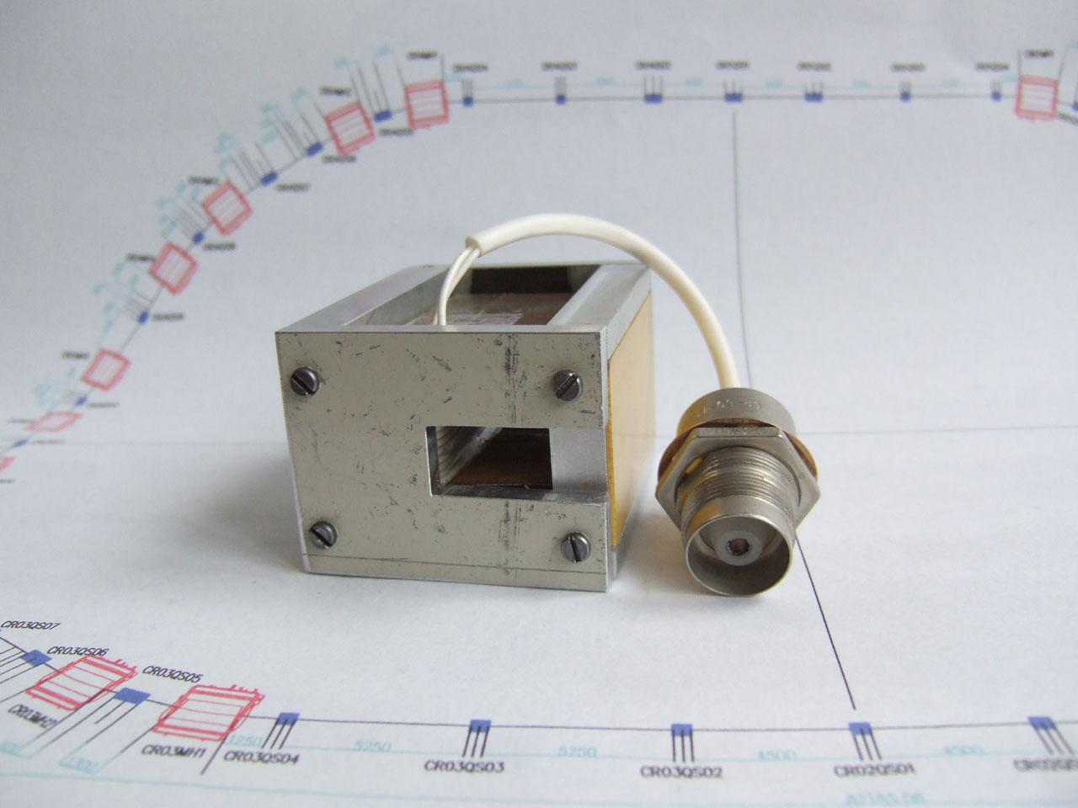
Septum toy model
Small stray field
outside the aperture
was demonstrated

Slide 41
Injection / Extraction Kicker CR
U.Blell design looks OK!
2 tanks instead of 3 ?
3 Modules in each tank

Slide 42
BINP Future Plans
Finalize the CR lattice study
Continue CR magnets design
Finalize the pbar transport line geometry - its end part
Continue pbar transport line optics calculations – match to CR
Make preliminary design of the injection septum
Start design work on the extraction septum
Start design work of specific 1-st dipole in pbar TL
Activate design work of pickups and other diagnostic
Prepare contract with FAIR on CR and related parts (TCR1) technical coordination
Keep close contact with GSI team!

