Slide 1
HEBT and beam dumps overview
F. Hagenbuck
11th FAIR – Machine Advisory Committee Meeting

Slide 2
Outline
Introduction
Magnets and Vacuum Chambers
Power Converters
Beam Diagnostics
Special Installations
Technical System Design
Connection SIS18 – CR
Status HEBT Buildings

Slide 3
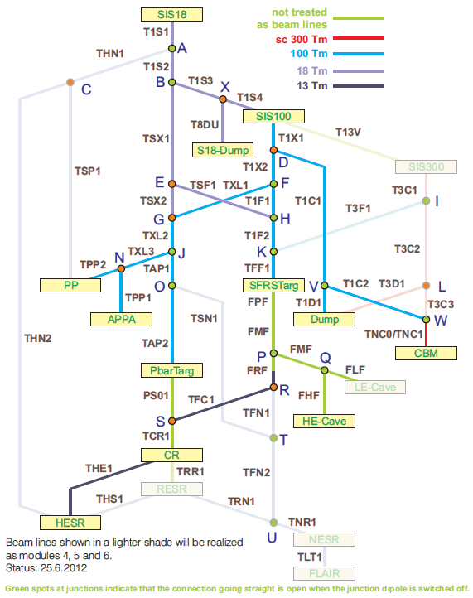
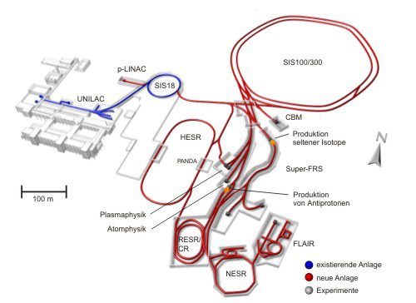
HEBT – Module 0-6
42 sections (22 connections/beam lines)
total length (HEBT) ca. 2.5 km
two superconducting beam lines (SIS300 – CBM, SIS300 – Dump), all other beam lines normal conducting
nominal magnetic rigidity: 300Tm, 100Tm, 18Tm, 13Tm
parallel operation

Slide 4
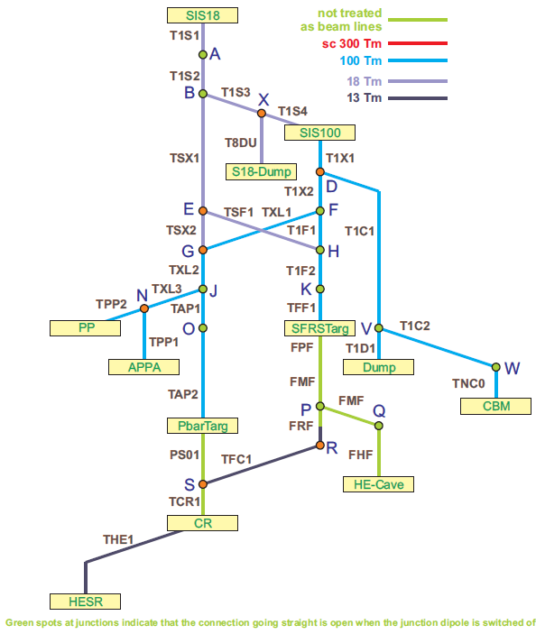
HEBT – MSV (Module 0-3)
27 sections (11 connections/beam lines)
total length (HEBT) ca. 1.5 km
all beam lines normalconducting
nominal magnetic rigidity 100Tm, 18Tm, 13Tm
parallel operation
full version has to be taken into account for building planning of the MSV

Slide 5
Outline
Introduction
Magnets and Vacuum Chambers
Power Converters
Beam Diagnostics
Special Installations
Technical System Design
Connection SIS18 – CR
Status HEBT Buildings

Slide 6
Magnet Types
75 dipole magnets (19 types) in M0-3
189 quadrupole magnets (7types) in M0-3
Almost all HEBT Magnets (338/356) ➔ Efremov institute (Council V, VI, VII)
Magnets similar to CR Magnets (2+5) ➔ Budker institute (IKRB VIII)
Super-FRS Quadrupoles (9) ➔ GSI in-kind (Council IV)
all HEBT magnets assigned
verbal confirmation that BINP will take over all related vacuum chambers (not yet all PSP-codes assigned to BINP, some PSP-codes unclear)
92 steering magnets (3types) in M0-3

Slide 7
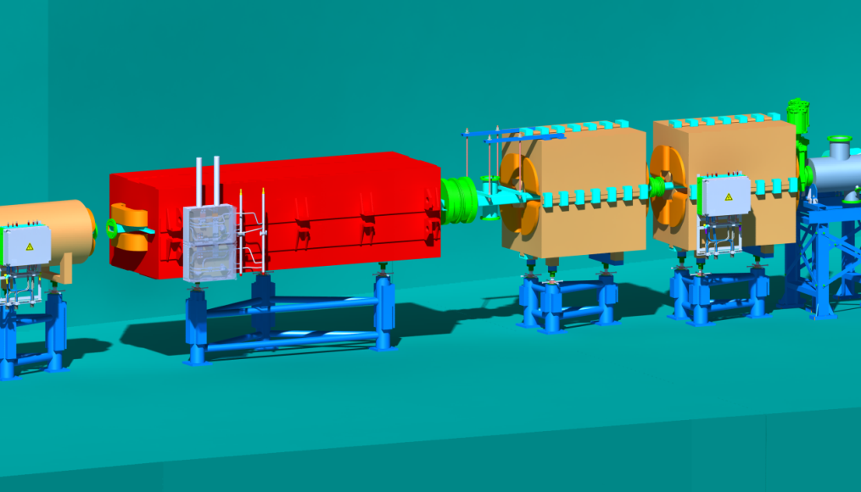
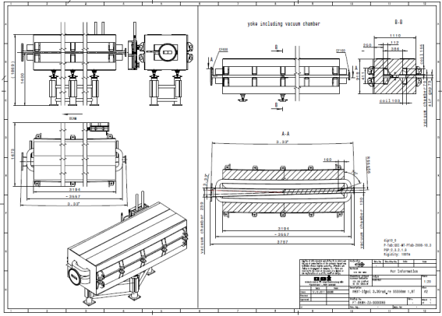
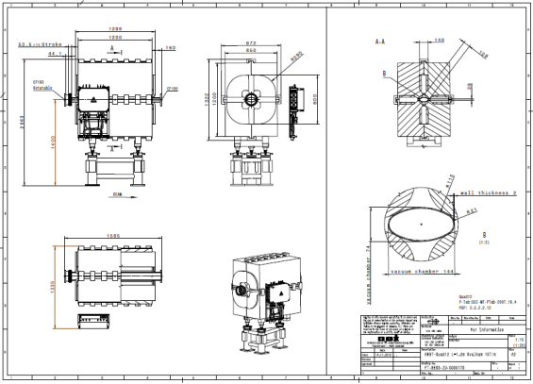
Batch1 – 3
Batch1
Content: 51 dipoles and related vacuum chambers
Contracts signed with BINP (Jan. 2013) and Efremov (Aug. 2013)
Exchange on working-level with BINP started in Feb. 2013, with Efremov in Oct. 2013
Common kick-off meeting at GSI on 10.-11.12.2013
Common techn. meeting at Efremov Inst. on 13.-14.5.2014
details on next slides
Batch2
Content: 17 dipoles, 102 quadrupoles, 80 steering magnets and related vacuum chambers
Detailed Specs in 2nd EDMS approval process (release expected 30.05.); draft version given to Efremov and BINP in Dec. 2013, EDMS approval version on 12 May
Draft version of contract will be sent to Efremov at beginning of June, to BINP at mid of June
Batch3
content: 5 dipoles, 71 quadrupoles, 12 steering magnets and related vacuum chambers
Parameter tables ready and given to Efremov and BINP in Dec. 2013; 3D models and 2D drawings ready
Detailed Specs ready in early summer; draft version will be given to Efremov and BINP until mid of June

Slide 8
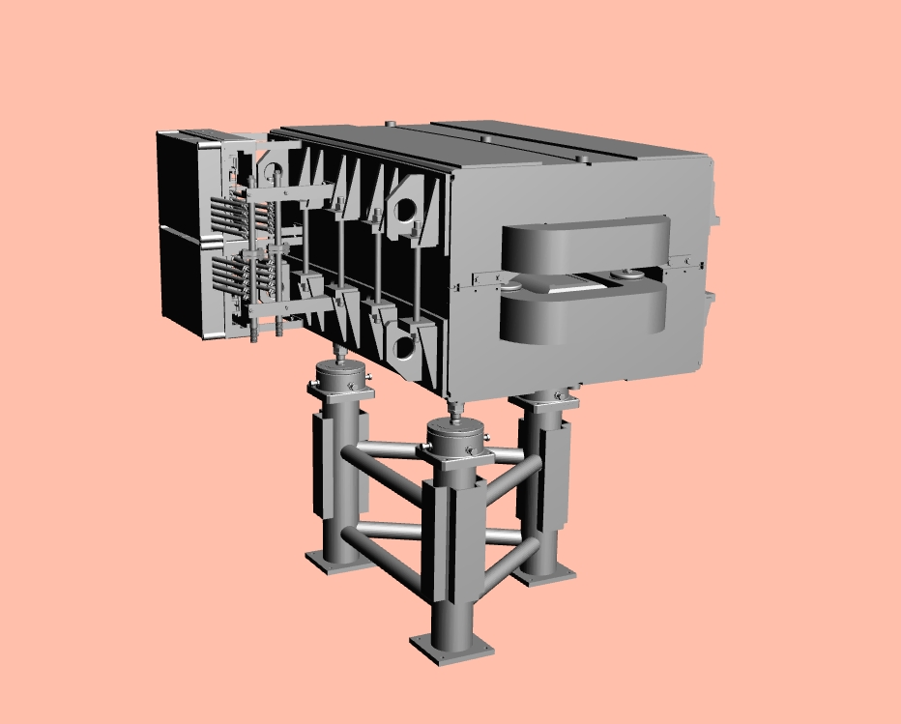
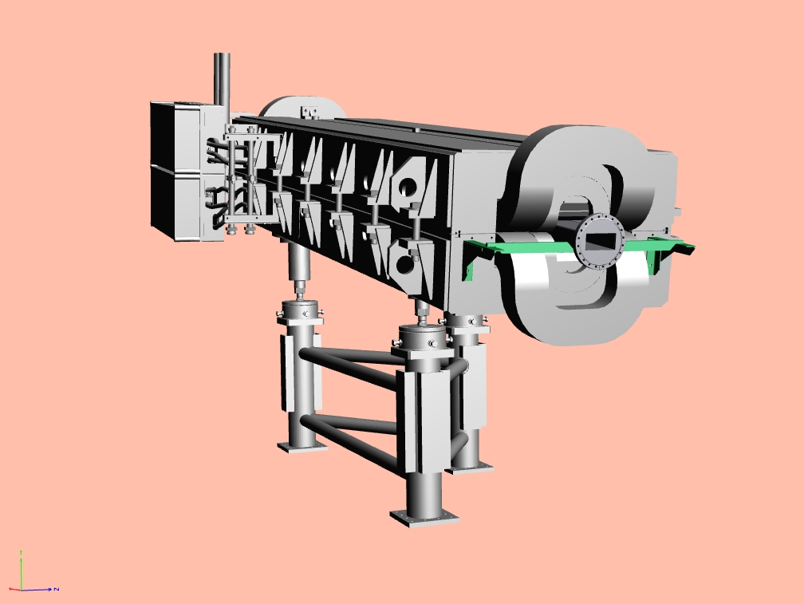
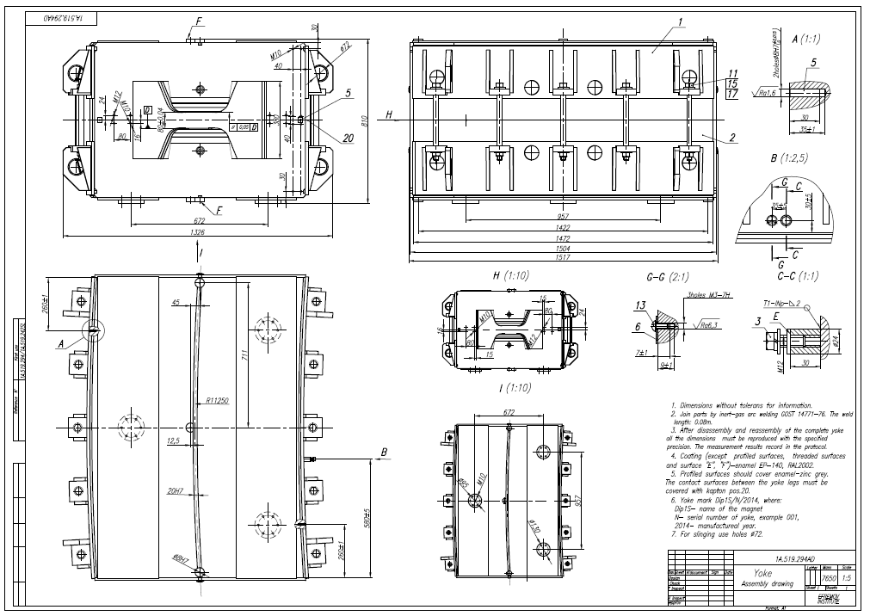
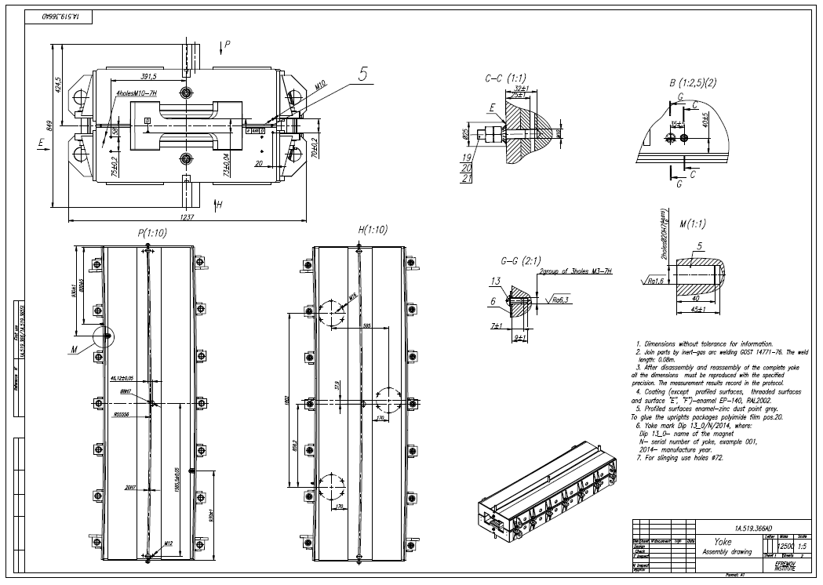
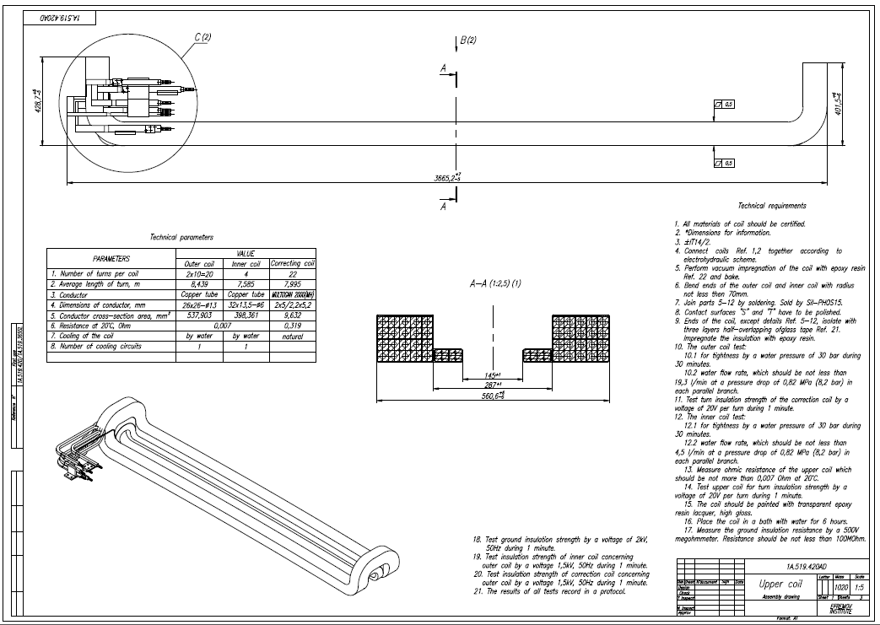
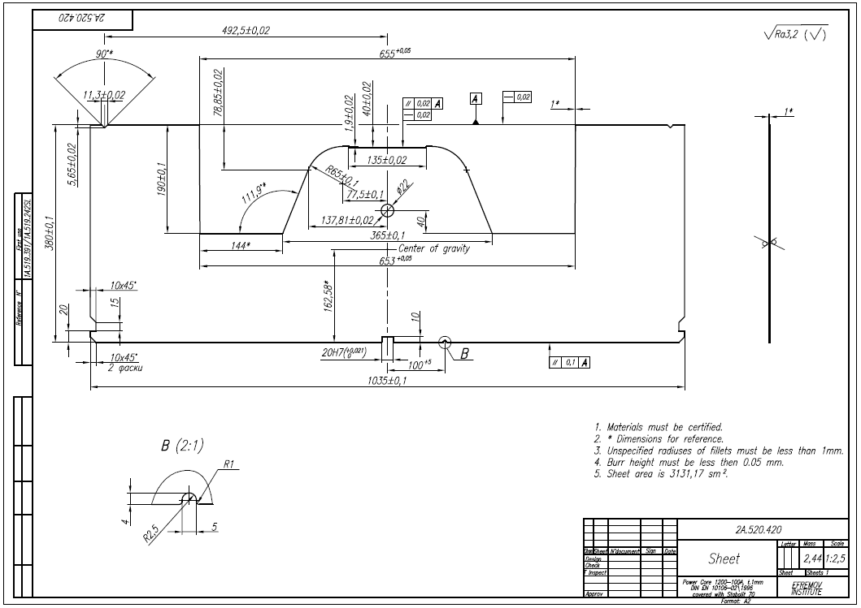
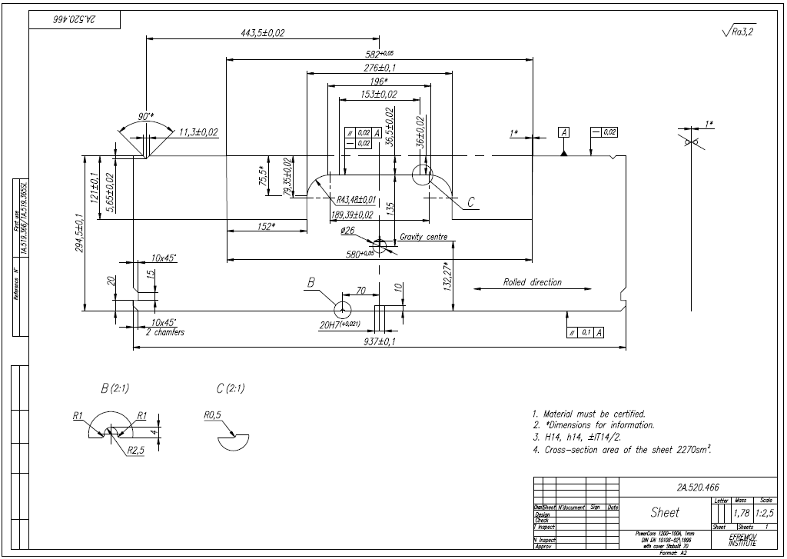
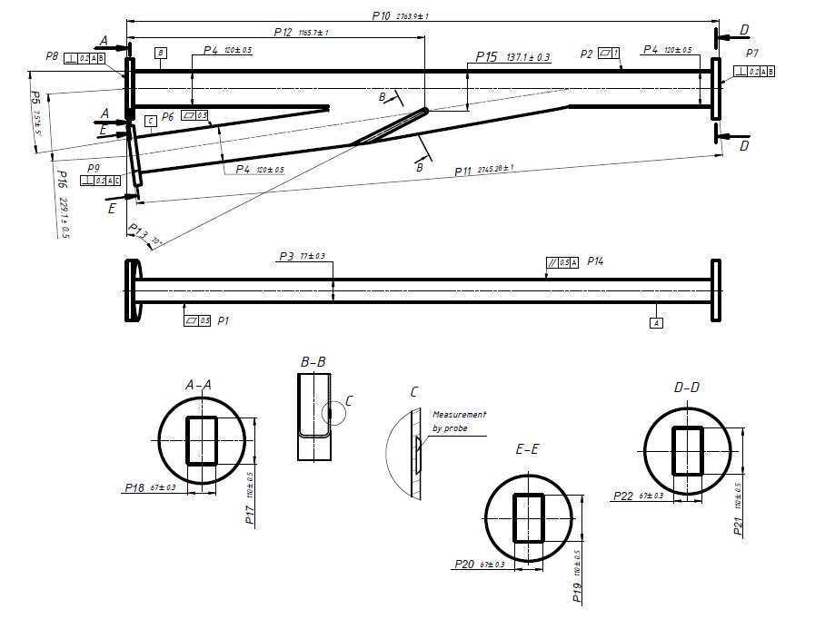
Status Batch1
Batch1 contains two pre-series magnets and vacuum chambers
at present – approval of 3D models and general drawings of pre-series magnets and vacuum chambers delivered by Efremov and Budker institute, resp.
dip1s_0
dip13_0
3D model by Efremov institute
3D model by Efremov/Budker institute

Slide 9
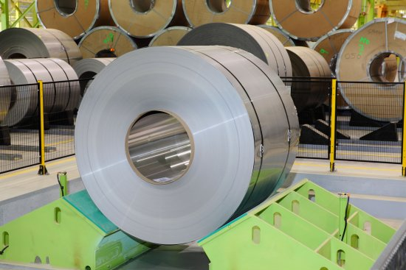
Purchase of Basic Materials
Purchase of basic materials is carried out only for the two pre-series magnets dip1s_0 and dip13_0.
Purchase of following positions are performed:
For yoke:
Electrical steel Power Core 1200-100A with cover Stabolit 70.
«ThyssenKrupp Steel Europe», Germany
Forecast material delivery date – September 2014
courtesy Efremov Inst.

Slide 10
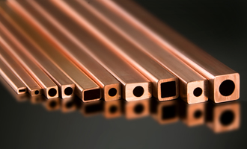
Purchase of Basic Materials
For coils:
Copper wire with dimensions12х12Ø6 mm (main winding) for dip1s_0.
- Copper wires with dimensions 26х26Ø13,5 mm (internal winding) and
32х13,5Ø6 mm (external winding) for dip13_0.
All «Luvata», Finland
Copper wire Multogan 2х5 mm (for correction winding)
«SCHEIING KG», Germany
courtesy Efremov Inst.

Slide 11
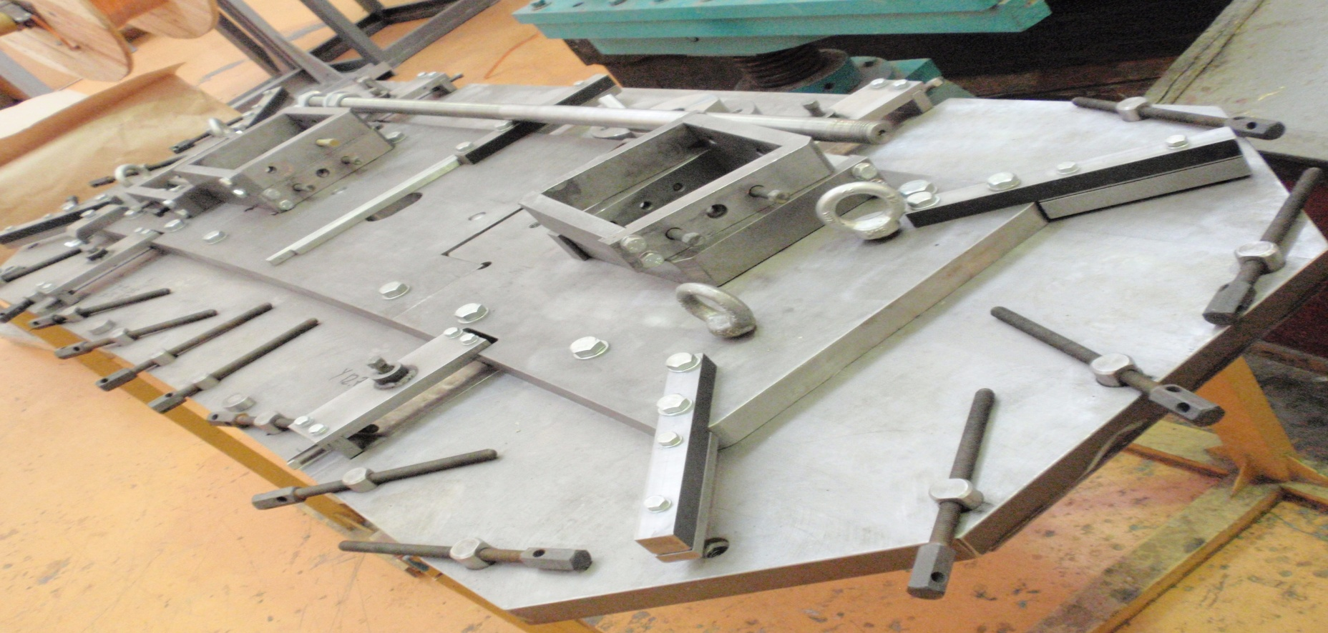
Production of Tooling
Fixture for winding of coils dip1s_0.
courtesy Efremov Inst.

Slide 12
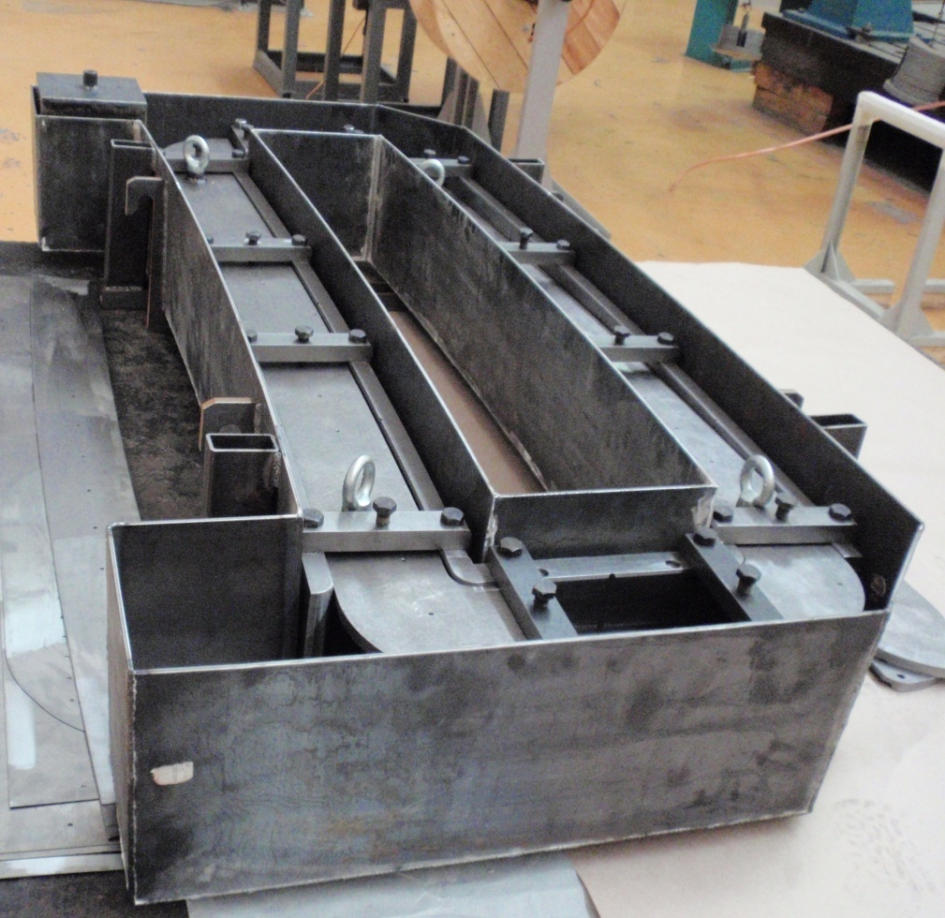
Production of Tooling
For dipole magnet dip1s_0:
Tooling for winding and impregnation of coils were developed, designed and produced.
Tooling for compression and impregnation of coils
courtesy Efremov Inst.

Slide 13
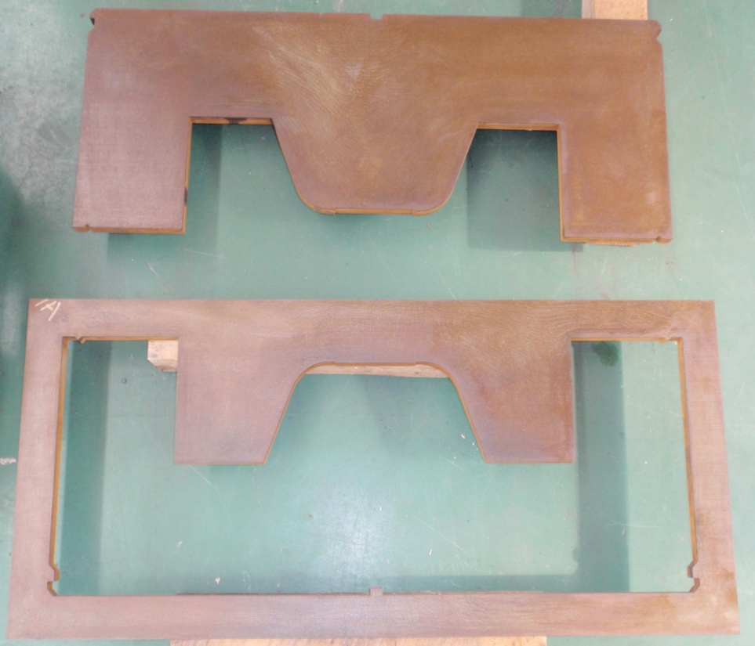
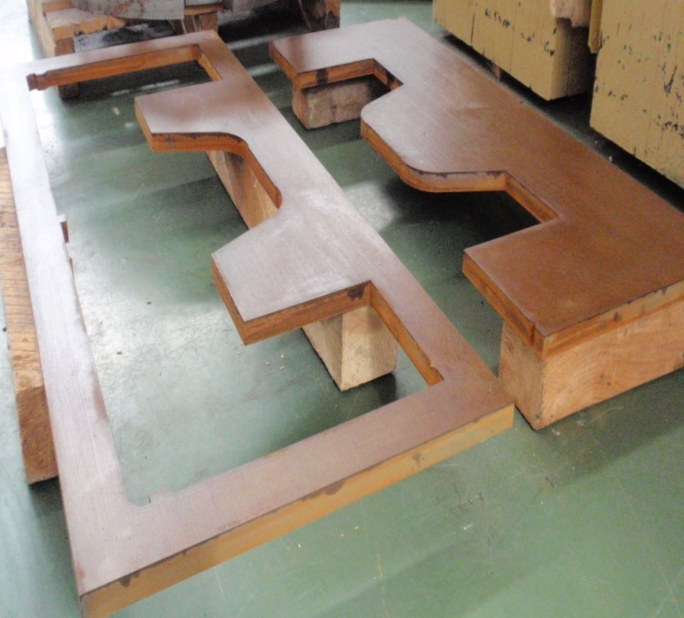
Production of Tooling
Manufacturing of die for punching of lamination dip1s_0.
Stripper and shedder for die of dip1s_0.
Other details of die are in the process of manufacturing.
courtesy Efremov Inst.

Slide 14
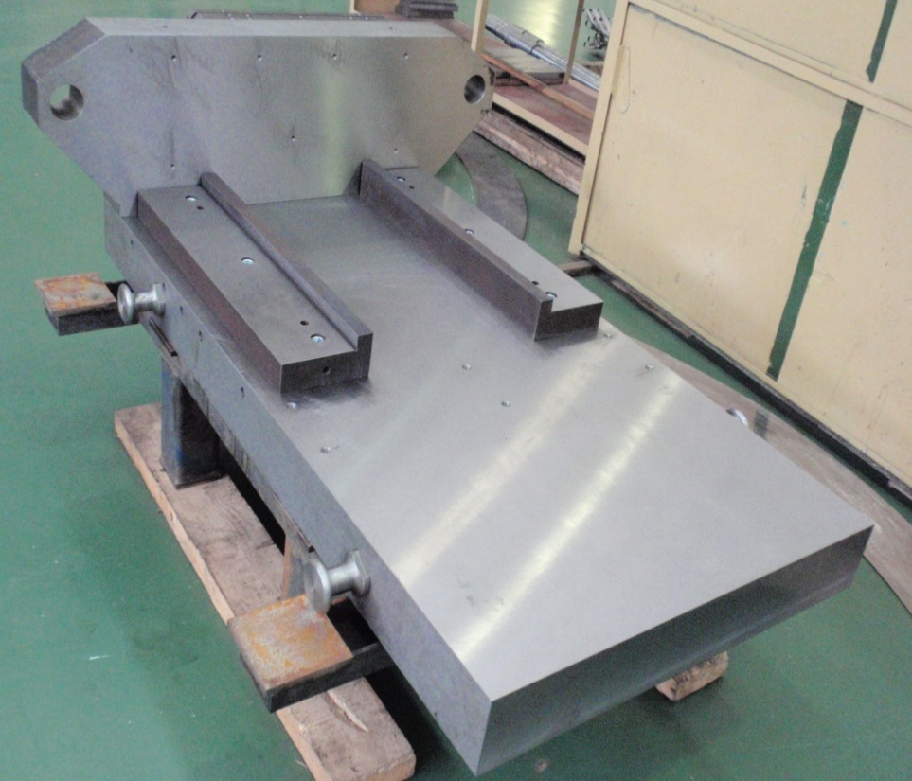
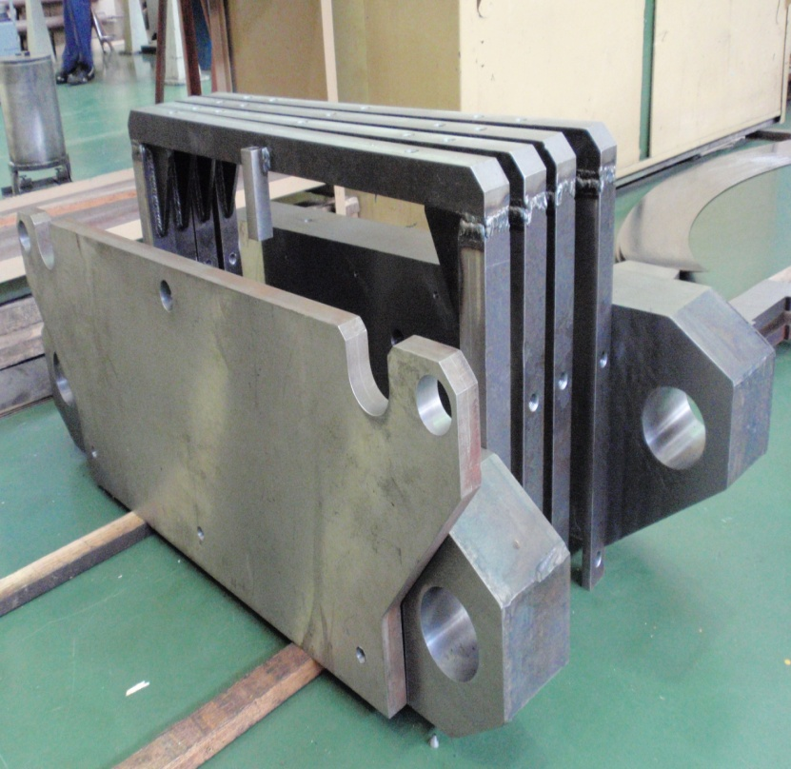
Production of Tooling
Details of fixture for assembly and baking of packets for yoke of magnet dip1s_0.
dip13_0:
Tooling was developed and designed.
Fixture for winding, baking and compression of coils are in the process of manufacturing. Die for punching is in production.
courtesy Efremov Inst.

Slide 15
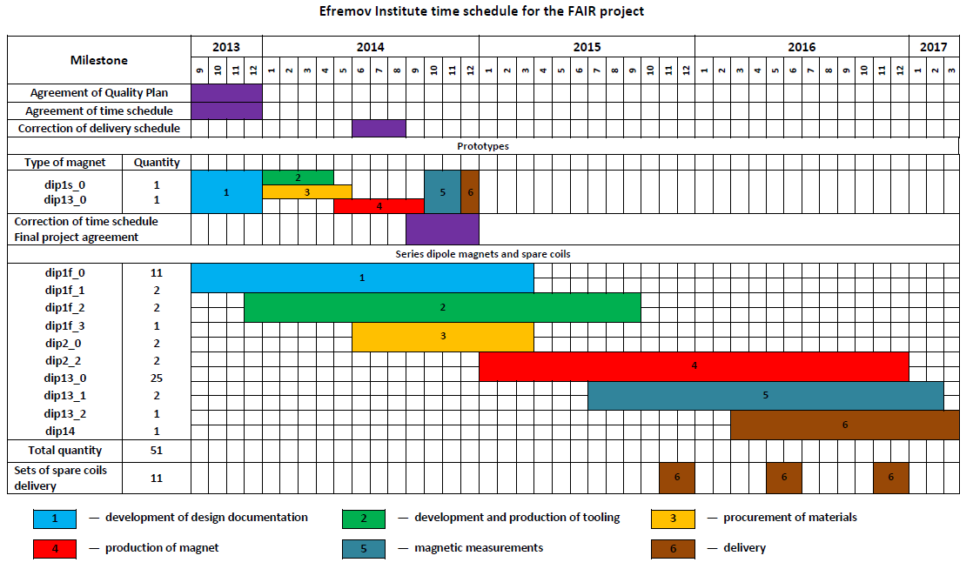
Schedule Magnets
Batch1: At the moment Efremov Institute is ruled by the production schedule presented at the Kick-off meeting in Darmstadt on 10th of December 2013, based on Annex 2, Table A1 of the contract.
pre-series vacuum chambers Q1/2015
Batch2&3: “At the present time the Efremov Institute goes behind drawings and parameter tables ...... and performs production schedule and commercial offer for HEBT magnets Batch2-3 for performance and agreement with FAIR and GSI.”

Slide 16
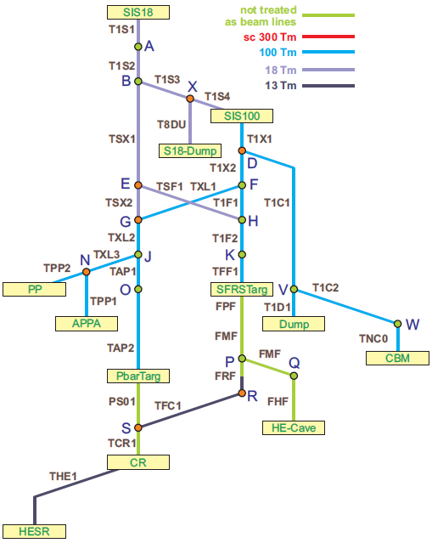
Prioritization at FAIR@GSI
FAIR@GSI
Primary Beams Q2/2018 (M11) (beams from SIS18, SIS100)
HEBT A
SIS18 → SIS100
SIS18 → S18-Dump
SIS18 → SFRS Target
SIS100 → Dump
SIS100 → CBM
SIS100
SIS18
P-LINAC
HEBT B
Dump
SIS100 → AP, PP
SIS100 → SFRS Target
SIS18 → AP, PP
CBM
AP, PP
SFRS
Secondary Beams Q1/2019 (M11) (beams from SFRS, pbar)
HESR
PBAR
HEBT C
SIS100 → pbar Target *
SFRS → CR
CR → HESR
CR

Slide 17
Prioritization at FAIR@GSI
In agreement between FAIR@GSI and FAIR
Efremov Institute and Budker Institute were asked (in meeting 12/2013 and 05/2014) to work out a production plan for Batch1-3 sorted according to HEBT A/B/C .

Slide 18
Outline
Introduction
Magnets and Vacuum Chambers
Power Converters
Beam Diagnostics
Special Installations
Technical System Design
Connection SIS18 – CR
Status HEBT Buildings

Slide 19
Power Converter
21 Dipole PC types
(quantity 51)
11 Quadrupole PC types (quantity 170)
Det. Specs released for 7 Quadrupole PC types (quantity 151)
3 Steerer PC types
(quantity 92)

Slide 20

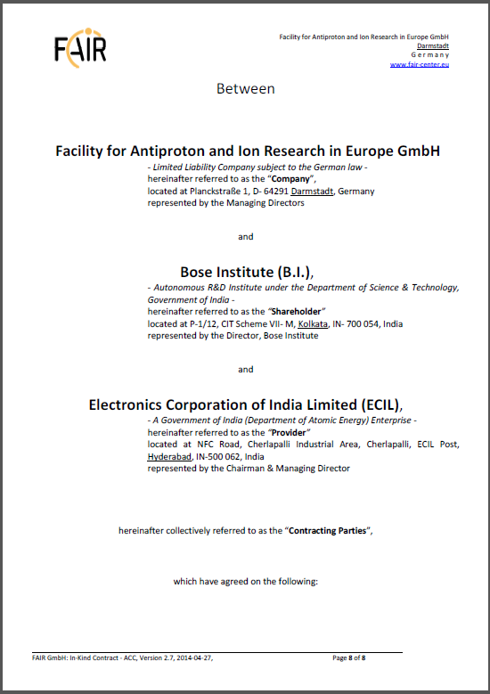
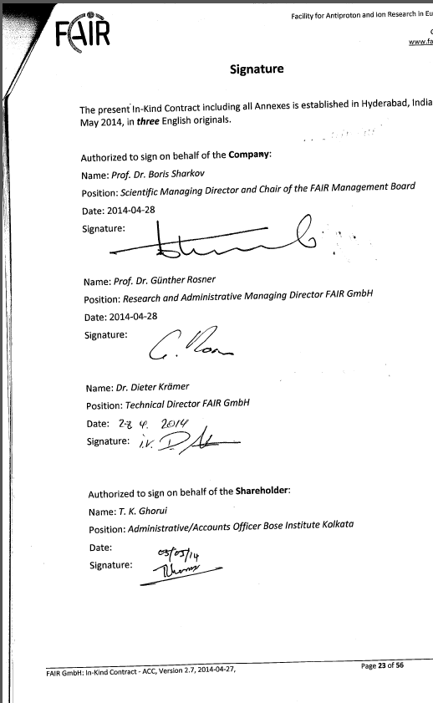
Power Converter
First Contract closed (May 5, 2014) on 3 (+1) HEBT Quadrupole PC types (quantity 77+1) with Bose Institute(shareholder)/ECIL (provider)

Slide 21
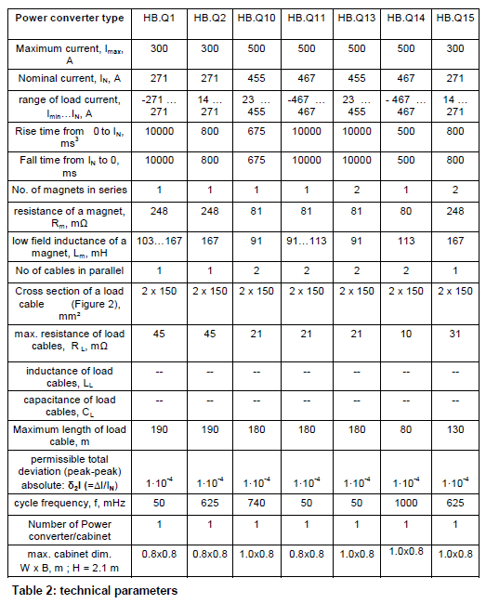
Power Converter
Scope of contract
2.3.3.2.1.1 – HB.Q1 (23)
(for quad2 in THE1, TSF1 – „slow“)
2.3.3.2.2.1 – HB.Q2 (50 incl. 1 pre-series) (for quad2 in T1S1-T1S4, TSX1 – „fast“)
2.3.3.2.15.1 – HB.Q15 (4)
(for quad2 in T1S3 – series connection, „fast“)
covers all quad2 of batch2 and batch3 (#81)
(= all* quadrupoles in 18Tm/13Tm sections)
* except CR similar quadrupoles
2.3.3.2.10.1 – HB.Q10 (1 pre-series )
(for quad11 in T1X1, T1X2, TXL2, TAP1 – „ fast“)
09/2015 – FAT pre-series HB.Q2, HB.Q10

Slide 22
Power Converter
FAIR@GSI
Primary Beams (beams from SIS18, SIS100)
HEBT A
SIS18 → SIS100
SIS18 → S18-Dump
SIS18 → SFRS Target
SIS100 → Dump
SIS100 → CBM
SIS100
SIS18
P-LINAC
HEBT B
Dump
SIS100 → AP, PP
SIS100 → SFRS Target
SIS18 → AP, PP
CBM
AP, PP
SFRS
Secondary Beams (beams from SFRS, pbar)
HESR
PBAR
HEBT C
SIS100 → pbar Target *
SFRS → CR
CR → HESR
CR

Slide 23
Power Converter
Quadrupole Power Converter
Primary Beams (beams from SIS18, SIS100)
Delivery series
02/2018
12/2018
HEBT A
SIS18 → SIS100
SIS18 → S18-Dump
SIS18 → SFRS Target
SIS100
SIS100 → Dump
SIS100 → CBM
SIS18
P-LINAC
HEBT B
Dump
SIS100 → AP, PP
SIS100 → SFRS Target
SIS18 → AP, PP
CBM
AP, PP
SFRS
Secondary Beams (beams from SFRS, pbar)
HESR
PBAR
HEBT C
SIS100 → pbar Target *
SFRS → CR
CR
CR → HESR

Slide 24
Outline
Introduction
Magnets and Vacuum Chambers
Power Converters
Beam Diagnostics
Special Installations
Technical System Design
Connection SIS18 – CR
Status HEBT Buildings

Slide 25
Beam Diagnostics
Overview devices
Common Specification:
F-CS-BD-01e: Common Specifications for FAIR Beam Diagnostics: RELEASED
Detailed Specifications:
F-DS-BD-04e_AC+FCT_T : Fast Current Transformer: RELEASED
F-DS-BD-08e_AC+CCC_T+CR: Cryogenic Current Comparator: IN WORK (not day 0 diagnostics)
F-DS-BD-09e_AC+RT_T+PT+F: Resonant Transformer: UNDER APPROVAL
F-DS-BD-12e_Elecprofile+MWPC_T :Multi Wire Proportional Chamber: IN WORK
F-DS-BD-13e_Elecprofile+SEM_PL+T+PT: Secondary Electron Emission Grid: UNDER APPROVAL
F-DS-BD-16e_Optprofile+SCR_T+PT+F Scintillating Screens: UNDER APPROVAL
F-DS-BD-19e_Optprofile_BIF_PL_T_F Beam Induced Fluorescence: IN WORK (not day 0 diagnostics)
F-DS-BD-23e_Pos+BPM_T+PT+F: Beam Position Monitor: RELEASED
F-DS-BD-26e_PD+BLM_T_1S_CR_PT Beam Loss Monitor: RELEASED
F-DS-BD-27e_PD+PDC_T: Particle Detection Combination: UNDER APPROVAL
F-DS-BD-40e_DAQ Data Acquisition System: RELEASED
F-DS-BD-43e_Mech+MechanicalDrives: Mechanical Drives: RELEASED
F-DS-BD-44e_Mech+VacuumChambers: Standard Vacuum Chambers for HEBT: RELEASED
F-DS-BD-46e_Subsys+HighVoltage High Voltage: RELEASED
F-DS-BD-47e_Subsys+PneumaticDrive Pneumatic Drives : RELEASED
F-DS-BD-48e_Subsys+DetectorGasflow: Detector Gas Flow: IN WORK
Most of the Specifications released or under approval
total 207
(without BLM)

Slide 26
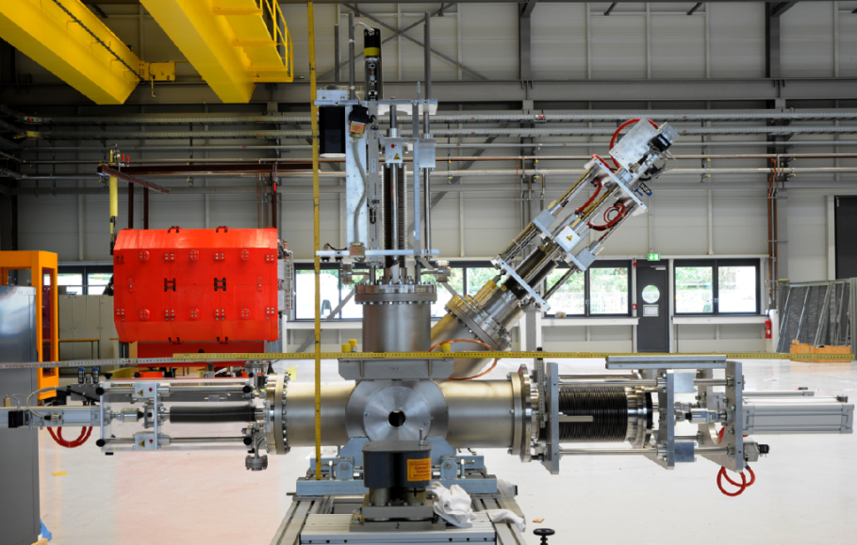
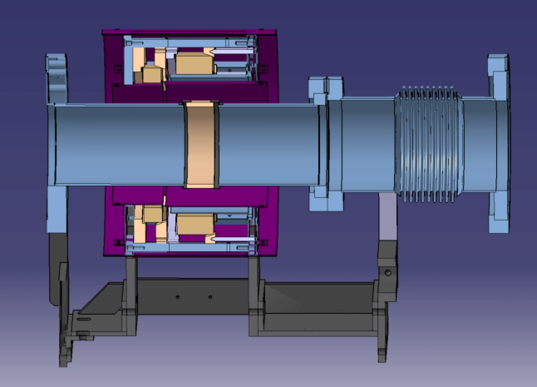
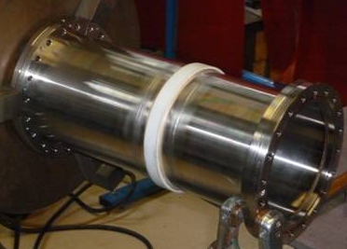
Mechanics
Detailed, technical drawing and specification of all standard diagnostic chamber, diagnostic chamber with collimator and BPM chamber
All technical documents of standard diagnostic chambers (8 types, ~65 pieces) delivered to Indian shareholder (April 14, 2014)
3D models for special diagnostic chamber
Test production of first FAIR-type diagnostic chamber
Detailed, technical drawing of FAIR standard pneumatic drive
Test production of first FAIR-type pneumatic drive
Detailed, technical drawing of transformer chamber
Test production of first FAIR-type RT/FCT

Slide 27
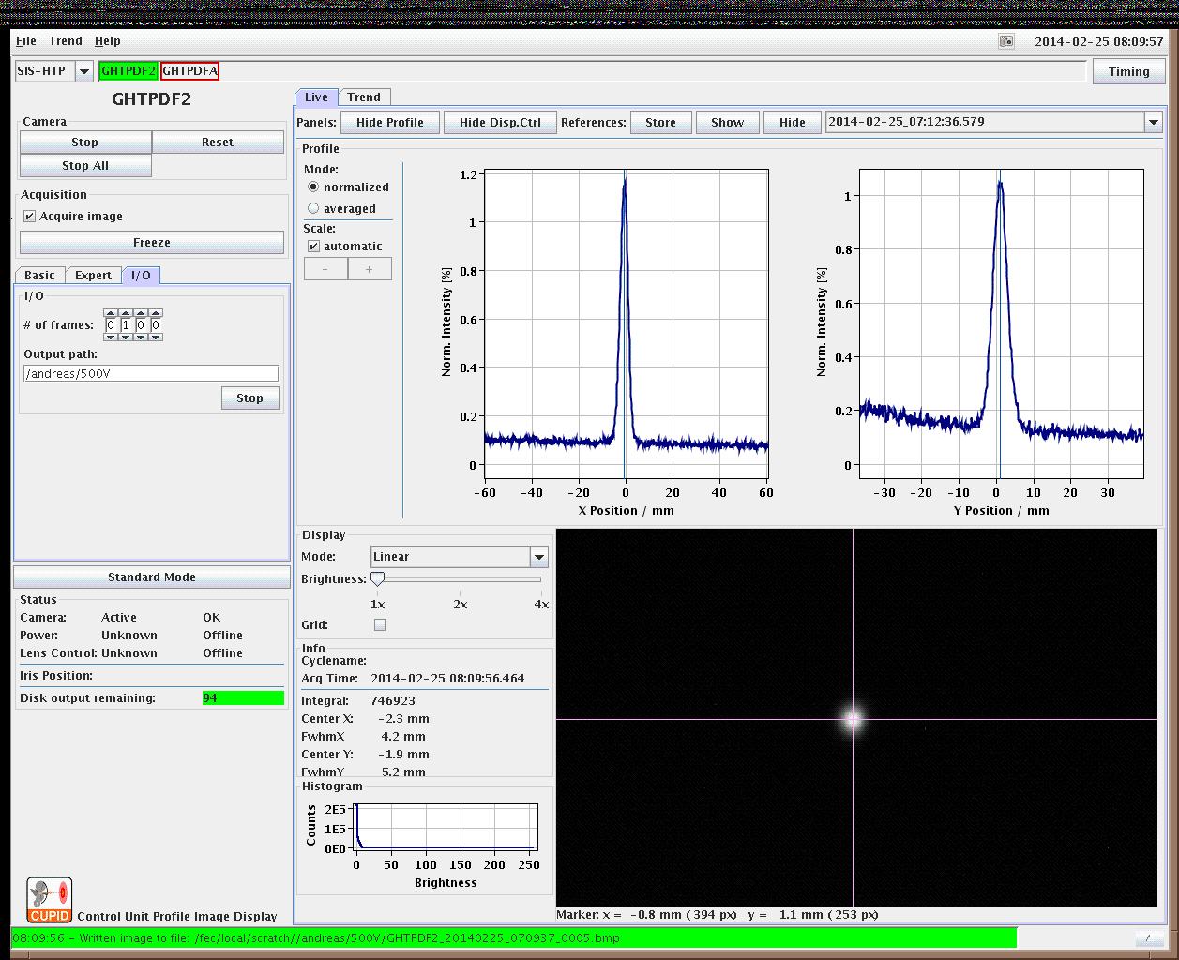
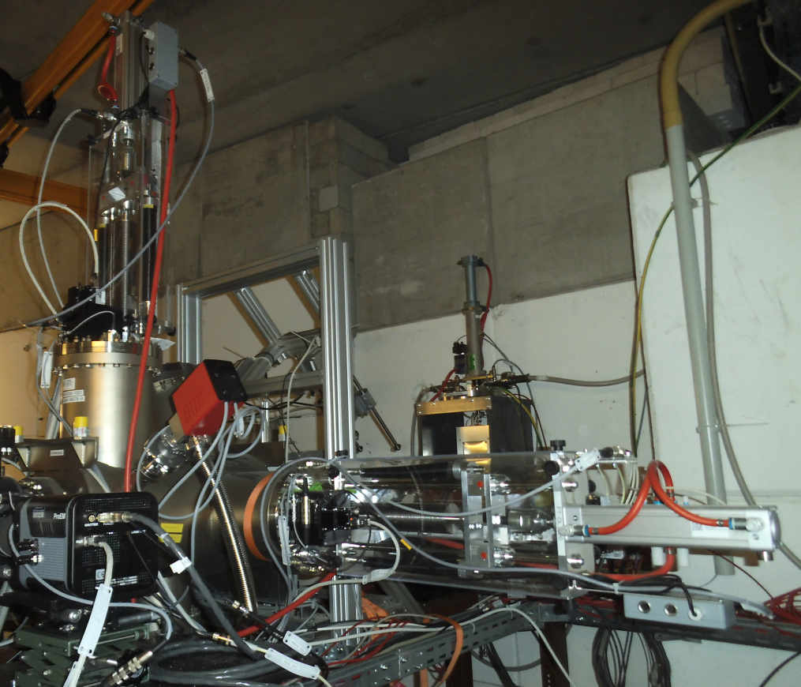
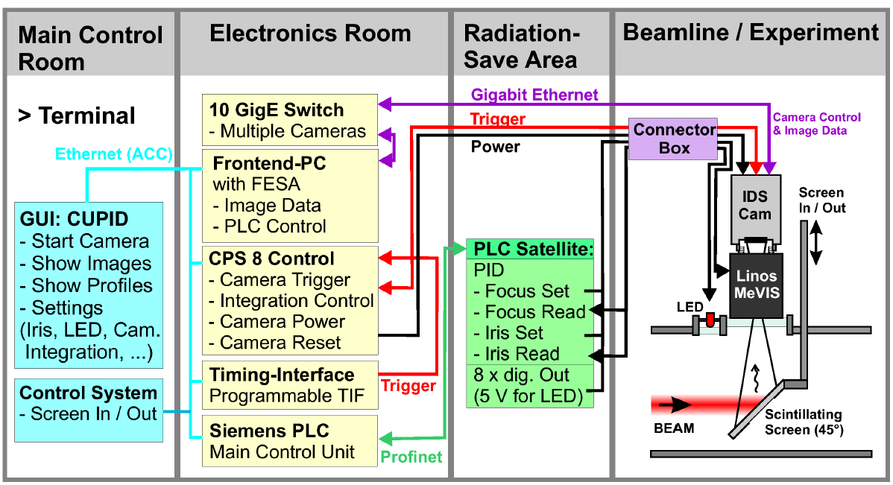
Scintillating Screen (Complete System)
A new, fully FAIR-conformal system for standard scintillating screen based beam diagnostics including digital image acquisition, remote controllable optical system and mechanical design, was set up and commissioned with beam during last beam time in Feb./March 2014. CUPID (Control Unit for Profile and Image Data) is based on the Front-End Software Architecture (FESA) to control beam diagnostic devices.

Slide 28
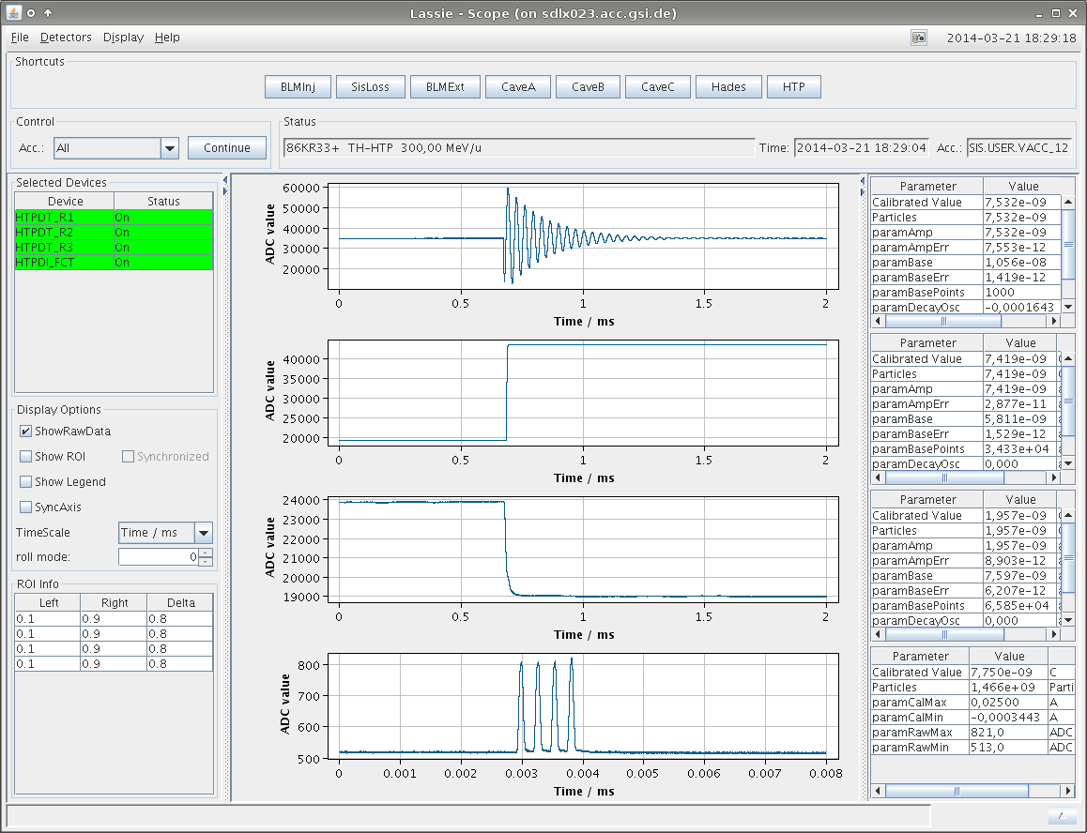
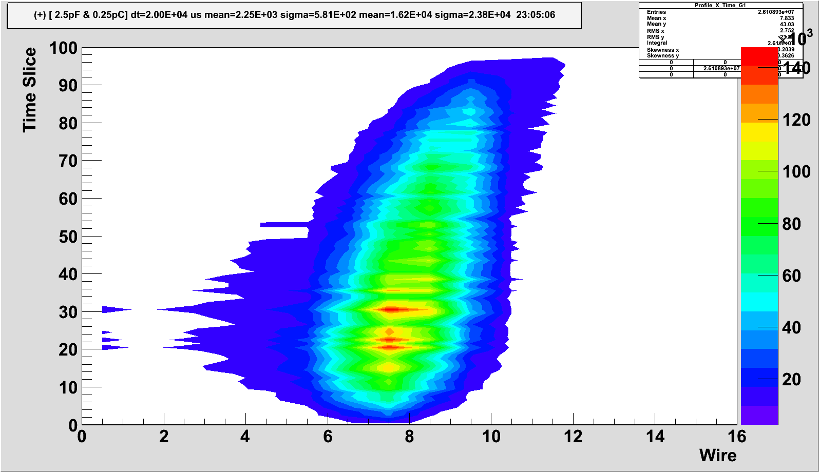
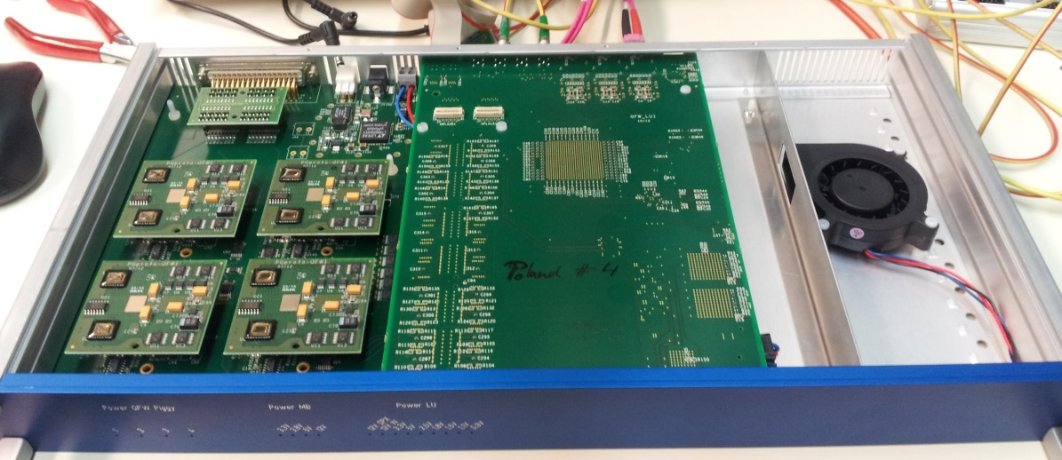
DAQ System
DAQ
BD acquired extensive expertise with the software architecture of the new control system, FrontEnd Software (FESA) as well as expert GUIs
Future software architecture for DAQ and expert GUIs have been implemented for major beam diagnostic devices: beam position monitors, beam transformers, GigE cameras for scintillating screens, counting devices like scintillators, ionization chambers or SEM-Grids
Electronics
Pre-series production and beam test of new MWPC and SEM-Grid electronics
New concept for pneumatic drive and stepping motor control system
1 ∙ 10⁸ Au¹⁸⁺,
300 MeV/u,
slow extr. 1.8s

Slide 29
Outline
Introduction
Magnets and Vacuum Chambers
Power Converters
Beam Diagnostics
Special Installations
  Charge State Stripper
  Halo Collimation Systems
  Safety Beam plugs
  SIS100 Injection/Extraction Beam Dump
Technical System Design
Connection SIS18 – CR
Status HEBT Buildings

Slide 30
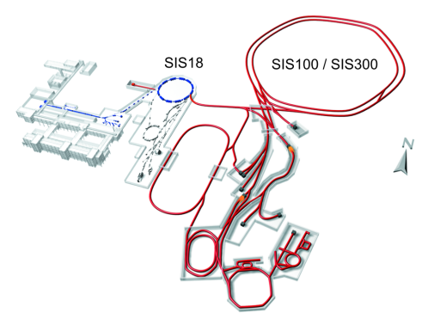
Stripping Stage SIS18 → SIS100
Stripping stage to increase the charge state between SIS18 and SIS100, i.e. U⁷³⁺ → U⁹²⁺
  higher energies for
  CBM-Operation
  H-like ions for atomic
  physics experiments
subsequent: 3 pairs of
collimators, to remove
unwanted charge states

Slide 31
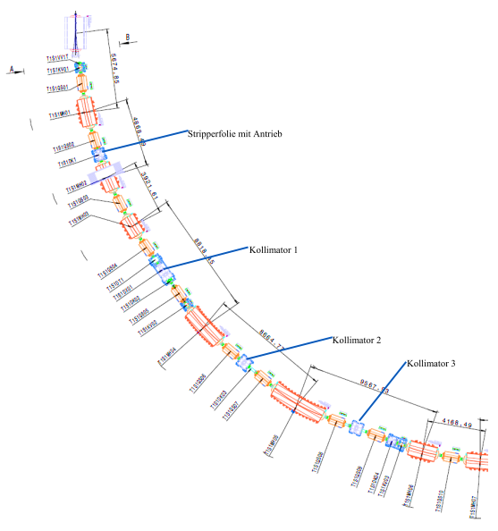
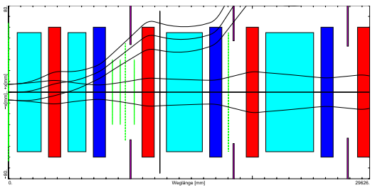

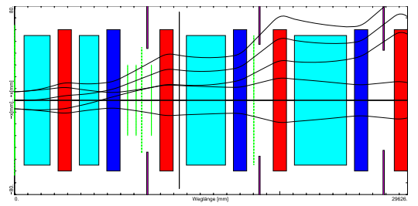

Stripping Stage SIS18 → SIS100
Stripping
stage
Chanel | Fraction
U⁹²⁺ | 87.0%
U⁹¹⁺ | 12.5%
U⁹⁰⁺ | 0.5%
Stripping efficiency
for U⁷³⁺ at 967 MeV
in Nb-foil, 195 mg/cm²
3 collimator pairs

Slide 32
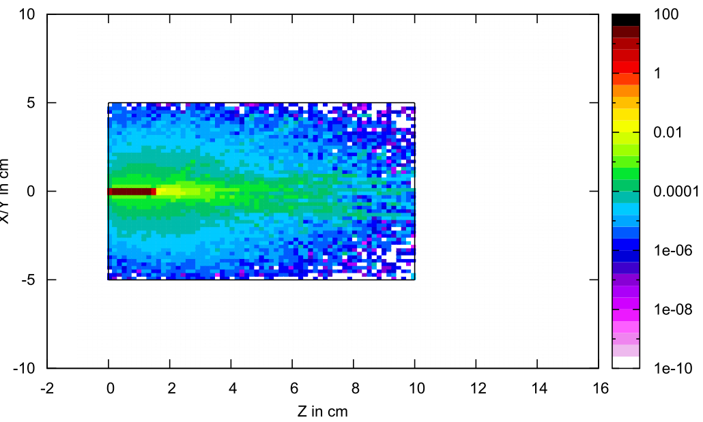
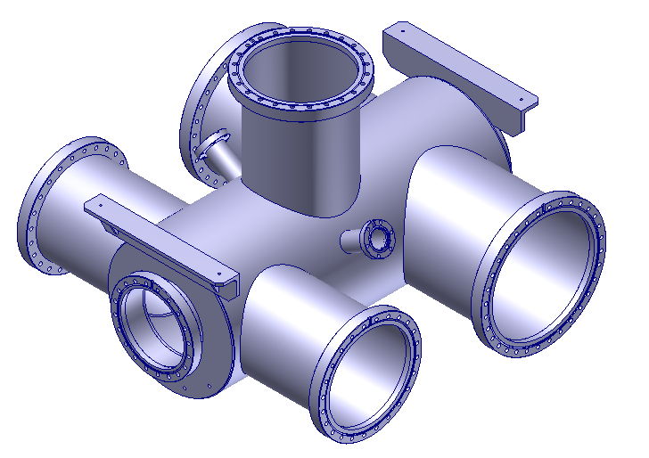
Collimators behind the Stripping Stage
Energydeposition
1 GeV Uranium in Cu
Incident particles of U⁷³⁺ :
  1.25 ∙ 10¹⁰ per shot primary beam
  1.37 ∙ 10⁹ Ions/s primary beam
  → up to 9.4 ∙ 10⁷ Ions/s lost on collimators
  Uranium @ 967 MeV: 3.5 W
Collimators will be installed in
beam diagnostics chambers
Length of 10cm assumed
Next steps:
  Choice of material
  Mechanical design
  Design Stripper Station
beam
CF250
for collimator

Slide 33
Outline
Introduction
Magnets and Vacuum Chambers
Power Converters
Beam Diagnostics
Special Installations
  Charge State Stripper
  Halo Collimation Systems
  Safety Beam plugs
  SIS100 Injection/Extraction Beam Dump
Technical System Design
Connection SIS18 – CR
Status HEBT Buildings

Slide 34
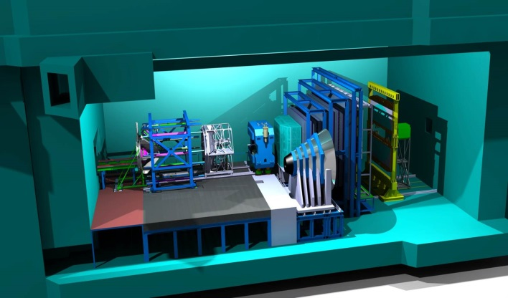
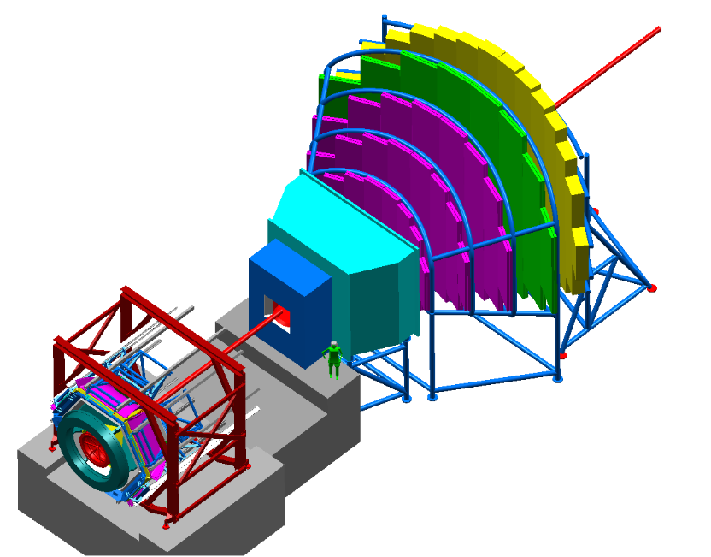

Halo Collimation SIS100 → CBM – Experiment
CBM-Experiment needs a
well collimated beam to
  protect the detectors
  (silicon tracker close to the beam)
  have a minimal background
At 5 mm distance to beam axis
→ intensity < 10⁻⁵
Showers of secondaries out of the collimators
have to be considered
  → collimator can produce background
  for experiment
  Dipole between last collimator and experiment
  to supress this background

Slide 35
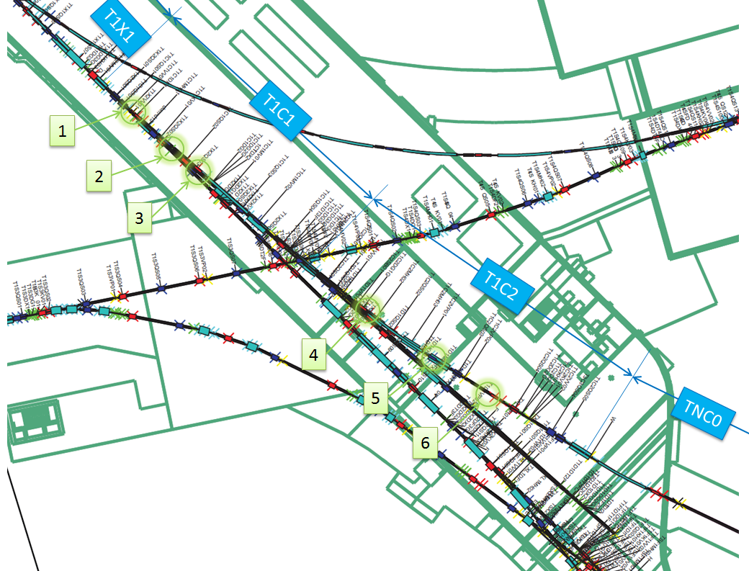
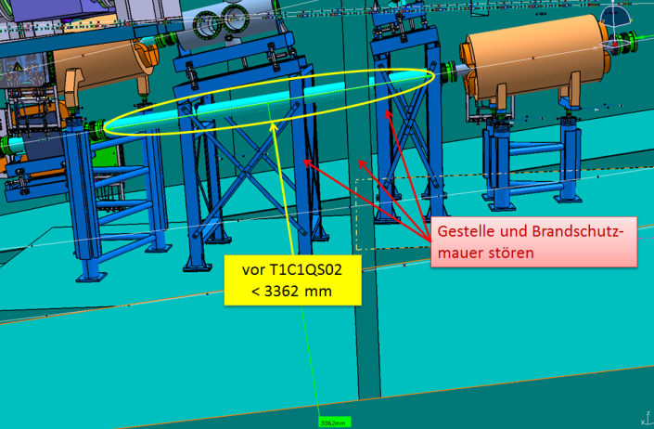
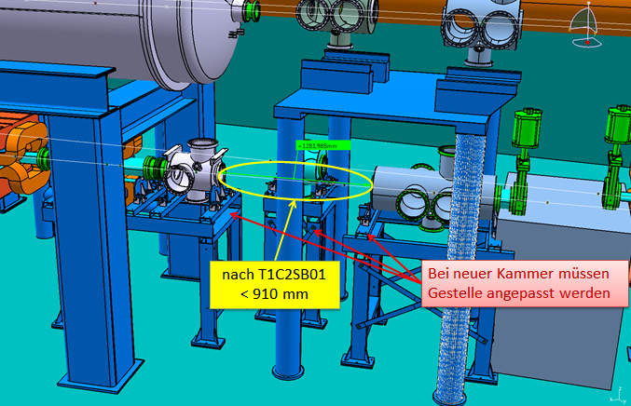
Halo Collimation SIS100 → CBM – Experiment
Appropriate positions for collimation determined by ionoptical calculations
Next steps
  Check of available space
  Tracking calculations of secondaries
  Choice of material
  Mechanical design
to CBM

Slide 36
Outline
Introduction
Magnets and Vacuum Chambers
Power Converters
Beam Diagnostics
Special Installations
  Charge State Stripper
  Halo Collimation Systems
  Safety Beam plugs
  SIS100 Injection/Extraction Beam Dump
Technical System Design
Connection SIS18 – CR
Status HEBT Buildings

Slide 37
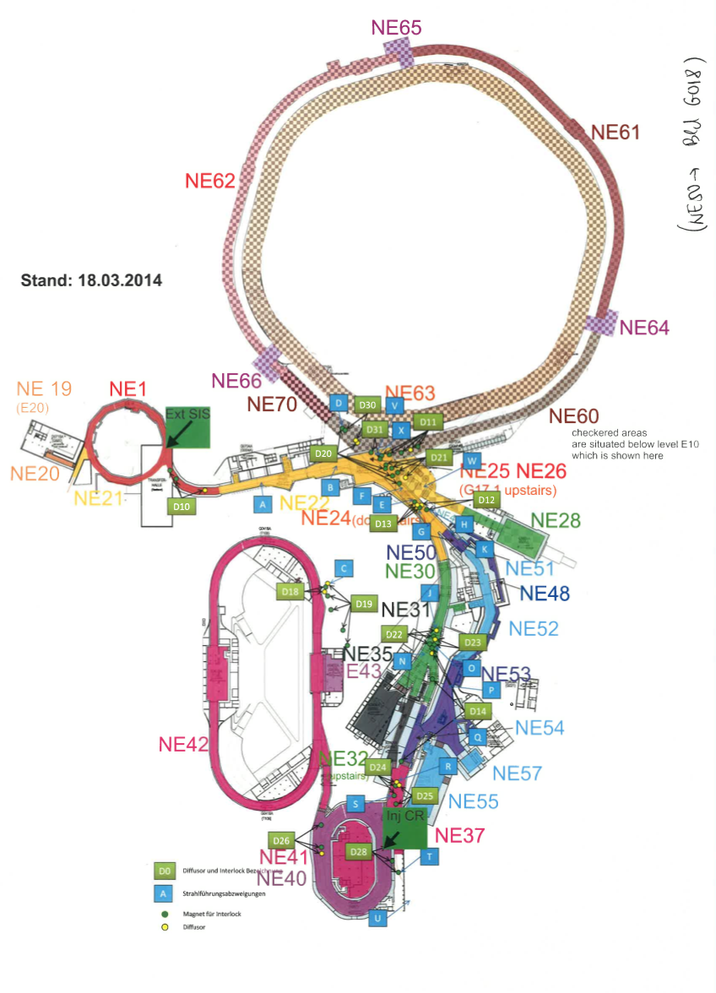
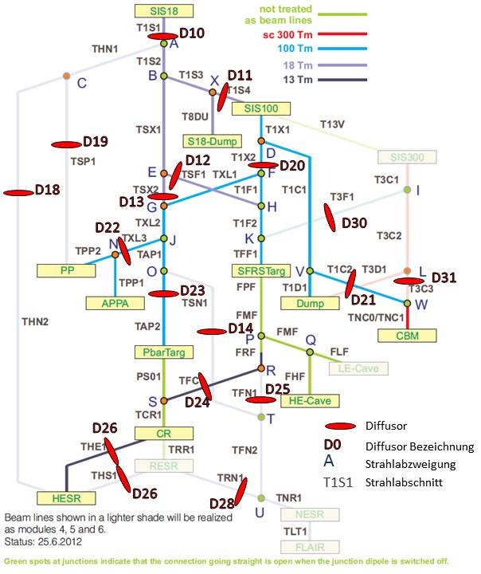
Safety Beam Plugs
Device to protect accessible areas from unwanted beam
→ block which intercepts the beam (accidential scenario!)
  Acess only possible, if dipole magnets in front of area in safe state
  Safety beam plugs provide redundancy to interlock magnets
18 beam plugs forseen
High energy beams can not be stopped completely, production of secondaries
Beam is „diffused“ → safety beam plugs = „diffusor“
D20 currently under investigation

Slide 38
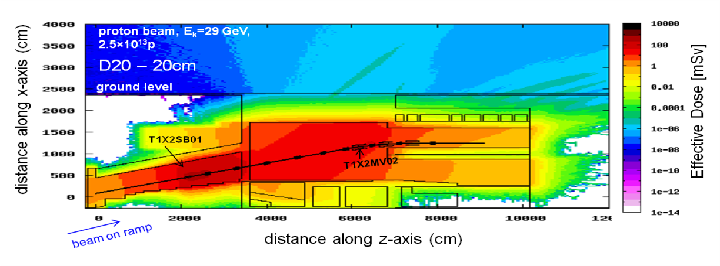

Safety Beam Plugs
Proton beam, E_{k} = 29 GeV, 2.5 x10¹³ p (one shot)
Effective Dose on ground level (G017.1) for different lengths of the diffuser D20 (1m, 0.5m, 0.2m)
Investigation of accessibility of neighbouring areas
G017.1
G004

Slide 39


Safety Beam Plugs
For an accidental scenario with D20, with the (shortest) length of 20 cm:
Effective Dose <1 µSv at the surface (Bld G17, NE25 and NE26)
Effective Dose <80,150 μSv in the underground areas NE50 and NE30, resp. Access to these areas possible.
Next steps
Investigation of the radiation level at different critical positions
Definition of the required length and material
Mechanical design of pneumatic drive and vacuum chamber
Design of drive control (safety aspects have to be considered)

Slide 40
Outline
Introduction
Magnets and Vacuum Chambers
Power Converters
Beam Diagnostics
Special Installations
  Charge State Stripper
  Halo Collimation Systems
  Safety Beam plugs
  SIS100 Injection/Extraction Beam Dump
Technical System Design
Connection SIS18 – CR
Status HEBT Buildings

Slide 41





SIS100 Injection Beam Dump
Located in H0705A (G004) U30
@-19.2m (relative to SIS18 beam height), slope -15°
For set value generation of beamline SIS18 – SIS100
For use with full intensity but reduced repetition rate
Dose rate for p@4.7GeV, 5∙10¹²/s: 50mSv/h, 500mSv/h (in beam direction)
Design – overlapping structure
  36 blocks of concrete, 4 types, m_{max}~3.5to, m_{total}~90to
  30 blocks of iron, 4 types, m_{max}~4.6to, m_{total}~95to
from SIS18
2m
to SIS100
3m
2m
5.65m
H0705A
2m
2m
3m
2m

Slide 42






SIS100 Extraction Beam Dump
Located in K0619A (T112)
@-9.4m (relative to SIS18 beam height), slope -3.333°
For set value generation of SIS100 (and later SIS300)
For use with full intensity but reduced repetition rate
Dose rate for ²³⁸U @2.7GeV/u,1∙10¹¹/s: 500µSv/h, 50µSv/h (in beam direction)
²³⁸U @1.5GeV/u,5∙10¹⁰/s (typ. SFRS)
T112
to CBM
Dump
Design – overlapping structure
  100 blocks of concrete, 5 types, m_{max}~2to, m_{total}~105to(+35to)
  199 blocks of iron, 7 types, m_{max}~3to, m_{total}~520to
  graphite core will be foreseen (SiSt)
1m
4m
2m
4m

Slide 43
Outline
Introduction
Magnets and Vacuum Chambers
Power Converters
Beam Diagnostics
Special Installations
Technical System Design
Connection SIS18 – CR
Status HEBT Buildings

Slide 44



Technical System Design
3D model of the complete HEBT system
Most complex – Central Transfer Building G004
SIS18
SFRS
DUMP
CBM
SIS100/300
SIS100/300

Slide 45

Technical System Design
Central Transfer Building G004
Branching and crossing point for 8 beam lines (full version)
Several beam lines inclined
Components of many other beam lines are transported through this building
pbar, APPA
SIS18
SFRS
CBM
SIS100/300
SIS100/300

Slide 46


Technical System Design
Two advanced design projects with the dept. of computer integrated design of TU Darmstadt
  Draft concept of assembly-, alignment- and disassembly processes in G004
  Draft concept for a transportation unit for assembly and disassembly on the injection and extraction ramp.
At the moment detailed specifications for the design of the support structure for G004 are under preparation – support structure not in costbook
to SFRS
to CBM/ DUMP
from SIS100/SIS300
to SIS100

Slide 47
Outline
Introduction
Magnets and Vacuum Chambers
Power Converters
Beam Diagnostics
Special Installations
Technical System Design
Connection SIS18 – CR
Status HEBT Buildings

Slide 48


Connection SIS18 → CR
current connection scheme
proposed connection scheme
Project lead:
Ions for HESR via CR
Investigate connection SIS18 – CR for MSV

Slide 49


Connection SIS18 → CR
current layout
to NESR (y=+1.2m)
y=+1.2m
in Module 6, bypassing CR
y=0
Δx=2m
y=0
to CR
from SIS18
TSN1
y=+1.2m
y=0
pbar
TAP1
new layout
to NESR (y=+1.2m)
Δx=2m
y=+1.7m
proposed for MSV (M0-3)
y=0
FREX
TSR1
y=0
to CR
TSN1
TSN2
y=+1.7m
TFC1
from SIS18
y=0
pbar
TAP1

Slide 50

Connection SIS18 → CR
T103
„no“ modification of building planning required
(new)
2m
TSR1
TSN1MH02
T113
(old)
TSN1

Slide 51
Connection SIS18 → CR
ion optical layout
check mechanical integration
„no“ (minor,CR138) modification at building T113
cost estimation (2005) 1.8 – 2.1 M€ (only HEBT)
include beam line into MSV?

Slide 52
Outline
Introduction
Magnets and Vacuum Chambers
Power Converters
Beam Diagnostics
Special Installations
Technical System Design
Connection SIS18 – CR
Status HEBT Buildings

Slide 53

HEBT Buildings
HEBT Buildings T101, T104, T106, T112, T113, G004, G004A
Execution planning
approval 2nd preliminary building shell summer 2013
2nd collision check DMU/building end 2013/beginning 2014
G004:
3rd preliminary building shell 12/2013
T106:
3rd preliminary building shell 01/2014
intermediate status TGA 03/2014
preliminary collision check DMU/building/TGA 03/2014
T101, G004A:
4th preliminary building shell 01/2014
intermediate status TGA 03/2014
preliminary collision check DMU/building/TGA 03/2014
5th preliminary building shell 05/2014
approval building shell plans until mid June
T110
T112
G017.1
G018
G004
T104
G004A
T113
T108N
G050
T101
G0
06C
T103
with HEBT Beamline
T106
with HEBT Supply
T108S
G0
07
GAP HEBT
53

Slide 54
Summary
Procurement of material and manufacturing of tooling pre-series magnets done/in work
Delivery of pre-series magnets and vacuum chambers expected for Q1/2015
Detailed Specs Batch2 close to release (30.05.); draft contract in preparation and will be sent to Efremov/BINP in June
Preparation Detailed Specs Batch3
Production plan for Batch1-3 sorted according to HEBTA/B/C needed
Contract on 78 Quadrupole Power Converters closed with Bose Institute/ECIL
Preparation Detailed Specs Dipole Power Converter
Progress in many fields of Beam Diagnostics (DAQ, electronics, Scintillating Screens, ....)
Detailed, technical drawings and specification (all released) of standard diagnostic chambers delivered to Indian shareholder
Completion of physical and design parameters of Special Installations
Proposal worked out to deliver Ions to HESR (via CR) – include into MSV?
Approval of building shell plans of T101, G004A until mid of June
Revision of MS-Project Plans in work
 | Primary Beams |  | Secondary Beams
status 26.05.2014 | HEBT A | HEBT B | HEBT C
M11 Magnets | 10/2018 | 12/2018 | 09/2019

Slide 55
Thank you
for your attention
and thanks to all colleagues from GSI, FAIR and international partners for their work and support for this presentation.

Slide 56
Backup

Slide 57
Magnets Batch 1 – 3

Slide 58

Operation Mode
Some sections are shared in a pulse to pulse mode by different beams with different targets and different magnetic rigidities, e.g :
Unilac
p-Linac
SIS18
SIS100
CR
HESR
D. Ondreka
pbar + RIB fixed target (U²⁸⁺) + AP (HE)
Parallel Operation requires pulsing of sections and switching between the sections with divider/combiner dipoles ➔ ‚fast‘ magnets
Some sections don‘t have to be pulsed (e.g. target-section, 13Tm, 300Tm) ➔ ‚slow‘ magnets

Slide 59





Halo collimation SIS100 → CBM – Experiment
Collimation in both transversal planes required
  Phase space needs to be cutted in position and angle
  Two different collimator positions required
225.7 m
CBM-Target
X
81.5 m of beam line
Y

Slide 60



Safety Beam Plugs
1dim projection along z – Tunnel 104 + NE50 (G018)
Maximum Effective Dose values :
<50 mSv after the first 4m length of Tunnel 104
<80 μSv along NE50 (G018)
1dim projection along the 80 m long Tunnel113 with NE30
Maximum Effective Dose values:
<0.7 mSv along the Tunnel 113;
<150 μSv along NE30 (Tunnel T113)

Slide 61



Cryo Current Comparator
Beam test with new SQUID electronics
Construction work preparation for new cryostat
Plot of a ~1 nA current signals which are produced by bunched beam of 109 particles of Ni26+ at an energy of 600 MeV extracted from SIS18. The beam is extracted with an extraction time of 500ms.

