Slide 1
ALFA - a common concurrency framework for ALICE and FAIR experiments
Mohammad Al-Turany
GSI-IT/CERN-PH

Slide 2
ALFA: New ALICE-FAIR framework
Motivation for ALFA
ALFA and FairRoot
Transport layer
Serializing message data
Deployment system
Examples
Summary

Slide 3
How it comes?
FairRoot (2013)
Concurrency is an issue
Online and offline can be joined
ALICE O² Project started (2013)
DAQ, Online and Offline : Together on one Framework

Slide 4
Similar online system requirements by ALICE and FAIR experiments

Slide 5
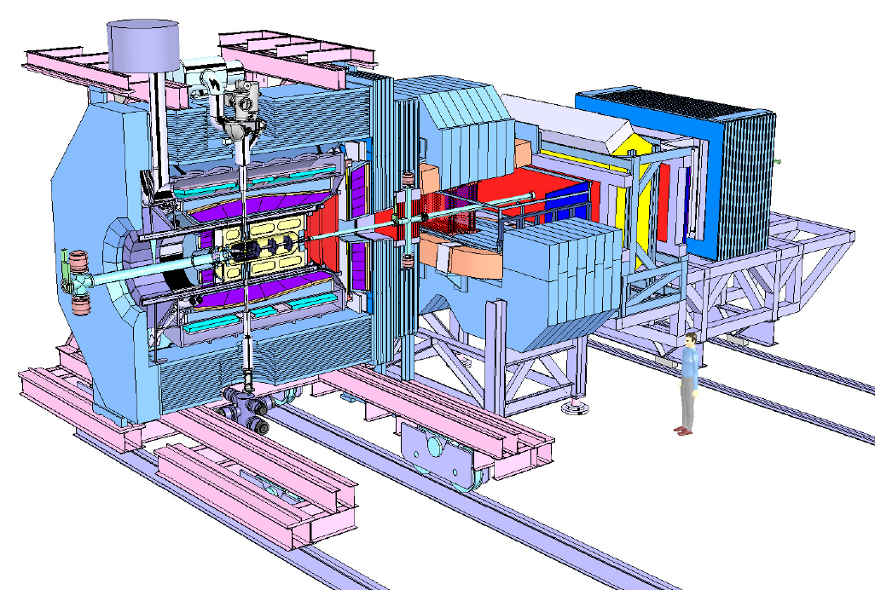
Online System Requirements PANDA
Interaction rates of 20 MHz (50 MHz peak)
Event size of 4-10 kB
data rates after front end preprocessing: 80GB/s ‐300 GB/s
No hardware trigger:
Autonomous recording frontends
Event selection in compute nodes

Slide 6
Online System Requirements CBM
At 10 MHz, online data reduction by 1000 is mandatory (1 TB/s)
Trigger signatures are complex (open charm) and require partial event reconstruction
No a-priori association of signals to physical events!
Need extremely fast reconstruction algorithms!

Slide 7
Online System Requirements ALICE Run3:
Sample full 50kHz Pb-Pb interaction rate (current limit at ~500Hz, factor 100 increase)
⇨ ~1.1 TByte/s detector readout but the ALICE data processing power capacity will not allow more than a Storage bandwidth of ~20 GByte/s

Slide 8
Strategy
Massive data volume reduction
Data reduction by (partial) online reconstruction and compression
Much tighter coupling between online and offline reconstruction software

Slide 9
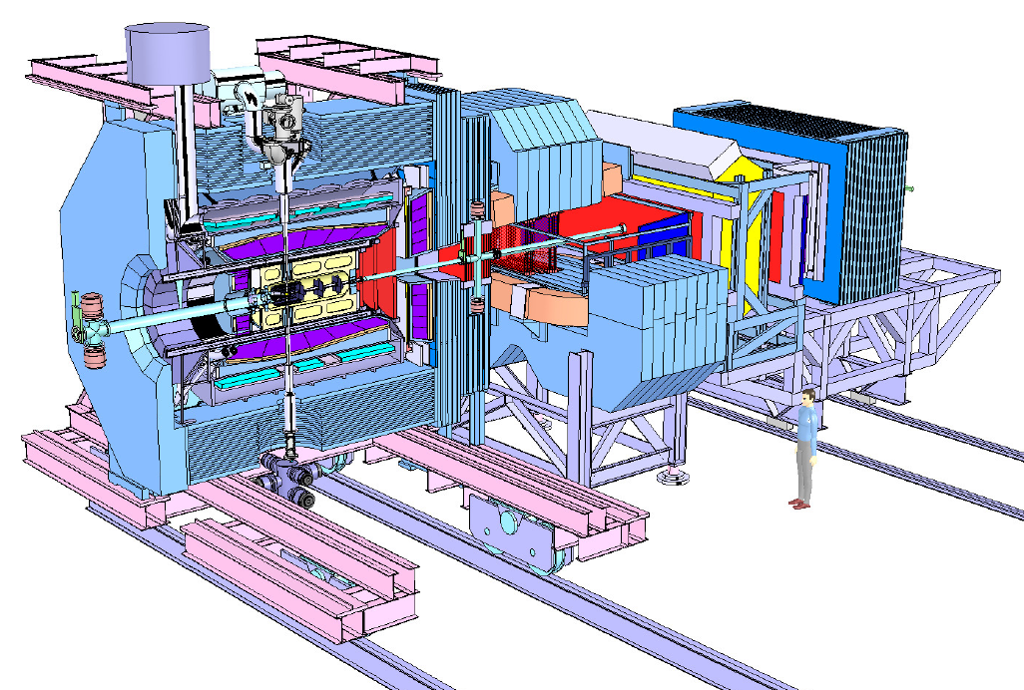
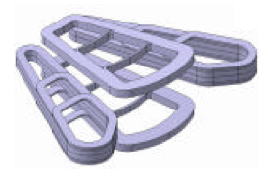
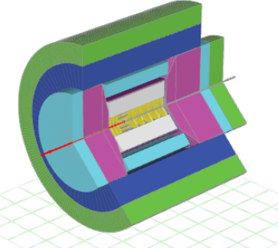
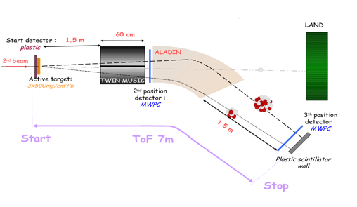
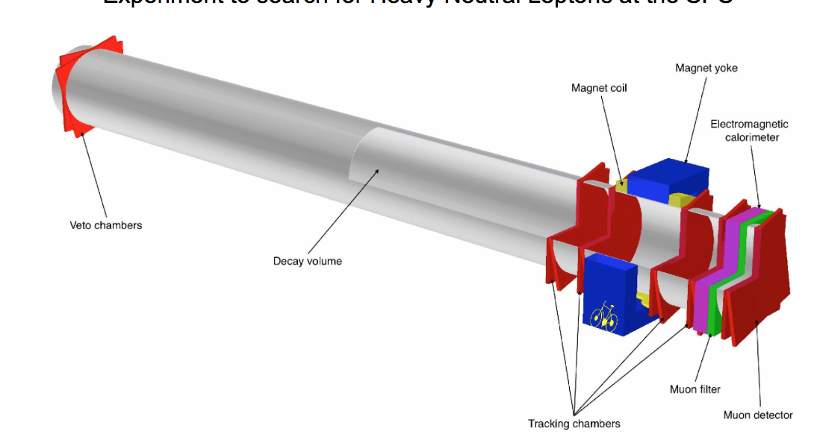
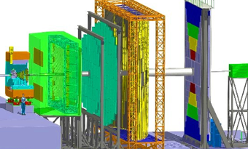
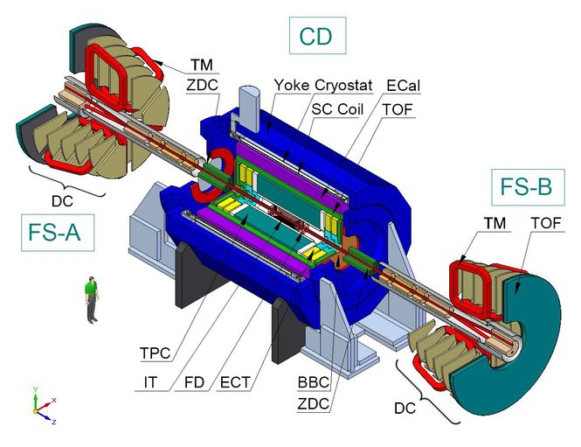
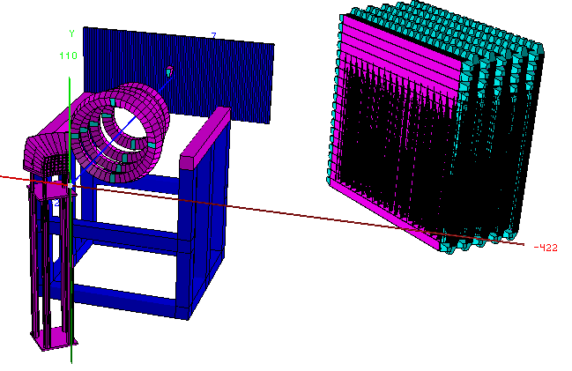
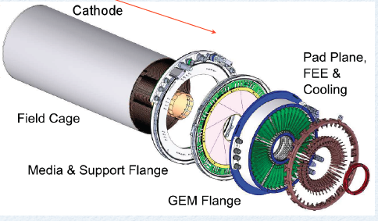
FairRoot
Start testing the VMC concept for CBM
Panda decided to join->
FairRoot: same Base package for different experiments
EIC (Electron Ion Collider BNL)
EICRoot
R3B joined
SOFIA (Studies On Fission with Aladin)
SHIP - Search for HIdden Particles
2004
2006
2010
2011
2012
2013
2014
First Release of CbmRoot
MPD (NICA) start also using FairRoot
GEM-TPC seperated from PANDA branch (FOPIRoot)
ENSAR-ROOT
Collection of modules used by structural nuclear phsyics exp.
ASYEOS joined
(ASYEOSRoot)

Slide 10
Current status of FairRoot
CbmRoot
R3BRoot
SofiaRoot
MPDRoot
PandaRoot
AsyEosRoot
FopiRoot
EICRoot
FairRoot
Run Manager
IO Manager
MC Application
Event Display
Runtime DB
DB Interface
Task
Magnetic Field
Module
Detector
Event
Generator
…
…
Root
Libraries
Cint
ROOT IO
TTree
TGeo
TVirtualMC
TEve
Proof
Geant4
Genat4_VMC
Geant3
VGM
…
…
5/18/13
M. Al-Turany, ACAT 2013, Beijing
Florian Uhlig ROOT Users Workshop, Saas Fee

Slide 11
ALICE and FAIR: Why?
A common framework will be beneficial for the FAIR experiments since it will be tested with real data and existing detectors before the start of the FAIR facility.
E.g.: Concepts for online calibrations and alignment can be tested in a real environment, similar to that of the planned FAIR experiments.
ALICE will benefit from the work already performed by the FairRoot team concerning already implemented features (e.g. the continuous read-out, building and testing system, etc)

Slide 12
Who is going to collaborate on ALFA
ALICE DAQ
ALICE HLT
ALICE Offline
FairRoot
Fair and Non-Fair experiments are welcome to join

Slide 13
ALFA
Common layer for parallel processing.
Common algorithms for data processing.
Common treatment of conditions database.
Common deployment and monitoring infrastructure.

Slide 14
ALFA
Will rely on a data-flow based model (Message Queues).
It will contain
Transport layer (based on: ZeroMQ, NanoMSG)
Configuration tools
Management and monitoring tools
Provide unified access to configuration parameters and databases.
It will include support for a heterogeneous and distributed computing system.
Incorporate common data processing components

Slide 15
Correct balance between reliability and performance
Multi-process concept with message queues for data exchange
Each "Task" is a separate process, which can be also multithreaded, and the data exchange between the different tasks is done via messages.
Different topologies of tasks that can be adapted to the problem itself, and the hardware capabilities.

Slide 16
FairRoot is undergoing a re-design process to make it more modular
CbmRoot
R3BRoot
SofiaRoot
MPDRoot
PandaRoot
AsyEosRoot
FopiRoot
EICRoot
Building configuraion
Testing
Transport (FairMQ)
Runtime DB
Fair DB
Module
Detector
MC Application
Magnetic Field
Event
Generator
Libraries
ROOT
ZeroMQ
CMake
Geant4
Genat4_VMC
Geant3
VGM
…

Slide 17
How is it with ALFA and FairRoot?
AliRoot6 (O²)
CbmRoot
R3BRoot
SofiaRoot
MPDRoot
PandaRoot
AsyEosRoot
FopiRoot
EICRoot
ALFA
FairRoot
????
DDS
Building configuraion
Testing
Fair MQ
Fair DB
MC Application
Module
Detector
Magnetic Field
Event
Generator
Runtime DB
Libraries and Tools
Protocol Buffers
BOOST
ROOT
ZeroMQ
CMake
Geant4
Genat4_VMC
Geant3
VGM
…

Slide 18
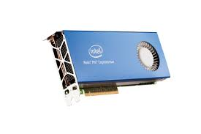
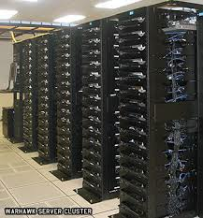
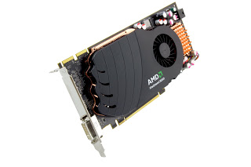
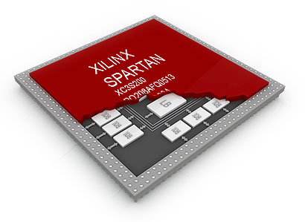
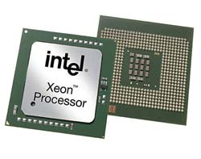
ALFA will use ZMQ to connect different pieces together
BSD sockets API
Bindings for 30+ languages
Lockless and Fast
Automatic re-connection
Multiplexed I/O

Slide 19
BUT: nanomsg is under development by the original author of ZeroMQ
Pluggable Transports:
ZeroMQ has no formal API for adding new transports (Infiniband, WebSeockets, etc). nanomsg defines such API, which simplifies implementation of new transports.
Zero-Copy:
Better zero-copy support with RDMA and shared memory, which will improve transfer rates for larger data for inter-process communication.
Simpler interface:
simplifies some zeromq concepts and API, for example, it no longer needs Context class.
Numerous other improvements, described here: http://nanomsg.org/documentation-zeromq.html
FairRoot is independent from the transport library
Modular/Pluggable/Switchable transport libraries.

Slide 20
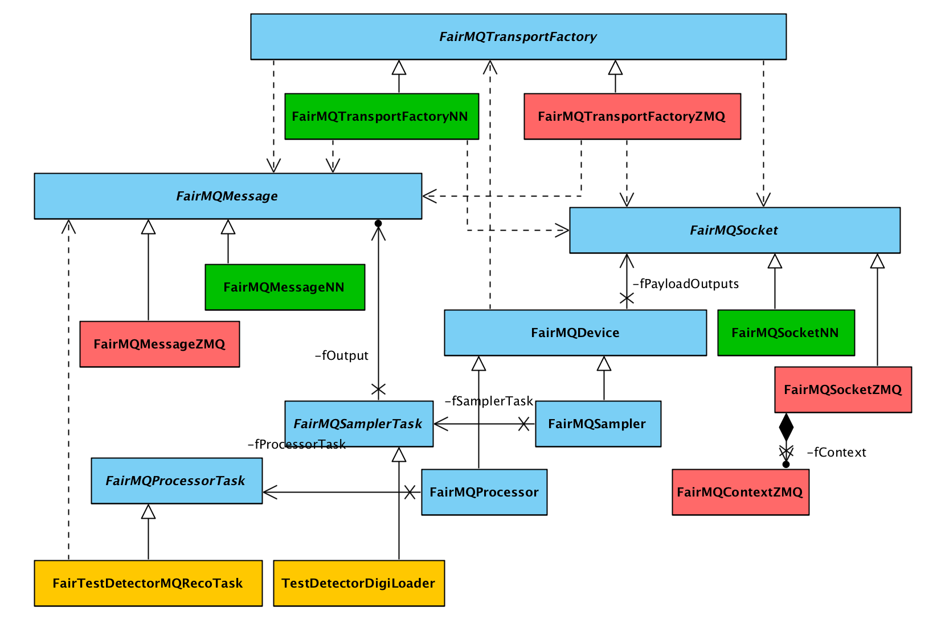
ALFA has an abstract transport layer

Slide 21
How the different processes are going to communicate with each other?
Different languages and hardware are possible how should the data exchange be done?
Schema evolution?

Slide 22
Protocol buffers
Google Protocol Buffers support is now implemented
Example in Tutorial 3 in FairRoot.
To use protobuf, run cmake as follows:
cmake -DUSE_PROTOBUF=1

Slide 23
Boost serialization
Code portability - depend only on ANSI C++ facilities.
Code economy - exploit features of C++ such as RTTI, templates, and multiple inheritance, etc. where appropriate to make code shorter and simpler to use.
Independent versioning for each class definition. That is, when a class definition changed, older files can still be imported to the new version of the class.
Deep pointer save and restore. That is, save and restore of pointers saves and restores the data pointed to.
….
http://www.boost.org/doc/libs/1_55_0/libs/serialization/doc/index.html
This is used already by the CBM Online group in Frankfurt and to we need
it to exchange data with them!

Slide 24
Protobuf, Boost or Manual serialization?
Boost:
we are generic in the tasks but intrusive in the data classes (digi, hit, timestamp)
Manual and Protobuf
we are generic in the class but intrusive in the tasks (need to fill/access payloads from class with set/get x, y, z etc ).
Manual method is still the fastest, protobuf is 20% slower and boost is 30% slower.
preliminary

Slide 25
How to deploy ALFA on a laptop, few PCs or a cluster?
We need to utilize any RMS (Resource Management system)
We should also run with out RMS
Support different topologies and process dependencies

Slide 26
How to deploy ALFA on a laptop, few PCs or a cluster?
We have to develop a dynamic deployment system (DDS):
An independent set of utilities and interfaces, which provide a dynamic distribution of different user processes by any given topology on any RMS.

Slide 27
The Dynamic Deployment System (DDS) Should:
Deploy task or set of tasks
Use (utilize) any RMS (Slurm, Grid Engine, … ),
Secure execution of nodes (watchdog),
Support different topologies and task dependencies
Support a central log engine
….
See Talk by Anar Manafov on Alice Offline week (March 2014)
https://indico.cern.ch/event/305441/

Slide 28
Elements of the topology
#### Task
* A task is a single entity of the system.
* A task can be an executable or a script.
* A task is defined by a user with a set of props and rules.
* Each task will have a dedicated DDS watchdog process.
#### Collection
* A set of tasks that have to be executed on the same physical computing node.
#### Group
* A container for tasks and collections.
* Only main group can contain other groups.
* Only group define multiplication factor for all its daughter elements.

Slide 29
MAIN
TASK_1
COLLECTION_1
GROUP_1
N=10
TASK_1
TASK_2
TASK_5
TASK_6
TASK_5
TASK_3
TASK_4
COLLECTION_2
TASK_2
TASK_7

Slide 30
Current Status
The Framework delivers some components which can be connected to each other in order to construct a processing pipeline(s).
All components share a common base called Device
Devices are grouped by three categories:
Source:
Data Readers (Simulated, raw)
Message-based Processor:
Sink, Splitter, Merger, Buffer, Proxy
Content-based Processor:
Processor

Slide 31
Using multi-part messages
It allows us to concatenate multiple messages into a single message without copying
All parts of the message are treated as a single atomic unit of transfer, however the boundaries between message parts are strictly preserved
A multi-part message is a message that has more than one frame. ZeroMQ sends this message as a single on-the-wire message and guarantees to deliver all the message parts (one or more), or none of them.

Slide 32
We need a proto type for ALICE O2 is under development

Slide 33
O2Merger
FLP
FLP
Merger
FLP
for(int i = 0; i < fNumInputs; i++) {
if (poller->CheckInput(i)){
received = fPayloadInputs->at(i)->Receive(msg);
}
if (received) {
if(i<NoOfMsgParts){
fPayloadOutputs->at(0)->Send(msg, ZMQ_SNDMORE);
}else{
fPayloadOutputs->at(0)->Send(msg);
}
received = false;
}
}
"Hold on! There are more data going to be added to this message!"

Slide 34
EPN
EPN can be added on the fly
EPN
FLP
EPN
FLP
Merger
EPN
FLP
EPN
New example (flp2epn) https://github.com/MohammadAlTurany/FairRoot/tree/NewMQEx/example/flp2epn
EPN

Slide 35
EPN
Multiple mergers are also possible
EPN
FLP
Merger
EPN
FLP
Merger
EPN
FLP
EPN
EPN

Slide 36
Summary
The AlFA project is starting
The Communication layer is ready to use
Different data serialization methods are available
DDS and Topology parser are under development

Slide 37
Backup and Discussion

Slide 38
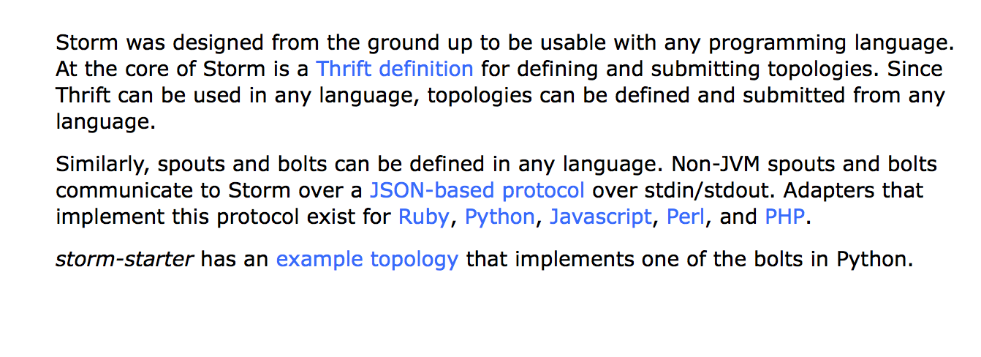
STORM is a very attractive option but no native support for C++ !
http://storm.incubator.apache.org/about/multi-language.html

Slide 39
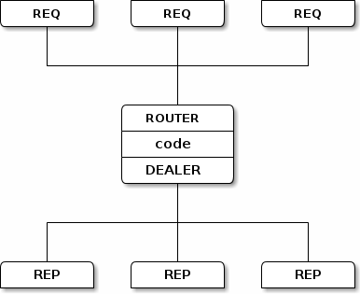
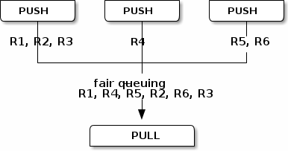
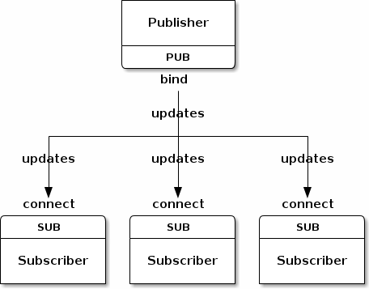
The built-in core ØMQ patterns are:
Request-reply, which connects a set of clients to a set of services. (remote procedure call and task distribution pattern)
Publish-subscribe, which connects a set of publishers to a set of subscribers. (data distribution pattern)
Pipeline, which connects nodes in a fan-out / fan-in pattern that can have multiple steps, and loops. (Parallel task distribution and collection pattern)
Exclusive pair, which connect two sockets exclusively

