Slide 1

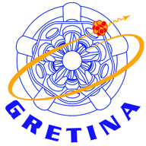


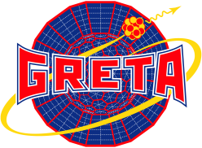



Studies of exotic nuclei: state-of-the-art tools and techniques
Stefanos Paschalis
Technical University of Darmstadt
R³B collaboration
September 21-28 2014, Vierti sul Mare, “FAIRNESS Workshop”

Slide 2
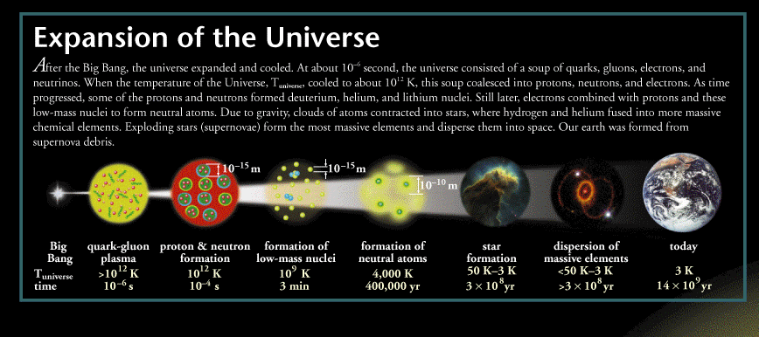
The nucleus in scale
http://www2.lbl.gov/abc/wallchart/

Slide 3
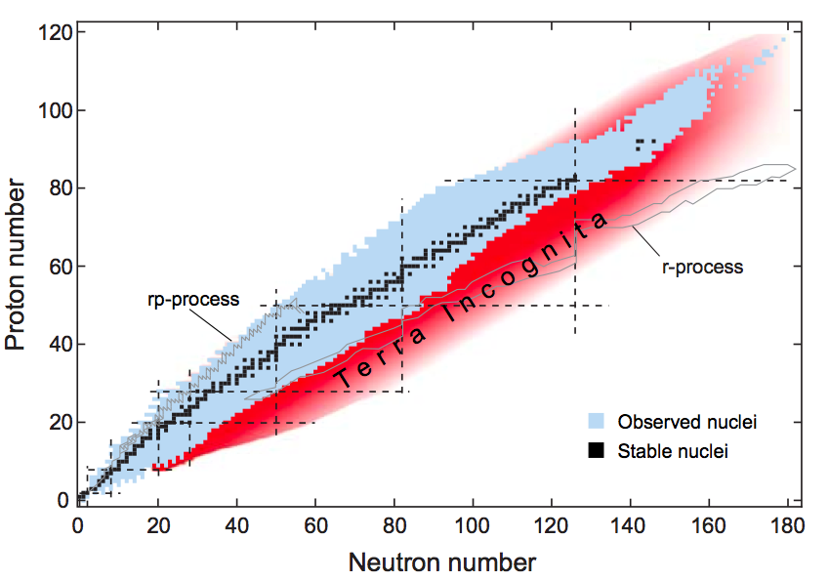
What are exotic nuclei?
Exotic: Short lived, not found on earth
There are ~ 300 stable nuclei (black).
There are ~ 3500 known unstable nuclei.
Picture from
ISF at MSU document
Notes:
Modified From ISF at MSU:
Nuclei are formed from protons and neutrons.
Of all the combinations of protons and neutrons, fewer than 300 form stable nuclei.
These stable isotopes lie along the line of stability, also referred to as the valley of stability. In this chart, which has axes the neutron and proton numbers, the stable nuclei are indicated with black colour. Some distance from this valley lie the proton and neutron drip lines, beyond which no bound system can be formed since nuclei are not particle stable. The region in between the drip lines and the stability line is filled with radioactive isotopes with lifetimes ranging from milliseconds to billions of years.
Most of these radioactive isotopes are exotic nuclei which have decayed in our solar system and hence do not normally exist on Earth.

Slide 4
Why do we study exotic nuclei?
Exotic nuclei are continually created and play a fleeting though important role in the cosmos
Nuclei are unique mesoscopic systems such as atomic clusters or quantum dots that are important in other fields of physics today
Fertile ground to study new quantum phenomena, weak binding
Major advances in many-body theory should result from investigations of nuclei with very different proton-to-neutron admixtures

Slide 5
To understand the origin of elements

Slide 6
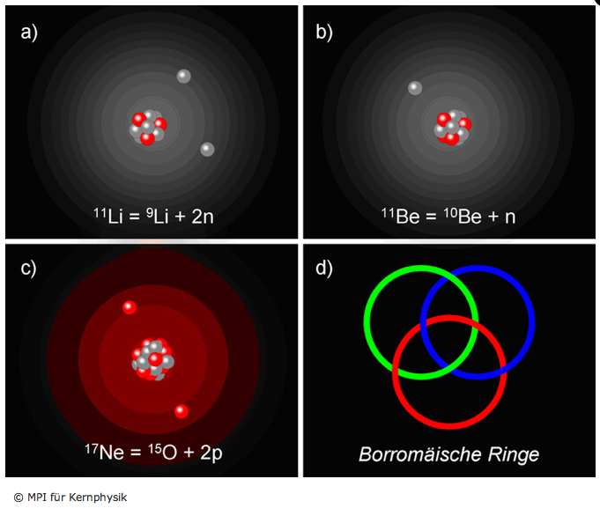
To investigate new phenomena: e.g. nuclear halo structure
Notes:
Suzuki book modified:
Much of the increased cross section comes from neutron-removal channels. Moreover, for these nuclei, the momentum distribution of the valence nucleon was measured to be narrow. According to the uncertainty principle, this implies large spatial distribution of the neutron(s) removed, with respect to the residue. These observations can be account for by the hypothesis that these nuclei have 'neutron halos’, where one or two nucleons orbit around a compact core in extremely extensive orbits and with small separation energies. The nuclear halo is a quantum effect where due to the small separation energies the exponential wave function tail extends way beyond the classically forbidden region.
Several experiments have now found results consistent with a halo nucleus image and a have identified new halo nuclei with the latest and heaviest one being 22C. All halo nuclei lie close to the drip line. Also in most cases the halo consists of two nucleons and the removal of one of them causes the nucleus to be unstable and to emit the other one.
Such bound quantum system consisting of three subsystems any two of which cannot form a bound state is known as a Borromean system. Originally referring to three rings each of which is interlaced with the other two such that by braking any of them the other two also release each other.

Slide 7
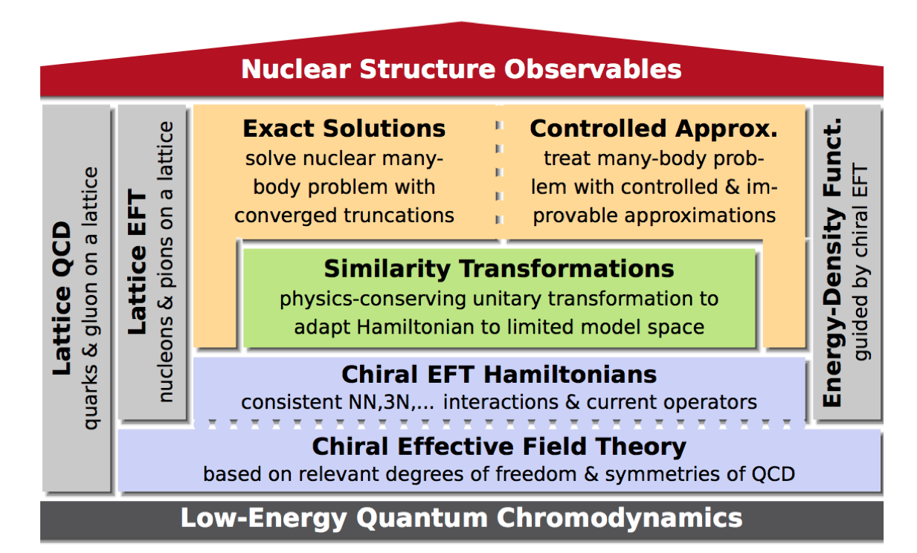
To test state-of-the-art nuclear theories
R. Roth, TU Darmstadt

Slide 8
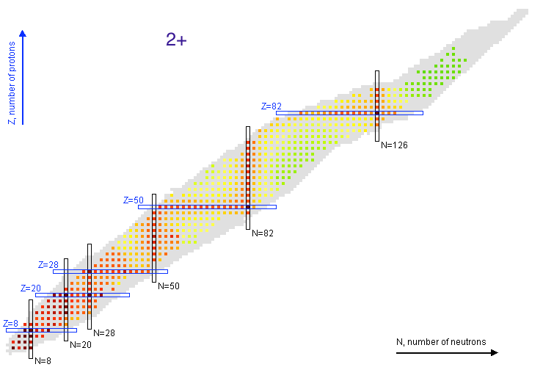
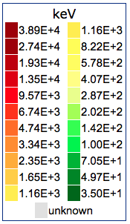
Nuclear chart
The energy of the first excited 2⁺ state
From NNDC

Slide 9
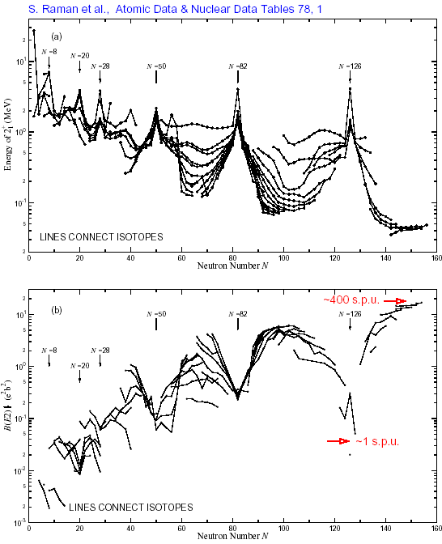
Nuclear chart
The energy of the first excited 2⁺ state
From NNDC

Slide 10
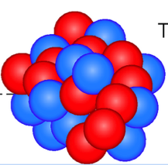
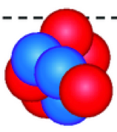
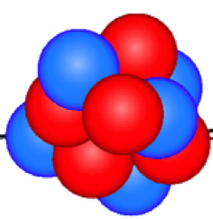
Ok, exotic nuclei are interesting… but how do we produce them?
Mainly two ways:
production at rest followed by Isotope-Separation-On-Line (ISOL-technique)
production and separation in flight using heavier ions (fragmentation technique)
primary beam
secondary beam
(includes exotic species)
fragment separator
secondary target:
to study
the exotic nucleus
primary target:
to fragment the beam

Slide 11
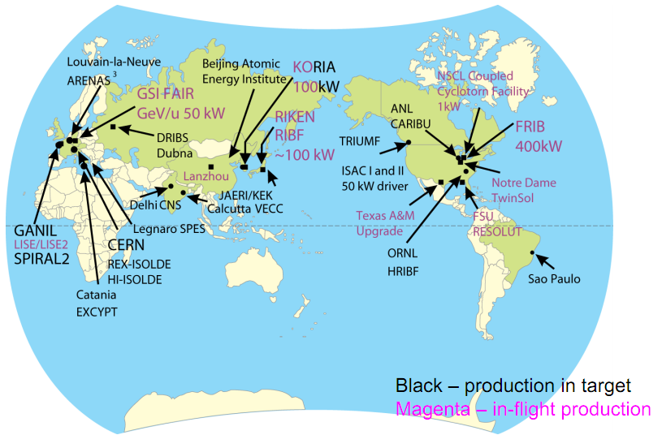
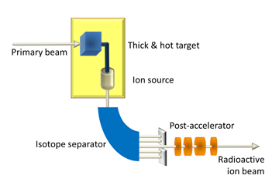
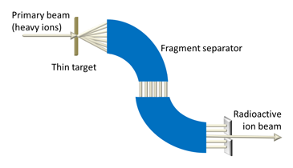
New RIB facilities give us access to exotic nuclei
RIB facilities | Upgrades
GSI | FAIR
NSCL/MSU | FRIB
GANIL | SPIRAL 2
REX-ISOLDE | HI-ISOLDE
ISAC TRIUMF | ISAC II
RIKEN | RIBF
Notes:
The exciting new physics which has been revealed from studies of exotic nuclei has lead to major upgrades in most of the existing RIB facilities worldwide, such as...
Two major techniques of radioactive isotope production and separation are currently pursued worldwide: production at rest followed by Isotope-Separation-On-Line (ISOL-technique) and production and separation in flight using heavy ions, also known as fragmentation technique. The work presented in this talk and most examples used are from facilities using the fragmentation technique.
As briefly mentioned earlier: in the example of the first radioactive beam experiment by Tanihata and col. the fragmentation technique involves accelerating heavy ions to intermediate energies (~100−1000 MeV/nucleon) and producing fast moving secondary nuclei in a production target. The fast moving rare isotopes are separated in flight using a fragment separator. The fragmentation technique allows for sub-microsecond isotope separation and is the technique of choice for experiments requiring energetic beams, such as knockout reactions. The fragmentation technique is preferred for studying very short-lived isotopes and rare isotopes that are difficult to access with the ISOL technique. On the other hand ISOl technique has its own advantages over the in-flight on, such as beam higher quality and intensity(?)

Slide 12
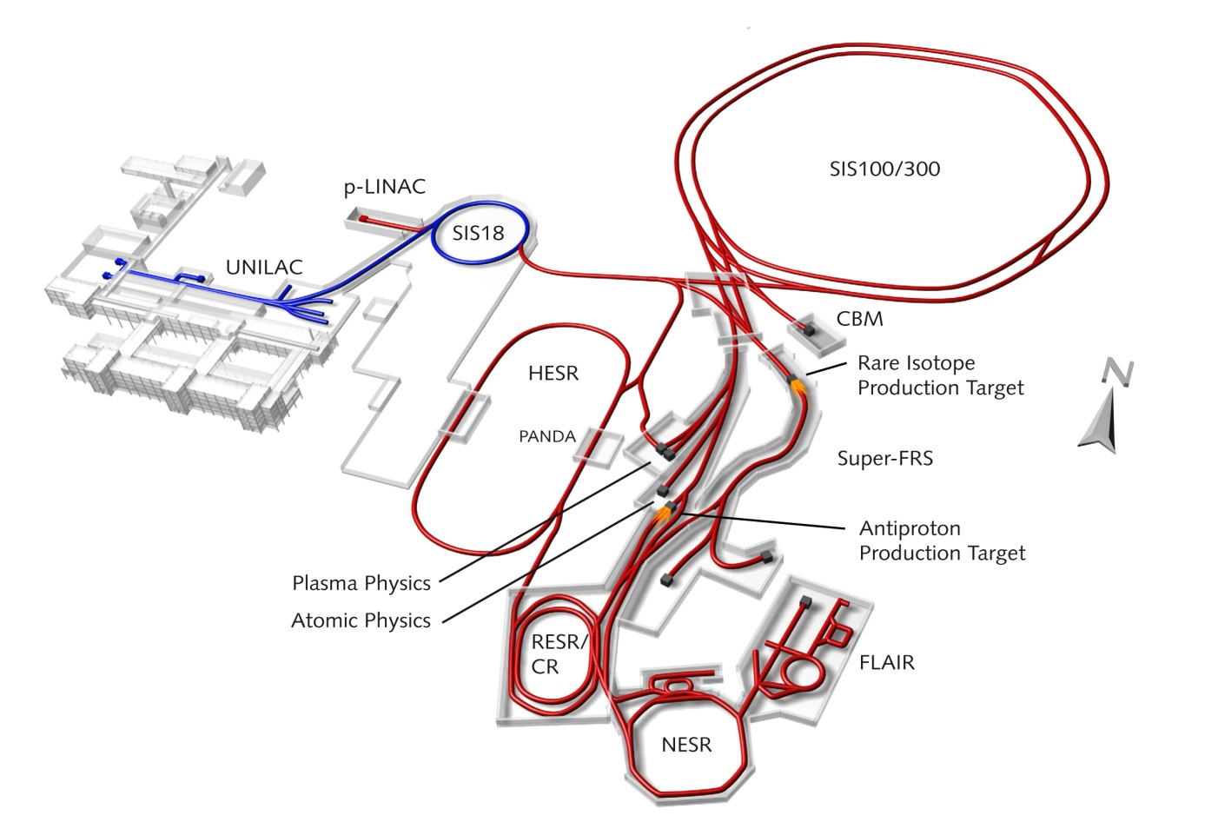
The FAIR facility
Existing
Primary beams
Faster cycling (3Hz instead of 0.3Hz)
10¹²/s 1.5-2 GeV/u ²³⁸U²⁸⁺
10¹⁰/s 35 GeV/u ²³⁸U⁷³⁺
Secondary beams
1.5-2 GeV/u
Beam intensity improvement FRS – Super-FRS: 10² to 10⁵
To be built

Slide 13
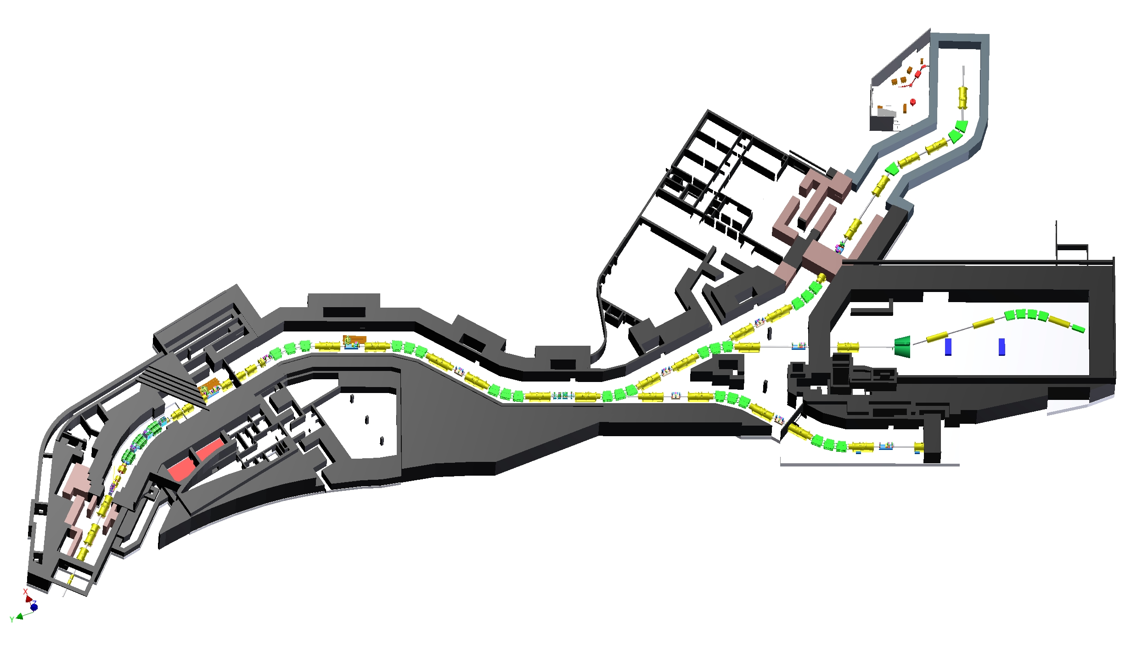
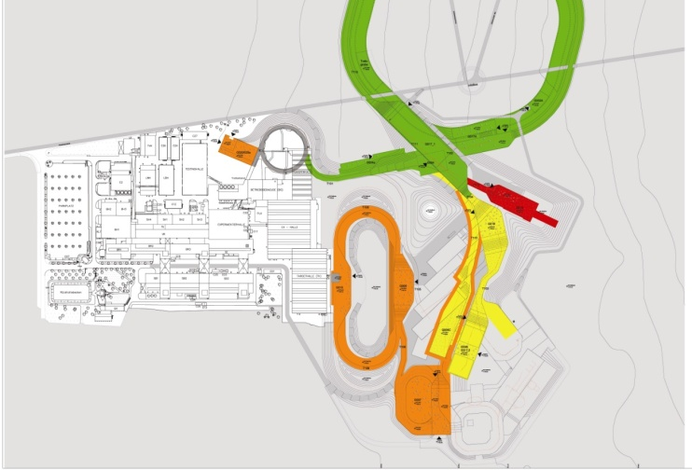

NUSTAR – The facility
LEB
HEB
HEB
Pre-
separator
Main
Separator
RING
Low Energy Branch: HISPEC, DESPEC, MATS, LaSpec
High Energy Branch: R³B
Ring Branch: EXL, ILIMA, ELISe
Super-FRS

Slide 14
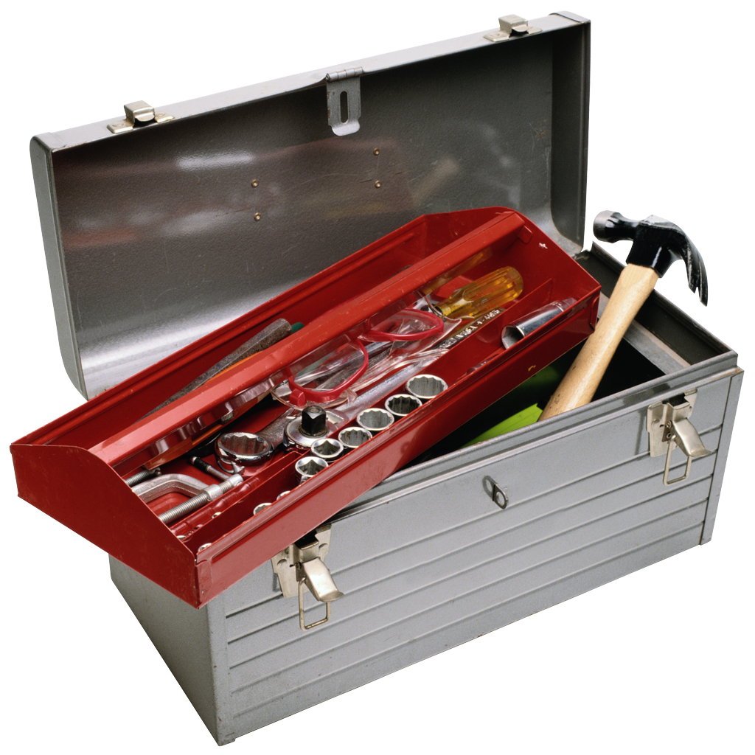

NUSTAR – The project
Super-FRS | RIB production, identification and high-resolution spectroscopy
DESPEC | γ-, β-, α-, p-, n-decay spectroscopy
HISPEC | in-beam γ spectroscopy at low and intermediate energy
ILIMA | masses and lifetimes of nuclei in ground and isomeric states
LaSpec | Laser spectroscopy
MATS | in-trap mass measurements and decay studies
R³B | kinematically complete reactions at high beam energy
ELISe | elastic, inelastic, and quasi-free e—A scattering
EXL | light-ion scattering reactions in inverse kinematics
The Approach
Complementary measurements leading to consistent answers
The Collaboration
> 800 scientists
146 institutes
38 countries
The Investment
82 M€ Super-FRS
73 M€ Experiments
Notes:
14

Slide 15
NUSTAR – The project
Super-FRS | RIB production, identification and high-resolution spectroscopy
DESPEC | γ-, β-, α-, p-, n-decay spectroscopy
HISPEC | in-beam γ spectroscopy at low and intermediate energy
ILIMA | masses and lifetimes of nuclei in ground and isomeric states
LaSpec | Laser spectroscopy
MATS | in-trap mass measurements and decay studies
R³B | kinematically complete reactions at high beam energy
ELISe | elastic, inelastic, and quasi-free e—A scattering
EXL | light-ion scattering reactions in inverse kinematics
The Approach
Complementary measurements leading to consistent answers
The Collaboration
> 800 scientists
146 institutes
38 countries
The Investment
82 M€ Super-FRS
73 M€ Experiments
Notes:
15

Slide 16
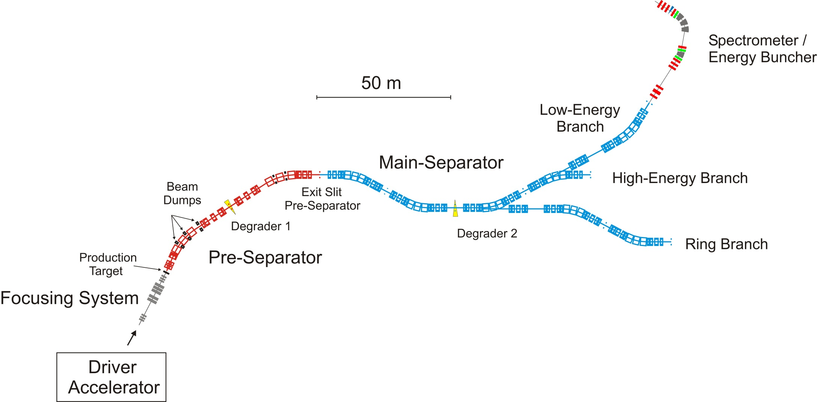
Super-FRS The backbone of the NUSTAR experiments
primary beam
secondary beam
primary target
fragment separator
secondary target

Slide 17
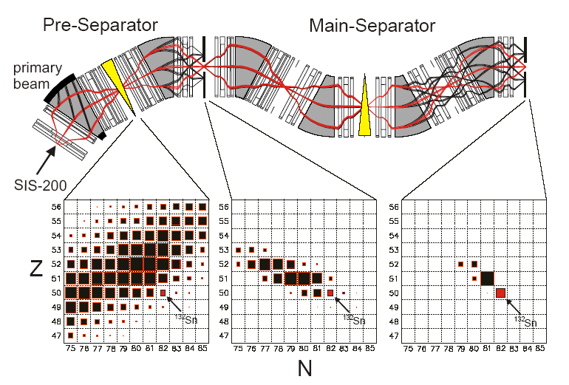
Super-FRS The backbone of the NUSTAR experiments
Separate and identify
the secondary fragments
in terms of A and Z.
Momentum: dP/P ~ 10⁻⁴
Z
A/Z

Slide 18
Super-FRS The backbone of the NUSTAR experiments
Separate and identify
the secondary fragments
in terms of A and Z.
Momentum: dP/P ~ 10⁻⁴
The higher the primary beam intensity and the acceptance of the separator the more exotic we can get

Slide 19
NUSTAR – The project
Super-FRS | RIB production, identification and high-resolution spectroscopy
DESPEC | γ-, β-, α-, p-, n-decay spectroscopy
HISPEC | in-beam γ spectroscopy at low and intermediate energy
ILIMA | masses and lifetimes of nuclei in ground and isomeric states
LaSpec | Laser spectroscopy
MATS | in-trap mass measurements and decay studies
R³B | kinematically complete reactions at high beam energy
ELISe | elastic, inelastic, and quasi-free e—A scattering
EXL | light-ion scattering reactions in inverse kinematics
The Approach
Complementary measurements leading to consistent answers
The Collaboration
> 800 scientists
146 institutes
38 countries
The Investment
82 M€ Super-FRS
73 M€ Experiments
Notes:
19

Slide 20

NUSTAR – High Energy Branch (HEB)
Super-FRS

Slide 21
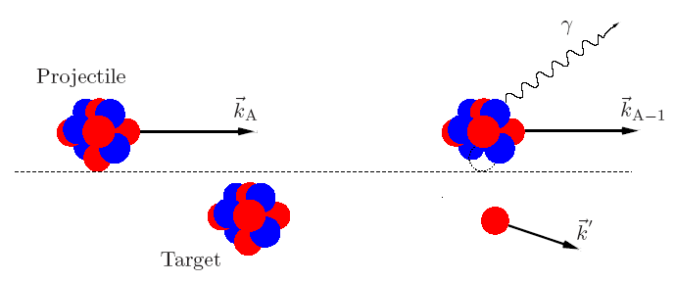
High Energy Branch (HEB)
Example of a reaction
After the reaction: heavy fragment,
neutrons, protons, gammas
Aim: measure all reaction products
10 m
dipole magnet
Neutrons
target
beam from SFRS
light particles
gamma rays
fragments
protons

Slide 22
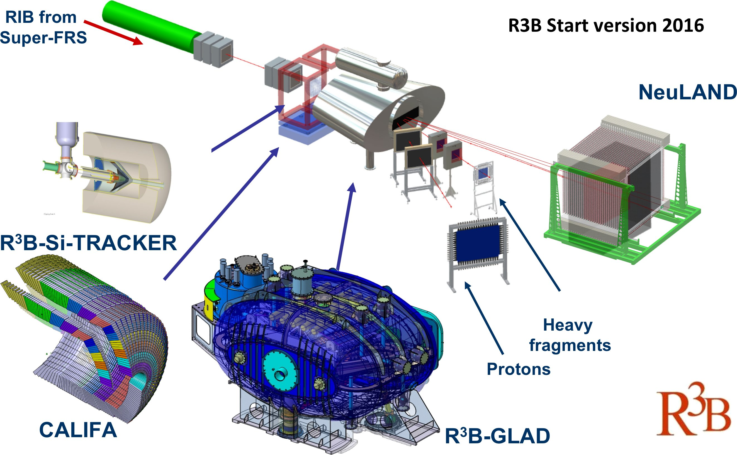
R³B - Reactions with Relativistic Radioactive Beams
R³B Start version 2017
NeuLAND

Slide 23
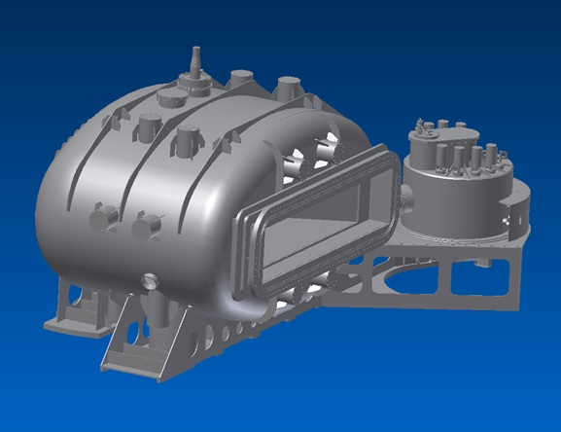
Large-acceptance superconducting dipole magnet GLAD
Bend and momentum analyze the rigid
beams while letting the decaying neutrons
fly through with large acceptance
Magnet parameters:
Large vertical gap ± 80 mrad
High integrated field of 4.5 Tm
Fringe field at the target position less than 20 mT
Operational temperature 4.6 K
The overall size of the conical cryostat: 3.5 m long, 3.8 m high and 7 m wide.
Technical drawing of the GLAD magnet.
Cold mass built at the CEA Saclay (France).
H. Simon
Notes:
23
1

Slide 24
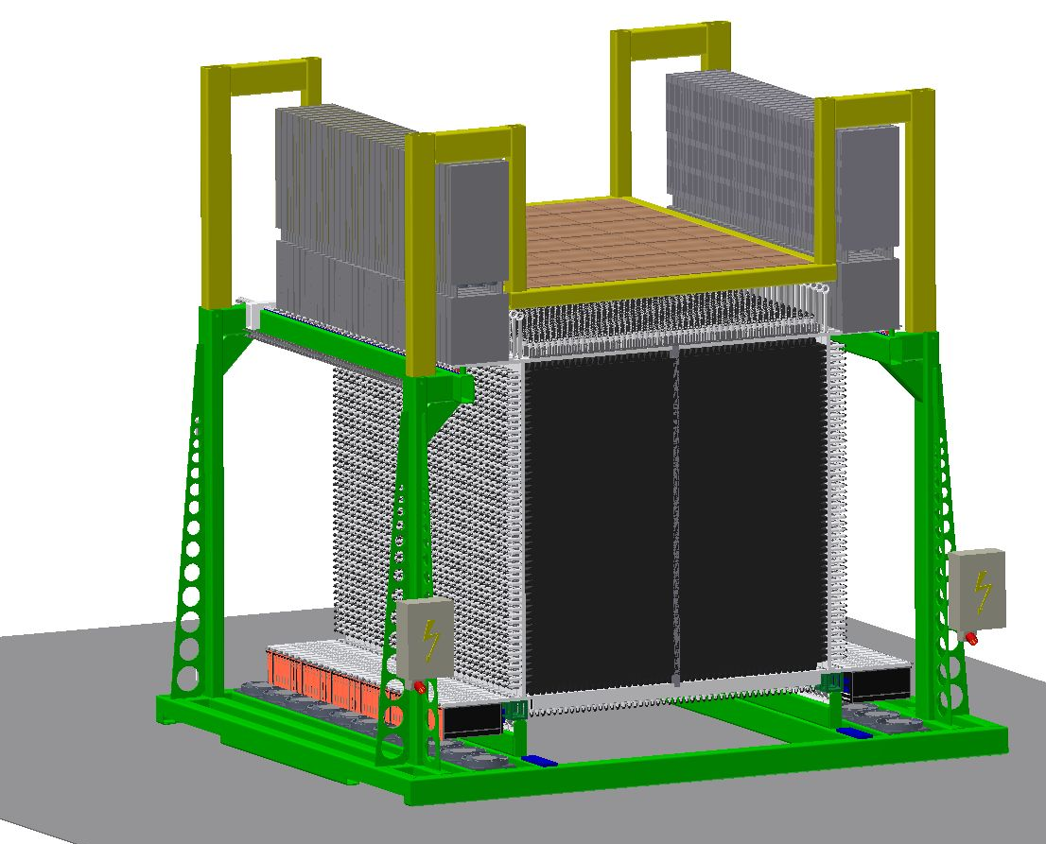
High-resolution neutron time-of-flight spectrometer NeuLAND
Detector parameters:
Full active detector using organic scintillator
Face size 250x250 cm², active depth 300 cm
3000 scintillator bars
6000 photomultiplier and readout channels
Modular design.
Performance goals:
>90% efficiency for 0.2-1 GeV neutrons
Multi-hit capability for up to 5 neutrons
<150 ps time resolution
20 keV excitation-energy resolution at 100 keV
above neutron threshold.
NeuLAND Technical Design Report has been approved on Jan. 18, 2013 by FAIR.
Notes:
24
1

Slide 25
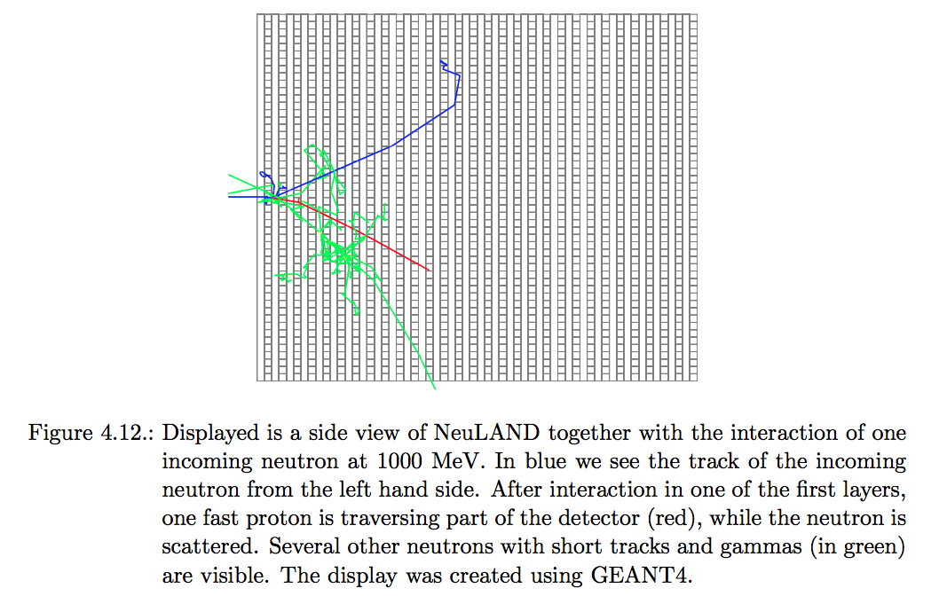
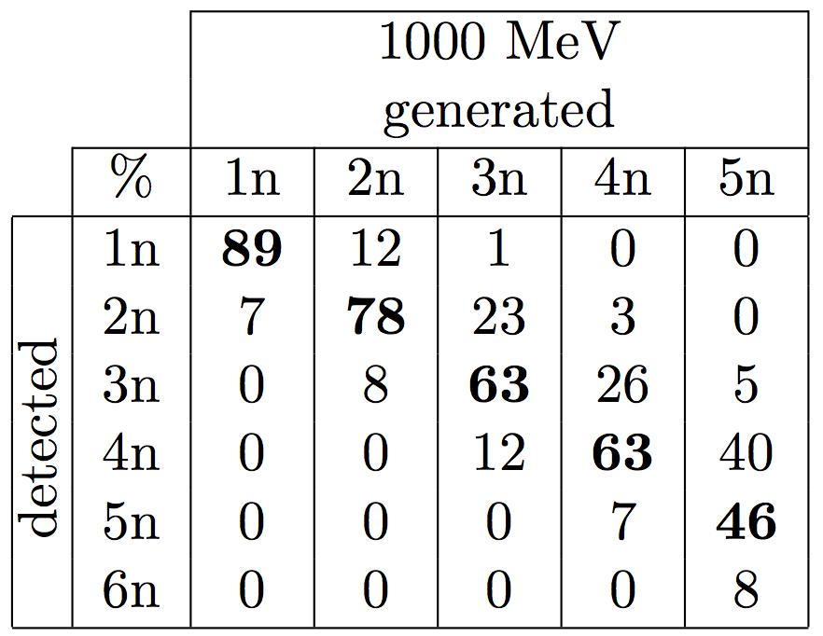
High-resolution neutron time-of-flight spectrometer NeuLAND
Detection efficiency
From NeuLAND TDR

Slide 26
R³B - Reactions with Relativistic Radioactive Beams
R³B Start version 2017
NeuLAND

Slide 27
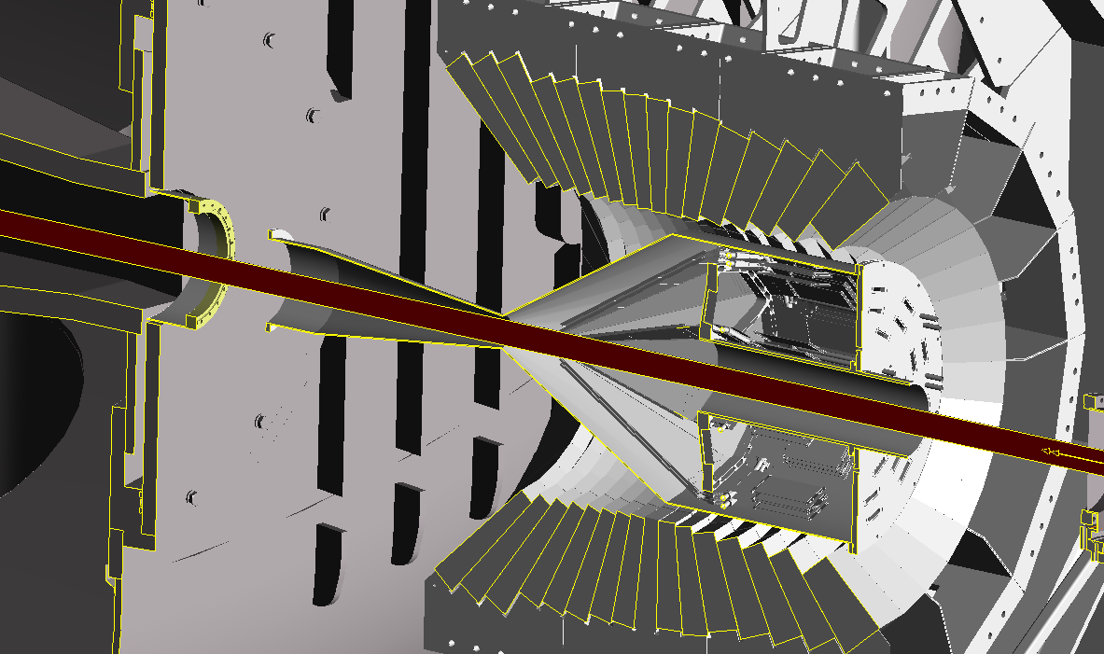
Target Recoil Detector:
CALIFA Barrel and Silicon Tracker
Chamber is 532mm diameter
Alan Grant,Daresbury

Slide 28
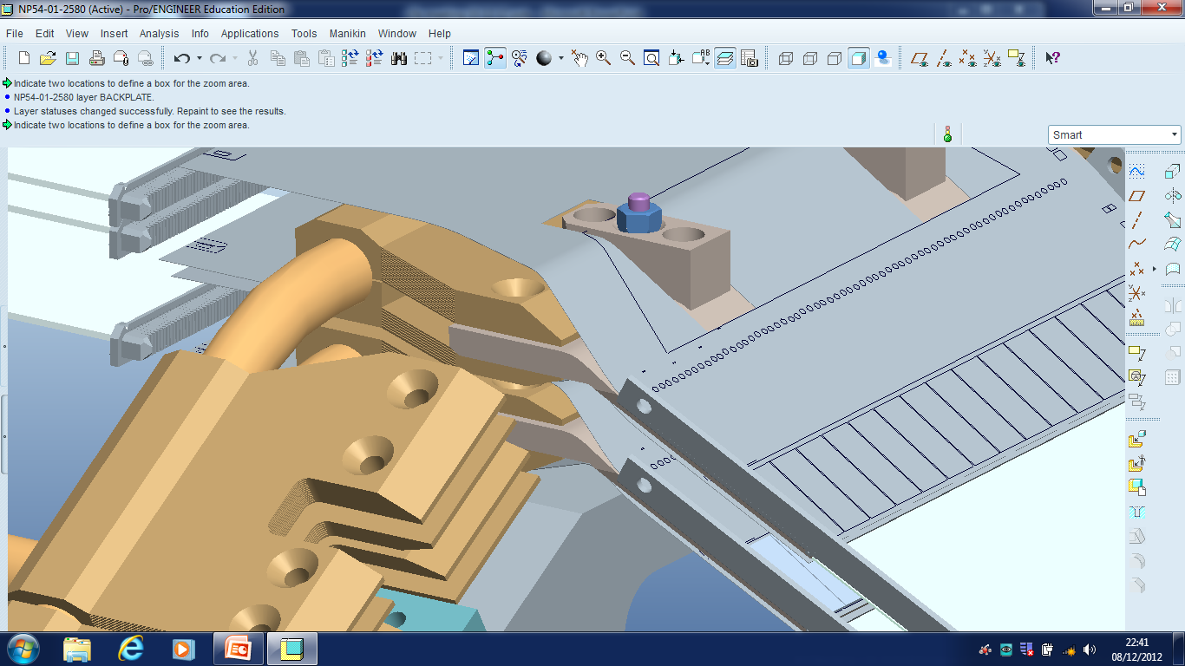
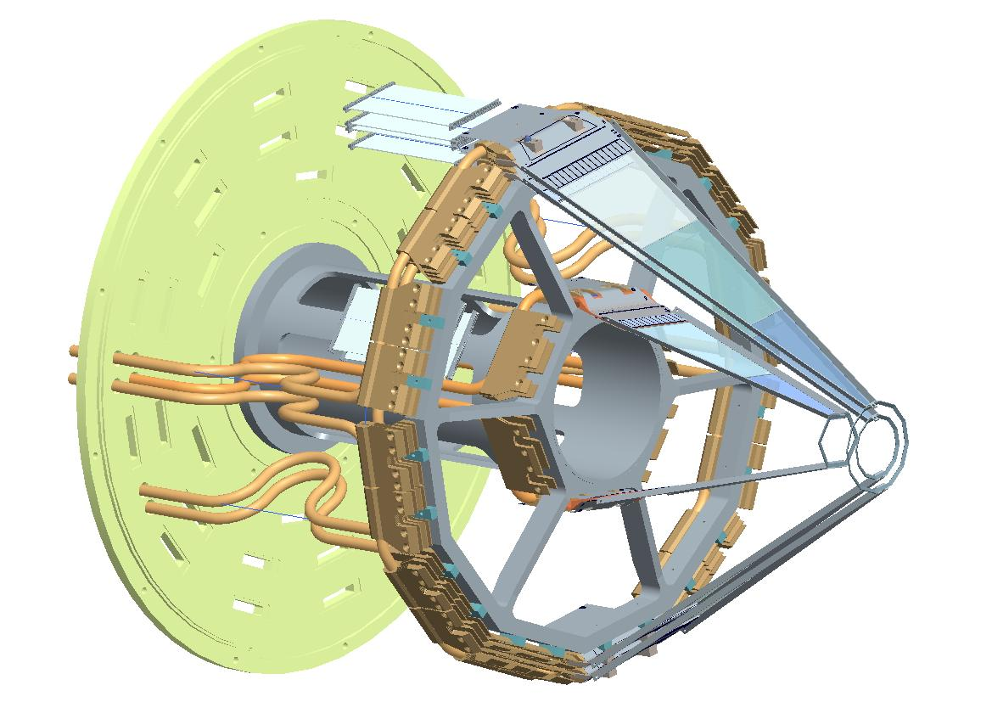
ASIC chips mounted on Flex board
120k Si strips
C fibre
structure
Cu cooling
blocks
Coolant ~-20° C
flowing in Cu pipe
M. Chartier,
R. Lemon,
Liverpool,
Daresbury

Slide 29
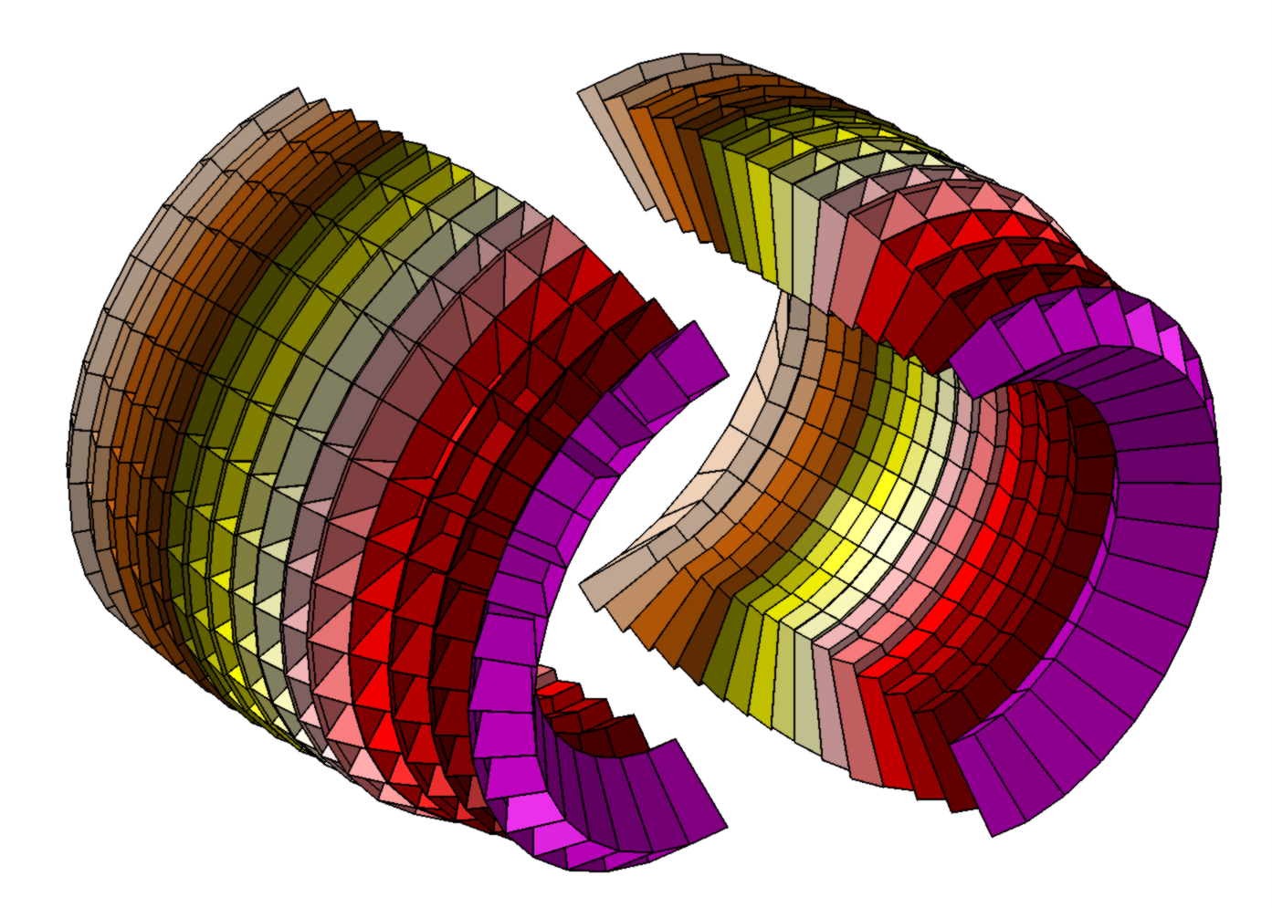
CALIFA γ-ray Calorimeter, Spectrometer, charged particle detector
→ large dynamic range (γ 100 keV - 20 MeV and p 1-320 MeV)
Calorimetrer
Intrinsic photopeak efficiency | 40% (up to Eg=15 MeV projectile frame)
Gamma sum energy resolution Δ(E_{γ}sum)/<(E_{γ}sum)> | < 10% for 5 γ rays of 3 MeV
Calorimeter for high energy Light charged particles | Up to 320 MeV in lab system
Gamma energy resolution | ~5-6% (FWHM at Eγ=1 MeV)
Light charged particles resolution | ~2%
Proton - γ ray separation | For 1 to 30 MeV
Spectrometer
Inner radius | 30 cm
N of crystals | 1952
Crystal geom. | 11
Crystal Volume/ weight | 285 000 cm³/ 1300 kg
D. Cortina

Slide 30
What can we study in R³B setup?

Slide 31
Nuclei beyond the drip line
“First observation of ¹⁵Ne ground and excited states”
¹⁵Ne and daughter nuclei
¹⁵Ne 3-body decay
¹⁶Ne
¹⁵Ne
¹⁶Ne exp data
♦ ¹⁵Ne exp data
¹⁶Ne isotropic 3-body decay
sequential decay via the ¹⁴F gs
¹⁵Ne ground state unbound by
S_{2p} = 2.522(66) MeV
¹⁵Ne is (like ¹⁶Ne) a true 2p-decay nucleus,
(despite available states in ¹⁴F)
F. Wamers et al., Phys. Rev. Lett. 112 (2014) 132502

Slide 32
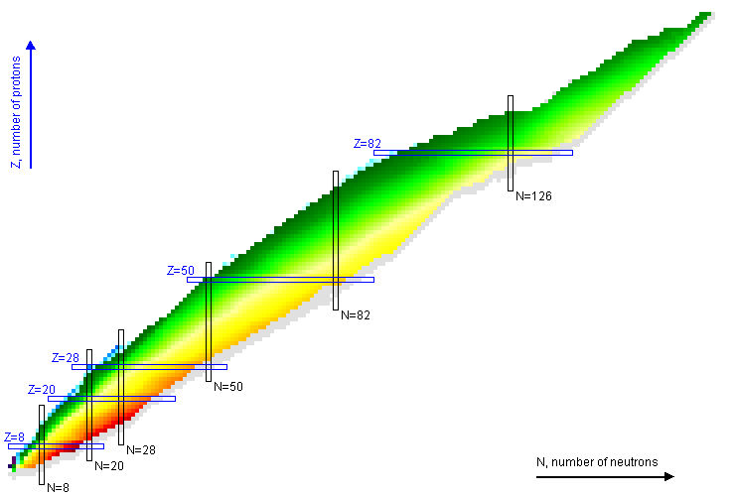
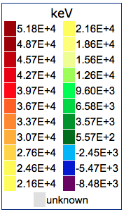
Nuclear chart
The two-proton separation energy S_{2p}
¹⁵Ne

Slide 33
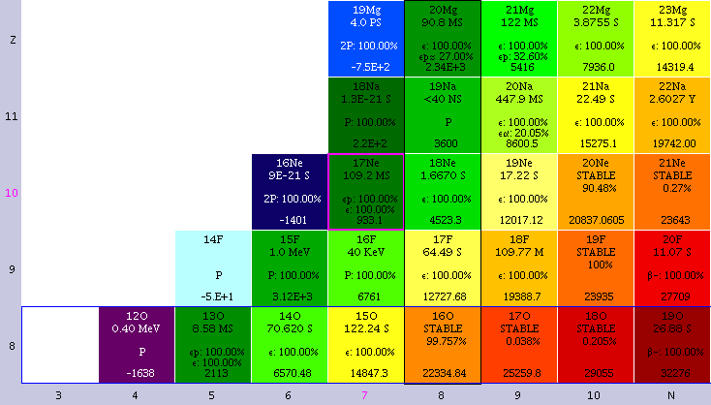
Nuclear chart
The two-proton separation energy S_{2p}
¹⁵Ne

Slide 34
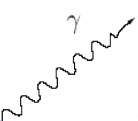
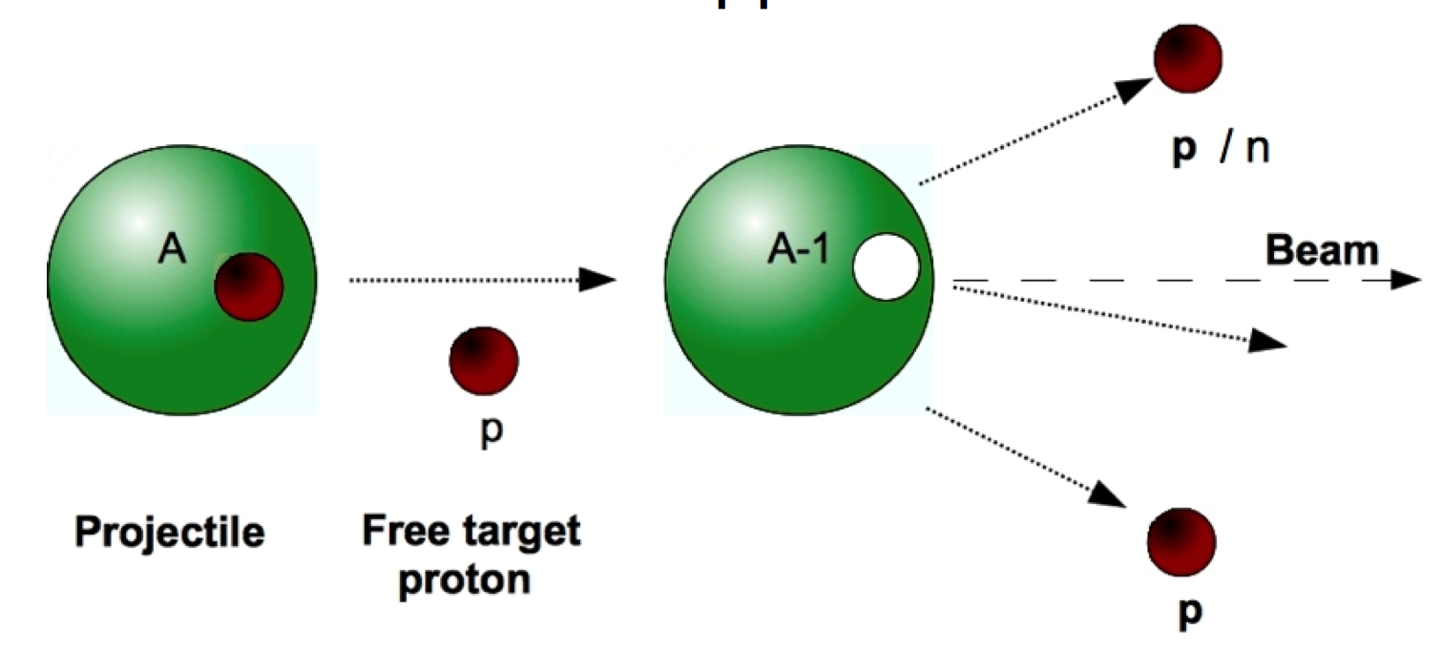
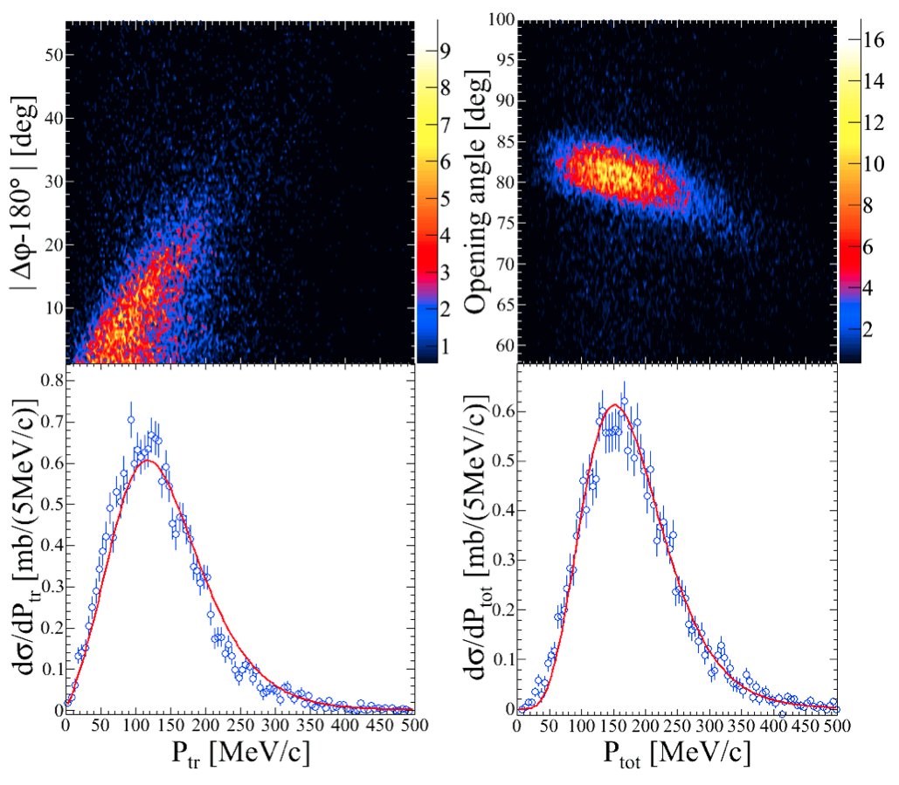
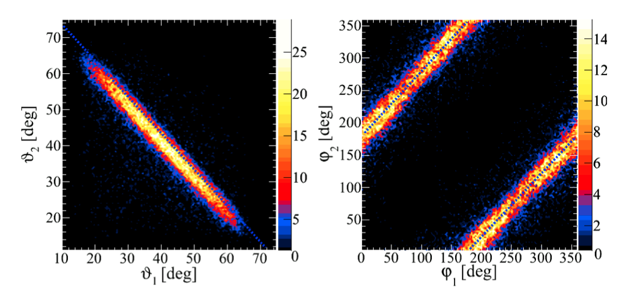
Quasi-free scattering from ¹²C a Benchmark experiment
Extract redundant nuclear structure information of bound and unbound states
Analysis by V. Panin
Calculations by C. Bertulani (solid line)

Slide 35
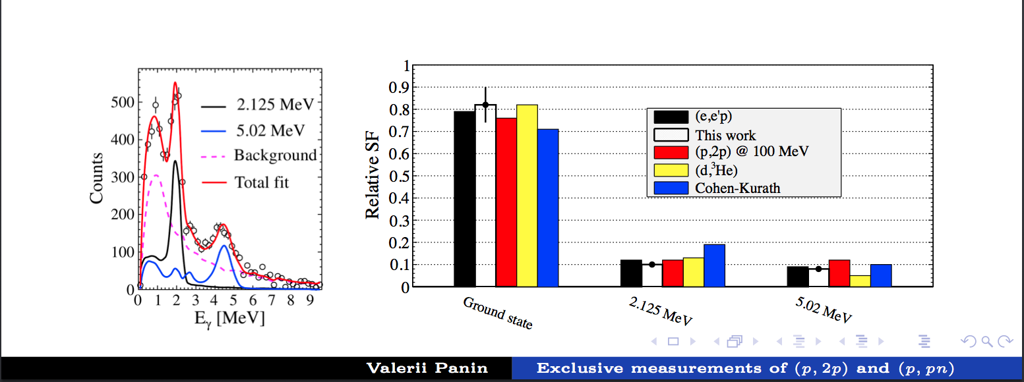
Quasi-free scattering from ¹²C a Benchmark experiment

Slide 36
The R³B collaboration
Aksouh, F.; Al-Khalili, J.; Algora, A.; Alkhasov, G.; Altstadt, S.; Alvarez, H.; Atar, L.; Audouin, L.; Aumann, T.; Pellereau, E.; Martin, J.-F.; Gorbinet, T.; Seddon, D.; Kogimtzis, M.; Avdeichikov, V.; Barton, Ch.; Bayram, M.; Belier, G.; Bemmerer, D.;Bendel, M.; Benlliure, J.; Bertulani, C.; Bhattacharya, S.; Bhattacharya, Ch.; Le Bleis, T.; Boilley, D.; Boretzky, K.; Borge, M. J.; Botvina, A.; Boudard, A.; Boutoux, G.; Boehmer, M.; Caesar, C.; Calvino, F.; Casarejos, E.; Catford, W.; Cederkall, J.; Cederwall, B.; Chapman, R.; Charpy, A.; Chartier, M.; Chatillon, A.; Chen, R.; Christophe, M.; Chulkov, L.; Coleman-Smith, P.; Cortina, D.; Crespo, R.; Csatlos, M.; Cullen, D.; Czech, B.; Danilin, B.; Davinson, T.; Diaz, P.; Dillmann, I; Fernandez Dominguez, B; Ducret, J-E.; Duran, I.; Egelhof, P.; Elekes, Z.; Emling, H.; Enders, J.; Eremin, V.; Ershov, S. N.; Ershova, O.; Eronen, S.; Estrade, A.; Faestermann, T.; Fedorov, D.; Feldmeier, H.; Le Fevre, A.; Fomichev, A.; Forssen, C.; Freeman, S.; Freer, M.; Friese, J.; Fynbo, H.; Gacsi, Z.; Garrido, E.; Gasparic, I.; Gastineau, B.; Geissel, H.; Gelletly, W.; Genolini, B.; Gerl, J.; Gernhaeuser, R.; Golovkov, M.l; Golubev, P.l; Grant, A.; Grigorenko, L.; Grosse, E.; Gulyas, J.; Goebel, K.; Gorska, M.; Haas, O. S; Haiduc, M.; Hasegan, D.; Heftrich, T.; Heil, M.; Heine, M.; Heinz, A.; Henriques,A.; Hoffmann, J; Holl, M.; Hunyadi, M.; Ignatov, A.; Ignatyuk, A. V.; Ilie, C. M.; Isaak, J.; Isaksson, L.; Jakobsson, B.; Jensen, A.; Johansen, J.; Johansson, H.; Johnson, R.; Jonson, B.; Junghans, A.; Jurado, B.; Jaehrling, S.; Kailas, S.; Kalantar, N.; Kalliopuska, J.; Kanungo, R.; Kelic-Heil, A.; Kezzar, K.; Khanzadeev, A.; Kissel, R.; Kisselev, O.; Klimkiewicz, A.; Kmiecik, M.; Koerper, D.; Kojouharov, I.; Korsheninnikov, A.; Korten, W.; Krasznahorkay, A.; Kratz, J. V.; Kresan, D.; Krivchitch,A.; Kroell, T.; Krupko, S.; Kruecken, R.; Kulessa, R.; Kurz, N.; Kuzmin, E.; Labiche, M.; Langanke, K.l-H.; Langer, C.; Lapoux, V.; Larsson, K.; Laurent, B.; Lazarus, I.; Le, X. Ch.; Leifels, Y.; Lemmon, R.; Lenske, H.; Lepine-Szily, A.; Leray, S.; Letts, S.; Li, S.; Liang, X.; Lindberg, S.; Lindsay, S.; Litvinov, Y.; Lukasik, J.; Loeher, B.; Mahata, K.; Maj, A.; Marganiec, J.; Meister, M.; Mittig, W.; Movsesyan, A.; Mutterer, M.; Muentz, C.; Nacher, E.; Najafi, A.; Nakamura, T.; Neff, T.; Nilsson, T.; Nociforo, C.; Nolan, P.; Nolen, J.; Nyman, G.; Obertelli, A.; Obradors, D.; Ogloblin, A.; Oi, M.; Palit, R.; Panin, V.; Paradela, C.; Paschalis, S.; Pawlowski, P.; Petri, M.; Pietralla, N.t; Pietras, B.; Pietri, S.; Plag, R.; Podolyak, Z.; Pollacco, E.; Potlog, M.; Datta Pramanik, U.; Prasad, R.; Fraile Prieto, L. M.; Pucknell, V.; Galaviz -Redondo, D.; Regan, P.; Reifarth, R.; Reinhardt, T.; Reiter, P.; Rejmund, F.; Ricciardi, M. V.; Richter, A.; Rigollet, C.; Riisager, K.; Rodin, A.; Rossi, D.; Roussel-Chomaz, P.; Gonzalez Rozas, Y.; Rubio, B.; Roeder, M.; Saito, T.; Salsac, M.-D.; Rodriguez Sanchez, J. L.; Santosh, Ch.; Savajols, H.; Savran, D.; Scheit, H.; Schindler, F.; Schmidt, K.-H.; Schmitt, C.; Schnorrenberger, L; Schrieder, G.; Schrock, Ph.; Sharma, M. K.; Sherrill, B.; Shrivastava, A.; Shulgina, N.; Sidorchuk, S.; Silva, J.; Simenel, C.; Simon, H.; Simpson, J.; Singh, P. P.; Sonnabend, K.; Spohr, K.; Stanoiu, M.; Stevenson, P.; Strchan, J.; Streicher, B.; Stroth, J.; Syndikus, I.; Suemmerer, K.; Taieb, J.; Tain, J. L.; Tanihata, I.; Tashenov, S.; Tassan-Got, L.; Tengblad, O.; Teubig, P.; Thies, R.; Togano, Y.; Tostevin, J. A.; Trautmann, W.; Tuboltsev, Y.; Turrion, M.; Typel, S.; Udias-Moinelo, J.; Vaagen, J.; Velho, P.; Verbitskaya, E.; Veselsky, M.; Wagner, A.; Walus, W.; Wamers, F.; Weick, H.; Wimmer, C.; Winfield, J.; Winkler, M.; Woods, Ph.; Xu, H.; Yakorev, D.; Zegers, R.; Zhang, Y.-H.; Zhukov, M.; Zieblinski, M.; Zilges, A.;
Notes:
36

Slide 37
NUSTAR – The project
Super-FRS | RIB production, identification and high-resolution spectroscopy
DESPEC | γ-, β-, α-, p-, n-decay spectroscopy
HISPEC | in-beam γ spectroscopy at low and intermediate energy
ILIMA | masses and lifetimes of nuclei in ground and isomeric states
LaSpec | Laser spectroscopy
MATS | in-trap mass measurements and decay studies
R³B | kinematically complete reactions at high beam energy
ELISe | elastic, inelastic, and quasi-free e—A scattering
EXL | light-ion scattering reactions in inverse kinematics
The Approach
Complementary measurements leading to consistent answers
The Collaboration
> 800 scientists
146 institutes
38 countries
The Investment
82 M€ Super-FRS
73 M€ Experiments
Notes:
37

Slide 38
High-resolution gamma spectroscopy

Slide 39
High-resolution gamma spectroscopy
has been one of the most sensitive probes of nuclear structure over the past decays and …
… continues to play a major role in our current understanding of the structure of atomic nuclei.

Slide 40
Evolution of gamma-ray detection technology
Resolving power:
Energy resolution (δE),
Efficiency (ε),
Peak-to-total (P/T)
A.O. Macchiavelli

Slide 41
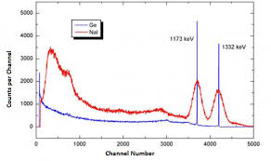
Evolution of gamma-ray detection technology
dE/E=10⁻³
A.O. Macchiavelli

Slide 42
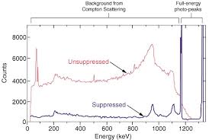
Evolution of gamma-ray detection technology
A.O. Macchiavelli

Slide 43
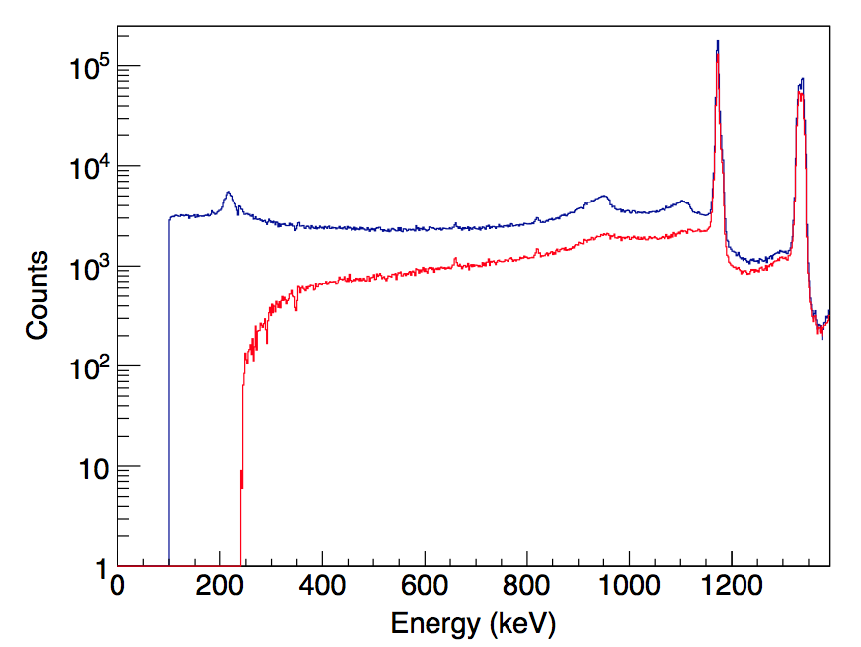
Evolution of gamma-ray detection technology
Gamma ray tracking arrays
A.O. Macchiavelli

Slide 44

Gamma-ray Energy Tracking Arrays
The two major projects worldwide:
In Europe:
In the USA:
Lawrence Berkeley National Laboratory (LBNL)

Slide 45
Compton Suppression
Ge
Photopeak event
Gamma ray
Notes:
A gamma-ray enters the Ge crystal and it can either deposit its full energy in the crystal and show up in the photopeak or it can scatter out of the crystal
depositing only part of its energy and ending up as a Compton background. This affects the P/T ration of the detector. To overcome this problem the
the current generation arrays, for example Gammasphere, are based on modules of Compton suppressed Ge detectors. With these modules such partial-energy events can be rejected by detecting the scattered gamma rays into a “Compton shield” (made with a high density scintillator such as BGO) surrounding the Ge detector. While this improves the peak-to-total ratio it does not improve the efficiency. Furthermore, the suppressors occupy about the same solid angle coverage as the germanium detectors. This limits the full-energy peak efficiency in Gammasphere, for example, to ~10% (at 1 MeV). To explore new scientific regions new technologies are required that go beyond those provided by arrays of Compton-suppressed detectors.
The efficiency limit reached in current arrays can be overcome by eliminating the Compton shields and by closely packing the Ge crystals. Rather than suppressing events that scatter out of individual crystals, the gamma rays can be tracked across crystal boundaries by determining the location of the scattering points (a 1 MeV gamma ray has typically 3 to 4 interactions within the Ge before depositing its full energy). This can be achieved by using highly segmented Ge detectors. With their outer electrical contact divided into a number of individual segments. By analyzing the direct and induced charges from these segments the interaction locations of gamma-rays can be determined to better than a few millimeters. The path of scattered gamma rays through the crystals can then be followed and the gamma-ray energies reconstructed by using suitable algorithms. This is the new concept of a gamma-ray energy tracking array, and GRETINA in the US and AGATA in Europe will be the first practical implementation. (from 15-v2)

Slide 46
Compton Suppression
Ge
Background event
Gamma ray
Notes:
A gamma-ray enters the Ge crystal and it can either deposit its full energy in the crystal and show up in the photopeak or it can scatter out of the crystal
depositing only part of its energy and ending up as a Compton background. This affects the P/T ration of the detector. To overcome this problem the
the current generation arrays, for example Gammasphere, are based on modules of Compton suppressed Ge detectors. With these modules such partial-energy events can be rejected by detecting the scattered gamma rays into a “Compton shield” (made with a high density scintillator such as BGO) surrounding the Ge detector. While this improves the peak-to-total ratio it does not improve the efficiency. Furthermore, the suppressors occupy about the same solid angle coverage as the germanium detectors. This limits the full-energy peak efficiency in Gammasphere, for example, to ~10% (at 1 MeV). To explore new scientific regions new technologies are required that go beyond those provided by arrays of Compton-suppressed detectors.
The efficiency limit reached in current arrays can be overcome by eliminating the Compton shields and by closely packing the Ge crystals. Rather than suppressing events that scatter out of individual crystals, the gamma rays can be tracked across crystal boundaries by determining the location of the scattering points (a 1 MeV gamma ray has typically 3 to 4 interactions within the Ge before depositing its full energy). This can be achieved by using highly segmented Ge detectors. With their outer electrical contact divided into a number of individual segments. By analyzing the direct and induced charges from these segments the interaction locations of gamma-rays can be determined to better than a few millimeters. The path of scattered gamma rays through the crystals can then be followed and the gamma-ray energies reconstructed by using suitable algorithms. This is the new concept of a gamma-ray energy tracking array, and GRETINA in the US and AGATA in Europe will be the first practical implementation. (from 15-v2)

Slide 47
Compton Suppression
BGO
Ge
Suppress background
Gamma ray
Improves Peak to Total (P/T) considerably!
Notes:
A gamma-ray enters the Ge crystal and it can either deposit its full energy in the crystal and show up in the photopeak or it can scatter out of the crystal
depositing only part of its energy and ending up as a Compton background. This affects the P/T ration of the detector. To overcome this problem the
the current generation arrays, for example Gammasphere, are based on modules of Compton suppressed Ge detectors. With these modules such partial-energy events can be rejected by detecting the scattered gamma rays into a “Compton shield” (made with a high density scintillator such as BGO) surrounding the Ge detector. While this improves the peak-to-total ratio it does not improve the efficiency. Furthermore, the suppressors occupy about the same solid angle coverage as the germanium detectors. This limits the full-energy peak efficiency in Gammasphere, for example, to ~10% (at 1 MeV). To explore new scientific regions new technologies are required that go beyond those provided by arrays of Compton-suppressed detectors.
The efficiency limit reached in current arrays can be overcome by eliminating the Compton shields and by closely packing the Ge crystals. Rather than suppressing events that scatter out of individual crystals, the gamma rays can be tracked across crystal boundaries by determining the location of the scattering points (a 1 MeV gamma ray has typically 3 to 4 interactions within the Ge before depositing its full energy). This can be achieved by using highly segmented Ge detectors. With their outer electrical contact divided into a number of individual segments. By analyzing the direct and induced charges from these segments the interaction locations of gamma-rays can be determined to better than a few millimeters. The path of scattered gamma rays through the crystals can then be followed and the gamma-ray energies reconstructed by using suitable algorithms. This is the new concept of a gamma-ray energy tracking array, and GRETINA in the US and AGATA in Europe will be the first practical implementation. (from 15-v2)

Slide 48

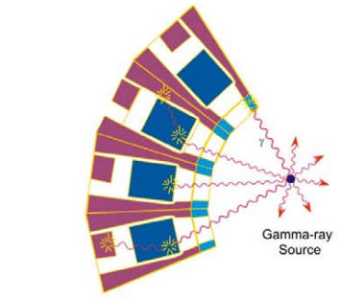
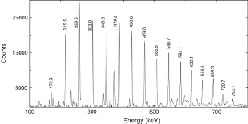
Compton Suppression
Compton suppressed arrays
Good P/T but limited efficiency
Gamma-ray
source
Notes:
A gamma-ray enters the Ge crystal and it can either deposit its full energy in the crystal and show up in the photopeak or it can scatter out of the crystal
depositing only part of its energy and ending up as a Compton background. This affects the P/T ration of the detector. To overcome this problem the
the current generation arrays, for example Gammasphere, are based on modules of Compton suppressed Ge detectors. With these modules such partial-energy events can be rejected by detecting the scattered gamma rays into a “Compton shield” (made with a high density scintillator such as BGO) surrounding the Ge detector. While this improves the peak-to-total ratio it does not improve the efficiency. Furthermore, the suppressors occupy about the same solid angle coverage as the germanium detectors. This limits the full-energy peak efficiency in Gammasphere, for example, to ~10% (at 1 MeV). To explore new scientific regions new technologies are required that go beyond those provided by arrays of Compton-suppressed detectors.
The efficiency limit reached in current arrays can be overcome by eliminating the Compton shields and by closely packing the Ge crystals. Rather than suppressing events that scatter out of individual crystals, the gamma rays can be tracked across crystal boundaries by determining the location of the scattering points (a 1 MeV gamma ray has typically 3 to 4 interactions within the Ge before depositing its full energy). This can be achieved by using highly segmented Ge detectors. With their outer electrical contact divided into a number of individual segments. By analyzing the direct and induced charges from these segments the interaction locations of gamma-rays can be determined to better than a few millimeters. The path of scattered gamma rays through the crystals can then be followed and the gamma-ray energies reconstructed by using suitable algorithms. This is the new concept of a gamma-ray energy tracking array, and GRETINA in the US and AGATA in Europe will be the first practical implementation. (from 15-v2)

Slide 49
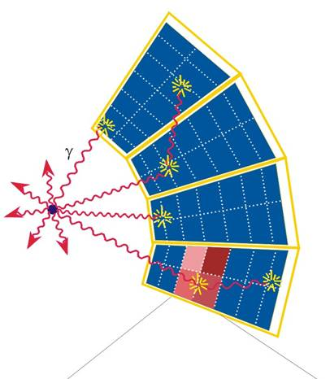
Gamma-ray tracking:
Principle of operation
The idea is:
Do not to reject but track instead!
Gamma-ray
source
Gamma-ray
source
Notes:
A gamma-ray enters the Ge crystal and it can either deposit its full energy in the crystal and show up in the photopeak or it can scatter out of the crystal
depositing only part of its energy and ending up as a Compton background. This affects the P/T ration of the detector. To overcome this problem the
the current generation arrays, for example Gammasphere, are based on modules of Compton suppressed Ge detectors. With these modules such partial-energy events can be rejected by detecting the scattered gamma rays into a “Compton shield” (made with a high density scintillator such as BGO) surrounding the Ge detector. While this improves the peak-to-total ratio it does not improve the efficiency. Furthermore, the suppressors occupy about the same solid angle coverage as the germanium detectors. This limits the full-energy peak efficiency in Gammasphere, for example, to ~10% (at 1 MeV). To explore new scientific regions new technologies are required that go beyond those provided by arrays of Compton-suppressed detectors.
The efficiency limit reached in current arrays can be overcome by eliminating the Compton shields and by closely packing the Ge crystals. Rather than suppressing events that scatter out of individual crystals, the gamma rays can be tracked across crystal boundaries by determining the location of the scattering points (a 1 MeV gamma ray has typically 3 to 4 interactions within the Ge before depositing its full energy). This can be achieved by using highly segmented Ge detectors. With their outer electrical contact divided into a number of individual segments. By analyzing the direct and induced charges from these segments the interaction locations of gamma-rays can be determined to better than a few millimeters. The path of scattered gamma rays through the crystals can then be followed and the gamma-ray energies reconstructed by using suitable algorithms. This is the new concept of a gamma-ray energy tracking array, and GRETINA in the US and AGATA in Europe will be the first practical implementation. (from 15-v2)

Slide 50
Gamma-ray tracking:
Principle of operation
The idea is:
Do not to reject but track instead!
(x, y, z, e) + Compton formula → Tracking
So, we need a 3D position sensitive
Ge detector
Gamma-ray
source
Notes:
A gamma-ray enters the Ge crystal and it can either deposit its full energy in the crystal and show up in the photopeak or it can scatter out of the crystal
depositing only part of its energy and ending up as a Compton background. This affects the P/T ration of the detector. To overcome this problem the
the current generation arrays, for example Gammasphere, are based on modules of Compton suppressed Ge detectors. With these modules such partial-energy events can be rejected by detecting the scattered gamma rays into a “Compton shield” (made with a high density scintillator such as BGO) surrounding the Ge detector. While this improves the peak-to-total ratio it does not improve the efficiency. Furthermore, the suppressors occupy about the same solid angle coverage as the germanium detectors. This limits the full-energy peak efficiency in Gammasphere, for example, to ~10% (at 1 MeV). To explore new scientific regions new technologies are required that go beyond those provided by arrays of Compton-suppressed detectors.
The efficiency limit reached in current arrays can be overcome by eliminating the Compton shields and by closely packing the Ge crystals. Rather than suppressing events that scatter out of individual crystals, the gamma rays can be tracked across crystal boundaries by determining the location of the scattering points (a 1 MeV gamma ray has typically 3 to 4 interactions within the Ge before depositing its full energy). This can be achieved by using highly segmented Ge detectors. With their outer electrical contact divided into a number of individual segments. By analyzing the direct and induced charges from these segments the interaction locations of gamma-rays can be determined to better than a few millimeters. The path of scattered gamma rays through the crystals can then be followed and the gamma-ray energies reconstructed by using suitable algorithms. This is the new concept of a gamma-ray energy tracking array, and GRETINA in the US and AGATA in Europe will be the first practical implementation. (from 15-v2)

Slide 51
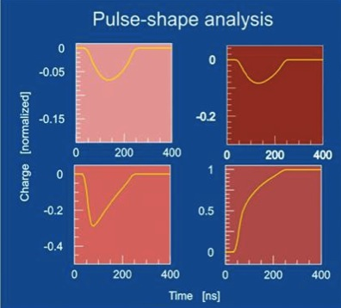
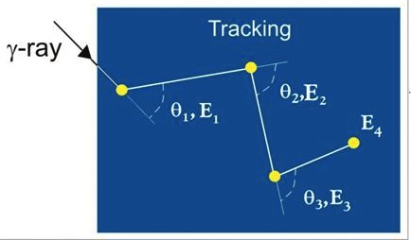
Gamma-ray tracking:
Principle of operation
A 3D position sensitive Ge detector
Electrically segmented
Pulse shape analysis
of position sensitive signals
9 cm
Determine
interaction
points
Determine
scattering
sequence
Notes:
A gamma-ray enters the Ge crystal and it can either deposit its full energy in the crystal and show up in the photopeak or it can scatter out of the crystal
depositing only part of its energy and ending up as a Compton background. This affects the P/T ration of the detector. To overcome this problem the
the current generation arrays, for example Gammasphere, are based on modules of Compton suppressed Ge detectors. With these modules such partial-energy events can be rejected by detecting the scattered gamma rays into a “Compton shield” (made with a high density scintillator such as BGO) surrounding the Ge detector. While this improves the peak-to-total ratio it does not improve the efficiency. Furthermore, the suppressors occupy about the same solid angle coverage as the germanium detectors. This limits the full-energy peak efficiency in Gammasphere, for example, to ~10% (at 1 MeV). To explore new scientific regions new technologies are required that go beyond those provided by arrays of Compton-suppressed detectors.
The efficiency limit reached in current arrays can be overcome by eliminating the Compton shields and by closely packing the Ge crystals. Rather than suppressing events that scatter out of individual crystals, the gamma rays can be tracked across crystal boundaries by determining the location of the scattering points (a 1 MeV gamma ray has typically 3 to 4 interactions within the Ge before depositing its full energy). This can be achieved by using highly segmented Ge detectors. With their outer electrical contact divided into a number of individual segments. By analyzing the direct and induced charges from these segments the interaction locations of gamma-rays can be determined to better than a few millimeters. The path of scattered gamma rays through the crystals can then be followed and the gamma-ray energies reconstructed by using suitable algorithms. This is the new concept of a gamma-ray energy tracking array, and GRETINA in the US and AGATA in Europe will be the first practical implementation. (from 15-v2)

Slide 52
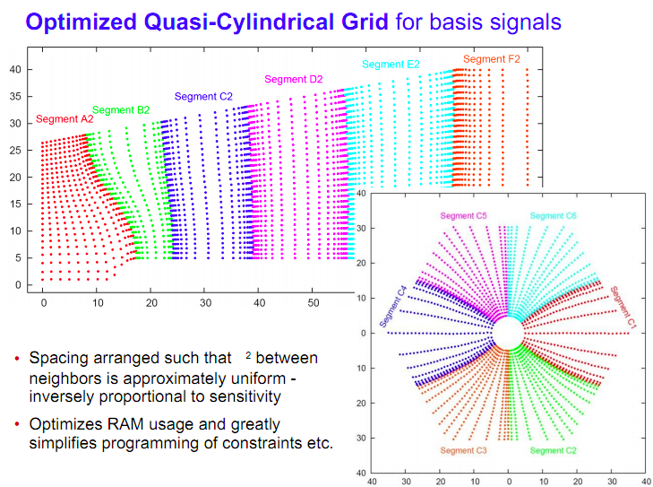
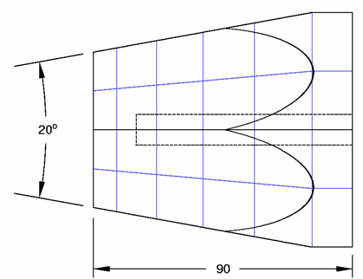
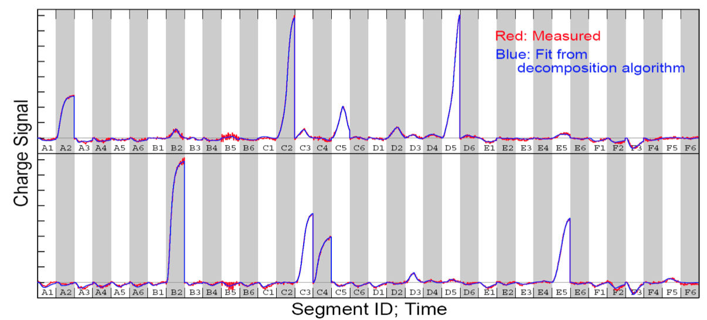
Principles of Signal Decomposition
Goal: To determine in real time the number of gamma-ray interactions, their positions and their energies
These interactions
are required as input
for gamma-ray tracking
Grid for calculated basis signals
Notes:
By signal decomposition we mean extracting information on the gamma-ray interactions from the
shape and size of the signal from the segments and the central contact. To do this we use a
model to generate pre calculated signals in each region of the detector and then event by event
fit the measured signals with the calculated ones in order to find the positions of the interactions.
In reality we have found that the calculated signals need to be folded with the detector response
such as cross talk between the channels in order to get a reliable fit.

Slide 53



GRETINA Detector module
~ 20 º
8 cm
9 cm
36 segments per Ge crystal
4 crystals per module
Two types of crystal, one cryostat – simple geometry
Warm FET for the segments – easy to replace, higher availability
30 modules for 4π
Notes:
The GRETINA array consists of 28 highly segmented HPGe crystals grouped in 7 modules such that 4 crystals share the same cryostat.
Each crystal has 38 signals originating from the 36 segments plus 2 identical central contact signals.
It covers 1Pi solid angle and, as mentioned earlier, is the first stage towards the full 4 Pi array GRETA.

Slide 54
Advantages of Tracking
Advantages of Tracking
Efficiency | No solid angle lost to suppressors
Peak-to-background | Reject Compton events
Doppler correction | Position of 1st interaction
Polarization | Angular distribution of the 1st scattering
Counting rate | Many segments
bonus
Particularly important for experiments with fast secondary beams from fragmentation
Notes:
A gamma-ray enters the Ge crystal and it can either deposit its full energy in the crystal and show up in the photopeak or it can scatter out of the crystal
depositing only part of its energy and ending up as a Compton background. This affects the P/T ration of the detector. To overcome this problem the
the current generation arrays, for example Gammasphere, are based on modules of Compton suppressed Ge detectors. With these modules such partial-energy events can be rejected by detecting the scattered gamma rays into a “Compton shield” (made with a high density scintillator such as BGO) surrounding the Ge detector. While this improves the peak-to-total ratio it does not improve the efficiency. Furthermore, the suppressors occupy about the same solid angle coverage as the germanium detectors. This limits the full-energy peak efficiency in Gammasphere, for example, to ~10% (at 1 MeV). To explore new scientific regions new technologies are required that go beyond those provided by arrays of Compton-suppressed detectors.
The efficiency limit reached in current arrays can be overcome by eliminating the Compton shields and by closely packing the Ge crystals. Rather than suppressing events that scatter out of individual crystals, the gamma rays can be tracked across crystal boundaries by determining the location of the scattering points (a 1 MeV gamma ray has typically 3 to 4 interactions within the Ge before depositing its full energy). This can be achieved by using highly segmented Ge detectors. With their outer electrical contact divided into a number of individual segments. By analyzing the direct and induced charges from these segments the interaction locations of gamma-rays can be determined to better than a few millimeters. The path of scattered gamma rays through the crystals can then be followed and the gamma-ray energies reconstructed by using suitable algorithms. This is the new concept of a gamma-ray energy tracking array, and GRETINA in the US and AGATA in Europe will be the first practical implementation. (from 15-v2)

Slide 55



Detector modules accepted and characterized
A-type
36 segments per crystal
4 crystal per module
148 signal channels per module
B-type
Notes:
You can see here an actual photograph of one module in our characterization room. A photograph of the preamp.
compartment is shown on the right, which is very compact in order to accommodate the preamplifiers for all the 148 signals from each module.
We have currently received all 7 modules of the GRETINA array, 5 of which are installed on the frame.

Slide 56




System Assembly
Mechanical Installation
Support structure in Cave 4C
5 modules installed
Target chamber (Washington University)
Notes:
The frame is specifically designed to be very precise and particularly rigid to stand the load of the modules which weight more than 50kgr each,
Since the position information is very crucial for performing gamma-ray tracking.
In addition each of the modules is scanned using a coordinate measuring machine which probes all the surfaces
to confirm that the dimensions and shapes are according to the design. A unique flange is built for each module such that when installed on the frame
it will cancel out any remaining small deviations.

Slide 57


Digital Electronics
Digitizer module
(designed & produced LBNL)
14bit, 100 MHz
Energy
Leading edge time
Constant fraction time
Pulse shape
Trigger Timing & Control module (ANL)
Fast trigger (<300 nsec)
Trigger conditions:
Multiplicity
Sum energy
Hit pattern
Isomer trigger
Notes:
GRETINA is an advanced instrument which employs the latest state-of-the art technologies in many fields.
The most crucial one probably being the advance of digital electronics in the last decade.
Without the digitizers the concept of signal decomposition could not be applied and thus the full tracking would not
be possible. The GRETINA digitizers where designed and produced @ LBNL and the latest generation consists of a 10 channel,
14 bit ADCs and an on board FPG chip applying a trapezoidal filter for obtaining the energies. The trigger system was designed
at ANL allowing for different trigger modes, such as crystal multiplicity, sum energy, hit pattern and isomer trigger.

Slide 58

Computing
Data from
GRETINA
Detectors
Segment events
37 signals
per detector
Crystal Event Builder
Crystal events
Signal Decomposition
Interaction points
1-28 crystals
Data from
Auxiliary
Detectors
Global Event Builder
Global Events
70 nodes
2 cpu / node
4 core / cpu
Goal:
Processing 20,000
Gamma rays /sec
Tracking
Analysis & Archiving
Notes:
The digitized signals are then send to a dedicated computer farm consisting of 70 multiprocessor nodes which
are responsible for performing real time decomposition and tracking.

Slide 59
Gamma Ray Energy Tracking
In beam Nuclear Array
$20M Funded by US- DOE Nuclear Physics Office
A first realization of a Tracking Array
Optimized for fast beam experiments
Coverage ∼ ¼ of 4π solid angle
28 36-fold segmented Ge crystals ( 7 Modules )
Mechanical support structure
Data acquisition system
Data processing software

Slide 60

Gamma Ray Energy Tracking
In beam Nuclear Array
$20M Funded by US- DOE Nuclear Physics Office
A first realization of a Tracking Array
Optimized for fast beam experiments
Coverage ∼ ¼ of 4π solid angle
28 36-fold segmented Ge crystals ( 7 Modules )
Mechanical support structure
Data acquisition system
Data processing software

Slide 61



Position resolution
Collimated beam of ¹³⁷Cs 663 keV
Highest energy point from signal decomposition
Gamma ray
beam
singles
σ_{x,y,z}~ 2 mm

Slide 62

11007—Weisshaar, D. et al. Commissioning of GRETINA + S800 at NSCL
²⁸Si from ³⁶Ar on 47 mg/cm² Be v/c = 0.38
γ rays of ²⁸Si
at v/c = 0.38 in
GRETINA
ϴ [rad] in GRETINA
Energy [keV] (laboratory frame)

Slide 63
Nuclear chart
The energy of the first excited 2⁺ state
From NNDC

Slide 64

Region around n-rich nuclei approaching N=40 is subject of rapid shell evolution
Neutron-rich ^{58,60}Ti are a good testing ground to study shell evolution and unravel the driving forces
Maybe the closest extrapolation points toward ⁶⁰Ca

Slide 65

⁵⁸Ti and ⁶⁰Ti were produced in the nucleon removal from ⁶¹V on a ⁹Be target
The ⁶¹V ions were produced from a 140-MeV/u primary beam of ⁸²Se
⁶¹V
⁸²Se
⁶⁰Ti
primary beam
secondary beam
primary target
fragment separator

Slide 66

⁵⁸Ti and ⁶⁰Ti were produced in the nucleon removal from ⁶¹V on a ⁹Be target

Slide 67
Nuclear chart
The energy of the first excited 2⁺ state
From NNDC
⁶⁰Ti

Slide 68

Acknowledgements
Construction and commissioning:
Operations:
ANL: S. Zhu, A. Ayangeakaa, M. Albers, J. Anderson, M. Carpenter, H. David,
T. Lauritsen, J. Rohrer, B. Zabransky
NSCL: D. Weisshaar, A Gade, F. Recchia, T. Baugher, C. Langer, E. Lunderberg,
A. Lemasson, S. Noji, M. Scott, D. Smalley, K. Wimmer, R.Zegers
R. Fox (NSCL DAQ) and D. Bazin, S. Williams (S800)
ORNL: D. Radford, J. M. Allmond
LBNL: C.M. Campbell, H. Crawford, M. Cromaz, P.Fallon, I.Y. Lee, C. Lionberger,
A.O. Macchiavelli, A. Wiens,
GRETINA was funded by the US DOE - Office of Science. Operation of the array at NSCL is supported by NSF under PHY-1102511(NSCL) and DOE under grant DE-AC02-05CH11231(LBNL).

Slide 69

Acknowledgements
Construction and commissioning:
I-Yang Lee
Operations:
ANL: S. Zhu, A. Ayangeakaa, M. Albers, J. Anderson, M. Carpenter, H. David,
T. Lauritsen, J. Rohrer, B. Zabransky
NSCL: D. Weisshaar, A Gade, F. Recchia, T. Baugher, C. Langer, E. Lunderberg,
A. Lemasson, S. Noji, M. Scott, D. Smalley, K. Wimmer, R.Zegers
R. Fox (NSCL DAQ) and D. Bazin, S. Williams (S800)
ORNL: D. Radford, J. M. Allmond
LBNL: C.M. Campbell, H. Crawford, M. Cromaz, P.Fallon, I.Y. Lee, C. Lionberger,
A.O. Macchiavelli, A. Wiens,
GRETINA was funded by the US DOE - Office of Science. Operation of the array at NSCL is supported by NSF under PHY-1102511(NSCL) and DOE under grant DE-AC02-05CH11231(LBNL).

Slide 70




Lawrence Berkeley National Laboratory (LBNL)
GRETINA Collaboration

