Slide 1
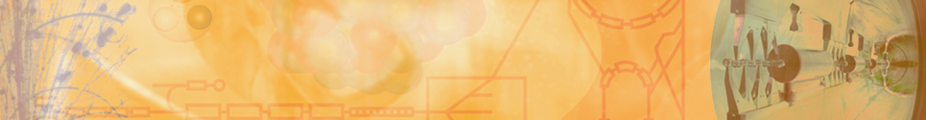
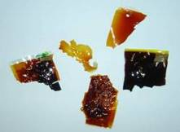
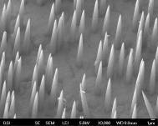
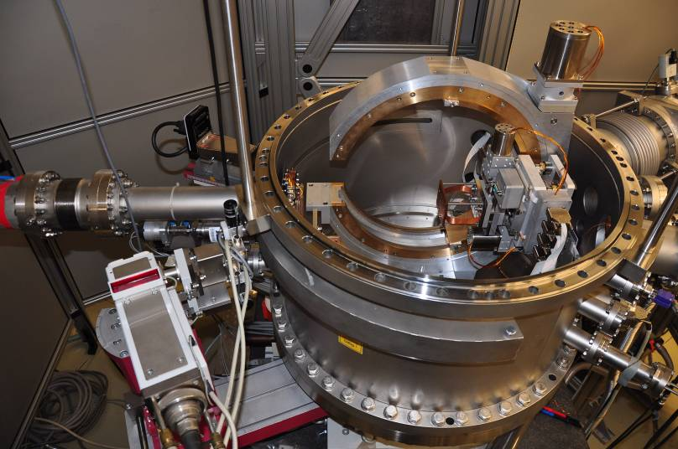
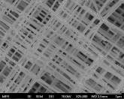
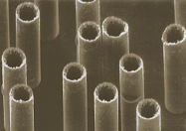
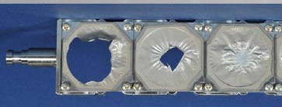
Material research with energetic ion beams:
Basic aspects and nanotechnology
energetic ion beams in solids
radiation damage & material modification
investigate
understand
overcome
functionalize
Notes:
At GSI all ion species from light ions to Uranium are available and can be accelerated in the UNILAC linear accelerator to a maximal specific energy of 11.4 MeV/u, which is equivalent to ~ 2 GeV for the heavies ion species, and corresponds to a penetration range of ~ 100 micrometers. There are two sites devoted to Materials research at the UNILAC.

Slide 2
Motivation
(Outline)
Swift heavy ions in materials
  Energy loss and damage creation
MF sites and their application for research
  X0: nano structures
  M-branch: in situ studies
Radiation damage
  FAIR materials
Materials under extreme conditions
  Material research with the FAIR facility
Notes:
At GSI all ion species from light ions to Uranium are available and can be accelerated in the UNILAC linear accelerator to a maximal specific energy of 11.4 MeV/u, which is equivalent to ~ 2 GeV for the heavies ion species, and corresponds to a penetration range of ~ 100 micrometers. There are two sites devoted to Materials research at the UNILAC.

Slide 3
Energetic ion beams in solids
nuclear stopping
electronic stopping
UNILAC
Notes:
At GSI all ion species from light ions to Uranium are available and can be accelerated in the UNILAC linear accelerator to a maximal specific energy of 11.4 MeV/u, which is equivalent to ~ 2 GeV for the heavies ion species, and corresponds to a penetration range of ~ 100 micrometers. There are two sites devoted to Materials research at the UNILAC.

Slide 4
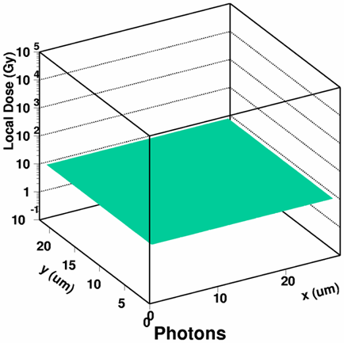
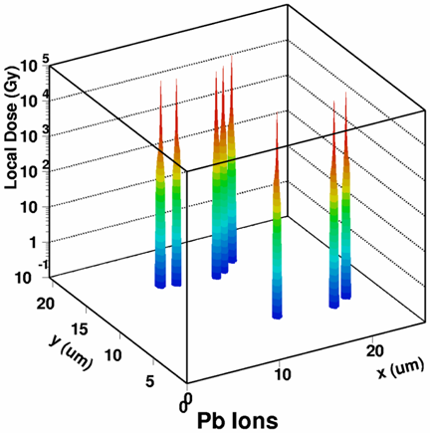
Energetic ion beams in solids
Notes:
At GSI all ion species from light ions to Uranium are available and can be accelerated in the UNILAC linear accelerator to a maximal specific energy of 11.4 MeV/u, which is equivalent to ~ 2 GeV for the heavies ion species, and corresponds to a penetration range of ~ 100 micrometers. There are two sites devoted to Materials research at the UNILAC.

Slide 5
Damage creation
energy deposition
electronic excitation & ionization
‘hot’ electrons
10⁻¹⁷ - 10⁻¹⁶ s
electron cascade
energy diffusion in electronic subsystem
cooling of hot electrons
'cold' lattice
10⁻¹⁵ - 10⁻¹⁴ s
Coulomb explosion
electron-phonon interaction
energy diffusion to atoms
lattice heating
melting
10⁻¹³ - 10⁻¹² s
thermal spike
quenching of atomic disorder
metals ~ 10⁻¹² s
insulators ~ 10⁻¹⁰ s
fast cooling of atoms
defect formation
Notes:
At GSI all ion species from light ions to Uranium are available and can be accelerated in the UNILAC linear accelerator to a maximal specific energy of 11.4 MeV/u, which is equivalent to ~ 2 GeV for the heavies ion species, and corresponds to a penetration range of ~ 100 micrometers. There are two sites devoted to Materials research at the UNILAC.

Slide 6
Material sensitivity
high sensitivity
low sensitivity
dE/dx
threshold
~1 keV/nm
~20 keV/nm
~50 keV/nm
insulators
semi-conductors
metals
☺ polymers
☺ oxides, spinels
☺ ionic crystals
☹ diamond
☺ amorphous Si
☺ GeS, InP, Si_{1-x}Ge_{x}
☹ Si, Ge
☺ amorphous alloys
😐 Fe, Bi, Ti, Co, Zr
☹ Au, Cu, Ag…
Notes:
At GSI all ion species from light ions to Uranium are available and can be accelerated in the UNILAC linear accelerator to a maximal specific energy of 11.4 MeV/u, which is equivalent to ~ 2 GeV for the heavies ion species, and corresponds to a penetration range of ~ 100 micrometers. There are two sites devoted to Materials research at the UNILAC.

Slide 7
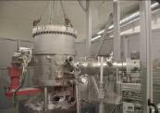

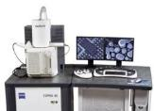
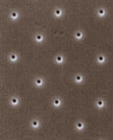
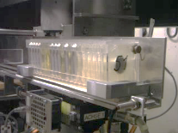
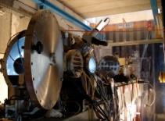
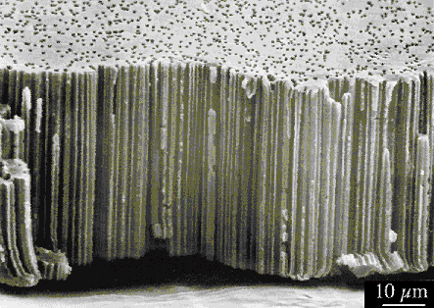
Materials Research Facilities @
GSI Helmholtz Centre for Heavy Ion Research
In-Situ and On-line Analysis of Irradiated Material
SIS
E ~ 1 GeV/u
range ~ mm-cm
M3
Multi-Analysing Chamber
M2
X-Ray Diffraction
M1
Microscopy
SIS
M-Branch
UNILAC
E ~ 11 MeV/u
range ~ 100 μm
UNILAC
X0
high pressure
irradiations
Heavy Ion Microprobe & Sample Inlet System
Cave A
10 μm
Notes:
The ions of the UNILAC accelerator are transferred to a heavy ion synchrotron in which they are further accelerated to energies of ~ 1 GeV/u, which means the ions can penetrate mm upto cm in the materials. Materials research experiments at these energies are hosted in cave A, for example high pressure irradiation experiments, for which the ions need to pass through the diamonds of a diamond-envil cell to reach the sample of interest. Phase change investigations and material characterization is done ex-situ after irradiation. In-situ and online monitoring is done at the M-branch which in turn consists of three separate beamlines.

Slide 8
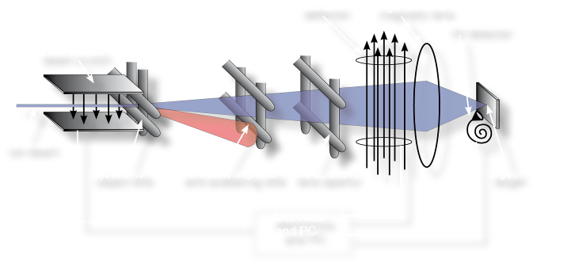
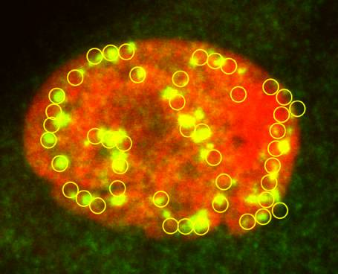
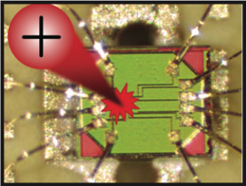
Heavy ion microprobe
Notes:
To check this, they performed another experiment irradiating a SGL previously tranferred onto a pre-structured Si substrate. In the circle parts (in blue) the SGL is suspended, while on the rest (orange) the SGL is lying on the Si substrate. The tracks on the supported SGL display the same morphology as the tracks on the previous example, altrhough much smaller (question: with smaller you mean shorter?). In the freestanding area, nano-rifts are observed.
The formation of CBE is thus attributed to the ejection of material of the underlying support, while in suspended graphene only the linear riffles are observed.
By irradiating samples with various ion energies, they determined experimentally that the threshold for defect creation directly by the SHI projectile is around S =5 keV/nm
Achtung: wenn Du vom Threshold sprichst ist das Substrat gemeint (ich denke SiO2)!

Slide 9
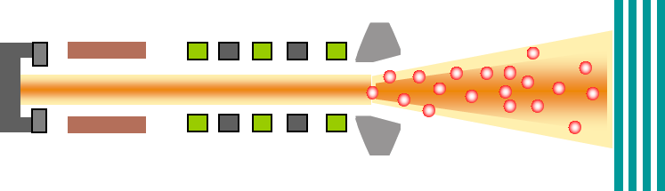
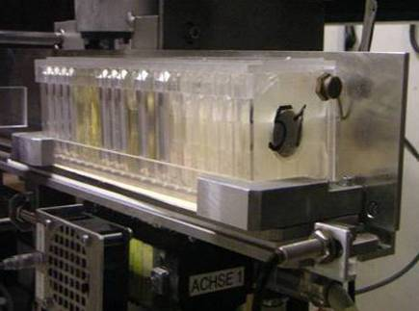
Templates for nano structures
Sample
stack
UNILAC
Au – U
11.4 MeV/u
Automatic load-lock system
Defocused beam (5x5cm²)
Random ion distribution
Fluence regime:
1 – 1E13 ions/cm²
Single ion irradiation
50 samples per hour
(for up to 1E8 ions/cm² per sample)
Notes:
To check this, they performed another experiment irradiating a SGL previously tranferred onto a pre-structured Si substrate. In the circle parts (in blue) the SGL is suspended, while on the rest (orange) the SGL is lying on the Si substrate. The tracks on the supported SGL display the same morphology as the tracks on the previous example, altrhough much smaller (question: with smaller you mean shorter?). In the freestanding area, nano-rifts are observed.
The formation of CBE is thus attributed to the ejection of material of the underlying support, while in suspended graphene only the linear riffles are observed.
By irradiating samples with various ion energies, they determined experimentally that the threshold for defect creation directly by the SHI projectile is around S =5 keV/nm
Achtung: wenn Du vom Threshold sprichst ist das Substrat gemeint (ich denke SiO2)!

Slide 10
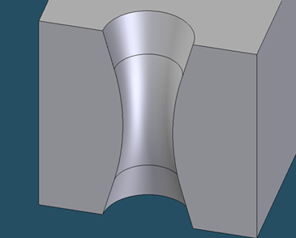
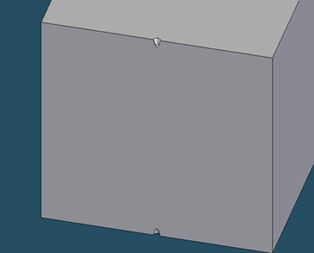
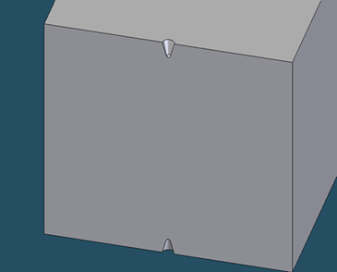

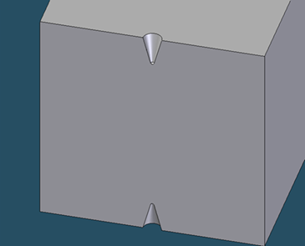


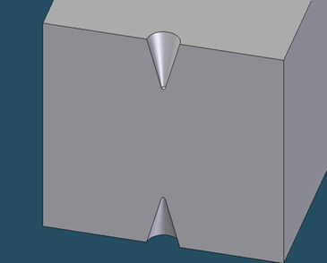

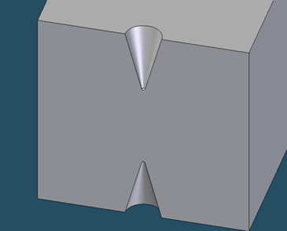
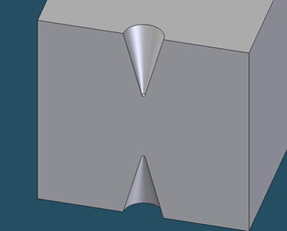

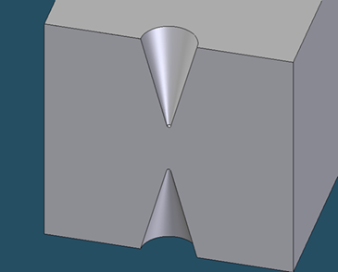
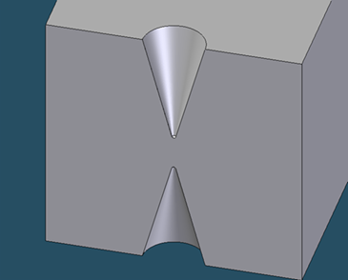
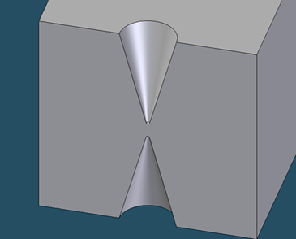

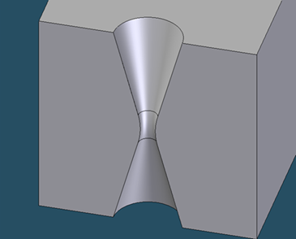




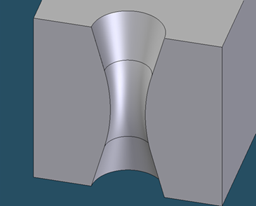
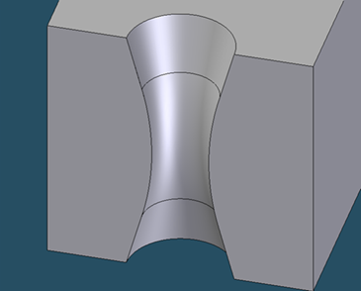
Fabrication of micro- and nano pores
selective ion-track etching
A. Akimenko, 2004
v_{bulk}
irradiation
v_{track}
Polymers
Mica
SiN thin films
chemical etching
(NaOH, NaOCl. HF)
track
Notes:
10

Slide 11
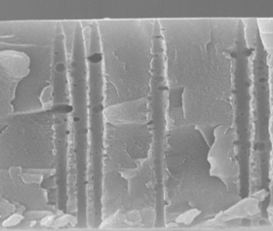
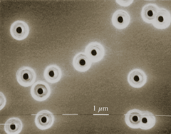
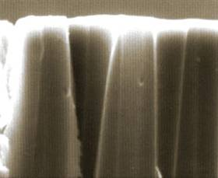
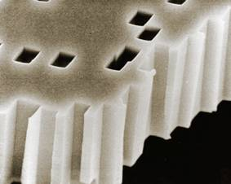
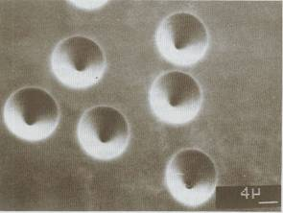
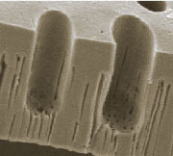
Pore geometries of etched tracks
1 µm
1 µm
cigar-shaped pores
pores in Kapton
funnel-shaped pores
conical pore shape
10 µm
pores in mica
etch pits in SiO₂
perforated dead-end pores

Slide 12
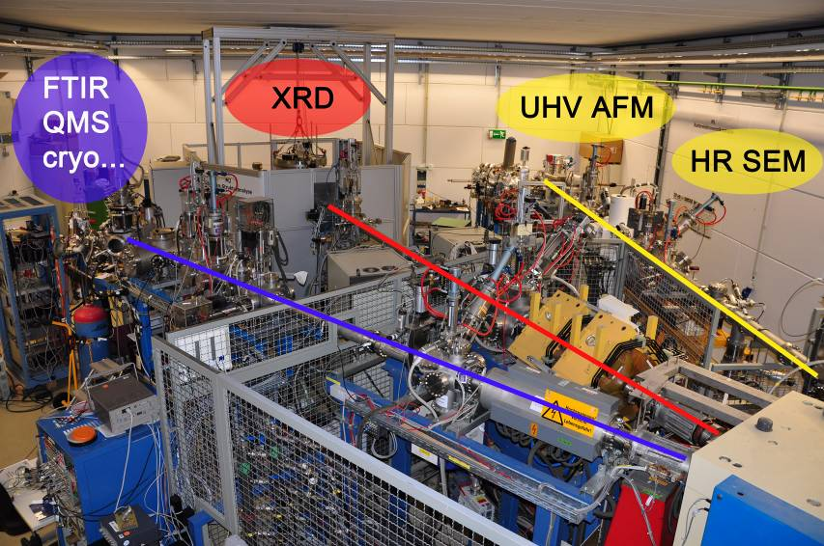
M-branch
Multi-purpose
chamber
- In-situ spectroscopy
(IR, UV-vis,)
- RGA
- T Stages, etc.
XRD
UHV
AFM/STM
HRSEM
M2
M1
M3
M. Bender, D. Severin
Notes:
The first beamline, M1, is devoted to surface analysis experiments by external users, and counts with two microscopes: a HRSEM microscope and a UHV AFM. The second line is devoted to crystallographic investigations by means of a 4-circle XRD. At M3, a multipurpose chamber hosts a number of techniques, such as in-situ spectroscopy (IR, UV, Raman??, residual gas analysis, and counts with both a hot and a cryo stage for experiments at high (above 900C) and low (down to 10K) temperatures. These three lines are available since 2009, and are since them also available to external users that come to GSI to perform a large variety of experiments. From all activities, and due to the limited time available, I have chosen two representative examples on surface modification that are performed at the M1 beamline by external users.

Slide 13
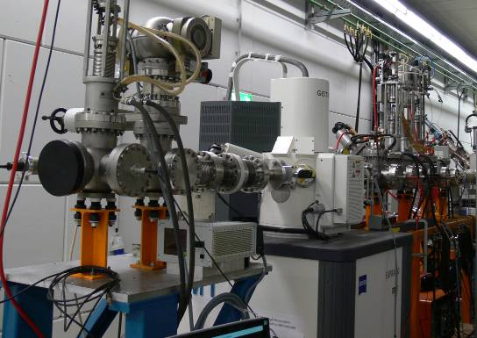
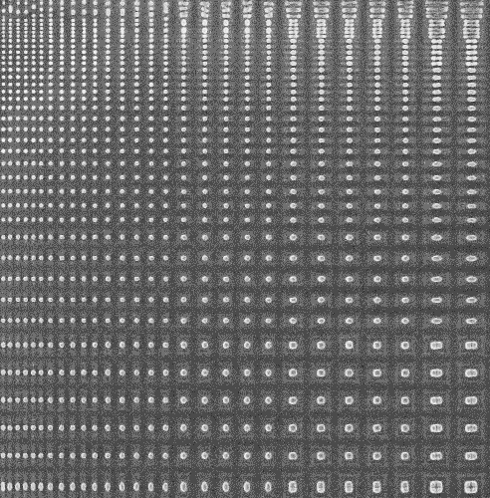
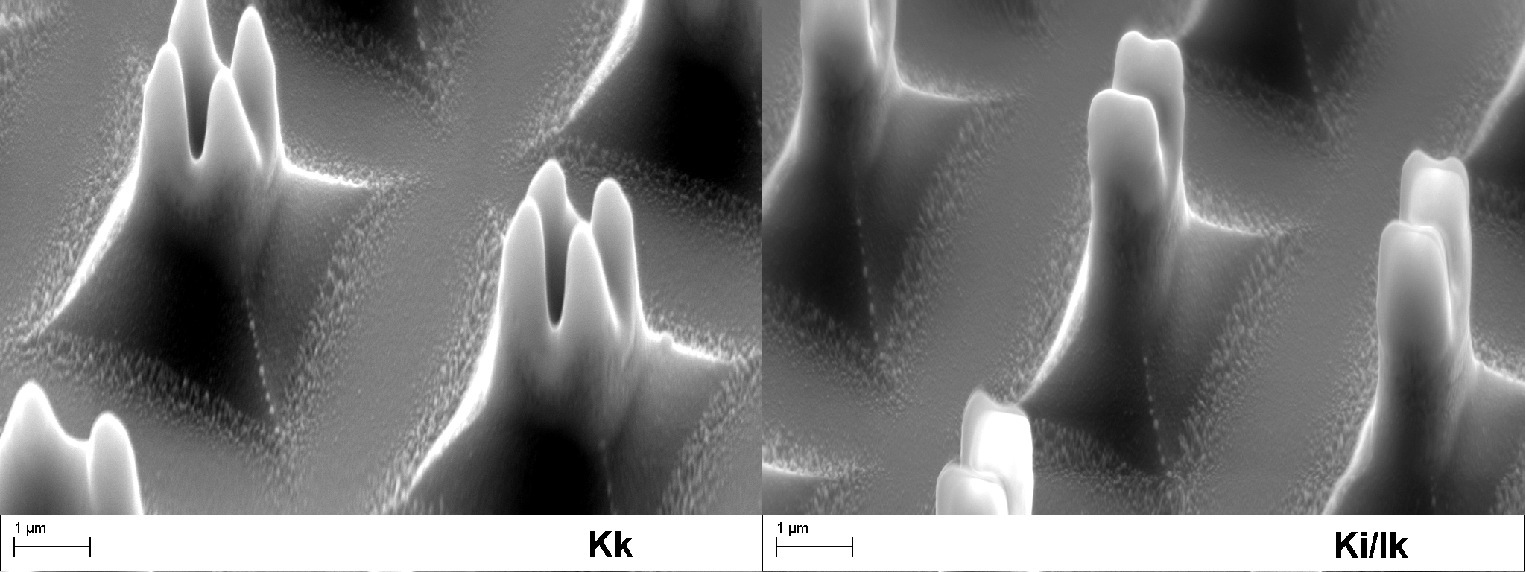
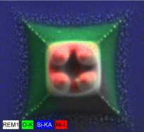
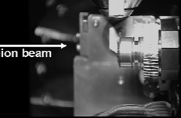
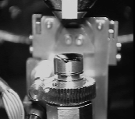


In-situ HRSEM
In-situ imaging without exposing the irradiated sample to air
Ion irradiation
SEM
Prof. Bolse et al. Universität Stuttgart
1 μm
Amirthapandian, Schuchart, Bolse, Rev. Sci. Instrum. 81 (2010) 033702
Notes:
The first one, by the group of Prof. Bolse, uses the HRSEM system installed by his group in collaboration with the GSI MR department. The SEM has a resolution of few nm, and counts with a sample stage with a 5-axes motor that allows us for example to turn the sample in an alternating manner between SEM observation position and ion irradiation position. The SEM counts with an EDX detector for compositional analysis and a nanomanipulator.

Slide 14
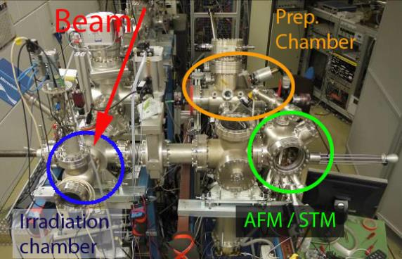


In-situ AFM/STM
In-situ imaging without exposing the irradiated sample to air
& clean surfaces on atomic scale
Omicron AFM/STM
UHV setup (p < 10⁻¹⁰mbar)
Load-lock system
In-situ sample preparation
Sample check via LEED
Prof. Schleberger et al.
Universität Duisburg
Notes:
The second example uses the UHV AFM system, placed in the same M1 beamline right after the SEM. The system installed by the group of Prof. Marika S. counts with an irradiation chamber evacuated to UHV conditions, and a Load-lock system enables the preparation of ultraclean surfaces high T annealing to T of up to 1200 C. The cleaness and crystallinity of the sample is checked? by LEED.
Nr. 11 M1-Analysis: Sample preparation: Die Proben können getempert werden (Direktstromheizung für Si oder ähnliche Proben mit ausreichendem elektroschen Widerstand und eine Elektronenkannone zum heizen vin anderen Proben) Temperaturen bis ca. 1500°C möglich); Gaseinlasssystem um z.B. mit Wasserstoff zu terminieren (Si-H zur besseren Auflösung von Oberflächeneffekten im STM); Sputtergun um dünnen Schichten in-situ aufzubringen.
Sample check via LEED: im LEED sieht man perfekte Beugungsbilder, wenn die Oberfläche glatt und sauber ist (ca. 1min. Messzeit). Dient vor allem zum checken der Si-Proben. Also, Si rein. Tempern bei ca. 800°C für 12h, dann flshen bei 1200-1500°C (wenige Minuten) und mit dem LEED schauen, ob die Oberfläche eine perfekte 7x7 Rekonstruktion zeigt.

Slide 15
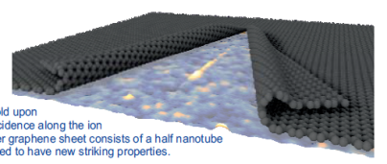
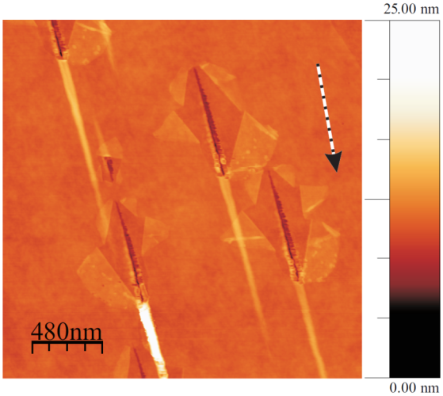
Modifying graphene with heavy ions
749 MeV, Pb, θ = 2°
Formation of closed bilayer edge graphene structure
Ion irradiation under
glancing incidence (θ = 2°)
single graphene layer
on PMMA
Prof. Schleberger et al., Universität Duisburg
Notes:
The group of Marika Schleberger uses this in-situ AFM facility to investigate the morphological modification of thin films, and in particular of graphene layers under swift heavy ion irradiation. They found out that that wehn irradiated under gracing incidence with heavy ions, the graphene folds along the ion trajectory creating a closed bilayer edge structure. On this picture they show a graphene layer placed on PMMA, that has been irradiated with Pb ions, 750 MeV under a small 2 degrees angle. The image visualies the graphene zipped structures.
The folding efficiency of SLG is typically around 100%. This can be used to test for successful irradiation.
It is thought that the ion creates a line of defects in the graphene sheet by direct damage due to electronic excitation.
Material from the substrate and/or the interfacial layer between the graphene layer and the substrate is ejected.

Slide 16
Modifying graphene with heavy ions
749 MeV Pb, θ = 2°
Swift heavy ions induced morphology changes on supported and free-standing graphene layers
Nano-rift
SiO₂
Closed bilayer edge structure
Prof. Schleberger et al., Universität Duisburg
Notes:
To check this, they performed another experiment irradiating a SGL previously tranferred onto a pre-structured Si substrate. In the circle parts (in blue) the SGL is suspended, while on the rest (orange) the SGL is lying on the Si substrate. The tracks on the supported SGL display the same morphology as the tracks on the previous example, altrhough much smaller (question: with smaller you mean shorter?). In the freestanding area, nano-rifts are observed.
The formation of CBE is thus attributed to the ejection of material of the underlying support, while in suspended graphene only the linear riffles are observed.
By irradiating samples with various ion energies, they determined experimentally that the threshold for defect creation directly by the SHI projectile is around S =5 keV/nm
Achtung: wenn Du vom Threshold sprichst ist das Substrat gemeint (ich denke SiO2)!

Slide 17
In-situ XRD
Notes:
The second example uses the UHV AFM system, placed in the same M1 beamline right after the SEM. The system installed by the group of Prof. Marika S. counts with an irradiation chamber evacuated to UHV conditions, and a Load-lock system enables the preparation of ultraclean surfaces high T annealing to T of up to 1200 C. The cleaness and crystallinity of the sample is checked? by LEED.
Nr. 11 M1-Analysis: Sample preparation: Die Proben können getempert werden (Direktstromheizung für Si oder ähnliche Proben mit ausreichendem elektroschen Widerstand und eine Elektronenkannone zum heizen vin anderen Proben) Temperaturen bis ca. 1500°C möglich); Gaseinlasssystem um z.B. mit Wasserstoff zu terminieren (Si-H zur besseren Auflösung von Oberflächeneffekten im STM); Sputtergun um dünnen Schichten in-situ aufzubringen.
Sample check via LEED: im LEED sieht man perfekte Beugungsbilder, wenn die Oberfläche glatt und sauber ist (ca. 1min. Messzeit). Dient vor allem zum checken der Si-Proben. Also, Si rein. Tempern bei ca. 800°C für 12h, dann flshen bei 1200-1500°C (wenige Minuten) und mit dem LEED schauen, ob die Oberfläche eine perfekte 7x7 Rekonstruktion zeigt.

Slide 18
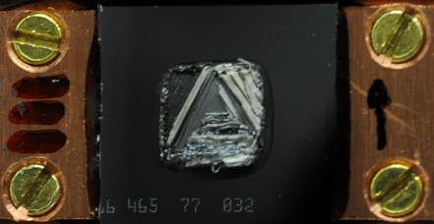
In-situ XRD
4.8 MeV/u
Au ions
Chi = 0°
crystal breaks
no amorphisation
high in-plane stress
NiO single crystal
Notes:
The second example uses the UHV AFM system, placed in the same M1 beamline right after the SEM. The system installed by the group of Prof. Marika S. counts with an irradiation chamber evacuated to UHV conditions, and a Load-lock system enables the preparation of ultraclean surfaces high T annealing to T of up to 1200 C. The cleaness and crystallinity of the sample is checked? by LEED.
Nr. 11 M1-Analysis: Sample preparation: Die Proben können getempert werden (Direktstromheizung für Si oder ähnliche Proben mit ausreichendem elektroschen Widerstand und eine Elektronenkannone zum heizen vin anderen Proben) Temperaturen bis ca. 1500°C möglich); Gaseinlasssystem um z.B. mit Wasserstoff zu terminieren (Si-H zur besseren Auflösung von Oberflächeneffekten im STM); Sputtergun um dünnen Schichten in-situ aufzubringen.
Sample check via LEED: im LEED sieht man perfekte Beugungsbilder, wenn die Oberfläche glatt und sauber ist (ca. 1min. Messzeit). Dient vor allem zum checken der Si-Proben. Also, Si rein. Tempern bei ca. 800°C für 12h, dann flshen bei 1200-1500°C (wenige Minuten) und mit dem LEED schauen, ob die Oberfläche eine perfekte 7x7 Rekonstruktion zeigt.

Slide 19

In-situ XRD
4.8 MeV/u
Au ions
Chi = 45°
crystal stays stable
smooth surface
decrease of intensity in the XRD pattern
amorphisation ?
NiO single crystal
Notes:
The second example uses the UHV AFM system, placed in the same M1 beamline right after the SEM. The system installed by the group of Prof. Marika S. counts with an irradiation chamber evacuated to UHV conditions, and a Load-lock system enables the preparation of ultraclean surfaces high T annealing to T of up to 1200 C. The cleaness and crystallinity of the sample is checked? by LEED.
Nr. 11 M1-Analysis: Sample preparation: Die Proben können getempert werden (Direktstromheizung für Si oder ähnliche Proben mit ausreichendem elektroschen Widerstand und eine Elektronenkannone zum heizen vin anderen Proben) Temperaturen bis ca. 1500°C möglich); Gaseinlasssystem um z.B. mit Wasserstoff zu terminieren (Si-H zur besseren Auflösung von Oberflächeneffekten im STM); Sputtergun um dünnen Schichten in-situ aufzubringen.
Sample check via LEED: im LEED sieht man perfekte Beugungsbilder, wenn die Oberfläche glatt und sauber ist (ca. 1min. Messzeit). Dient vor allem zum checken der Si-Proben. Also, Si rein. Tempern bei ca. 800°C für 12h, dann flshen bei 1200-1500°C (wenige Minuten) und mit dem LEED schauen, ob die Oberfläche eine perfekte 7x7 Rekonstruktion zeigt.

Slide 20
In-situ XRD
Chi scan of the NiO (200) reflex (raw data)
Chi scan of the NiO (200) reflex (raw data)
Au ions
4.8 MeV/u
8E14
6E14
4E14
2E14
0
Fluence
Fluence
Notes:
The second example uses the UHV AFM system, placed in the same M1 beamline right after the SEM. The system installed by the group of Prof. Marika S. counts with an irradiation chamber evacuated to UHV conditions, and a Load-lock system enables the preparation of ultraclean surfaces high T annealing to T of up to 1200 C. The cleaness and crystallinity of the sample is checked? by LEED.
Nr. 11 M1-Analysis: Sample preparation: Die Proben können getempert werden (Direktstromheizung für Si oder ähnliche Proben mit ausreichendem elektroschen Widerstand und eine Elektronenkannone zum heizen vin anderen Proben) Temperaturen bis ca. 1500°C möglich); Gaseinlasssystem um z.B. mit Wasserstoff zu terminieren (Si-H zur besseren Auflösung von Oberflächeneffekten im STM); Sputtergun um dünnen Schichten in-situ aufzubringen.
Sample check via LEED: im LEED sieht man perfekte Beugungsbilder, wenn die Oberfläche glatt und sauber ist (ca. 1min. Messzeit). Dient vor allem zum checken der Si-Proben. Also, Si rein. Tempern bei ca. 800°C für 12h, dann flshen bei 1200-1500°C (wenige Minuten) und mit dem LEED schauen, ob die Oberfläche eine perfekte 7x7 Rekonstruktion zeigt.

Slide 21

M3 - beam line
Cryostat
UV/Vis and fluorescence
Long-distance
microscopy
FT-IR
Sample curvature
measurement
Ion beam
Multipurpose chamber
Variable beam spot size
(max. 4x4 cm²)
On-line beam monitoring
Hot stage ( > 900 °C )
Cryo-stage ( 10 – 300 K )
Residual gas analyzer
In-situ spectroscopy
etc.
M₃ all-in-one chamber
QMS
Gas flow
controller
Notes:
Finally the M3 multipurpose chamber counts with various analysis techniquesthat, among other topics, are very suitable for the investigation of radiation hardness of materials.

Slide 22

Radiation effects in astrophysical ice
Sample preparation out of gas phase, sublimation on cold surface
Measure sputter & desorption yields by RGA & ToF SIMS
Notes:
Finally the M3 multipurpose chamber counts with various analysis techniquesthat, among other topics, are very suitable for the investigation of radiation hardness of materials.

Slide 23


Radiation hardness of materials
Effect of swift heavy ion irradiation on graphene FETs
Radiation-induced degradation of accelerator materials for FAIR
irradiated
epoxy
graphite
target
FET irradiated with 1.14 GeV U²⁸⁺ ions
Studying the effect of cosmic rays in space applications
stripper foils
Ochedowski et al., J. of Appl. Phys. 1113 (2013)
M. Tomut et al., GSI Darmstadt
Notes:
Thus on the one hand, one can study how devices are affected by SHI irradiations. In this the performance and electrical characterisctics of a graphene FET were measured before and after heavy ion irradiation, thus learning how these devices may be affected by cosmic rays during outer space applications. On the other hand, at GSI we also investigate the radiation ghardness of materials relevant for the new accelerator facilities at FAIR

Slide 24







Radiation hardness & FAIR materials
“hot spots”
Graphite Analysis
deformation
stress
crack formation
Super-FRS target wheel
beam catchers
Tests of organic insulators
voltage stability
graphitization
structural changes
beam-induced outgassing
Stripper foils for UNILAC upgrade
in collaboration with activities at LHC (CERN), FRIB (Michigan), RIBF (RIKEN)
Notes:
At the M-branch, relevant components identified as “hot-spots” are being analyzed. This includes stripper foils, beam cathers, graphite-based FRS target wheels, among others.

Slide 25


Radiation hardness & FAIR materials
“hot spots”
Graphite Analysis
deformation
stress
crack formation
Related topics under study:
Reliability tests of functional properties
Understanding failure mechanisms
Testing new materials, new designs
Provide reliable lifetime predictions
Develop failure criteria and diagnostics
Super-FRS target wheel
beam catchers
Tests of organic insulators
voltage stability
graphitization
structural changes
beam-induced outgassing
Stripper foils for UNILAC upgrade
Thermal imaging
Laser vibrometer
Eddy current
in collaboration with activities at LHC (CERN), FRIB (Michigan), RIBF (RIKEN)
Notes:
At the M-branch, relevant components identified as “hot-spots” are being analyzed. This includes stripper foils, beam cathers, graphite-based FRS target wheels, among others.

Slide 26
Radiation hardness of materials
Irradiation of materials (predominately carbon materials) with different dE/dx, flux, fluence, ...
in situ (& online) / ex situ investigations of
mechanical properties
hardness
stiffness
brittleness
...
structure
amorphization
swelling
...
electrical
conductivity
impedance
...
thermal
diffusivity
emissivity
...
Notes:
Thus on the one hand, one can study how devices are affected by SHI irradiations. In this the performance and electrical characterisctics of a graphene FET were measured before and after heavy ion irradiation, thus learning how these devices may be affected by cosmic rays during outer space applications. On the other hand, at GSI we also investigate the radiation ghardness of materials relevant for the new accelerator facilities at FAIR

Slide 27


Radiation hardness of materials
Also: dynamical mode, kHz read out
measuring temperature
(as function of space and time)
→ Input and benchmark for ongoing simulation studies (e. g. stress waves)
Notes:
Thus on the one hand, one can study how devices are affected by SHI irradiations. In this the performance and electrical characterisctics of a graphene FET were measured before and after heavy ion irradiation, thus learning how these devices may be affected by cosmic rays during outer space applications. On the other hand, at GSI we also investigate the radiation ghardness of materials relevant for the new accelerator facilities at FAIR

Slide 28

Super-FRS production target: key parameters
Beam
beam
catcher
← 25 cm →
← 80 cm →
²³⁸U (200 GeV)
5 ×10¹¹ ions/pulse
graphite (800 K)
small beam spot
graphite
large beam spot
medium Z
(neutrons)
E ≈ 60 kJ
E ≈ 10 kJ
E ≈ 40 kJ
E ≈ 10 kJ
Case 1:
slow extraction ( ≈ 1 s)
 rotating wheel target
Case 2:
fast extraction ( ≈ 60 ns)
 rotating wheel target or liquid-metal target
problems to face: - radiation damage → material degradation
thermal conductivity reduction, embrittlement
- intense transient loads → thermal shock
- cyclic thermal loads → thermal fatigue

Slide 29
Materials under extreme conditions
pressure
irradiation
temperature

Slide 30


Materials under extreme conditions
Simulating geological processes in the inner Earth
Ion-beam stabilized high pressure phases
Notes:
30

Slide 31



Irradiation experiments with pressurized samples
relativistic ions (e.g., Au, Pb, U
200 MeV/u
40 GeV
Notes:
31
(1) Slowing down of ions in matter –> important in field of Earth science (2) fragments of decay induce damage within the lattice

Slide 32



High pressure irradiation of Zircon
Raman spectroscopy
P = 14.2 GPa
U (E_{f} = 60 MeV/u)
dE/dx = 24.5 keV/nm
2×10⁹ ions/cm²
before irradiation
after irradiation
ZrSiO4
Glasmacher et al., Phys. Rev. Lett 96 (2006)

Slide 33



Target station in APPA cave
@ FAIR
higher beam intensities
larger sample volumes (mm³)
add temperature by laser heating

Slide 34





Thanks!
GSI Materials Research
Darmstadt (Germany)

Slide 35

See you...

Slide 36

Radiation Damage Study on Carbon-Based Stripper Foils
Radiation effects
- microstructural damage
- thermal effects
- stress waves
Tests of different carbon materials
Define failure criteria
Lifetime estimates
Irradiation experiments at UNILAC
U, Au ions @ 1.4 – 11.4 MeV/u
flux: 10⁹ - 10¹⁰ ions/(cm²·s),
fluence: up to 5×10¹⁴ ions/cm²
beam pulse: between 4 ms @ 38 Hz
  and 150 µs @ 0.2 Hz
M-branch
PhD thesis (2012 -2015) by K. Kupka
supervised by M. Tomut
Notes:
Investigates experimentally the radiation damage and pressure wave effects in different carbon-based foils exposed to high intensity heavy ion beams in order to predict and increase the lifetime of carbon stripper foils under these extreme conditions.

Slide 37

Radiation Damage Study on Carbon-Based Stripper Foils
20 µg/cm² amorphous carbon (GSI target lab)
Au²⁵⁺ 3.6 MeV/u, 38 Hz, 4 ms
graphitization
compaction
cracking
U²⁸⁺ 4.8 MeV/u, 1 Hz, 0.4 ms
Notes:
graphitization under high fluences leads to compaction and finally fracturing of foil
compaction=higher density → increase of dE/dx → higher damage

Slide 38


Radiation Damage Study on Carbon-Based Stripper Foils
Analysis of irradiated stripper foils
Raman spectroscopy
Stiffness tests by AFM
pristine
irradiated
Initial amorphous structure (low density) transforms under irradiation into nanocrystalline carbon (high density)
irradiation results in
→ increased stiffness
→ enlarged brittleness
Notes:
Umwandlung amorph (low density) target → nanocrystalline graphitic (higher density) structure
AFM = atomic force microscopy

Slide 39

Energy deposition
Au → Ti
electronic stopping
nuclear stopping
stopping range ~ 1 µm
dominated by electronic interaction
ion projectile

Slide 40



Energy deposition
Au → Ti
electronic stopping
direct interaction with atoms
two steps:
1) interaction with electrons
2) energy transfer to atoms
nuclear stopping
target atoms
target electrons
1 µm
electron cascade
atomic collision cascade
10 - 100 µm
coupling to lattice
lattice disorder
defects
track

