Slide 1
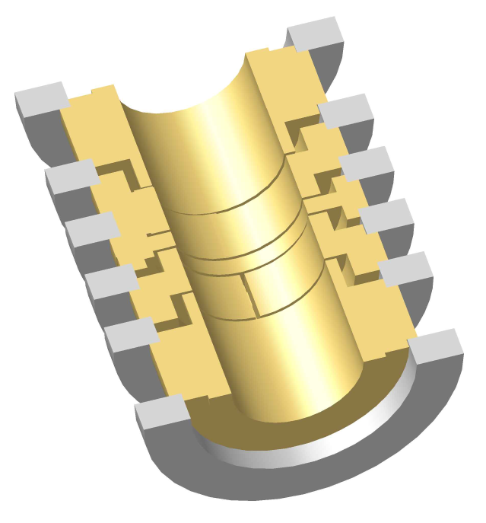
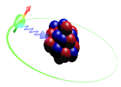




The g-factor of Highly Charged Ions
Stress Test for the Standard Model and
Access to Fundamental constants
Sven Sturm
September 25th, 2014

Slide 2

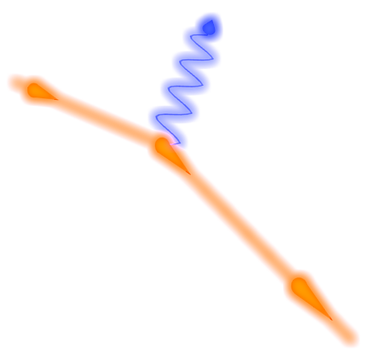
Quantum ElectroDynamics (QED)
Quantum Electrodynamics (QED), the theory of light and matter, is tested and proven in the lab
  But what about more extreme conditions?
Richard P. Feynman
  Non-linear QED processes ?
      Photon-photon interaction
  Lorentz symmetry violation?
      Standard Model Extension (Kostelecky)?
Combine strongest fields and highest precision !

Slide 3
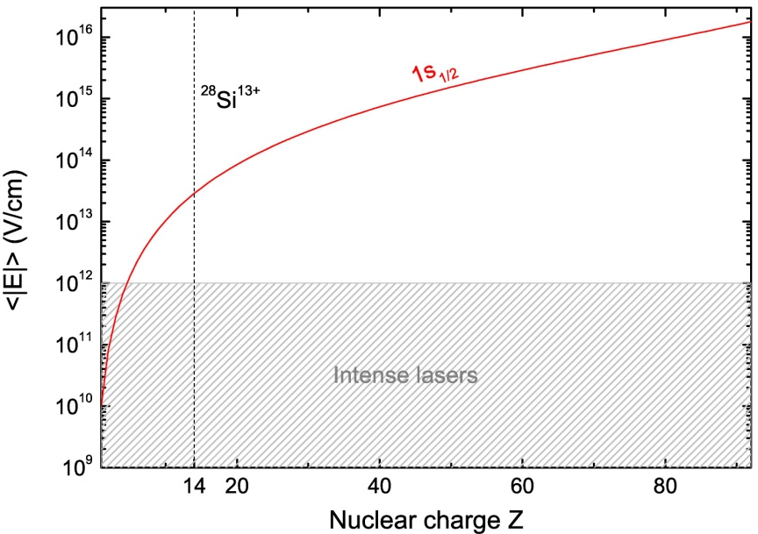
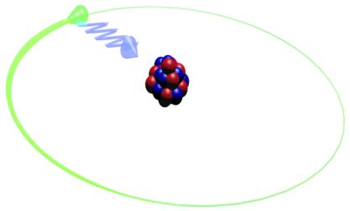
QED of Bound States
  Few or single electron systems are calculable to very high accuracy in QED series solution

Slide 4
QED of Bound States
  Few or single electron systems are calculable to very high accuracy in QED series solution
Low field strength
High to ultra-high
field strength
The Standard Model in extreme conditions
Electron mass

Slide 5

QED of Bound States
  Few or single electron systems are calculable to very high accuracy in QED series solution
Low field strength
High to ultra-high
field strength
The Standard Model in extreme conditions
Electron mass

Slide 6
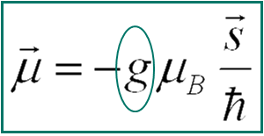
The g-Factor
B
e⁻
  Results allow determination of
  fundamental constants (m_{e} , α)
[J. Zatorski et al., 2011]

Slide 7
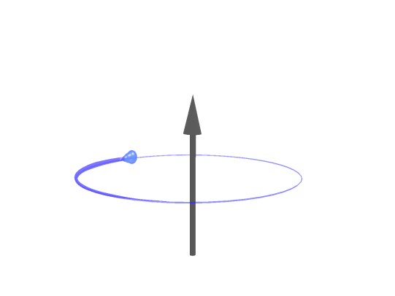
Measurement Principle
Measurement of the Larmor frequency in a well-known magnetic field:
Measurement of the free cyclotron frequency to determine the magnetic field:
B
B
e⁻
has to be
determined
Measured by independent precision experiments

Slide 8
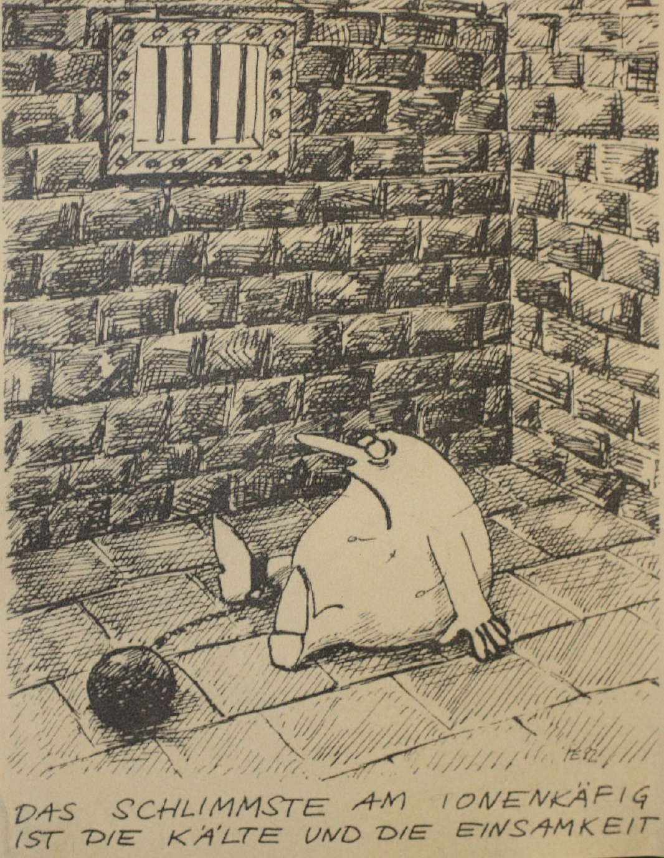
Experimental Requirements
Requirements of the experiment:
Extremely homogeneous
magnetic field (3.7 T)
Single, cold ion
Long storage times (months)
“Perfect“ vacuum
Experimental conditions
Cryogenic temperatures (4.2K)
Vacuum better than 10⁻¹⁶ mbar
  less than 20 gas atoms
in the trap volume !
“ The worst part about the ion trap
is the cold and the loneliness “
[P. Evers, Wundersame Welt der Atomis]

Slide 9
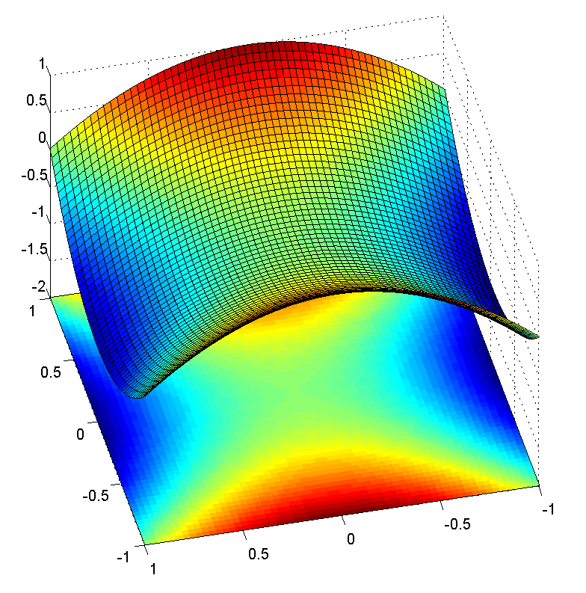

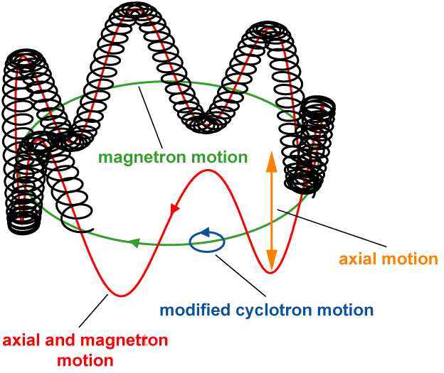
Our measurement tool - the Penning trap
B
U₀
Three independent eigenmotions
Reduced cyclotron
frequency:
~2π∙27 MHz
Magnetron drift
frequency:
~ 2π∙ 9 kHz
Axial frequency:
~ 2π∙ 700 kHz
Free cyclotron frequency
(Brown-Gabrielse invariance theorem)

Slide 10
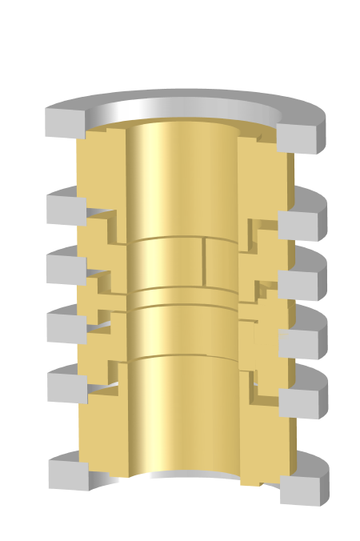
Eigenfrequency Detection
Oscillating ion
induces image charges
in trap electrodes

Slide 11
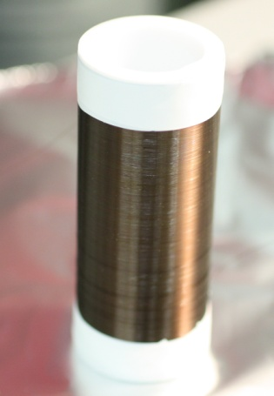
Eigenfrequency Detection
A
Oscillating ion
induces image charges
in trap electrodes
Tank circuit with high impedance
R_{p} = 50 MΩ
Q = 3200

Slide 12
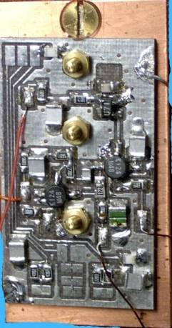
Eigenfrequency Detection
A
Oscillating ion
induces image charges
in trap electrodes
Tank circuit with high impedance
R_{p} = 50 MΩ
Q = 3200
Cryogenic ultra low-noise amplifier
e_{n} = 400pV/ √Hz
i_{n} ≤ 10fA/ √Hz

Slide 13
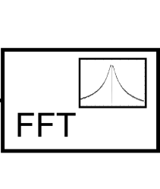
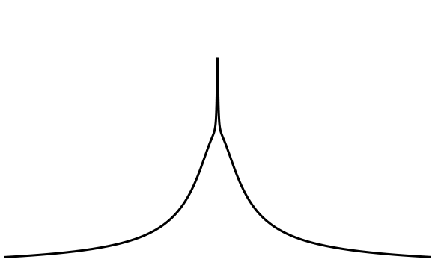
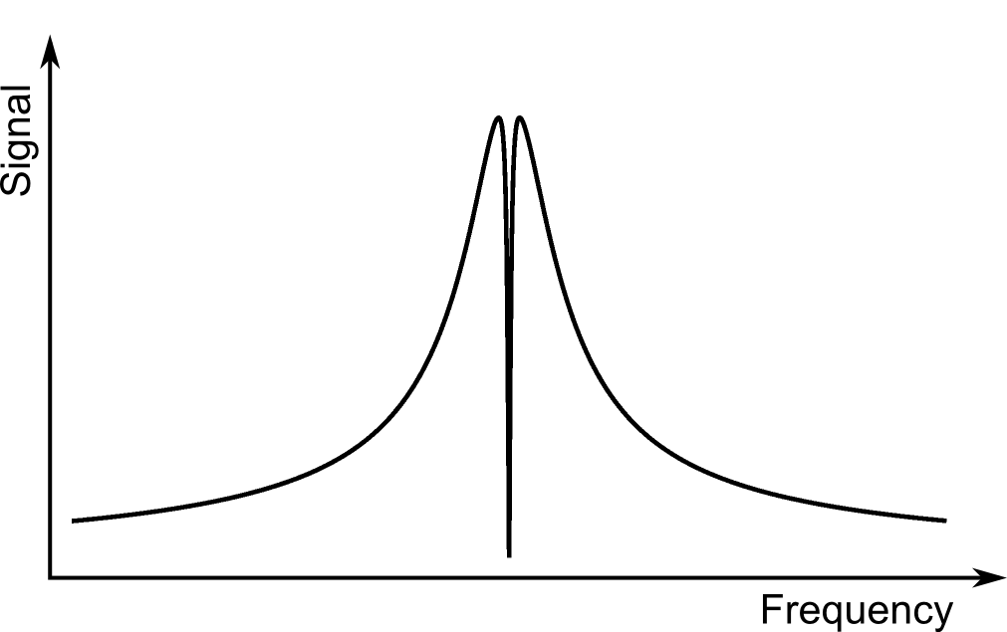
Eigenfrequency Detection
A
Oscillating ion
induces image charges
in trap electrodes
Tank circuit with high impedance
R_{p} = 50 MΩ
Q = 3200
Cryogenic ultra low-noise amplifier
e_{n} = 400pV/ √Hz
i_{n} ≤ 10fA/ √Hz
Fast Fourier Transformation to obtain the frequency information

Slide 14
Eigenfrequency Detection
A
Ion is resistively cooled until it reaches thermal equilibrium with the tank circuit
Oscillating ion
induces image charges
in trap electrodes
Tank circuit with high impedance
R_{p} = 50 MΩ
Q = 3200
Cryogenic ultra low-noise amplifier
e_{n} = 400pV/ √Hz
i_{n} ≤ 10fA/ √Hz
Fast Fourier Transformation to obtain the frequency information

Slide 15
Eigenfrequency Detection
A
Ion is resistively cooled until it reaches thermal equilibrium with the tank circuit
Oscillating ion
induces image charges
in trap electrodes
Tank circuit with high impedance
R_{p} = 50 MΩ
Q = 3200
Cryogenic ultra low-noise amplifier
e_{n} = 400pV/ √Hz
i_{n} ≤ 10fA/ √Hz
Fast Fourier Transformation to obtain the frequency information

Slide 16
Eigenfrequency Detection
  Axial frequency directly detected as narrow
  “dip”
  Other modes can be coupled to axial motion
  via rf-sideband coupling
    Splitting of the axial frequency allows
    to deduce radial eigenfrequencies

Slide 17
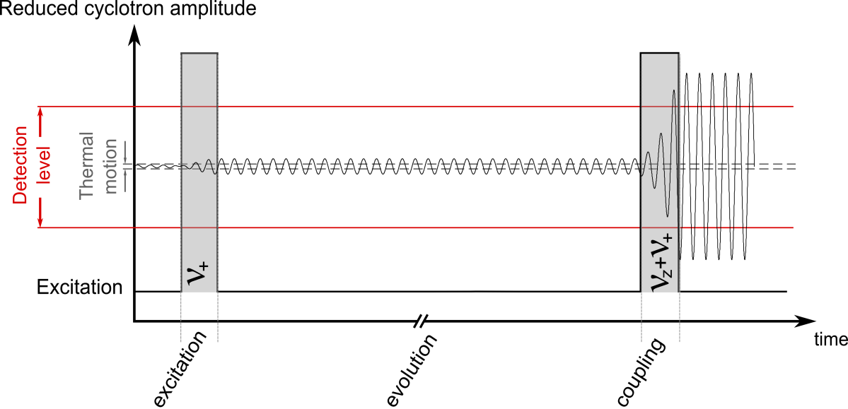
Ultra Precise Detection Method: PnA
Phase-sensitive detection technique allows coherent detection of the
modified cyclotron frequency ν₊
  rapid measurement time ( ~ 5s instead of ~ 3min)
  → reduction of impact of B-field fluctuations
  small radial kinetic energies during phase evolution
    → smaller magnetic and relativistic shifts
[S.Sturm et al., PRL 107 (2011)]

Slide 18
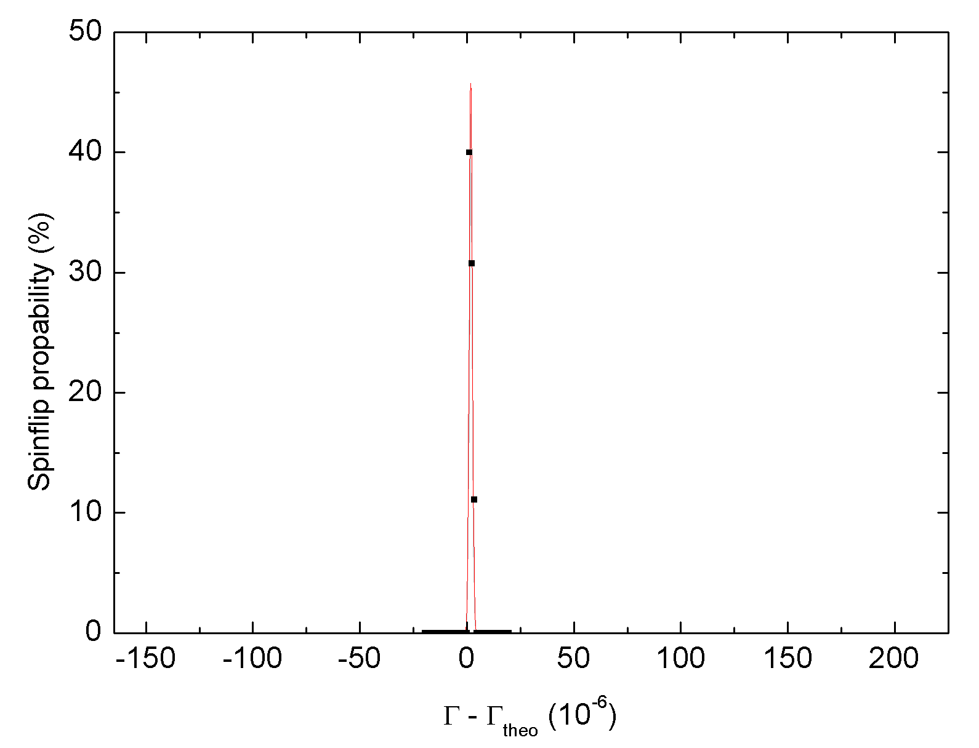
PnA
  Improvement by an order of magnitude
  Enables measurements on ppt scale (10⁻¹²) !
²⁸Si¹³⁺
dΓ/ Γ ~ 4 10⁻¹¹
[S. Sturm et al., PRA 87, 030501 (2013)]

Slide 19
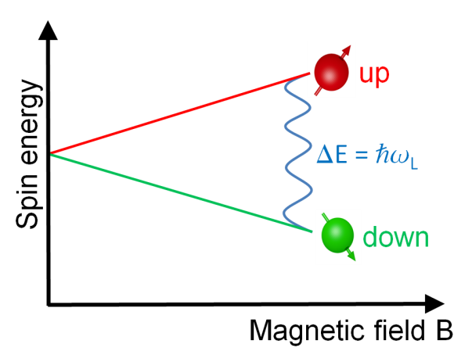

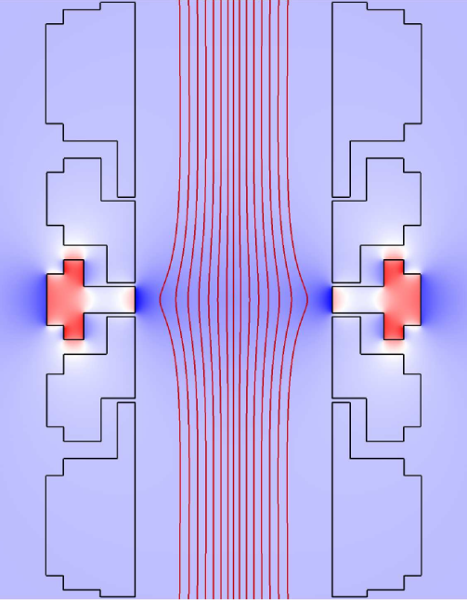
Spin-State Detection
Probe Zeeman transition with millimeter waves
Detect spin quantum state with continuous
Stern-Gerlach effect
  Magnetic inhomogeneity maps spin-state onto axial frequency
Ferromagnetic ring produces a magnetic bottle

Slide 20
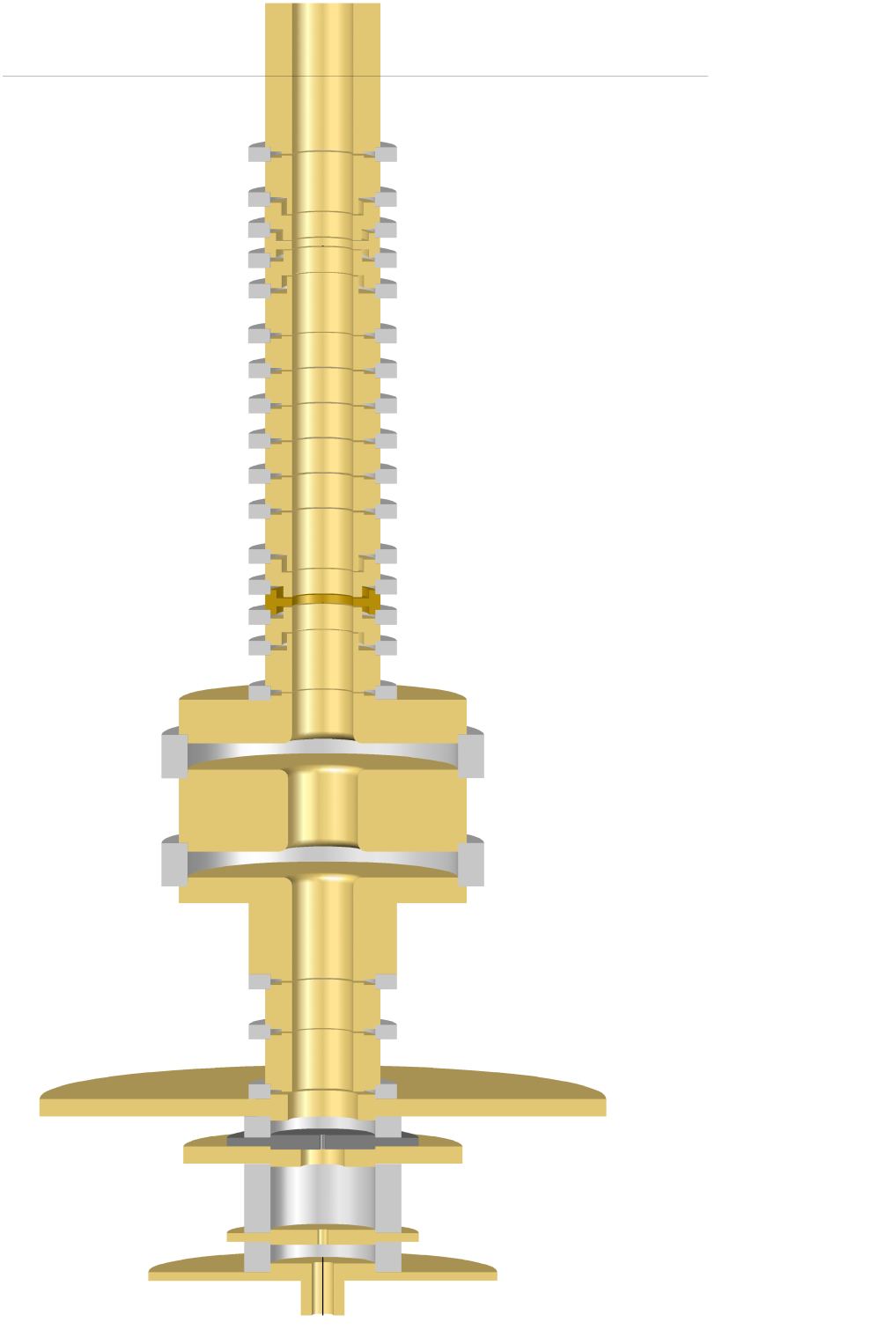
Triple Penning trap system
7 mm
Precision trap
Very homogeneous magnetic field
Measurement of the frequency ratio Γ
Analysis trap
Magnetic inhomogeneity (B₂≈10mT/mm²)
Detection of spin direction
~14 cm
Creation trap
In-trap ion creation of highly-charged ions
Miniature EBIT/S

Slide 21
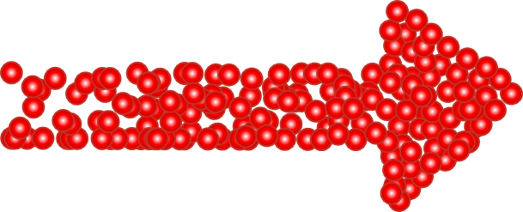
Electron-Beam Ion Trap - EBIT
Potential

Slide 22
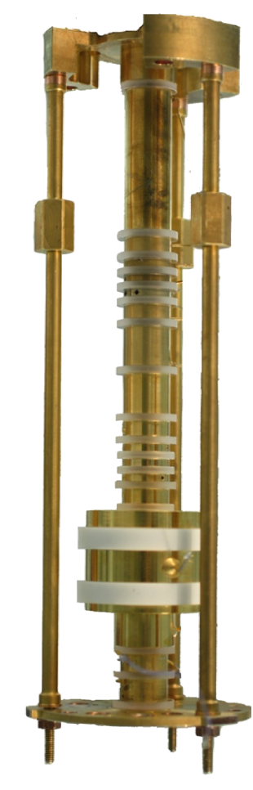
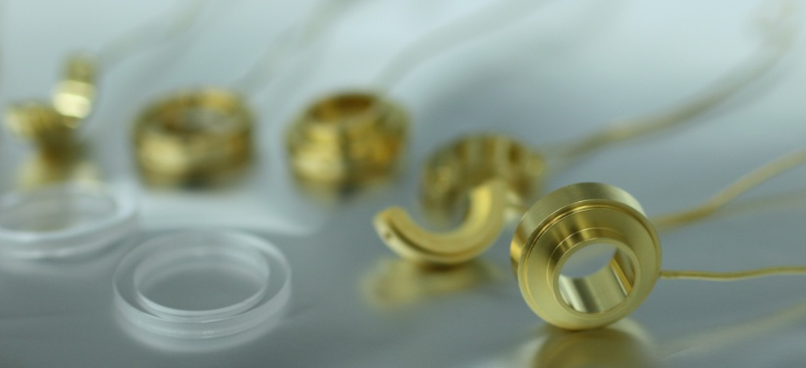
Triple Penning trap system
7 mm
Precision trap
Very homogeneous magnetic field
Measurement of the frequency ratio Γ
Analysis trap
Magnetic inhomogeneity (B₂≈10mT/mm²)
Detection of spin direction
~14 cm

Slide 23
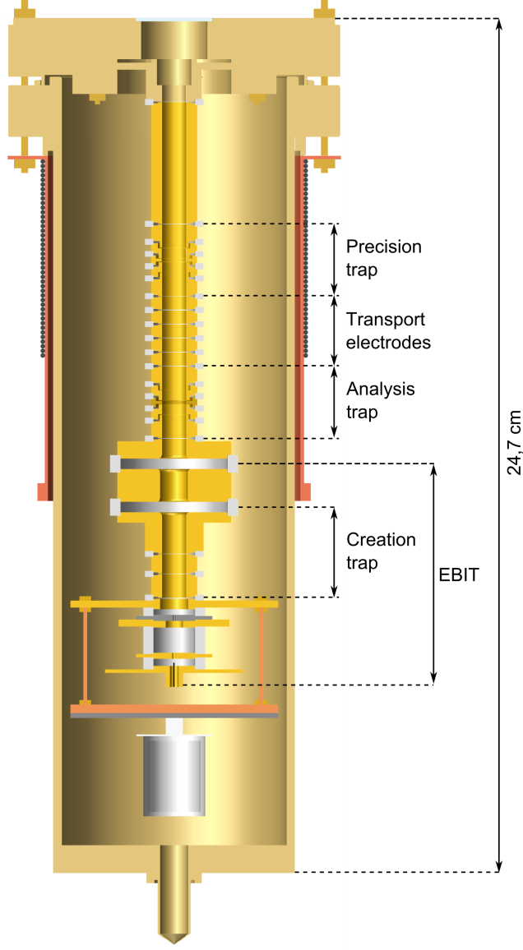
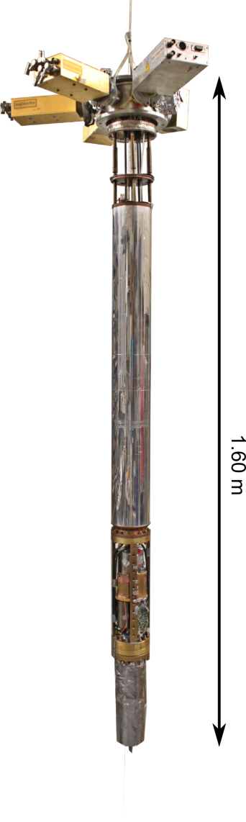
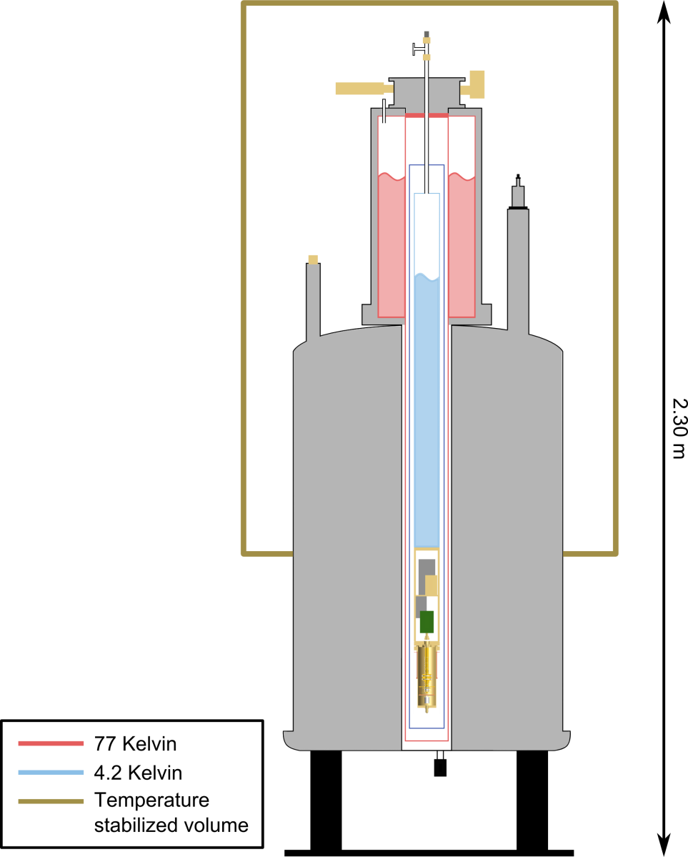
Experimental setup
Cryogenic temperatures (4.2K)
Vacuum better than 10⁻¹⁶ mbar
  less than 20 gas atoms in the trap volume

Slide 24

Measurement cycle
PT
AT

Slide 25

Measurement cycle
PT
AT: Detection of spin orientation
AT

Slide 26
Measurement cycle
PT
AT: Detection of spin orientation
AT

Slide 27
Measurement cycle
PT: Measurement of frequency ratio
PT
AT: Detection of spin orientation
AT

Slide 28
Measurement cycle
PT: Measurement of frequency ratio
PT
AT: Detection of spin orientation
AT

Slide 29
Measurement cycle
PT: Measurement of frequency ratio
PT
AT: Detection of spin orientation
AT

Slide 30
Measurement cycle
PT: Measurement of frequency ratio
PT
2
+
2
+
2
=
2
AT: Detection of spin orientation
AT

Slide 31
Measurement cycle
PT: Measurement of frequency ratio
PT
2
+
2
+
2
=
2
AT: Detection of spin orientation
AT

Slide 32
Measurement cycle
PT: Measurement of frequency ratio
PT
2
+
2
+
2
=
2
AT: Detection of spin orientation
AT

Slide 33
Measurement cycle
PT: Measurement of frequency ratio
PT
2
+
2
+
2
=
2
AT: Detection of spin orientation
Compare
AT
spin state

Slide 34
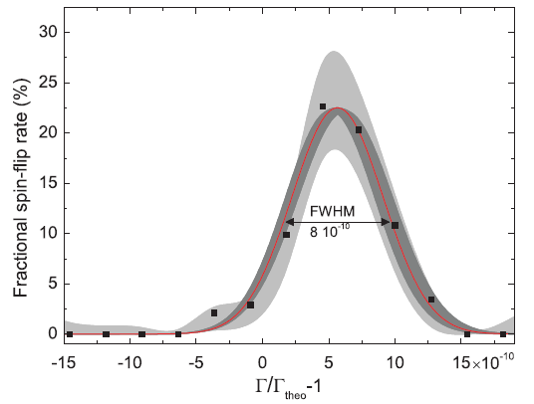
g-Factor Resonance
Many repetitions for random frequencies
    g-factor resonance
Γ₀ is extracted from fit
    g-factor is calculated

Slide 35
g-Factor Resonance
Many repetitions for random frequencies
    g-factor resonance
Γ₀ is extracted from fit
    g-factor is calculated
our measurement
g_{exp} = 1.995 348 958 7 (5)(3)(8)
g_{theo}= 1.995 348 958 0 (17)
[S. Sturm et al., PRL 107, 2 (2011)]
g_{exp} = 1.995 348 959 04(8)(6)
g_{theo}= 1.995 348 958 0(17)
Error dominated by uncertainty of electron mass
Theoretical value by:
[Z. Hamann, J. Zatorski, C. Pachucki et al. 2011]
[S. Sturm et al., PRL 107, 2 (2011)]
Theoretical value by:
[Z. Harman, J. Zatorski, C.H. Keitel, C. Pachucki et al. 2011]

Slide 36
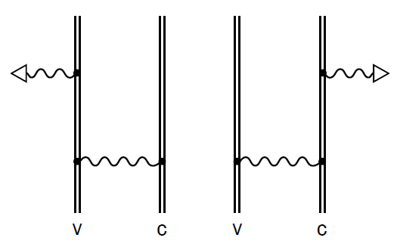
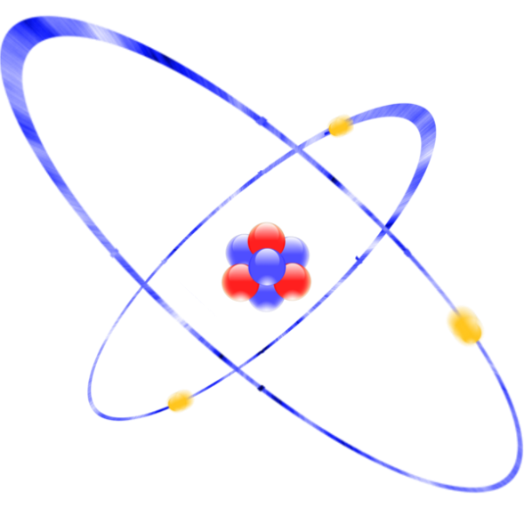
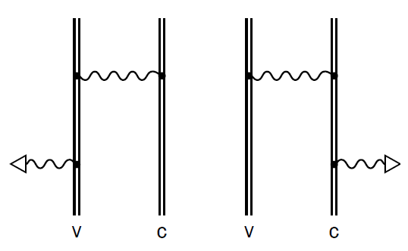
Other systems…
Lithiumlike ions:
Probe relativistic
3 electron dynamics
Specifically address
nuclear contributions
Interelectronic interaction
[A. Wagner et al., PRL 110, 033003 (2013)]

Slide 37
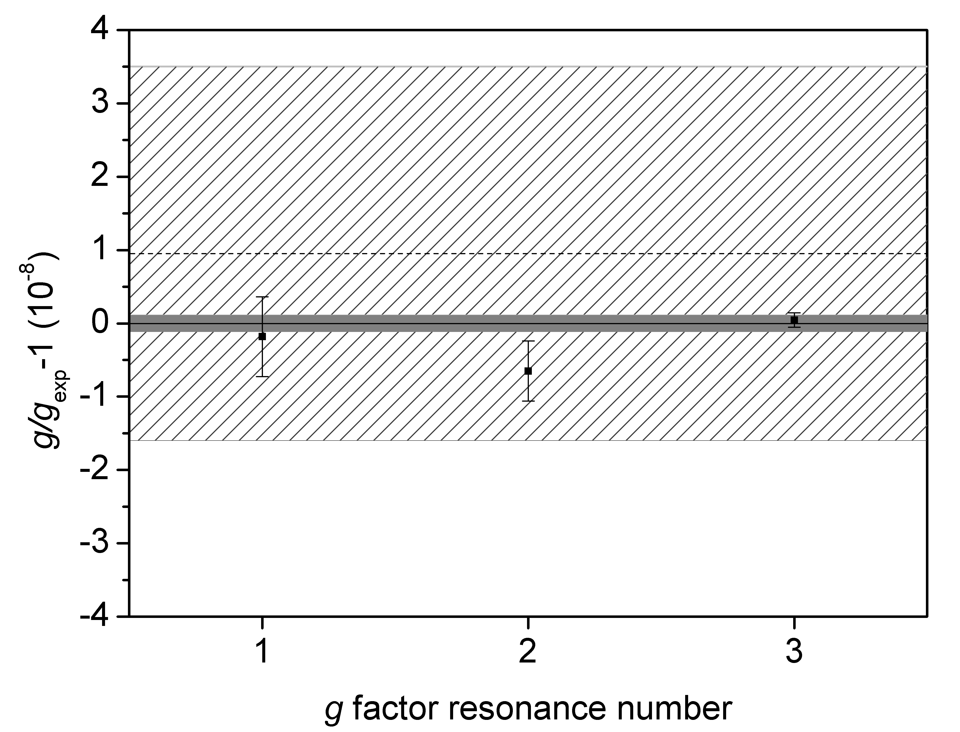
Other systems…
Lithiumlike ions:
Probe relativistic
3 electron dynamics
Specifically address
nuclear contributions
Interelectronic interaction
[A. Wagner et al., PRL 110, 033003 (2013)]

Slide 38
Direct measurement of the electron mass
Cyclotron frequency in a Penning trap

Slide 39
Direct measurement of the electron mass
Cyclotron frequency in a Penning trap
Limitation:
Relativistic mass increase due to low mass of the electron

Slide 40
Direct measurement of the electron mass
direct approach

Slide 41
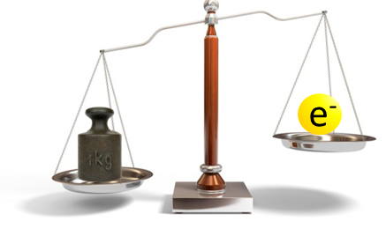
The electron’s mass
Electron mass from ultra-high precision g-factor of hydrogenlike carbon:
Theory (Pachucki et. al)
x 10⁻¹²
Experiment

Slide 42
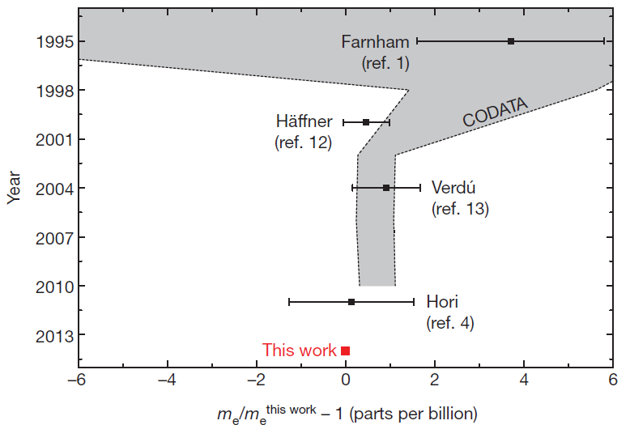
The electron’s mass
Electron mass from ultra-high precision g-factor of hydrogenlike carbon:
m_{e}=0.000 548 579 909 067(16) u
Order of magnitude improved value !
Nature 506, 467-470, 2014

Slide 43
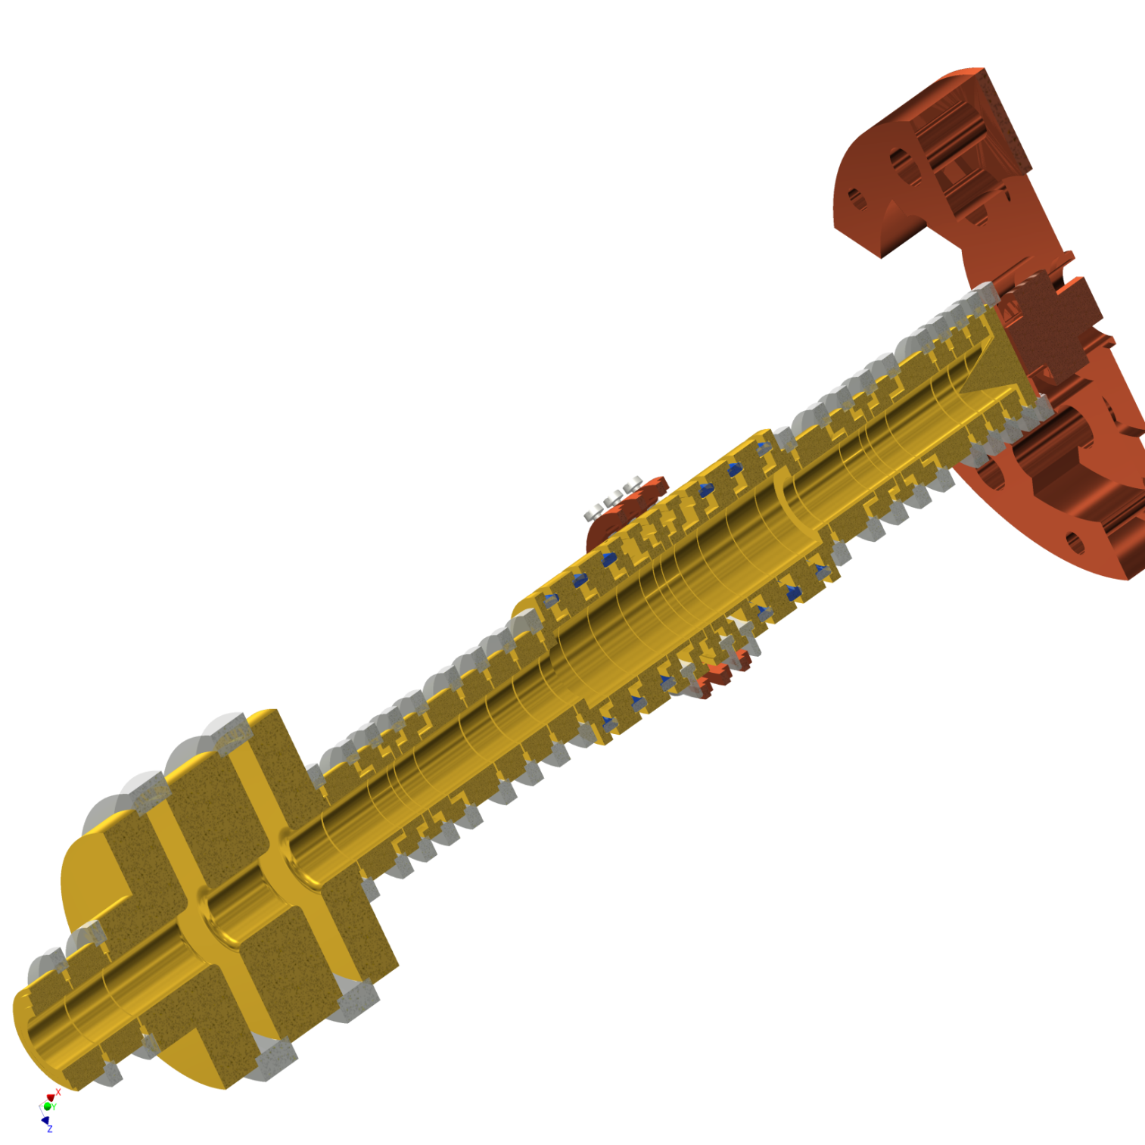
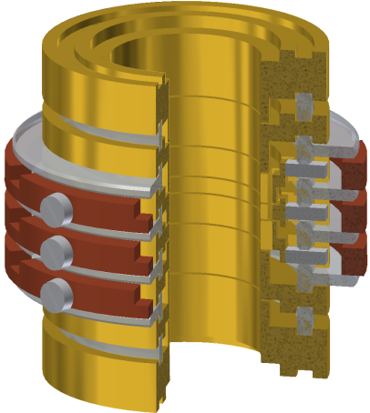
The proton’s mass
A specially tailored trap design

Slide 44
The proton’s mass
A specially tailored trap design
Simultaneous measurement cancels magnetic field fluctuations
We aim for δm/m<10⁻¹¹

Slide 45
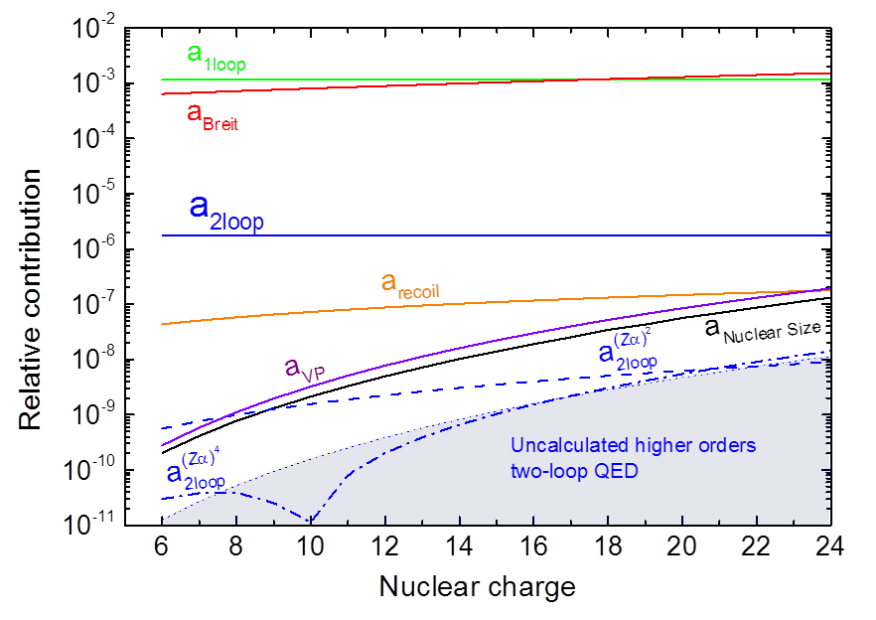
ALPHATRAP: Exploring the highest fields
Schwinger-Limit
Nonlinear contributions become increasingly
important at high nuclear charge Z
What happens if Zα → 1 ?

Slide 46
ALPHATRAP: Exploring the highest fields
Schwinger-Limit
Injection from external ion source
Nonlinear contributions become increasingly
important at high nuclear charge Z
What happens if Zα → 1 ?

Slide 47
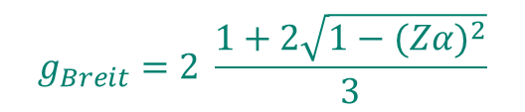
ALPHATRAP: Exploring the highest fields
$$g_{Breit}=2 \frac{1+2\sqrt{1−{(Zα)}^{2}}}{3}$$
New and independent access to fine-structure constant α !
ALPHATRAP: Next-generation, online-coupled
g-factor experiment for highly-charged ions

Slide 48
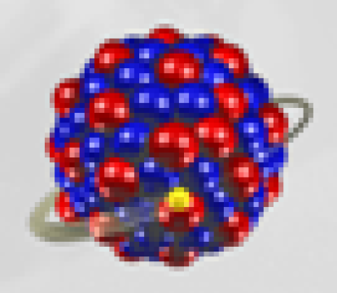
The “ultimate” test
The heaviest nuclei give the highest sensitivity
to non-linear effects ⇒ ²⁰⁸Pb^{77,81+}
Have to fight nuclear contribution by measuring several charge states
Specific difference is insensitive to nuclear effects:

Slide 49
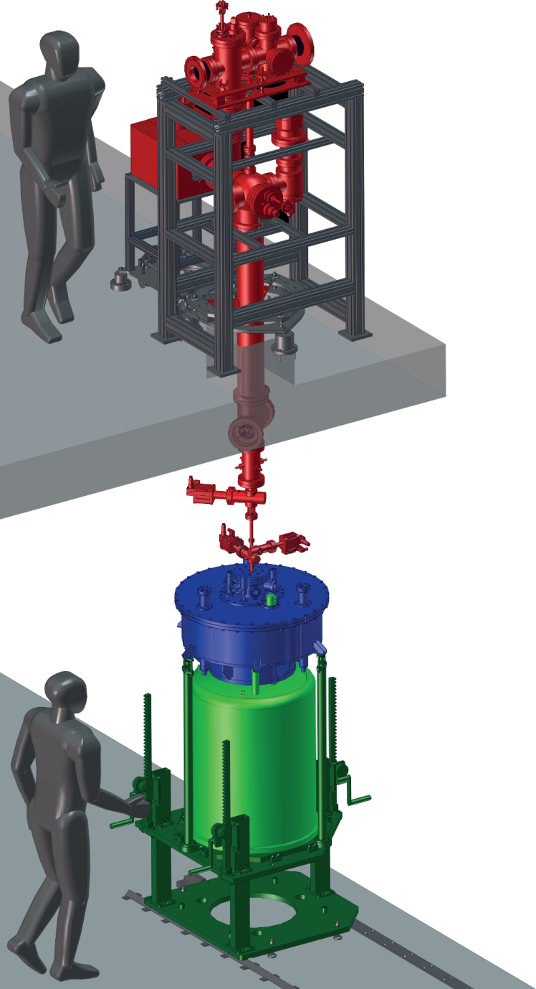
ALPHATRAP: Exploring the highest fields
Highly-charged ions from HD-EBIT
Goals:
Probe QED in strongest fields
  Physics beyond the Furry picture
  Extract nuclear structure information
Determine fundamental constants
Probe relativistic electron dynamics with lithium- and boronlike ions

Slide 50
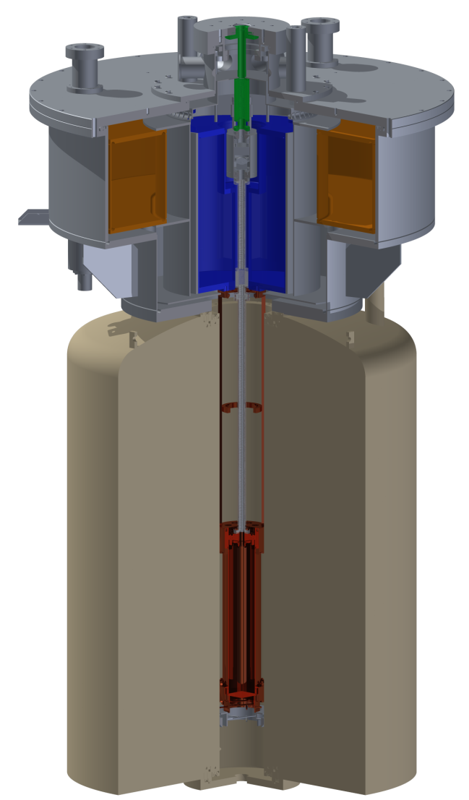
ALPHATRAP: Exploring the highest fields
Ions
Goals:
Probe QED in strongest fields
  Physics beyond the Furry picture
  Extract nuclear structure information
Determine fundamental constants
Probe relativistic electron dynamics with lithium- and boronlike ions
Cryostat
Magnet
Trap

Slide 51
Summary
Most stringent test of bound-state QED
  Most stringent test of relativistic electron dynamics in strong fields
  Measurement of heavier systems up to calcium currently running
Electron mass improvement by an order of magnitude
New setup for proton mass measurement – CPT test at FAIR ?
Next generation experiment ALPHATRAP
  Towards the Schwinger-limit
    Push precision towards 10⁻¹²
    All charge-states available from HD-EBIT

Slide 52

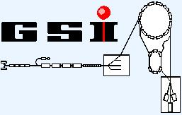


Special thanks to
“Abteilung für gespeicherte und gekühlte Ionen” at MPIK, Heidelberg
MATS group within QUANTUM at the Institut für Physik, Mainz
Atomic Physics Division at GSI Helmholtzzentrum, Darmstadt
Funding
Adv. Grant MEFUCO (#290870)
Helmholtz Alliance (HA216)
Experimental support: F. Köhler, J. Hou, A. Wagner, W. Quint,
G. Werth, K. Blaum
Theory support: Z. Harman, C.H. Keitel, J. Zatorski,
V. Shabaev, K. Pachucki

Slide 54
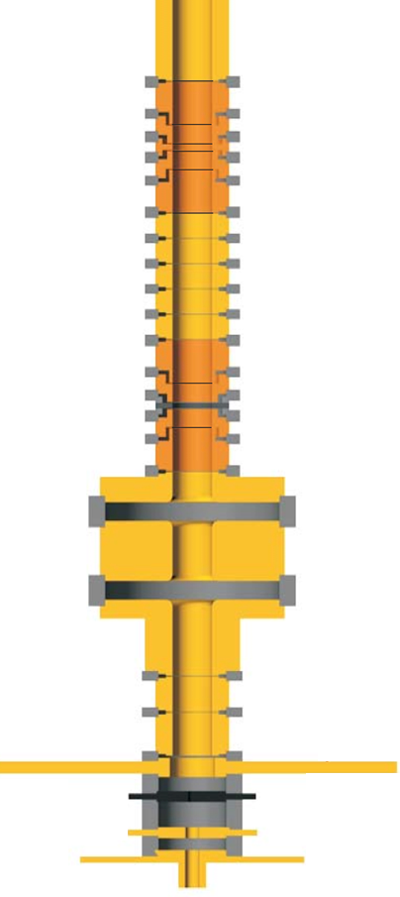
Triple Penning Trap System
7mm
Precision trap (PT)
Very homogeneous magnetic field
Analysis trap (AT)
Magnetic bottle for spin detection
~14 cm
Creation trap (CT)
In-trap ion creation of
highly-charged ions

Slide 55




g-Factor Measurement Process
Measurement of eigenfrequencies and simultaneous irradiation with microwaves (10min)
Detection of spin-orientation in analysis trap (2-3 min)
Spin flip in the precision trap?
B
Transport to precision trap (20s)
Transport to analysis trap (20s)

