Slide 1
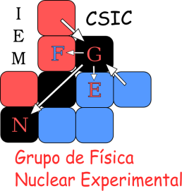
Study of the unbound ¹³Be and CEPA: Future of ( p, 2p) proton detection for R3B at FAIR
Guillermo Ribeiro
G. Ribeiro , E. Nácher, A. Perea, J. Sánchez del Río, O. Tengblad
Instituto de Estructura de la Materia – CSIC, Madrid
M. Mårtensson, A. Heinz, T. Nilsson
Chalmers University, Göteborg
And all the R3B Collaboration
26th September 2014

Slide 2
Outline
¹³Be Analysis from GSI experiment
¹³Be Experiment & Motivation
Knockout reaction (p,2p)
Setup and Analysis
Gamma situation
Preliminary interpretation
CEPA: Future of ( p, 2p) proton detection for R3B at FAIR
Why: CALIFA @FAIR
How: Phoswich solution
Krakow test:Pulse-shape analysis

Slide 3
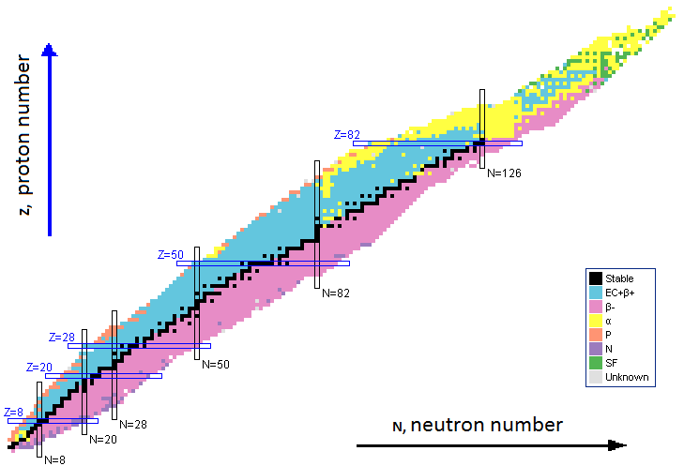
S393 experiment & Motivation
Study light neutron-rich nuclei (Be-Ne), using kinematically complete measurements, and inverse kinematics in GSI.
Objective:
Studying unbound nuclei ¹³Be using quasi-free scattering reactions
¹³B
17.3ms
¹⁴B
12.5ms
¹⁵B
9.93ms
¹⁶B
Unbound
¹⁷B
5.08ms
¹⁸B
Unbound
¹⁹B
2.92 ms
¹²Be
21.5 ms
¹³Be
Unbound
¹⁴Be
4.35ms
Study the previous step before the borromean nuclei ¹⁴Be
Extreme nuclei structure

Slide 4
Quasi-Free Scattering: Knockout reaction
¹⁴B(p,2p)¹³Be
Direct Reaction:
These reactions occur quickly and proceed directly from initial to final states without producing an intermediate compound state.
If both outgoing particles have the same masses, in the lab system:
(p,2p), (p,np)
Target (CH₂)
Target (CH₂)
^{Proton}
θ_{a}
θ_{b}
¹⁴B
¹³Be
^{Proton}
¹³B
17.3ms
¹⁴B
12.5ms
¹⁵B
9.93ms
¹⁶B
Unbound
¹⁷B
5.08ms
¹⁸B
Unbound
¹⁹B
2.92 ms
$$θA+θB≃ 81∘$$
¹²Be
21.5 ms
¹³Be
Unbound
¹⁴Be
4.35ms

Slide 5
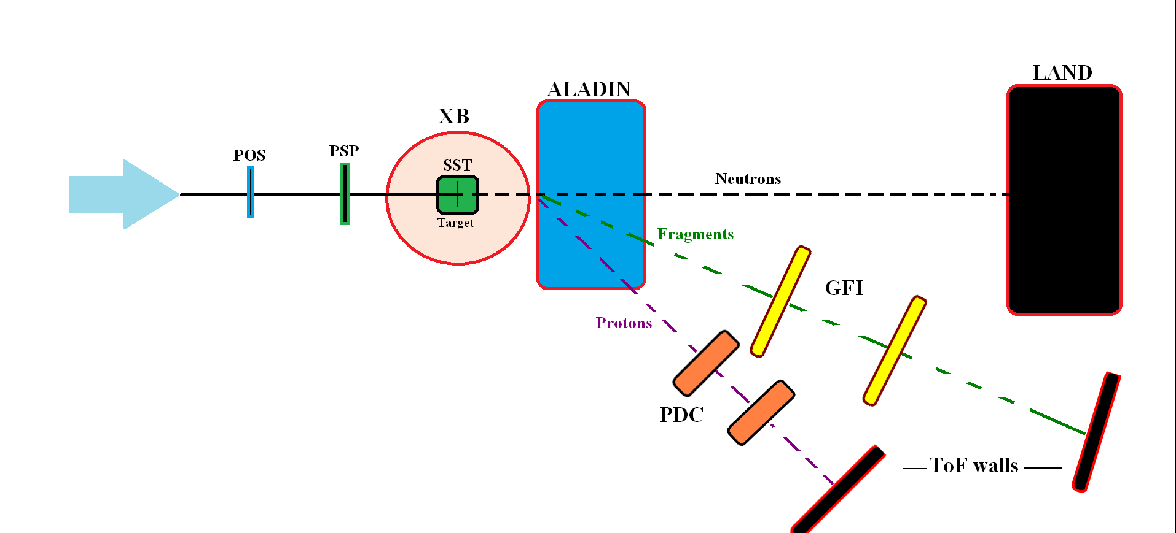
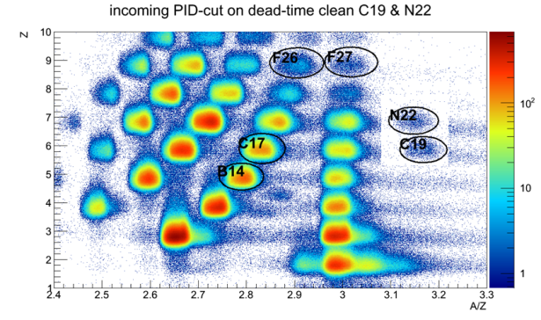
Experiment:Cave C
⁴⁰Ar¹¹⁺ Primary beam at 490 MeV/u with an intensity of 6·10¹⁰ ions/spill. The production target was Beryllium with 4011 mg/cm²

Slide 6
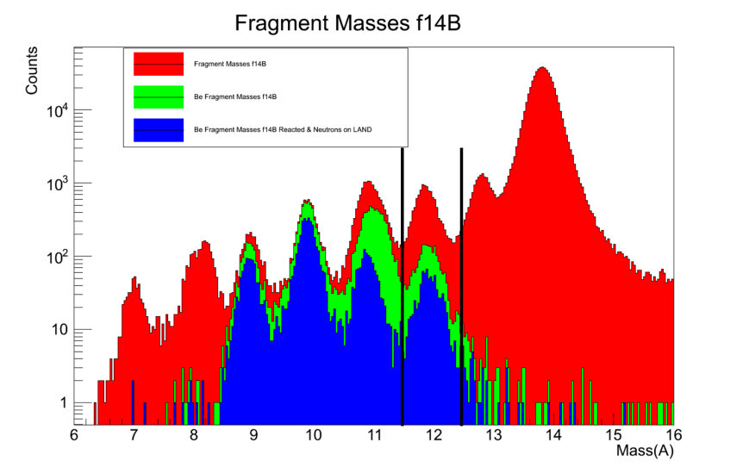
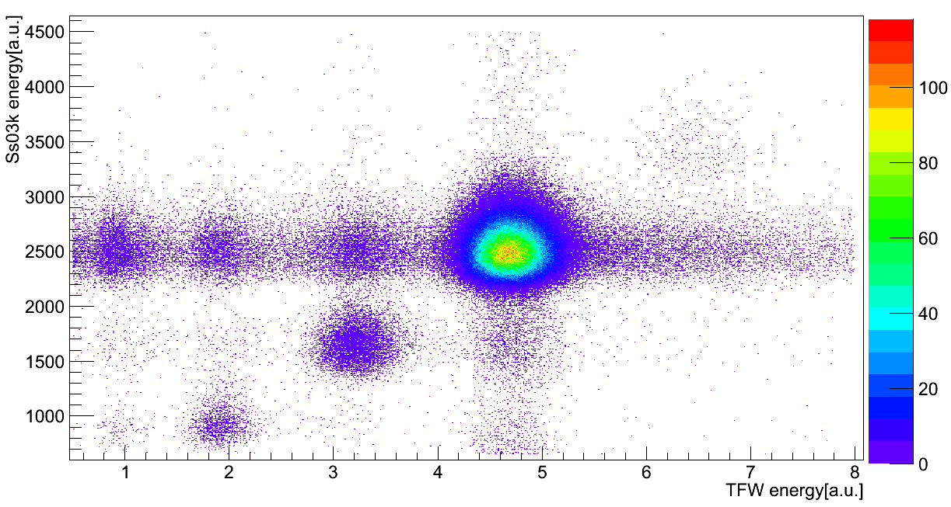
Analysis: Selecting the channel
Energy loss in the TFW & SST after the target: Identify the element after the reaction.
Identify the isotope from the ALADIN position deviation and beta of the fragment.
From ¹⁴B to ¹²Be + n
Fragments from ¹⁴B
Be Fragments from ¹⁴B
Be Fragments from ¹⁴B & Neutrons
Be
¹²Be

Slide 7
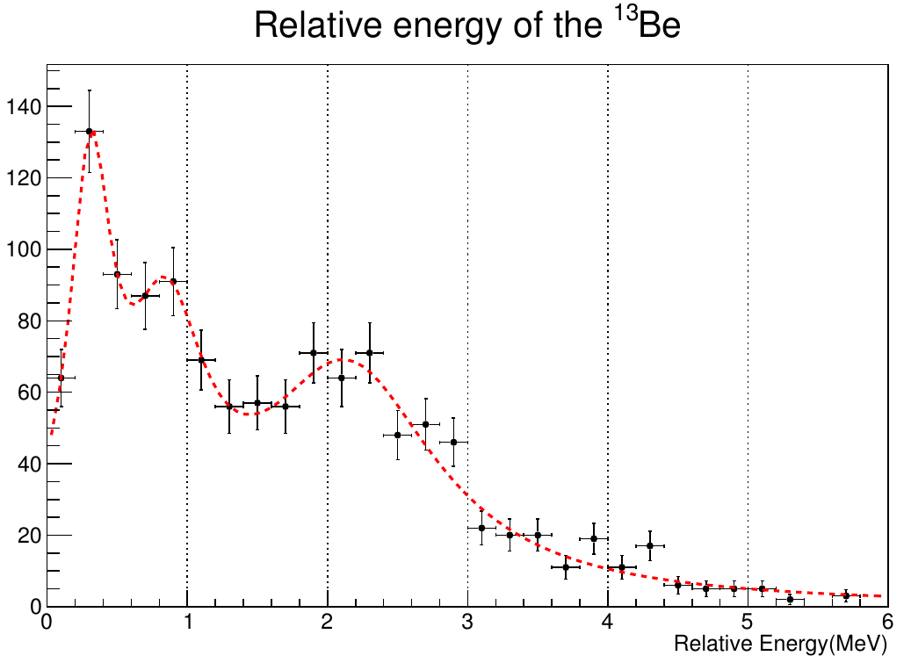
Relative Energy of ¹²Be + n
¹³Be

Slide 8
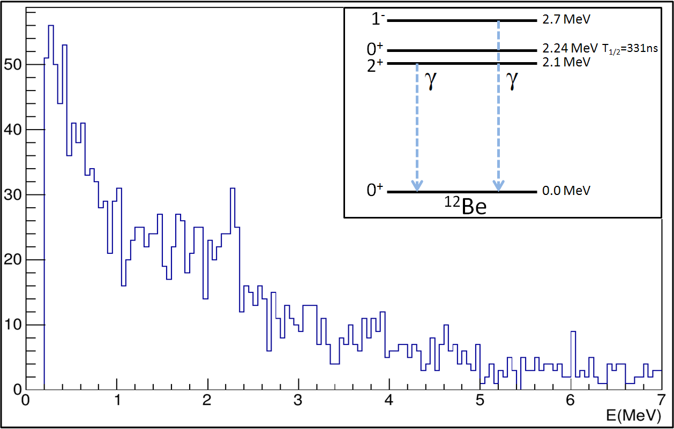
Looking for gammas of the ¹²Be: XB
2.11MeV
2.7MeV
gamma?
The two main gamma sources are:
- 2⁺ state at 2.11 MeV
- 1⁻ state at 2.71 MeV
None of them seems like the possible peak showed.

Slide 9
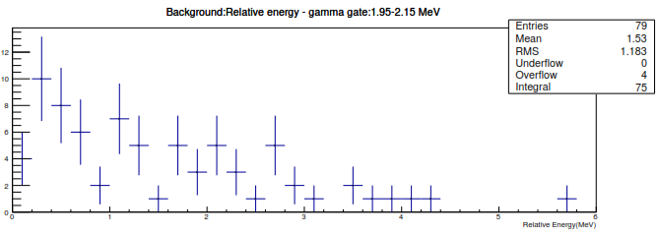
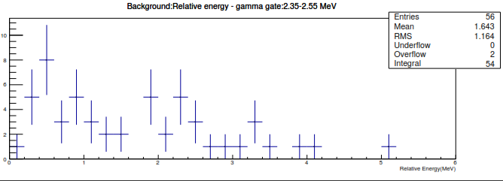
Gamma check: gates on peak, and off peak
Peak | R.Energy Plot | Background1 | Background2
≈0.4 | 18±4 | 10±3 | 5±2
≈0.85 | 7±3 | 2±1 | 5±2
≈2.2 | 9±3 | 3±1 | 5±2
No feature
No gamma

Slide 10
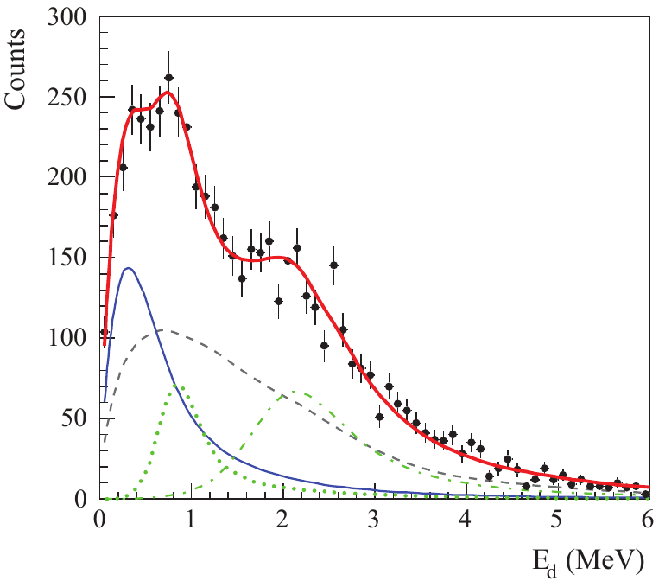
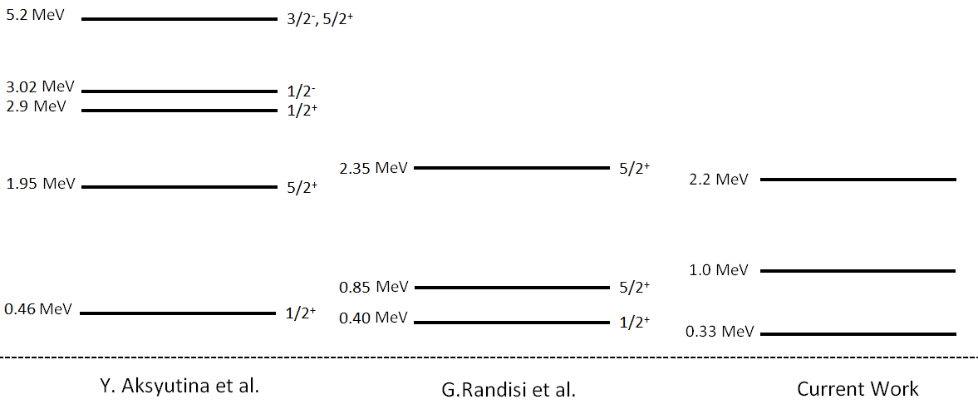
Interpretation: Preliminary
GANIL: Reaction from ¹⁴B
From PRC89 034320(2014)
No gammas → Only fed the 0⁺ of the ¹²Be
¹³Be
From PRC87 064316(2013)

Slide 11
Conclusions and Future
Conclusions
Preliminary relative energy spectra .
Gamma spectra without any feature → Implies that only 0⁺ states of ¹²Be are fed.
Current results are closer to the GANIL results, which used the same incoming beam.
Last steps
LAND efficency
Check for the ( p, 2p ) protons in Crystal Ball
Improve the relative energy fit and the interpretation.
….It’s not finished…Continue!

Slide 12
CEPA: Future of ( p, 2p) proton detection for R3B at FAIR

Slide 13
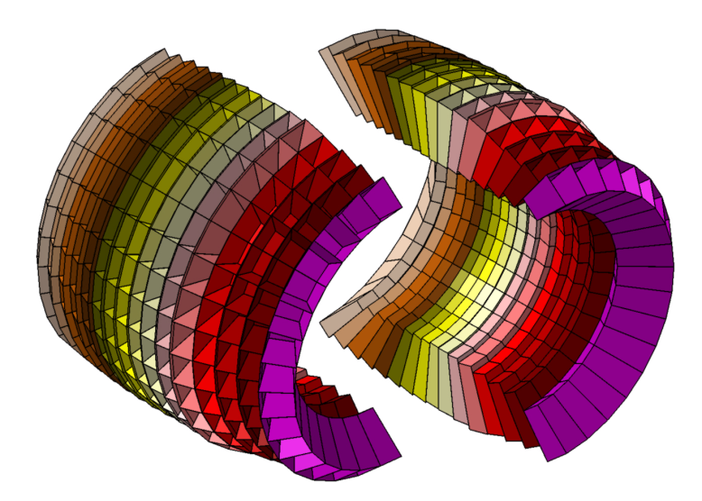
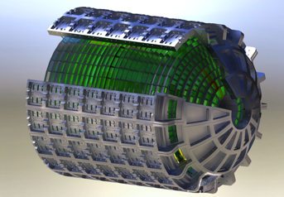
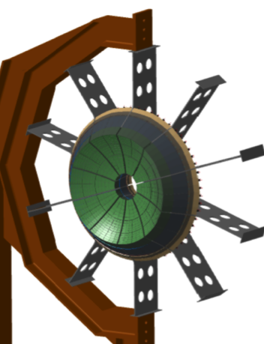
From Crystal Ball to CALIFA
CALorimeter for In-Flight gAmma-rays and protons
CALIFA = BARREL(CsI) + ENDCAP
CEPA : CALIFA Endcap Phoswich Array
Detect with good energy resolution & high peak efficiency (not so easy!!):
γ→ E < 30 MeV
p→ E < 300 MeV
How to avoid the nuclear reactions produced by high energy protons in the Bragg peak?

Slide 14
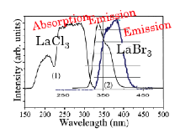
Endcap: The phoswich solution
60 +
40 mm
Phoswich:
2 high-resolution scintillators optically coupled and with a common readout
Different decay time → possible PSA applications to decouple the energy deposited in both crystals
Materials | ΔE/E (% at 662 keV) | Light yield (photons/keV) | Decay time (ns) | λ_{emision}
LaBr₃ | 2.9 | 63 | 16 | 380 nm
LaCl₃ | 3.8 | 49 | 28 | 350 nm

Slide 15
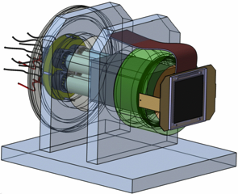
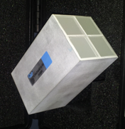
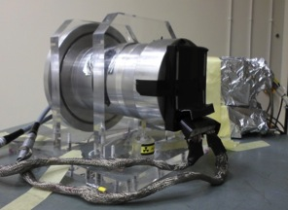
CEPA4: A prototype of phoswich array
4 phoswich units inside Al can(0.5mm)
LaBr₃ (4 cm) + LaCl₃ (6 cm) and
27 x 27 mm² entrance window
No Al between the crystals, just
1 mm of Teflon (waterproof?)
- Readout: 4 Hamamatsu 8-stage PM Tubes R5380
(recently changed to R7600U-200: shorter & square-shaped )
- A VME CAEN Flash ADC (V1742) to digitize the signals.
60 +
40 mm

Slide 16
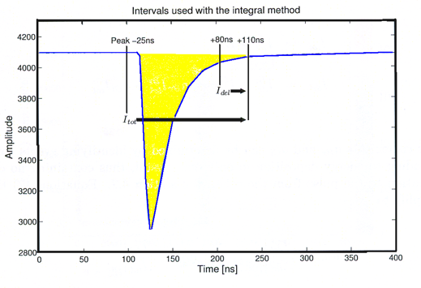
Krakow Test: Pulse-Shape Analysis
Krakow CCB: Proton beam energies within 70-230 MeV (ΔE~0.7%)
Data Analysis at 3 different levels
1 – Tail vs Total integral
2 – Solve a set of linear equations to find E_{LaBr3} and E_{LaCl3}
(→ See: O. Tengblad, T. Nilsson, E. Nacher et al., NIM A 704 (2013) 19)
3 – Project on the appropriate lines depending on the energy region
(→ Analyze the energy resolution & the response after the total punch-through)
Main Goal:
Being able to reconstruct the proton energies. Taking into account that until 130 MeV will be stopped in the first scintillator(LaBr₃), the second(LaCl₃) will stop protons from 130 up to 200 MeV, the following will punch-through the whole detector.
Tail
Amplitude
Integral
Sampled (1 Gs/s)
anode pulse
Time [ns]

Slide 17
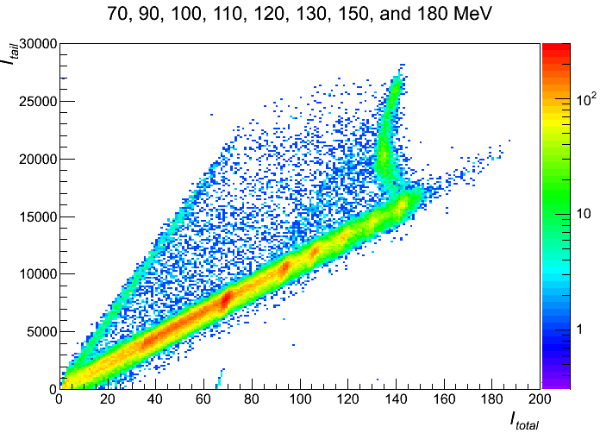
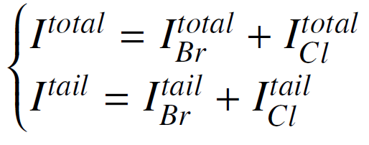
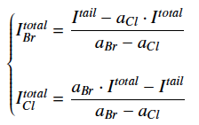
CEPA4:Response to Protons
Krakow CCB: Proton beam energies within 70-230 MeV (ΔE~0.7%)
1 - Integrals: tail vs total

Slide 18
CEPA4:Response to Protons
Krakow CCB: Proton beam energies within 70-230 MeV (ΔE~0.7%)
1 - Integrals: tail vs total
Energy dep. in both crystals
Energy dep. only in the 2nd crystal
Energy dep. only in the 1st crystal

Slide 19
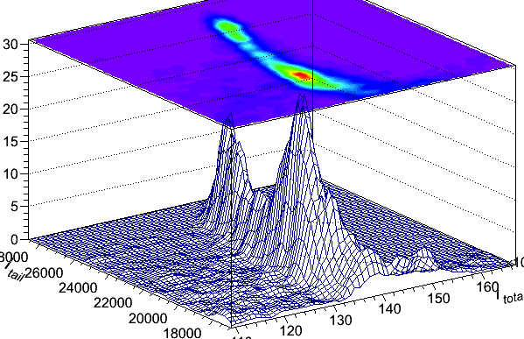
CEPA4:Response to Protons
1 - Integrals: tail vs total
Zoom in the black banana (after 1st punch through)
180 MeV
150 MeV

Slide 20
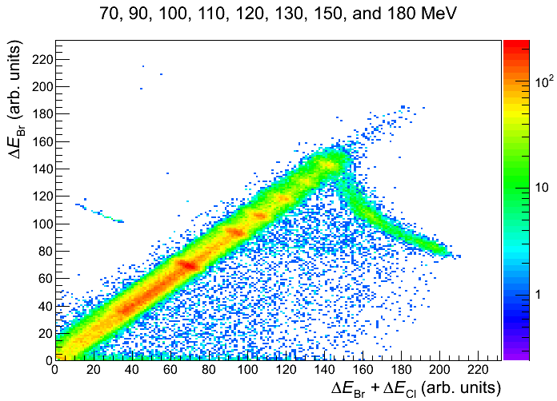
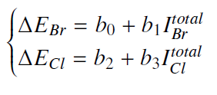
CEPA4:Response to Protons
2 - E_{LaBr3} vs E_{tot}

Slide 21
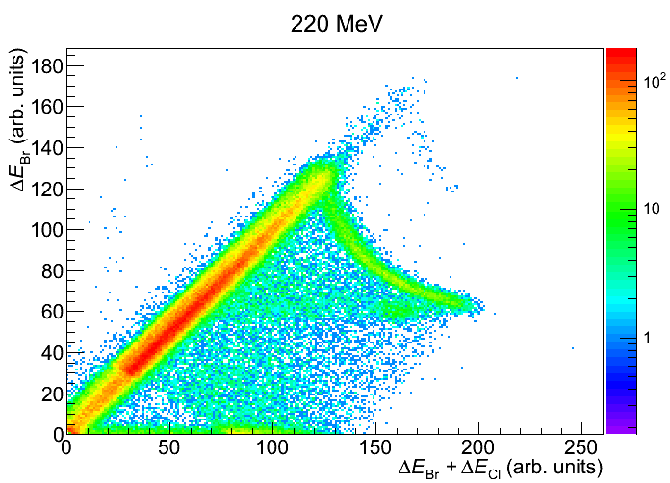
CEPA4:Response to Protons
2 - E_{LaBr3} vs E_{tot}
Energy above punch through measured for the first time!!

Slide 22
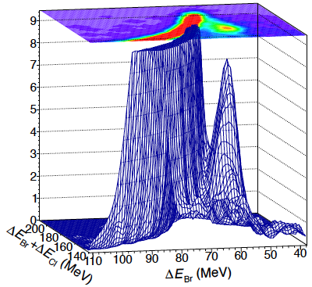
CEPA4:Response to Protons
2 - E_{LaBr3} vs E_{tot}
Energy above punch through measured for the first time!!
220 MeV

Slide 23
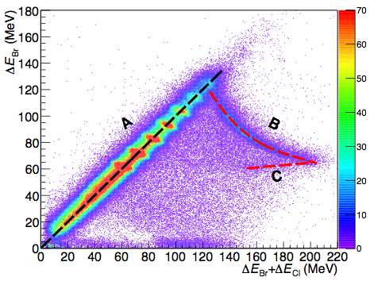
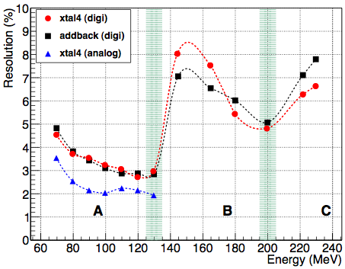
CEPA4:Response to Protons
3 - Calibration:
Energy resolution

Slide 24
Conclusions
New phoswich array: CEPA4 which is a protopype for the forward endcap array for CALIFA.
Test of the detector and the Pulse-shape analysis
The energy resolution is good up to the total punch-through and still acceptable at 230 MeV
Need of more tests with protons and gammas.
Currently developing new analysis methods.

Slide 25
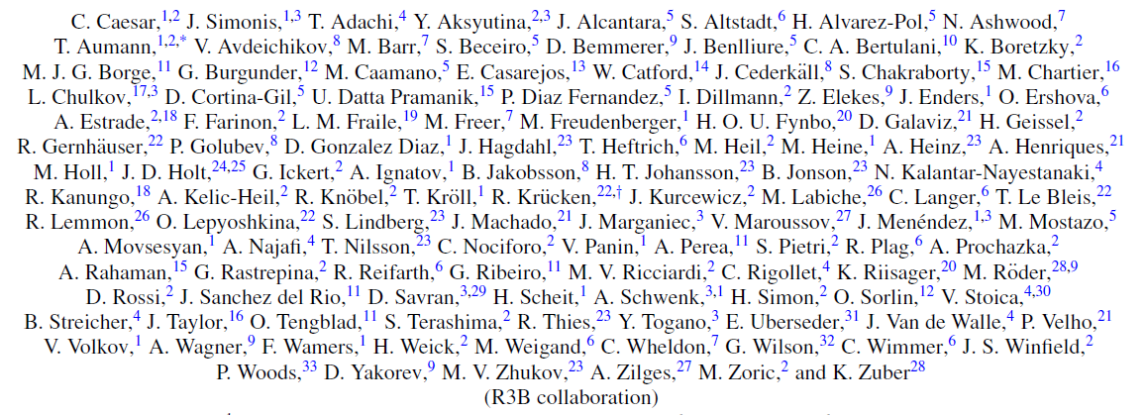
Thank you!

