Slide 1
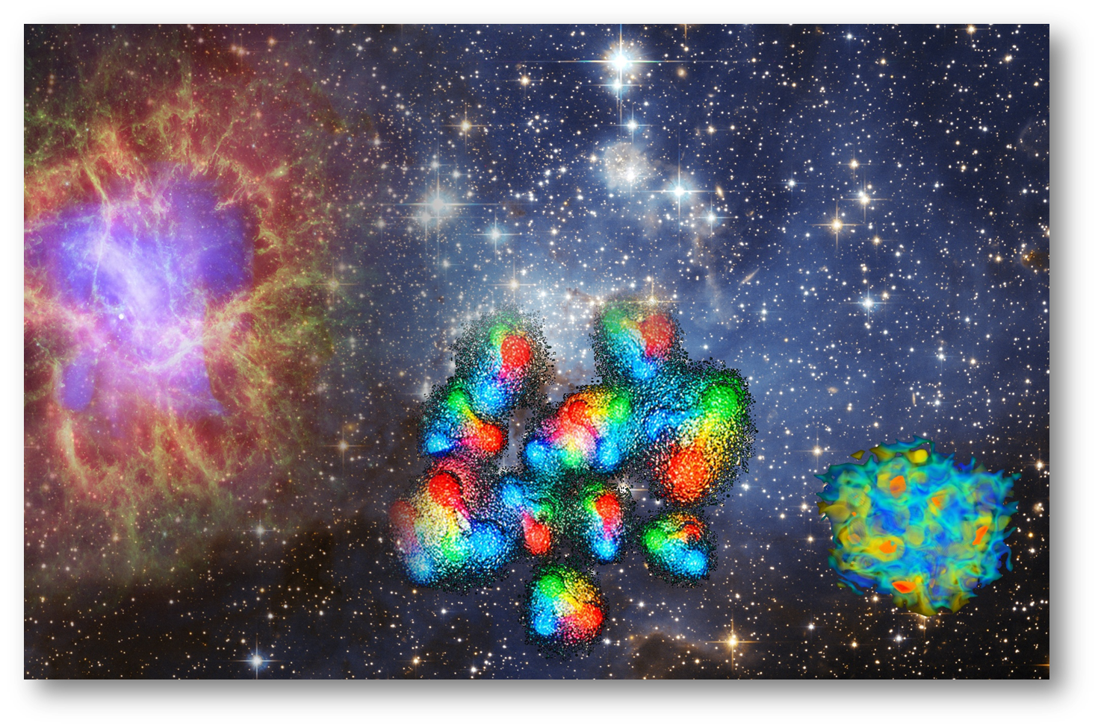
Notes:
Means Motive Opportunity

Slide 2
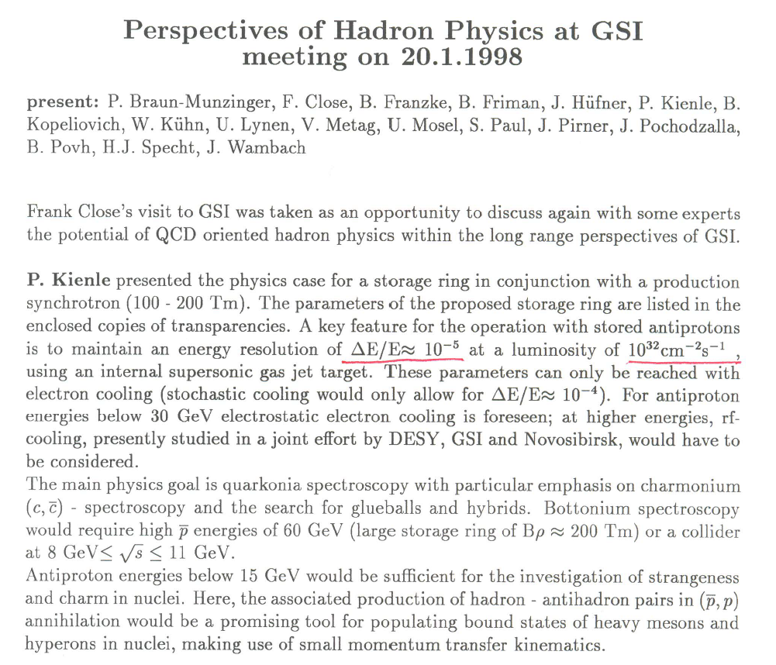
PANDA in 2019/2020
Luminosity probably below design luminosity
Not all components of the PANDA detector completed
No long running periods of HESR
⇒ Redefine physics program for commissioning phase of PANDA
Process with large cross section
Only charged particles (calorimeter ?!)
Unique ⇒ experiment only possible with antiproton beam
Interesting and timely physics

Slide 3







A one day day-one experiment for PANDA and much more:
from anti-hyperons and resonances in nuclei to the neutron skin of Nuclei
Alicia Sanchez Lorente, Sebastian Bleser, Marcell Steinen, Josef Pochodzalla
Notes:
Means Motive Opportunity

Slide 4
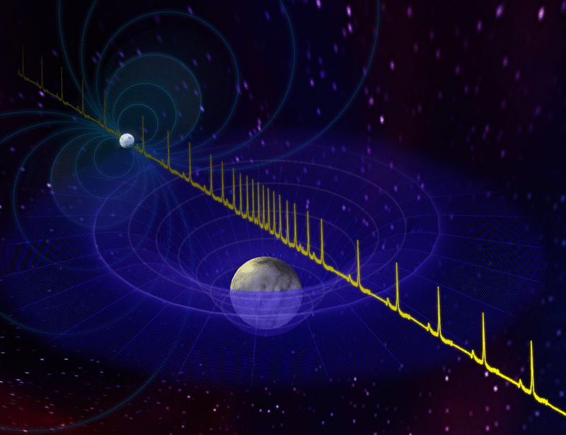
Heavy Neutron Stars
M(PSR J1614-2230)=1.97±.0.04 M⊙
M(PSR J0348+0432)=2.01±.0.04 M⊙
P. B. Demorestet al., Nature 467 (2010)
John Antoniadis et al., Science 340 (2013)
Even if hyperons do not appear in neutrons stars, why so ?
Stone, Guichon and Thomas:
”Rather than being a surprise to find hyperons it would stretch our understanding of fundamental strong and weak interaction processes to breaking point if they were not to appear. It is certainly inconceivable that a nucleon-only EoS could be realistic at such large densities.”
⇒Need a precise understand Y-N, Y-Y, Y-N-N, … interactions !
The composition of the inner core determines the maximum mass of a neutron star
Notes:
PSR J1614−2230, which
show a strong Shapiro delay signature. The implied pulsar mass
of 1.97±0.04M⊙
Companion: white dwaft

Slide 5
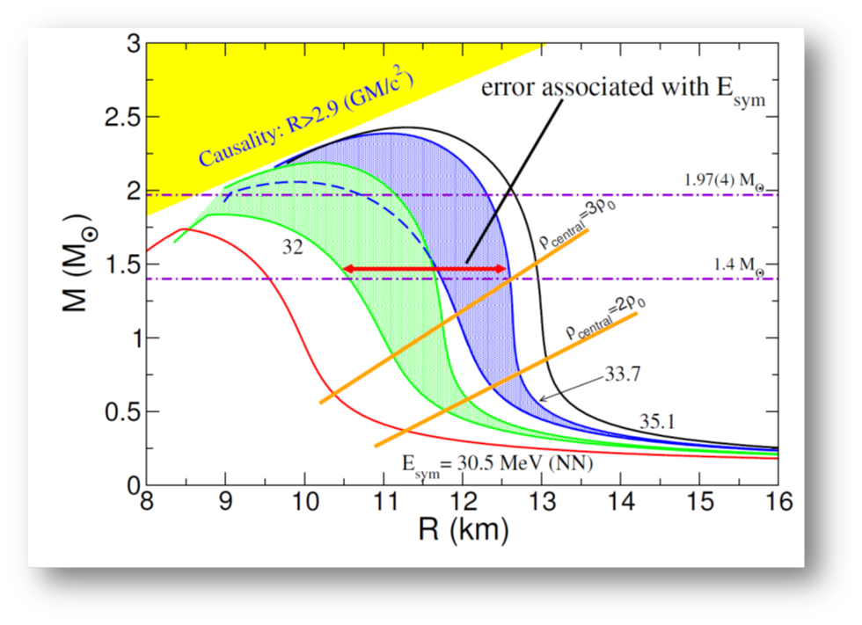
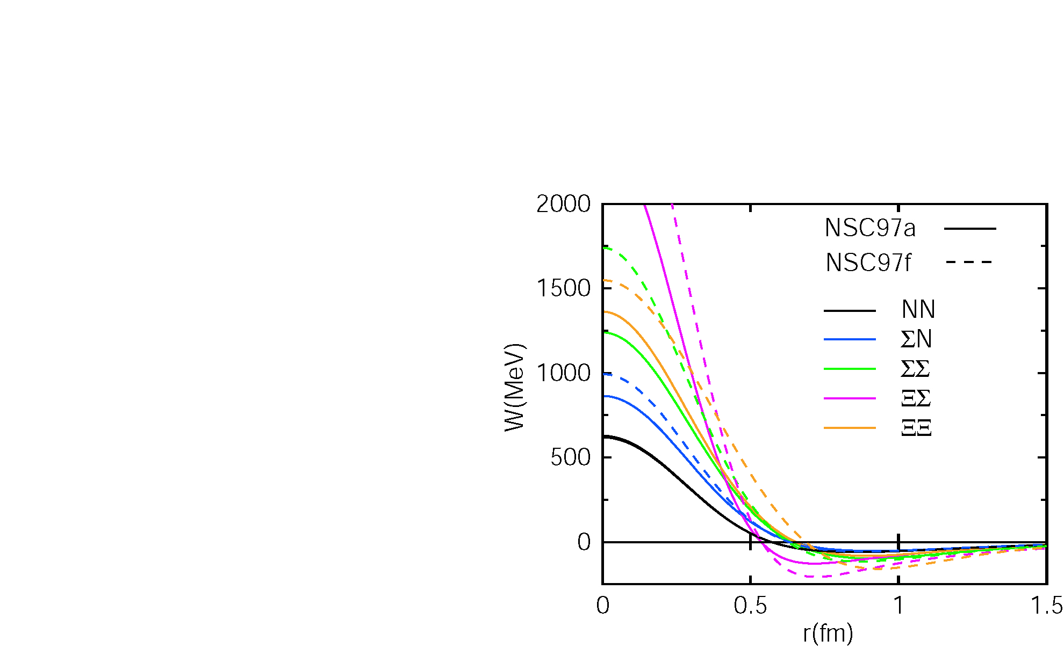
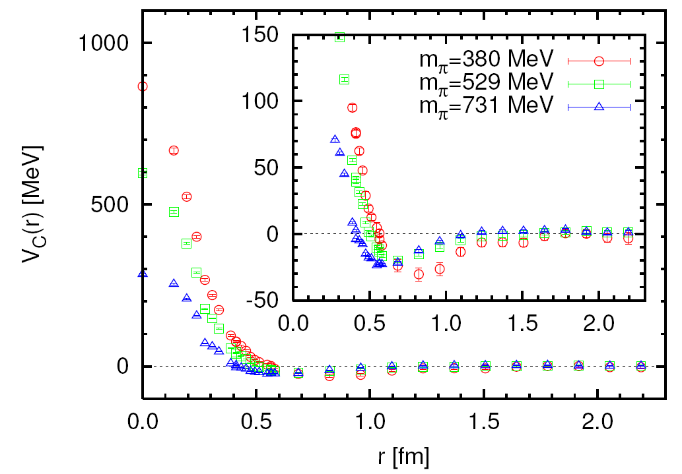
The short range challenge (I)
Understanding neutron stars requires understanding of baryon-baryon force in SU(3) at short distances
Lattice simulations might eventually provide a comprehensive description of B-B interactions and nuclei in terms of basic principles (QCD) to allow quantitative predictions in regions not directly accessible by experiments
8
4
2
1
quark picture
Stefano Gandolfi and Andrew W. Steiner arXiv:1308.6002
S. Aoki, T. Hatsuda and N. Ishii, Prog. Theor. Phys. 123 (2010) 89
Notes:
Spin singlett channel
The phenomenological NN potentials in the coordinate space are known to reflect some
characteristic features of the NN interaction at different length scales:2)
(i) The long range part of the nuclear force (the relative distance r > 2 fm) is dominated
by the one-pion exchange introduced by Yukawa.8) Because of the pion’s Nambu-
Goldstone character, it couples to the spin-isospin density of the nucleon and hence
leads to a strong spin-isospin dependent force, namely the tensor force.
(ii) The medium range part (1 fm < r < 2 fm) receives significant contributions from the
exchange of two-pions (ππ) and heavy mesons (ρ, ω, and σ). In particular, the spinisospin
independent attraction of about 50 - 100 MeV in this region plays an essential
role for the binding of atomic nuclei.
(iii) The short range part (r < 1 fm) is best described by a strong repulsive core as originally
introduced by Jastrow.9) Such a short range repulsion is important for the stability of
atomic nuclei against collapse, for determining the maximum mass of neutron stars,
and for igniting the Type II supernova explosions.10)
(iv) There is also a strong attractive spin-orbit force in the isospin 1 channel at medium
and short distances. This leads to the 3P2 neutron pairing in neutron matter and hence
the neutron superfluidity inside neutron stars.10)
2

Slide 6
The short range challenge (II)
Central heavy ion collisions are the usual tool to probe high densities
But…
Central collisions → hot hadronic finite matter with mesons and baryons
Neutron stars → Cold neutral baryonic infinite matter
⇒ Let us try a complementary approach
GiBUU code, Phys. Rep. 512, 1 (2012)
Notes:
Cold baryonic infinite matter - hot hadronic finite matter with mesons and baryons

Slide 7
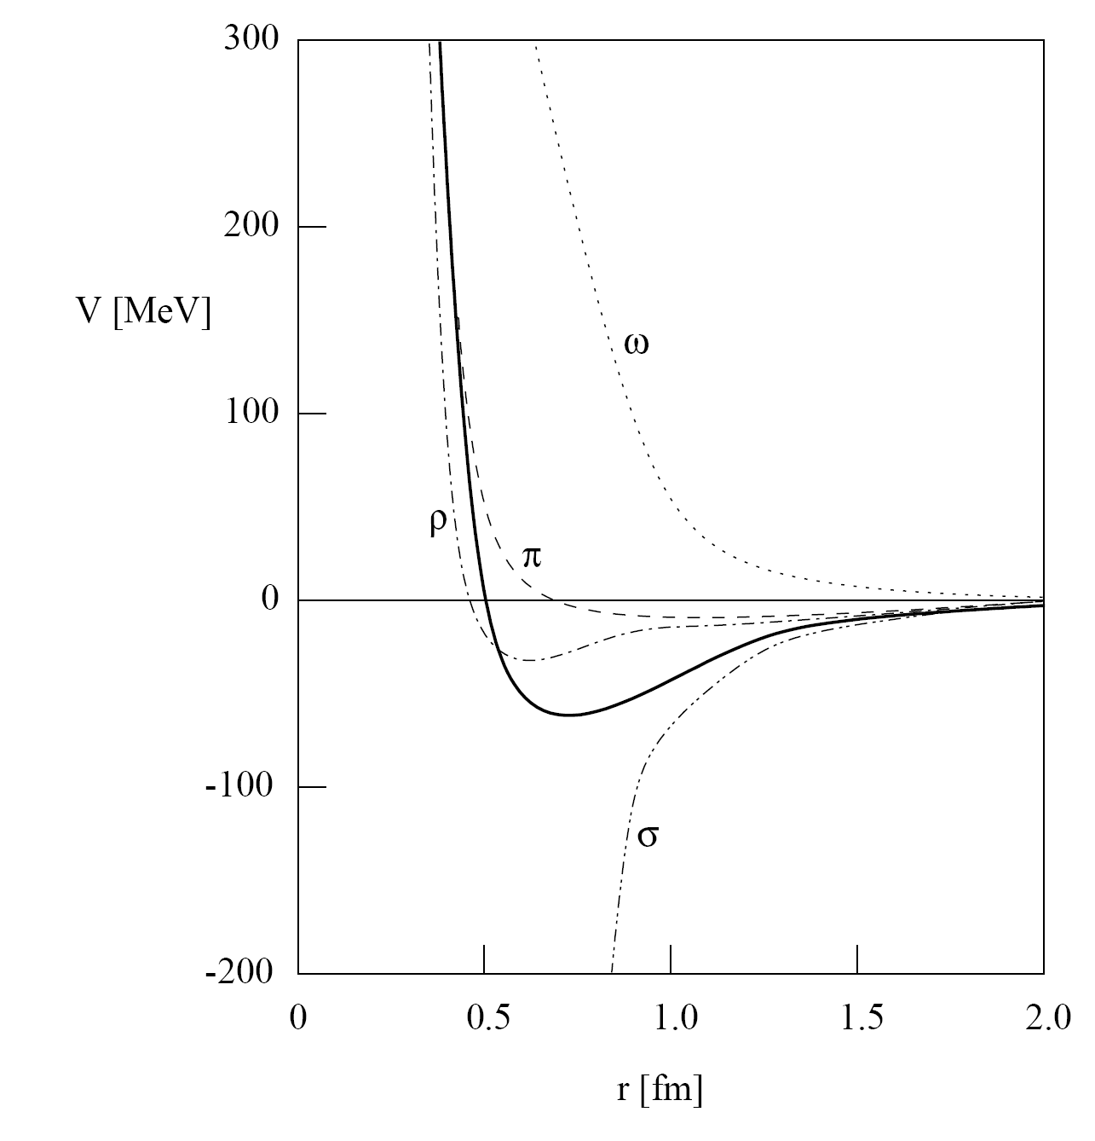
G-Parity and NN Potential
_
G=charge conjugation + 180° rotation around 2nd axis in isospin (Lee und Yang 1956, L. Michel 1952 „Isoparität“)
G-parity of particle-antiparticle multipletts
Hans-Peter Dürr and Edward Teller, Phys. Rev. 101, 494 (1956)
sign change in coupling constant when going from NN to NN
Caveat: meson picture will probably not work at small distance
Chance to study transition from meson to quark-gluon regime
quark picture
-
+
-
+
Notes:
omega zerfällt nur in 3 pionen, nicht in 2
rho zerfällt in 2 pionen, nicht in 3
Vector potential changes sign

Slide 8
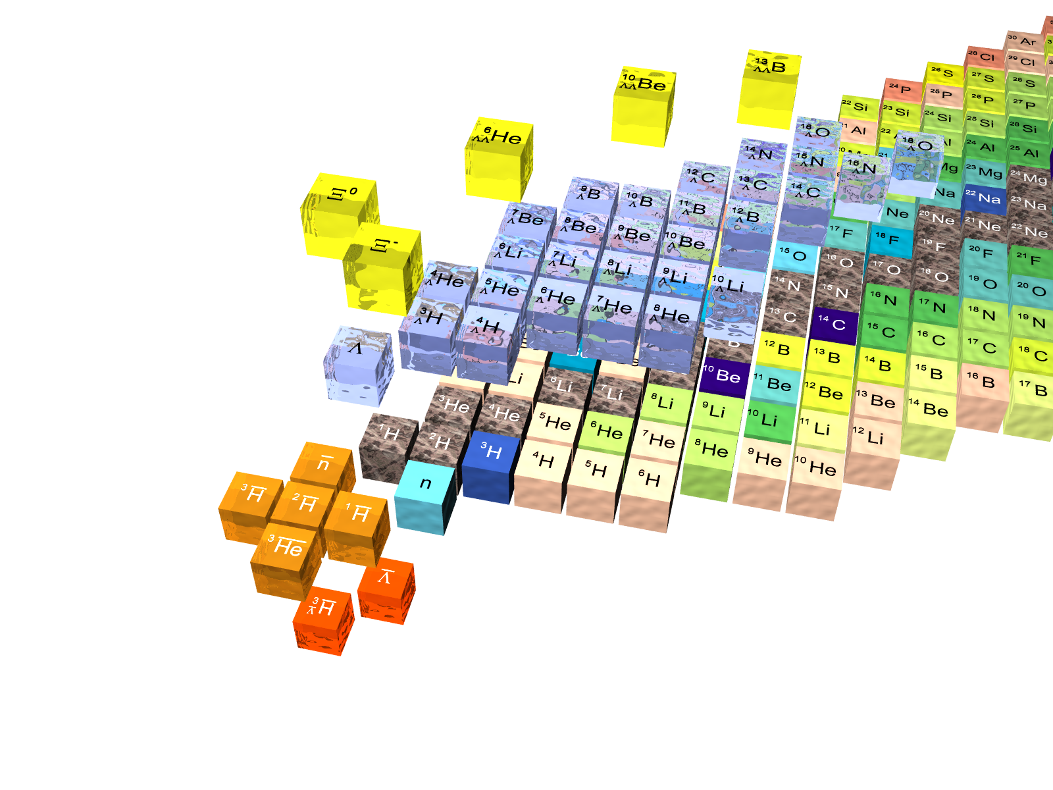
Nuclei with (anti)hyperons
Increasing strangeness

Slide 9
Can we measure the potential for ?
antiprotons are optimal for the production of mass without large momenta
consider exclusive p+p(A)  Y+Y close to threshold within a nucleus
Λ and L that leave the nucleus will have different asymptotic momenta depending on the respective potential
experimental complications
Fermi motion of struck proton
Non-isotropic production
Density distribution U(ρ)
Exclusiveness
⇒ need to look at average transverse momentum close to threshold of coincident YY pairs
p
J.P., PLB 669 (2008) 306

Slide 10
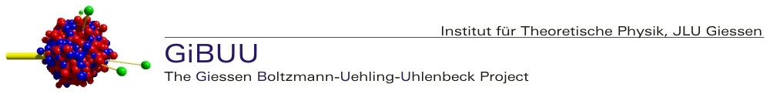
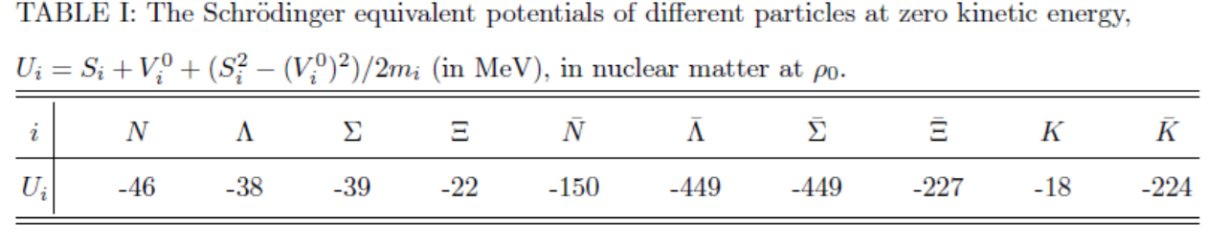
GiBUU 1.5
https://gibuu.hepforge.org/trac/wiki
G-parity used to estimate anti-baryons potential
Drawbacks
Antiproton potential needs to be scaled by 0.22 to obtain -150MeV
Σ potential attractive
Kaon attraction
Notes:
GIBUUPhys. Rev. C 85, 024614 (2012)
HIMSTER
260 cores
100GB RAM
The Helmholtz Institute Mainz (HIM) is running a big cluster dedicated for experiment simulation - the HIMster. The HIMster consists of 130 compute nodes each having 2 AMD 8-core processors (Magny Cours series) running at a clock frequency of 2.3 GHz. All nodes are equipped with 3 1-Gbit Nics and a QDR Infiniband-HCA (Mellanox Connect-X). Currently we are running the system in diskless mode, where:
the first 14 Nodes have 64 GByte RAM ⇒ 4 GByte / core
and the remaining nodes have 32 GByte RAM ⇒ 2 GByte / core
The central storage amounts to roughly 130 TByte net capacity, with FhGFS as the underlying parallel file system. The peak read/write performance is roughly 1.4 GByte/s. The storage is built up of 2 file servers, where each server is connected to
2 Promise VTrak Subsystems via Fibre-Channel ⇒ total of 40 2 TByte disks
4 Promise JBODs via SAS ⇒ total of 80 2 TByte disks
Currently the volumes are grouped in 4 RAID6 arrays.

Slide 11

GiBUU Simulations
pp threshold 1435MeV/c
27M inclusive events for each data set calculated at HIMster
Cross section for YY production increased by factor of 10
Approximately 10k exclusive ΛL pairs in each set
Energy (MeV) | Momentum (MeV/c) | Excess energy (MeV)
850 | 1522 | 30.6
1000 | 1696 | 92.0
Default parameters for RMF
V(N)=-46MeV
V(Λ)=-38MeV
V(N)=-150MeV
V(L)=-449MeV
Notes:
GIBUUPhys. Rev. C 85, 024614 (2012)
HIMSTER
2600 cores
100GB RAM
The Helmholtz Institute Mainz (HIM) is running a big cluster dedicated for experiment simulation - the HIMster. The HIMster consists of 130 compute nodes each having 2 AMD 8-core processors (Magny Cours series) running at a clock frequency of 2.3 GHz. All nodes are equipped with 3 1-Gbit Nics and a QDR Infiniband-HCA (Mellanox Connect-X). Currently we are running the system in diskless mode, where:
the first 14 Nodes have 64 GByte RAM ⇒ 4 GByte / core
and the remaining nodes have 32 GByte RAM ⇒ 2 GByte / core
The central storage amounts to roughly 130 TByte net capacity, with FhGFS as the underlying parallel file system. The peak read/write performance is roughly 1.4 GByte/s. The storage is built up of 2 file servers, where each server is connected to
2 Promise VTrak Subsystems via Fibre-Channel ⇒ total of 40 2 TByte disks
4 Promise JBODs via SAS ⇒ total of 80 2 TByte disks
Currently the volumes are grouped in 4 RAID6 arrays.

Slide 12
Scan of L potential
U(L)= -449MeV, -225MeV, -112MeV, 0MeV
All other potentials unchanged
E(p)=850MeV
Λ−L

Slide 13
Scan of L potential
U(L)= -449MeV, -225MeV, -112MeV, 0MeV
All other potentials unchanged
E(p)=1000MeV
Λ−L

Slide 14
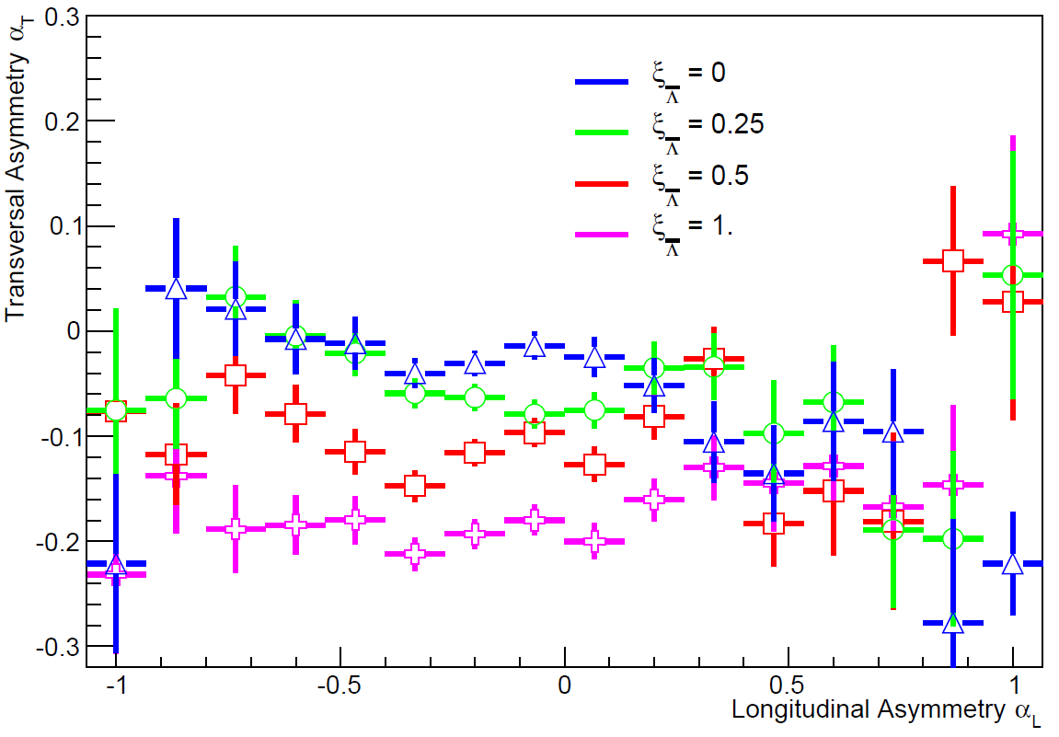
Other |s|=1 channels @ 1000MeV
p+p→L+Λ p+p→S⁰+Λ
p+n→L+Σ⁻ p+n→S⁺+Λ (×1/100)
E(p)=1000MeV
Σ⁻−L

Slide 15
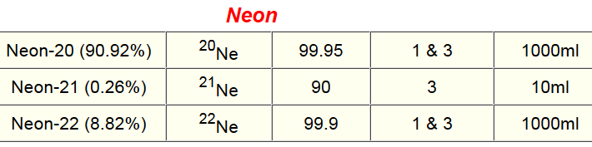
Probing the neutron skin of nuclei
p+p→L+Λ p+p→S⁰+Λ p+n→L+Σ⁻ p+n→S⁺+Λ
Rare gas Isotopes are available
http://www.iconisotopes.com/Code/NobleGas.asp
other (also semi-magic) rare gases available like ³⁸Ar, ⁸⁶Kr
F. Grümmer et al., Phys. Lett. B 387 (1996) 673
Notes:
Z=36 Krypton N=50 17.3%

Slide 16
Reactions within the neutron skin
1000MeV p+²⁰Ne and p+²²Ne
Scaling factor for potential ξ(L) = 0.25
the ratio L+Σ⁻/L+Λ may provide a measure of the neutron skin
explore potentials in neutron-rich environment by neutron rich targets
 | p+p→L+Λ | p+n→L+Σ⁻
²⁰Ne | 18868 | 3667
²²Ne | 15733 | 4516
²²Ne/²⁰Ne =R | 0.83 | 1.23
R(L+Σ⁻)/R(L+Λ ) | 1.34

Slide 17

Further options
X-Ξ production
p+¹²C
2.9 GeV/c
60M events
~500 X-Ξ pairs
Unstable resonances
Λ(1520) Γ=15.6 MeV
Ξ(1530) Γ=9.9 MeV

Slide 18
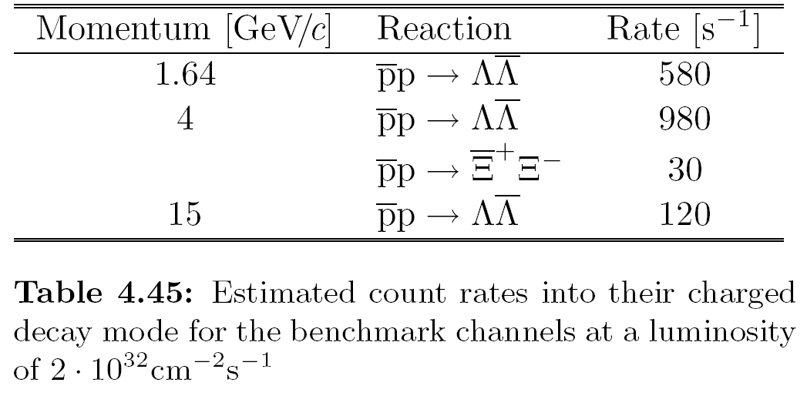

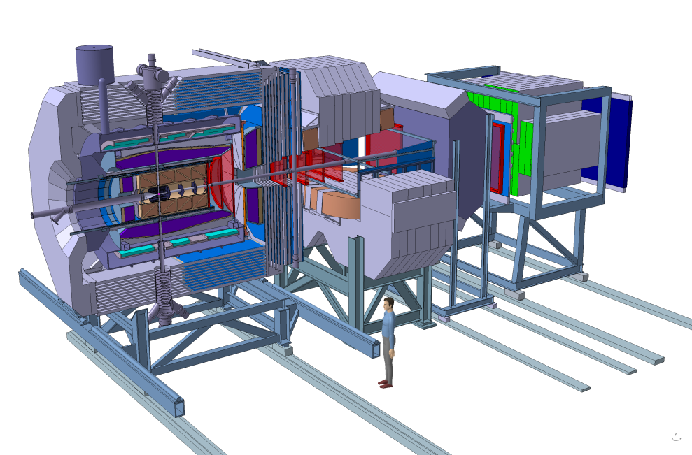
YY at PANDA
p Momentum [GeV/c]
0
2
4
6
8
10
12
15
light qq
Hyp
YY
cc
Y_{c}Y_{c}
DD^{(*)}, D_{s}D_{s}^{(*)}
ggg,gg
qqqq
ccqq
nng,ssg
ccg
pA
elm. FF
Spin
1
2
3
4
5
s^{½}=m [GeV/c²]

Slide 19
Requirements
²⁰Ne, ²²Ne, H for calibration; later: ⁸⁶Kr, ...
L+Λ
²⁰Ne target, H for calibration
only charged particle detection
>10¹¹ detected interactions
interactions rate 10⁵s⁻¹
10⁶ s 14 days of data taking
detection efficiency 10%
0.5M detected L+Λ pairs (30 × present GiBUU simulations)
L+Σ⁻
²⁰Ne; ²²Ne, H for calibration; later: ⁸⁶Kr (36 Protons, 50 Neutrons)
Σ⁻ tracking, Σ⁻→nπ⁻; missing momentum?
similar production rate (at least in light nuclei)
detection efficiency ??%
The ratio L+Σ⁻/L+Λ may provide a measure of the neutron skin
explore potentials in neutron-rich matter by neutron rich isotopes

Slide 20
Stored antiproton beams offer several unique opportunities to study the interactions of hyperons and antihyperons in nuclear systems
The antihyperon-hyperon production is an ideal experiment fpr the commissioning phase of PANDA
THANK YOU
Notes:
HIM JSPS

Slide 21

Scan of L potential
Λ
Default parameters for RMF
V(N)=-46MeV
V(Λ)=-38MeV
V(N)=-150MeV
V(L)=-449MeV
Most obvious change: transvere momenta of antilambdas
Transverse Momentum (GeV/c)
Transverse Momentum (GeV/c)

Slide 22
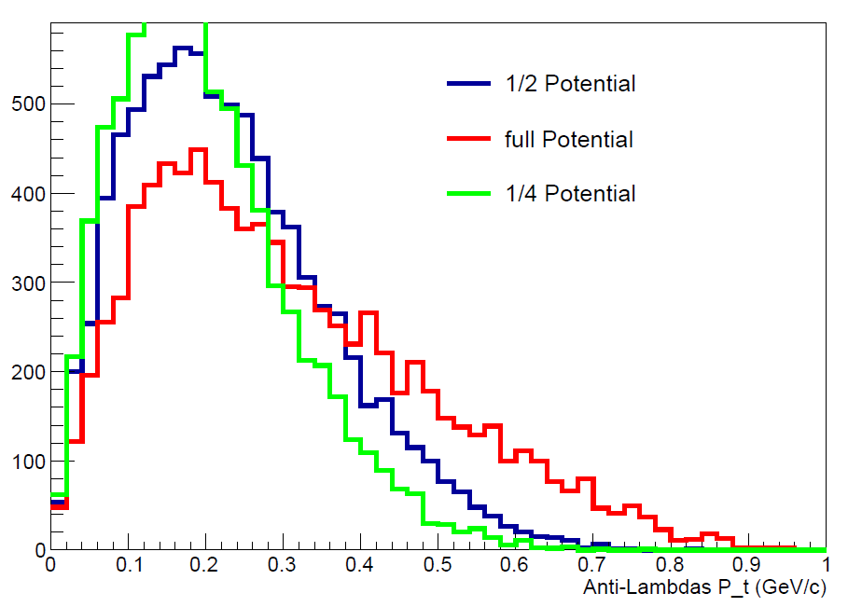
p_{t} distributions
Change of transverse momenta in qualitative agreement of schematic simulations
Λ
L
Notes:
A. B. Larionov, T. Gaitanos, and U. Mosel
Phys. Rev. C 85, 024614 (2012)

