Slide 1
OPERATOR ROLES AT THE AUSTRALIAN SYNCHROTRON LIGHT SOURCE
How We Keep Our Operators Motivated
Don McGilvery
Greg LeBlanc

Slide 2
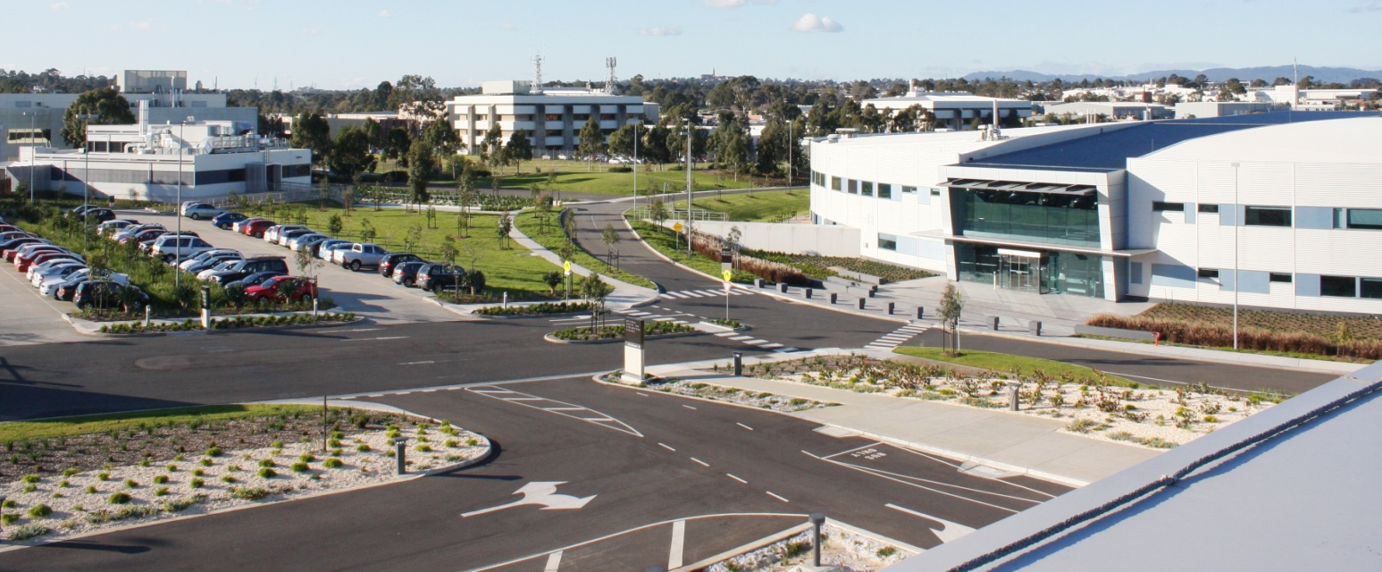
OPERATOR ROLES AND MOTIVATION
ASLS in User Operation for 7 years
Schedule 5000 hours of User beam per year
2000 hours of Machine Development and Physics per year
Operators cover 24 hours a day, 7 days a week
For 75% of the week, Operators are the only AS staff on site
They play a key role in delivering great science!

Slide 3
KEY MACHINE PARAMETERS
3GeV Electron Storage ring with full energy injector
Normal Operating current is 200mA
10 Operational Beamlines
Small Facility (120 staff total, 18 staff in Physics, RF and Operations)
More than 2000 Users per year
More than 400 publications per year

Slide 4
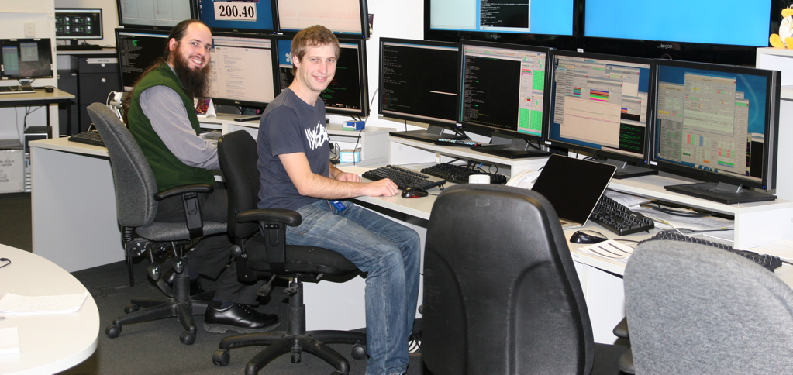
HOW DO WE KEEP OPERATORS MOTIVATED?
Operator Skill Set
Shift Structure
Diversity of Roles
Maintain Good Communication

Slide 5
OPERATOR SKILL SET
Begins at Interview
Choose carefully
We look for complimentary skills with new hires
People who have had exposure to shift work
Naturally Inquisitive
Hands on Person
Computer Competent
Graduate in Physics or related Discipline
Lifetime Learners
Provide Training including CAS / USPAS
Facility Tour

Slide 6
SHIFT STRUCTURE
The most challenging aspect of the Operator role is living with shift work.
It requires
Disruptive Sleep patterns
Working in isolation with minimal supervision
Necessity to sacrifice social life for work

Slide 7
ESTABLISHING A SHIFT ROSTER THAT WORKS
What was important to our Operators
Minimise day/night shift changes
Every second weekend off
Shift changeover times match good commuting times (7am-7pm)
A stable roster (6-12 months at a time)
Build around the weekly machine schedule
Provide some overlap with other Operators
Trust the Operators to build a pattern that works best for the team

Slide 8
THE SHAPE OF OUR ROSTER
7 days on / 7 days off / 7 nights on / 7 days off
12 hours shifts with shift changes mid week
Alternating weeks of day / night
2 Operators per shift with 1 shift overlap with alternate team
Shift times 7:00 to 19:00 and 19:00 to 7:00 (+ 10 min handover)
2014 | Wed |  | Thu |  | Fri |  | Sat |  | Sun |  | Mon |  | Tues
 | Day | Night | Day | Night | Day | Night | Day | Night | Day | Night | Day | Night | Day | Night
Week1 | Joel | Simon | Joel | Simon | Joel | Simon | Joel | Simon | Joel | Simon | Joel | Simon | Joel | Cam
 | Rod | Robbie | Louise | Stephen | Louise | Stephen | Louise | Stephen | Louise | Stephen | Louise | Stephen | Louise | Stephen
Week2 | Pete | Cam | Pete | Cam | Pete | Cam | Pete | Cam | Pete | Cam | Pete | Cam | Pete | Joel
 | Louise | Stephen | Robbie | Rod | Robbie | Rod | Robbie | Rod | Robbie | Rod | Robbie | Rod | Robbie | Rod
Week3 | Simon | Joel | Simon | Joel | Simon | Joel | Simon | Joel | Simon | Joel | Simon | Joel | Simon | Pete
 | Robbie | Rod | Stephen | Louise | Stephen | Louise | Stephen | Louise | Stephen | Louise | Stephen | Louise | Stephen | Louise
Week4 | Cam | Pete | Cam | Pete | Cam | Pete | Cam | Pete | Cam | Pete | Cam | Pete | Cam | Simon
 | Stephen | Louise | Rod | Robbie | Rod | Robbie | Rod | Robbie | Rod | Robbie | Rod | Robbie | Rod | Robbie

Slide 9
ADVANTAGES OF THIS ROSTER
Only 1 night shift week per month
A week between shifts to recover
2 or 3 days to recover before a weekend.
Can start preparing for night shift a couple of days before
Can have a weekly meeting with half the team
Can have a life during their week off

Slide 10
DIVERSITY OF TASKS
Keeping Beam in the Machine
Since Top Up and Facility UPS very little intervention required
We recently achieved 982 hours delivery of User Beam without a beam dump
Fault Diagnosis and Recovery
Emergency Management
First Aid, Safety Warden, Security Backup etc.
Projects
Electronic Log Book
Facility Statistics
EPICS, Databases, WEB pages
Tunnel Robot
Environment Monitoring
Improvement to Diagnostics
Auto-tune Routines
After hours Beamline Support

Slide 11
BEAMLINE SUPPORT
Operators provide after hours support for Users on Beamlines
Trained by Beamline Science staff
Able to apply machine problem solving skills to Beamlines

Slide 12
BEAMLINE SUPPORT
What do Operators Do?
Gas bottle changes and Liquid Nitrogen refills
User Malfunctions
Crystallography Robot Issues
Remote User Assistance
IOC fault recovery
Machine Protection Issues
Beamline/User Inductions
Maintain the Vending Machine !!! (Chocolate & Coke)

Slide 13
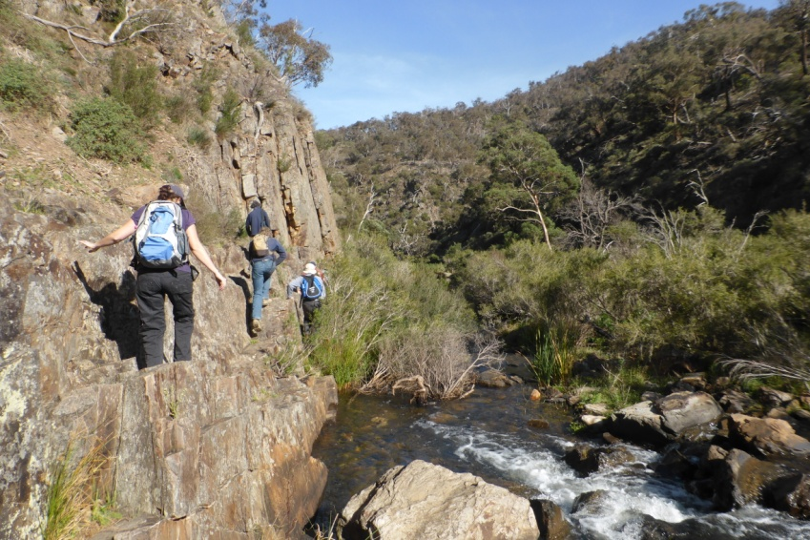
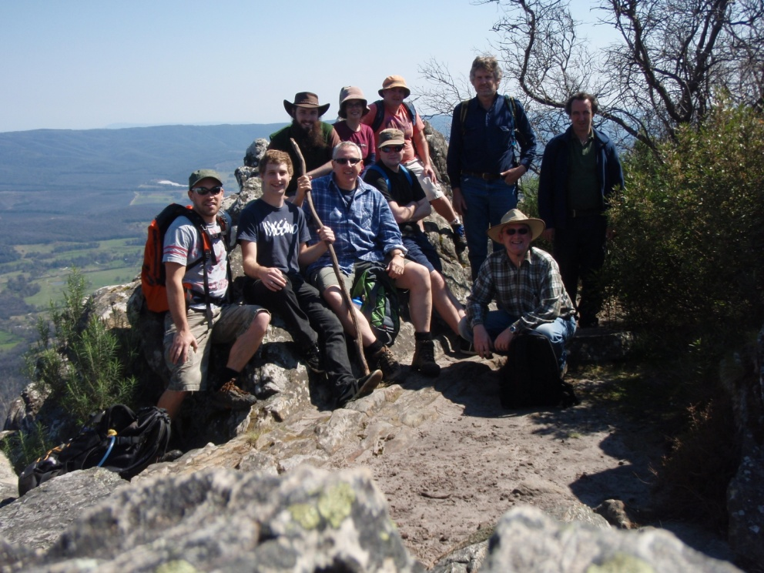
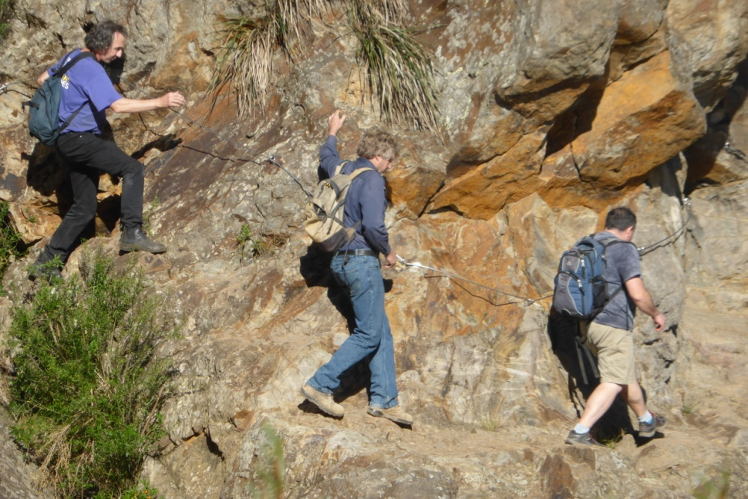
OPERATOR TEAM BUILDING DAYS
Our Operators Enjoy Challenges

Slide 14
MEASURING OPERATOR MOTIVATION
Happy Operator Index
Low Operator turnover - half have been more than 6 years.
Operators prefer the 7 day roster to regular day job
Very low absenteeism
Operators enjoy coming to work
Able to have a life outside

Slide 15
GOOD COMMUNICATION
eLog (Presentation tomorrow morning)
Weekly Meetings Thursday evenings 18:30 – 19:30 (up to 6 of the 10 Operators present)

Slide 16
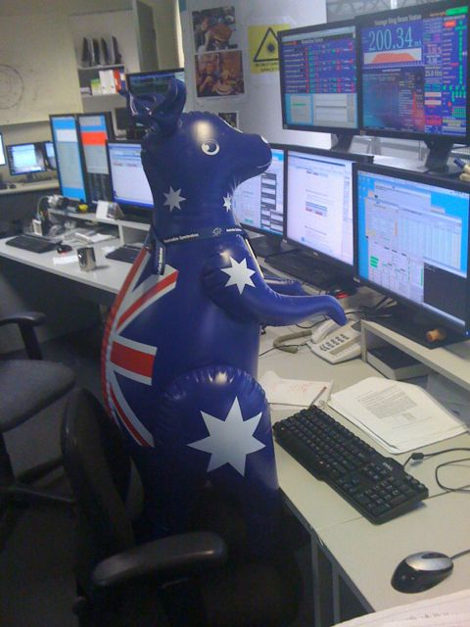
CONCLUSION
Have a diverse Team
Have a Shift Roster that Works
Provide Diversity and Stimulation

Slide 17
Greg LeBlanc – Head of Accelerator Physics
OPERATORS
Joel Trewhella
Cameron Rodda
Rod King
Robbie Clarken
Peter Jones
Stephen Martin
Mark Atkinson (seconded to Inst Scientist)
Louise Header
Simon Cunningham
Keara Marshall (Contract)

Slide 18
OPERATOR THOUGHTS ON 12x7 ROSTER
“Having worked shifts for a large portion of my working life, I believe the current 12hrs x 7 shift has definitely been the best for recovery from my experience. I have worked a variety of 8, 10 and 12 hour and various combinations of each and have found them as hard to do and no less tiring.
I prefer the 12 hour roster we currently work and prefer it over any other roster combinations”.
Peter Jones, Operator at the Australian Synchrotron

