Slide 1
The Automation of the Sequencing of Accelerator Cycles and Events at Fermilab
Stanley Johnson
Fermilab Accelerator Operations

Slide 2
The Danger of Automation
Loss of skills and understanding of the system
Troubleshooting and configuring the system now becomes an expert only job.

Slide 3
Task to accomplish: Control How and When the accelerators operate

Slide 4
Why Automate? Very Complex Tasks
Many Accelerators
Many Experiments
Machine Protection
Rapid Cycle times
Efficient setups for new conditions

Slide 5
Definitions, History, and What we are doing
To understand the automation we have to understand the task we are working to automate

Slide 6
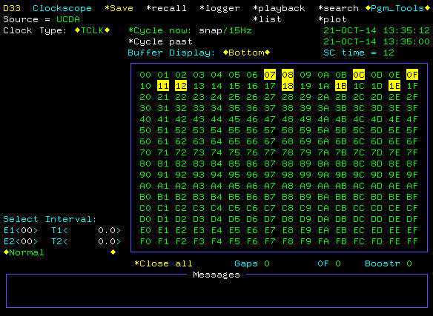
Clock System
Broadcast globally to all accelerators and systems
255 possible events; about half are used
Special events called machine resets start and define what happens in the accelerators

Slide 7
Machine Cycle Definition and basic example
Basic operation to configure or deliver beam
One or more accelerators involved
One machine reset event per accelerator
Once a machine cycle is started, it must be completed before a new cycle can start

Slide 8
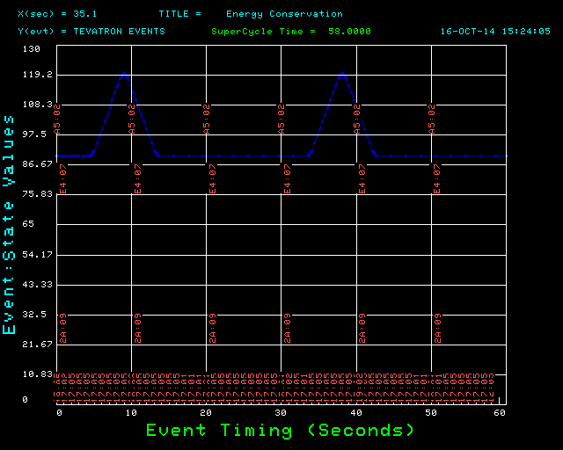
Time Line Generator
Sequences Timing (clock events) and Machine State to control the accelerators

Slide 9
History of the Task
Early years: Discrete hardware, little/no software interface, hard to configure
Middle years: Discrete hardware, crude software interface, can be configured with training
Recent years / Now: Computer driven hardware and interface, easy to configure, but hides complexity.
Future: more complex, more automation

Slide 10
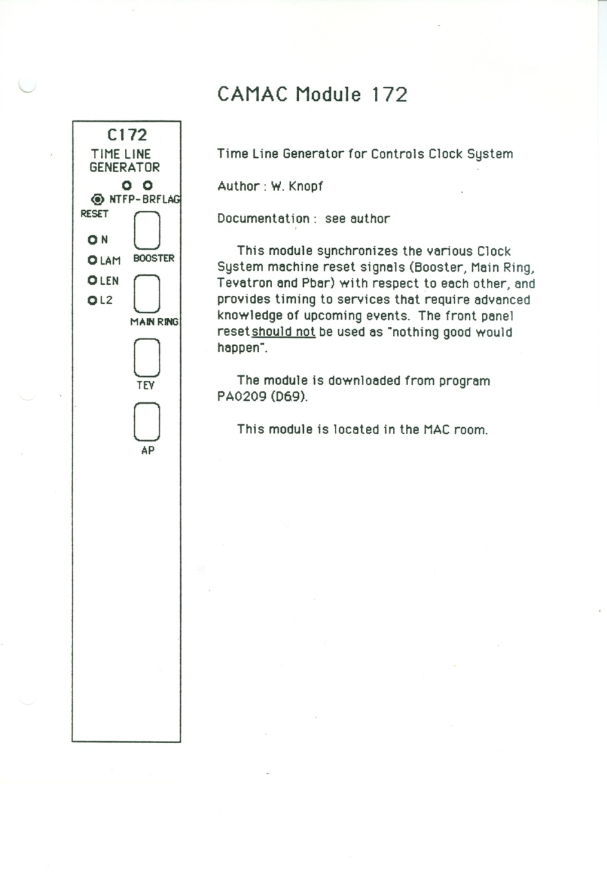
Hardware Evolution Starting Design
Custom Hardware
Discrete Logic
Inflexible

Slide 11
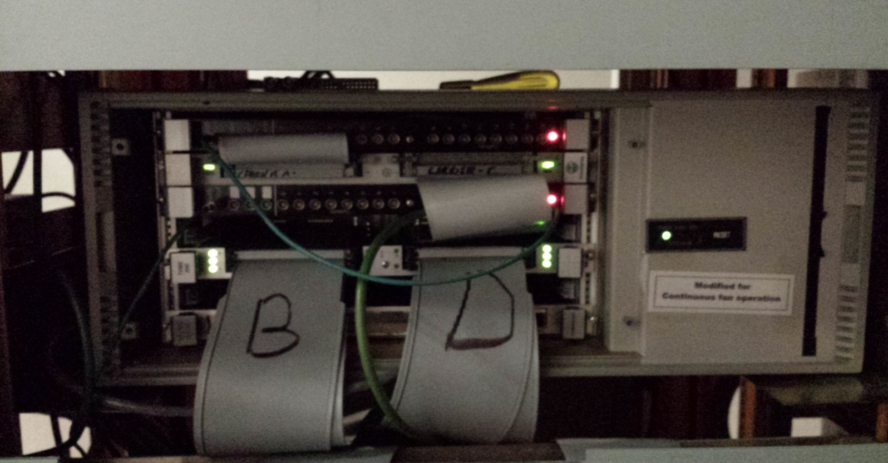
Hardware Evolution Current Design
Micro Processor Design with a commercial product
Can be reprogrammed
Hot Spare / Test Stand

Slide 12
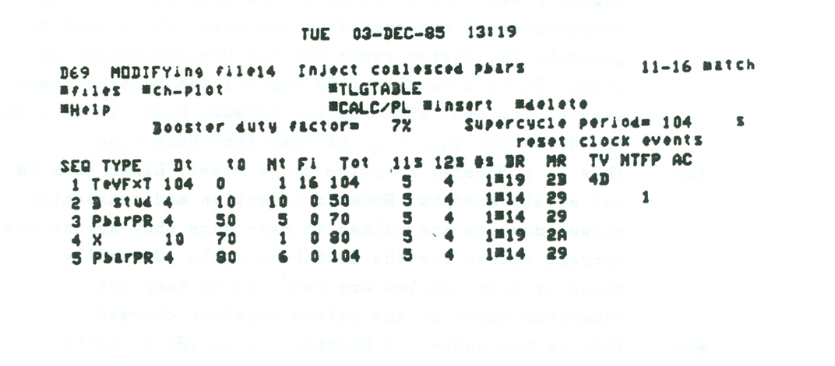
History of the Application
Starting Version from ~ 1985
All events placed manually in time
Minimal Machine protection
No Automation

Slide 13
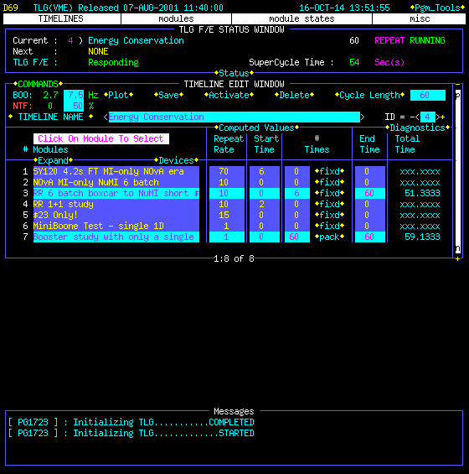
History of the Application #2
Sets of events collected to form modules
Rules for event placement
Machine protection
Automatic placement of events for high rate experiments
External API for scripting

Slide 14
System Status
Critical system for the operation of the Accelerator complex
Any changes must be approved between Operations, Controls and the System groups
All modification both software and hardware must be tested
System changes slowly

Slide 15
Current/Recent Automation Experiences
Collider
Automation was key to the success of the program
Machine events for collider were driven by external sequencers
Expert setup, operator driven, and hard to troubleshoot
Configuration mostly static once setup
Complex different sequences
Neutrino Production
Automation is the key to the success of the program
Rapid cycle times for maximum beam power on target
Working with operators on the setup
Still evolving
Building tools to help understand the system
Rapidly repeating complex sequences

Slide 16
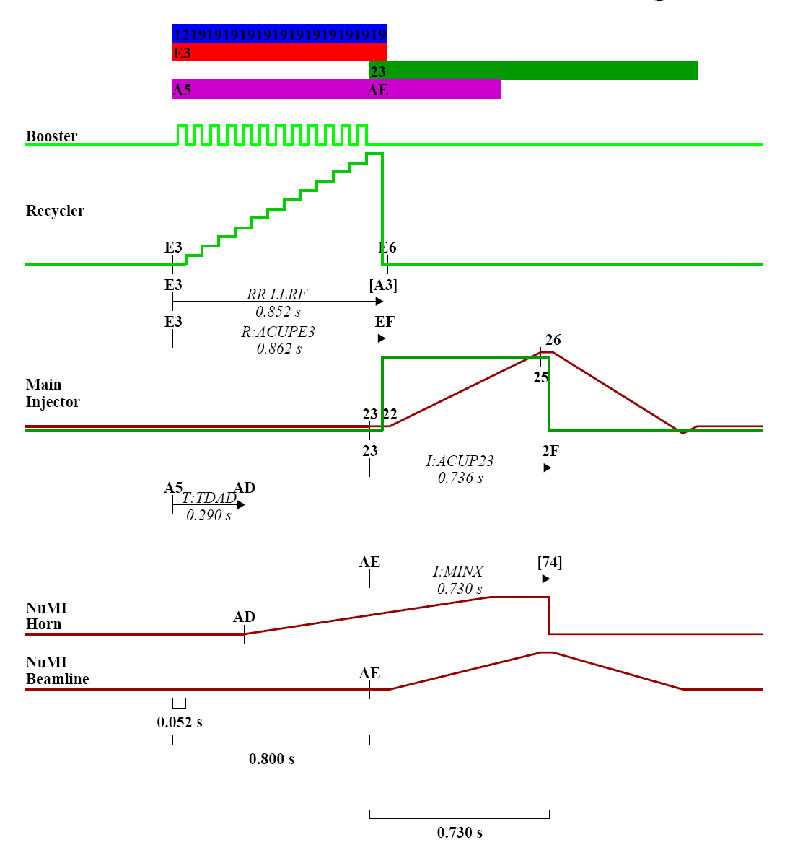
NOvA/ANU Timing

Slide 17
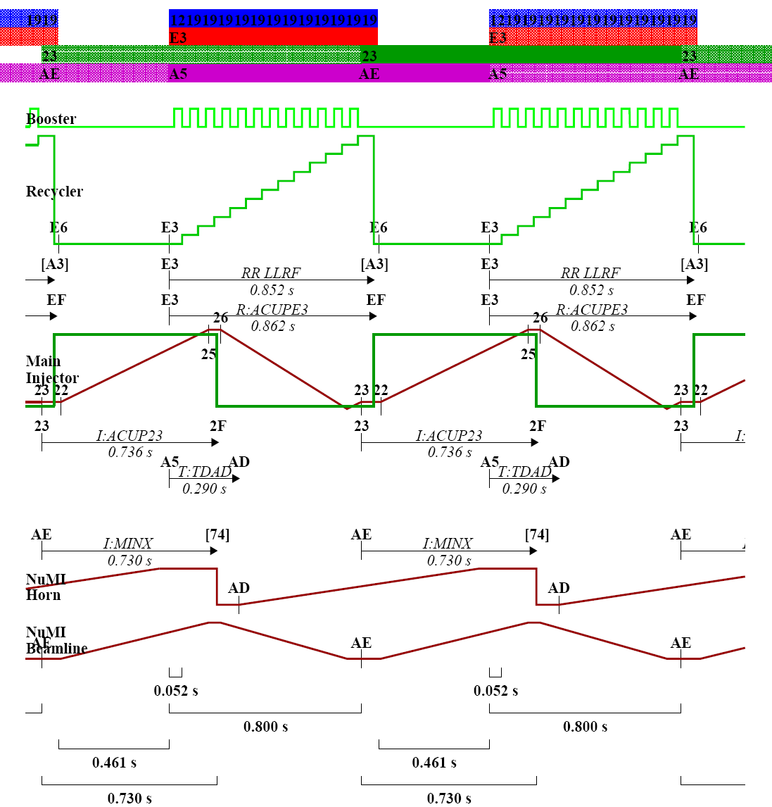
Repeating NOvA Cycles

Slide 18
Operator View
Complex system that is hard to learn
Critical to operations so operators must be careful
Everyone notices when you make a mistake

Slide 19
Expert and Management Response
Balance automation vs operator skill
Efficiency
Any changes to the Time Line Generator triggers a retraining process
Involve the operators with the automation
Bring the experts to the Control Room

Slide 20
Future Trends
Expect automation to continue:
This will be in direct response to having limited resources (Operators) to run ever more complex machines/accelerators.
Our Responsibility:
Ensure operators are trained to deal with the automation and able to safely and efficiently operate their accelerator complex.

Slide 21
Credits and Thanks
Accelerator Operators for input and feedback on the system
Various Accelerator system groups for input on system operation
Greg Vogel for input on the Clock system
Linden Carmichael for system design and programming

