Slide 1
SARAF phase-I status and challenges
Soreq
Leo Weissman
Soreq Nuclear Research Center
Outlook of the talk
Introduction
Status of the accelerator
Recent operation experience
Challenges in operation

Slide 2
SARAF – Soreq Applied Research Accelerator Facility
To enlarge the experimental nuclear science infrastructure and promote nuclear research in Israel
To modernize the source of neutrons at Soreq and extend neutron based research and applications
To develop and produce radioisotopes for bio-medical applications
Notes:
2

Slide 3
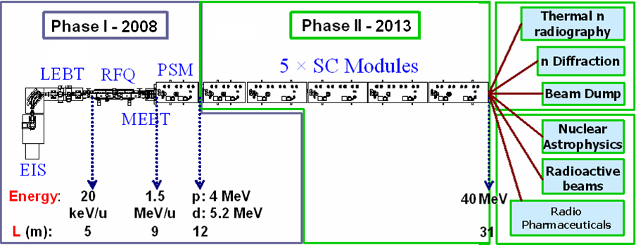
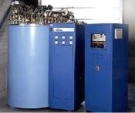

SARAF vision in 2006
Phase I - 2006
Phase II – 2014
Phase II - 2010
DC
176 MHz
2 mA
2 mA
LINAC 2006
Phase I linac (excluding auxiliaries) was expected to be delivered as a
turn-key by the industrial company, Research Instruments, former ACCEL.
Small local group will participate in the Phase I commissioning and will
receive adequate training from the industrial partner
Phase II built will be lunched after successful commissioning of Phase I
Notes:
3
3

Slide 4
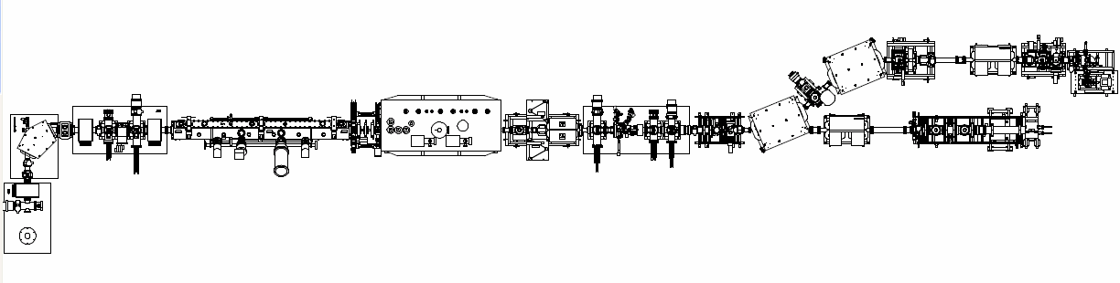
SARAF today
targets
MEBT
LEBT
PSM
RFQ
D-plate
EIS
Beam dumps
Phase I operational, but not all specifications have been reached
Since 2008 complete decoupling from the industry partners. Commissioning and operation by local team. Local team and its
expertise has grown considerably
Experiments at the temporary beam line
Phase II is under design (in 5 years)
The linac is operated with CW/pulsed protons and pulsed deutrons beams.
For CW proton beam : 1mA at ~3.7 MeV~ 10 hours/trip
2 mA at ~ 2 MeV ~ 2 hours/trip
The accelerator is used to:
  Collecting expertise in the accelerator field
  Study high intensity beam tuning
  Development with high intensity targets
  Basic research in nuclear astrophysics and nuclear medicine
Notes:
4
4

Slide 5
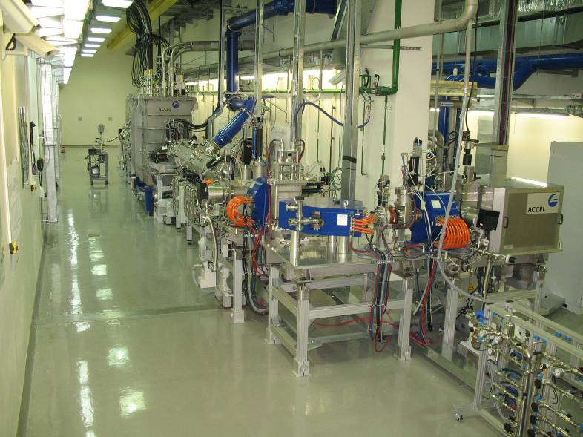
SARAF Phase I – Upstream View
PSM
MEBT
RFQ
EIS
LEBT
A. Nagler, Linac-2006
C. Piel, EPAC-2008
A. Nagler, Linac-2008
I. Mardor, PAC-2009
L. Weissman, Linac-2010
D. Berkovits, Linac-2012
L. Weissman, Rupac-2012
5
Notes:
5

Slide 6
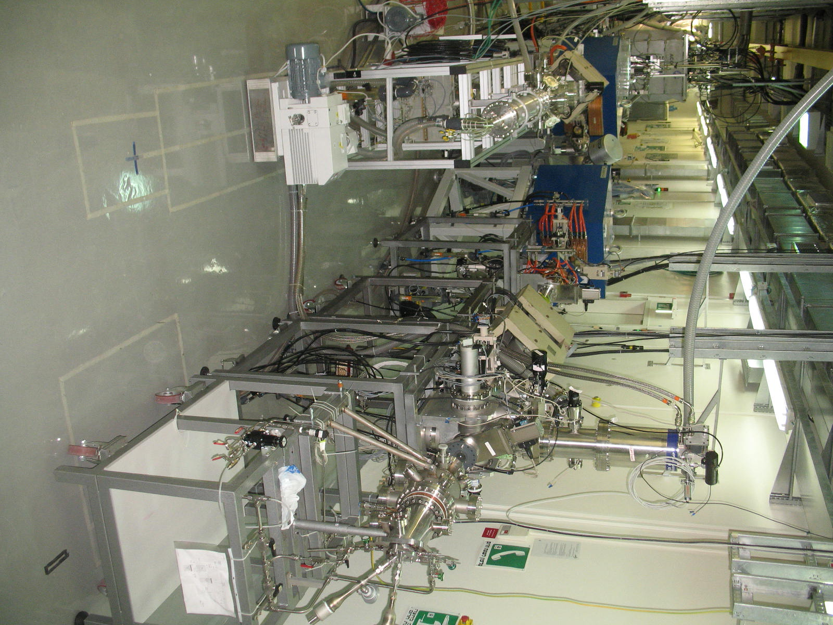
Beam lines downstream of the linac
PSM
Beam dump
target

Slide 7
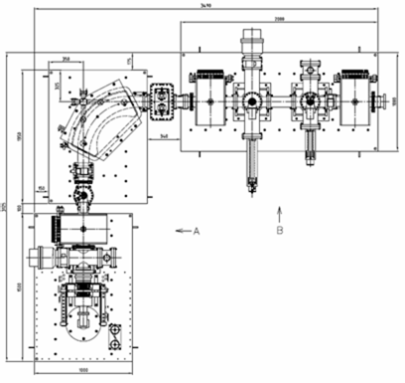
ECR/LEBT
analyzer
magnet
sol2
sol3
aperture
beam
blocker
wire/FC
slits
sol1
ECRIS
8 mA p/d
DC/pulsed
Notes:
7

Slide 8
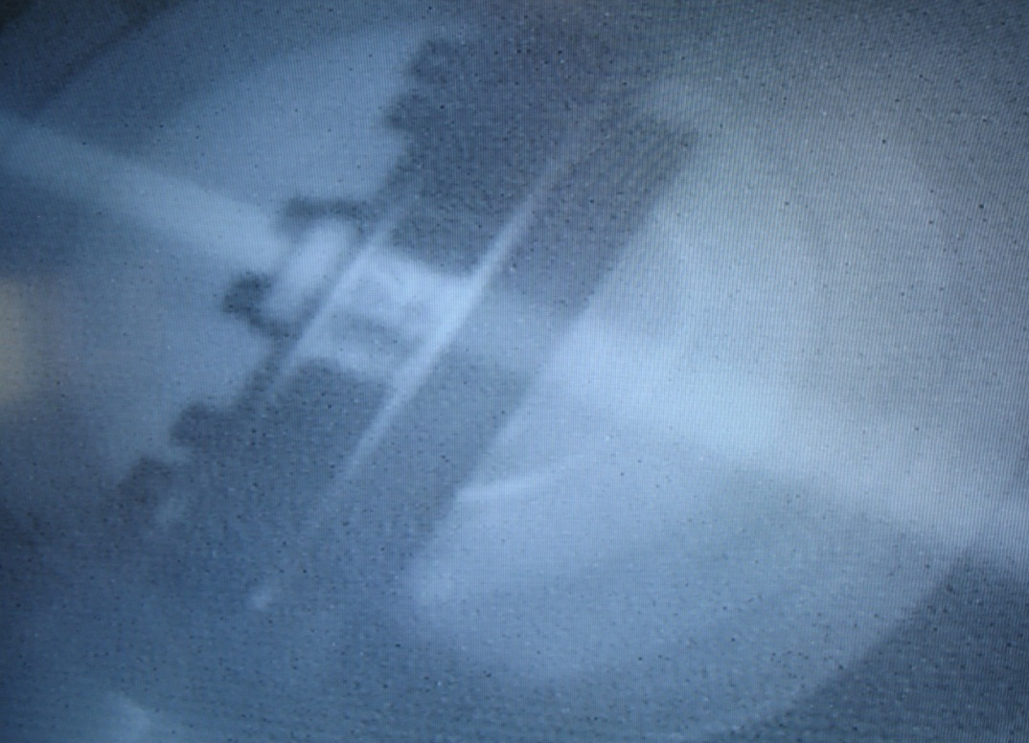
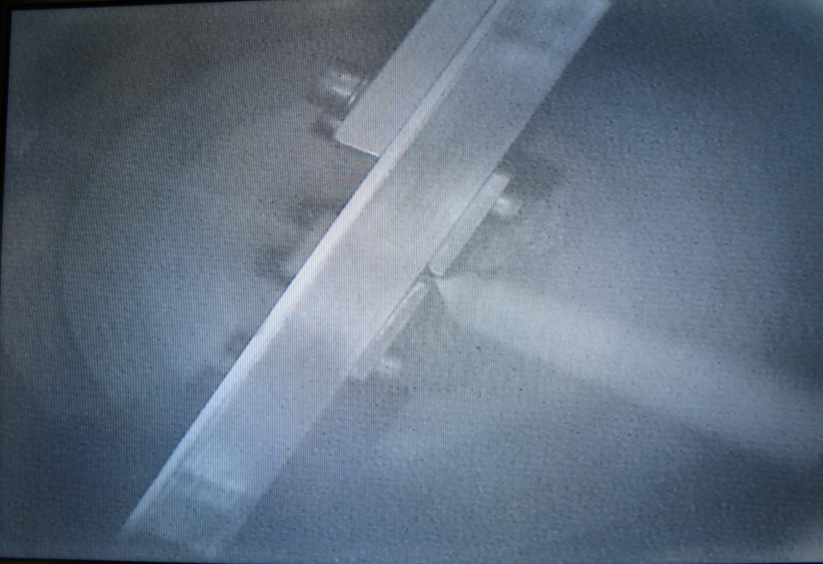
Beam observation in LEBT
Slit is inserted

Slide 9
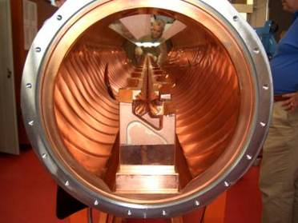
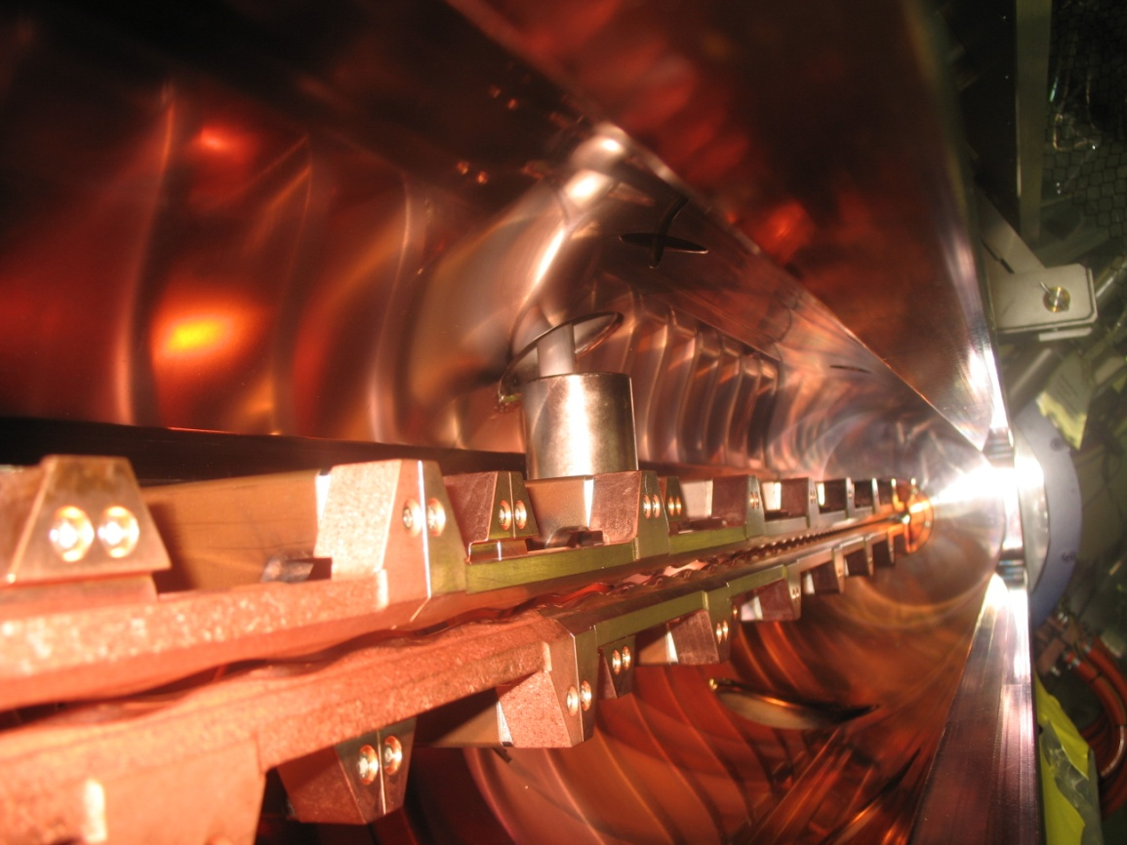
Radio Frequency Quadruple injector
4 rods structure traps and transport
the low-energy beam
Acceleration and bunching is performed
by sophisticated modulation of the rods
built by NTG/U. Frankfurt
RFQ works, but ….

Slide 10
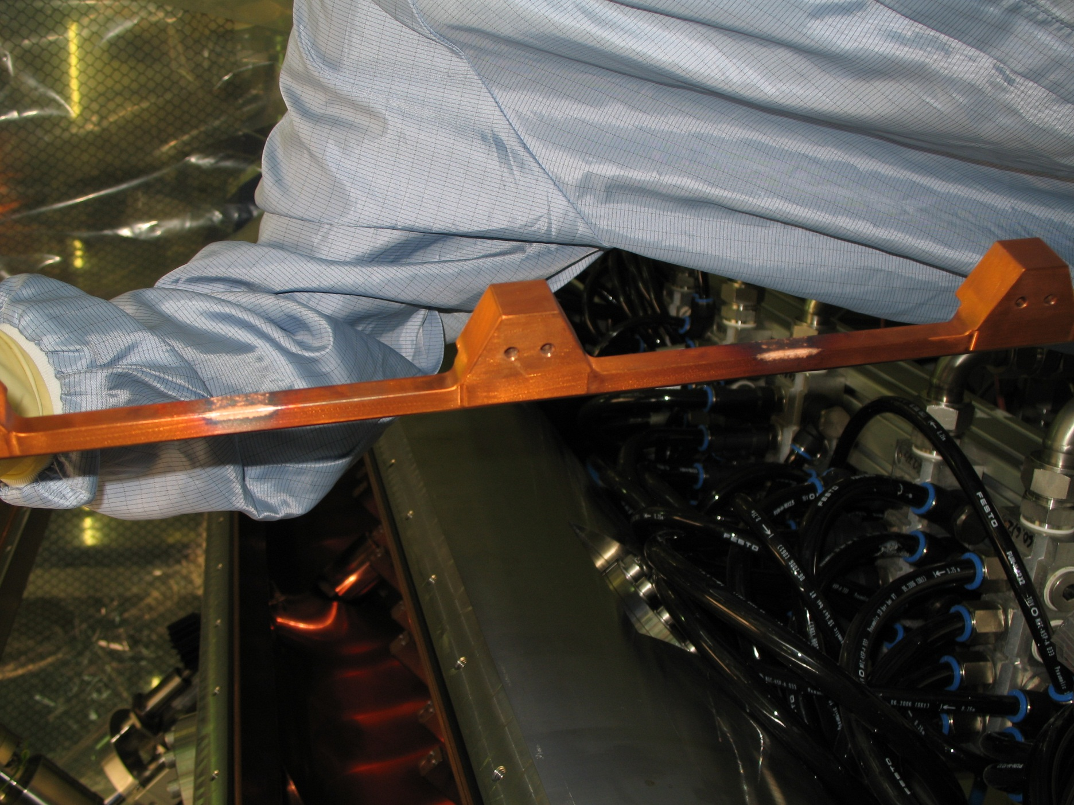
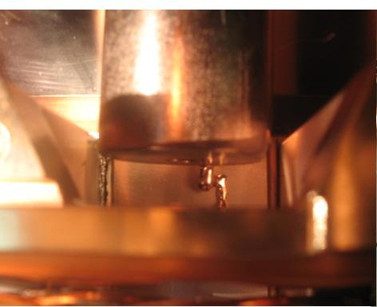
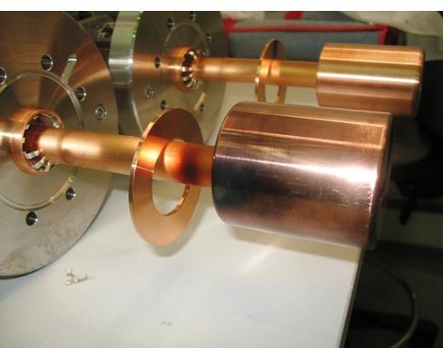
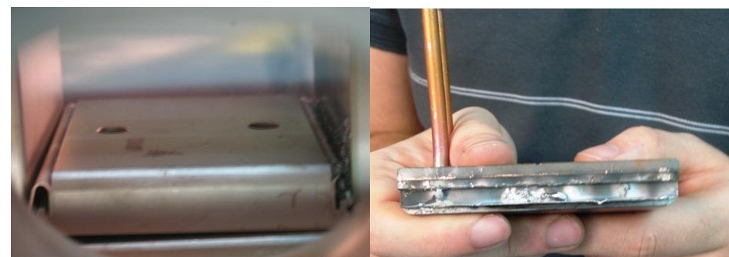
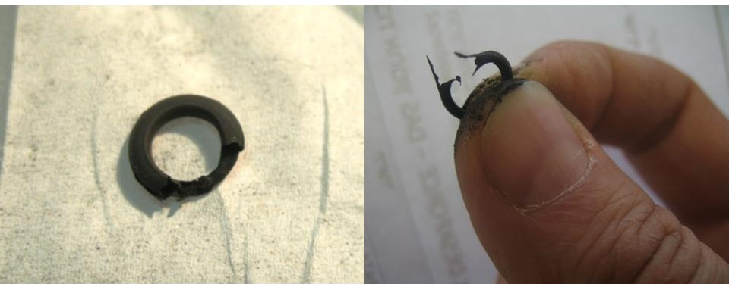
RFQ conditioning
Deuterons CW
Protons CW
Stable operation of deuterons only at low DC(<10%)

Slide 11
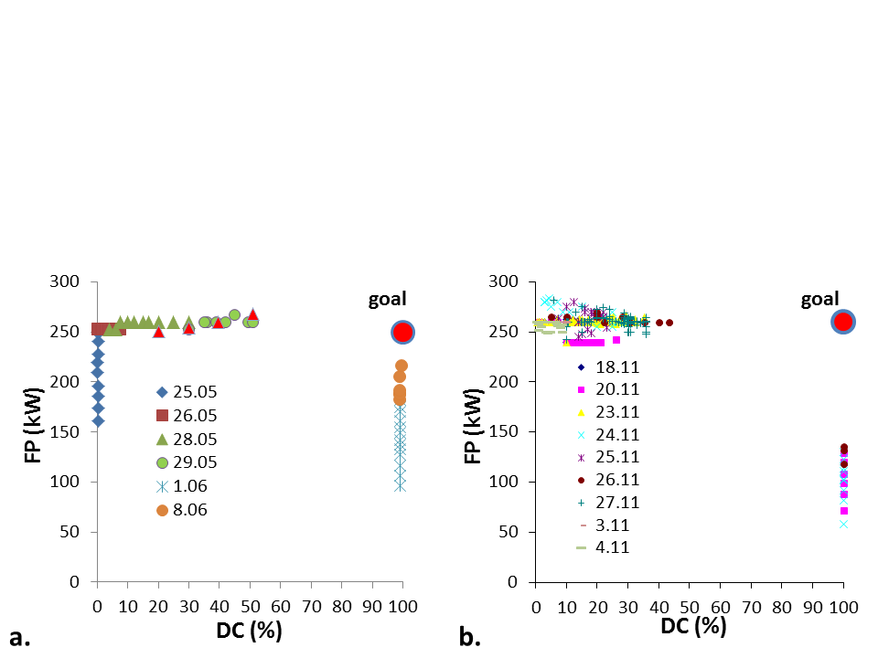
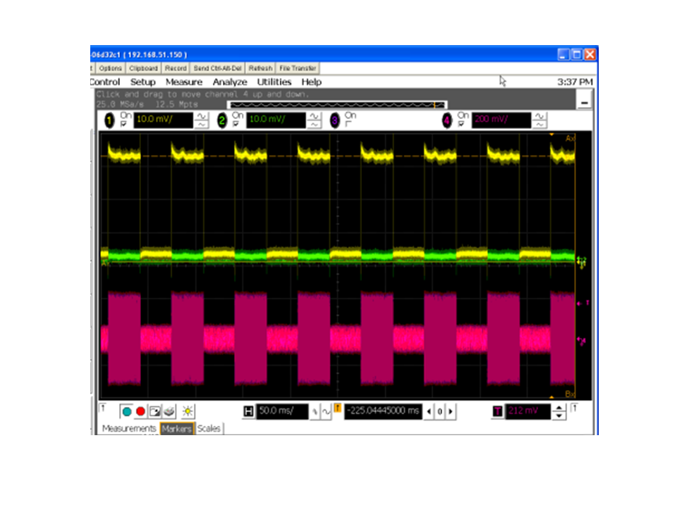
May-June 2014 RFQ conditioning campaign

Slide 12
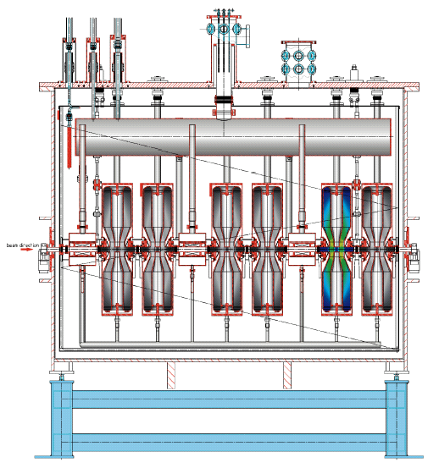
Prototype Super conducting Module (PSM)
Houses 6 x 176 MHz HWR (Half Wave Resonator) and 3 SC 6T
Accelerates protons and deuterons from
1.5 MeV/u to 4 and 5.5 MeV
Very compact design
Cavity vacuum and insulation vacuum
are separated
Beam
The main goal of the prototype cryomodule was demonstration of
acceleration of high current (> 1mA) CW proton/deuteron beams to variable energy up to 4(5.5) MeV
2500 mm
M. Pekeler, LINAC 2006
Notes:
12
12

Slide 13
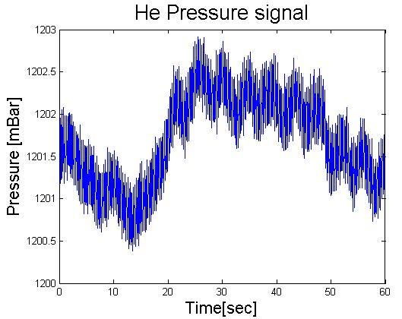
HWR Microphonics measurements
HWRs are extremely sensitive to LHe pressure fluctuations (60 Hz/mbar)
Detuning signal is dominated by the Helium pressure drift
Detuning sometimes exceeds +/-200 Hz (~ +/-2 BW)
Frequency Detuning
BW
45 sec
45 sec
* Performed in collaboration with J.Delayen and K. Davis (JLab)

Slide 14
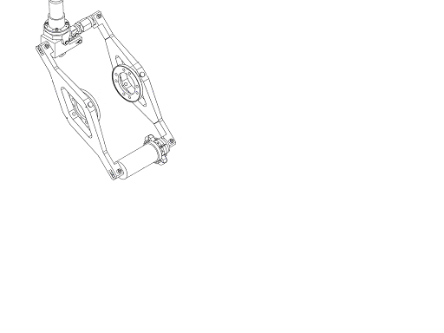
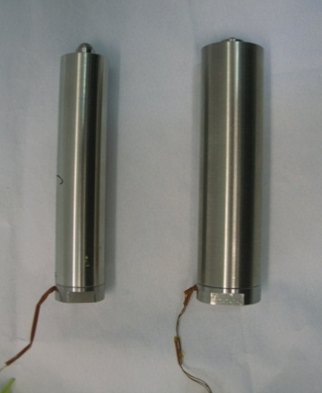
Deterioration of piezo ranges
stepping motor
May 2012
2011
Piezomechanik Gbm
beam axis
Cavity BW
LV PZT
HV PZT
Piezo tuner

Slide 15
Monitoring new piezo ranges
May 2012
BW

Slide 16
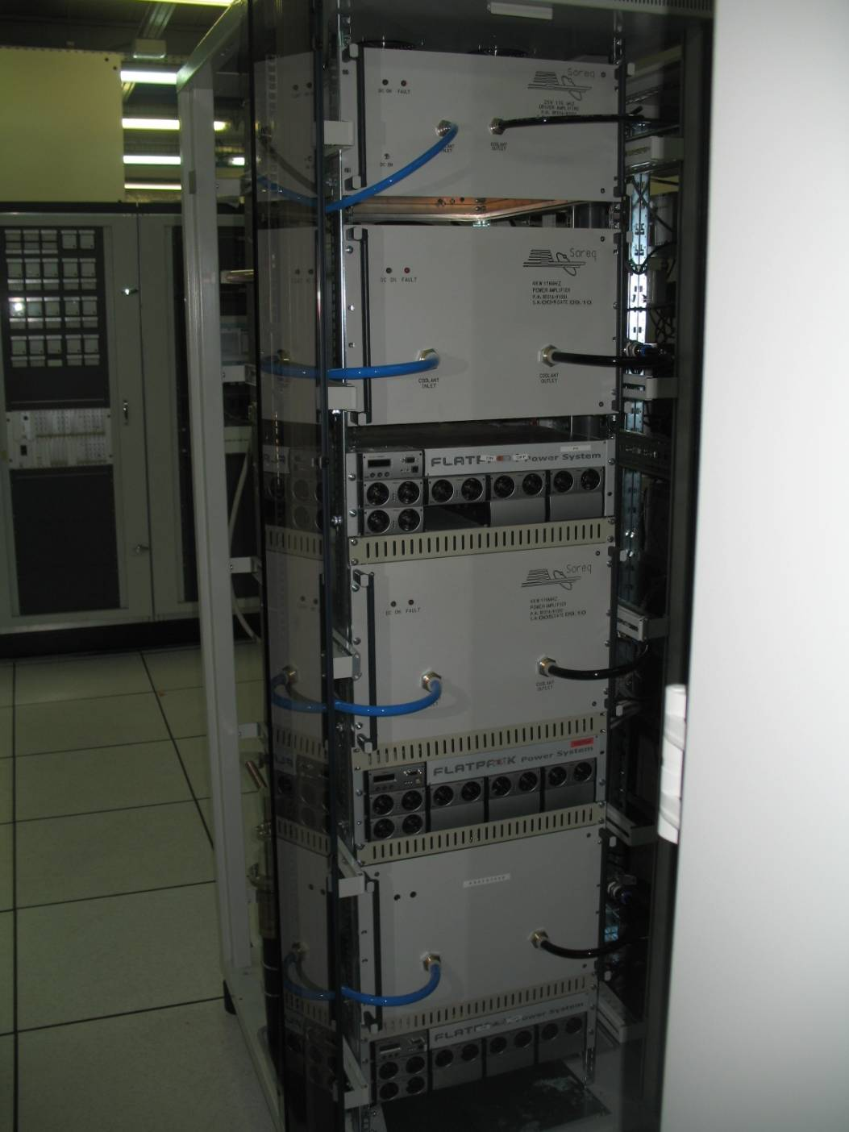
4 kW RF power supplies
I. Fishman, LINAC 2012

Slide 17
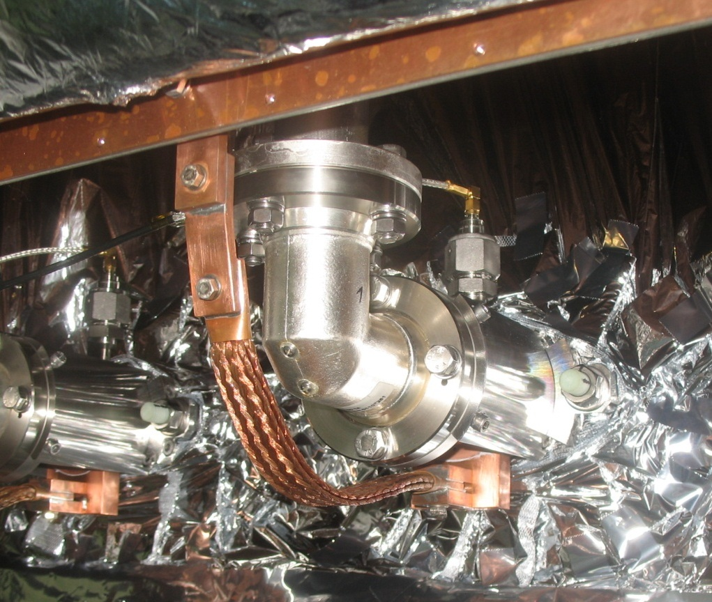
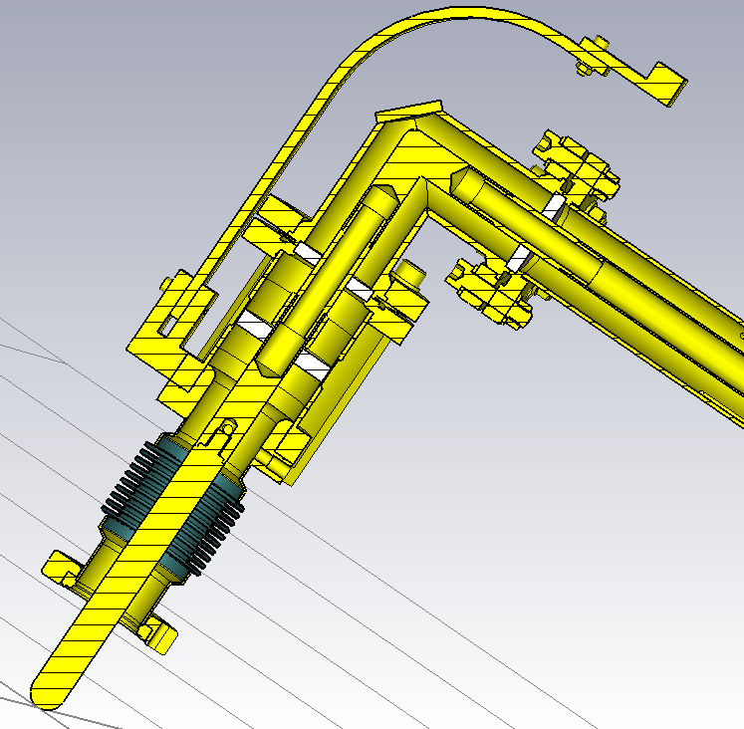
RF couplers
Thermal shiled 50^{O}K
Cold window
70^{O}K
Temperature
sensor
10⁻¹¹ mbar
4 ⁰K
Copper strip to
thermal shield for cooling

Slide 18
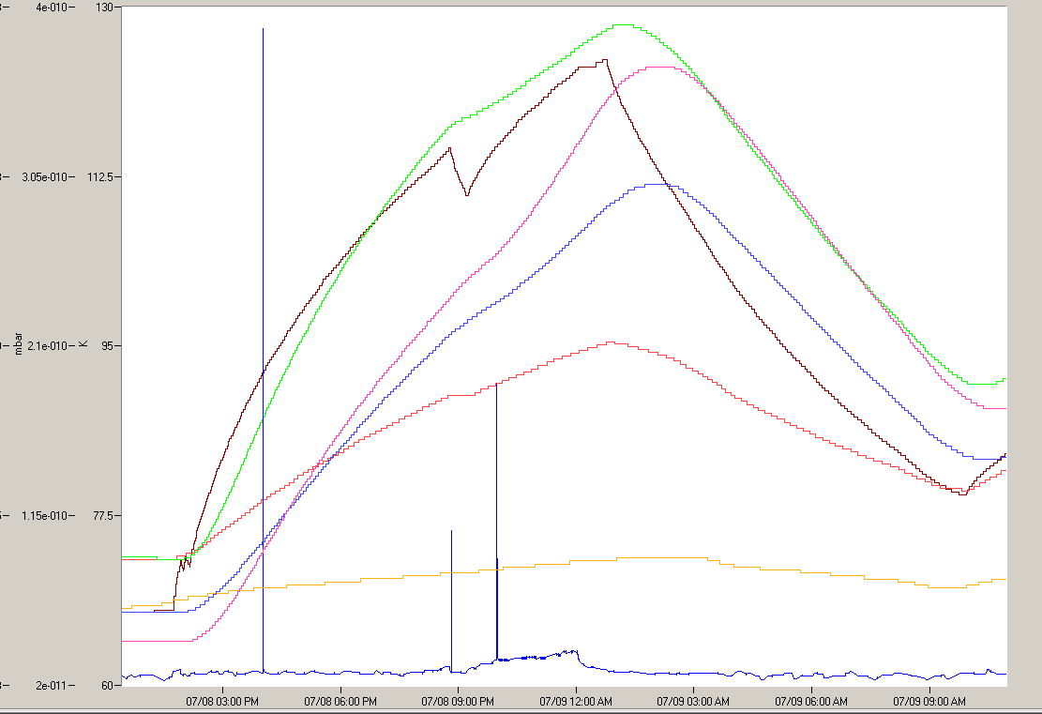
Coupler warming up during operation (set for 3.9 MeV)
130
HWR6
425 kV
12 hours
112.5
HWR4
720 kV
HWR2
460 kV
HWR3
460 kV
95
T (K)
HWR5
830 kV
77.5
HWR1
230 kV
RF off
RF on
RF on
RF off
60

Slide 19
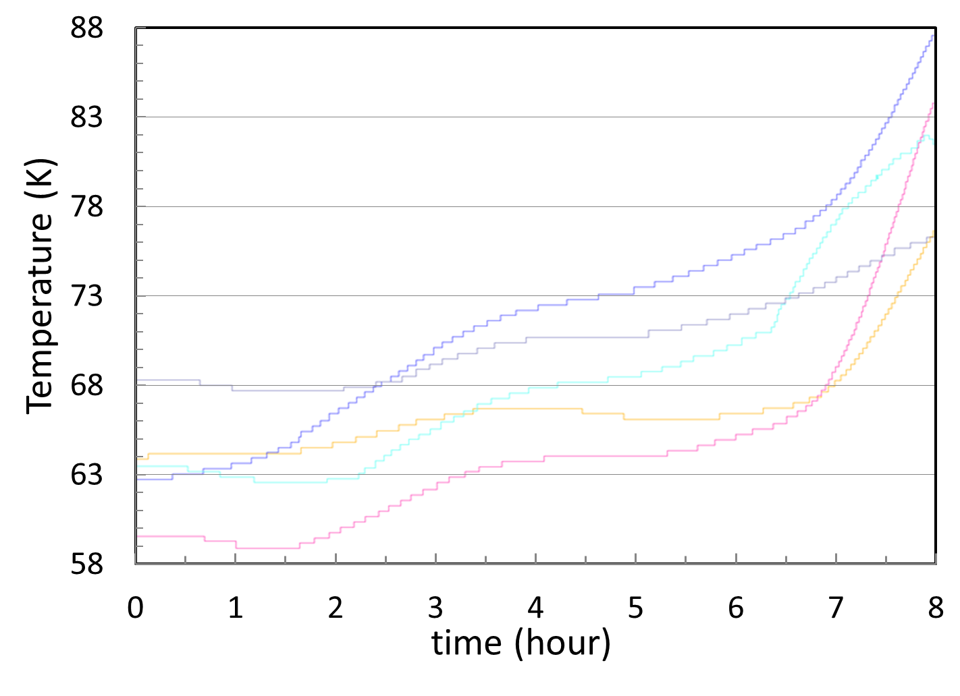
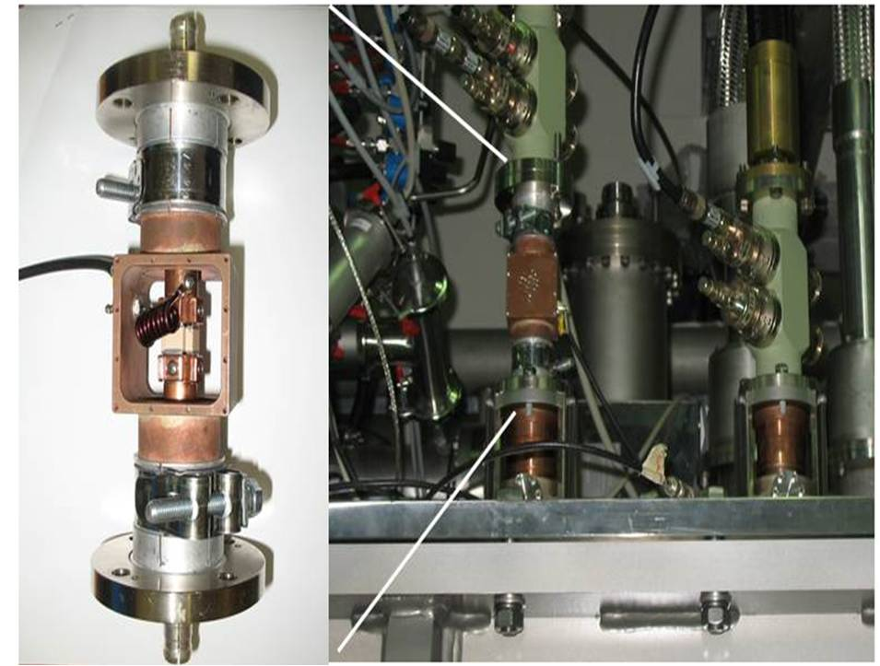
Implementation - DC bias-T element
1 kV bias
no bias
B. Kaizer LINAC2014

Slide 20
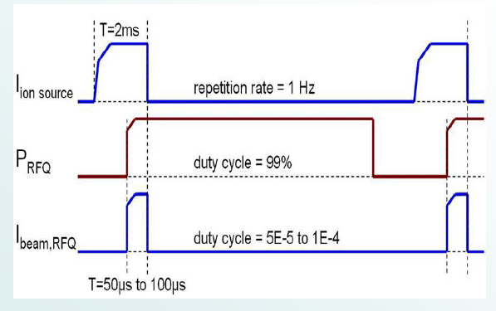
Production pilot beams

Slide 21
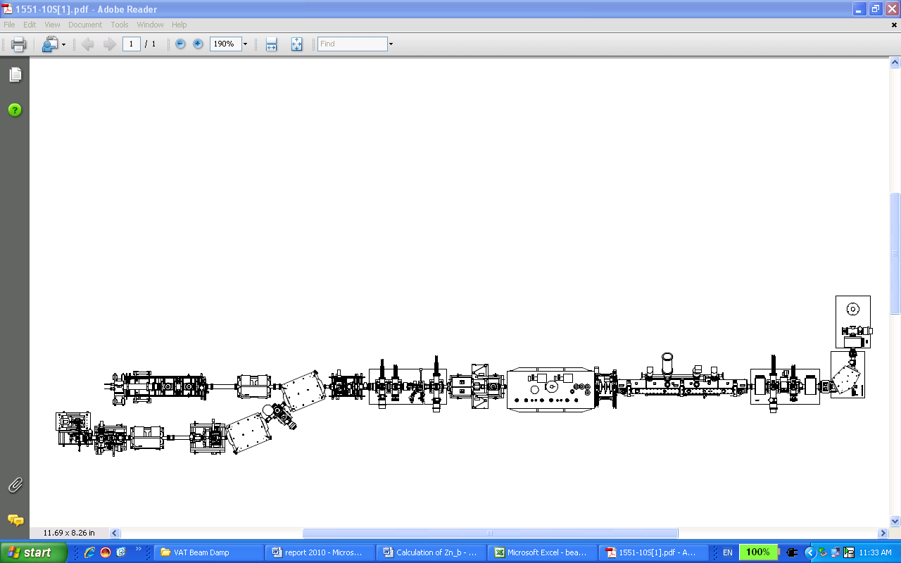
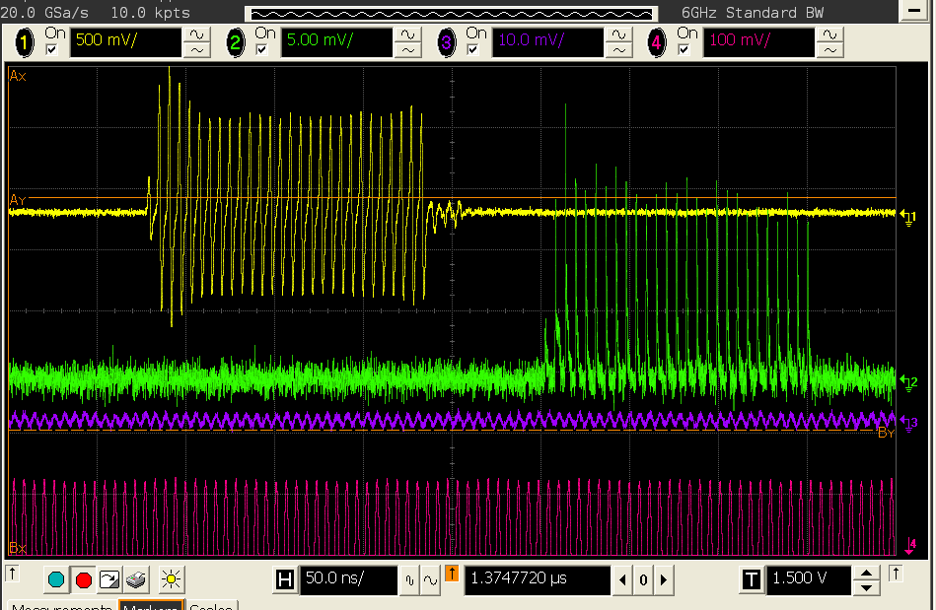
Acceleration of chopped beam
7 m
EIS
FFC
chopper
BPM
VAT
BD
D-plate
MEBT
RFQ
LEBT
PSM
chopper
BD
The shortest chopped time 200 ns
The rise/fall time better than 10 ns
D-plate FFC
MEBT BPM
RFQ pickup

Slide 22
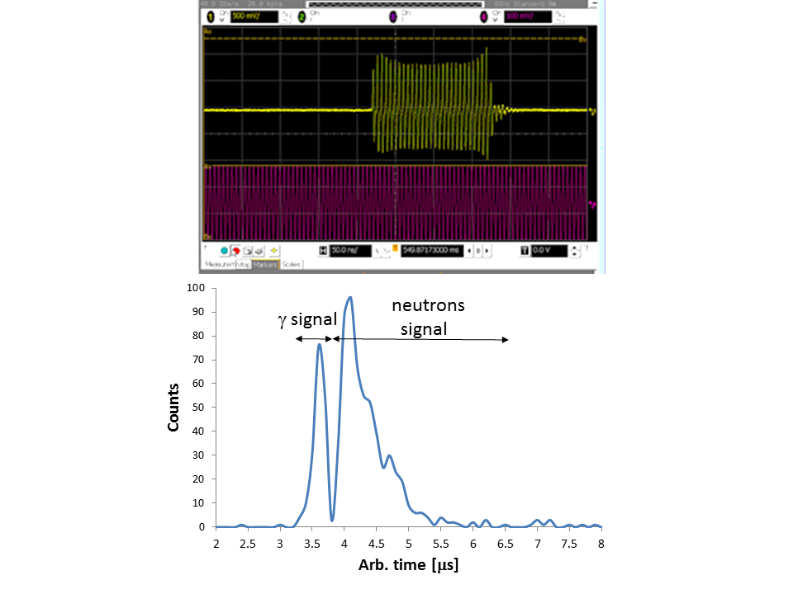
Neutron TOF measurements with LiLiT
MEBT BPM
A 0.5 mA, 4 MeV proton pulses were sent to the liquid lithium target (LiLiT).
Duration of the pulses was 200 ns and frequency 500 Hz.
The TOF spectrum was taken with a plastic scintillator placed at a 5 meters distance upstream from the target
RFQ pickup

Slide 23
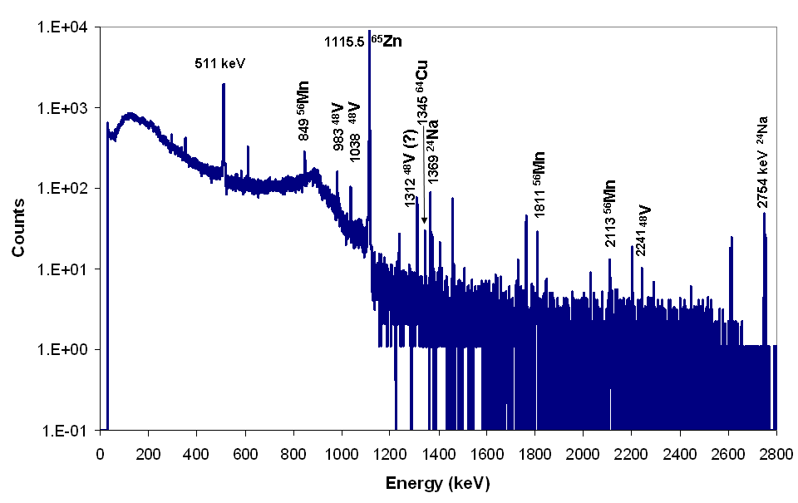
Activation VAT copper beam dump
GM counter next to the VAT BD
The VAT beam dump is made from copper.
3 MeV 1 mA CW protons, ~ 9 hours
We have created ~0.1 mCi source of
⁶⁵Zn (T^{1/2}=244 d) via ⁶⁵Cu(p,n)⁶⁵Zn reaction
Overflow during
beam operation
Activation after
proton irradiation
Original
background
Ge detector 8 hour after irradiation
Gamma spectrum is dominated
by ⁶⁵Zn activity
The reaction threshold 2.1 MeV
L. Weissman et al, JINST 6, 2011, T03001

Slide 24
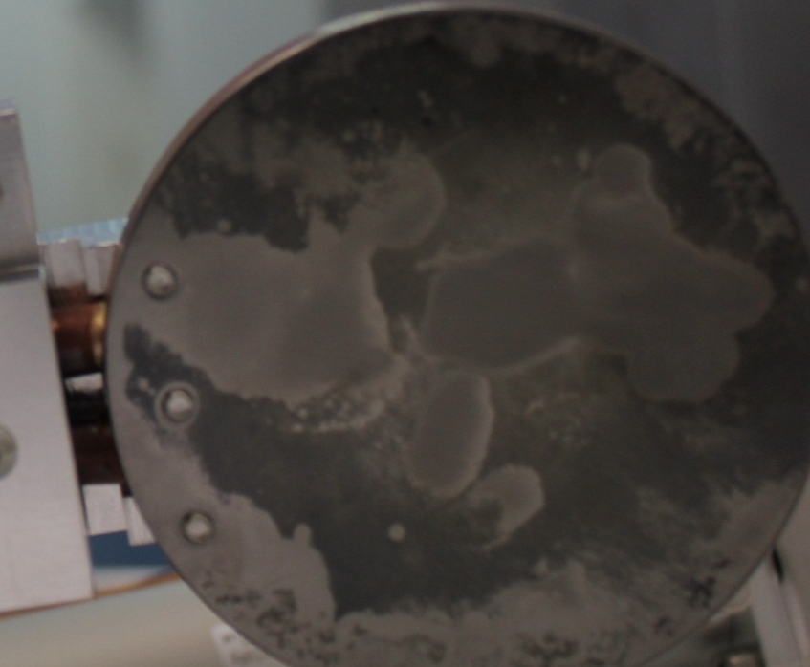
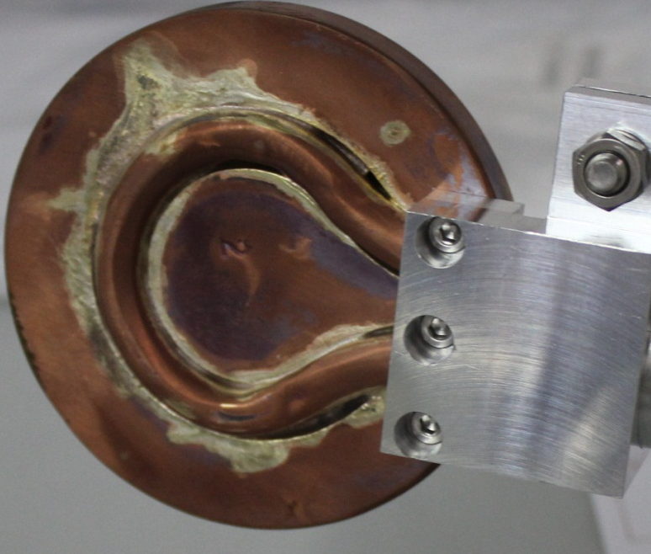
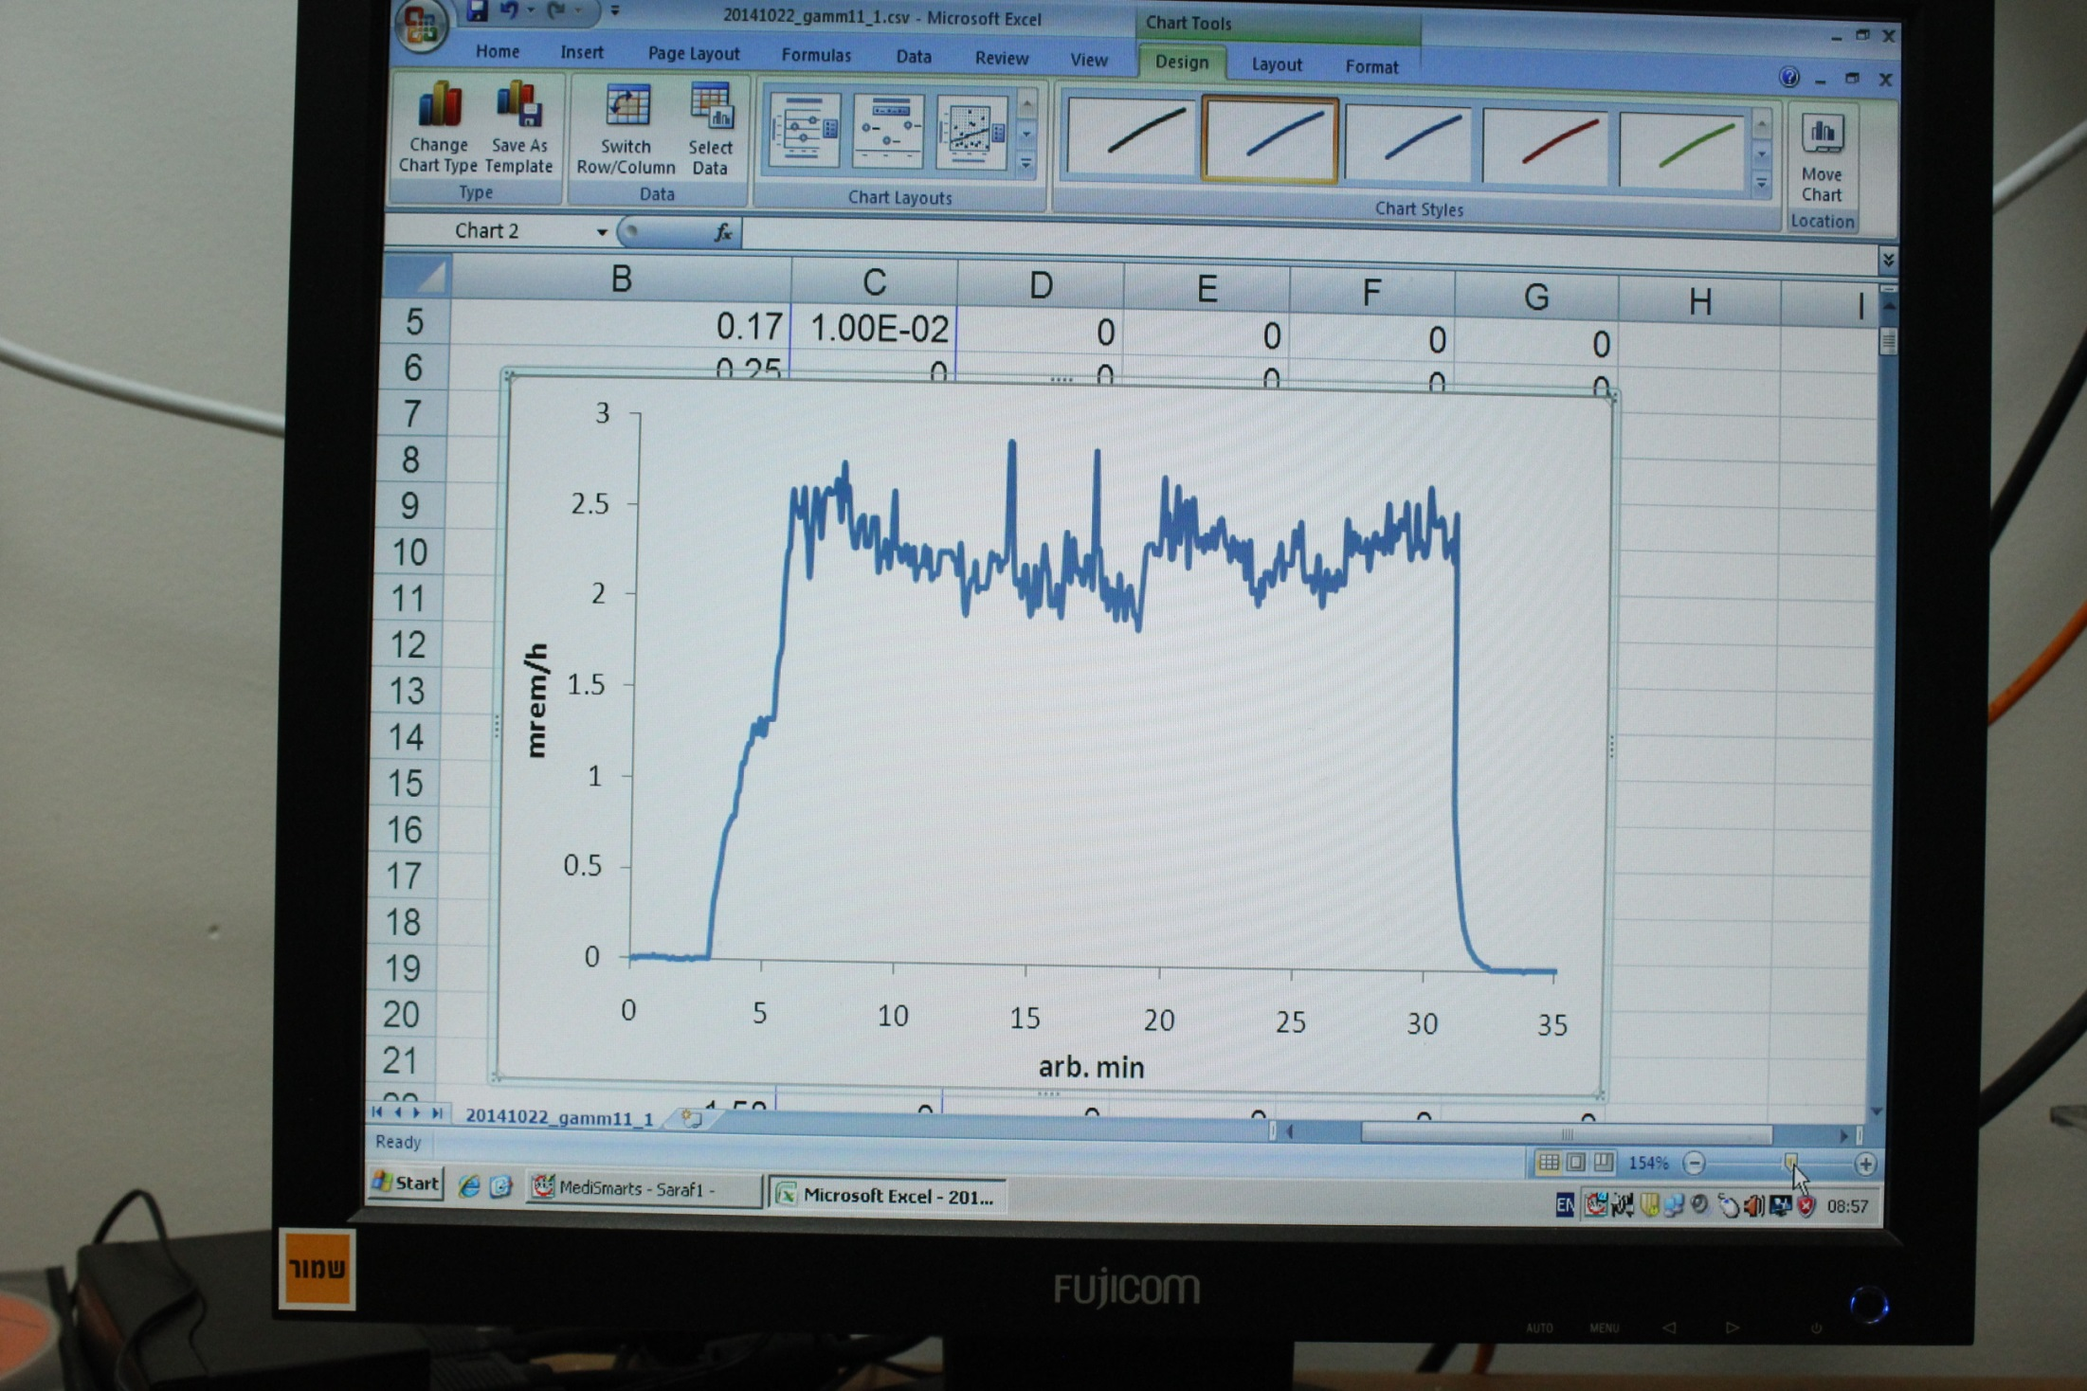
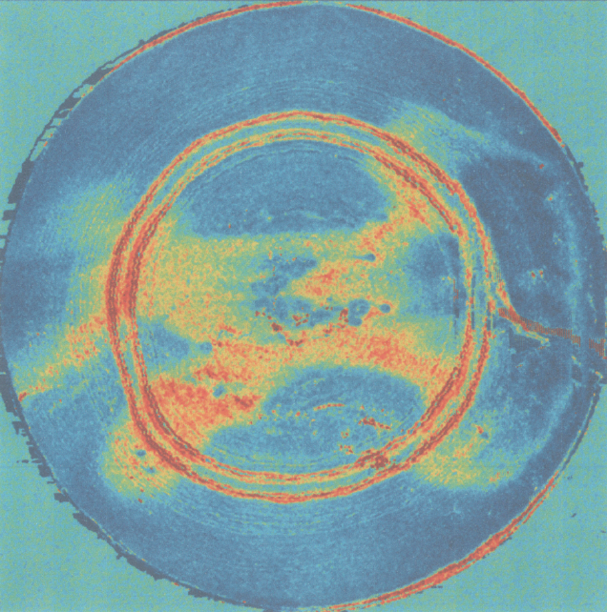
Copper beam dump with Ta front
3.9 MeV protons
CW 1 mA
GM 0.5 m distance
A. Grin

Slide 25
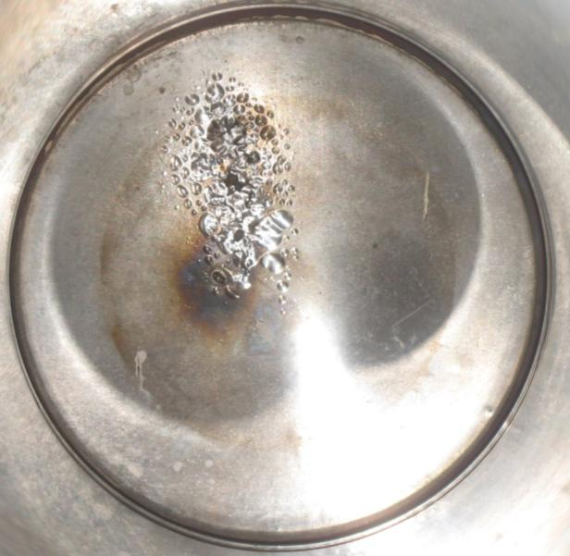
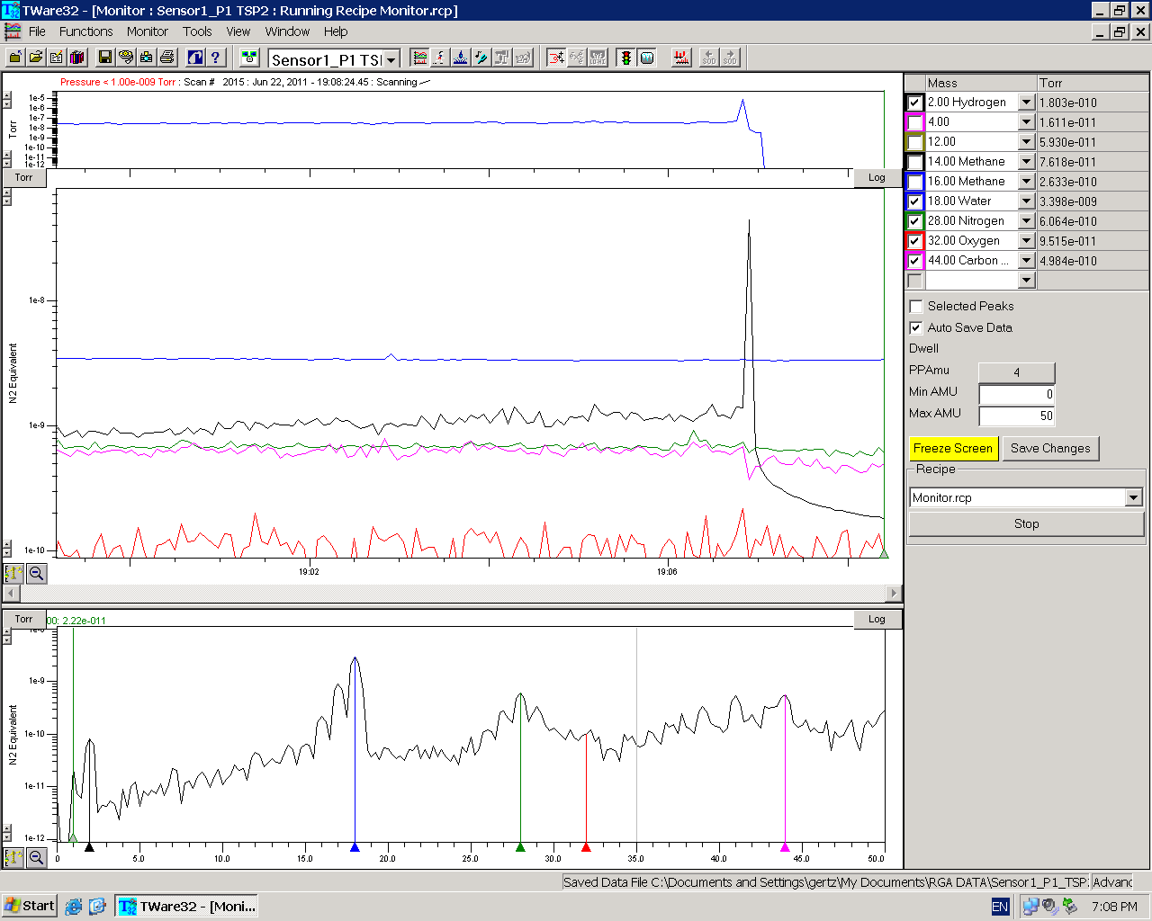
Experience with the Tungsten Beam dump
50 micron Tungsten sheet fused to a water cooled cooper plate.
No activation, low neutron radiation is expected at beam energy up to 10 MeV.
BD #2
BD #3
Visual inspection reveal strong blistering effects
H₂

Slide 26
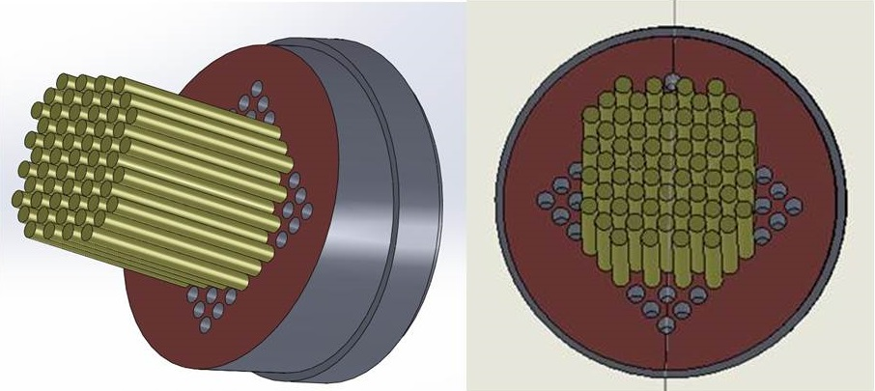
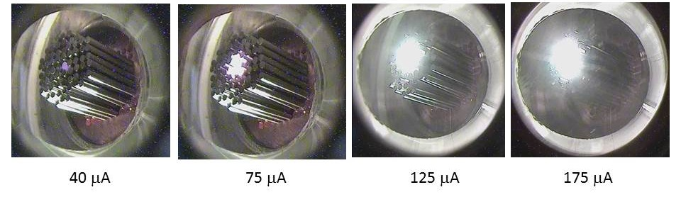
Tungsten Pin Beam dump
A 40 mm diameter prototype tested up to
1 kW with 3.7 MeV and
2 MeV beams
A. Arenstam et al. JINST 8 T07004 (2013)

Slide 27
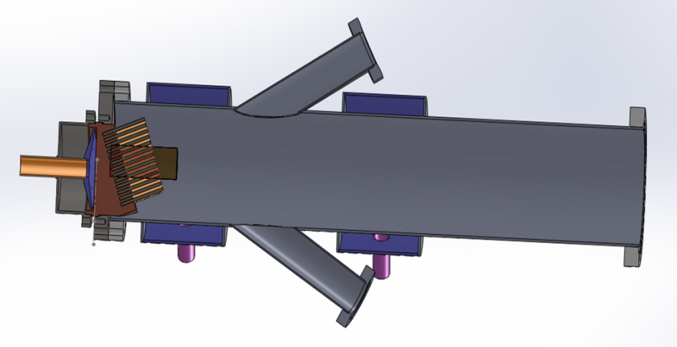
Full scale W pins beam dump
No residual activity up to 10 MeV
Most of the beam power is removed by radiation
Target is always hot (independed on beam current) do implanted hydrogen diffused out very fast
10 deg relative to be axis (copper is shaded by the W pins)
4 mm dia 60 mm long W pin
8” ID vacuum tube
280 W pins
Beam diagnostic viewports
beam
Water cooling channels

Slide 28
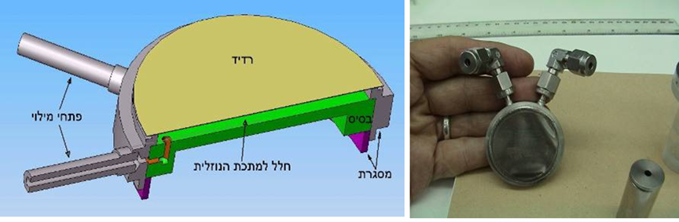
Example of radioisotope production
¹⁰³ Pd production via ¹⁰³Rh(d,2n)¹⁰³Pd reaction
deuteron beam
filling ports
Rh foil
metal coolant
frame
I. Silverman et al., NIM B261, 747-750 (2007)
Notes:
28

Slide 29
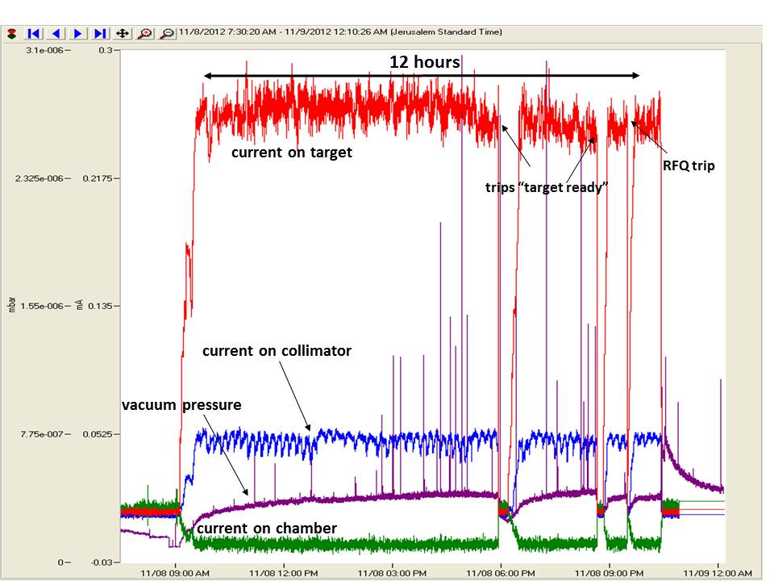
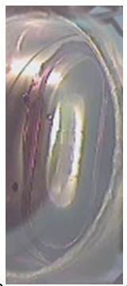
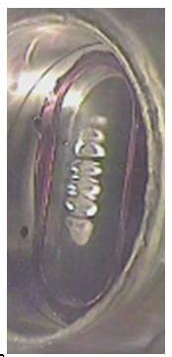
Foil target tests (2011)
25 mm
25 μm SS + 1 mm NaK + 2 mm SS base
Maximum power ~ 1 kW
Maximum irradiation time > 40 hours
Peak dose corresponds to ~ a displacement per target atom (DPA)
I. Silverman et al., ACCAP 2013

Slide 30
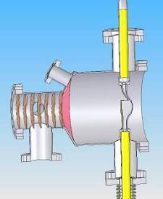
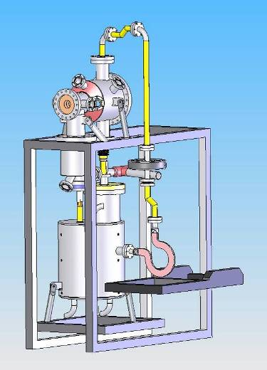
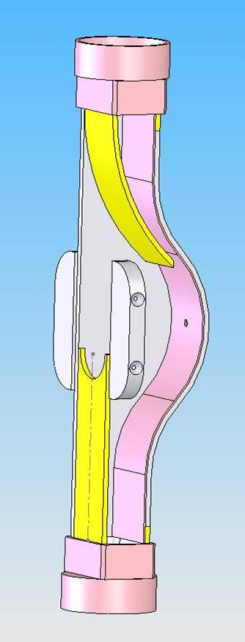
Liquid Lithium Target - LiLiT
Jet chamber
Design parameters:
Proton energy: ~2 MeV
Proton current: <3.5 mA
T ≈ 220⁰C
T_{max} ≈ 350⁰C
liquid lithium
Jet: 18 mm x 1.5 mm
Lithium velocity: 20 m/s
Wall assisted lithium jet
beam
Notes:
30

Slide 31
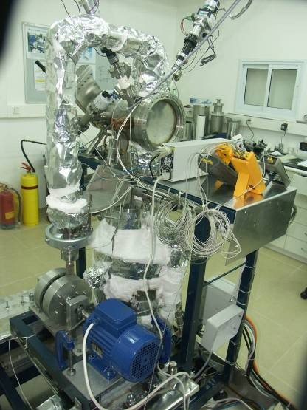
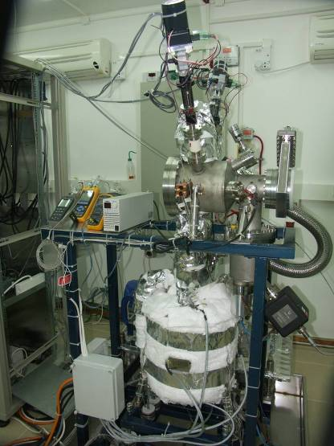
LiLiT - Lithium installed and heated

Slide 32


Lithium jet circulating (LiLiT)
Measured velocity 7 m/s
Maximum e power density 2.0 MW/cm³ @ 4 m/s
18 mm
S. Halfon et al. App. Rad. Isot. 2011, INS26 2012, CARRI 2012

Slide 33



LiLiT at SARAF beam corridor - 2013
Remote control
Safety measures
“Blind” beam tuning
Nuclear detectors
LiLiT
PSM
RFQ
Max beam intensity
~ 1.6 mA
Peak power densities:
3 kW/cm² and
~ 0.6 MW/cm³
Ion source

Slide 34

Protons on Li target
⁷Li(p,n)⁷Be
E_{thres}=1.88 MeV
G. Feinberg et al., PRC 2012,
M. Freidman et al., NIM 2013
Application of protons at ~ 1.92 MeV produce spectrum similar to a Maxwelian distribution at ~ kT=30 keV
This distribution mimics stellar neutron spectrum
2 ·10¹⁰ n/s/mA

Slide 35
Experiments at LiLiT
Experiment | Collaboration | Status
Stellar neutron capture cross section on ⁹⁴Zr and ⁹⁶Zr | HeU-SNRC | Finished
Primordial 7Li problem | UCONN-CERN-PSI-HeU-SNRC | First run
Stellar neutron capture cross section for ^{nat.}Kr | HeU-SNRC-ANL-UnFrankfurt | First run
Stellar neutron capture cross section on ⁹²Zr | HeU-SNRC-ANL | Planned
Neutron capture cross section for ²⁰⁹Bi | HeU-SNRC-IRMM | Planned
Stellar neutron capture cross section on ⁹⁰Sr | HeU-SNRC-ANL | Planned
Operation deuteron beam on LiLiT; high energy neutrons | SNRC-WI | Planned

Slide 36

Boron Neutron Capture Therapy
Sh. Halfon PhD. Thesis

Slide 37

Research with deuterons ^{nat}Cu(d,x)⁶⁵Zn
⁶³Cu(d,γ)⁶⁵Zn
⁶⁵Cu(d,2n)⁶⁵Zn
SARAF 2014
L. Weissman NIM B 342(2015)7-12.

Slide 38
Statistics of net operation hours
Type of operation | 2013 | 2014 (October)
RFQ conditioning | 154 | 92
Beam studies | 151 | 61
Accelerator tune | 73 | 155
Beam on targets | 97 | 106
Total operation | 321 | 322

Slide 39
Items for improvement
Action item | Improvement | Status
A separated target room | 1.5-2 | Designed
The electrical system upgrade | 1-1.5 | Installed
Training of new operator(s) | 1.5-2.5 | In progress
Upgrade of control system | 1.5-2 | In progress
Total | 3-15

Slide 40
Conclusion(s)
SARAF phase-I is running high intensity CW and pulsed beams on experimental irradiation targets
LiLiT experiments will be the main direction for the next future
However, the facility is not operating at its full capabilities.
Improvement of the operation performance should become the major objective for the next future
This should be done by :
Improving the accelerator subsystem
Improving the facility infrastructure
Expanding the operation team and its expertize

Slide 41
People involved in phase I/phase II/experiments
(including consulters, students and partially affiliated personal ):
D. Berkovits, A. Arenshtam, Y. Ben-Aliz, Y. Buzaglo, Y. Eisen,
I.Eliyahu, I. Gertz, A. Grin, S. Halfon, D. Har-Even, Y. Haruvy,
D. Hirshman, T. Horovits, B. Kaizer, A. Kreisel, D. Kijel, Y. Luner, J. Rodnizki, G. Shimel, A. Shor, I. Silverman, S.Vaintraub, L. Weissman
+ support from general Soreq technical and logistical services
+ support from the users
Total ~ 20 PPY (Persons Per Year)
Operation/support phase I ~ 6-7 PPY

Slide 42
Backup slides

Slide 43



Pin Beam dump as a diagnostic tool

Slide 44


Pin Beam dump; one of high power tests
1.7 mA of 3.5 MeV proton beam
Beam dynamics analysis shows that beam was over
focused in one direction
Prompt neutron radiation ~ 10 mrem/h at 1 m
No residual activity

Slide 45


Experiment with dummy LiLiT nozzle
Pulse was red from the left and right plates
and effect of beam steering on temperature
was studied.
It was demonstrated that temperature reading
is adequate for beam diagnostics
The dummy system operated robustly at
1 mA CW beam

Slide 46




Use radiation detectors for current monitoring
NaI spectrum
Peak power densities:
3 kW/cm² and ~ 0.6 MW/cm³

Slide 47

High power targets

Slide 48

Lithium florescence
LiLiT screen
a few W
LiLiT, 2 kW beam
Light ON Light OFF

Slide 49

Lorentz detuning and microphonics
The cavities are sensitive to Lorentz detuning. Intense ponderomotive oscillations appear at certain power on the high frequency side. These oscillations significantly hinder locking of the cavities at high RF power values.

Slide 50

HWR – parameters
176 MHz | Frequency
0.09 | Geom. β
0.15 m | L_{acc}=βλ
5.5 MV/m 840 kV | E_{acc} V_{acc}
>4.7x10⁸ | Q₀@E_{acc}
~1.3x10⁶ ~130 Hz | Q_{ext} Loaded BW
< 10 W @E_{max} | Cryo load
The main goal of the prototype cryomodule is demonstration of
acceleration of high current (> 1mA) CW proton/deuteron
beams to variable energy up to 4(5.5) MeV
Notes:
50
50

Slide 51

First experience with accelerated deuterons
Water flow
10⁹ n/sec
Isotropic distribution
Fast neutrons up to 20 MeV
4.7 MeV d beam
Fast neutrons
150 μm LiF layer
T. Hirsh PhD. Thesis

Slide 52


Slide 53

LEBT aperture
Manipulating beam size, current and emittance using the LEBT aperture
50 mm
25 mm
15 mm
10 mm
5 mm
Aperture diameter (mm)
5
10
15
20
25
50
π
norm rms emit ( mm mrad)
Transmission (%)

Slide 54



Rutherford Scattering monitor
target ladder
drive
target change
chamber
Beam
Beam
Si det
Si det

Slide 55


New instrumentation LEBT
New beam blocker/collimator
Grin
New RFQ entrance flange
Rodnizki

Slide 56

X-ray detectors
RFQ

Slide 57


DC breaker for RF coupler

Slide 58


Slide 59
Beam characterization:
1. Total current (slow FC)
2. Beam position monitor (beam position monitor, 50 Ohm strips)
3. Beam emittance (x-y slits/wires)
4. Bunch phase measurement ( phase probes,
capacitive pick up rings, allows to obtain energy from TOF
5. Longitudinal profile measurements, Fast FC
( C. Deibele et al , SNS)
6. Beam current monitoring
( Modular Parametric Current Transformer, MPCT)
7. Halo measurements (halo monitor)
SNS design
Bergoz Instrumentations
Soreq
Most of the measurements will be performed at reduced beam
of 200 W power using pulse mode of the ion source and RFQ (duty cycle ~1/100)

Slide 60



Testing RGM from GANIL
RGM
Wire profiler
* E. Gueroult et al. , JINST 8, T0805 (2013)

Slide 61

Use of commercial VAT beam dump
Due to logistics constrains we used the commercial VAT beam dump during the tests with
3 MeV 1mA proton beam. VAT beam dump water cooled copper plate, up to 6 kW.
VAT-BD
PSM
D-plate
VAT-BD
Tungsten-BD
permanent
magnets
suppressor
Ta collimator
beam blocker
N
S

Slide 62

Tuning accelerator
Rutherford Scattering technique
Typical spectrum without cavity voltages (RFQ only)
300 μg/cm2 gold foil
glued on graphite frame
Pulser peak
resolution 6.6 keV
1.5 MeV peak
used for calibration
Probably doubly
scattered particles
Measurements provide calibration of asynchronous phase and resonator voltage
L. Weissman, DIPAC2009

Slide 63





Resonator calibration
176 MHz
~
L
LLRF RFQ
HWR6 200 kV
HWR6 0 kV
Δf
176 MHz
~
L
LLRF HWR
HWR6 400 kV
HWR6 600 kV
HWR6 1000kV

Slide 64


Prototype of the Beam Loss Monitor system

Slide 65
Challenges of LiLiT experiment
Impossible to read current as lithium jet is grounded
Limited tools for tune and monitoring (radiation monitoring,
temperature of the side plates)
Demand for accurate set of beam energy
Actions items:
Developed a special diagnostic station
Efforts on energy calibrations
Test with dummy LiliT nozzle
Beam calibration with radiation detectors

Slide 66


Use of quartz viewer
Use of combination quartz and Ta viewers
Quartz < 1 W beam power
Ta foil < a few 10 W beam power

Slide 67


Vacuum protection
target
fast valve

Slide 68

Radiological test, tungsten beam dump
The beam dump
50 micron Tungsten sheet fused to a water
cooled cooper plate.
Up to 10 MeV, no activation, low neutron
radiation is expected.
Radiological test:
3.5 MeV ~ 1mA, 4 hours
CR-90 radiation tags
(fast, thermal neutrons and gammas)
Results:
No sign of fast neutrons
5 mrem thermal neutrons
15 mrem gamma in contact downstream
450 mrem gammas in contact upstream
No residual activation

Slide 69



Neutron flux and profile
Total neutron rate: ~2×10¹⁰ n/s/mA
Autoradiography
2 cm
σ = 6 - 6.5 mm
σ_{x} =6 mm
σ_{y} =5.5 mm

Slide 70


Be-7 production
⁷Be: half-life of 53 days, 478 keV gamma radiation.
Annual irradiation with 4 mA, 2 MeV proton beam, will produce the following dose rate, 30 cm from the system.
Solutions:
Most of the Be-7 will be accumulating at the cold trap and heat exchanger area^{[1]}.
The temperature in the loop and in the cold trap should be set to 190°C according thermodynamic analysis of ⁷Be in molten lithium.
The area will be shielded (2 cm of Pb).
The irradiation periods were calculated in advance in order to control the radiation levels.
^{[1]} M. Ida et. al., Fusion Engineering and Design 82 (2007) 2490-2496.
Notes:
70

Slide 71



⁷Be dose rate around LiLiT

Slide 72

Example of accelerator operation
two weeks in 2012
9 days of continuous operation of two experiment
This is the mode we would like to work at SARAF
However, this approaches to the limit of operation with a single operator
Training of 1(2) operator(s) will increase availability by
a factor of 2

Slide 73
Control system: work in progress
1. Migration to new Labview version
2. Migration to new control computers and new Window systems
3. New data base system
4. New control system server
5. Replacement of outdated hardware
6. Improvement of network infrastructure
7. Improvement of Labview applications
8. Improvements in the control cabinets
Huge front of work.
Only one control engineer.
This work will effect beam availability in the next future
Eventually increase of availability by a factor of 1.5

Slide 74


Temporary beam line
Increase of availability
by a factor of 2

Slide 75
Poor electricity quality
New UPS operational
in 2014
Increase availability by
a factor of 1.5

Slide 76


He-burning stage:
¹³C(α,n)¹⁶O
²²Ne(α,n)²⁵Mg
86
87
88
T≈350 MK
~ 30 keV
80
82
s-only
76
70
64
G. Feinberg PhD thesis

Slide 77


Big Bang Li production problem
Measure destruction rate of ⁷Be
via the ⁷Be(n,α)α reaction
M. Gai et al

Slide 78

⁹⁴Zr experiment
⁹⁴Zr(n,g) activation:
  Measured: 28.6 mb
  Literature: 27.7 mb
Neutron fluence according to gold activation:
6.85 10¹³ neutrons (0.83 mA-h at 1.913 MeV)
Zr
gold
M. Tesler M Sc. Thesis

Slide 79
Accelerator tunes
Type 1
Type 2
Cavity | Acceleration voltage (kV) | Phase (deg) | Energy (MeV)
HWR 1 | 213 | -90 | 1.536
HWR 2 | 0 | 0 | 1.536
HWR 3 | 646 | -10 | 2.003
HWR 4 | 493 | -15 | 2.416
HWR 5 | 697 | -35 | 2.971
HWR 6 | 544 | 10- | 3.501
Cavity | Acceleration (voltage (kV | Phase (deg) | Energy (MeV)
HWR 1 | 212 | -95 | 1.5
HWR 2 | 552 | 30 | 1.86
HWR 3 | 646 | -25 | 2.36
HWR 4 | 493 | -10 | 2.81
HWR 5 | 552 | -10 | 3.31
HWR 6 | 544 | -20 | 3.82
HWR6
HWR6
HWR5
HWR4
HWR3
HWR2
HWR1
from Arik Kreisel

Slide 80






Use neutrals for tune LEBT
x-x’
y-y’
I_{dipole}=38.65 A
I_{dipole}=38.95 A
I_{dipole}=38.80 A
L. Weissman et al.
TUP74 LINAC 2010

Slide 81

ANL conceptual design (2012)
5mA, 40 MeV p/d
The ion source and LEBT are in the original position
New (RFQ) MEBT and superconducting linac
176 MHz β=0.09 and β=0.16 Half Wave Resonators
Total superconducting linac = 19.47 m
7 low-β HWR operating at 1 MV and 21 high-β HWR operating at 2 MV
  Beam dynamics study at [B. Mustapha et al. IPAC 2012, J. Rodnizki et al. LINAC12]
Total (static and dynamic) power dissipation ~ 350 W @4K
P. Ostroumov et al. LINAC12

Slide 82

Target Hall
(2019)
2001
2010
Phase II linac :
40 MeV 5 mA
two proposals :
ANL and CEA
2014
2019
R&D
Radiopharmaceutical
Physics ?
Thermal neutrons
Thermal n source
40 m
diffractometer
radiography
Notes:
82

Slide 83

Effect of Proton Beam Energy
For 1905 keV (instead of 1915 keV)
we would get 71% of neutrons less

Slide 84

¹³C(p,γ) resonance at 1.751 MeV

Slide 85

Proton energy tune and verification
Time of Flight and
Rutherford Back Scattering
Neutron counting rate as function of proton “energy”

