Slide 1
Checklists !
Vince Kempson
Head Accelerator Operations
Diamond Light Source ltd

Slide 2
Presentation structure
An Introduction
Why checklists
Checklist database
Where we use checklists at Diamond
Other points
Developments
Summary
References/Appendices

Slide 3
Light Sources
Diamond is a third generation light source, medium energy, 3GeV, 300mA machine with nearly 26 beamlines. Installing 4 beamlines/front ends and lattice modifications each year until 2017
Operationally Light sources live (and die) by critical performance indicators amongst which are:
Uptime >97% expected, 99% preferred!
MTBF >70 hours expected, 150 to 200hrs achievable in some labs
And their subsets downtime, MTTR etc
Interruptions to beam time are disruptive to users , users optics, samples, robots, sample changers and general logistics
5000 users year, 1000’s of publications a year
We do have different modes (high/low current. Hybrid bunch structures, reconfigure for Coherent synchrotron radiation and terahertz light). We do this mostly with Epics BURT tool (backup and restore).

Slide 4
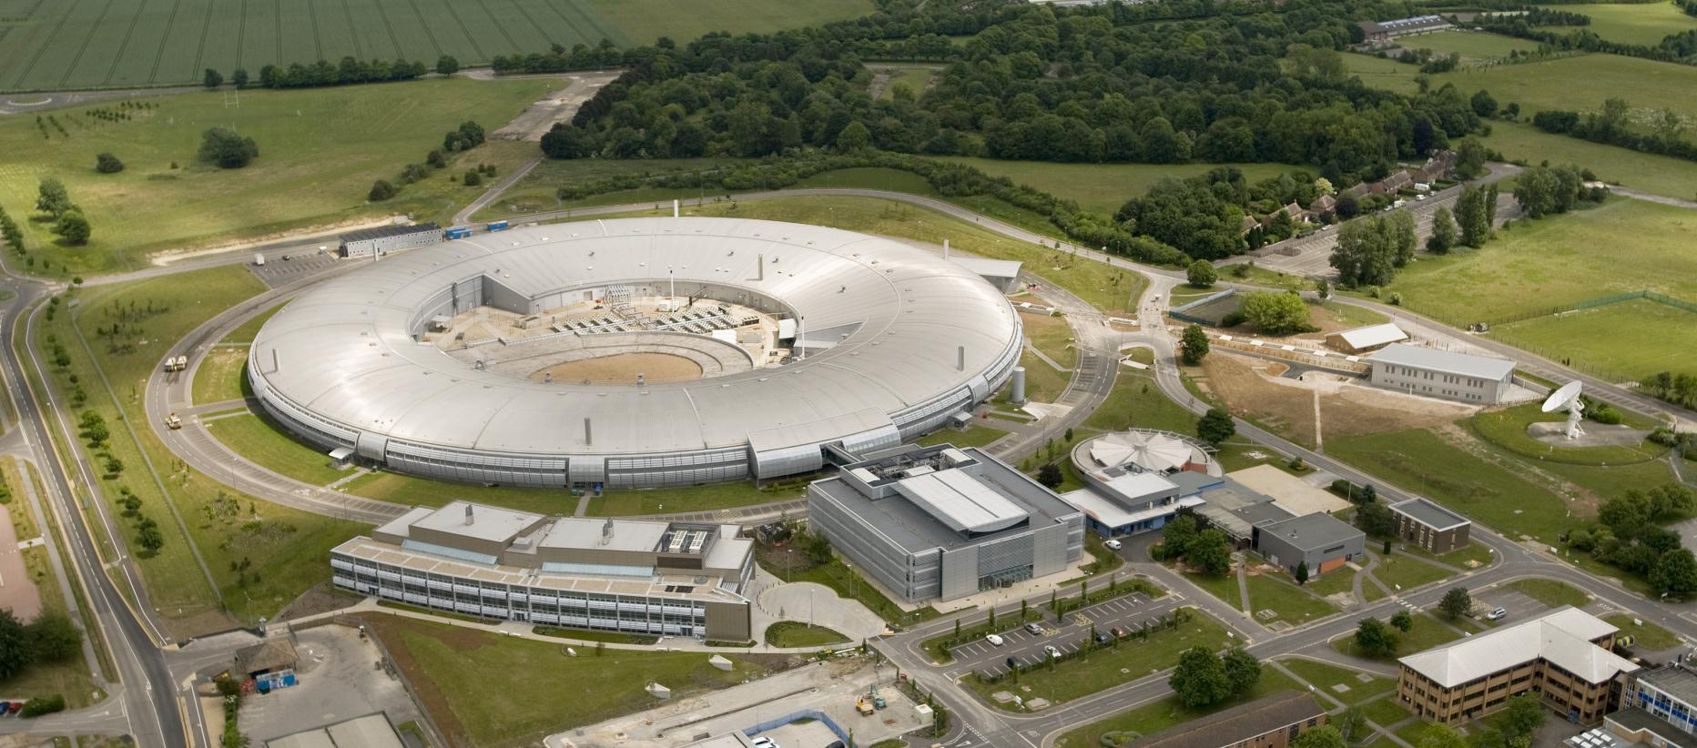

Slide 5
When operating Accelerators
Types of errors that can be made….
Errors of ignorance (mistakes due to not knowing enough)
Errors of Ineptitude (mistakes due to not making effective use of what is known)
Sequence errors (mistakes due to doing the right things but in the wrong order)
Errors of omission (mistakes due to leaving things out altogether)
Communication….Etc….

Slide 6
What does documentation do for you?
Manuals- big, complex and often…vague
Procedures- not so big but often complex
Summarised Instructions – are just notes
Automation/Sequencers/script Task generators can’t handle non computerised ,soft’ processes
All have their place. But a checklist does something else – checks the basics, records that they have been done and allows inclusion of the things that are not automated on your control system, even checking that you have turned a sequencer on in the first place!

Slide 7
Quote from the Checklist Manifesto
“Checklists remind us of the minimum necessary steps and make them explicit. They not only offer the possibility of verification but also instil a kind of discipline of higher performance.” — Atul Gawande reference 1
My italics!

Slide 8
Checklists are the answer to consistency issues in accelerators?
Yes with some Caveats;
They are not ‘To do’ lists on a scrap of paper to stick on the fridge!
You do have to know what you are doing at least once to get the list up and running…….!
They are not bits of software, you can’t handle ‘if then > else if’ statements
The checklist steps do not have to be sequentially connected but helps if they are
You can leave things out if the ‘knowledge base’ makes it so familiar all staff know it ( this is common in aircraft checklists)
Build and test until it works, modify if it stops working so ease of modification is important (Note: you can test by walkthrough if used infrequently)

Slide 9
Limitations of Checklists
Tick in the box mentality
Need to be thinking!!!! Avoid tick boxes!
Use ownership, a name or initials
They don’t work if you don’t know what you are doing….
Well defined processes steps and sequences fit best
Must not be a chore to the Operations crew
Not too long , pauses and logical structure, get them to write it in the first place if they use it
Have to be kept up to date regularly
Dated and reviewed as changes needed
A simple checklist database and editor helps a lot
Easy porting into elog helps visibility

Slide 10
Let the checklist remove the hard work
Use a time marker on the steps ( we use days)
Some start up activities start at -7 days before the start up
They then act as a countdown marker to the Beam on time
try not to overdo it, sufficient concise steps are ok

Slide 11
How to do things right!
Where are checklists appropriate in accelerator Operations?
Startups
Shutdowns
Special procedures ( quite a few)
Emergencies

Slide 12
Checklist database @ diamond
Holds all the checklists for use and for editing changes and historical store of completed ones
Only operations staff use the operations ones, usually the operator of the day but can be passed on.
All checklists are dated, completed ones are directly exported into elog (electronic logbook) and kept in the Checklist database on a run by run basis.

Slide 13
Checklist database –Diamond ops
Make a new one!
MD = Machine Development day , to re-establish user time beam conditions
Run Start, Power supplies tech group
A start up activity to clear interlock overrides in a shutdown as boxes simulate open signals as well
Run Start, RF tech group start up checks
During run a quick vault zone inspection if a zone has to be opened
To recover and instrumentation area after power off or breaker trip ( very sequential)
Main run start-up, spread over 7 days. Stops before ‘beam on’
End of run shutdown to open access conditions
Visual post run inspection of areas closed in run (shutdown)
Walkround split so 2 people can do independently (shutdown)
Walkround split so 2 people can do independently ( shutdown)
The real beam startup at front of a run
Tests on injection process after each startup/machine day
Run Start, Vac tech group start up checks
Database design setup and maintained by Adrian Johnson, this workshop

Slide 14
Illustrative checklist #1 time sequenced in anticipation of start day ‘ day 0’

Slide 15
Illustrative checklist #2
This is step based rather than days.
The first part is house keeping, the latter part getting 10mA before going to full current

Slide 16
Illustrative checklist #3 Primarily a closedown sequence based on priorities and access to vaults

Slide 17
Creating better Checklists
Presentation,
Fonts, Black on white, font size
Content
Grouping by common factors
Flow , logical, coherent
Urgency
Critical items near the start
Redundancy
Put critical items in more than one section
Phrasing
Proper unambiguous terms, vague is not good enough!
Status
Use the actual status required after the action in a READ> DO format (Challenge > response)
Eg Lattice F Quadrupoles > ON
Size
As short as possible but as long as needed
Trial
Test and test modify until all agree it works!
Do not be afraid to make changes
Approaches 3 main ones
To Do List ( not worth the trouble!)
To do list which you look through then check for the ones not done
Challenge > response ( as in aircraft a reader with a doer who says ‘Check’)
Resistance: I’m a skilled (insert Job title here) this checklist insults my intelligence…..
Hire someone else immediately!

Slide 18
Recursion

Slide 19
Developments @ Diamond
Paperless – Key checklists go direct into elog on their completion into the database.
Avoiding tick boxes – all checks are named by who did them without typing
Using a tablet touch screen device to manage the checklist live into the data base while on the move through the building
Allows others to view it simultaneously
Can post complete without being in the control room
Some issues of log in and vault wifi to sort but convinced this is the way to go
Using the software on the tablet to check and assist the operator
How many unchecked steps at each pause point, hiding completed steps, etc
Colour
New checklists easy to create using database list generator

Slide 20
Why would you NOT use a checklist for;
complex operational and equipment steps mixed in with routine checks that are moving towards goal completion:
in a structured and reliable checklist communicating to your colleagues and you, that the individual tasks are valid, completed and finished at the right time so you can move on to the next item?
!! I have absolutely no idea!!

Slide 21
Summary, two quotes
“the volume and complexity of what we know has exceeded our individual ability to deliver its benefits correctly, safely, or reliably.”
“Good checklists, on the other hand are precise. They are efficient, to the point, and easy to use even in the most difficult situations. They do not try to spell out everything--a checklist cannot fly a plane. Instead, they provide reminders of only the most critical and important steps--the ones that even the highly skilled professional using them could miss. Good checklists are, above all, practical.”
Both of course from Gwande, The Checklist manifesto

Slide 23
Dilbert does checklists………

Slide 24
References
Atul Gwande ‘The Checklist manifesto’ ‘How to get things right’ Profile books ISBN 978-184668 3145
Checklists V C Kempson ARW Melbourne 2013 http://accelerators.org.au/indico/contributionListDisplay.py?confId=55

Slide 25
Appendix 1 H1N1 Patient care (WHO)

