Slide 2
Safety in Modern Particle Accelerators: The role of control room operators.
Workshop on Accelerator Operations
WAO, Mainz 2014 - 26-31 October 2014
Authors: P. Ninin, F. Valentini
Edms: 1422714

Slide 3
Outline
PS Accelerators complex at CERN.
Operators safety tasks overview.
Risks related to Machine Operation.
System Automation for risks mitigation.
Remarks
Edms: 1422714

Slide 4
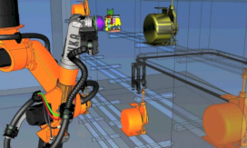
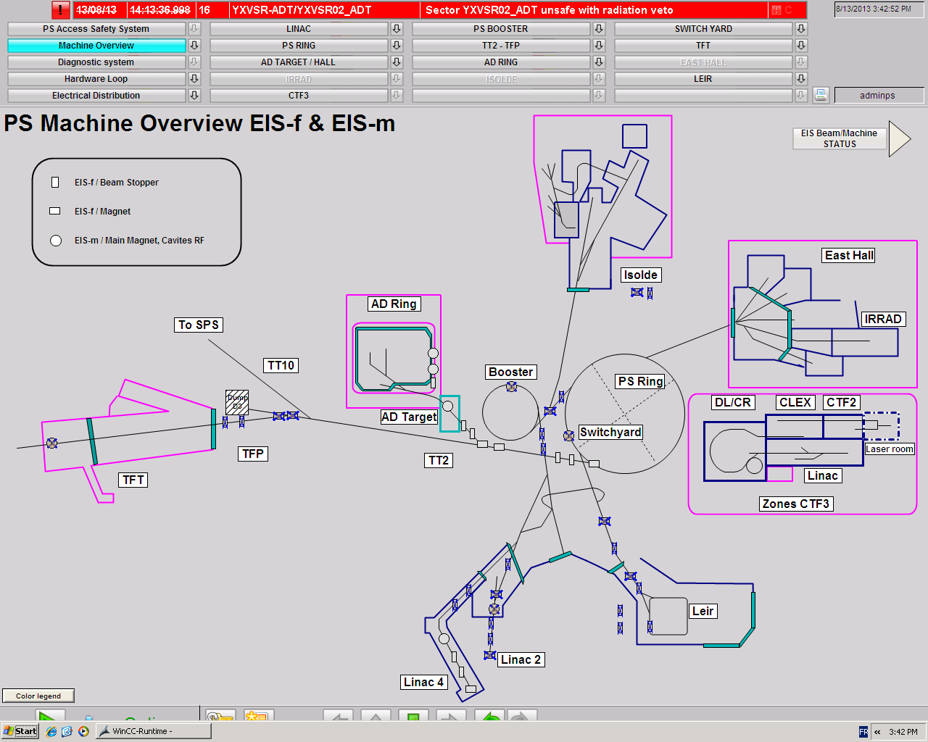
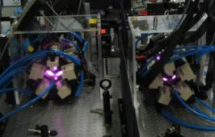
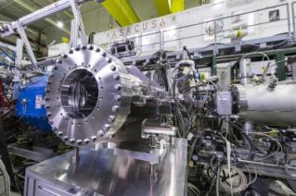
PS Accelerators Complex
Medicis
CTF-3
Asacusa
BEAM ON
ACCESS ON

Slide 5
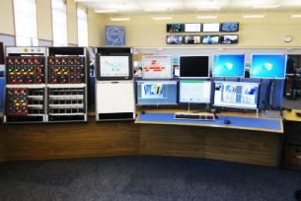
Safety Tasks Performed by Operators
Safety Conditions for BEAM
Verify that nobody is in the zone. Execute patrol of the zone. Verify safety conditions for Beam. Execute beam startup sequence.
Safety Conditions for ACCESS
Consignation of safety equipment. Verify safety access conditions.
Short Interventions
Plan beam shutdown. Verify safety access conditions. Coordinate intervention phases. Maintain of safety conditions.
Hardware Tests
Evaluate operational risks. Establish operational procedures. Filter accesses to the zone. Authorize de-consignation of equipment.
Access Requests
Handle calls from Access Point. User access rights verification. Verify user safety equipment. Deliver Safety Tokens. Check log of users in zone.
Co-Activities Coordination
Plan/schedule interventions. Verify zone safety conditions. Check specific authorizations.
Edms: 1422714

Slide 6
Main Critical Points for Machine Operation
Large accelerator facility to be monitored operators.
High volume of user requests to be treated at the same time.
Management/Execution of high number of different operational
procedures.
Heterogeneous user population accessing to dangerous area.
Edms: 1422714

Slide 7
Main Hazards Related to Machine Operation
ONE OR SEVERAL PERSONS REMAIN INSIDE THE MACHINE WHEN BEAM IS ON.
Main Consequences
Initiating Causes
Violation of procedures.
C1: Exposition to ionizing radiations (injury), x-rays, activated material.
Users not properly trained.
Undisciplined users.
C2: Exposition to electrical hazards (death).
Human Errors:
Work under stress conditions.
Lack of communication.
Insufficient supervision tools.
C3: Accident to be reported to Nuclear Authorities.
Lack of operational procedures.
Particular incident scenarios not handled.
Unclear consigns for operators.
Not adequate PPS tools.
Edms: 1422714

Slide 8
Main Hazards Related to Machine Operation
Costs factors: easy to estimate.
Probability of occurrence: many factors to consider.
Factors Related to Probability Estimation
History of incidents reported for similar installations:
Historical data may likely be incomplete: incidents not documented / unknown.
Quality Measure of existing operational procedures:
Difficult to evaluate if existing procedures are efficient for handling all incident scenarios.
Typology of users operating into the installation:
Common sense of users in respecting rules depends from the subjective risk perception and from the motivations to break rules under certain circumstances.
Edms: 1422714

Slide 9
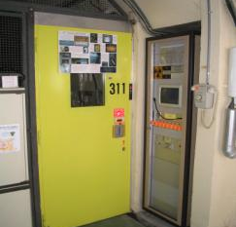
Typical Incident Scenario (1): Unsafe Access
1
User call Control Room (CR) for entry permission.
Access Point
2
CR verifies (via CCTV) authorizations and unlocks
the safety token.
3
User turns the token without extracting it and enters.
4
Another user exiting the zone notices the un-removed token at set it back in safe pos.
Edms: 1422714

Slide 10
Typical Incident Scenario (1): Unsafe Access
Control Room
5
Control Room operator verify safety conditions
of the zone for Beam reactivation:
Patrol state OK.
All safety tokens safe inside distributor.
6
Operator set BEAM ON for the zone.
BEAM ON
 | Safety Barriers
Prevention | Checklist execution / Manual count of users in zone.
Mitigation | Public Address messages before beam injection.
INCIDENT
Edms: 1422714

Slide 11
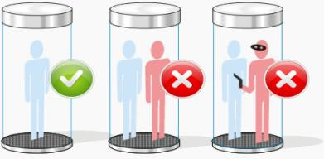
Typical Incident Scenario (2): Intrusion
Access Point inside
1
User calls Control Room to request the exit.
2
CR unlocks the door for exit and closes audio/video
connection.
3
User opens the door and leaves the zone.
4
At the same time, an intruder accesses the zone though the opened door: TAILGATING Intrusion.
Edms: 1422714

Slide 12
Typical Incident Scenario (2): Intrusion
Control Room
5
Control Room operator verify safety conditions
of the zone for Beam reactivation:
Patrol state OK.
All Safety Tokens safe inside distributor.
User count in zone = 0.
6
Operator set BEAM ON for the zone.
BEAM ON
 | Safety Barriers
Prevention | NONE
Mitigation | Public Address messages before beam injection.
INCIDENT
Edms: 1422714

Slide 13
System Automation for Risks Mitigation
USERS CONTROL AT THE ACCESS POINT
FRAUDULENT ENTRIES VIA THE ACCESS POINT
CRITICAL TESTING ACTIVITIES COORDINATION
Edms: 1422714

Slide 14
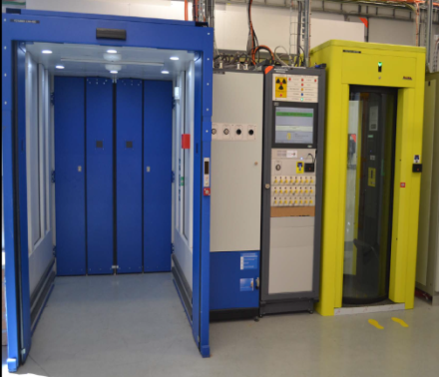
User Control at the Access Point
Main Covered Risks
Non trained users access. Access without rad dosimeter. User overpassing radiation limits.
Automatic System Verifications
Training validity of the user.
Authorization to access the area.
Authorization to work in the area (IMPACT).
Possession of radiation dosimeter.
Identification via biometry system (eye recognition).
Possession of personnel safety token before accessing the zone.
Count of people in zone and track of Safety Tokens delivered.
Edms: 1422714

Slide 15
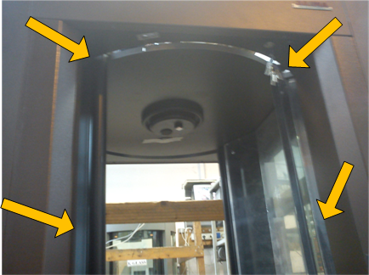
Fraudulent Entries Via the Access Point
Main Covered Risks
Undetected person in zone. Exposition to radiological hazards. Exposition to electrical hazards.
Anti-intrusion Detection Systems
Dynamic weight detection system.
Infrared access detection barrier.
PERSONNEL ACCESS DEVICE
Limitation of the internal space.
Edms: 1422714

Slide 16
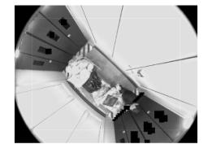
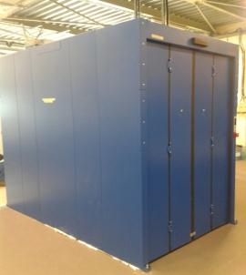
Fraudulent Entries Via the Access Point
Human Presence Detection System
FRAME 0
FRAME 1
MATERIAL ACCESS DEVICE
FRAME DIFFERENCE

Slide 17
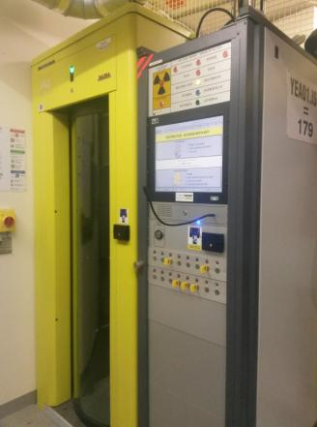
Critical Testing Activities Coordination
Main Covered Risks
Exposition to Electrical Hazards. Beam accidental startup.
Access procedure supervised by the system
(1) Operator authorizes electrical tests in zone by setting a special TEST Mode.
(2) The system verifies that NO beam can be injected in the zone and authorizes the Test mode.
(3) Users entry requests are automatically filtered at Access Point (reduced authorization list): only accepted calls are treated by operators.
(4) The operator unlocks the safety tokens for the validated users.
(5) Access System waits for an additional key confirmation given, locally, by the zone responsible officer.
Edms: 1422714

Slide 18
Remarks
In addition of all the automated Safety and non-safety functionalities performed by the Personnel Protection System, the role of the operators is still essential for the operational risks reduction.
In Particular:
Deep knowledge of the automation system.
Analyze/Evaluate system actions.
Identify/Handle situations where Safety is bypassed.
Recognize system erroneous behaviors.
Handle risks not covered by the system during specific situations.
Commissioning phases of the machine.
Maintenance periods of Personnel Protection System.
Failures of Personnel Protection System.
Edms: 1422714

