Slide 1
Software Tools for the ATLAS Superconducting Accelerator
Maria Power
Principal Engineer
Accelerator Control Systems
Argonne National Laboratory
Workshop on Accelerator Operations
Mainz, Germany
October 2014
This material is based upon work supported by the U.S. Department of Energy, Office of Science, Office of Nuclear Physics, under contract number DE-AC02-06CH11357
This research used resources of ANL’s ATLAS facility, which is a DOE Office of Science User Facility

Slide 2
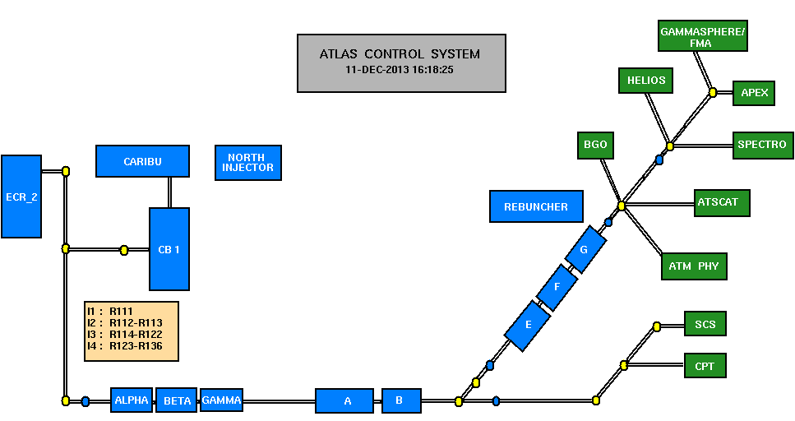
ATLAS Control System Overview
The ATLAS Control System Group is responsible for…
Control System – covering Ion Sources up to (but not including) the target areas.
Paradox System
Hercules
Document Index
Operators Notebook
SharePoint BBS
Radiation Safety Systems
Website(s)

Slide 3
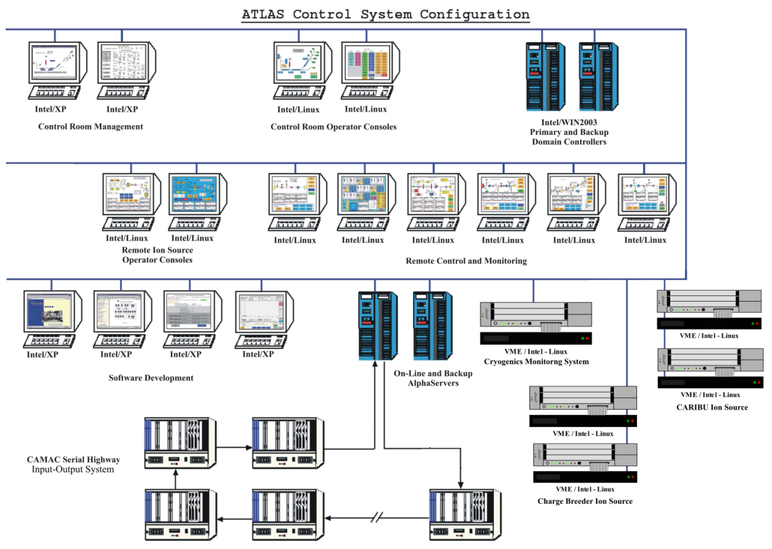
ATLAS Control System Hardware
AlphaServer running OpenVMS
CAMAC Serial Highway
Distributed Linux based Controllers
VME Crates and Hytec 9010 Blade Controllers using Industry packs
Networked Devices over TCP/IP, SNMP

Slide 4
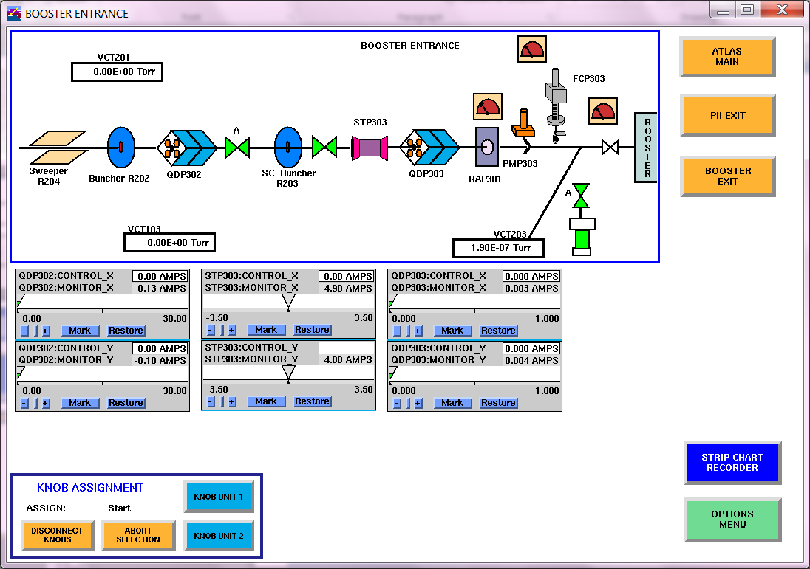
Control System Software Vista Control Systems, Inc. – VSystem
Distributed, real-time, networked, control software tools
Available for OpenVMS, Linux, (and Windows)
Tools:
VAccess
VScan
VDraw
VAlarm
VLogger
VTrend
VCzar
VScript

Slide 5
ATLAS Data Management
CAMAC Serial Highway
Distributed Controllers on Network
Update Accelerator Operating Conditions
Archive Accelerator Operating Data
Alpha Server
Windows PC
VSystem
Real-time Database
Oracle RDB
Relational Database
Paradox
Relational Database
Set Runtime Database
to Past Accelerator Configuration
Retrieve Past Accelerator Tuned Configuration

Slide 6
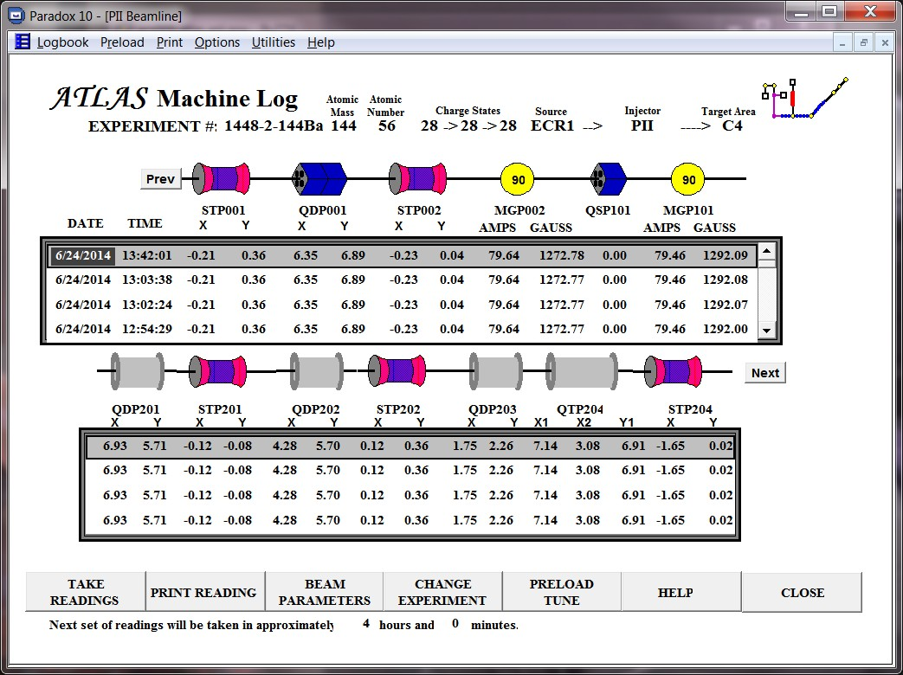
Paradox Data View

Slide 7
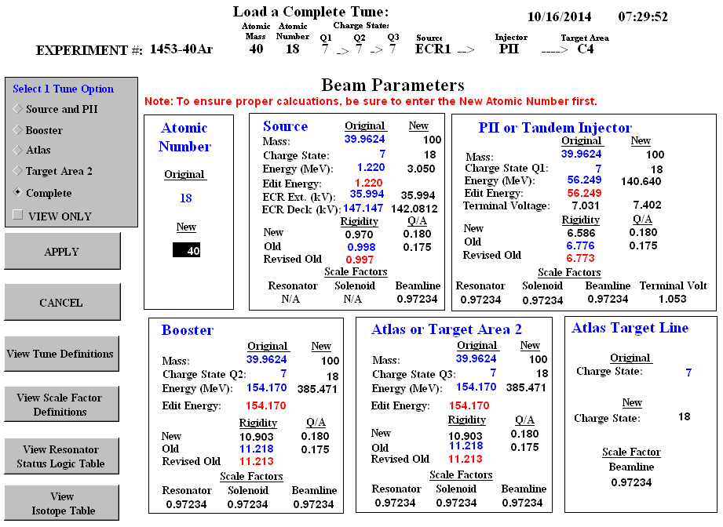
Paradox

Slide 8
Hercules
Legacy software using a database package called Alpha 4
Software tools originally included in Hercules:
Document catalog for drawings
Shift Log
Pin Diode Fuse Log
Equipment Database and Maintenance Log
Conversion to modern software of this package has been implemented in pieces using Java Swing applications and MySQL
Disadvantages:
Time of development
Advantages:
readily available development software and tools
Existing data migrated easily
Can get exact functionality desired
Can update as machine configurations change

Slide 9
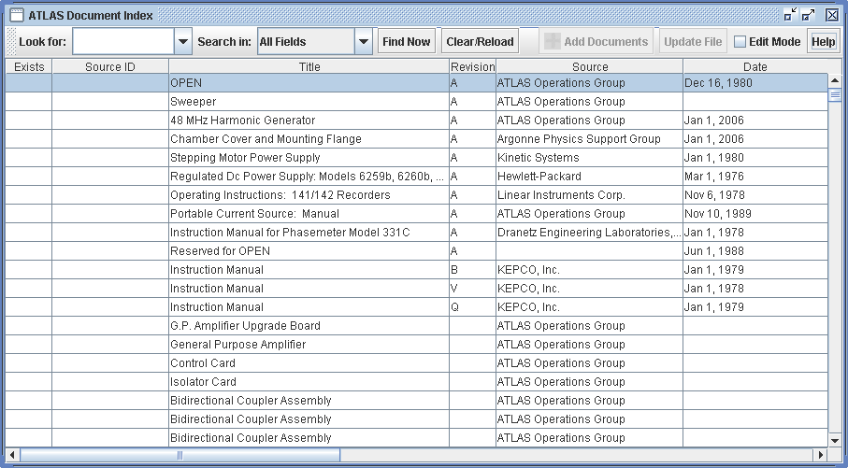
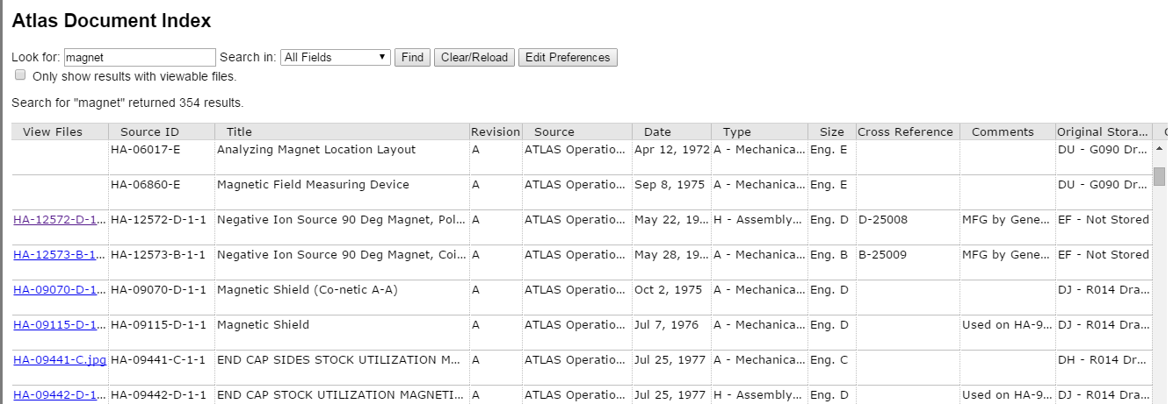
Document Index

Slide 10
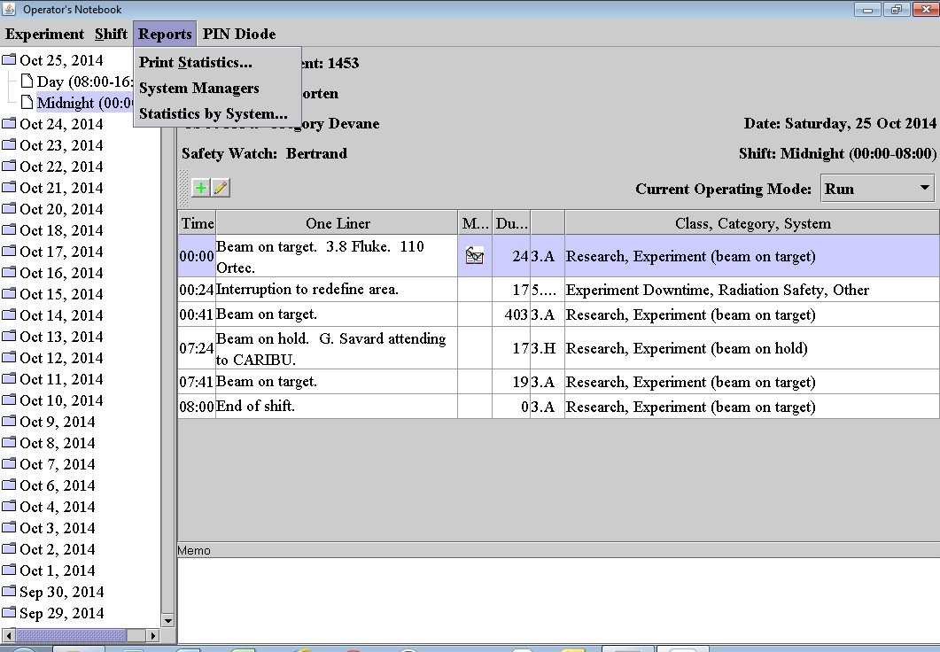
Operators Notebook

Slide 11
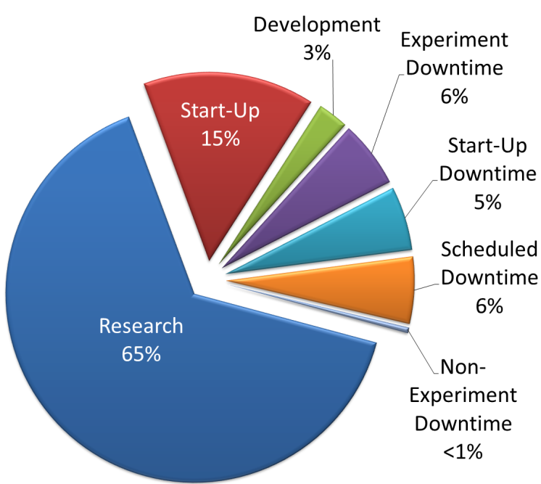
Operators Notebook
Staffed hours for 2014

Slide 12
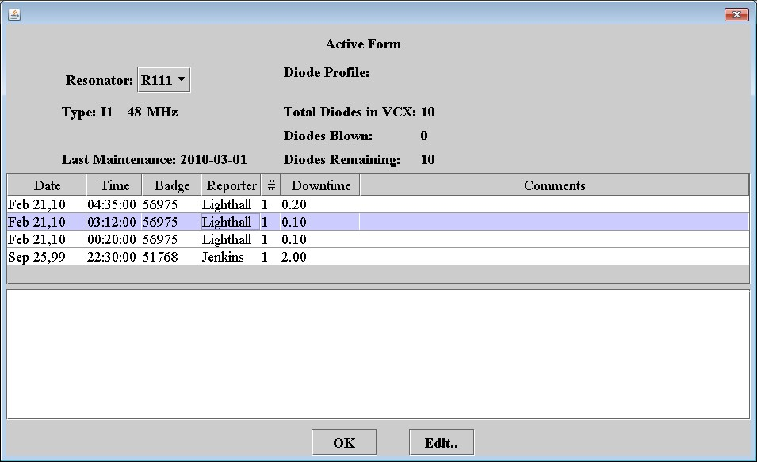
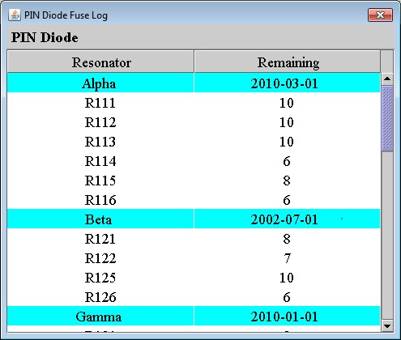
Operators Notebook

Slide 13
Remote Operations
Remote control is obtained via a VPN connection into the control system network.
Limited personnel: Control Systems Group, Management, System Experts
Once ‘inside’ they can access the control system directly through an X-windows session
Remote viewing is also available through standard VPN and web pages tailored to specific subsystems.

Slide 14
ATLAS Data Management
CAMAC Serial Highway
Distributed Controllers on Network
Update Accelerator Operating Conditions
Archive Accelerator Operating Data
Alpha Server
Windows PC
VSystem
Real-time Database
Oracle RDB
Relational Database
Paradox
Relational Database
Set Runtime Database
to Past Accelerator Configuration
Retrieve Past Accelerator Tuned Configuration
Windows PC Inside
Control System Network
Windows PC Outside
Control System Network
Live Data Server
External Web Server
Internal Web Server

Slide 15
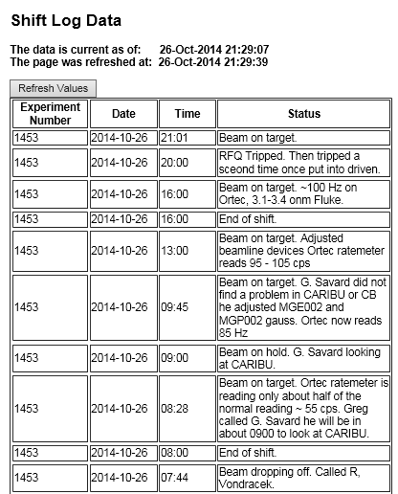
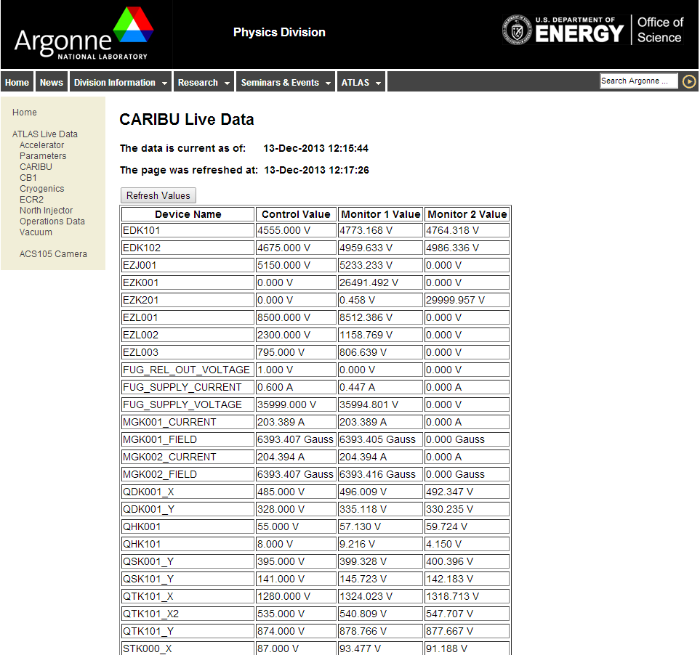
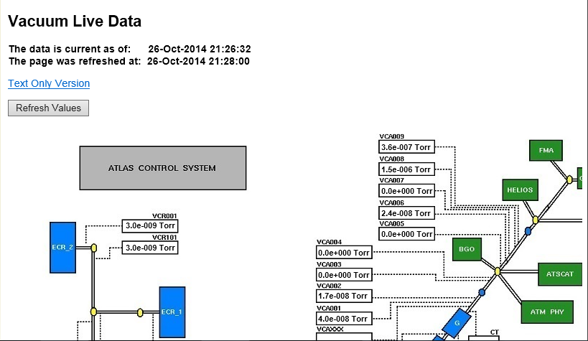
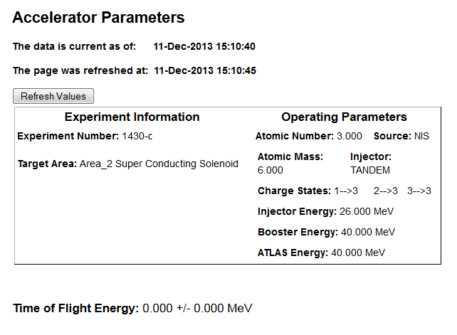
Live Web Page Data

Slide 16
Summary
Primary Control System Software Vsystem
Paradox Archival System allows the reloading of the accelerator parameters with previous ‘snapshots’ or scaled values.
Hercules software rewritten to Java based applications using MySQL
Remote control via VPN access
Live Data (read-only) webpages
Controls Group is always looking for ways to improve operations and all requests are considered.

Slide 17
Thank you!
Question & Answer

