Slide 1
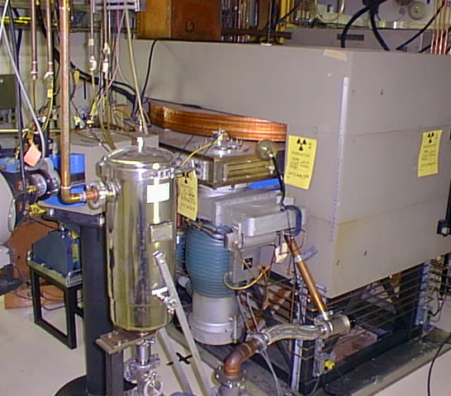
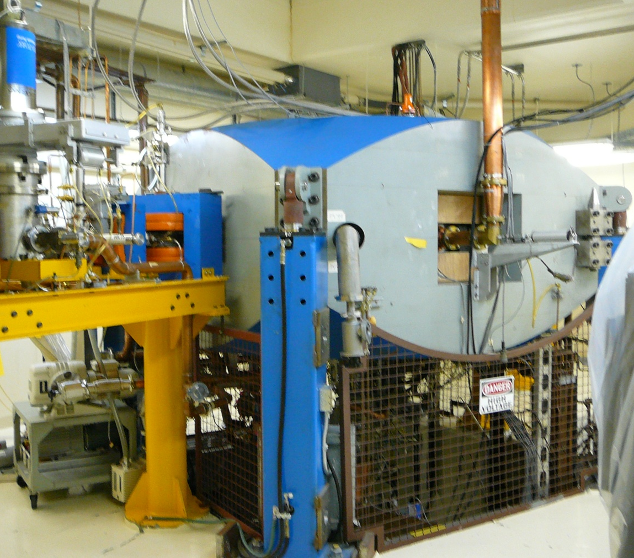
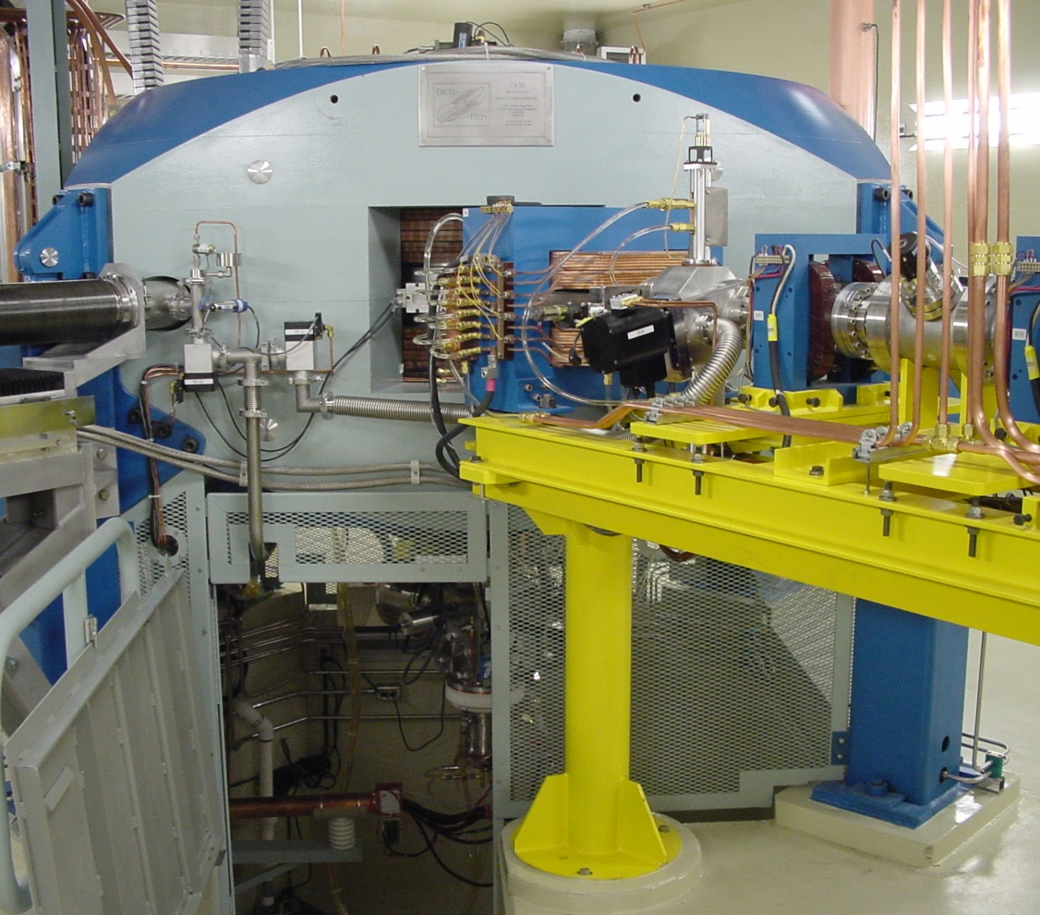
Operation of the compact cyclotrons
WAO 2014
Jozef Orzechowski, Manager, Applied Technology Group
Yetvart Hosepyan, Group Leader, Engineering Support
Gabriel Cojocaru, Group leader, Cyclotron Operations
Steve Sapriken, Maintenance Coordinator
Jerry Porter, General Manager, Van Ops., NORDION

Slide 2
Operation of the compact cyclotrons
Applied Technology Group (ATG) is a part of TRIUMF working closely with NORDION for over 30 years
ATG provides irradiation service to NORDION
ATG consists 30 people, engineers, technologists and technicians
ATG operates and maintains three cyclotrons
  CP42
  TR30-1
  TR30-2
ATG is also responsible for building safety and all building services:, nuclear ventilation, compressed air, water cooling etc.

Slide 3
Operation of the compact cyclotrons
Challenges
Just in time manufacturing
Radiation dose
Skills required vs. small pool of people
Maintenance/repairs
Regulatory and documentation requirements

Slide 4
Operation of the compact cyclotrons
Just in time manufacturing
No advance knowledge of production requirements
Need for flexibility
Need for contingency planning

Slide 5
Operation of the compact cyclotrons
Radiation dose
Dose reduction
Equipment activation reduction
Dose planning
Skills selection for the task

Slide 6
Operation of the compact cyclotrons

Slide 7
Operation of the compact cyclotrons
Skills vs. small pool of people
Who would be best for the job
Who gets the lowest dose
Who is available

Slide 8
Operation of the compact cyclotrons
Maintenance/repairs
Planned vs. opportunistic
ATG Maintenance program has two components:
  Preventive maintenance
  Corrective/opportunistic maintenance
Is this a hybrid???
Yes, because it is hard to get consistency of failure as illustrated in the following example, chart of extraction foil life

Slide 9
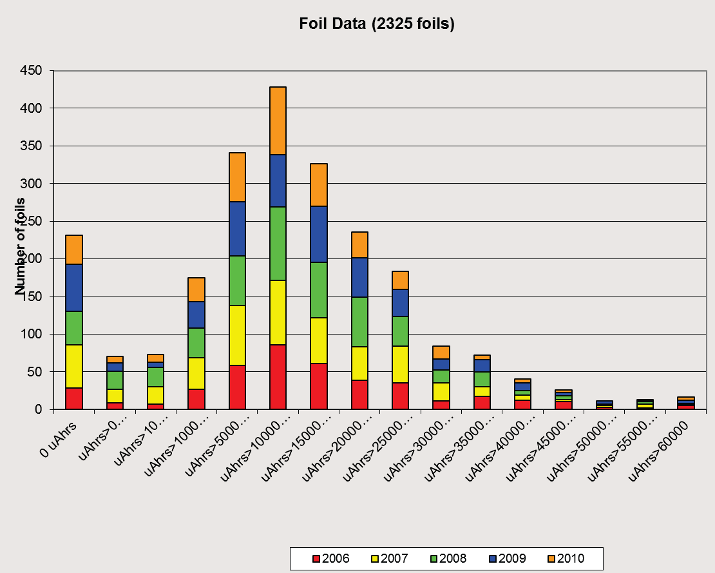
Operation of the compact cyclotrons
Extraction foil life

Slide 10
Operation of the compact cyclotrons
Maintenance/repairs
A training program for certain maintenance related activities
A configuration binder for each high radiation area
A tighter coordination scheme with surveyors
A Work Order program.

Slide 11
Operation of the compact cyclotrons
Maintenance/repairs
A configuration binder helps with:
  Maintaining the list of equipment used in each cave.
  Configuration of various wire terminations, ports sizes, valve logic.
  Identifying the tools used and parts needed
Benefits:
  Reduces time inside caves due to preplanning the entry

Slide 12
Operation of the compact cyclotrons
Maintenance/repairs
Limited tasks require instructions and certification before work.
Due to dose sharing, expertise is not the main criterion in determining who does a given task. All ATG employees are required to share dose.
Limited number of “Experts”

Slide 13
Operation of the compact cyclotrons
Maintenance/repairs
Preventive Maintenance is done in 6 months intervals for a four year cycle.
Reasonably low dose incurred in PM but high value of damage averted.
The intervals are dynamic and can be adjusted as new info becomes available. 2013 was when last adjustment was made

Slide 14
Operation of the compact cyclotrons
Maintenance/repairs

Slide 15
Operation of the compact cyclotrons
Maintenance/repairs
The following graph tracks the changes to “Expert” dose for the last three years
Expert dose share decreases with time for the last three years

Slide 16
Operation of the compact cyclotrons
Maintenance/repairs

Slide 17
Operation of the compact cyclotrons
Maintenance/repairs
What we have works for us
Is it perfect ? No
Needs improvements? Yes

Slide 18
Operation of the compact cyclotrons
Regulatory and documentation requirements
Needed but it takes time
Need for automation
Existing individual systems were not connected
Needs for integration of the old systems into coherent and functional system
How to get there?

Slide 19
Operation of the compact cyclotrons
Regulatory and documentation requirements
There is no commercial platform to connect these old systems
Is in house solution the best answer? Time will show
We are working on full integration

Slide 20
Operation of the compact cyclotrons
Regulatory and documentation requirements
This full integration includes:
Cyclotron log books
Shift schedule
Beam/maintenance scheduling
Inventory
Work order
Document control

