Slide 1
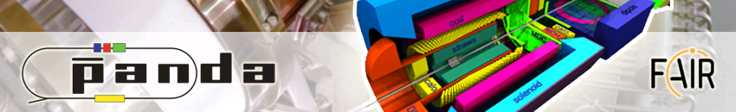


status of EMP activities and plans for the future
48th PANDA Collaboration Meeting
GSI, 10 March 2014
B. Ramstein IPN Orsay

Slide 2
Outline
Brief review of on-going activities
Might well be incomplete , please provide information about your activities
Forum: https://forum.gsi.de/
PANDA » PANDA - Physics » PANDA – EMP discussions
Mailing list : PANDA-EMP@WWW-LISTSERV.GSI.DE
2

Slide 3
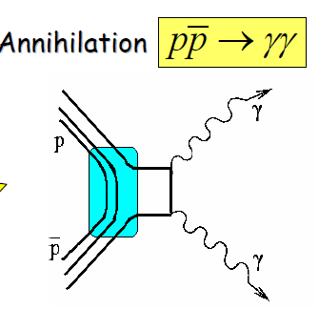
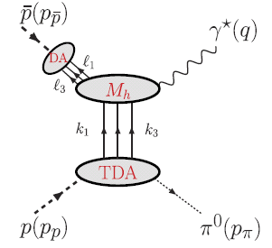
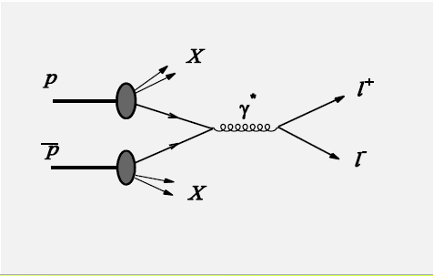
Electromagnetic Processes
Four main topics were studied up to now:
-
pp→J/ψ ⁻π⁰
 |  | γ
-
large p_{t}
-
-
-
pp→ γ γ
pp→e⁺e⁻π⁰ / μ⁺μ⁻ π⁰
pp→μ⁺μ⁻X/e⁺e⁻X
pp→e⁺e⁻ / μ⁺μ⁻
-
-
-
γ*
Fwd/bwd
-
Drell-Yan
p
e⁻
p
γ
p
q²
p
PDF
l⁺
s
Large q²
small t or u
q²>0
π⁰
p
l⁻
p
q²>0
e⁺
p
p
t
Parton Distrib.
Functions
Time Like electro
magnetic Form factors
Generalized Distrib.
Amplitudes
Transition Distrib.
Amplitudes
PDF
Orsay-Mainz
Giessen
Orsay-Mainz
Torino
+ meson/baryon Dalitz decays A→Be⁺e⁻
Interest from Groningen, Uppsala, Krakow, Orsay
studies are strating in Uppsala for hyperon Dalitz decays

Slide 4
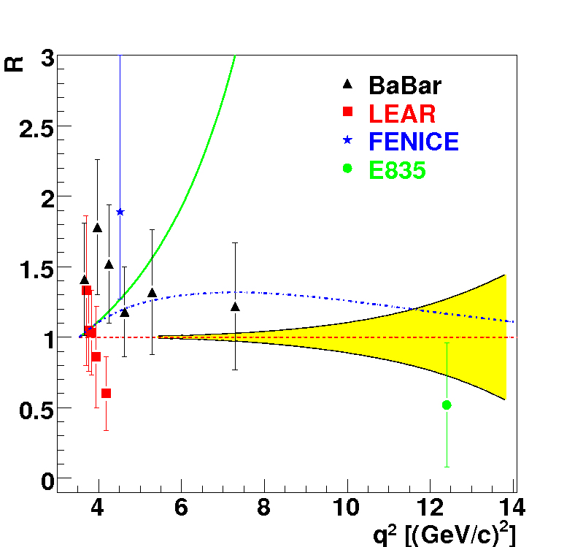
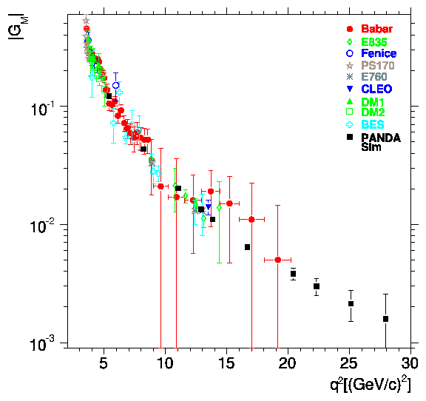
Electromagnetic Time-Like form factors
-
G_{eff}
pp→e⁺e⁻ / μ⁺μ⁻
-
e⁻
p
q²>0
PANDA
p
q²>0
e⁺
Time Like electro
magnetic Form factors
PANDA
-
< 1% ~10% ~23% ~50%
-
Background rejection > 10⁹ contamination < 1% in each angular bin
pp→e⁺e⁻
Studies with Babar framework
M. Sudol et al. EPJA 44 (2010) 373 Orsay/Mainz
M. Mora-Espi, PhD Mainz 2013
→ update with PANDARoot in progress
Feasibility studies for form factor in the unphysical region (q²<4m_{p}²) with PANDA
in pp→e⁺e⁻π⁰ (J. Boucher, Orsay, PhD 2011)
In pd →ne⁺e⁻ (H. Fonvieille and V.A. Karmanov EPJA42 (2009) 287-298)
-
-

Slide 5
Electromagnetic Time-Like form factors
-
-
pp→e⁺e⁻ studies with PANDAroot
A. Dbeyssi PhD Orsay 2013 and PANDA note
D. Khaneft on-going PhD work in Mainz
pp→e⁺e⁻ / μ⁺μ⁻
Several talks at
PANDA CMs
-
e⁻
p
q²>0
p
q²>0
e⁺
Pending questions:
Pion rejection power at forward/backward angles
Problems in simulation with oct12 version
( EMC resolution, geometry bug,… )
Electron momentum correction ( Bremstrahlung γ detection)
Radiative corrections
Time Like electro
magnetic Form factors
How to finalize these PANDAroot analysis ?
5

Slide 6
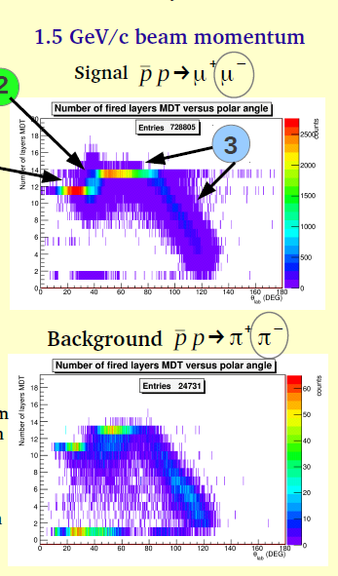
First studies for pp→μ⁺μ⁻
-
eff*acc after PID and kinematical cuts:
for μ⁺μ⁻= 50%
for π⁺π⁻ = 0.02%
(10⁻⁸ needed !)
-
pp→ μ⁺μ⁻ analysis :
I. Zimmermann (HIM Mainz),
on-going PHD work Mainz
talk Tuesday in computing session
Work on muon tracking:
Stefano, Hifeng, Ronald,….
What π/µ discrimination power can be
reached ?
Number of MDT layers
Pion decays
θ (deg)
Tracking software (S. Spataro Torino)
Simulations: I. Zimmerman (HIM Mainz)
Muon tracking will significantly improve the result,
but π⁺π⁻ subtraction probably necessary
6

Slide 7
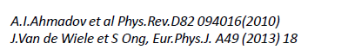
Radiative corrections
-
e⁻
-
p
p
γ
e⁻
q²>0
+
+ ……
p
γ
e⁺
p
q²>0
e⁺
-
Radiative corrections for pp→e⁺e⁻
models
without radiation from hadrons ; PHOTOS event generator
with radiation from hadrons
studies with PHOTOS generator : A. Dbeyssi PhD 2013, Orsay
studies with Van de Wiele’s model
method for radiative corrections
effect of Bremsstrahlung photon detection
Orsay-Dubna
Orsay
B. Ma, on-going PHD work Orsay
talk at December PANDA CM
-

Slide 8
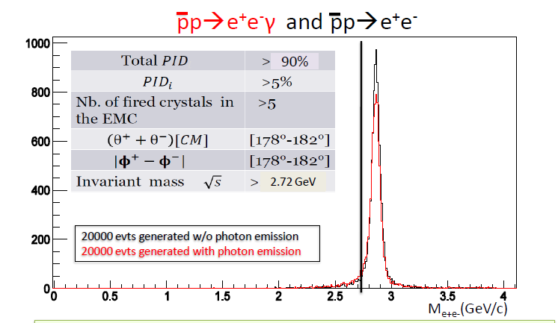
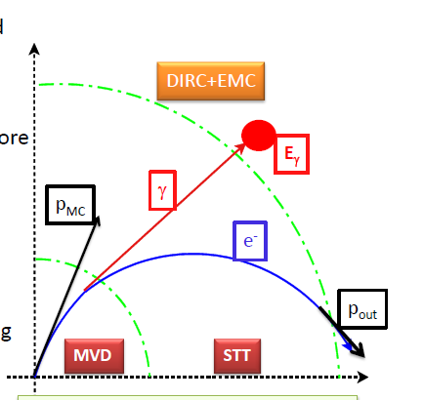
Radiative corrections for pp → e⁺e⁻ in practice
-
Effect of radiation
→ reduction of the selection efficiency
by 17% without Bremsstrahlung correction
by 10 % with Bremsstrahlung correction
B. Ma (IPN Orsay)
PANDA CM Dec.2013
p_{p}=3.3 GeV/c
q²=8.21(GeV/c)²
Bremsstrahlung correction using photon detection in EMC
strategy for radiative corrections
Implement photon emission (both from electron and protons) in the event generator
Global correction: efficiency + radiative correction
8

Slide 9
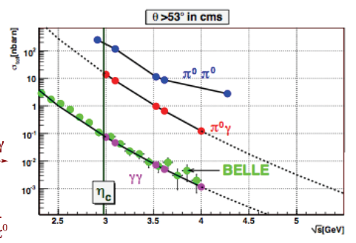
Generalized Distribution Amplitudes
-
large p_{t}
Generalized Distrib.
Amplitudes
pp→ γ γ
PANDA sensitivity
σ=0.2 pb
100 evts/month at 100% efficiency
σ(nb)
-
γ
p
s
-
p
-
PANDA group from
Giessen university
-
Studies with PandaRoot
E. Ezelmüller on-going work at Giessen
Studies with BABAR framework for pp→ γ γ
and pp→ π⁰ γ (including background rejection)
M. Dueren et al. Giessen
PANDA Physics Performance Report arXiv:0903.3905
-
S/B ~ 1 for γ γ (25% signal efficiency)
S/B ~ 2 for π⁰γ (50% signal efficiency)
Could be improved with
optimized algorithms?

Slide 10
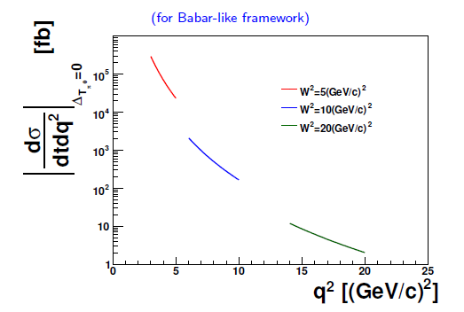
Transition Distribution Amplitudes
-
-
pp→J/ψ ⁻π⁰
Studies with BABAR framework for pp→e⁺e⁻π⁰
-
π⁰ emitted at 0⁰ or 180⁰
pp→e⁺e⁻π⁰ / μ⁺μ⁻ π⁰
-
-
γ*
Fwd/bwd
p
q²
Large q²
small t or u
p
π⁰
t
Transition Distrib.
Amplitudes
Draft in preparation: M. Mora-Espi and M. Zambrana
cf also J. Boucher’s PHD : extraction of electromagnetic nucleon TL form factor
in the unphysical region (low q²) in pp→e⁺e⁻π⁰
-

Slide 11
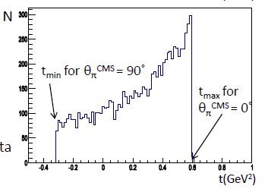
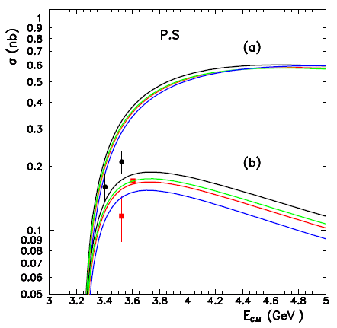
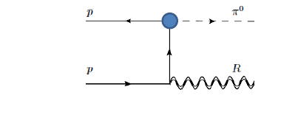
Predictions for PANDA pp→J/ψ π⁰
-
New event generator based on TDA model
B. Pire et al., Phys.Lett. B724 (2013) 99-107
σ=102 pb at s = 12.25 GeV/c²
Consistent with data (141 evts in total from FERMILAB E760,E835)
alternative approach: Lagrangian models
B. Ma (IPN Orsay) in collaboration with
K. Semenov (university of Liege)
pp → J/Ψ π⁰
J. Van de Wiele and S. Ong, EPJC (2013) 73:2640
s=12.25 (GeV/c)²
pp → J/Ψ π⁰
no Hadronic FF
Hadronic FF
13000 evts (2fb⁻¹) for forward π⁰ emission
J/ψ can be easily reconstructed
Total and differential cross section can be measured with PANDA
Background study needed (e⁺e⁻ π⁰, π⁺π⁻π⁰ )
11
Should be started soon (E. Atomssa, IPN Orsay)

Slide 12
Drell-Yan
Simulations for PANDA
Used generators
DUBNA:PYTHIA: A. Skachkova hep-ph/0506139 (Dubna)
A. Bianconi, M. Radici, Phys. Rev. D71, 074014 (2005) (Brescia)
Yields and kinematical criteria to reject lepton pairs
of non Drell-Yan origin A. Skachkova et al. (Dubna)
- Angular asymetries: M. Destefanis, M. Maggiora (Torino)
13000 evts per month at full luminosity (30% efficiency)
Detailed study of charged pions rejection necessary
-
pp→μ⁺μ⁻X/e⁺e⁻X
-
Drell-Yan
p
PDF
l⁺
p
l⁻
Parton Distrib.
Functions
PDF
N. B. in μ⁺μ⁻ recent developments for muon tracking should be very helpful
probably more difficult than form factors studies
(background is 10⁷ higher than signal and no kinematical constraints can be used

Slide 13
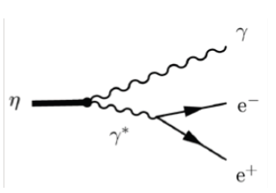
Perspectives for other studies
Meson transition Form Factors: (J. Meschendorp, KVI)
η→γe⁺e⁻, η’→γe⁺e⁻ , ω→π⁰e⁺e⁻, J/ψ→ e⁺e⁻ η_{c, .}η_{c}→ e⁺e⁻ γ …..
Hyperon transition Form Factors: (T. Johansson, K. Schőnning)
Σ⁰→Λe⁺e⁻ see K. Schönning’s talk last CM
To be extended to many mesonic or baryonic transitions ( baryonic resonance Dalitz decays,
cf HADES)
Detailed study just starting (Karin Schönning)
Specific problems of these channels:
Low energy electrons
Photon conversion contamination (close pair rejection)

Slide 14
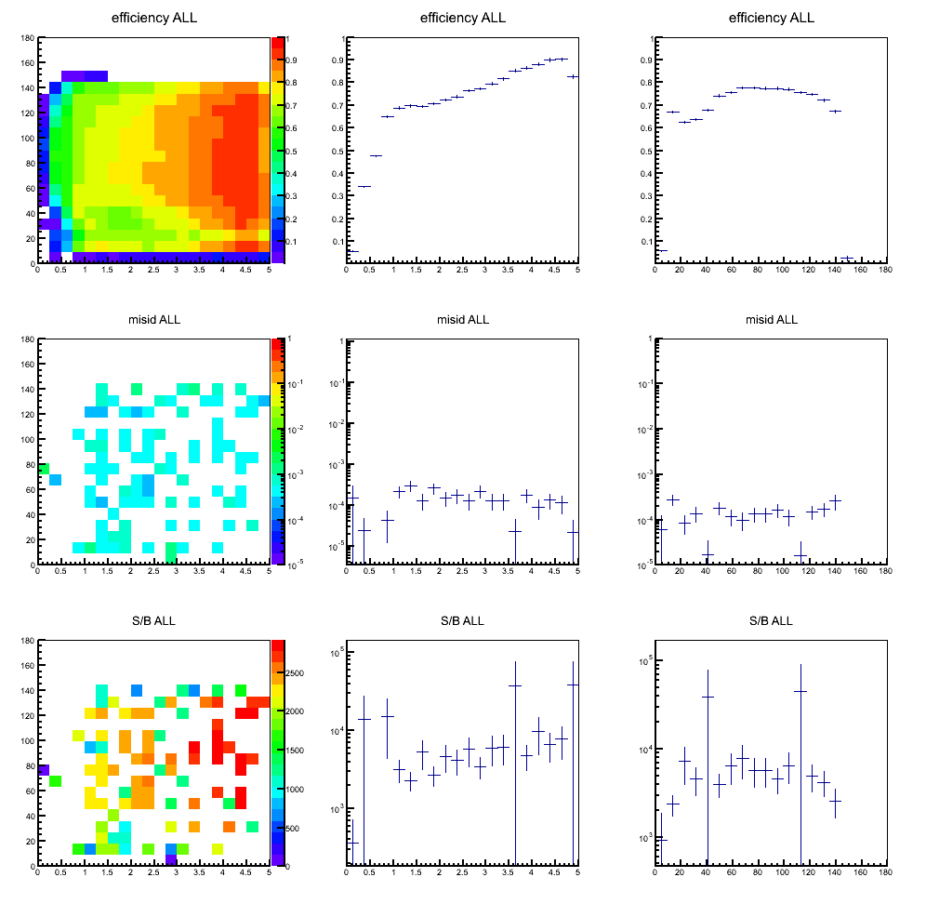
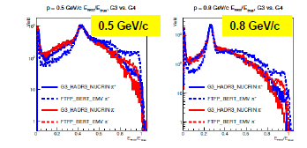
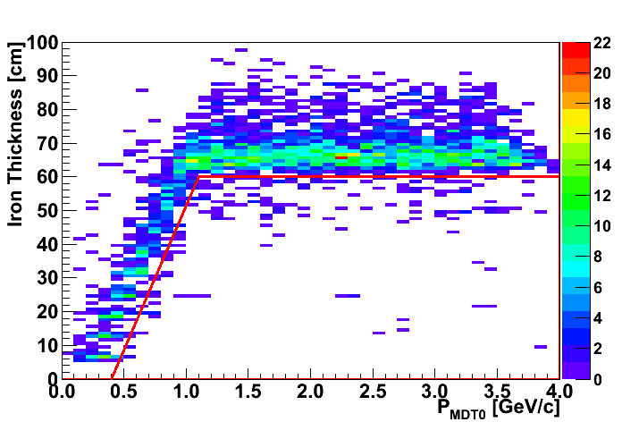
Analysis tool developments for electromagnetic channels
Morceaux choisis (2)
e/π Identification
Response of EMC to charged pions:
dependence on GEANT3/GEANT4 hadronic
models ( E. Atomssa’s talk , computing session )
Bayesian PID method R. Kunne (Orsay)
π⁻ efficiency
π⁻ efficiency
ε< 3 10⁻⁴
e⁻ efficiency
π⁺
π⁻
p (GeV/c)
p (GeV/c)
Electron momentum resolution:
Energy deposit in EMC/ total pion energy
Bremsstrahlung correction method using photon detection in EMC :
implementation in PANDAROOT (B. Ma and E. Atomssa, IPN Orsay)
MDT: Hard Cuts
P(μ)=1
Muon tracking:
P(μ)=0
S. Spataro (Torino)

Slide 15
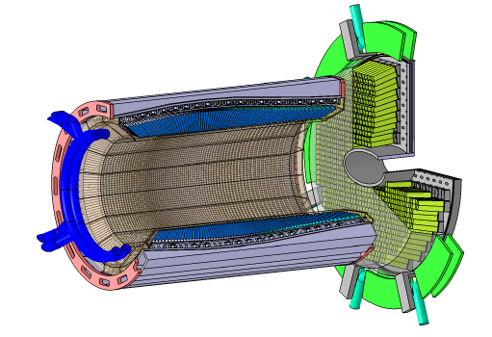
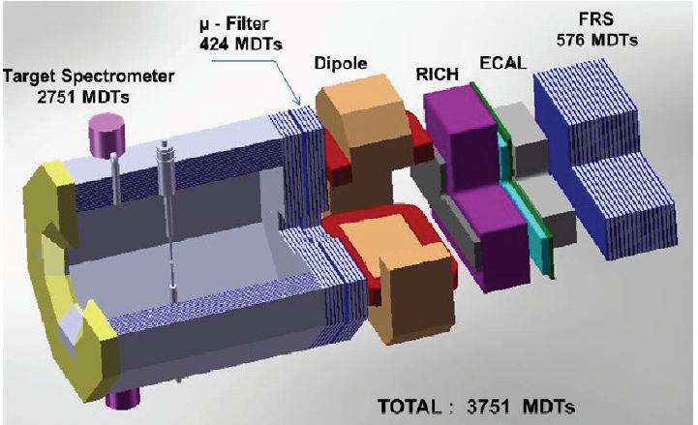
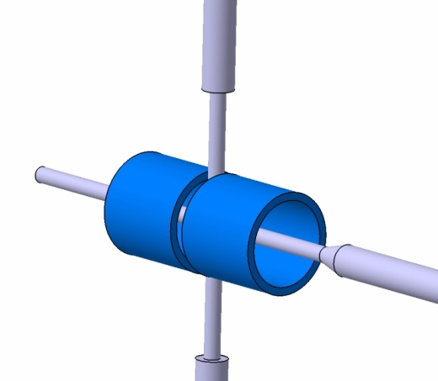
Tecnical developments for electromagnetic channels
R&D on detectors: EMC, muon tracker many labs involved
Filters for electromagnetic channels:
R. Kunne (IPN Orsay) and DAQT-FEE groups
Polarized target studies : B. Froehlich et al. (HIM Mainz)
15

Slide 16
THANK YOU

