Slide 1
EM channels with reduced luminosity and aceptance: preliminary results
T. Hennino, E. Atomssa, S. Ong, B. Ramstein, J. Van de Wiele
(IPN Orsay)
PANDA coll. Meeting
GSI, 10-14 march 2014

Slide 2
Investigation of EM channels with different scenarios
Conditions of the simulation
  Accceptance sudies
    Geometrical cuts only (θ and ϕ)
    Detectors PID & tracking capabilities remain identical
  Fast simulations without reconstruction or resolution
  No PID considered (cf full simulation)
  Detector framework
    no DIPOLE ( 5/10°<θ< 147° )
    5°/10°< θ< 22° , 0<ϕ<360° : Forward ECAL + Tracking
    22°< θ< 147° : Barrel ECAL + Tracking
      modularised Barrel ECAL
        16/16 (= full barrel)
        6/16 (3 back to back) (= scenario C)
        2/16 (back to back) (intermediate cheap scenario)
        1/16 (the only slice available today)
    θ >147° : No Backward calorimeter (for simplicity)
    No muon detector

Slide 3
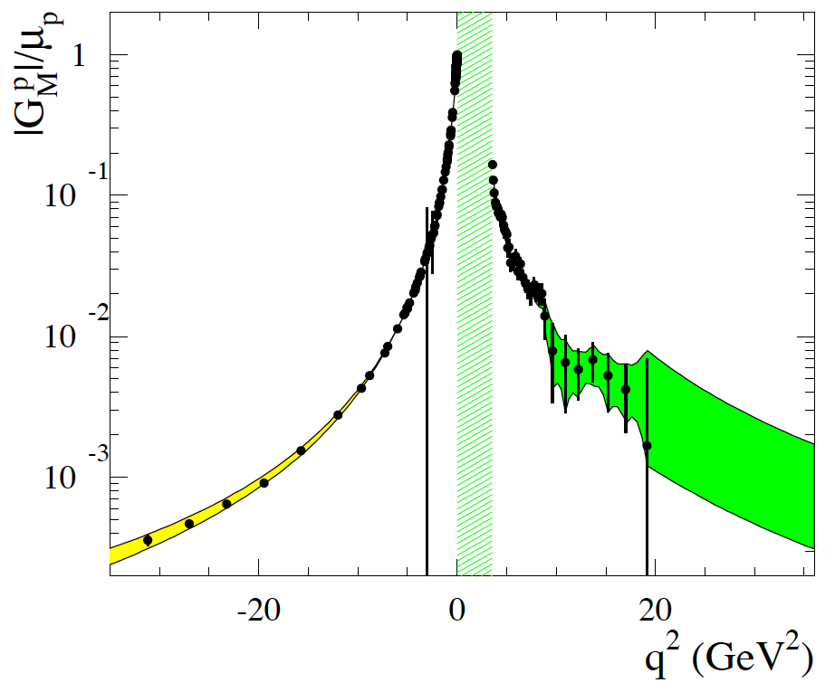
Nucleon Form factor
Access to Time-Like Form Factors (up to 28 GeV²)
Asympotic behavior G_{E} TL = G_{E}SL …
Dispersion relation relates SL and TL
Dominant background channel π⁺π⁻ (ECAL is a KEY detector )
Assume reduced acceptance but same PID capabilities
From S. Pacetti, arXiv:1012.1232v1
From S. Pacetti, arXiv:1012.1232v1
10⁰
-
Time-Like
p
e⁺
Space-like
e⁻
e⁻
10⁻¹
-Q²=q² < 0
q²>4m_{p}²
p
e⁻
|G_{M}/μ_{p|}|
p
p
e⁺
p
10⁻²
-
unphysical
e⁻
p
10⁻³
-30
-20
-10
10
30

Slide 4
pbar p → e⁺ e⁻ at 1 GeV (s=5.4 GeV²)
cos(θ_{CM}) distributions
16 slices
Reduced luminosity
With 16 slices:
ΔR/R = 2.7 %
With 6 slices (back to back)
ΔR/R = 4.4 %
With 2 slices:
ΔR/R= 8.2 %
With 1 slice
impossible
6 slices
2 slices
1 slice
Important loss due to e+/e-
opposite curvature

Slide 5
pbar p → e⁺ e⁻ at 4 GeV (s=11 GeV²)
cos(θ_{CM}) distributions
16/16 slices
6/16 slices
Reduced luminosity
With 16 slices:
ΔR/R = 11 %
With 6 slices (back to back)
ΔR/R = 47 %
With 2 slices
ΔR/R > 80 %
With 1 slice
impossible
1/16 slices
2/16 slices

Slide 6
Error on ΔR/R versus scenario
With
and
ε = 0.5
K=75 % for |cos(θ)| < 1.
K=115 % for |cos(q)| < 0.8
K=220 % for |cos(q)| < 0.6
Numbers in black: reduced Barrel EMC
Numbers in blue: red. Barrel + reduced luminosity (0.2 fb⁻¹)
T_{inc} (GeV) | q² (GeV²) | Full Barrel EMC (16/16) | Barrel EMC (6/16) | Barrel EMC (2/16) | Barrel EMC (1/16)
1 | 5.4 | 0.85% → 2.7% | 1.4% → 4.4% | 2.6% →8.2% | >100%
2.5 | 8.21 | 4.6% 14.5% | 7.8% → 25% | 16.5% →52% | >100%
4 | 11.0 | 14.9% → 47% | 26% → 82% | 65% → > 100% | >100%
5.5 | 13.9 | 37% → 120% | 62% → 190% | >100% | >100%

Slide 7
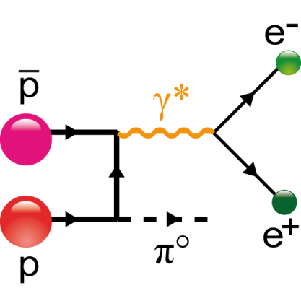
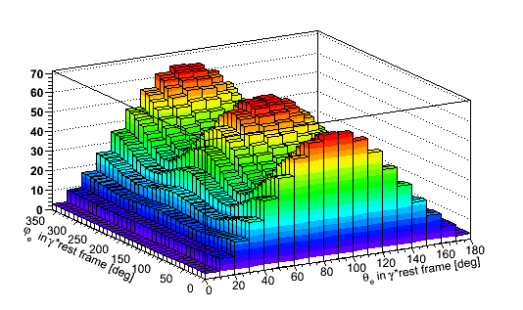
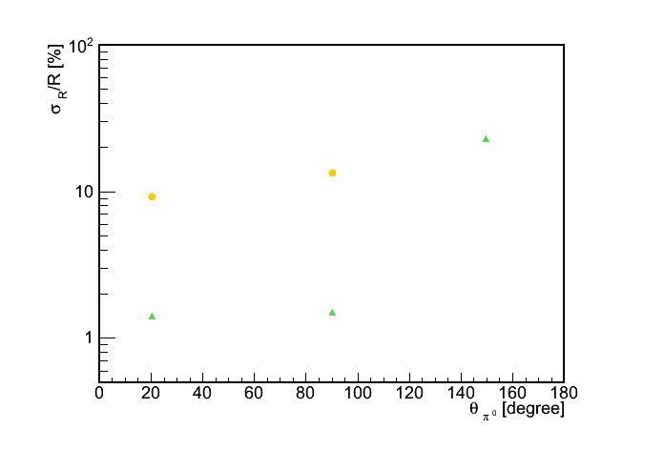
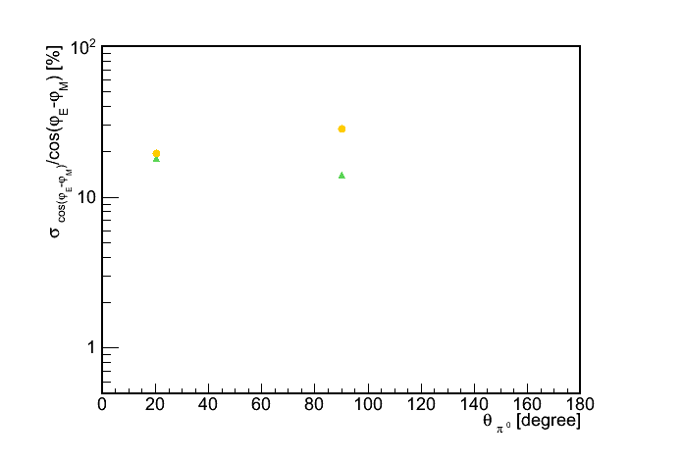
Unphysical region: pbar p → π⁰ e⁺ e⁻ at 1 GeV
Access to N FF in the unphysical region (thesis J. Boucher (2011) + J. Van de Wiele)
Through e⁺ angular distribution in γ* rest frame, access to |G_{E}|/|G_{M}| and |ϕ_{E}-ϕ_{M}|
N^{th}=18 486
Predicted e⁺ distribution in γ*
|G_{E}|/|G_{M}|
σ_{R}/R [%]
q²=2
q²=2
σ_{cos(δφ)} /cos(δφ) [%]
q²=0.6
q²=0.6
cos(ϕ_{E}-ϕ_{M})

Slide 8
pbar p → π⁰ e⁺ e⁻ at q² = 0.64 GeV² (ω region)
π⁰ angular distribution
θ_{e} distribution
Multiplicity
Full Barrel ECAL
Average loss : 1/11
Forward (1/6) less
affected than backward (1/20)
Most events in M=0
Retrieve M=3 events ?
6/16 slices

Slide 9
pbar p → π⁰ e⁺ e⁻ at q² = 2 GeV²
8.61 %
Full Barrel ECAL
6/16 slices
6 slices / 16 slices:
Average loss : 1/10
Forward (1/5) less
affected than backward (1/30)
Most events in M=2
Possibility to retrieve M=3 events ?
π⁰ angular distribution
θ_{e} distribution
Multiplicity

Slide 10
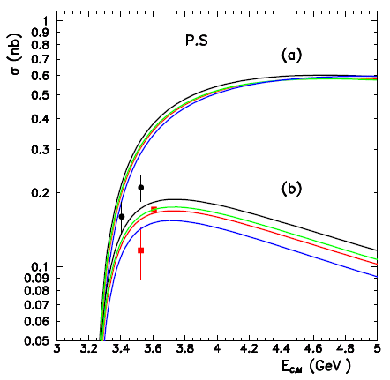
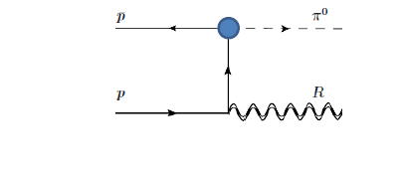
pbar p → π⁰ J/Ψ
Recent Lagrangian-based model calculations ( S. Ong and J. Van de Wiele)
OK with data (only 4 data points with large discrepancies)
σ = 0.1-0.2 nb
Test of models PS vs PV, w or w/o FF, 1 nucleon exchange vs nucleon + resonances
π⁰ detected by 2 γ
J/Ψ by e⁺ e⁻ (BR=6%)
5000 counts with ε_{rec+PID} =0.3 at full luminosity L = 2 fb⁻¹
Loss of a factor 100 with 6 slices (6/16) and reduced luminosity (1/10)
pp → J/Ψ π⁰
no Hadronic FF
J. Van de Wiele and S. Ong, EPJA 2013
Hadronic FF

Slide 11
Pbar p → π⁰ J/Ψ
Full Barrel ECAL
6/16 slices
π⁰ angular distribution
Θ_{e} distribution
Multiplicity
6 slices/ 16 slices
Forward suppressed by ¼ only
Strong suppression of the backward Backward π⁰ : 1/15
Sizeable amount of M=3 events
Possibility to retrieve them?

Slide 12
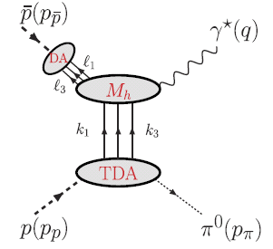
Transition Distribution Amplitudes
Access to a new component of the Nucleon WF (p → π, η, ρ, )
B. Pire, K. Semenov, L. Szymanowski,
Thesis M.C. Mora Espi (Mainz/2013)
B. Ma, B. Ramstein
pp→e⁺e⁻π⁰
-
Kinematical conditions:
large q²
small t or u (θ_{π}=0⁰ or θ_{π} = 180⁰)
γ*
p
q²
t
p
π⁰
π⁰
Transition Distribution Amplitudes

Slide 13
TDA at s=10 GeV² and q²=7.5 GeV²
Full Barrel ECAL
π⁰ angular distribution
θ_{e} distribution
Multiplicity
6 slices / 16 slices:
Average loss : 1/10
Forward (1/3) less
affected than bacward (1/25)
Most events in M=2
Retrieve M=3 events ?
6/16 slices

Slide 14
TDA at s=5 GeV² and q²=4 GeV²
Full Barrel ECAL
6/16 slices
π⁰ Angular distribution
θ_{e} distribution
Multiplicity
6 slices / 16 slices:
Average loss : 1/20
Forward less affected(1/7) than backward hemisphere (1/20)
Shifted multiplicity distribution: most events in M=1
Retrieve M=3 events?

Slide 15
Counting rate vs scenario
Preliminary
Pbar p → a + b → (1 + 2) + (3 + 4)
L = 0.2 fb⁻¹
T (GeV) | s (GeV²) | a (GeV) | b (GeV) | q² (GeV²) | σ(0°)/σ(90°) | Full EMC | Sc. C (6/16) | 2 opp. slices | 1 slice | comment
1 | 5.4 | π⁰ | ω (0.8) | 0.64 | 1/1 | 100 % | 8.33 % | 0.40 % | < 0.01 % | Nucleon FF G_{E},, G_{M} , δϕ.
1 | 5.4 | π⁰ | ω (0.8) | 0.64 | 100/1 | 100 % | 9.01 % | 0.49 % | < 0.01 % | Nucleon FF G_{E},, G_{M} , δϕ.
1 | 5.4 | π⁰ | 1.414 | 2.25 | 1/1 | 100 % | 7.97 % | 0.36 % | 0.013 % | Nucleon FF G_{E},, G_{M} , δϕ.
1 | 5.4 | π⁰ | 1.414 | 2.25 | 100/1 | 100 % | 10.9 % | 0.85 % | 0.044 % | Nucleon FF G_{E},, G_{M} , δϕ.
1 | 5.4 | π⁰ | γ | 0. | 1/1 | 100 % | 29.8 % | 5.97 % | 0.49 % | Background for γγ
4 | 11.0 | π⁰ | γ | 0. | 1/1 | 100 % | 34.0 % | 9.32 % | 2.0 % | Background for γγ
1 | 5.4 | γ | γ | 0. | 100/1 | 100 % | 37.0 % | 12.5 % | 3.85 % | Crossed Channel Compton
4 | 11.0 | π⁰ | π⁰ | − | 100/1 | 100 % | 29.7 % | 5.54 % | 2.4 % | Hadronic models,Background for e⁺ e⁻
1.5 | 9.15 | η | 1.8 | 3.24 | 100/1 | 100 % | 5.98 % | 0.24 % | <0.01 % | Nucleon FF slightly below theshold
4 | 11.0 | π⁰ | J/Ψ | 9.61 | 1/1 | 100 % | 9.11 % | 1.13 % | 0.24 % | Hadronic midels
4 | 11.0 | π⁰ | J/Ψ | 9.61 | 100/1 | 100 % | 13.5 % | 2.27 % | 0.58 % | Hadronic models
0.79 | 5.0 | π⁰ | 2.0 | 4. | 1/1 | 100 % | 4.43 % | 0.14 % | 0.007 % | TDA
3.45 | 10.0 | π⁰ | 2.74 | 7.5 | 1/1 | 100 % | 10.2 % | 1.22 % | 0.26 % | TDA
Counting rate color code | > 10⁵ | 10⁴ → 10⁵ | 10³ → 10⁴ | 100 → 1000 | 10 → 100 | < 10

Slide 16
Conclusion and outlook
First order acceptance simulations done with
  Reduced luminosity
  Reduced ECAL
Main conclusion
  Full Barrel ECAL is strongly preferred
  Only possible reduced scenario for the Barrel ECAL is 6/16
  Loss due to reduced luminosity and reduced Barrel ECAL are comparable
Nucleon Form Factor feasible in a first phase
  G_{eff} possible up to q²= 20 GeV²
  G_{E}/G_{M} possible only up to q²=9 (instead of q²=14)
  Competition with BES?
3 body final states (π⁰ e⁺ e⁻ ) reduced by a factor 1/100
  Only 200-300 counts per campaign
  Possibilty to measure the q dependance
  1 exception: π⁰ e⁺ e⁻ at 1 GeV and low q² (< 1 GeV²) → R ( 5%) and cos(δϕ) ( 60-80%)
Hadronic and mixed channels with γs (π⁰ π⁰, π⁰ γ and γ γ )
  Doable : CR > 10⁵ per campaign → measure poorly known channels and understand the detector
  γγ restricted to the lowest energy
Further steps
  Select a few channels to perform full PANDAroot calculations if PID capabilities are reduced (not considered in the present simulation)

