Slide 1
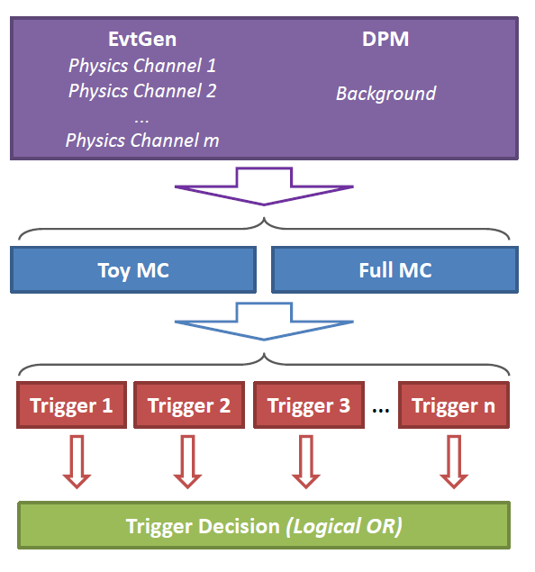
PANDA Software Trigger Status Report
PANDA Collaboration Meeting
Computing Session
March 2014, GSI
K. Götzen, D. Kang, R. Kliemt, F. Nerling

Slide 2
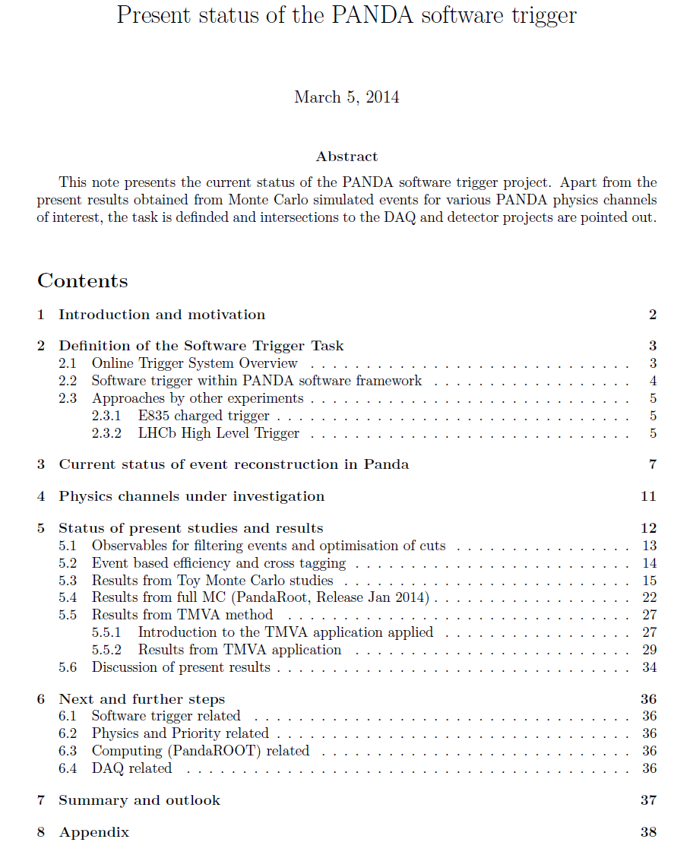
Status Report about to be released
K. Götzen, D. Kang, R. Kliemt, F. Nerling
58 pages
(including
appendix)

Slide 3
Definition of Software Trigger Task
Duties of the Software Trigger Group
Find principle potential by starting from idealised conditions
Identify observables allowing signal/background separation
Develop algorithms suppressing data rate at high efficiencies
Determine performance for different scenarios
Connected issues
Define a complete list of physics channels
Develop realistic online-like reconstruction (→ time-based simulation + event building + online reco algo's)
Implement selection algorithms on appropriate online compute elements like FPGA, GPU, ...
Acquisition and handling of the information necessary to perform selection (DAQ level)

Slide 4
Toy & Full MC
Assumption: tracking, neutral reco, PID & event building works
Toy MC (50k each signal, 500k DPM)
Find principal potential under defined conditions
Tracking: ε_{trk} = 95%, Δp/p = 5%, Δθ = Δφ = 1 mrad
PID: ε_{PID} = 95%, mis-ID = 5%
Neutrals: ΔE/E = 5%, Δθ = Δφ = 3 mrad
Full MC (500k each signal, 1M DPM)
More realistic, but stick to the current sotware
PandaROOT release/jan14, external packages apr13
Tracks: p > 100 MeV/c
Neutrals: E > 100 MeV
PID: P > 10%

Slide 5
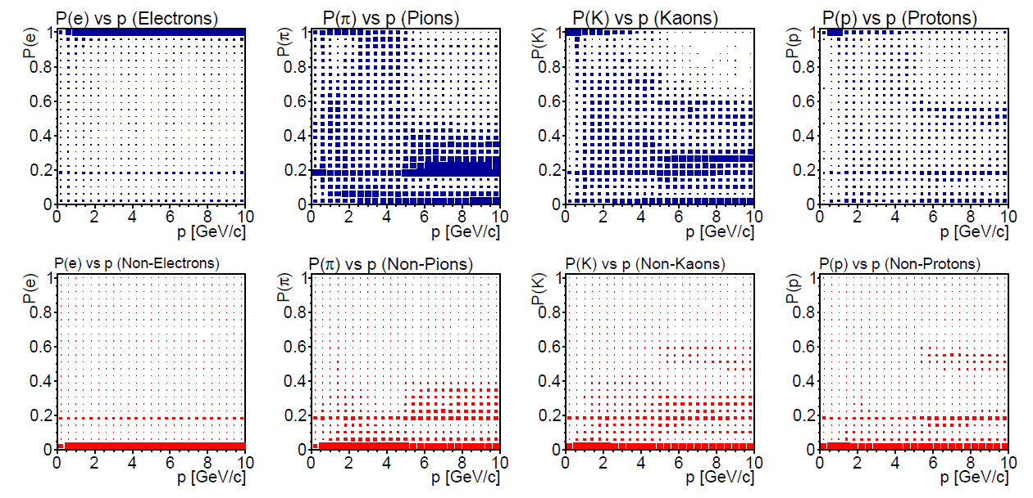
Full MC PID
Particle Identification: P > 10%
Hadron PID worse than before
due to often missing DIRC info
correct
wrong

Slide 6
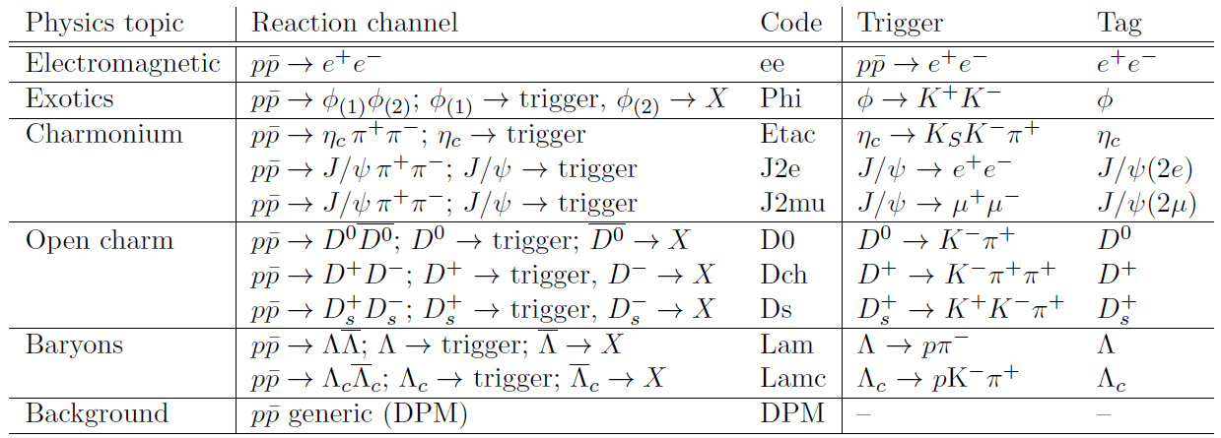
Channel List
10 Channels under investigation
Data sets at 4 different center-of-mass energies

Slide 7
Strategy
EvtGen
Physics Channel 1
Physics Channel 2
...
Physics Channel m
DPM
Background
Event Generation
Signal
Background
Simulation &
Reconstruction
Toy MC
Full MC
Event Filtering
Combinatorics
Mass Window Selection
Trigger Specific Selection → Event Tagging
Trigger 1
Trigger 2
Trigger 3
...
Trigger n
Trigger Decision (Logical OR)
Global Trigger Tag

Slide 8
Event Based Efficiency
All presented efficiencies are event based
In general: ε_{tot} < ∑ε_{trig}
Four different cases:
Trigger T_{X} tags due to correctly reconstructed candidate X
T_{X} tags due to random cand. form event containing signal X
T_{Y} tags due to random cand. from event containing signal X
T_{X} tags due to random cand. from background
ε_{X}
ε_{tot}
Λ_{c} ± : ε₁ = 2/3 = 66%
D_{s}± : ε₂ = 1/3 = 33%
Evt.
1
2
3
tag: 1, 2
tag: 1
ε_{tot} = 2/3 = 66%
< ε₁ + ε₂
m(pKπ)
m(KKπ)

Slide 9
Selection Optimisation
Four different selection approaches have been studied
Preselection
Combinatorics
Mass window cut ±8σ around nominal mass
High Signal Efficiency (manually)
Retain 90% of efficiency per trigger line w.r.t. preseletion
High Background Suppression (manually)
Reject 99.9% DPM in total (all triggers simultaneous)
TMVA based
Classification problem in multi-dimensional parameter space
Proper handling of correlations between observables
Each trigger line @ each energy → individual optimisation!

Slide 10
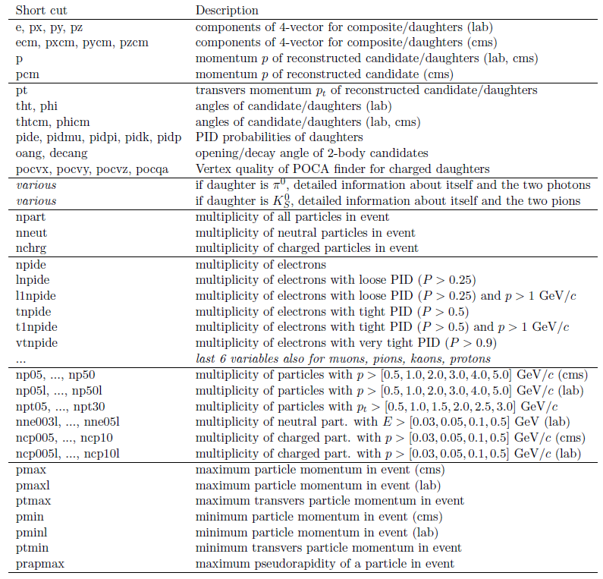
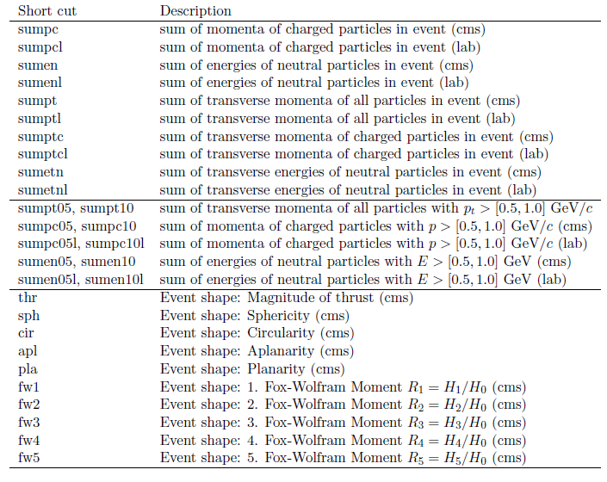
Observables
O(100) event and candidate related observables considered

Slide 11
Identification of Selection Observables
Observable ranking (hint for manual optimisation):
Example: D_{s}@5.5 GeV
Fixed efficiency (e.g. 98%)→ ranking by best background suppression
Fixed suppression (e.g. 98%) → ranking by best signal efficiency
sig
bkg
sig
bkg

Slide 12
Selection Example
D± trigger on D± /DPM data @ 5.5 GeV: ε_{sig,ini} = 79.4%
High efficiency optimisation (ε_{sig} / ε_{sig,ini} ≈ 90%)
High suppression optimisation (ε_{bg} = 0.01%)

Slide 13
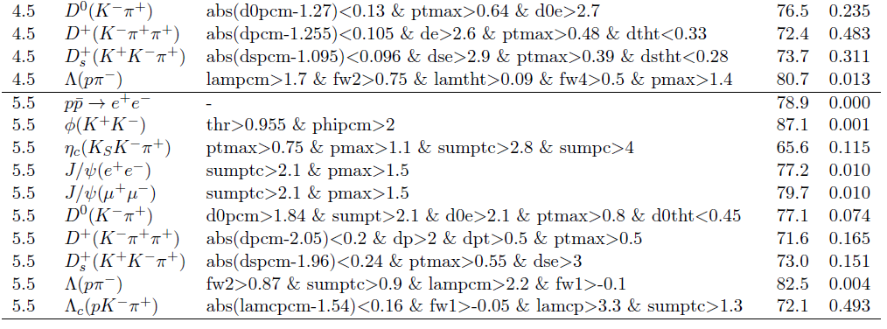
Toy MC – High Efficiency Algorithms
...

Slide 14
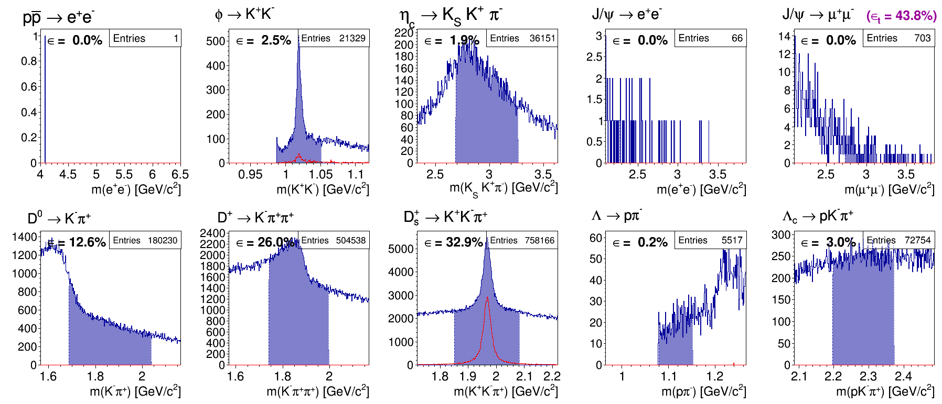
The 10 Trigger Lines (e.g. D_{s} data @ 5.5GeV)
Each plot → invariant mass of trigger specific candidates
Single trigger efficiency
(event based)
Preselection region
Total efficiency
(event based)
MC truth matched spectrum

Slide 15
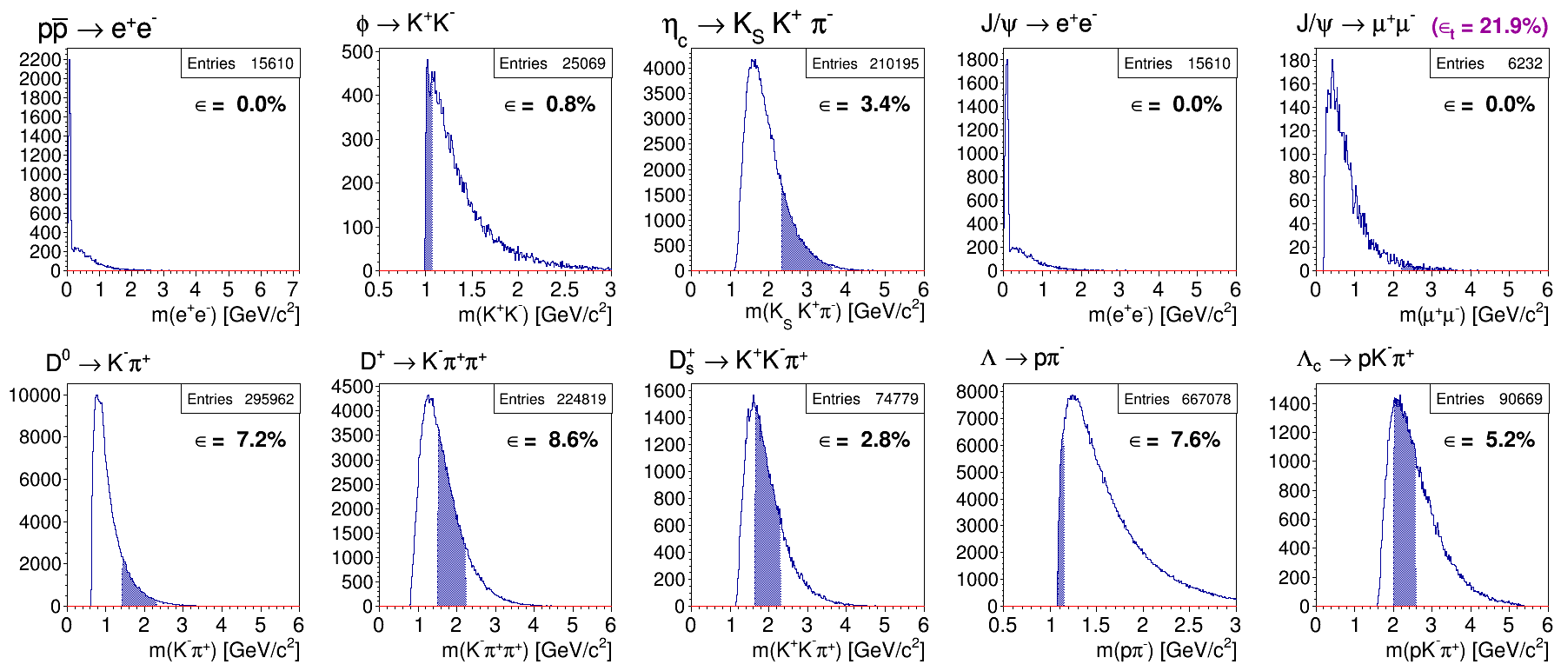
Toy MC Example – Preselection
Data set (5.5GeV)
Ds → K+ K- pi+
ε_{trig} = 80.9%
ε_{tot} = 90.4%
DPM
ε_{tot} = 21.9%

Slide 16
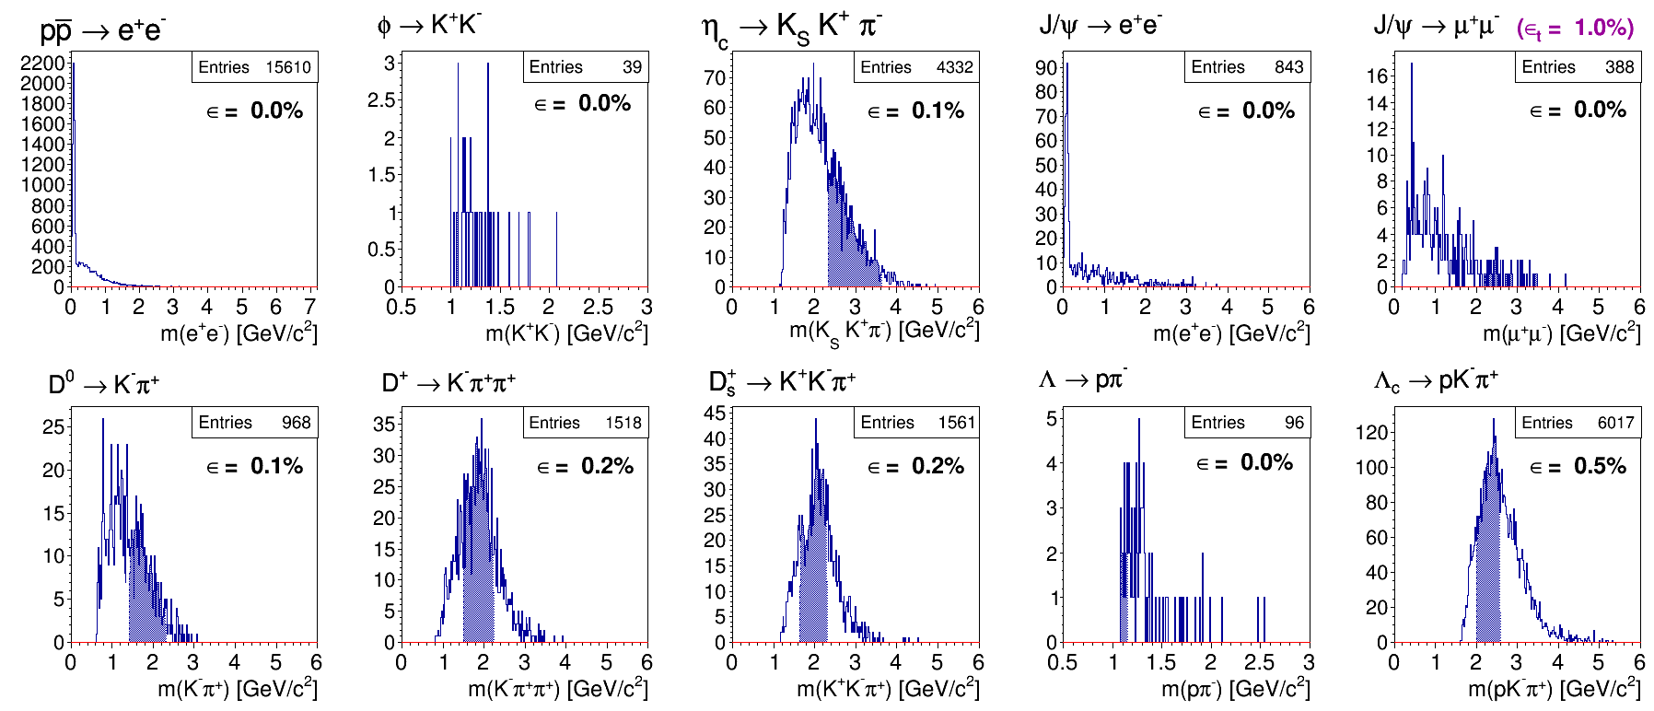
Toy MC Example – High Efficiency
Data set (5.5GeV)
Ds → K+ K- pi+
ε_{trig} = 73.0%
ε_{tot} = 74.2%
DPM
ε_{tot} = 1.0%

Slide 17
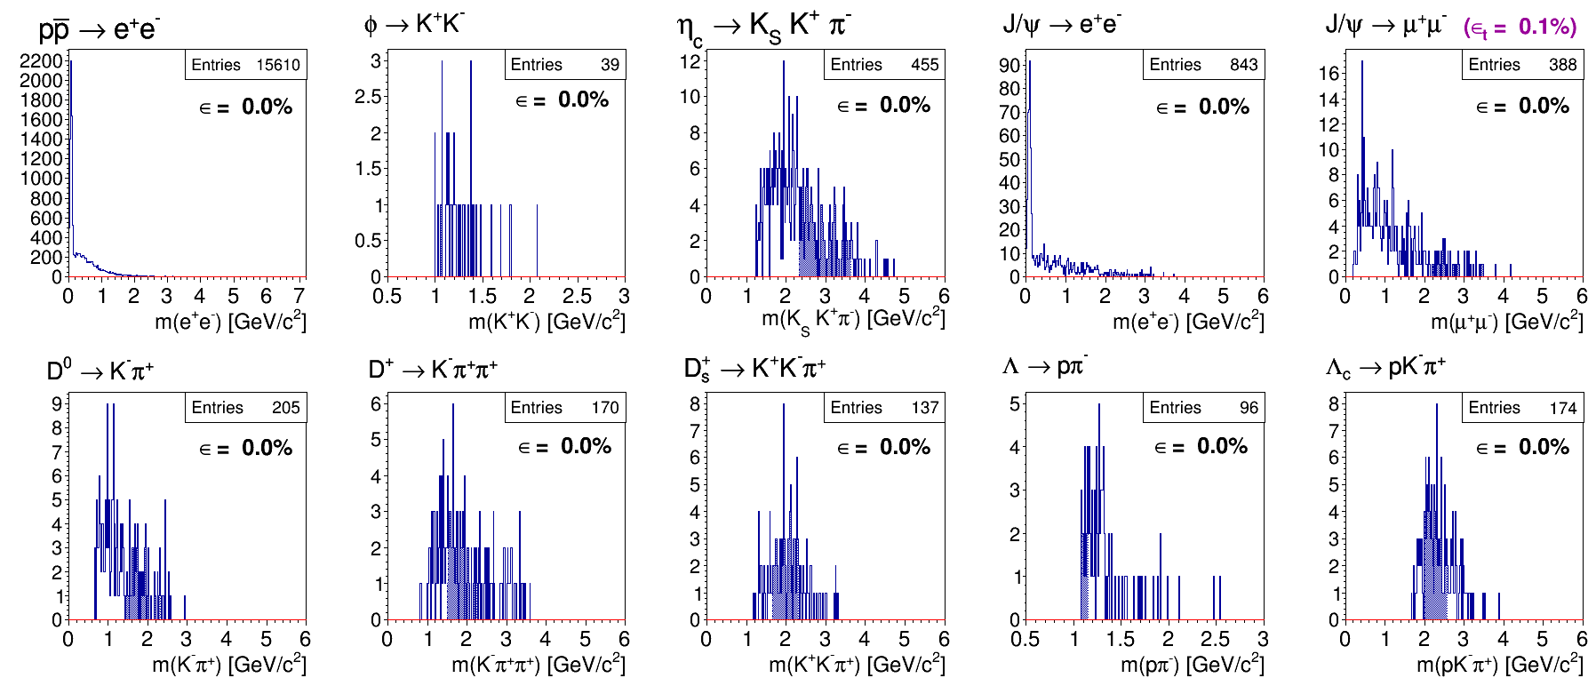
Toy MC Example – High Suppression
Data set (5.5GeV)
Ds → K+ K- pi+
ε_{trig} = 57.2%
ε_{tot} = 57.8%
DPM
ε_{tot} = 0.1%

Slide 18
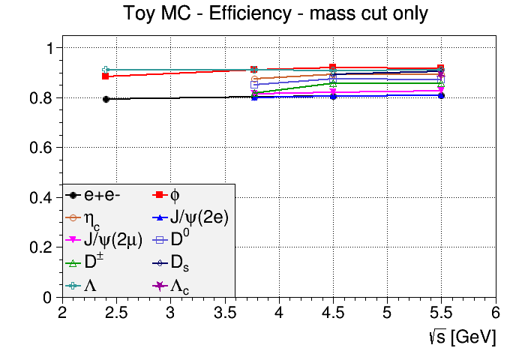
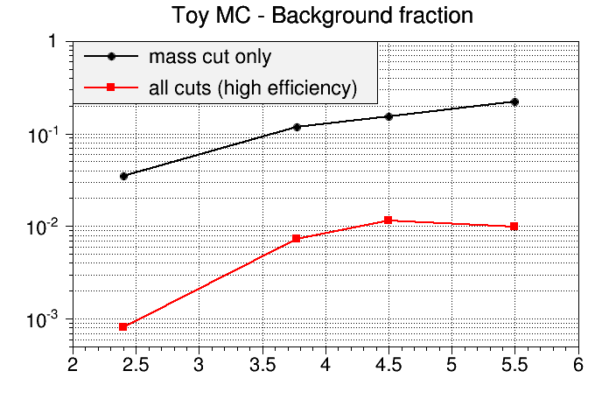
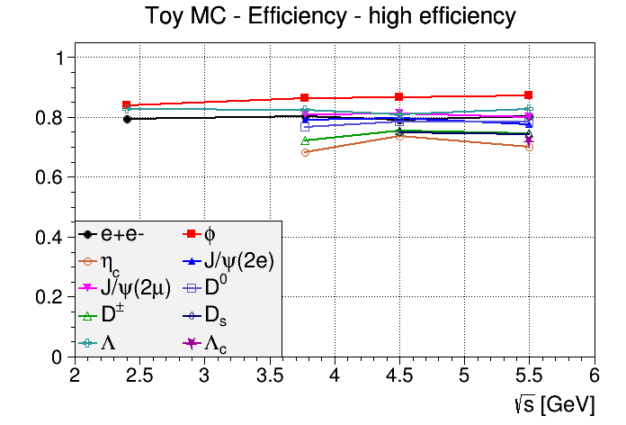
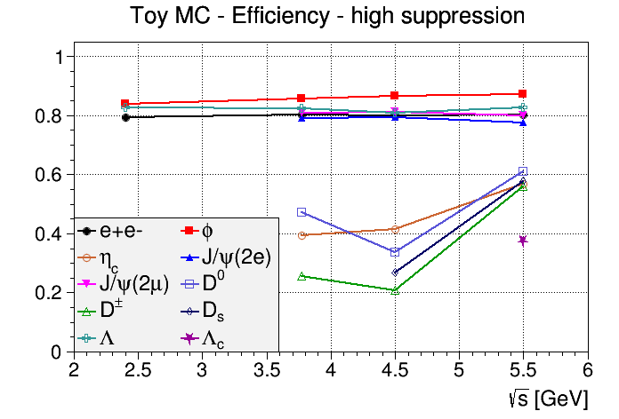
Toy MC – Efficiency Summary
D⁰, D⁺, D_{s}, η_{c}, Λ_{c}

Slide 19
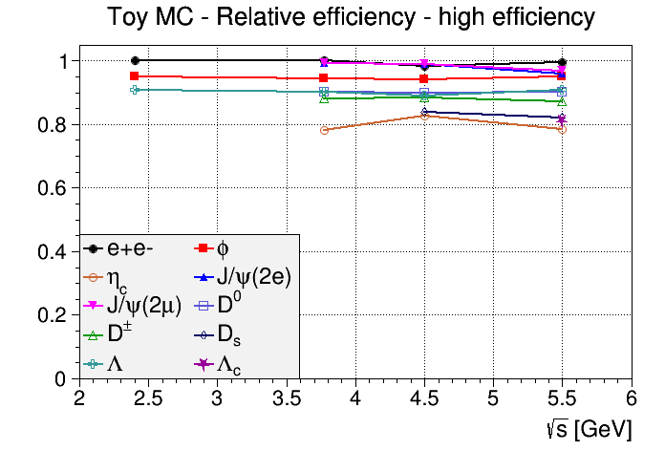
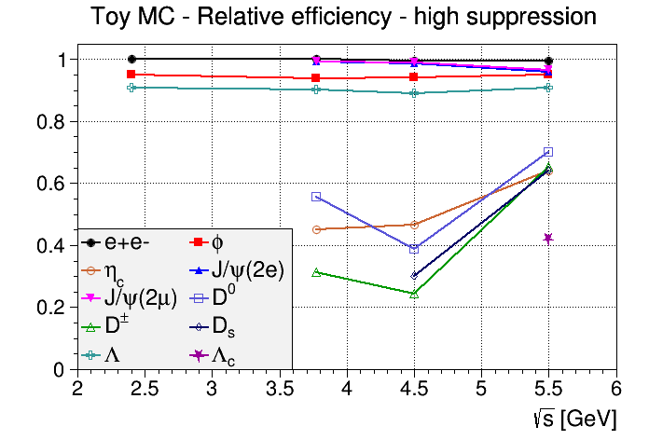
Toy MC – Relative Efficiencies
D⁰, D⁺, D_{s}, η_{c}, Λ_{c}

Slide 20
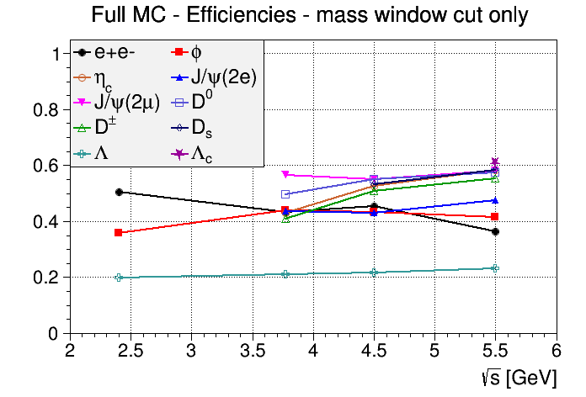
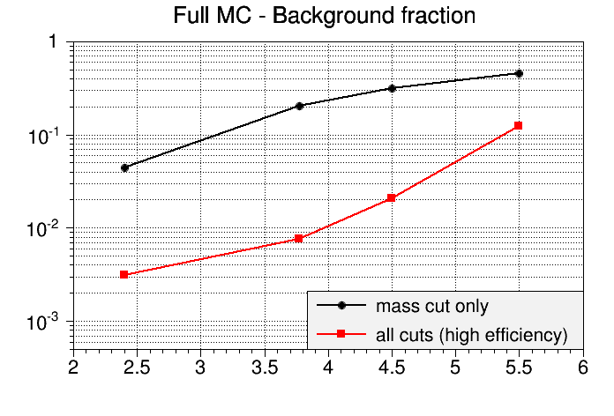
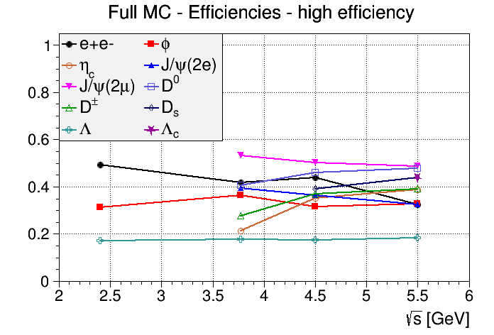
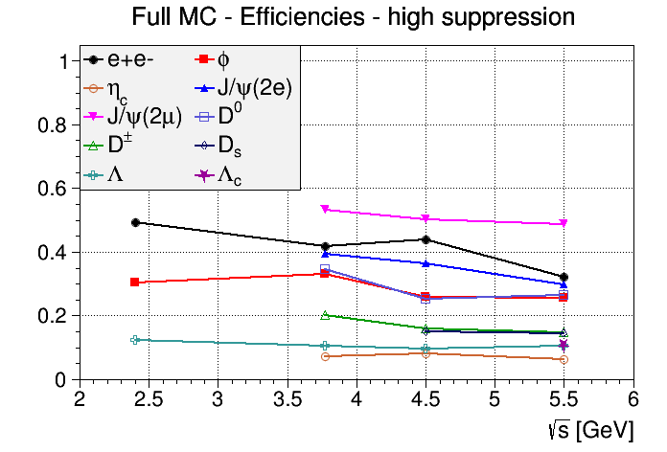
Full MC – Efficiency Summary

Slide 21
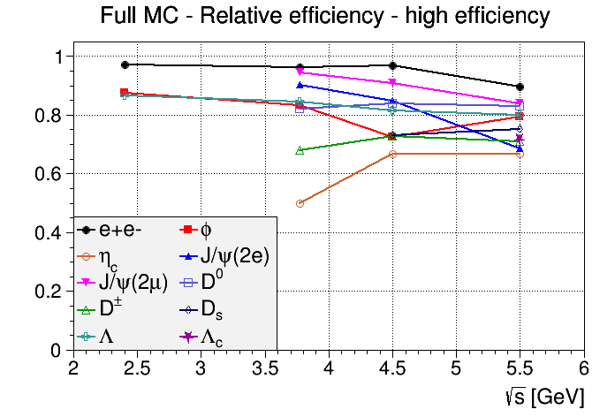
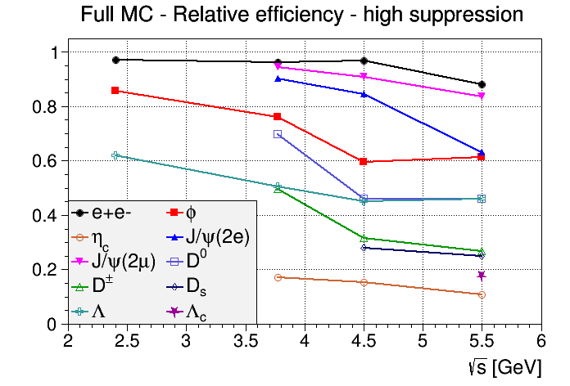
Full MC – Relative Efficiencies

Slide 22
Interesting observation...
Mass cut only
High Efficiency
High Suppression
Trigger
eff
ε_{trig} = 36.9%
ε_{trig} = 32.9%
rel: 89%
ε_{trig} = 11.8%
rel: 32%
MCT
peak
N = 3300
N = 2900
rel: 88%
N = 2400
rel: 73%
→ High eff@loose criteria due to non-MCT combinatorics!

Slide 23
Summary/Conclusion
Background level increases with cms-energy
Individual selection algorithm for each trigger at each energy
Background reduction of 1/1000 can be reached, but at cost of signal efficiency
Additional trigger lines costs individual efficiency
Open charm, charmed baryons and non-leptonic charmonium are more difficult to separated from background
Cross tagging effect could be important, strongly depending on full trigger system configuration

Slide 24
Open issues/next steps
Software Trigger related
Phase space distortion after triggering?
Add missing physics cases (Hypernuclei, in-matter phys.)
Triggering with sparse information possible?
Physics related
Final/complete list of trigger lines
Always simultaneous tagging or different configurations?
Robustness of triggers → alternative background generator
Computing/DAQ related
Time-based simulation + real event building
Algorithms suitable for online reconstruction
Data flow management (e.g. 0MQ)
Implementation of algorithms on FPGA/GPU

Slide 25
BACKUP

Slide 26
Software Trigger within Trigger System
Raw Data/Simulation
Physics Channels
Online Trigger System (FPGA, GPU, CPU)
Online Reco
Tracking
Event Building
Software Trigger
PID
Neutral Reco
Trigger Tag
Data Storage

Slide 27
Full MC Tracking - Discrepancy!
Current tracking efficiency lower than in STT TDR
(target pipe region taken out by ||φ| - 90°| > 4° for plots below)
unisotropic
in FWD region
75-80% average
Susanne confirmed the
TDR numbers – has to be
clarified.
drop at low
momenta

Slide 28
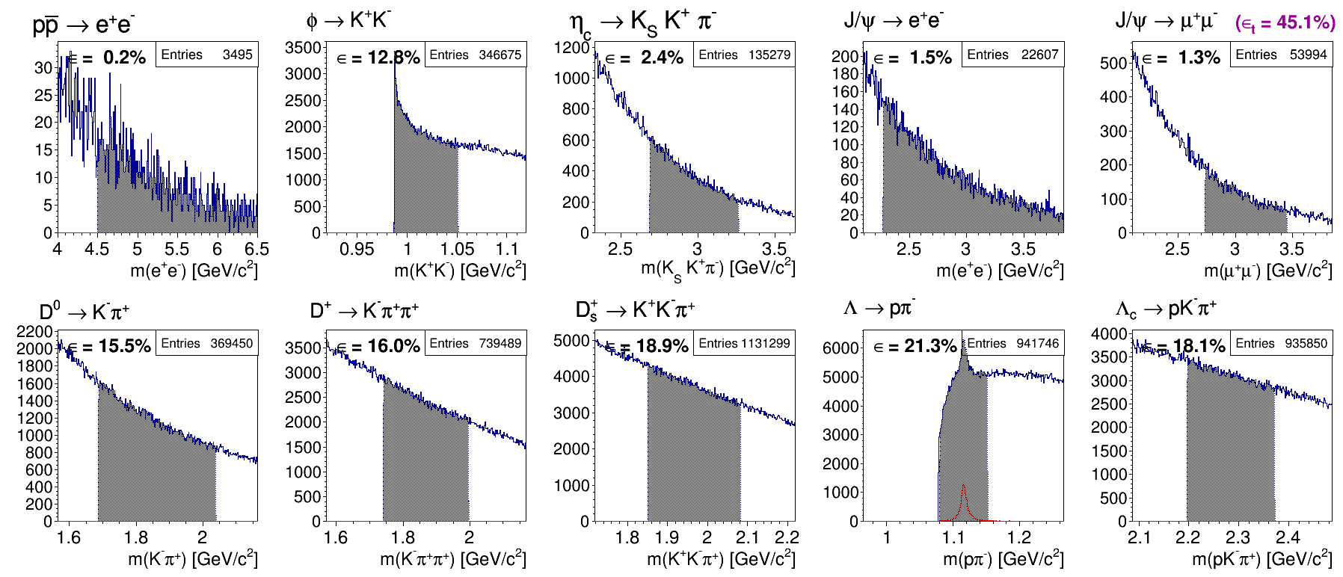
Full MC Example – Preselection
Data set (5.5GeV)
Ds → K+ K- pi+
ε_{trig} = 36.9%
ε_{tot} = 58.3%
DPM
ε_{tot} = 45.1%

Slide 29
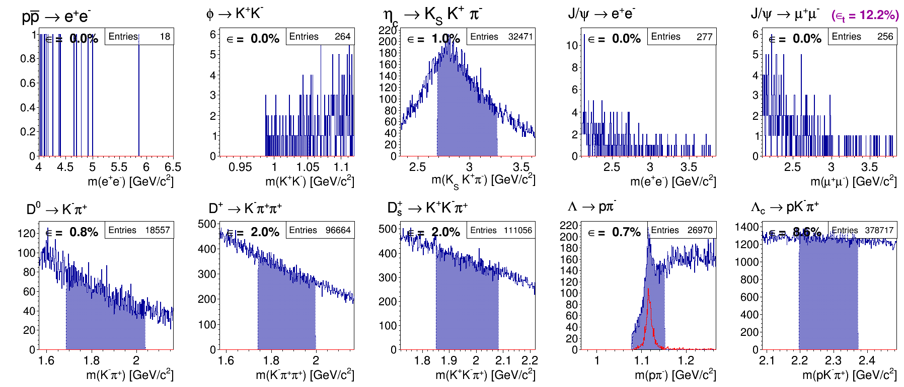
Full MC Example – High Efficiency
Data set (5.5GeV)
Ds → K+ K- pi+
ε_{trig} = 32.9%
ε_{tot} = 43.8%
DPM
ε_{tot} = 12.2%

Slide 30
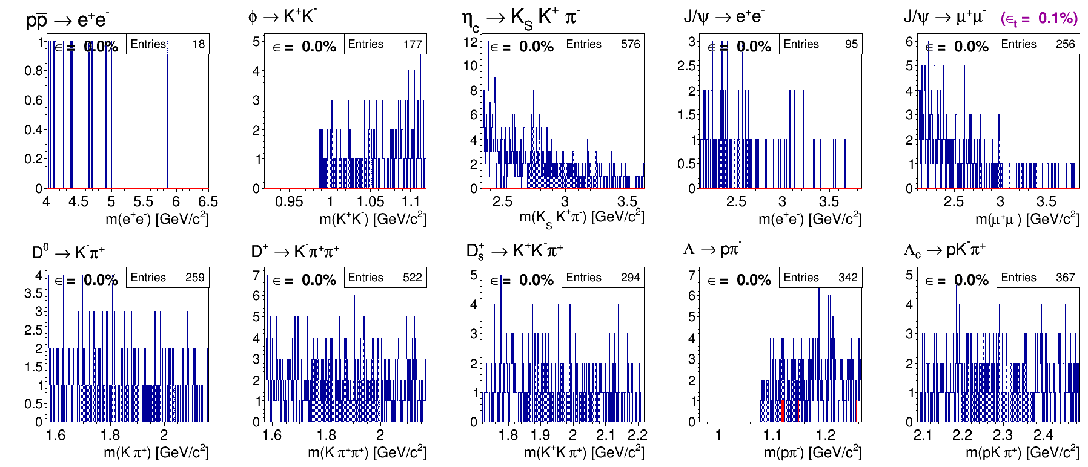
Full MC Example – High Suppression
Data set (5.5GeV)
Ds → K+ K- pi+
ε_{trig} = 11.8%
ε_{tot} = 14.5%
☹
DPM
ε_{tot} = 0.1%

