Slide 1




Time and Energy resolved Photon detection for bunched beam collinear Laser spectroscopy at
TRIGA-MAINZ
Speaker: Simon Kaufmann
Advisor: Prof. Dr. Nörtershäuser
Helmholtzzentrum für
Schwerionenforschung

Slide 2
Outline
collinear laser spectroscopy (cls)
  principle
  Overview of LaSpec – cls at FAIR
TRIGA-SPEC development platform for LaSpec in Mainz
  Overview and Status
  time resolved cls on bunched beams using an FPGA
  first results on cls of bunched ions at TRIGA-SPEC
Outlook

Slide 3
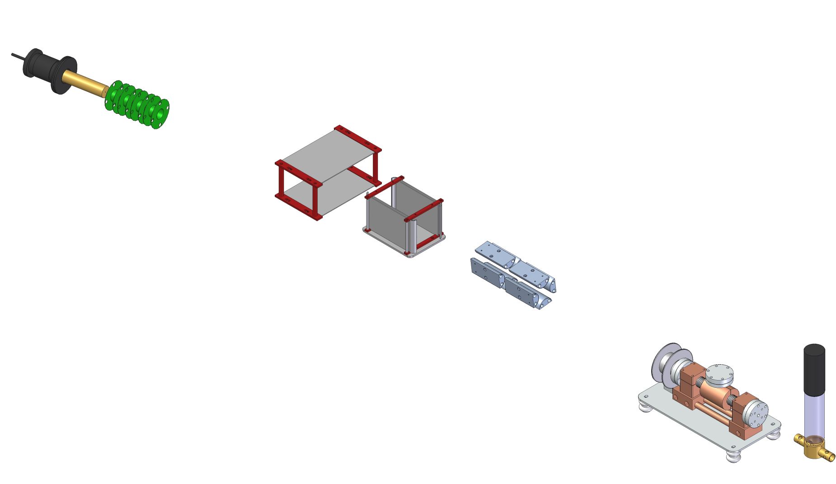
collinear laser spectroscopy – basic principle
high voltage (10-60 kV)
+
Laser
ionsource
+
deflector unit
(overlapping ion & laser beam)
ionoptics
+
Ionoptic
(ion beam shaping)
scanvoltage
optical
detection
Dopplertuning
by accelerating the ions, the laser frequency in the ion rest frame is shifted according to the doppler formula:
charge exchange cell
+

Slide 4

collinear laser spectroscopy – basic principle
high voltage (10-60 kV)
+
Laser
ionsource
+
deflector unit
(overlapping ion & laser beam)
ionoptics
+
Ionoptic
(ion beam shaping)
E
scanvoltage
cts
E₁
optical
detection
ΔE ?
charge exchange cell
+
E₀
$$E=hν$$
U_{Scan}

Slide 5

collinear laser spectroscopy – basic principle
high voltage (10-60 kV)
+
Laser
ionsource
+
deflector unit
(overlapping ion & laser beam)
ionoptics
+
Ionoptic
(ion beam shaping)
E
scanvoltage
cts
E₁
optical
detection
ΔE ?
charge exchange cell
+
E₀
$$E=hν$$
U_{Scan}
Doppler formula

Slide 6

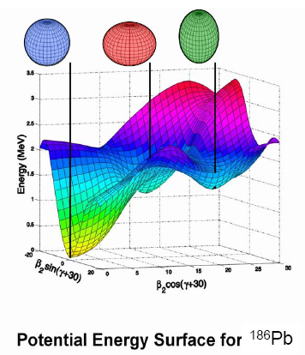
collinear laser spectroscopy – basic principle
high voltage (10-60 kV)
principle
Funktionsweise
Laser
resonant laser excitation
flourescence detection
dopplertuning
energy levels ion/atom
+
ionsource
+
deflector unit
(overlapping ion & laser beam)
ionoptics
+
Ionoptic
(ion beam shaping)
scanvoltage
groundstate characteristics
short lived exotic isotopes
optical
detection
nuclear spin
charge radius
magn. dipole moment
electr. quadrupole moment
charge exchange cell
+

Slide 7
collinear laser experiments
2010
D. Rodriguez, et al.: “MATS and LaSpec: High-precision experiments using ion traps and lasers at FAIR”, Eur. Phys. J. Special Topics 183, 1–123 (2010)
Notes:
evtl. weglassen

Slide 8
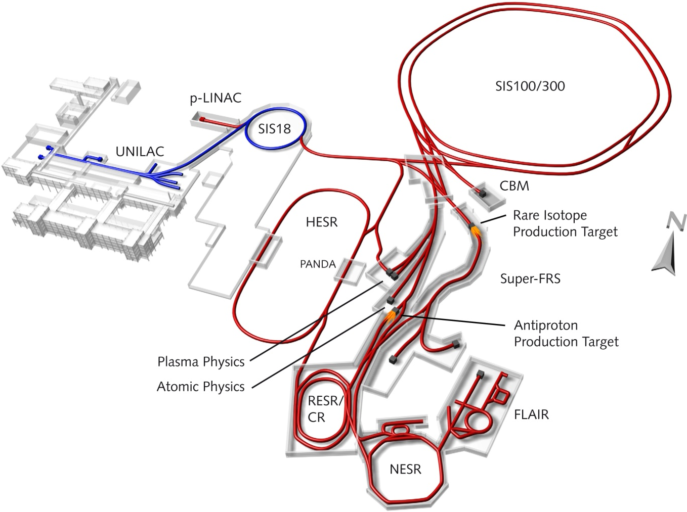
collinear laser spectroscopy - at FAIR
further information see:
Technical Design Report of MATS & LaSpec:
D. Rodriguez, EPJ Special Topics 183 (2010) 1-123
Notes:
FRS= fragment seperator

Slide 9
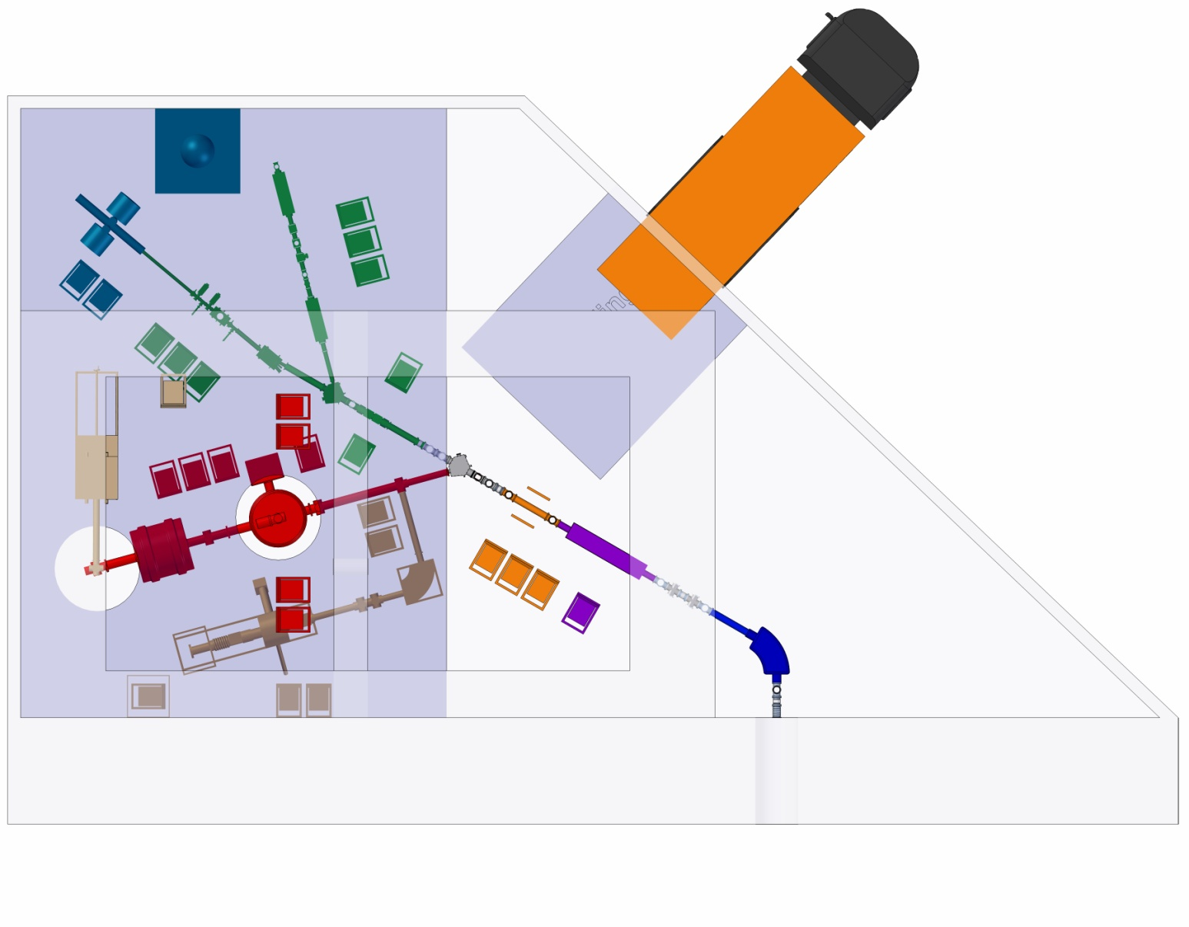
collinear laser spectroscopy - at FAIR
prototype build at the TRIGA facility, Mainz
laser spectroscopy
MR-TOF
RFQ -cooler & -buncher
MATS
EBIT
dipole-magnet
further information see:
Technical Design Report of MATS & LaSpec:
D. Rodriguez, EPJ Special Topics 183 (2010) 1-123
gas cell

Slide 10
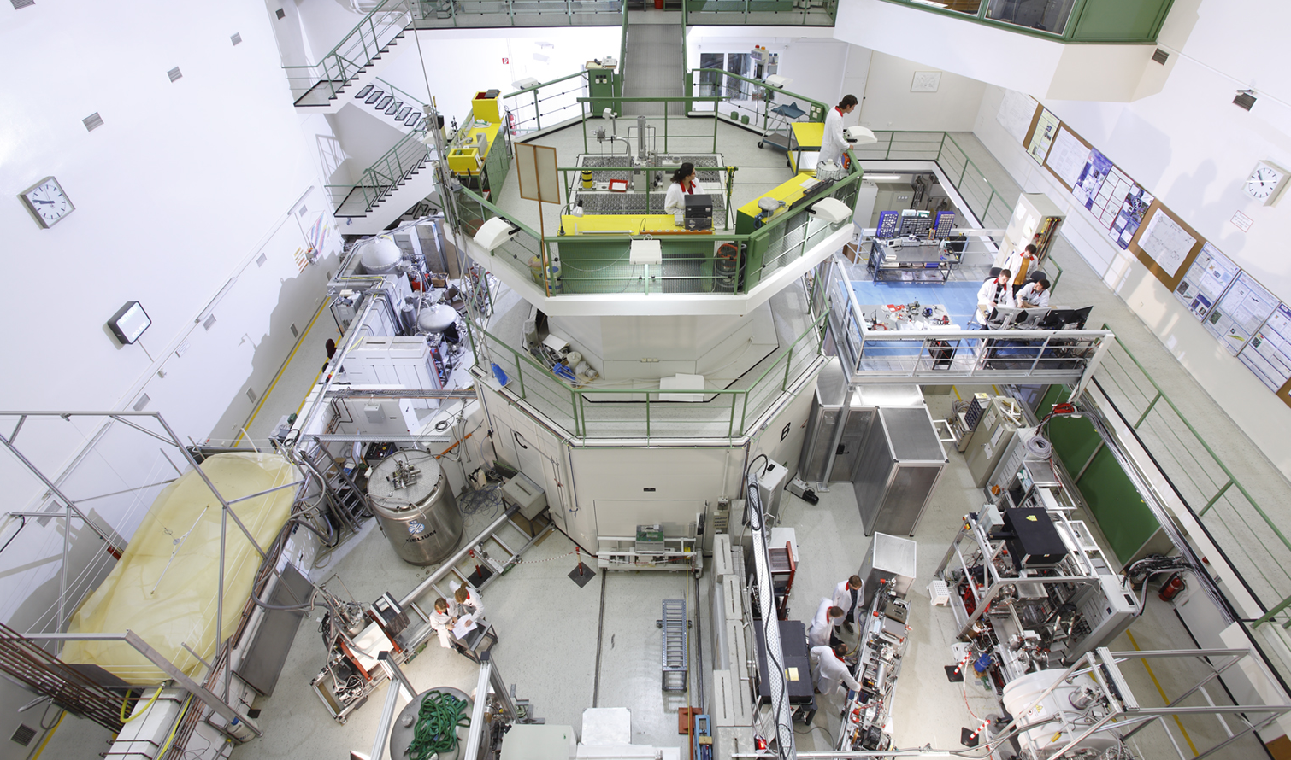
TRIGA –SPEC

Slide 11
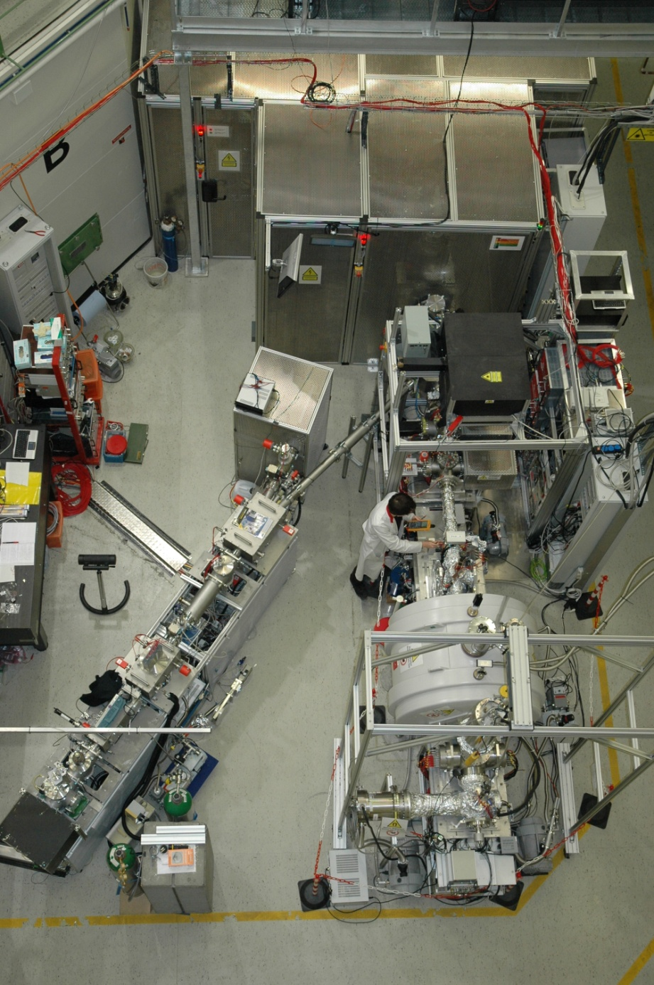
TRIGA-SPEC - Overview
common beamline

Slide 12
TRIGA-SPEC - Overview
COLETTE
„cooler for emittance elimination“
used in MISTRAL until 2010 only in cw-mode
axial confinement implemented at TRIGA-SPEC¹
cls on bunched beams massively reduces underground² (straylight of laser)
common beamline
gated (26µs)
ungated
¹⁷⁴Hf⁺
@IGISOL
²A. Nieminen, et al. „On-Line Ion Cooling and Bunching for Collinear Laser Spectroscopy”, Phys. Rev. Lett. 88, 094801 (2002)
¹T. Beyer, et al.: „An RFQ cooler and buncher for the TRIGA-SPEC experiment“, Appl. Phys. B (2014) 114:129–136
Notes:
t_{acc}=500 ms und t_{gate}=26 µs
wurde an University of Jyväskylä gemessens

Slide 13
radio frequency quadrupole - cooling
E_{kin}≈ 30keV
radial confinemt due to RF on quadrupole rods
  ionguide

Slide 14
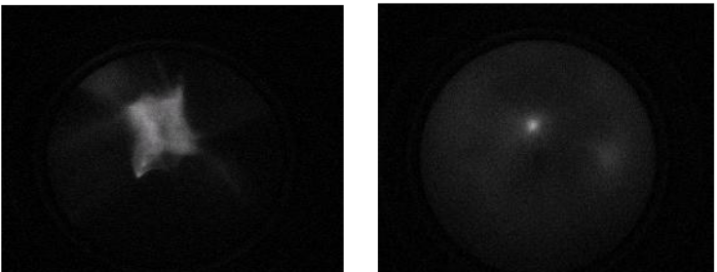
radio frequency quadrupole - cooling
E_{kin}≈ 30keV
beamprofile in CW-mode
radial confinemt due to RF on quadrupole rods
ions dissipate their energy to buffer gas and are cooled to a circular spot of appr. 1 mm diameter
without buffergas
with gas in ionguide

Slide 15
radio frequency quadrupole - bunching
E_{kin}≈ 30keV
segmented rods enable DC potential for axial confinement
„linear Paul-trap“
up to 10⁶ ions can be accumulated

Slide 16
radio frequency quadrupole - bunching
E_{kin}≈ 30keV
for extraction last and 3rd last electrodes are switched

Slide 17
anticollinear laser spectroscopy on bunched ion beams
bunch
extracted
bunch
in
optical
detection
bunch
extracted
TOF
time

Slide 18
anticollinear laser spectroscopy on bunched ion beams
FPGA – Field programmable gate array
FPGA scheme
Chip: Virtex-II
1M logic blocks
40 MHz onboard oscillator
  x up to 200 MHz
  typ. 100 MHZ
    10ns time resolution
16-Bit DAC/ADC
  ±10 V
bitfiles compiled via the LABVIEW to VHDL compilers
  flexibility in field of application
Notes:
we use an fpga to count the signals in coincidence with the bunch. Dann FPGA kurz vorstellen.
das fpga reprogrammierbare Hardware ist nur erwähnen…
heutzutage gibt es den Virtex 7

Slide 19
anticollinear laser spectroscopy on bunched ion beams
Data Acqusition – in bunched beam cls
not time resolved
bunch
extracted
bunch
in
optical
detection
bunch
extracted
gated (26µs)
TOF
time
easiest way to get in coincidence with bunch is to set a gate and only count pmt events, when gate is open.
but:
User has to set gates and delay in advance
User has to adapt the delay for each isotope
by counting over the whole gate, velocity to time information is lost.
  okay as long as velocity inside each bunch is constant
voltage
Notes:
just by gating the

Slide 20
anticollinear laser spectroscopy on bunched ion beams
Data Acqusition – in bunched beam cls
time resolved
bunch
extracted
bunch
in
optical
detection
bunch
extracted
TOF
time
Count all PMT events and sort them by time relative to extraction. Typical it is useful to use channels with some 10ns width.
Data set will be a matrix containing all pmt-events for each time and voltage
  no time information is lost
  center frequency can be found in projection
  gates can be set afterwards
Notes:
just by gating the

Slide 21
First results with cls on bunched beams at TRIGA-SPEC
Comissioning of the rfq with stable Ca⁺-Ions

Slide 22
First results with cls on bunched beams at TRIGA-SPEC
Day 1: Oscillation in velocity observed
frequency:
appr. 3 MHz
oscillation in phase to extraction
countrate is color coded
⁴⁰Ca⁺
Notes:
this is summation of 100 Bunches
ions are positiv -> positive scan voltage decelerates ions to get in resonance.
ions that must be more decelerated (higher scan voltage) are faster, than ions in resonance at lower scan voltages

Slide 23
First results with cls on bunched beams at TRIGA-SPEC
Day 1: Oscillation in velocity observed
switching behaviour of last electrode in rfq, observed with oscilloscope
trapping potential
40 V
extraction potential
-250 V
Notes:
overswing

Slide 24
First results with cls on bunched beams at TRIGA-SPEC

Slide 25
First results with cls on bunched beams at TRIGA-SPEC
changing extraction potential to 0 V
oscillation disappears
bunch is longer
  about 11.74µs

Slide 26
Outlook
Upcoming Projects at TRIGA-SPEC
Short term:
  repeat the systematic studies on the energy behaviour of the bunches from RFQ
  establish a python based Control System („TRITON“)
  stable Ca⁺ isotope shift of D₂-line (4s ²S_{1/2} → 4p ²P_{3/2})
long term:
  plasma ion source in common beamline
    investigation of short lived isotopes which are currently not ionisable with the surface ion source
Notes:
Technetium and ruthenium could be one of the first interesting physics cases at TRIGA-LASER, to study the behavior at N=60 where a sudden appearance of deformation was observed on the elements with slightly lower Z.

Slide 27
Thank you, for your attention!
Questions?

Slide 28

Kollineare Laserspektroskopie radioaktiver Isotope
Hochspannung
Funktionsweise
+
Laserstrahl
(feste Wellenlänge)
resonante Laseranregung
Nachweis über Fluoreszenz
Dopplertuning
Energieniveaus Ion/Atom
Ionenquelle
+
Deflektor-Einheit
(10° horizontal)
Ionenoptik
+
Ionenoptik
(Quadrupol Doublett etc..)
Scan-
Spannung
Grundzustands-Eigenschaften kurzlebiger exotischer Nuklide
optischer
Nachweis
Kernspin
Ladungsradius
magn. Dipolmoment
elektr. Quadrupolmoment
+
Ladungsaus-tausch-Zelle
universelle Methode
Laser-
strahl

Slide 29
Vergleich Online vs. Offline
Notes:
Fwhm:
Online CW: 184,81389 11,66189
Offline : 90,92702 0,91471

Slide 32
gasflow variation

Slide 33
number of Ions

Slide 34
ions/bunch

Slide 35
Variation der Kühlzeit
Fläche ist konstant
➔keine Ionen gehen verloren
Notes:
1V = 17Mhz
Haben kleinere V -> mehr Energie

Slide 36
Variation der Kühlzeit
Linienlage verschiebt sich
➔Ionenenergie nach Ausschuss nimmt ab
Notes:
1V = 17Mhz
Haben kleinere V -> mehr Energie

Slide 37
Vergleich: Spektren an ISCOOL
ISCOOL
RFQ-Cooler and Buncher an ISOLDE
4 µs lange Pulse
FWHM: 5,7 V || 100 MHz
30 kV,
rel. Dopperlfaktor: 17,5 MHz

