Slide 1
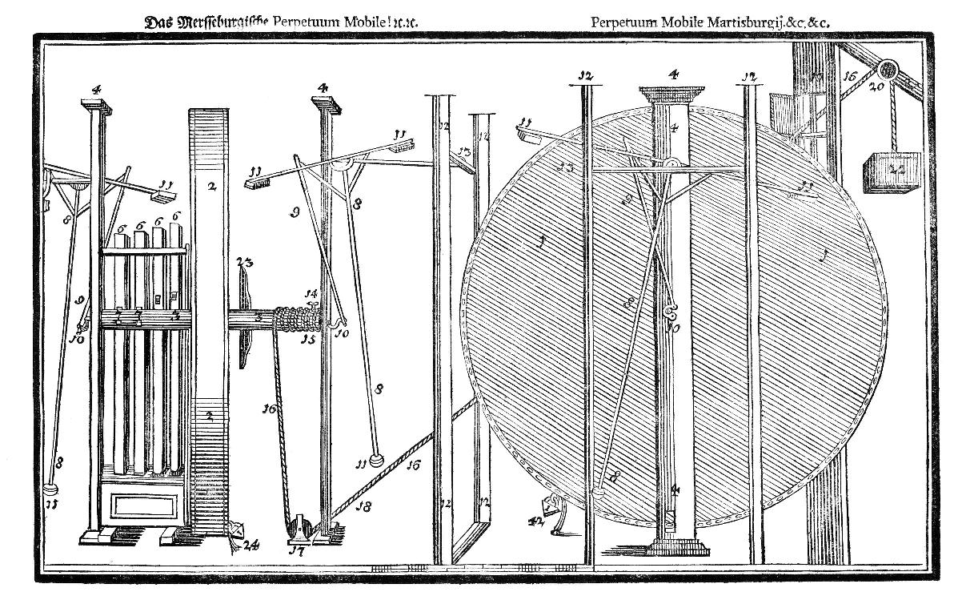
NUSTAR DAQ developments H.Simon
MENU
Building blocks
Precision time base on the campus
… and measurement
New Frontends
Summary

Slide 2
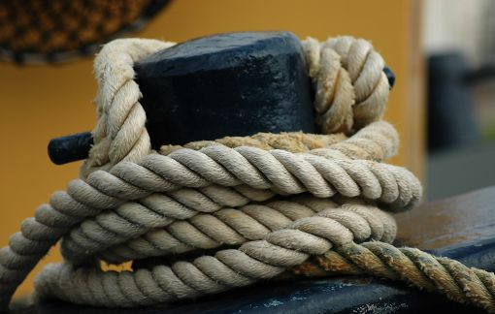
NUSTAR DAQ: Providing building blocks and links …
Integration of foreign systems
GET, AGATA, …
and ‚Triggerless‘ / dead time free sys.
Compact time and charge measurement systems
Upgrade to tac-asic-free fpga-based multihit-tdc
Time distribution and stamping
BuTiS
White Rabbit

Slide 3
AGATA coupling – data flow merging/coupling
N. Kurz, S. Pietri, H. Schaffner, X. Grawe
Two parallel data flows
AGATA needs Tracking information for Doppler correction
FRS needs Gamma data to optimize beam
Common time stamps
3

Slide 4
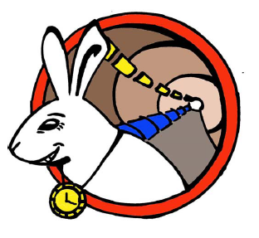
White Rabbit: Timing and Data T. Włostowski/CERN
Extension to Ethernet providing
A common clock via synchronous ethernet + compensation from PHY clock (PTPv2@125MHz IEEE1588 + compensation) 10MHz with ~1ns precision and ~100ps accuracy
A real time Protocol with guaranted latency

Slide 5
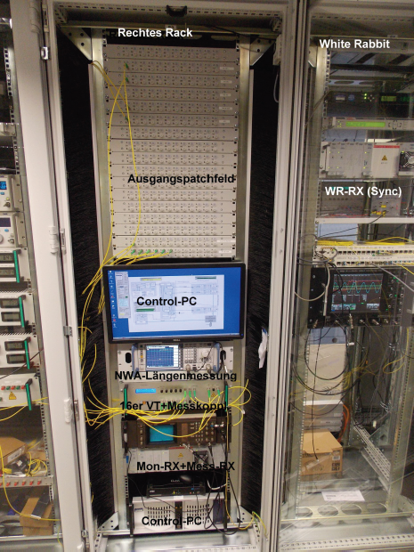
White Rabbit (CERN/GSI/Bilbao/DESY/MIKES FI/VU Amsterdam,…) - implementation studies (D. Beck, N.Kurz)
Good timing (~100ps acc./km)
Open hardware:
http://www.ohwr.org/projects/white-rabbit
14-08-2013: WR running on official Dutch national timescale

Slide 6
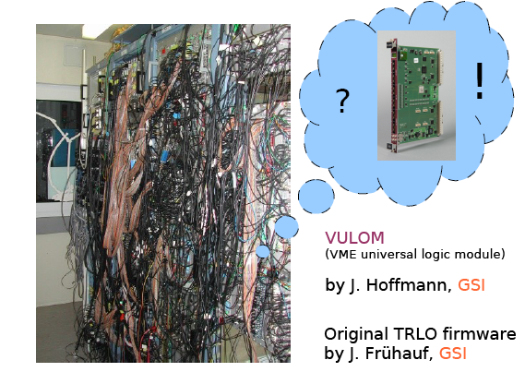
Along the line: Flexible Trigger electronics H.T. Johansson/CTH

Slide 7
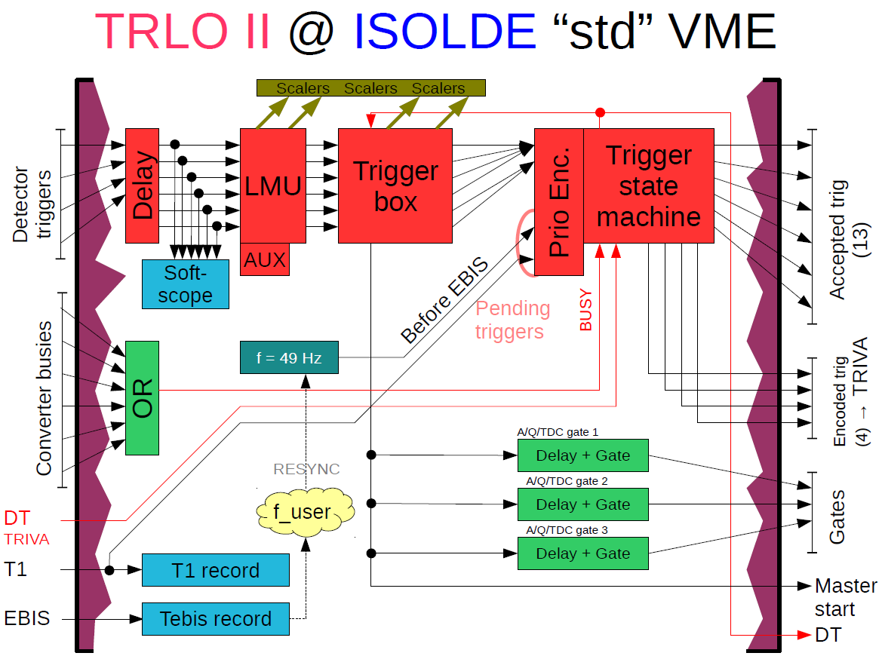
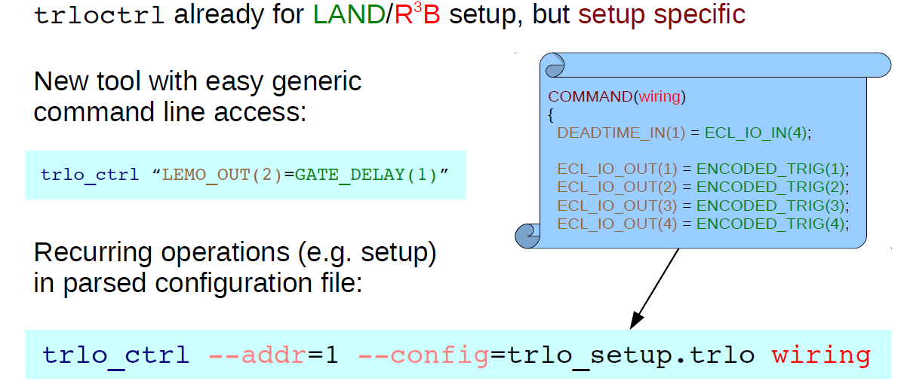
Flexible trigger electronics
H.T. Johansson/CTH

Slide 8
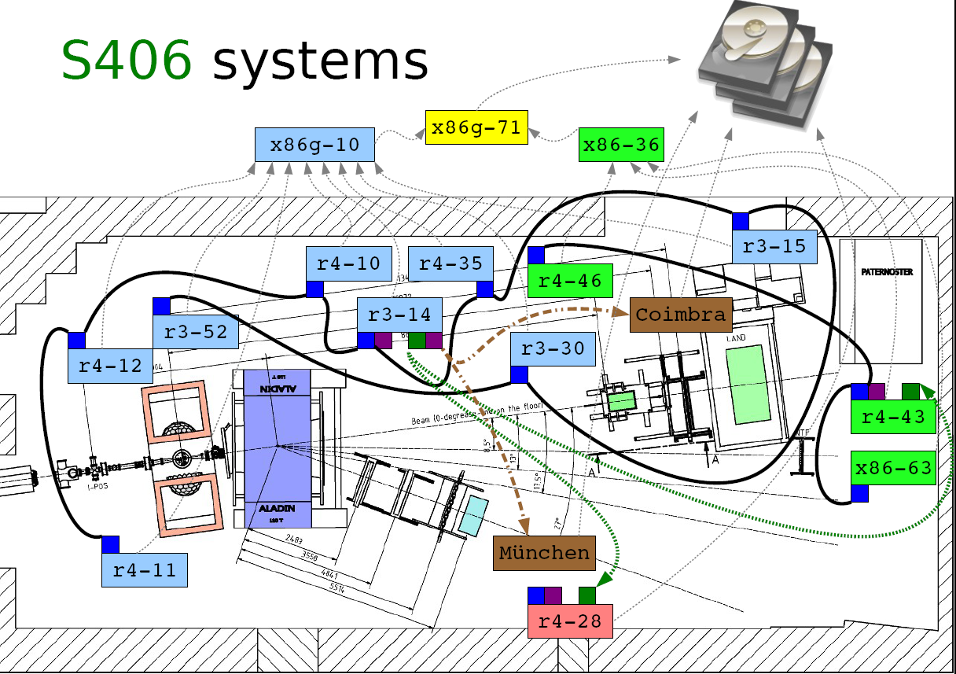
Flexible Coupling - H.T. Johansson, D. Rossi, H.S.
Coupling with timestamps
(e.g. via WR; TRB, indep. DAQs)
Ligthweight Serial Timestamp distribution (several 100m)

Slide 9
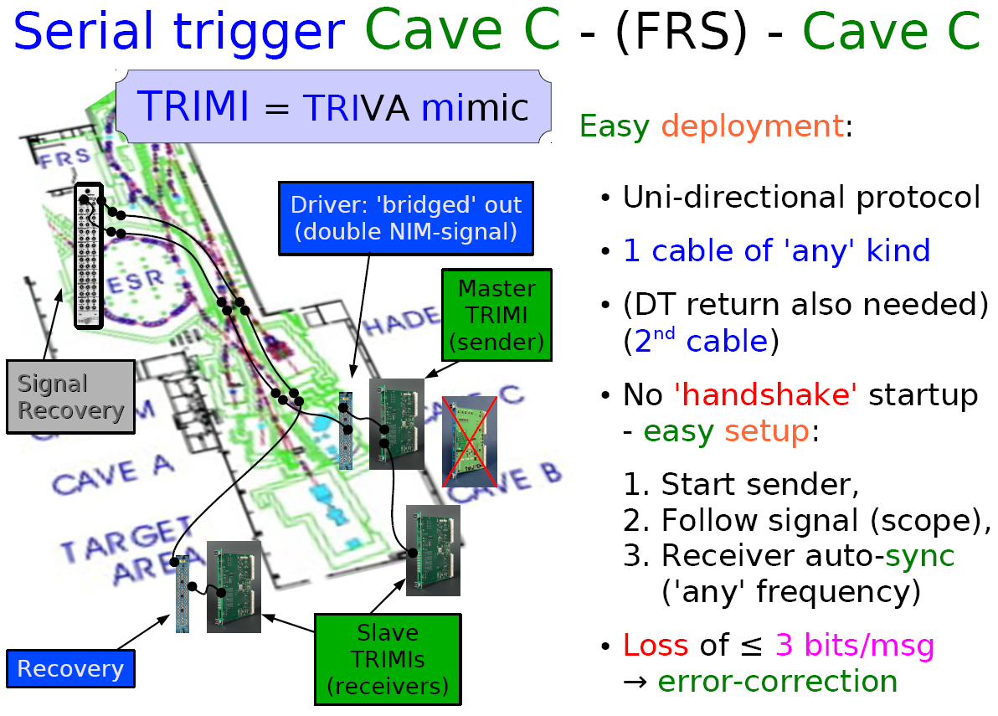
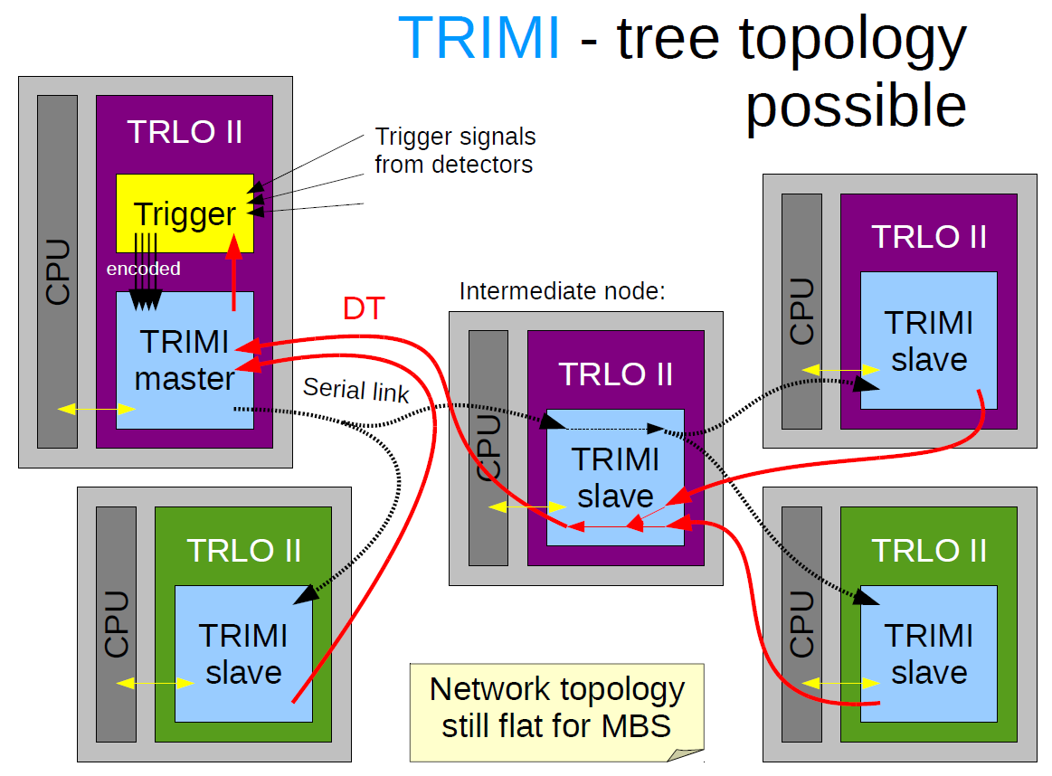
Flexible Coupling: Trigger Distribution
- H.T. Johansson, H. Törnquist, M. Heil
First tests Q4/2013

Slide 10
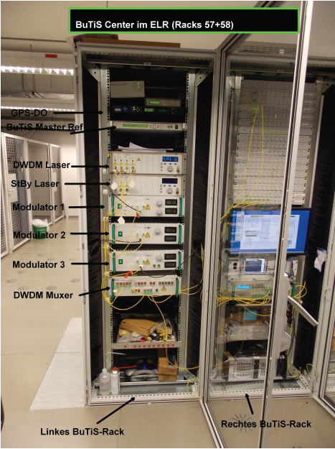
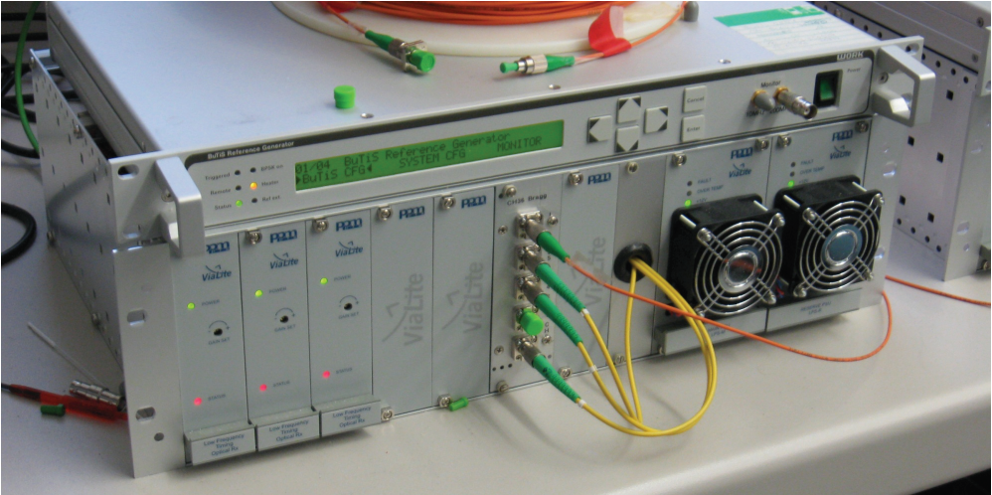
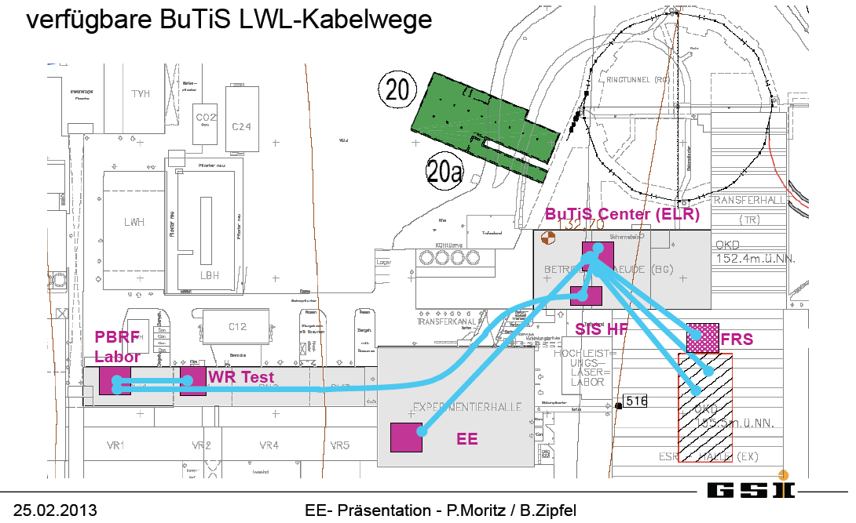
Precision Time distribution: (b) BuTiS (P. Moritz, B. Zipfel)

Slide 11
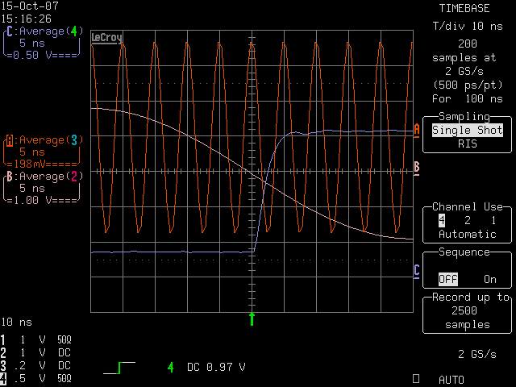
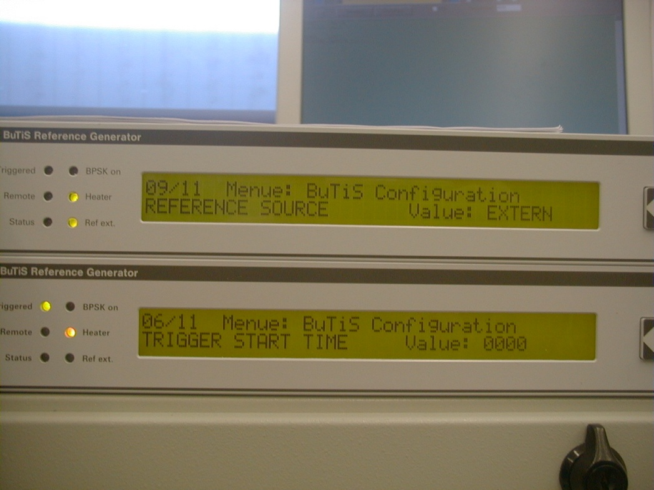
Precision timing (<50ps) vs. Campus Clock
0
1
2
3
4
5
6
7
8
9
t₀ time- stamp
several 100 m
ch. i det A
ch. j det B

Slide 12
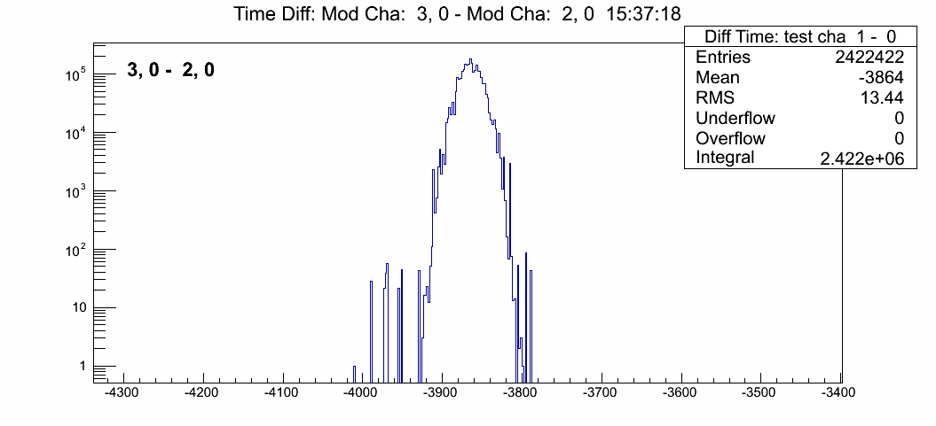
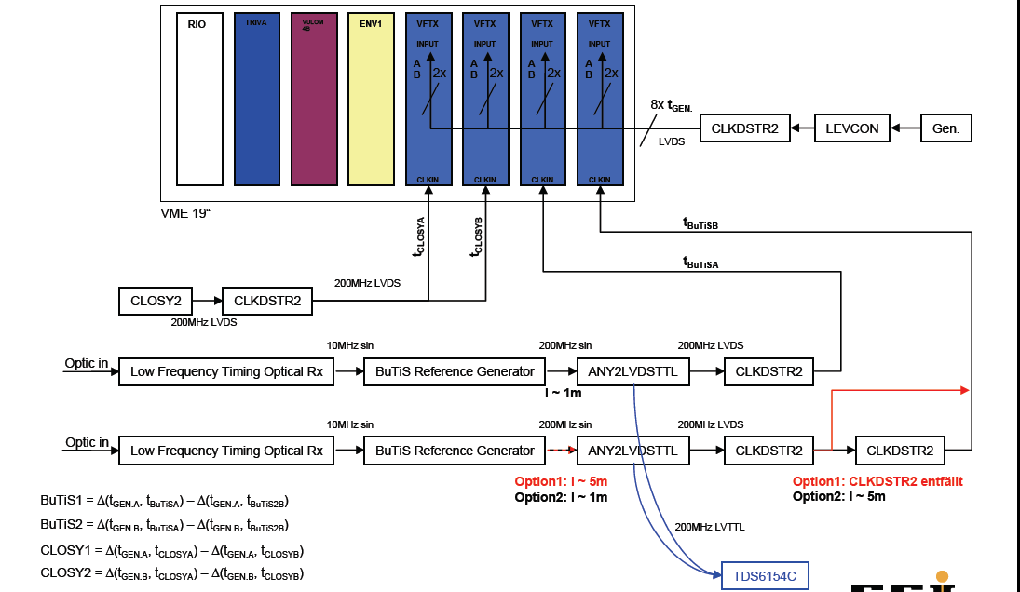
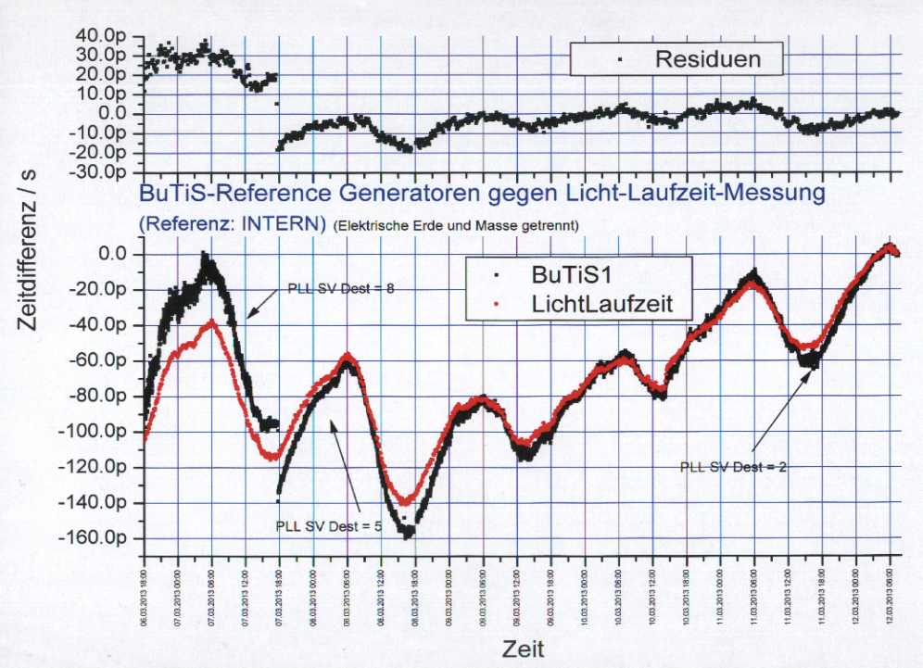
Performance: Accuracy and Precision … J. Frühauf, K. Koch, N. Kurz, P. Moritz, B. Zipfel
Q1/2013
Optical distance ~2 km!
Path compensation
Better than 50ps design goal ! Test 2014
13ps RMS
+-10ps syst.

Slide 13
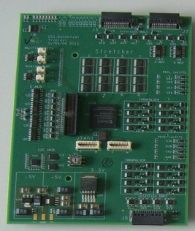
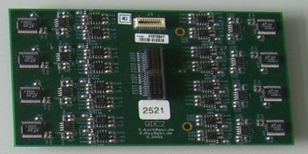
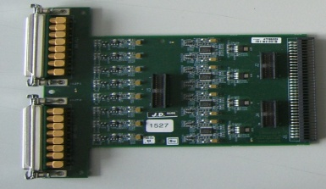
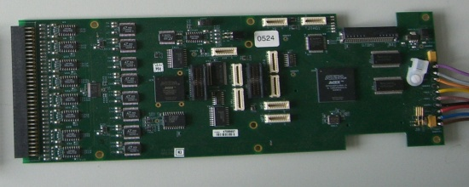
Fully Integrated Readout System: (orig. for FOPI) (K. Koch, C. Caesar/TUDA)
Tacquila
TRIPLEX
controls/monitor (new)
piggyback - QDC
LAND FEE (new)
tacquila board
(17 ch.)
complete system

Slide 14
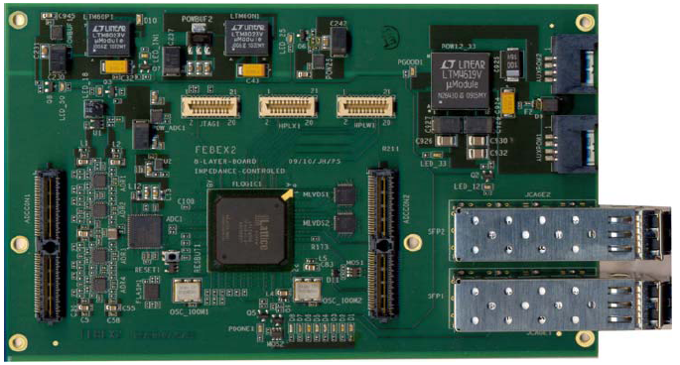
Tacquila (TAC27 ASIC) ➔ FPGA TDCs
J. Fruehauf, N. Kurz, J. Hoffmann, M. Traxler & E. Bayer (CSEE)
VME based system for SOFIA run at Cave-C: 07-09/2012
Implementation in Lattice FPGA LFE3-150 (Board → 2014)
coupling to modified FEBEX (←→Hades TRB)
readout architecture (2 fibre links)
(no SAM, no TAC27, multihit
& ToT capable :o)
TDC implementation Q4/2013.

Slide 15
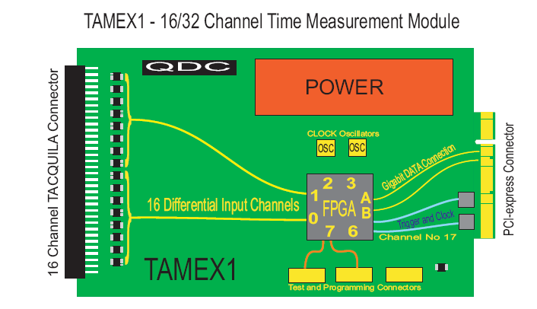
Tamex J. Hoffmann
Based on Febex:
-FPGA TDC
-Time over Threshold
-QDC interface
-48V Power
-BuTiS/Closy clock
& gate (ch. 17)
via backplane
Prototyping underway

Slide 16
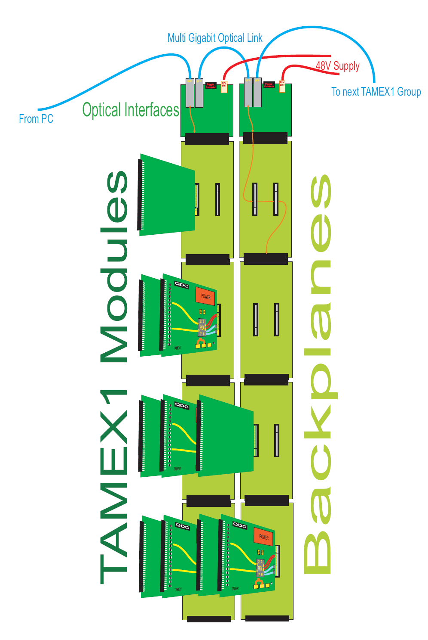
System Design (for two double planes)
No LV power distribution issues
Optical interface
Local trigger/controls
via copper (double plane)

Slide 17
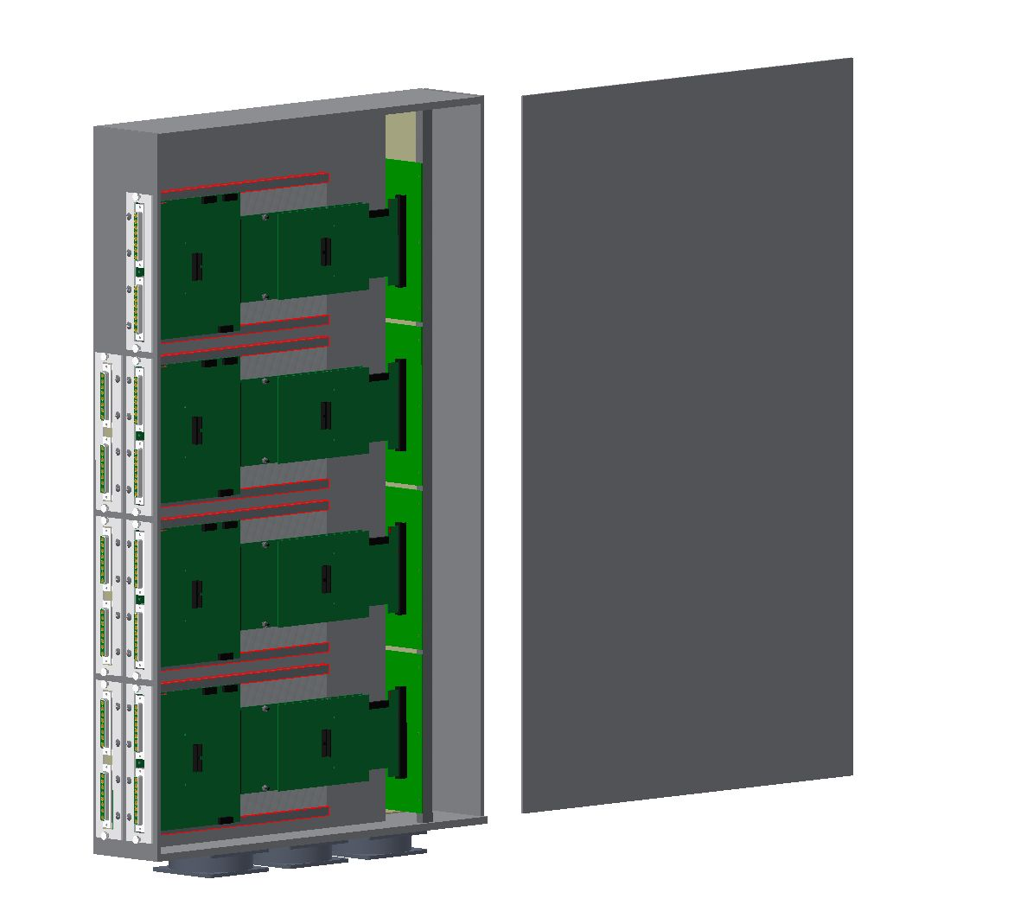
Electronics box
Void: Triplex
interface card
optional QDC
Boxes can be moved
out for maintenance
Air cooling (vertical flow)
reduced cabling through backplane!

Slide 18
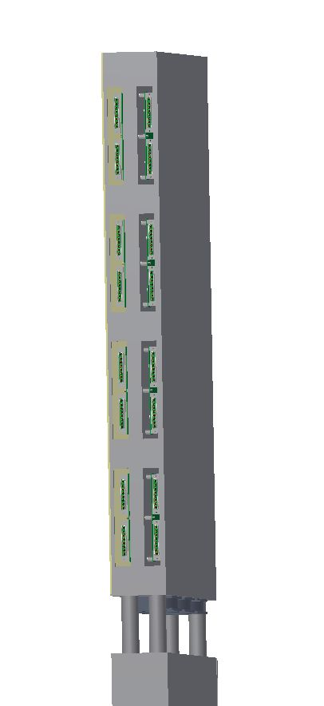
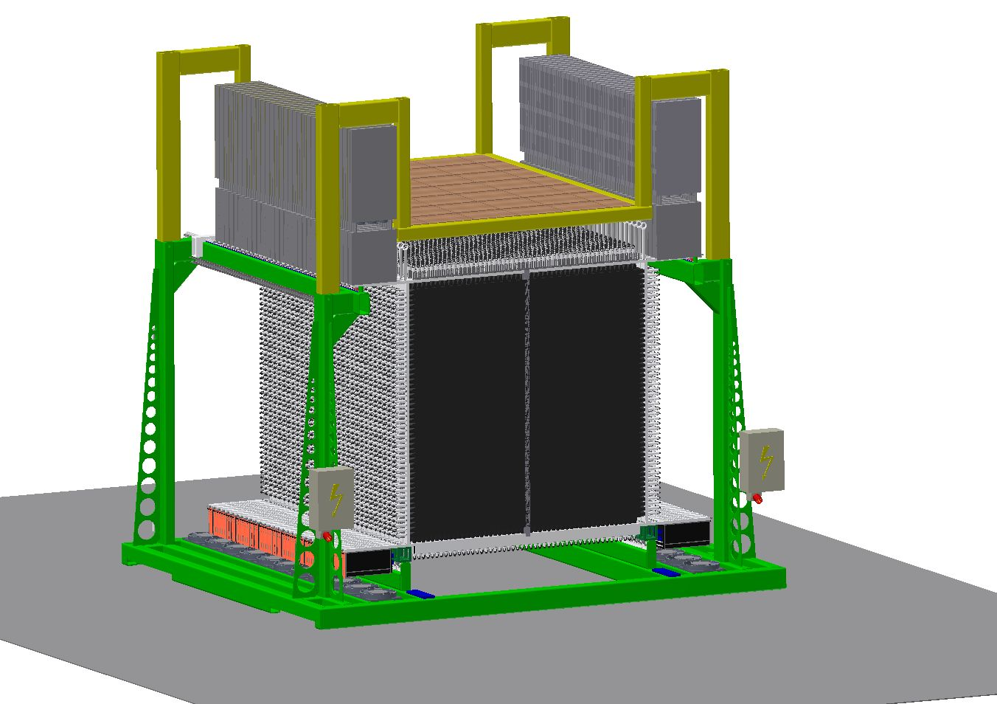
NeuLAND integration D. Körper, C. Cäsar/TUDA
←Electronics→
Self contained
Readout and
supplies
HV 2kV main supply
Controllable dividers
↑
HV
↓

Slide 19
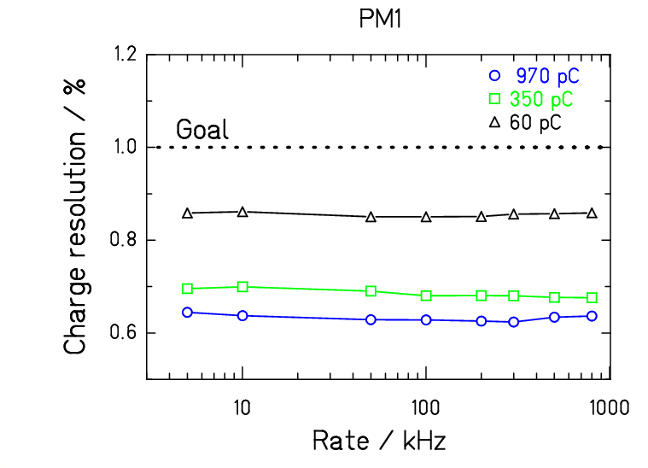
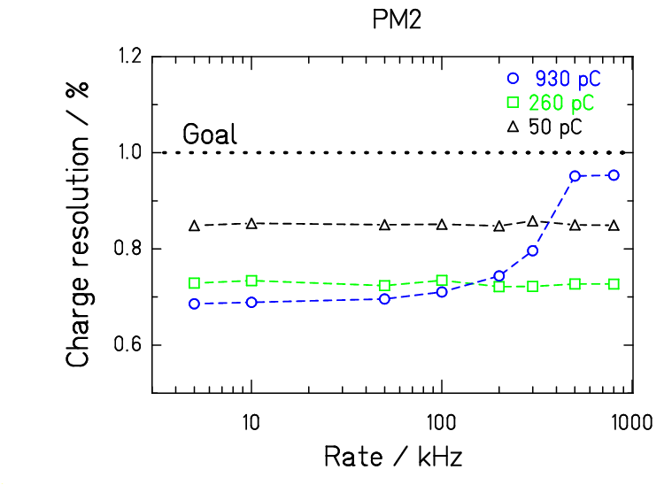
Rate dependence for ToF/ΔE measurement (Scintillator Wall)
PM1: Fully active base, PM2: 1st generation NeuLAND PM
In test: QTC (ASIC), ToT + FPGA TDC, dedicated QDC board (for reference)
large signals ➔ time resolution does not depend on tts
electronics & scintillator properties
J. Gerbig, M. Heil, A. Kelic-Heil
Notes:
I do not show PM3, as due to strong shift in the average charge, one obtains unrealisticly good resolution.

Slide 20
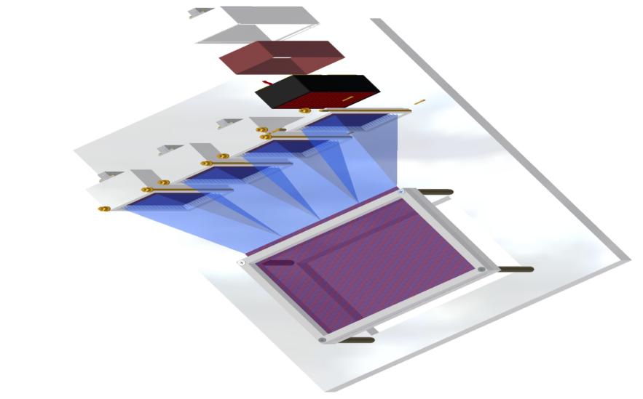
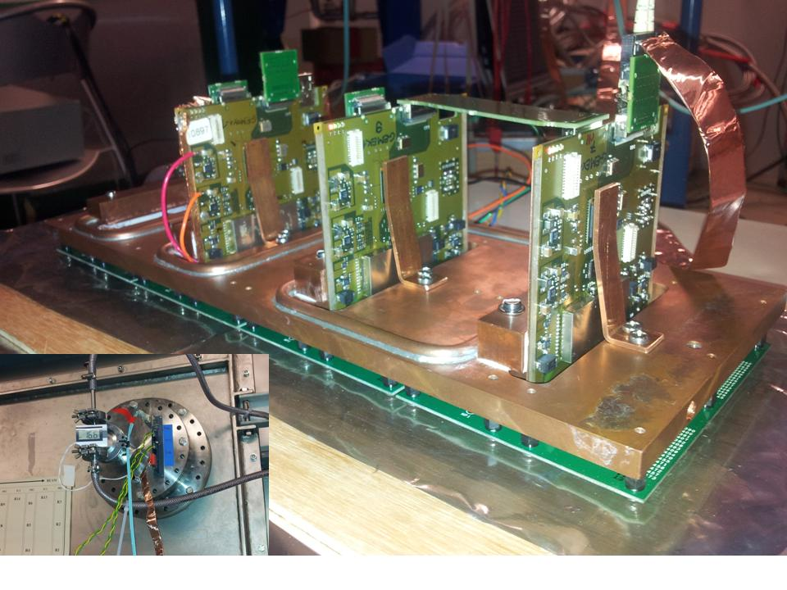
NXYTER (PMT adapted readout system)
J. Hoffmann, N.Kurz, B.Voss, P. Schrock
NXYTER Readout
(in vacuum and as MBS subsystem
→ SuperFRS/R³B) Exp: 2012/14
➔ Attenix
HM9500

Slide 21
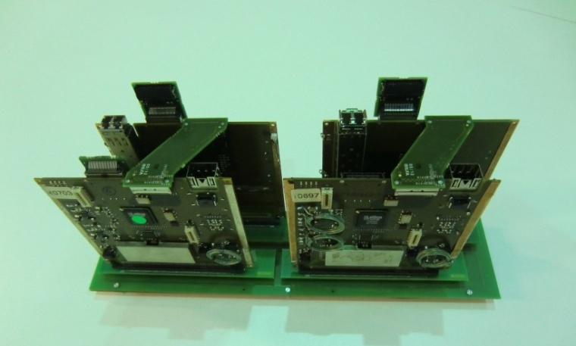
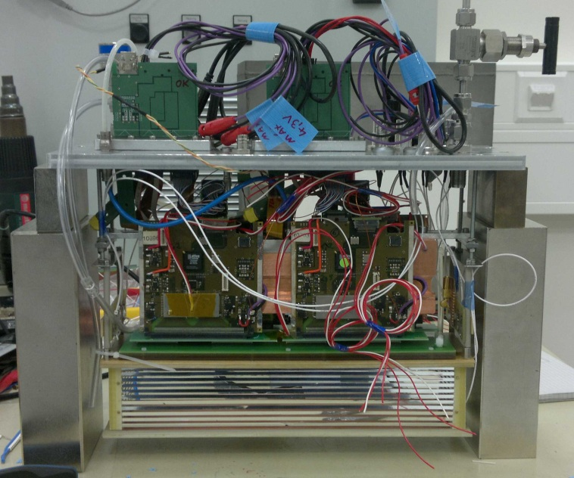
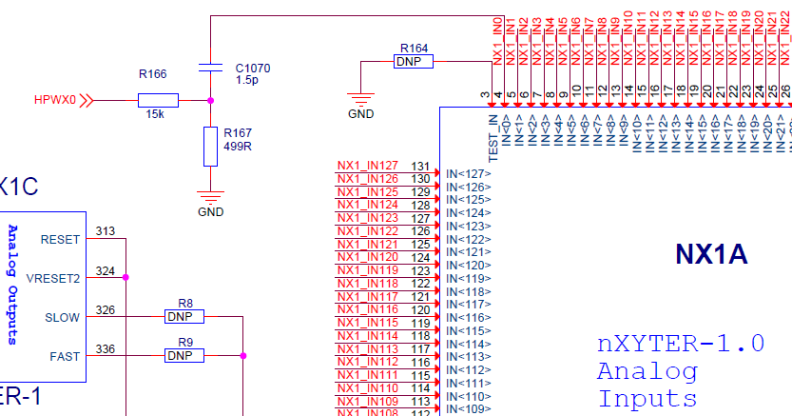
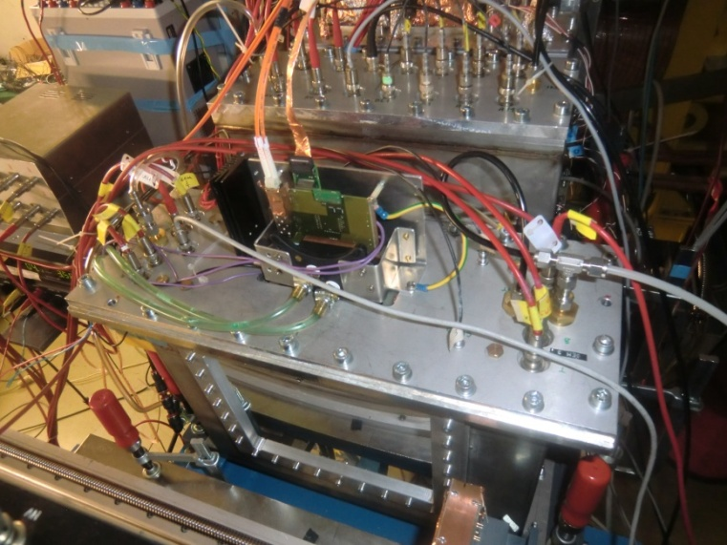
Super-FRS: Gemex V2 J. Hoffmann, N.Kurz, B.Voss, C. Nociforo, A. Prochazka, F. Garcia/HIP
Tracking Detectors (GEM TPC)
32 pieces, In-kind HIP
Noise problems
Time Correlations (free running readout)
Bonding
Board just ordered
short and long multiplet tank with quadrupoles (yellow) and sextupoles (red)

Slide 22
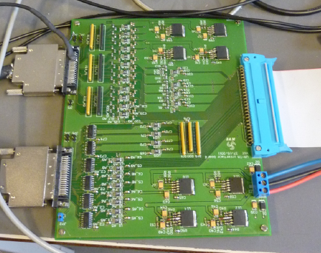
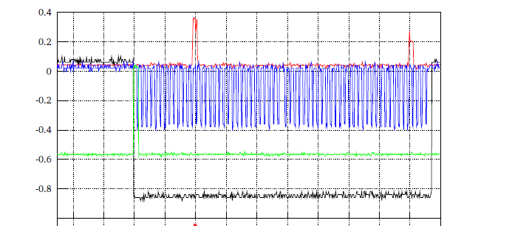
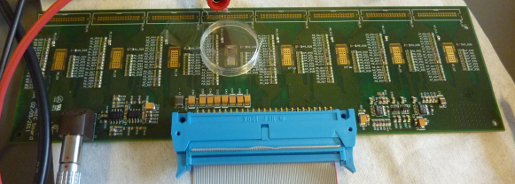
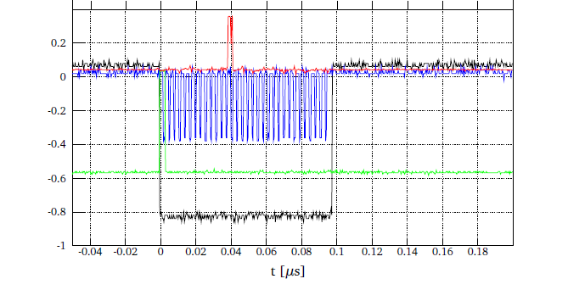
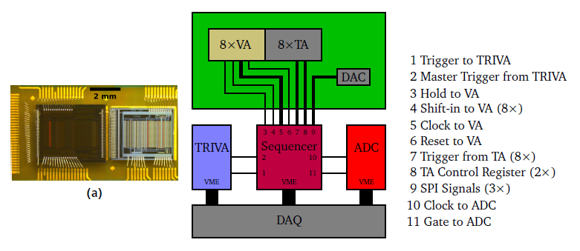
VA-TA/Si-Detector controlled by Logic Module M.Holl (PHD thesis), P. Schakel
Interface Board
VA/TA Board
(256 Channel)
Self-triggered, vacuum
compatible electronics
with sparse readout

Slide 23
Open Issues (under discussion) NUSTAR DAQ WG ➔ TDR 2014
Settings and Setup descr.:
where and how to store them ?
SCADA functionality
Feedback Loops
-Interaction with controls
Controls (EPICS)
-Interaction with accelerator controls
-Online Analysis
-Webservice based middleware

Slide 24
NUSTAR DAQ: Summary
Free configurable DAQ nodes
Time stamped
Triggered
„Foreign“ systems easily being integrated
Compact time and charge measurement systems
FPGA based TDCs
Time distribution and stamping
BuTiS precision timing
White Rabbit + lightweigth serial protocol
Frontends
Frontends Si/PMT in vacuum (NXYTER ff.)

Slide 25
Summary

Slide 26
Test Bench 20091208 (schematic)
Demonstration of BuTiS capabilities
Two Tacquila systems at two coupled BuTiS generators
Schematic View:
Tacquila
BuTiS
Diskr.
CLOSY.
#2
clk
10 MHz
T0/10µs
Tacquila
BuTiS
Diskr.
CLOSY.
#2
clk
10 MHz Function generator
‚Events‘

Slide 27
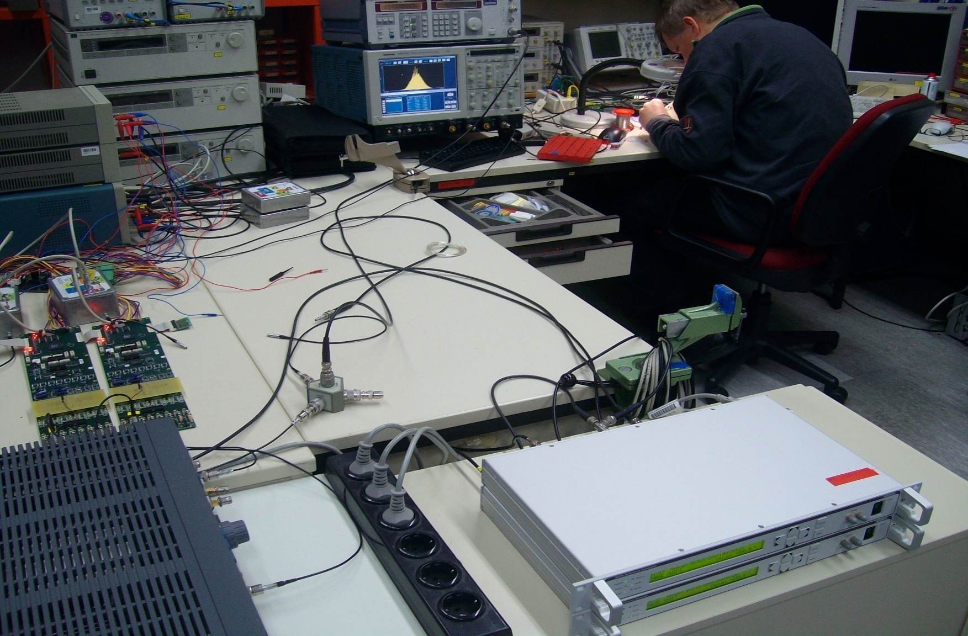
Result: Test Bench
Karsten Koch
17ps rms ch-ch
Very good
Stability !
Drift few ps/
few seconds

Slide 28
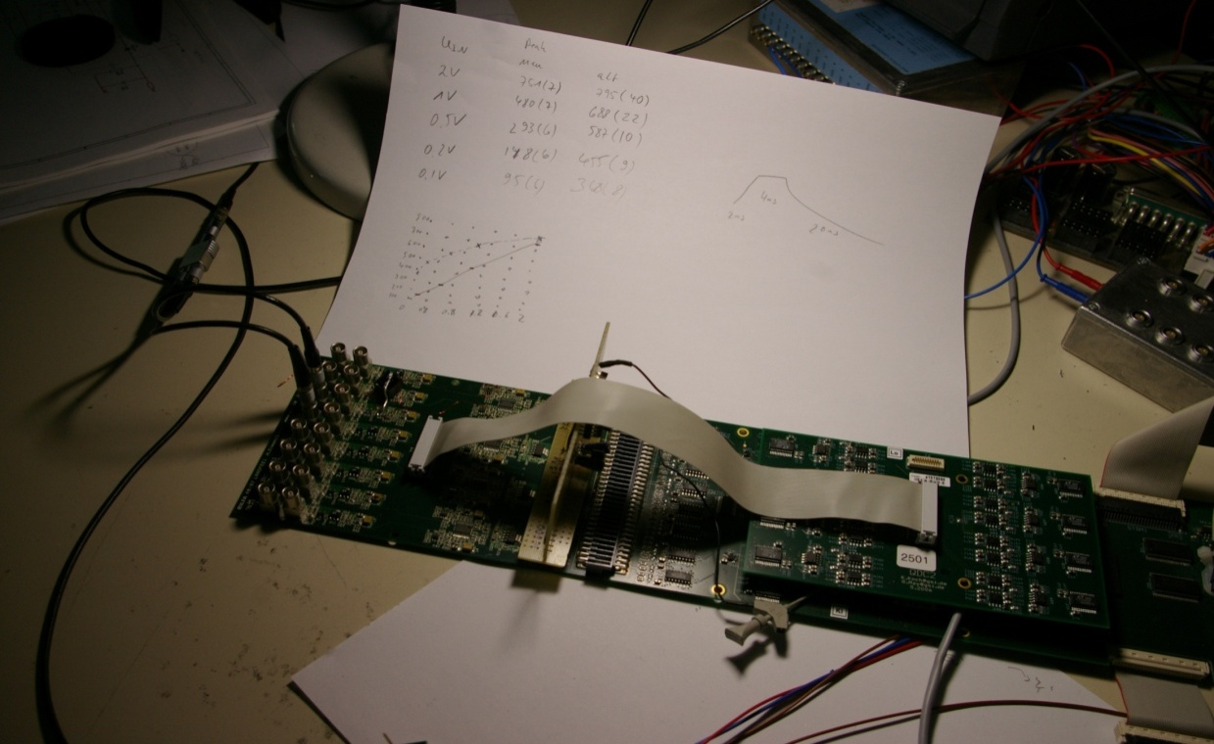
Tacquila system developments
Further changes FEE (ongoing)
Production run 2012
→ NeuLAND test (ok)
& New Network
Triplex Controler
Next step
FPGA TDC
(Talk: J. Taieb)

Slide 29
FEC (Front End Card) changes → ( 1V → 150mV)
Splitter *3
QDC
→ADC Reference
Voltage change
*2.5
T
Discriminator
(leading edge)

Slide 30
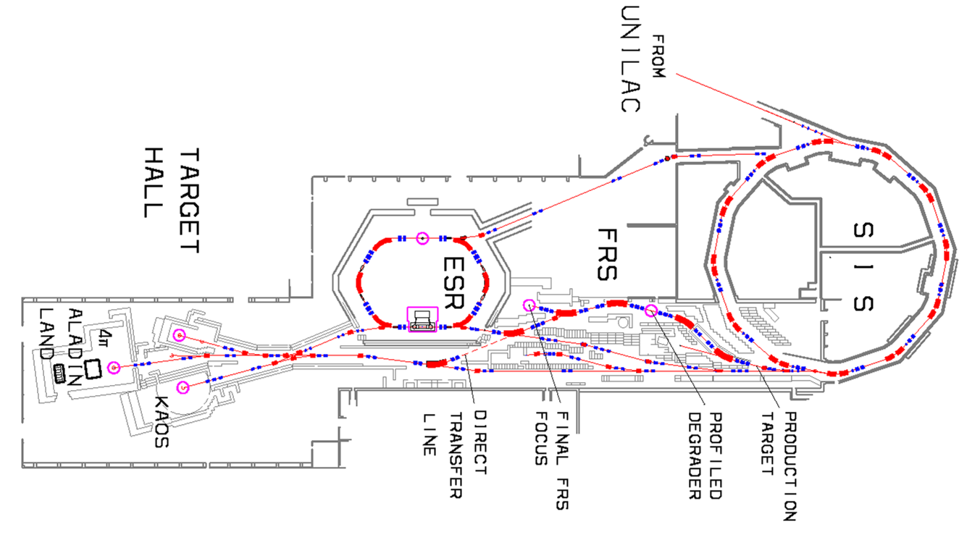
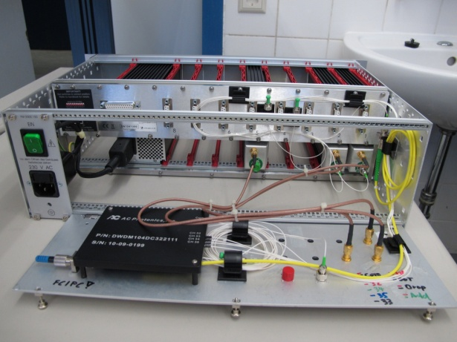
BuTiS status
0
1
2
3
4
5
6
7
8
9
t₀ time- stamp
several 100 m
ch. i det A
ch. j det B
Master
North
Build.
07/12: All BuTiS generators in house
11/12: 4Receiver stations ready.
Master: Q4/2012
→ connected to CSEE
R³B
Cave-C
Interm.
Focus→
Cave-C
End-focus
Mid-focus

Slide 31
Software ff.: New VME library
A. Charpy, B. Löher, H. Johansson (CTH&EMMI)
RIO4(r4-12)
{
multi_event_mode = true; // hmm, more global than this rio even?
VME_CRATE(crate1)
{
CAEN_V775(tdc1)
{
address = 0x00400000;
virtual_slot = 1;
setting_xy = 100 ns;
[…]
}
CAEN_V785(adc1)
{
address = 0x00410000;
virtual_slot = 2;
}
}
}
DAQ mode
Parsed Config file
→ no compilation !
sane defaults
Features:
Config check &dump
Test programmes
Module setup

Slide 32
Linear FEE - 20111012
GALI Amplifier
replaced by
transformer

Slide 33
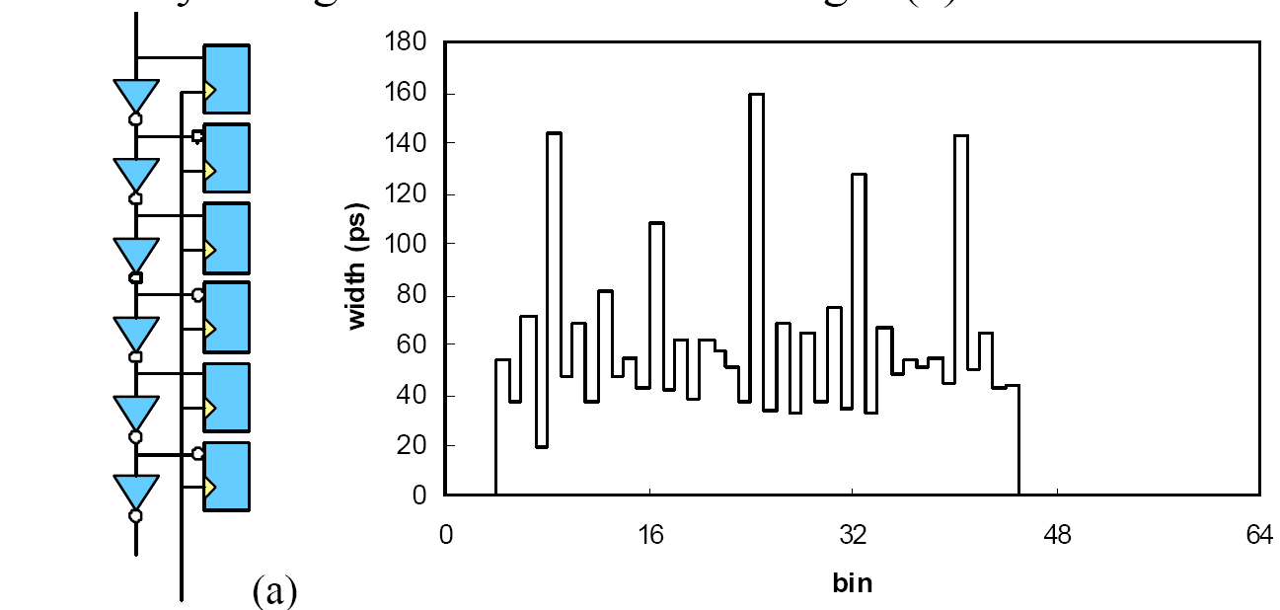
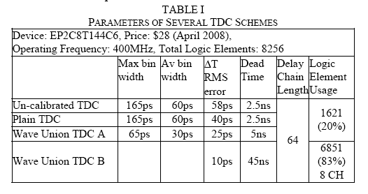
Further steps: FPGA TDC; replacing TAC27 ASICS ➔ multihit/deadtime-free readout
The 10-ps Wave Union TDC:
Improving FPGA TDC Resolution beyond Its Cell Delay
Jinyuan Wu and Zonghan Shi
IEEE Nuclear Science Symposium Conference Record, 2008. NSS '08.
GSI implementation
E. Bayer, M. Traxler,
N. Kurz
Altera Cyclone II device (EP2C8T144C6)

Slide 34
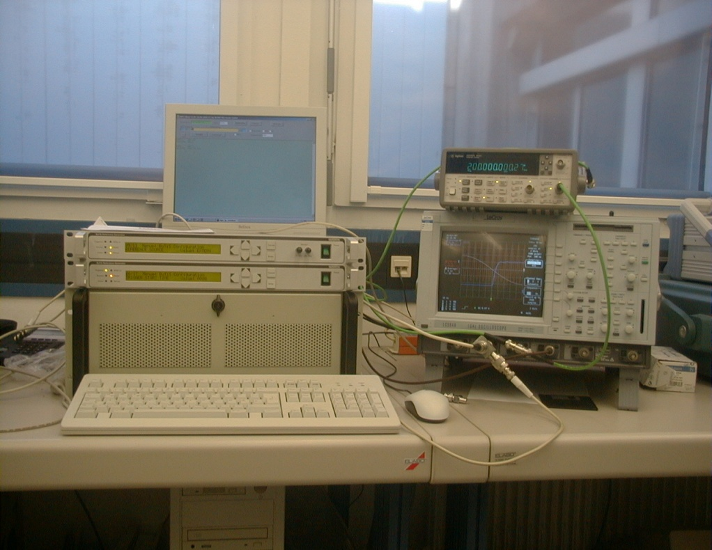
Campus wide time distribution (BuTiS) P.Moritz/GSI
Campus wide time distribution via fibre optics / local TDS(s)
Synchronized local oscillators (10kHz, 10Mhz, and e.g. 200, 155 or 76 Mhz) with +/-100ps/km absolute uncertainty and << 10ps oscillator jitter

Slide 35
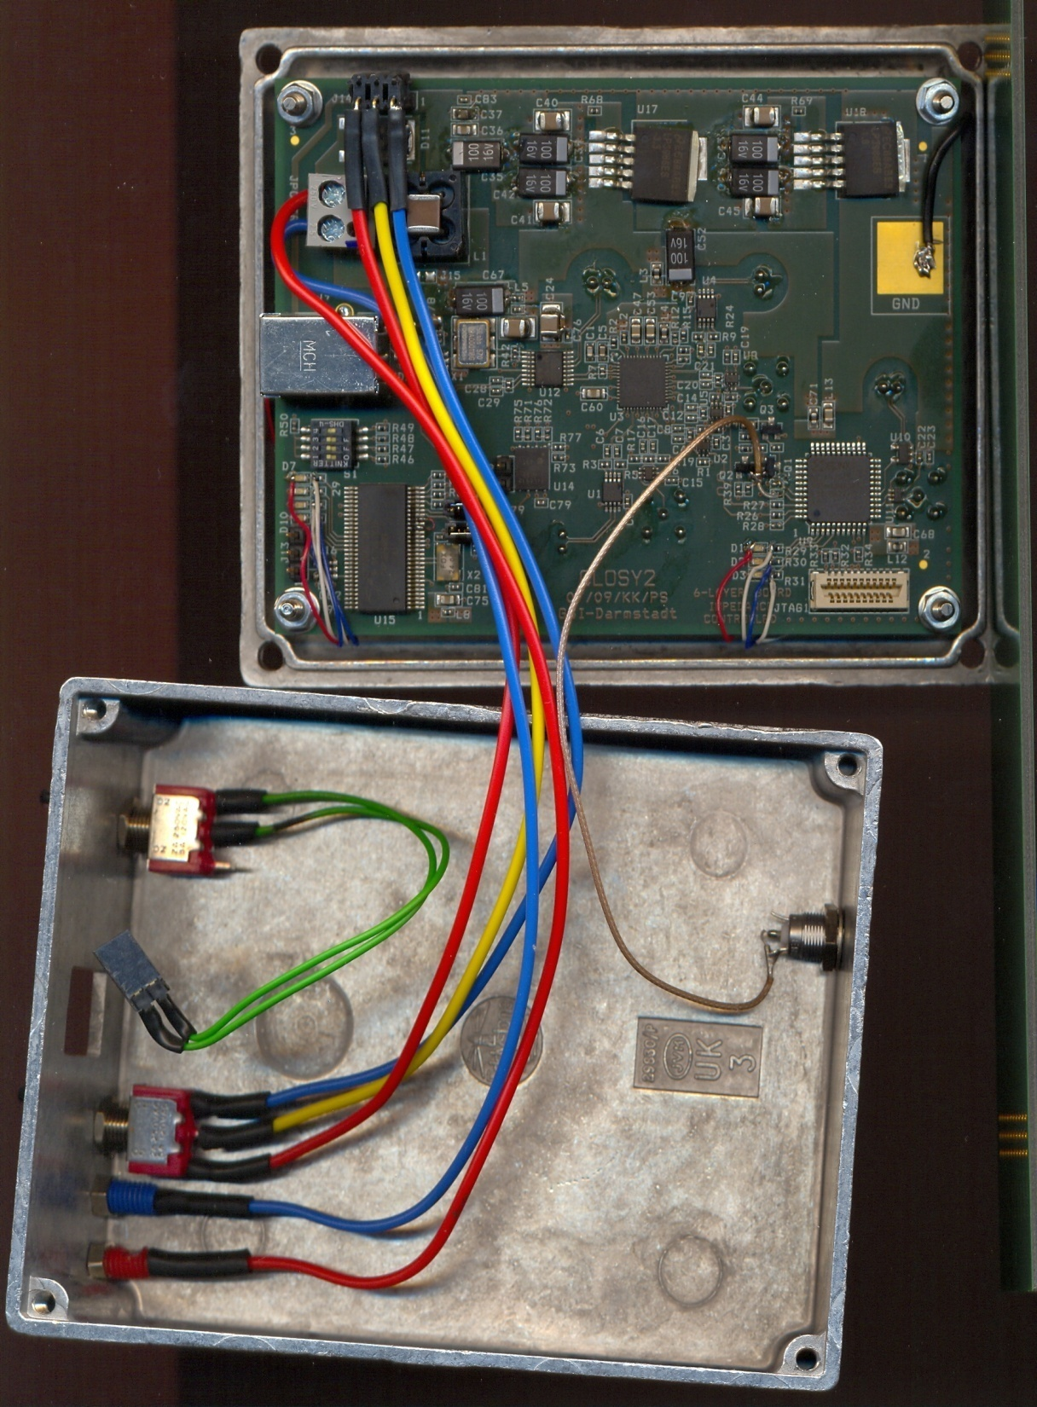
CLOSY (modified CBM prototype)
PLL based clock divider
input range limited ➔ CPLD stage
Butis: division/5
➔ 200 MHz to 40 MHz
for Tacquila
Discriminator:
K. Koch 20091001
H. Simon ● 20091210 ICC Electronics

Slide 36
Test bench on larger scale
Master
North
Build.
BuTiS receiver installation 9/2011 White Rabbit asap (VME implementation)
R³B
Cave-C
Interm.
Focus→
Cave-C
End-focus
Mid-focus

Slide 37
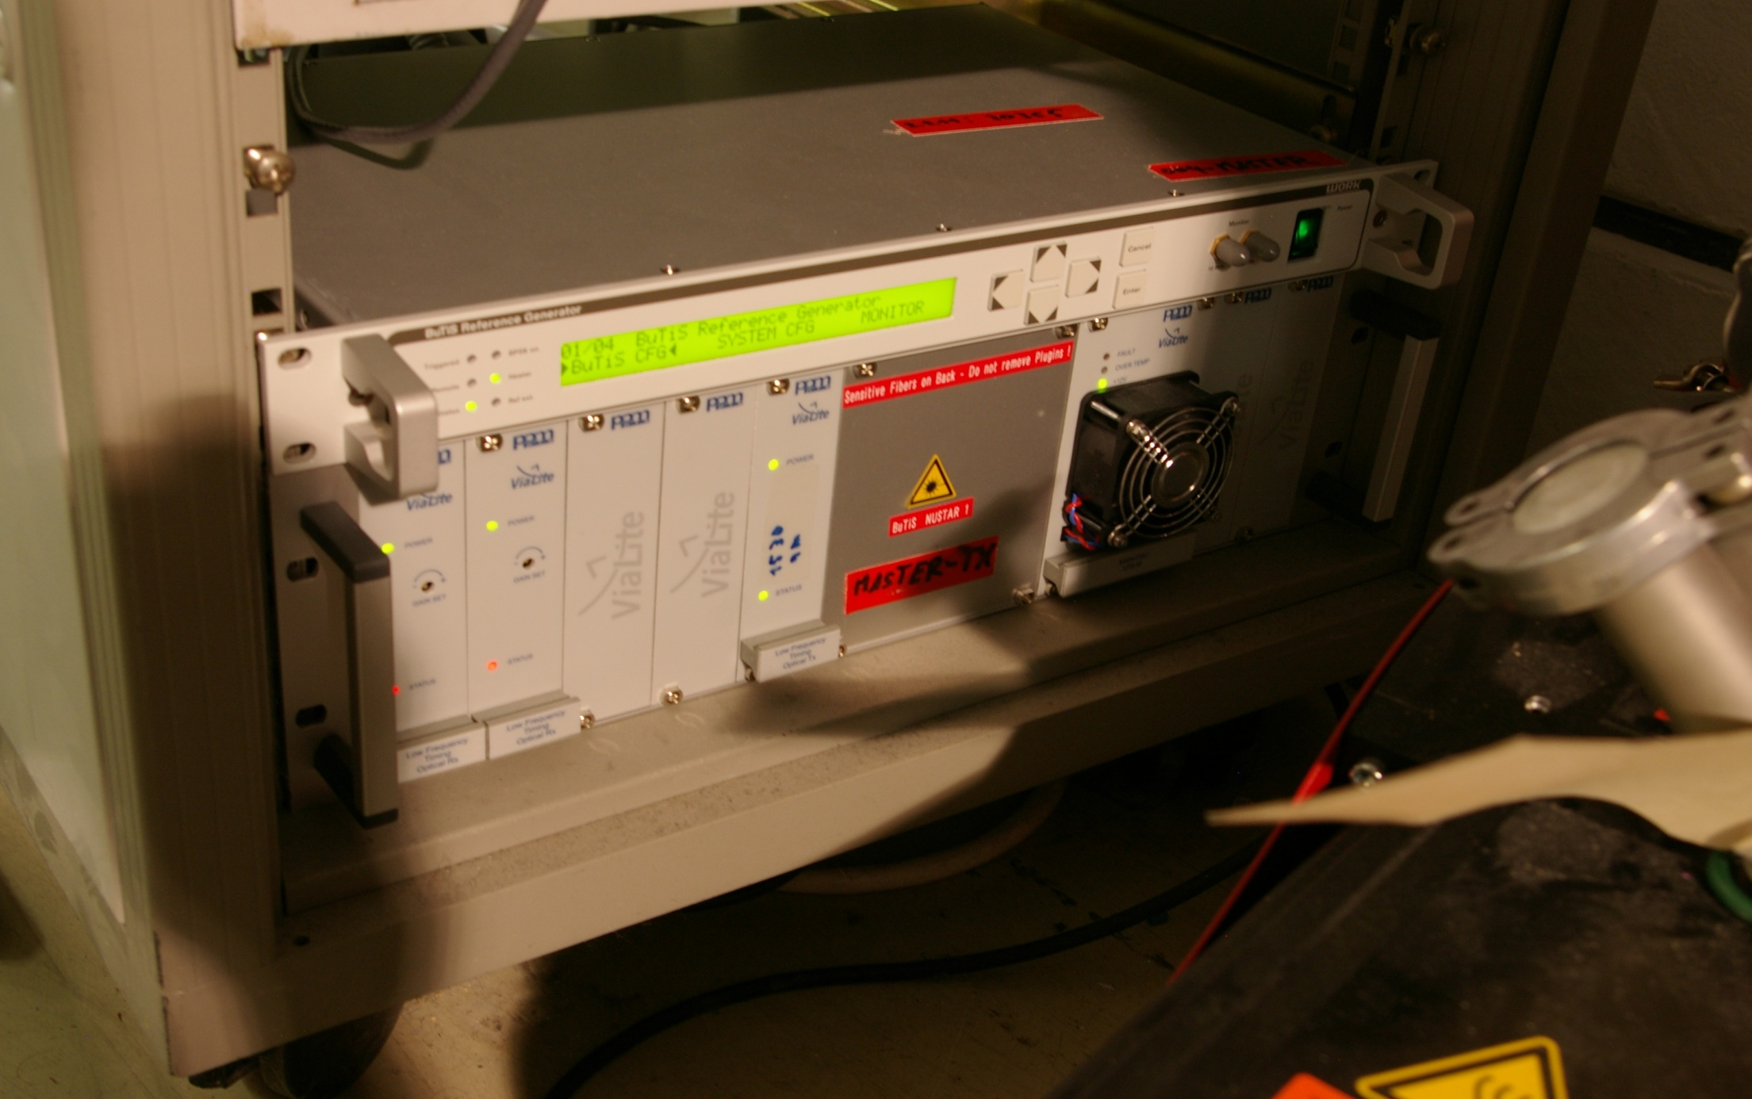
First steps 09/2011 field test (J. Taieb/J. Belliure test exp.)

Slide 38
Optical Receiver Station Prototypes: 6/2011

Slide 39
Event labels: White Rabbit T. Włostowski/CERN
Extension to Ethernet providing
A common clock via synchronous ethernet + compensation from PHY clock (PTPv2@125MHz IEEE1588 + compensation) 10MHz with ~1ns precision and ~100ps accuracy
A real time Protocol with guaranted latency

Slide 40
Rate dependence of charge measurement (Scintillator Wall)
The figures show the dependence of the average charge measured by a QTC + multihit TDC on the pulser frequency for three different PMs.
PM1: 2nd gen. NeuLAND PM (fully active base), PM2: 1st gen. LAND PM, PM3: old NTF PM.
M. Heil
A. Kelic-Heil
Notes:
I wrote here that y axis in channel is, although it was calibrated in ns. But, as in different QTC sensitivity ranges the same values in ns leads to different charges in pC and we cannot show all this in the figures, I thought in order to avoid confusion I write it in channels.

