Slide 1







Status of R³B
Stefanos Paschalis
for the R³B Collaboration

Slide 2
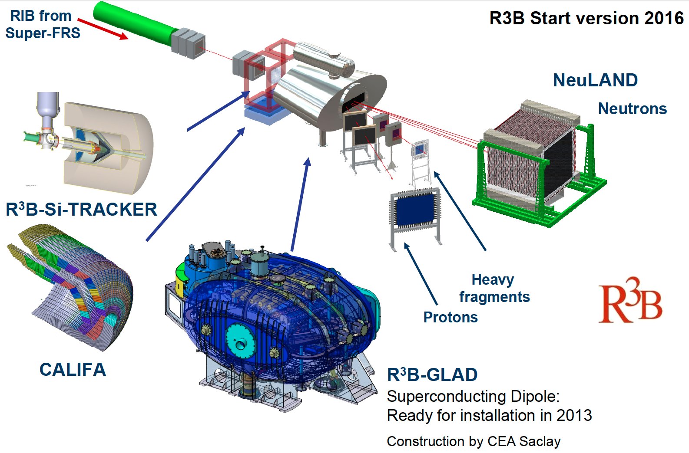
R³B
Reactions with Relativistic Radioactive Beams
Addresses:
nuclear reactions
nuclear astrophysics
structure of (exotic) nuclei
neutron-rich matter
kinematically complete measurements of nuclear reactions
invariant mass
high beam energies: ∼100–1000 MeV/u
high energy branch of SuperFRS

Slide 3
R³B
Reactions with Relativistic Radioactive Beams
Key Components:
GLAD: large acceptance dipole magnet
NeuLAND: Large area neutron detector (time-of-flight spectrometer)
Target recoil detector: Si Tracker + CALIFA
    CALIFA: /p Calorimeter-spectrometer
    Si Tracker: high-precision tracking of high-energy protons
  Heavy-ion tracking detectors
  Active Target
  ELENS: Low-energy neutron detector
  DAQ, slow control
  Simulation
  Infrastructure
  HRS: High-resolution spectrometer

Slide 4
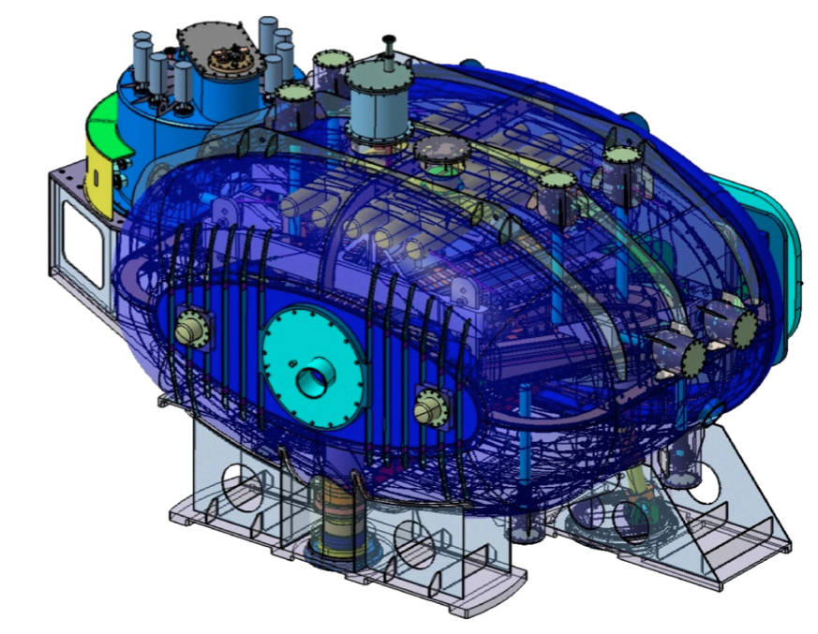
Large-acceptance superconducting dipole magnet GLAD
WG leader: H. Simon
at CEA: Ch. Mayri, W. Korten
Slides on GLAD by H. Simon

Slide 5
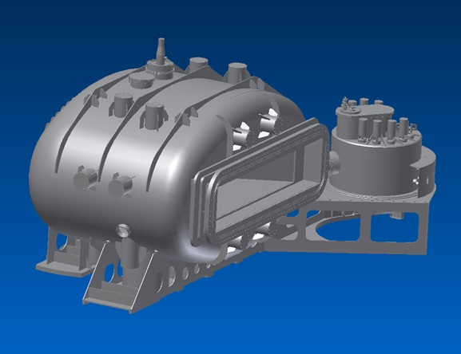
Large-acceptance superconducting dipole magnet GLAD
Magnet parameters:
Large vertical gap ± 80 mrad
High integrated field of 4.5 Tm
Fringe field at the target position less than 20 mT
Operational temperature 4.6 K
The overall size of the conical cryostat: 3.5 m long, 3.8 m high and 7 m wide.
Magnet financing (GSI contribution):
EU contract: 4.5 M€ / GSI & CEA Saclay
Cryocomplex for the GLAD magnet (475 k€) BMBF
Completion of GLAD (cryostat) (1.8 M€)
BMBF
Vacuum-chamber (190 k€) State of Hesse
Power supply (190 k€) State of Hesse
Technical drawing of the GLAD magnet.
Cold mass built at the CEA Saclay (France).
Notes:
5
1

Slide 6
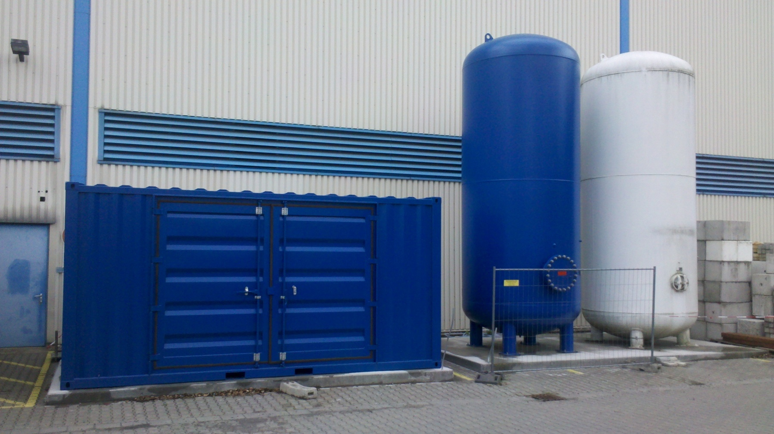
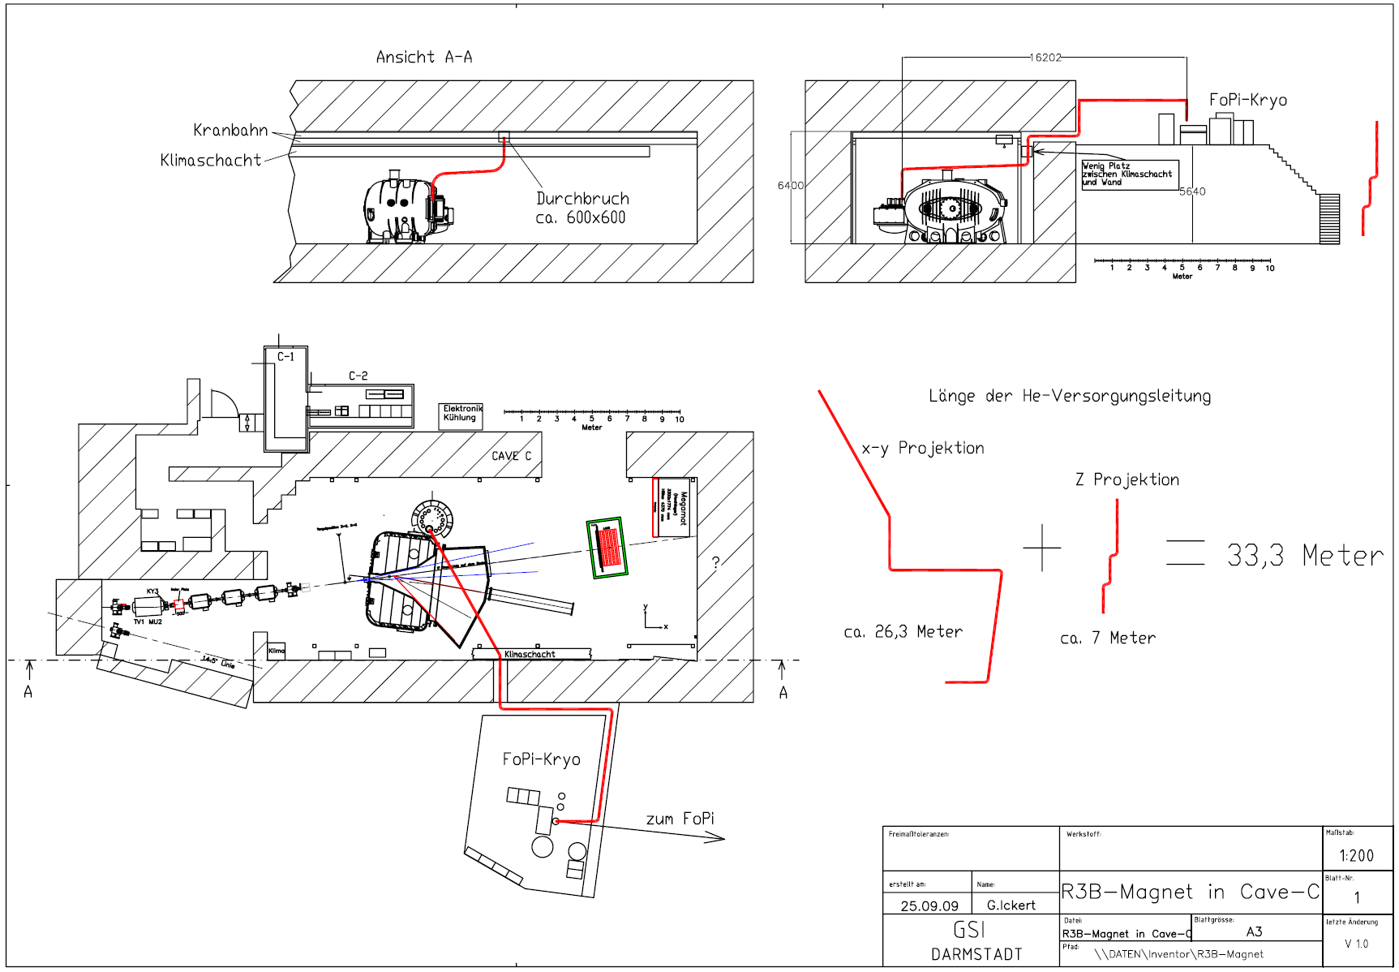
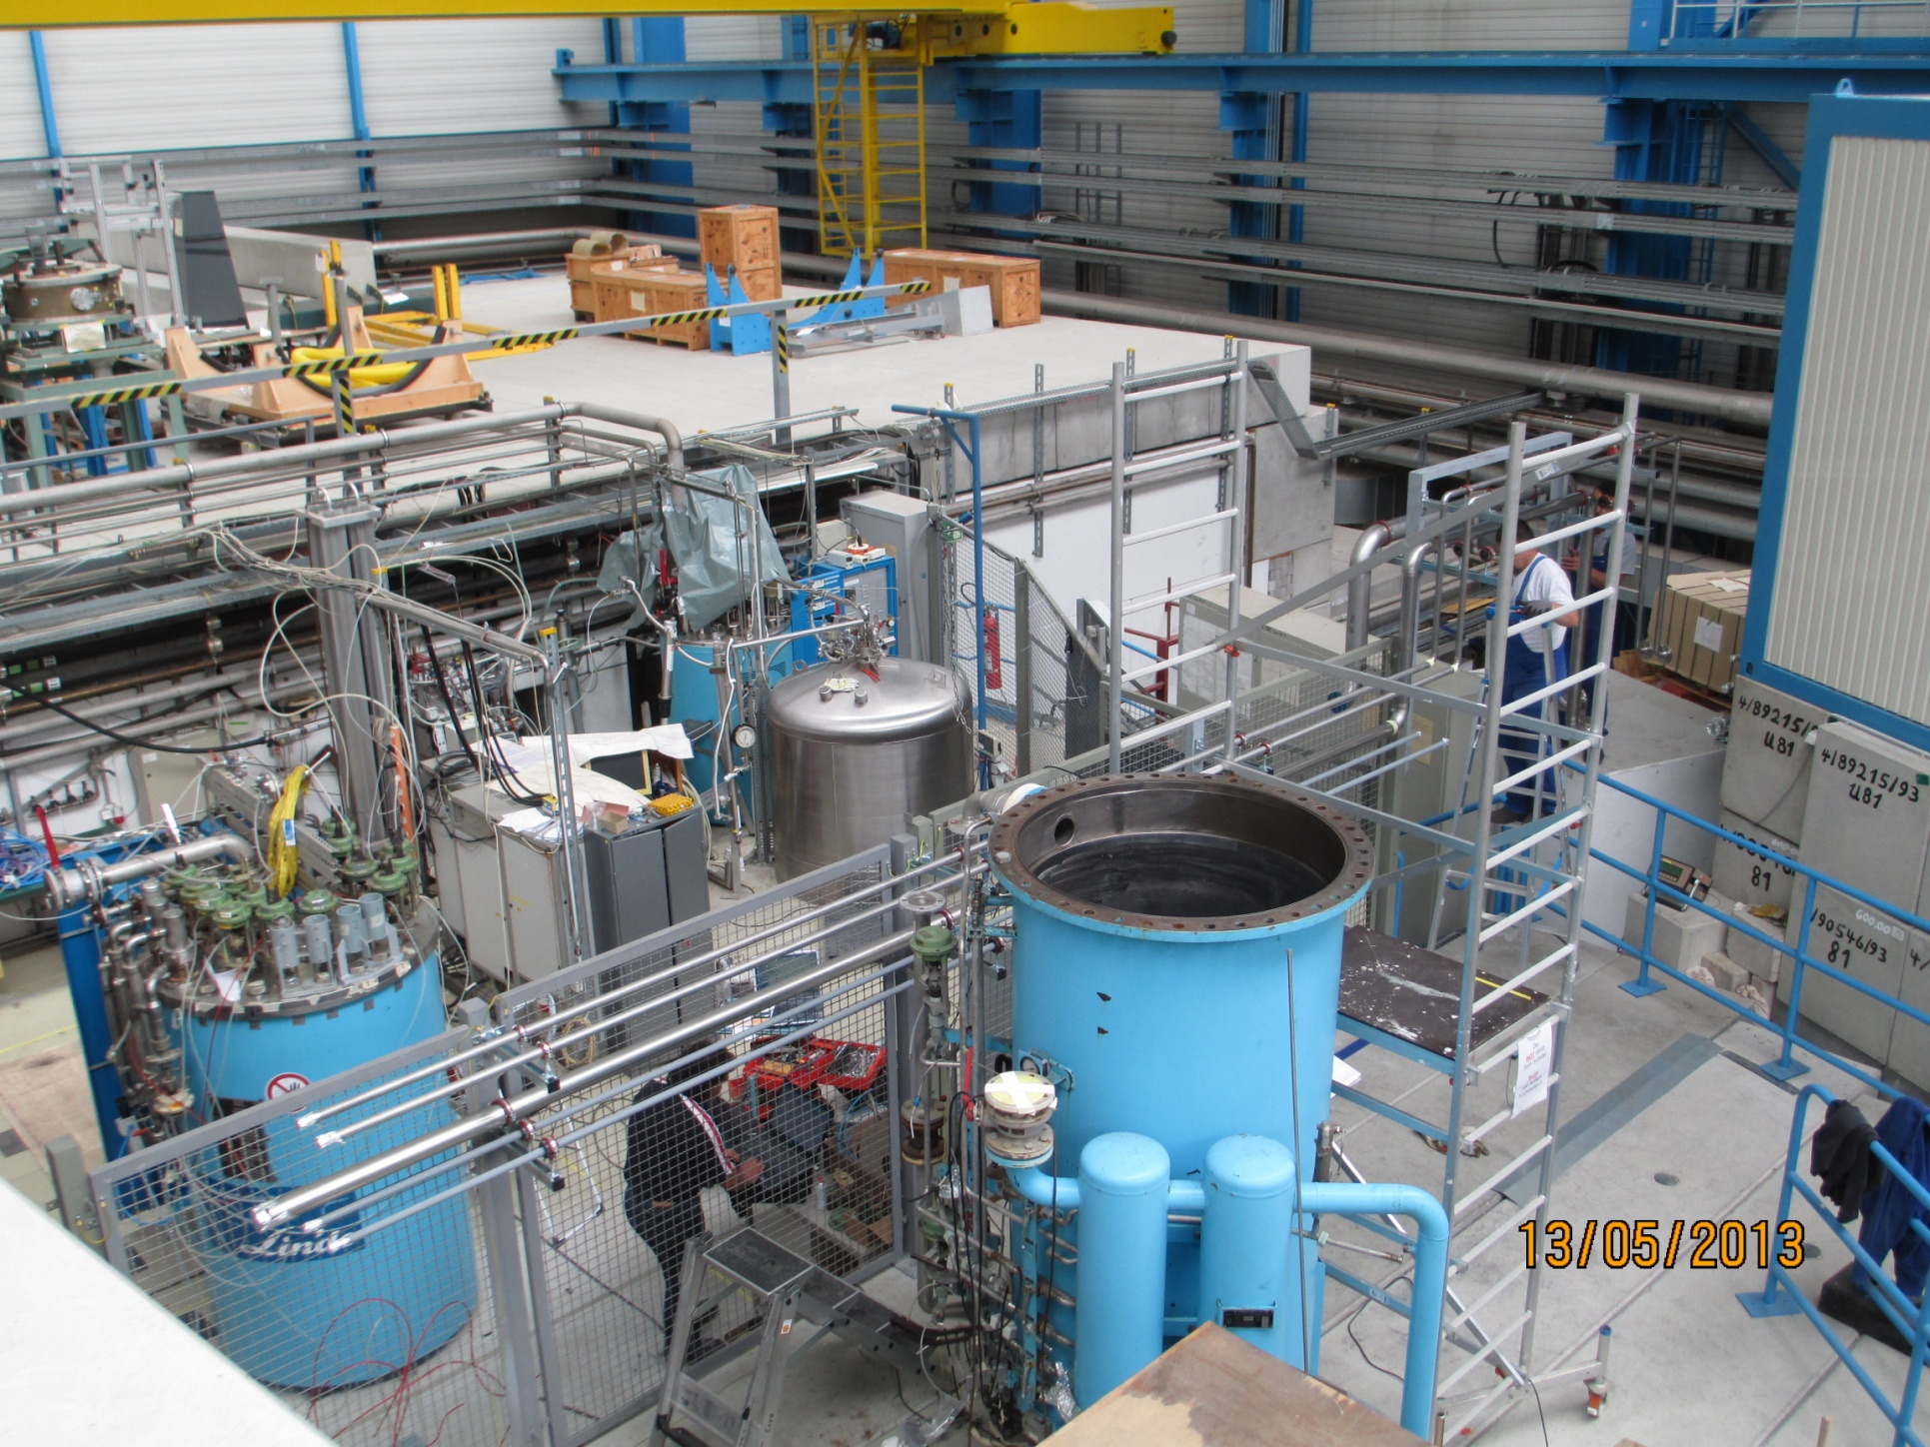
GLAD cryosystem - Completed production
Cryoplant - container containing compressor and helium buffer tank
Cryoinfrastructure is being refurbished.
Cryolines (total length 33.3 m) are on site.
Notes:
6
1

Slide 7
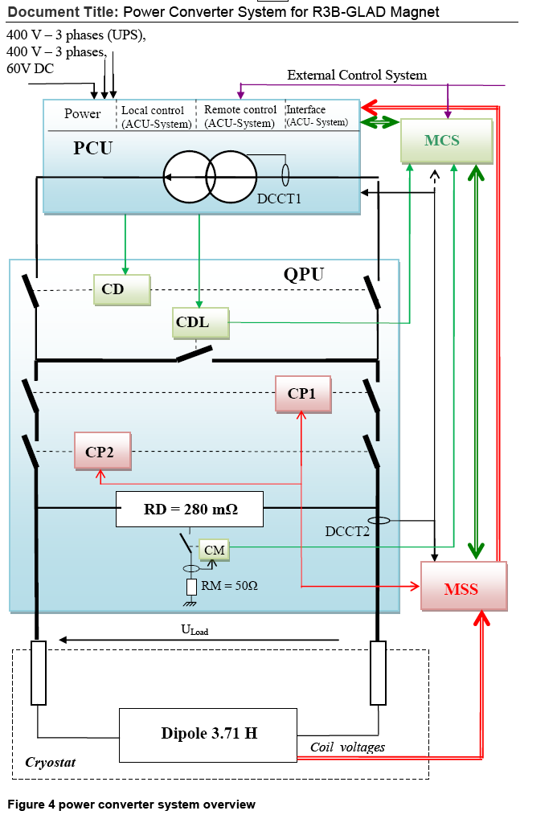
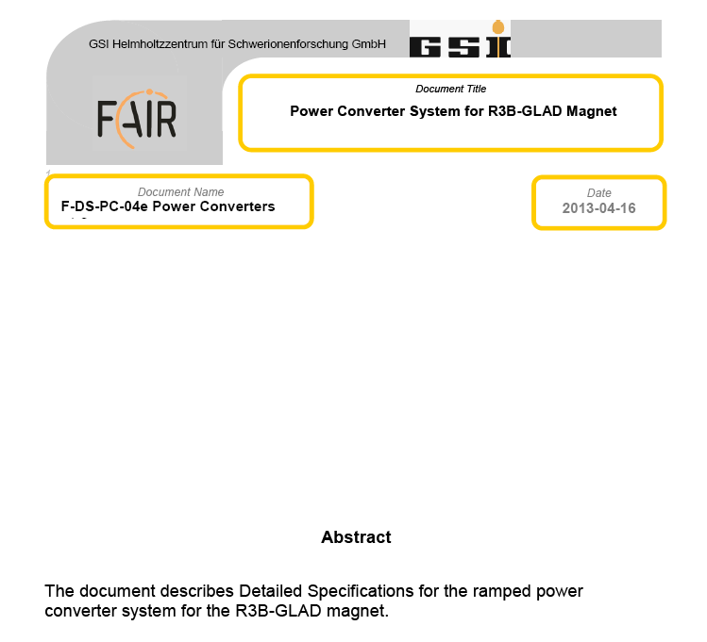
GLAD power supply – Completed procurement
Deatailed specifications have been aproved
by CEA:
The power supply system has been ordered ➔ 12.12.2013 Supplier chosen. Delivery Q2/2014.
Notes:
7
1

Slide 8
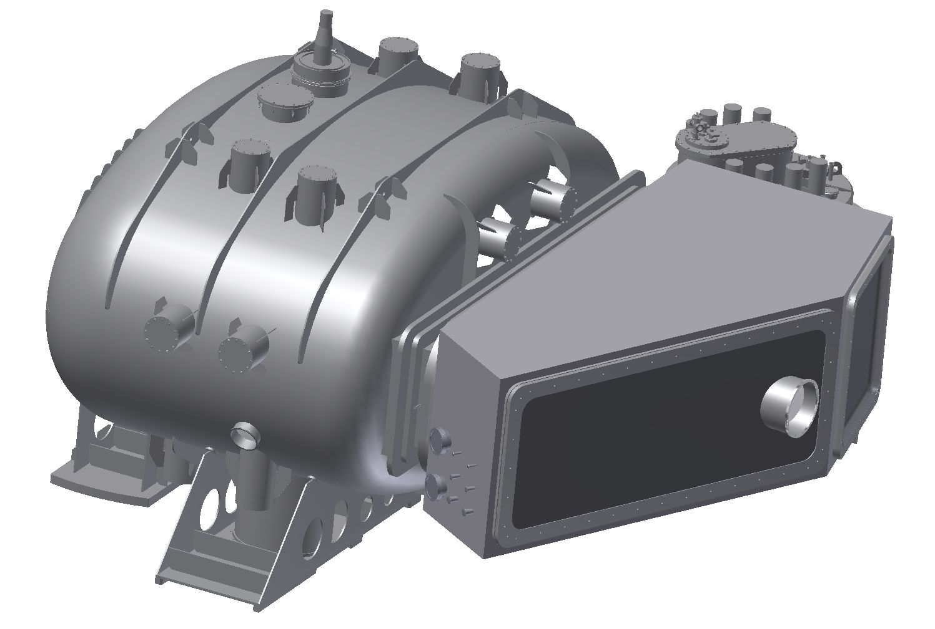
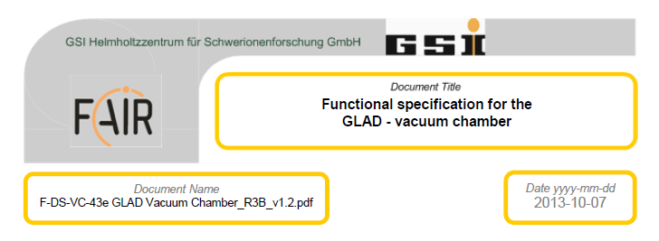
GLAD - Vacuum Chamber
Specifications ok.
Cost estimate 190 k€.
Tendering closed on 2.12.2013,
order placed for 202k€.
Expected delivery Q2 2014.

Slide 9
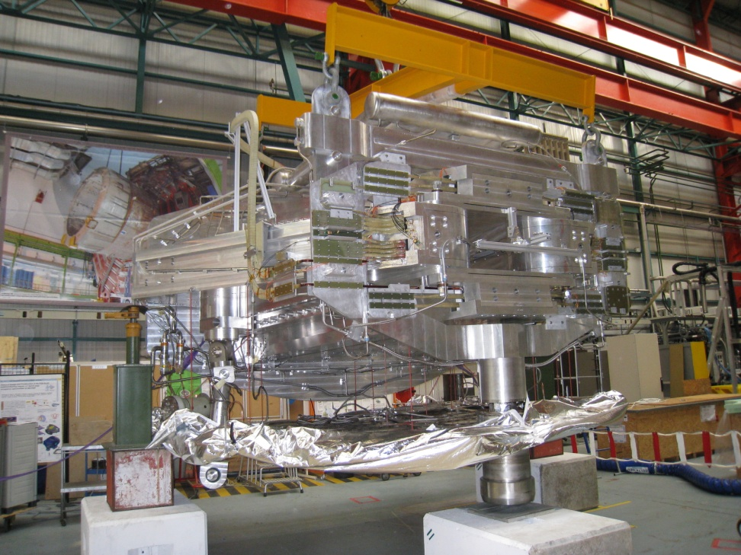
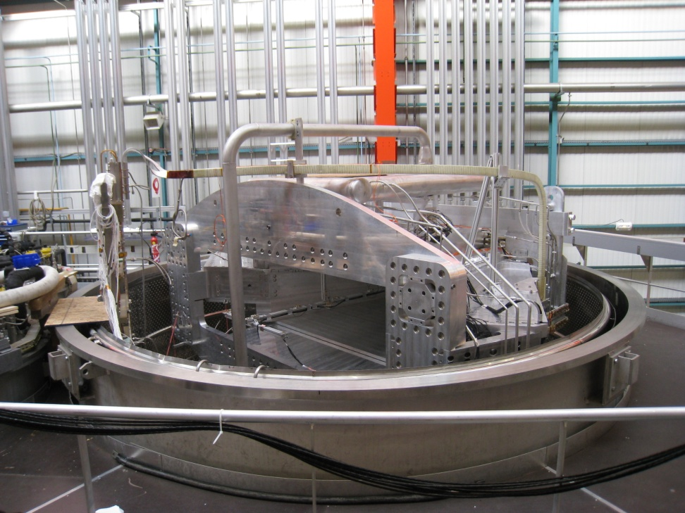
GLAD magnet – Started production
Magnet has been designed and built at CEA/Saclay
Cold-mass tests has been successfully ended at CEA/Saclay in December 2013.
Coil tests successful: nominal current of 3584 A reached on 5.12.2013.
Magnet should be delivered to GSI Q3/2014. Mitigating actions in process.
Test cryostat setup built at the CEA/Saclay: cold mass outside (left) and inside the test cryostat (right).
Notes:
9
1

Slide 10
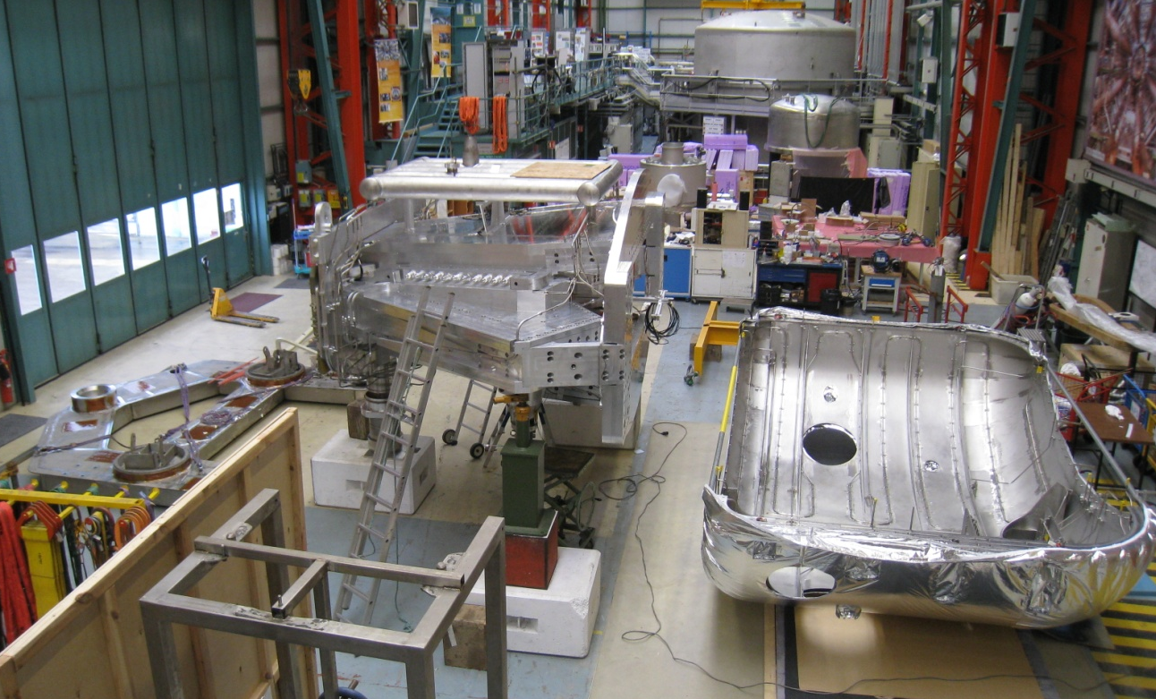
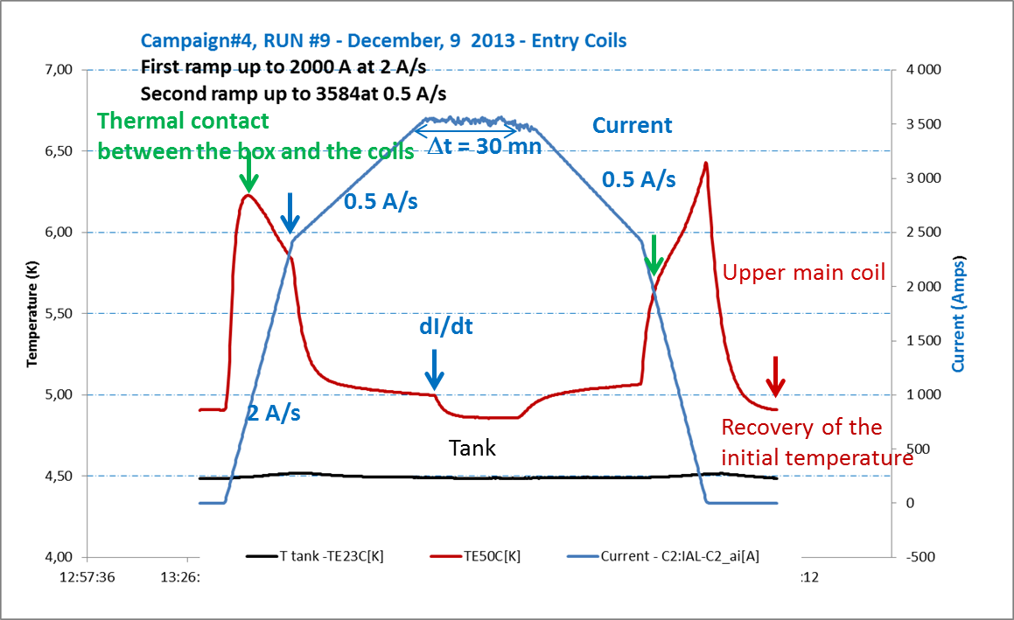
RB-RB Status – GLAD magnet
Magnet cold mass ready and tested.
Integration into cryostat Q1/2014.
Delivery to GSI expected Q3/2014.
preliminary
Cryoplant has been installed at the GSI site. Cryolines already on site.
Successful Compressor test January 2014. Cryoplant operation Q1/2014.
The power supply ordered Q4/2013.
Delivery Q2/2014.
Vaccum chamber ordered Q1/2014.
Delivery Q2 2014.

Slide 11
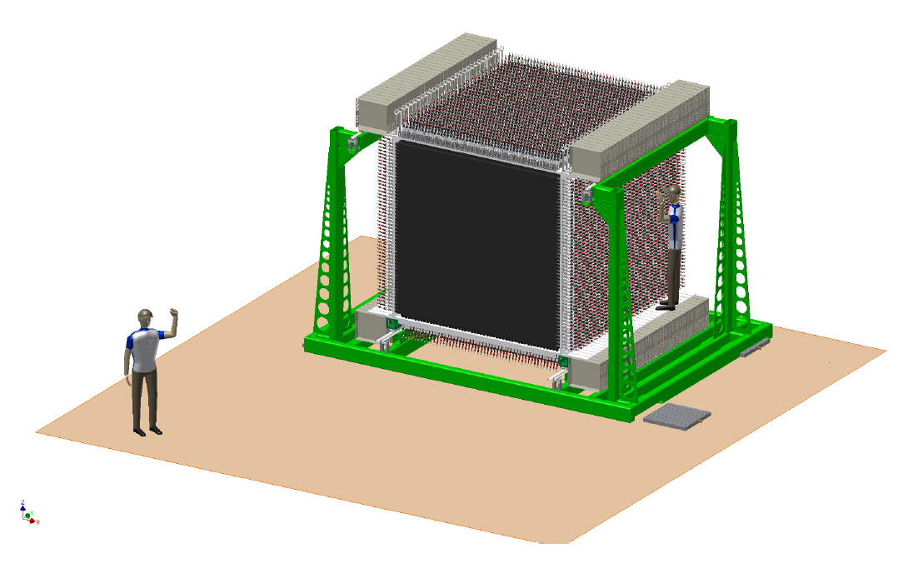
NeuLAND: High-resolution neutron time-of-flight spectrometer
WG leader:
K. Boretzky (GSI),
U. Datta-Pramanik (SINP, Kolakta, India)
Slides by K. Boretzky

Slide 12
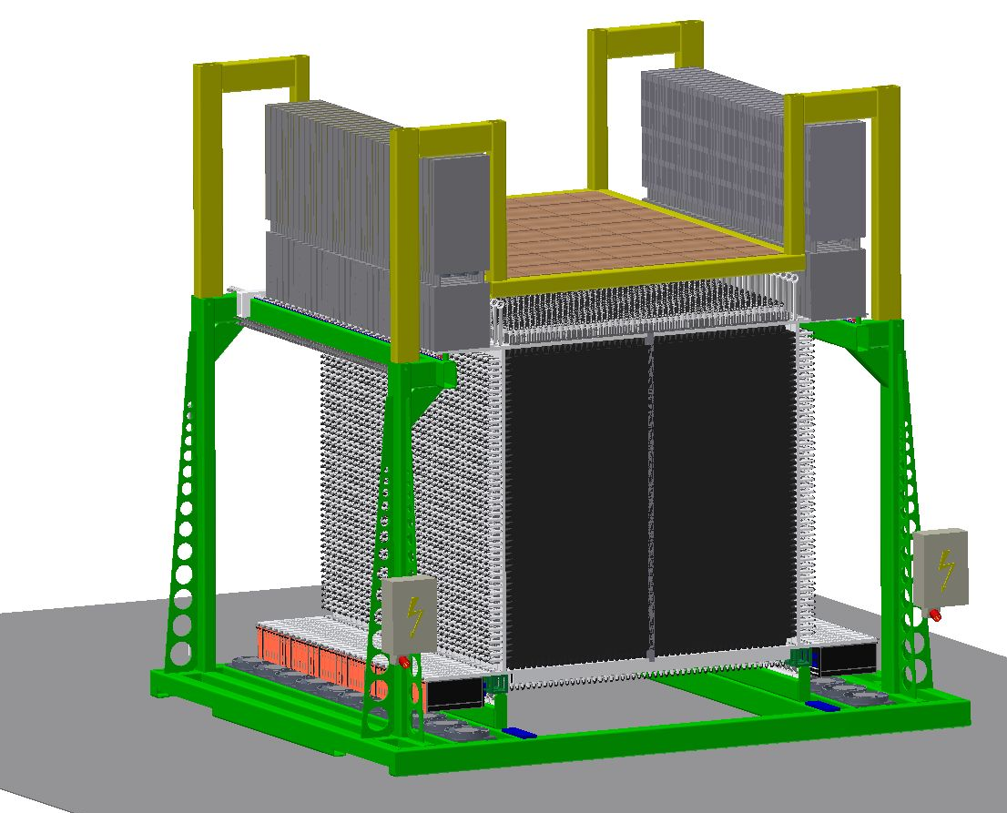
High-resolution neutron time-of-flight spectrometer NeuLAND
Performance goals:
>90% efficiency for 0.2-1 GeV neutrons
Multi-hit capability for up to 5 neutrons
<150 ps time resolution
20 keV excitation-energy resolution at 100 keV
above neutron threshold.
Detector parameters:
Full active detector using organic scintillator
Face size 250x250 cm², active depth 300 cm
3000 scintillator bars
6000 photomultiplier and readout channels
Modular design.
Detector financing:
20% demonstrator (1020 k€) already financed by BMBF and PMA; demonstrator ready by Q1/2014
Upgrade to 45% detector (1180 k€) will be financed by secured funds of BMBF and PMA plus proposed in-kind contribution by PNPI, Russia (3.6.2013); 45 % detector ready by Q4/2015
High Voltage system (527k Euro) proposed as in-kind contribution by PNPI, Russia (3.6.2013)
NeuLAND mechanics and infrastructure (248k Euro) financed through PMA.
NeuLAND Technical Design Report has been approved on Jan. 18, 2013 by FAIR.
Notes:
12
1

Slide 13
NeuLAND: High-resolution neutron time-of-flight spectrometer
For more on NeuLAND see talk of C. Caesar
Tomorrow (Friday 21) @ 9:30

Slide 14
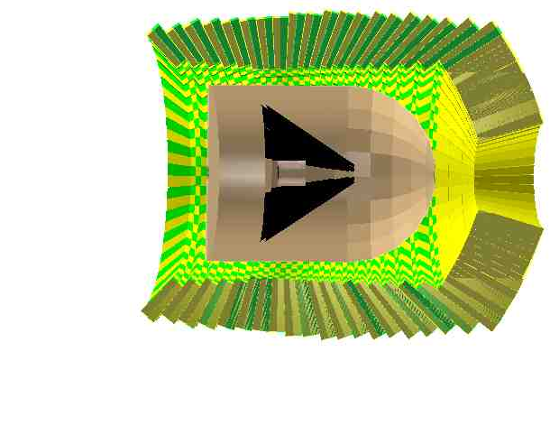
Target Recoil Detector: Si Tracker + CALIFA
CALIFA
Si Tracker

Slide 15
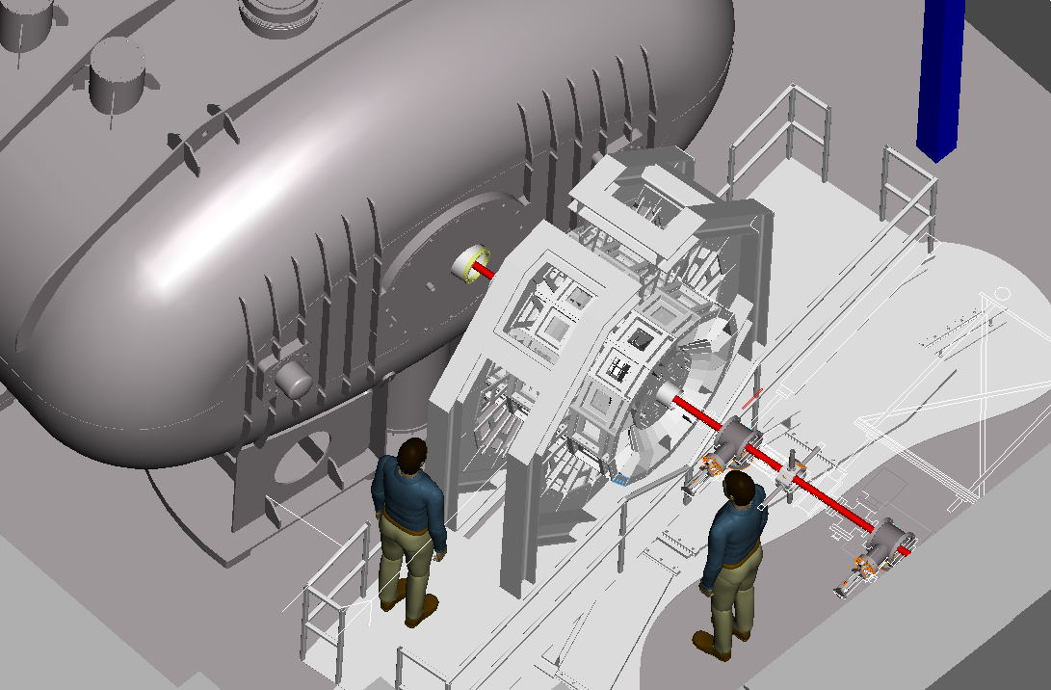
CALIFA Barrel and Silicon Tracker
Alan Grant,Daresbury

Slide 16
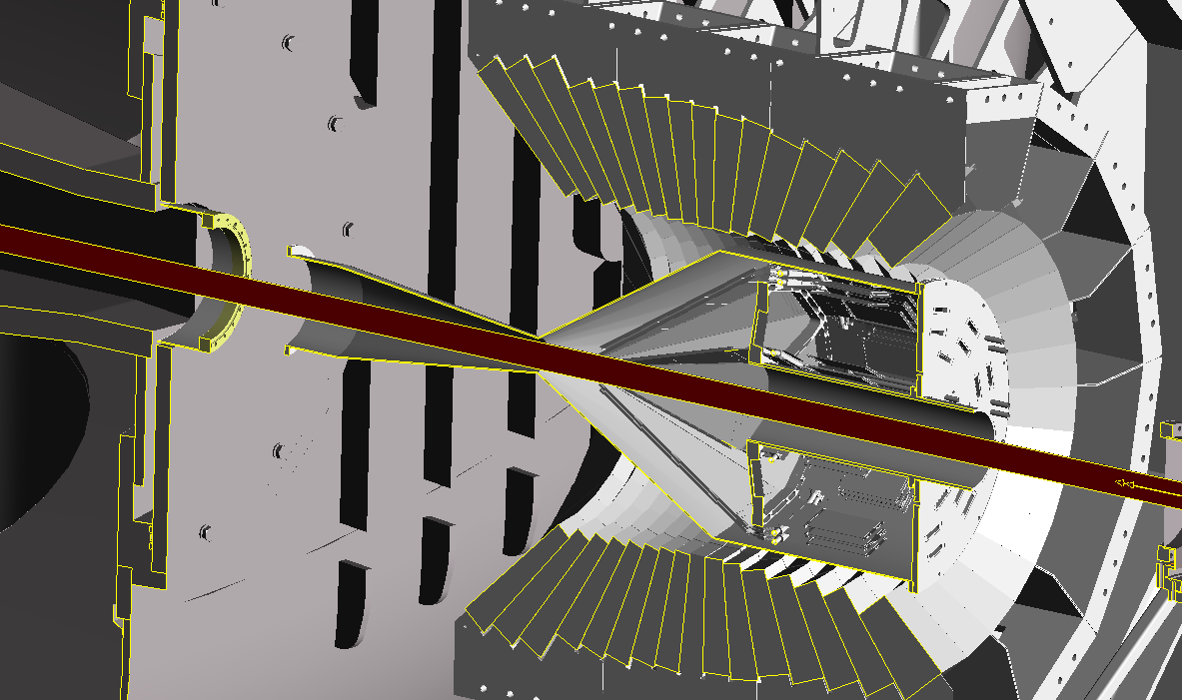
CALIFA Barrel and Silicon Tracker
Chamber is 532mm diameter
Alan Grant,Daresbury

Slide 17
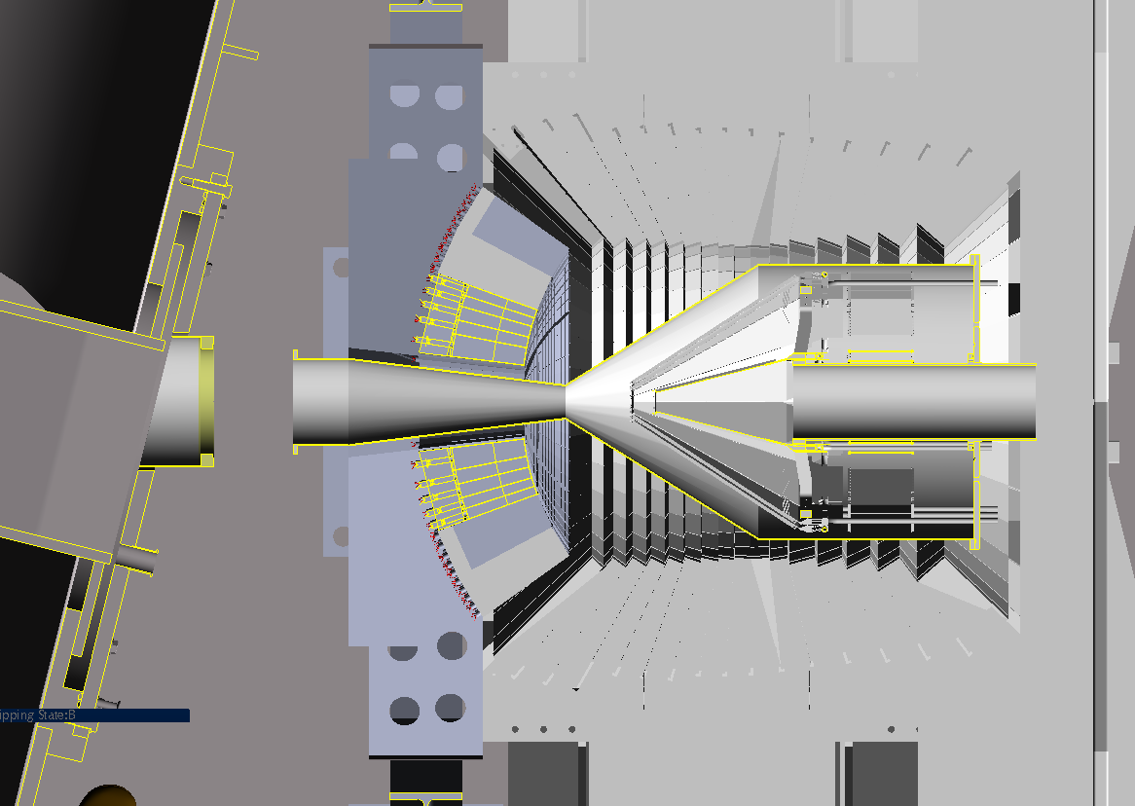
CALIFA Barrel+End Cap and Silicon Tracker
Alan Grant,Daresbury

Slide 18
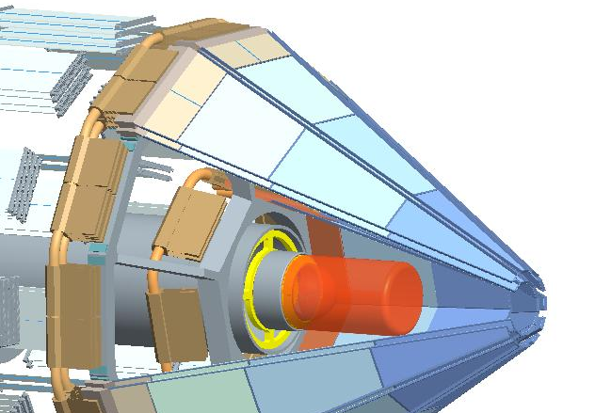


Si Tracker
WG leader:
R. Lemmon, M. Chartier
Fully funded NUSTAR/R³B grant ~ £5M 2010 - 2015
(Liverpool, Daresbury, Birmingham, Edinburgh, Surrey)
Project leader: Roy Lemmon
Slides by M. Chartier

Slide 19
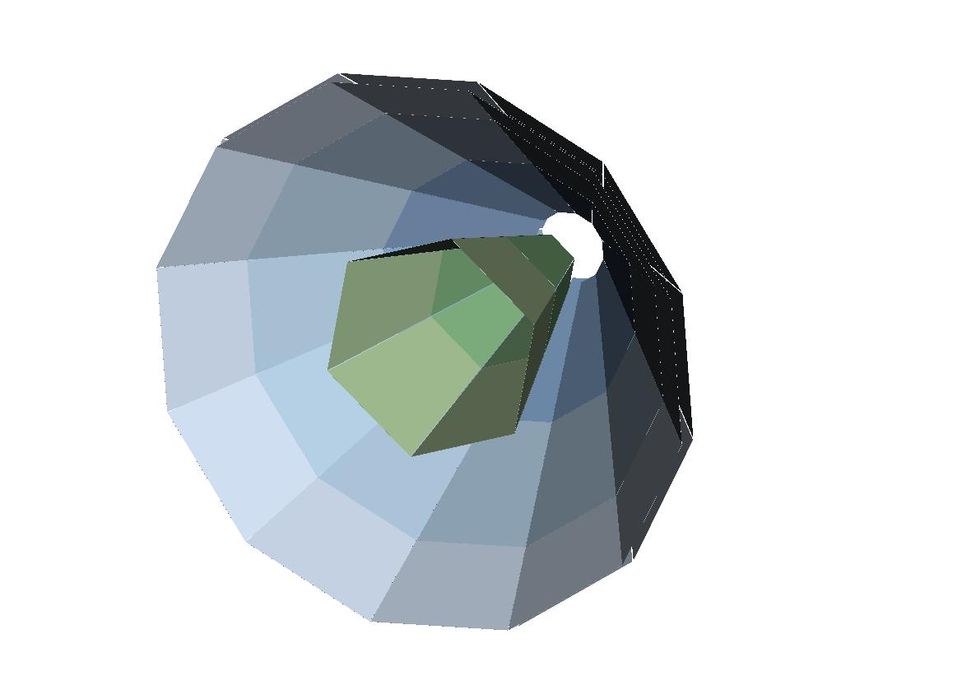
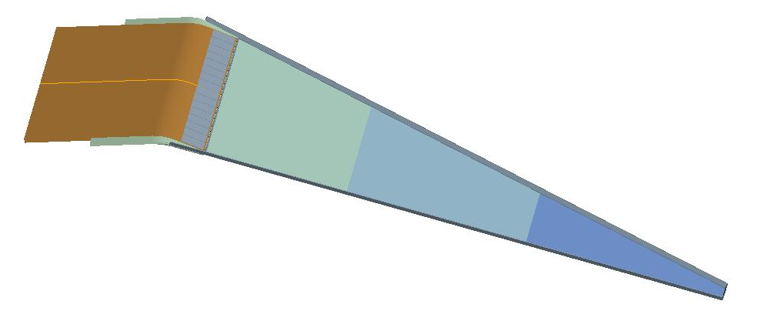
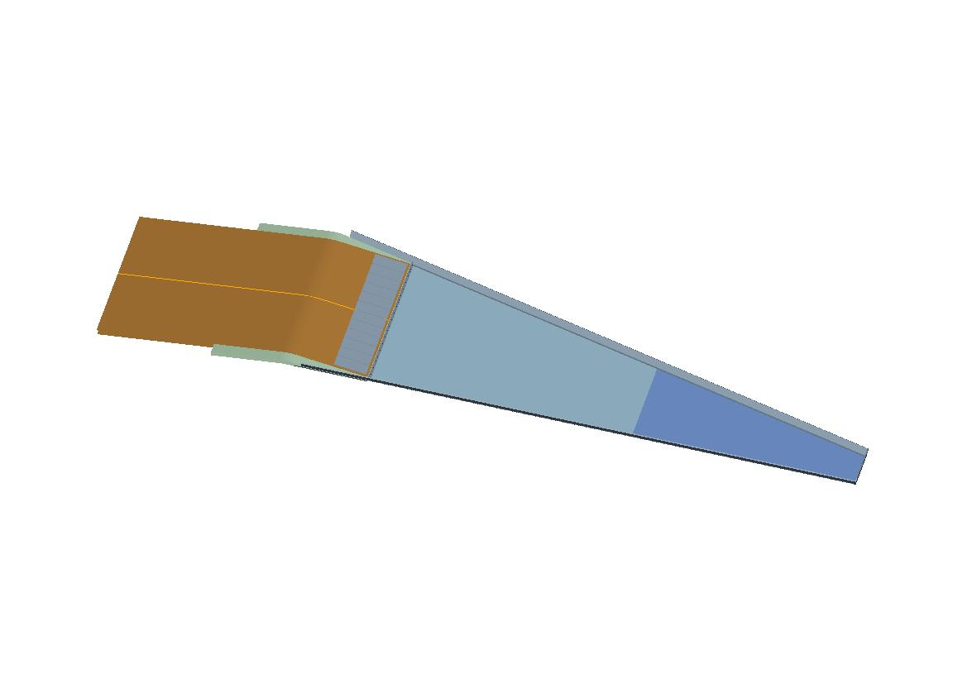
R³B Si Tracker Design
Optimised for tracking of high-energy protons to select events from quasifree scattering reactions in inverse kinematics,
e.g. (p,2p), (p,pn)...
Good separation energy and position resolution.
Lampshade design
Outer detector assembly (300µm)
Outer detectors (blue)
2 layers of 12 detector modules,
each with 3 silicon wafers (300um).
Inner layer (green)
6 detector modules, each with
2 silicon wafers (100um).
Inner detector assembly (100µm)
Jim Thornhill,
Liverpool
Notes:
We finally refined this ‘Lampshade’ design to that we see here.
A short inner layer of 6 detectors and 2 outer layers, in close proximity, each of 12 detector assemblies.
The angles between the opposite edges of the trapezoid allow a us to use a technique of ‘stereo angle strips’. For producing our positional pixels
In the current situation this angle is approximately 17 degrees.

Slide 20
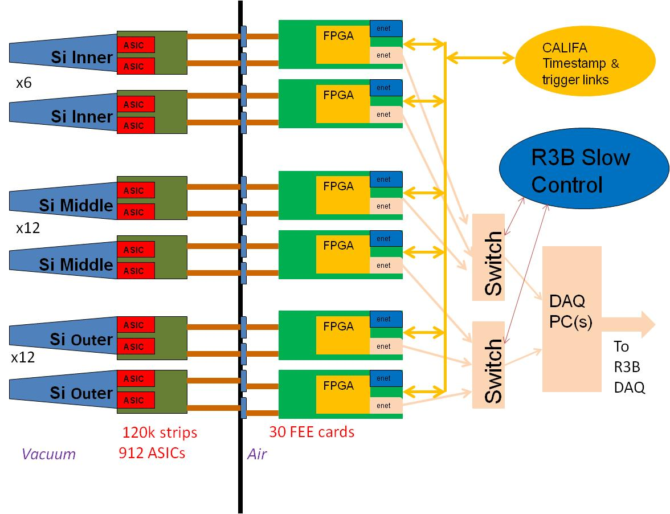
R³B Si Tracker Schematic FEE/DAQ System
Custom ASIC used as part of Si ladders and read out through μTCA
format readout cards designed in-house.
Resolution 10keV - Threshold to be measured in situ - Dyn. range 40
keV to 50MeV - Counting Rate max 5kHz/channel.
STFC DL & RAL, Liverpool

Slide 21
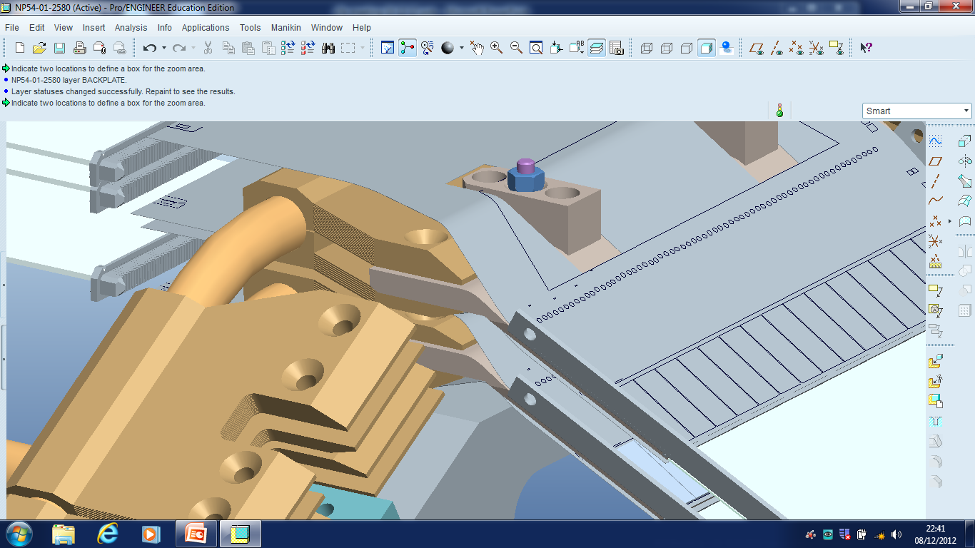
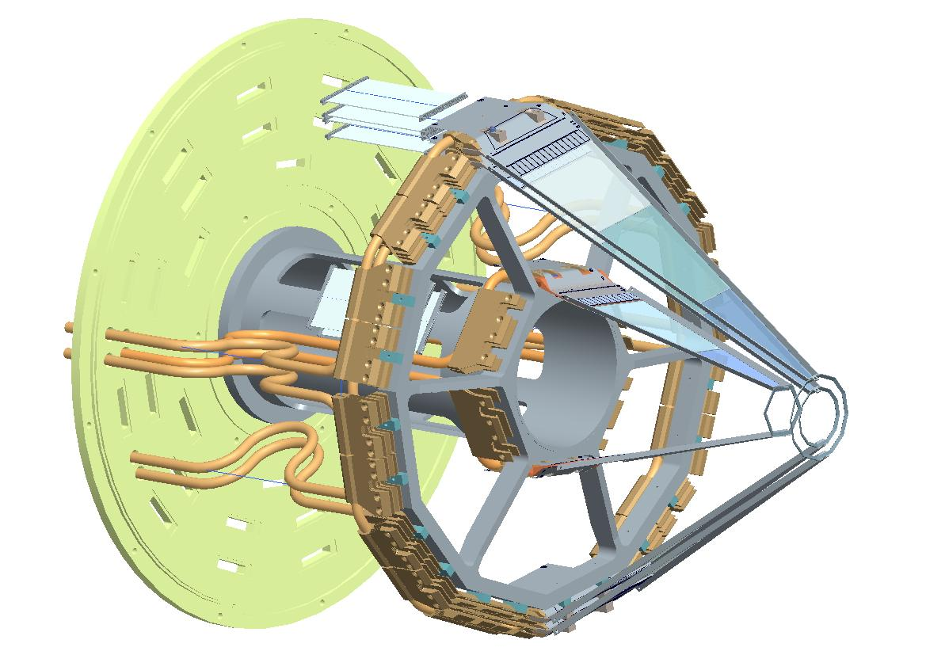
ASIC chips mounted on Flex board
Si
C fibre
structure
Cu cooling
blocks
Coolant ~-20° C
flowing in Cu pipe
Dave Seddon,
Liverpool

Slide 22
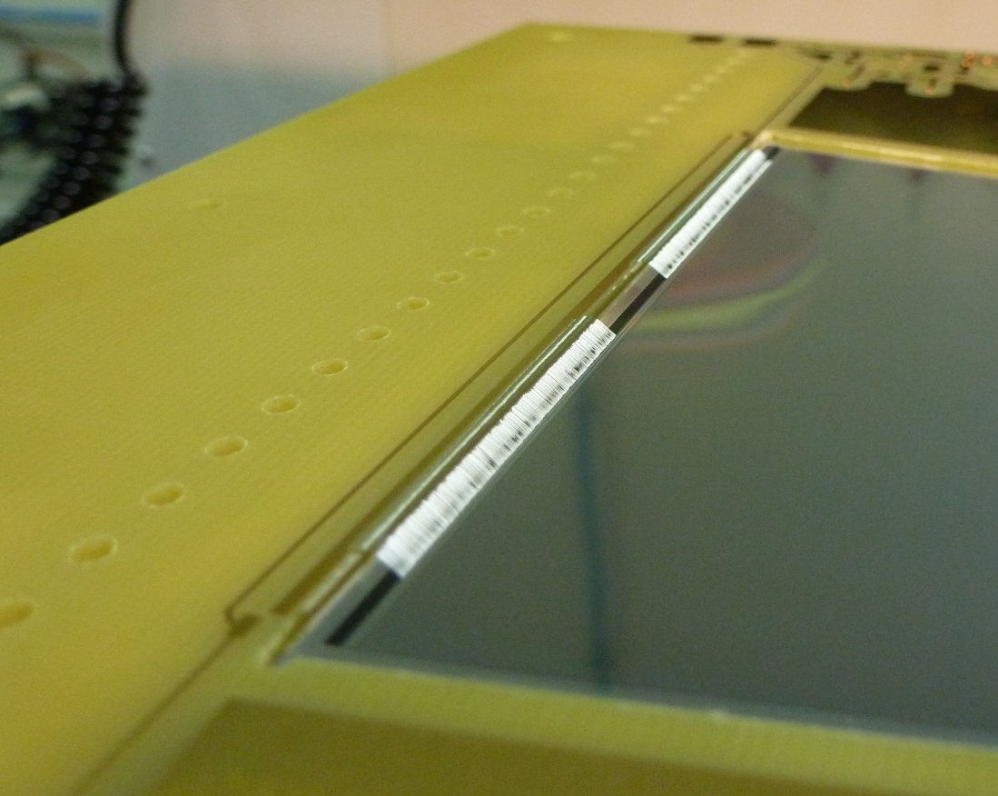
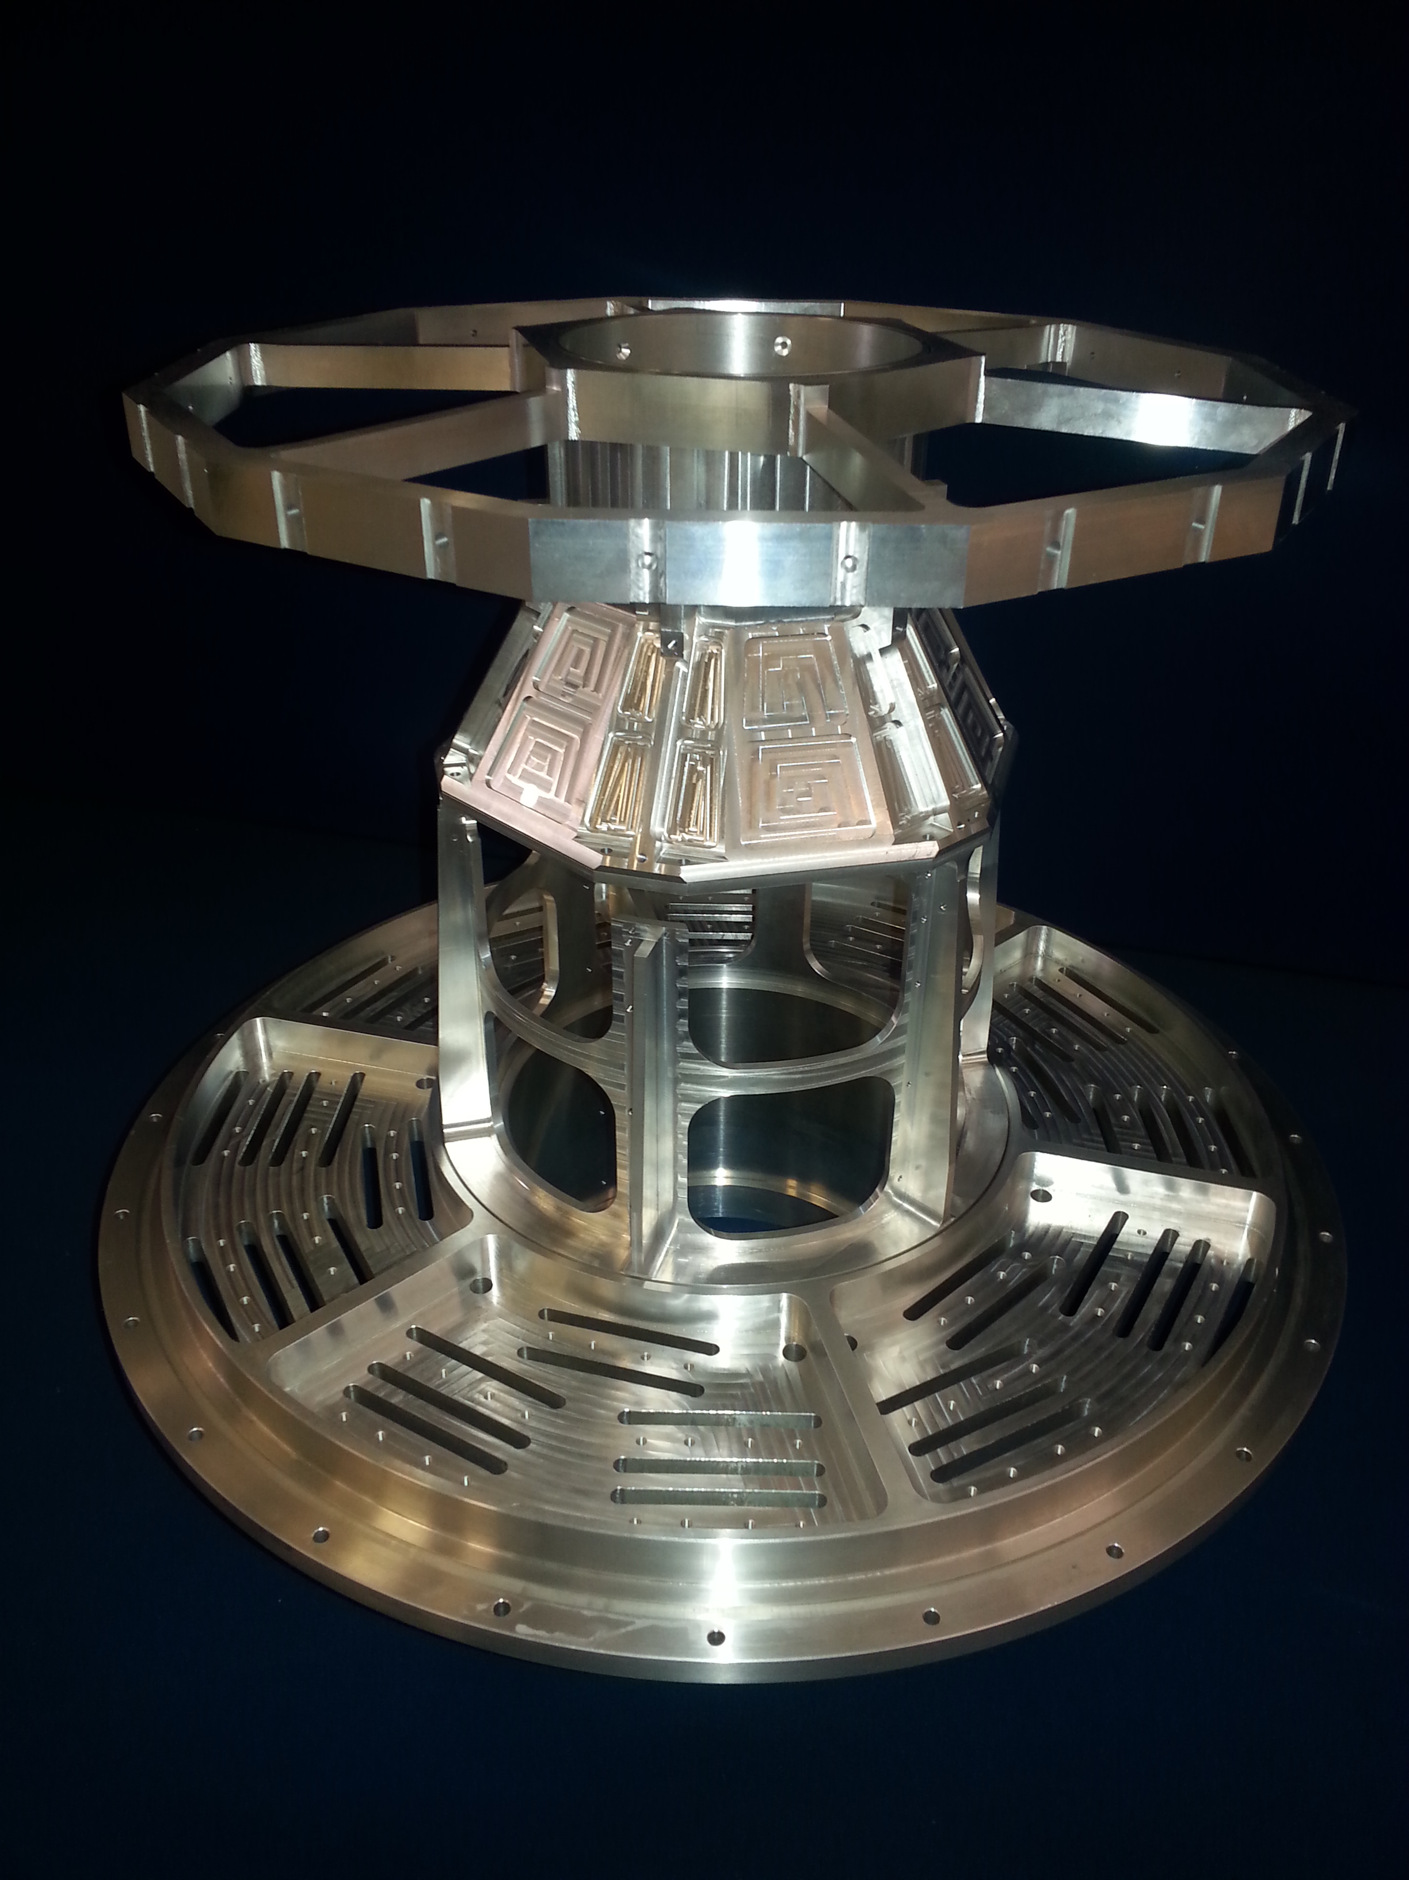
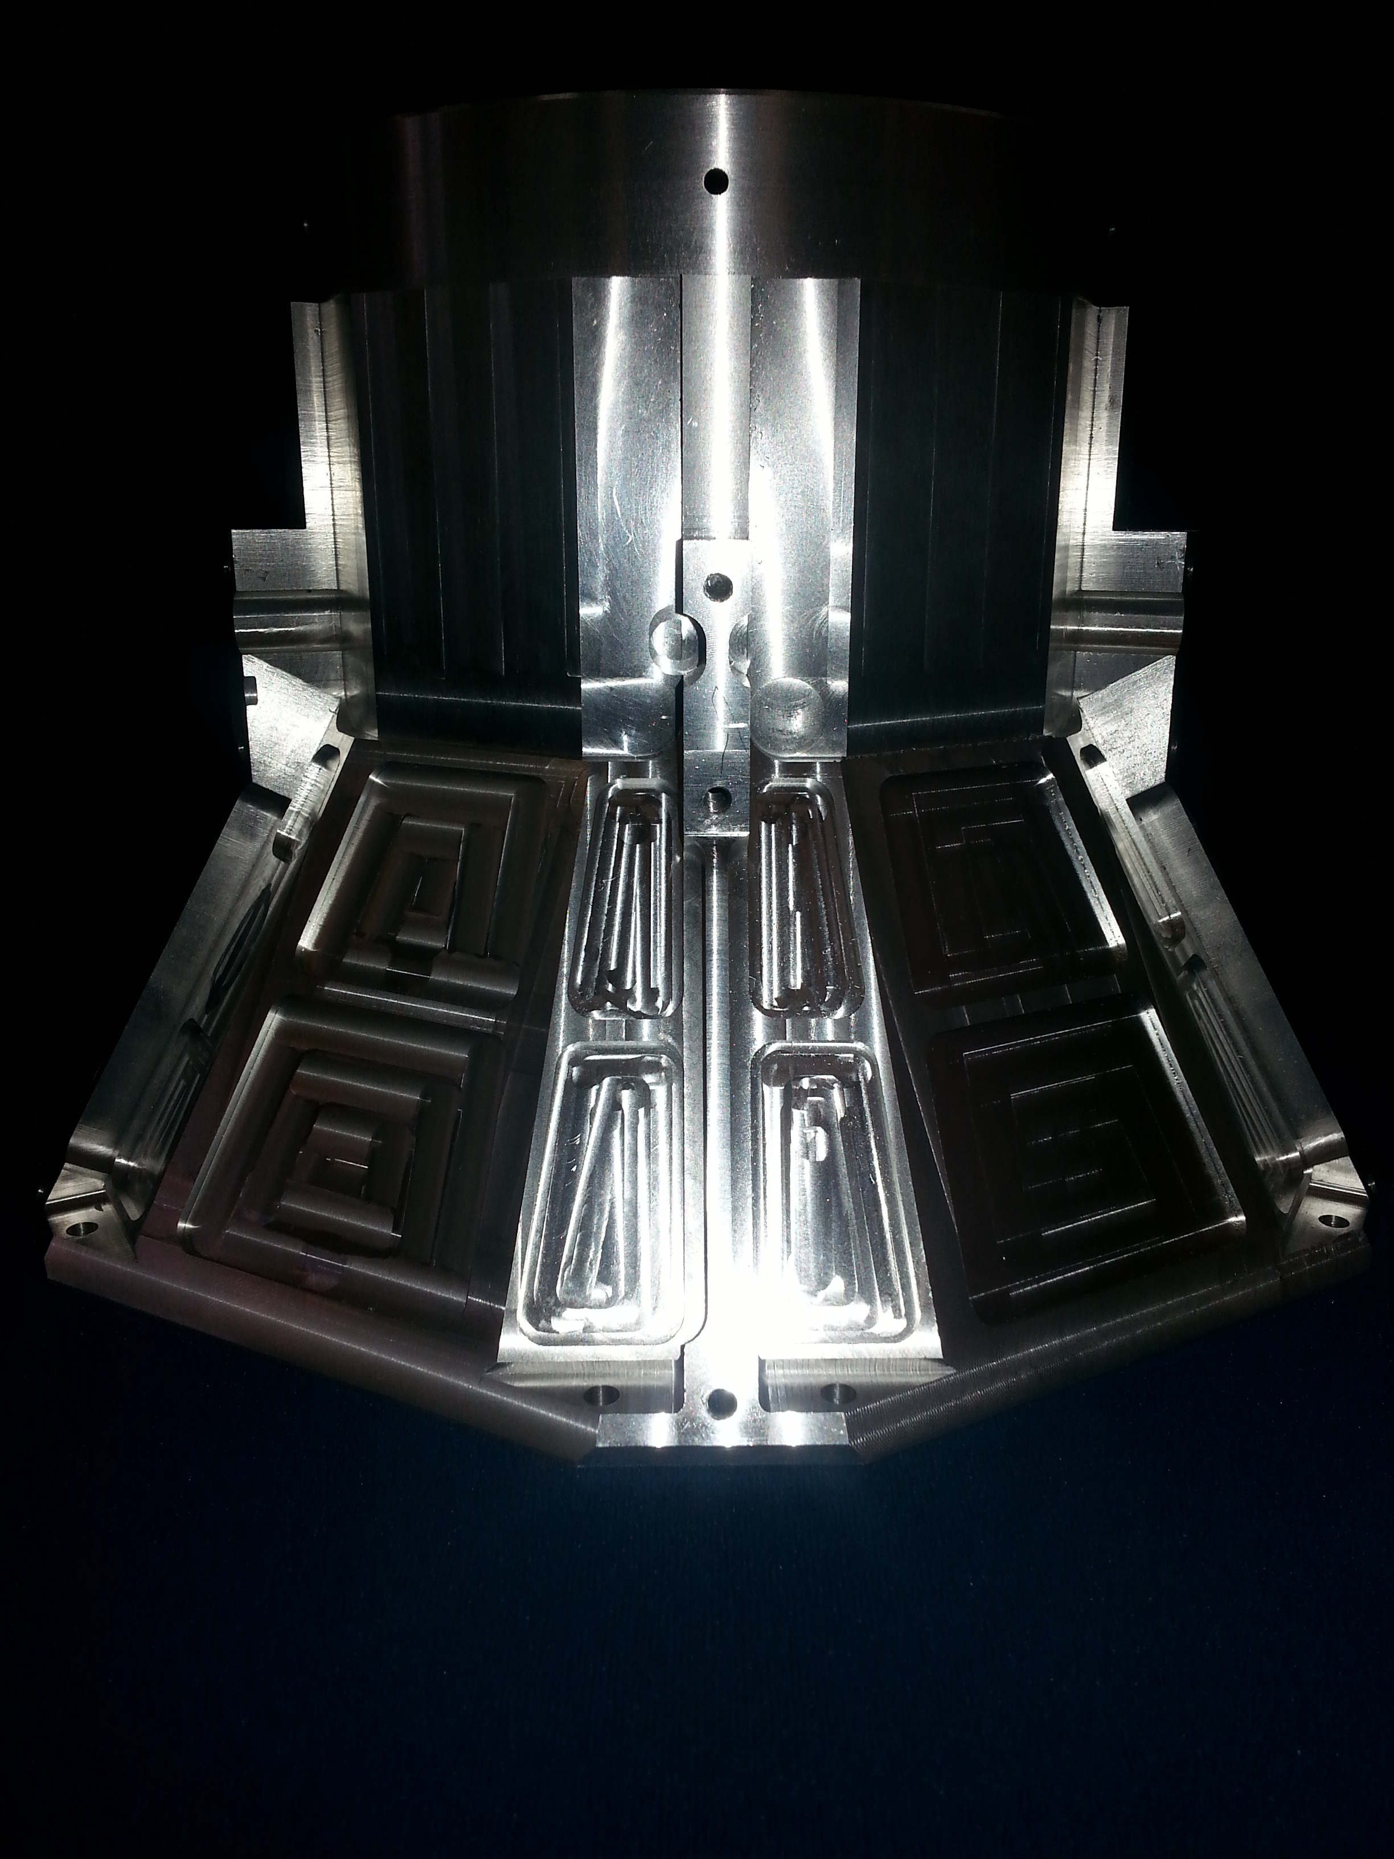
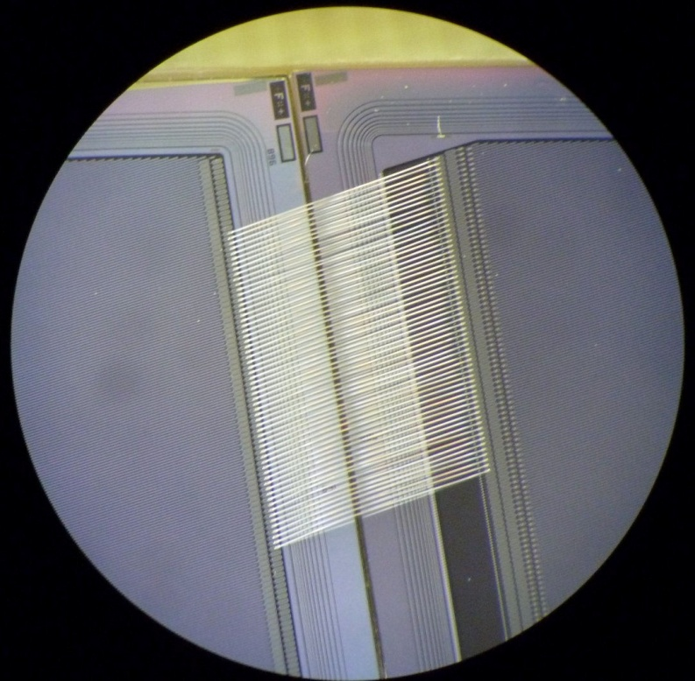
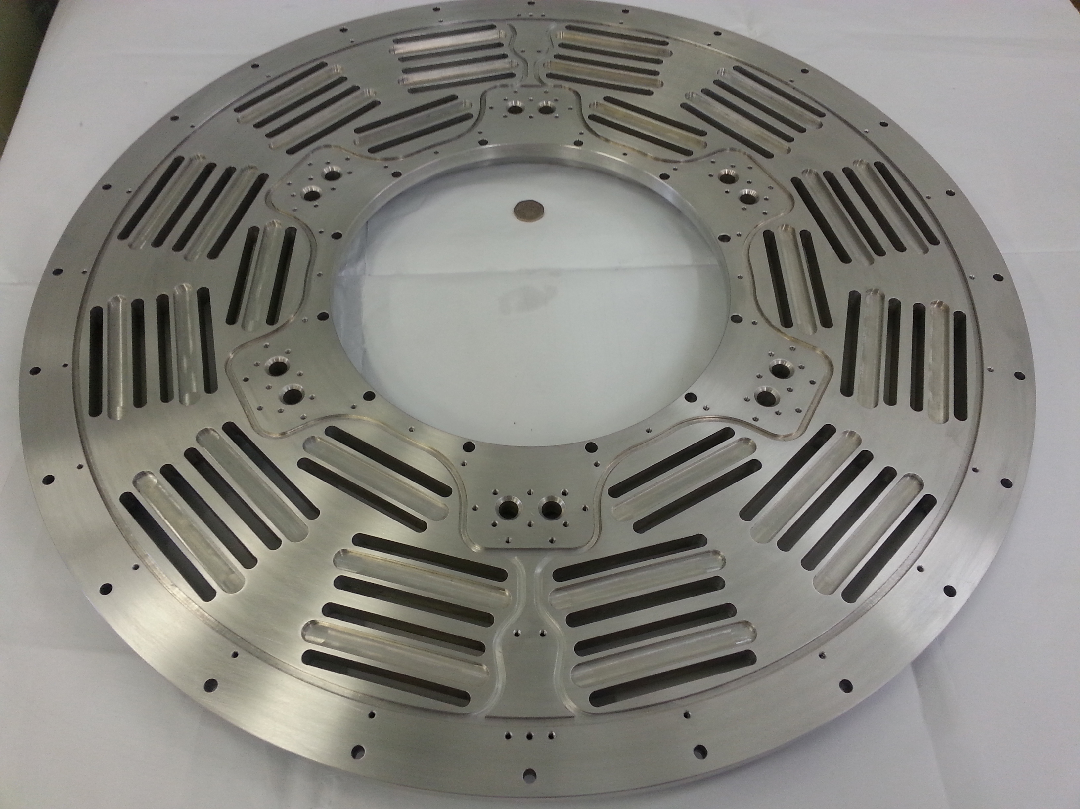
Bonding tests with 100um silicon
Construction of Mechanics
has started

Slide 23
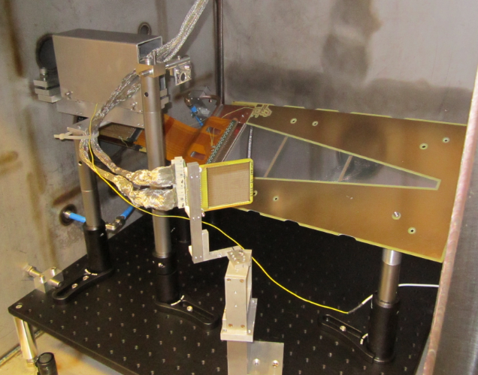
In-Beam Tests at Birmingham Cyclotron
Beam
⁴He @ 11.5 MeV
gold target (1.2 mg/cm²)
Rutherford scattering
R³B prototype:
~ 70 to 16 deg
collimators
Rate monitor:
500 μm DSSD
@ 47 deg

Slide 24
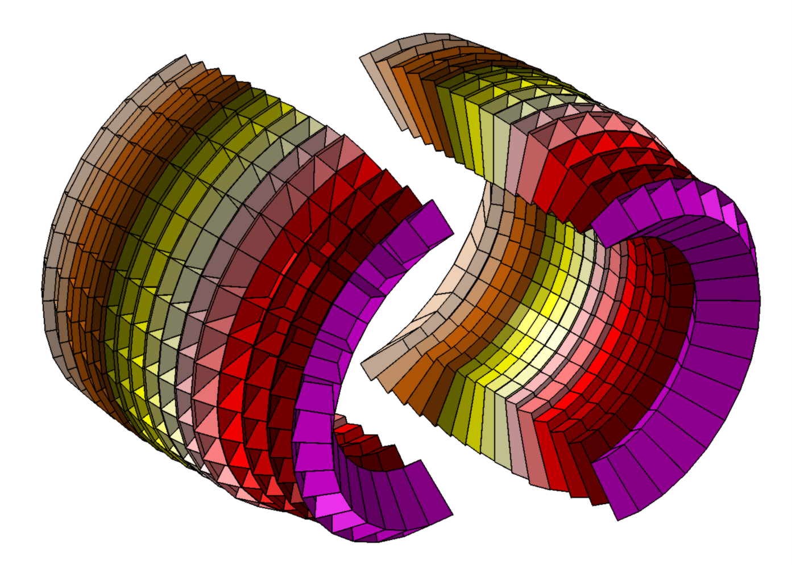





CALIFA γ-ray Calorimeter, Spectrometer, charged particle detector
WG leader:
D. Cortina, O. Tengblad
CALIFA Working Group
USC-IEM-UVigo
GSI-TUM
EMMI-TUD
Chalmers
Lund
CFNUL
JINR - NRC
Slides by D. Cortina

Slide 25

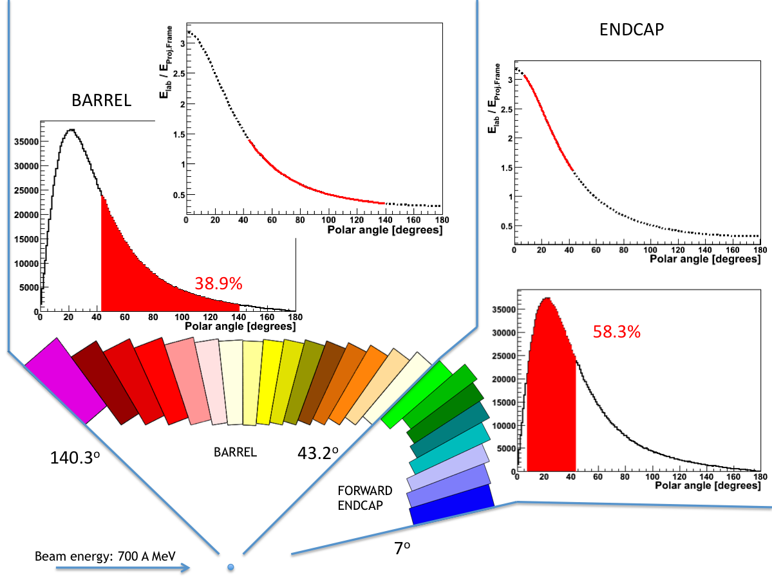

CALIFA a calorimeter for R3B@FAIR
CALorimeter for In Flight detection of γ rays and light charged pArticles
→ Huge dynamic range (γ 100 keV - 20 MeV and p 1-320 MeV)
Calorimetrer
Intrinsic photopeak efficiency | 40% (up to Eg=15 MeV projectile frame)
Gamma sum energy resolution Δ(E_{γ}sum)/<(E_{γ}sum)> | < 10% for 5 γ rays of 3 MeV
Calorimeter for high energy Light charged particles | Up to 320 MeV in lab system
Gamma energy resolution | ~5-6% (FWHM at Eγ=1 MeV)
Light charged particles resolution | ~2%
Proton - γ ray separation | For 1 to 30 MeV
Spectrometer
The detector is splited into a Barrel (backward
angles) and a Forward Endcap (forward angles)
The technical design for the Barrel was submited
(TDR Nov 2011) for the Forward Endcap design is expected for 2014

Slide 26
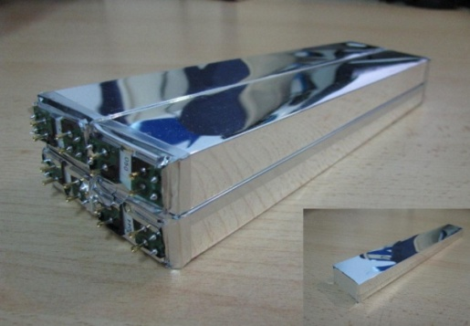
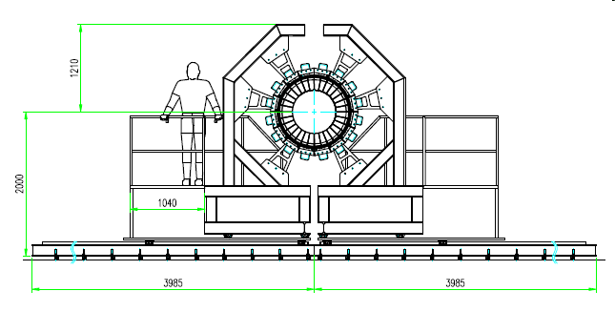
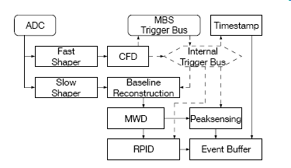
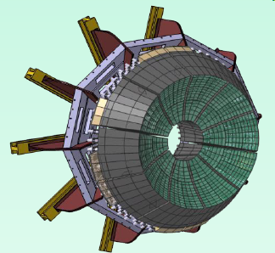
CALIFA BARREL & Forward Endcap
TDR for Barrel approved by FAIR management January 2013
Long CsI(Tl) crystals + Large Area Avalanche Photodiodes (LAAPD)
Inner radius | 30 cm
N of crystals | 1952
Crystal geom. | 11
Crystal Volume/ weight | 285 000 cm³/ 1300 kg
Dedicated electronics (analogue + digital)
N of crystals | 750
Crystal geom. | 15
Tot. Crystal Volume/ weight | 110000 cm³/ 560 kg
R&D work on going
→ TDR for forward endcap submission expected for first half 2014
CALIFA Working Group

Slide 27
CALIFA γ-ray Calorimeter, Spectrometer, charged particle detector
For more on CALIFA see talk of A. Ignatov
tomorrow (Friday 21st @ 9:00)

Slide 28
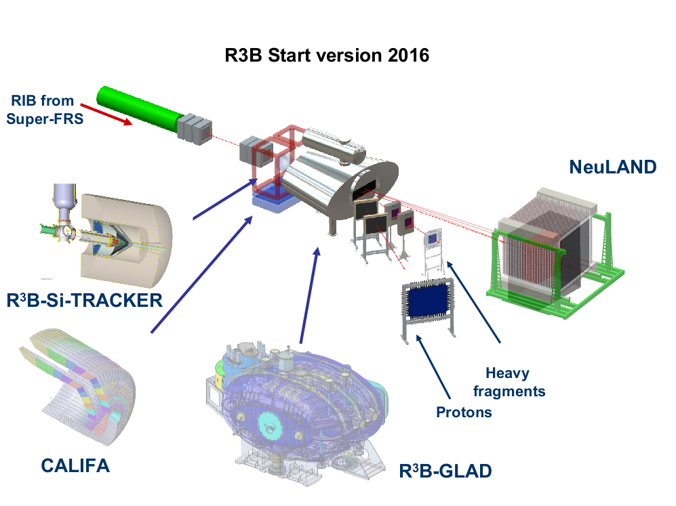
Heavy-ion tracking detectors
WG leader:
S. Paschalis, R. Gernhaüser
More details on tracking detectors were given
by J. Johansen earlier today @ 15:00

Slide 29
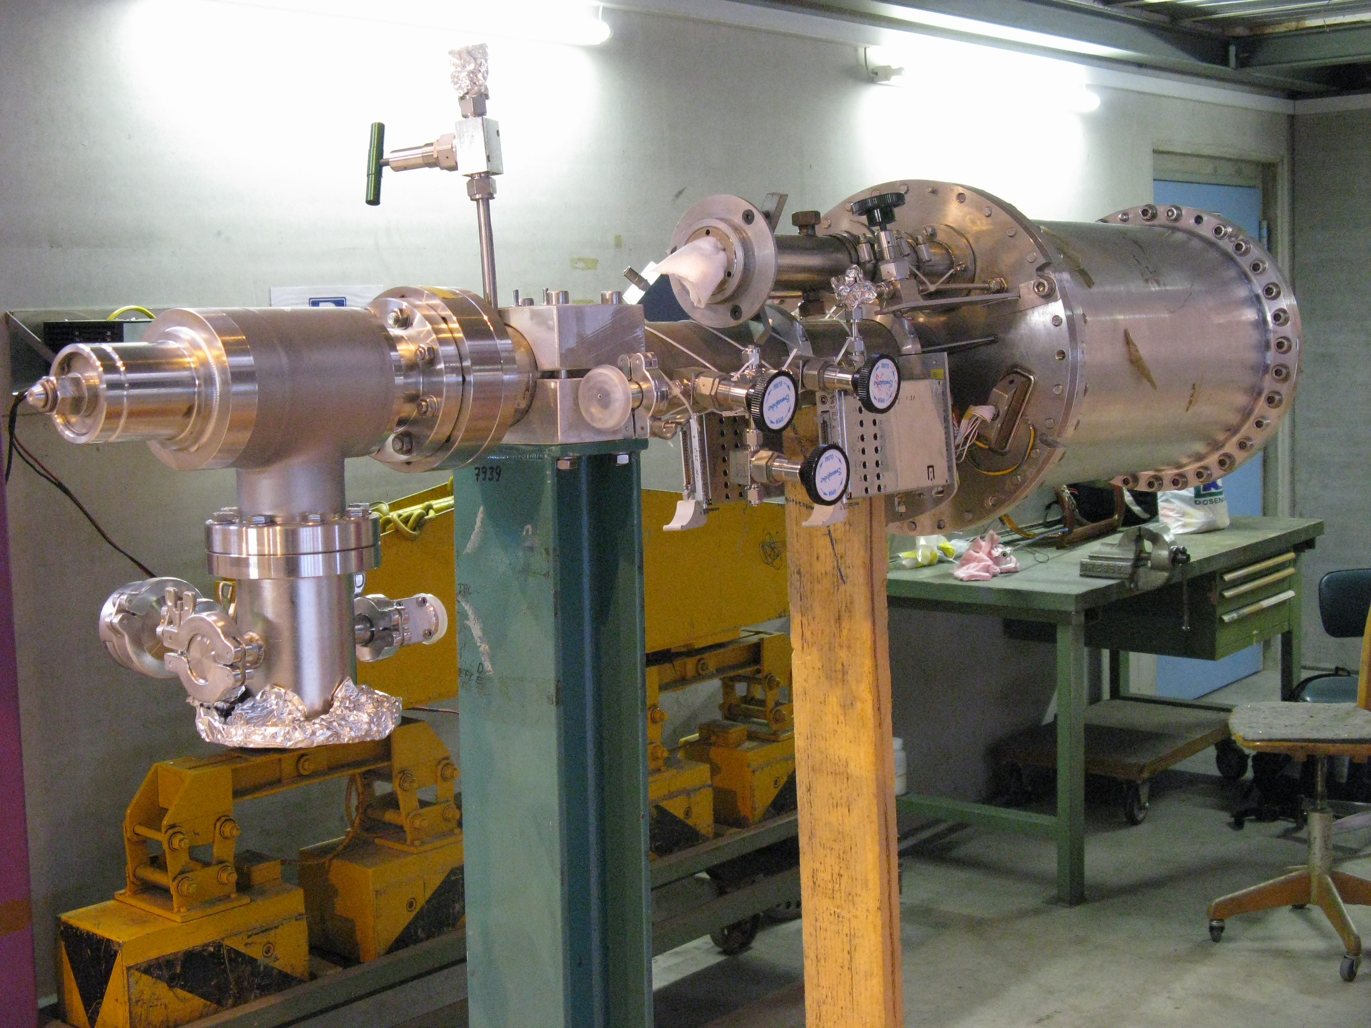
Active Target
WG leader:
P. Egelhof, O. Kiselev, D. Savran
Slides by O. Kiselev

Slide 30
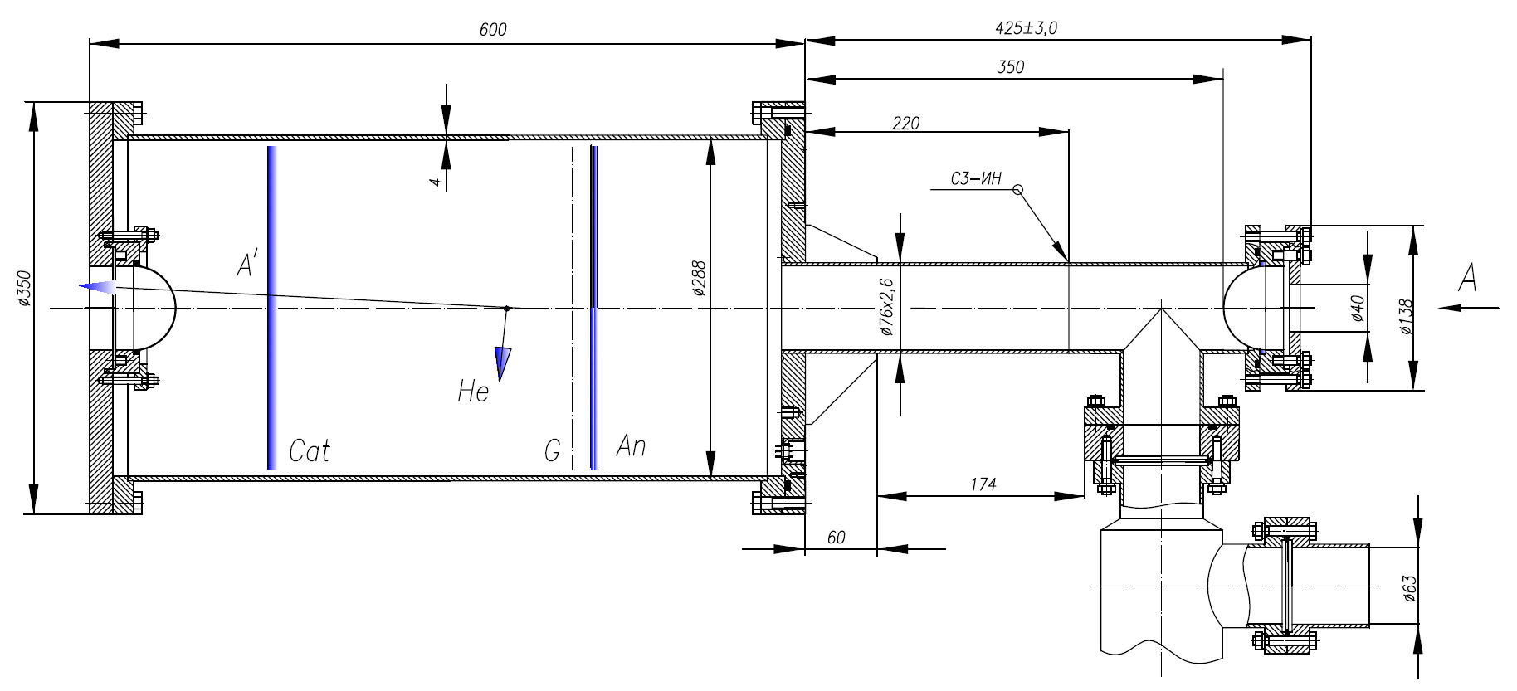
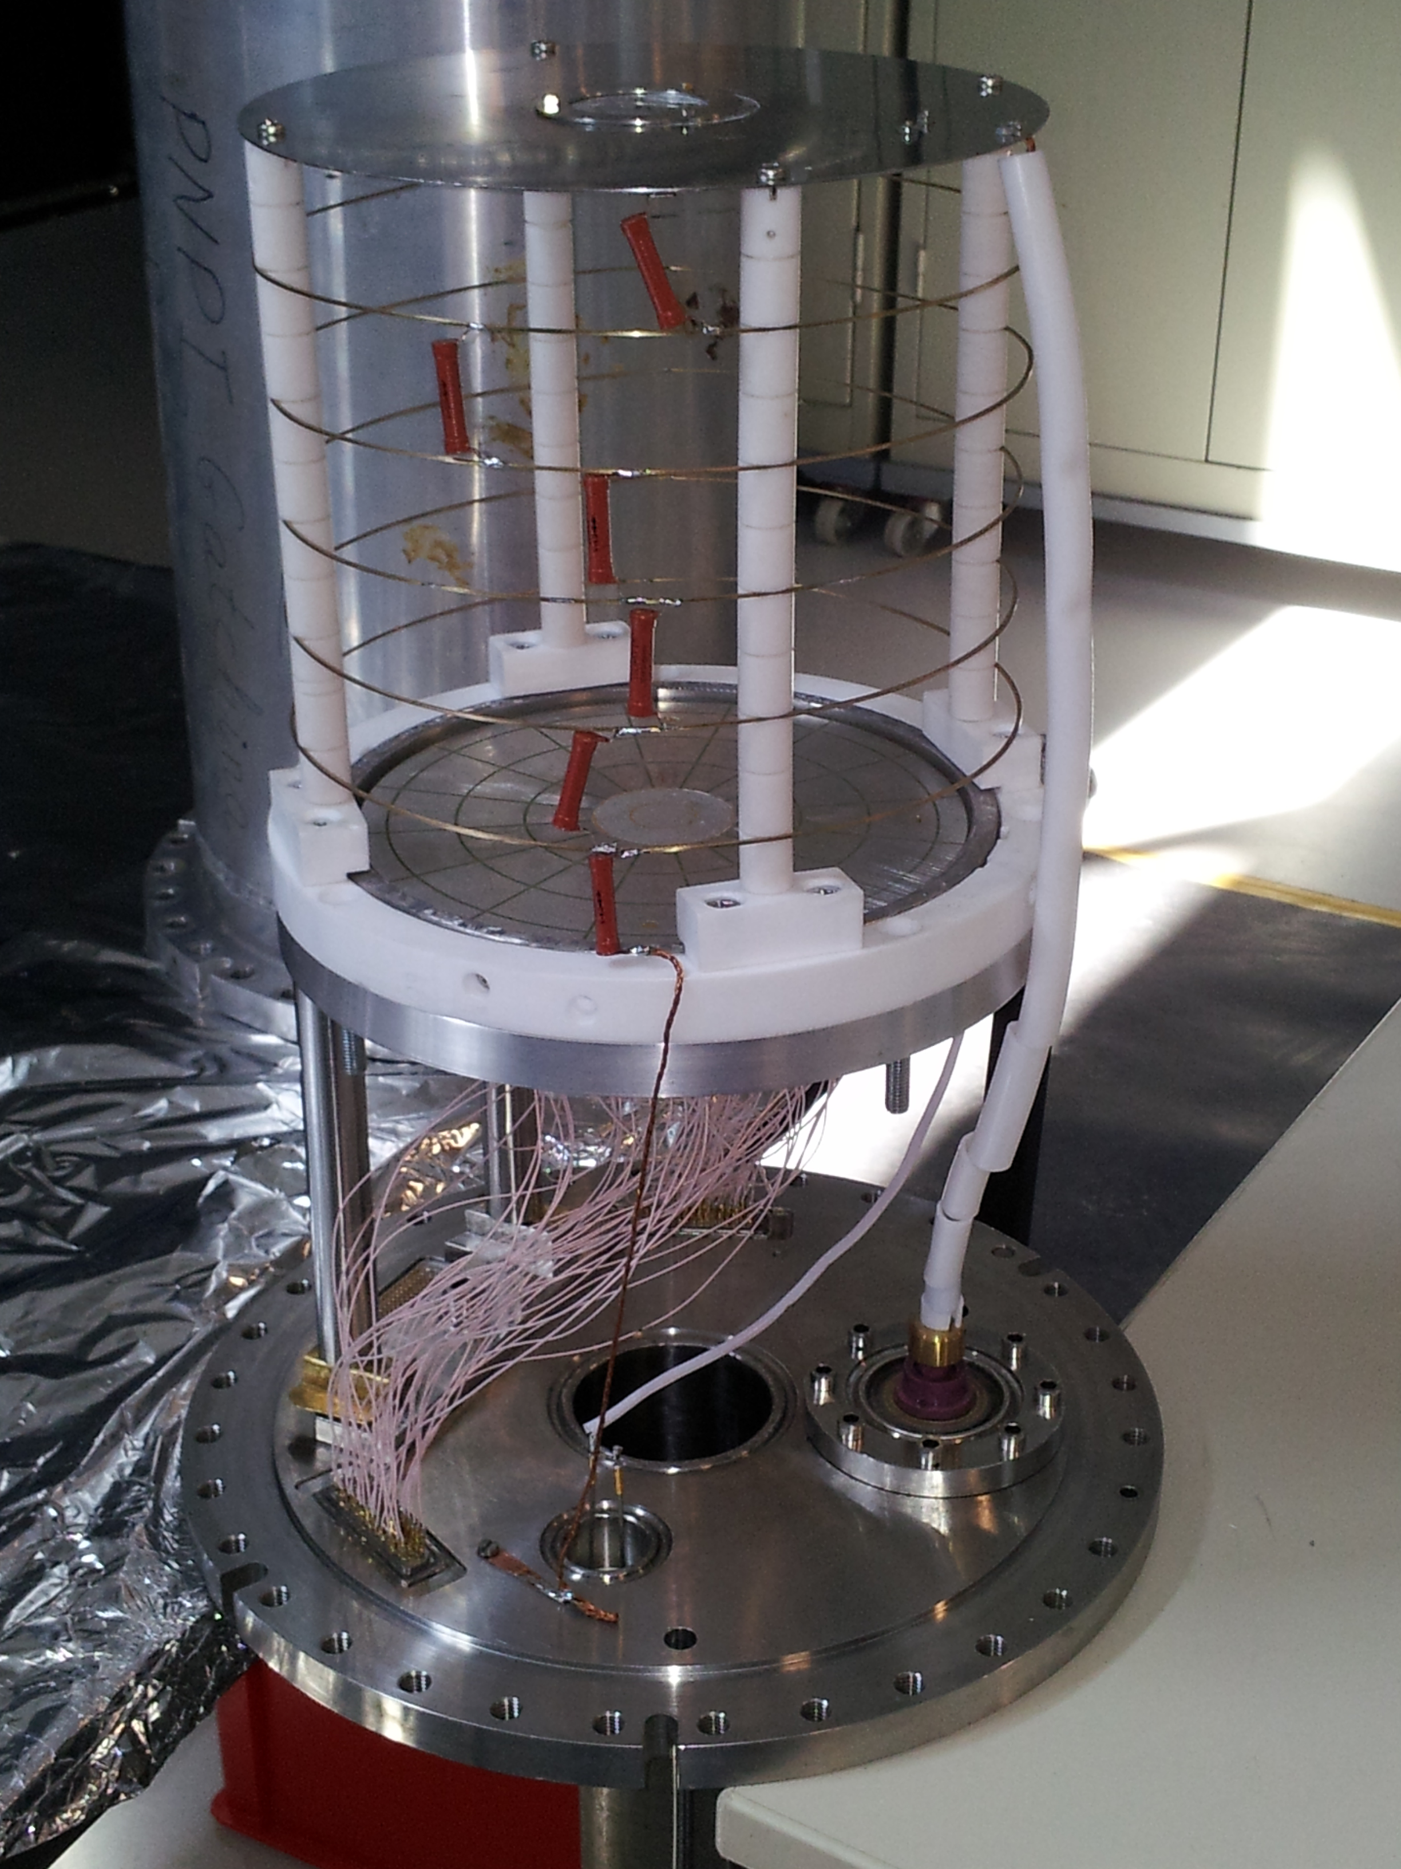
Status of the Active Target, electrodes and vacuum
Small ionization chamber is rebuilt (new electrodes with high segmentation)
Second Be window installed, vacuum system rebuilt
Test for high pressure (TÜV) is performed

Slide 31
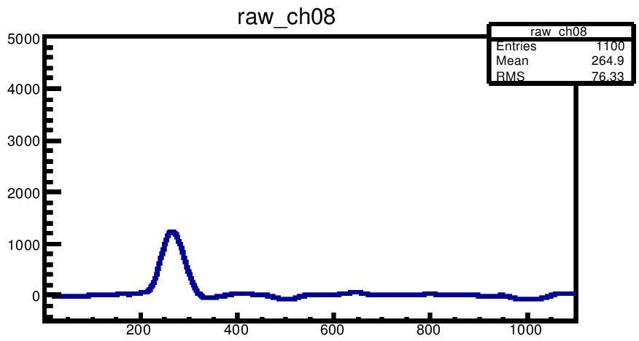
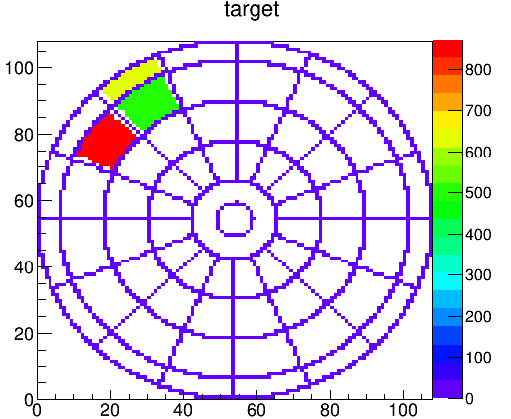
Status of the Active Target, electronics
New preamplifiers (80 channels) with better energy resolution are produced and tested
New VME FADC modules (250 MHz, 14 bit) are tested
Slow Control System (temperature, pressure, HV and current) is assembled and programmed

Slide 32
Status of the Active Target, test in December 2013
Full chamber assembled and filled with gas -10 bar, 95%He + 5% H₂
New HV devices tested, system stable within many days
25% of electronics tested with generator and α–source placed inside the chamber
Readout and online programs are prepared
Active Target setup will be tested with ⁵⁸Ni beam in April 2014

Slide 33
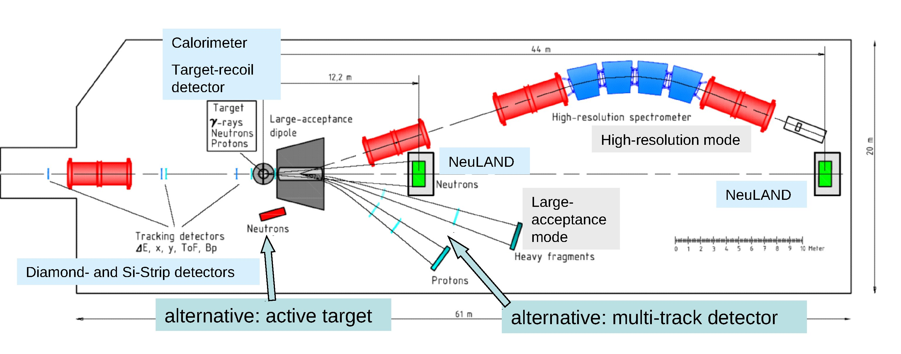
R³B High-resolution spectrometer (HRS)
Slides by O. Haas

Slide 34
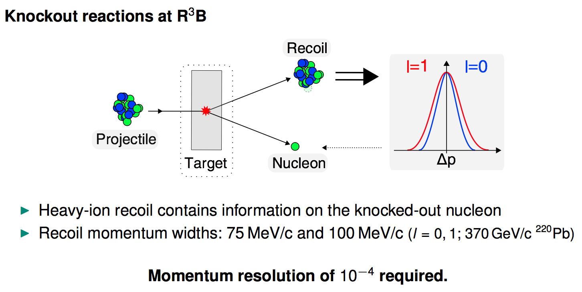
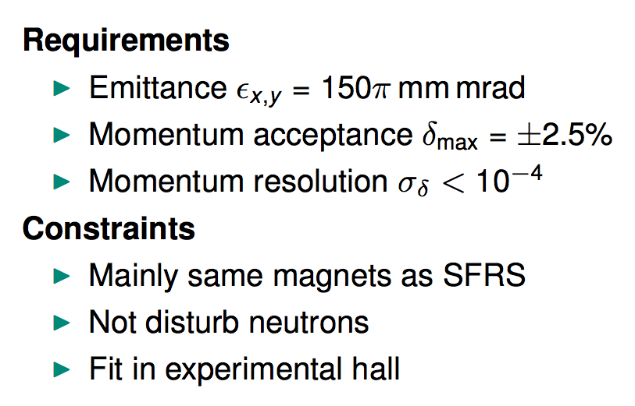
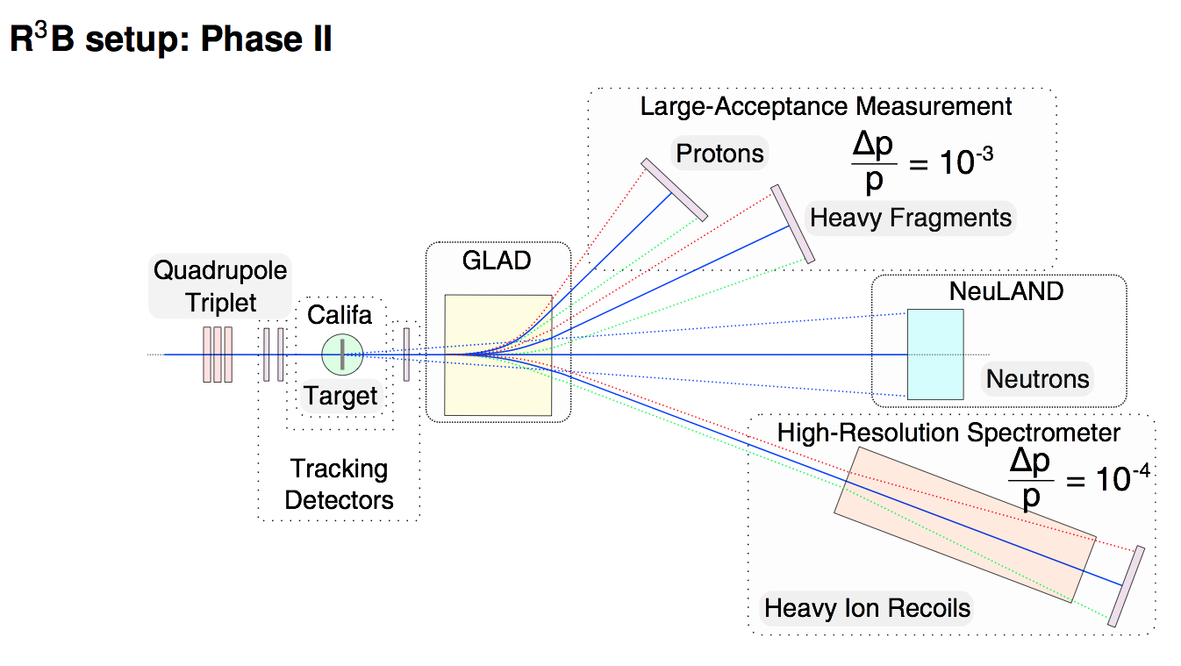
R³B High-resolution spectrometer (HRS)
Slides by O. Haas

Slide 35
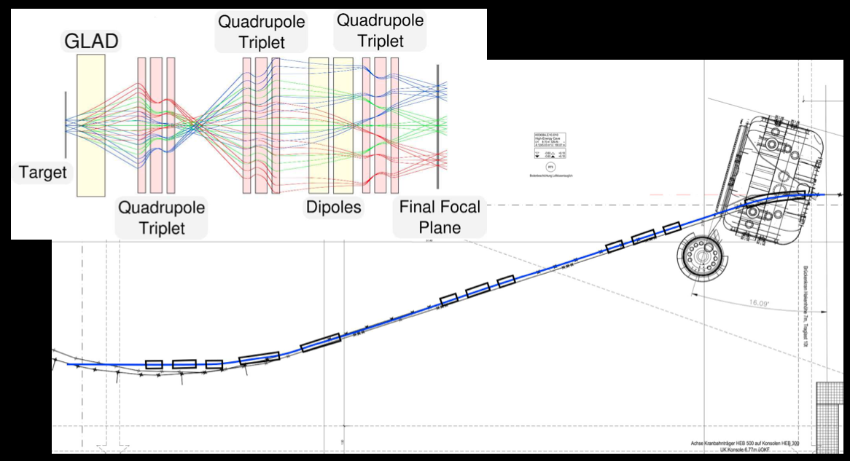
R³B High-resolution spectrometer (HRS)
momentum resolution w/o HRS: ∆p/p ∼ 10⁻³
if better resolution is needed: HRS can be used
using “standard” SuperFRS Dipole and Quadrupole magnets
momentum resolution: ∆p/p ∼ 0.3 · 10⁻⁴, with 10% reaction target: ∆p/p ∼ 1.1 · 10⁻⁴
design to be finalized → Technical Design Report
total: 5 SuperFRS magnets
not funded yet
This design:
Oliver Haas in group of M. Petri

Slide 36
Summary
several R³B components in production phase
2014: pilot experiments in current GSI cave with
    ~20 % NeuLAND
    ~20 % CALIFA
    Part of Si Tracker
    Active Target
    Prototypes of Heavy-ion tracking detectors
GLAD installation and testing Q4/2014
2015 – 16: Complete full detection systems
Designs for R³B High-resolution spectrometer
R³B Collaboration

Slide 37

R3B Si Tracker Layout
Calorimeter
Vacuum Chamber
High energy Ions
From this direction
3 Layers of Silicon
Liquid Hydrogen Target
Gold Foil surround (Not Shown)

Slide 38


The active Target for (α,α‘γ) experiments
Investigation of low-lying dipole strength in inelastic α scattering
Experiments on stable nuclei show significant difference to (γ,γ‘)
Extension to unstable nuclei in inverse kinematics
¹⁴⁰Ce
D. Savran et al., Phys. Rev. Lett. 97 (2006) 172502
J. Endres,et al., Phys. Rev. Lett. 105 (2010) 212503
active target
γ
Coincident determination of excitation and decay energy
Allows selection of decay channel
Clean separation of E1 excitation in (α,α‘γ) experiments
α
CALIFA

Slide 39

GLAD magnet – Next steps
Testing and Software (UNICOS) for Cryoplant
First compressor test Nov 2013.
Cryoplant operation tests Q1/2014.
Adaptations to Magnet (?)
Infrastructure works in Cave-C Q2/3 2014
Glad magnet with its vacuum chamber.
Notes:
39
1

Slide 40
R³B High-resolution spectrometer (HRS)
Summary
Momentum resolution is dominated by straggling effects
HRS plays a minor role in final resolution
Economical design proposed
Transmission limited due to small apertures
Outlook
  Detector development
  Experience large-acceptance measurement, SFRS, ...
  Accurate magnetic field measurements

