Slide 1

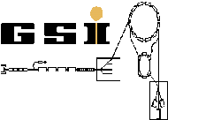






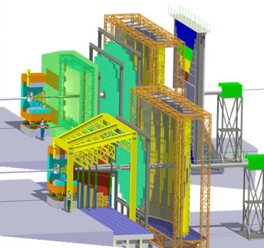
Status of the CBM Micro Vertex Detector
M. Deveaux, Goethe University Frankfurt

Slide 2

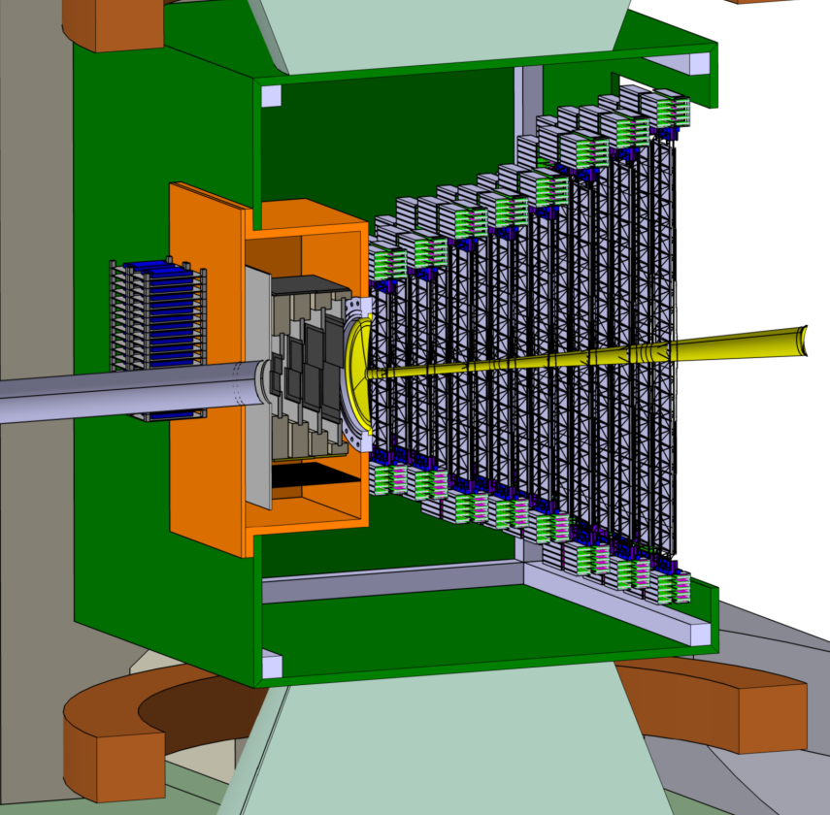
Outline
Some propaganda slides on MAPS
Some science behind the propaganda
DAQ concept and beam test results
Toward detector construction
STS
Beam
MVD
2.5°
25°

Slide 3
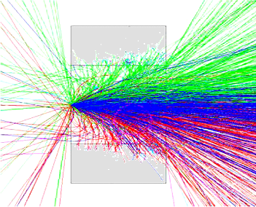
Open charm reconstruction: Concept
z
Reconstructing open charm requires:
Excellent secondary vertex
resolution (~ 50 µm)
=> Excellent spatial resolution (~5 µm)
=> Very low material budget (few 0.1 % X₀)
=> Detectors in vacuum
Target
(Gold)
Detector2
Detector 1
Primary Beam: 25 AGeV Au Ions (up to 10⁹/s)
Primary
vertex
Secondary
vertex
A good time resolution to distinguish
the individual collisions (few 10 µs)
Short lived particle
D⁰ (cτ = ~ 120 µm)
Reconstruction concept for open charm
Very good radiation tolerance
(>10¹³ n_{eq}/cm²)
Central Au + Au collision (25 AGeV)

Slide 4
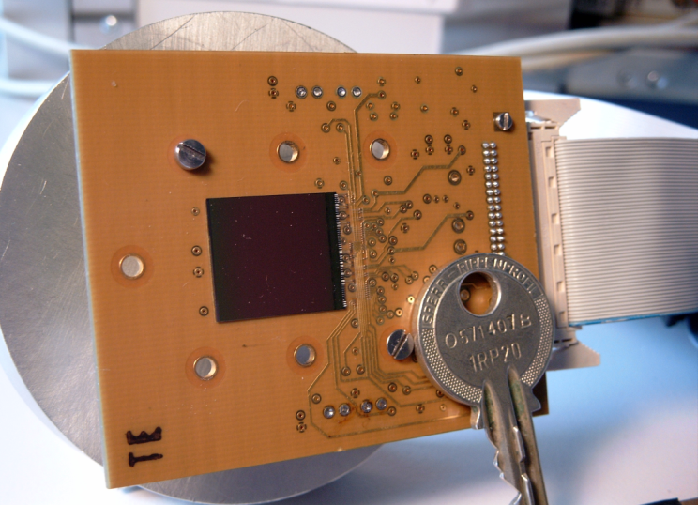
Performances of MAPS (2003)
MAPS provide an unique compromise between:
sensitivity
high rate capability
R&D is needed on radiation tolerance and read-out speed.
 | Required | Hybrid pixels
Single point res. [µm] | ~ 5 | ~ 30
Material budget [ X₀ ] | ~ 0.3% | 1%
Time resolution [µs] | few 10 | 0.025
Rad. hardness [n/cm²] | > 10¹³ | >> 10¹⁴
CCD
~ 5
~0.1%*
~100
<< 10¹⁰
MIMOSA-5 (2001)
3.5
~0.1%*
~25000
~ 10¹²
*Sensor only

Slide 5
Speed of MAPS vs. needs of CBM
CBM maximum
ASTRAL*
CBM minimum
MIMOSA-26
MIMOSA-5
MIMOSA-20
*predicted

Slide 6
Tolerance to ionizing radiation
Mimosa-32
CBM minimum
Mimosa-15
Mimosa-4
Mimosa-1

Slide 7
Tolerance to non-ionizing radiation
CBM minimum
MIMOSA-18AHR
MIMOSA-26AHR
MIMOSA-11
MIMOSA-1

Slide 8

Performances of MAPS (2014)
 | Required | Hybrid pixels
Single point res. [µm] | ~ 5 | ~ 30
Material budget [ X₀ ] | ~ 0.3% | 1%
Time resolution [µs] | few 10 | 0.025
Rad. hardness [n/cm²] | > 10¹³ | >> 10¹⁴
CCD
~ 5
~0.1%*
~100
<< 10¹⁰
MAPS² (2013)
3.5
~0.05%*
32
> 3x10¹⁴
ASTRAL³ (2014E)
~5
~0.05%*
15-20
> 10¹³
*Sensor only
²Best of specialized sensors
³Estimate (submitted)

Slide 9
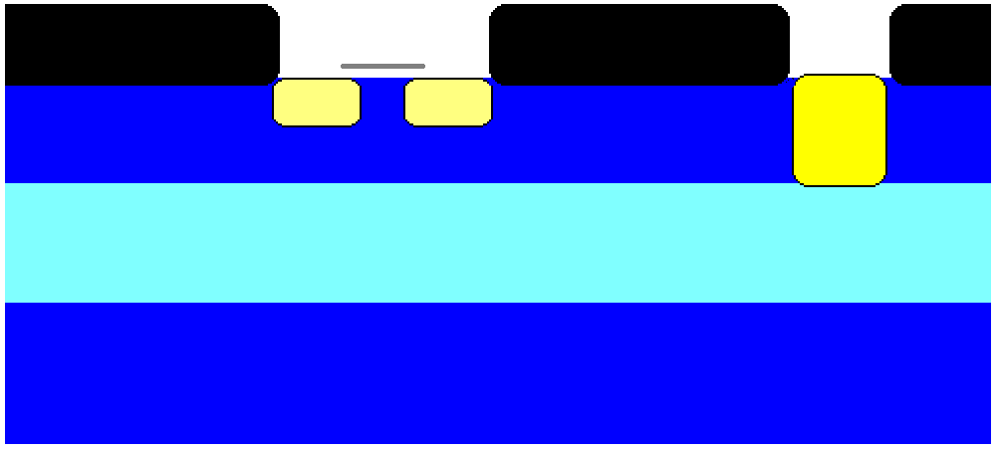
Sensor R&D: The operation principle
+3.3V
Reset
+3.3V
Output
SiO₂
SiO₂
SiO₂
N++
N++
N+
P+
50µm
15µm
P-
P+

Slide 10
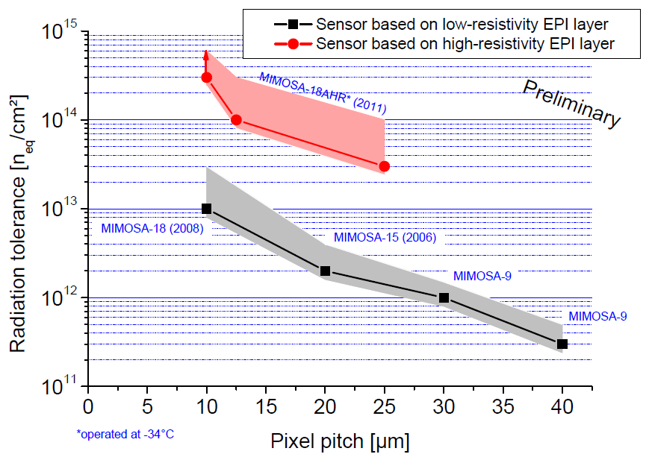
Radiation tolerance vs. pixel pitch
Partially depleted sensor
Undepleted sensor
Better CMOS-technology – better performance

Slide 11
Limitations of traditional MAPS
+3.3V
Reset
+3.3V
Output
PMOS Transistor
SiO₂
SiO₂
SiO₂
N+
N++
P
N++
P
N+
P+
50µm
15µm
P-
P+
No PMOS transistors => No discriminators on pixel => “slow”

Slide 12
Today: 2.5D-MAPS
+3.3V
Reset
+3.3V
Output
SiO₂
SiO₂
SiO₂
Sensor design: PICSEL Group, IPHC Strasbourg, et al.
N+
N++
P
N++
P
N+
P+
deep P-well
50µm
15µm
P-
P+
Modern 0.18µm process was identified:
Deep P-well isolates sensor from electronics
PMOS transistor available

Slide 13

The science behind the propaganda
Reset
+3.3V
+3.3V
Output
SiO₂
SiO₂
SiO₂
N+
N++
P
N++
P
N+
P+
deep P-well
D. Doering, B. Linnik
50µm
P-
P+
Question:
Does deep P-well really
separate electronics and
sensor?
Fe-55, 5.9 keV
Answer: Yes, it does.

Slide 14
The science behind the propaganda
Reset
+3.3V
+3.3V
Output
SiO₂
SiO₂
SiO₂
Qestion:
Does the charge collection
still work?
N+
N++
P
N++
P
N+
P+
deep P-well
d
50µm
P-
P+
D. Doering, B. Linnik
Answer:
d= 6µm => reduced
d=10µm => ok

Slide 15
The science behind the propaganda
Reset
+3.3V
+3.3V
Output
Qestion:
Any impact on the noise?
(Expect reduced noise)
SiO₂
SiO₂
SiO₂
N+
N++
P
N++
P
N+
P+
deep P-well
50µm
P-
P+
Answer:
Ouups…
…lets have a closer look…
old 0.35µm
D. Doering, B. Linnik
new 0.18µm

Slide 16

The science behind the propaganda
Observation (measurement + literature):
Pre-amps of individual pixels suffer from RTS-Noise
  in input transistors.
May be cured by enlarging the gate of affected transistors

Slide 17

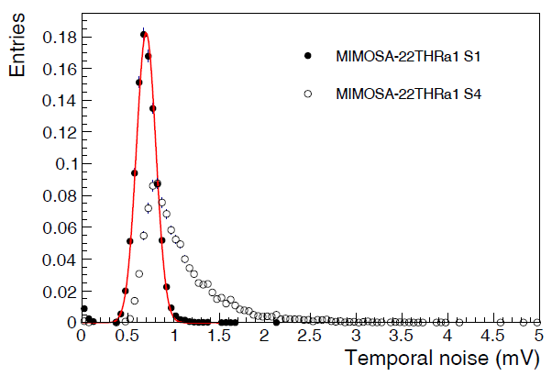
The science behind the propaganda
Gate: 0.35µm in 0.18µm CMOS
Reported in Strasbourg
Reported on ALICE-ITS meeting
(March 2013)
Gate: 0.2µm
250k€
From: ALICE TDR for the
upgrade of the ITS (Nov. 2013)
Submitted to JINST
Migrating a technology to a different CMOS process comes
with many challenging details.
It works best, if many experiments contribute (financially).
HIC for FAIR has some outreach…

Slide 18


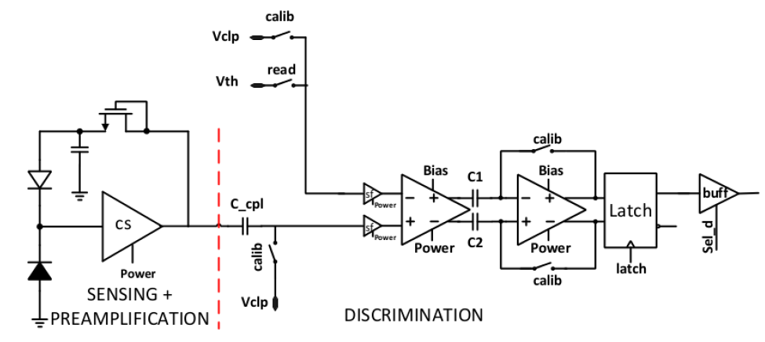
Pixels of the past, pixels of the future…
Pixel of MIMOSA-11
2 transistors
Signal handling outside
1x
Pixel of AROM-0
??? transistors
Signal discrimination inside
Digital data transport on chip
=> Much more speed

Slide 19

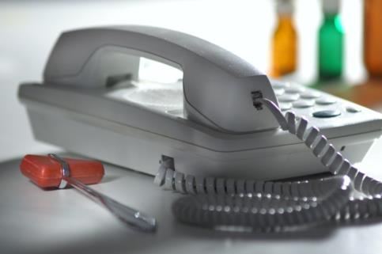
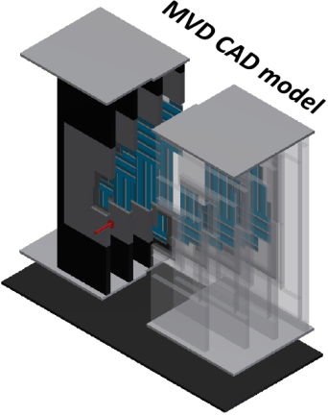
“If I give you the data…
= 36 000 x
CBM-MAPS
~ 2 Gbit/s per chip
Conventional phone
~ 56 kbit/s
= 320 x
… you are going to have (to deal with) it.”

Slide 20
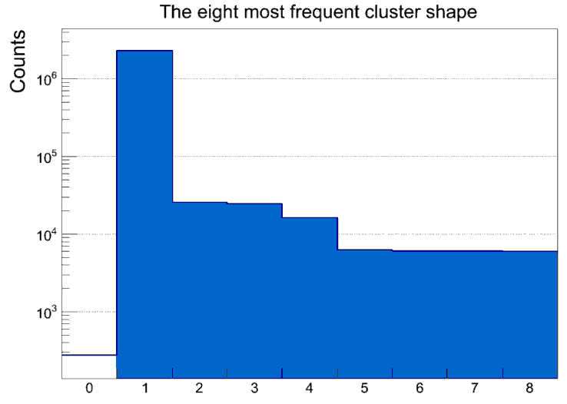
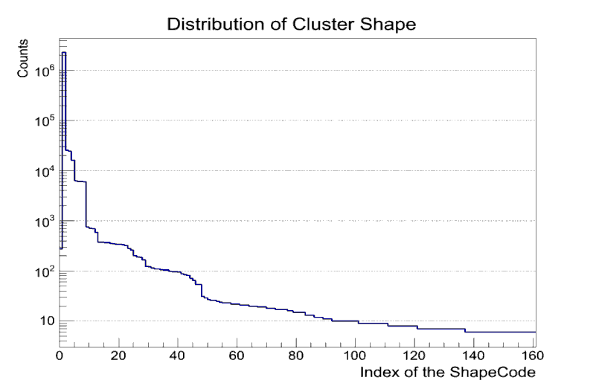
Cluster compression (Q. Li)
Idea:
 | * |  | *
 |  | * *
There are plausible clusters
There are not so plausible clusters
Don‘t encoding full window (25bit),
define shape code (10bit)
Plausible cluster
Unplausible cluster
>90%
Data: MIMOSA-26AHR
Beam test @SPS 2012
Observation (real data):
99.99% of all clusters
are successfully encoded
0 = overflow/fail

Slide 21
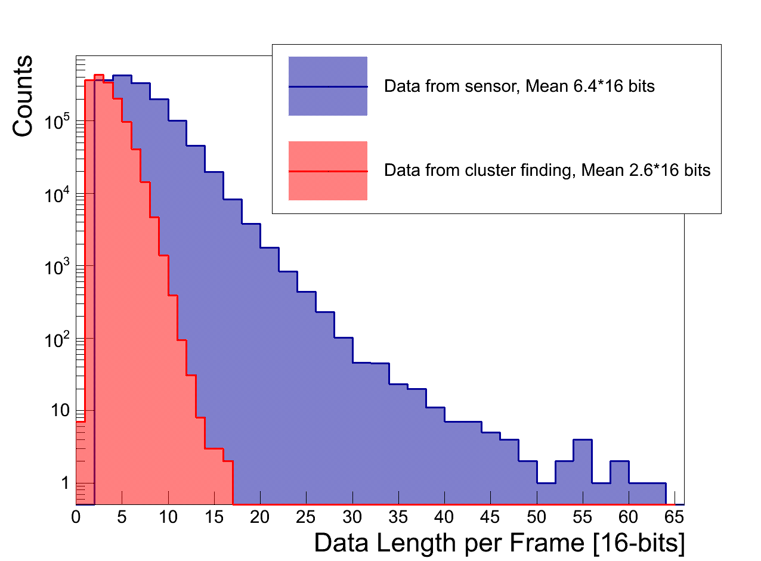
Possible cluster encoding (Q. Li)
N=ClusterNum
Header
Framecpt
ClusterNum
Cluster1
ClusterN
Trailer
0 | … | 9 | 10 | … | 20 | 21 | … | 30 | 31
Bit(0-9) |  |  | Bit(0-10) |  |  | Bit(0-9) |  |  | Bit0
Row Address |  |  | Column Address |  |  | Index of the ShapeCode |  |  | OVF
Result:
Encode cluster in 32bit
Grouping done on FPGA (implementation ongoing)
Data reduction: Factor 2 (SPS beam test data)
Real data:
MVD prototype@CERN SPS

Slide 22
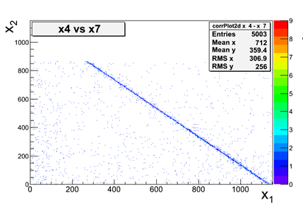
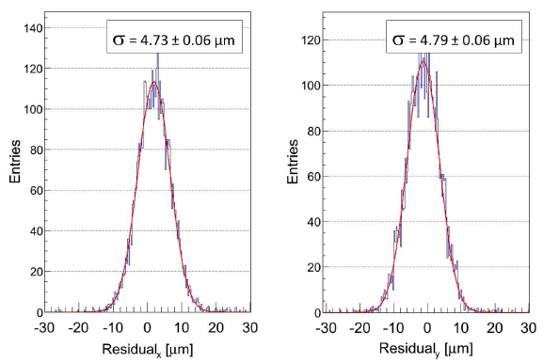
Beam test of the MVD-prototype
After fine analysis: Nominal resolution of
MIMOSA-26AHR (3.5µm) reproduced.

Slide 23
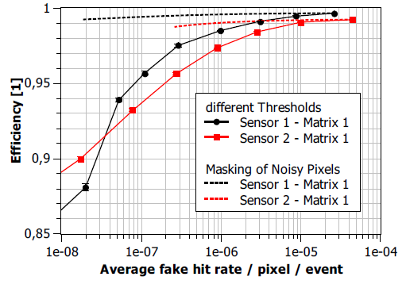
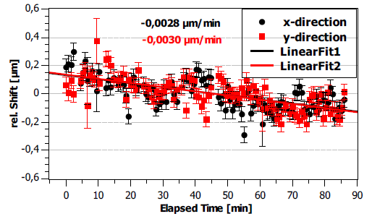
Refined results on the prototype
Observation:
Background is generated by
very limited number of noisy
pixels.
Observation:
Device under test moved…
…with 3nm / min…
…(30 atom layers/min)…

Slide 24
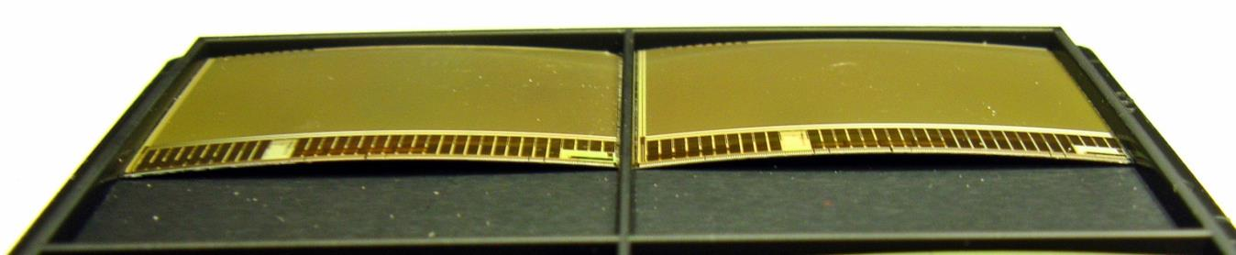
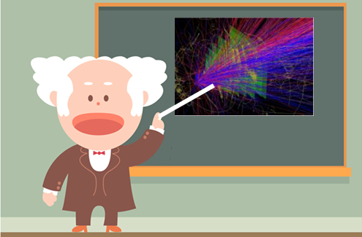
A word on integration
Size: 21.2 x 10.6 mm²
Bending radius: ~30 cm
The CBM – MVD should
Have 3-4 layers
~0.3% X₀ (first station)
~0.5% X₀ (other stations)
Operate in target vacuum
Cooling <1 W/cm²

Slide 25
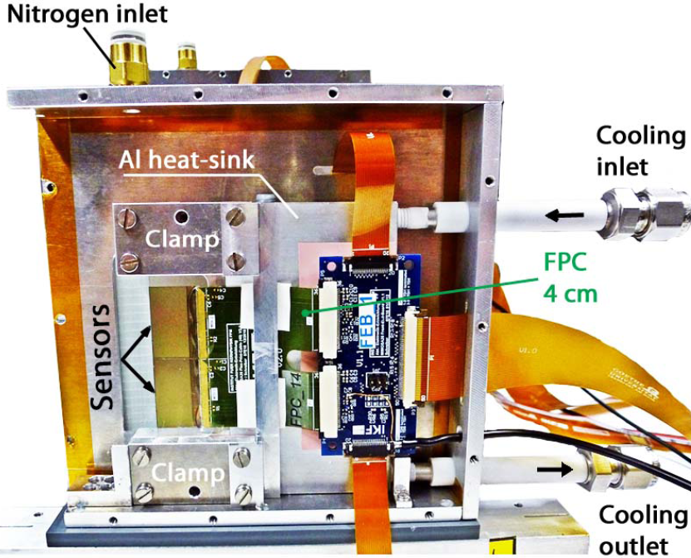
Integration concept of the MVD
Sensor
Sensor
Discri
Discri
Sensor
Sensor
Sensor
MIMOSIS-1B
Sensor
Discri
Discri
Discri
Discri
Sensor
Sensor
Sensor
Discri
Discri
Discri
Sensor
MIMOSIS-1A
Discri
T. Tischler
M. Deveaux
25

Slide 26
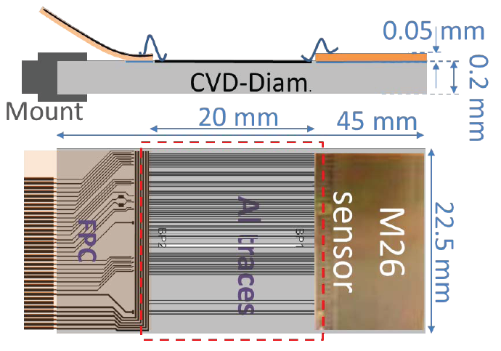
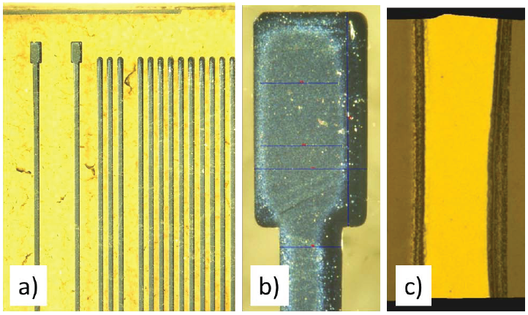
Why cables?
Together with R. Visinka (GSI), A. Meier, F. Völklein (Hochschule RheinMain, IMtech)
C. Müntz
Cables are material…
… material is evil…
Try to avoid cables.
Idea: Put traces directly
on the CVD diamond.
Status: Demonstrator produced, tests underway.

Slide 27

Test of the sensor before integration
The challenge:
Take 50µm thin sensor
Connect ~50 pins with a probe
Operate the sensor via the probes
Test the sensor…
M. Koziel, B. Milanovic

Slide 28
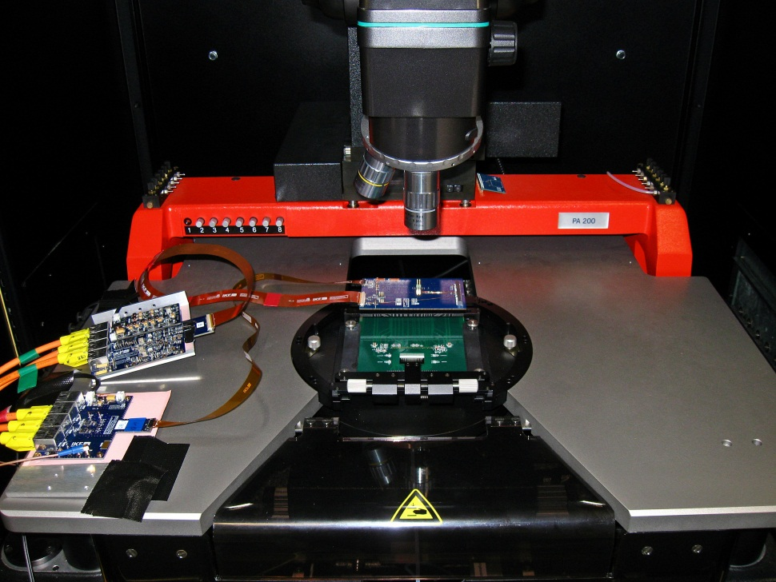
Probe testing of MIMOSA-26AHR
M. Koziel, B. Milanovic
50µm thick MIMOSA-26AHR operated successfully
Software for detailed tests is being developed

Slide 29
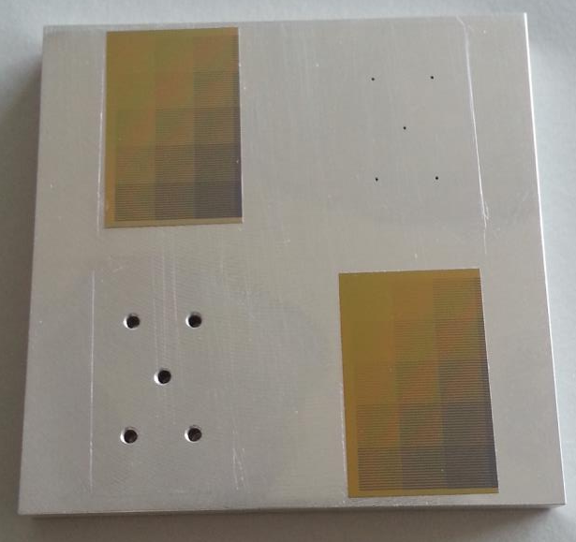
Vacuum compatibility
First tests on vacuum:
Goal: Absence of air
Issues:
Outgasing
Mech. stress due to cavities
Observations with 50µm dummies:
No significant outgasing (test not very sensitive)
Cavities of ~0.5mm can be tolerated
M. Koziel, G. Kretzschmar, T. Tischler

Slide 30
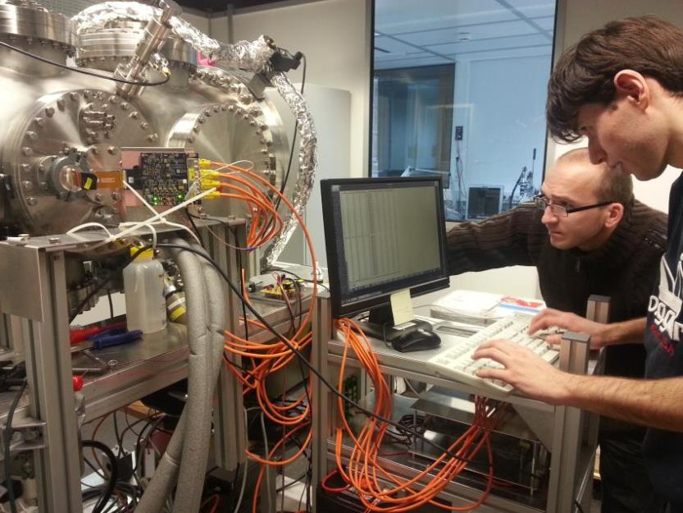
Vacuum operation
Yesterday:
18:38… a reference station of the MVD prototype is
switched on within the vacuum vessel…
19:12… System tolerates pumping to 7mBar…
(Smoke test passed… still high noise).
To be continued…

Slide 31
Conclusion
Sensor R&D in schedule:
  All requirements individually demonstrated
  Expect first full prototype in 2014
  Sensor might exceed initial performance expectations
Beam test of the prototype successful:
  Reached nominal sensor resolution (3.5 µm)
  Reached >99% detection efficiency for MIPs
  Dark rate << 10⁴
  Still open: DUT moved by 3nm/min
DAQ concept demonstrated with beam data…
Studies on sensor QA, vacuum operation, … in schedule
There are thousand open issues remaining,
but I dare to predict…

Slide 32
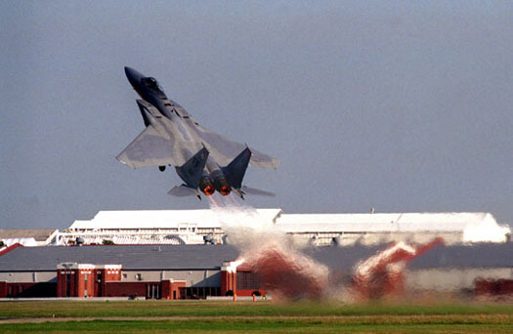

Conclusion
The MVD will fly…

Slide 33
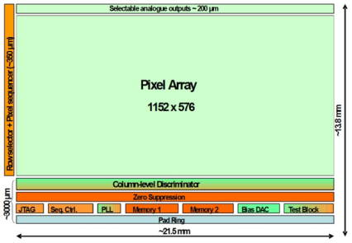
Instances of the processing chain
MIMOSA-Sensor:
Rolling shutter readout
On-chip noise discrimination
On-chip group finding
Output: High level protocol
 |  | 0 | 1 | 2 | 3 | 4 | 5 | 6 | 7 | 8 | 9 | 10 | 11 | 12 | 13 | 14 | 15
1 | Header | 0x5555
2 | Header | 0x5555
3 | Framenr | Frame Number 1
4 | Framenr | Frame Number 2
5 | Datalength | Data Length a
6 | Datalength | Data Length b
 | State Row | Of | Address line |  |  |  |  |  |  |  |  |  |  | States per line
 | State Col |  |  |  | Address column |  |  |  |  |  |  |  |  |  |  | NN
N-1 | Trailer | 0x8001
N | Trailer | 0x8001
Native MIMOSA-26 data word

Slide 34
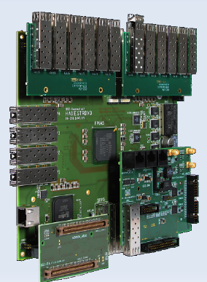
Instances of the processing chain
TRBv3 - FPGA:
Sensor control
Test for data consistency
SEU – detection and sensor restart
MVD synchronization
Time stamping
Add absolute system time
Data reduction
Idle bit removal
Data compression

