Slide 1
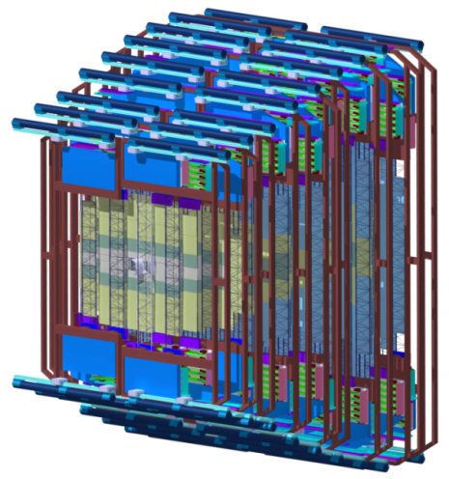
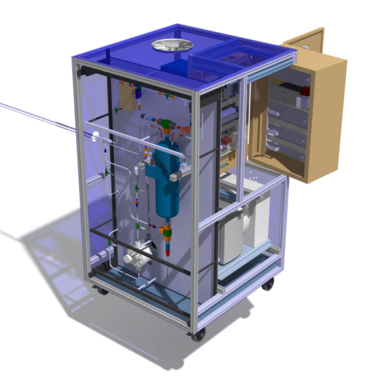
The Silicon Tracking System of the CBM experiment
The Silicon Tracking System of the CBM experiment
detector concept
prototype components
system integration
Tomas Balog
on behalf of the STS group
4th HIC for FAIR Detector Systems Networking Workshop
Notes:
Hello everyone,
my name is Tomas Balog and on behalf of the STS group in CBM I will present you our Silicon Tracking System with emphasis on detector description and characterization and further system integration.

Slide 2
CBM experimental setup
Notes:
But first the Compressed Baryonic Experiment. It is a fixed target experiment designed to explore the QCD phase diagram at high net baryon densities. This means looking at the rare observables which occur in early stages of the fireball created during nuclei collisions. To crosscheck the systematics of the measurements, the experiment has muon and electron configuration. Closest to the target is Micro-vertex Detector with Silicon Tracking System and they are used in both configurations. These detector systems are placed inside the gap of the 1 Telsa magnetic field. For further particle identification the Ring Imaging Cherenkov Detector with Transition Radiation Detector or Muon Chamber, Time of Flight detector and Electromagnetic Calorimeter are used, depending on the system configuration. Additionally Particle spectator detector is used to define the centrality and event plane.

Slide 3
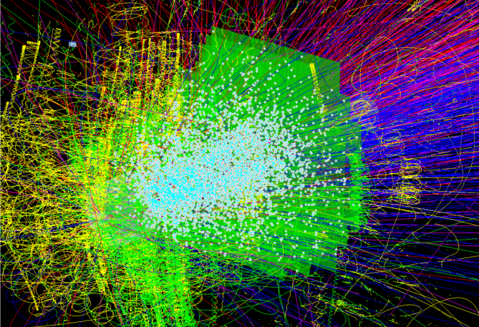
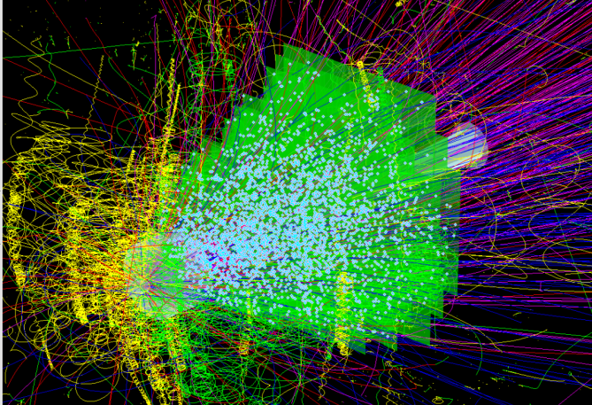
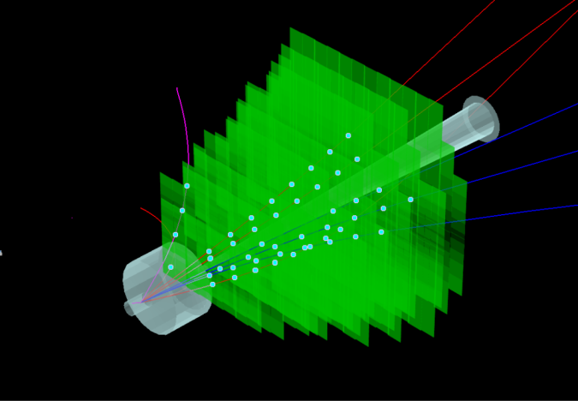
Tracking nuclear collisions at SIS-300 and at SIS-100
central Au+Au, 25 AGeV
central Au+Au, 8 AGeV
p+C, 30 GeV
~700 charged particles
~350 charged particles
few charged particles
CBM: high-rate experiment 10⁵ -10⁷ interactions/sec
hit rates 3-20 MHz/cm²
fast free-streaming readout
online event selection
radiation hard sensors
low mass large-area detector
high-resolution momentum determination
track matching into MVD and RICH/MUCH
Notes:
The Silicon Tracking System of the CBM has main task to provide tracking of the charged particles and their momentum determination. Multiplicity of the passing particles can be up to 700 particles per event in central gold gold collision at 25 AGeV. In the pictures you can see the amount of particles passing through detector in different interactions.
Additionally to multiplicities also high rates in which CBM will operate must be considered. Up to 10MHz interaction rate leads to hit rates from 3 – 20 MHz per squared cm. This requires fast free-streaming readout and online event selection. To maintain the high momentum resolution the detector has to be from low mass and radiation hard materials to minimize the material budget.

Slide 4
STS design constraints
Coverage:
rapitidies from center-of mass to close to beam
aperture 2.5° < Θ < 25°
Momentum resolution
δp/p ≅ 1%
field integral 1 Tm, 8 tracking stations
25 µm single-hit spatial resolution
material budget per station ~1% X₀
No event pile-up
10 MHz interaction rates
self-triggering read-out
signal shaping time < 20 ns
Efficient hit & track reconstruction
close to 100% hit eff.
> 95% track eff. for momenta > 1GeV/c
Minimum granularity @ hit rates < 20 MHz/cm²
maximum strip length compatible with hit occupancy and S/N performance
largest read-out pitch compatible with the required spatial resolution
Radiation hard sensors compatible with the CBM physics program
1 × 10¹³ n_{eq}/cm² (SIS100)
1 × 10¹⁴ n_{eq}/cm² (SIS300)
Integration, operation, maintenance
compatible with the confined space in the dipole magnet
Notes:
Everything what was mentioned before creates constraints to STS design. First of all it is an aperture of the CBM experiment which covers the angles from 2.5 degree to 25 degrees. Thus covering the rapidities from center of mass to the close to beam ones. Momentum resolution has to be kept at level of 1 per cent. Here material budget per each of the eight stations should be kept at material budget of 1 per cent. Single hit resolution is required to be at 25 micrometers. At highest interaction rates it is needed to have no pile-ups which leads to usage of the self-triggered read-out electronics with signal shaping time at level of tens of ns. The efficiencies have to be kept close to 100 per cent for hits and tracks.
Since hit rates are up to 20 MHz per squared cm the strip lengths are set to be compatible with hit occupancy and signal to noise ratio. Sensors have to be radiation hard up to 10 to the 14 neutron fluence equivalent per square cm, especially for SIS300 running scenario.
And the whole system with all the cabling, cooling and all the infrastructure has to fit into the gap of the dipole magnet.

Slide 5
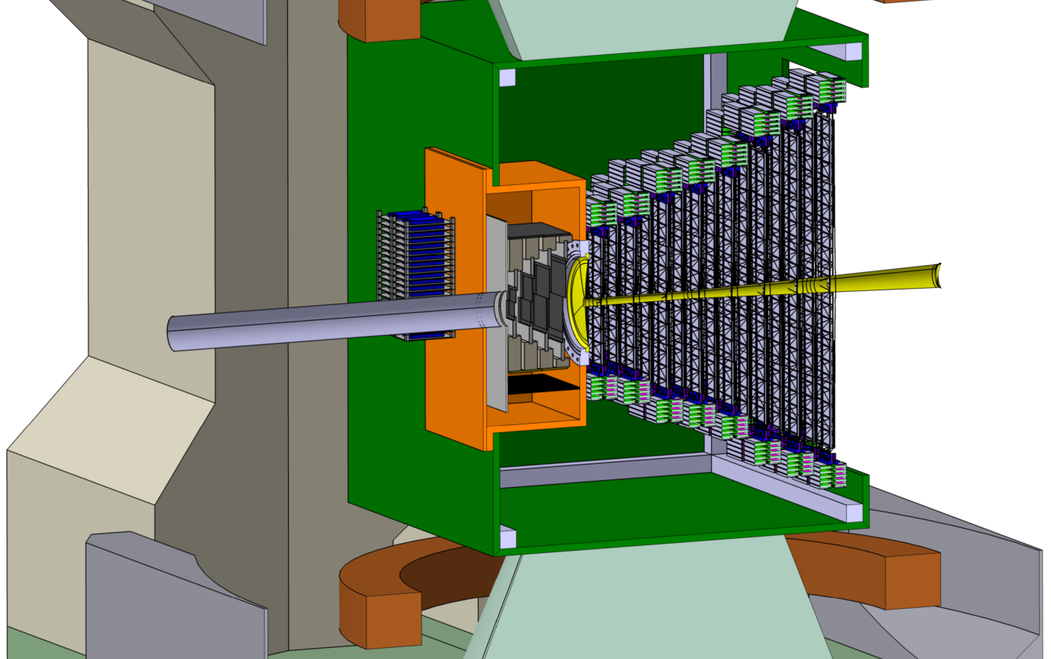
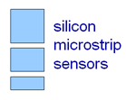
STS concept
Aperture: 2.5° < Θ < 25° (some stations up to 38°).
8 tracking stations between 0.3 m and 1 m downstream the target.
Built from double-sided silicon micro-strip sensors in 3 sizes, arranged in modules on a small number of different detector ladders.
Readout electronics outside of the physics aperture.
STS
Beam
2.5°
25°
Notes:
So how the STS is built? It will consists out of 8 tracking stations equally distributed from 30 cm to 1 meter downstream the target. To minimize material budget within aperture the double-sided silicon sensors of 3 different sizes will be used and read-out electronics will be placed outside the aperture. Sensors and electronics will be interconnected with low mass micro cables. Sensor, cable and electronics built main building block of the STS called the module. Modules are arranged on ladders and ladders placed next to each other build stations.
The aperture is in y-axis (right-left) in first stations increased up to 38 degrees to enable tracking of the particles created at lower energies.

Slide 6
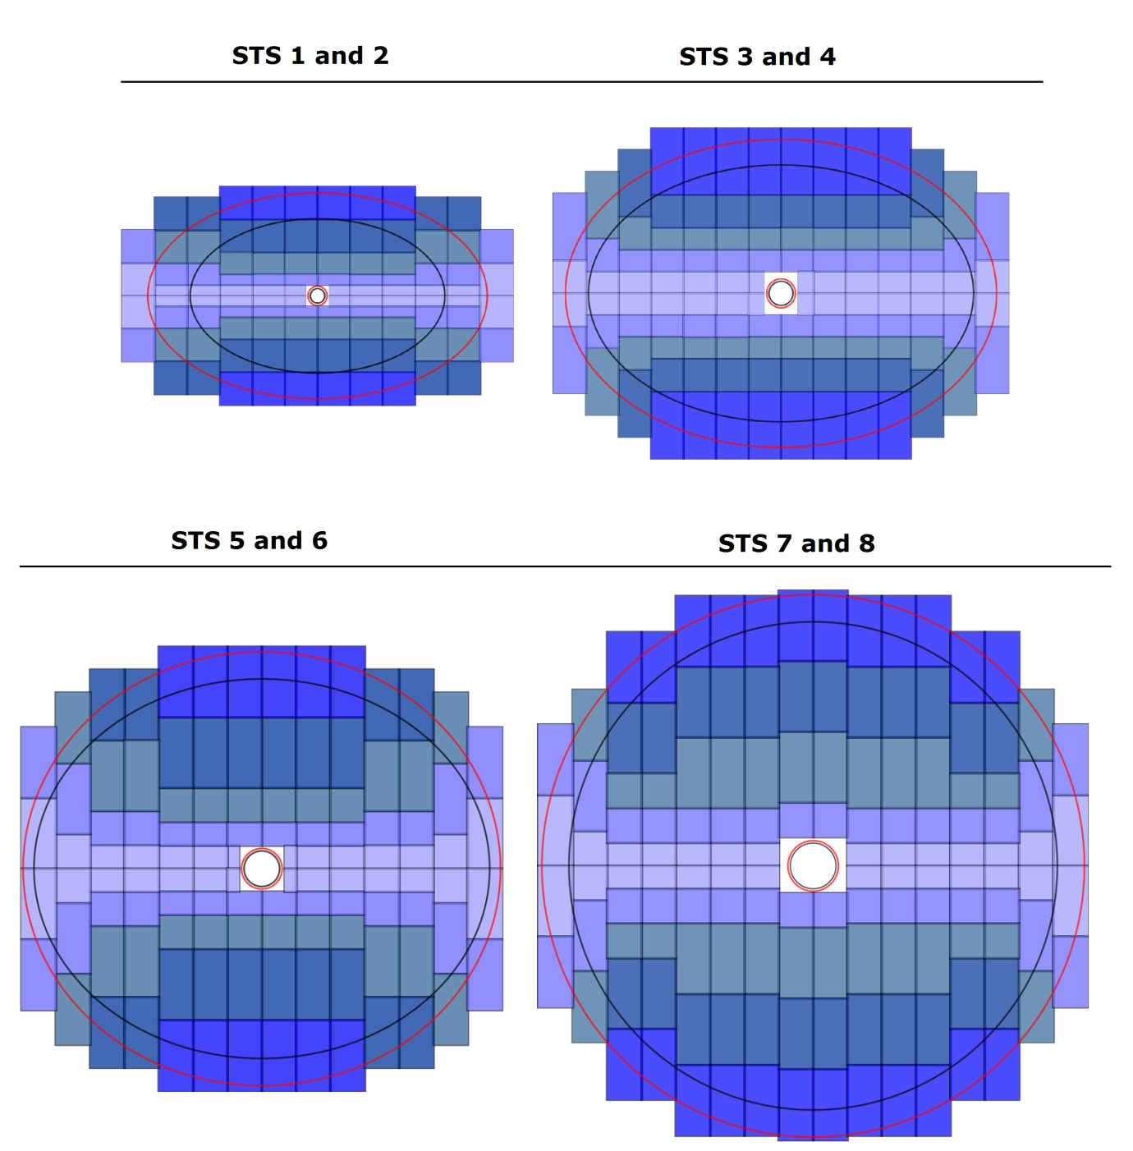
STS layout
Stations arranged in 4 duplets
Minimizing amount of modules
Strips lengths – 2 cm, 4 cm, 6 cm and in case of daisy chained sensors 12 cm
Granularity according to the hit densities
Components breakdown:
106 ladders (17 types)
896 modules
1220 sensors
14144 chips
1.8 Mio channels
Notes:
Taking in account all the constrains, hit distributions, expected occupancies and noise performance the STS layout was created. To populate stations with sensors three different strip lengths of the sensors are used, namely 2 cm, 4 cm and 6 cm. In outermost areas also daisy chained sensors of two sensors with 6 cm long strips. To minimize the amount of modules and spare parts stations are arranged into four duplets. In shown pictures you can see those duplets.
In the end 106 ladders populated with 896 modules will be used. To cover the full 8 stations altogether 1220 sensors will be used connecting to 14thousand chips leading into more than 1.8 million channels.
The black ellipse or circle shows the aperture of the station with odd number and red one the station with even number. Due to the paths of delta electrons created during ions passing through the target the granularities are kept higher in first four stations at positions left-right to the beam-pipe.

Slide 7
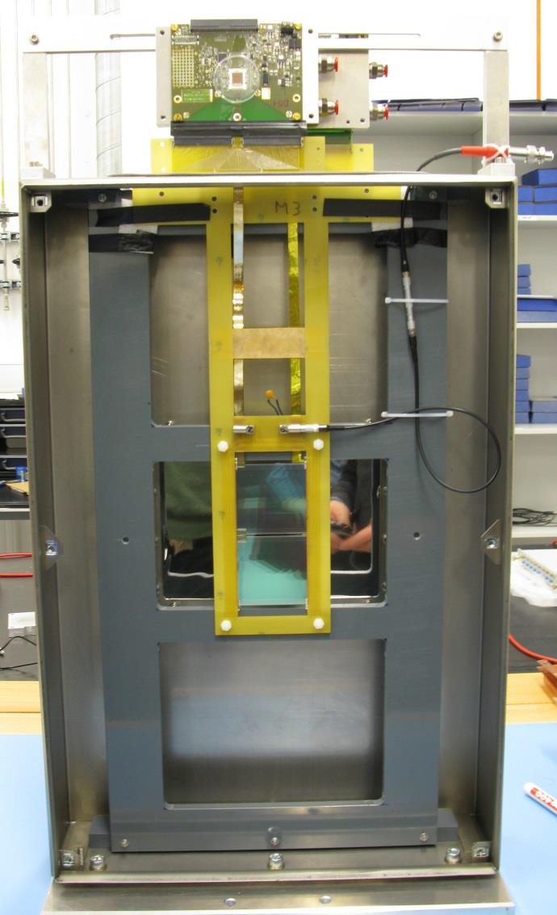
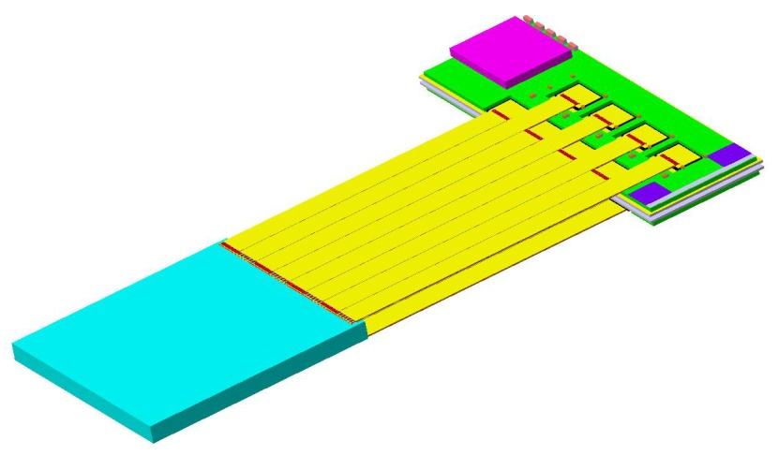
STS module
module := building block of ladders
smallest assembled functional unit
front-end electronics board
read-out cables
10 – 50 cm
sensor
2, 4, 6, (12) cm
daisy chained module
under test
6 cm
Notes:
STS stations will be built out of ladders populated by the modules. Module is defined as main building block of the STS as it is the smallest assembled functional unit. In consists out of the silicon sensor read-out cables and board with front end-electronics. The cables are divided into 8 groups of 128 channels allowing easier interconnection from sensor to each of the 8 chips at the front-end electronics board and making the production simpler.
As mentioned before three different sensors sizes are used allowing to populate stations with four different granularities.
In the photo on the right the prototype of module with daisy chained sensor is shown. Each side of the sensor has 128 channels connected to read-out electronics by low mass micro cable which in case of the largest stations can have length up to 50 cm.

Slide 8
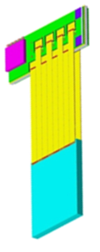
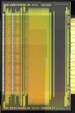
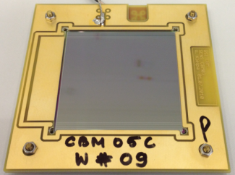
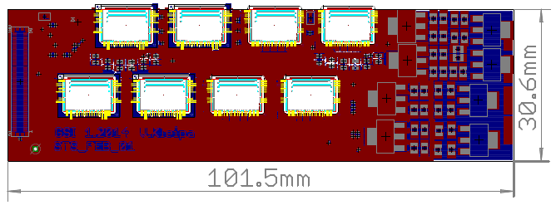
STS module integration
High-density silicon detector module
Procedures for module assembly + integration
Exploration of technologies for mass-production
components: ASICs, sensors, FEB, read-out cables
module assembly study
EU-FP7 HadronPhysics3 – Work Package ULISINT
http://www.hadronphysics3.eu/
Notes:
To populate ladders with modules and to build modules themselves the procedures for assembly have to be realized. These procedures are being investigated and studied and here you can see how such fully assembled module might look like. Eight cables to connect from sensor to chips are well seen.

Slide 9
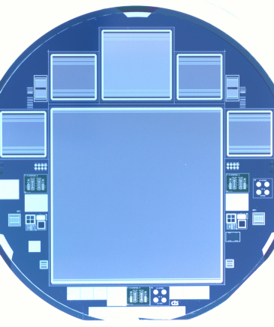
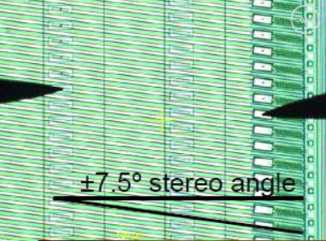
Micro-strip silicon sensors
double-sided, p-n-n structure
width: 6.2 cm
1024 strips at 58 μm pitch
three types, strip lengths: 2, 4, 6 cm, 12 cm
stereo angle front-back-sides 7.5°
integrated AC-coupled read-out
double metal interconnects on p-side, or replacement with an external micro cable
operation voltage up to few hundred volts
radiation hardness up to 1 × 10¹⁴ n_{eq}/cm²
Strips reaching the border are
continued on the other side
Needs double metal layer
or external cable
Notes:
Now lets go step by step through the particular parts of the modules. The main part is the one giving us the signals which are the micro-strip silicon sensors. They are going to be double sided sensors so one sensor of 300 micrometer thickness will provide two position information. Strips are angled by 7.5 degree where only p-side has strips angled as seen on the picture and n-side has vertically oriented strips. The strip pitch is 58 micrometer to provide required hit position resolution 25 micrometer. Each sensor will have 1024 strips. Due to the angle on the p-side some of the strips are not directly accessible for connection. That’s why two options are investigated. Either double metal interconnection will be realized directly on the sensor or external micro cable will be used.

Slide 10
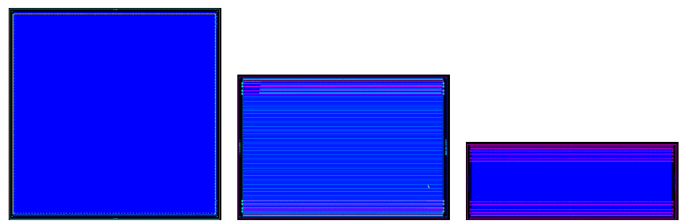
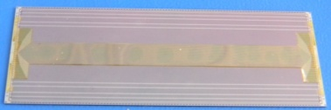
Prototypes of STS micro-strip silicon sensors
Prototype | Year | Vendor | Processing | Size [cm²] | Description
CBM01 | 2007 | CiS | double-sided | 5.5 × 5.5 | ±7.5 deg
CBM03 | 2010 | CiS | double-sided | 6.2 × 6.2 | ±7.5 deg
CBM03’ | 2011 | CiS | Single/CBM03 | 6.2 × 6.2 | test for CBM05
CBM05 | 2013 | CiS | double-sided | 6.2 × 6.2 | 7.5/0 deg, full-size
CBM05H4 | 2013 | Hamamatsu | double-sided | 6.2 × 4.2 | 7.5/0 deg, full-size
CBM05H2 | 2013 | Hamamatsu | single-sided | 6.2 × 2.2 | 7.5/0 deg, full-size
CBM06 | 2014 | Hamamatsu, CiS | double-sided | 6.2 × 6.2 | 7.5/0 deg, full-size
under study: replacement for integrated 2nd metal layer
CBM05
CBM05H4
CBM05H2
external on-sensor cable
Notes:
During the R&D phase several prototypes of sensors have been realized with different sizes and also different stereo-angles leading to the latest family prototypes called CBM05 used also these days for the tests.
Here also external cable is shown.

Slide 11
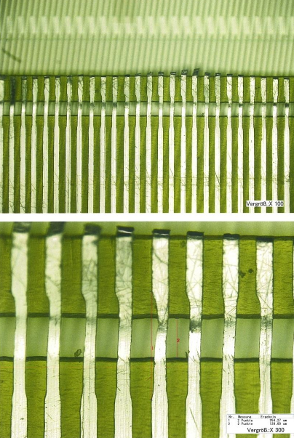
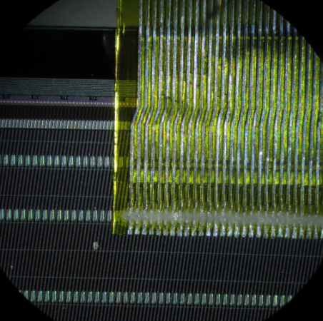
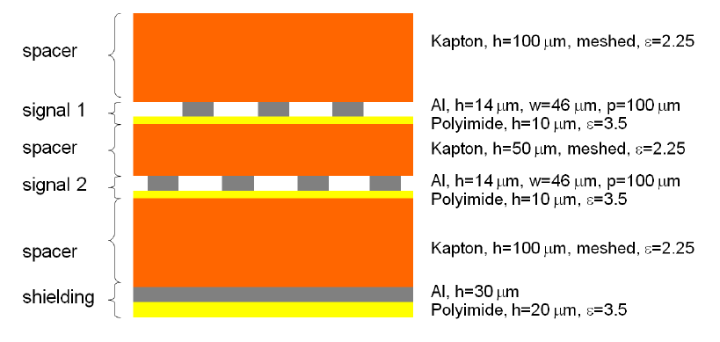
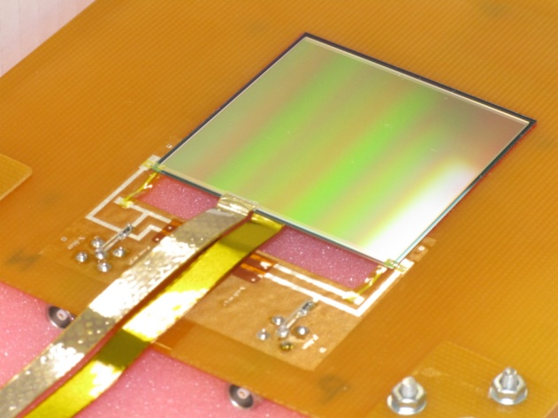
STS low-mass micro-cables
Cable
radiation length: 0.1% Xo
two signal layers
strip pitch 116 µm
thickness 24 µm
additional spacer to reduce the capacitance
tap bonded to sensor
1024 channels to connect
in prototypes 128 channels on each side are connected
Notes:
Second part of the module is an interconnection between the sensor and read-out chip is the low mass micro cable. The radiation length of one cable is 0.1 per cent which leads to 0.2 per cent for one module, since front and back side have they own individual connection cables. Each cable consists out of two layers with wires with pitch 116 micrometer. Thickness of the signal layer is 24 micrometer and additional spacer is implemented to reduce the capacitance between the channels. The cables are tap bonded to the sensor and to the read-out chip. In prototypes up to now 128 channels were connected to provide testing possibilities.

Slide 12
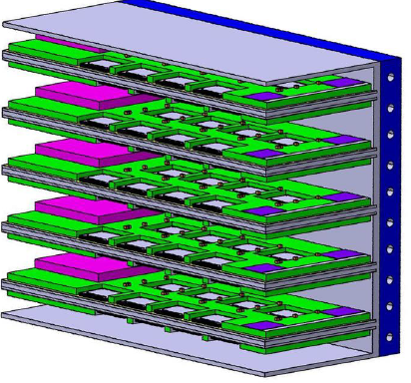
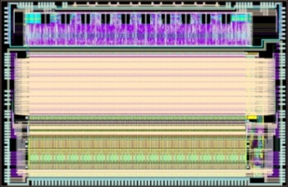
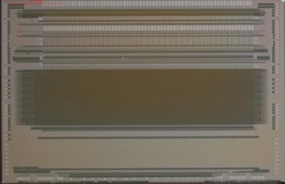
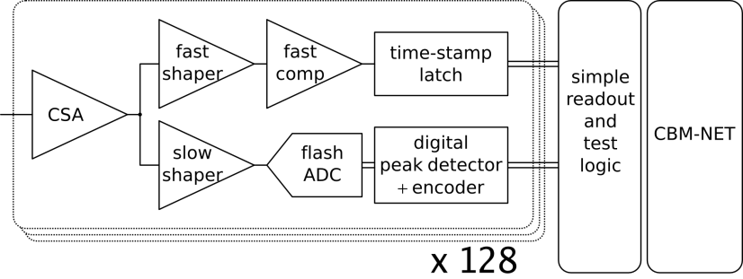
Read-out chip STS-XYTER
full-size prototype dedicated to signal detection from the double-sided micro-strip sensors in the CBM environment
fast ⇔ low noise ⇔ low power dissipation
new w.r.t. n-XYTER architecture:
effective two-level discriminator scheme
design V1.0 @ AGH Kraków
UMC 180 nm CMOS
Channels, pitch | 128 + 2 test
Channel pitch | 58
Input signal polarity | + and -
Input current | 10 nA
Noise at 30 pF load | 900 e⁻
ADC range | 16 fC, 5 bit
Clock | 250 MHz
Power dissipation | 4 mW/channel (analog)
Timestamp resolution | < 10 ns
output interface | 4 × 500 Mbit/s LVDS
Notes:
As a readout-chip the dedicated STS-XYTER chip will be used. It was designed in AGH Krakow and for production radiation hard 180 nm technology was used. It is designed for the purposes and according to the requirements of the STS. It consists out of two shapers – fast and slow. Fast with 30 ns shaping time is used to create internal trigger and time-stamp creation. Slow shaper with 80 ns shaping time is used for peak amplitude determination by flash 5 bit ADC. The noise level at 30 pF load is simulated to be 900 electrons which is well below maximum required 1300 electrons. Up to now for prototyping purposes the n-XYTER electronics was used. The new STS-XYTER will have lower power dissipation and additionally two level discriminator scheme. The STS-XYTER adds additional veto if the ADC has generated zero. This means that additional discriminator is implemented but due to higher shaping time this discriminator is exposed to lower bandwidth as it is in fast shaper. This allows to set thresholds to lower values as it would be in case of discrimination only with fast shaper. On the top picture one can see the FEB cooling box with FEB boards in shelves.

Slide 13
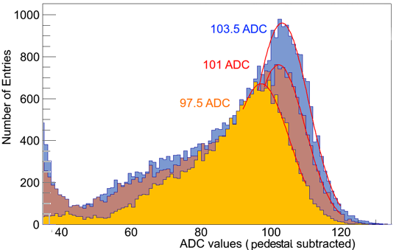
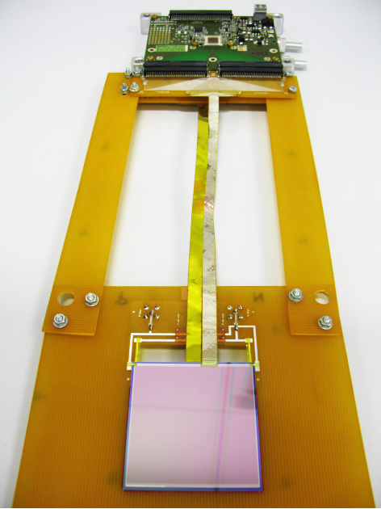
Module prototype tests
First module prototype with CBM01 sensor and first batch of the low-mass micro-cables and n-XYTER FEB
ADC spectrum, ²⁴¹Am source
59.5 keV
γ line
10 cm: 15.0 ke⁻
20 cm: 14.7 ke⁻ 30 cm: 14.1 ke⁻
10 cm
20 cm
30 cm
threshold @ 3σ noise
S/N for MIP > 20
Notes:
We have now prototypes available and they were the focus of our study. First module prototype comprises CBM01 sensor with three different interconnection cable lengths, namely 10, 20 and 30 cm. Here charge transmission efficiency was studied together with noise level of the modules. Charge transmission efficiency was still 85 per cent even for the longest cable length. The studies shown decrease of about 5 per cent of signal amplitude loss per 10 cm of cable. Here one has to mention that due to production error the first batch of the cables was missing one spacer layer, thus only one strip clusters were studied. From the noise point of view with 3 sigma level the noise was below maximum required required level and signal to noise ration is above 20.

Slide 14
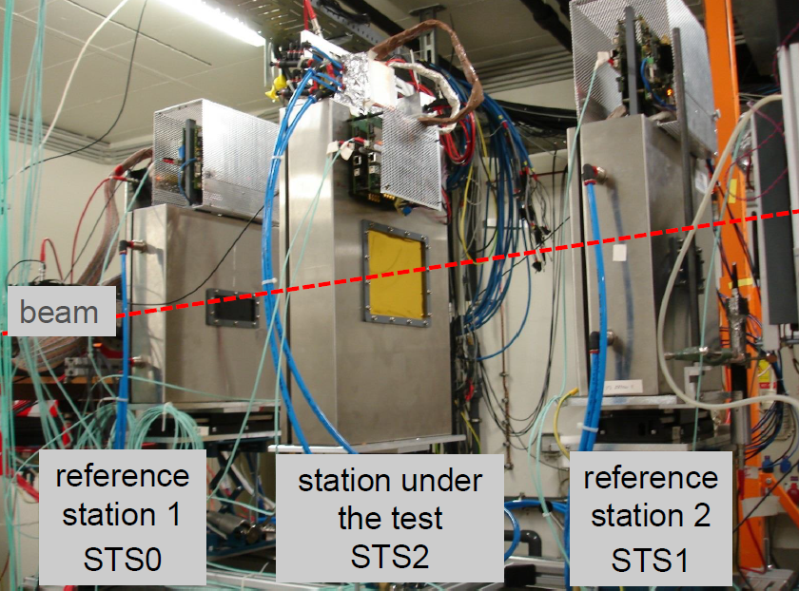
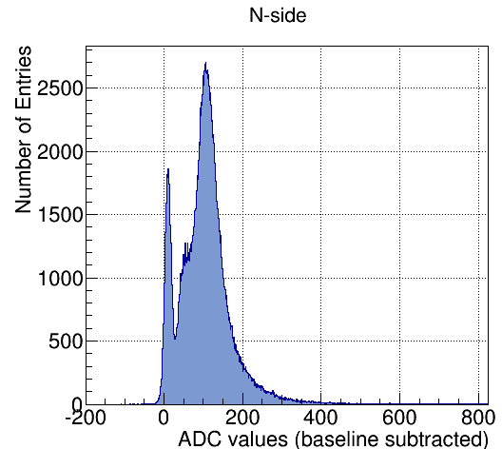
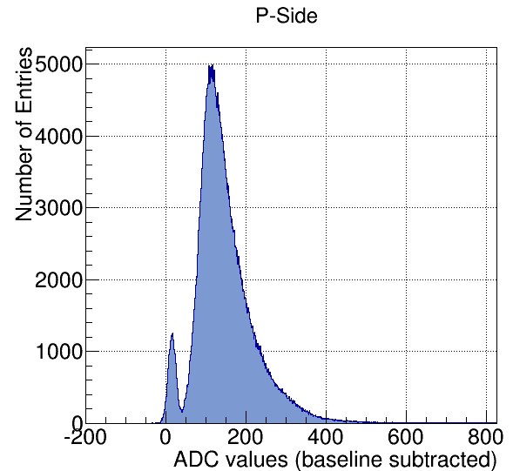
Module prototype tests
Second module prototype with CBM05 sensor and second batch of the low-mass micro-cables and n-XYTER FEB
Detailed analysis in progress
COSY @ Jülich
Notes:
New prototypes were build from the new CBM05 full size sensors with low-mass micro-cables. Such modules were also under beam tests which took place in COSY Julich in December of last year. Two STS sensors were used as reference stations and middle station was the one under test having the CBM05 sensor. Modules were tested using 2.4 GeV protons and since the detailed analysis is still in progress I am able to show the beam profile as seen in reference station and ADC response from the n-side of the module.

Slide 15
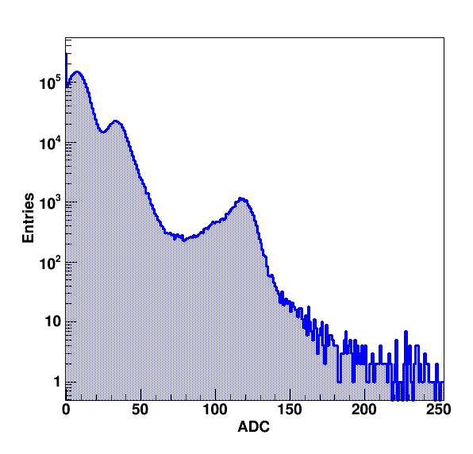
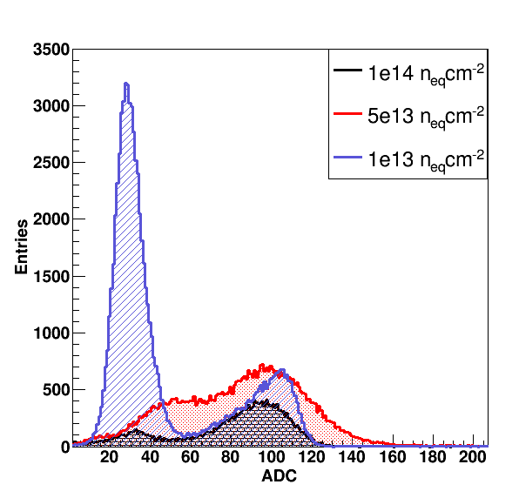
Source tests of the latest silicon sensor prototype CBM05
Fluence | ADC (peak) | Efficiency
0 n_{eq}/cm² | 117 | 100 %
1 × 10¹³ n_{eq}/cm² | 104 | 89 %
5 × 10¹³ n_{eq}/cm² | 98 | 84 %
1 × 10¹⁴ n_{eq}/cm² | 97 | 83 %
ADC spectrum, ²⁴¹Am gamma source
expected signal at 117 ADC - 16.5 ke-
0 n_{eq}/cm²
59.5 keV
117 ADC
S/N for MIP > 20
Notes:
Meanwhile also source tests were performed in the GSI laboratory using the 241 Americium gamma source on the CBM05 sensor, now without interconnection cable. Here sensors before and after irradiation were tested. Expected ADC response for the 59.5 keV peak is 117 ADCs. This was observed for the non-irradiated sensors. With increased neutron fluence equivalent the peak mean value was falling down to 97 ADC for 10 to the 14 neutron fluence equivalent which is 83 per cent of the expected peak value. Such irradiation is expected after years of working in the SIS300 conditions. Signal to noise ratio is thus still above 20.

Slide 16
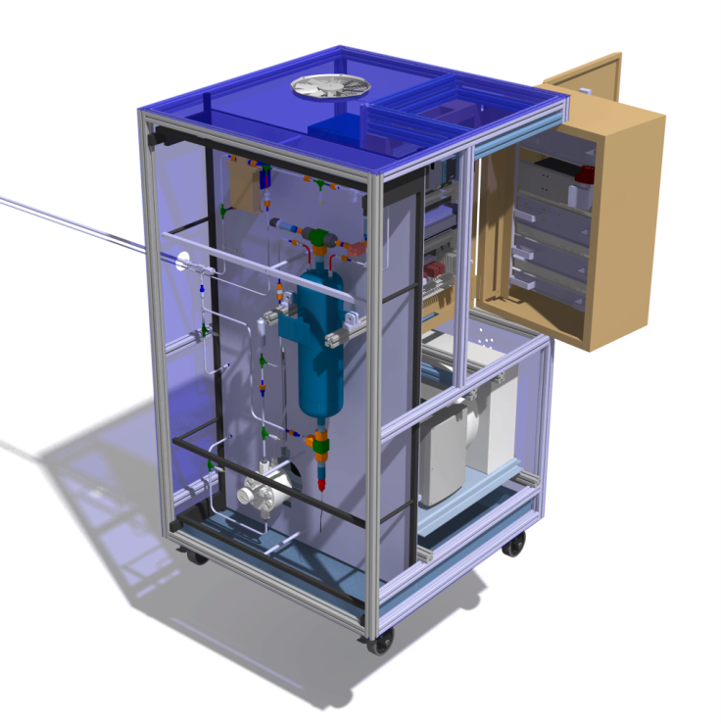
Cooling
20 kW
STS read-out electronics dissipates ca. 40 kW
cooling with bi-phase CO2:
high efficiency at small spatial requirement
standard for tracker upgrades at LHC
cooperation of GSI with CERN: TRACI-XL
20 kW
TRACI-XL:
1 kW test cooling system
“2-phase accumulator controlled loop”
EU-FP7 CRISP– Work Package CO₂ cooling
http://www.crisp-fp7.eu/
Notes:
From integration point of view the STS stations will be made as half stations which can be put into the STS box using rails from both sides. Within 1 cubic meter the power dissipation from electronics is 40 kW where half goes from upper and half from lower part of stations. Cooling will be realized using bi-phase CO2 which is a standard for tracker upgrades at LHC and it provides high efficiency at small spatial requirements. The TRACI-XL cooling system is made with cooperation with CERN.

Slide 17
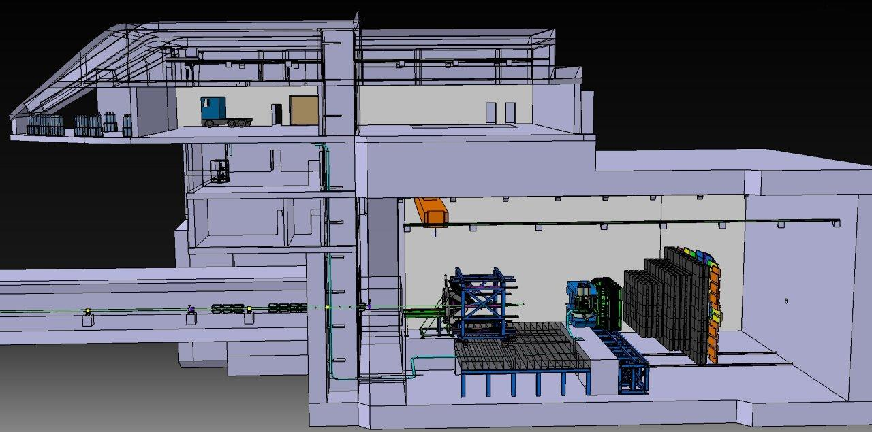
Cooling infrastructure inside CBM building
Underground hall: Length: 37 m Width: 22 m Height: 17 m
gas storage
CO₂ plant
room height: ~ 3.70 m
CBM experiment
STS
accelerator tunnel
pipe length ~ 70 m

Slide 18
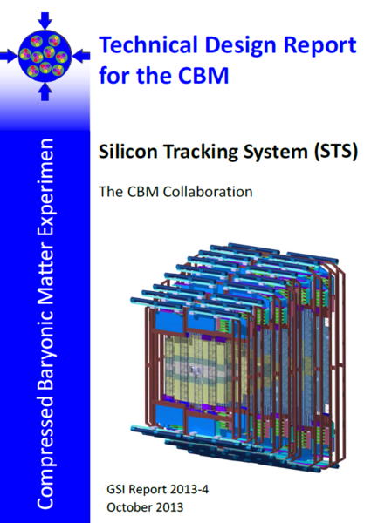
STS Technical Design Report
Approved by FAIR in Summer 2013
Content:
CBM experiment
Silicon Tracking System
constraints
concept
layout
Physics performance
Radiation environment
Development of components
micro-strip sensors
read-out cables
front-end electronics
module, ladders
Prototypes
System integration, maintenance
Project structure
t

Slide 19
Timeline for the STS
I 2014: R&D, prototyping and engineering design
II 2014 – 2017: Production phase - Pre-production (2014 - 7/2015)
- Production Readiness Review mid 2015
- Series production (2015 - 2017)
III 2018: Installation, commissioning w/o beam, ...

Slide 20
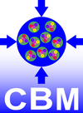
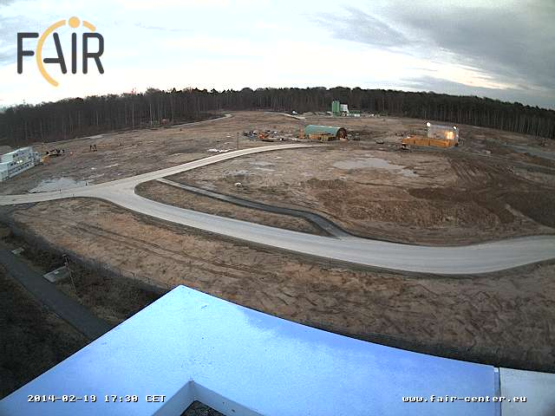
Thank you!

