Slide 1
Status of FAIR accelerators
4th HIC for FAIR Detector Systems Networking Workshop, JLU Gießen, 20-21.2 .2014
Jens Stadlmann, FAIR@GSI, Primary Beams

Slide 2
Overview
Introduction to FAIR and it‘s accelerator challenges
FAIR injectors: UNILAC, SIS18, p-LINAC
Main synchrotron: SIS100
Highlights from common systems and a look at the future FAIR control system
brief look at FAIR storage rings
… and Civil construction

Slide 3
Requirements to the FAIR accelerators
Beam intensity increase:
  Primary beams:
  x 100 – x 1000
  Secondary beams:
  x 10.000
Beams:
  Anti protons
  Protons to uranium
  RIBs
Beam quality:
  Cooled anti proton beams
  Cooled, intense RIBs
Beam pulse structure:
extreme short pulses to
quasi continuous
Modularized
start version
SIS18
UNILAC
CBM
Design ion beam: U²⁸⁺ with 2.7 GeV/u, 5x10¹¹ Ions/Cycle
Protons up to 29 GeV
Heavy ion beams up to about 11 GeV/u

Slide 4
The FAIR injectors
UNILAC
SIS18
CBM

Slide 5
Preparing the Injector Chain
UNILAC upgrade
High power (high intensity),
short pulses
Increase of beam brilliance (Beam current / emittance)
Increase of transported beam currents
Improvements of high current beam diagnostics / operation
SIS 18 upgrade
Fast ramping, enhanced intensity
per pulse
Increase of injection acceptance
Improvement of lifetime for low-charged U-ions
Increase of beam-intensity per time due to reduction of SIS18- cycle time

Slide 6
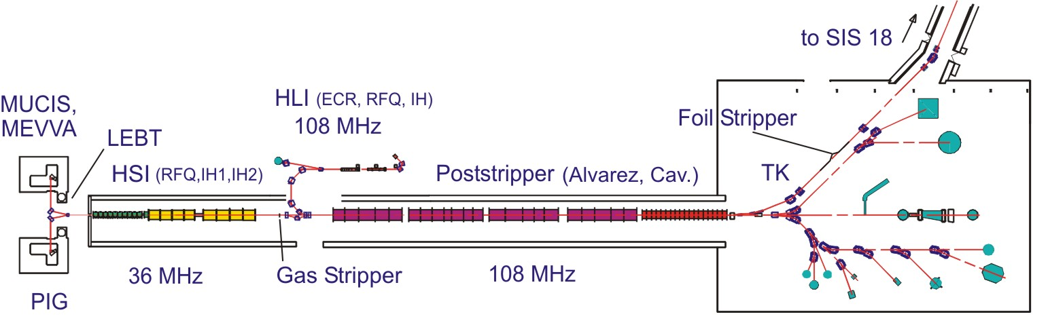
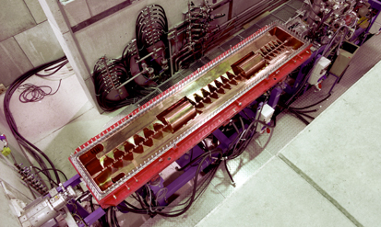
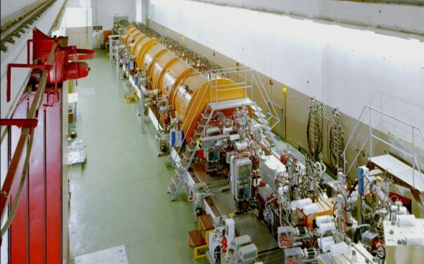
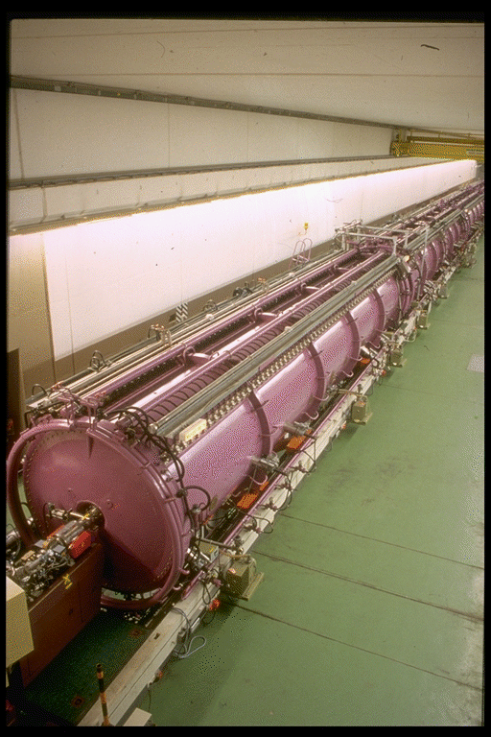
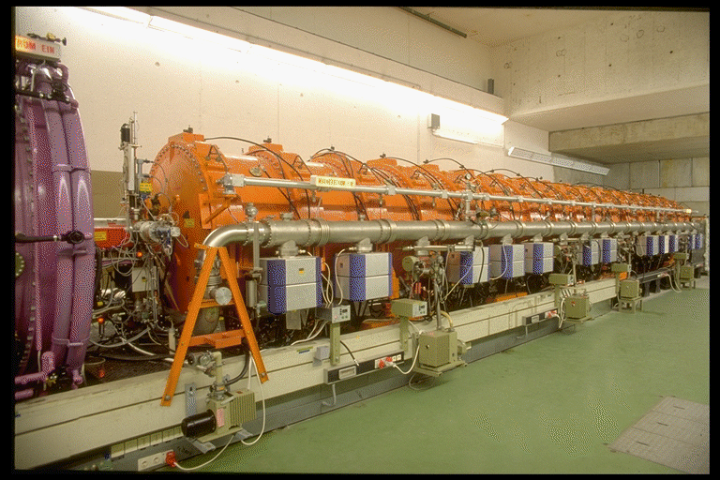
GSI UNIversal Linear ACcelerator
High Charge State Injector (1991)
High Current Injector (1999)
Alvarez (1975)
Single Gap Resonators (1975)

Slide 7
Emittance transfer: to be tested next weeks
Emittance transfer via Eigen Emittance shaping
→Beam tailored to
an optimized synchrotron injection

Slide 8
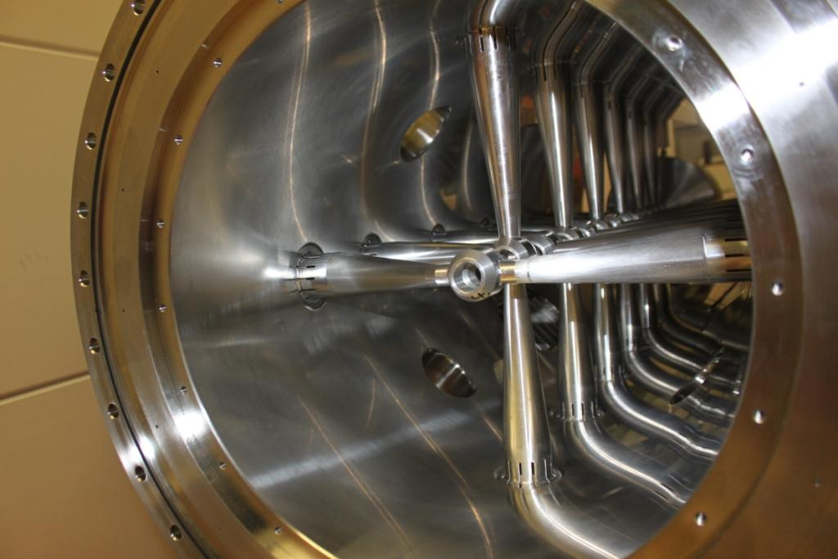
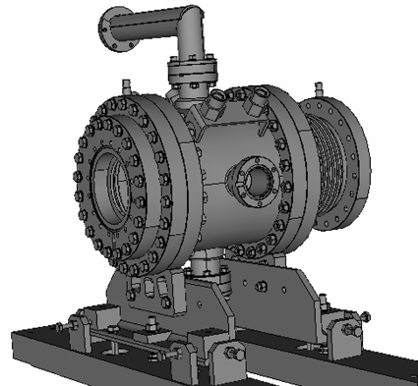
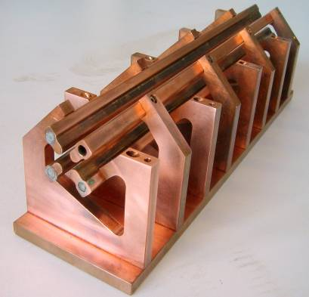
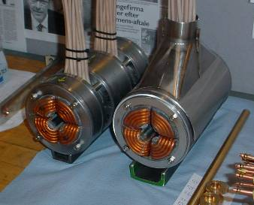
p-Linac overview, first modules on site!
ECR proton source & LEBT
4-rod RFQ, 325.224 MHz
6 accelerating cavities, 35 mA beam current
5 MW of beam loading (peak), 710 W (average)
11 MW of total rf-power (peak), 1600 W (average)

Slide 9
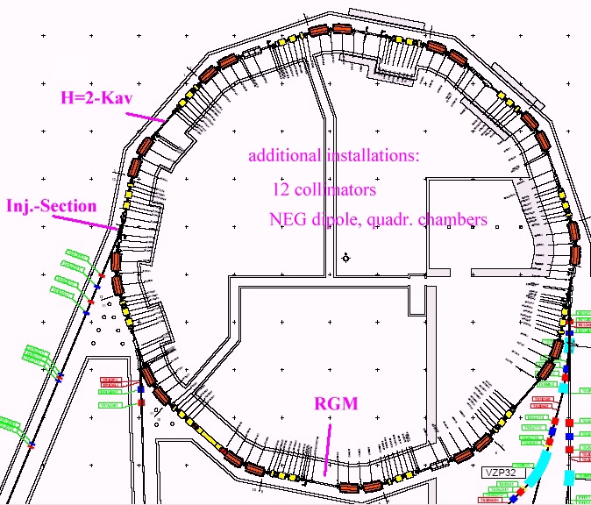
SIS18 high current upgrade
SIS-Ring with modifications
Main tasks:
pulse power conn. finished
ramping 4 T/s (12 Tm: 10 T/s)
new injection system
finished
RF Upgrade: first H=2 cavity
installed + Bunch compressor
Dynamic vacuum:
  * UHV upgrade
  * ion catcher system,
  collimators
  * optimized beam
  diagnostics (RGM)
Theoretical Investigations
(and machine Exp., biggest
campaign starting now)
Better orbit correction

Slide 10
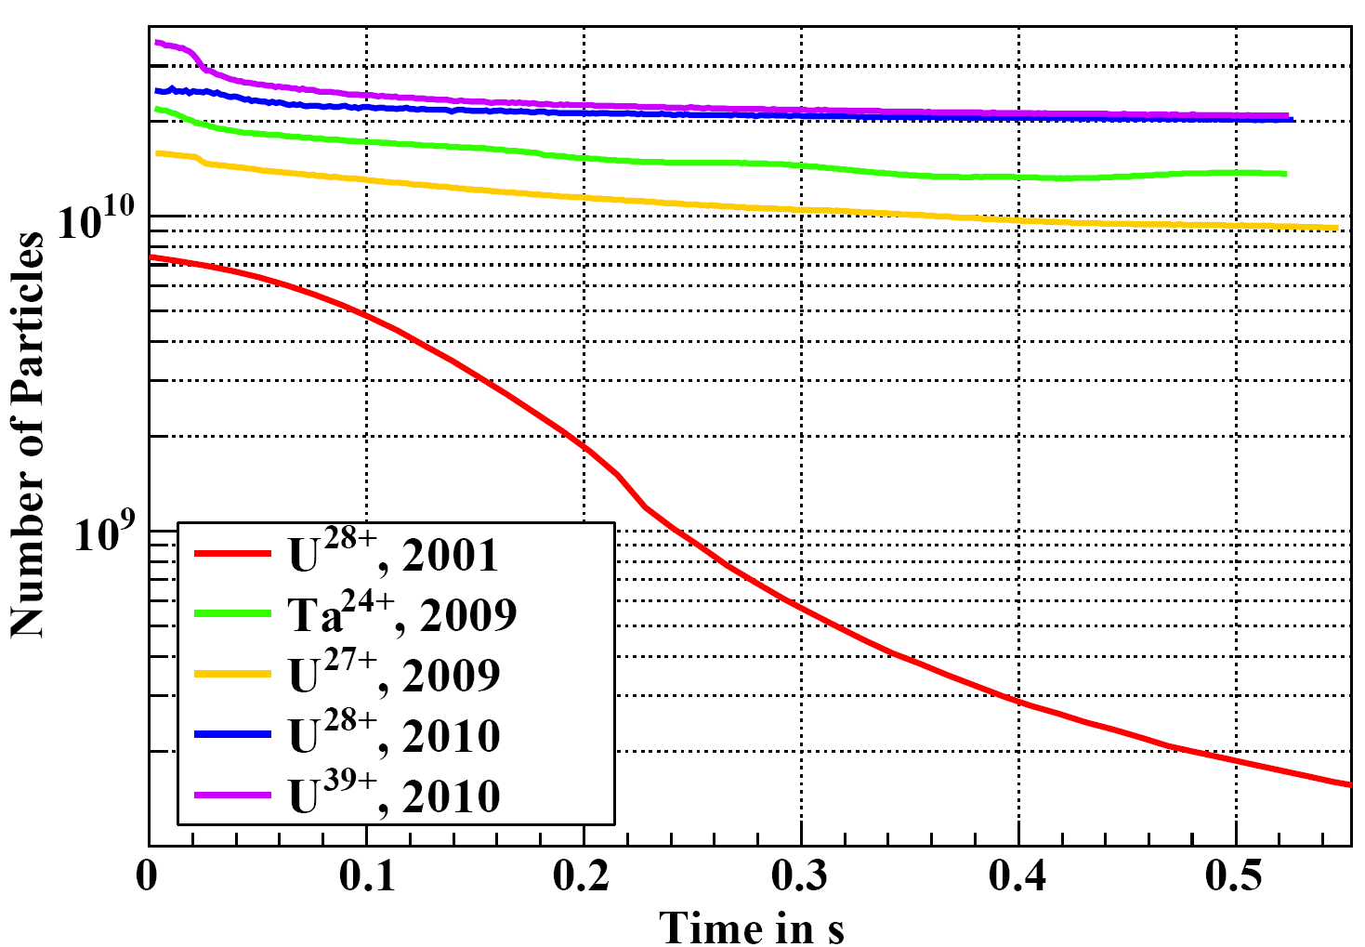
Dynamic Vacuum effect and collimation
Results of the combined upgrades
till now. H=2 RF, fastest ramps and
final UHV not inluded!

Slide 11
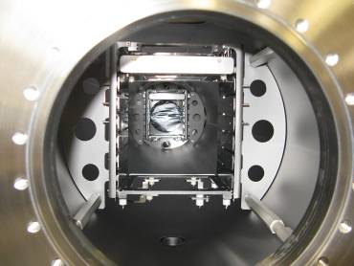
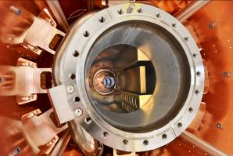
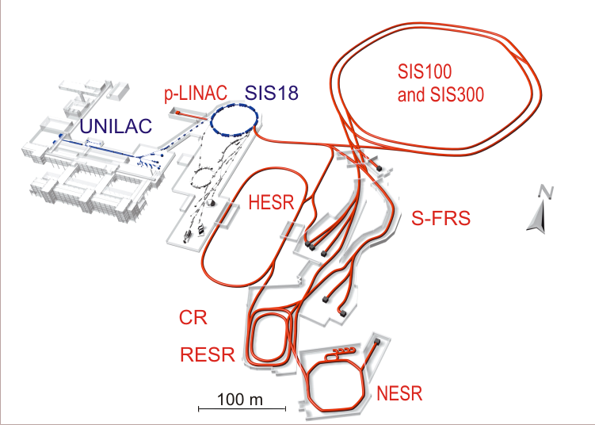
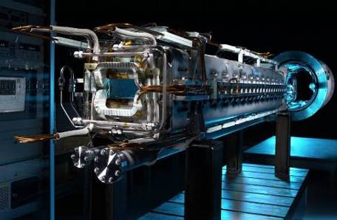
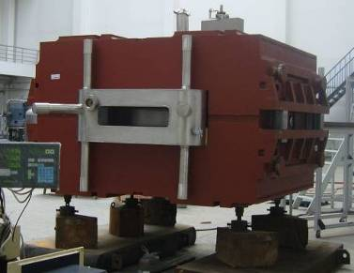
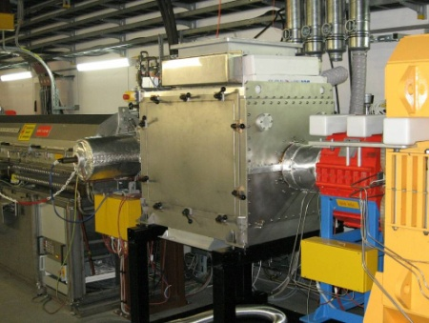
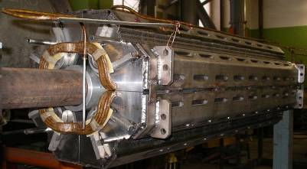
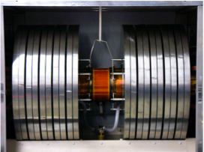

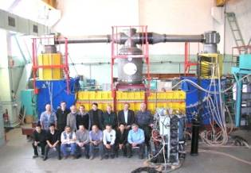
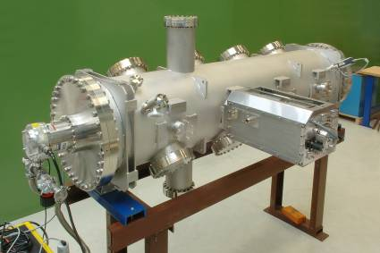
FAIR accelerator challenges
Diagnostic and XHV at highest intensities
Superconducting magnets
Rf-cavities
Beam cooling
FLAIR

Slide 12
SIS100 synchrotron

Slide 13
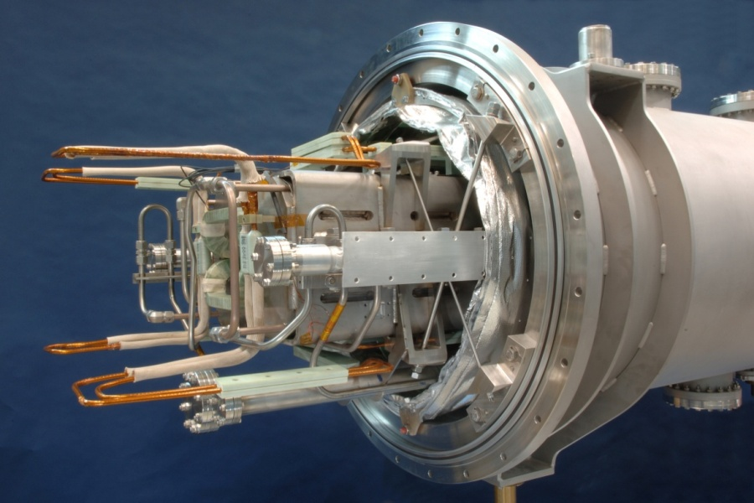
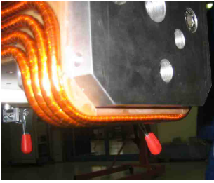
Challenges of the SC-magnets development for SIS100
Fast ramped magnets (synchrotrons)
  Dynamic load and AC heat losses
  Bρ= 100 Tm - Bmax= 1.9 T - dB/dt= 4 T/s
  High field quality, low multipole strength
R&D Goals
- Reduction of eddy / persistent current effects
Guarantee of long term mechanical stability (≥ 2*10⁸ cycles )
  (mechanical stress →coil restraint)

Slide 14
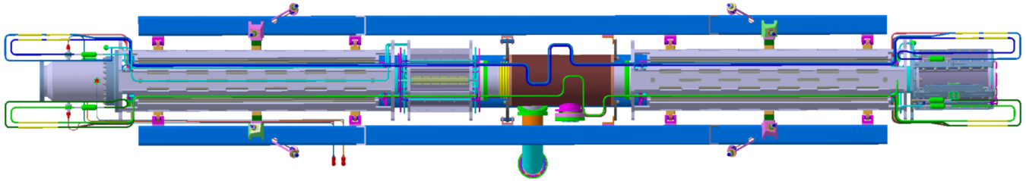
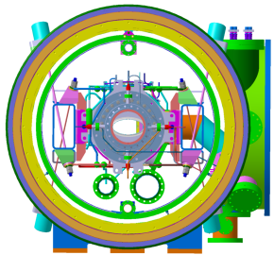
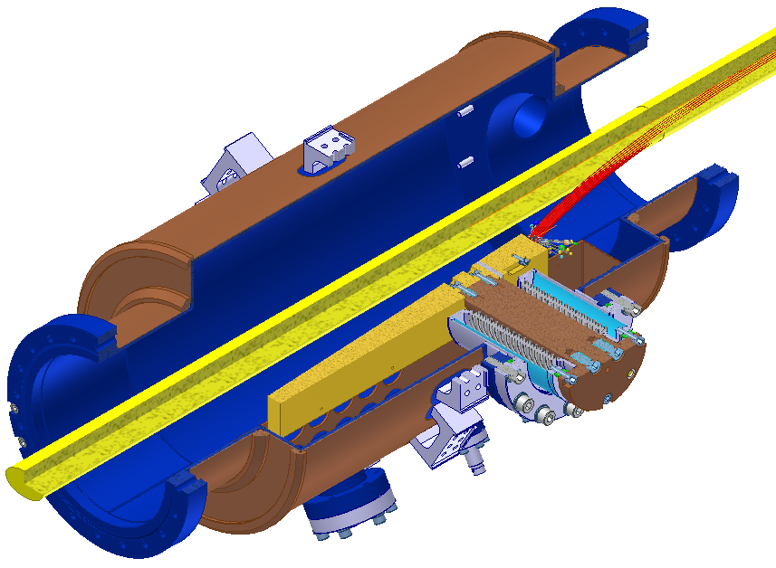
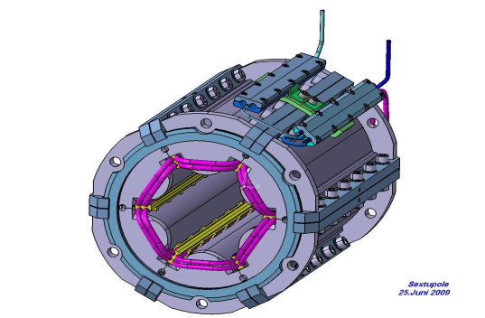
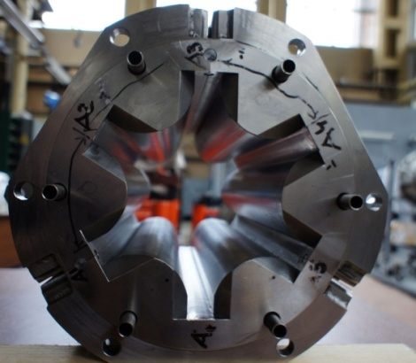
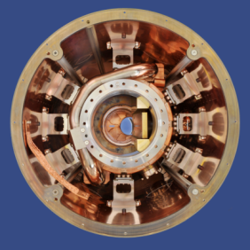
SIS100 quadrupole doublet modules
SIS100 sextupole → Dubna prototype
SIS100 cryo catcher
(prototype tested)

Slide 15
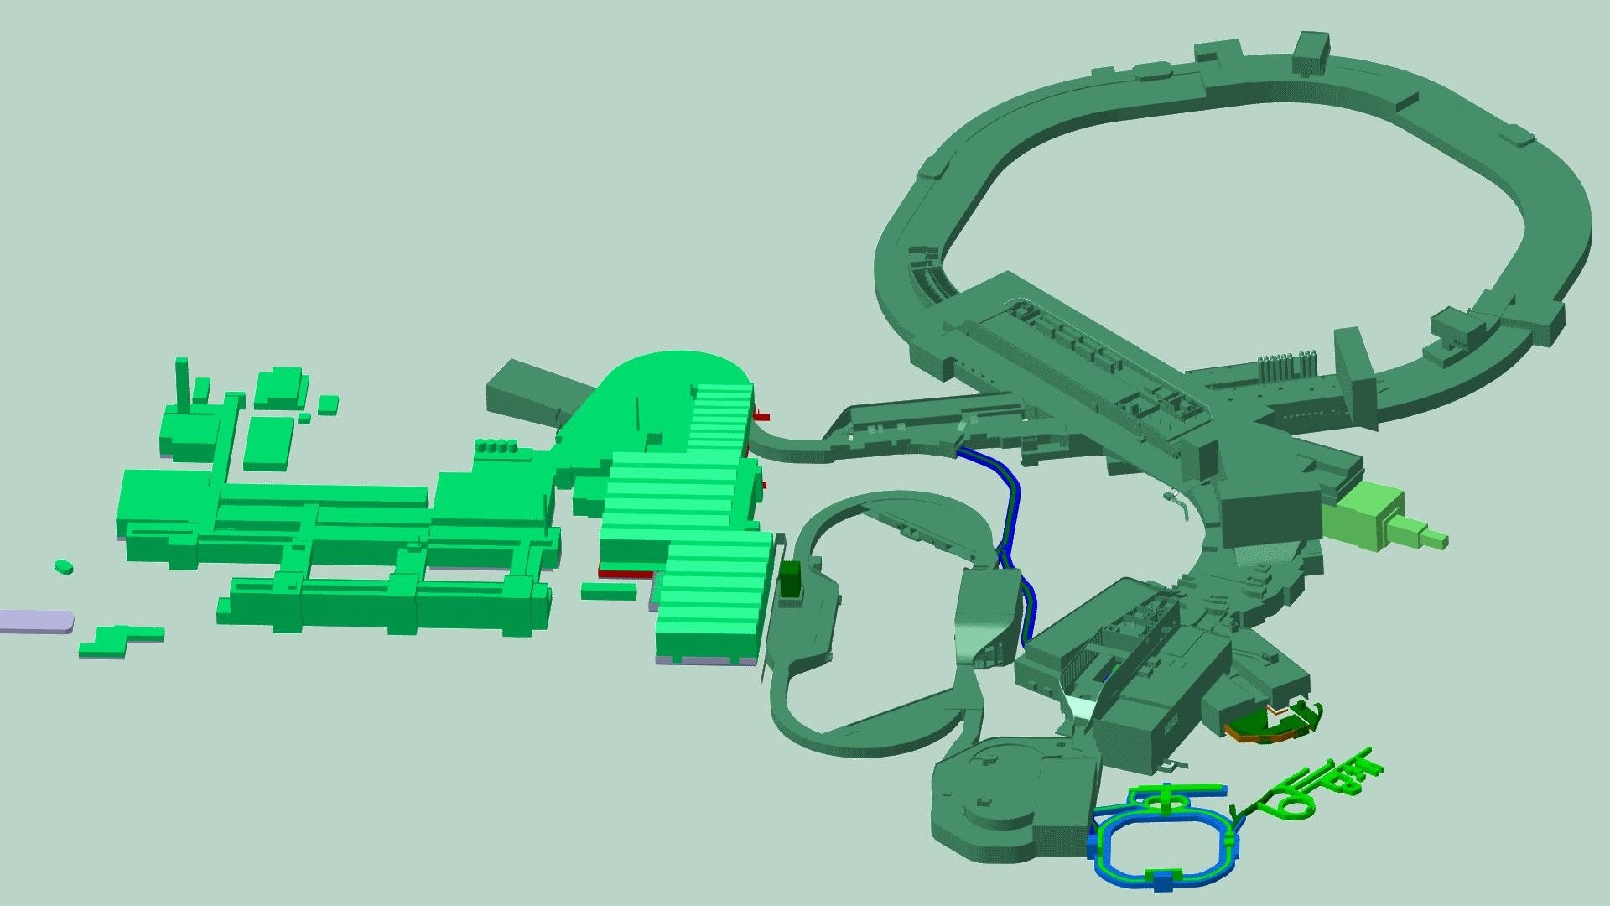
FAIR DMU

Slide 16
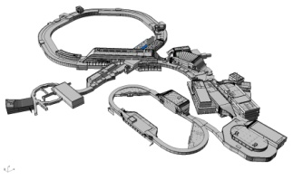
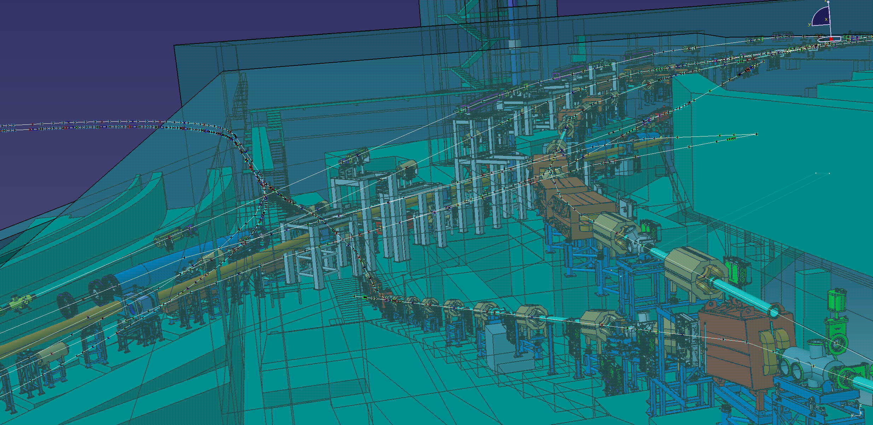
HEBT system lay-out of transfer lines
SFRS
SIS100/300
DUMP
SIS18

Slide 17
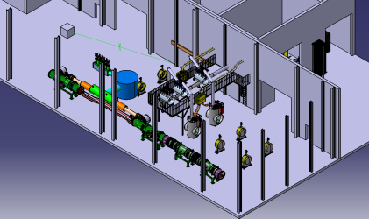
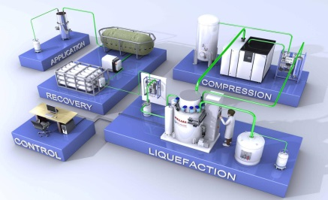
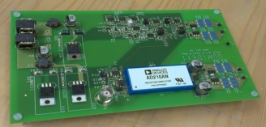
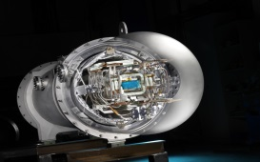
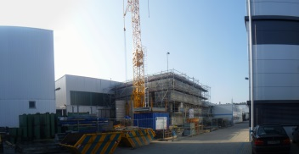
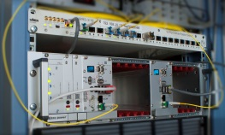
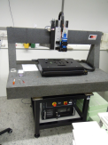
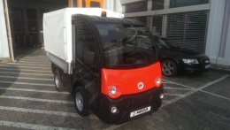
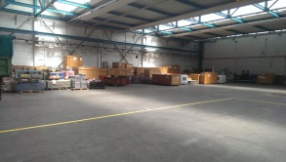
STF : cryogenic infrastructure ordered (LINDE) → delivery Summer 2014, civil construction ongoing
Common Systems 2013
.....some highlights....
CSCY
CSVS
SIS100 dipole chamber prototype:
procurement raw material
test : soldering, ceramic coating
HeSu : cryogenic infrastructure ordered (AirLiquide) → delivery spring 2014
CSEE
PTF: SIS FoS dipole testing ongoing
Mutual-inductance-quench (MIQ) Detector:
first prototype successfully tested
ready for tests at prototype magnet coils
CSTI
CSCO
CSTL
SCU (standard equipment controller) finished
FESA-3 framework completed,
„Mini control system“ based on FAIR standards for Saclay (inkind p-ion source) completed,
timing system FAIR controls exceed expectations (<1ns precision, <50ps jitter)
. target preparation for 2014 beamtime and external experiments,
new film thickness measurement equipment
start of procurement transport vehicles and equipment,
preparation of GSI infrastructure for storage and assembly
H. Reich-Sprenger, Common Systems (CS)

Slide 18

Civil Construction Work
Civil Construction will be finished including all technical infrastructure in Mai 2014
Holger Kollmus, CSCY

Slide 19
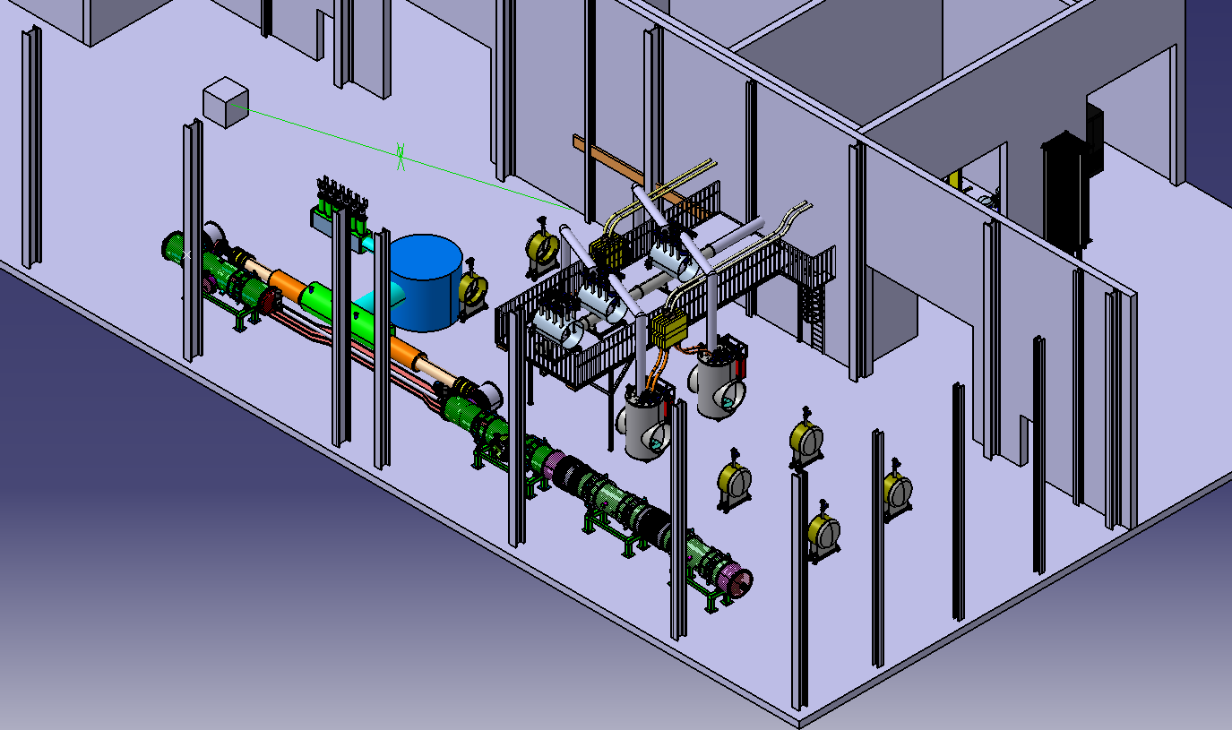
Prototype and Series Test Facilities
Cryogenic infrastructure ordered at LKT
FDR was at the 10th of December
Ready in Summer 2014
CC ongoing, significantly delayed with respect to initial planning but it still might work

Slide 20
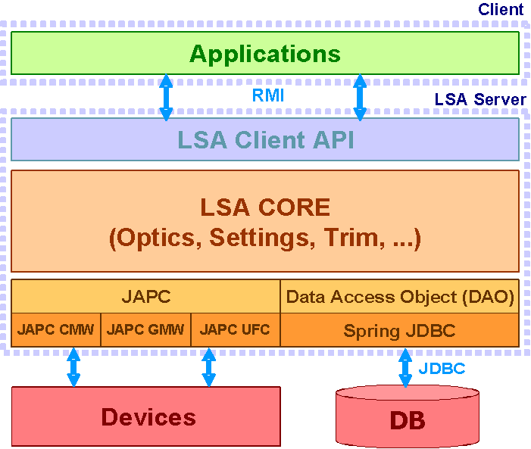
Setting Generation for FAIR using LSA
Setting generation component of FAIR control system will be realized using the LSA framework from CERN
  LHC Software Architecture: CERN setting generation system
  Framework for accelerator modeling
    Modern (JAVA/DB based 3-tier architecture)
    Mature (production use for LHC, SPS, LEIR)
    Maintained (CERN INCA project, FAIR!)
Realization by project group 'FAIR DV' (since 12/2009)
  Joint expertise
    Machine physics divisions (synchrotrons, storage rings)
    Controls and operations divisions
  Main tasks
    Development of physics model for all FAIR machines
    Compilation of reference cycles for specifications
    Development of applications for setting management
    Adaptation of LSA framework to FAIR requirements
Collaboration with CERN established to adapt LSA

Slide 21
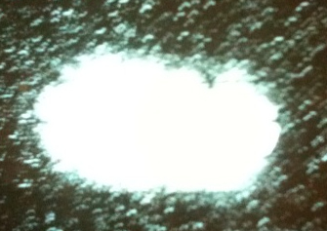
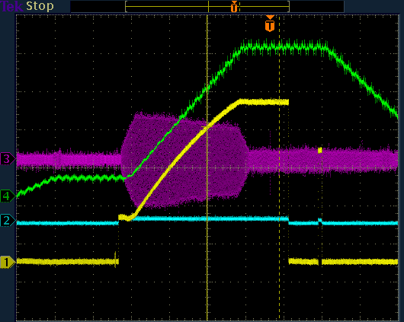
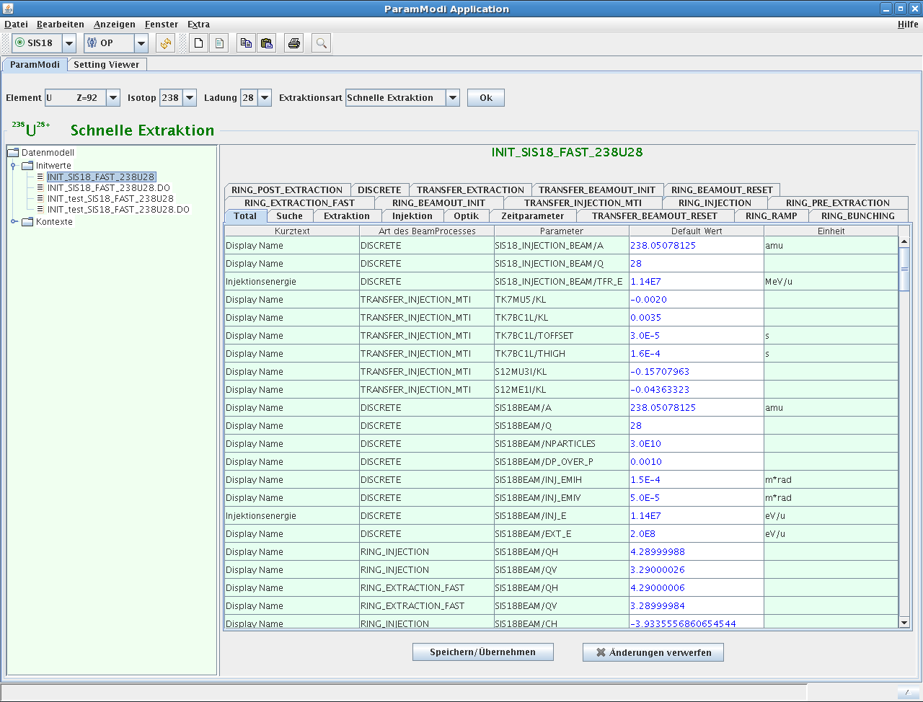
Testing the Physics Model
LSA not yet productive at GSI, but...
...LSA system can be used to run SIS18!
First test with beam performed
Further tests planned for 2012
  Test of system after refactoring
  Test of new algorithms
    New optics for booster mode
    Dual harmonic acceleration
    Space charge corrections
Increase of availability foreseen
  Two independent LSA systems (test/dev)
  Freeze on test system between releases
  Tailored applications
12.03.2010
First LSA generated
beam from SIS18
(U⁷³⁺, 300 MeV/u,
fast extraction)
LSA application for parameter modification
(ParamModi)

Slide 22
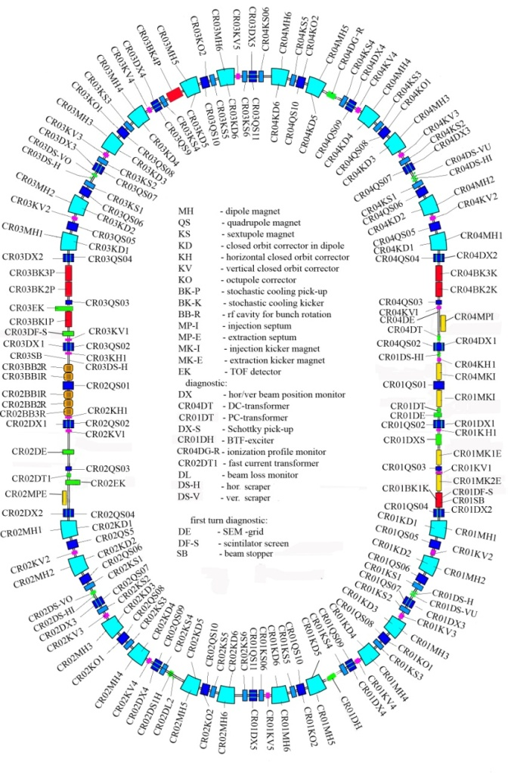
The FAIR storage rings
CR
circumference 221 m
magn. rigidity 13 Tm
acceptance ε_{x,y} =
240 (200) mm mrad
Δp/p = ± 2.7 (1.5) %

Slide 23
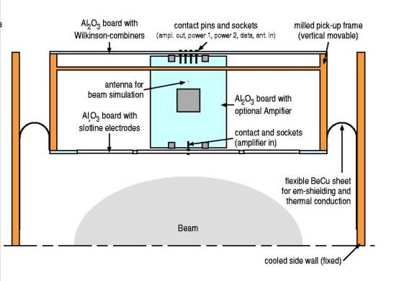
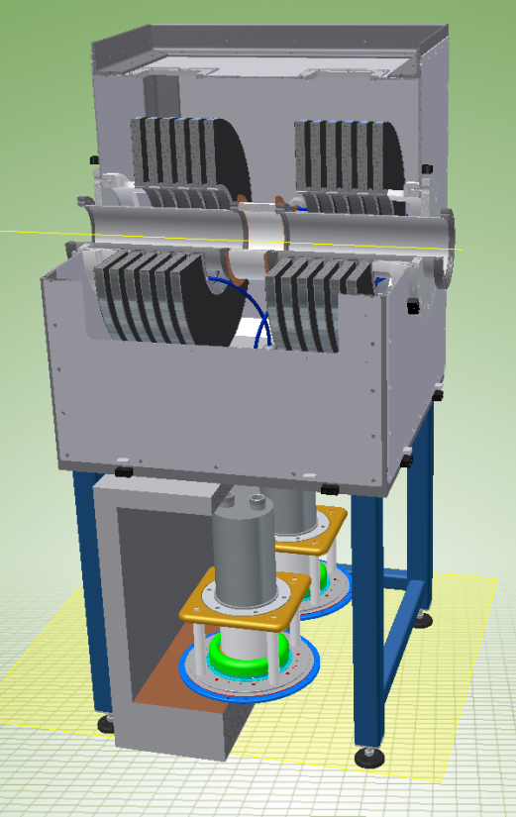
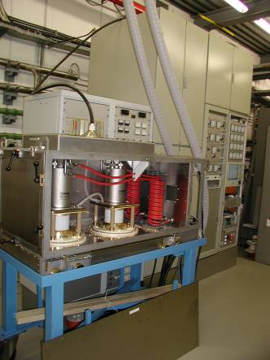
CR – responsibility to BINP, debuncher RF already ordered!
Proposal to consider the entire CR machine (except stochastic cooling and CR-de buncher), as Russian in‐kind contribution (similar to the HESR with Jülich)
Draft MoU distributed (27.09.2013), discussion with
Budker started
Meeting in Novosibirsk, with FAIR/GSI delegation
→ first signature on a MoU
update of TDR in preparation

Slide 24

Stacking of particles in the FAIR storage rings -> pbar with modular start version
p_{trans}
circulating, cooled beam
t
Circulation time
rf-Barriers
Creation of a gap for injection of
additional particles
New injected bunch
Cooling

Slide 25





HESR project work
COSY:
2 MeV cooler
→first test
Status:
Magnets ordered
Stochastic cooling prototype pickup structures tested
→ first cooling with these structures at the Nuclotron
in Dubna
Injection kicker magnet and power supply ordered
Purchasing of vacuum steel under way
Notes:
25
25
Point out interaction section, electrons, antiprotons, solenoids, (normal conducting) (Magnetic spectrometer energy calibration)
Cooling force needs to be stronger than at Fermilab to counteract the internal target

Slide 26





The FAIR project is moving forward

Slide 27

Status of pilling works
about > 800 holes drilled
(1.5 m diameter, 60 m deep)
holes concrete-lined
http://www.fair-center.eu/construction/webcam.html

Slide 28
Summary and present state
SIS100 dipole pre-series tests are running
SIS100 dipole test facility under construction
SIS300 dipole prototype manufacured (Italy and ARD money)
RF -> CR debuncher, SIS100 bunch compressor, SIS 100 main RF ordered, barrier bucket system in tendering process
p-Linac first CH-structure + klystron on site (produced in France)
UNILAC + SIS18 machine development campaign starting
Source development -> Bi, Au, Ta, U, N, Ne, Ar, Xe, Kr… available in „FAIR“-quality. Already used for experiments.
SIS100 QP module blueprints for manufacturing drawn by BNG
CR and HESR progressing, tests for pbar chain of start version
Civil construction done right now
…. FAIR IS HERE!

Slide 29

Thanks for your attention

Slide 30
First beam scenarios for FAIR, Option 1
Option 1: Experiments start with SIS18 beam
available now:
- 5x10⁹ U⁷³⁺, up to 1 GeV/u, uncooled
- 3x10⁹ U⁷³⁺, up to 1 GeV/u, cooled
- 3x10¹⁰ U²⁸⁺, up to 200 MeV/u
- special exclusive mode: 3x10¹⁰ U³⁹⁺, 350 MeV/u
(striper foil instead of gas stripper in UNILAC)
- 4.5 GeV protons with fast extraction. 3 GeV with slow extraction
- bunch compression
projected:
- increased U⁷³⁺ intensity (uncooled) to about 10¹⁰ particles/spill
- U²⁸⁺ intensity to 4x10¹⁰
- higher proton intensity depending on status of p-linac

Slide 31
First beam scenarios for FAIR, Option 2
Option 2: Experiments start with SIS100 “early” beam
projecting the present SIS 18 performance towards SIS100 early experiments will start with:
- 2 to 4x10¹⁰ U⁹²⁺, up to 10.7 GeV/u
(4 injections from SIS18 with stripping between SIS18 and SIS100)
- 1 to 2x10¹¹ U²⁸⁺, up to 2.7 GeV/u
(4 injections from SIS18)
- 29 GeV protons with fast extraction
additional “early features” but probably after day zero:
- increased intensities of intermediate charge state ions
- bunch compression after commissioning of the compressor RF
- slowly extracted protons and higher proton intensities due to
SIS100 and p-linac commissioning progress

Slide 32
Synchrotron movement (not oscillations)
relative vertical missalignment of about 4 mm.
the specific reason is unknown
lots of installations and concrete block moving
first changes due to FAIR construction site?
BUT: Orbit corrected last weekend and machine working!

Slide 33

Berechnungen durch CDM Smith (05/2012)
TH
EX (ESR)
TR-Halle
S05
S04
S03
S02
S01
S12
S11
S10
S09
S08
S07
S06
Bis zu 4 cm Setzungen nach Abschluss der Baumaßnahmen

Slide 34

Setzungen (II)

